Slide 1



RFD HOM Coupler Challenges
Naeem Huque – Jefferson Lab
13th HL-LHC Collaboration Meeting. – Sep. 25th–28th 2022

Slide 2
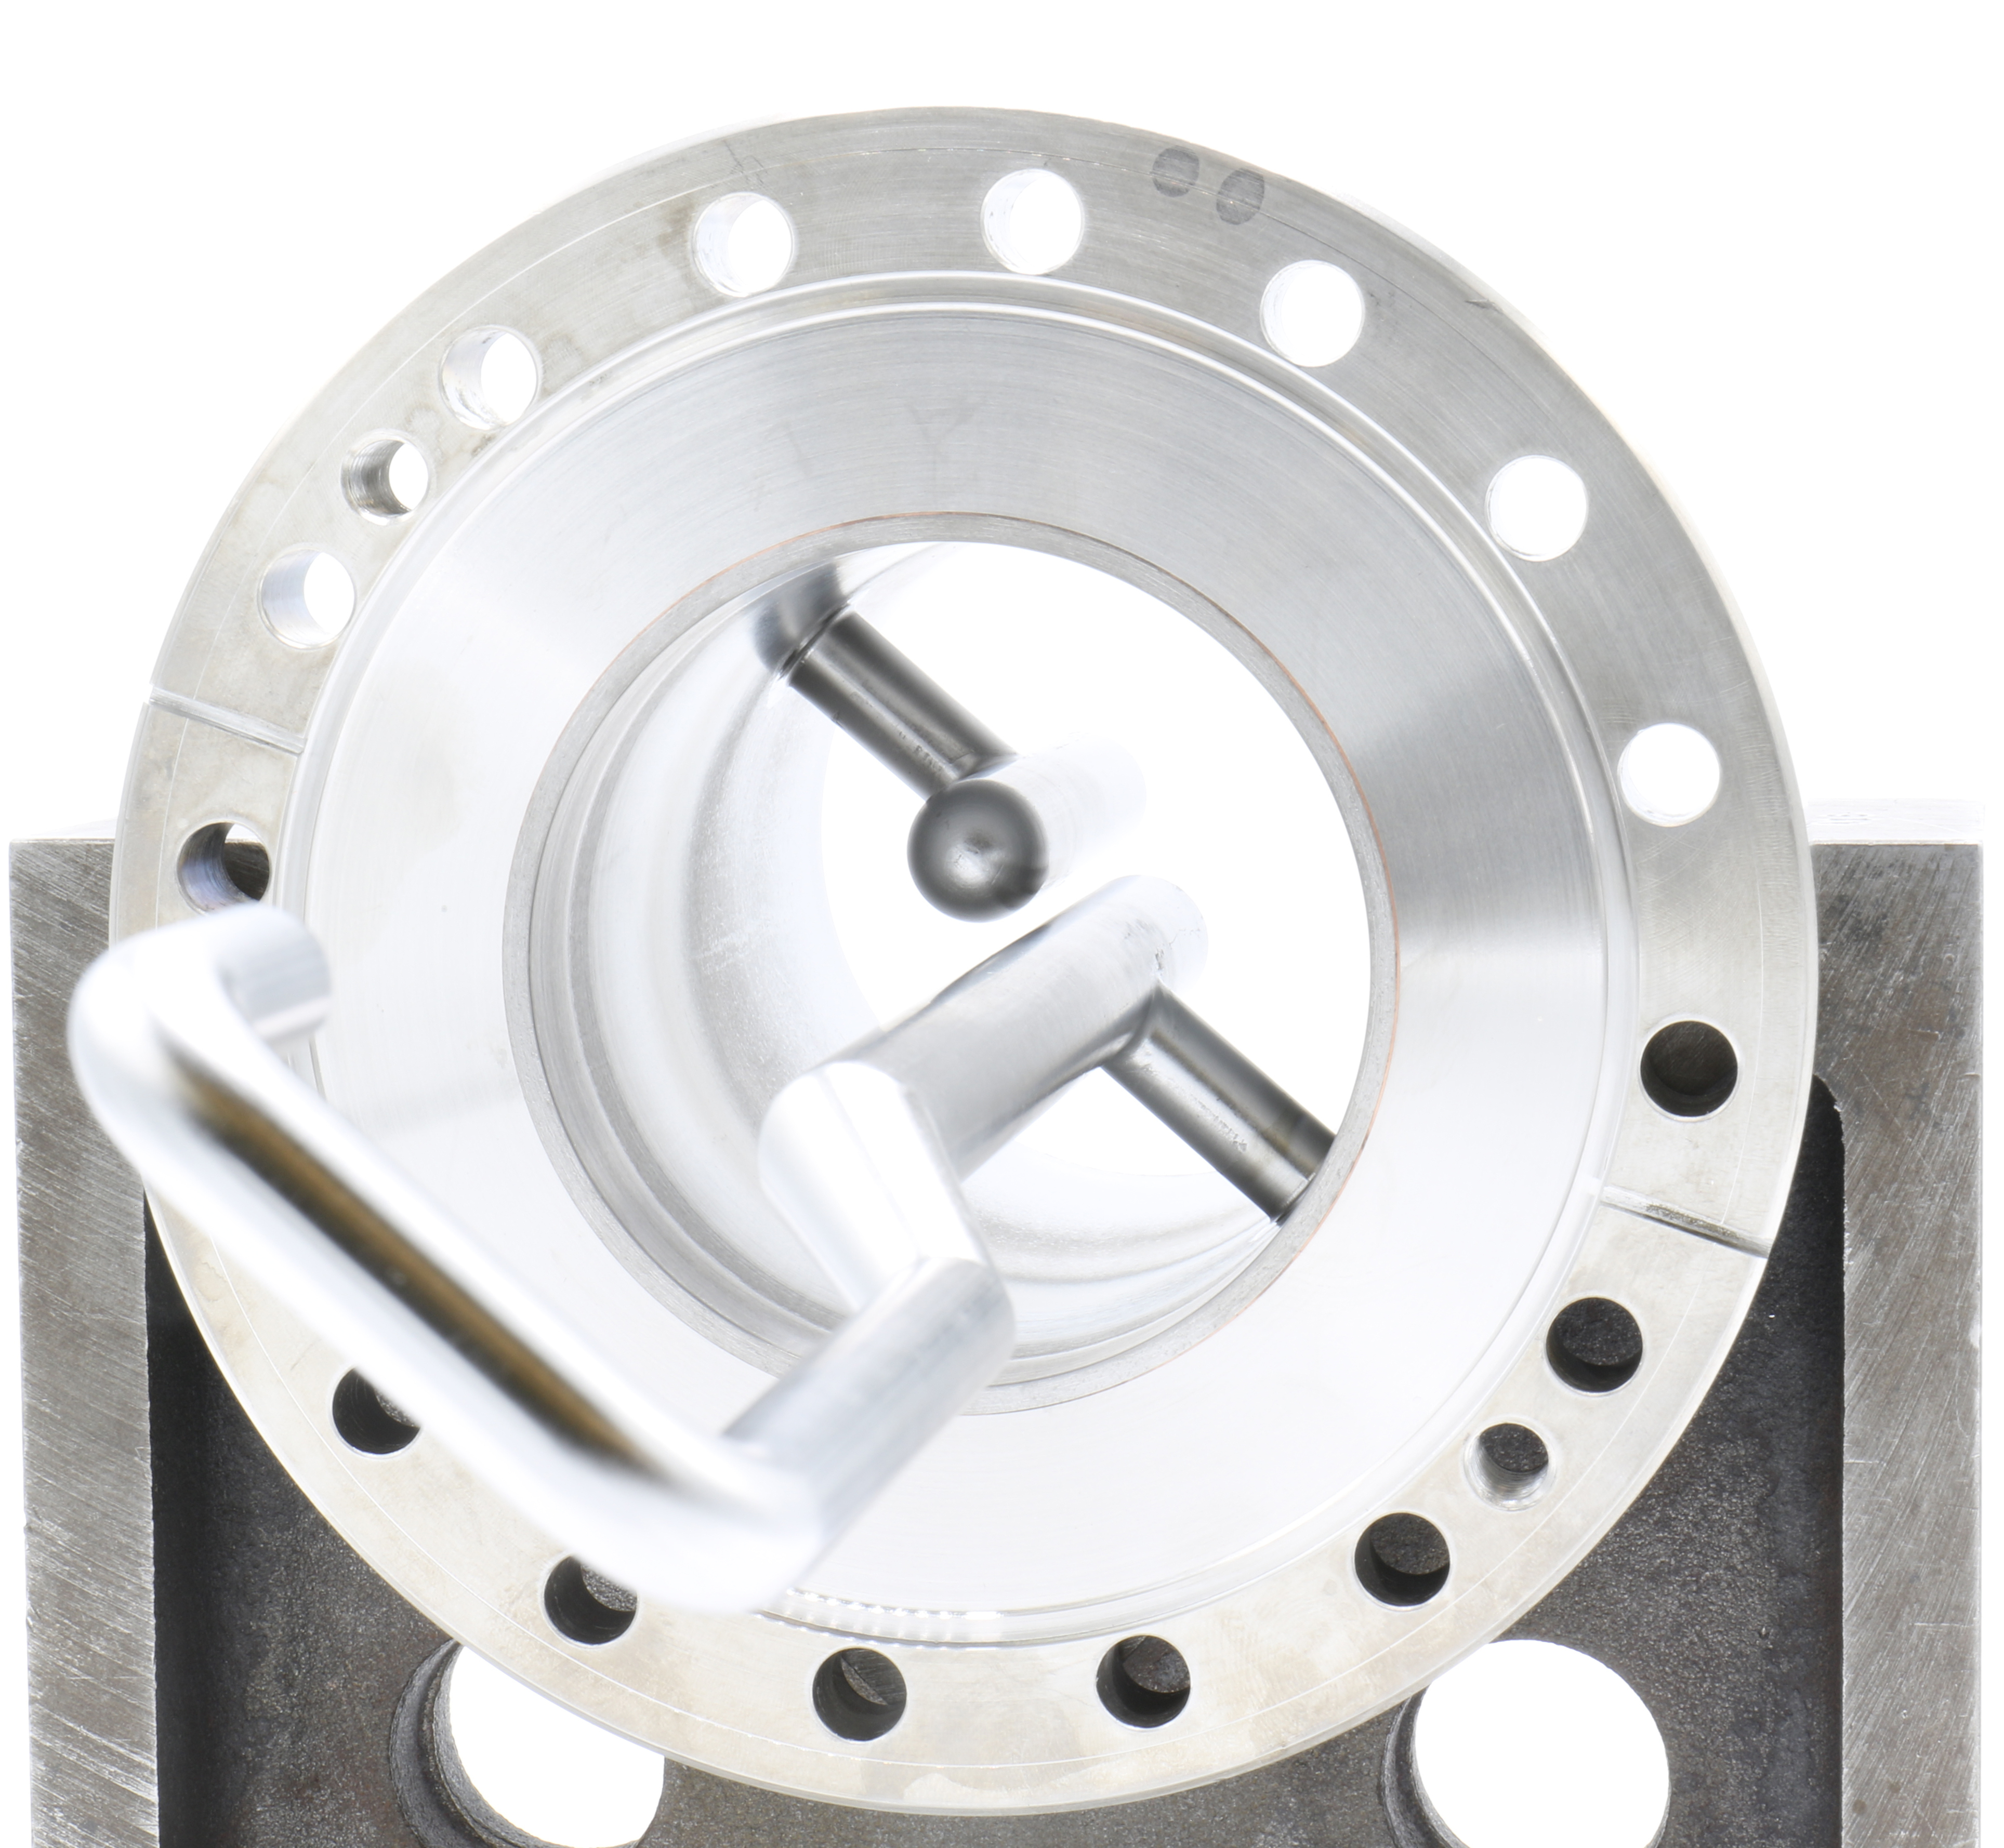
Outline
Scope
Interfaces
QA/QC
Production Status
Current Challenges
Series Production Status
Summary

Slide 3
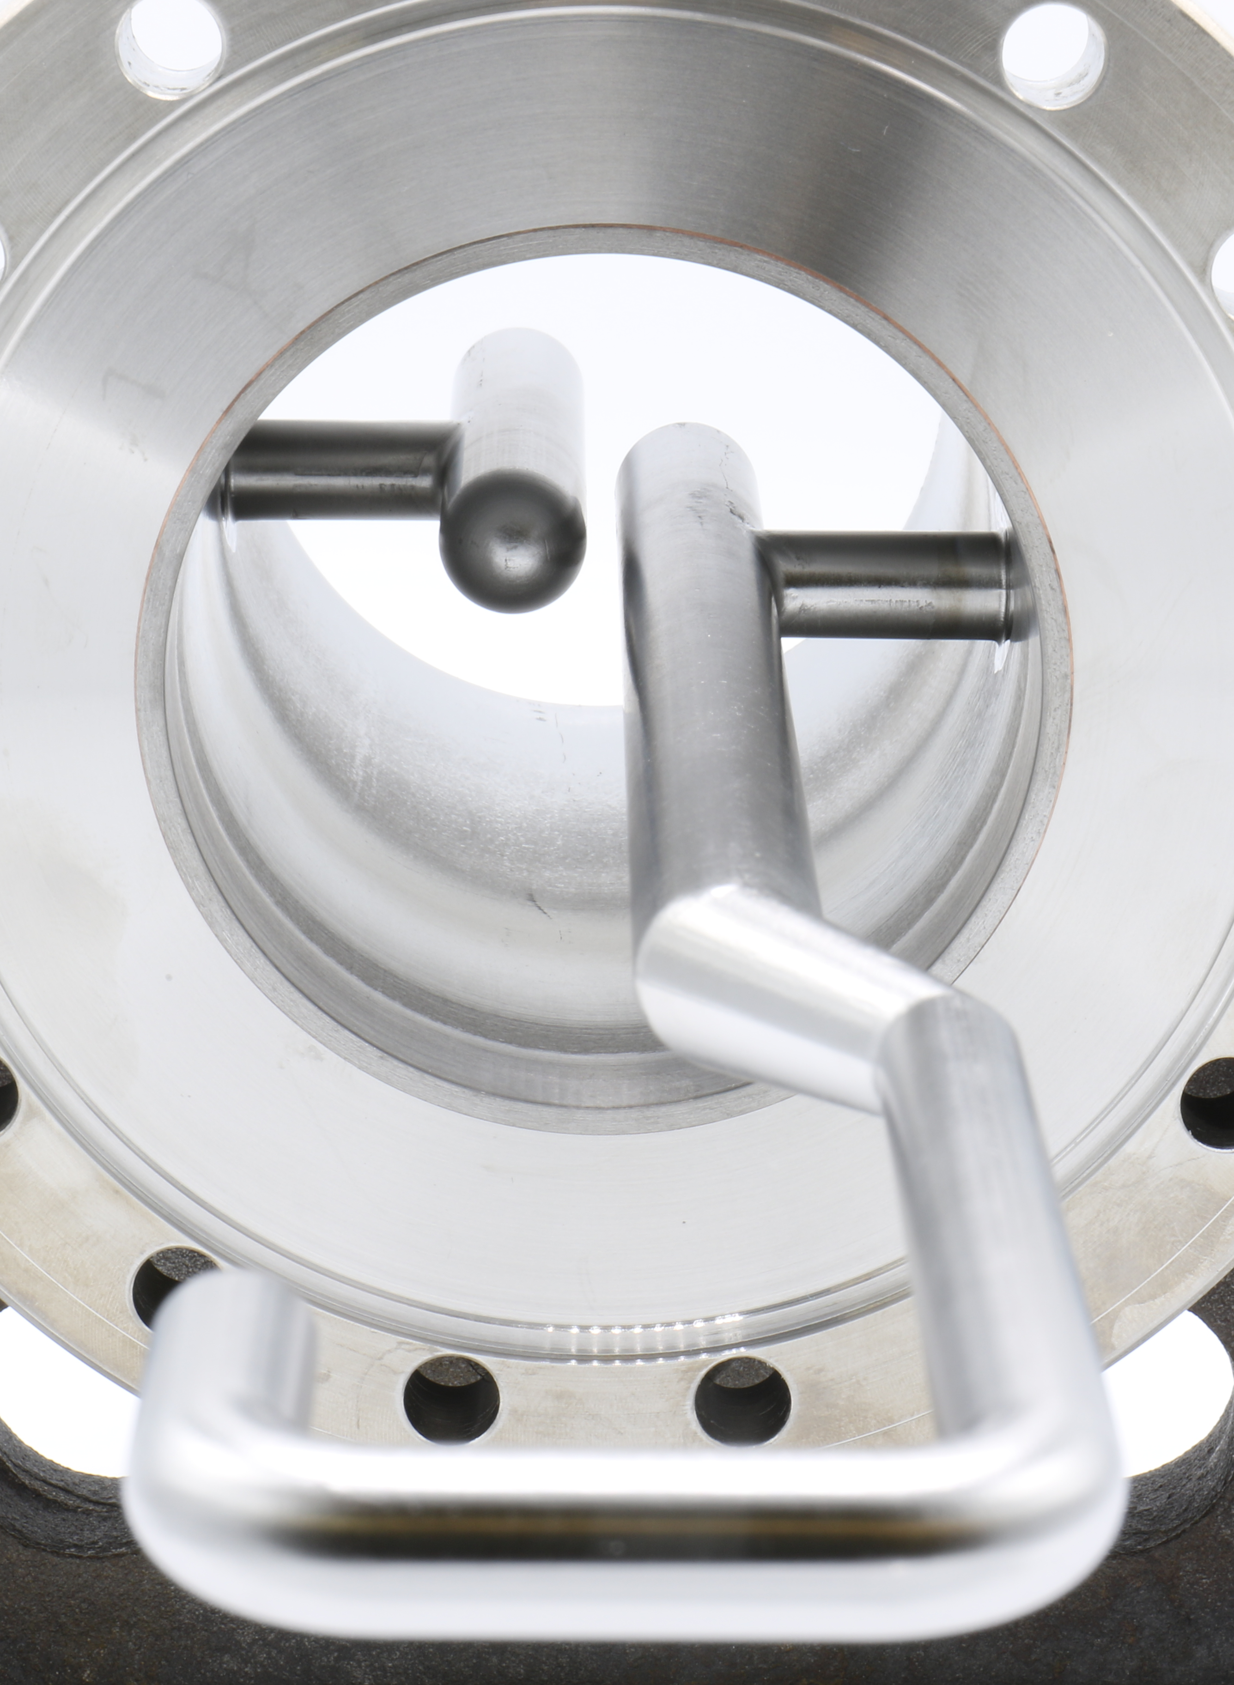
JLab Scope of Work
Fabricate sets of RFD Cavity Ancillaries
  Prototype: 3 sets (FY21/FY22) Complete (1 usable set)
  Pre-Series: 3 sets (FY23/FY24)
  Series: 8 sets (FY24)
RF design is provided by AUP
All activities are in full compliance with CERN Engineering Specification Document (EDMS 1389669 v2.6)
Share production information with the CERN MTF
PRR held in May 2022

Slide 4
JLab Scope of Work: Interfaces
VHOM
DN40 CF
Interfaces are defined in LHCACFDC0001 - CERN EDMS 2420659
HHOM-FT
DN40 CF
HHOM
DN100 CF
Pick-Up
DN40 CF
RFD Cavity
4

Slide 5
Manufacturing Inspection Plans (MIPs)
A separate MIP is developed for each ancillary component
The MIPs are based on the design, required standards and the CERN engineering specification
  The MIP is the master document that lists all the fabrication and inspection steps
  The MIP defines the structures of the individual travelers
Each assembly is tracked with a traveler in the JLab Pansophy system
The travelers collect relevant data during production e.g. test reports and dimensional inspection results
  The travelers also collect sign-offs that particular operations have been carried out
The information from the travelers are transferred manually to the CERN MTF
Standards: ASME, ISO
Specifications: CERN, JLab
Manufacturing Inspection Plan
Drawings
Leak/Pressure Test Reports
JLab Traveler
WPS, WPQR, BPS, BPQR
Metrology Reports
CERN MTF
Material Certifications

Slide 6
Production Status
Jacketed prototype cavities are scheduled to arrive at JLab from ZRI in Jan 2024
Pre-Series RFD cavity with Helium Jacket is expected to arrive at JLab in Spring 2024
The goal is to have one set of ancillaries ready for Pre-Series cavity cold test at JLab
  HHOM Damper (and feedthrough)
  Field Antenna
  VHOM Damper
Fabrication of Series parts are being carried out in parallel

Slide 7
Current Challenges
PRR was successfully held in May 2022
  Drawings, MIPs, procedures, material certificates etc. were all approved by CERN
  JLab was given the go-ahead to start production
Issues with the design were uncovered by CERN in mid 2023
  Production was halted to have drawings rechecked
  Revisions are in progress; parts will be remade
Ceramic braze qualifications failed on samples
  Prototype parts are currently in use for cold tests

Slide 8
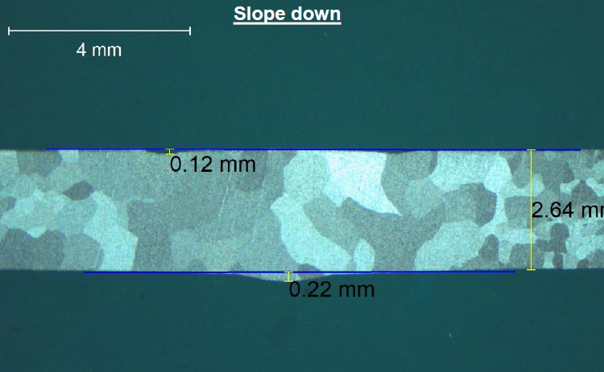
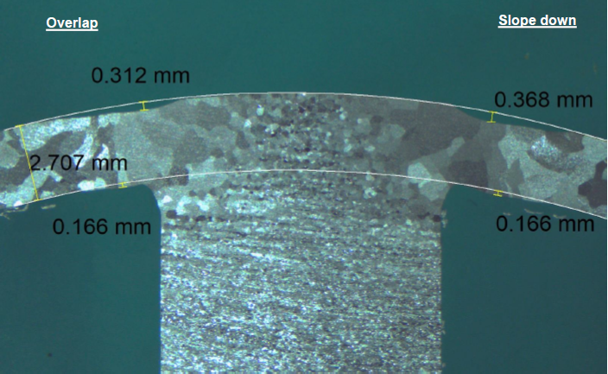
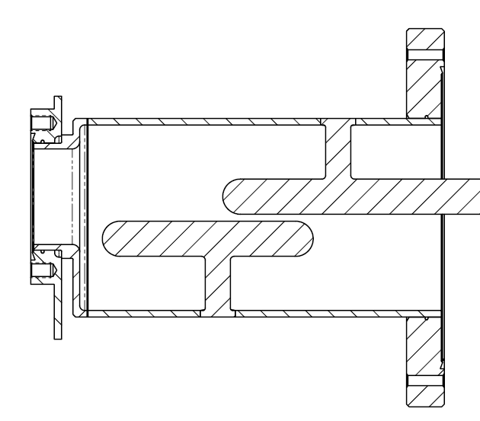
Niobium EBW Qualifications
Testing of all Nb EBW qualifications are complete
Results adhere to engineering specification document
Visual Test
Penetrant Test
Radiographic Test
Metallographic Test
Bend Test
Tensile Test
Visual Test
Penetrant Test
Radiographic Test
Metallographic Test

Slide 9
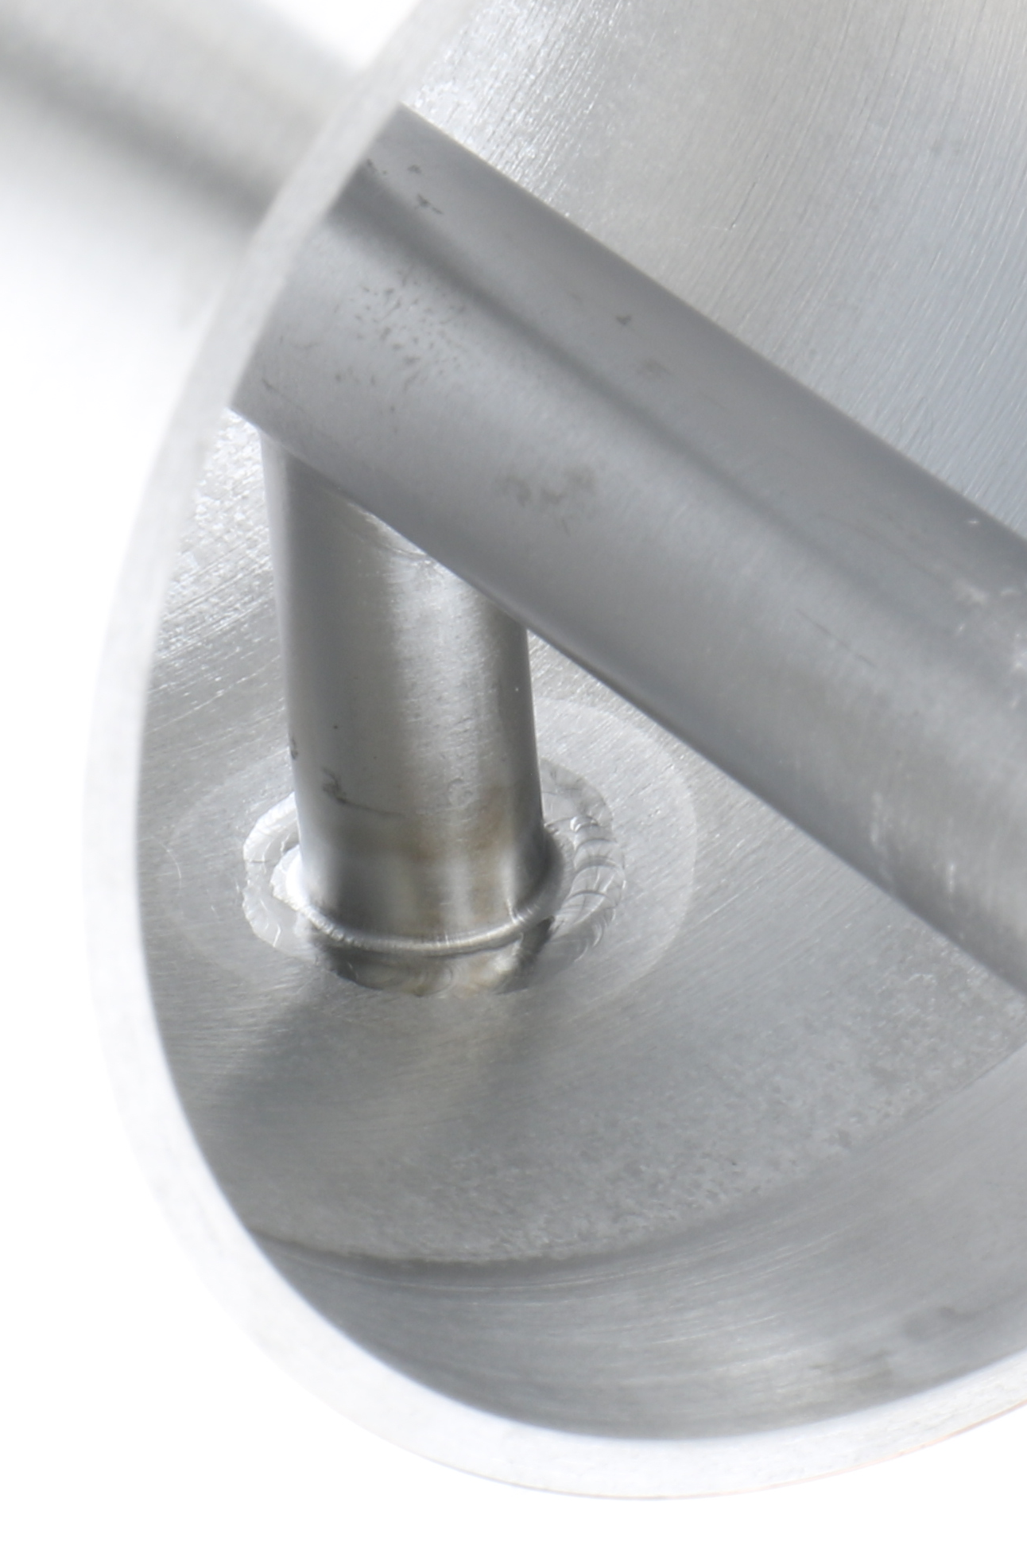
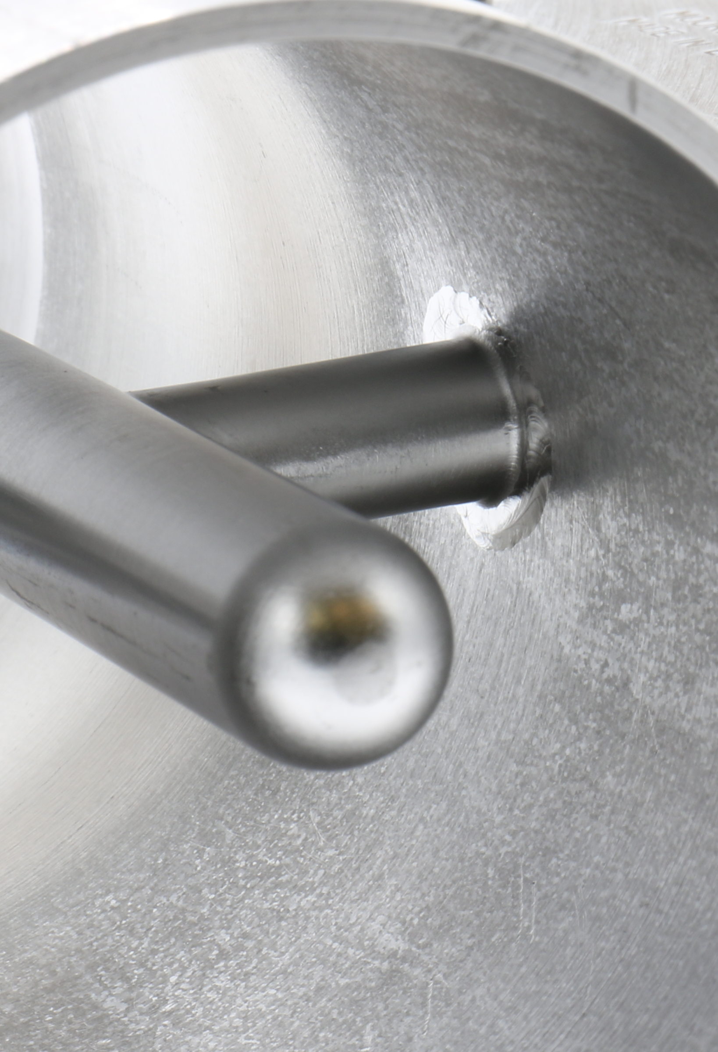
Pre-Series Status: HHOM
The three pre-series HHOMs are in late stages of production
Issues with prototype Hook/Tee welds have been successfully addressed
NC generated due to machining error
  Discrepancy was deemed okay after RF simulations
  Under review in EDMS
Three units are scheduled to be complete by December 2023

Slide 10
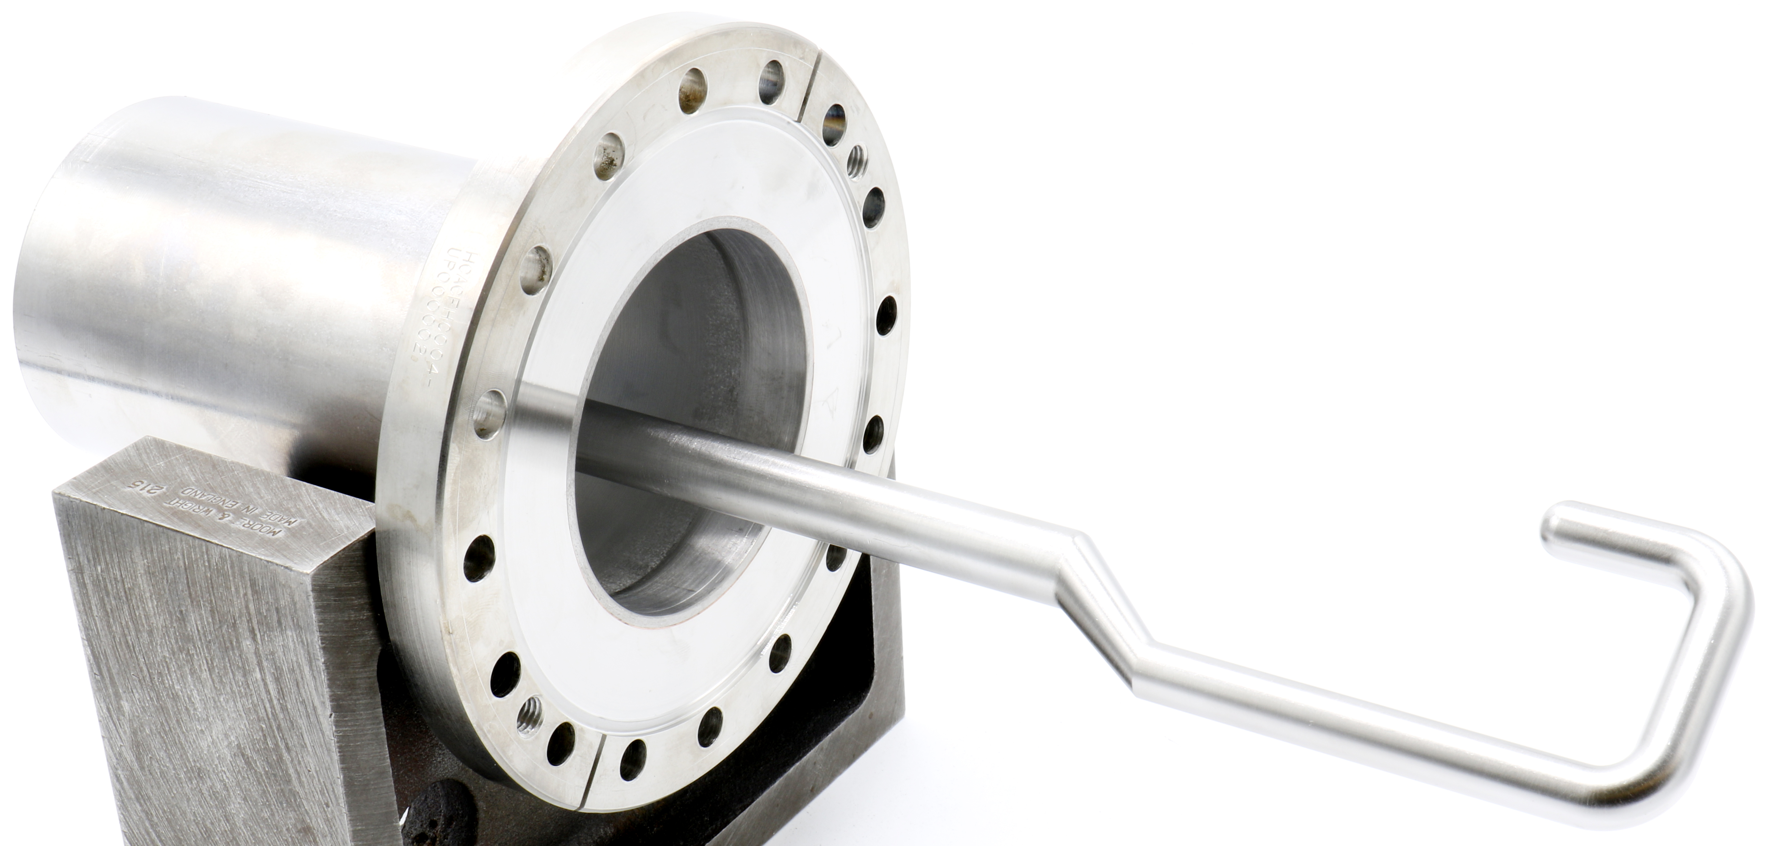
Pre-Series Status: HHOM
The most critical dimensions are the gap and parallelism between the hook and tee
Gap needs to be 2.5 – 3.1mm
Will increase after BCP
Serial No. | Hook Perpend. | Hook Position | Tee Position
001 | 0.3 | 0.3 | 0.2
002 | 0.2 | 0.2 | 0.8
003 | 0.3 | 0.5 | 0.9
Serial No. | Gap | Parallelism
001 | 2.7 | 0.0
002 | 2.6 | 0.1
003 | 2.5 | 0.2
Deviations are smaller than found on the prototypes, which passed simulations and RF check
Physically changing the positions of the hook/tee is possible if required (unlikely)
Summary
The EBW fixture functioned well, but its alignment can be adjusted to improve Tee position

Slide 11
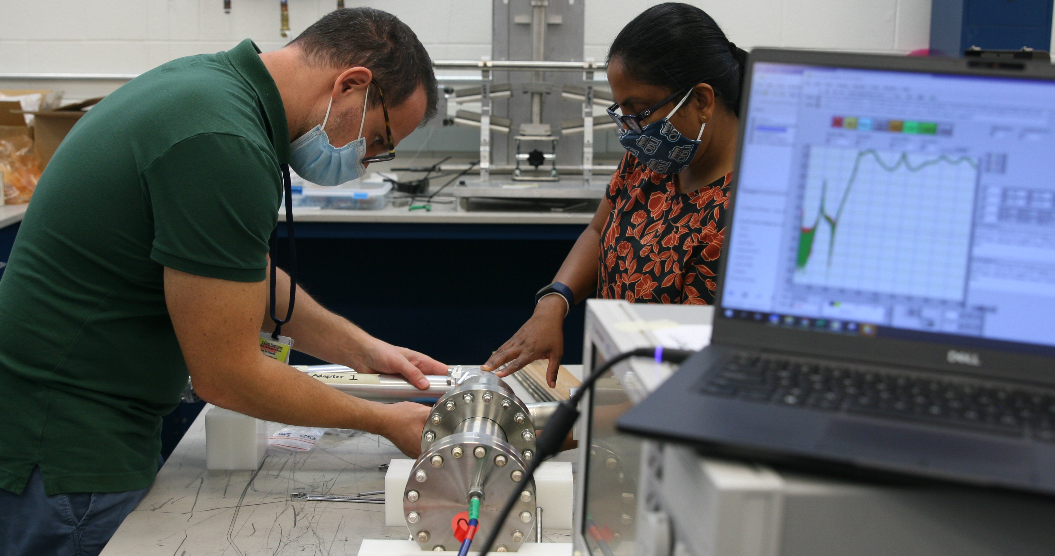
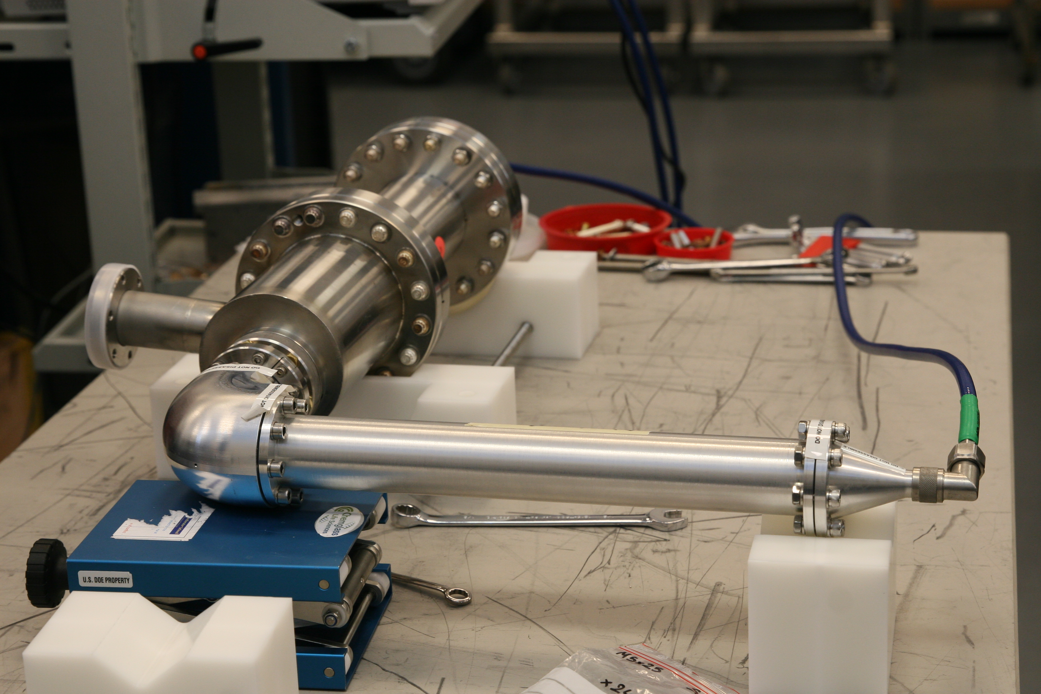
HHOM Final Verification Plan
Warm RF measurements are used to validate the HHOM fabrication
A test box designed in collaboration with ODU, SLAC, and CERN will be used to take the measurements
The S21 curve must meet the following requirements:
  S₂₁ in the 390 – 410 MHz range must be below < -61 dB
  S₂₁ in the 0.1 – 2000 MHz must be within CERN and AUP mask
System was successfully tested with the prototypes

Slide 12
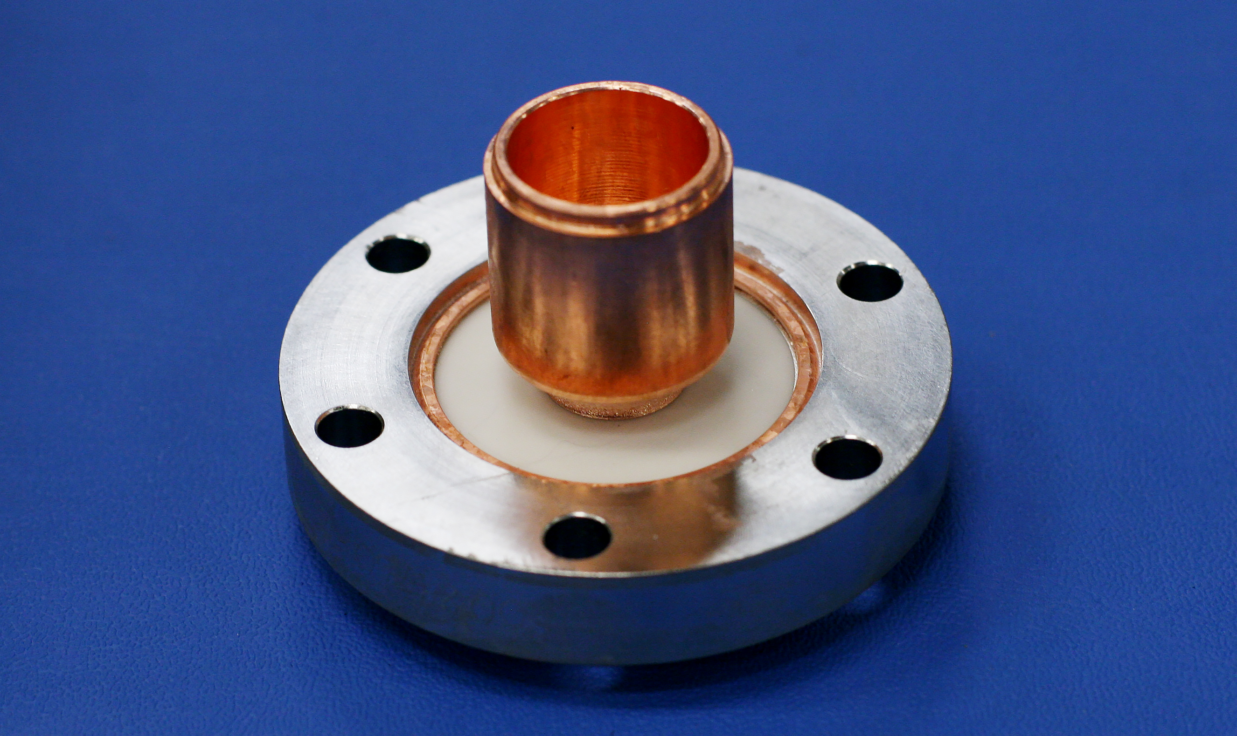
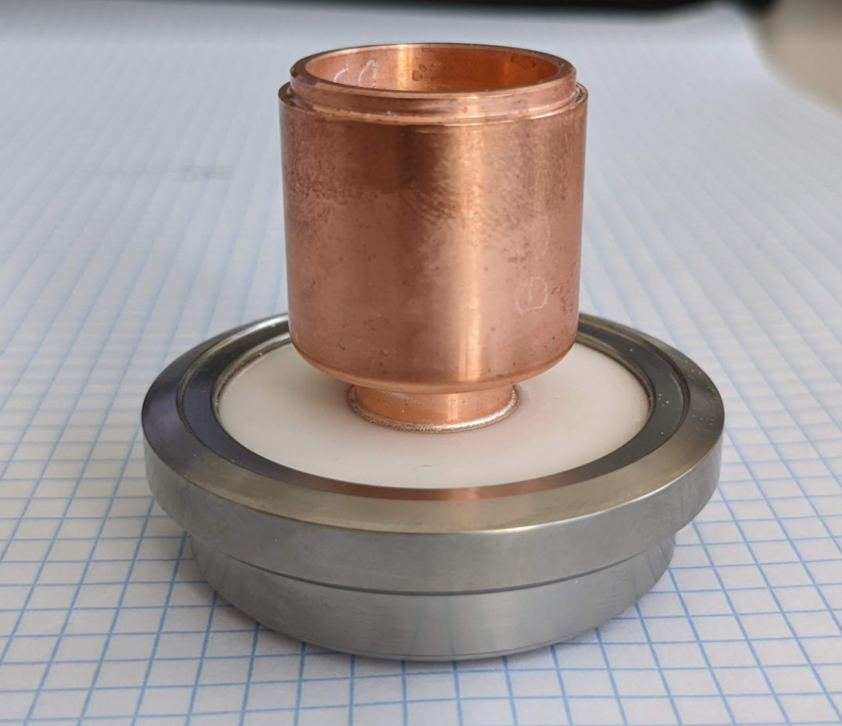
Ceramic Feedthrough Design
CERN uses a rotatable titanium flange on the ceramic feedthroughs (below right)
JLab uses a copper interface ring between the ceramic and a 316LN non-rotatable flange (below left)
A thorough testing and qualification process is implemented at CERN to verify the two designs
In particular, the concern is that the brazing/installation process will form cracks within the ceramic which will propagate over time
  Destructive section is the only way to identify cracks
The JLab design has been implemented on prototypes and has been included in a number of VTA cycles without failure
Subsequent failures in samples is still to be understood
JLab Design
CERN Design

Slide 13
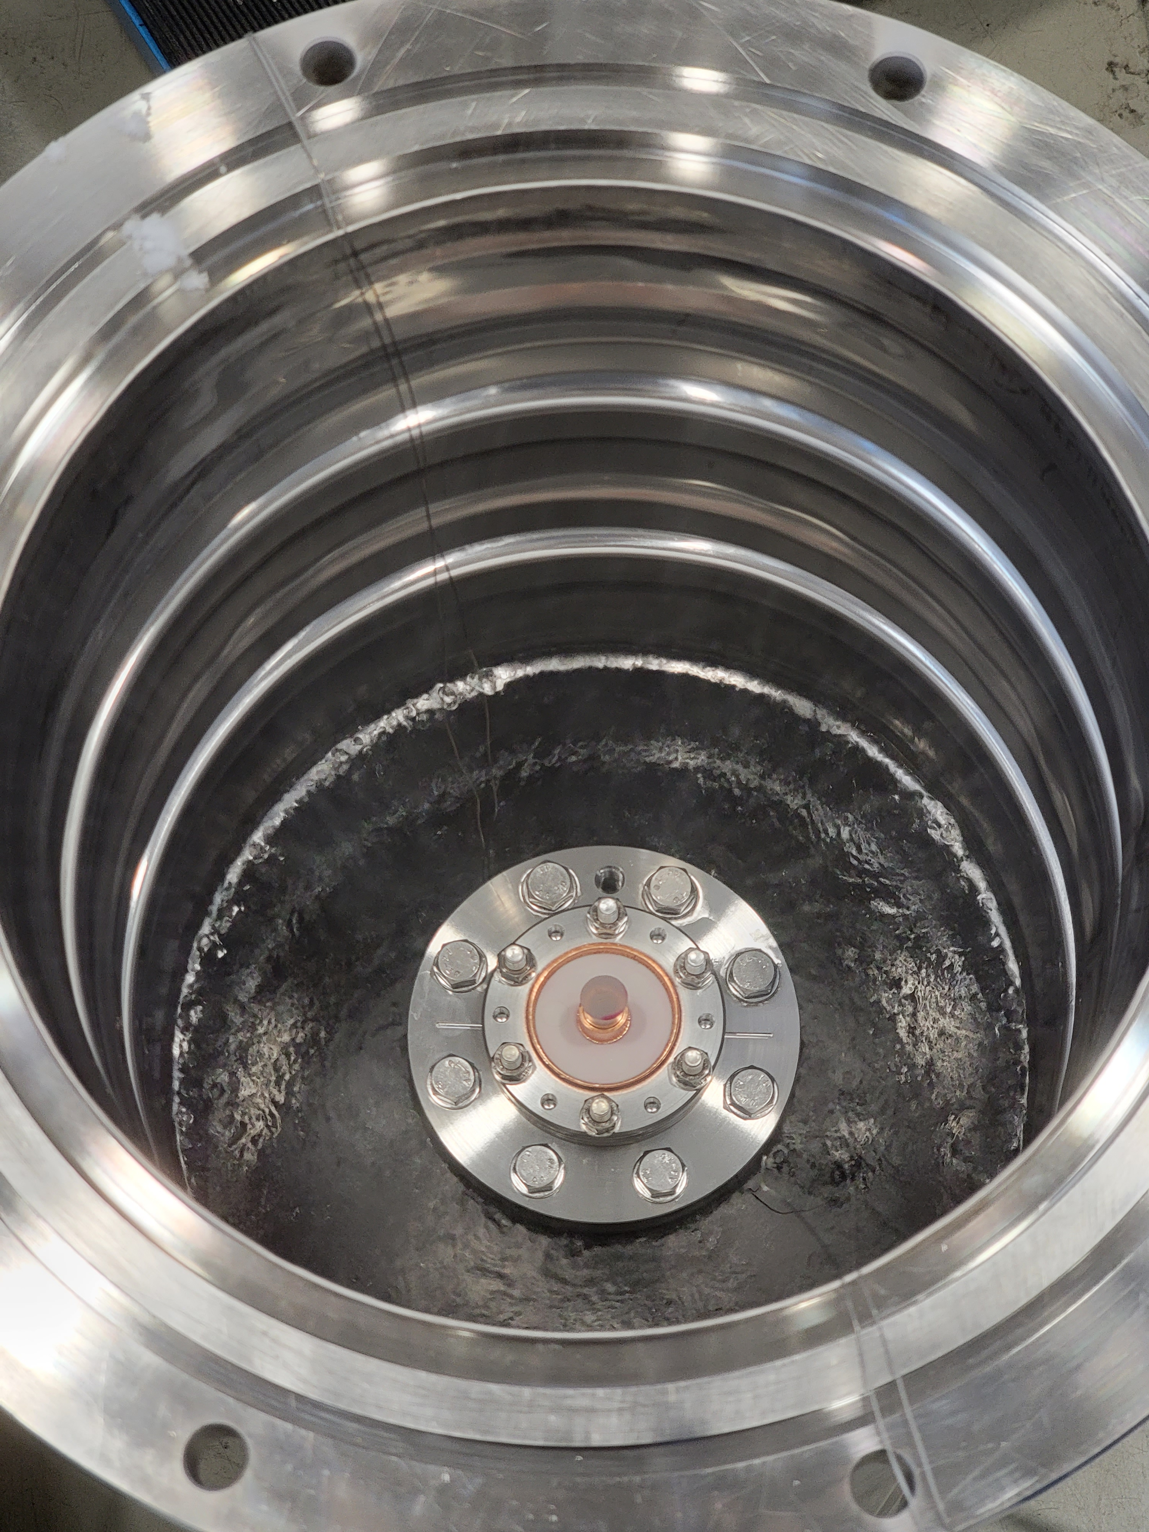
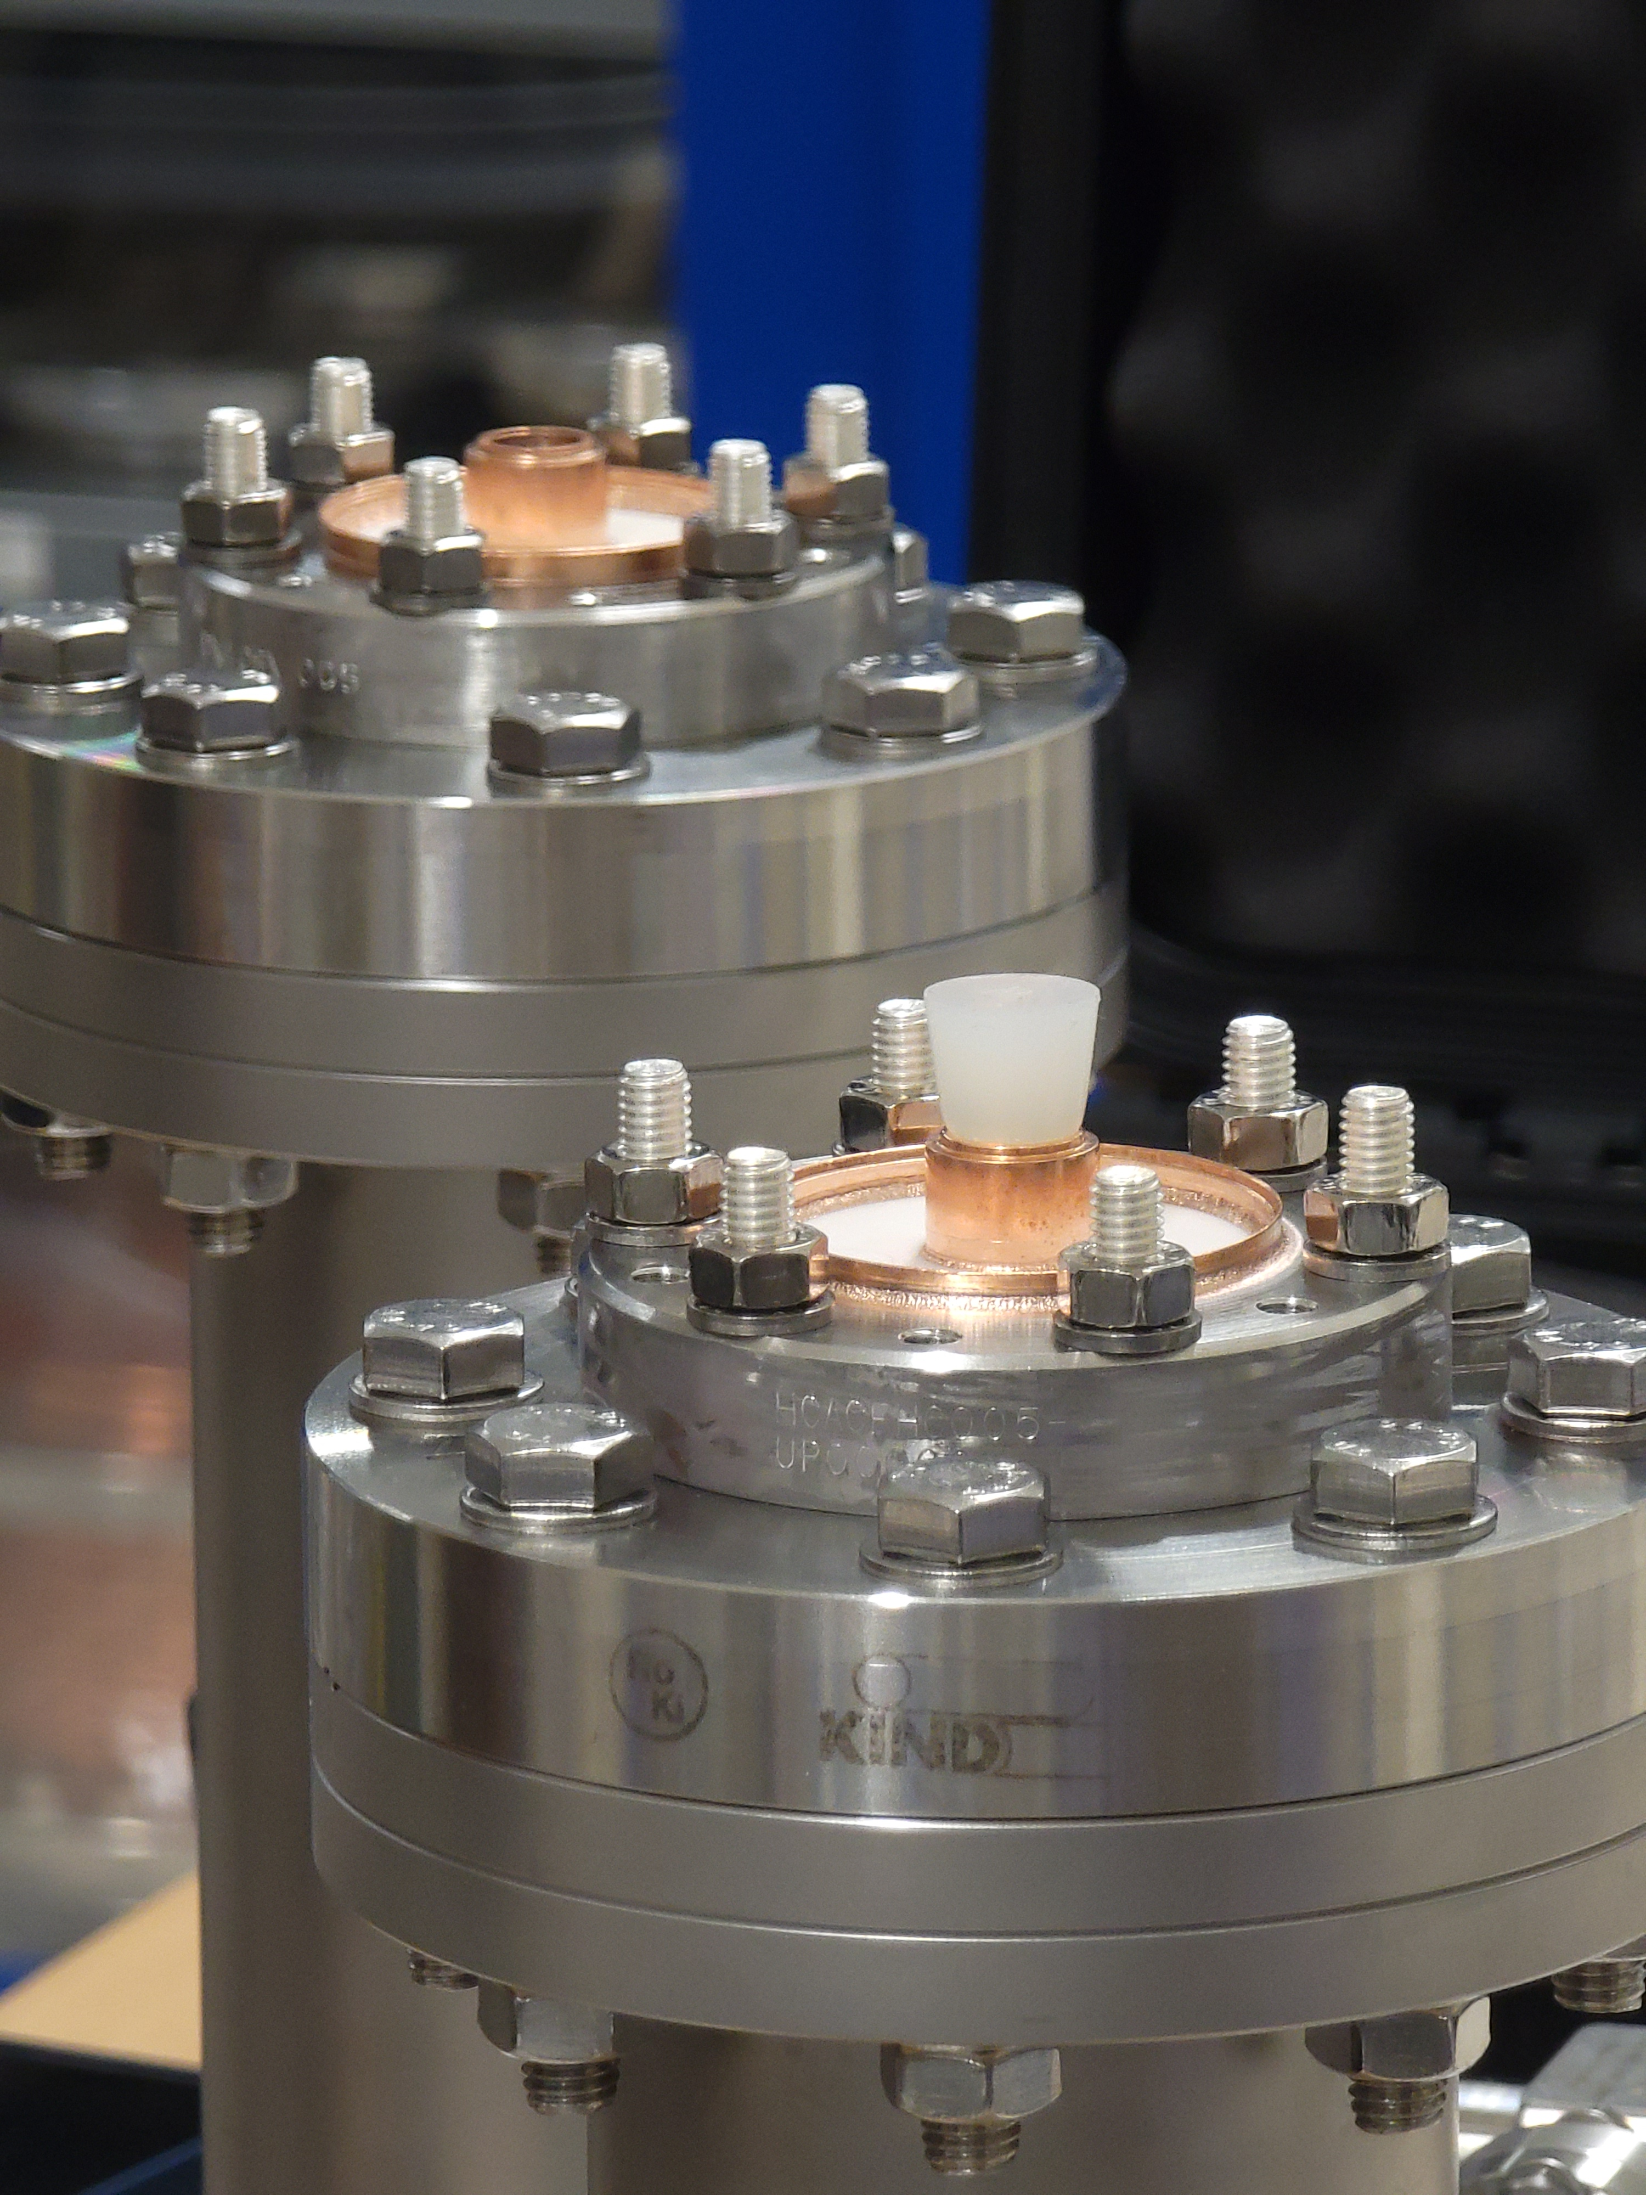
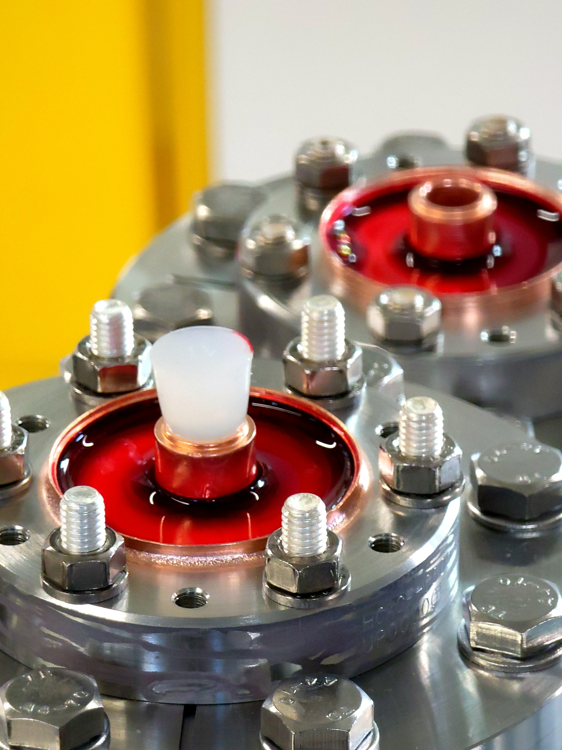
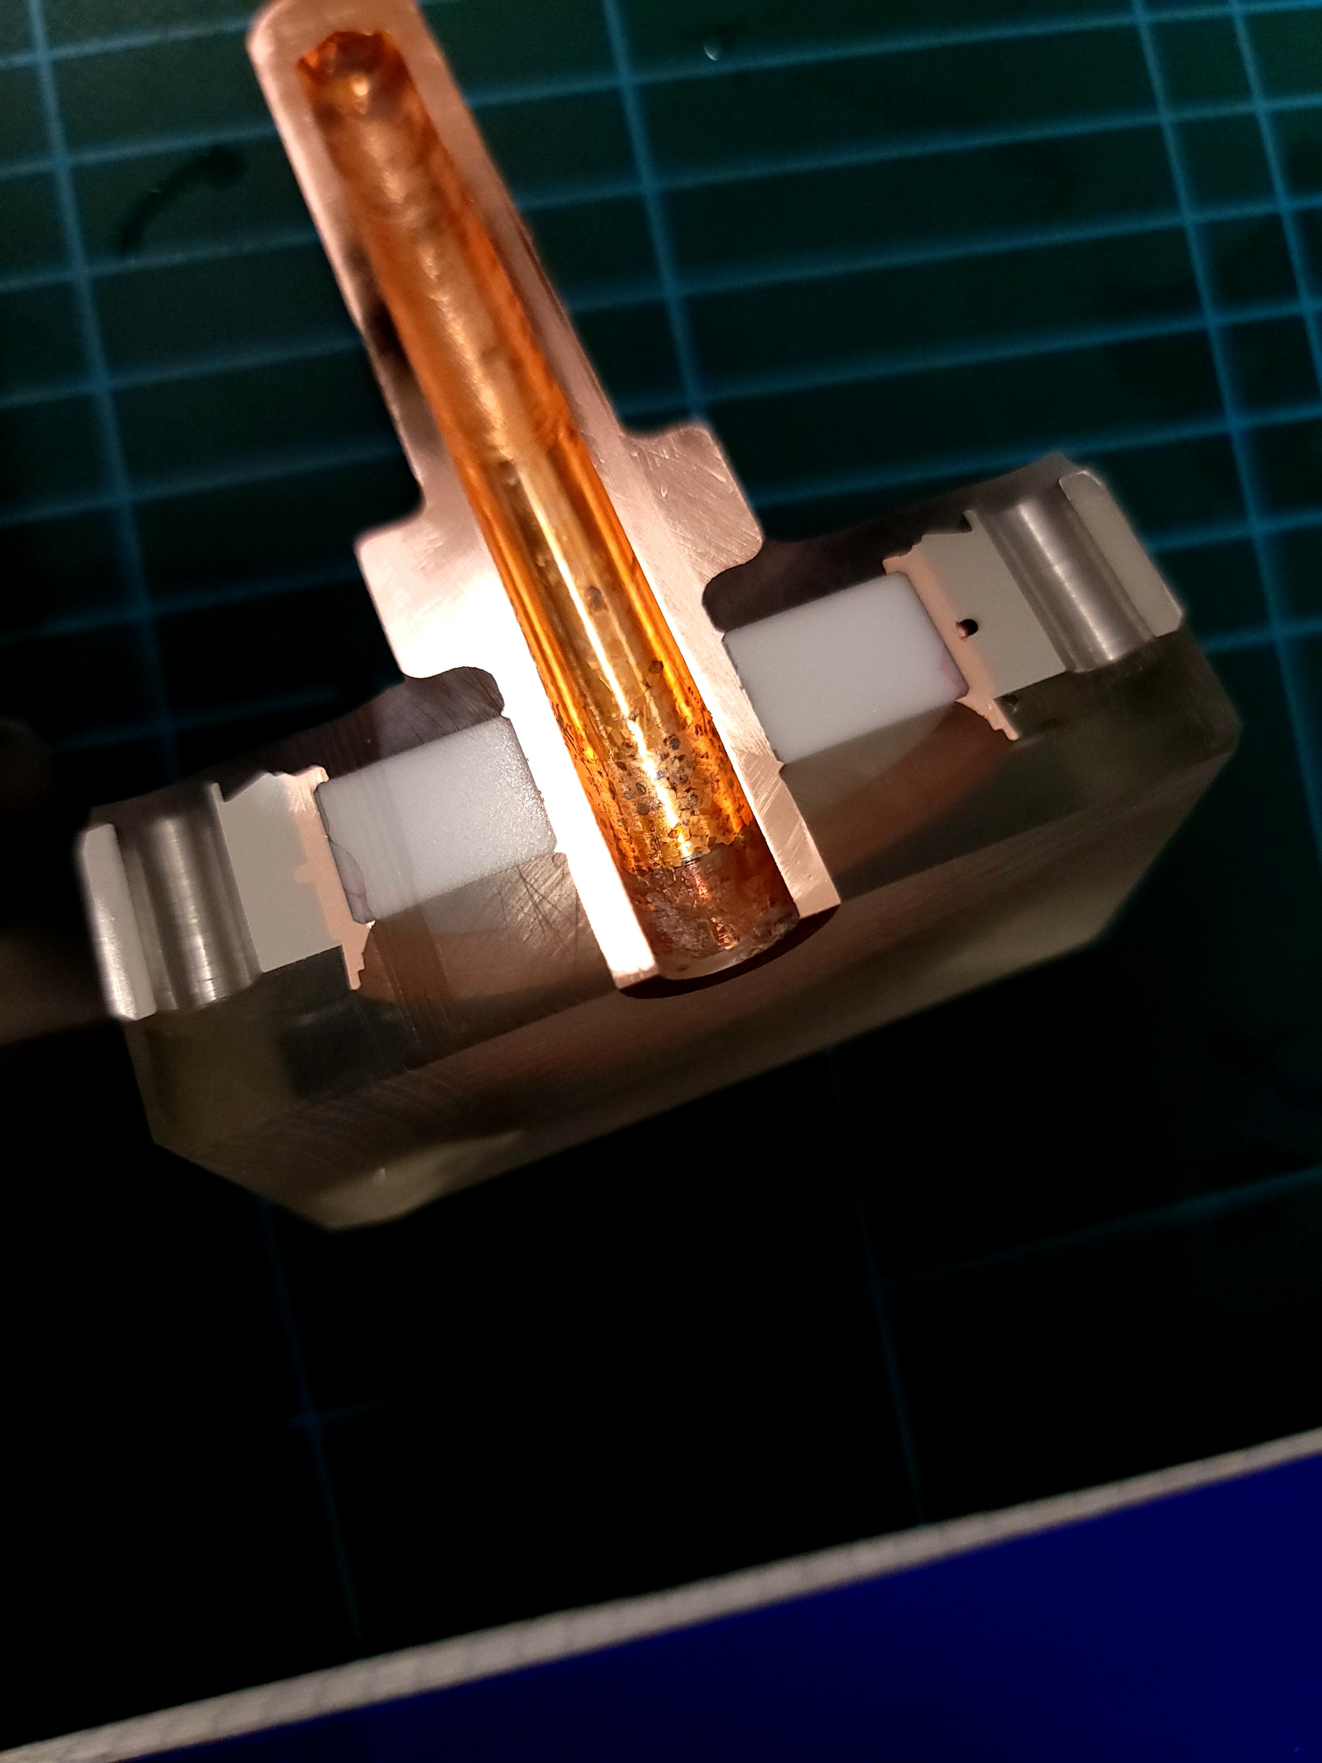
Ceramic Braze Qualifications
Metrology
Penetrant Test
Leak Test
Assembly (Cu Gasket)
Leak Test
Penetrant Test
Thermal Shock 1
Penetrant Test
Thermal Shock 2
Penetrant Test
Leak Test
Ultrasonic Test
Metallography

Slide 14
Ceramic Braze Qualifications
Test / sample name | Sample history at JLAB | Metrology knifes (EN-MME B.72) | VT (EN-MME B.112) | PT on the ceramic (both sides) | Assembly, with VITON gasket (SY-RF workshop) | LT (SY-RF workshop) | Assembly, with Cu gasket | LT (SY-RF workshop) | PT "air side" (SY-RF workshop) | Thermal shock No.1 (EN-MME B.112) | PT "air side" after shock No.1 (EN-MME B.112) | Thermal shock No.2 (EN-MME B.112) | PT "air side" after shock No.2 (EN-MME B.112) | LT (TE-VSC at 4030) | Dissassembly + Final PT (UHV side) | UT (EN-MME B.112) | Cold resin + wire cut | Metallography results
12-01 | 1 x assembly using flat gasket | Done | Done | Done | Done | Passed | Done. RF gasket | Passed | Done. No radial cracks. | Done | Done. No radial cracks. | Done | Done | Passed | - | Done | Done | 4-5 mm internal crack in OD 'air side'.
12-03 | 1 x assembly using flat gasket | Done | Done | Done | Done | Passed | Done. RF gasket | Passed | Done. No radial cracks. | Done | Done. No radial cracks. | - | - | Passed | Done | Done | Done | 3-4 mm internal crack in OD 'air side'.
05-01 | 1 x assembly using flat gasket | Done | Done | Done, few indications (about 1mm) on ceramic OD | Done | Passed | Done. Flat gasket | Passed | Done. No radial cracks. Same indications observed in previous PT. | Done | Done. No radial cracks. Same indications observed in previous PT. | Done | Done | Passed | Done | Done | Done | 5 mm internal crack in OD 'air side'.
#3 | 5x assembly + 5x thermal shocks using flat gasket | - | - | Done few indications (3-5mm) on ceramic OD | - | - | - | - | - | - | - | - | - | - |  | - | Done | 2 mm circumferential surface crack on air side
#4 | 5x assembly + 5x thermal shocks using flat gasket | - | - | Done few indications (3-5mm) on ceramic OD | - | - | - | - | - | - | - | - | - | - |  | - | Done | 2-3 mm circumferential surface crack on air side
PT: red penetrant liquid, 10 minutes dwell per face, rinsing with water
LT: leak rate < 1E-10 mbar * l/s (chamber pressure 1E-3 mbar)
Assembly: Untill 10 Nm in steps of 1 Nm (starting at 4 Nm).
Thermal shock: 30 min filling with N2, 10 minutes waiting with N2 at top flange, warm up in forced air during 1.5 h approx.

Slide 15
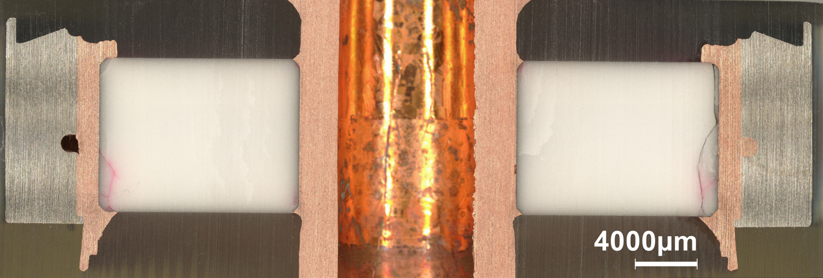
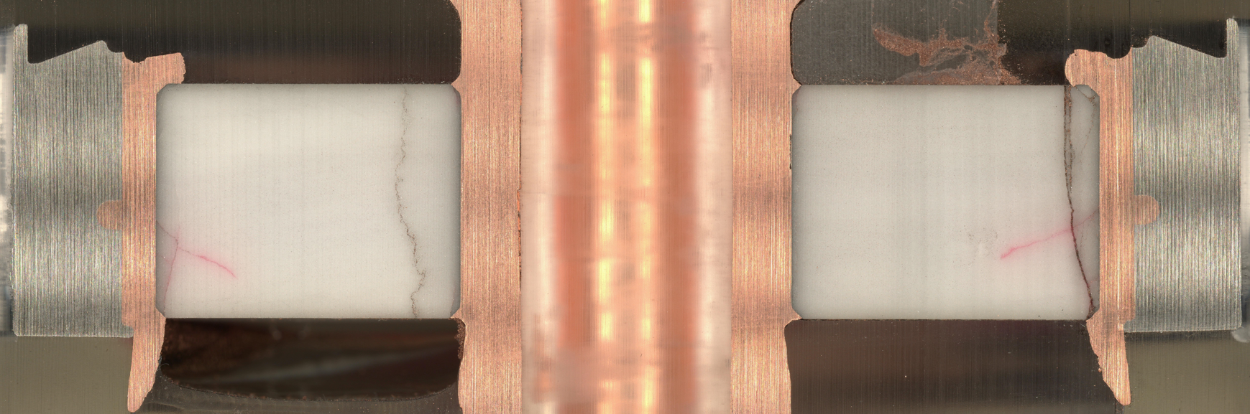
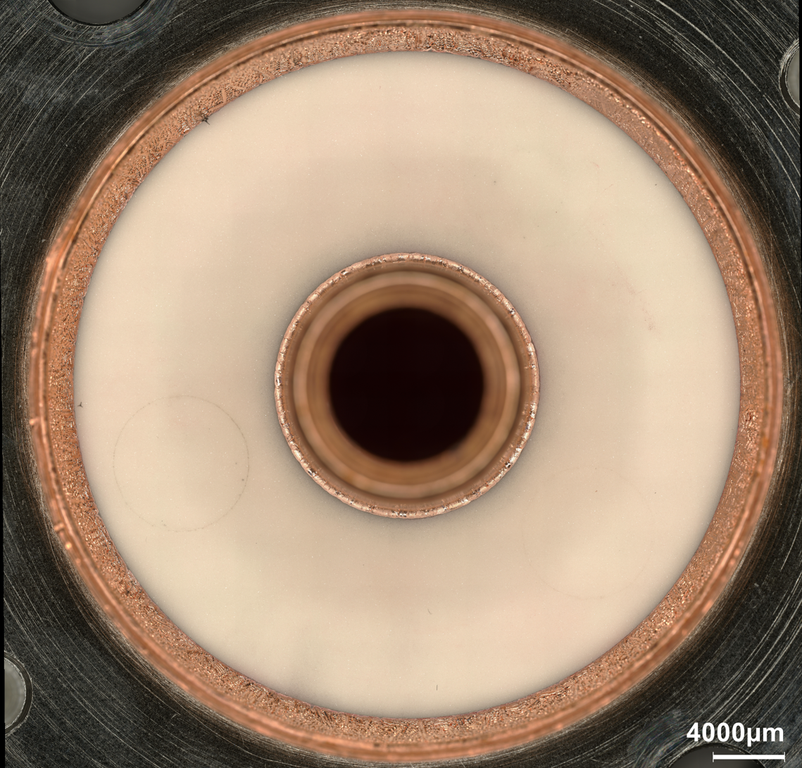
Ceramic Braze Qualifications
Tests were carried out at CERN in Feb 23
No radial cracks were discovered on the ceramic surface; no loss in vacuum (bottom image)
Ceramic samples were cut and polished to find potential internal cracks
  Penetrant dye is present only from cracks from the PT
  Cracks from cutting should have no dye
Cut samples showed internal cracks in the ceramic
The original CERN samples that showed no surface cracks were sectioned for re-inspection
  Similar internal cracks were found
Is this the best that is possible?

Slide 16
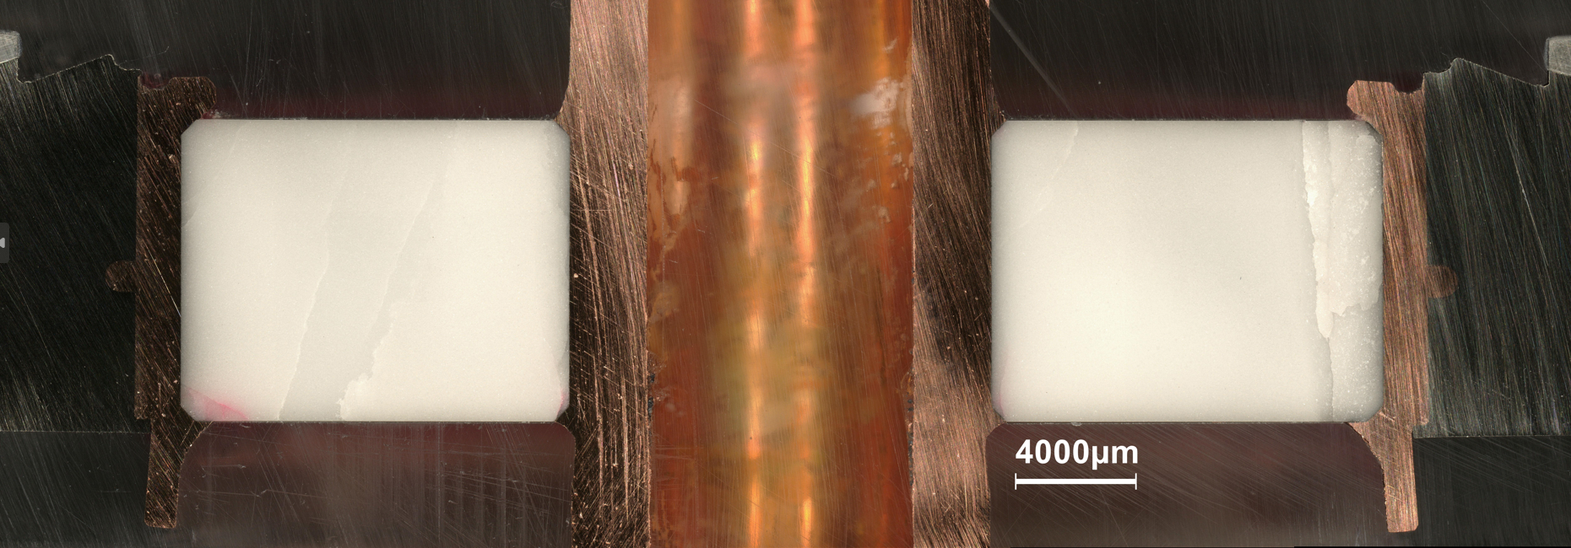
Ceramic Braze Qualifications
Further investigation found possible issues with identifying the internal cracks
  Cracks may form during the cold shock/mounting process, and they definitely form during the cutting process
  The challenge is to isolate the two
  The dye from the PT was meant to only be present in the cracks from the cold shock/mounting process
Internal cracks were found to be exaggerated presumably due to dye flowing into cracks from cutting process
Cracks were present in samples sectioned right after PT (left) but not samples cut one week after PT (right)
  This could be due to the dye having additional time to dry for the latter

Slide 17
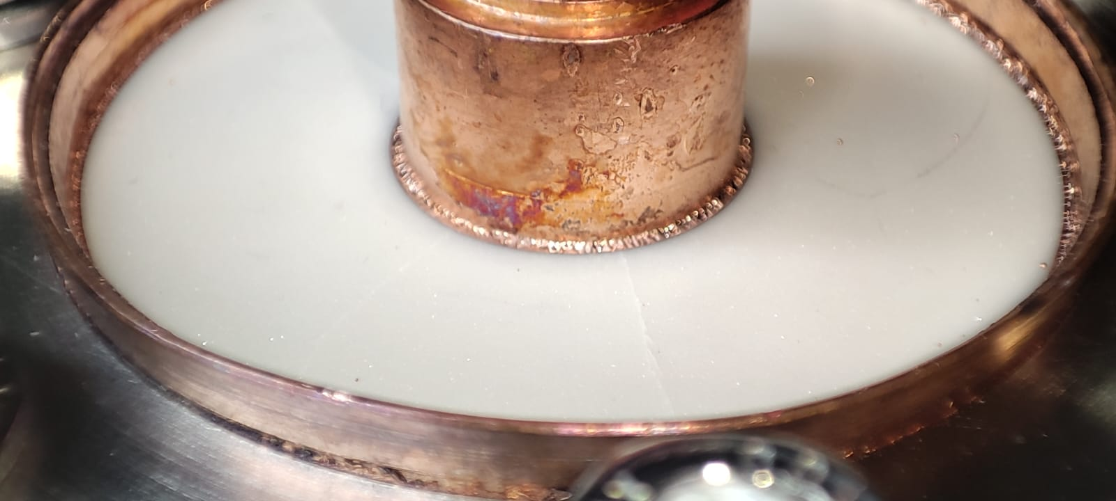
Ceramic Braze Qualifications
Tests were repeated in August 2023
Samples had radial cracks during installation, observed from the surface
Brazing process was exactly the same as the Feb tests
  Only difference was ceramics were from a different lot (though same vendor)
  Exact cause of failures is unknown

Slide 18
Ceramic Braze Qualification: Path Forward
New samples will be brazed and tested
One set of feedthroughs will be fast-tracked for the first pre-series jacketed cavity
  All machining will be done prior to brazing to reduce additional stress on the ceramic
  Remaining ceramics from the older batch will be used
  The back-up plan is to use a set of qualified ancillaries from CERN for the first cavity
Testing at CERN has shown that higher purity alumina (99.5%) is more resistant to cracking
  A set of feedthroughs and testing samples will be fabricated using 99.5% alumina parts from CERN
All units will go through a cold shock/mounting process to ensure no radial cracks form
Resolution is expected by the end of 2023

Slide 19
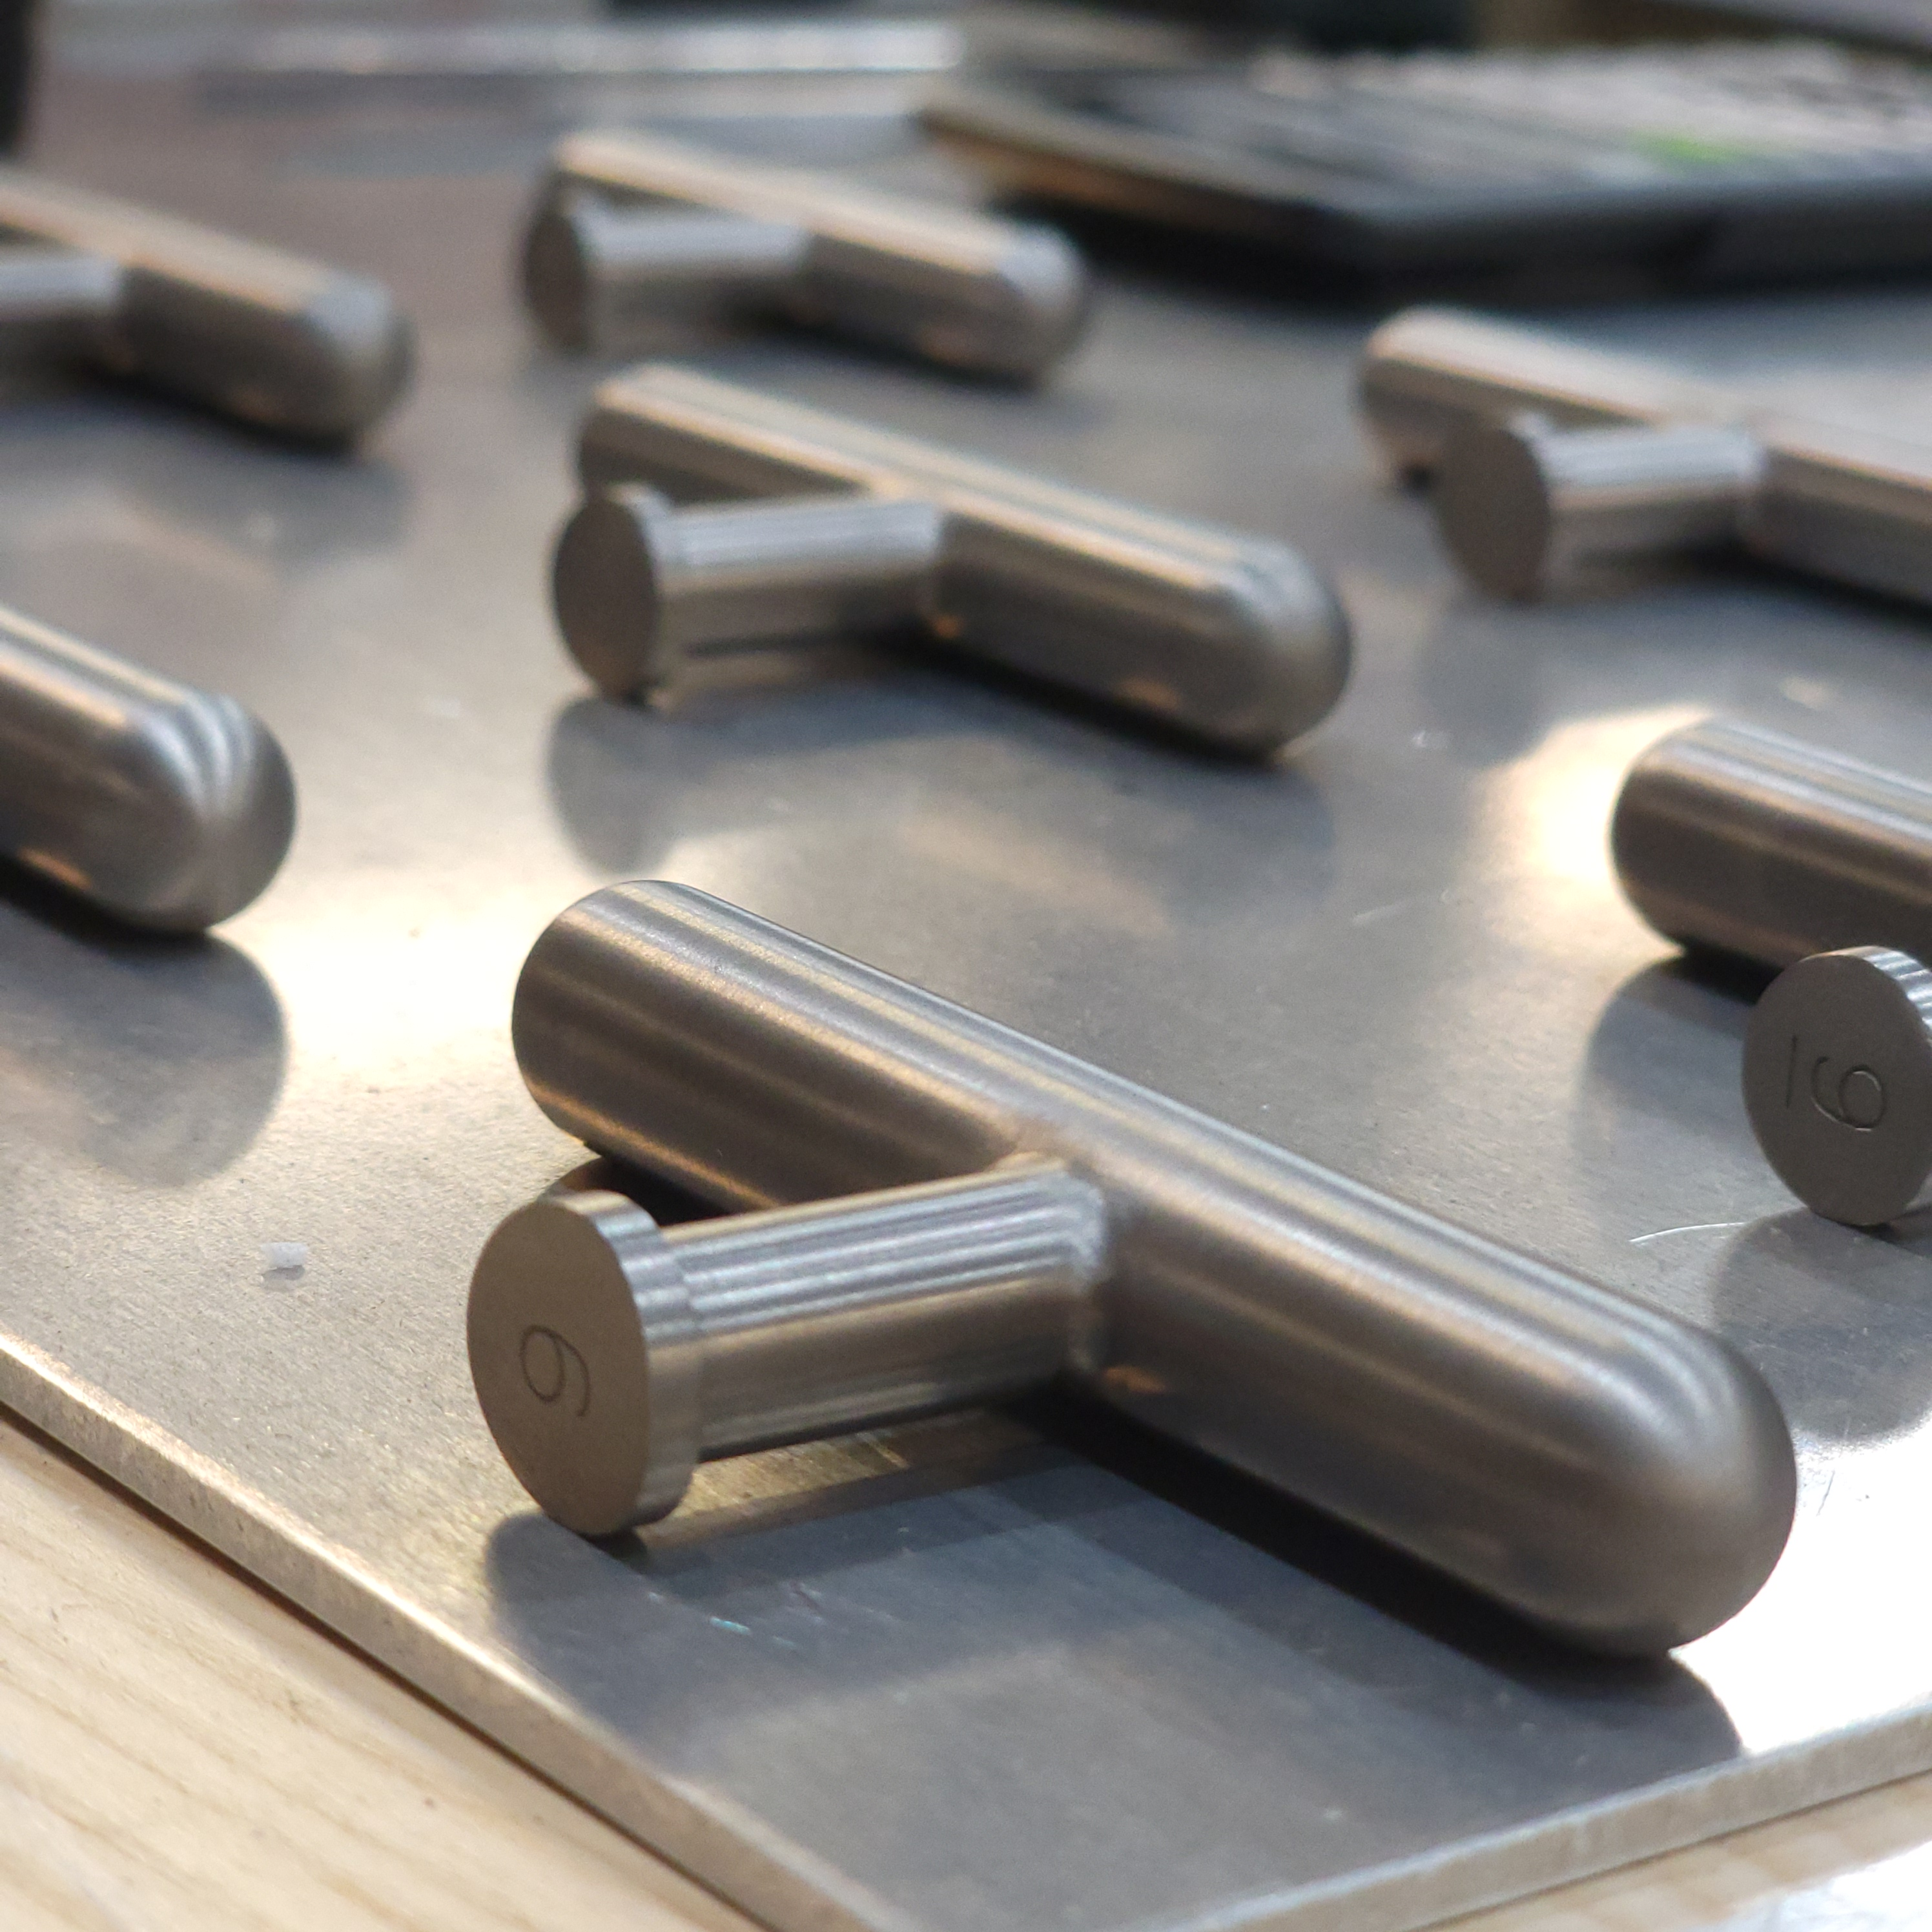
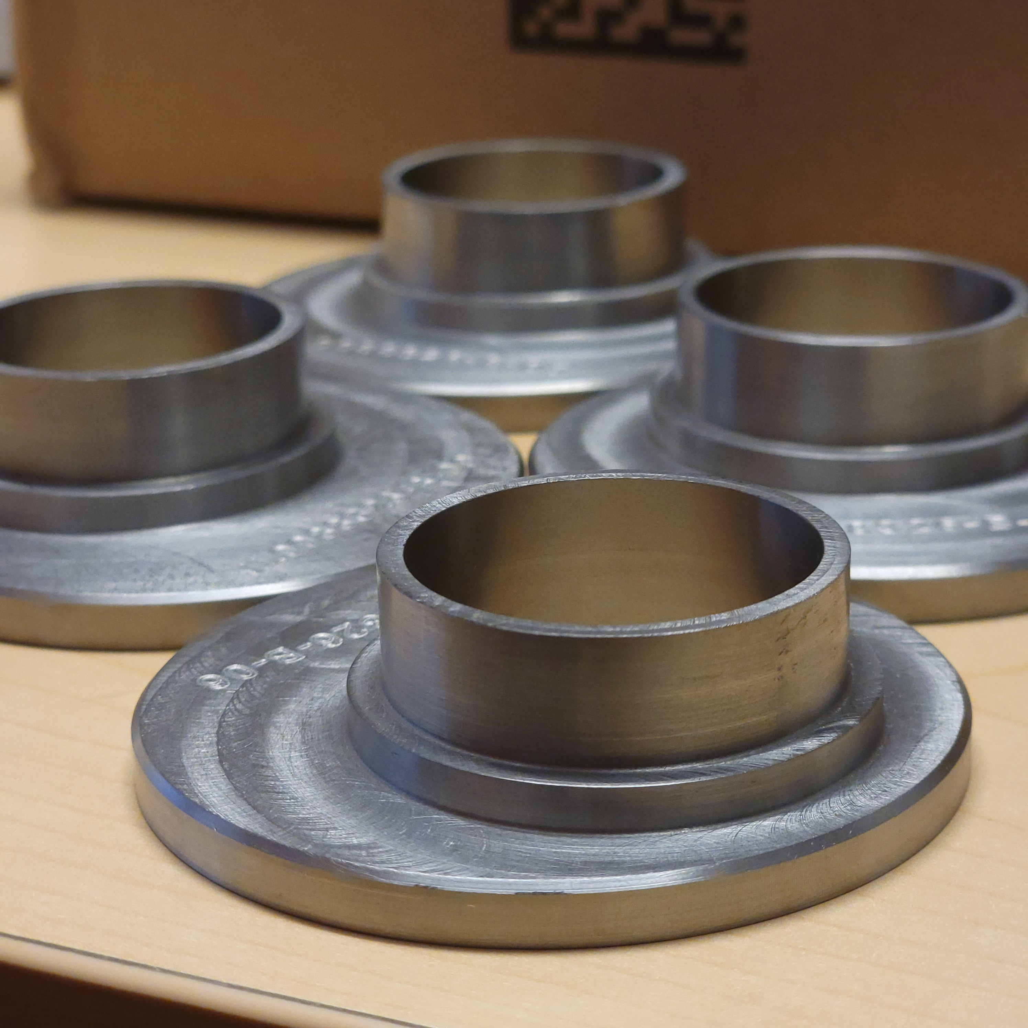
Series Status
All raw material for Series production has been received at JLab
  Material certificates are released in EDMS
Series component fabrication is being carried out in parallel with Pre-Series
  Only parts not affected by drawing reviews are being fabricated at the moment
First series units are due in mid-2024

Slide 20
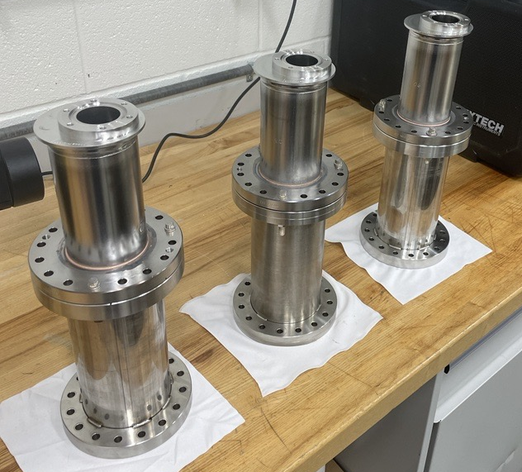
Summary
Pre-Series couplers are currently in production at JLab
  Goal is to have them ready for the first Pre-Series cavities in Spring 2024
Ceramic brazes have been a challenge for both JLab and CERN
  A viable path forward has been identified and is in process
Raw material procurement for Pre-Series and Series production is complete
Series part fabrication is being carried out alongside the Pre-Series

Slide 21
Thanks to the RFD Ancillary Team
Fermilab – Paolo Berrutti, Manuele Narduzzi, Colin Narug, Leonardo Ristori
ODU – Suba De Silva, Jean Delayen
SLAC – Zenghai Li
CERN – Nuria Valverde Alonso, Adria Gallifa Terricabras, Eric Montesinos

Slide 22
Back-Up Slides

Slide 23
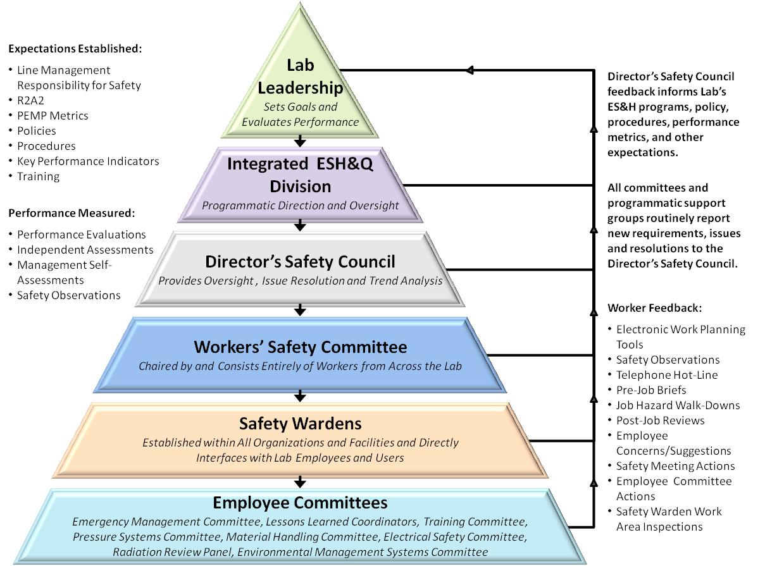
Safety
Safety processes leverage JLab's work planning and control system as well as ESH Manual for program guidance
Safety
Quality
Schedule

Slide 24
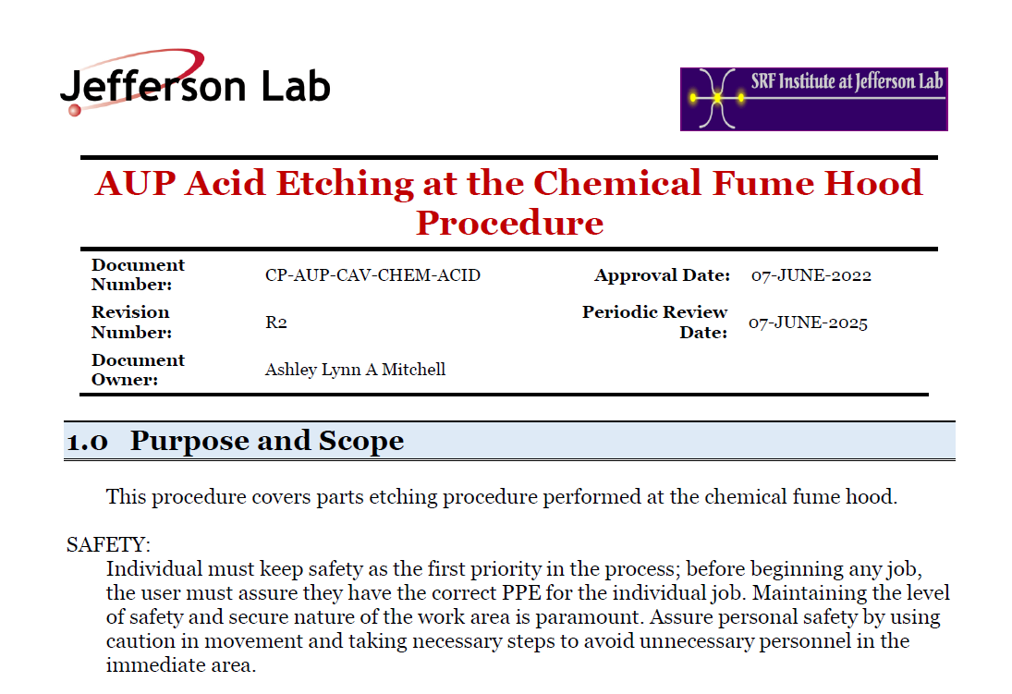
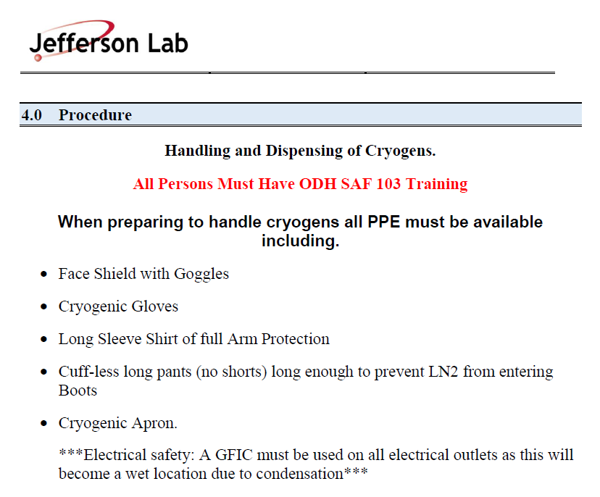
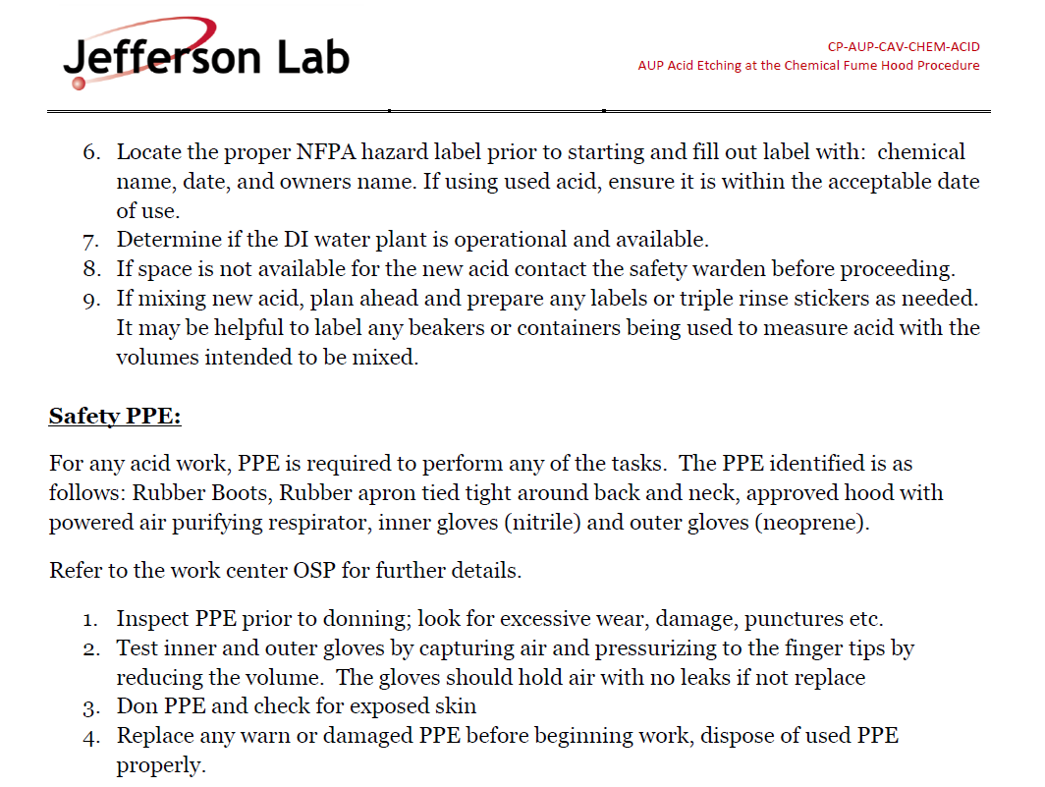
Safety
In addition to JLab’s EH&S manual, safety processes are specified in individual AUP procedures

Slide 25
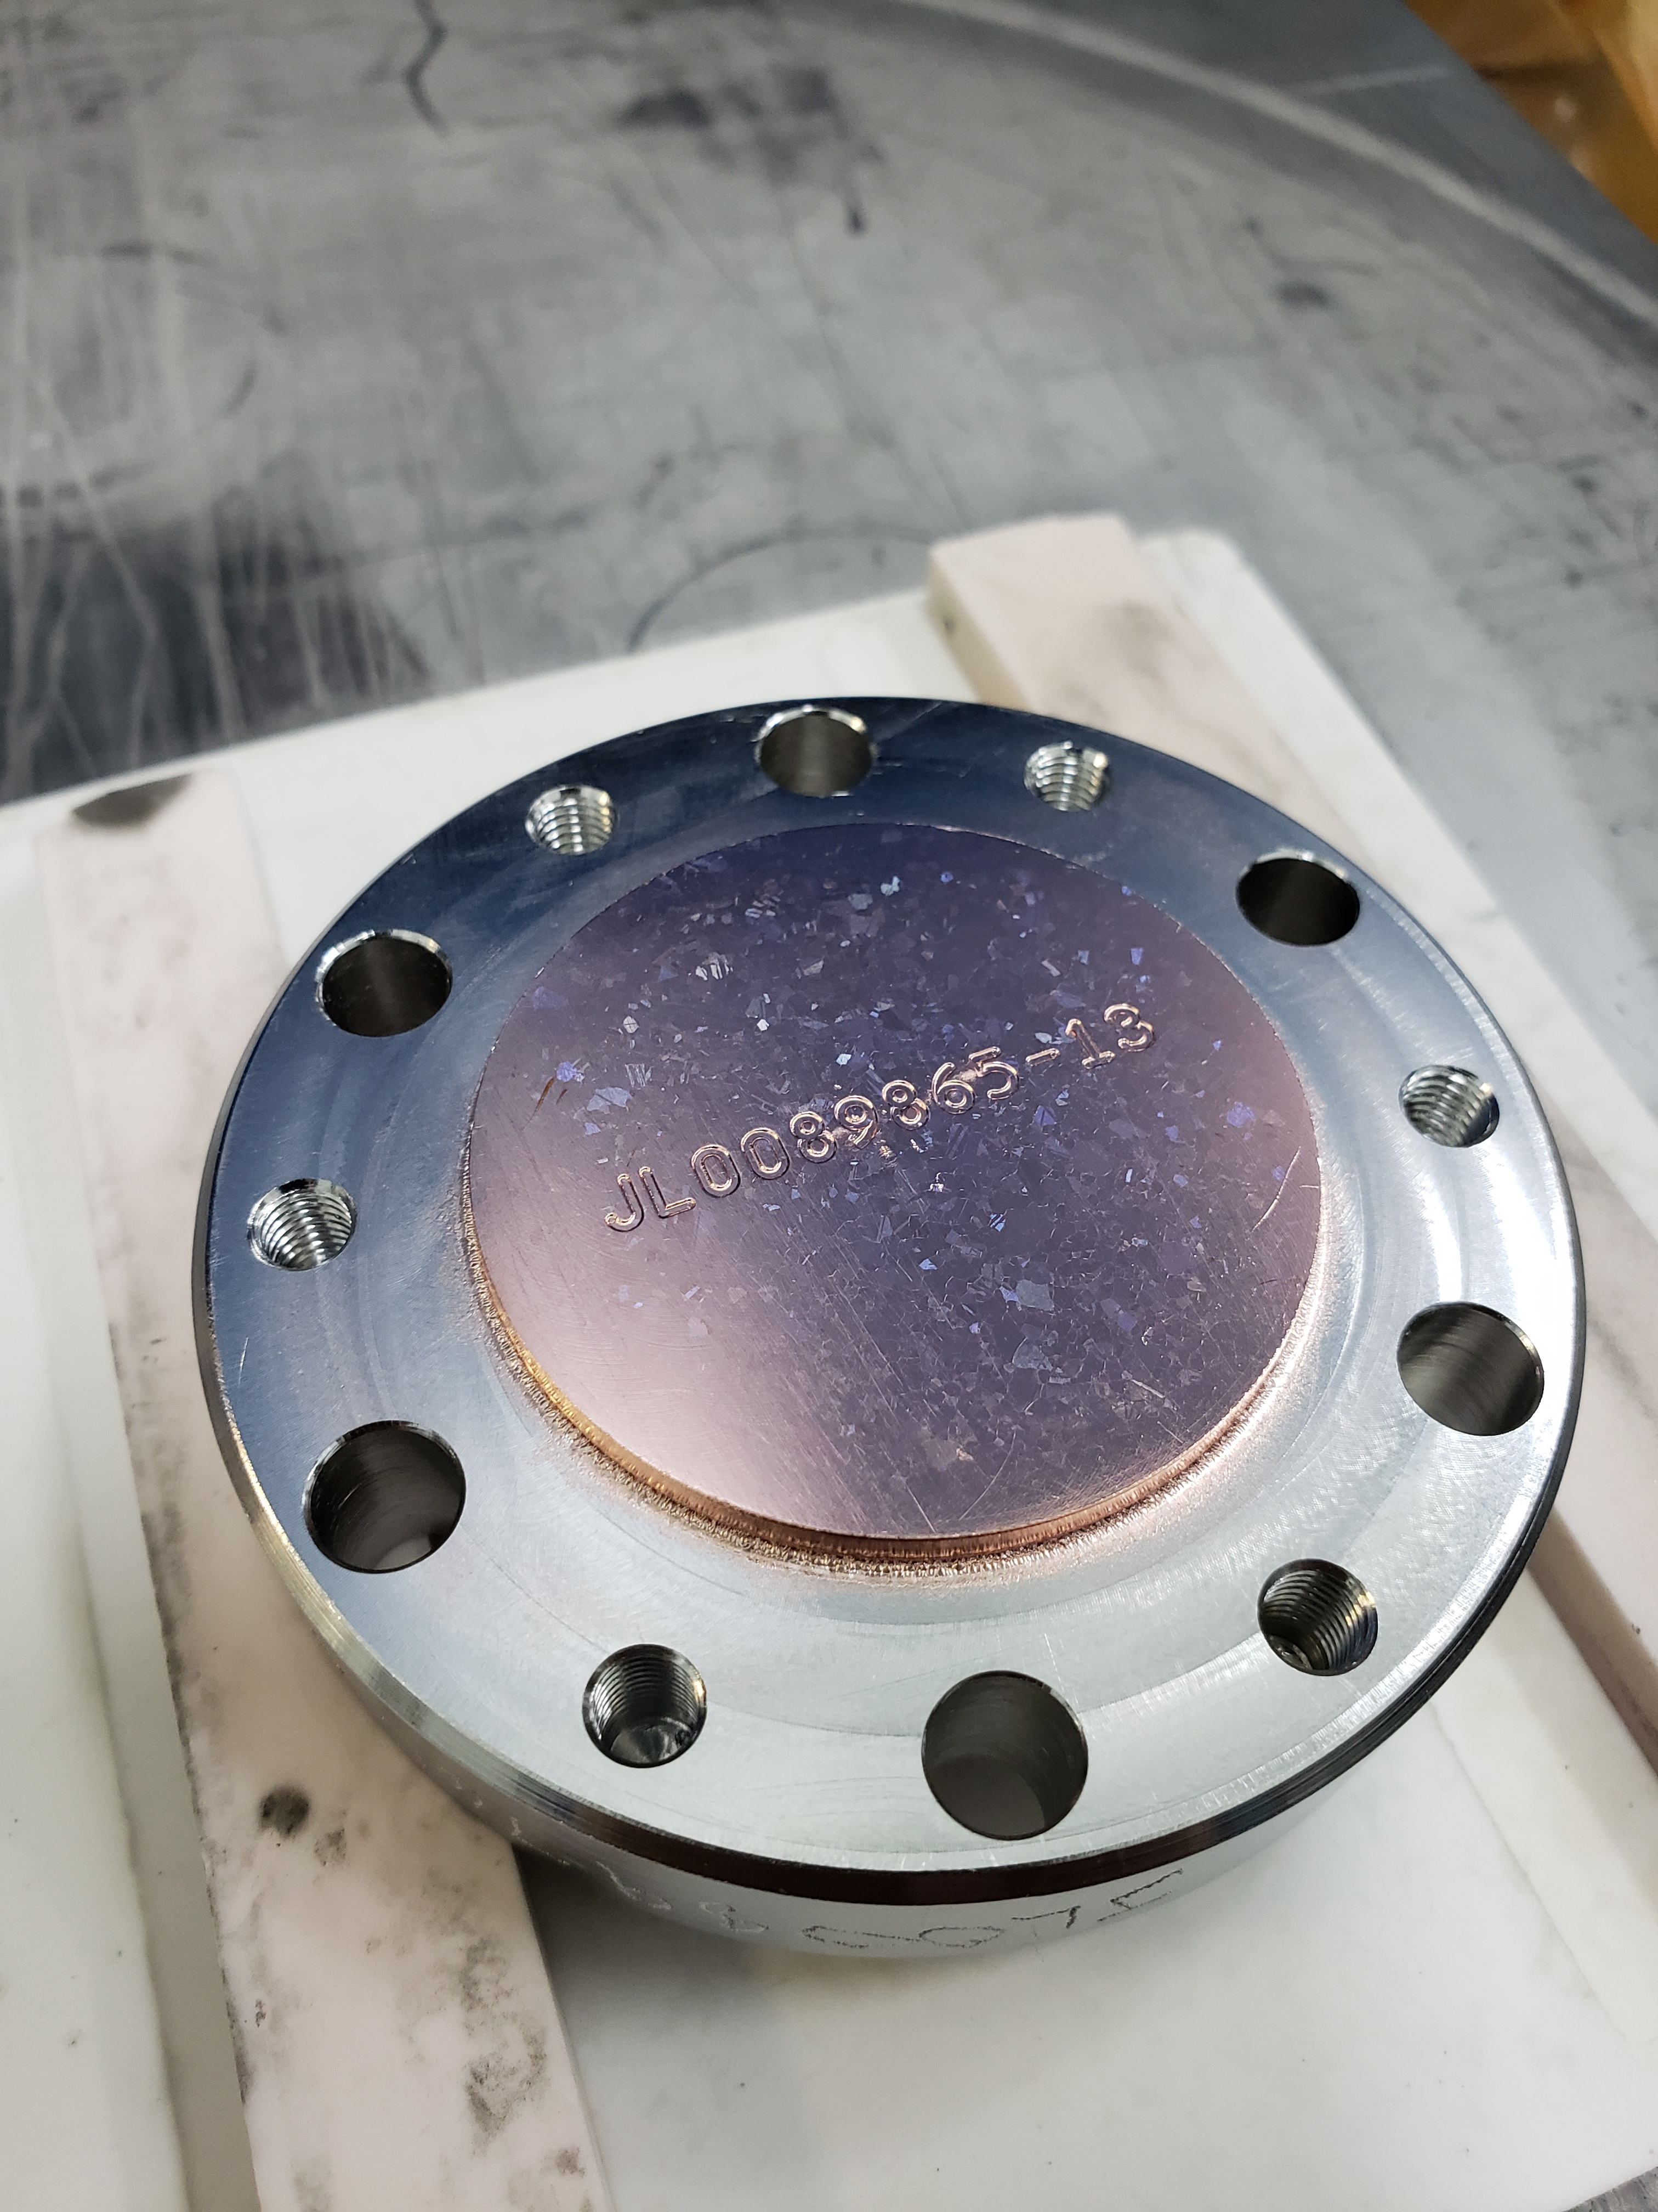
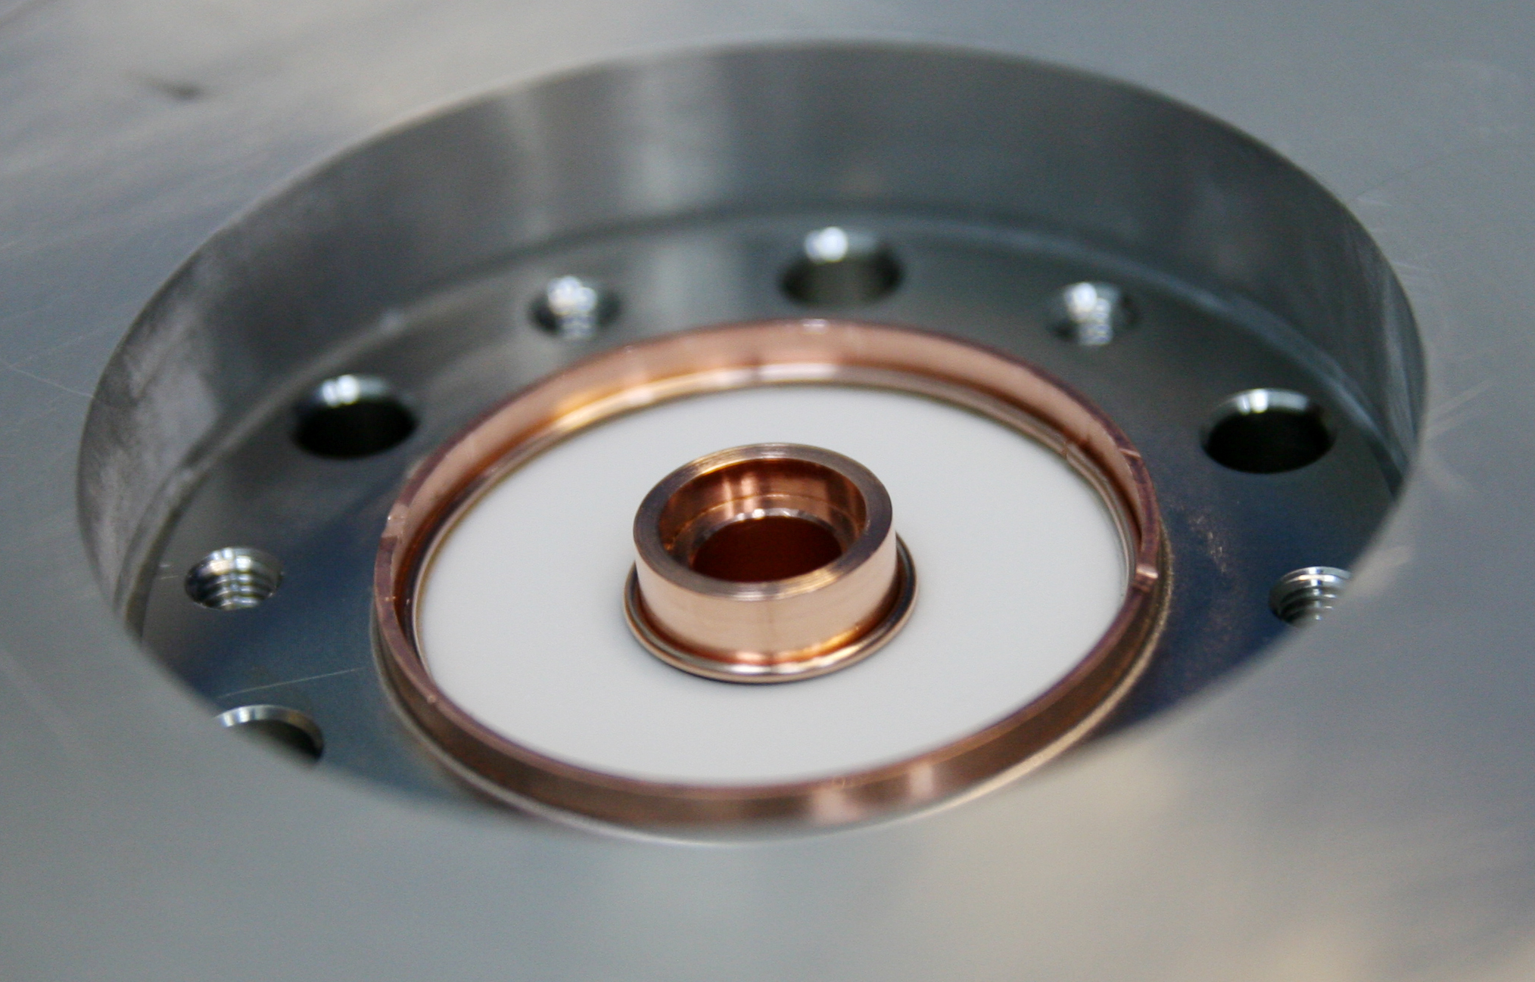
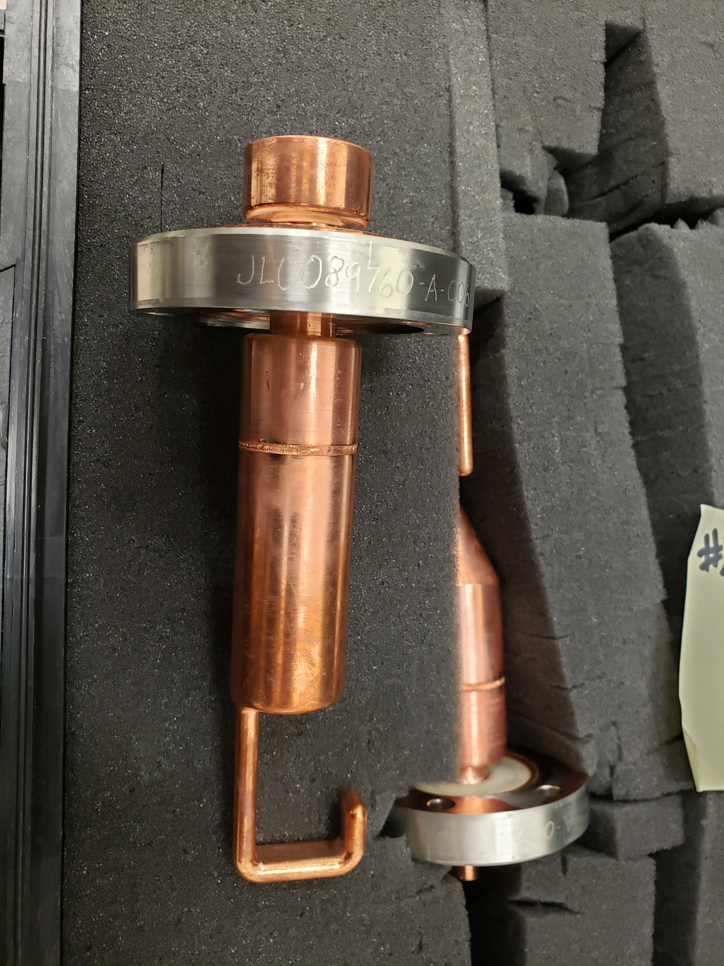
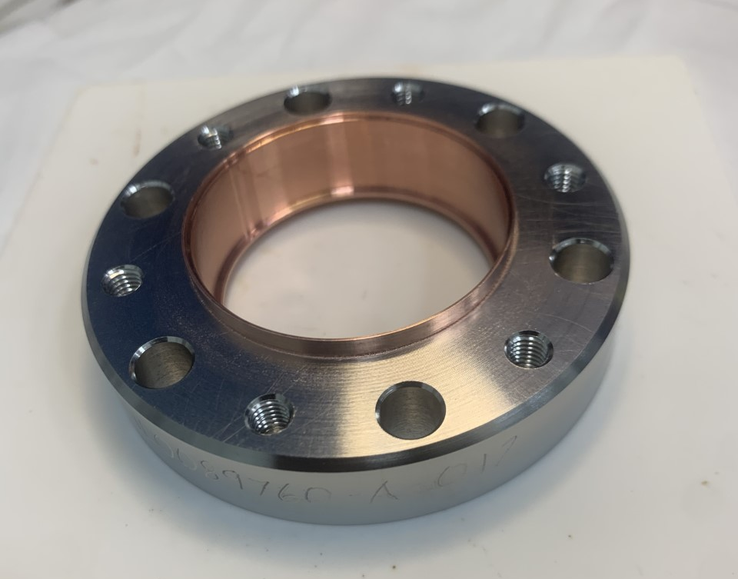
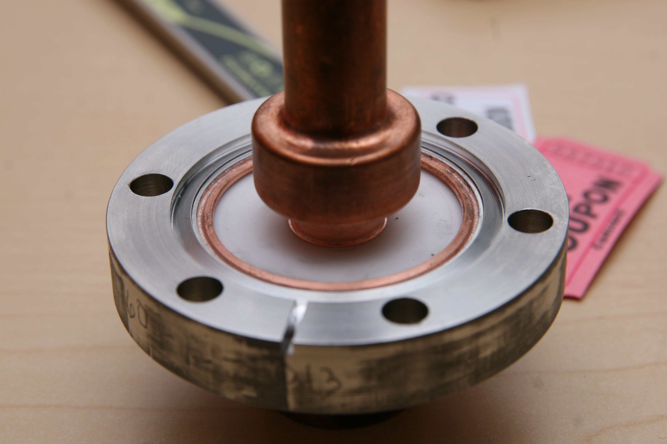
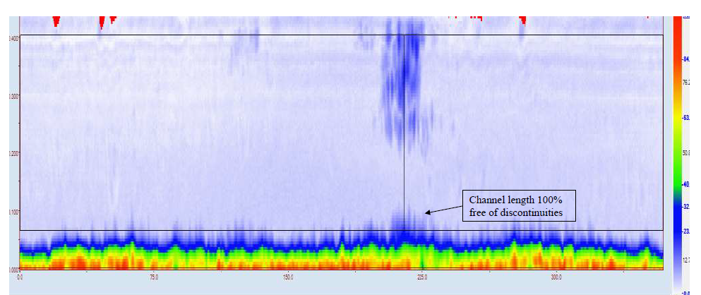
Prototype Fabrication: Ceramic Feedthrough
Braze 1
Leak Check
Mach
UT
Braze 2
Leak Check
UT
Mach
EBW
Leak Check
RT
LN2 Shock

