Slide 1

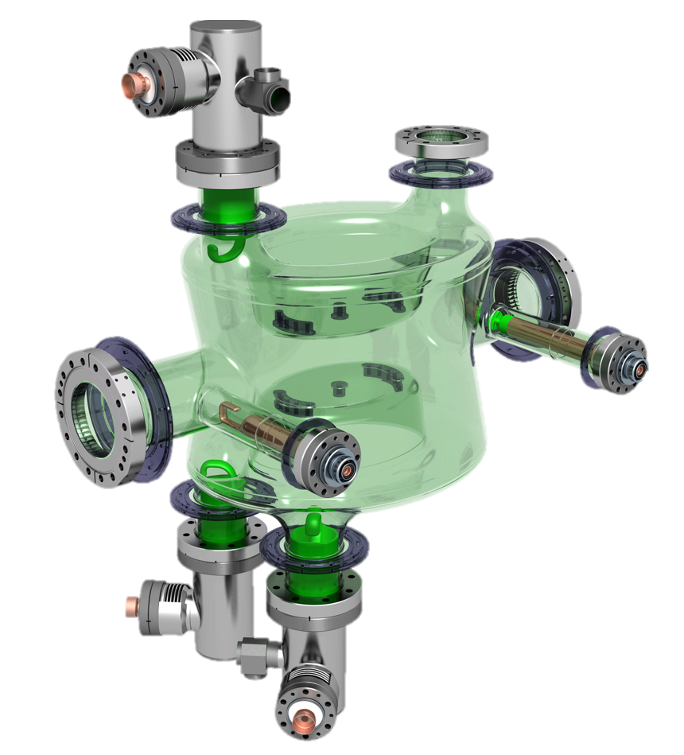
HL-LHC Crab Cavities:
DQW HOM couplers & FPC challenges
Simon Barrière, Eric Montesinos – CERN
on behalf of the WP4 manufacturing team
13th HL-LHC Collaboration Meeting – Vancouver, Canada – 27th September 2023

Slide 2
Outline
A status update on ongoing productions and some fabrication highlights for:
  DQW High-Order Modes Couplers;
  RFD & DQW Fundamental Power Couplers;
  with particular focus on:
Scope of Production
Status & Planning
Manufacturing Challenges & Highlights
Many interactions between HL-WP4 teams

Slide 3
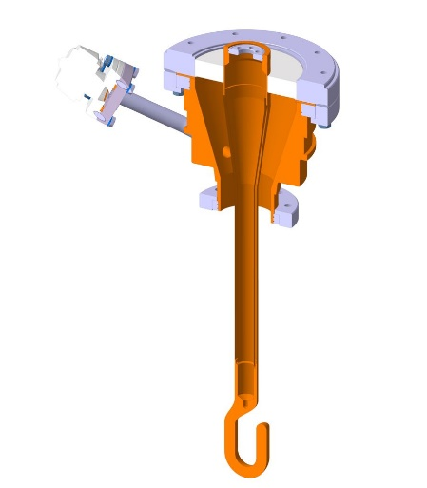
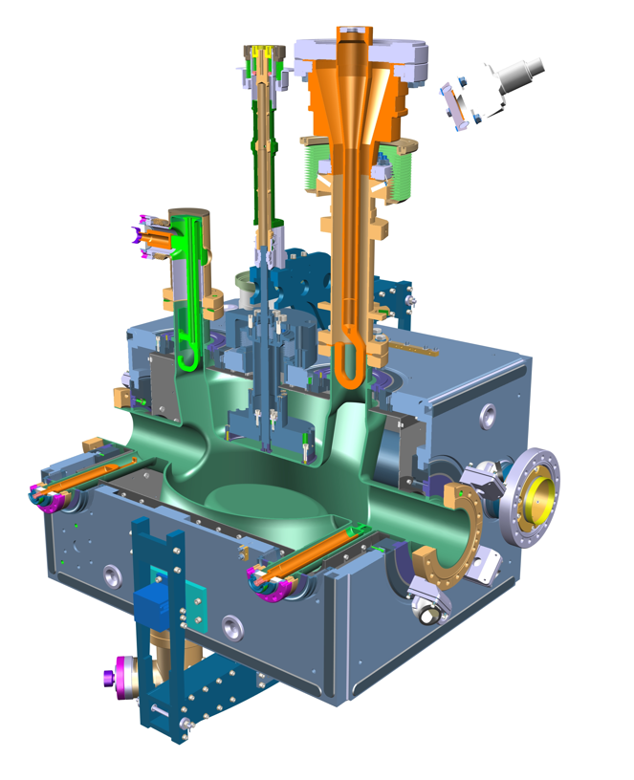
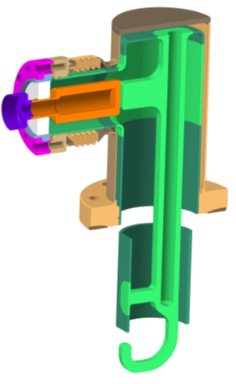
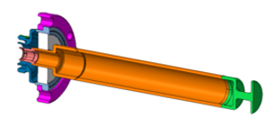
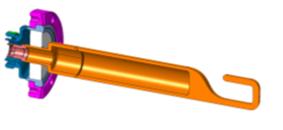
Production Scope
HOM Couplers, Feedthrough & Field Antennas for all LHC-series* DQW crab cavities are being manufactured at CERN Main Workshop
HOM Couplers + Feedthroughs
x 34 units*
also for RFD series
Production kicked-off in Q4-2021:
Definition of project team, mandates & milestones
Launch of raw materials procurement
Preparation & approval of MIPs
Fundamental Power Couplers
x 14 + 14 units*
HF-HOM Couplers
x 12 units*
RF Field Antenna
x 12 units*
*quantities for 8 cavities including spares

Slide 4
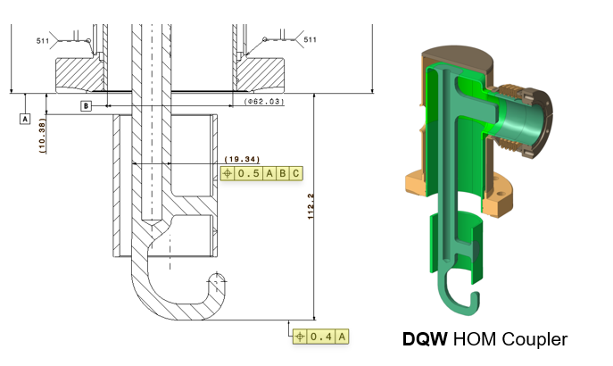
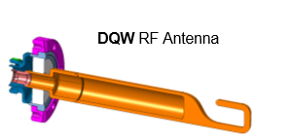
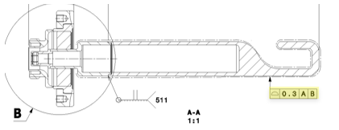
Why are these Objects a Manufacturing Challenge?
  Specific (and expensive!) materials
    Extra-pure niobium, OFE copper, titanium grade 23 (TA6V ELI), stainless steel 316LN
  (S)RF performance highly dependent on geometry and surface quality
    Final tolerances in few tens of millimetres after many assembly (welding!) steps
    Machined and welded RF surfaces = specific parameters
  Multi-Technology components with pressure joints
    ~13 technologies involved and intertwined
    Multiple activities and actors in parallel in different groups
    Advanced follow-up to fulfil HL-LHC quality standards (PED-related normative, MTF steps, traceability)

Slide 5
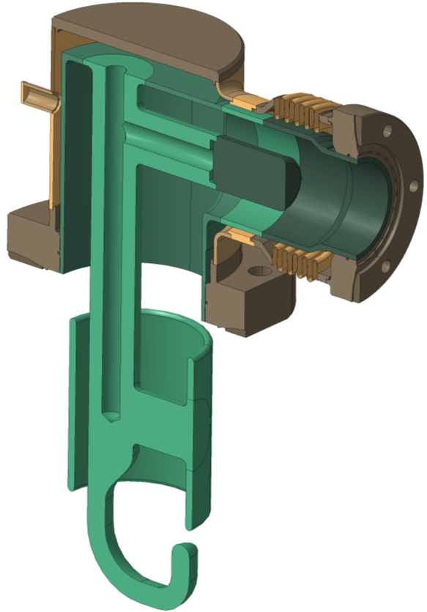
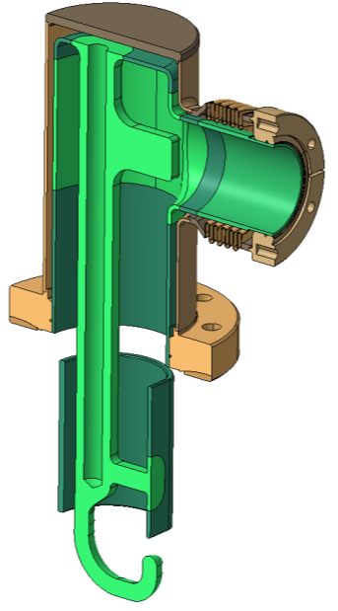
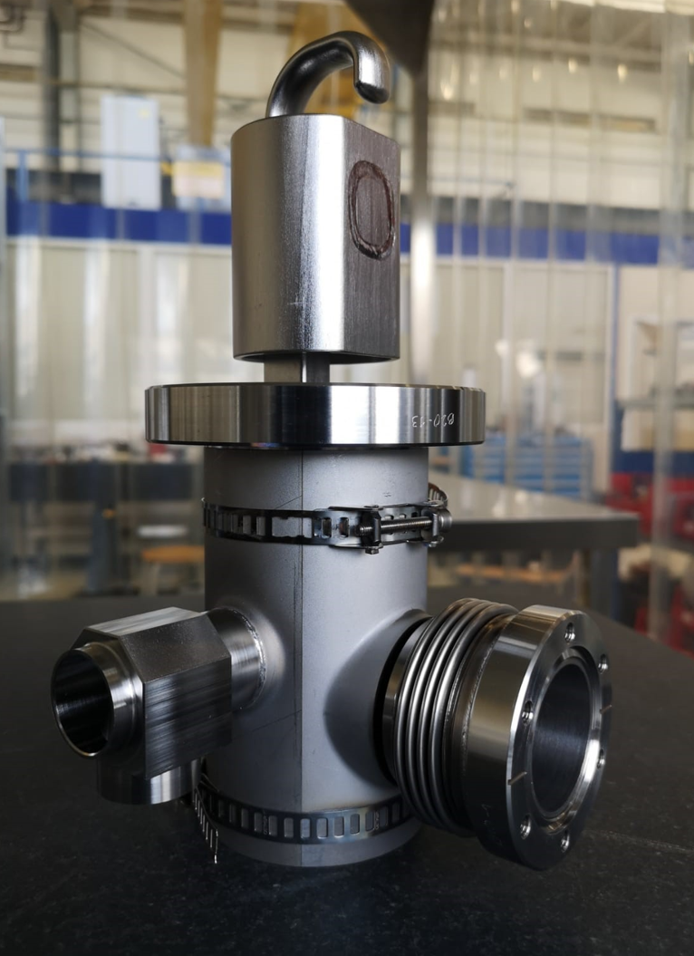
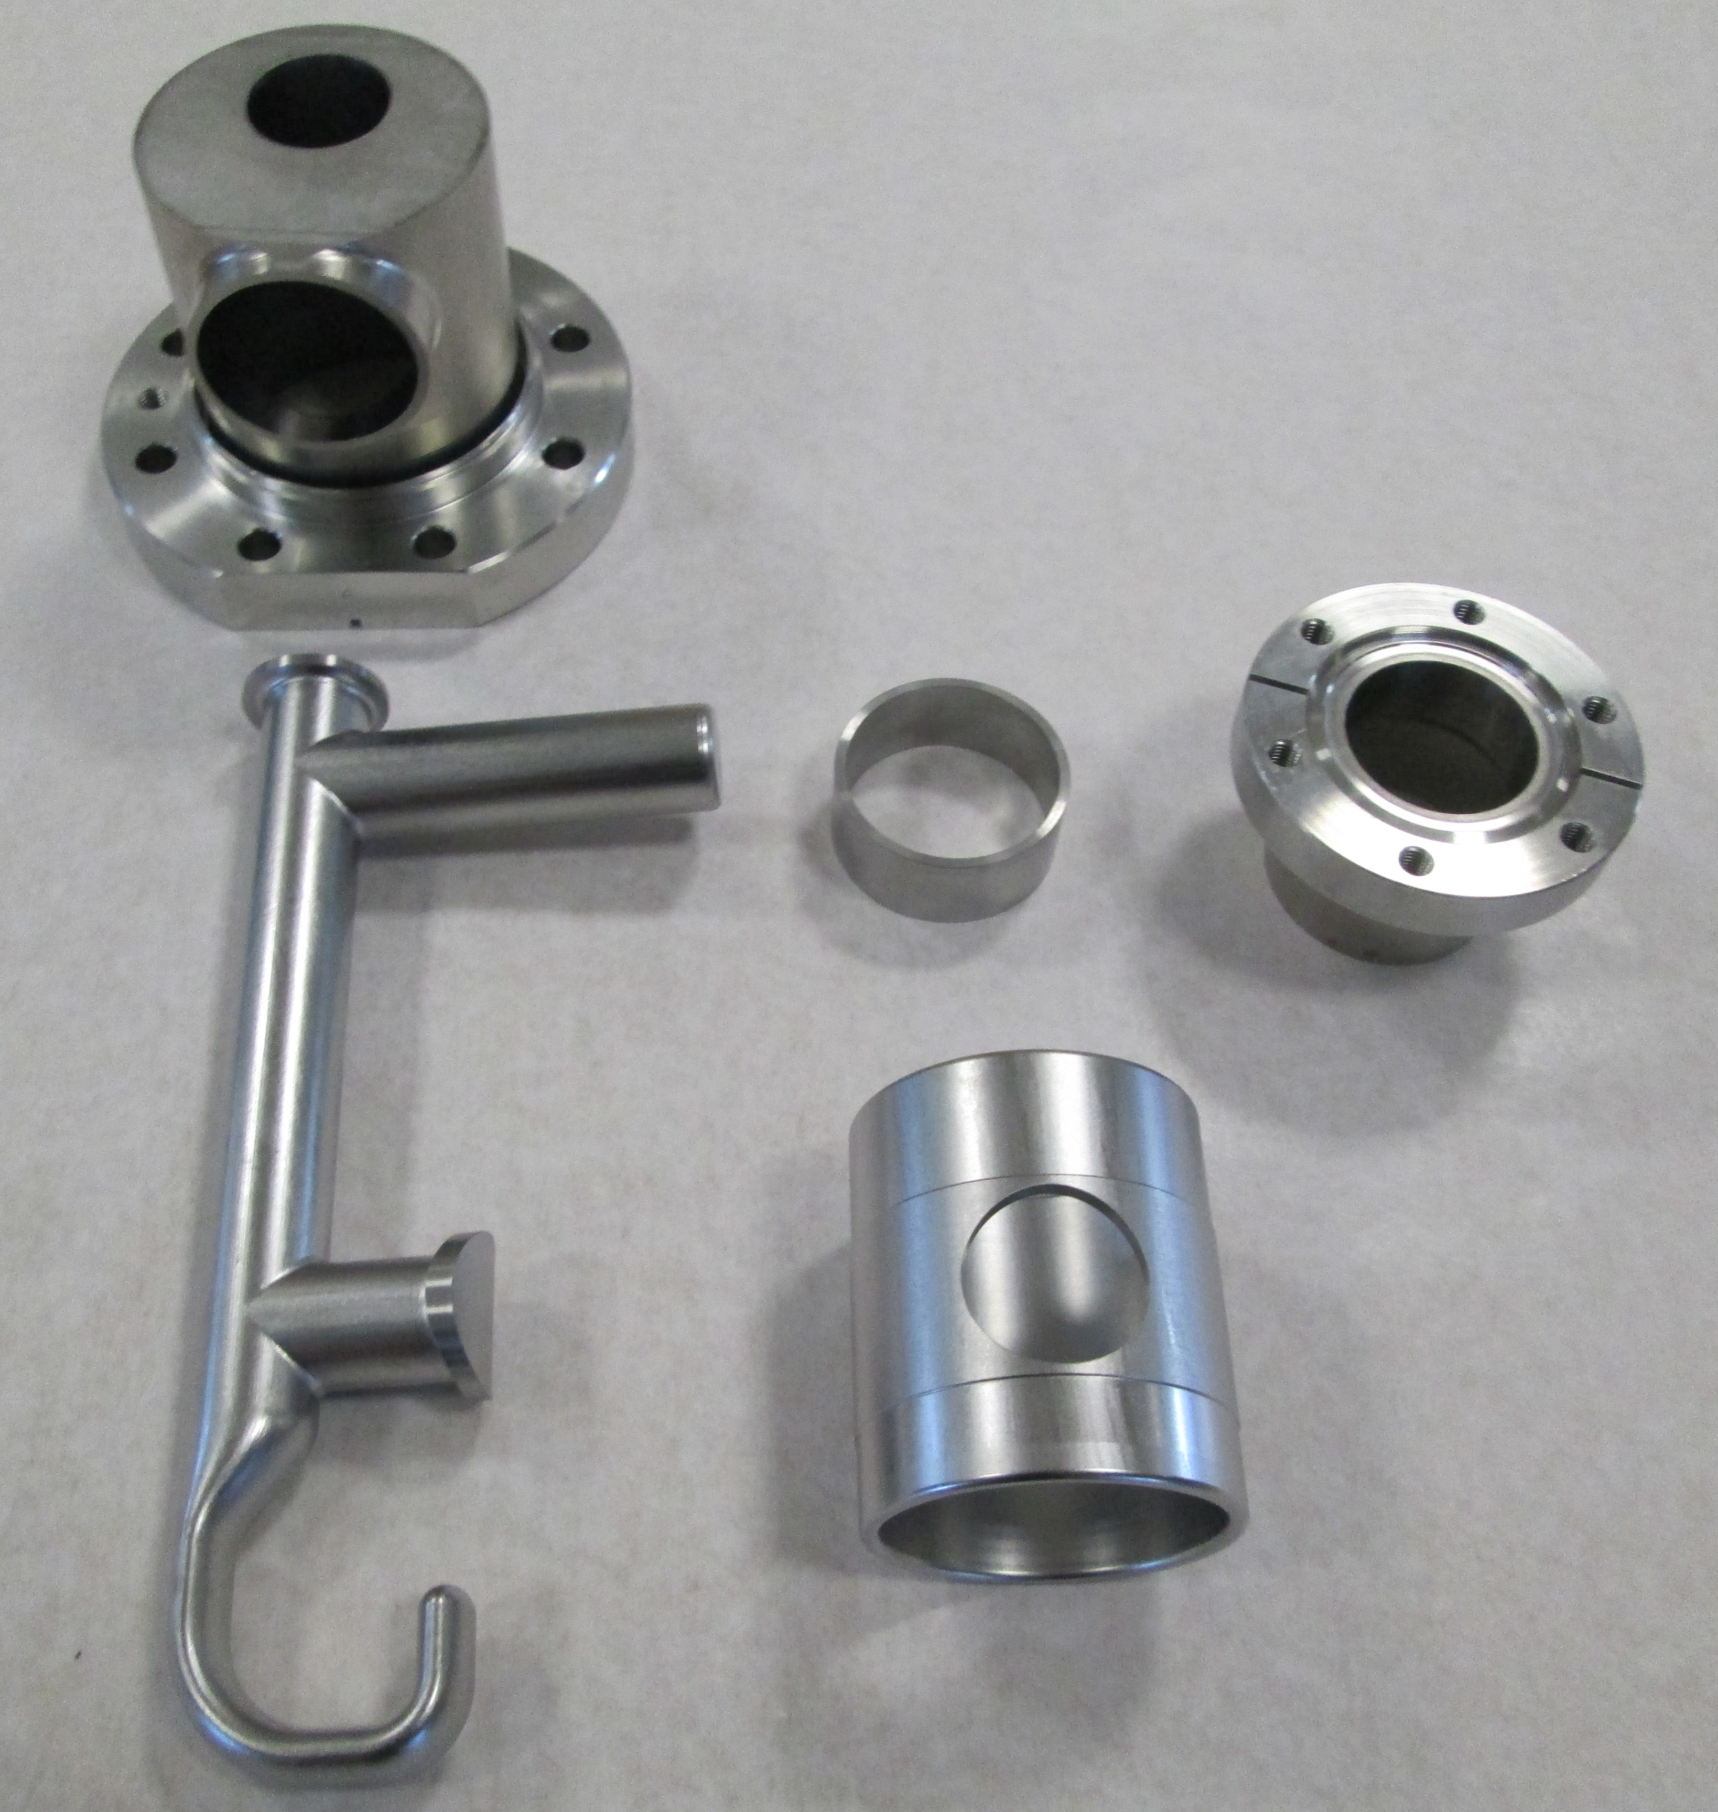
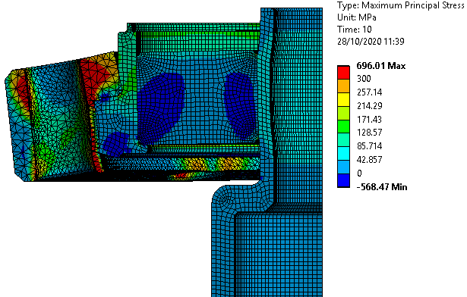
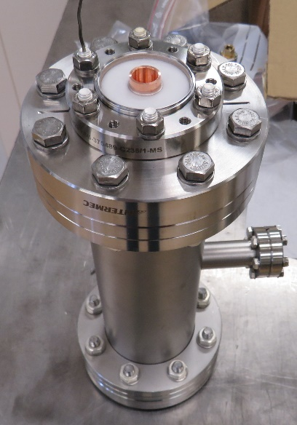
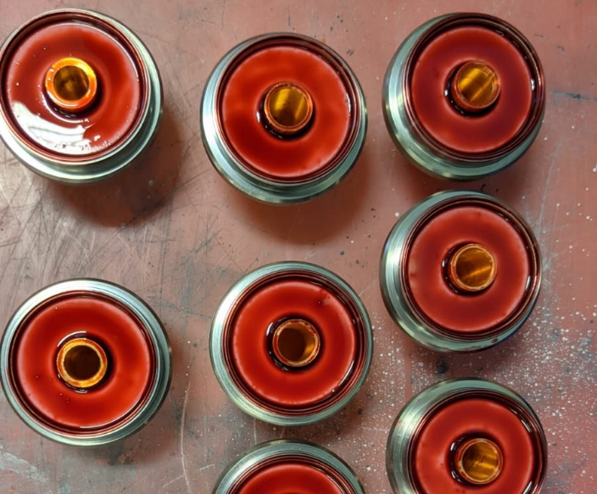
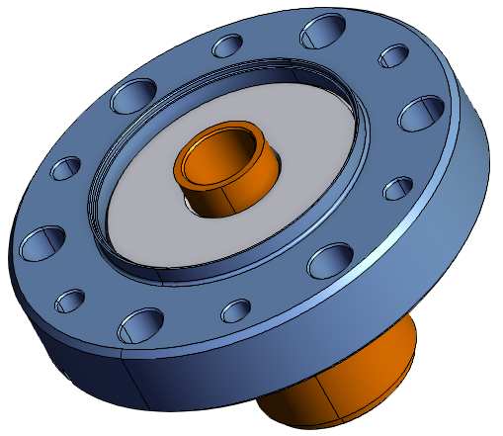
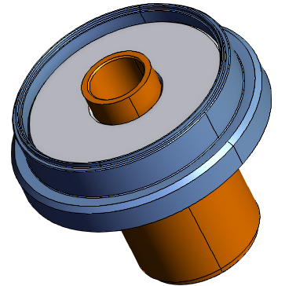
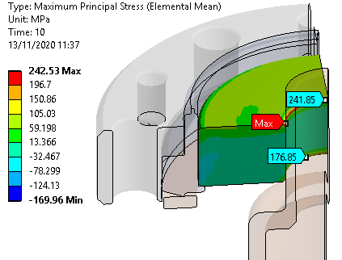
From Prototypes to Series Production
DQW series production built according to consolidated design thanks to prototyping at CERN: DQW SPS (2015 – 2016) & RFD SPS (2019 – 2020)
Key updates:
  Easier welding configurations to ease assembly and improve precision
Circular joint =
hook orientation issues
Hippodrome shape
Reduced number of components for easier assembly
Cylinder-cylinder interface
Thickness variation
Modified design for flat interface
Easier to weld
SPS-DQW HOM Coupler
  Brazed feedthrough design: stress reduction on ceramics
LHC-DQW HOM Coupler
Fixed flange
(more titanium = higher strains)
Rotative flange
Stress analysis
Leak checks Penetrant testing

Slide 6
Production Status

Slide 7
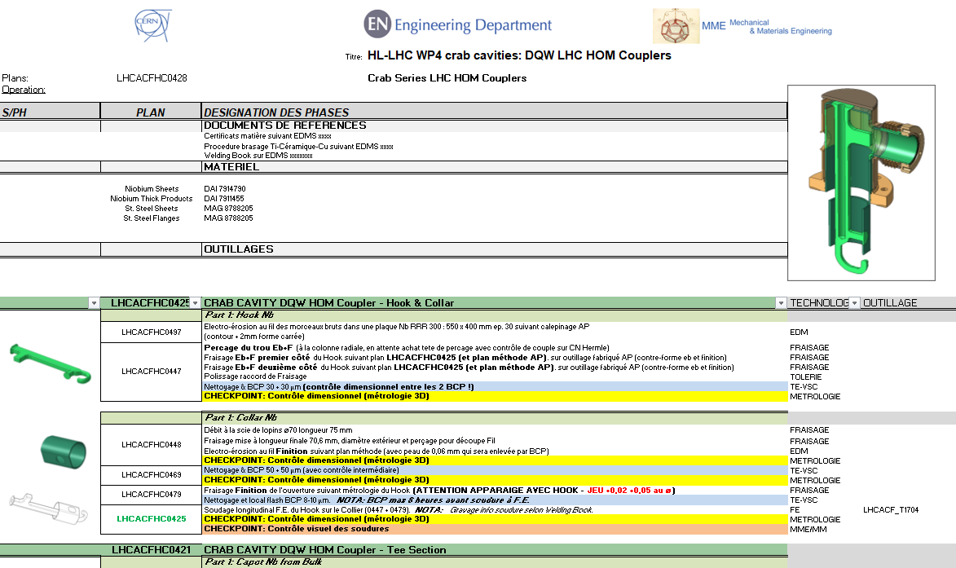
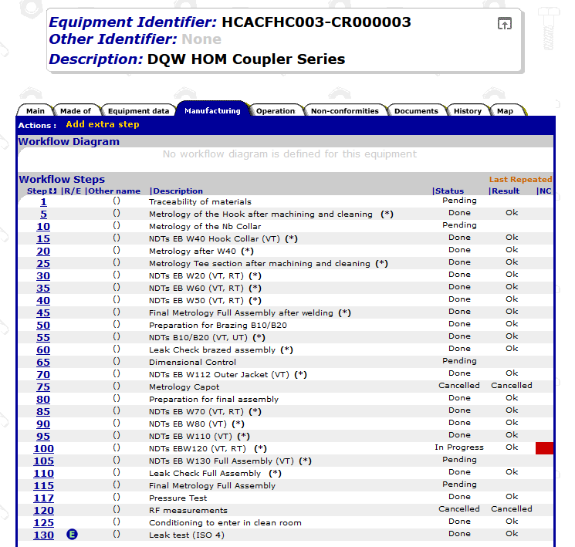
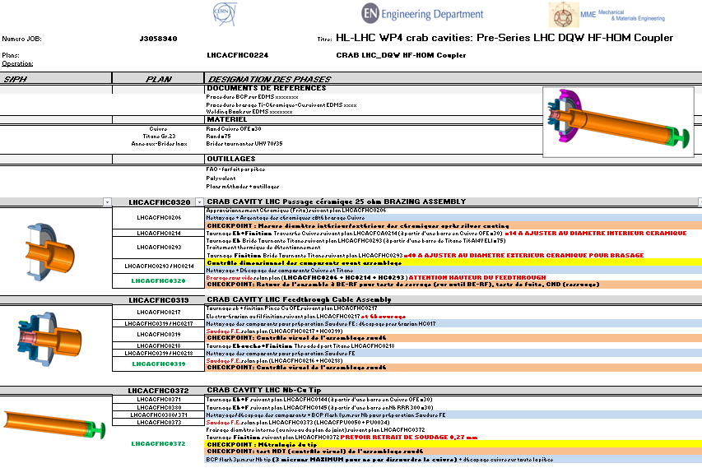
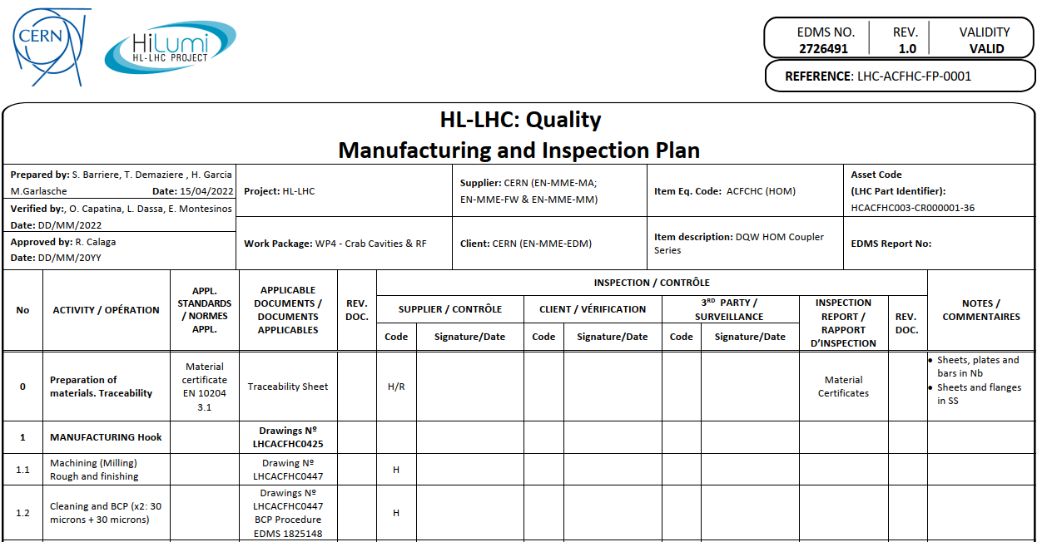
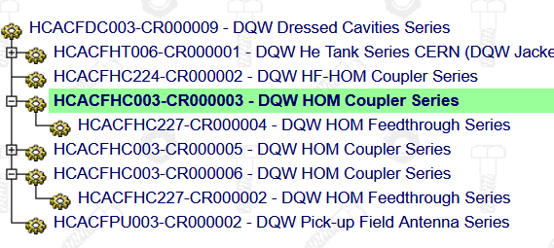
Manufacturing and Inspection Plans
Strong commitment from WP4 teams to fulfil HL-LHC quality standards
More than 120 assets to be managed in MTF!
From detailed manufacturing sequences…
…To MIPs and MTF assets

Slide 8
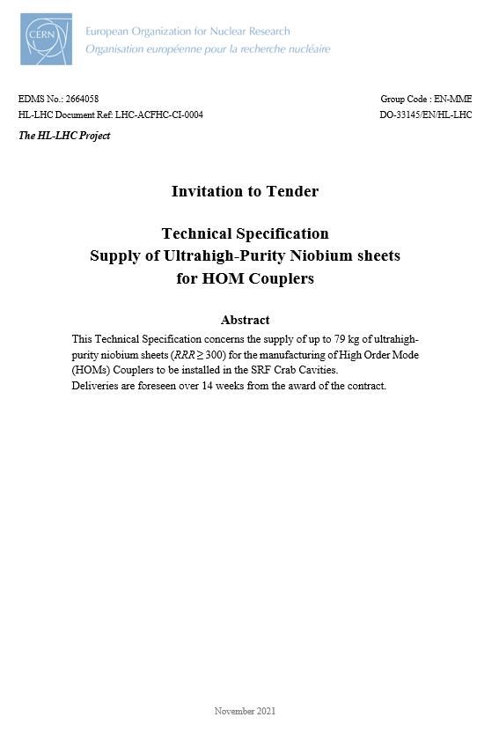
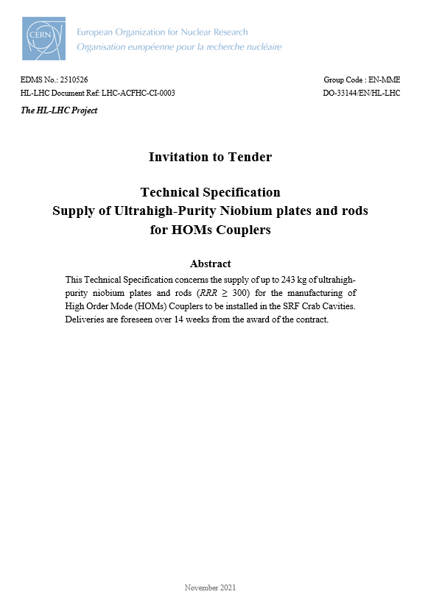
Raw Material Procurement
316LN stainless steel, OFE copper
  CERN “standard” materials, no shortages expected as of today (procurement anticipated)
Titanium Grade 23
Received and available for remaining production
All raw materials available at CERN to build the DQW LHC couplers
RRR300 Niobium
320 kg of ordered in 2021 (rods, plates, sheets)

Slide 9
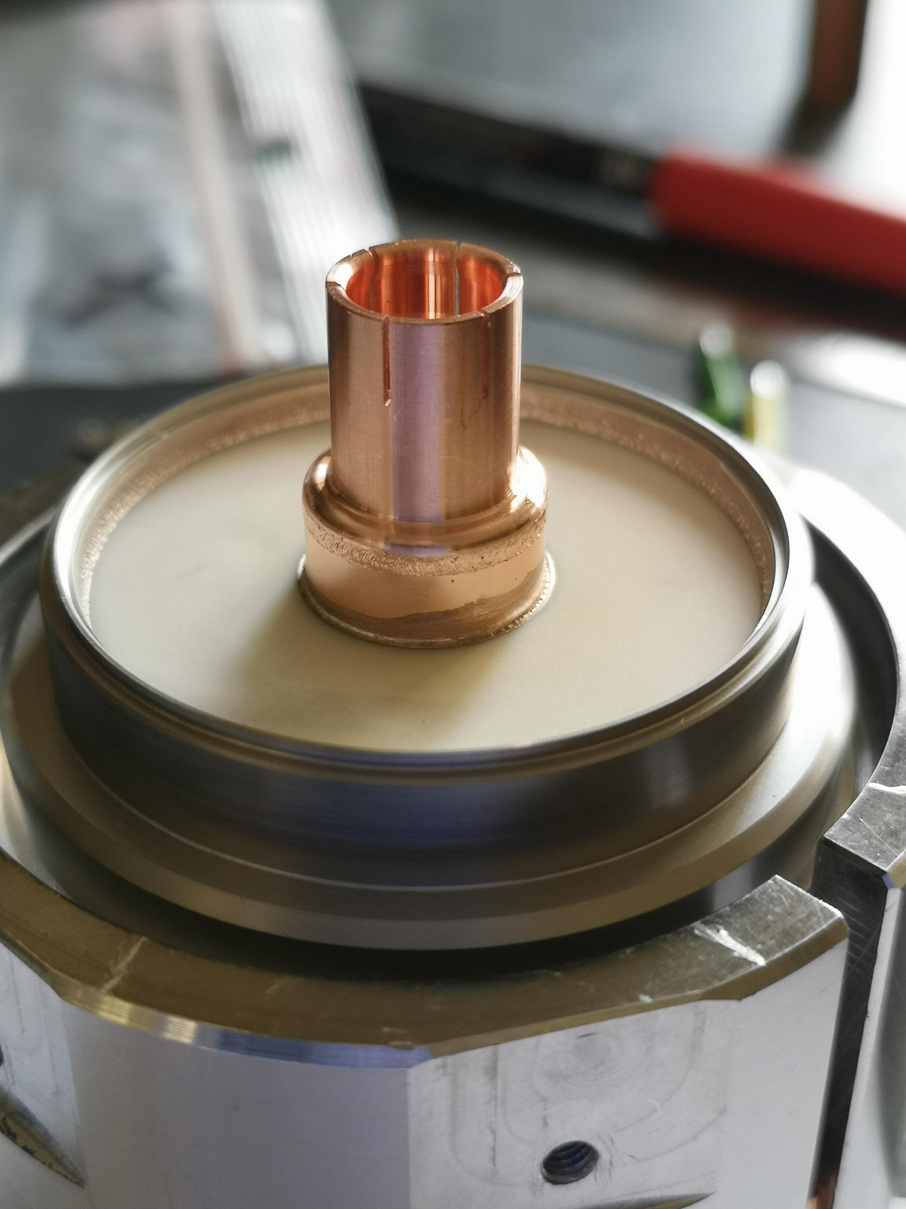
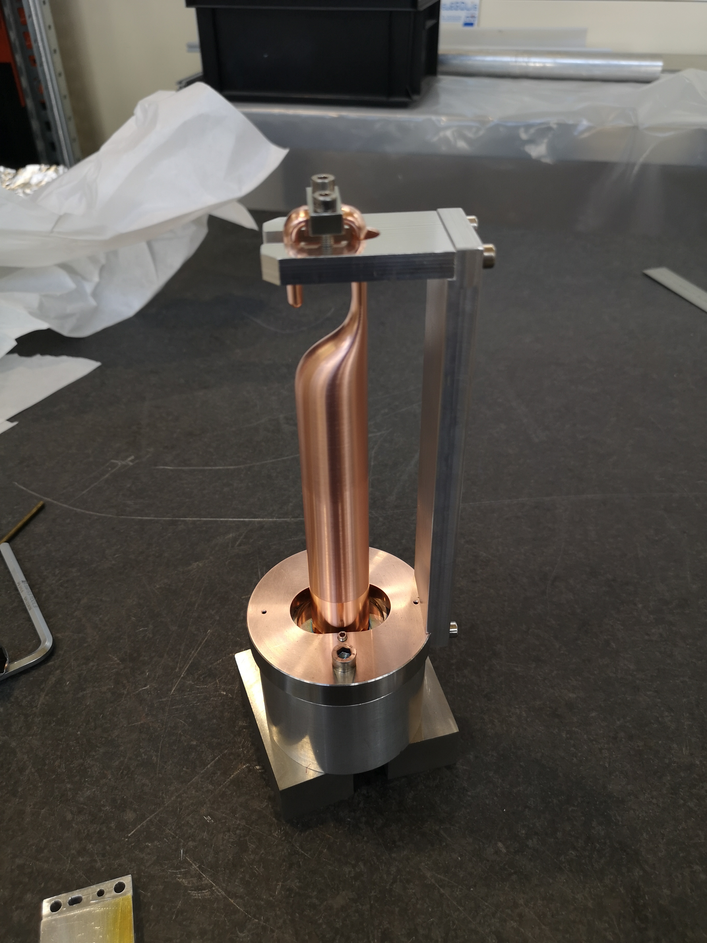
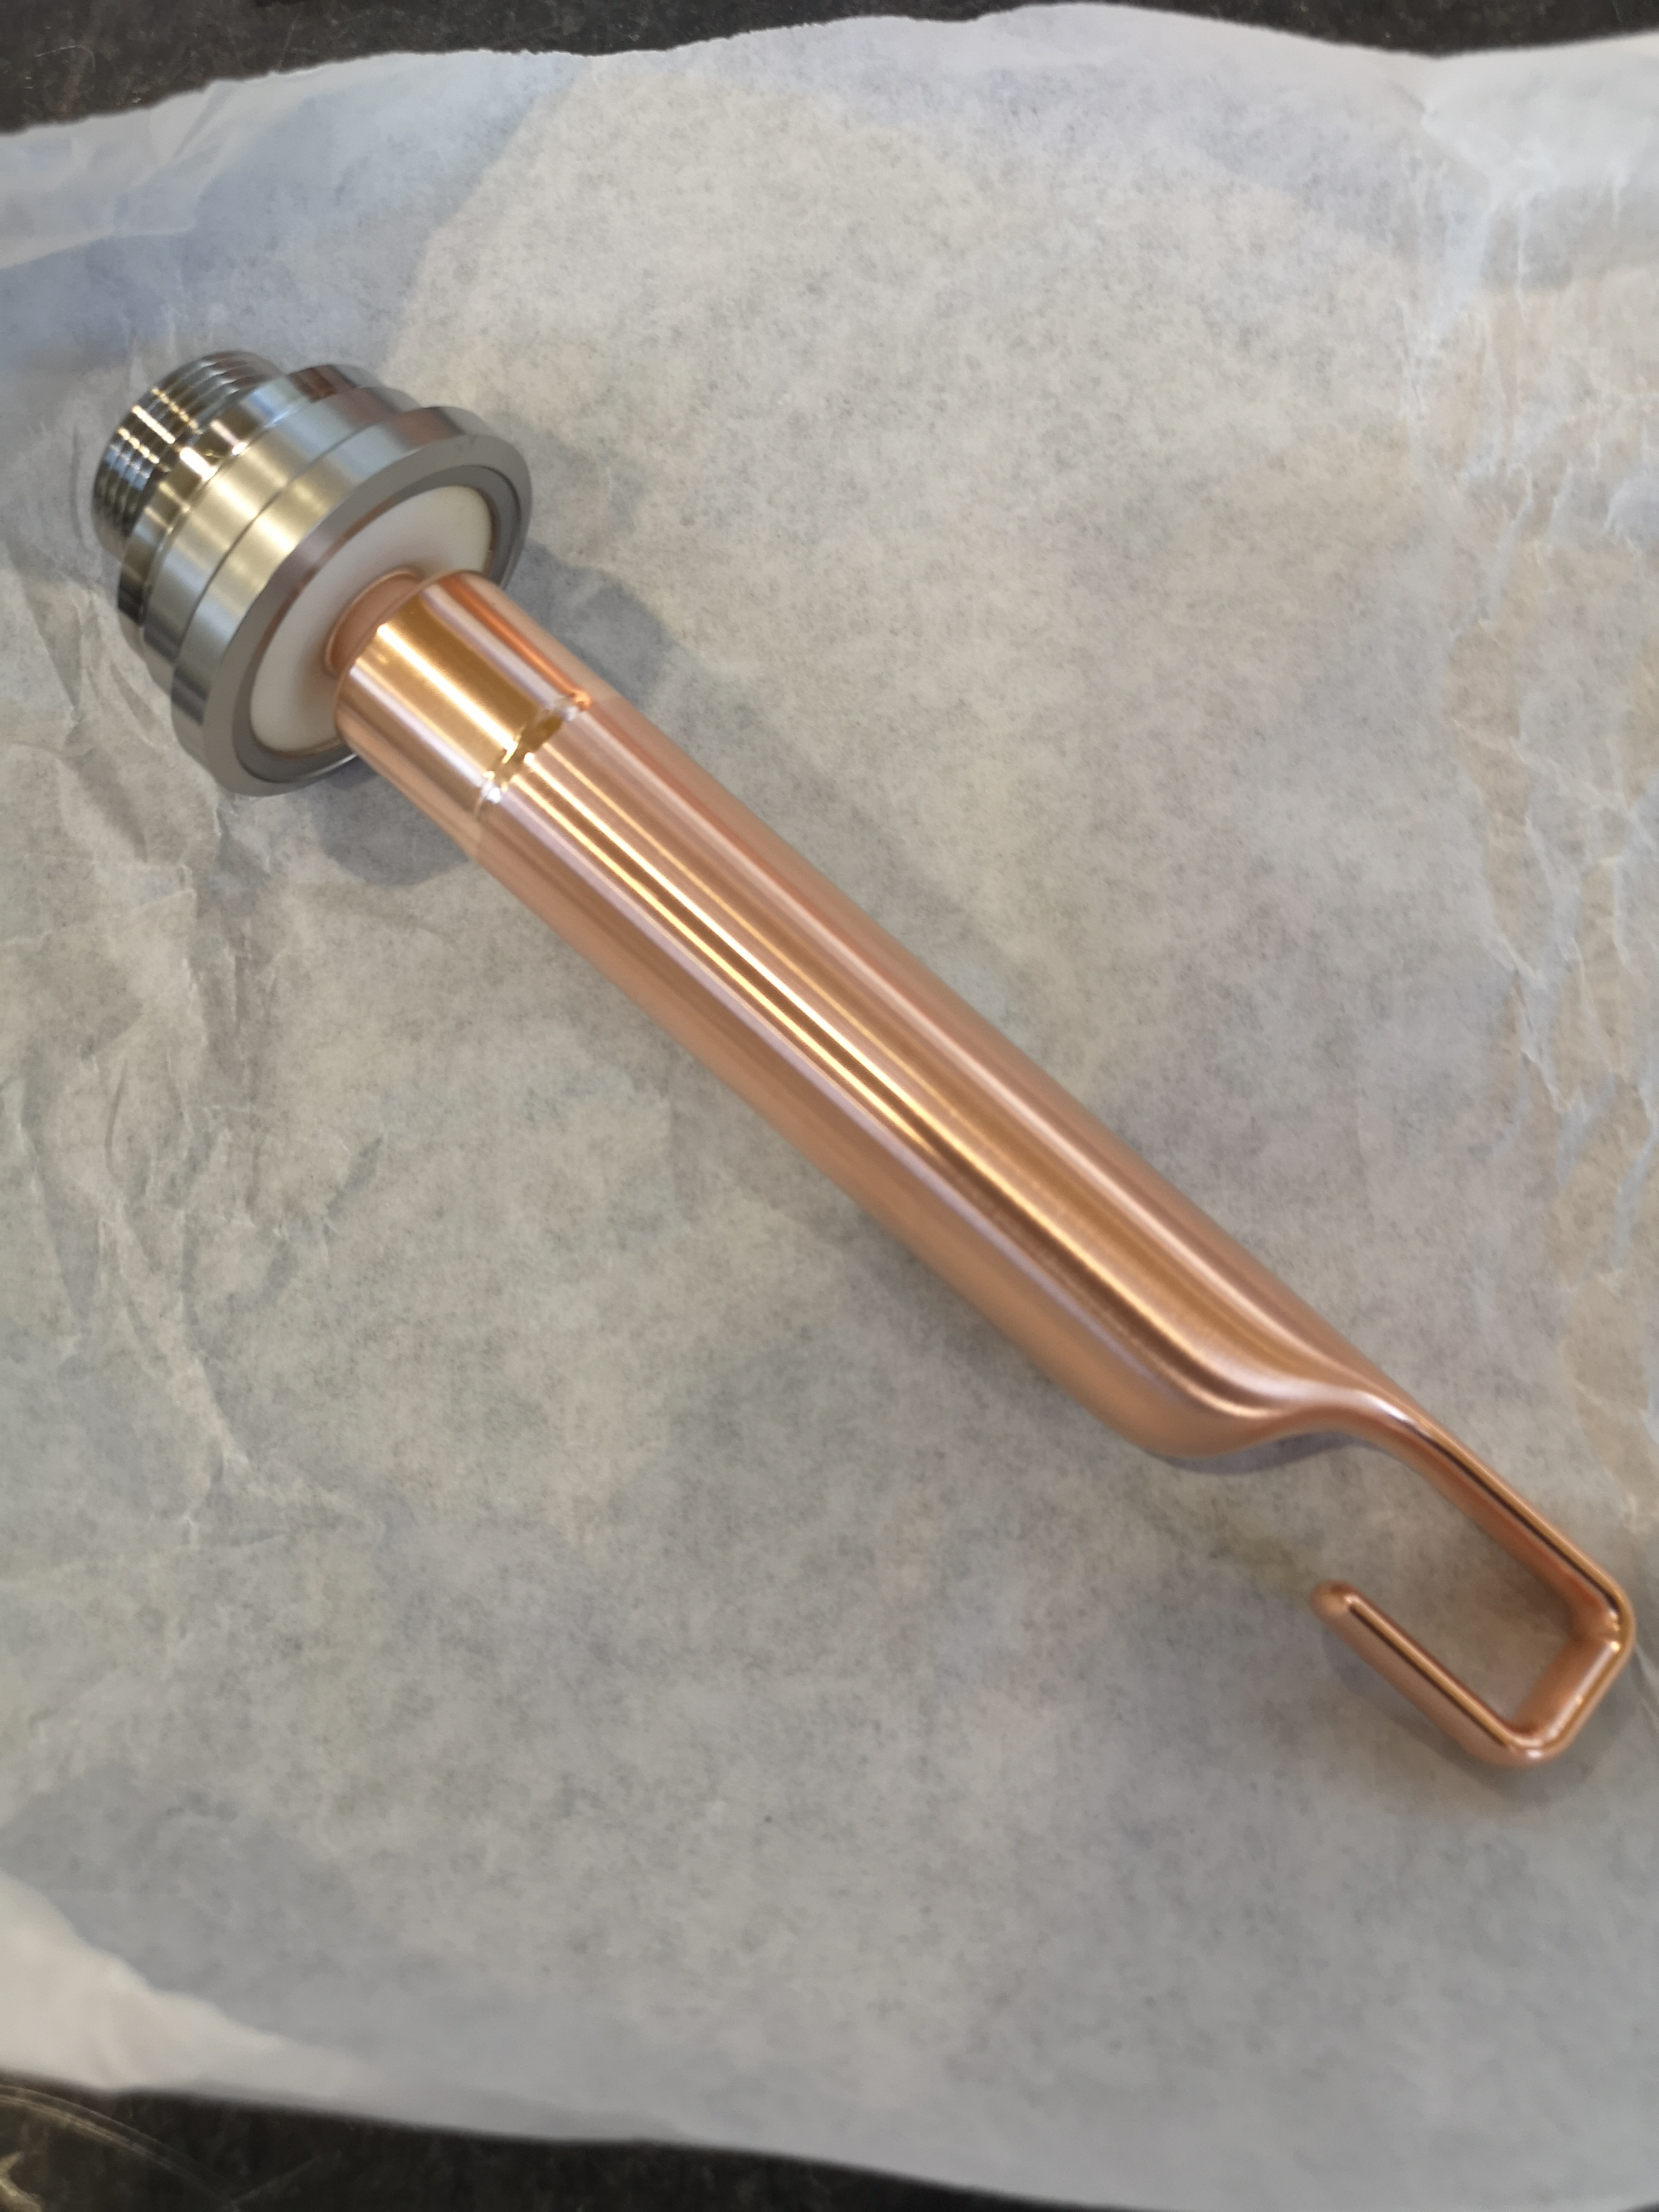
RF Field Antennas Status
Bulk-machined OFE copper hook welded to a “standard” 25Ω RF brazed feedthrough
Brazed feedthrough with RF clamp
EB weld tooling for last weld
Final assembly
2022 |  |  |  |  |  |  | 2023 |  |  |  |  |  |  |  |  |  |  |  | 2024
06 | 07 | 08 | 09 | 10 | 11 | 12 | 01 | 02 | 03 | 04 | 05 | 06 | 07 | 08 | 09 | 10 | 11 | 12 | 01 | 02 | 03 | 04 | 05 | 06 | 07 | 08 | 09 | 10 | 11 | 12
3x
Field Antenna
5x
Field Antenna
4x
Field Antenna

Slide 10
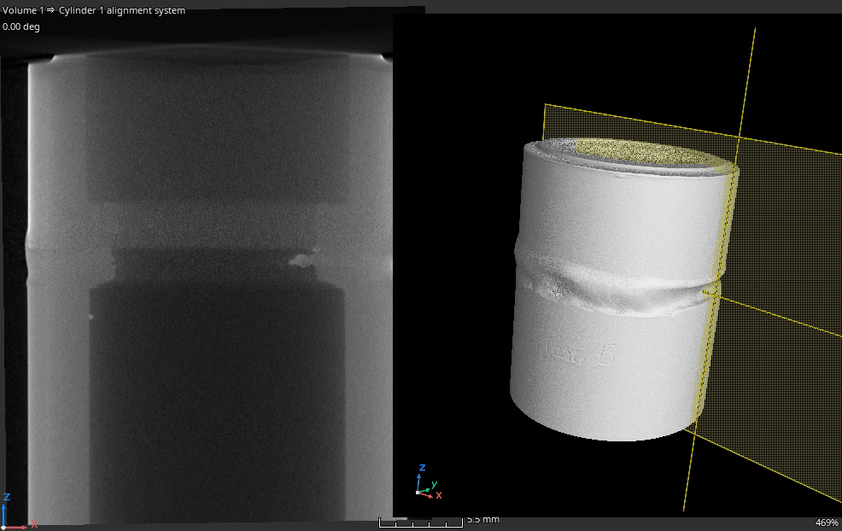
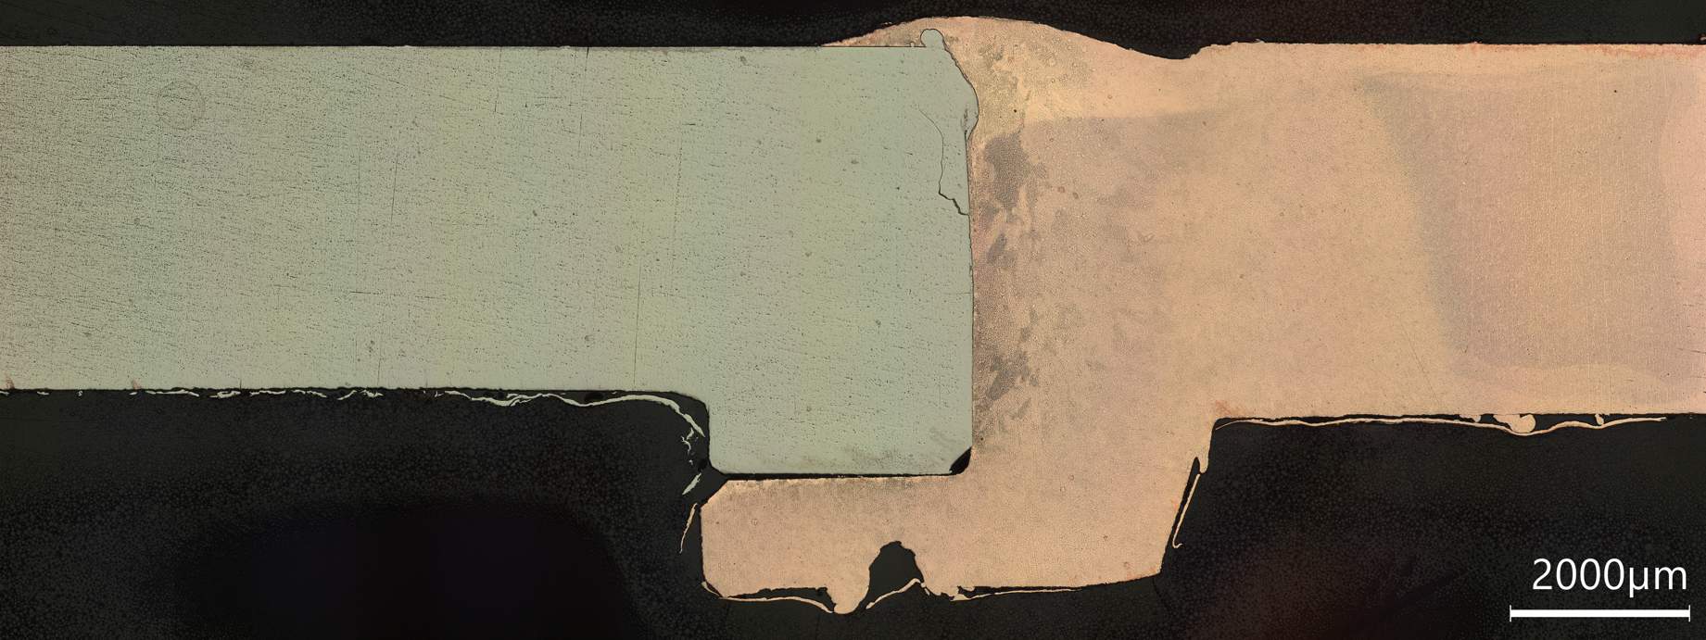
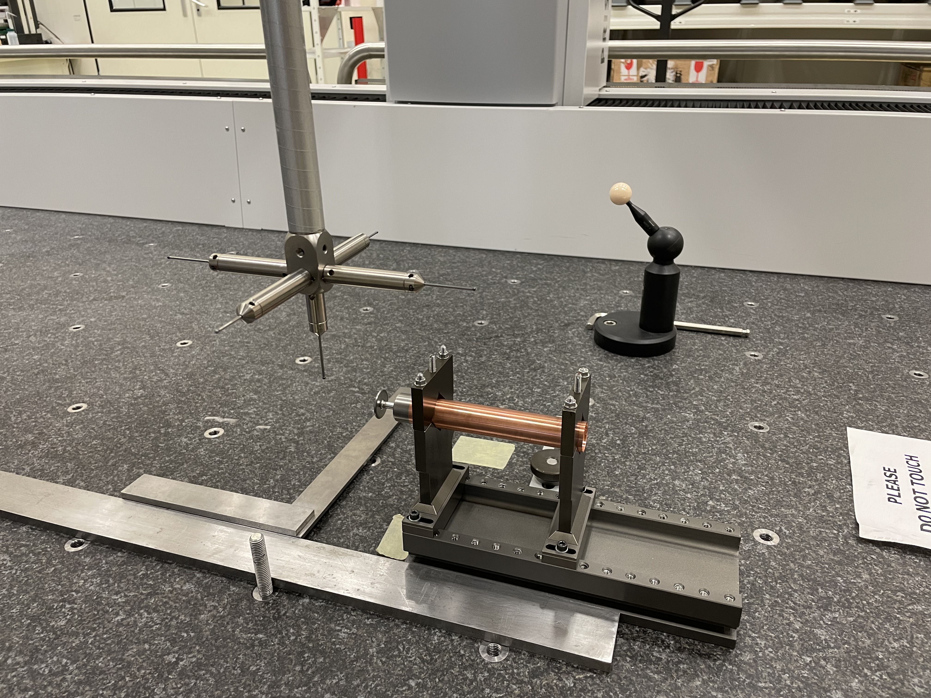
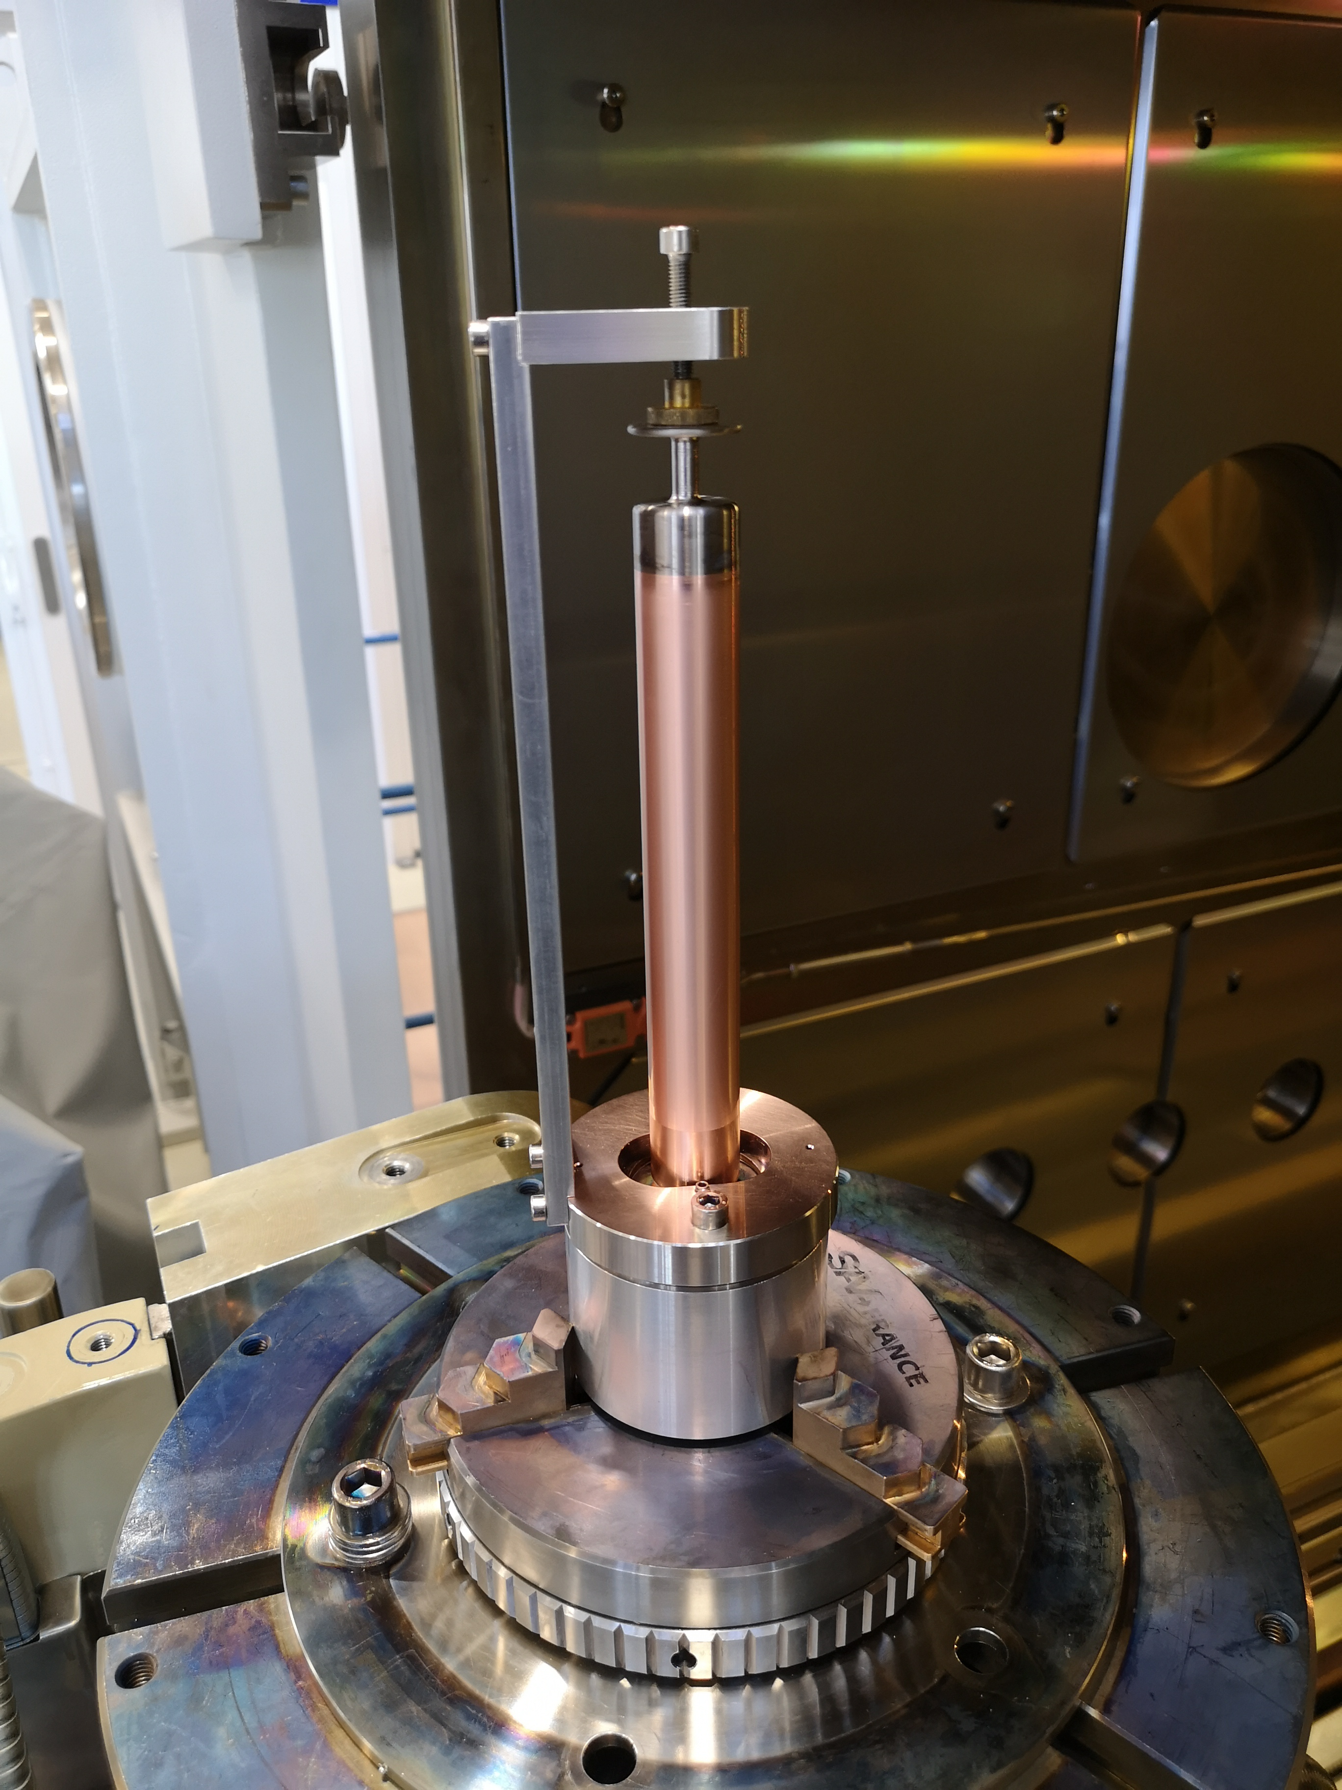
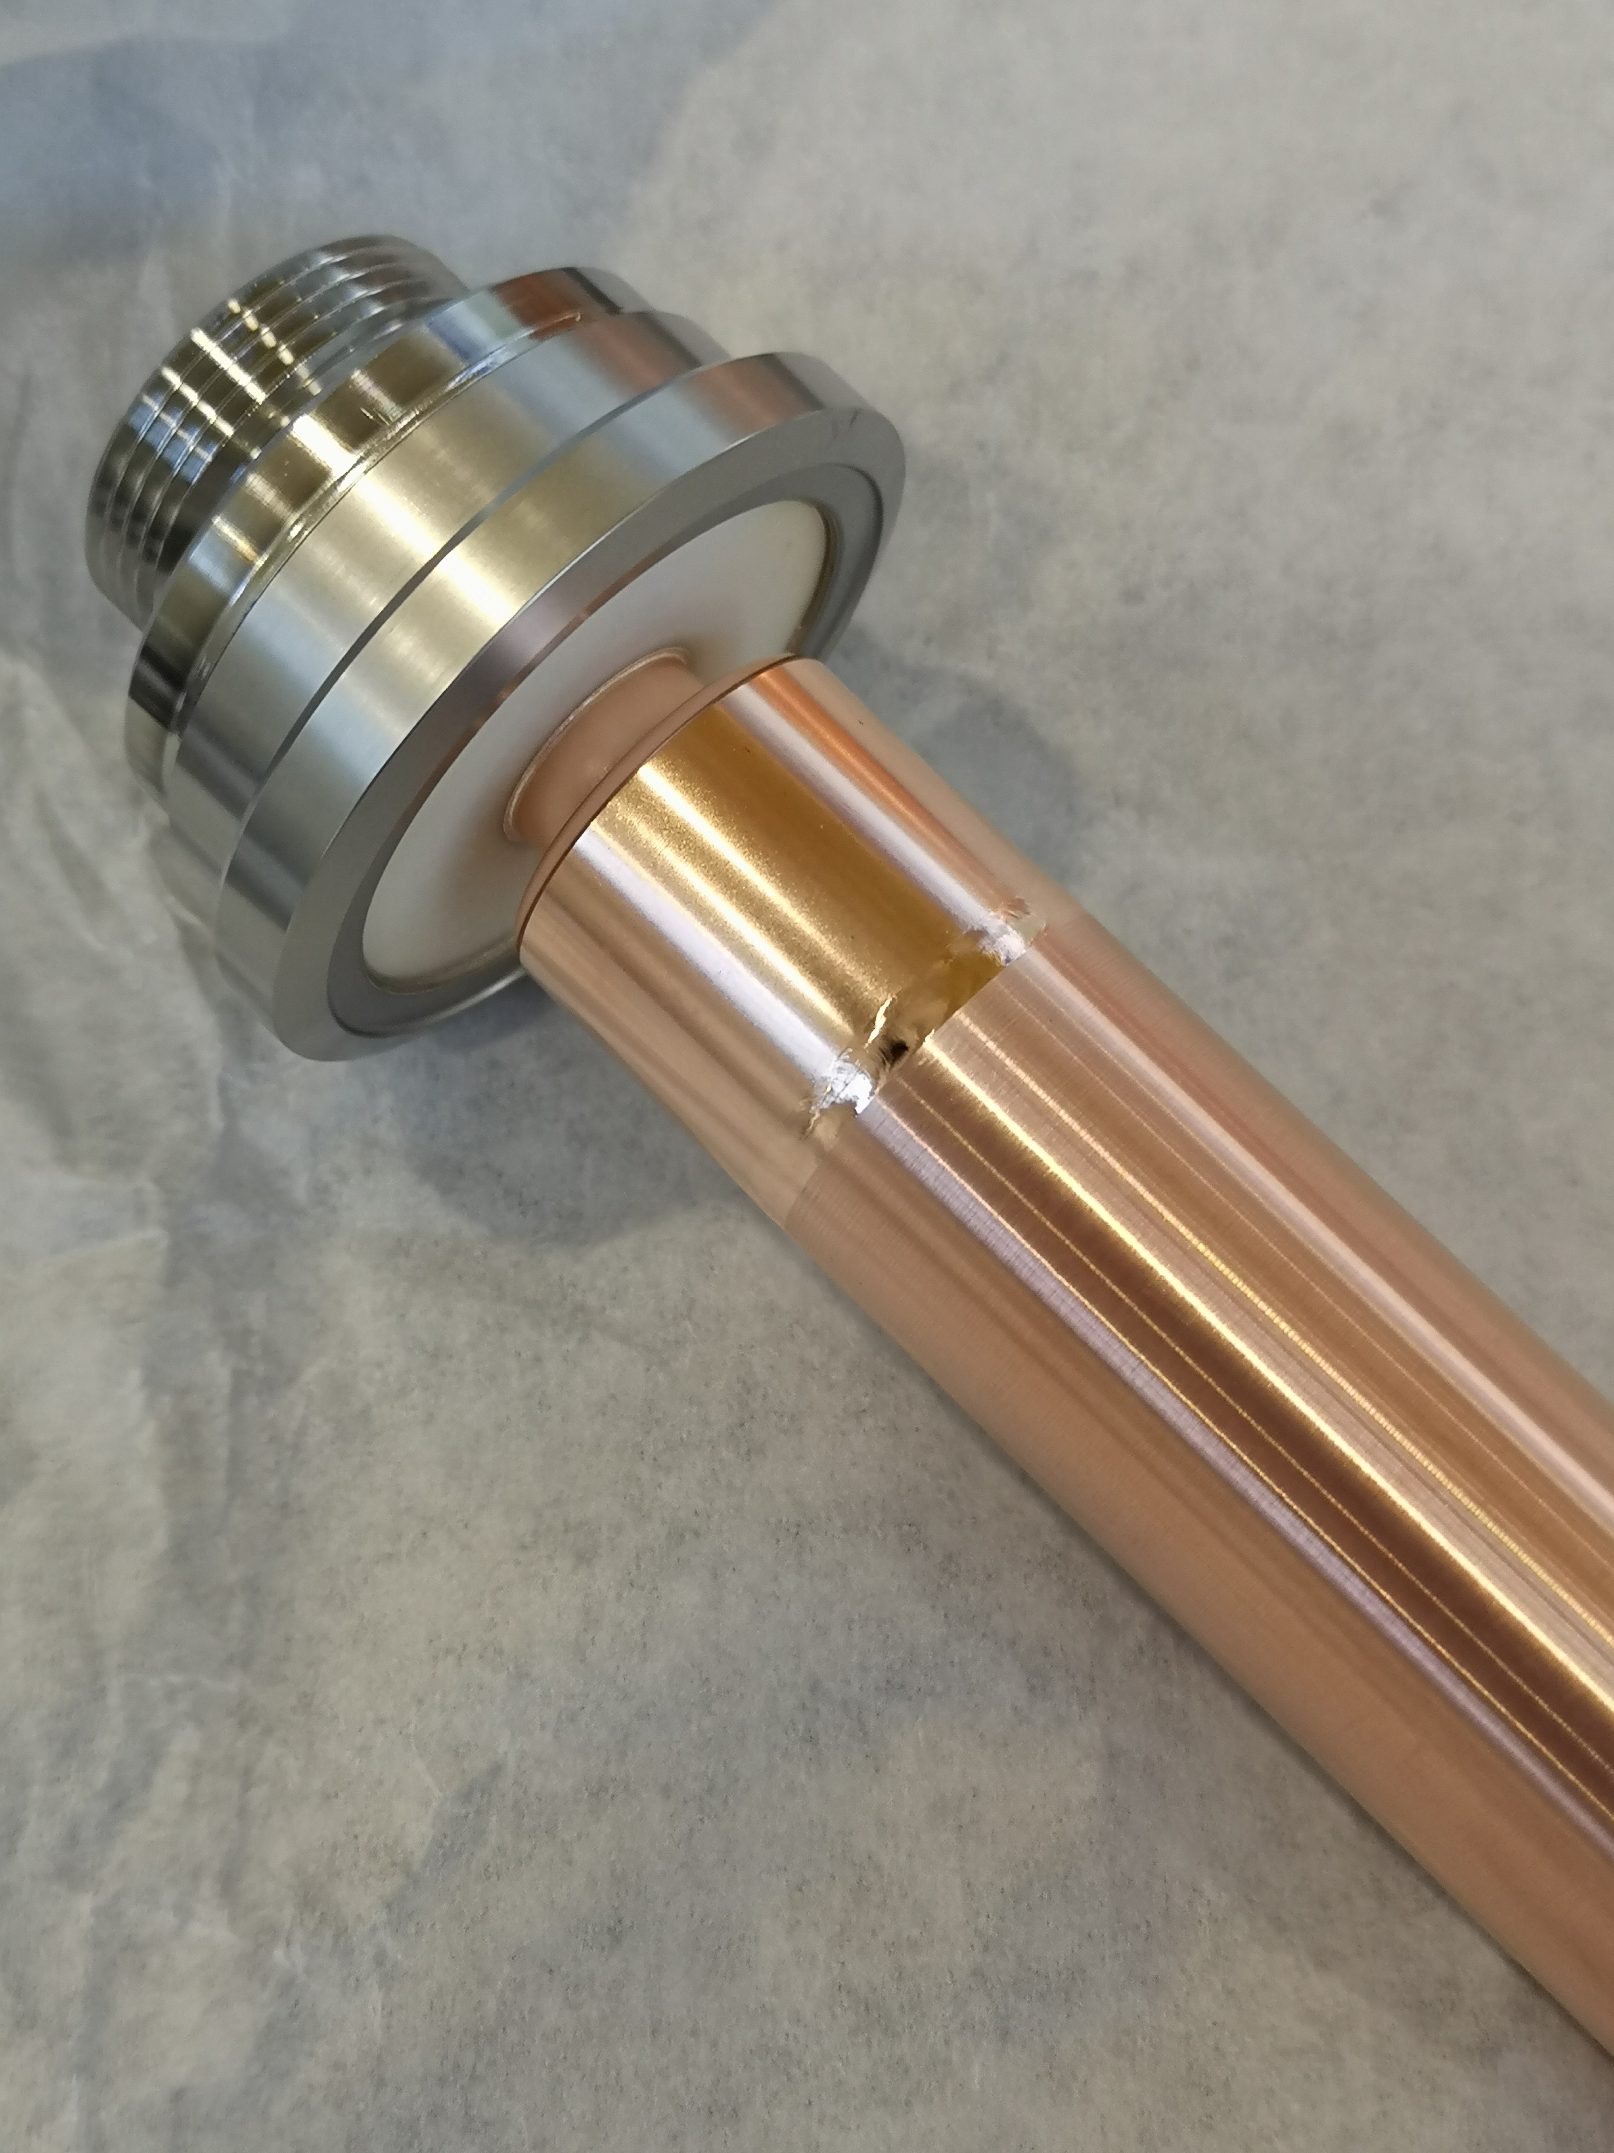
HF-HOM Couplers Status
  Cu-Nb transitions
    Complex joining of two heterogenous materials
    New process developed at CERN fully tested and qualified
Macrograph
X-rays µ-computed tomography
Metrology before final assembly
Final EB weld
2022 |  |  |  |  |  |  | 2023 |  |  |  |  |  |  |  |  |  |  |  | 2024
06 | 07 | 08 | 09 | 10 | 11 | 12 | 01 | 02 | 03 | 04 | 05 | 06 | 07 | 08 | 09 | 10 | 11 | 12 | 01 | 02 | 03 | 04 | 05 | 06 | 07 | 08 | 09 | 10 | 11 | 12
3x
HF-HOM
5x
HF-HOM
4x
HF-HOM

Slide 11
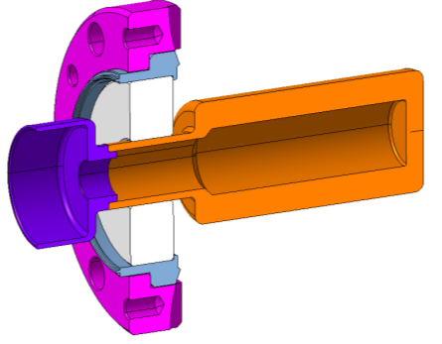
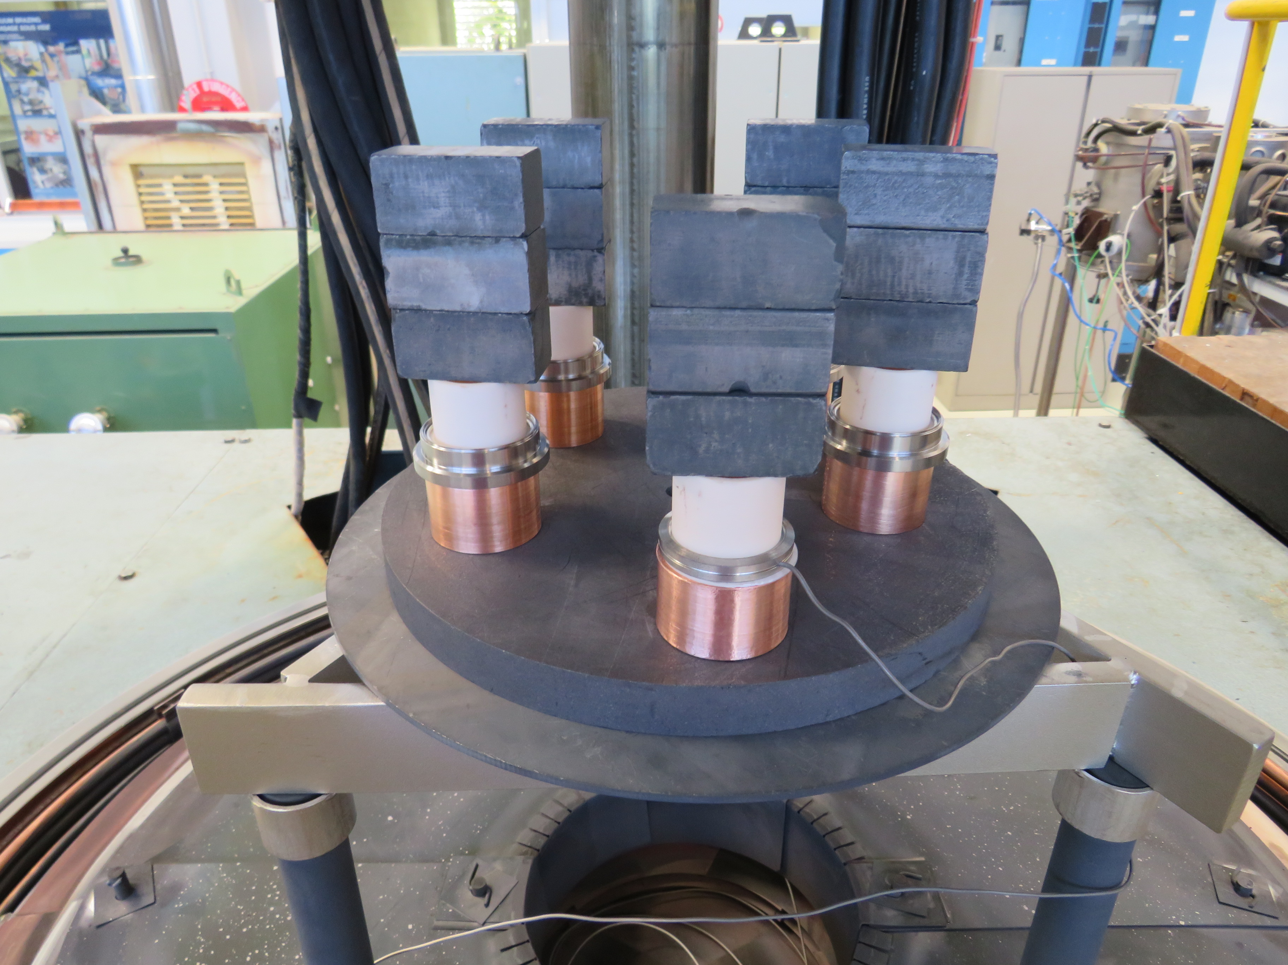
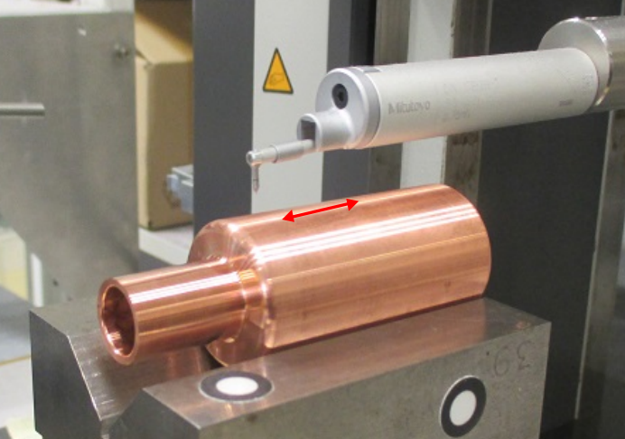
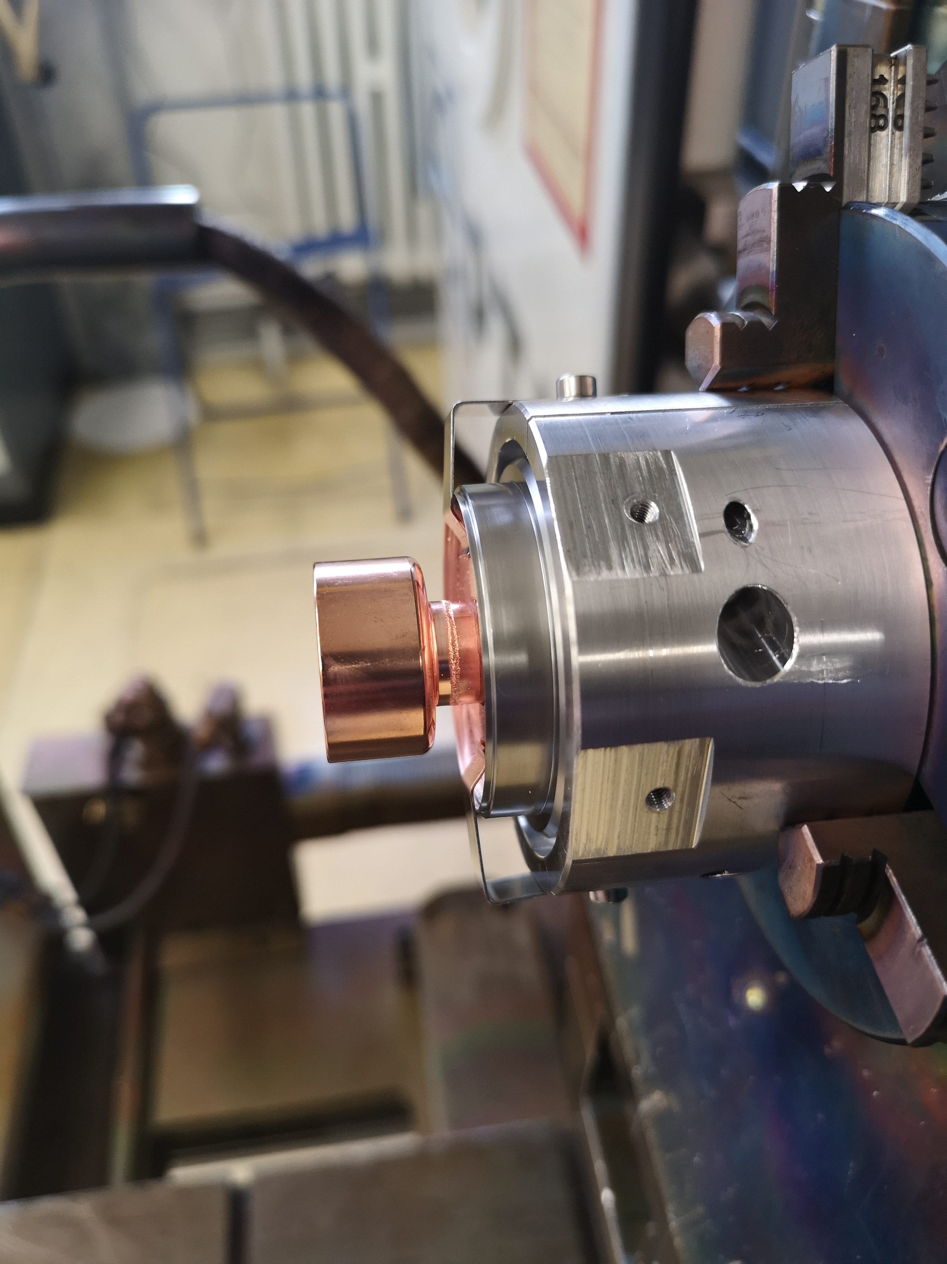
Brazed HOM Feedthrough Status
    Machining of inner volume to reduce weight as much as possible
    Improved quality control thanks to µ-computed tomography (quality and dimensions of inner surfaces)
    Ra 0,4
Rugosity measurements
Vacuum brazing
EB weld of RF clamp
2022 |  |  |  |  |  |  | 2023 |  |  |  |  |  |  |  |  |  |  |  | 2024
06 | 07 | 08 | 09 | 10 | 11 | 12 | 01 | 02 | 03 | 04 | 05 | 06 | 07 | 08 | 09 | 10 | 11 | 12 | 01 | 02 | 03 | 04 | 05 | 06 | 07 | 08 | 09 | 10 | 11 | 12
8x
HOM Feedthrough
6x
HOM Feedthrough
8x
HOM Feedthrough
14x
HOM Feedthrough

Slide 12
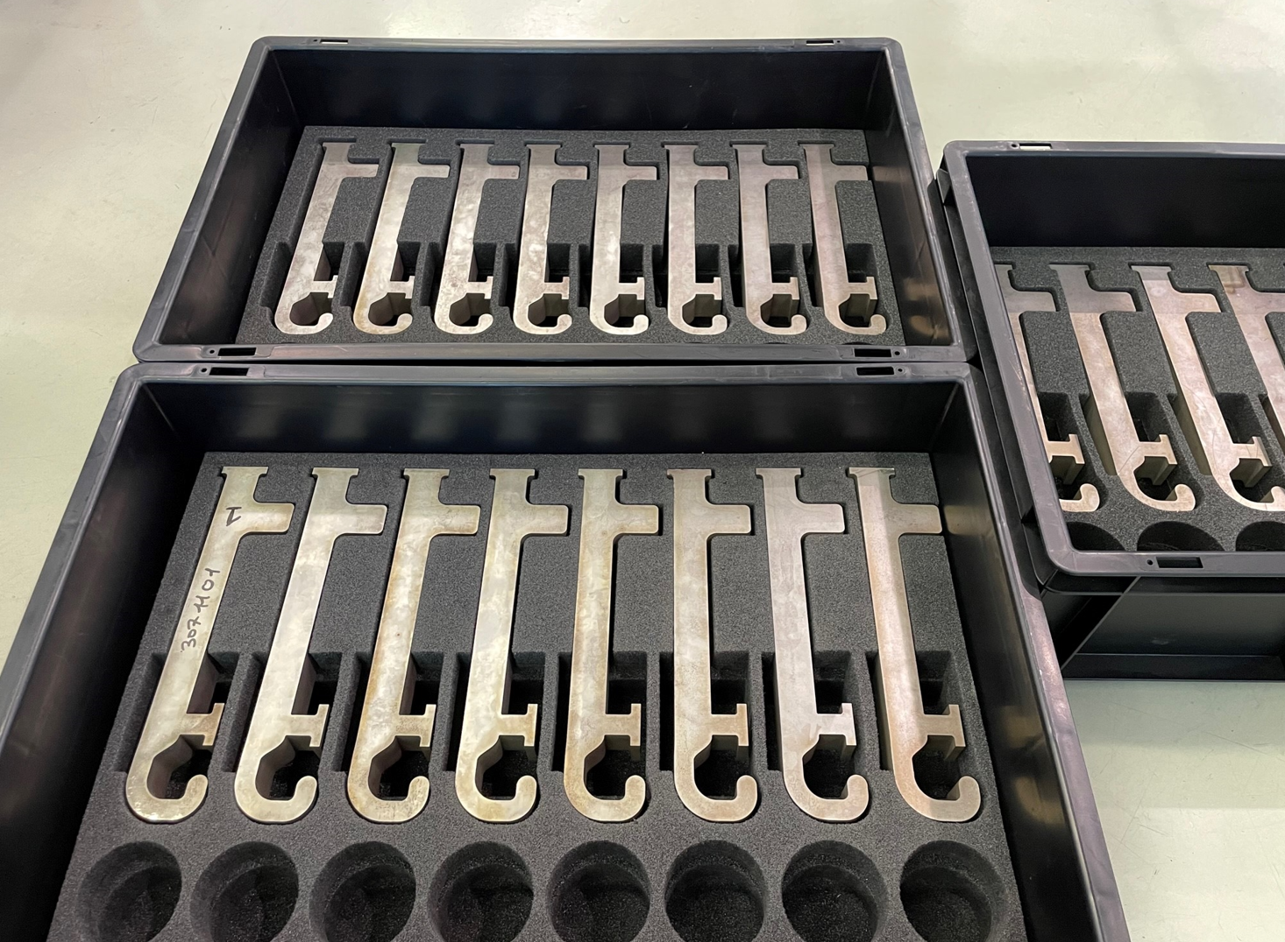
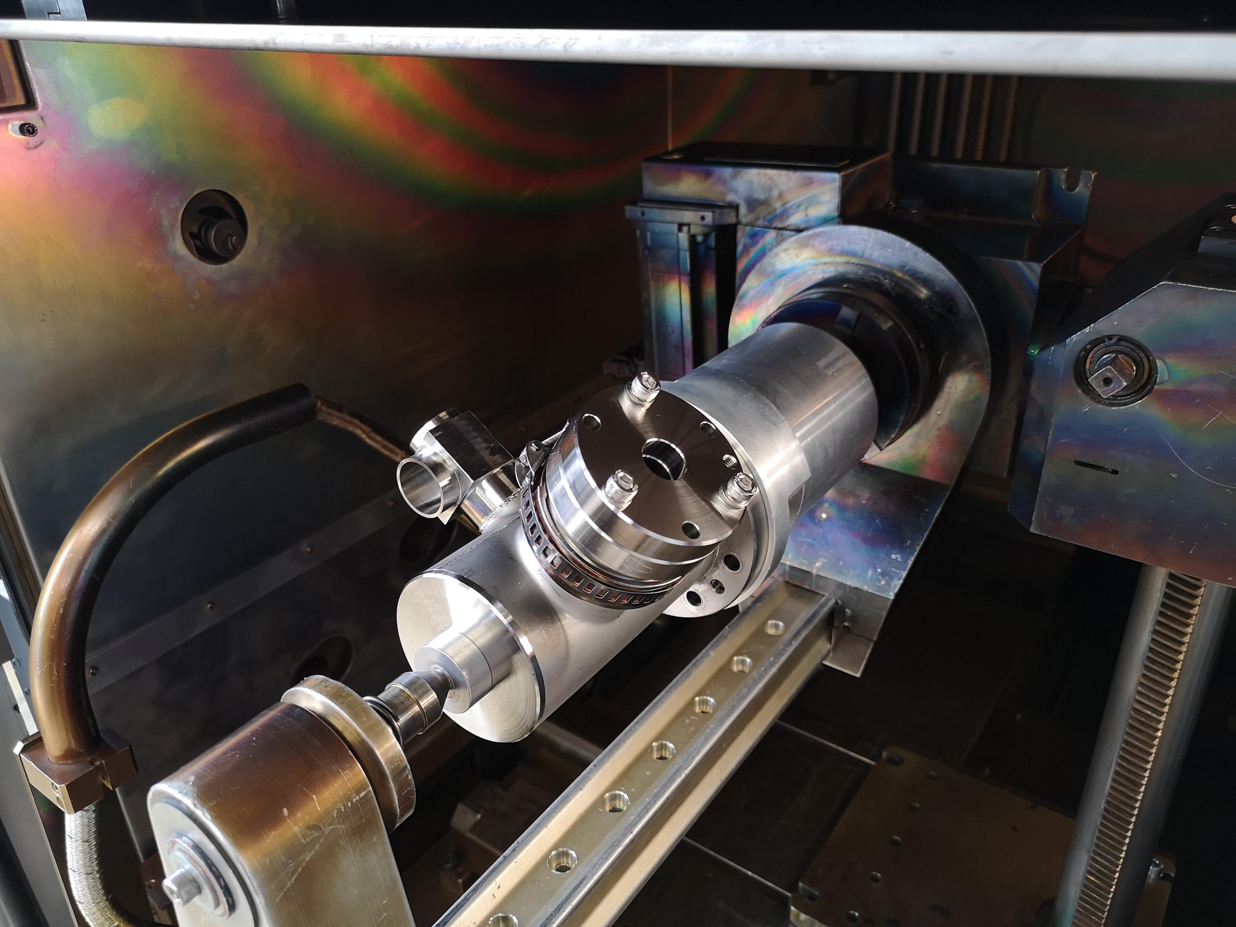
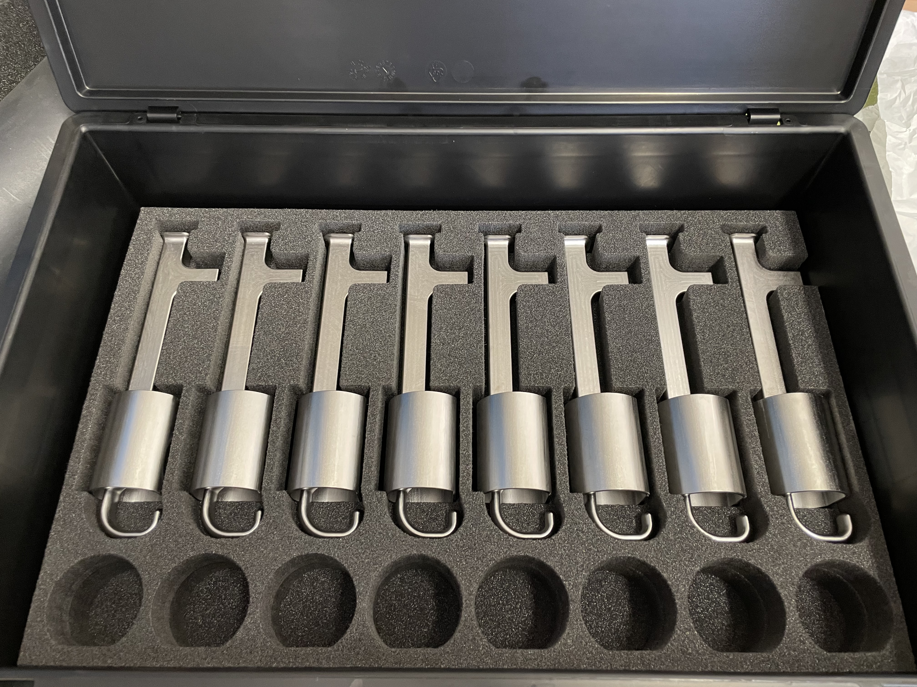
HOM Couplers
    160+ fabrication steps to be managed in series production: intense intertwining of techniques
    PED requirements impose full qualification of all weld & inspection processes with full traceability down to all subcomponents
  Final EB weld to close helium vessel

Slide 13
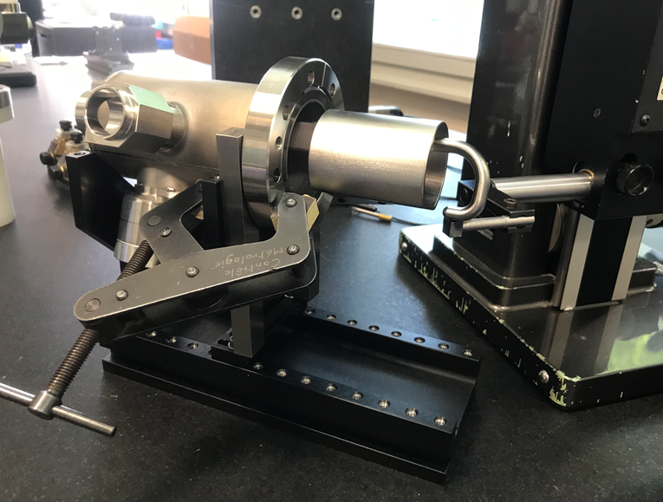
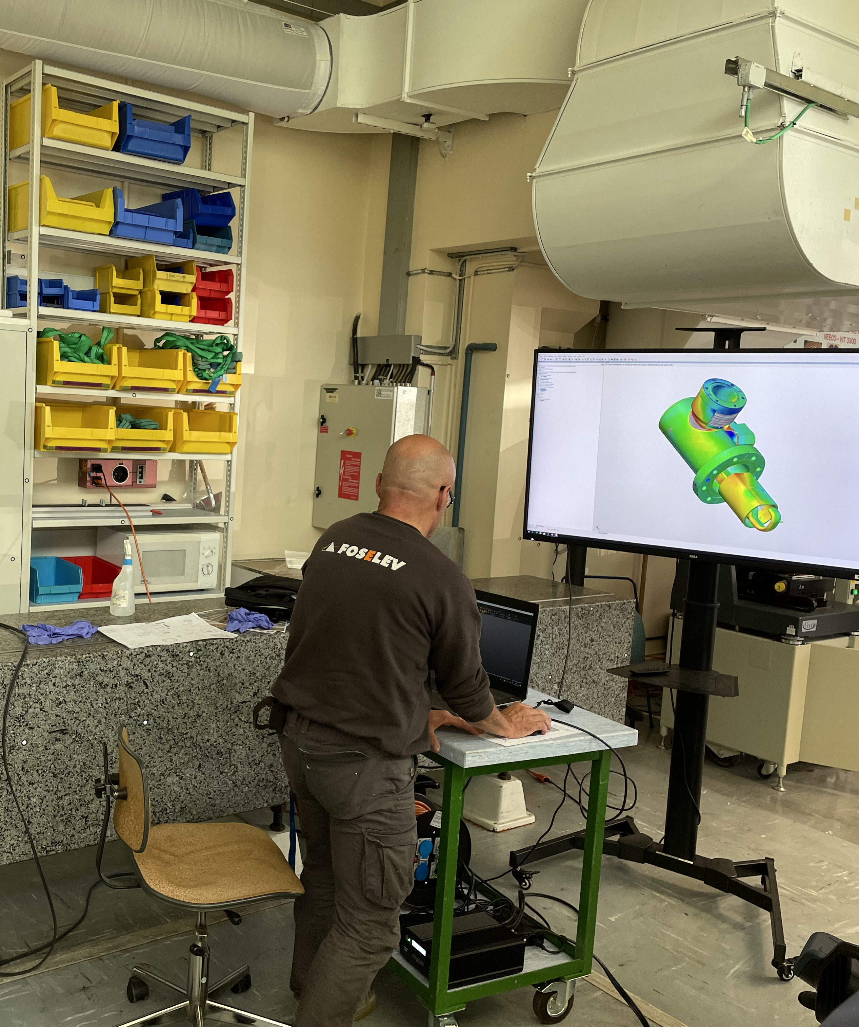
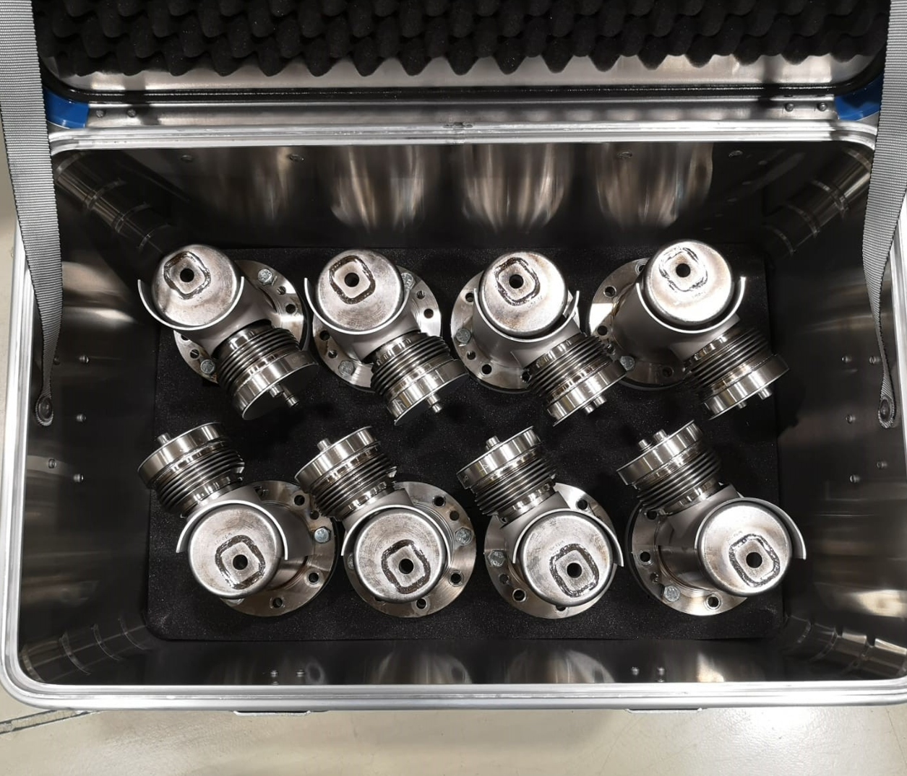
HOM Couplers
  3D-scan of final assembly
2022 |  |  |  |  |  |  | 2023 |  |  |  |  |  |  |  |  |  |  |  | 2024
06 | 07 | 08 | 09 | 10 | 11 | 12 | 01 | 02 | 03 | 04 | 05 | 06 | 07 | 08 | 09 | 10 | 11 | 12 | 01 | 02 | 03 | 04 | 05 | 06 | 07 | 08 | 09 | 10 | 11 | 12
8x
HOM Coupler
8x
HOM Coupler
10x
HOM Coupler
10x
HOM Coupler

Slide 14
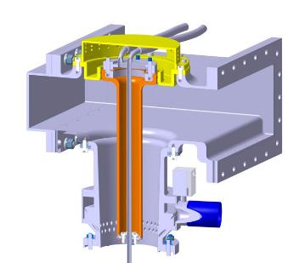
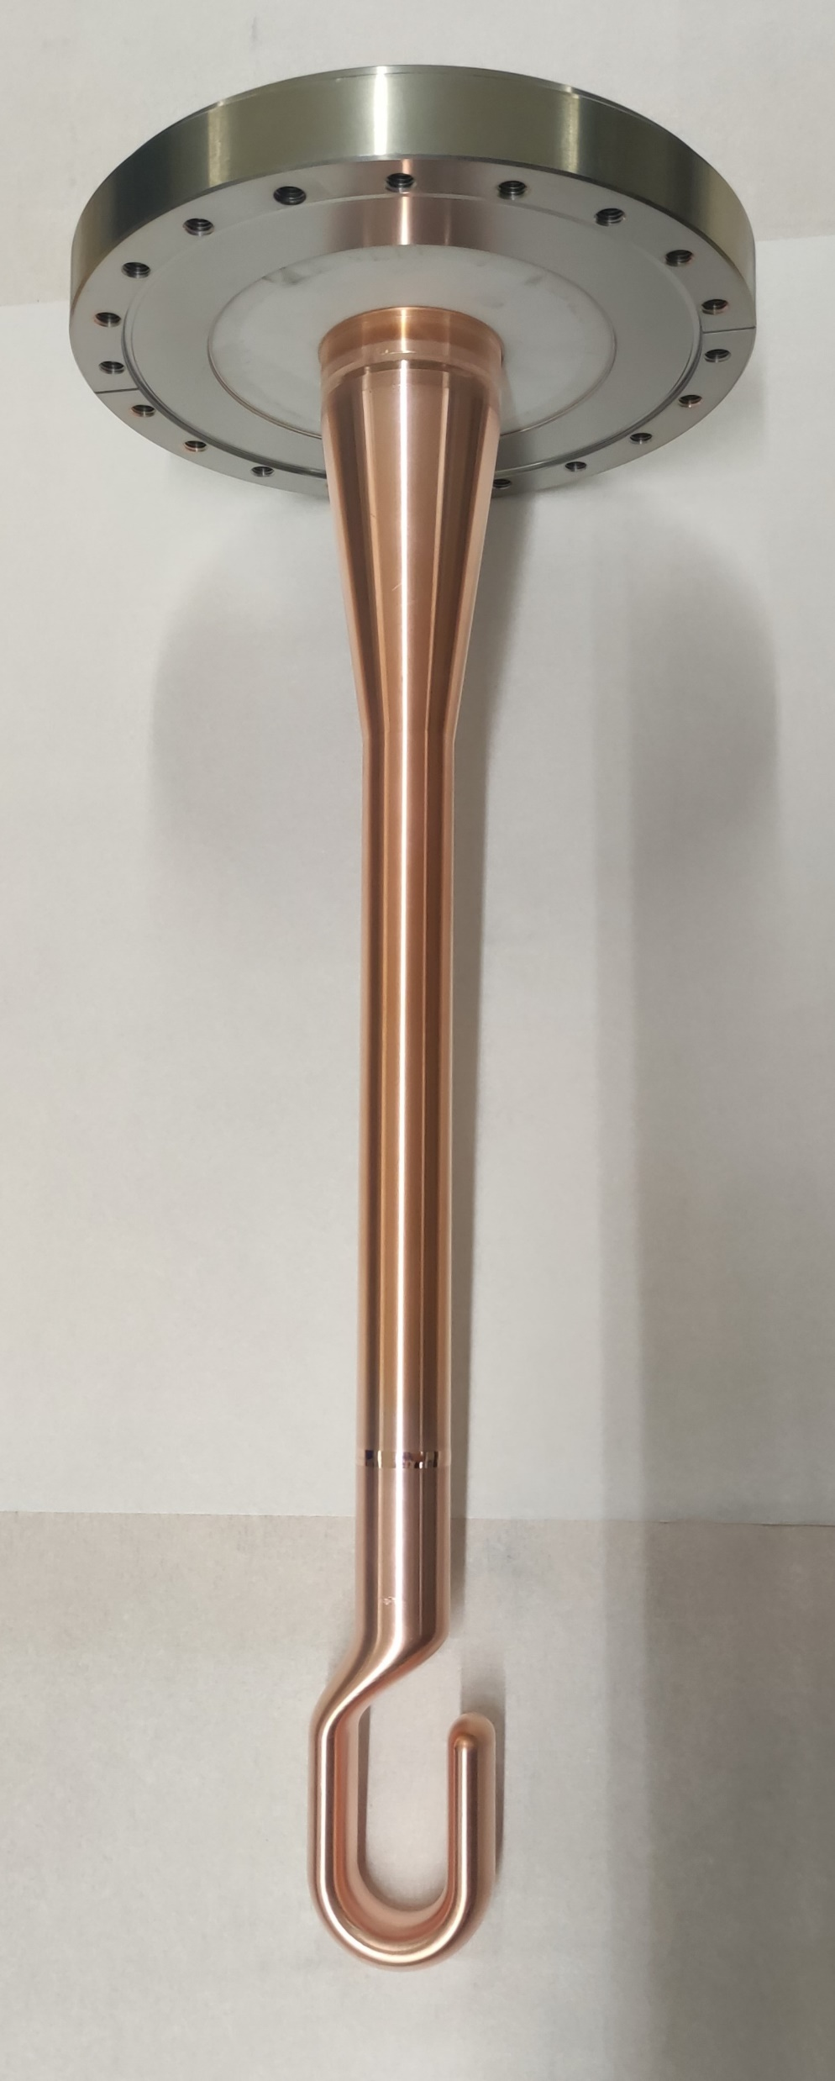
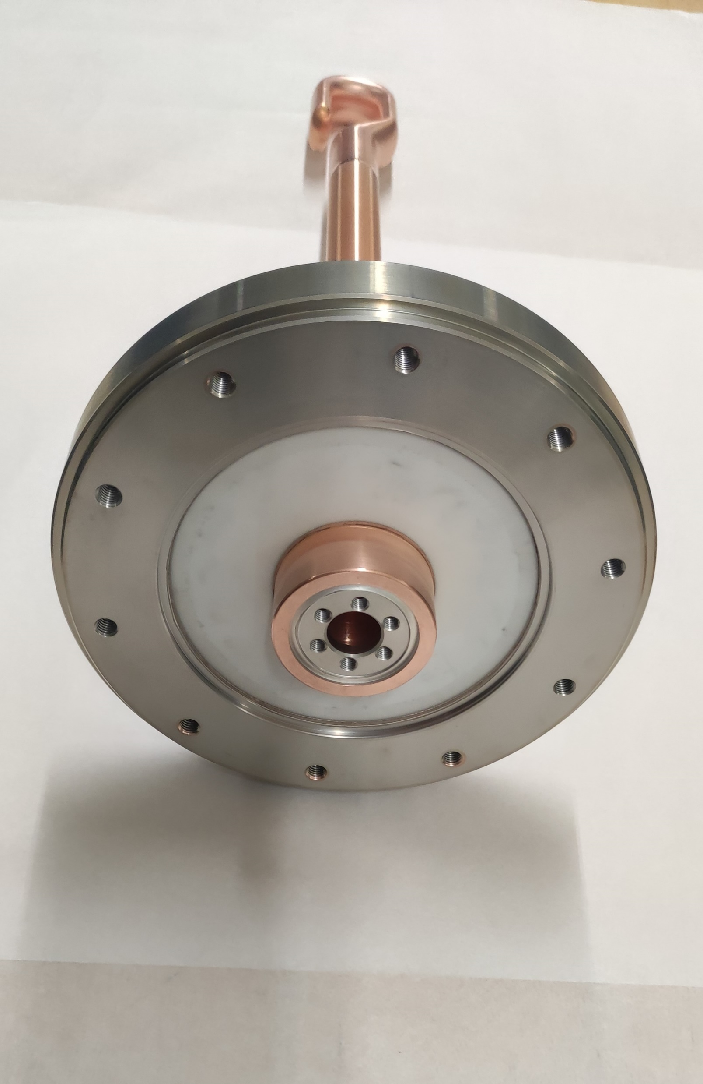
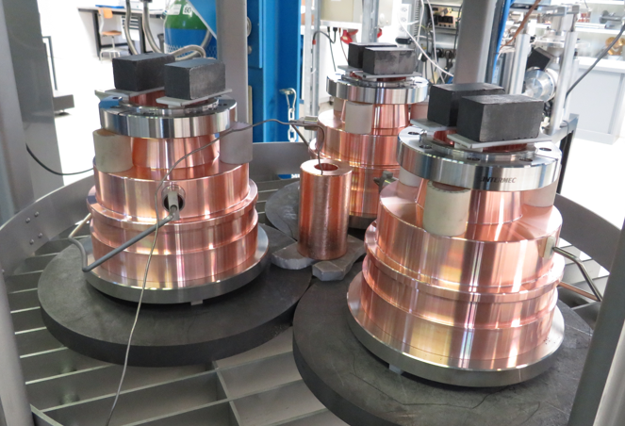
FPC Status
Air side
100% of production complete!
Transport engineering also ongoing!
Vacuum side
Vacuum bodies
FPC DQW antenna
2022 |  |  |  |  |  |  | 2023 |  |  |  |  |  |  |  |  |  |  |  | 2024
06 | 07 | 08 | 09 | 10 | 11 | 12 | 01 | 02 | 03 | 04 | 05 | 06 | 07 | 08 | 09 | 10 | 11 | 12 | 01 | 02 | 03 | 04 | 05 | 06 | 07 | 08 | 09 | 10 | 11 | 12
2x
DQW FPC
4x
DQW FPC
4x
DQW FPC
4x
DQW FPC
2x
RFD FPC
2x
RFD FPC
4x
RFD FPC
6x
RFD FPC

Slide 15
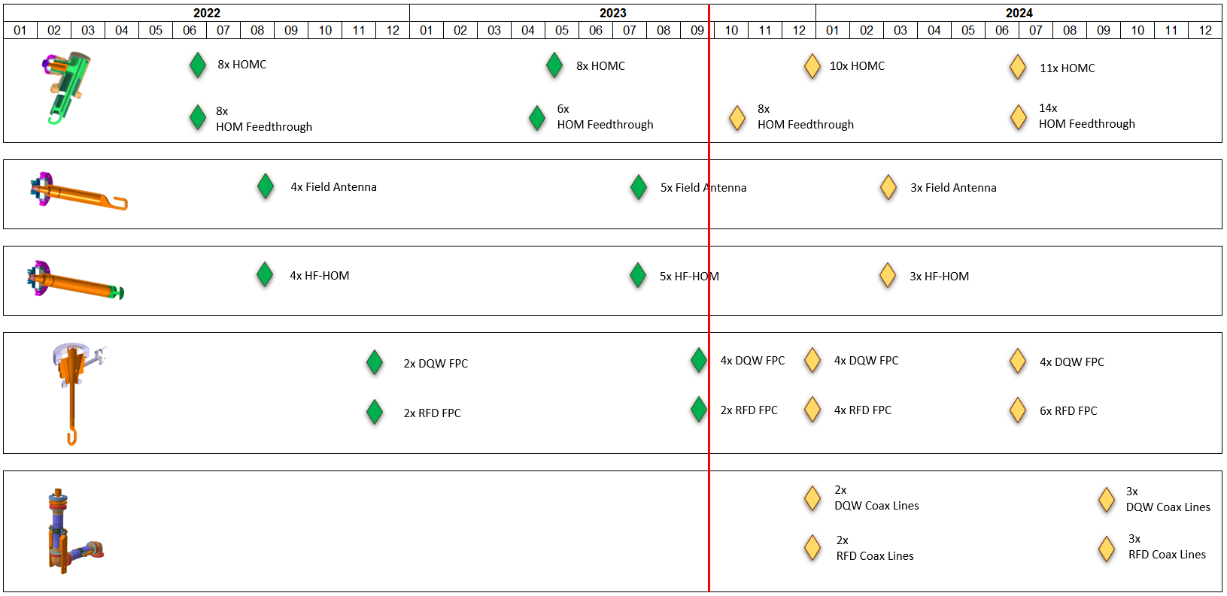

Master Planning
We put a lot of efforts to match:
RF cold testing planning @ CERN
Assembly planning @ CERN and collaborations
So far, RF ancillaries are on track!
4x DQW delivered to UK
4x RFD delivered to CAN
1x DQW delivered to UK
2x RFD delivered to CAN
Effort is now on RF Lines for first modules

Slide 16
A Few Technical Highlights

Slide 17
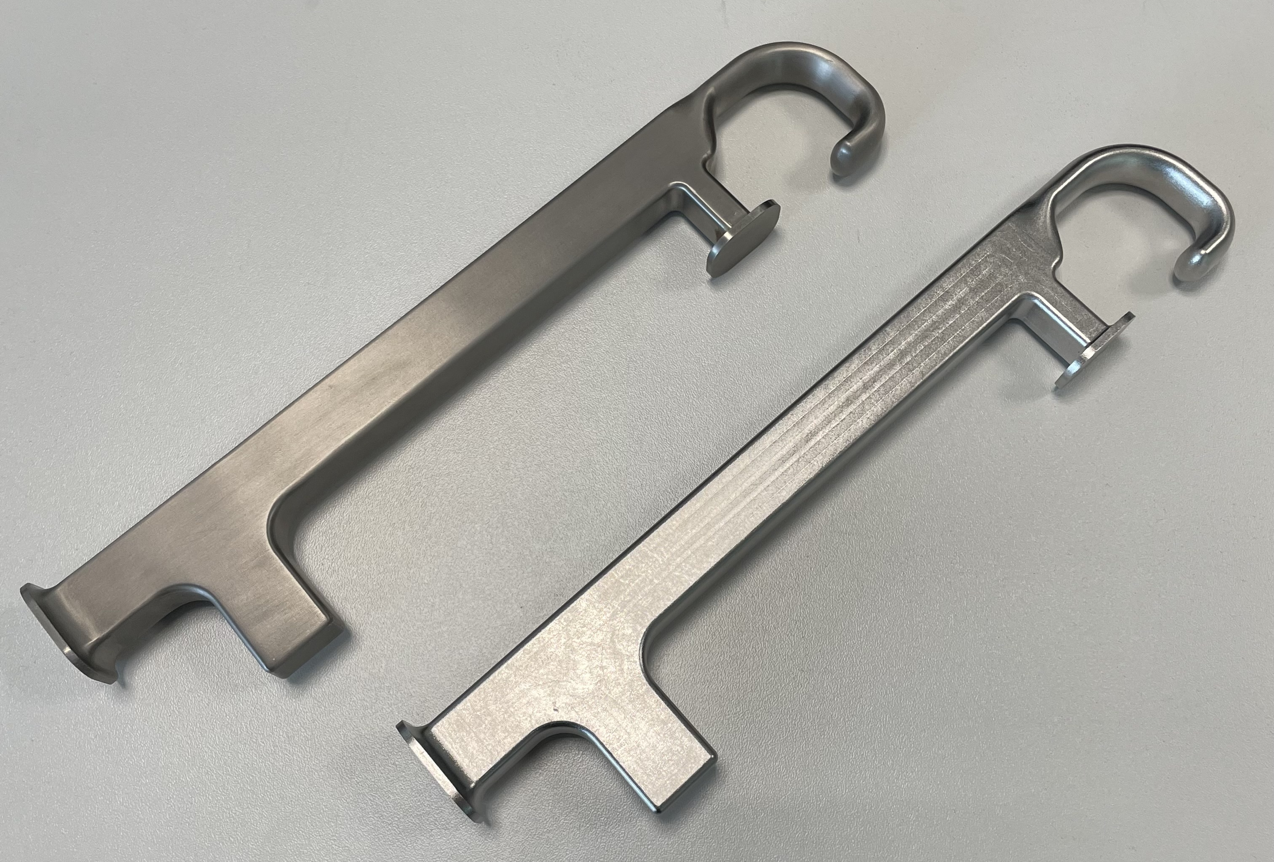



Machining
Recent developments for hook machining & drilling (200 mm depth in Nb!)
200 mm
  Nb machined Hooks (before and after BCP)
Roughing 1st side
Finishing 2nd side
Machining is key to ensure optimum EB welding morphology (thickness uniformity, 3D profiles)

Slide 18






Electron Beam Welding
Neat processes for series production of SRF ancillaries (tooling, shrinkage management)
  St. Steel jacket welding
  St. Steel jacket welding
  Field Antenna EBW fixture
  Full penetration weld of Nb hook to the collar
  EB Weld Hook to Nb Collar

Slide 19




Calibration
Final EB welds on FPC antennas induce deformation leading to hook position out of tolerance (> 0,5 mm)
EBW
Manual (delicate!) calibration needed to bring the hooks closer to nominal position
Precise adjustment & monitoring
Many thanks to Laurent
and Jean-Philippe!

Slide 20




3D Laser Scans
DQW FPC
0,13 mm
1,1 mm
Calibration is followed by leak checks, visual inspection (as per required standards) and RF commissioning
RFD FPC
0,16 mm
0,9 mm

Slide 21


Lessons Learned
Many techniques intertwined: advanced coordination and follow-up daily through all processes
Fragile and high added-value components: require specific processes for clean handling and storage, especially for series production. Logistics, packaging, transport… to be tackled as soon as possible
Typical issues inherent to this kind of productions debugged and documented on the field, NCR written and checked by project when needed
Synergy between SY-RF, EN-MME and TE-VSC groups at CERN

Slide 22
Conclusion
  Fabrication of RF couplers & antennas at CERN for DQW series is currently on track for assembly on series cavities in coming months/years
  We are still learning many things on-the-field during this series production phase and implementing actions to improve quality & production lead times.
  RF Lines will be another challenge – efforts are ongoing to conclude production for 1x DQW and 1x RFD cryomodule as soon as possible
  We stay attentive and flexible to meet the Project needs, both for CERN and collaborations activities

Slide 23









Many thanks to all the colleagues involved in the production of such beautiful objects!
Special thanks to Thomas, Julien, Sébastien, Stefanie & Eric for the inputs

Slide 24
Thank you!

