Slide 1


RF power system
IOTs & challenges
Erci.Montesinos@cern.ch on behalf of all colleagues involved in the topic

Slide 2
RF system
HPRF High Power RF station (including power transmission lines)
FPC Fundamental Power Coupler
HOMC High Order Mode Coupler
LLRF Low Level RF
HPRF
FPC
Cryomodule
Controls
LLRF
HOMC

Slide 3
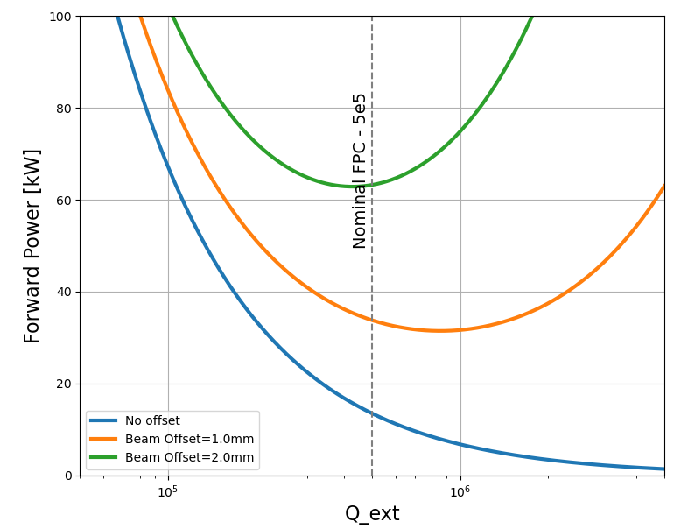
HPRF stations Technical Specification
Courtesy Rama Calaga
With a no offset beam, HPRF will have to provide 20 kW
HPRF has been defined such to deliver up to 40 kW, about
1 mm+ offset
In case of a too large offset, HPRF must provide up to 80 kW during almost 1 ms, allowing for a clean beam dump

Slide 4
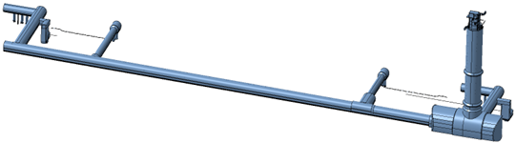
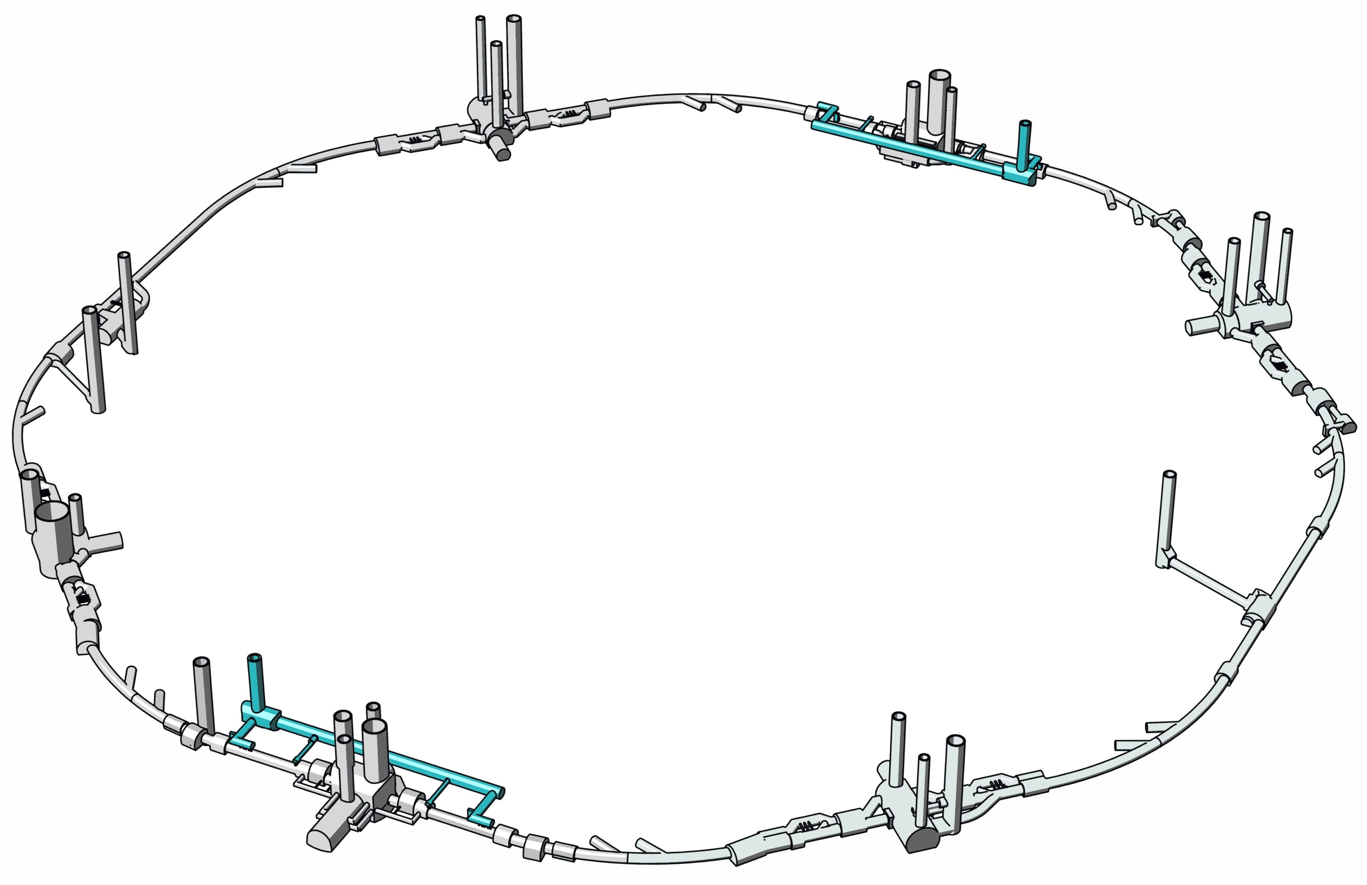

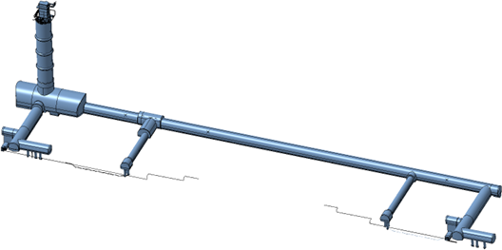
Integration of the HPRF in the galleries
Four different places
with four HPRF stations each
Total 16 HPRF stations
P5 - CMS
P1 - ATLAS

Slide 5
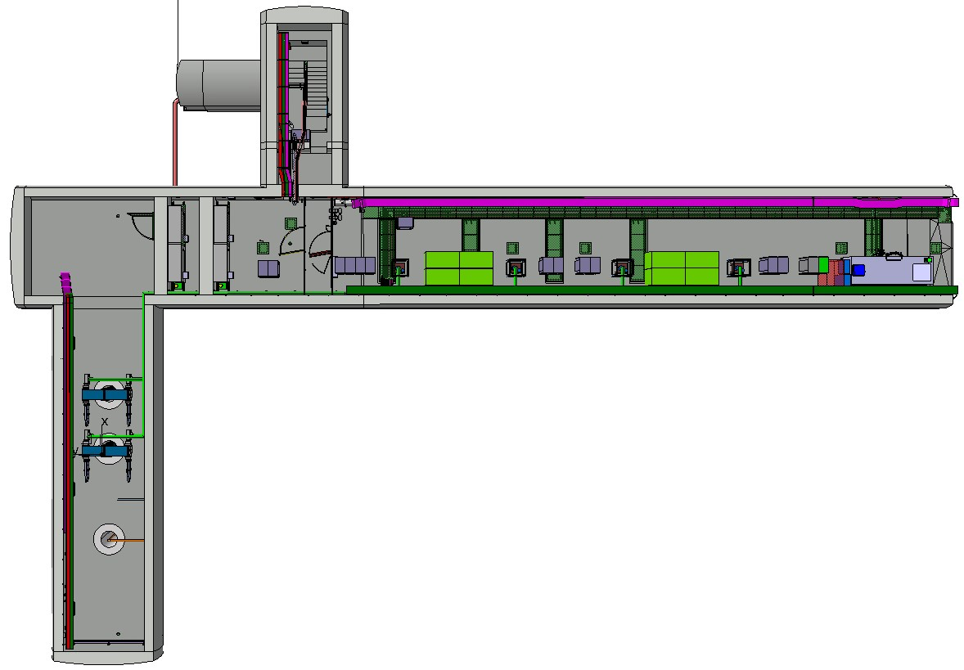
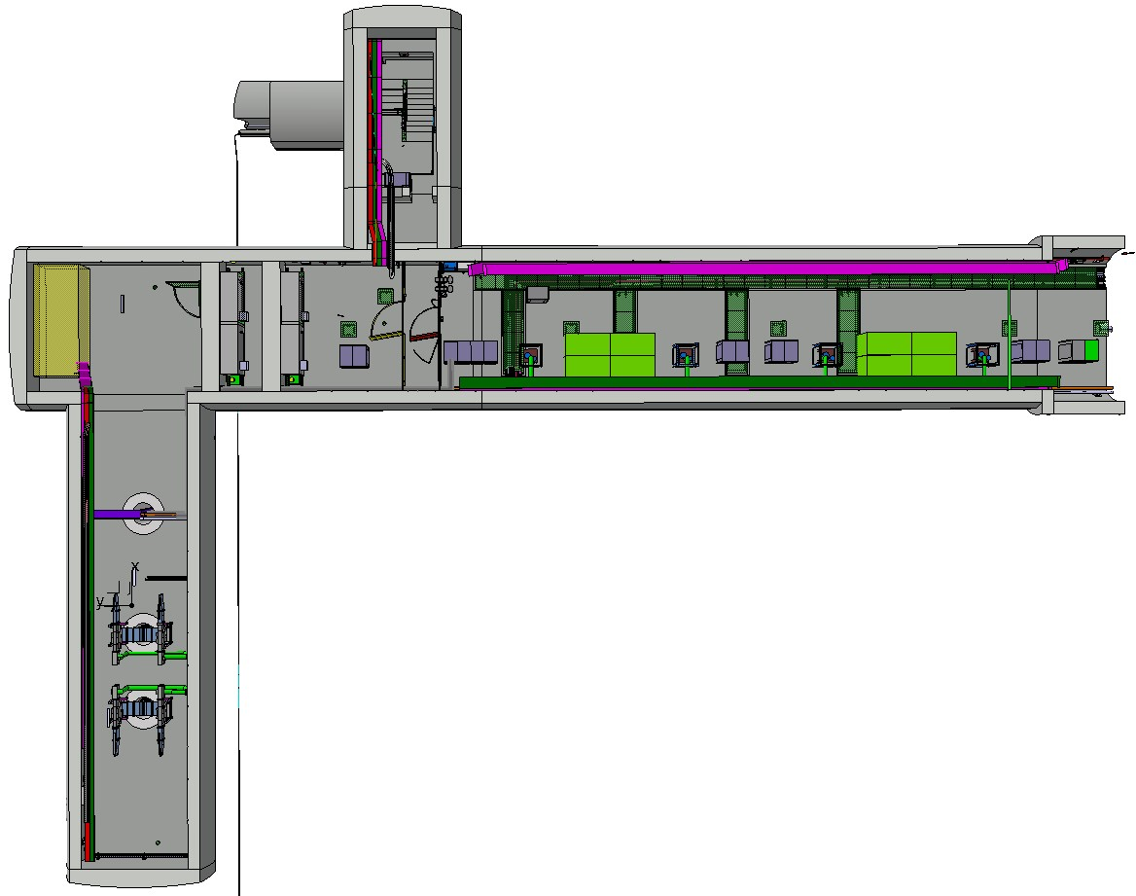
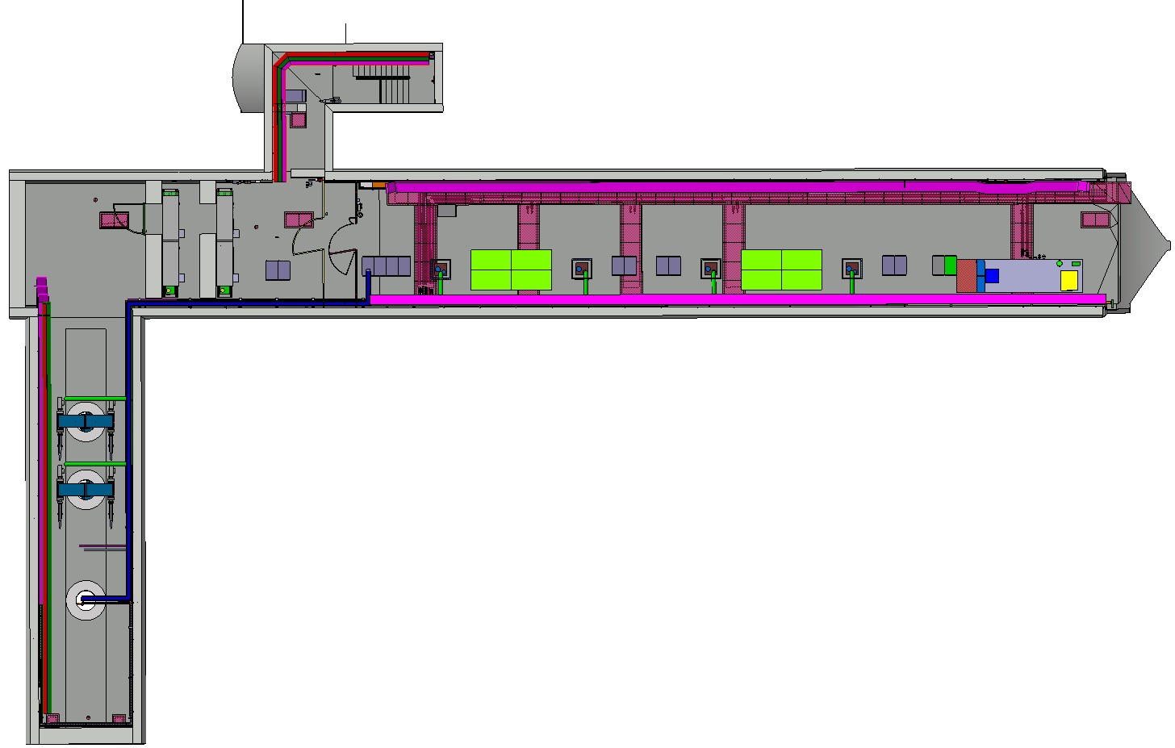
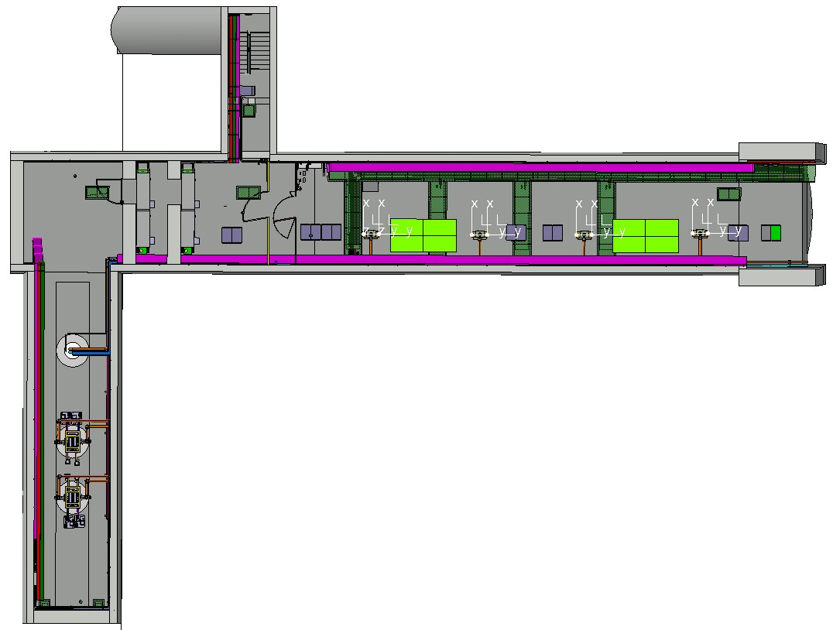
Integration of the HPRF in the galleries
Left side
Right side
Point 1
Point 5

Slide 6
Integration of the HPRF in the galleries
Volume L x l x h each HPRF station must be
maximum 2 x 2 x 2 meters all inclusive
In a gallery so no possibility to increase the size

Slide 7
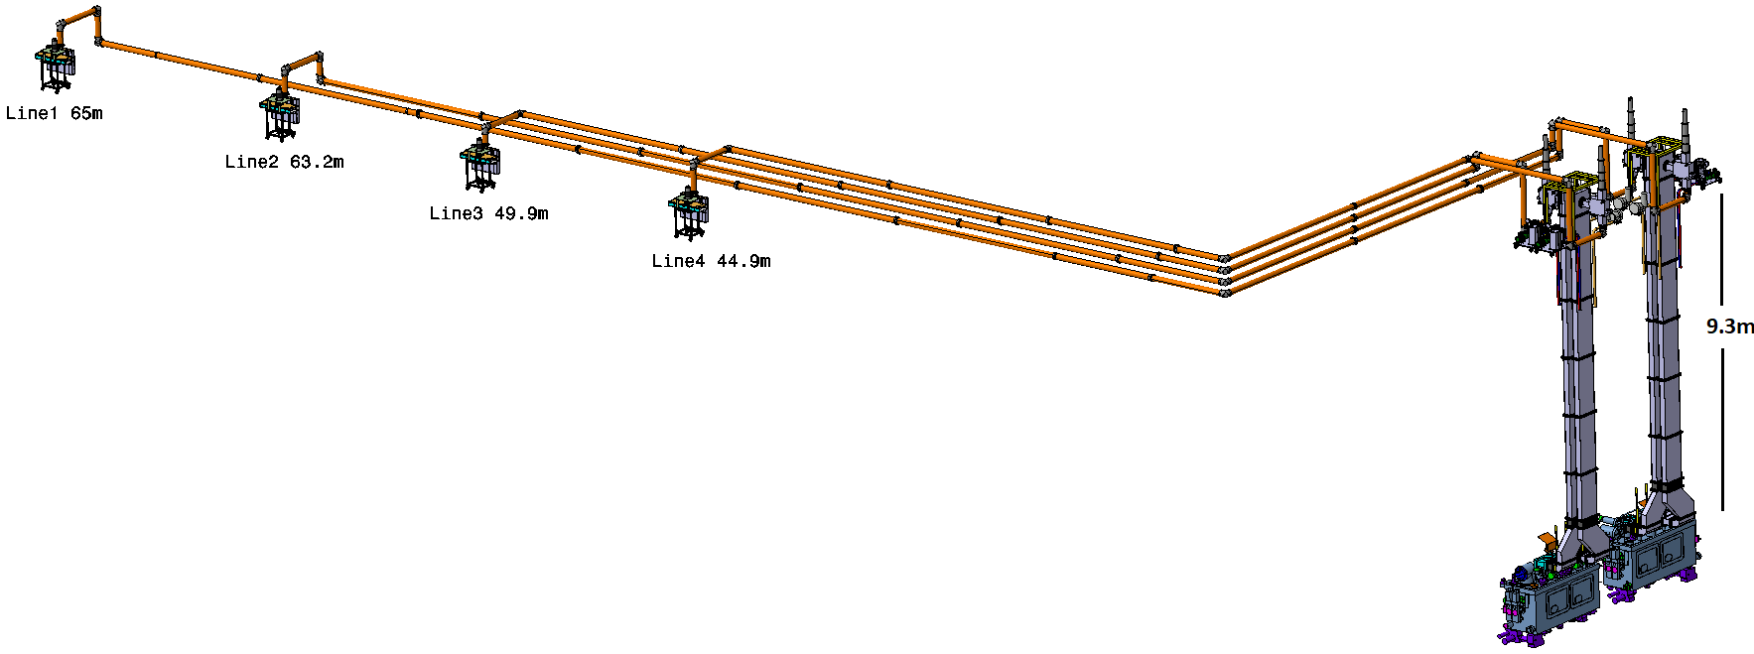
Integration of the HPRF in the galleries
From HPRF station to cavity
Line 1 65 meters
Line 2 59 meters
Line 3 52 meters
Line 4 45 meters
Almost the same for all four points

Slide 8
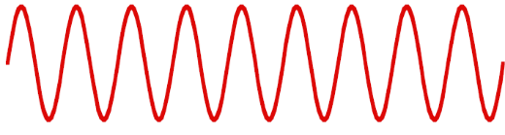
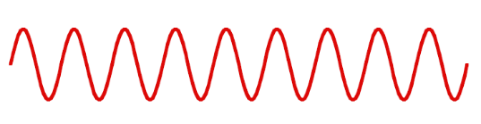

Mismatch
V _{forward}
V _{transmitted}
V _{reflected}
Cavity
Transmission Lines
HPRF station

Slide 9
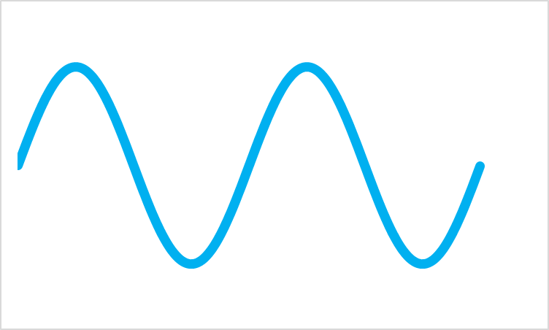
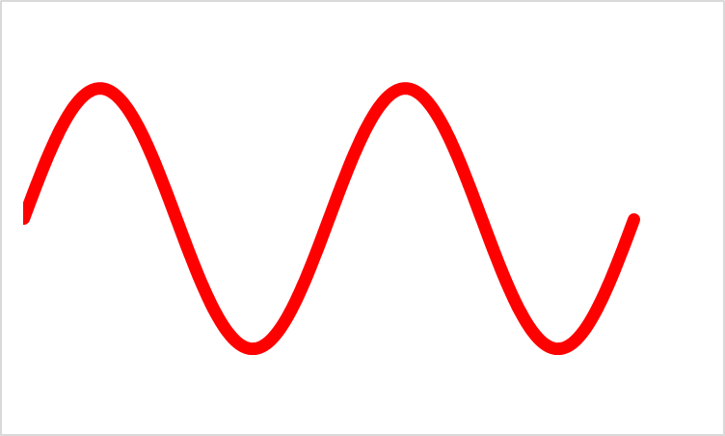
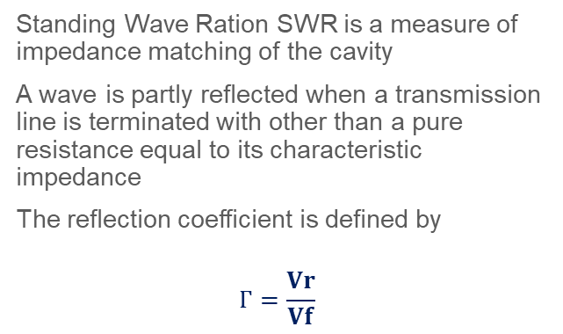
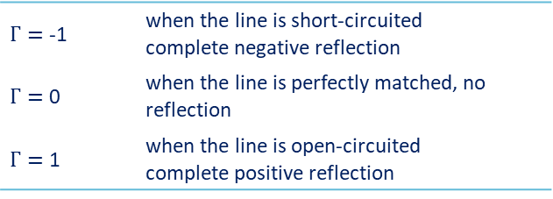
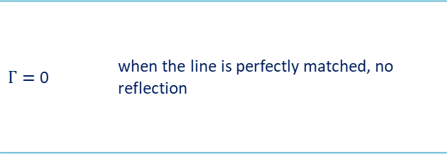
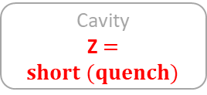

Reflection from cavity
Standing Wave Ration SWR is a measure of impedance matching of the cavity
A wave is partly reflected when a transmission line is terminated with other than a pure resistance equal to its characteristic impedance
The reflection coefficient is defined by
$$Г=\frac{Vr}{Vf}$$
V_{f}
Cavity
Z $≠$ Z_{c}
Cavity
Z $=short (quench)$
Line = Z_{c}
Cavity
Z_{c}
Z_{c}
V_{r}
$Г=$ 0 | when the line is perfectly matched, no reflection
$Г=$ -1 | when the line is short-circuited complete negative reflection
$Г=$ 0 | when the line is perfectly matched, no reflection
$Г=$ 1 | when the line is open-circuited complete positive reflection

Slide 10
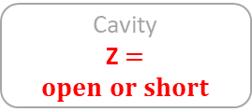
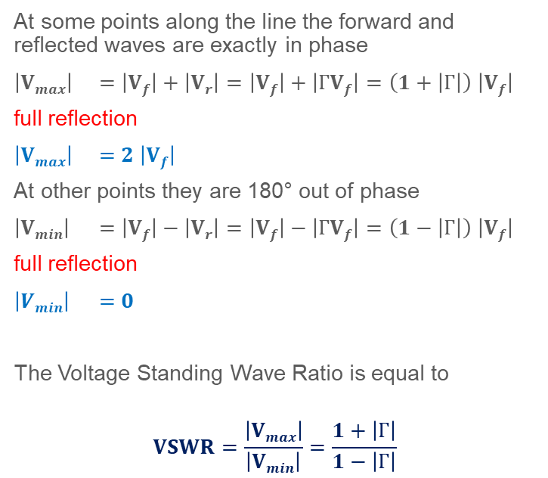
Reflection from cavity
At some points along the line the forward and reflected waves are exactly in phase
$\left|Vmax\right|$ $=\left|Vf\right|+\left|Vr\right|=\left|Vf\right|+\left|ГVf\right|=\left(1+\left|Г\right|\right) \left|Vf\right|$
full reflection
$\left|Vmax\right|$ $=2 \left|Vf\right|$
At other points they are 180° out of phase
$\left|Vmin\right|$ $=\left|Vf\right|−\left|Vr\right|=\left|Vf\right|−\left|ГVf\right|=\left(1−\left|Г\right|\right) \left|Vf\right|$
full reflection
$\left|Vmin\right|$ $=0$
The Voltage Standing Wave Ratio is equal to
$$VSWR=\frac{\left|Vmax\right|}{\left|Vmin\right|}=\frac{1+\left|Г\right|}{1−\left|Г\right|}$$
V_{f}
Cavity
Z $=open or short$
Line = Z_{c}
DUT
(Device Under Test)
Z_{c}
Z_{c}
V_{r}

Slide 11

Full reflection
In case of full reflection V_{max} = 2 V_{f}
(Pmax equivalent to 4 P_{f})
RF power amplifiers based on Klystron and SSPA will not like this reflected wave
If correctly designed, Grid tube and IOT can sustain it
Swift protection if P_{r} > P_{rmax}, but then the system is NOT operational (not always possible)
P_{f}
Cavity
P_{r}
Swift protection if P_{r} > P_{rmax}

Slide 12
Circulator
1
2
V_{f} →
The circulator helps the system to remain operational and to protect our lines and our amplifiers from the reflected power
It is a passive non-reciprocal three-port device
The signal entering any port is transmitted only to the next port in rotation, an RF signal experiences a low loss in the direction of the arrow and high loss in reverse direction while propagating through the Circulator
The best place to insert it is close to the reflection source
If full reflection lines between circulator and cavity, the lines shall sustain
V_{max} = 2 V_{f} (P_{max} equivalent to 4 P_{f})
A load of P_{f} is needed on port 3 at all time
V_{f} →
← V_{r}
3
In case of full reflection
there will be 2 V_{f} along the line
(4 P_{f})
V_{r}
↓
Load
4 P_{f}
Cavity
P_{f}
P_{f}

Slide 13
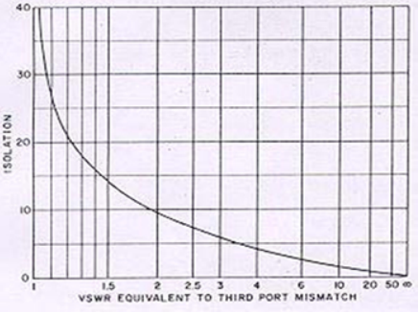
Circulator
1
2
Reflected signal from 3 is circulated back to 1
3
Isolation from 2-1 depends on 3 termination VSWR
Reverse power flows from 2 to 3
The most misunderstood concept of circulators is that of isolation
Circulators do not provide isolation until one of the ports is terminated
Then the isolation between the other two ports (in the direction opposing the direction of circulation) is approximately equal to the return loss due to any mismatch on the terminated port
So, a very good load is needed on port 3 in order to guaranty a good isolation at port 1
VSWR
Load on 3 absorb most of the signal coming from 2

Slide 14
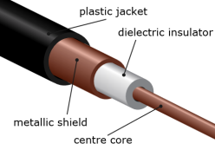

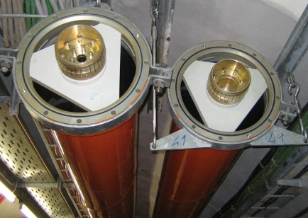
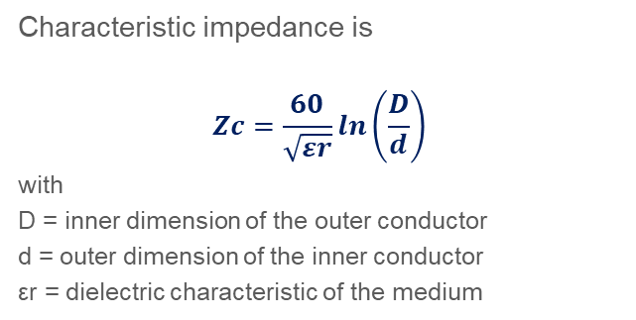
Coaxial Lines
Coaxial cables are often with PTFE foam to keep concentricity
Characteristic impedance is
$$Zc=\frac{60}{\sqrt{εr}}\ln\left(\frac{D}{d}\right)$$
with
D = inner dimension of the outer conductor
d = outer dimension of the inner conductor
εr = dielectric characteristic of the medium
Flexible lines have spacer helicoidally placed all along the line
Size | Outer conductor |  | Inner conductor
 | Outer diameter | Inner diameter | Outer diameter | Inner diameter
7/8" | 22.2 mm | 20 mm | 8.7 mm | 7.4 mm
1 5/8" | 41.3 mm | 38.8 mm | 16.9 mm | 15.0 mm
3 1/8" | 79.4 mm | 76.9 mm | 33.4 mm | 31.3 mm
4 1/2" | 106 mm | 103 mm | 44.8 mm | 42.8 mm
6 1/8" | 155.6 mm | 151.9 mm | 66.0 mm | 64.0 mm
Rigid lines are made of two rigid tubes maintained concentric with supports

Slide 15
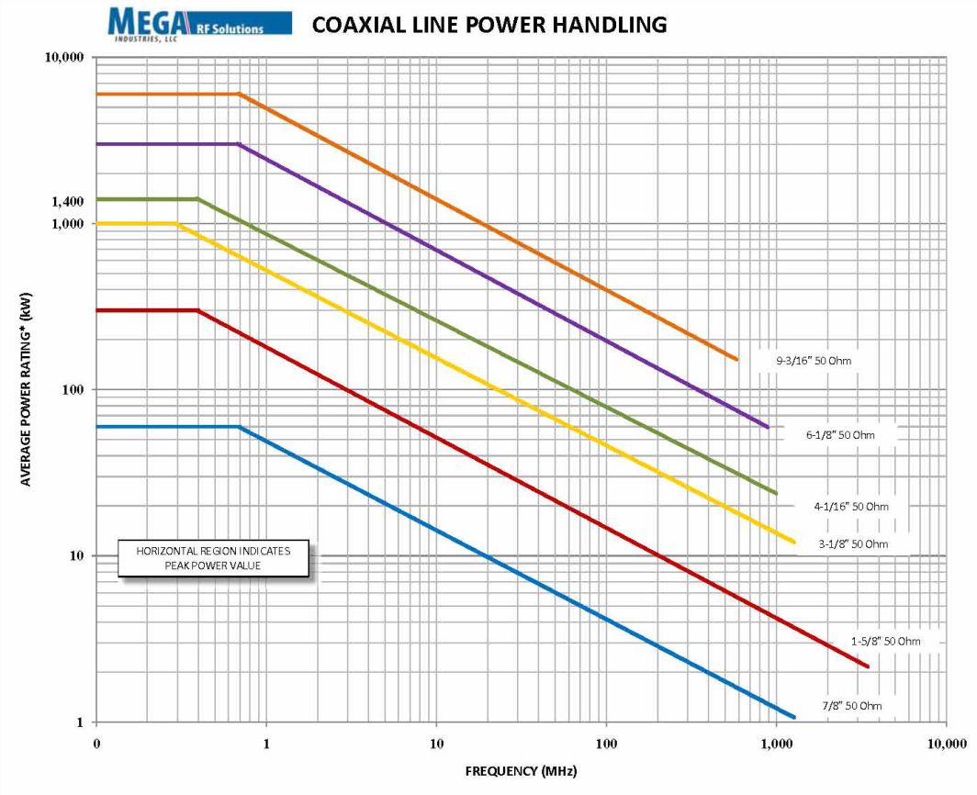
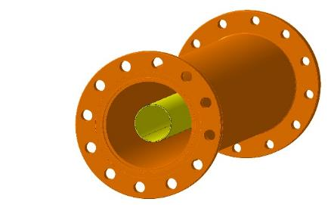
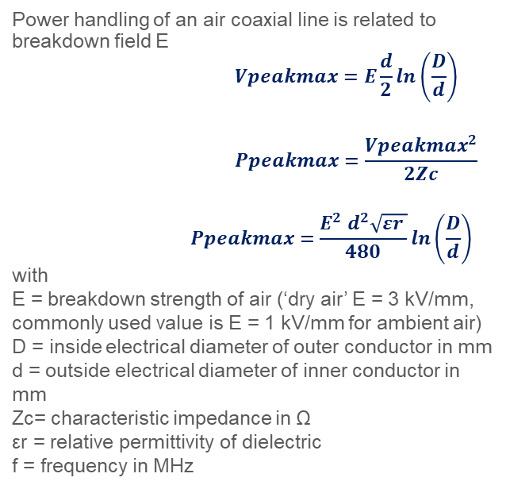
Coaxial lines Maximum Power handling
Power handling of an air coaxial line is related to breakdown field E
$$Vpeakmax=E\frac{d}{2}\ln\left(\frac{D}{d}\right)$$
$$Ppeakmax=\frac{{Vpeakmax}^{2}}{2Zc}$$
$$Ppeakmax=\frac{{E^{2} d}^{2}\sqrt{εr }}{480}\ln\left(\frac{D}{d}\right)$$
with
E = breakdown strength of air (‘dry air’ E = 3 kV/mm, commonly used value is E = 1 kV/mm for ambient air)
D = inside electrical diameter of outer conductor in mm
d = outside electrical diameter of inner conductor in mm
Zc= characteristic impedance in Ω
εr = relative permittivity of dielectric
f = frequency in MHz
Valid only for straight Lines, in case of elbows, reduce at minimum
by – 30 %
d
D

Slide 16
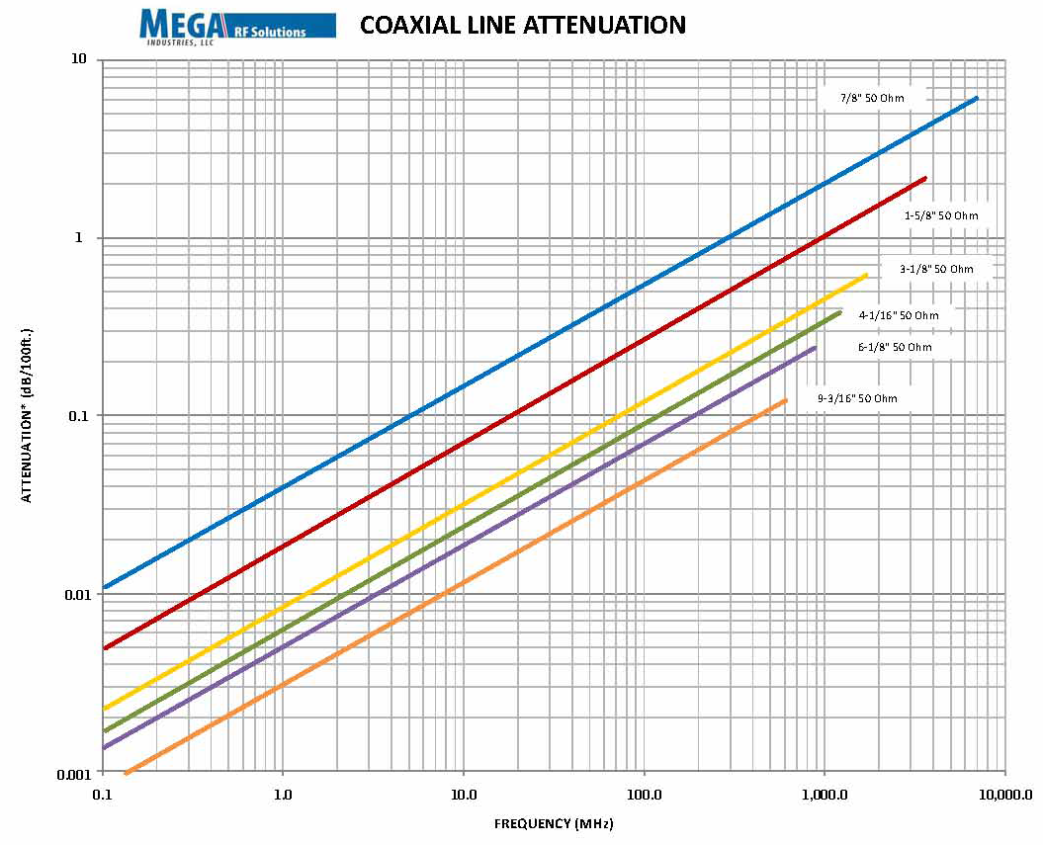
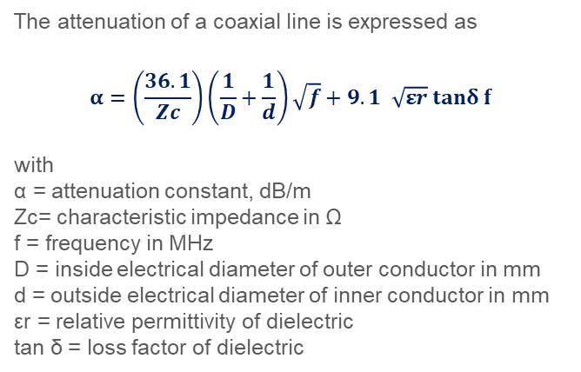
Coaxial lines Attenuation
The attenuation of a coaxial line is expressed as
$$α=\left(\frac{36.1}{Zc}\right)\left(\frac{1}{D}+\frac{1}{d}\right)\sqrt{f}+9.1 \sqrt{εr} tanδ f$$
with
α = attenuation constant, dB/m
Zc= characteristic impedance in Ω
f = frequency in MHz
D = inside electrical diameter of outer conductor in mm
d = outside electrical diameter of inner conductor in mm
εr = relative permittivity of dielectric
tan δ = loss factor of dielectric
Material | ε_{r} | tan δ | Breakdown MV/m
Air | 1.00006 | 0 | 3
Alumina 99.5% | 9.5 | 0.00033 | 12
PTFE | 2.1 | 0.00028 | 100

Slide 17
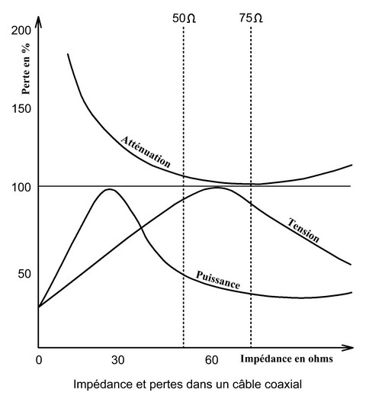
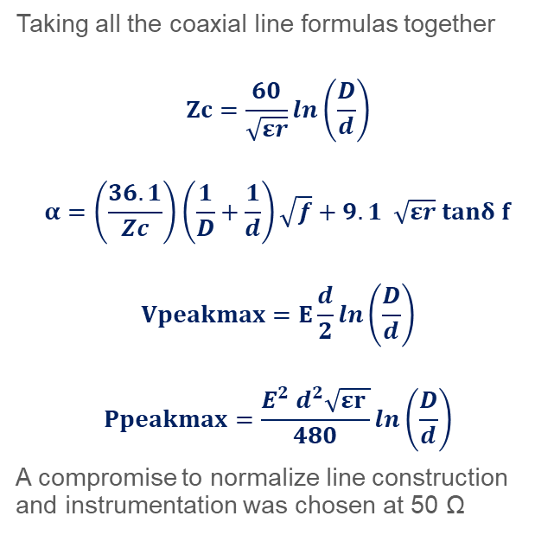
Why 50 Ohms lines ?
50 Ω
Best compromise
75 Ω
Best for losses
Taking all the coaxial line formulas together
$$Zc=\frac{60}{\sqrt{εr}}\ln\left(\frac{D}{d}\right)$$
$$α=\left(\frac{36.1}{Zc}\right)\left(\frac{1}{D}+\frac{1}{d}\right)\sqrt{f}+9.1 \sqrt{εr} tanδ f$$
$$Vpeakmax=E\frac{d}{2}\ln\left(\frac{D}{d}\right)$$
$$Ppeakmax=\frac{{E^{2} d}^{2}\sqrt{εr }}{480}\ln\left(\frac{D}{d}\right)$$
A compromise to normalize line construction and instrumentation was chosen at 50 Ω
60 Ω
Best for voltage
30 Ω
Best for power

Slide 18
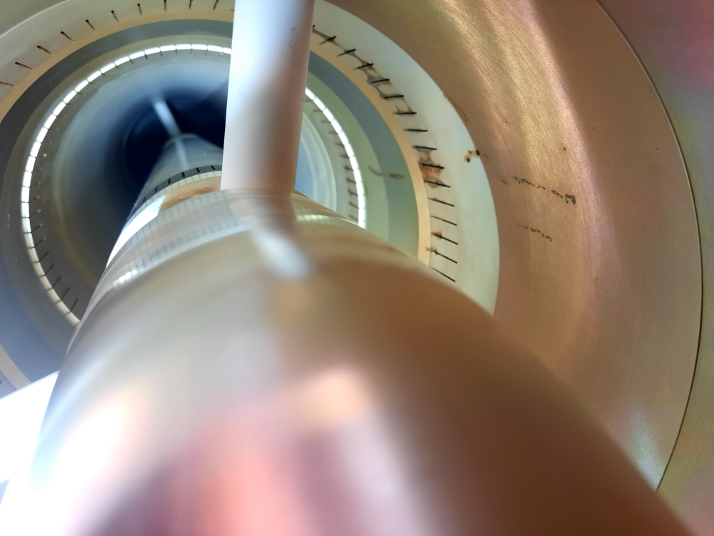
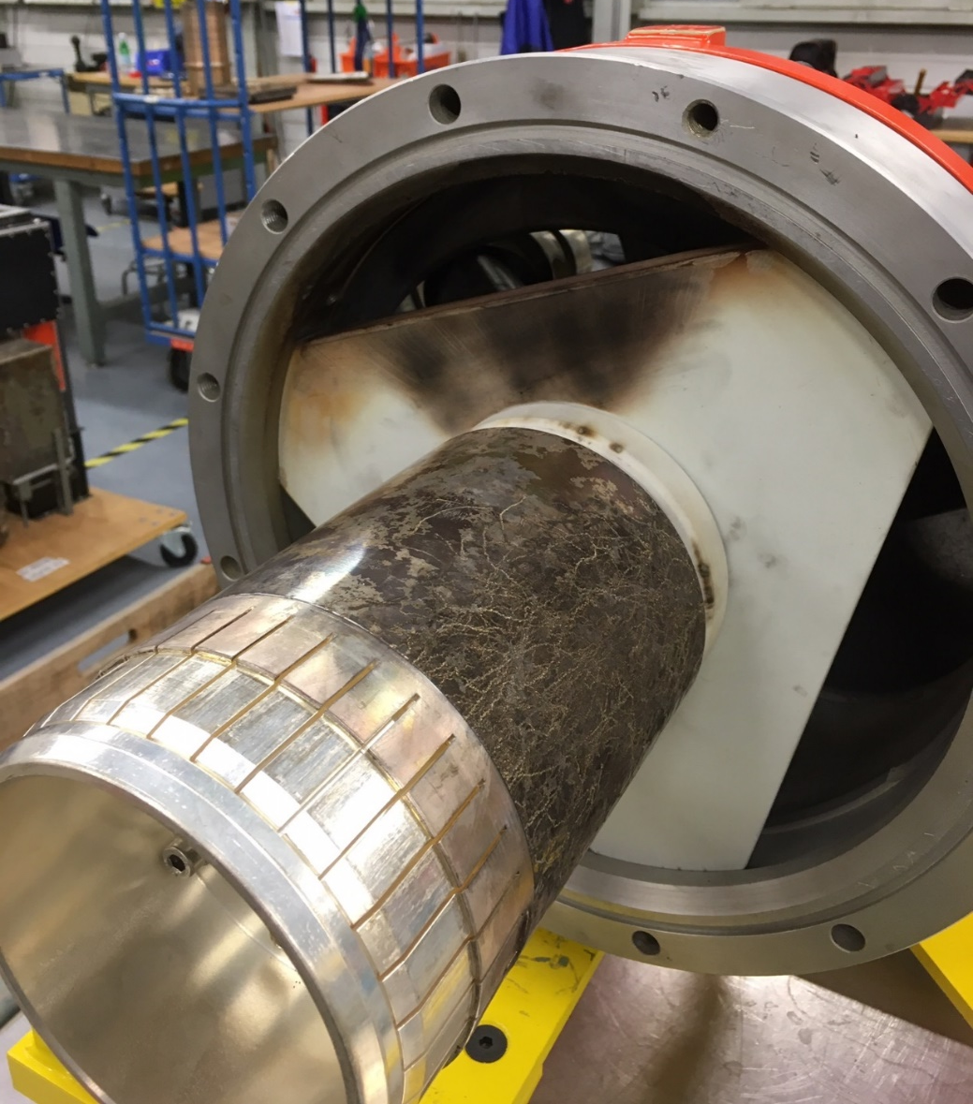
Possible damages
Damages to internal conductor of a coaxial line in case of excess of power

Slide 19
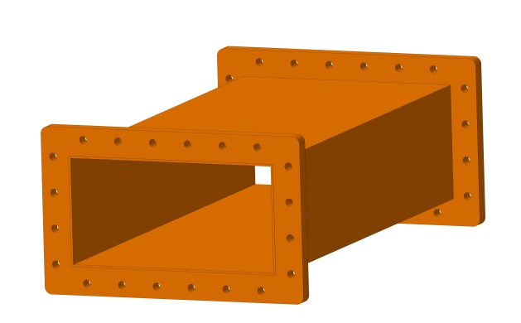
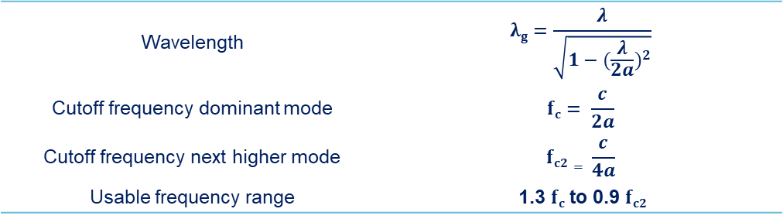
Rectangular waveguides
The main advantage of waveguides is that waveguides support propagation with low loss
b
a
Wavelength | $$λg=\frac{λ}{\sqrt{1−{(\frac{λ}{2a})}^{2}}}$$
Cutoff frequency dominant mode | $$fc= \frac{c}{2a}$$
Cutoff frequency next higher mode | $$fc2= \frac{c}{4a}$$
Usable frequency range | 1.3 $fc$to 0.9 $fc2$

Slide 20
Rectangular waveguides
Waveguides are usable over certain frequency ranges
For very lower frequencies the waveguide dimensions become impractically large
For very high frequencies the dimensions become impractically small & the manufacturing tolerance becomes a significant portion of the waveguide size
b
a
Waveguide name |  |  | Recommended frequency band of operation (GHz) | Cutoff frequency of lowest order mode (GHz) | Cutoff frequency of next mode (GHz) | Inner dimensions of waveguide opening (inch) | Inner dimensions of waveguide opening (mm)
EIA | RCSC | IEC
WR2300 | WG0.0 | R3 | 0.32 — 0.45 | 0.257 | 0.513 | 23.000 × 11.500 | 584.2 x 292.1
WR1150 | WG3 | R8 | 0.63 — 0.97 | 0.513 | 1.026 | 11.500 × 5.750 | 292.1 x 146
WR340 | WG9A | R26 | 2.20 — 3.30 | 1.736 | 3.471 | 3.400 × 1.700 | 86.1 x 43.2
WR75 | WG17 | R120 | 10.00 — 15.00 | 7.869 | 15.737 | 0.750 × 0.375 | 19.05 x 9.52
WR10 | WG27 | R900 | 75.00 — 110.00 | 59.015 | 118.03 | 0.100 × 0.050 | 2.54 x 1.27
WR3 | WG32 | R2600 | 220.00 — 330.00 | 173.571 | 347.143 | 0.0340 × 0.0170 | 0.86 x 0.43

Slide 21
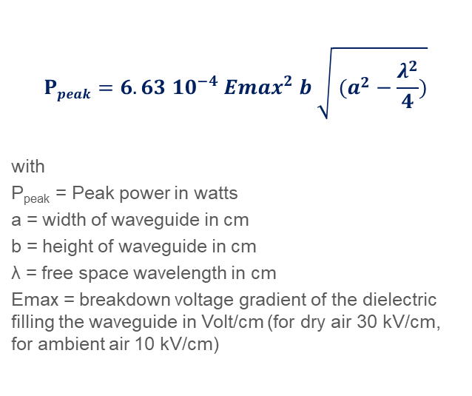
Rectangular waveguides, Maximum Power handling
Theoretical for straight WG, in in practice consider the limit being 10 % of this value
$$Ppeak=6.63 {10}^{−4} {Emax}^{2} b \sqrt{ (a^{2}−\frac{λ^{2}}{4})}$$
with
P_{peak} = Peak power in watts
a = width of waveguide in cm
b = height of waveguide in cm
λ = free space wavelength in cm
Emax = breakdown voltage gradient of the dielectric filling the waveguide in Volt/cm (for dry air 30 kV/cm, for ambient air 10 kV/cm)
WR2300
WR2100
WR1800
WR1500
WR1150
WR975

Slide 22
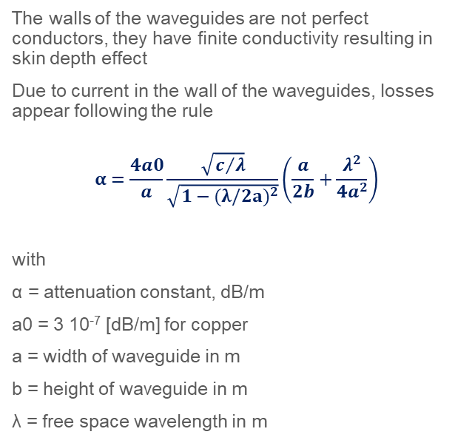
Rectangular waveguides, Attenuation
The walls of the waveguides are not perfect conductors, they have finite conductivity resulting in skin depth effect
Due to current in the wall of the waveguides, losses appear following the rule
$$α=\frac{4a0}{a}\frac{\sqrt{c/λ}}{\sqrt{1−{(λ/2a)}^{2}}}\left(\frac{a}{2b}+\frac{λ^{2}}{{4a}^{2}}\right)$$
with
α = attenuation constant, dB/m
a0 = 3 10⁻⁷ [dB/m] for copper
a = width of waveguide in m
b = height of waveguide in m
λ = free space wavelength in m
WR975
WR1150
WR1500
Attenuation factors of waveguides made from different material normalized to a waveguide of same size made of copper
Copper | 1.00
Silver | 0.98
Aluminium | 1.30
Brass | 2.05
WR2100
WR2300

Slide 23
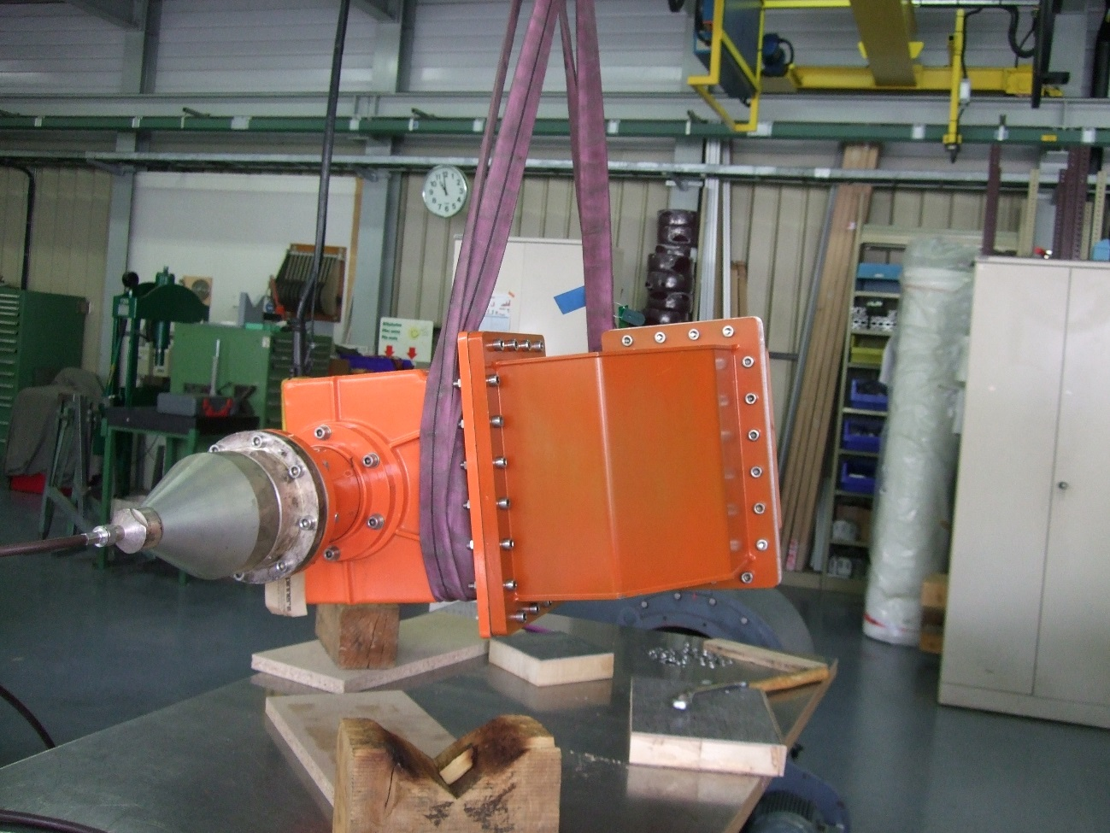
Rectangular waveguides
Adaptor from WR 1150 to N

Slide 24
Integration of the HPRF in the galleries
Taking into account the theory of transmission lines, and to be compatible with the integration, we decided to have
6-1/8’’ coaxial lines in the galery (attenuation ~ 0.5 dB)
A circulator to protect the coaxial lines (attenuation ~ 0.3 dB)
WG WR 2300 HH in the core (to match high power and to ease installation) (attenuation ~ 0.1 dB)
Total attenuation ~ 1 dB

Slide 25
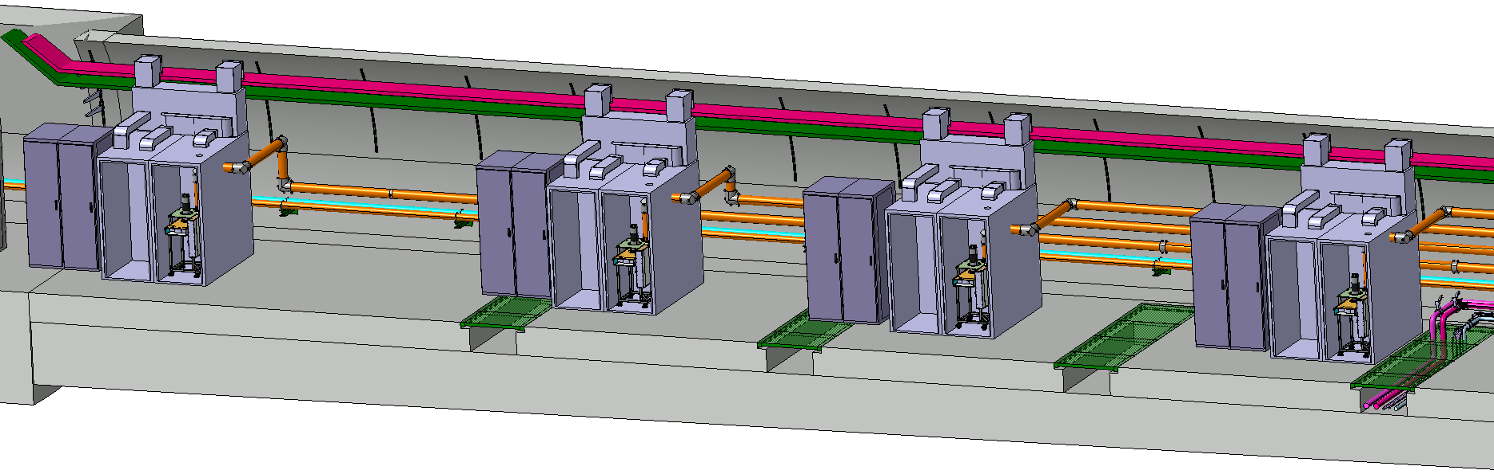
HPRF stations in galery
One HPRF station per cavity, delivering power through 6-1/8’’ coaxial lines

Slide 26
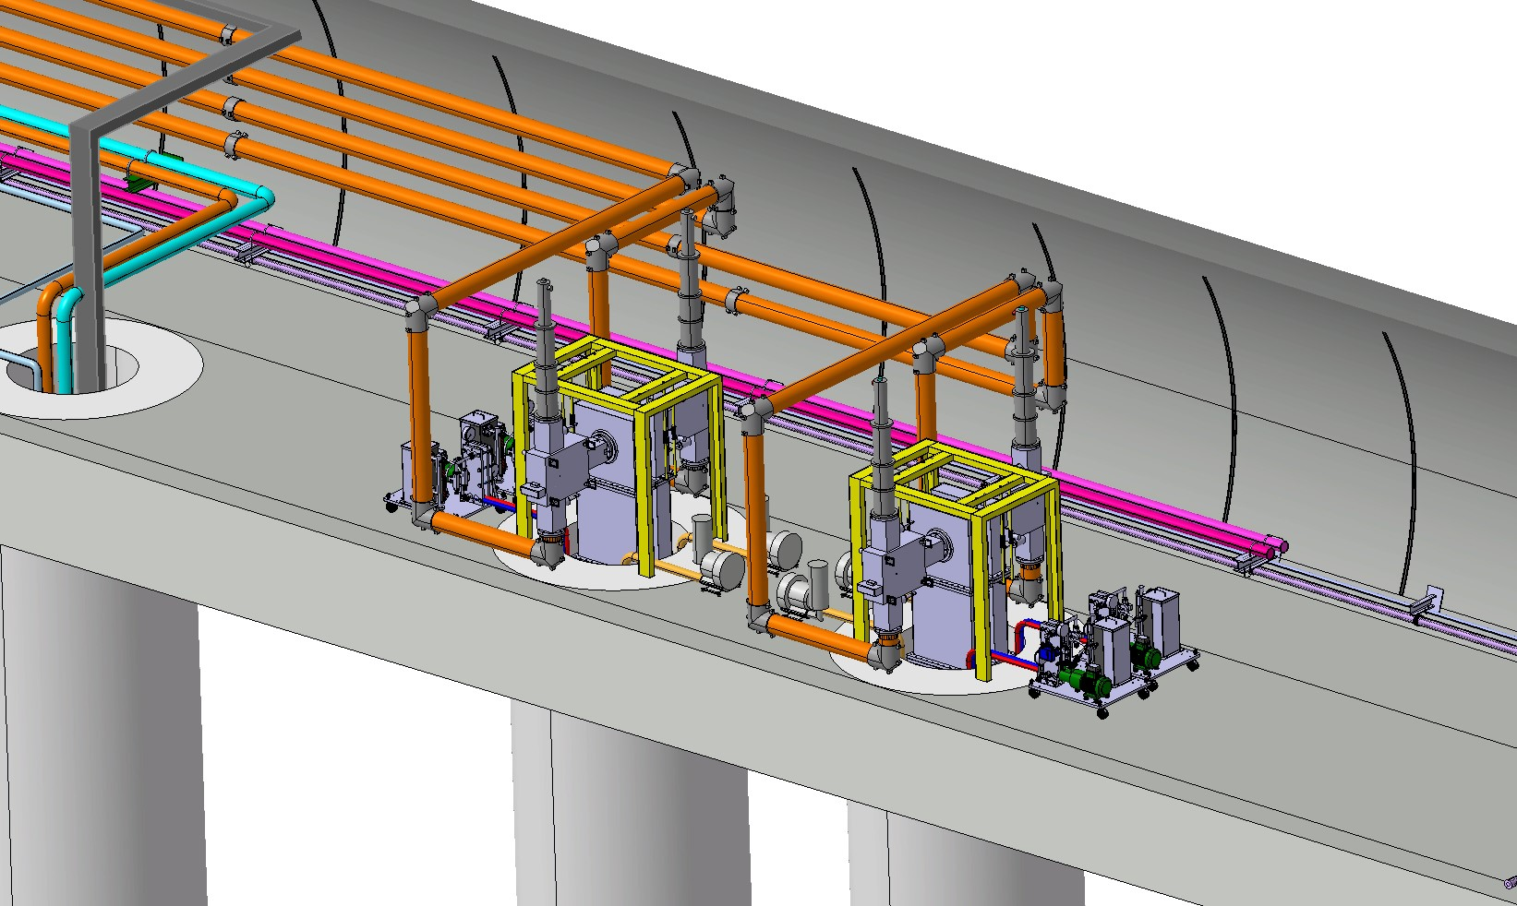
Circulators
6-1/8’’ coaxial lines connected to a circulator, with its port 2 connected to a WG WR 2300 HH

Slide 27
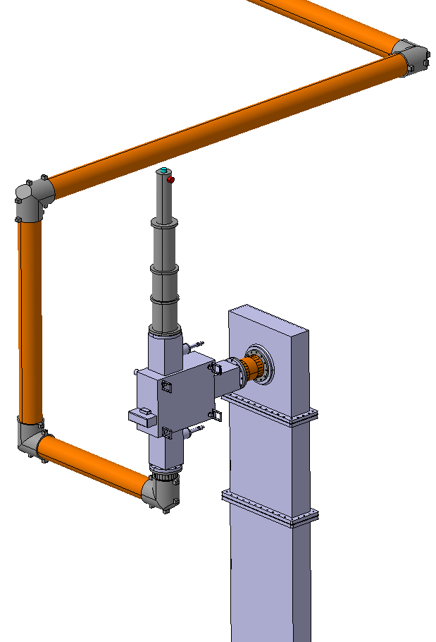
Detailed view of circulators
6-1/8’’ RF coaxial line
One can notice that the load is vertically oriented to avoid trapped air
50 kW load
Adapter to WG WR 2300 HH
Circulator
Waveguide WR 2300 HH

Slide 28
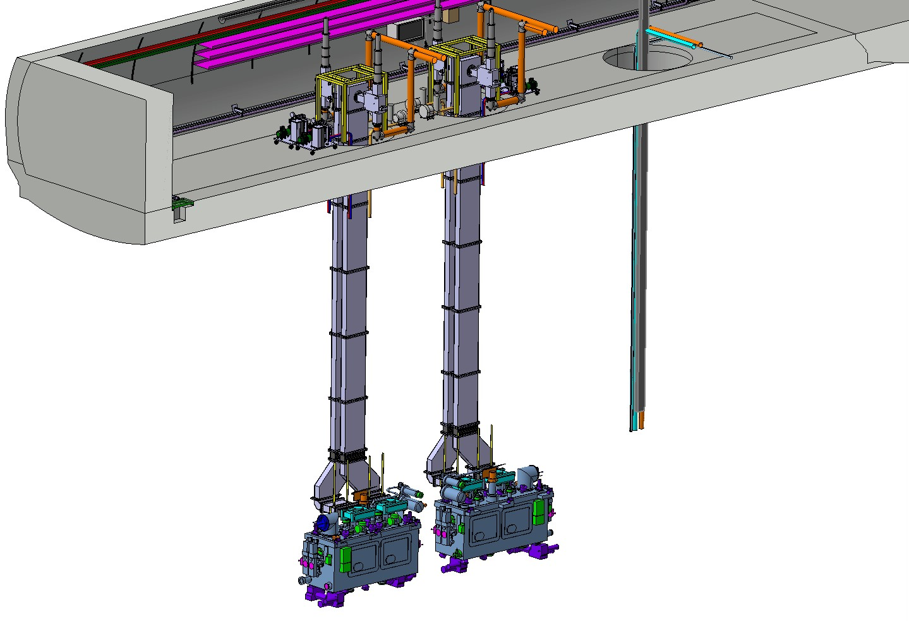
WG in the cores
The waveguide WR 2300 lenght is 10.4 metre
The line is composed of an adpter, 7 straight parts, a tailor made 45°, a 90° elbow and 2 belows
10.4m

Slide 29
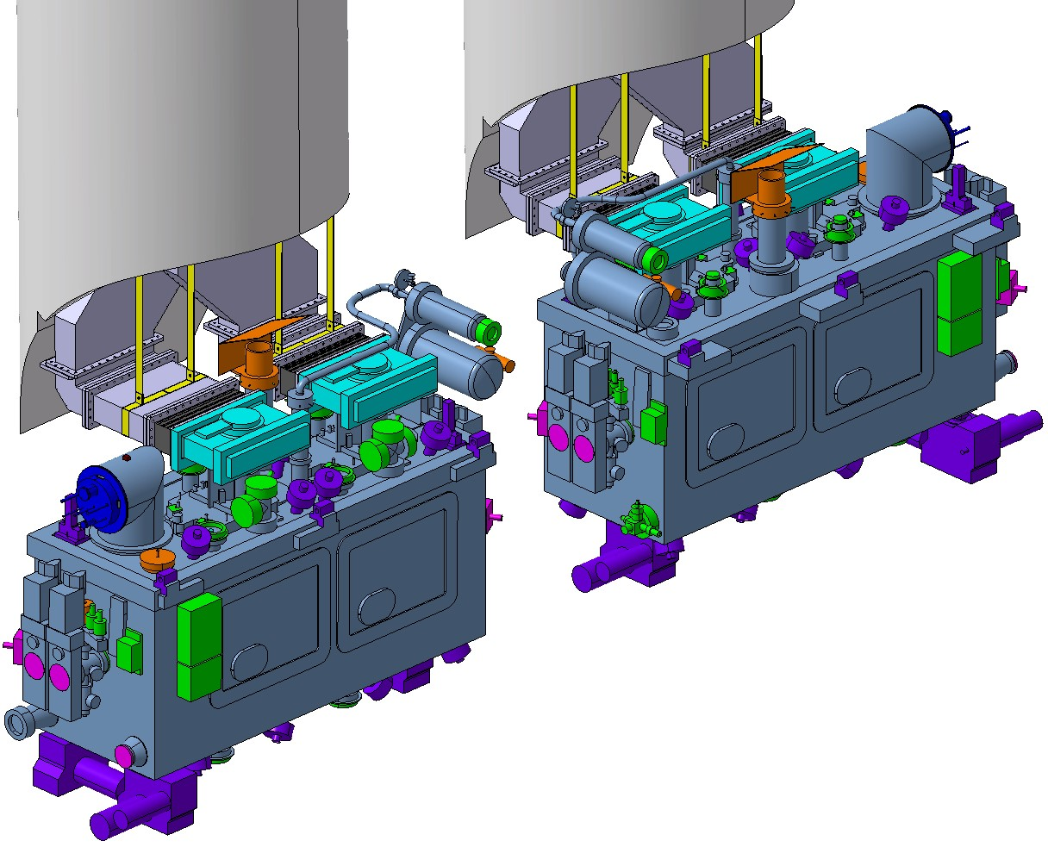
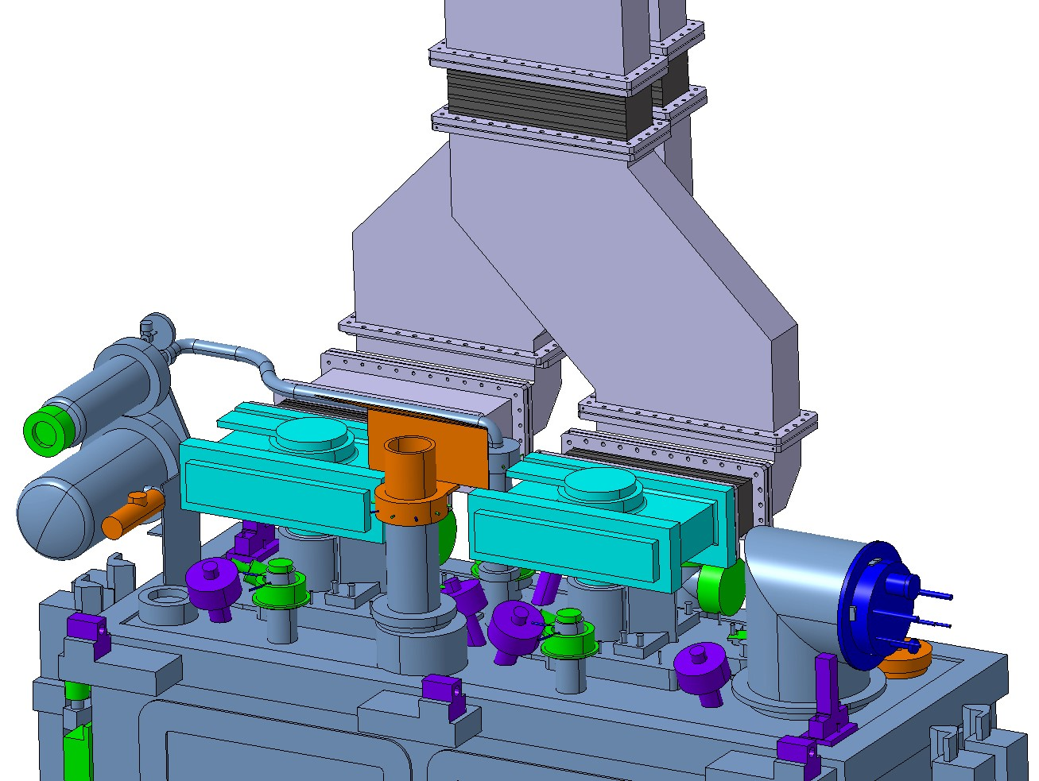
WG connection to FPC
Tailor made 45° waveguide
Due to the opening of the cores, we have to design a tailor made 45° waveguide with an inclination of 0.7 degrees

Slide 30
Power requirements from HPRF system
RF output power [kW]
Average output power is ~ 50 [kW]
10 ms
80 kW → 100 kW
40 kW → 50 kW
10 seconds
0 kW
Time

Slide 31
Gain flatness & monotonous
Gain
CW + pulsed
Pulsed
4 dB
Output
Power
100 W
50 kW
100 kW

Slide 32
Gain flatness & monotonous
Output power
100 kW
Nominal gain
Pulsed
Nominal gain + 2 dB
50 kW
Nominal gain - 2 dB
CW + pulsed
100 W
Input Power
0 dBm

Slide 33
Phase flatness & monotonous
CW + pulsed
Pulsed
100 W
50 kW
100 kW
Output power
30 deg

Slide 34
RF power source classification
Vacuum Tubes
Transistors
Bipolar Junction Transistor (BJT)
Field Effect Transistor (FET)
Junction Gate FET (JFET)
Metal Oxide Semiconductor FET (MOSFET)
power MOSFET
Vertically Diffused Metal Oxide Semiconductor (VDMOS)
Laterally Diffused Metal Oxide Semiconductor (LDMOS)
Silicon Germanium (SiGe)
Gallium Arsenide (GaAs)
Gallium Nitride (GaN)
Grid Tubes
Triodes
Tetrodes
Pentodes
Diacrodes
Linear Beam Tubes
Klystrons
Travelling Wave Tubes (TWT)
Gyrotrons
Inductive Output Tubes (IOT)
Crossed-field Tubes
Magnetrons

Slide 35
Available RF sources at a glance

Slide 36
Overhead and maximum power
Possibility of short power excursions only for gridded tubes
(possible for SSPA at a cost of an overdesigned system)

Slide 37
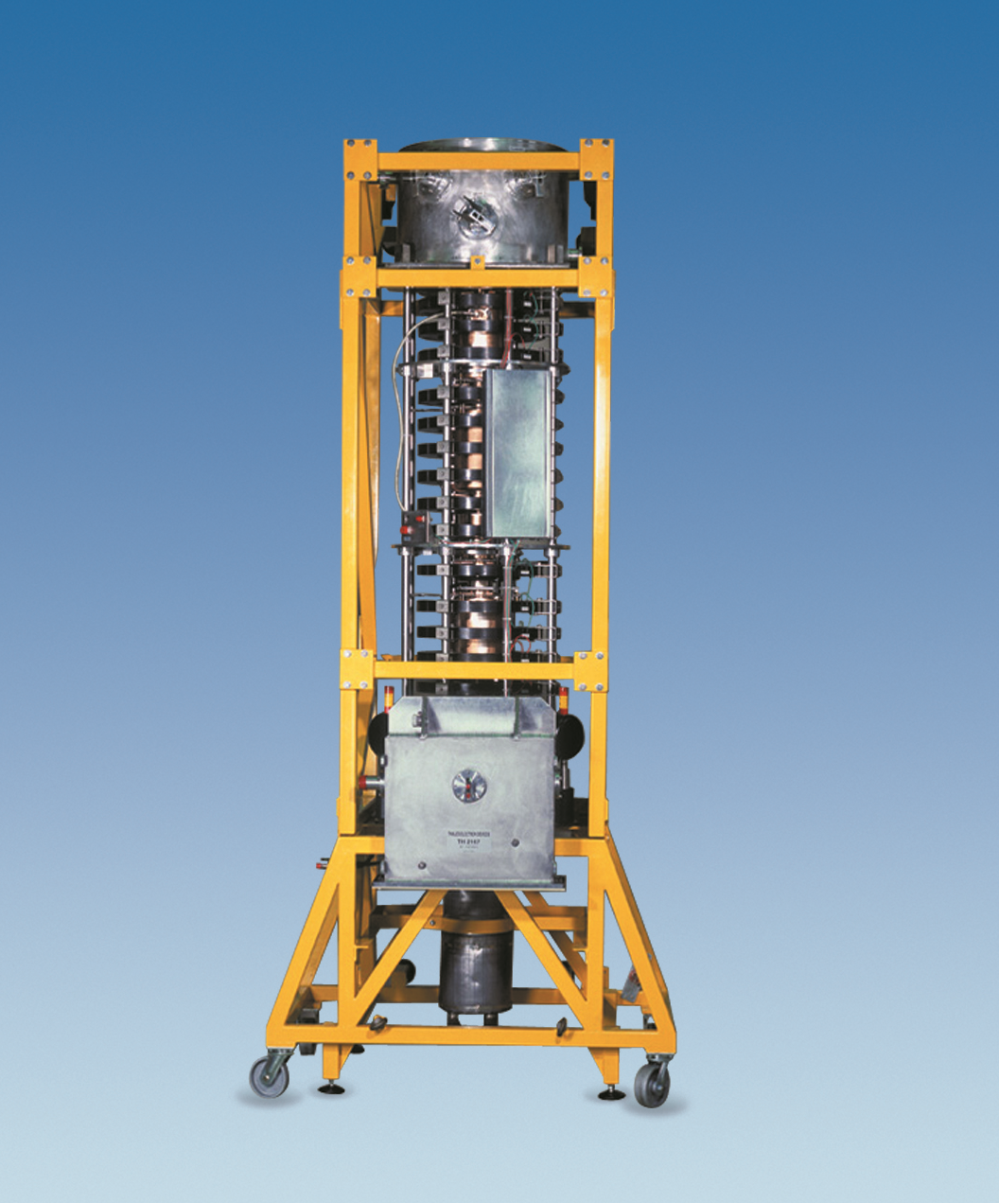
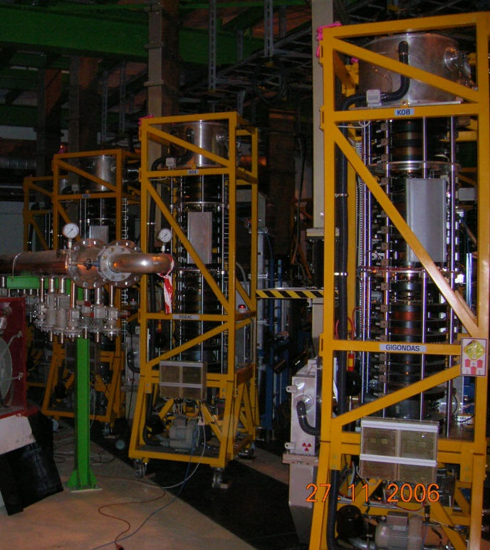

No klystron at that ‘little power’ available
Klystron of such small power does not exist on the market
The ones that exist provide too much power and are not possible to integrate in our ‘small’ galleries
In addition, for such specific power requirements, as output power reduces if we go over saturation (nominal) point of operation, we would need to operate lower than nominal point of operation
This would induce loss of efficiency, almost doubling the cost (acquisition + operation)
Finally, phase stability is given by construction from HV stability (very expensive)
CERN LHC, 16 x TH 2167 klystrons in LHC UX45 cavern
delivering 330 kW @ 400 MHz, into operation since 2008

Slide 38
SSPA, an option but at high cost
Transistors are destroyed in case of large overdrive (+ 3 dB = x 2) longer than ~ 100 µs
Hard protection limit are needed, could be built in, but then it is complex to manage for LLRF, so we try to have a good LLRF protection system
To avoid destruction, overhead must be perfectly and correctly defined
Overhead very costly (compare to gridded tubes)
Operating point pulsed
Operating point CW
Spare slides if you wish to better understand the constraints

Slide 39
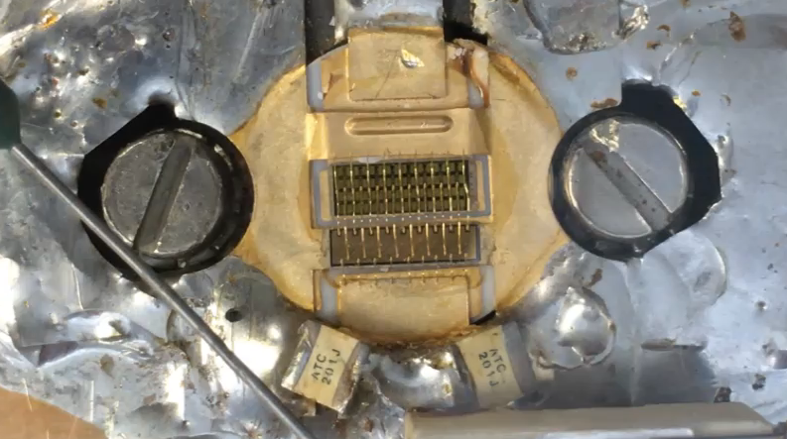

Slide 40
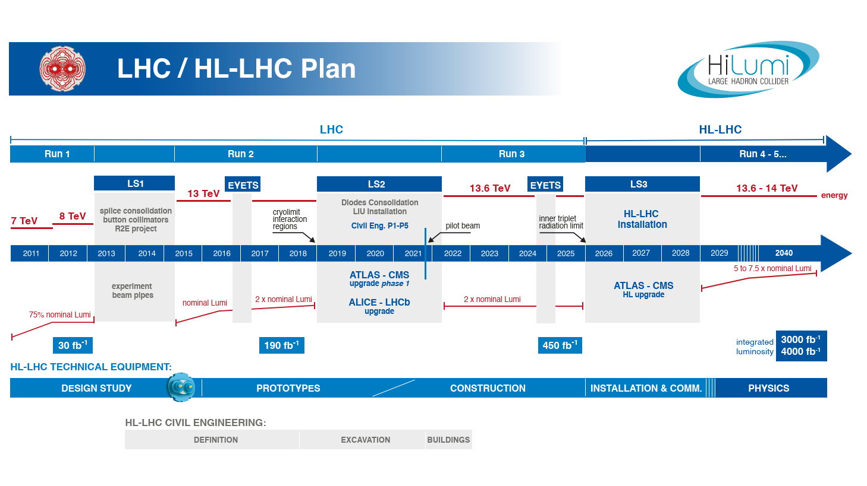
SSPA obsolescence
When we started SPS SSPA in 2017, the chosen transistor was the ‘best for new design’ quoted by the transistor supplier
Beginning 2022, we received a ‘Last Buy Order’ email…
(the same with other labs, within 3-5 years, ‘best to use’ transistors turn to be ‘do not use for new design’, and to ‘obsolete’ item…)
The difficulty with Accelerators is that when we buy a new amplifier, it must last 20-25 years
Changing the transistor generation is often linked to changing the operating voltage, this makes that change out of budget
The amplifier architecture should then be designed such that the amplifier will last the 20 years without major upgrade
Spare slides if you wish to better understand the constraints

Slide 41
IOT, ‘like if designed’ for the Crab
A great advantage of gridded tubes is that they allow overdrive without damage
Tetrodes & Diacrodes are limited in frequency (max ~ 400 MHz)
IOT can operate from low (100 MHz) to high frequencies (1.3 GHz), including 400 MHz
The gain of an IOT is around 23 dB, so to reach 100 kW, an only 500 W driver is needed
Operating point pulsed
Operating point CW

Slide 42
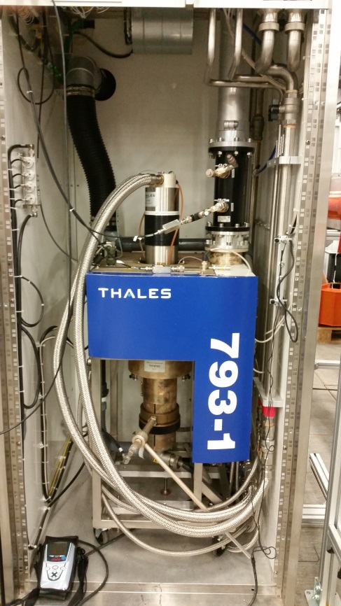
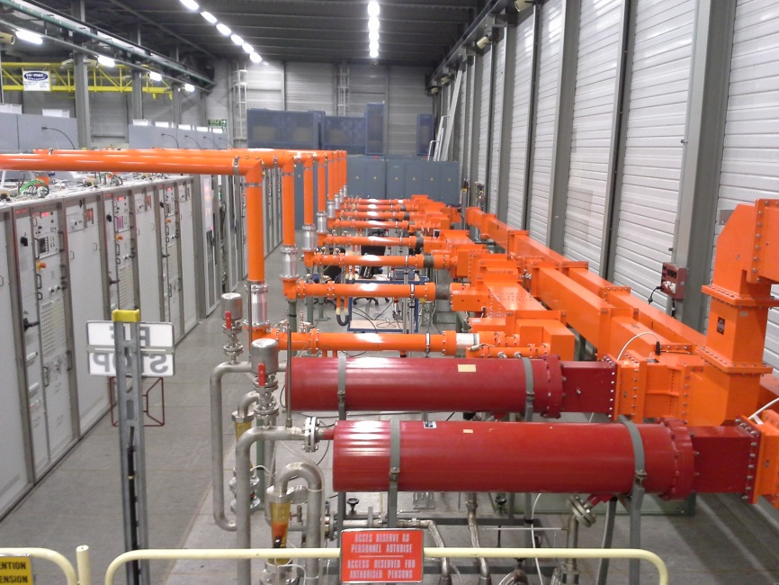
IOT, Already tested in the SPS
CERN SPS, TH 793 IOT, Trolley (single amplifier), and transmitter (combination of amplifiers)
Two transmitters of four tubes delivering 2 x 160 kW @ 801 MHz, into operation since 2014

Slide 43

IOT, Already tested in the SPS
CERN SPS, TH 795 IOT upgrade to deliver full power at 801 MHz
The tube is an evolution of the TH793, providing even more reliability than the TH793

Slide 44




IOT trolley designed by CERN for SPS tests
605
788
593
620
TH18795 800 MHz trolley
TH18795 modified by CERN 400 MHz trolley

Slide 45




IOT trolley designed by CERN for SPS tests
TH18795modified by CERN
400 MHz trolley and
400 MHz coupling elements
TH18795 800 MHz trolley and 800 MHz coupling elements

Slide 46


Still difficult linearisation at very low power
Following a careful adjustment of all parameters (Fc, BW, HV, Focus, Heater), correct transfer curve
If some parameters are not correct (Fc, BW, HV, Focus, Heater), step in transfer curve at low power
The difficulty is that this never occurs on a 50 Ω load

Slide 47


Still difficult linearisation at very low power
During MD, we noticed a problem with a tube that needed a replacement of this tube
After exchange, as retuning all parameters, we were able to remove the nonlinearity
The difficulty is that this phenomena does not appear when the amplifier is connected onto a 50 Ω load
Next MD, we will retune all parameters of the second amplifier
Jun 2023, MD
Jul 2023, MD
Cav 1
Cav 1
Cav 2
Cav 2

Slide 48

New trolley as a collaboration CERN/Thales
Two output cavities
will become
one single output cavity with a radial coupling element

Slide 49

New HPRF as a collaboration station CERN/Thales

Slide 50
IOT HPRF schedule
As per 2018
2022
2023
2024
2025
2026
2027
2028
Pre-series
Series production
2
4
4
4
4
2
Integration & commissioning
As per 2023
2022
2023
2024
2025
2026
2027
2028
2029
Pre-series
Series production
MS
Contract
Proto at CERN
Proto OK
In line with possible Japanese in-kind
edms 2874821
4
4
4
4
2
Integration & commissioning

Slide 51
HPRF stations, where?, when?
2023
2024
HPRF1
BB3 (FPC processing)
Canada on request
HPRF2
BA6
BA6 + FPC processing
HPRF3
BA6
Collaboration with Thales
SM18

Slide 52






FPC

Slide 53







RF Processing

Slide 54







Clean room preparation of FPC

Slide 55


Arcing in FPC

Slide 56


Arcing in FPC

Slide 57
RF processing to avoid failures

Slide 58

FPC RF processing

Slide 59


FPC transport to Canada and UK
Initially, we intended to disassemble the two couplers from their test box, and to transport them individually
However, this would remove all the RF processing work we did, so we now prefer to send them still assembled onto their test box, under vacuum

Slide 60

Last year at Uppsala

Slide 61
Couplers Master Schedule
Delivered CERN
Delivered UK
Delivered Canada
2023
2024
2025
01
02
03
04
05
06
07
08
09
10
11
12
01
02
03
04
05
06
07
08
09
10
11
12
01
02
03
04
05
06
07
08
09
DQW
3 HOMC
3 HOMC
9 HOMC
10 HOMC
11 HOMC
2 PUA + 2 HFHOMC
5 PUA + 5 HFHOMC
7 PUA + 7 HFHOMC
2 FPC
2 FPC
2 FPC
2 FPC
2 FPC
4 FPC
2 Lines
6 Lines
6 Lines
RFD
2 FPC
2 FPC
2 FPC
2 FPC
2 FPC
4 FPC
2 Lines
6 Lines
6 Lines

Slide 62
Conclusion
IOT is really THE solution for Crab
We really hope that in-kind with Japan will happen
Our schedule is in-line with proposals made by our colleagues
Production of FPC (and HOMC and RF lines for cryomodule) is on good way

Slide 63
They did not know it was impossible, so they did it
(Mark Twain)
Simplicity is the ultimate sophistication
(Leonardo da Vinci, 500 years ago)

Slide 64
Thanks to all colleagues involved with this HPRF & couplers projects
Thanks to all colleagues from Japan for trying to make the in-Kind a reality
Thanks to Rama and Ofelia (WP4 leaders), to RF management and to HL-LHC management for supporting us with this very exciting (and very challenging) project
We (SY-RF teams and all associated colleagues from many groups) are devoted to provide HL-LHC with reliable RF systems

Slide 65
SSPA obsolescence spare slides

Slide 66

Transistor power ratings
Device | Distance | Power
Phone | 20 km | 2 W
Microcell | 2 km | 10 W
Macrocell | 20 km | 50 W
Voltage limits
 | 2002 | Since 2006
900 MHz | 41 V/m | 3 V/m
1800 MHz | 58 V/m
2100 MHz | 61 V/m
The tendency is to increase the number of smaller cells in order to keep the phone battery autonomy, increase the data bandwidth, and reduce the exposition of population to too high electromagnetic fields

Slide 67


Macro cells vs Small cells vs femtocells

Slide 68
A few numbers to situate RF transistors in accelerators
Some of the Key Players
Ampleon
Analog Devices
BONN Elecktronik
Broadcom Pte.
Cree
General Dynamics
Infineon
Integra
MACOM
Maxim Integrated
Mitsubishi
NoleTec
NXP Semiconductors
Qorvo
Qualcomm
Skyworks Solutions
STMicroelectronics
Tagore Technology
Thales Alenia Space
Toshiba

Slide 69


A few numbers to situate RF transistors in accelerators

Slide 70


A few numbers to situate RF transistors in accelerators
Source: RF Power Semiconductor Market Trends
From Yole Développement
Patrick Hindle - Editor, Microwave Journal July 11, 2017

Slide 71


A few numbers to situate RF transistors in accelerators
FCC (400 MHz to 800 MHz) due in ~ 15 years

Slide 72
Transistor power ratings – personal view of future perspective (CWRF 2016, updated 2022)
Transistor supplier main business will not be higher power per transistor
Conclusion: below a GHz, 1 kW per transistor (LDMOS) seems (to me) a very good goal
8.5 Billions Smartphones in 2021
90 Millions Femtocell stations 2016
7 Millions Macrocell stations 2017
NXP Semiconductors revenue in 2020 was
$8’600 Millions
Assumption (with a lot of simplifications)
  Cost of a LDMOS ~ $100
  Total cost of FCC ~ $100 Million
  Over minimum 5 years
  of construction ~ $20 Million per year
RF for accelerators could be
20 / 8600 = 0.2 % of main suppliers' revenue
Machine | # RF stations | Power | # 1 kW LDMOS
FCC | 1’000 | 1 MW | 1’000’000

Slide 73



Drain voltage
SOLEIL elementary 600 W 300 Vdc / 30 Vdc converter board
Why LDMOS is the best technology for RF energy
Technology
News | June 21, 2018
By Jean-Pierre Joosting
Evolution of the transistors market is quick
This is still a volatile market (as tubes have been a century ago)
Drain voltage is increasing with the development of transistors, and the Drain supply used with a generation of device could not suit the next generation
(moving from 12V to 24 V to 30 V to 36 V to 48 V to 50 V to 60 V to 80 V to 100 V)
Changing the transistor will not be the only challenge, either it will be under used as keeping the previous power supply, or power supply voltage will have to be upgraded

Slide 74
SSPA granularity & redundancy

Slide 75




Combination
$$Σ=\frac{PA1+PA2}{2}+ \sqrt{PA1 PA2}$$
3 dB combiner is very common for RF power combination at these frequencies since the 70’s
If one correctly adjusts the phases and the amplitudes, equations show that
With PA1 = PA2 = PA3 = PA4 = P then
Pout = 4 P
Load A5 = A6 = A7 = 0
In case one amplifier is stopped (PA1 for example), then
Pout = (9/16) 4P = 2,25 P
Load A5 = 0,5 P
Load A7 = 0,25 P
$$Δ=\frac{PA1+PA2}{2}− \sqrt{PA1 PA2}$$

Slide 76


Cavity Combiner
With our latest combiner, @ 750 MHz, the body is composed of four main pieces
a tube
a bottom plate
a top plat
an output probe housing
The tube has machined holes compatible with N-type solder cups, the bottom plate has an indentation for disc tuning and the output probe housing is compatible with a standard EIA 3-1/8” flange
The return loss of the output port is ≤ -20 dB between over a 1 MHz bandwidth
The transmission between the 96 individual inputs and output is -19.84 ± 0.05 and the cross talk between the inputs is < -35 dB

Slide 77


Redundancy
In order to ensure 100 % availability, given a Redundancy, the technology of the combining system will define the number of Units
P_{out} must be 12 x P
at all time, even with 2 Units ‘off-line’
In order to be 100 % available a 3 dB combiner requires
16 Units
P_{out} must be 12 x P
at all time, even with
2 Units ‘off-line’
In order to be 100 % available a cavity combiner only requires 14 Units
Power per Unit = 1
$$Pout=\frac{A1+A2}{2}+\sqrt{A1 . A2}$$
$$Pout=n A1$$

Slide 78

Redundancy
In order to ensure 100 % availability, given a Granularity, the technology of the combining system will define the number of Units
P_{out} must be 8 x P
at all time, even with
1 Unit ‘off-line’
In order to be 100 % available a 3 dB combiner requires 16 Units
P_{out} must be 8 x P
at all time, even with
1 Unit ‘off-line’
In order to be 100 % available a cavity combiner only requires 12 Units
1 Module =
4 x Units
$$Pout=\frac{A1+A2}{2}+\sqrt{A1 . A2}$$
$$Pout=n A1$$

Slide 79
Redundancy & Granularity for Crab
Let imagine that we go for a SSPA for Crab
We would have to deliver 50 kW CW and 100 kWp
At 400 MHz, power per LDMOS transistor would (safely) be around 500 W, breaking with 2.2 x the 500 W equivalent drive
Going with single Power Supply per transistor to keep the granularity, and imposing full characteristics even with 10 % Units off, this would mean
With a 3 dB combiner
256 Units
Full power with 230/256 Units = 103 KWp
With a cavity Combiner
220 Units
Full power with 200/220 Units = 100 kWp
Operating point pulsed
Operating point CW

Slide 80

CERN 2 x 16 x 80 = 2560 modules of 2 kWp each @ 200 MHz solid state amplifiers (2021) in the SPS
delivering 2 x 1.6 MWp (compared to 2 x 2.5 MW possible)

