Slide 1
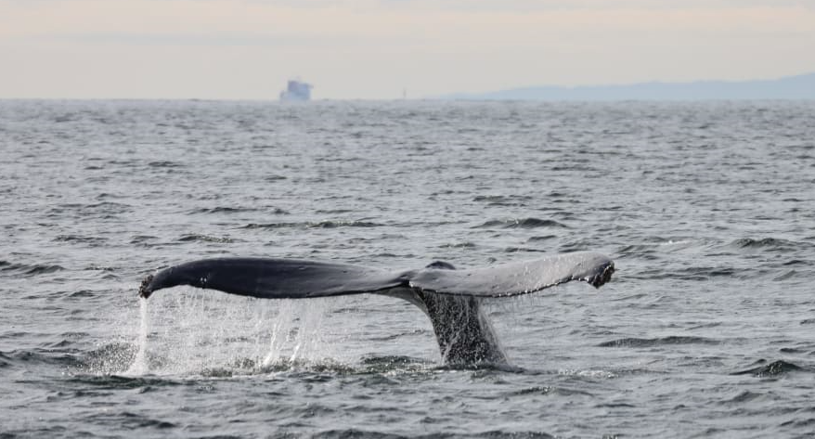
Status report on alignment on RFD prototype : Crab-cavities
(Collaboration : STFC / CERN)
Vancouver, 24 Sept. 2023
Vivien RUDE
2023-09-27
On behalf :
Mateusz SOSIN
Clara CALA FRANCO
Hélène MAINAUD DURAND
Andreas HERTY
Vincent BARBARROUX
Michel NOIR
Roberto FERNANDEZ BAUTISTA
13th HL-LHC Collaboration Meeting, Vancouver (Canada), 25-28 September 2023

Slide 2
Outline
Alignment objective for HL-LHC internal monitoring
  Internal monitoring
  Crab-cavities configuration
  Alignment requirement
  Alignment simulation for RFD prototype
RFD prototype (Survey tasks : STFC-CERN collaboration)
  Determination of the position of the capacitive plates of the cavities
  Alignment of the 2 cavities before and after connection in clean room
  Thermal contraction anticipation
  Alignment at step 4 : on the trolley
  Alignment at step 6 : cavities suspended from the top plate
  Alignment at step 9 : cavities suspended from the top plate inserted in the cryomodule
  FSI installation
  Diverse information
  Schedule expected after reception of the cryomodule at CERN

Slide 3
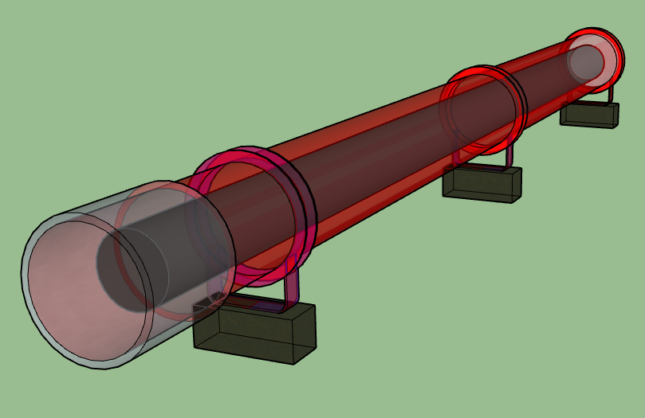
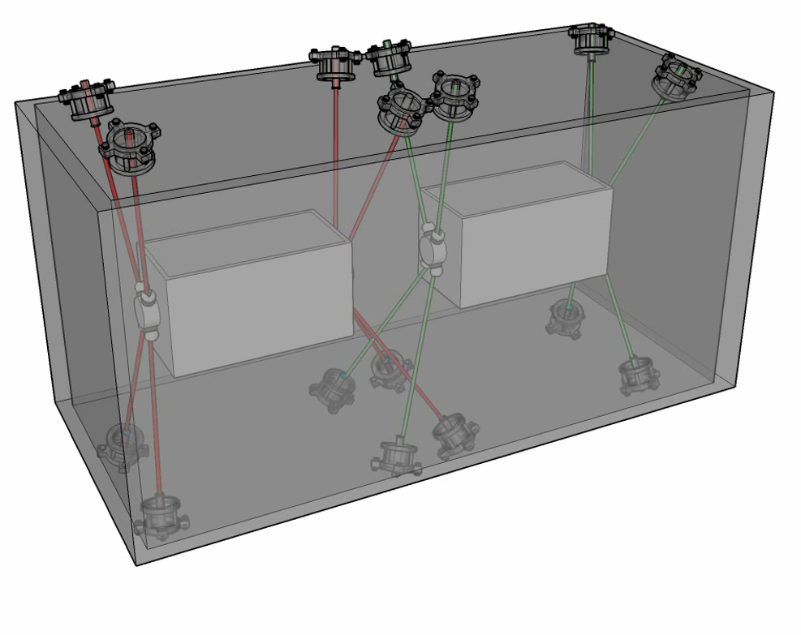
Internal monitoring for “special” components
Q1, Q2a, Q2b, Q3
Crab-Cavities
Cryomodule
Vacuum vessel
Cold mass
Crab cavities
Vacuum vessel
Cryomodule
Axis of the Cold mass
Nominal axis
Axis of the Crab cavities

Slide 4
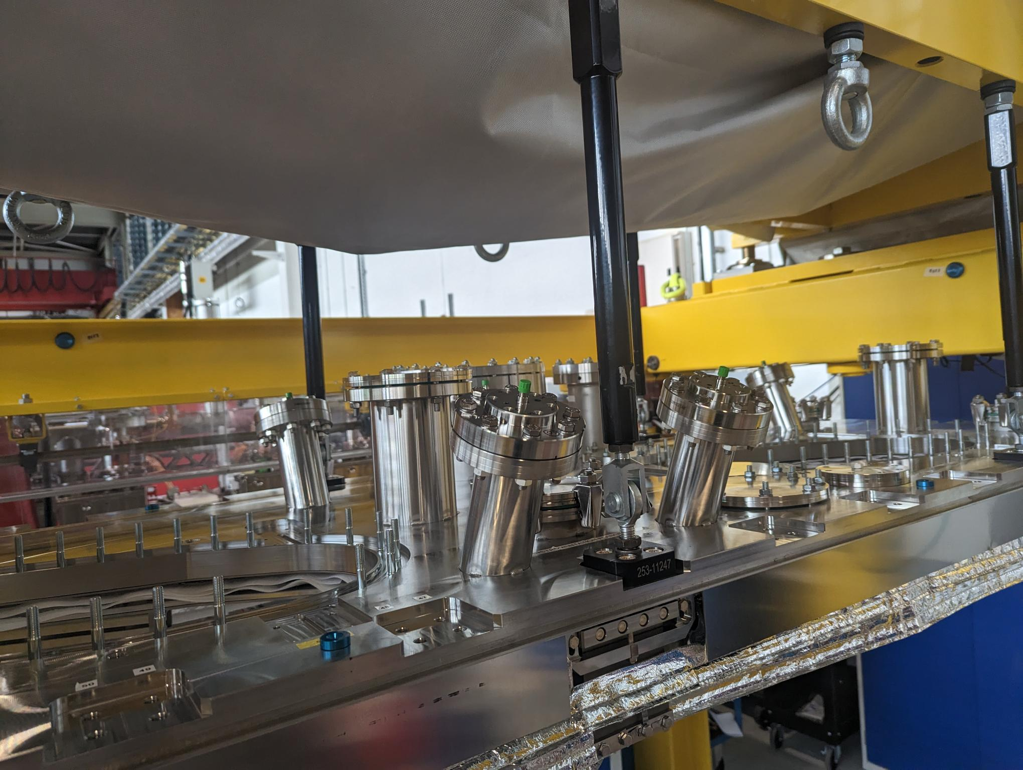
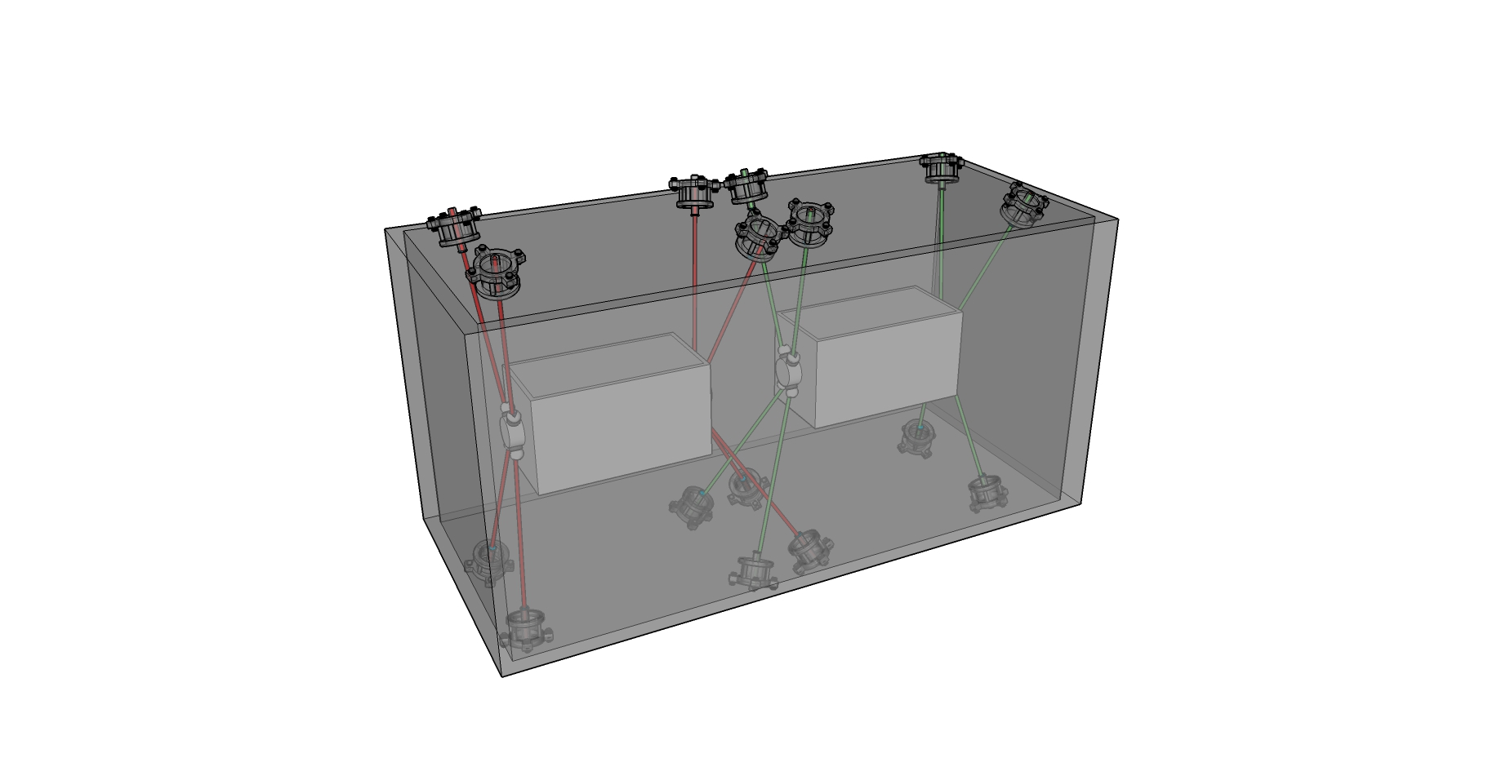
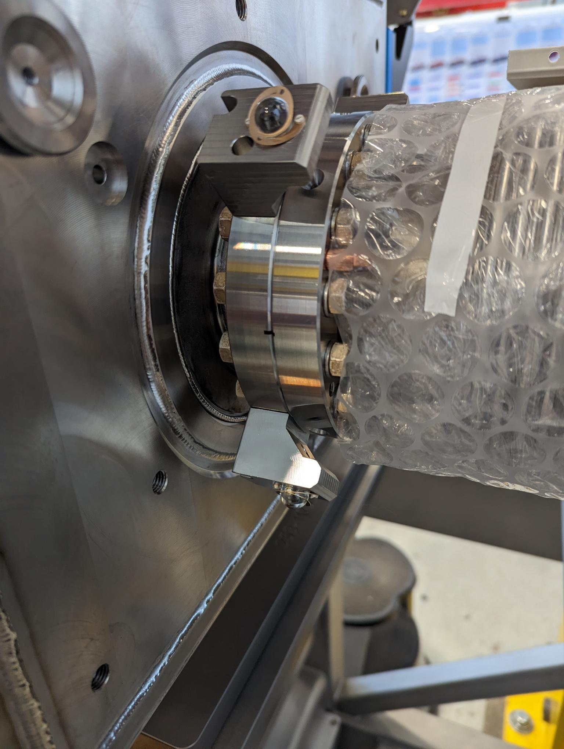
Internal monitoring : Configuration
FSI Head (sensor) on the Cryomodule
  FSI : Frequency Scanning interferometry
  → Absolute distance measuring interferometric technique
FSI target on the flange of
Helium TANK of the cavities
beam

Slide 5
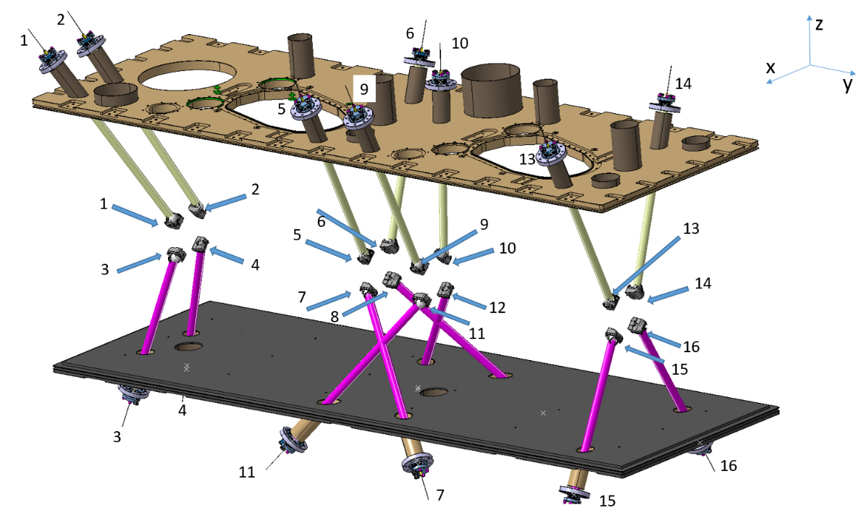
Configuration (RFD prototype) : Requirement and Uncertainty
TANK1
 | Requirement
Tx (mm) Radial | < 0.1
Ty (mm) longitudinal | --
Tz (mm) vertical | < 0.1
Rx (mrad) | <0.3
Ry (mrad) | <1.7
Rz (mrad) | <0.3
Scale (ppm) | --
TANK2
TANK 1 | Accuracy
Tx (mm) Radial | 0.088
Ty (mm) longitudinal | 0.044
Tz (mm) vertical | 0.015
Rx (mrad) | 0.044
Ry (mrad) | 0.215
Rz (mrad) | 0.233
Scale (ppm) | 66
TANK 2 | Accuracy
Tx (mm) Radial | 0.021
Ty (mm) longitudinal | 0.077
Tz (mm) vertical | 0.011
Rx (mrad) | 0.023
Ry (mrad) | 0.180
Rz (mrad) | 0.047
Scale (ppm) | 101

Slide 6
Outline
Alignment objective for internal monitoring
  Internal monitoring
  Configuration
  Alignment requirement
  Simulation for RFD prototype
RFD prototype (Survey tasks)
  Determination of the position of the capacitive plates of the cavity
  Alignment of the 2 cavities before and after connection in the clean room
  Thermal contraction anticipation
  Alignment at step 4 : on the trolley
  Alignment at step 6 : cavities suspended from the top plate
  Alignment at step 9 : cavities suspended from the top plate inserted in the cryomodule
  FSI installation
  Diverse information
  Schedule expected after reception of the cryomodule at CERN

Slide 7
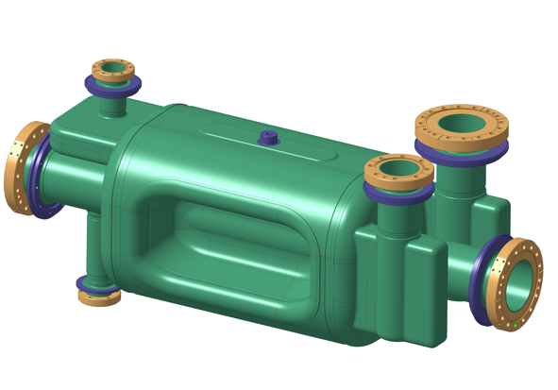
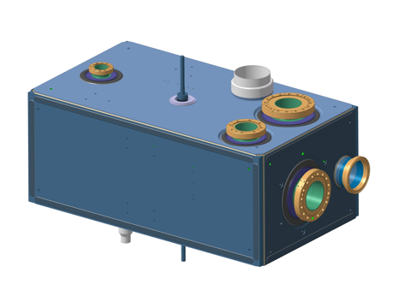
Determination of the position of the capacitive plate of the cavity
Bare Cavity
V_HOM
Z
Z
Plot
tuning
H_HOM
A
Capacitive
plates
A
FPC
Y
B
B
Side view
(VERTICAL)
Y
Pick-up
X
Capacitive
plates
Cavity inside the TANK
Z
Z [mm]
V_HOM
Flange A
Z
Rod
tuning
H_HOM
A
FPC
Y
Y [mm]
X
Y
Capacitive
plates
B
Axe AB
(Stainless steel flanges axis)
Flange B

Slide 8
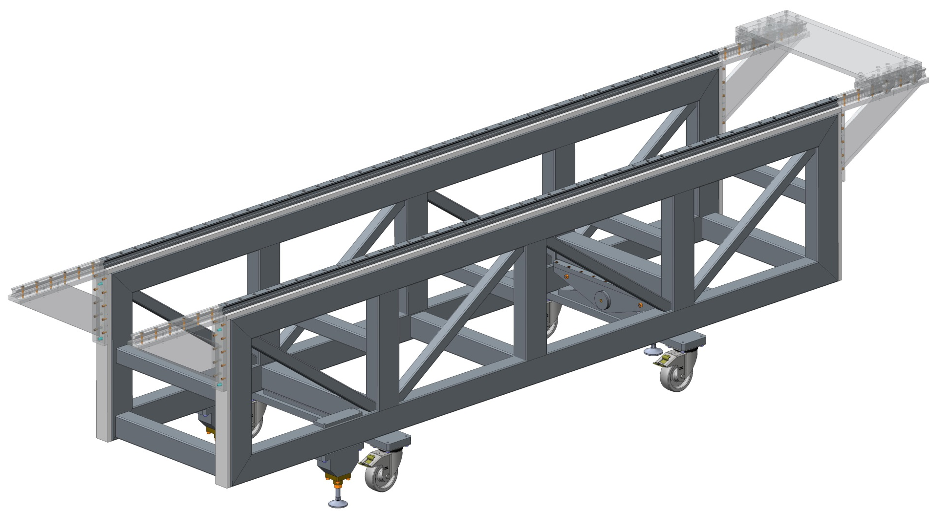
Alignment of the 2 cavities before connection in the clean room
X
Nominal axis (cavity line)
→ trajectory of the rails
Y
Z
Origin
324 mm
283 mm
Coordinate frame :
Primary axis : Nominal axis (cavity line) → trajectory of the rails
Secondary axis : Normal vector to vertical plane of rails
Origin : Beginning of the rail

Slide 9
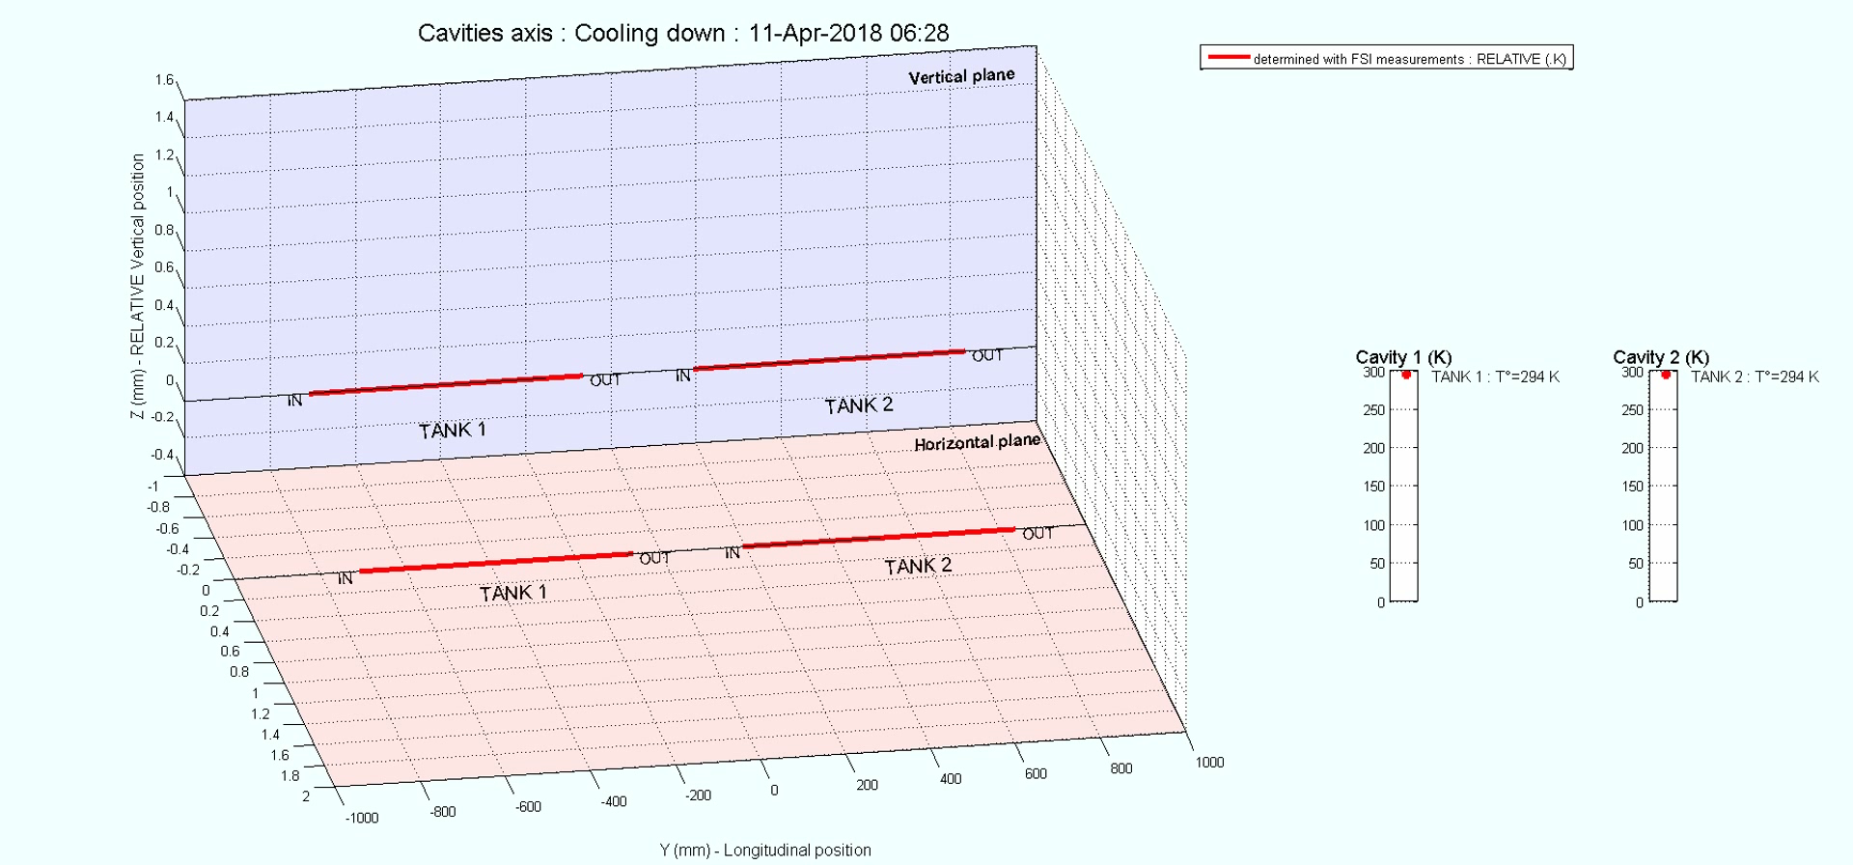
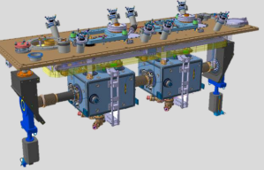
Configuration (DQW-SPS-2018) : Cooling down
Take into account of thermal contraction and vacuum
Z
Y
X

Slide 10
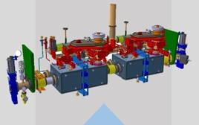
Position after STEP 4 (June 2023)
Vertical : Difference to nominal
Max : 0.1 mm
Radial : Difference to nominal
Max : 0.1 mm
Longitudinal | Nominal | After step 4
TANK1 | 809.6 mm | 809.6 mm
TANK2 | 1992.1 mm | 1992.1 mm
Longitudinal . Difference to nominal
Max : 0.1 mm

Slide 11
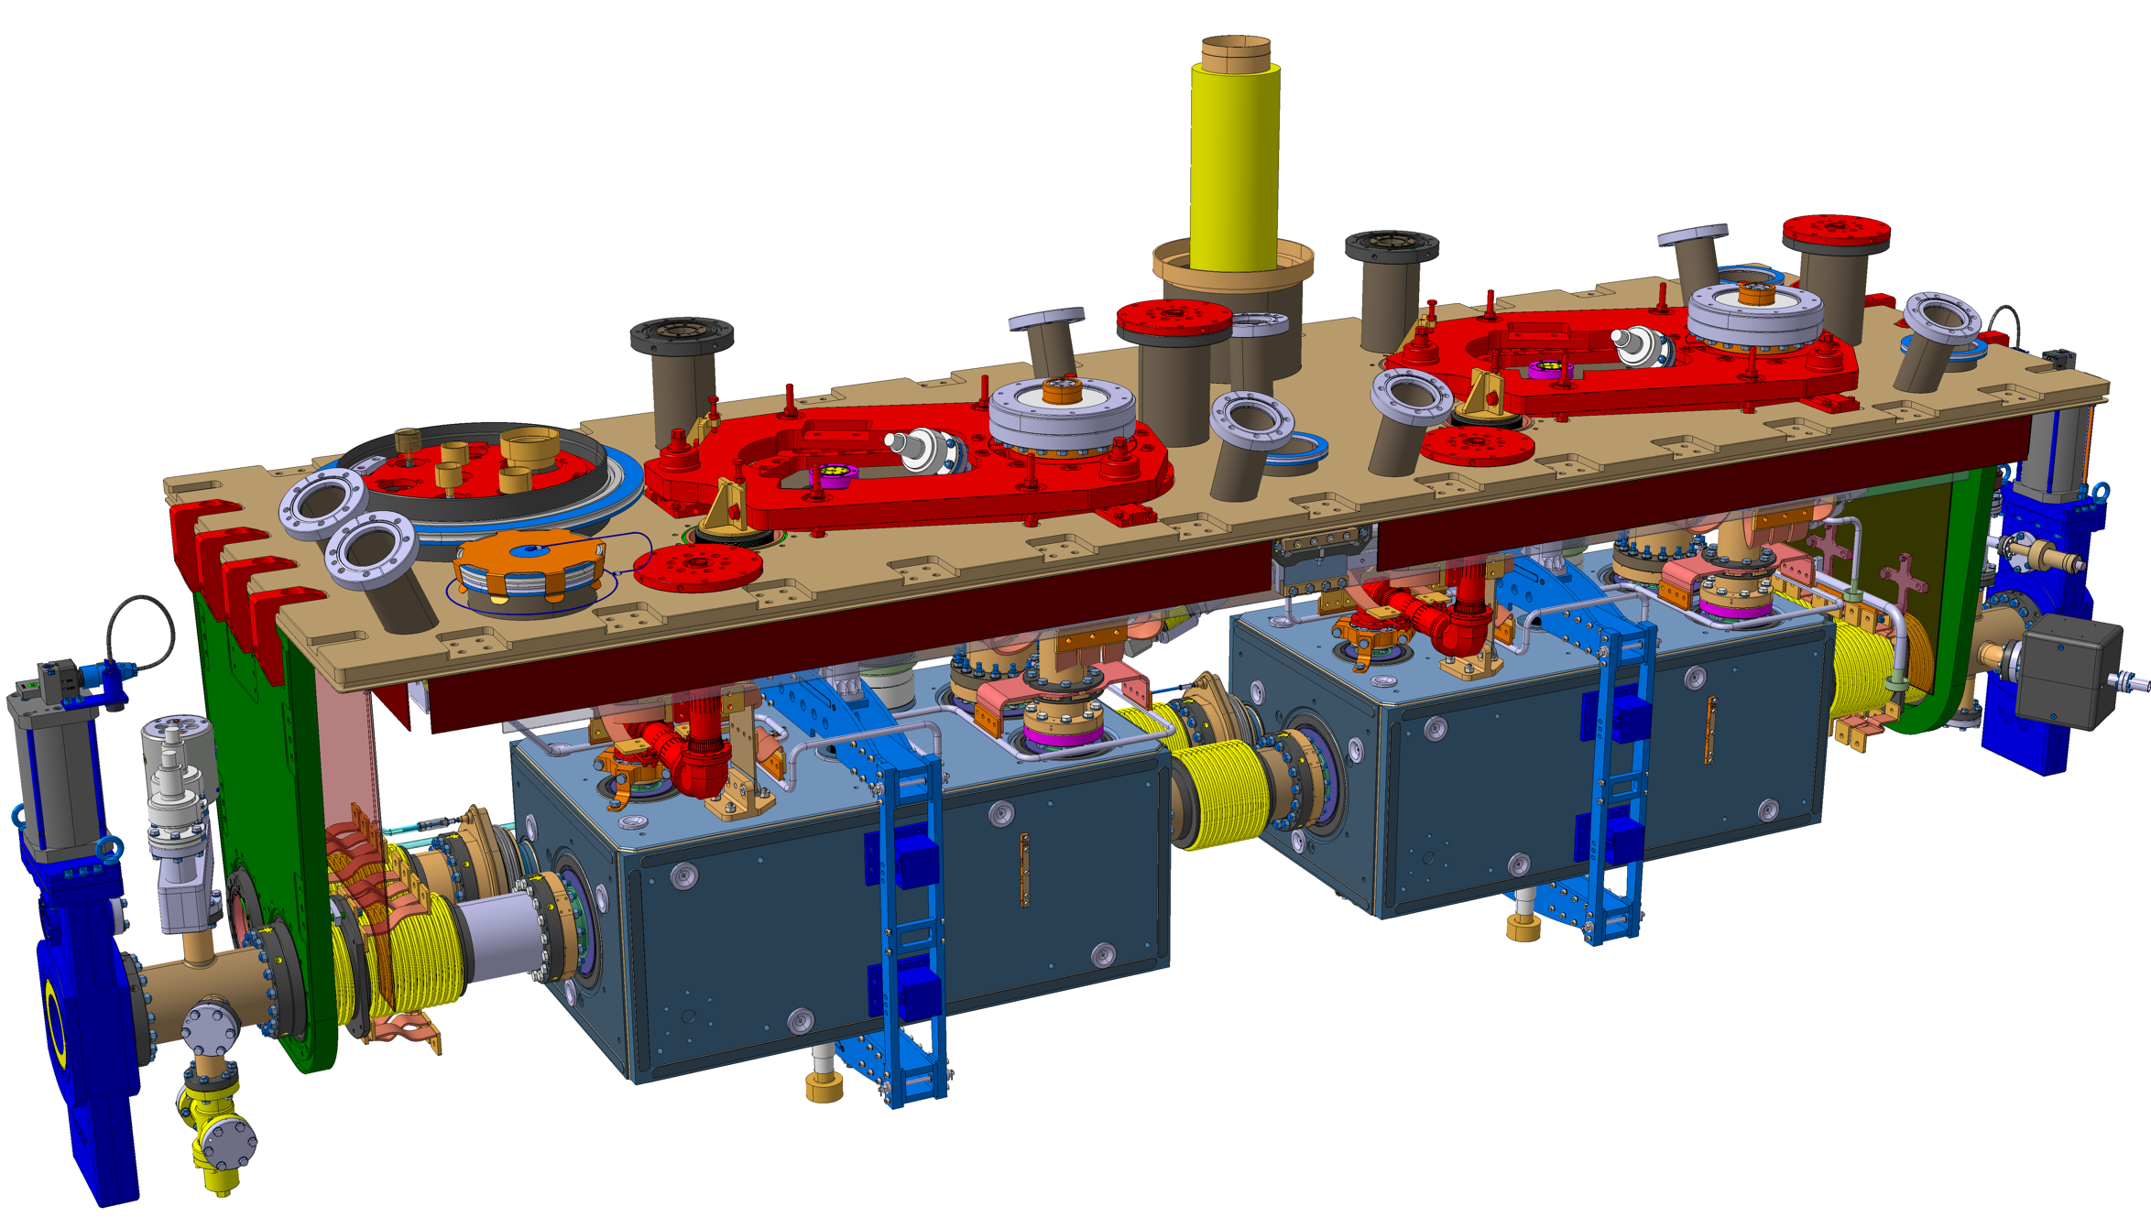
Position after STEP 6 (July 2023)
TOP VIEW
Y
X
5 mm
5-6 mm

Slide 12
Position after STEP 6 (August 2023)
Vertical : Difference to nominal
Max : 0.2 mm
Radial : Difference to nominal
Max : 0.2 mm
Difference
to nominal
Longitudinal | Nominal | After step 6
TANK1 | 809.6 mm | 813.6 mm
TANK2 | 1992.1 mm | 1995.5 mm
+4.0 mm
+3.4 mm

Slide 13
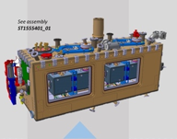
Position after STEP 9 (September 2023)
Radial and vertical objectives for the final alignment : < 0.1 mm
(will be done at CERN, before Bunker test)
Vertical : Difference to nominal
Max : 0.6 mm
Radial : Difference to nominal
Max : 0.3 mm
Difference
to nominal
Longitudinal | Nominal | After step 9
TANK1 | 809.6 mm | 813.5 mm
TANK2 | 1992.1 mm | 1995.6 mm
+3.9 mm
+3.5 mm

Slide 14
FSI installation
targets
Sensors : FSI Heads

Slide 15
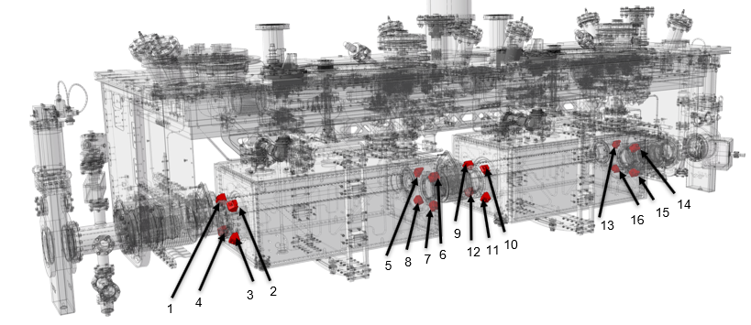
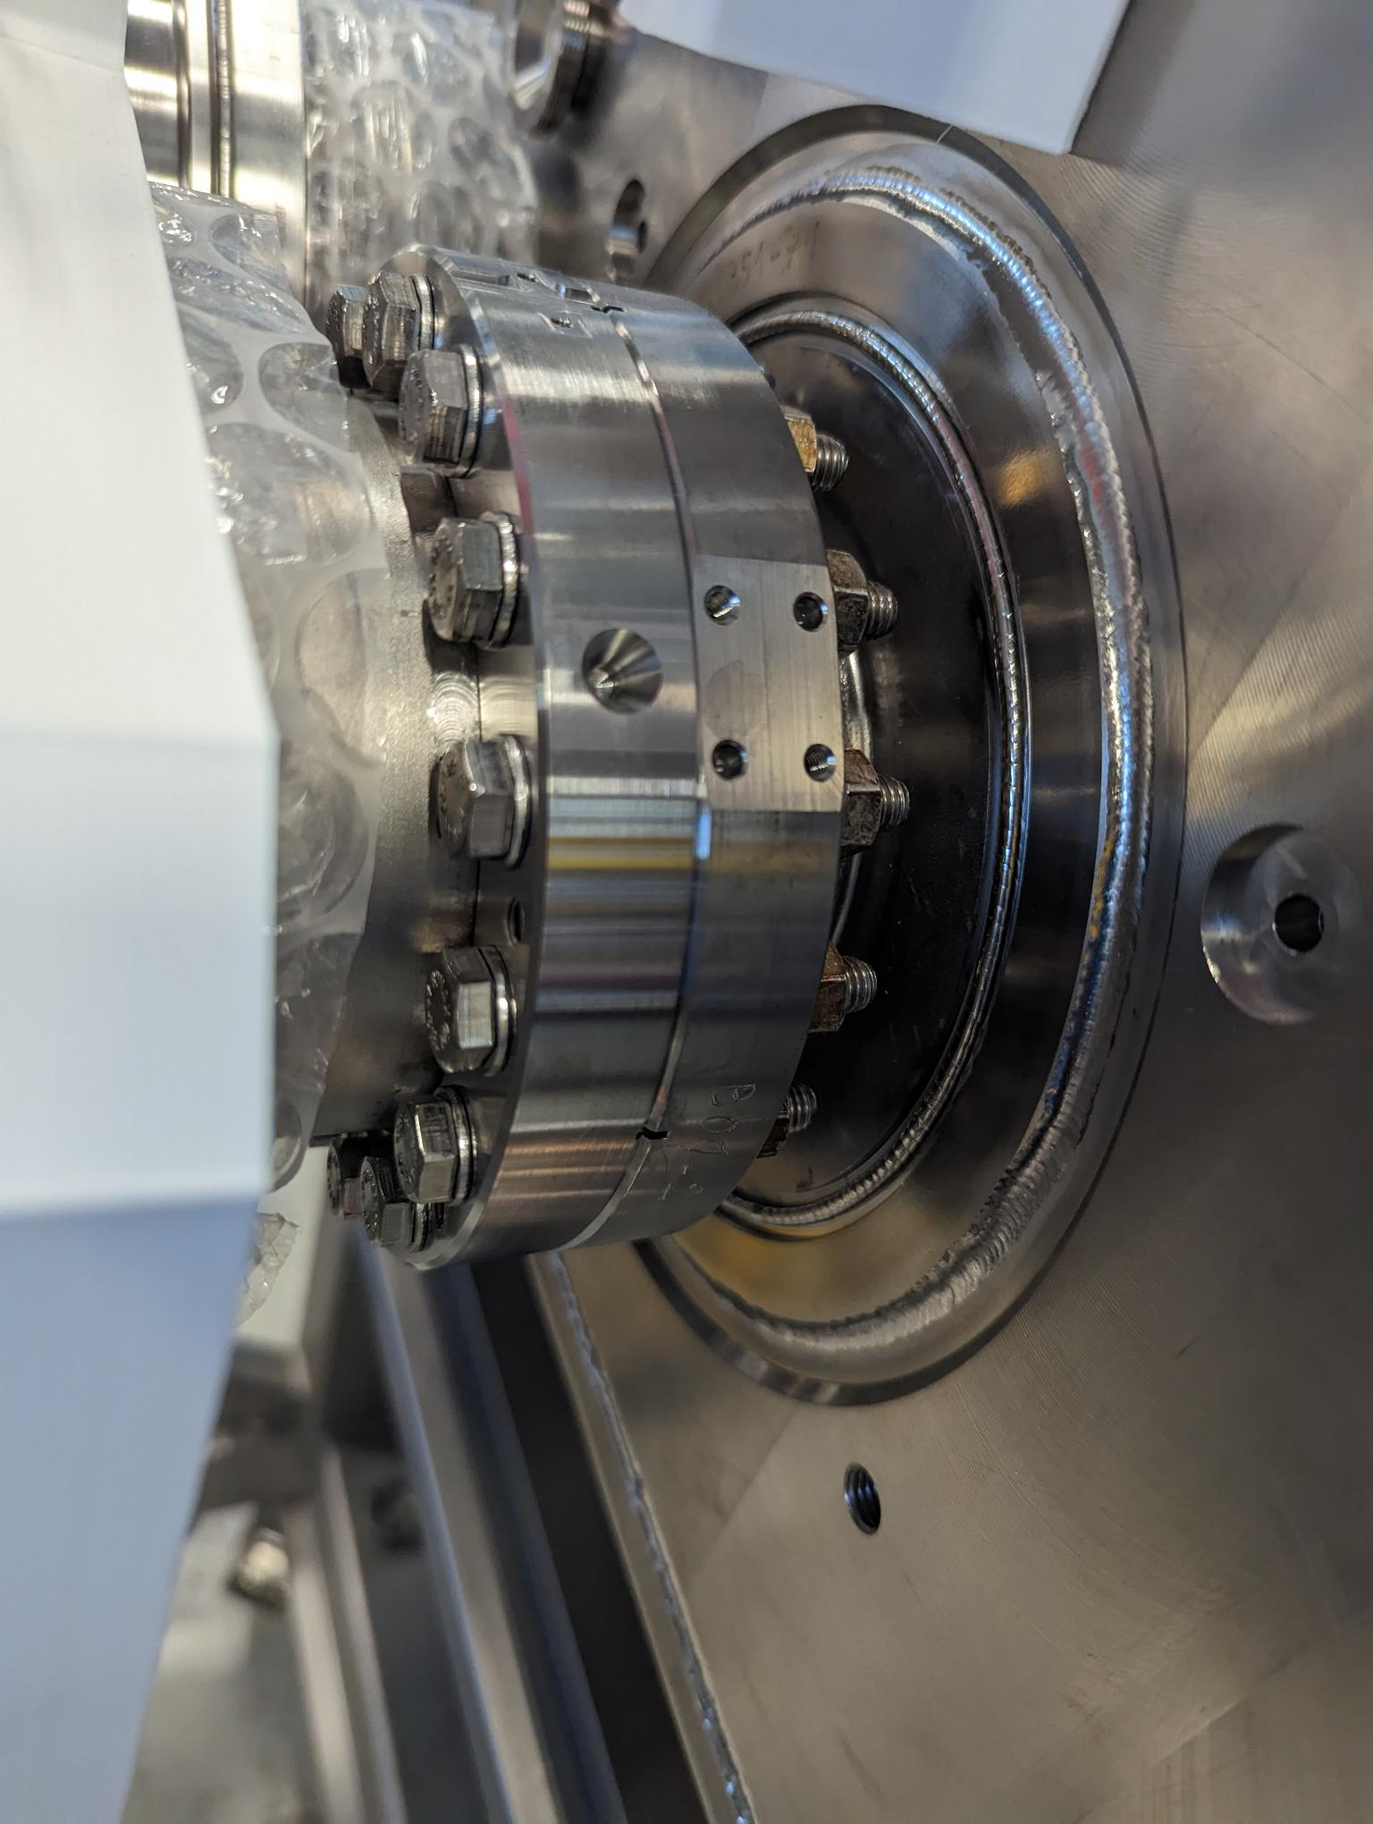
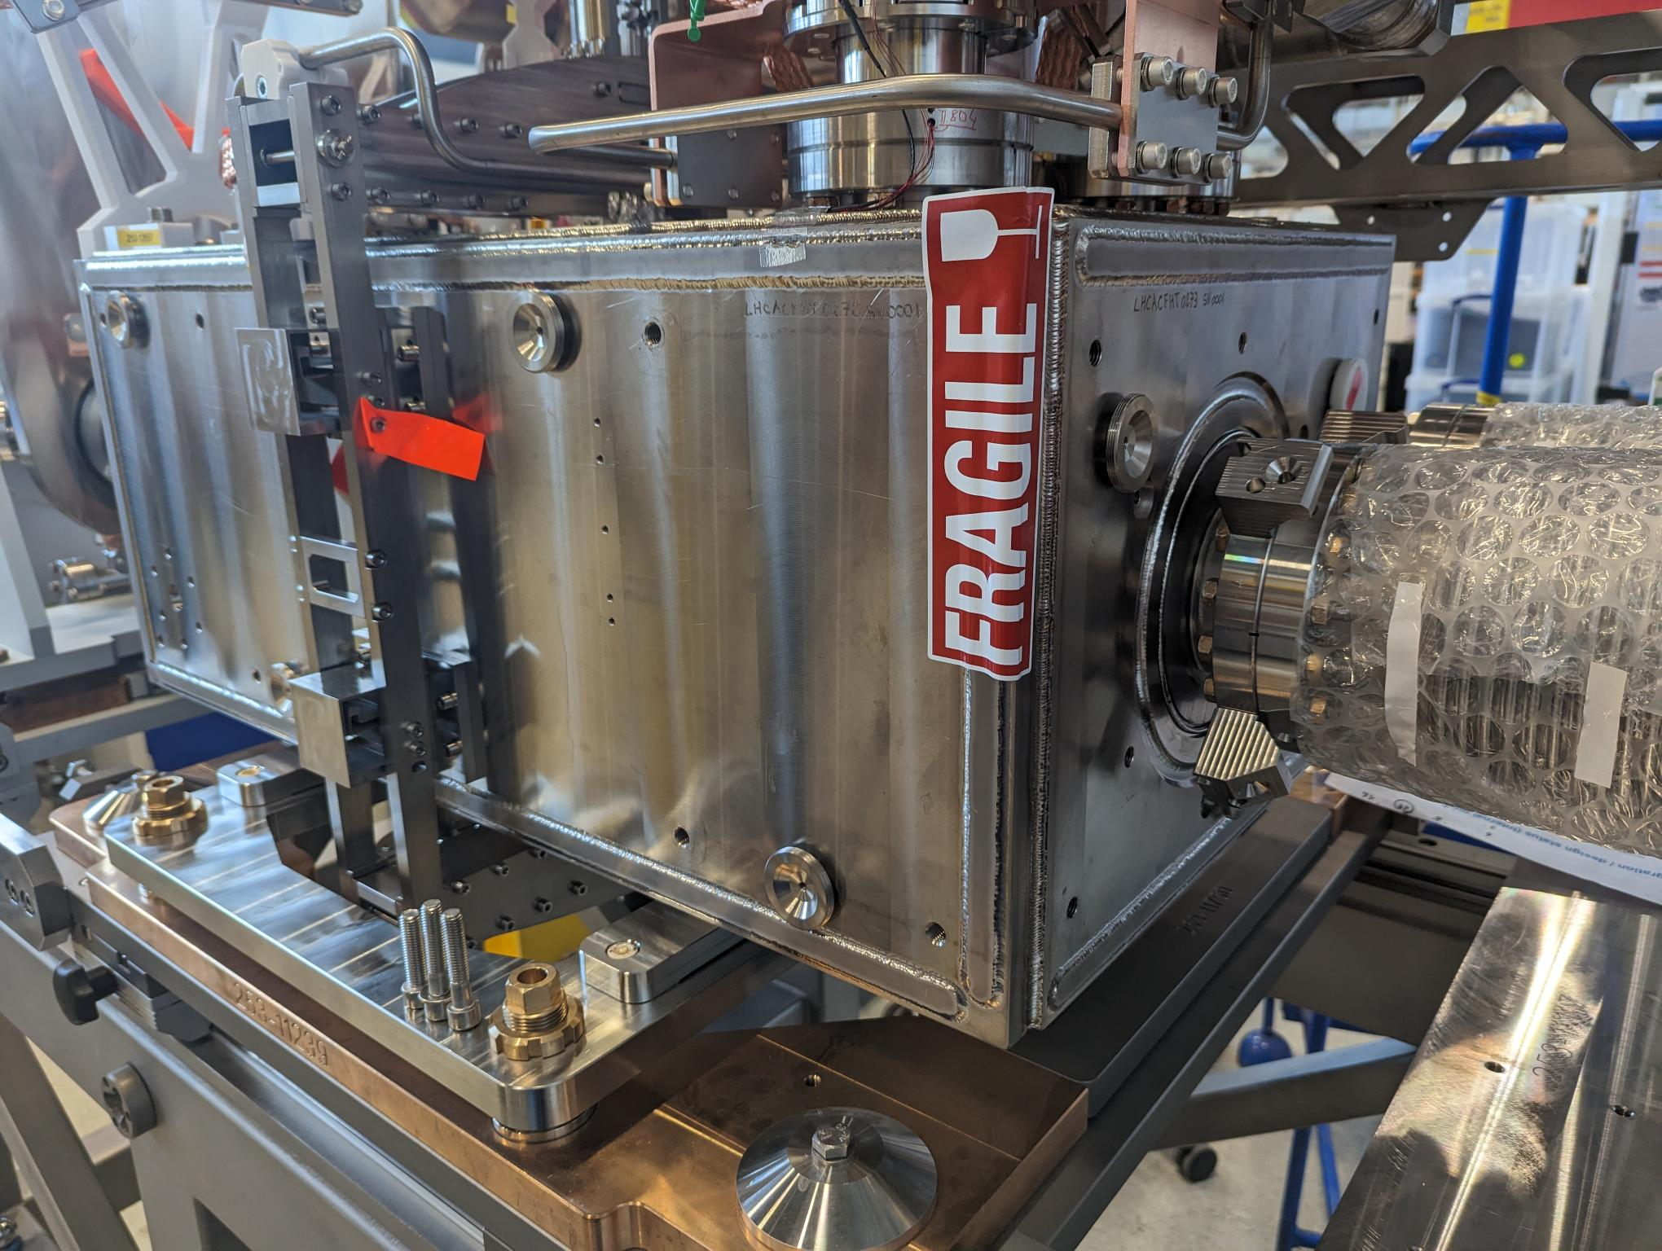
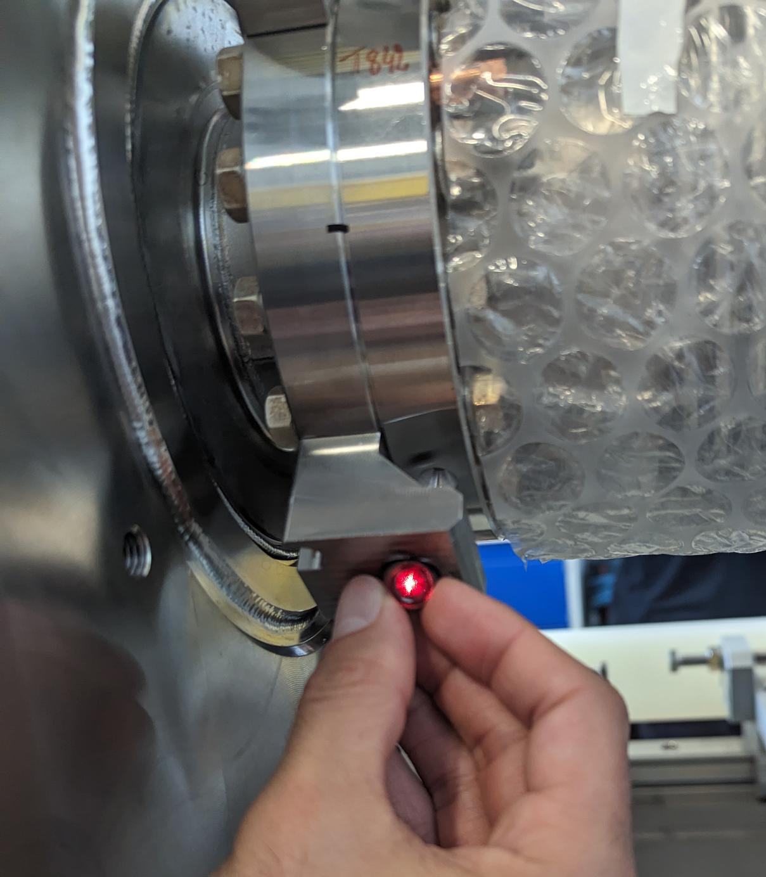
FSI targets (installation done in June 2023)
Y
X
Z
Origin
Objective : Δ < 2 mm
 | Difference To nominal position
 | X [mm] | Y [mm] | Z [mm]
1 | -1.1 | 0.4 | 0.8
2 | -0.8 | 0.2 | 1.5
3 | 0.1 | -0.3 | 1.9
4 | 0.1 | -0.2 | 0.6
5 | 0.8 | 0.5 | -2.0
6 | 1.1 | 0.2 | -2.6
7 | 0.6 | -0.4 | -2.1
8 | 0.3 | -0.3 | -1.7
9 | -0.9 | 2.1 | -0.9
10 | -0.5 | 1.8 | 0.0
11 | 0.2 | 2.1 | 0.4
12 | 0.3 | 2.3 | -0.7
13 | 0.3 | -1.1 | -0.2
14 | 0.5 | -1.4 | -0.2
15 | 0.3 | -1.4 | 0.3
16 | 0.6 | -1.2 | 0.2

Slide 16
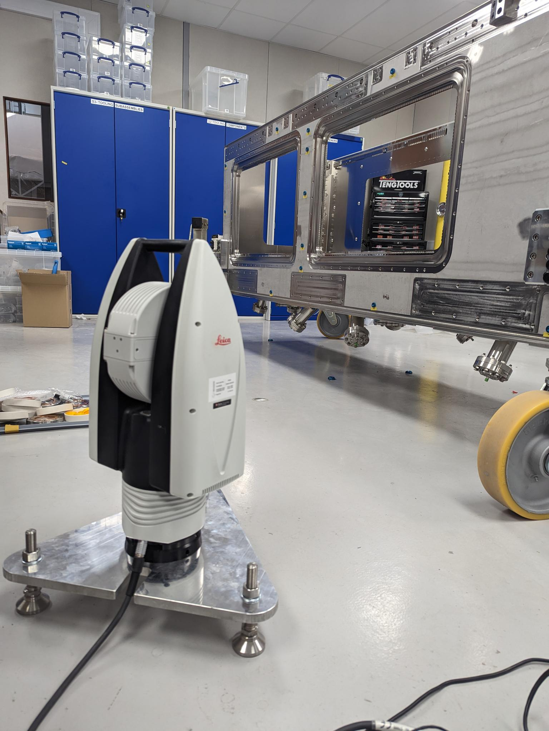
FSI heads / installation on top plate and cryomodule

Slide 17
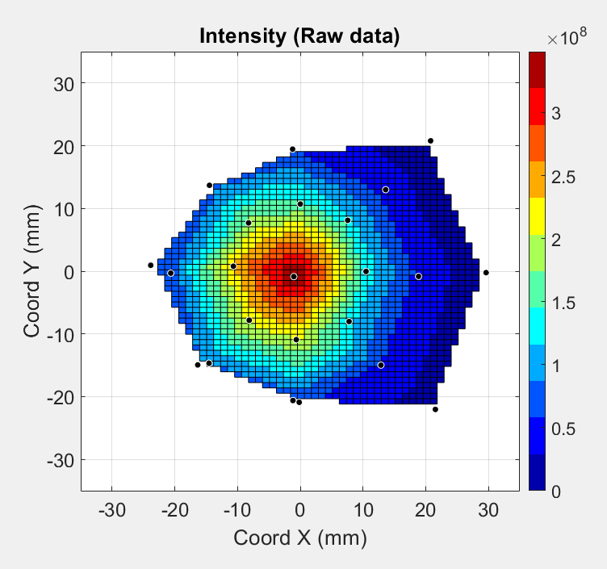
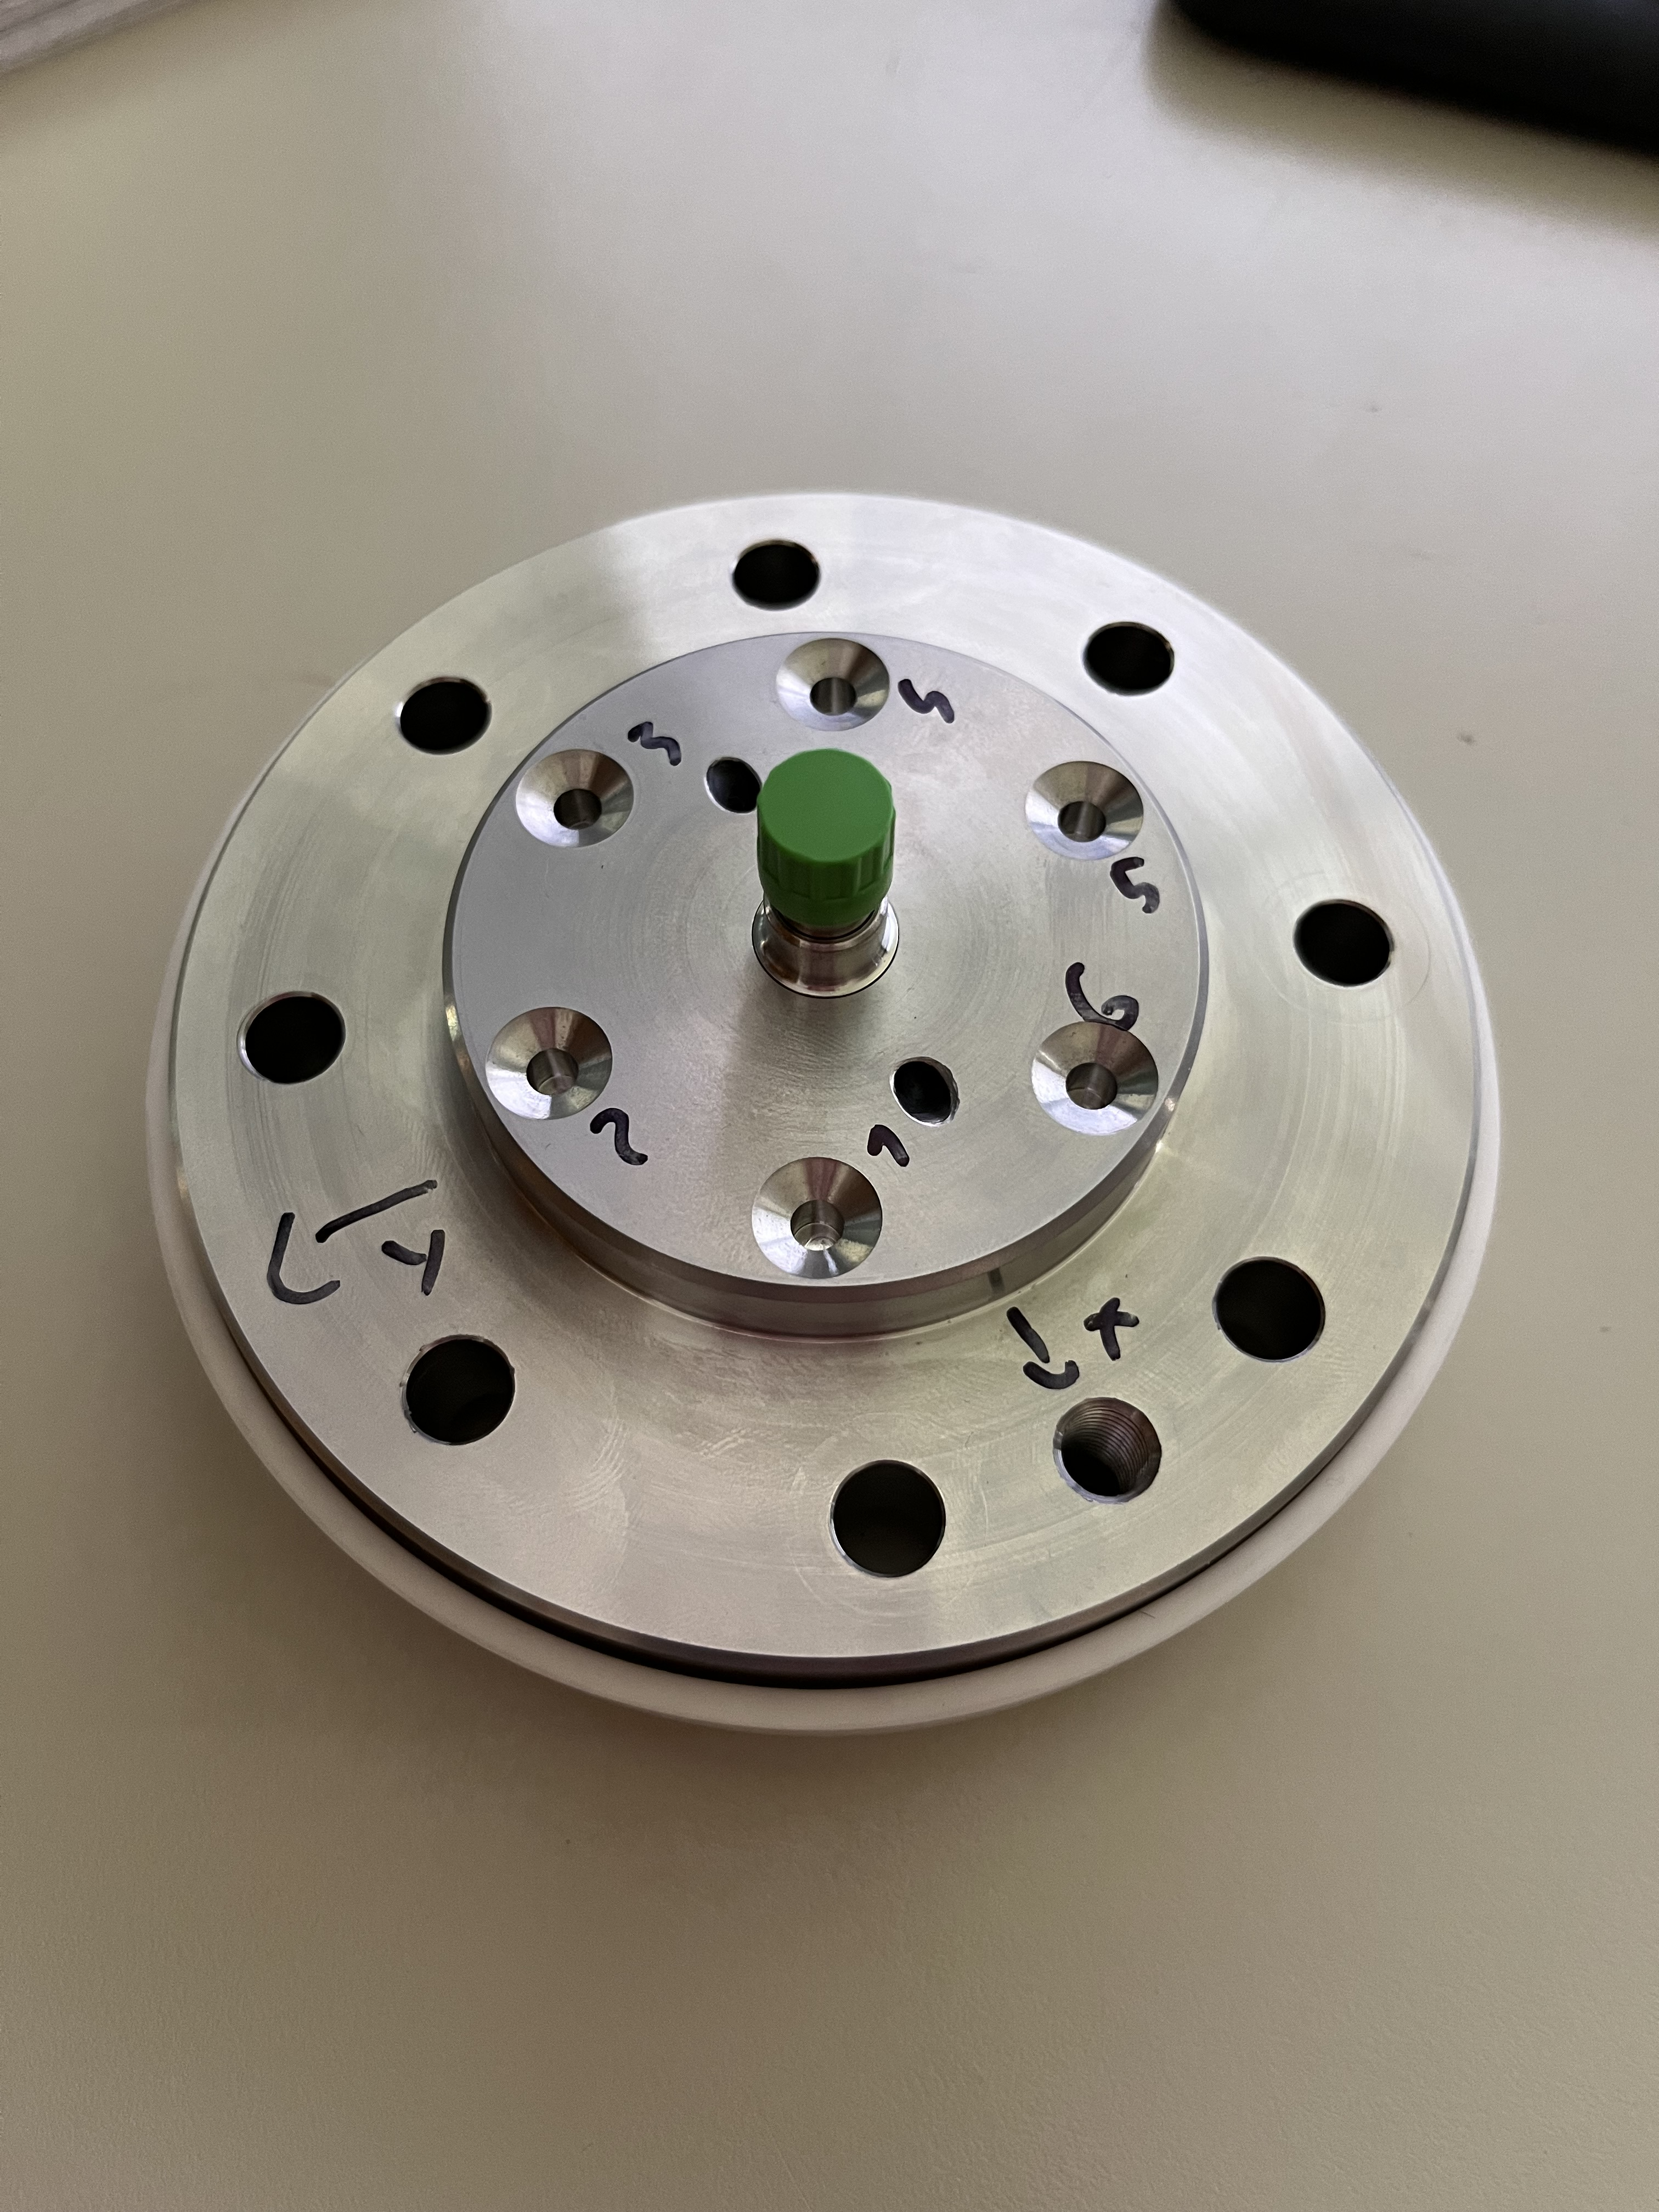
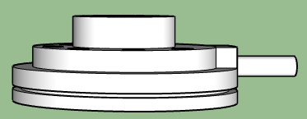
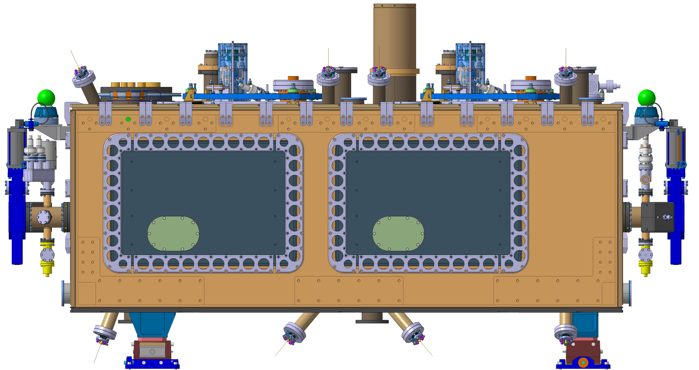
FSI heads : Calibration
2 °
1 °
0.5 °
Close
to the
noise
0.5° = 8.7 mrad → 8.7 mm at 1 m

Slide 18
Validation of FSI observation (June and September 2023)
 |  | After step 4
 | Optical sight | WARM Angle (°) [ < 0.5° ] | Estimated COLD Angle (°) [ < 0.5° ]
TANK1 | Head1 → Target 1 | 0.36 | 0.42
TANK1 | Head2 → Target 2 | 0.23 | 0.33
TANK1 | Head3 → Target 3 | 0.05 | 0.12
TANK1 | Head4 → Target 4 | 0.20 | 0.05
TANK1 | Head5 → Target 5 | 0.17 | 0.22
TANK1 | Head6 → Target 6 | 0.32 | 0.24
TANK2 | Head7 → Target 11 | 0.33 | 0.27
TANK2 | Head8 → Target 12 | 0.17 | 0.09
TANK2 | Head9 → Target 9 | 0.40 | 0.42
TANK2 | Head10 → Target 10 | 0.11 | 0.18
TANK1 | Head11 → Target 7 | 0.27 | 0.24
TANK1 | Head12 → Target 8 | 0.25 | 0.37
TANK2 | Head13 → Target 13 | 0.13 | 0.19
TANK2 | Head14 → Target 14 | 0.26 | 0.31
TANK2 | Head15 → Target 15 | 0.23 | 0.24
TANK2 | Head16 → Target 16 | 0.26 | 0.26
After step 9
WARM Angle (°) [ < 0.5° ] | Estimated COLD Angle (°) [ < 0.5° ]
0.40 | 0.40
0.20 | 0.22
0.42 | 0.29
0.55 | 0.42
0.48 | 0.51
0.56 | 0.53
0.47 | 0.43
0.31 | 0.32
0.64 | 0.60
0.34 | 0.28
0.19 | 0.07
0.18 | 0.26
0.37 | 0.40
0.26 | 0.32
0.20 | 0.27
0.13 | 0.20
+ 3.5 mm
w.r.t. nominal
+ 3.9 mm
w.r.t. nominal
Objective
α < 0.5 °
Acceptable
0.5 ° < α < 1 °
Not acceptable
α > 1 °

Slide 19
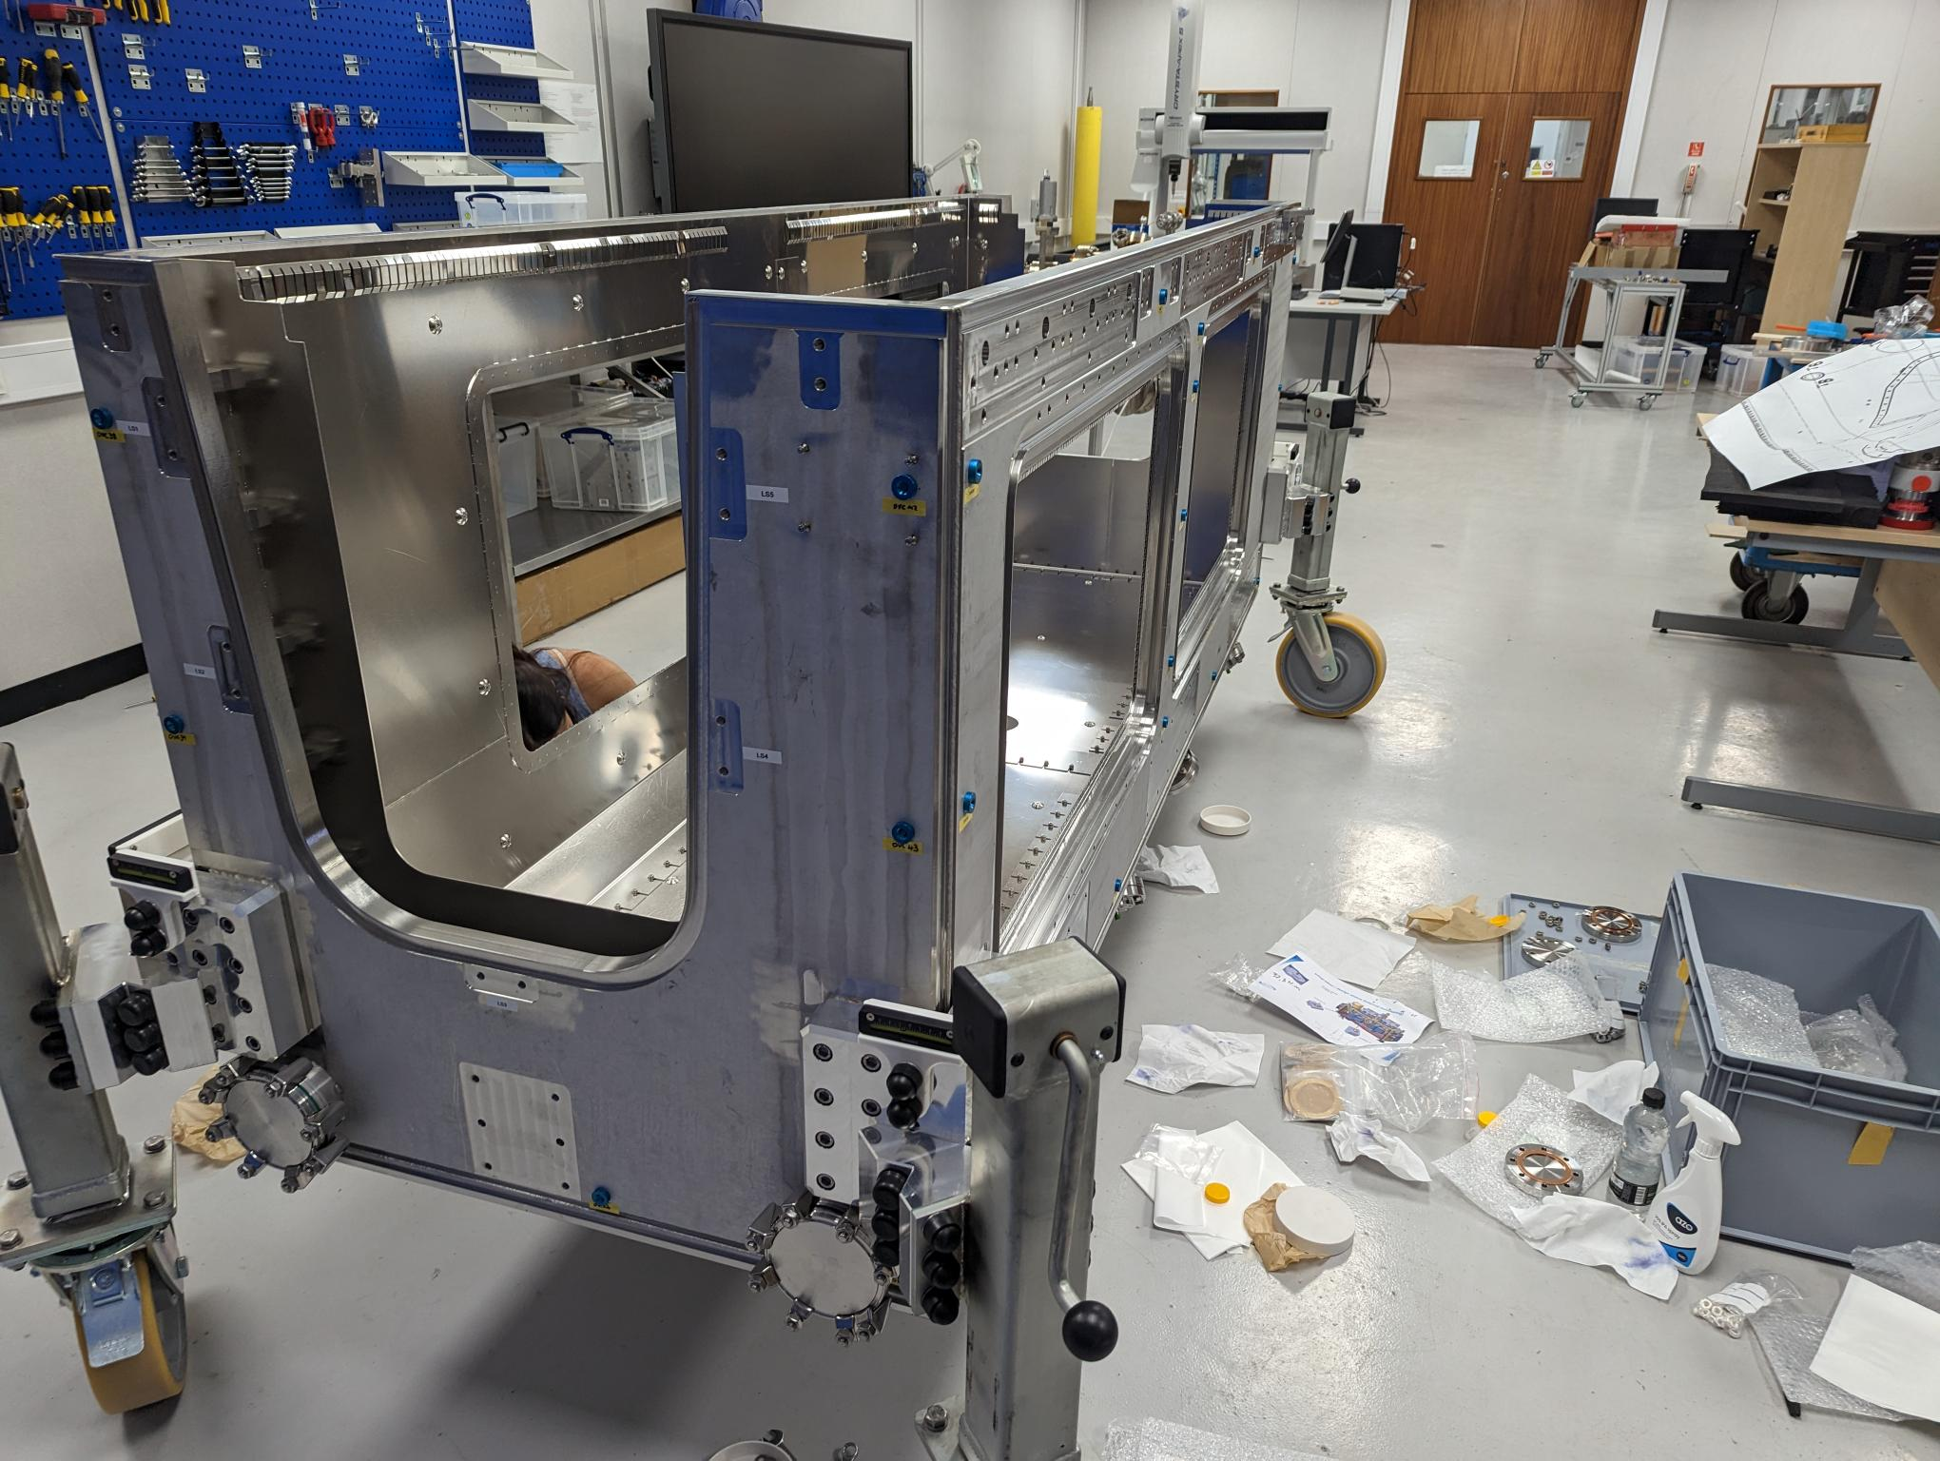
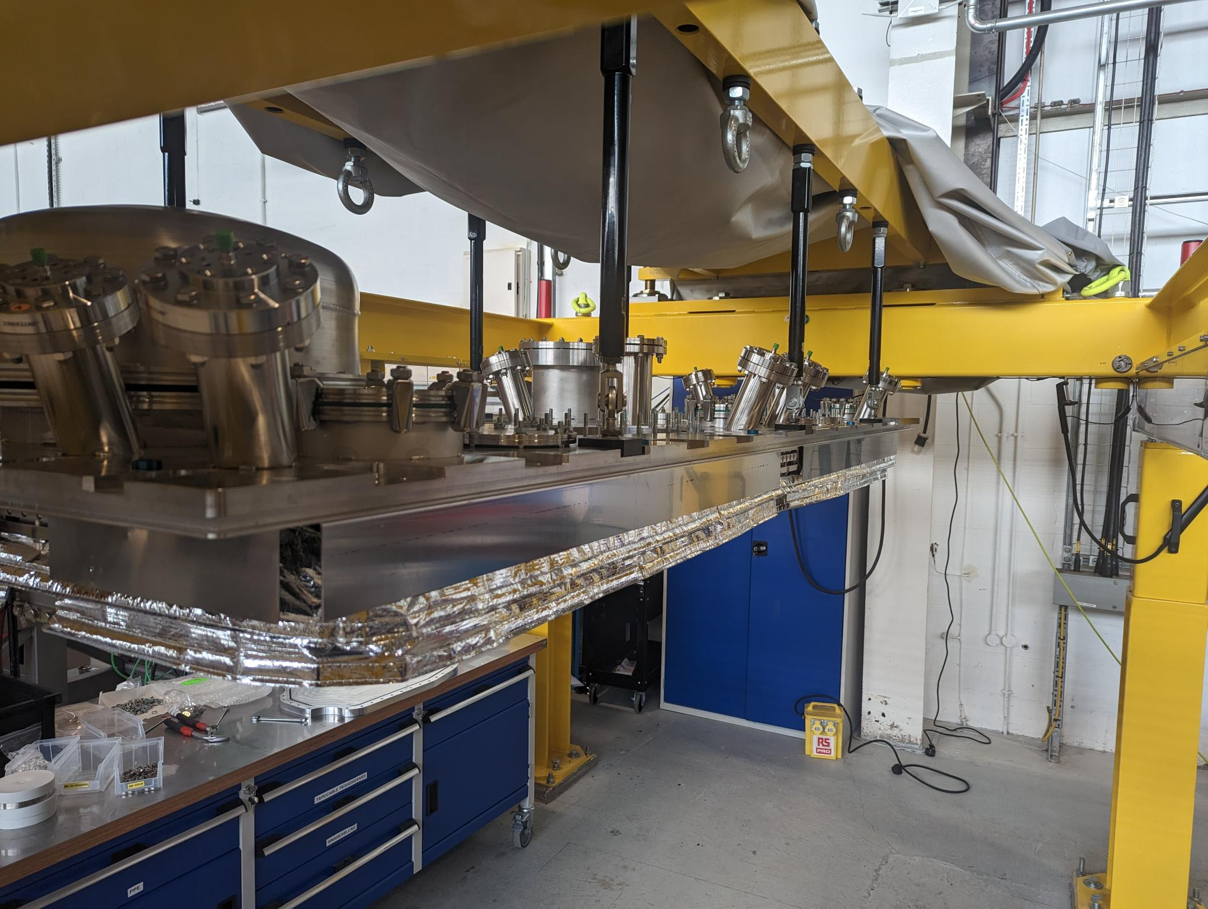
Cryomodule and
top plate measurement

Slide 20
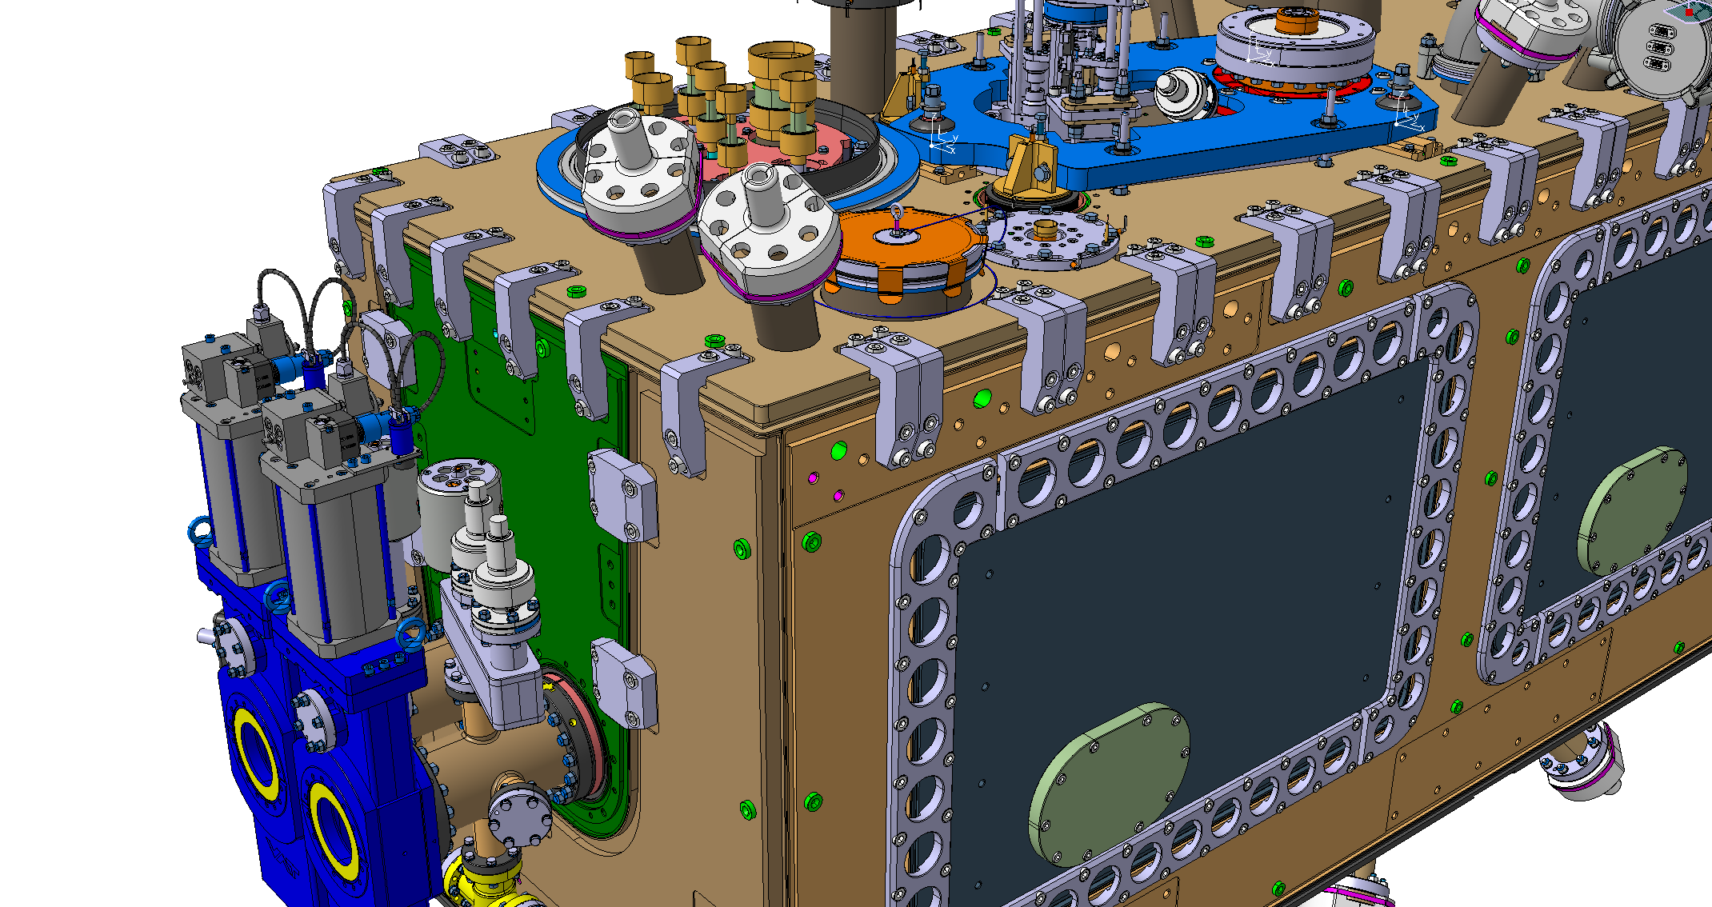
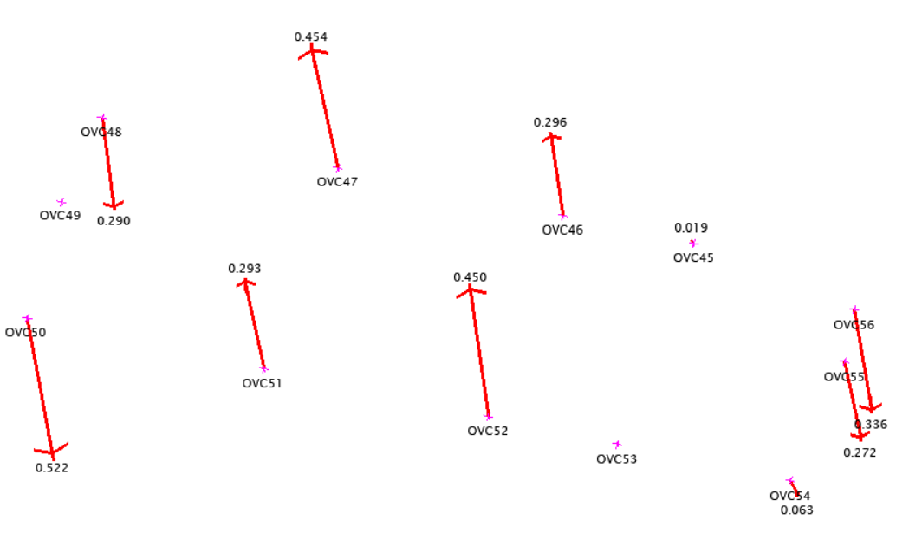
Deformation of the top plate between installation on cryomodule and hanging
Difference
For the test under vacuum scheduled end of September, a special attention will be given
1 mm
Top plate installed on the cryomodule
Top plate hanging

Slide 21
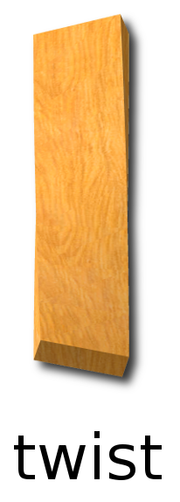
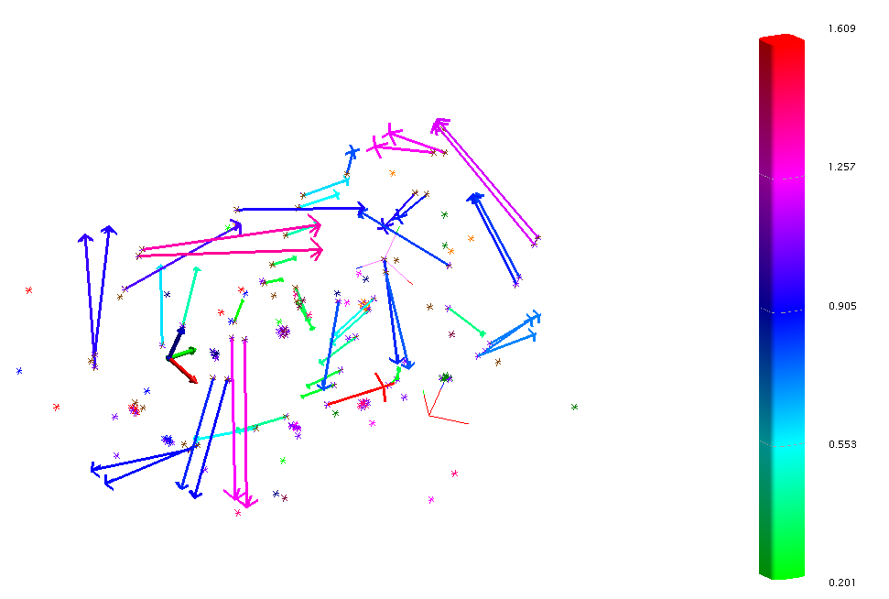
Deformation of the cryomodule with and without the top plate installed on the top
Difference up to 1.6 mm
For the test under vacuum scheduled end of September, a special attention will be given

Slide 22
Next step (at CERN)
RFD prototype at CERN
2 days of installation
and measurement
Installation : FSI system, Optical fibers
Laser Tracker : Measurement of FSI Heads
Measurement with FSI possible
→ Position of the cavities inside the cryomodule
Test of adjustment system
+ realignment
Objective : < 0.1 mm w.r.t. nominal
Under vacuum
0.5 days of measurement
Laser Tracker
Laser Tracker : Impact of vacuum on the cryomodule
Measurement with FSI possible
→ Position of the cavities inside the cryomodule
Cooling down
0.5 days of measurement
Laser Tracker if possible
Laser Tracker : Impact of cooling down on the cryomodule
Measurement with FSI possible
→ Position of the cavities inside the cryomodule

Slide 23
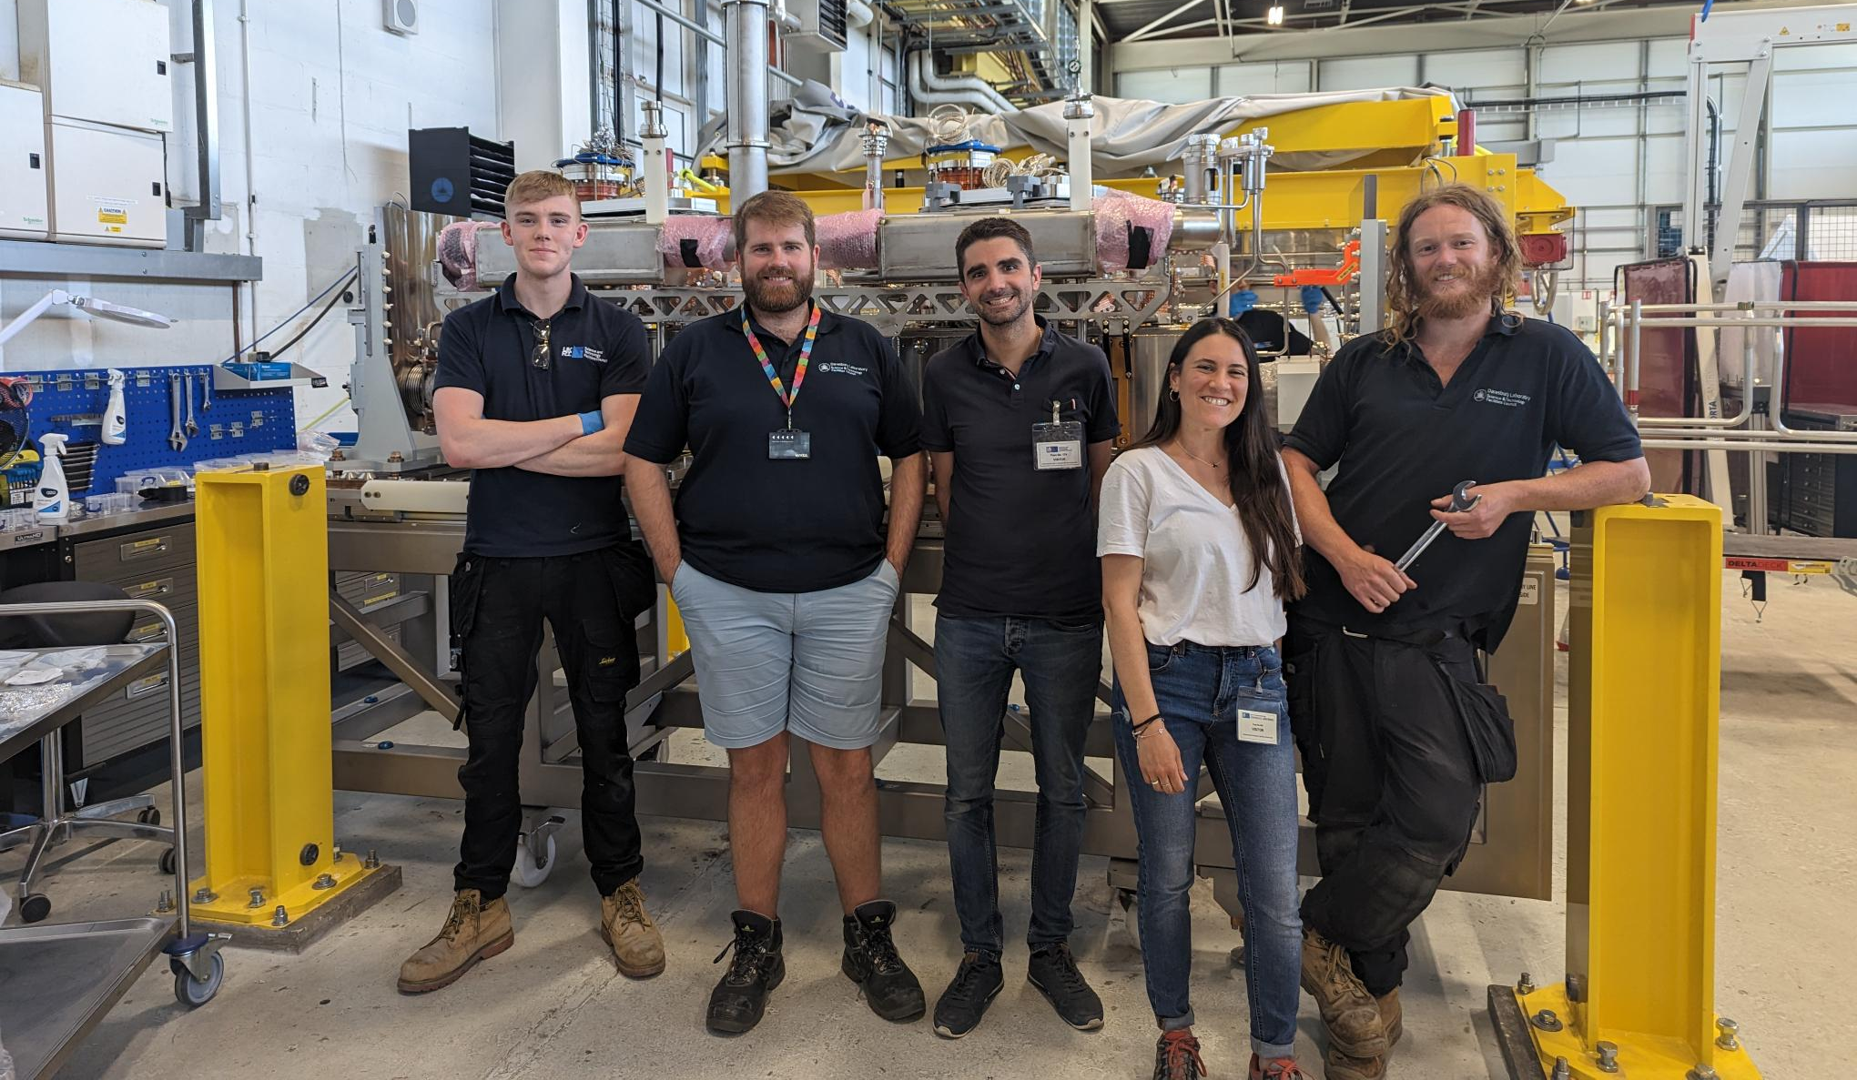
Conclusion
The RFD prototype is ready to go into the SPS accelerator !
Many thanks to STFC team :
Nik
Ed
Luke
Ryan
Carlos
Andy
…
Many thanks to CERN team :
Teddy
Marco
Kurt
Simon
Raphael
Luca
Nuria
Katarzyna
Rama
Ofelia
Julien
…
Thank you for your attention

Slide 24
Thank you
for your attention

Slide 25
SPARE

Slide 26
Alignment requirements for the cryostat / cryomodule
* On main components
Alignment objectives (2023) for FRAS
  Position of the components cryostat along one side of the tunnel : +/- 0.1 mm *
  Position of the components cryostat along one side of the tunnel w.r.t the other side : +/- 0.33 mm *
UPS gallery
P1
P2
P3
P4
P5
P6
Alignment between Q1 and Q5 :
Limits : σ (1 sigma) < 0.1 mm
Alignment between Q5-left and Q5-right :
Limits : σ (1 sigma) < 0.33 mm
Inner
Tracker
EXP.
Q5
Q4
CC2
CC1
D2
TCLX
TCTPH
TCTPV
TAXN
D1
CP
Q3
Q2b
Q2a
Q1
Q1
Q2a
Q2b
Q3
CP
D1
TAXN
TCTPV
TVTPH
TCLX
D2
CC1
CC2
Q4
Q5
Left
Right
R = 0.33 mm
R = 0.1 mm
R = 0.1 mm

Slide 27
Alignment requirements for the cryostat / cryomodule
* On main components
Alignment objectives (2023) for FRAS
  Position of the components cryostat along one side of the tunnel : +/- 0.1 mm *
  Position of the components cryostat along one side of the tunnel w.r.t the other side : +/- 0.33 mm *
UPS gallery
P1
P2
P3
P4
P5
P6
Inner
Tracker
EXP.
Q5
Q4
CC2
CC1
D2
TCLX
TCTPH
TCTPV
TAXN
D1
CP
Q3
Q2b
Q2a
Q1
Q1
Q2a
Q2b
Q3
CP
D1
TAXN
TCTPV
TVTPH
TCLX
D2
CC1
CC2
Q4
Q5
Left
Right
R = 0.33 mm
R = 0.1 mm
R = 0.1 mm

Slide 28
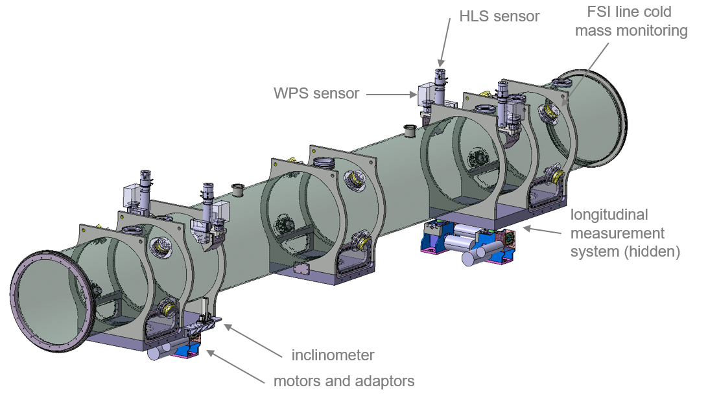
External monitoring
Remote alignment thanks to alignment sensors and actuators:
FRAS LSS components equipped with reference sensors
  WPS – Wire Position Sensor (Radial, Vertical position)
  HLS – Hydrostatic Reference Sensor (Vertical Leveling, roll)
  Inclinometers – (Roll)
  Long range monitoring from UPS gallery
  Longitudinal monitoring
Each component equipped in motorized adapters – for the remote adjustment of its position
Accuracy of each sensor in the framework of cryostat
Sensors | Technology | Largest standard uncertainties | Uncertainty on 2023
WPS | Capacitive | Calibration of WPS (if Lcable < 70 m) Calibration of WPS (if 70m < Lcable < 100 m) | 5 µm 15 µm | 50 µm (12 µm for WPS in UPS)
 |  | Shape of wire | 10 µm
 |  | Position of WPS in the framework of the vacuum vessel Position of WPS in the framework of the UPS plate | 50 µm 2 µm
HLS | Interferometry | Calibration of HLS | 5 µm | 50 µm (70 µm for HLS double)
 |  | Shape of water | 10 µm
 |  | Position of HLS in the framework of the vacuum vessel | 50 µm
Inclinometer | Capacitive Interferometry | Calibration of inclinometer | 15 µrad | 150 µrad
 |  | Position of the inclinometer in the framework of the vacuum vessel | 150 µrad
Long range FSI 14 m | Interferometry | Calibration of the Long range FSI | 20 µm | 50 µm
 |  | Position of the FSI in the framework of the UPS plate | 2 µm
 |  | Position of the target in the framework of the vacuum vessel | 50 µm
Longitudinal FSI | Interferometry | Calibration of Longitudinal FSI | 10 µm | 300 µm
 |  | Position of Longitudinal FSI in the tunnel framework | 300 µm
 |  | Position of the target in the framework of the vacuum vessel | 50 µm

Slide 29
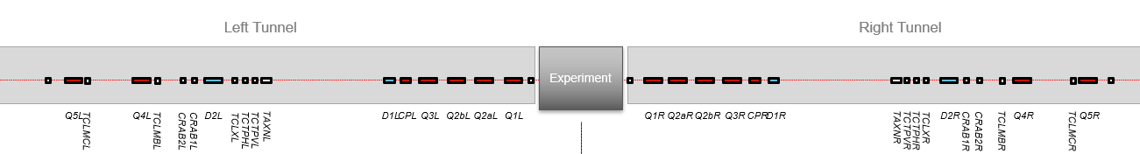
Position accuracy (radial) of the mechanical axis of component in R-general
The RADIAL propagation of errors is linear
The uncertainty at Q5 is largely influenced by :
Uncertainty Q3-Q3 (link Left-Right through UPS gallery)
Uncertainty Q1-D1 (slope of the error propagation)
P1
P2
P3
P4
P5
P6
Wire Q1-D1
Wire Q1-D1
Wire Q1-Q5
Wire Q1-Q5

Slide 30

Precision / Accuracy
General coordinate system
Accuracy and precision
UPS gallery
P1
P2
P3
P4
P5
P6
Experience
Left
IP
Right
CC1
R = 0.1 mm
R = 0.33 mm
CC2
R = 0.1 mm
  The “absolute” position of CC1 (in general coordinate system) will be known with an accuracy of 0.25 mm (1σ)
  The “absolute” position of CC2 (in general coordinate system) will be known with an accuracy of 0.25 mm (1σ)
  The “relative” position of CC1 w.r.t. CC2 will be known with a precision of few microns
  The “relative” movement of CC1 will be known with a precision of few microns

Slide 31
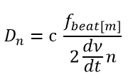

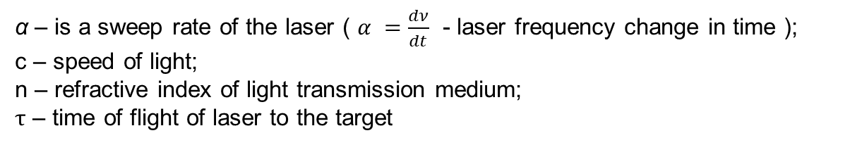
Multi-target Frequency Scanning Interferometry (FSI)
RT3
RT1
$$f_{beat[n]}=ατ=α \frac{2D_{n}}{c}$$
RT2
α – is a sweep rate of the laser ( $α =\frac{dν}{dt}$ - laser frequency change in time );
c – speed of light;
n – refractive index of light transmission medium;
$τ$ – time of flight of laser to the target
from Mateusz Sosin

