Slide 1

Cryogenic status of SM18, SPS and HL-LHC and challenges/open points
K. Brodzinski and V. Gahier
with contribution from: L. Alaux, O. Capatina, T. Capelli, S. Claudet, L. Delprat, J. Dequaire, N. Guillotin, B. Ivens, R. Mauny, M. Sisti and N. Vauthier
on behalf of HL-LHC WP4 and WP9 working teams
2023.09.27_HiLumi Annual meeting, Vancouver, Canada

Slide 2
Outlook
SM18 readiness status
Overview on operation of SPS BA6 in 2023
  Cool down phase and global feedback
  Perspectives – preparation for RFD test
Cryomodule design
  Instrumentation and safety devices
  fabrication
HL-LHC – supply line design and integration
Conclusions

Slide 3
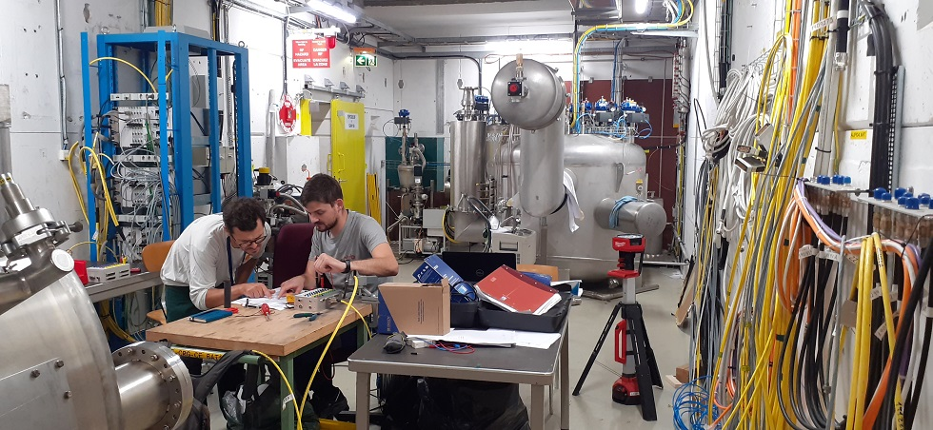
SM18 – M7 readiness
New transfer line installed as interface to cryomodule jumper
Electrical rack for instrumentation
Test end cap to the crab cryomodule
Status:
Mechanical adaptation of the transfer lines is completed,
Valve Box commissioning is completed (Autumn 2022),
Instrumentation electrical chain is constructed (electrical racks ready, cabling prepared),
M7 cryogenics mechanical and instrumentation interfaces are ready for cryomodule connection from now.
photo on 13.09.2023

Slide 4
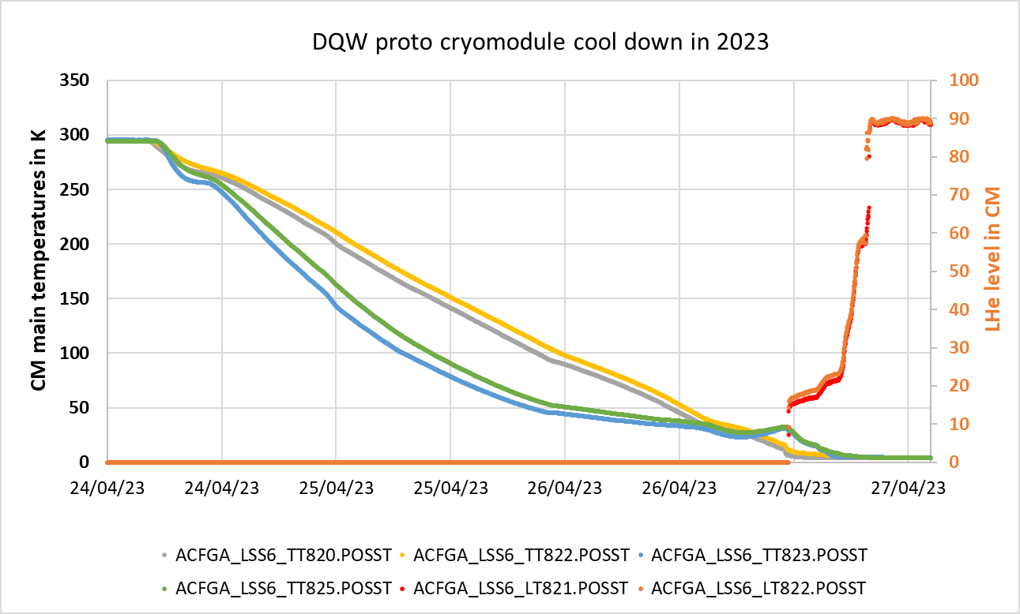
SPS – feedback from 2023
CM main temperatures
CM LHe level
Operation is fully mastered with standard duration of ~3 days from cool down start @300K up to LHe regulation at 90%
(~1 hour needed to transit from stable 4.5 K to 2 K)

Slide 5
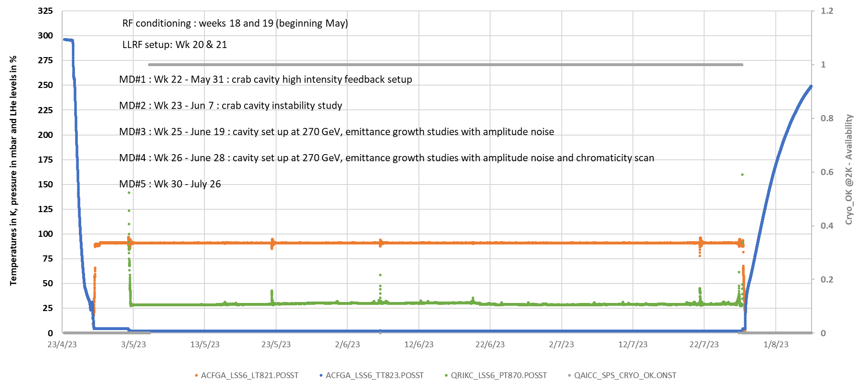




SPS – feedback from 2023
List of operational issues (not critical – just a real life):
TSH731 issue, August 02, beep acknowledged
Cryo OK loss, July 26, due to pressure increase on WPU system. Origin was a too high RF power
400V electrical cut, June 27
WPU output flowmeter issue, June 19. Repaired during the shutdown.
CM Peak pressure with cryo OK loss, June 6, due to RF activities. Then return to nominal.
Pressure sensor default for WPU (with indication of 0 mbar), May 3, control support intervention
2023 annual availability : 99.9%

Slide 6
SPS – perspectives
Regarding future operation there is one consolidation and two modification to be done in SPS:
After first year of operation we noticed failure of the main helium flowmeter, caused by non-sufficient oil separation in the pumping system. In order to avoid migration of oil from the pump into other part of the system, additional separation device shall be installed close to flowmeter area. The equipment is present at CERN (ex-CMS coalescing filter), manpower and integration to be planned ➔ Action TE-CRG (LS)
Jumper interface between the Service Box and the cryomodule must be redesigned and adapted for next modules ➔ Action EN-MME and TE-CRG
(applicable for next module RFD going to the SPS)
For replacement DQW → RFD adaptation of instrumentation treatment chain is required (RFD has much more instrumentation than DQW) ➔ Action TE-CRG-IC (this action is being handled, no showstopper for swap of modules)
However, extremely tight planning for SPS RFD connection!
Notice: Added to the system Beam Screen cooling loop can be tested in SM18 M7 but cannot be operated in SPS.

Slide 7
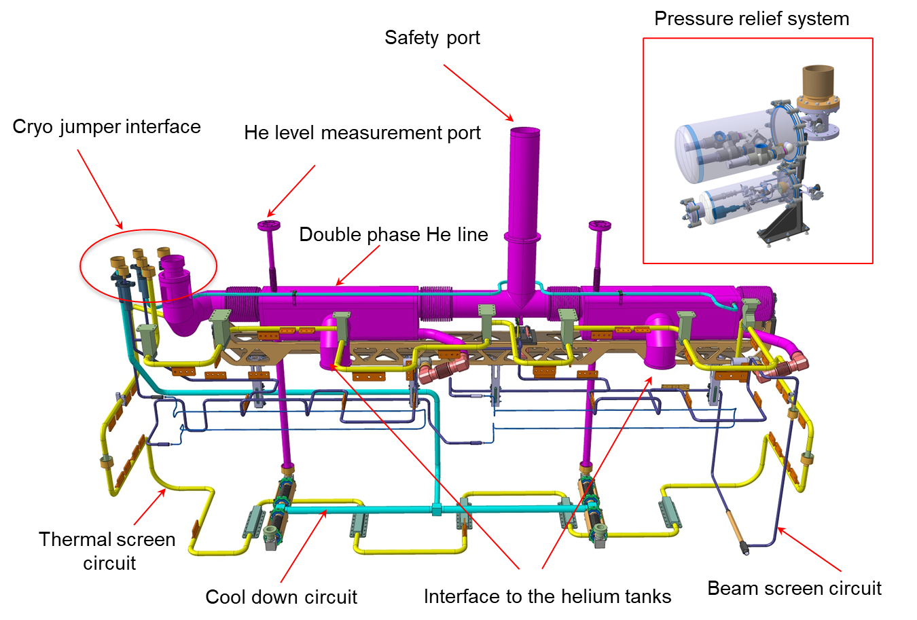
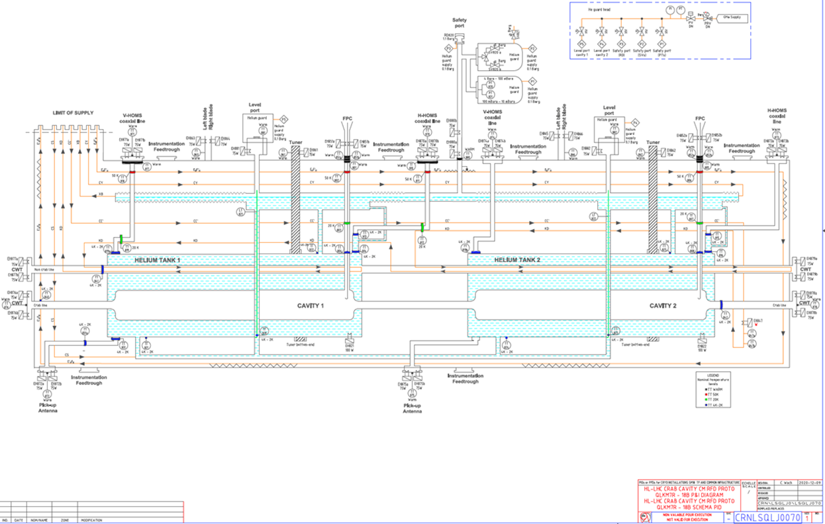
Cryomodule design – cryogenic circuits
Instrumentation list for all types of the cryomodules (proto and series for DQW and RFD) was defined and validated between MME and CRG
Flow schemes for both types of the cryomodules were prepared and are validated and available
RFD module

Slide 8
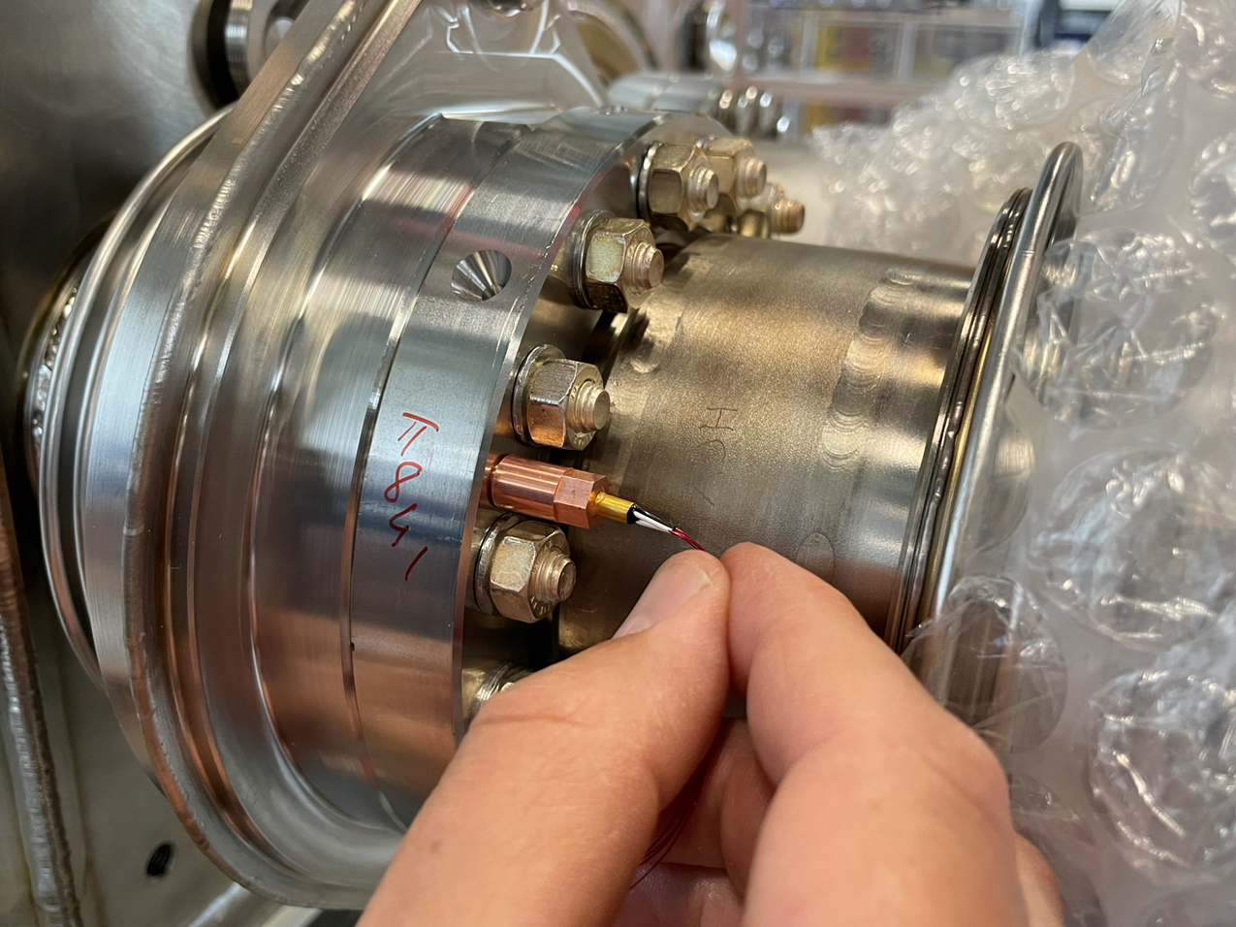
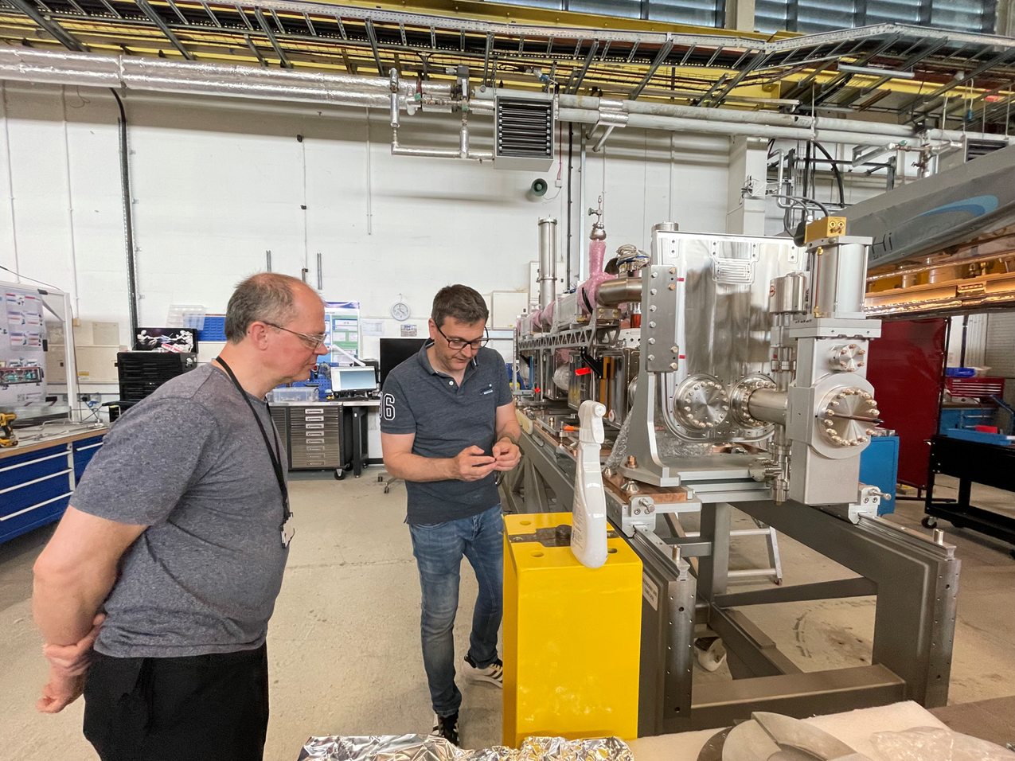
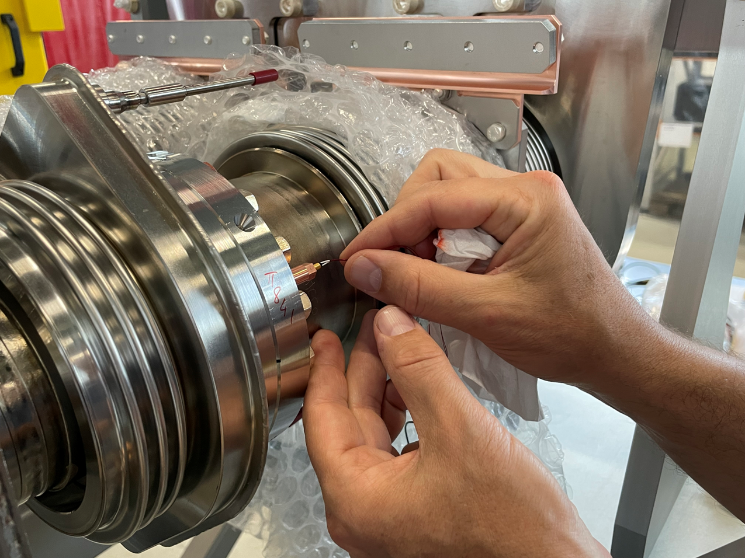
Focus on instrumentation – status
RFD prototype:
All instrumentation for RFD prototype was supplied to the builder for the installation. Dedicated installation training for CERNOX was done by TE-CRG in Daresbury on 24th May 2023.

Slide 9
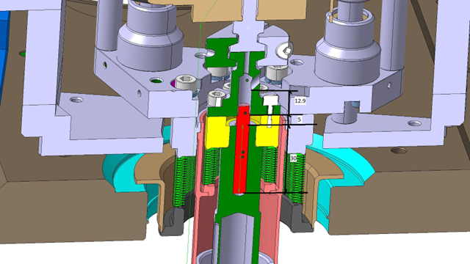
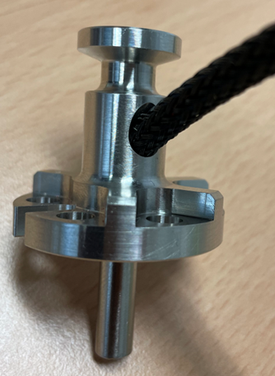
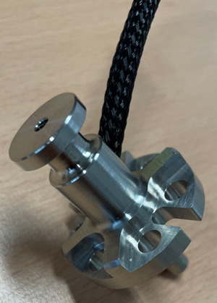
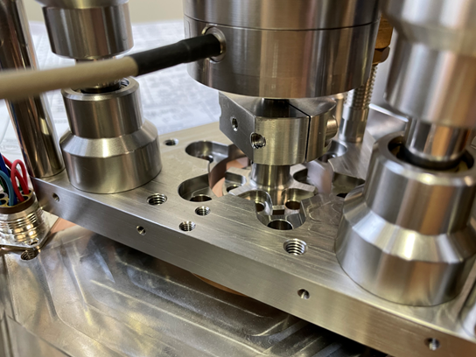
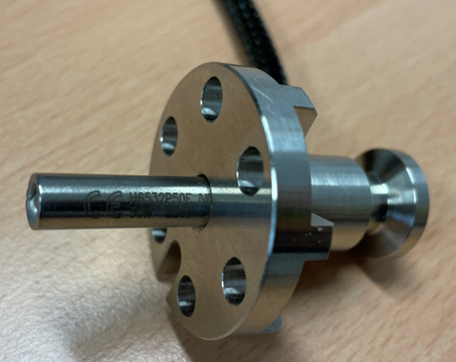
Focus on instrumentation – status
Tuner heaters:
following problems on first DQW prototype during SPS run 2018 when we have lost both tuner heaters, the new concept of integration was developed by MME and CRG with dedicated assembly allowing for effective heating and optimized integration of the heating cartridges – see pictures below.
This solution will be tested on RFD prototype module.
Heating cartridge

Slide 10
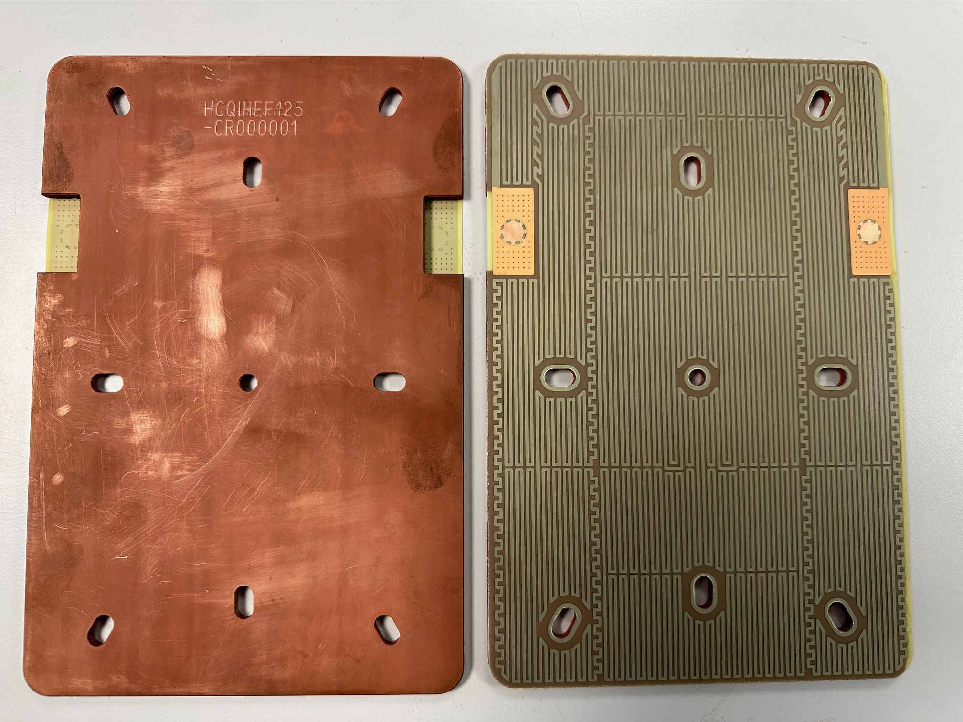
Focus on instrumentation – status
RFD and DQW series modules:
All sensitive items (long delivery CERNOX) are available at CERN
Beam screen heaters: available at CERN
Helium tank heaters: produced and available at CERN
Level gauges: to be ordered
Pressure transducers: to be ordered
External heaters: to be ordered
All foil heaters were transferred (glued) on copper support and identified for QA plan.

Slide 11
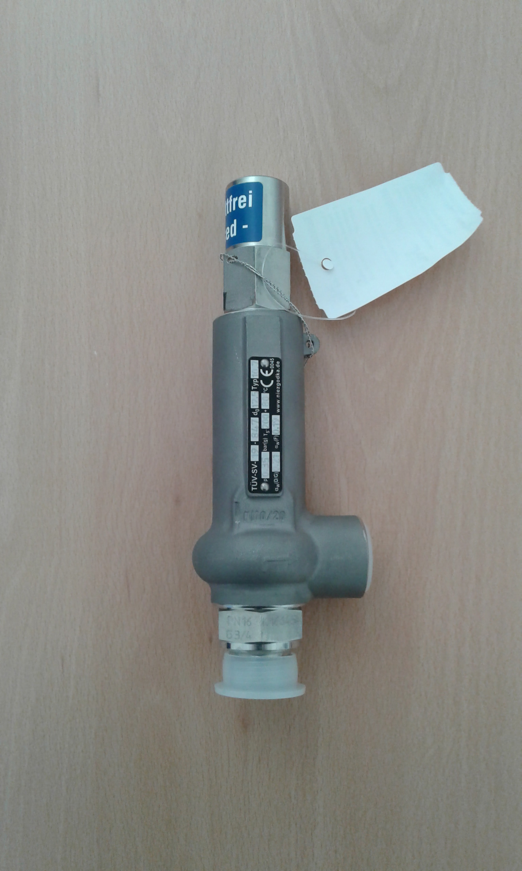
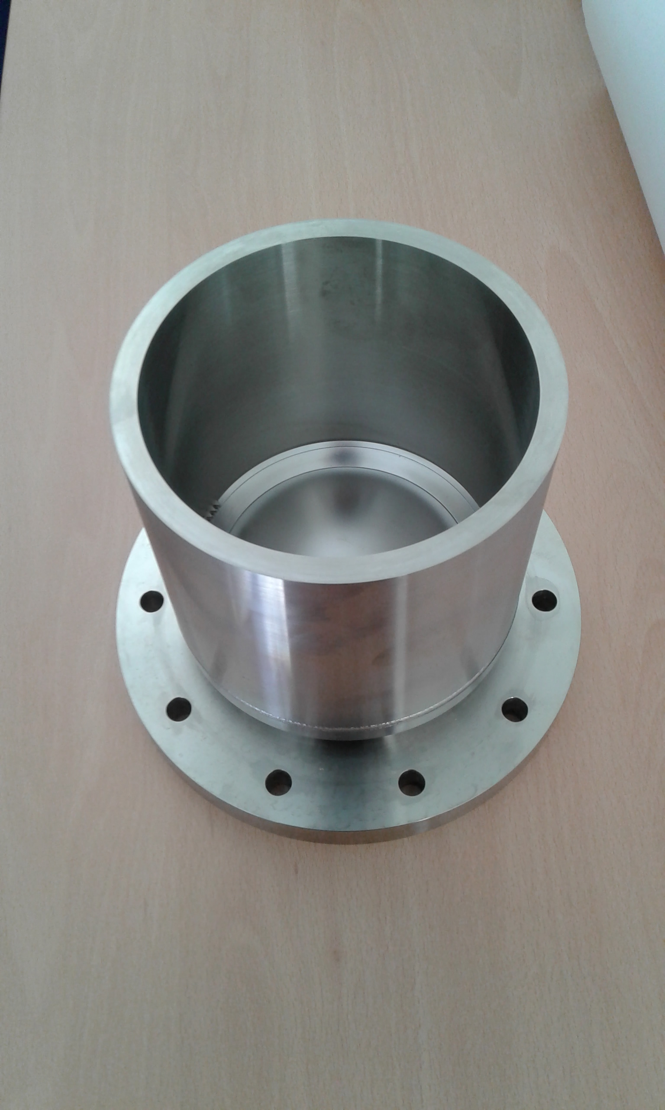
Safety devices
Both safety devices for RFD prototype: safety valves and rupture disc were supplied for installation
Series modules:
Rupture discs produced by two suppliers from UK and D (10 + 10 pieces), still to be tested at max. allowable working pressure for acceptance. One of the supplier out of specification – clarification for acceptance is underway.
SV – specified and to be ordered
Nota: Safety valves and rupture discs for series will be the same as for RFD prototype
Safety valve
Rupture disc

Slide 12
Fabrication of the cryomodules
General remark:
Concerning the fabrication process (RFD in UK) we did not experienced direct difficulties on the interface between Daresbury and CRG (only very few interactions). Some consultation for cryo aspects were done mainly via MME. The visit for instrumentation installation training was done.
A few comments:
Instrumentation installation training was largely postponed – but very good collaboration during the visit with Daresbury personnel for RFD proto module – Thanks!
Be very careful to respect geometry of the internal cryo system/lines. The module is crowded inside and geometrical deviations may lead to additional, not expected mechanical stresses during thermal cycling and higher heat load in case of contact between parts with different temperatures.
Do not hesitate to contact us in case of needs

Slide 13
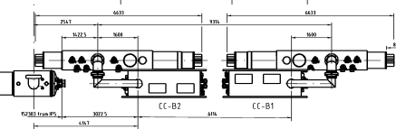
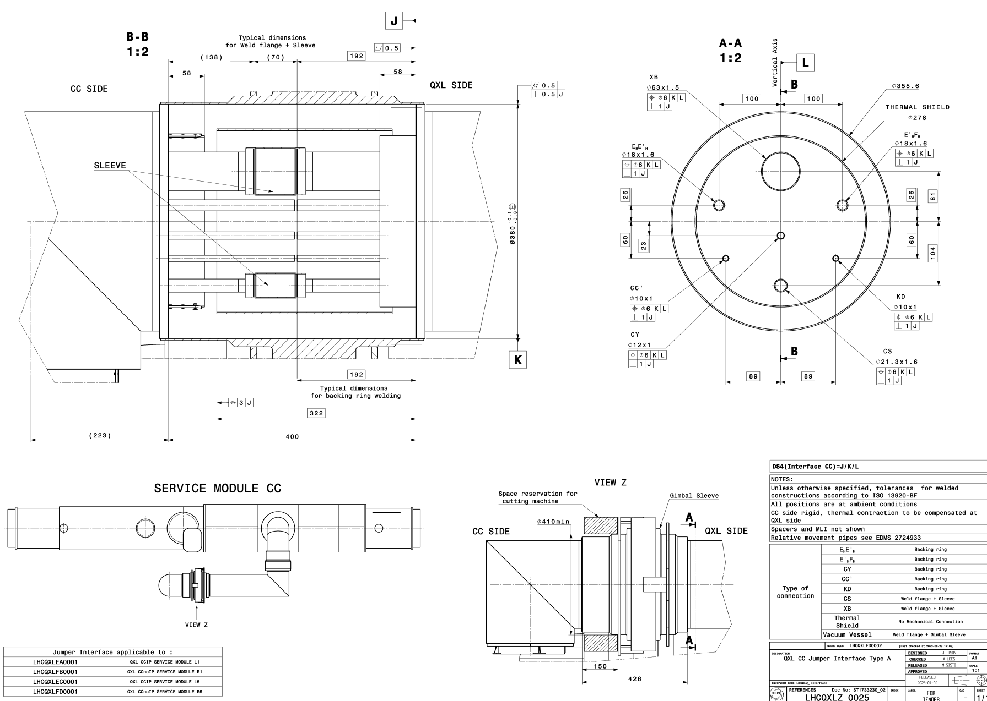
HL-LHC – design and integration
Contract for the distribution line QXL is signed and design work progressing. Requirements for the jumper interfaces for all crab cavity modules are defined.

Slide 14
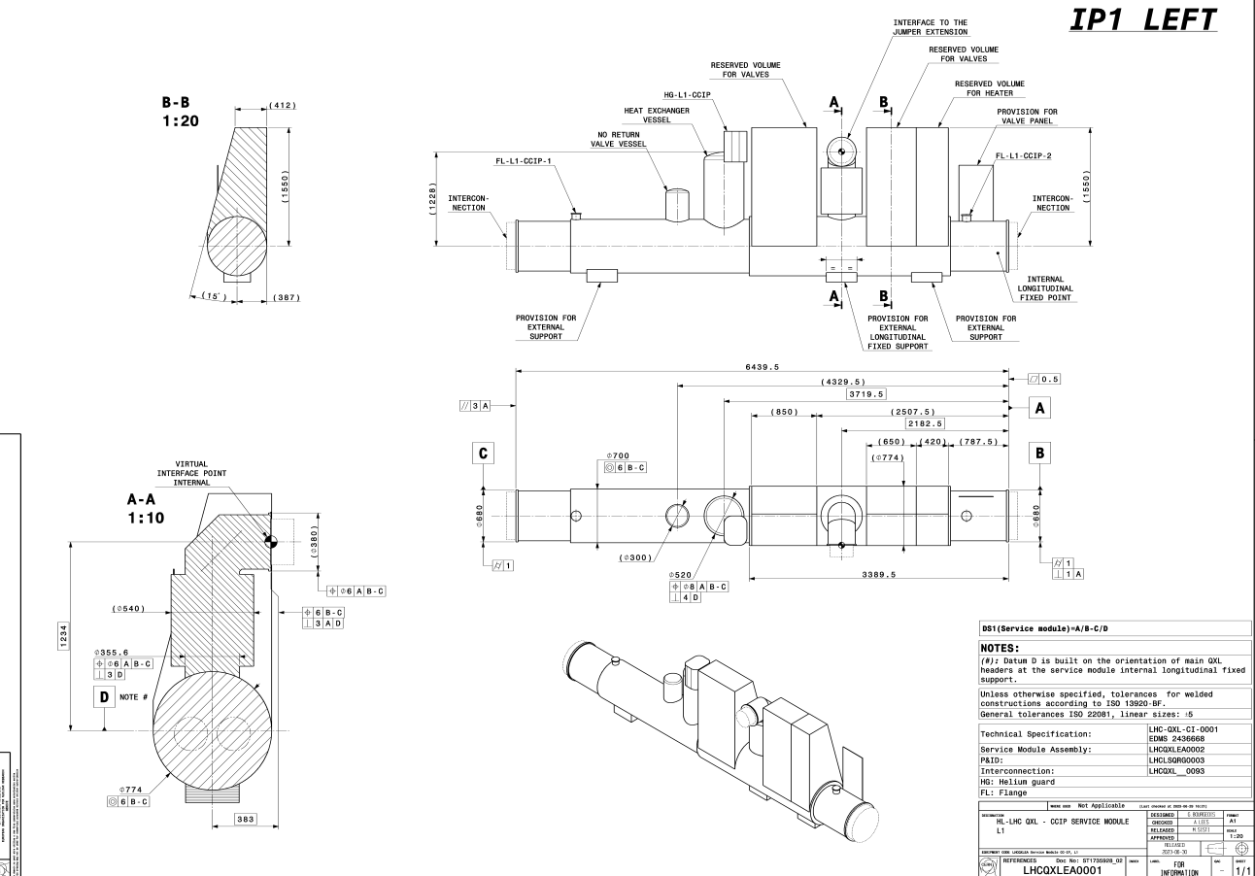
HL-LHC – design and integration
The service module space occupation with functional requirements are defined and design work started.

Slide 15
Conclusions
SM18 M7 for RFD: cryogenically (mechanical and instrumentation aspects) ready to receive the module
Test facility at BA6: operated reliably for last a few years, ready for RFD adaptation during YETS,
SPS consolidations: oil separation system to be improved (LS), adaptation
of interface for RFD and series to be done (YETS),
Cryomodule design is progressing well: all flow schemes are available, internal instrumentation for series modules is available, safety system is in final validation stage, externally installed instrumentation – to be ordered.
HL-LHC: integration and functionality of the infrastructure is defined: contract for QXL signed, design of distribution system is underway.
Great thanks to design team from EN-MME and SY-RF
for smooth and efficient collaboration !

Slide 16
Thank you for your attention!
Questions?
Great thanks to all people involved in HiLumi adventure!

