Slide 1


TE-VSC contribution to WP4:
Vacuum aspects & procurement status
EDMS 2954141
V. Baglin, G. Bregliozzi, C. Pasquino, I. Lopez Cuevas on behalf of TE-VSC contribution to WP4
13th HL-LHC Collaboration Meeting, Vancouver, Canada, 25-28th September 2023
https://indico.cern.ch/event/1293138/overview

Slide 2
Outline
Overview
Status of the series production
Layout

Slide 3
1. Overview

Slide 4
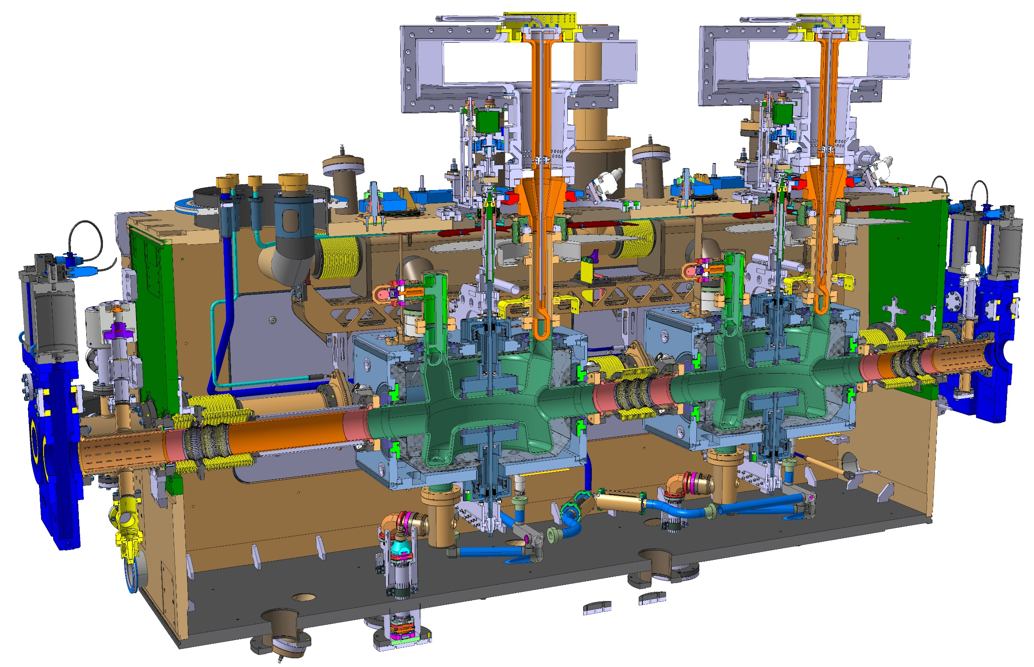
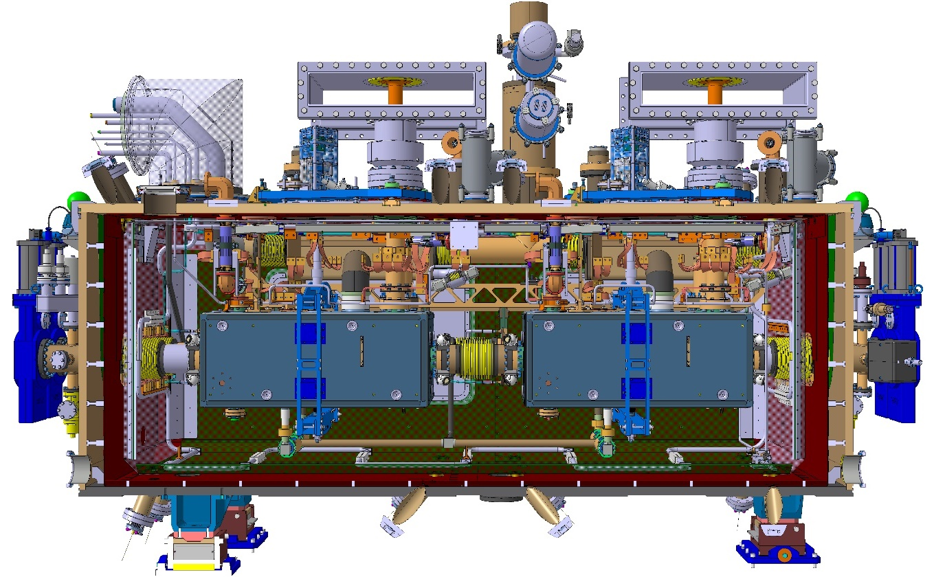
TE-VSC to WP4 contributions
What is planned to be installed:
  SPS – LSS6 : 1 X RFD – LHC type cryomodule (EYETS 2023/2024);
  LHC – LSS1 (L+R) : 4 (2 + 2) DQW cryomodules;
  LHC – LSS5 (L+R) : 4 (2 + 2) RFD cryomodules;
What is planned for production: 10 CC cryomodules
  SPS – LSS6 : 1 RFD (spare RFD);
  LHC:
    5 (4 + 1 spare) DQW;
    5 (4 + 1 spare) RFD;
UK-CERN DQW CMs
Canada-CERN RFD CMs

Slide 5
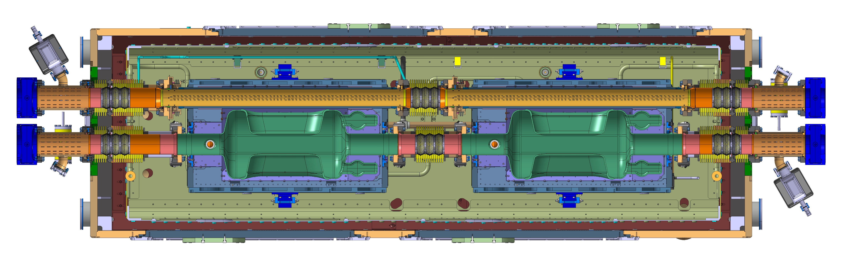
TE-VSC to WP4 contributions
Extremity vacuum chamber LHCVMACAA_T0001
Beam screen Cold/Warm transition Long
Inter beam screen plug-in module
Beam screen Cold/Warm transition Short
Extremity vacuum chamber LHCVMACAA_T0001
Beam screen
Beam screen
Extremity vacuum chamber LHCVMACAA_T0001
Cavity Cold/Warm transition Long
Inter cavities plug-in module
Cavity Cold/Warm transition Short
Extremity vacuum chamber LHCVMACAA_T0001
Courtesy of WP4

Slide 6
2. Status

Slide 7
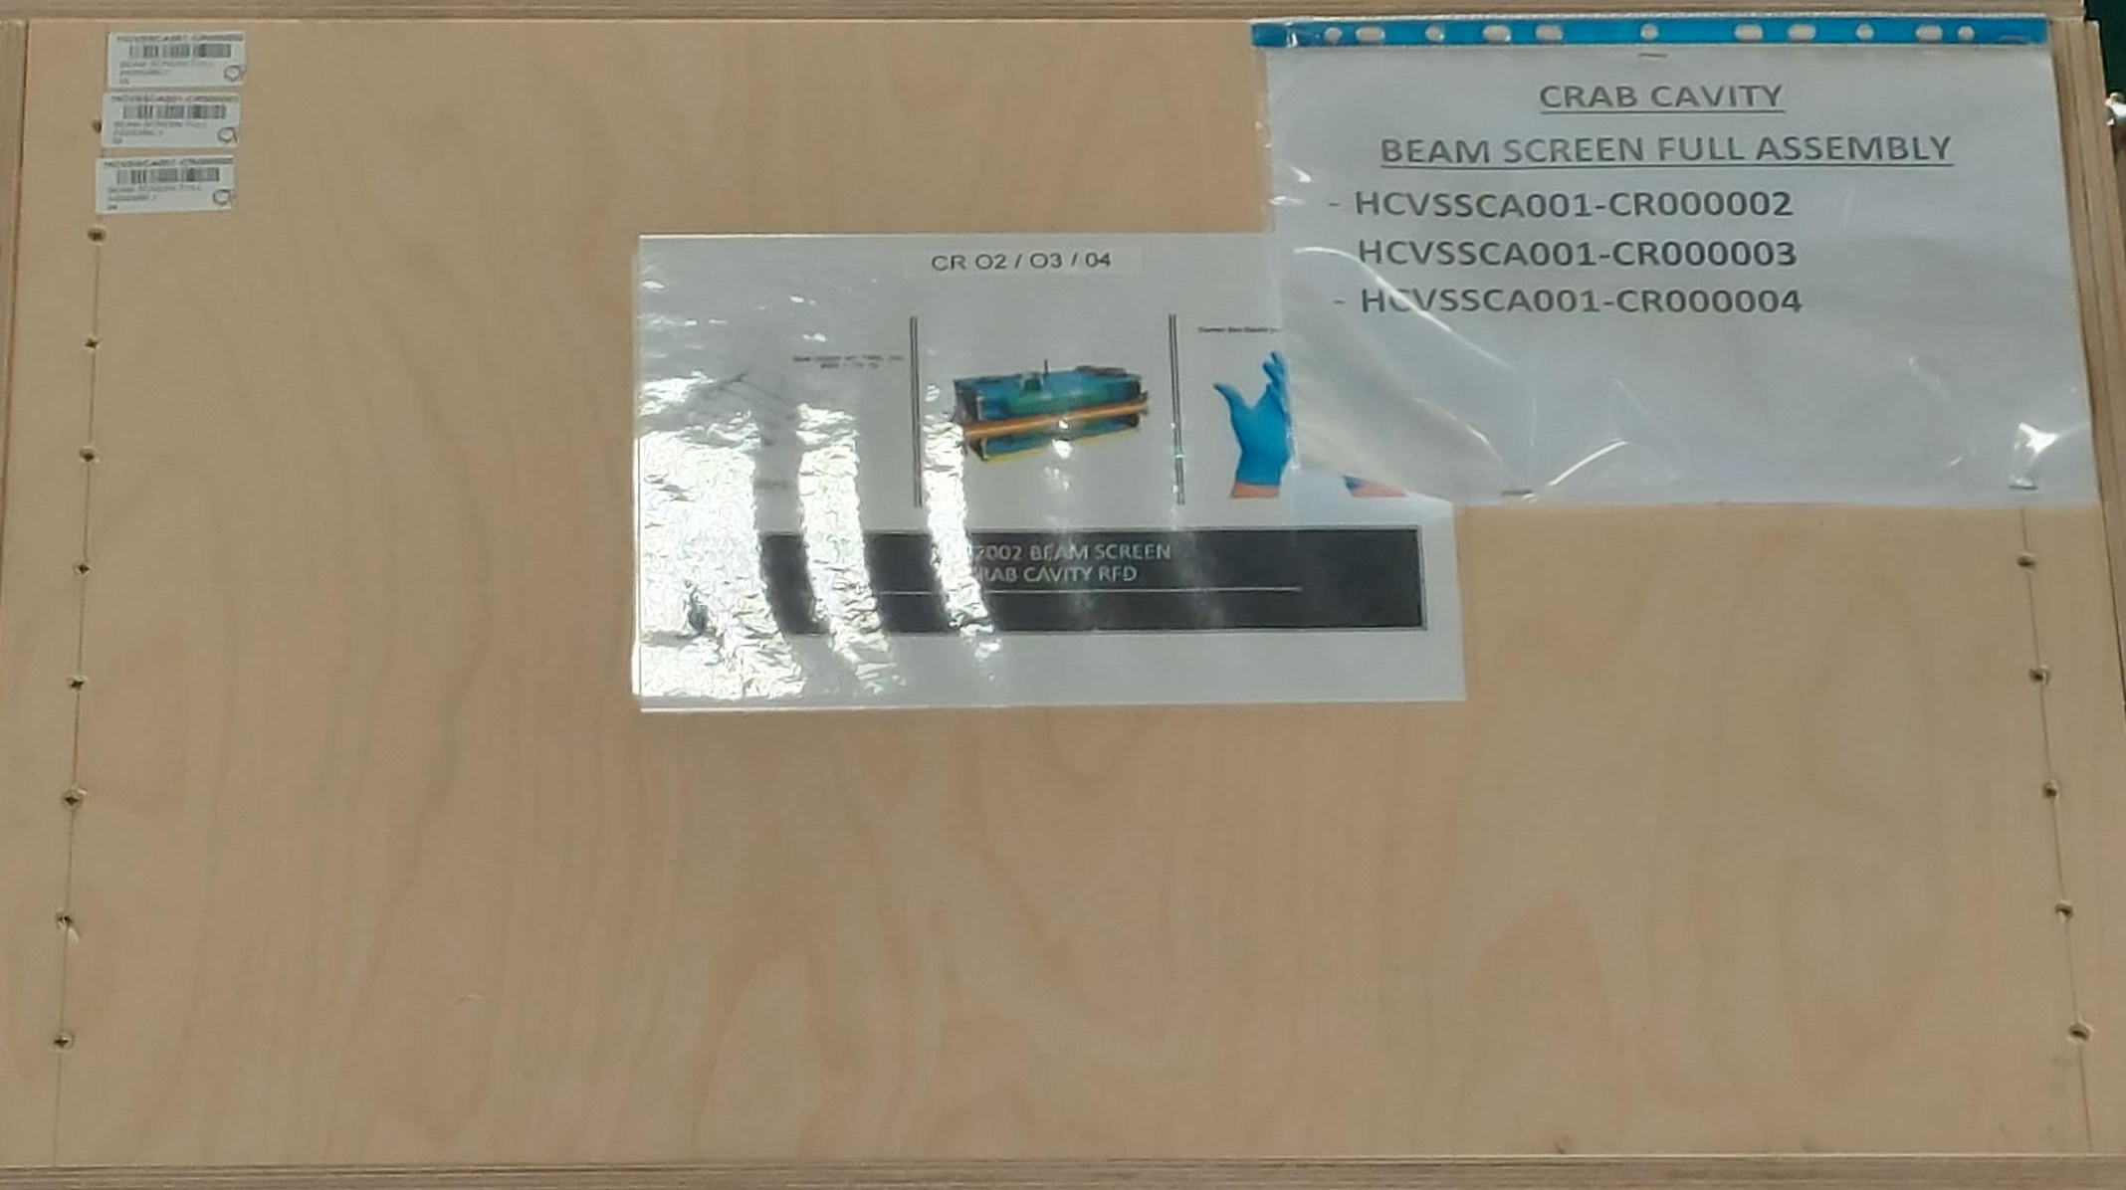
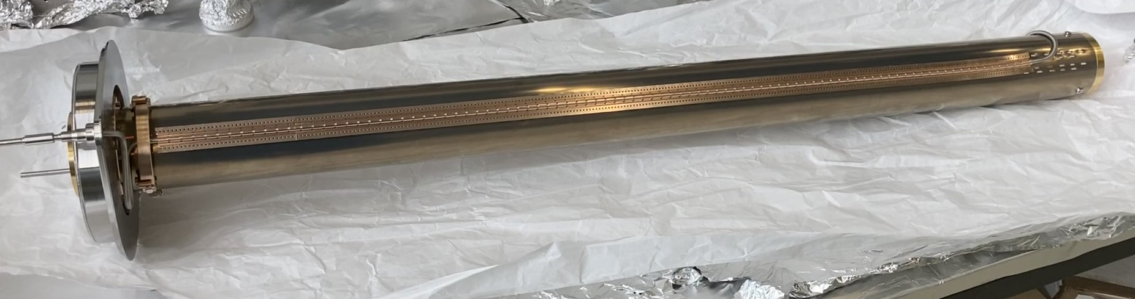
Beam screens in non-crabbed line
Ongoing production
Item | Needed | Spare | Produced | Comments
Beam screen | 20 | 2 | 29 | 14 DQW, 15 RFD, 4 DQW aC coated 2 RFD aC delivered to UK
BS Bellows | 20 | 2 | 9 | 63 bellows delivered by Q4 2023 (more spares for the bellows) 2 delivered to UK
RFD type is1019 mm long, DQW type is 800 mm long
RFD beam screens in CERN storage

Slide 8
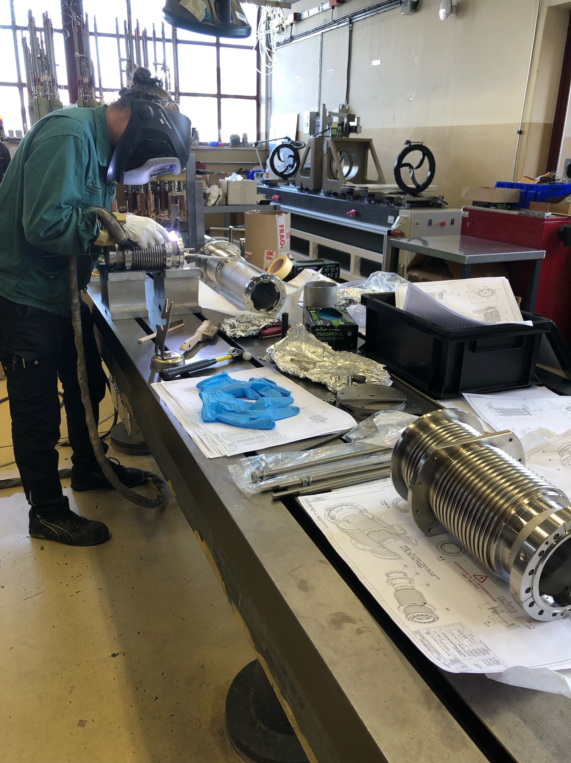
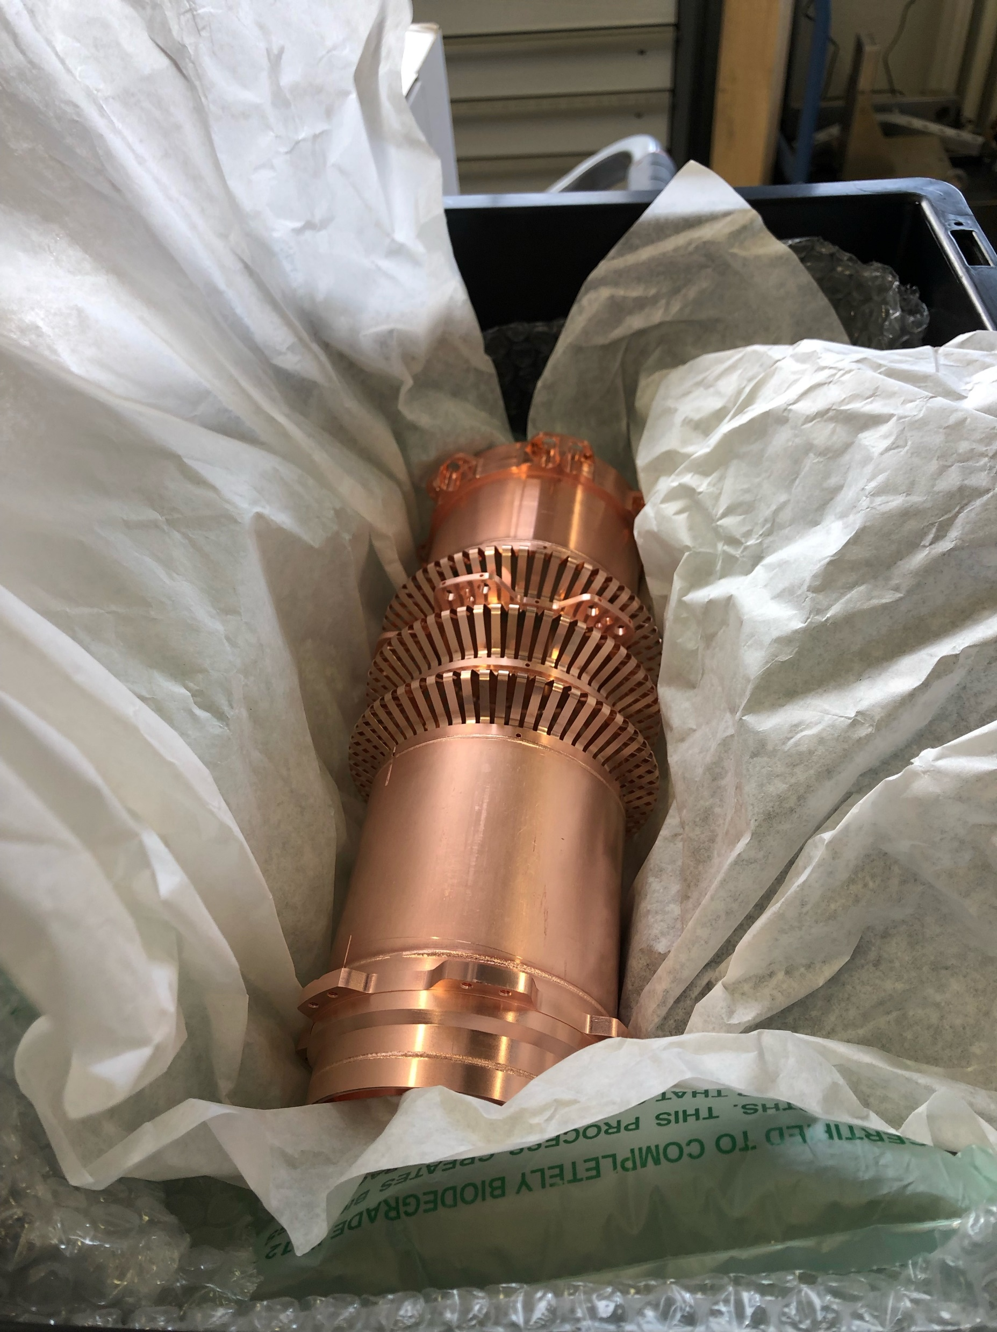
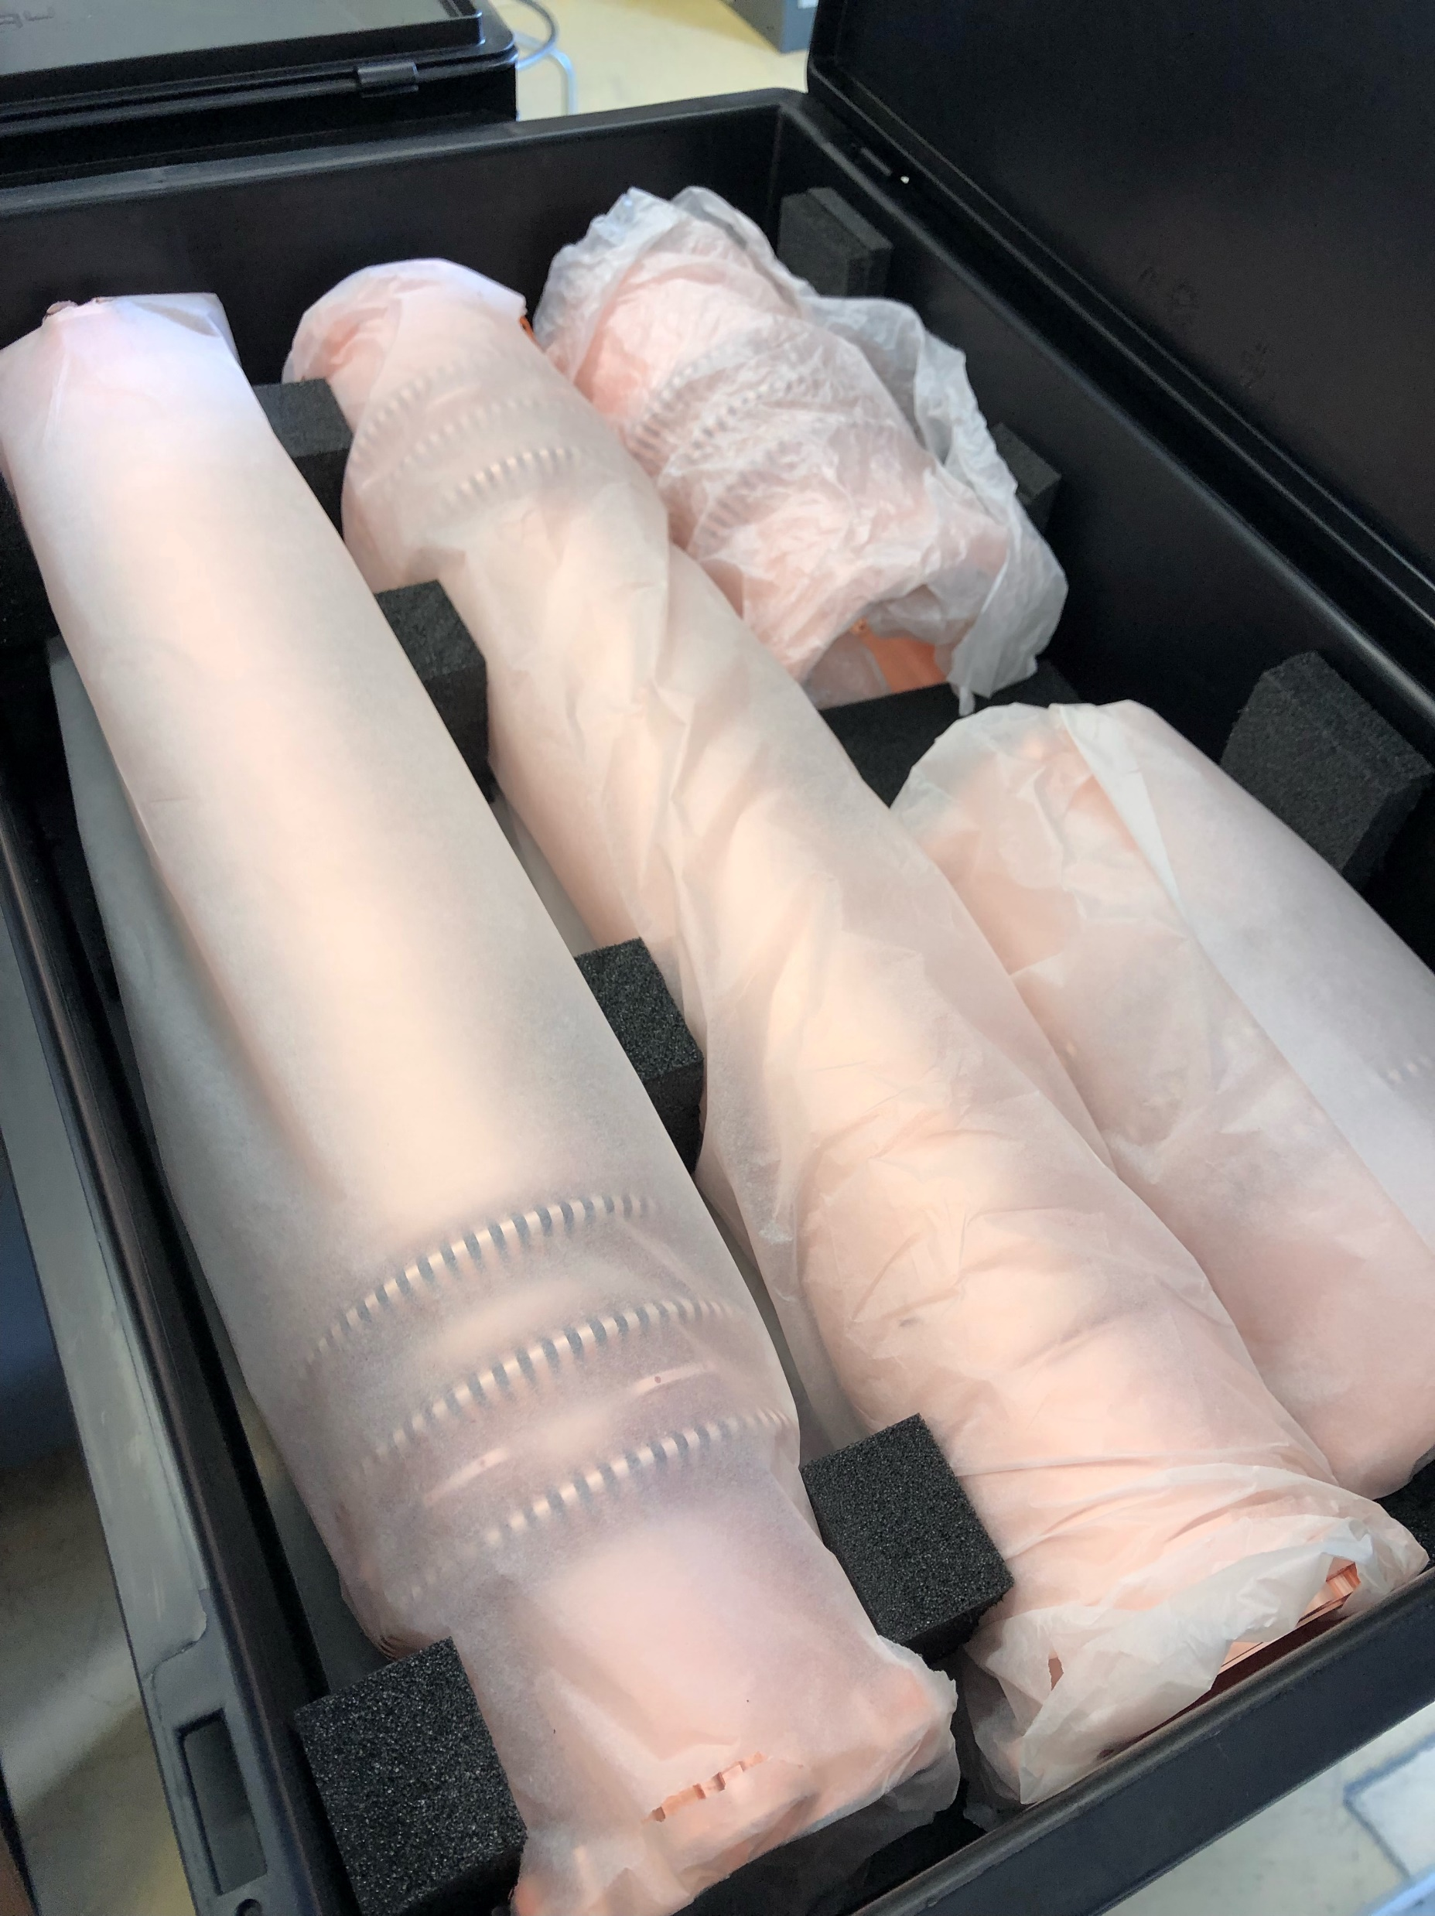
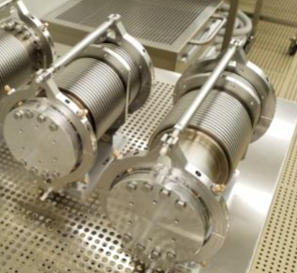
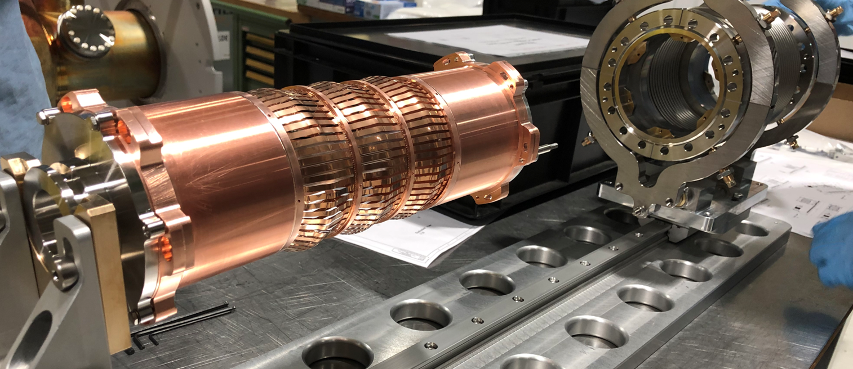
Plug-In-Modules & cold to warm transitions
Ongoing production
Item | Needed | Spare | Produced | Comments
PIM & cold to warm transitions | 60 | 6 | 21 | 63 bellows delivered by Q4 2023 (more spares for the bellows) 6 assemblies for RFD delivered to UK
PIMs and cold to warm transitions production

Slide 9
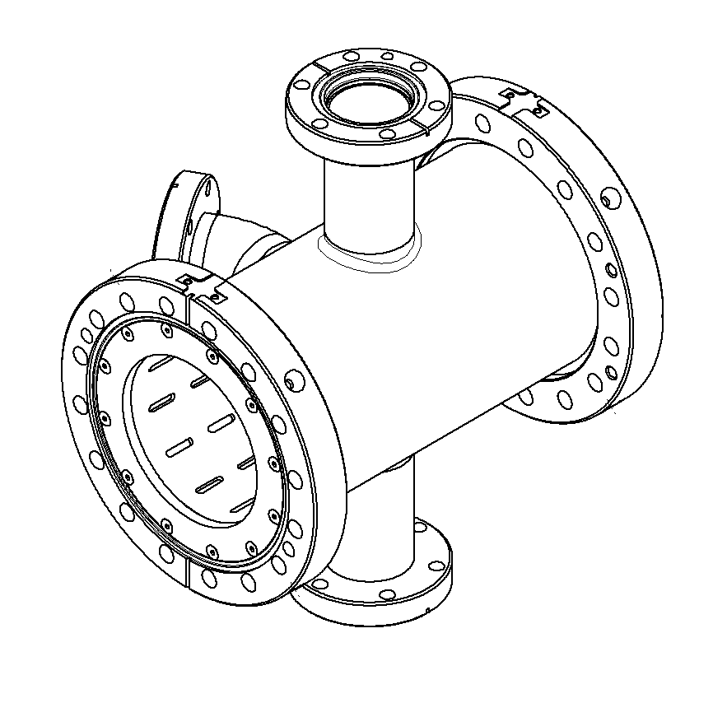
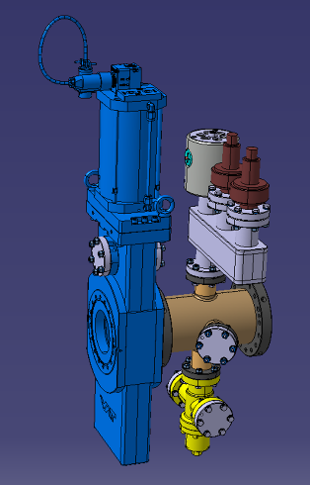
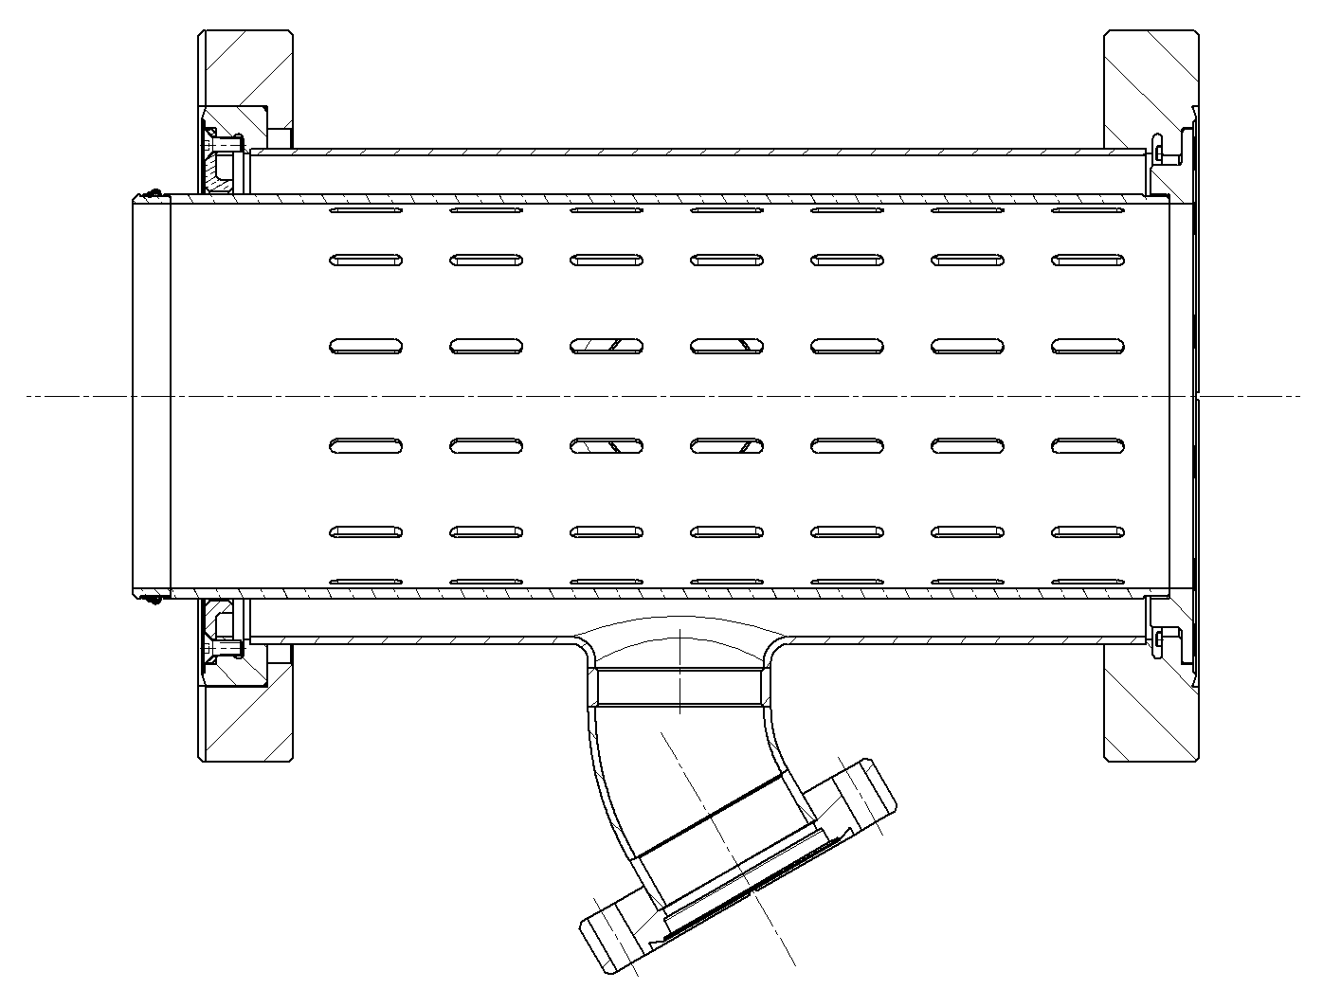
Extremity vacuum chambers
Production completed
Item | Needed | Spare | Produced | Comments
Ext. Vac. Ch | 40 | 4 | 44 | 4 for RFD delivered to UK

Slide 10
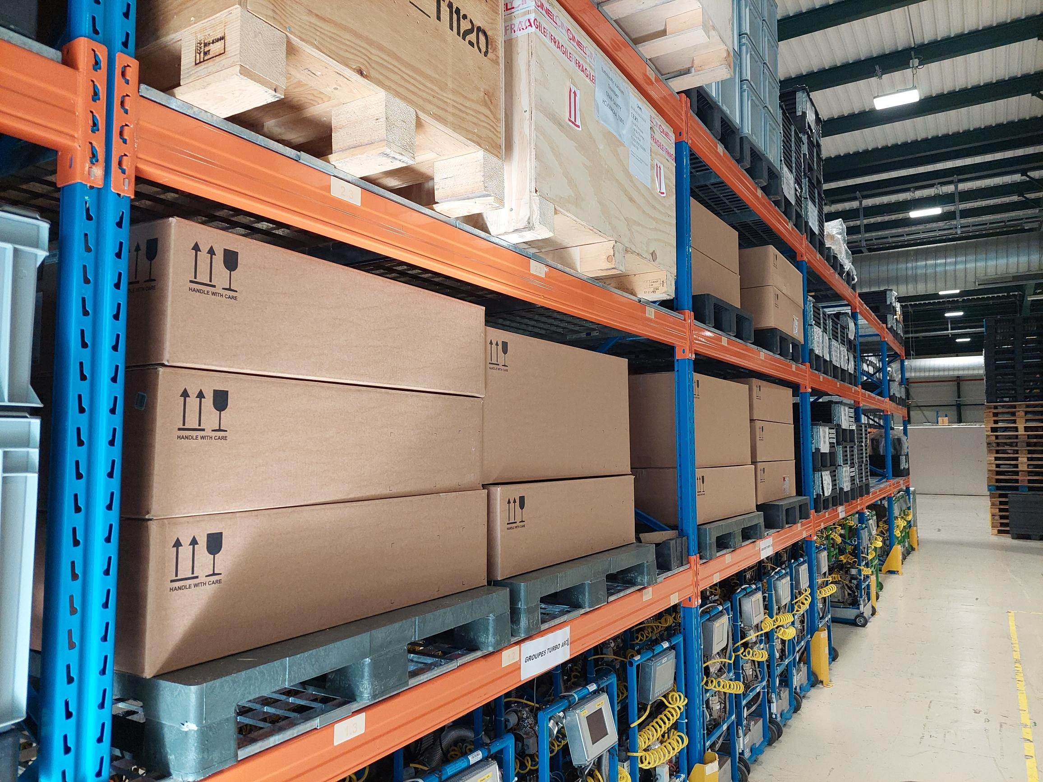
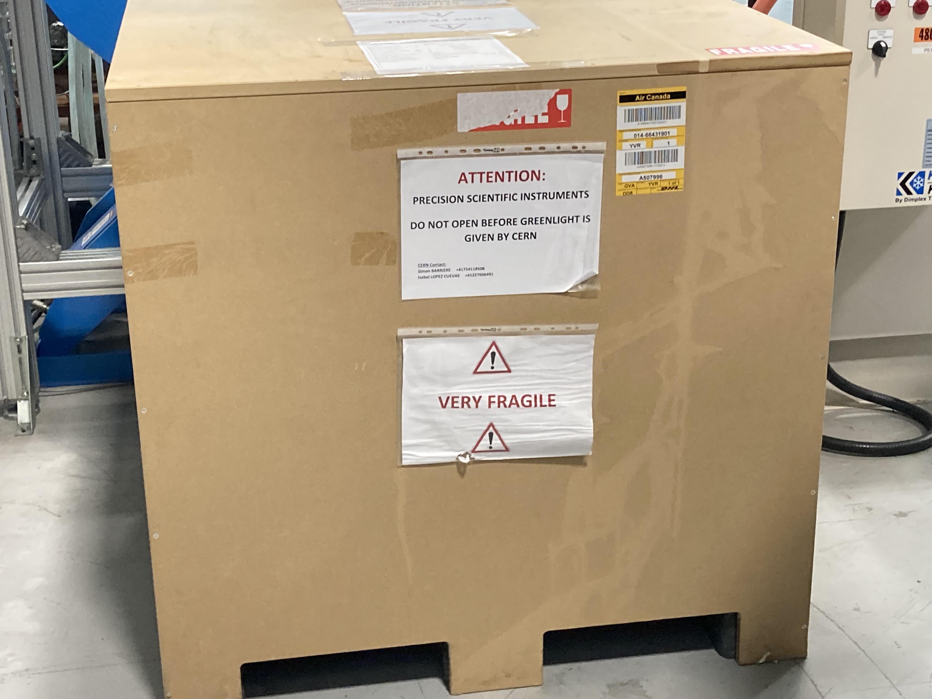
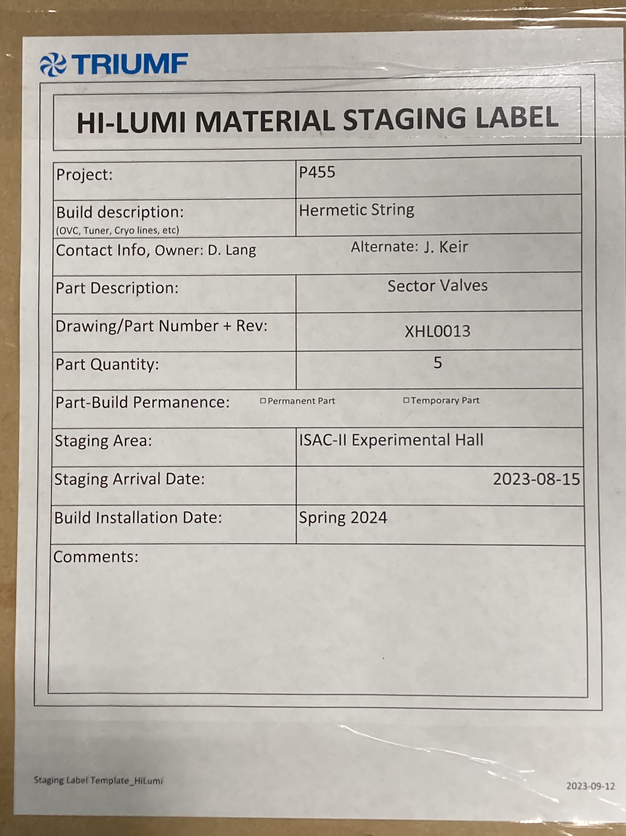
DN80 Sector valves
Procurement completed
Item | Needed | Spare | Produced | Comments
Sector valves | 40 | 4 | 44 | 4 for RFD delivered to UK 5 for RFD delivered to TRIUMF
Sector valves in CERN stores
Sector valves at TRIUMF

Slide 11
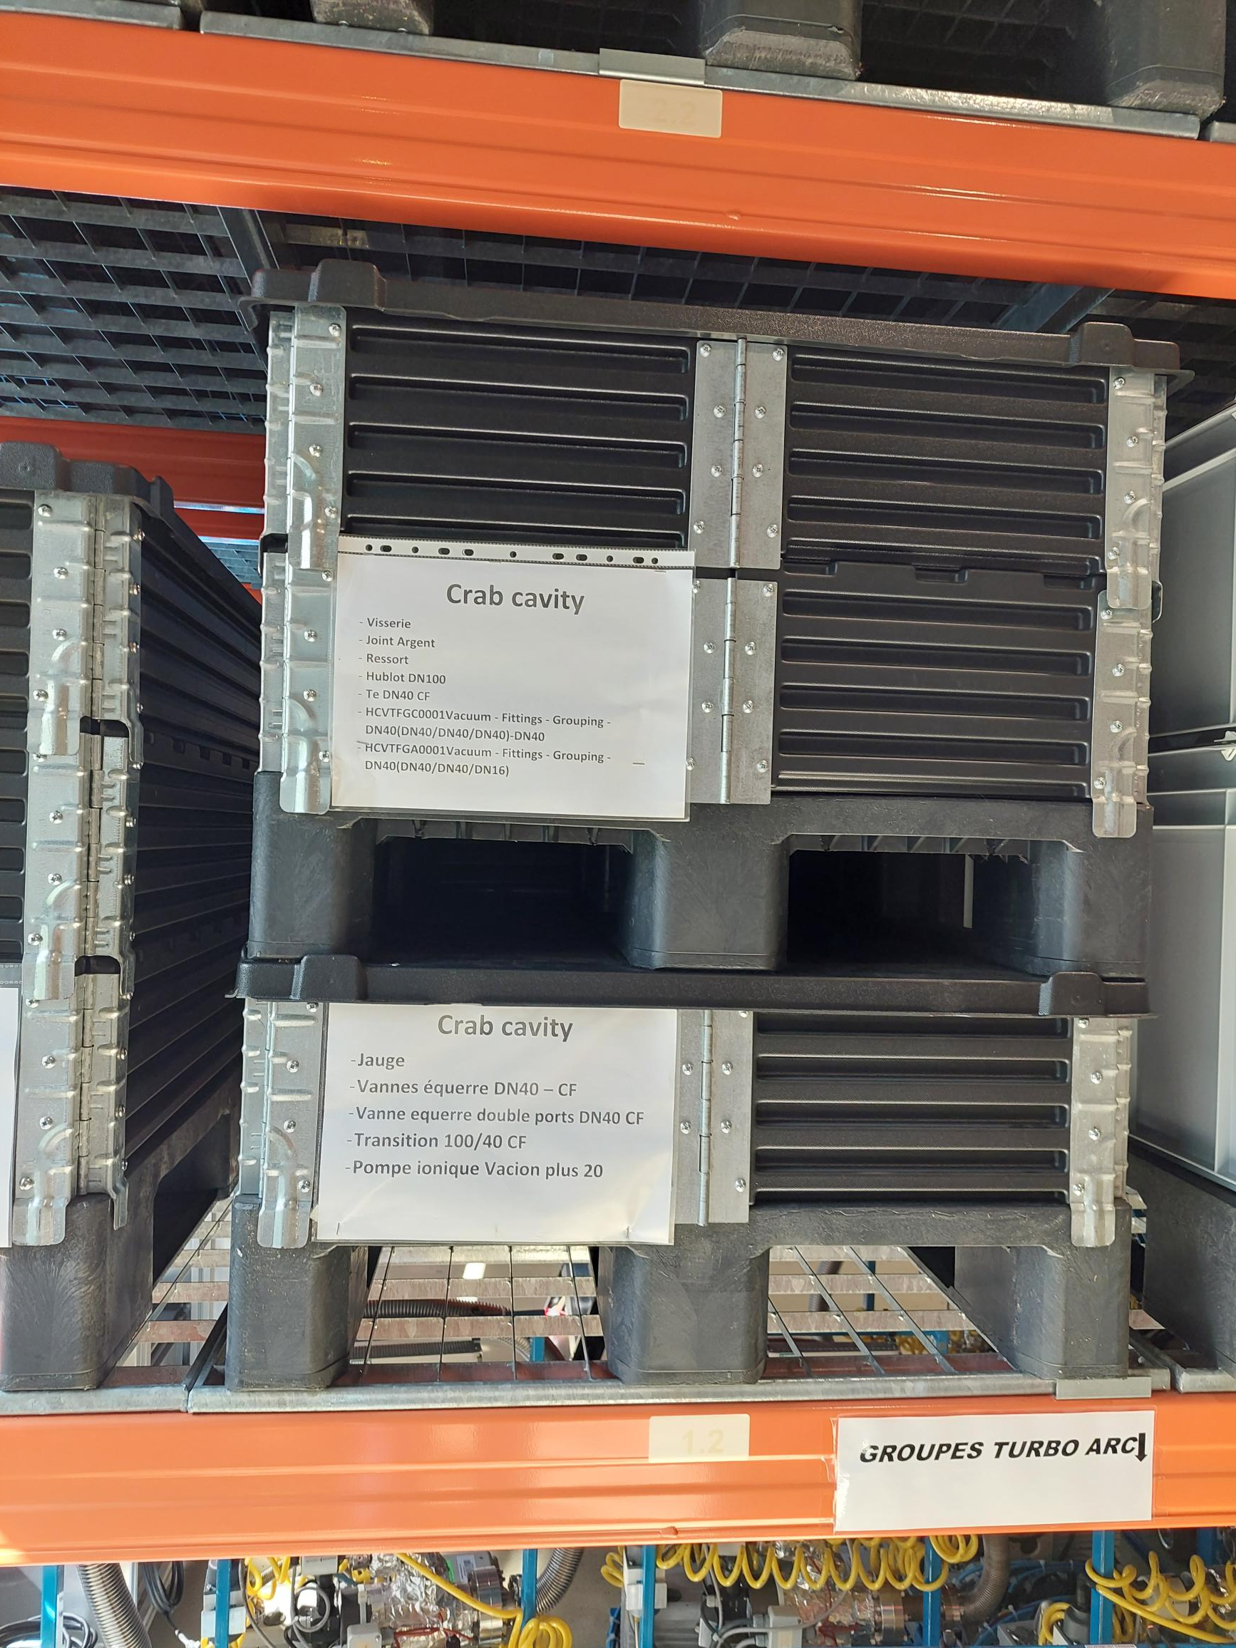
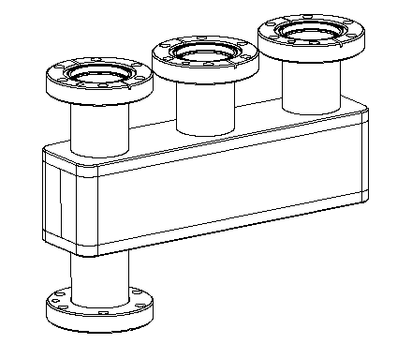
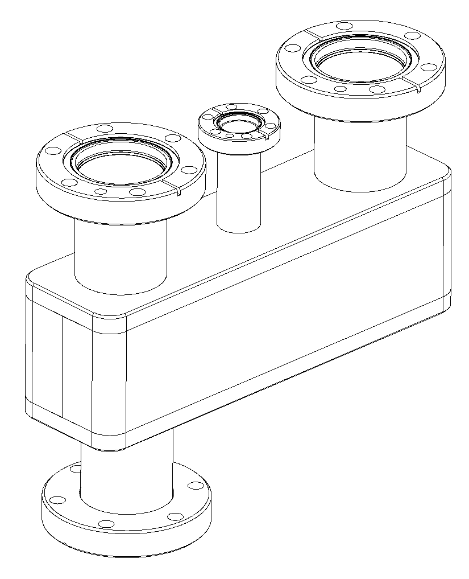
Standard equipment
Production / procurement completed
Item | Needed | Spare | Received | Comments
Vacuum Manifold (VGP, VGR, VVR, VV) | 40 | 2 | 42 21 (LHCVTFGC0001) 21 (LHCVTFGA0001) | 4 delivered to UK
Other/Standard Equipment’s:
Rupture disks
Ion pumps
Gauges
Roughing valves
Vacuum transition
LHCVTFGC0001
All ordered/Received
Vacuum manifold in CERN stores
LHCVTFGA0001

Slide 12
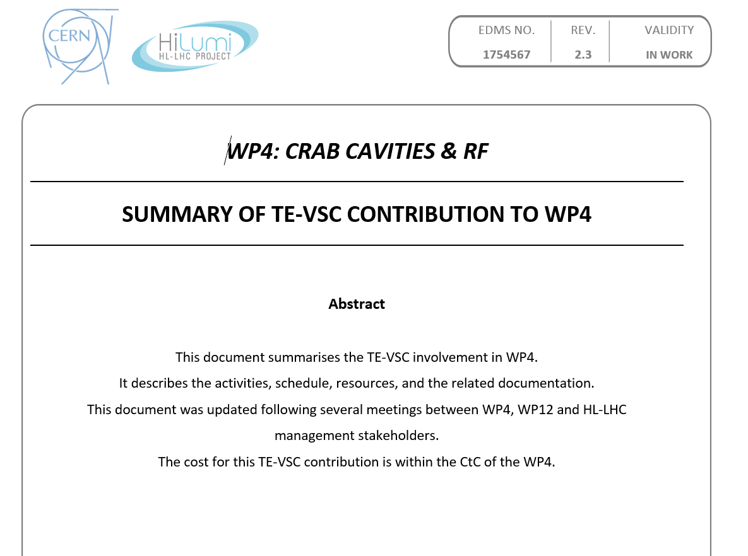
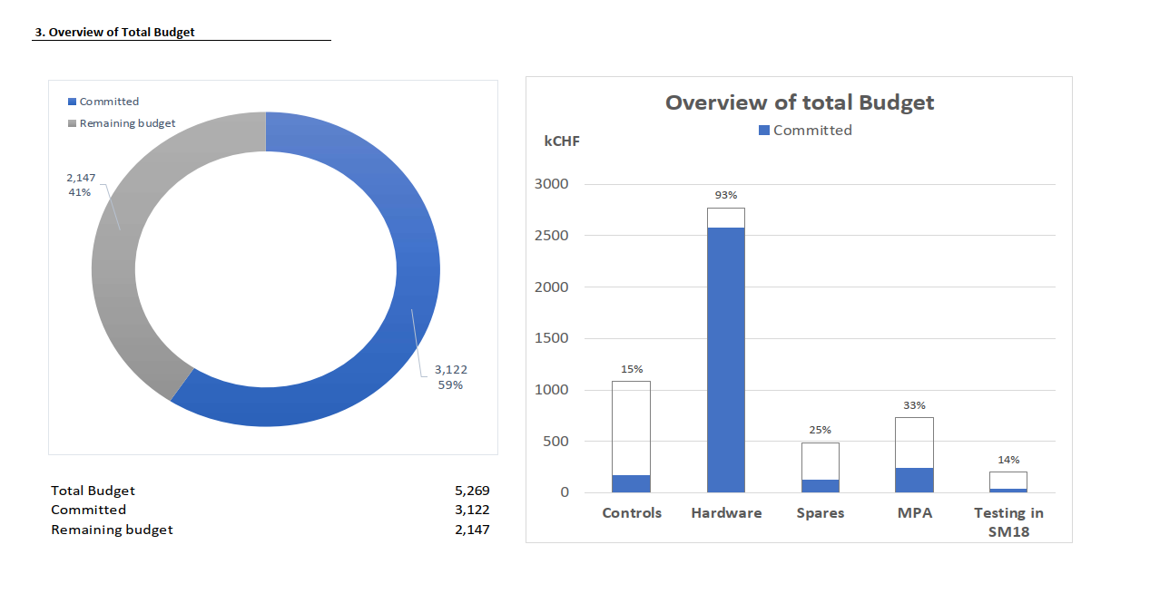
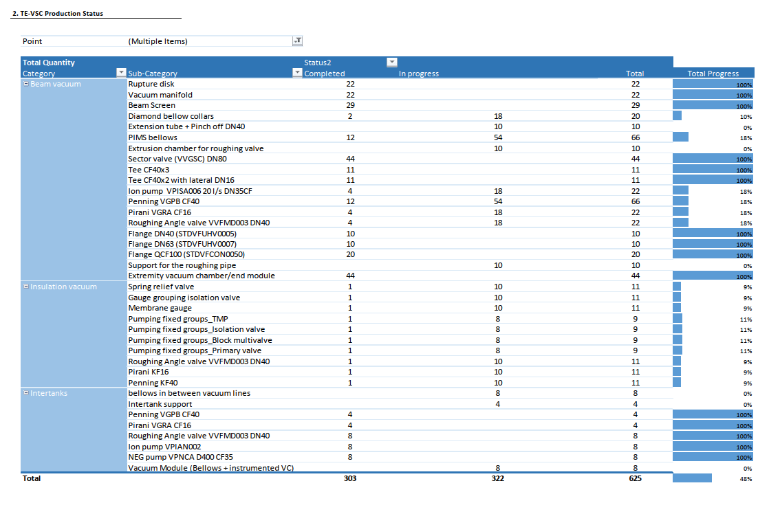
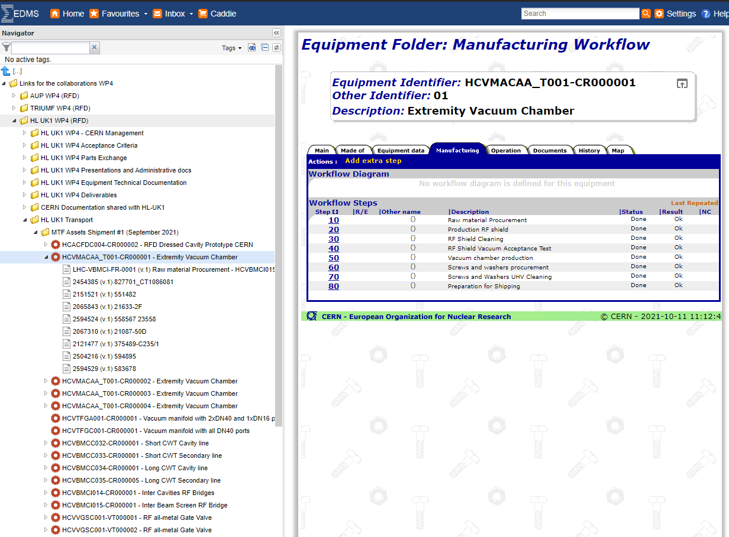
Project & quality management
TE-VSC Contribution to WP4 definition
TE-VSC WP4 contributions EDMS node:
  TE-VSC production Plan
  Spending Profile
  Long Term Planning (WP4 planning)
  List of Assets
  Monthly reports
Production status for a specific item and related documentation
TE-VSC Budget follow-up
TE-VSC Production follow-up
TE-VSC MTF

Slide 13
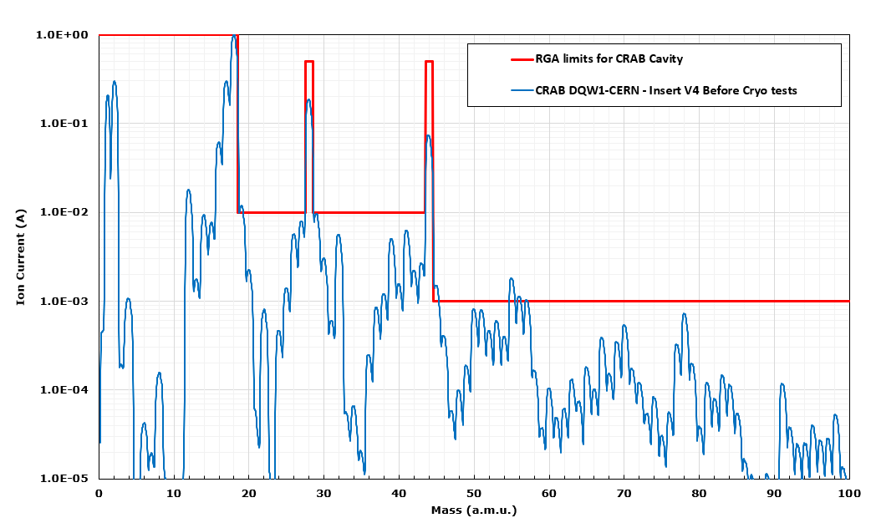
Vacuum acceptance tests
Residual gas composition.
  The RGA scan must be normalized to the highest peaks (H₂ or H₂O) and the RGA is considered non-conform if one of the following levels is not respected (EDMS 2779658)
    Highest gas not being H₂ or H₂O;
    Mass of 40 (argon) > mass 39: indication presence of air;
    Light hydrocarbon (27,29,35,37,39,41): at least 100 times lower the maximum peak;
    Masses > 50: at least 1000 times lower the maximum peak;
    Presence of mass 4 (He).

Slide 14
3. Layout

Slide 15
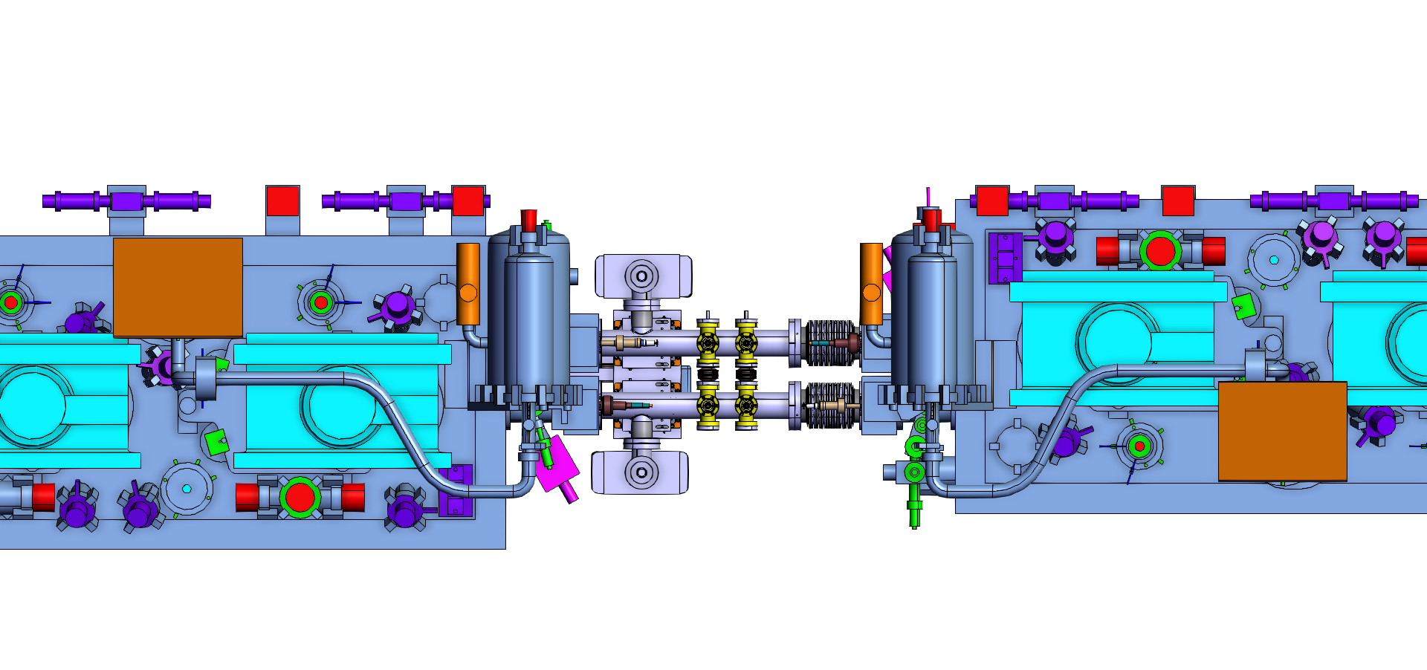
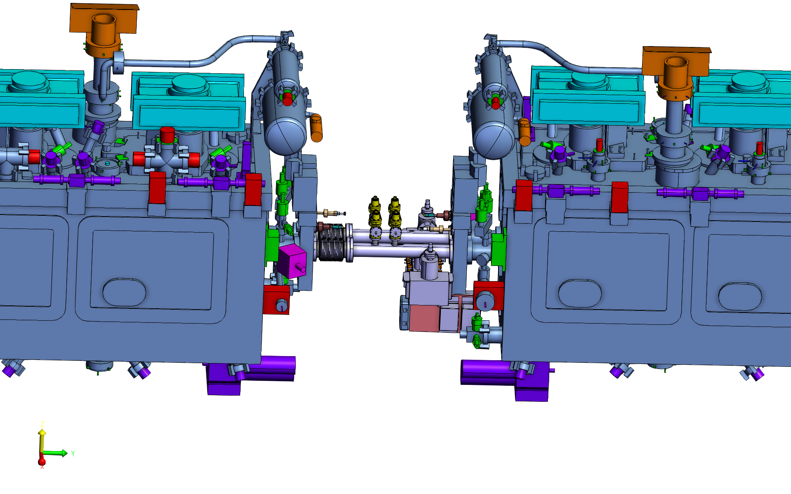
Inter-crab vacuum sector: integration
Inter-tanks cryomodules design is at his final step
Layout already in Optic LS3 V1.7 of Layout Data Base
Engineering report will circulate soon for a final approval at the project level:
  EDMS 2045739
LSS5R
Top view
Side view
Optics v1.7

Slide 16
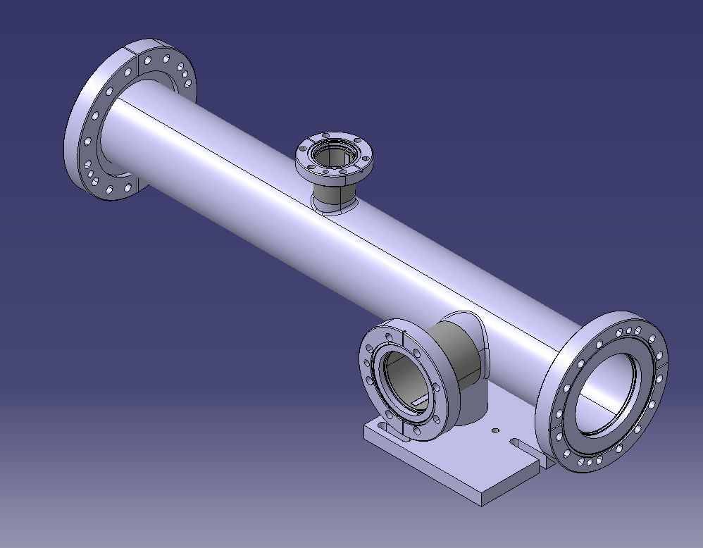
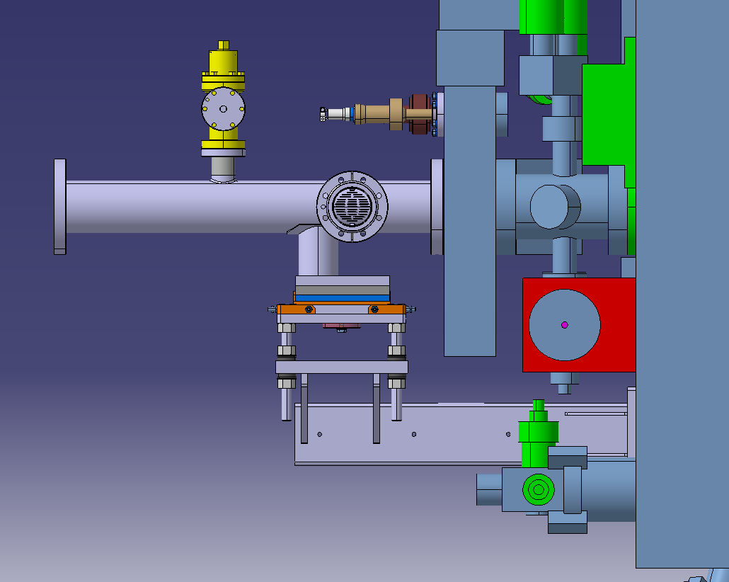
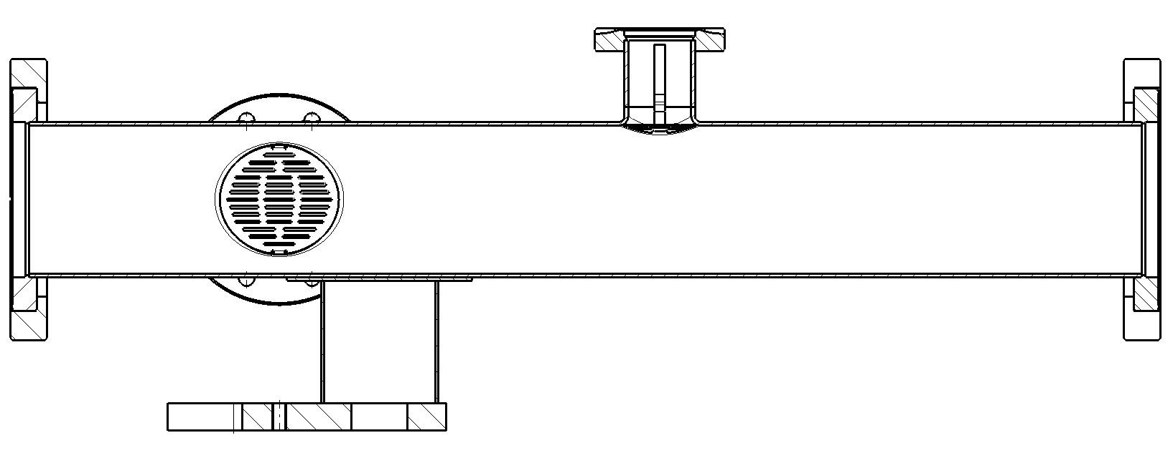
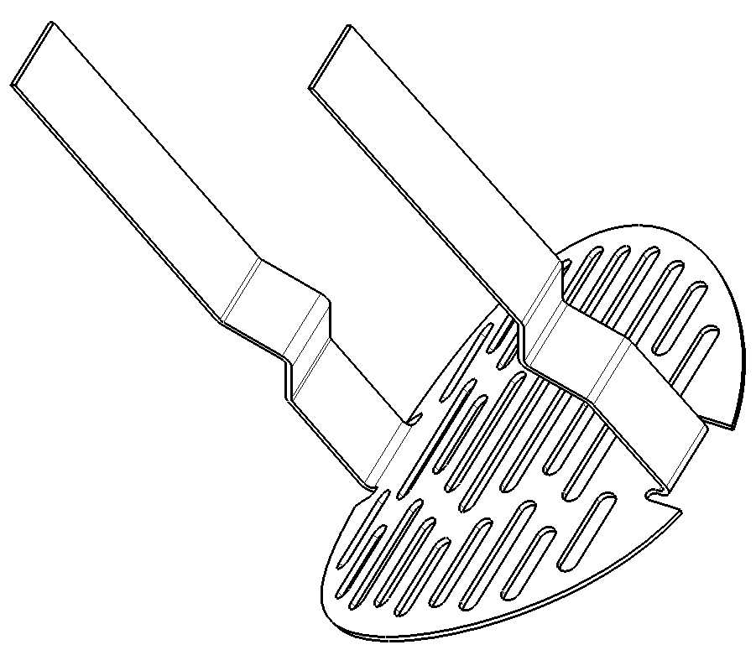
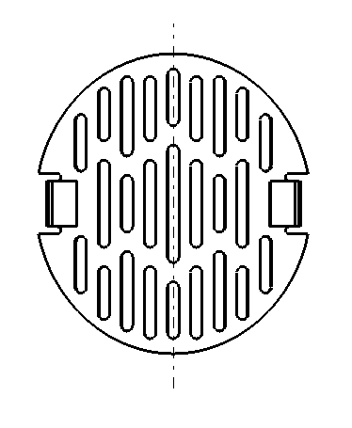
inter-crab vacuum sector: components
Compact and easy installation or intervention
Support integrated in the CRAB vessel (EDMS 2899757)
Stainless steel vacuum fired
Copper Pated, NEG coated
Special RF shield for pumping and valves ports

Slide 17
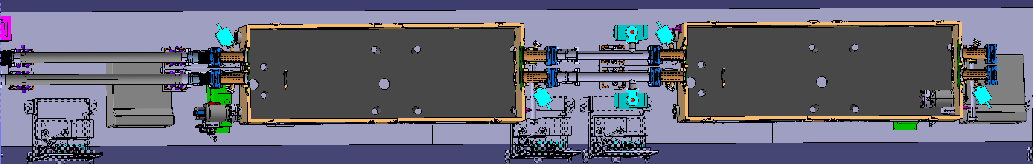

Electron cloud mitigation
NEG
NEG
NEG
Crab cavities are not expected to contribute to the e-cloud: EDMS 2663141
aC
aC
aC
aC
No coating
No coating

Slide 18
Pressure profile in D2-Q4
Simulations of the blue beam (B1) in LSS1R as a worst-case scenario:
  LSS1: shorter inter-cavity sector
  Outgoing beam from IP having more SR radiation from the D2 dipole
Three configurations investigated:
  All extremity vacuum chambers uncoated
  Baseline: aC coating on the extremity vacuum chambers of the non-crabbed line only
  All extremity vacuum chambers aC coated
D2
CC
CC
TCLM
Q4

Slide 19
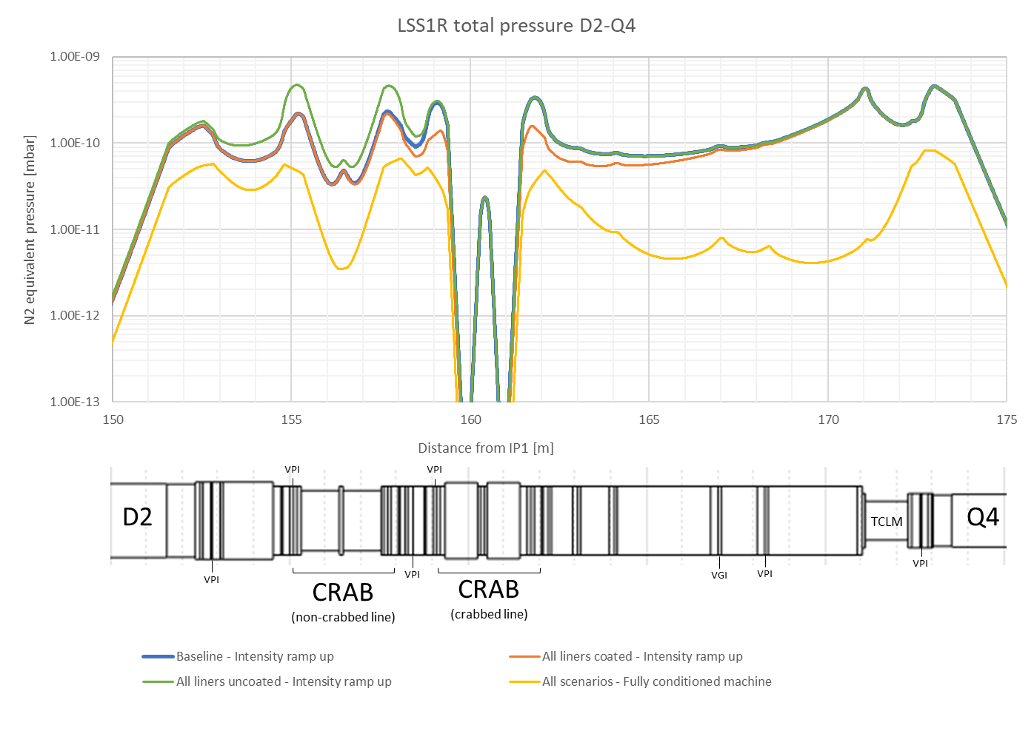
Pressure profile in D2-Q4
Beam parameters:
  Energy: 7 TeV
  Intensity: 1.08A per beam
  (2748 bunches, 2.2×10¹¹ppb)
Baseline:
  P@NCL = 2 10⁻¹⁰ mbar
  P@CL = 3 10⁻¹⁰ mbar
All aC coated:
  P@NCL = 2 10⁻¹⁰ mbar
  P@CL = 1.5 10⁻¹⁰ mbar
Full conditioned machine:
  P@NCL = 4 10⁻¹¹ mbar
  P@CL = 4 10⁻¹¹ mbar

Slide 20
Thank you for your attention
Many thanks to all contributors

Slide 21
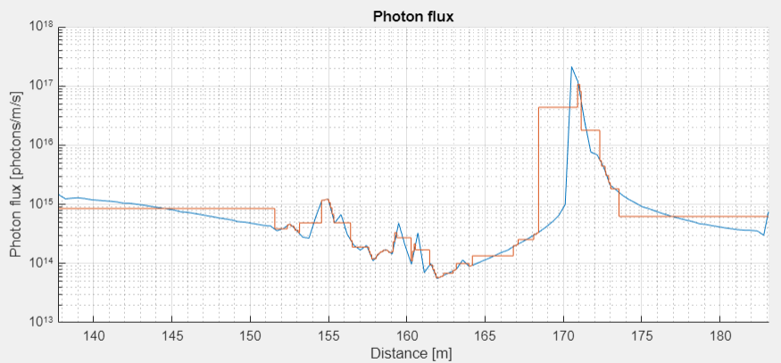

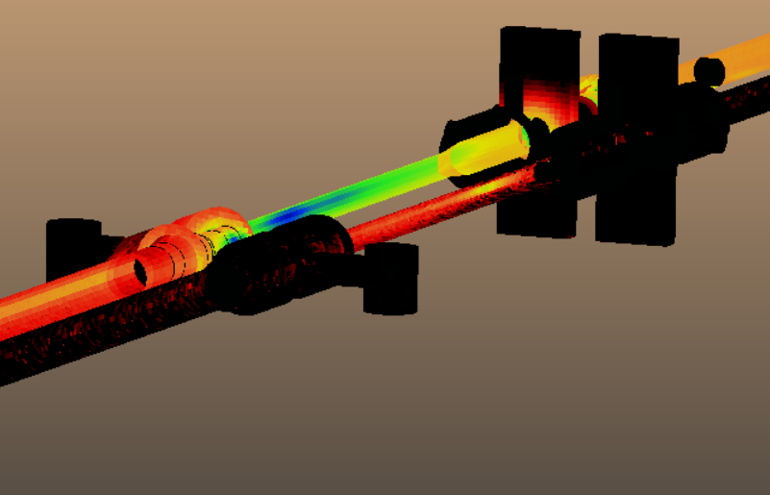
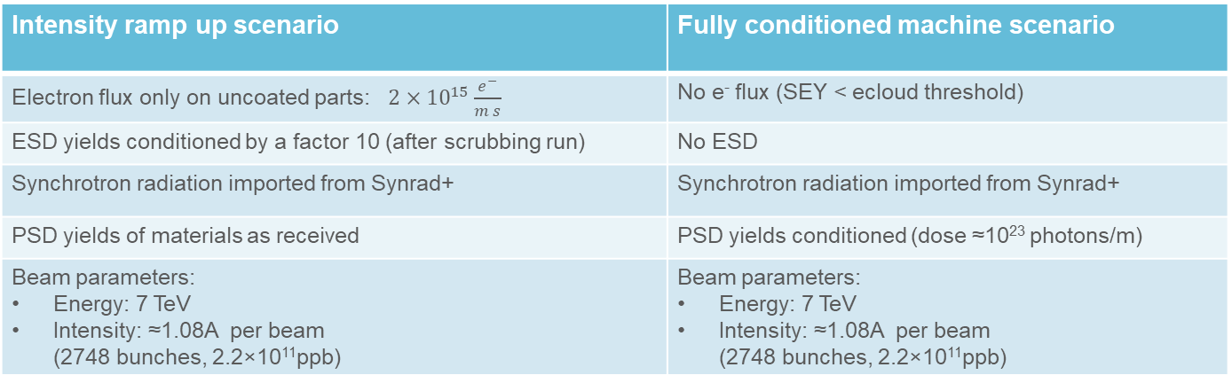
Inputs for simulation scenarios
Intensity ramp up scenario | Fully conditioned machine scenario
Electron flux only on uncoated parts: $2×{10}^{15}\frac{e^{−}}{m s}$ | No e⁻ flux (SEY < ecloud threshold)
ESD yields conditioned by a factor 10 (after scrubbing run) | No ESD
Synchrotron radiation imported from Synrad+ | Synchrotron radiation imported from Synrad+
PSD yields of materials as received | PSD yields conditioned (dose ≈10²³ photons/m)
Beam parameters: Energy: 7 TeV Intensity: ≈1.08A per beam (2748 bunches, 2.2×10¹¹ppb) | Beam parameters: Energy: 7 TeV Intensity: ≈1.08A per beam (2748 bunches, 2.2×10¹¹ppb)
Notes:
Note that the script to extract the photon flux from synrad does a first averaging on segments of ~1m of lenght

Slide 22
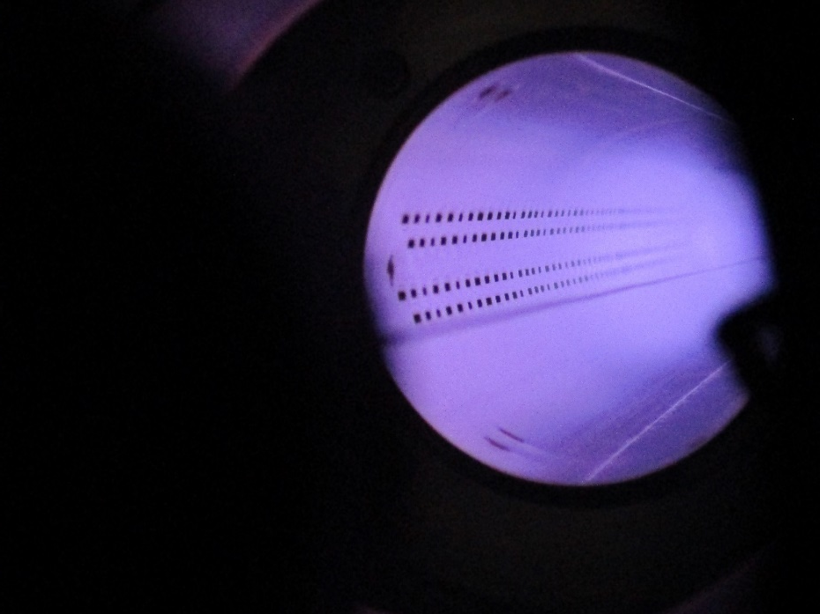
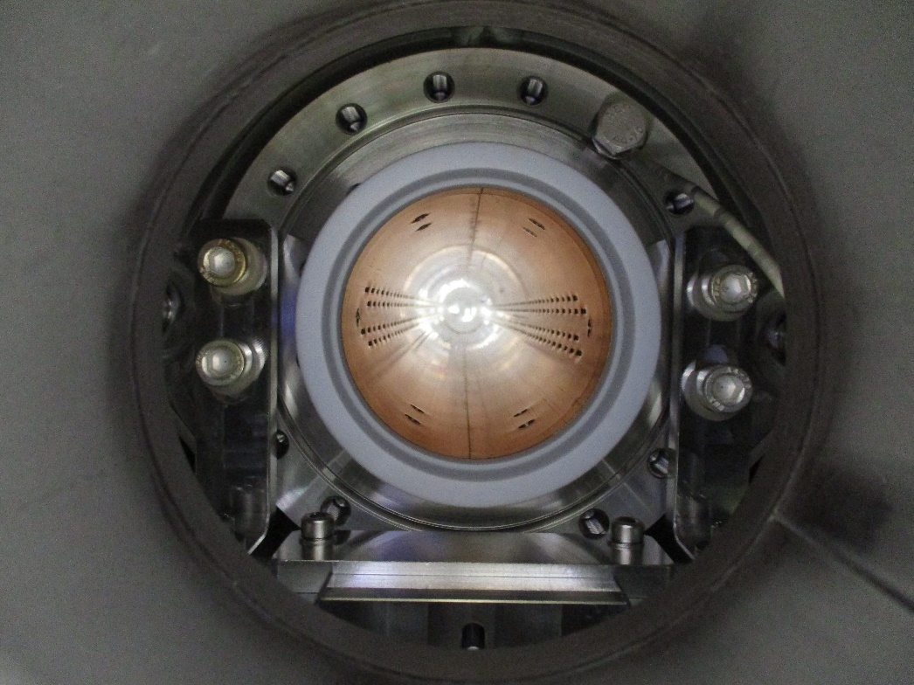
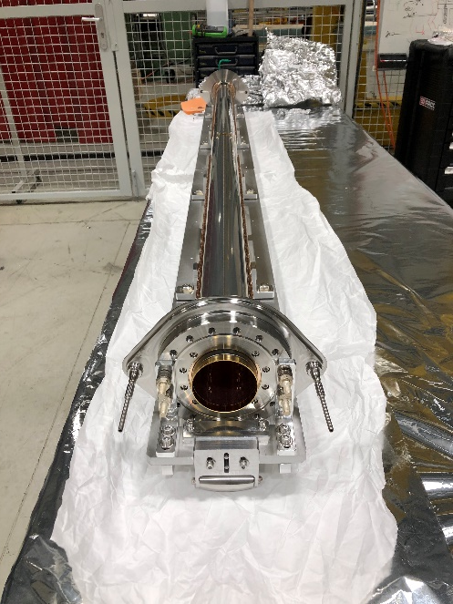
a-C coating for beam screen: Argon cleaning
Argon glow discharge surface preparation step before a-C coating
  Remove the native oxide layer
  Then build a new oxide layer with dry air to avoid presence of copper hydroxides, detrimental for the adhesion.
Beam screen
Insertion on special support system
Plasma cleaning process

Slide 23
Plasma cleaning of cold bore
Plasma cleaning of the cold bore using O2 glow discharge.
  Generation of a plasma inside the cold bore, using a Ti wire in the centre of the cold bore as anode and grounding the cold bore, that acts as a cathode.
  O radicals and O ions are formed and clean the cold bore surface.
  The O ions acquire an energy of ~200 eV and cause some sputtering of the cold bore.
  The cleaning effect is clearly seen by comparing the spectra before and after cleaning. (the cold bore was dirty)
ONGOING:
  Finalization of a plasma cleaning process using a “remote plasma source”: the plasma is generated in a source and then injected in the cold bore -> The main advantages are the lower energy of the ions (~50 eV, practically no sputtering), and the simplicity (do not require the assembly of an anode; easier to operate).

