Slide 1

UK DQW Challenges & Schedule Discussions
Niklas Templeton – STFC Daresbury Laboratory
On behalf of the UK Crab Cavity collaboration
13th HL-LHC Collaboration Meeting – Vancouver (CA) – 27 Sep ‘23

Slide 2
UK DQW Challenges & Schedule Discussions
Schedule
  Keys to success
Open discussion on challenges & mitigations
  Please contribute
  I don’t want to talk everyone to sleep (even more)
Comments, suggestions, questions on all UK talks

Slide 3
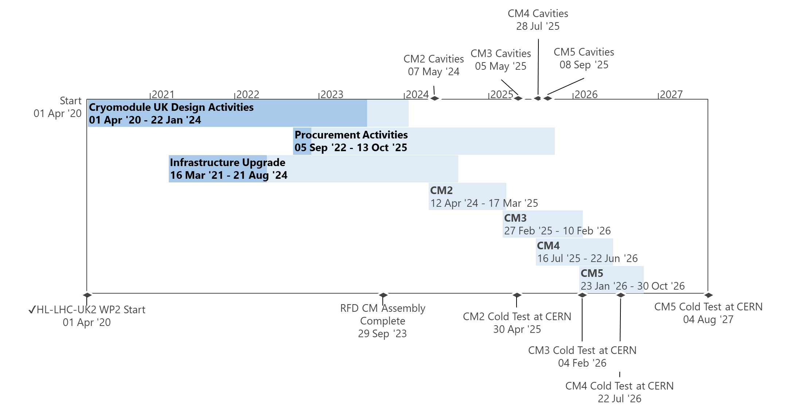
UK DQW Schedule
Success Requirements
Maintain effort & output
Use experience & lessons learnt
Keep staff + more where & when need
Upskilling new technicians for parallel build management
Better suppliers & supplier management

Slide 4
Equipment Challenges
# | CHALLENGES | TYPE | CRITICAL (/5) | MITIGATION OPTIONS | ACTION(S) | OWNER
1 | Cryoline raw materials (plates, tube, bar) | Equip. | 5 | CERN supply low vol items (t>15mm) STFC & TRIUMF share plate proc. (t<15mm) | Evaluate combined plate requirements & options | RL
2 | Equipment underspend FY23/24 | Finance | 4 | More CM Proc. info & drawings Bring forward off-shelf / short-lead items FSI? Instruments? More raw materials, rf adaptors?
5 | Parts Management (storing & locating) | Equip. | 4 | Collaboration knowledge transfer 5S consultancy Improved incoming travellers
15 | Fastener grades, mag perm, coating & venting | Equip. | 2 | Relax and/or simplify specs Procurement support

Slide 5
Staff Challenges
# | CHALLENGES | TYPE | CRITICAL (/5) | MITIGATION OPTIONS | ACTION(S) | OWNER
7 | Retaining key staff | Staff | 4 | New pay deal DL Programme resource discussions Rewards & recognition
8 | Securing & training additional mech techs | Staff | 4 | RFD Technician knowledge transfer Technician CERN & TRIUMF knowledge transfer visits UK-CM2 placements for new staff
9 | Apprentice supervision load | Staff | 3 | Discussed with apprentice & DL management Improved Tech Man planning | Raise formally | NT
17 | Info & EDMS drawing releases | Staff | 3 | More design & manufacturing readiness reviews Improve release processes
16 | PLM usability (where used & export BOMs) | Staff | 2 | Improve usability & access Use EDMS instead CERN BOM Support
19 | Procedure bottleneck | Staff | 1 | More staff Improved & hybrid styles (detailed vs lightweight) Use CERN DQW
20 | Coded & Orbital Welding | Staff | 0 | More welding and weld eng staff

Slide 6
Management Challenges
# | CHALLENGES | TYPE | CRITICAL (/5) | MITIGATION OPTIONS | ACTION(S) | OWNER
12 | Co-ordinating specialist resource & visits | Planning | 4 | Develop & improve DQW logic poster | Draft poster logic with CAD for discussions | EJ
6 | Storage space | Infrastr. | 3 | Build area optimisations on-site mitigation options
11 | Top plate integration strategy | Infrastr. | 3 | Design mods: gantry, floor, pushers, FPC top-hat Survey & rigging analysis
18 | In & Out manufacture processes | Infrastr. | 2 | On-board machinist

Slide 7
QA & Technical Challenges
# | CHALLENGES | TYPE | CRITICAL (/5) | MITIGATION OPTIONS | ACTION(S) | OWNER
3 | Supplier QA | QA | 5 | Free issue materials Market surveys Large tender processes - more control More staffing
4 | Protecting bellows | Technical | 5 | Bellow guards on as much as possible (Eliminate, Reduce, Isolate, Control, Protection, Signs)
10 | Survey effort & strategy | Technical | 3 | Recruitment, upskilling, outsourcing Changing & improving strategy
13 | RF tasks | Technical | 3 | Better planning, Upskilling (UK), more staff (CERN)
14 | EDMS & MTF barriers & workload | QA | 3 | Local Instructions / Procedures, more training, resource management, outsourcing

Slide 8
Comments, suggestions, Qs for UK
…

Slide 9

Thank You! Questions?

Slide 10
UK DQW Project Structure
HL-LHC-UK PM
Graeme Burt
Tech Oversight
Phil Atkinson
CC Sponsor
Ian Lazarus
WP Lead
Nik Templeton
New/Change
Leaving project
Specialist Support
Tech Manager
Paul Hindley
PM Support
Anna Vikhoreva
Riggers
Tooling & Procedure Lead
Ed Jordan
QA & Weld Lead
Carlos G
FAT Lead
Andy B-M
Lead Technician
Luke Bladen
Senior Technician
Tom Hanley
Survey & Alignment
Ryan Cash
Outside Manufacturing (Procurement)
Senior Mech Eng
James Bourne
Welder
John Hassall
Senior Vac Eng.
Stuart Wild
Cryo Tech
Ivan S
Technician
Abigail Lee
+2 Mech Tech’s (peak)
Mech Eng
Ricardo L
In-house Manufacturing
YII Mech Eng
Luke C
Vac Eng.
Ollie Poyton
Design Apprentice
Dan Skae
Mech Tech Apprentices
Vac Processing
Logistics
*Does not reflect STFC pay bands. Some staff are shared between multiple projects.

Slide 11
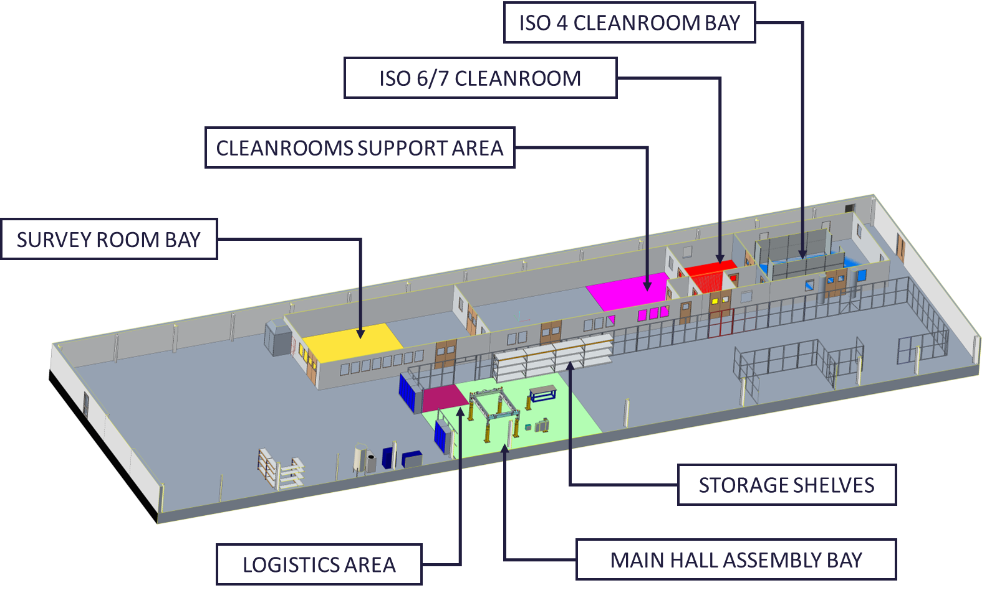
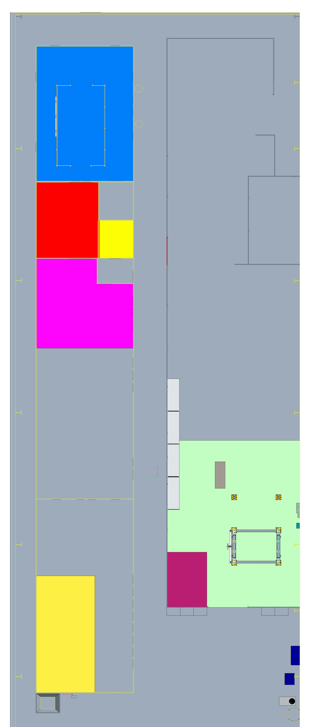
Infrastructure Layout

