Slide 1

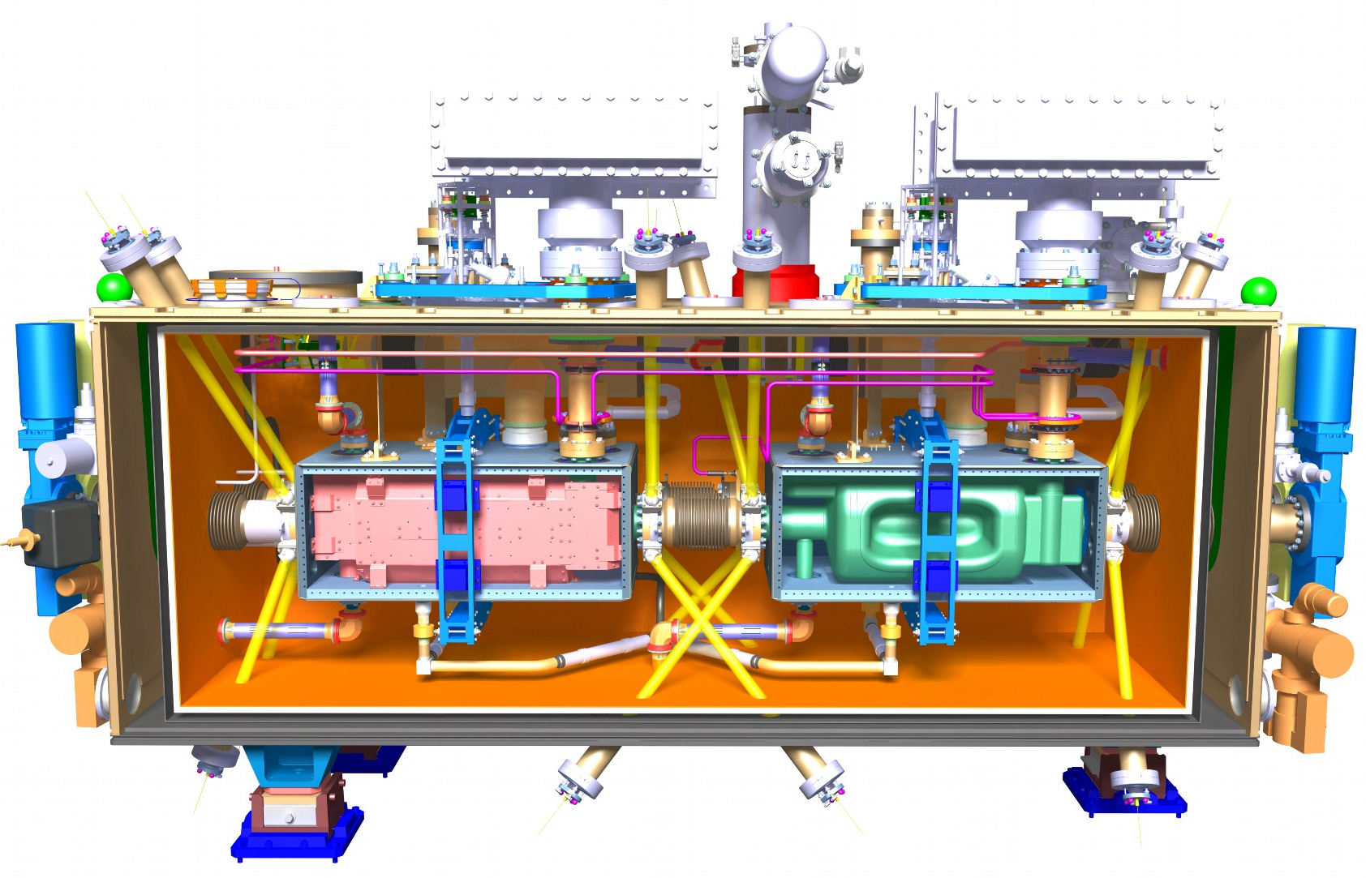
RFD Engineering Issues – Interpreting European standards for North America manufacture
Oliver Law
Project Engineer – TRIUMF contribution to HL-LHC collaboration
TRIUMF

Slide 2
Project Overview
TRIUMF is to assemble and qualify 5 cryomodules for the Hi-Lumi upgrade under the WP4 collaboration and ship to CERN
Current project status:
  TCM0 - Outer Vacuum Chamber (OVC) has been awarded to a local company (est. March 2024) and pre-fabrication documentation is in progress
  Clean room & Mu-Metal (series) contracts awarded
  In-house tooling and fixtures in design/manufacturing phase
  Material for the OVC series has been procured (est. mid-October 2023)
Future outlook:
  Series OVC will be contracted out following the successful site acceptance tests and approval of TCM0 OVC
  MLI, Cryo lines, Thermal shield, etc. contracts

Slide 3
OVC Documentation
Pre-Fabrication Phase
Document Name | Type | Standard | Action | Status | Notes
3D Models | Design | N/A | N/A | Completed
2D drawings | Manufacturing | ASME Y14.5 | N/A | Completed
Manufacturing drawings | Manufacturing | ASME Y14.5 | TRIUMF | In Progress | Under internal review prior to EDMS/MTF
Manufacturing and Inspection Plan (MIP) | Manufacturing | Axton | Axton | In Progress | Document in progress
Welder Certification | Certification | ISO 9606-1 | Axton | In Progress | Certification in progress
Welding Procedure Specifications (WPS) | Certification | ISO 15609-1 | Axton | In Progress | Document in progress
Welding Procedure Qualifications Records (WPQR) | Certification | ISO 15613 ISO 15614-1 | Axton | In Progress | Document in progress
Raw material certificates | Material | EN 10204 Type 3.1 | TRIUMF | In Progress | Expected mid-October 2023
Filler material certificates | Material | EN 10204 Type 2.2 (or higher) | CERN | In Progress | https://edms.cern.ch/document/2953464/1
Material samples | Material | N/A | TRIUMF | In Progress | Waiting for material to be received
Scheduling (incl. preliminary dates) | Project | Axton | Axton | In Progress | Document in progress
Traceability procedure | Manufacturing | Axton | Axton | In Progress | Procedure document in progress
Cleaning procedure | Manufacturing | TRIUMF | TRIUMF | In Progress | Draft document in progress
Leak test procedure | Manufacturing | TRIUMF | TRIUMF | In Progress | Draft document in progress

Slide 4
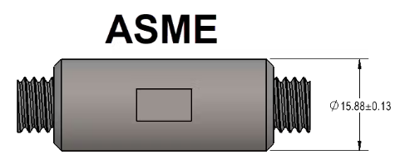
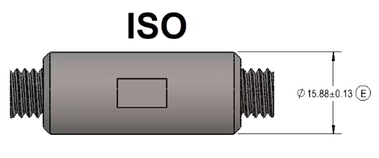
Engineering Challenges – North American Manufacturing
Manufacturing Drawings Interpretation - ASME Y14.5 vs ISO GPS
Interpreting ISO GPS-compliant drawings for North American manufacturers
Symbology and intent generally identical but unfamiliarity with ISO GPS standards can lead to reluctancy to bid or manufacturing errors
Example: Envelope vs Independency Principle
  ASME Y14.5 Rule #1: Envelope Principle
    The form of a regular feature of size is controlled by its “limits of size.”
    Boundary prescribed by feature of perfect form at MMC
  ISO GPS: Independency Principle
    Each dimensional or geometric tolerance is met independently unless a relationship is specified on the drawing

Slide 5
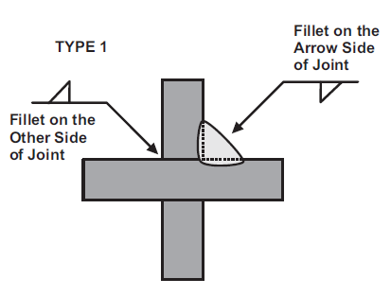
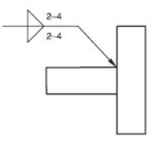
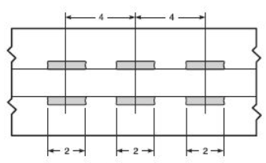

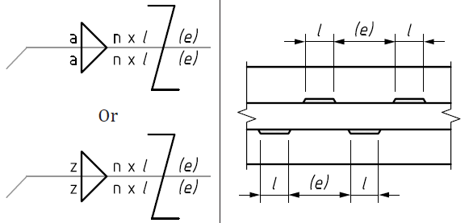
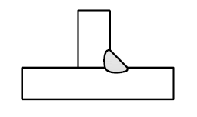
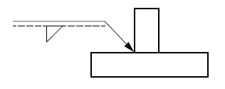
Engineering Challenges – North American Manufacturing
Manufacturing Drawings Interpretation – AWS A2.4 vs ISO 2553
AWS A2.4: Standard Symbols for Welding, Brazing, and Nondestructive Examination
ISO 2553: Welding and allied processes – Symbolic representation on drawings
Symbology and intent generally identical but without knowledge of specific differences can lead to misinterpretation of resulting welds
AWS A2.4
ISO 2553 – System A

Slide 6

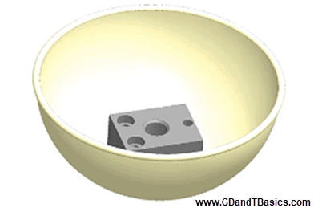
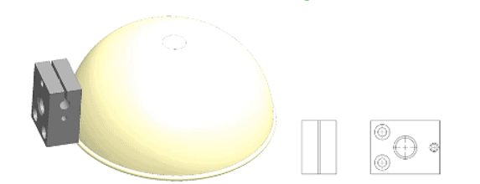
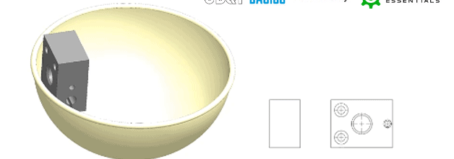
Engineering Challenges – North American Manufacturing
Manufacturing Drawings Interpretation – First vs Third Angle
First Angle Projection
Third Angle Projection

Slide 7
Material Requirements and Procurement
TRIUMF is responsible for the procurement of all material for the series OVC
Current status: Production series ordered (Outokumpu). Expected delivery mid-October 2023.
Approval for EN 1.4307 (304L) to be used with additional chemical composition requirements:
  Co < 0.3 wt%
  P < 0.03 wt%
  S < 0.015 wt%
Challenges:
  Metric sizing – specifically plate thicknesses and availability
    35mm vs 38.1mm (1.5in)
    30mm vs 31.75mm (1.25in)
  Cobalt content restriction

Slide 8
Challenges – Weld Qualifications
ISO/TR 15608 and Qualification of Non-Standard Joints
ISO/TR 15608: Welding – Guidelines for a metallic materials grouping system
  Provides guidelines for grouping materials for welding purposes
  Group 8, Subgroup 8.1: Austenitic stainless steels with Cr ≤ 19 %
EDMS 2706475: Welded Joints for DQW & RFD Crab Cryomodule
  Section 2: Qualification of Non-Standard Joints
    The 304L (1.4306, 1.4307) / 316L (1.4404, 1.4435) / 316LN (1.4429) being in the same material group 8.1, it is accepted to use the 316L as the base material for the samples required by the qualification process
    Corrected to: “it is accepted to use any of these alloys as the base material for the samples required by the qualification process”
Weld filler material: ER317L (mod.) / EN ISO 14343-A – W Z 18 16 5 Mn N L
  Production series received – inspection certificate 3.1 (EN 10204) under review
  https://edms.cern.ch/document/2953464/1

Slide 9
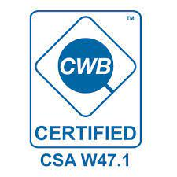

Challenges - Welder Qualifications
CSA W47.1 vs ISO 9606-1
No reciprocal agreement exists between CSA and ISO allowing the acceptance of either standard to the other
Canadian Welding Bureau (CWB) is permitted to test welders to ISO 9606-1 provided the appropriate WPS are submitted
Local third-party certification companies available to create WPS and WPQR according to ISO 15609-1 and ISO 15613/15614-1 – suggestions given to supplier

Slide 10
Leak Testing Procedure & Personnel Qualifications
TRIUMF personnel will perform the leak tests on the OVC using TRIUMF equipment
Leak check procedure document draft in progress
Laboratories under WP4 Collaboration are given 3 options:
  Personnel shall be qualified to EN ISO 9712 or Recommended Practice No. SNT-TC-1A (minimum level 2, for both)
  Leak-testing personnel provide the following documents:
    Copy of at least 2x leak tests performed in the last 6 months and on equipment with comparable vacuum levels
    Proven experience in comparable vacuum level (ex. 2-3 representative reports spanning the last 3 years)
  Auto-certification of consistent experience (years + vacuum level) must be signed by leak-testing personnel and the project leader
Correction to requirements: No deviation request required
☑
☑
OPTION 2!

Slide 11

Conclusion
TCM0 OVC pre-fabrication documents in progress or waiting for approval
TRIUMF has translated or retained ISO specifications and requirements where applicable
TRIUMF has taken on some of the responsibilities to alleviate the requirements for NA manufacturers (ex. Material procurement & leak checking)
Corrections to specification documents that aid TRIUMF and suppliers in compliance with the requirements have been discussed and approved with CERN
TCM0/Series procurement is ongoing and TRIUMF expects to issue tender contracts within the coming months
CERN/TRIUMF/UK teams' collaboration has proven to be very helpful
Keep your ducks in a row!

Slide 12




Thank you
Merci
www.triumf.ca
Follow us @TRIUMFLab

Slide 13
References
ASME Y14.5 vs ISO GPS:
  https://www.gdandtbasics.com/
  GeoTolPro
First angle vs third angle projection: https://www.gdandtbasics.com/
AWS A2.4: Welding for Design Engineers (CWB – 2006)
ISO 2553: https://www.iso.org/standard/72740.html
CSA W47.1: https://www.cwbgroup.org/certification-and-qualification/csa-w471-fusion-welding-steel-company-certification
ISO 9606-1: https://www.iso.org/standard/54936.html

Slide 14
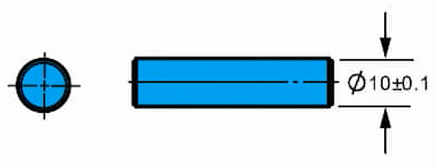
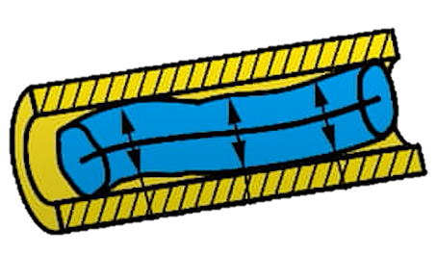
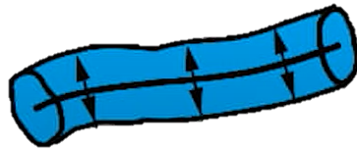
Extra Slides – ASME Y14.5 Rule #1 vs ISO GPS Envelope
MMC: Ø10.1mm
LMC: Ø9.9mm
Rule #1/Envelope Requirement
Without Envelope Requirement
Mating Envelope: Ø10.1mm
No mating envelope applies
Ex. Straightness not controlled
Local size varies between MMC and LMC
Local size varies between MMC and LMC

Slide 15
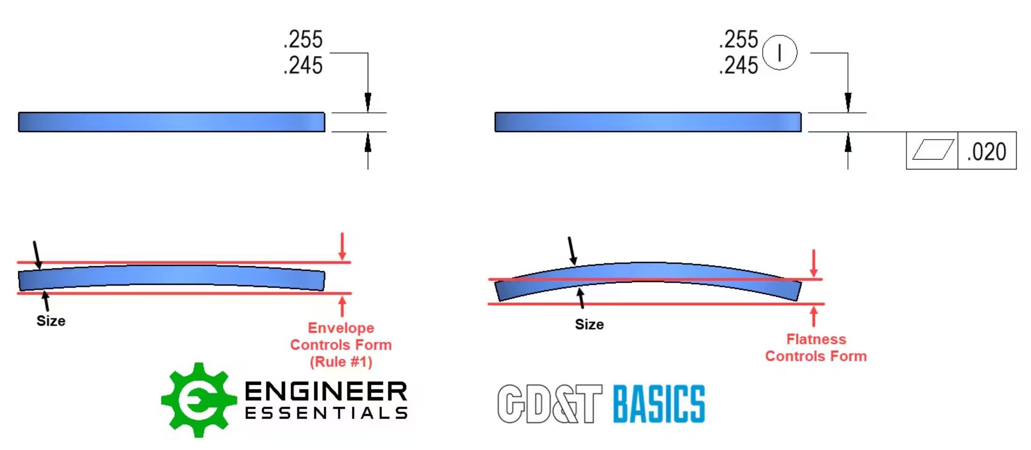
Extra Slides – ASME Y14.5 Rule #1 vs ISO GPS Envelope

