Slide 1

Full Remote Alignment System (FRAS)
Status and plans
Hélène Mainaud Durand, on behalf of WP15.4 members
HL-LHC collaboration board, Vancouver, 27 September 2023

Slide 2
Outline
A short reminder on Full Remote Alignment System (FRAS)
Single Component Test : status
Inner-Triplet String Test: status and next steps

Slide 3
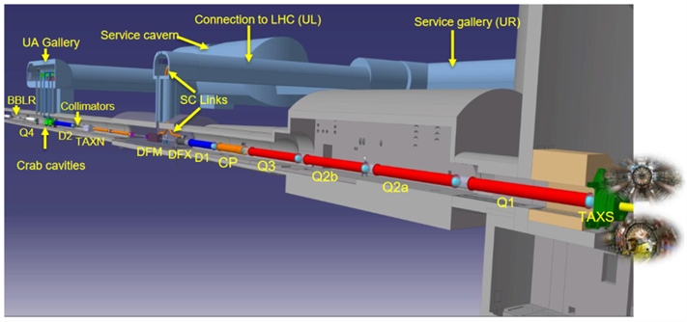
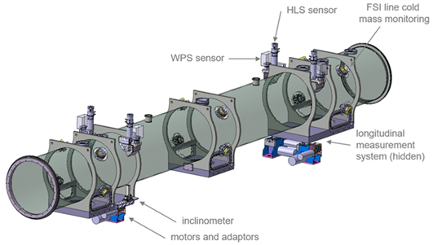
Introduction to Full Remote Alignment System (FRAS)
It consists of alignment systems (alignment sensors, motorized adapters, their acquisition and control/command systems, associated software) allowing to determine the position of components and readjust them remotely within a range of ± 2.5 mm.
FRAS will provide:
  An important reduction of the dose taken by surveyors as no access in tunnel will be needed between YETS or LS
  A reduction in the mechanical misalignment, allowing to decrease the required correctors strength and to push the accelerator performance
  A gain in aperture for several components
All components from Q1 to Q5 will be:
  Either equipped with sensors and motorized axes
  Or FRAS compatible: they are static components that can absorb the displacements of their adjacent components.

Slide 4
Alignment requirements for the components
Alignment objectives (2023) for FRAS
  Position of the components cryostat along one side of the tunnel : +/- 0.1 mm *
  Position of the components cryostat along one side of the tunnel w.r.t the other side : +/- 0.33 mm *
UPS gallery
* On main components
P1
P2
P3
P4
P5
P6
Alignment between Q1 and Q5 :
Limits : σ (1 sigma) < 0.1 mm
Alignment between Q5-left and Q5-right :
Limits : σ (1 sigma) < 0.33 mm
Inner
Tracker
EXP.
Q5
Q4
CC2
CC1
D2
TCLX
TCTPH
TCTPV
TAXN
D1
CP
Q3
Q2b
Q2a
Q1
Q1
Q2a
Q2b
Q3
CP
D1
TAXN
TCTPV
TVTPH
TCLX
D2
CC1
CC2
Q4
Q5
Left
Right
R = 0.33 mm
R = 0.1 mm
R = 0.1 mm

Slide 5
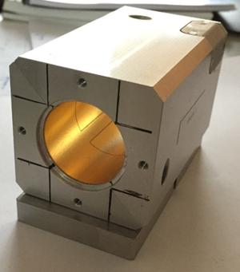
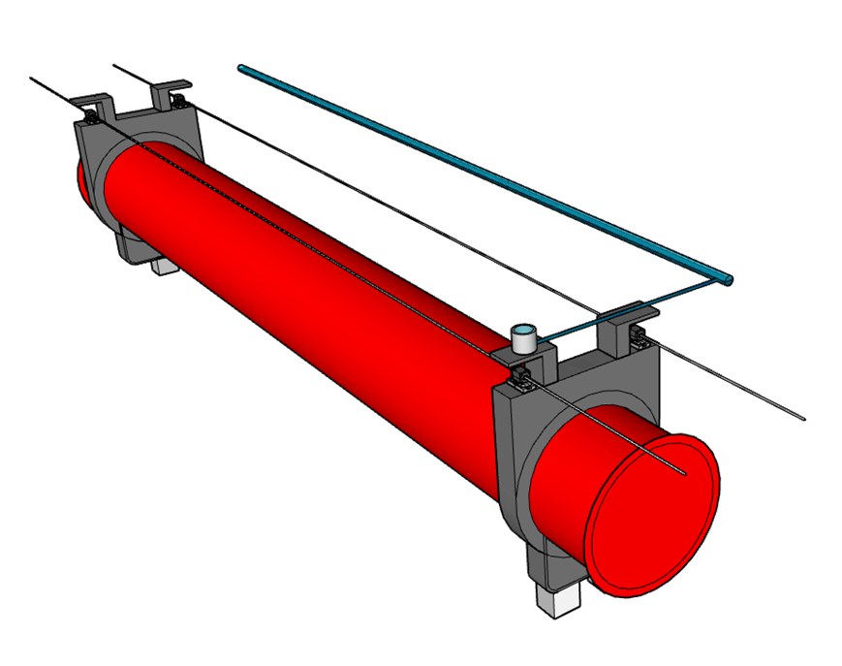
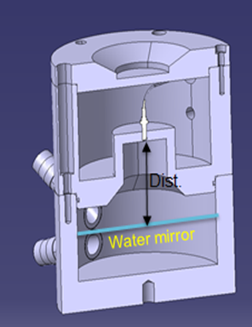
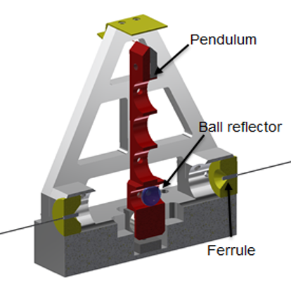
Solutions for Full Remote Alignment
  Wire Positioning Sensors (WPS):
    Based on capacitive technology, performing continuous radial and vertical offset measurements w.r.t. a stretched wire, within a submicrometric resolution
    In-house design based on flexible polyimide PCB with electrodes printed on the surface and coated with gold
WPS
WPS
HLS
  Hydrostatic Levelling Sensor (HLS):
    Based on the communicative vessel principle, performing vertical offset w.r.t. a water surface, within a submicrometric resolution
    Frequency Scanning Interferometry (FSI) technology
    Qualification under finalization
WPS
WPS
  Inclinometers (in-house concept):
    Vertical pendulum measured either via capacitive or FSI technologies
    First tests: repeatability below ±10 µrad

Slide 6

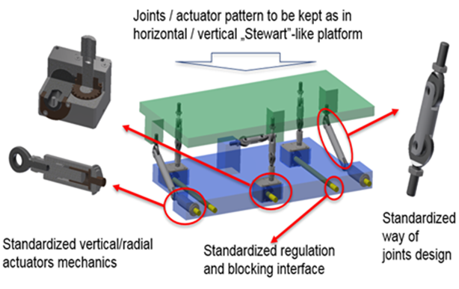
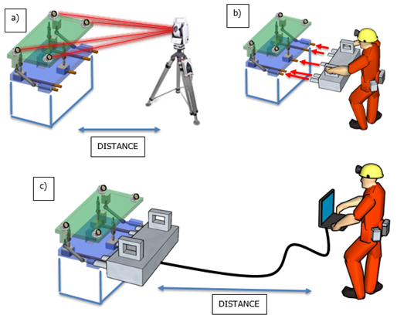
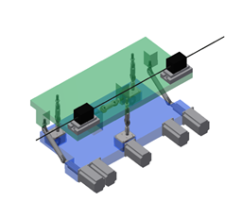
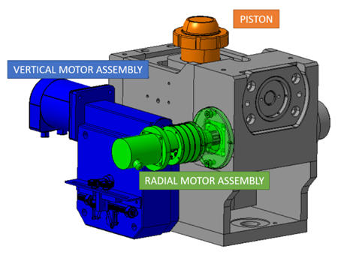
Solutions for Full Remote Alignment
Alignment solutions for a heavy component (> 2 tons)
Alignment solutions for a light component (< 2 tons)
UAP platform permanently equipped with WPS sensors, inclinometers and motor assemblies
UAP platform temporarily equipped with plugged-in motor assemblies

Slide 7
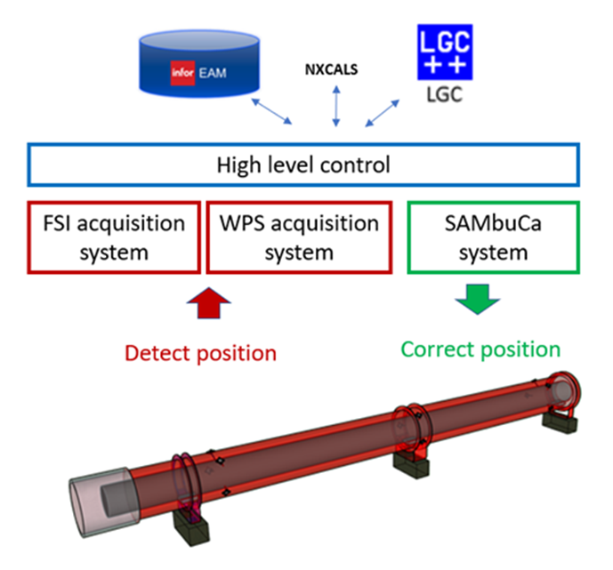
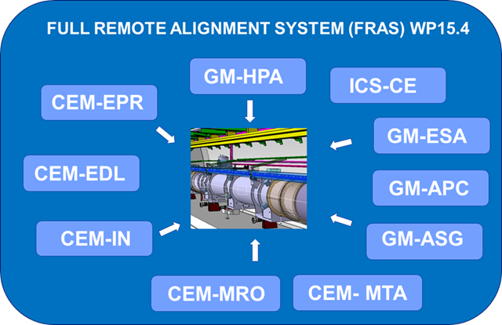
Full Remote Alignment: control/command & acquisition aspects
68 components
In-house designs, with prototypes being qualified on the Single Component Test
Collaboration between 3 groups of the BE department at CERN
9 sensor systems
1150 sensors
344 motors
Acquisition & control/command chain

Slide 8
FRAS risk and safety assessment
  FRAS must be operated and maintained without putting the LHC components or the persons intervening in the tunnel at risk.
  Identification of the main failure modes and their consequences, using the Failure Mode And Effect Analysis (FMECA):
    Damage at an interconnection bellow
    Damage of the HL-LHC components
    Risk for personnel less critical as limited exposure time and all safety procedures already in place.
  Development of control measures reducing the risk to an acceptable level:
    Use of standard IEC 61511-3
    Application of protection layers to mitigate the risk of bellow damage during the displacements of 2 adjacent components: use of independent solutions based on different technologies to determine the 3D position of components and bellows
  Corresponding document approved : EDMS 2727128

Slide 9
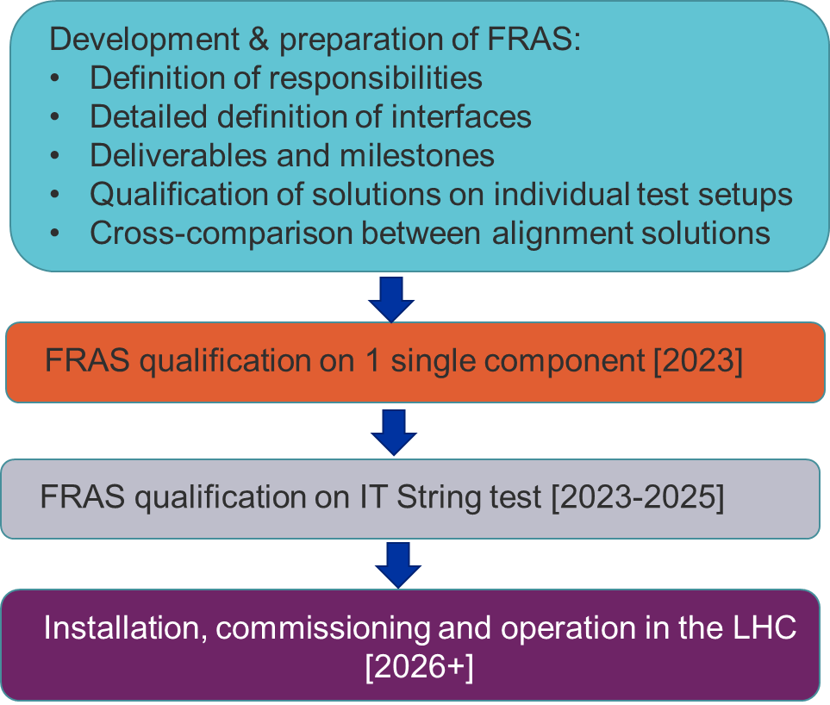
FRAS qualification strategy
We are there

Slide 10
Outline
A short reminder on Full Remote Alignment System (FRAS)
Single Component Test : status
Inner-Triplet String Test: status and next steps

Slide 11
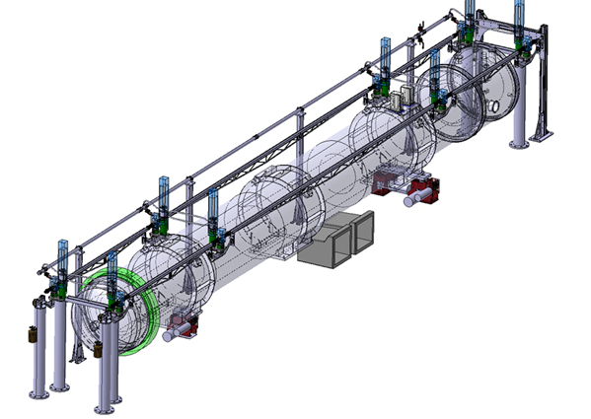
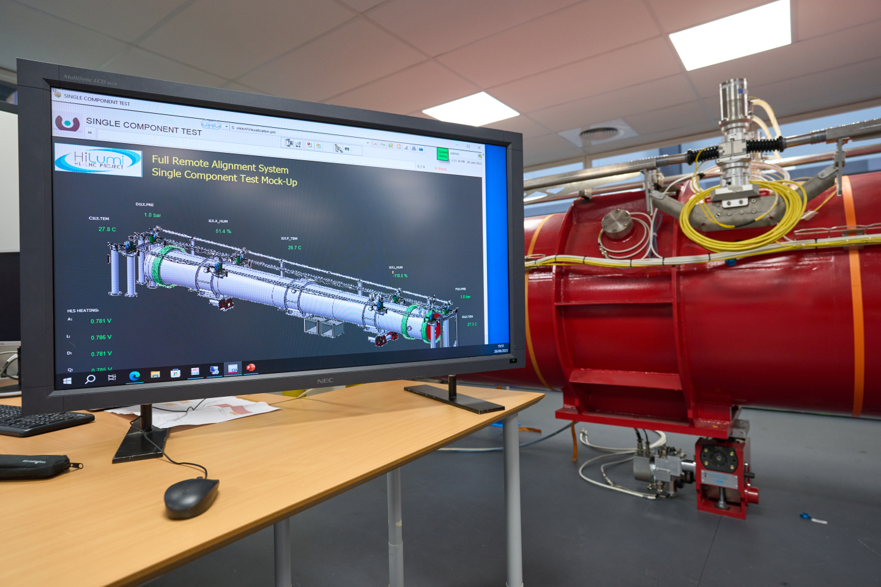
Single Component Test - Objectives
To perform the individual and combined qualification of sensors, measurements systems, motorized adapters, data acquisition and alignment algorithms
To provide the possibility to qualify the FRAS performance before the IT String Test
To validate the interfaces between the 3 groups CEM, GM and ICS

Slide 12
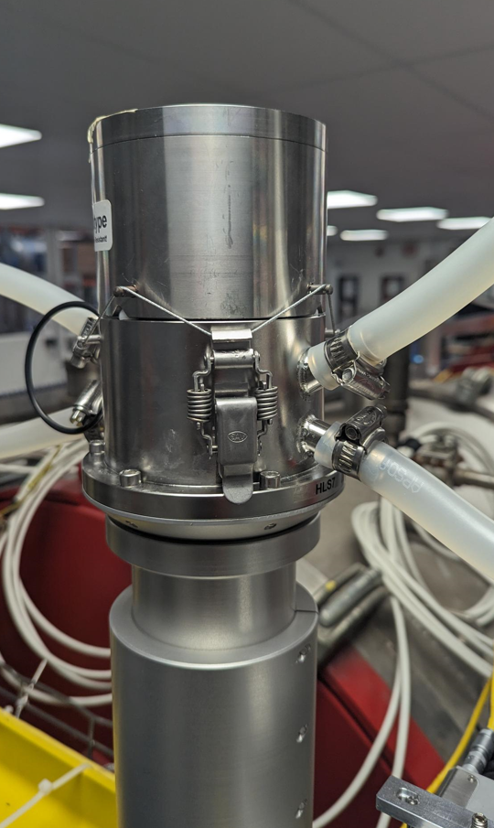
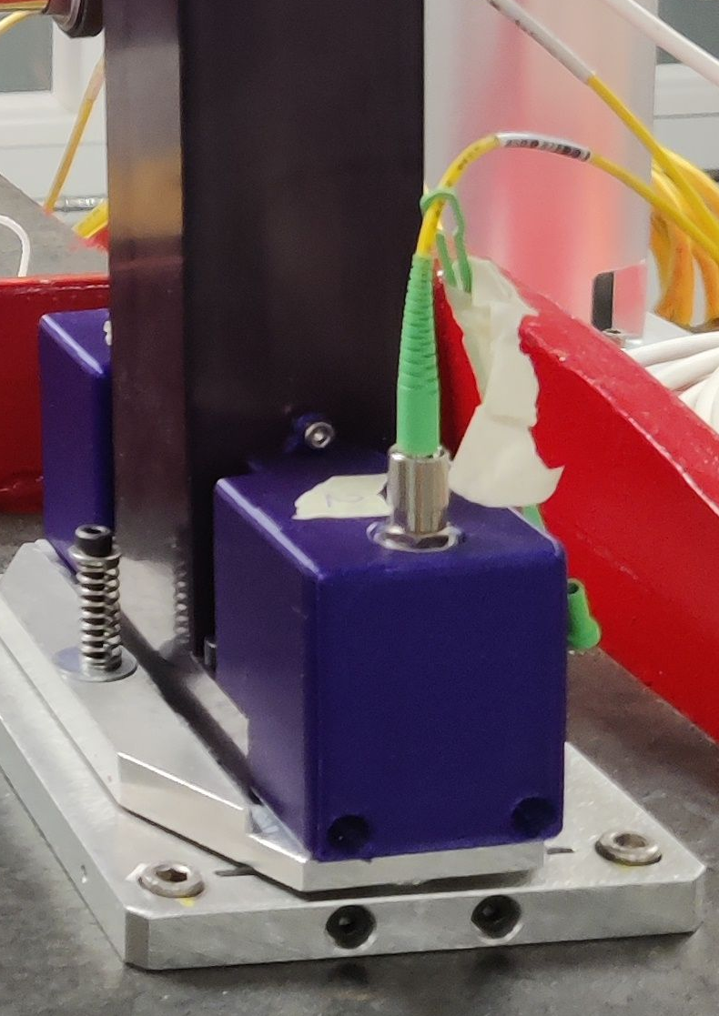
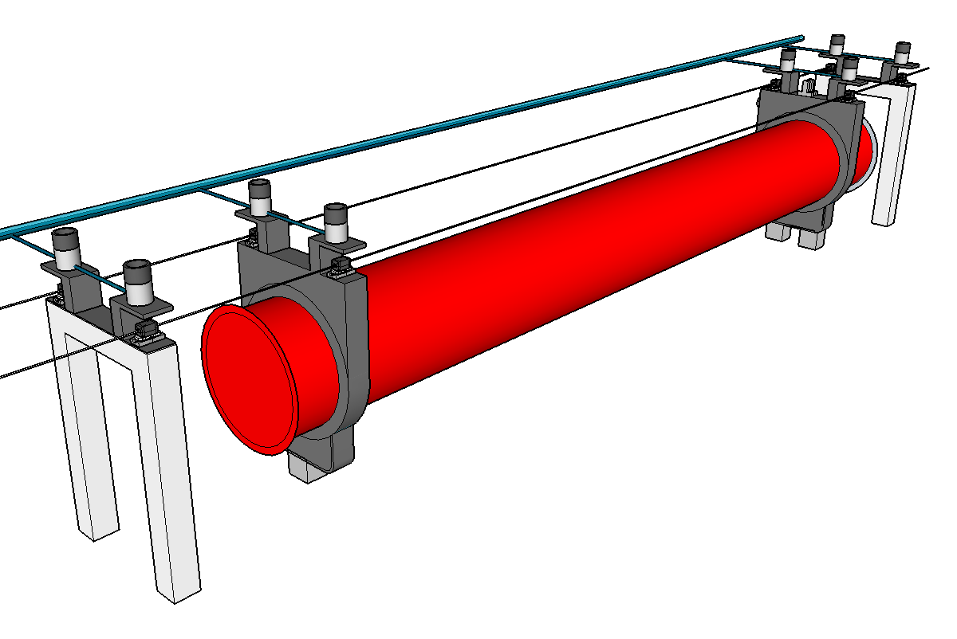
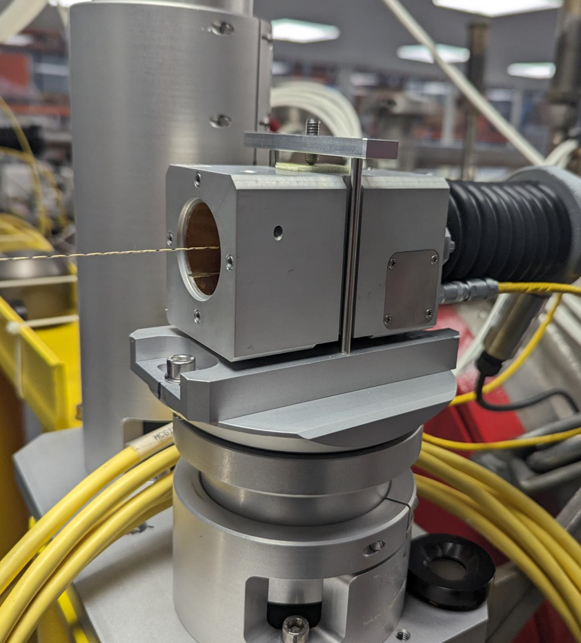
Single Component Test - Sensors
8 HLS installed on 1 hydraulic network
8 WPS installed on 2 wires
2 inclinometers
Distance sensors
Environmental
sensors
Inclinometer
Hydrostatic Levelling Sensor (HLS)
Wire Position Sensor (WPS)

Slide 13
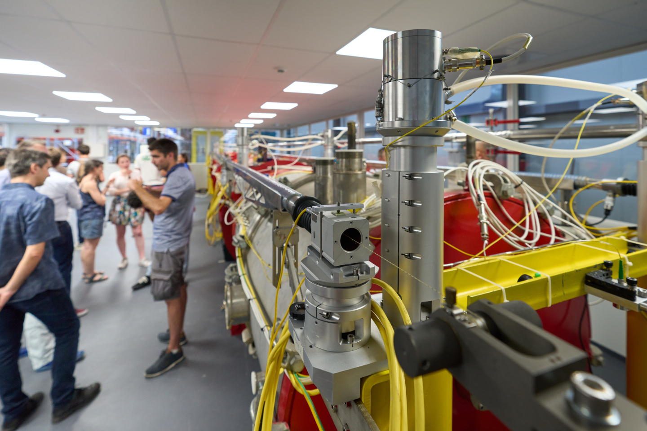
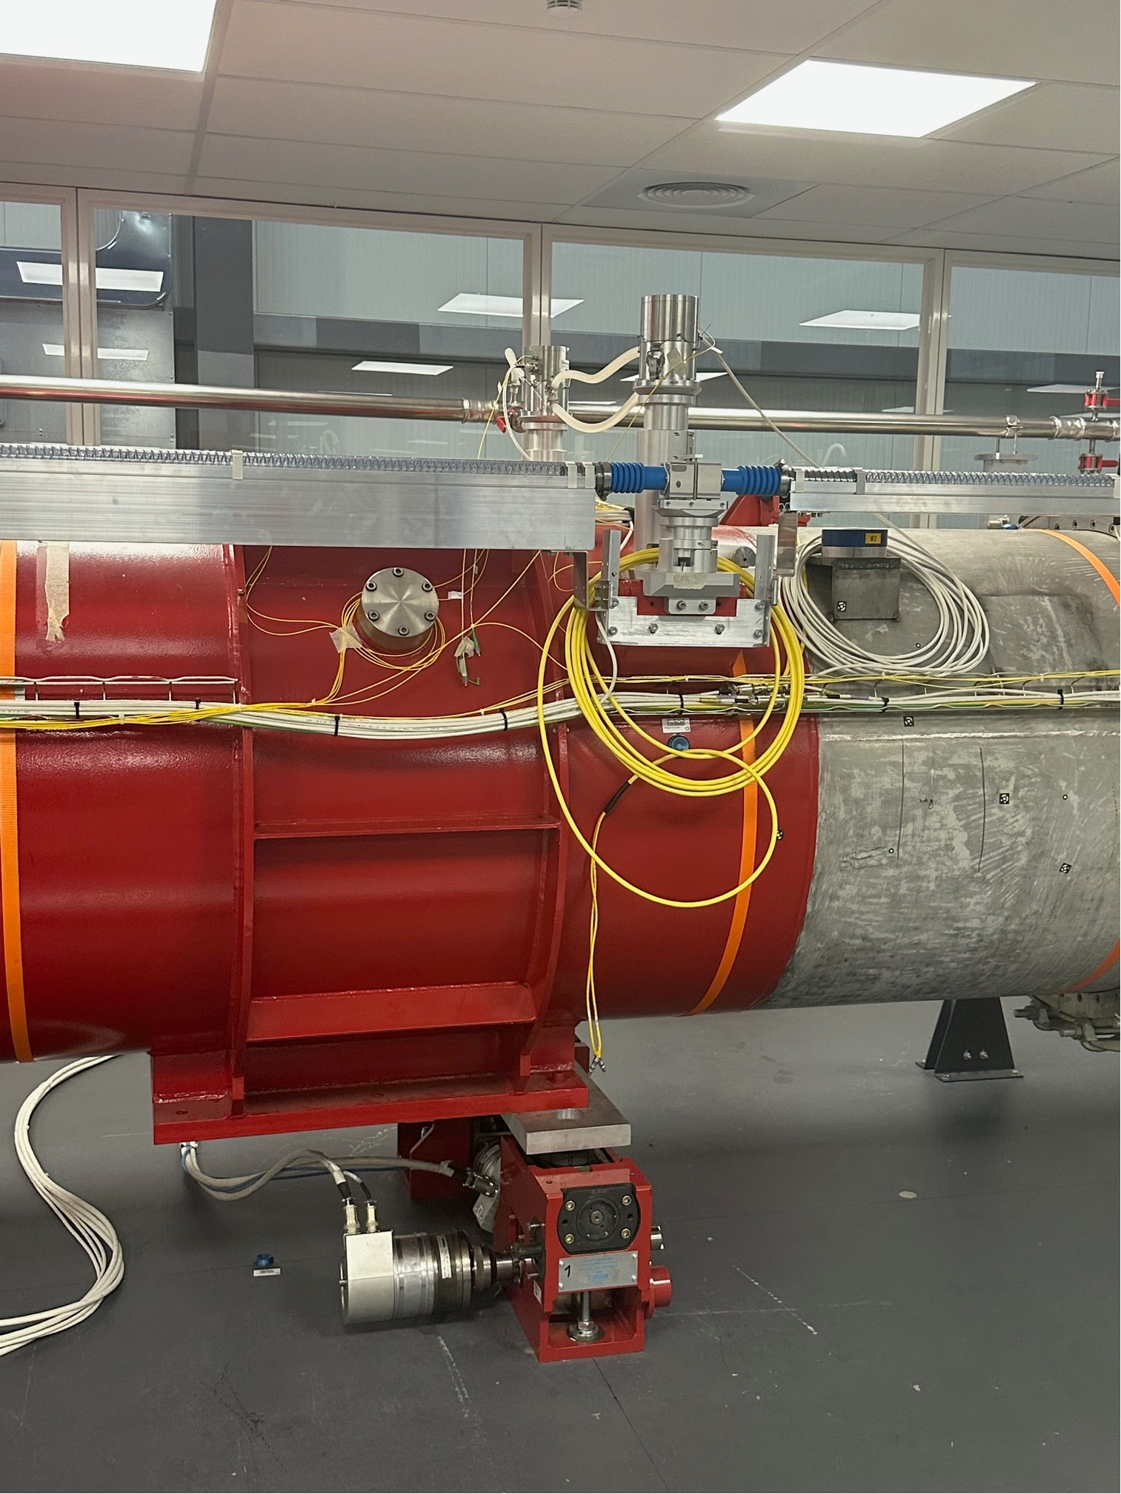
Single Component Test – Position determination
Position determination
Alignment systems
Accuracy (absolute position in R-general) :
Radial position of TAP Magnet : 27 μm
Vertical position of TAP Magnet : 17 μm
Roll : 18 μrad
VERY GOOD RESULTS ACHIEVED! → Launch of procurement for IT String Test

Slide 14

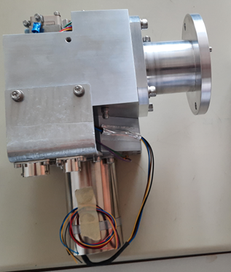
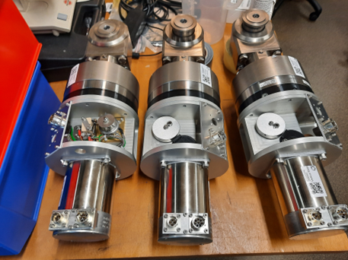
Single Component Test - Adjustment
Radial assembly
Vertical motor assembly
3 Gear trains for speed reduction and absolute position monitoring
Epicycloid standard reduction for actuation
Hydrostatic actuation based on polyurethane pastille
Resolver implemented in absolute mode – ~350° for full adapter range (+/-2.5mm)
Both types of motor assemblies qualified locally. Final qualification scheduled
in October.

Slide 15
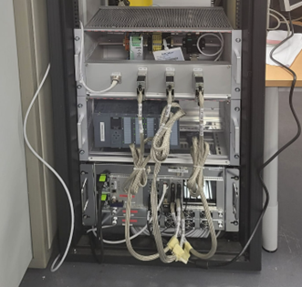
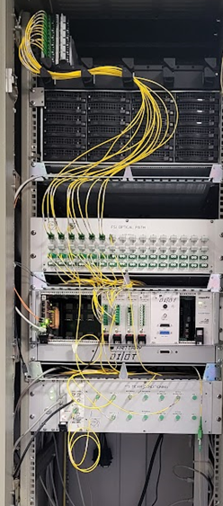
Single Component Test – Acquisition & control/command systems
24 channels FSI acquisition system developed and qualified.
Software specification prepared and approved: LHC-_-ES-0047
Low Level and High Level software under finalization – final qualification scheduled in November 2023.
Low Level controls
New in-house solution named SAMbuCa (Sensors Acquisition and Motion Control system) - EDMS 2274146
FSI acquisition system

Slide 16
Outline
A short reminder on Full Remote Alignment System (FRAS)
Single Component Test : status
Inner-Triplet String Test: status and next steps

Slide 17
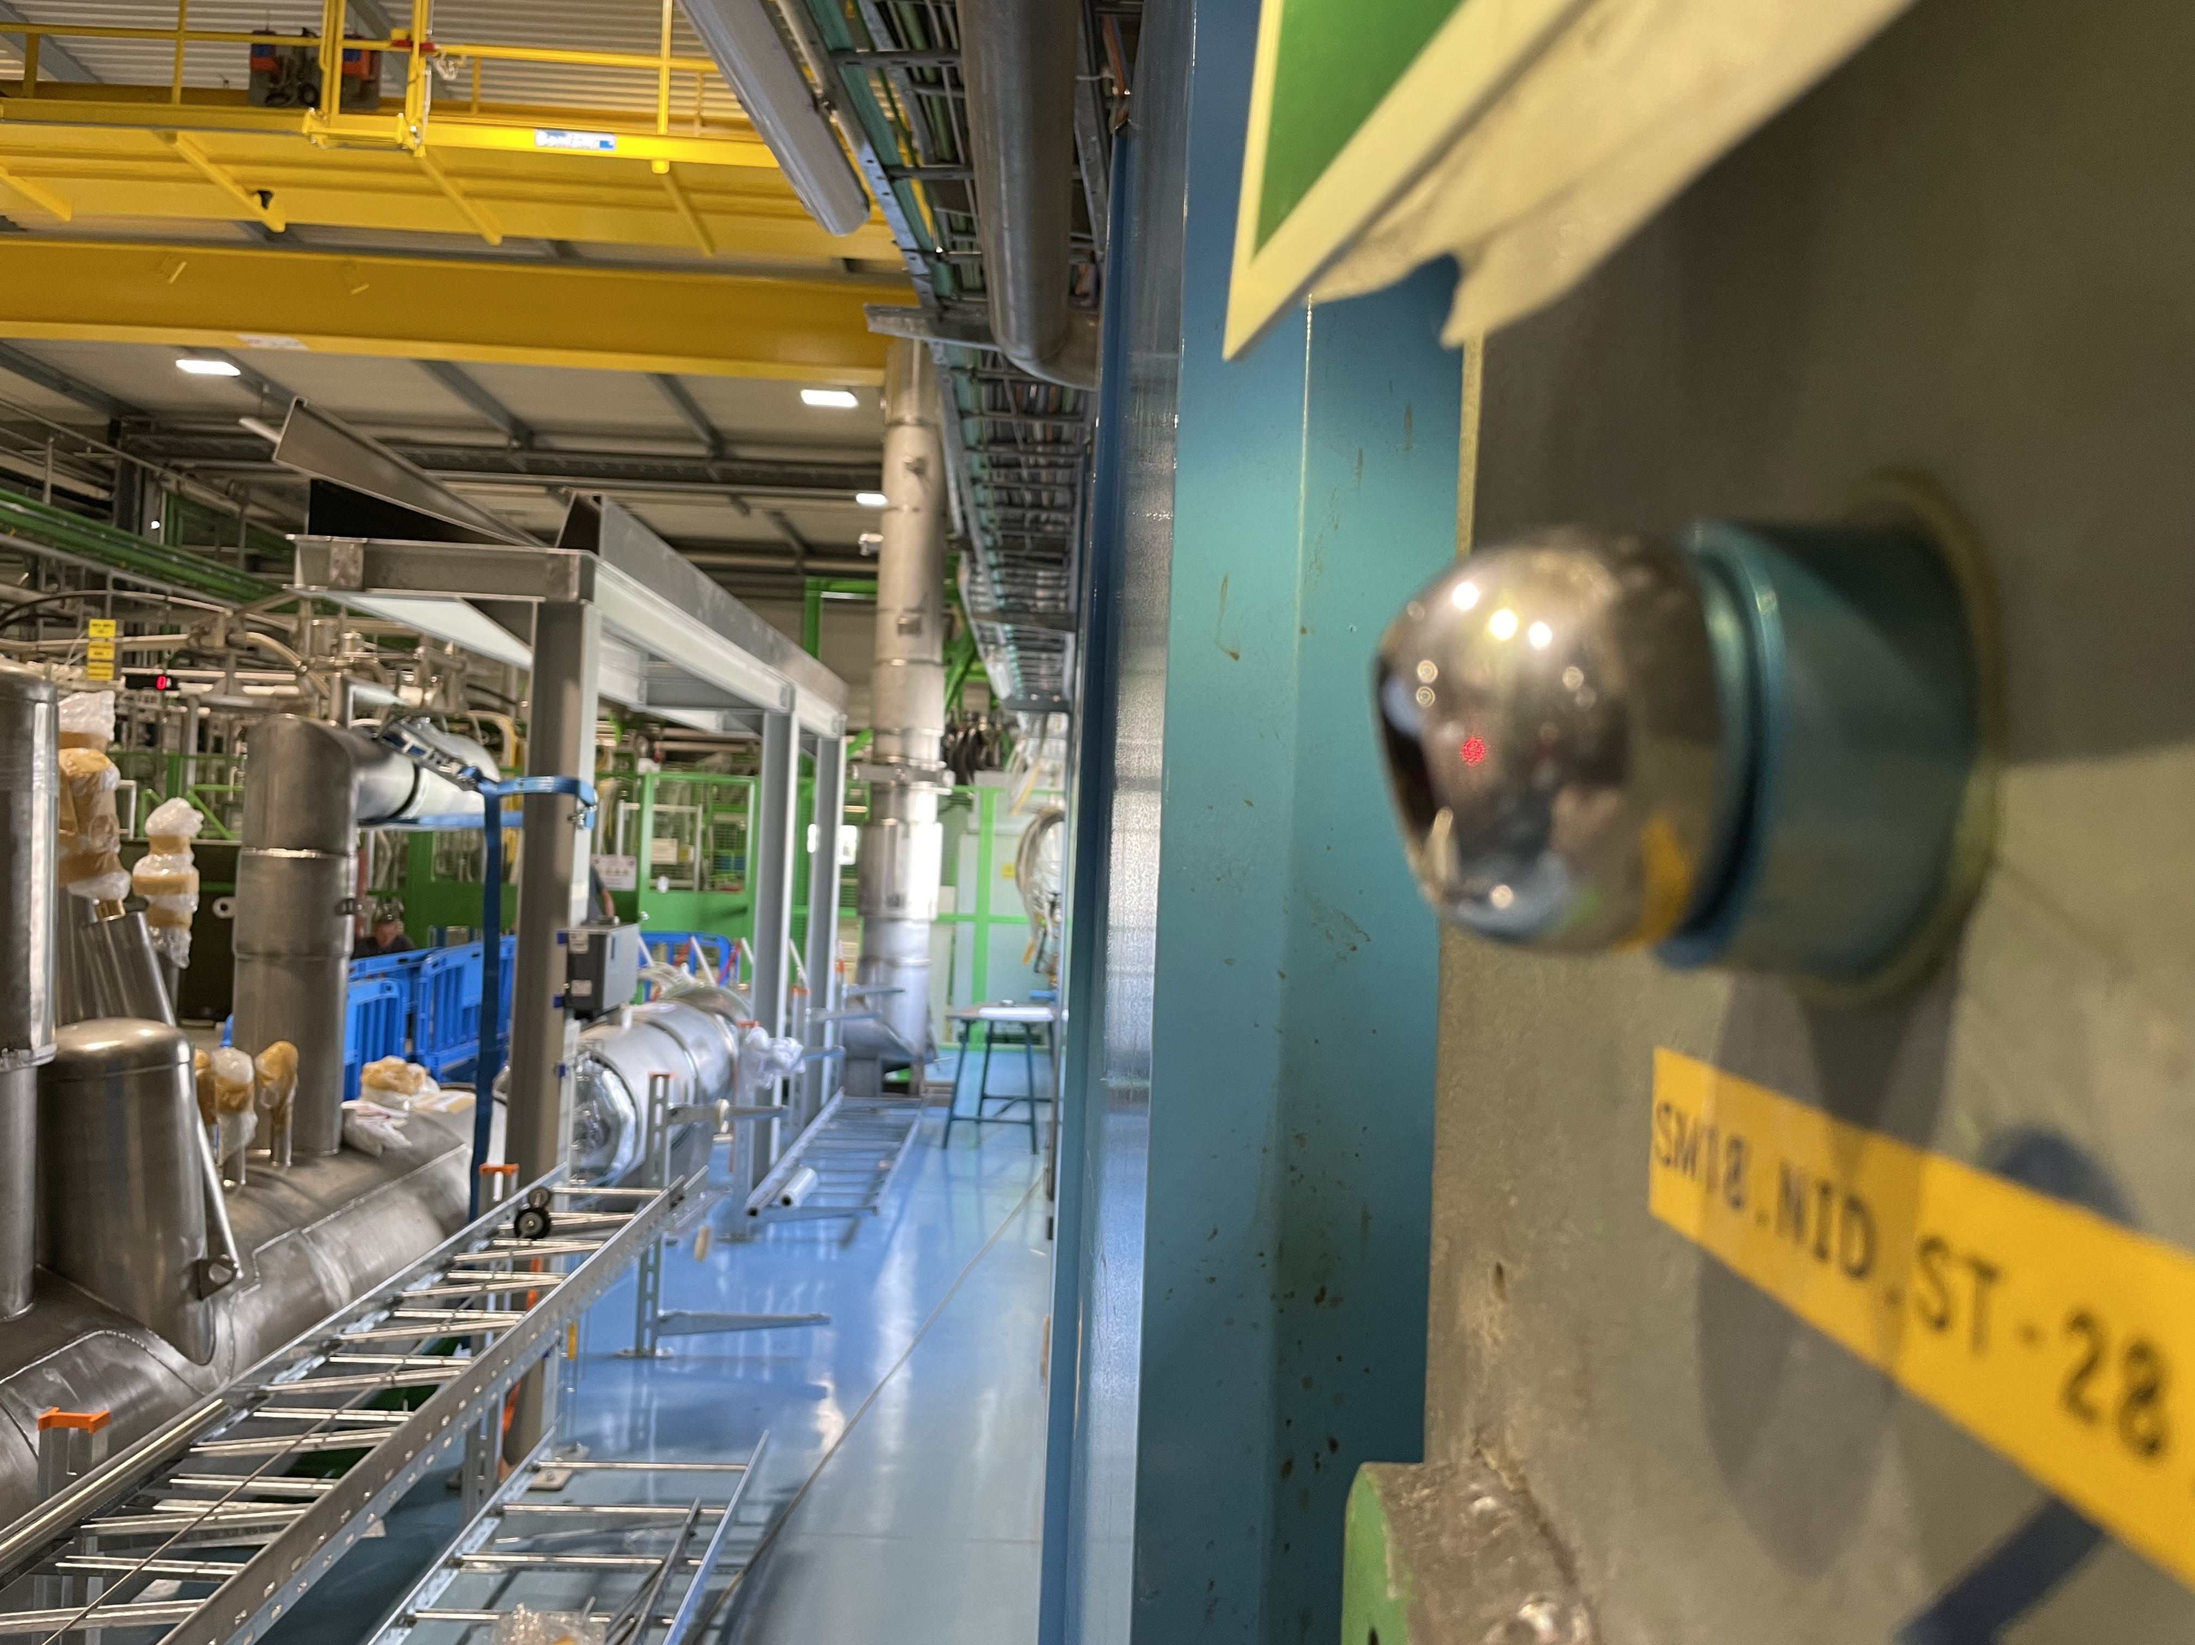
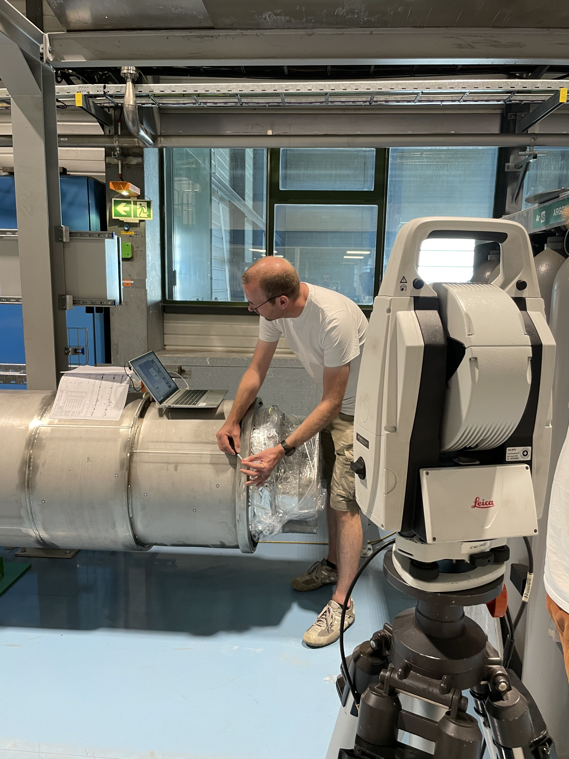
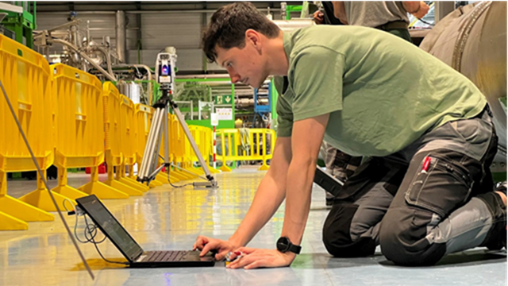
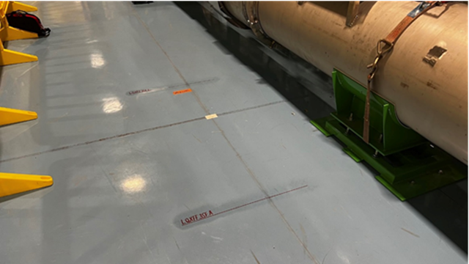
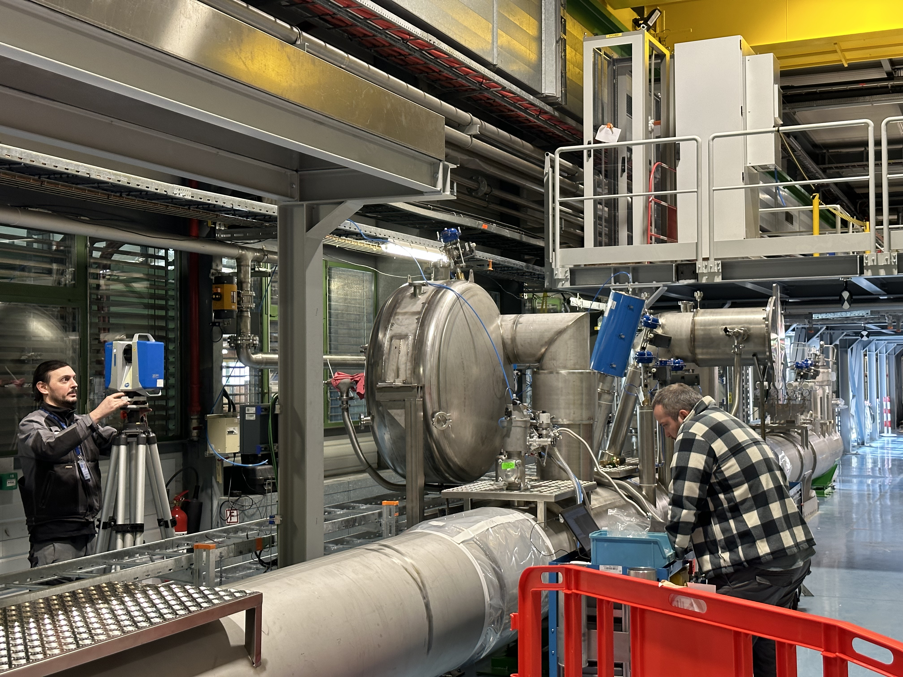
IT String Test status
Network determined
Cryo installation
Marking performed

Slide 18
Next steps
SCT: Final qualification of low level and high level software (November 23)
Procurement of mechanical equipment and sensors launched → control at reception, assembly and calibration
IT-String Test:
  Jacks installation & alignment
  Components alignment
  FRAS installation
  FRAS local qualification
  Final smoothing of components using FRAS

Slide 19
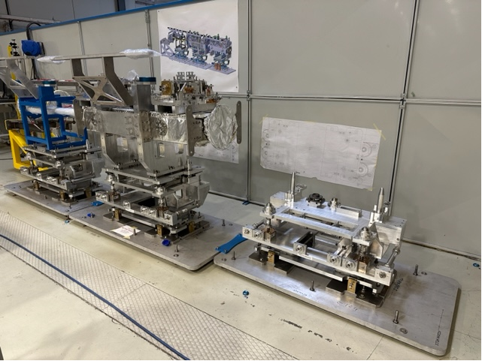
Other items from WP15.4
Standard alignment of the collimator mock-up and final qualification of the Universal Adjustment Platform and sensors supports
Fiducialisation measurements on-going
A lot of work on-going on quality aspects: naming, preparation of databases, etc.
Internal monitoring & assembly measurements of crab cavities :
→ See presentation by V. Rude
Internal monitoring of MQXF :
→ See presentation by V. Rude.

Slide 20
Summary
The Single Component Test (SCT) confirms to be a very useful mock-up to qualify the hardware (motor assemblies, sensors) and software for the Full Remote Alignment System (FRAS) in order to be ready for the IT String Test.
All sensors (except longitudinal sensors) have been qualified. Procurement launched for the IT String Test.
All motor assemblies qualified on individual test benches; to be qualified through repositioning cycles on the SCT in October.
Low-level and high-level software under finalization (final qualification expected in November 2023); they will have to be extrapolated to the control of the 6 components of the IT String Test.
Once fully qualified on the SCT, a 1000 channels FSI acquisition system will be developed for the IT String Test.

Slide 21
Thank you very much!

Slide 22
3D calculation
WPS5
WPS6
WPS7
WPS8
R-general
Z
HLS5
HLS6
Inclino 1
HLS7
HLS8
Y
HLS2
HLS3
HLS4
X
WPS1
WPS2
WPS3
WPS4
3D calculation with :
8 / 8 : WPS
7 / 8 : HLS → Issue with sliding part ?
1 / 2 : inclinometer → issue with one sphere
 | Residual |  | A priori precision
WPS1-WPS_rad | 10 | μm | 20 | μm
WPS1-WPS_vert | 2 | μm | 20 | μm
WPS5-WPS_rad | -10 | μm | 20 | μm
WPS5-WPS_vert | -7 | μm | 20 | μm
WPS2-WPS_rad | -12 | μm | 20 | μm
WPS2-WPS_vert | -6 | μm | 20 | μm
WPS3-WPS_rad | -5 | μm | 20 | μm
WPS3-WPS_vert | 13 | μm | 20 | μm
WPS6-WPS_rad | 12 | μm | 20 | μm
WPS6-WPS_vert | 11 | μm | 20 | μm
WPS7-WPS_rad | 5 | μm | 20 | μm
WPS7-WPS_vert | -6 | μm | 20 | μm
WPS4-WPS_rad | 7 | μm | 20 | μm
WPS4-WPS_vert | -8 | μm | 20 | μm
WPS8-WPS_rad | -7 | μm | 20 | μm
WPS8-WPS_vert | 2 | μm | 20 | μm
HLS5-HLS_vert | 24 | μm | 20 | μm
HLS2-HLS_vert | -11 | μm | 20 | μm
HLS3-HLS_vert | 4 | μm | 20 | μm
HLS6-HLS_vert | 6 | μm | 20 | μm
HLS7-HLS_vert | -10 | μm | 20 | μm
HLS4-HLS_vert | -10 | μm | 20 | μm
HLS8-HLS_vert | -3 | μm | 20 | μm
inclino 1 | 63 | μrad | 150 | μrad
FUV : 0.6 [1]
A priori precision WPS : 20 μm
A priori precision HLS : 20 μm
A priori precision inclino : 150 μrad
Accuracy (absolute position in R-general) :
Radial position of TAP Magnet : 27 μm
Vertical position of TAP Magnet : 17 μm
Roll : 18 μrad

