Slide 1
Electron cloud status
L. Mether, K. Paraschou
With input from:
the Electron cloud team,
the Beam-Induced Heat Load task force

Slide 2
Outline
LHC electron cloud status
  2022 summary
Impact on intensity reach
  The e-cloud simulation model
  Mitigation with filling pattern
  Scenarios for HL-LHC
Other studies
  Incoherent e-cloud effects
  Build-up studies in interaction region
  Coherent tune shifts from e-cloud

Slide 3
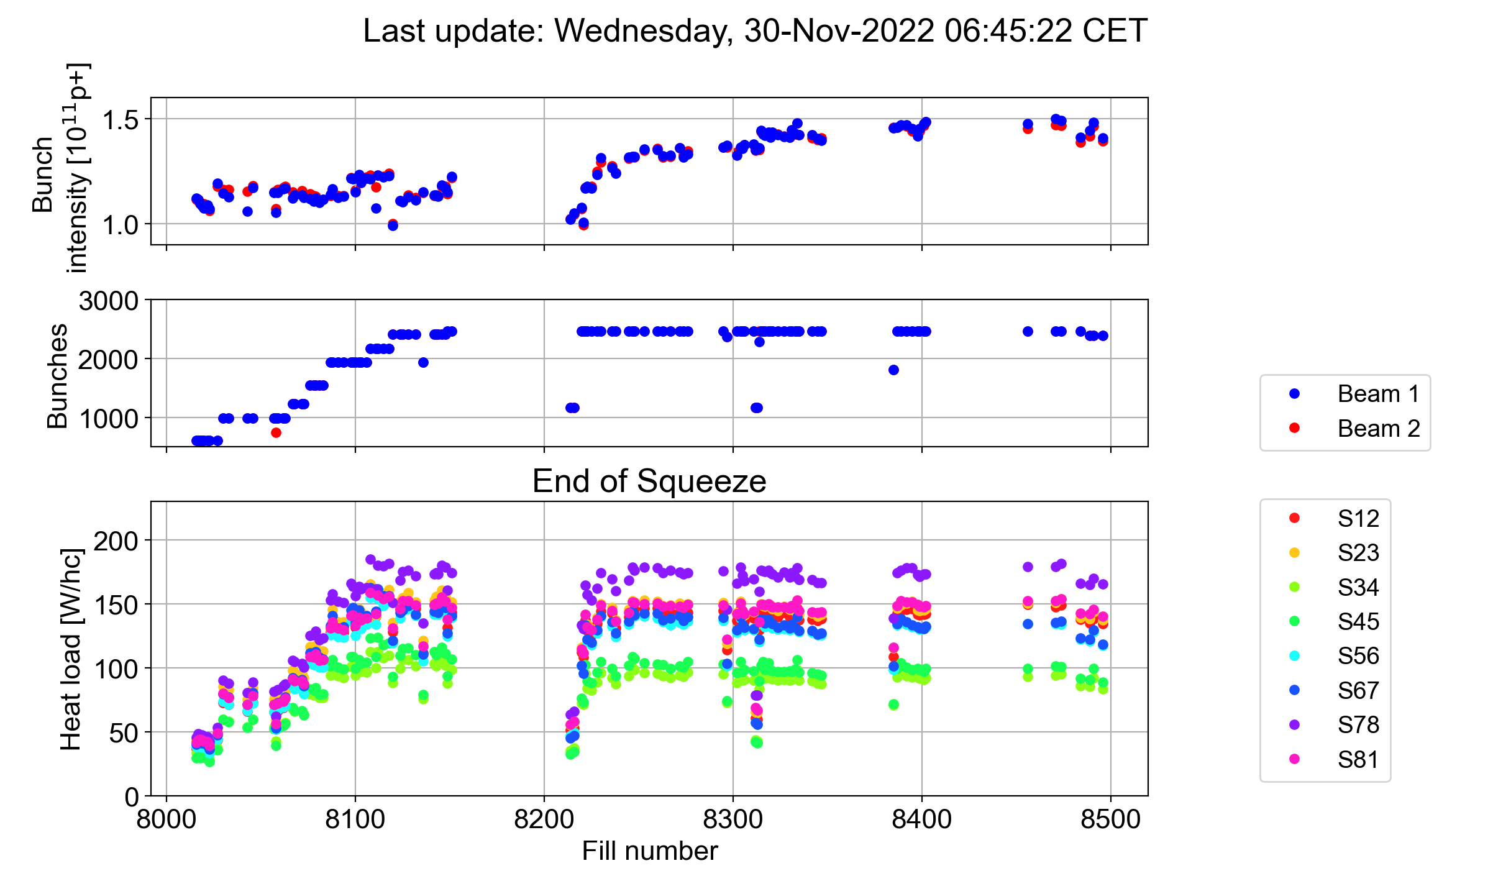
2022 summary
The heat load in sector 78 limited the total intensity throughout the year
  2462 bunches with 1.5e11 p/b in trains of 5x36b reached by the end of the year
5x48b
5x36b

Slide 4
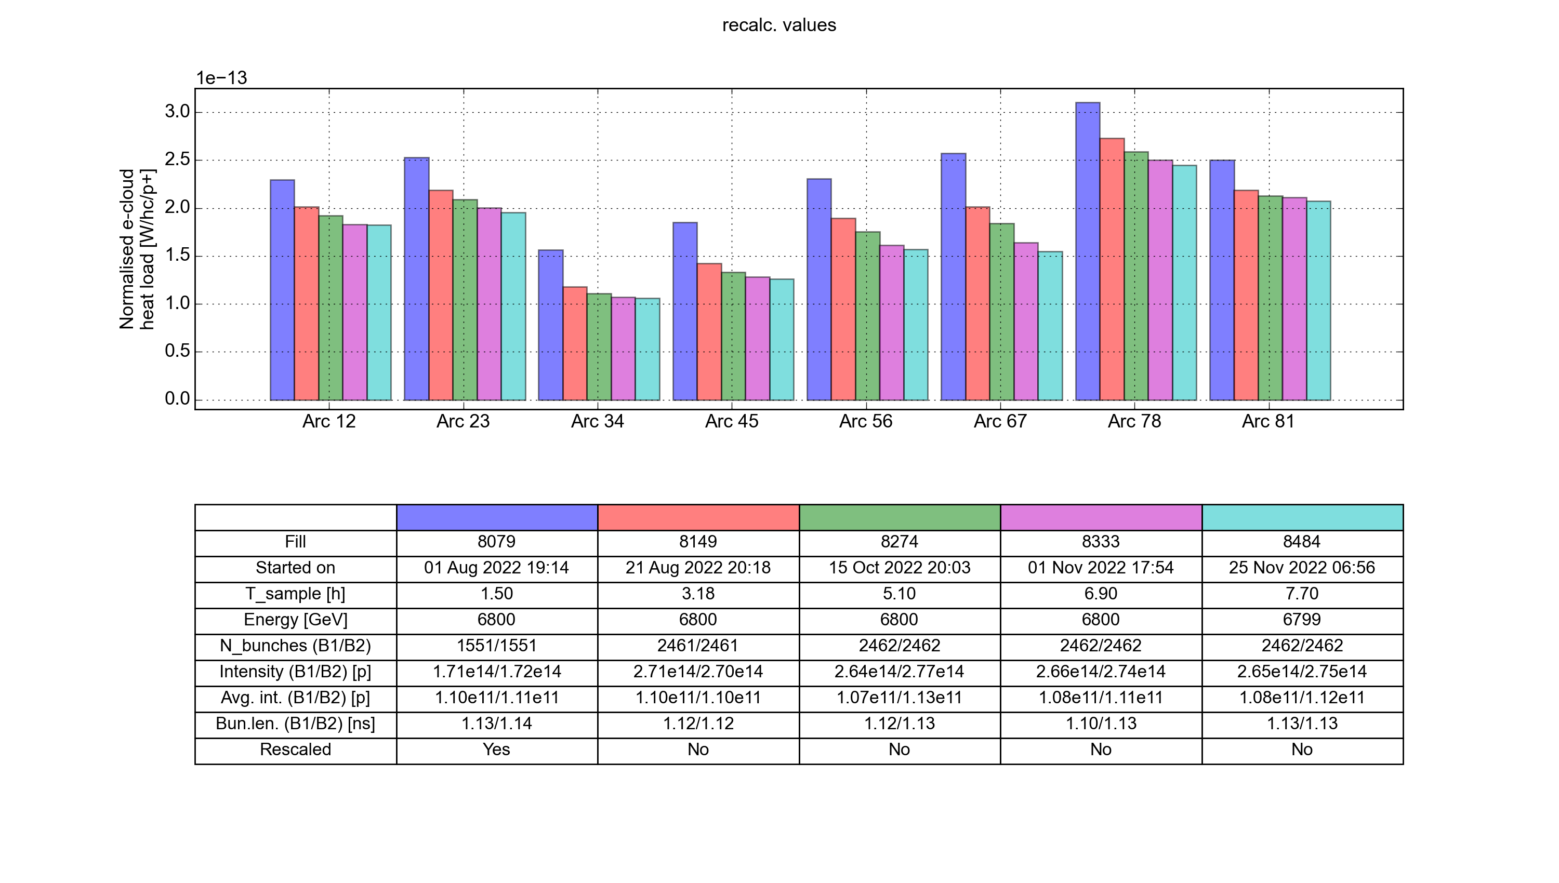
Conditioning over 2022
The scrubbing evolution was reconstructed by comparing fills separated by equal heat load dose, choosing moments with similar bunch intensity and length
  Scrubbing slowed down in all sectors – significant further scrubbing not expected

Slide 5
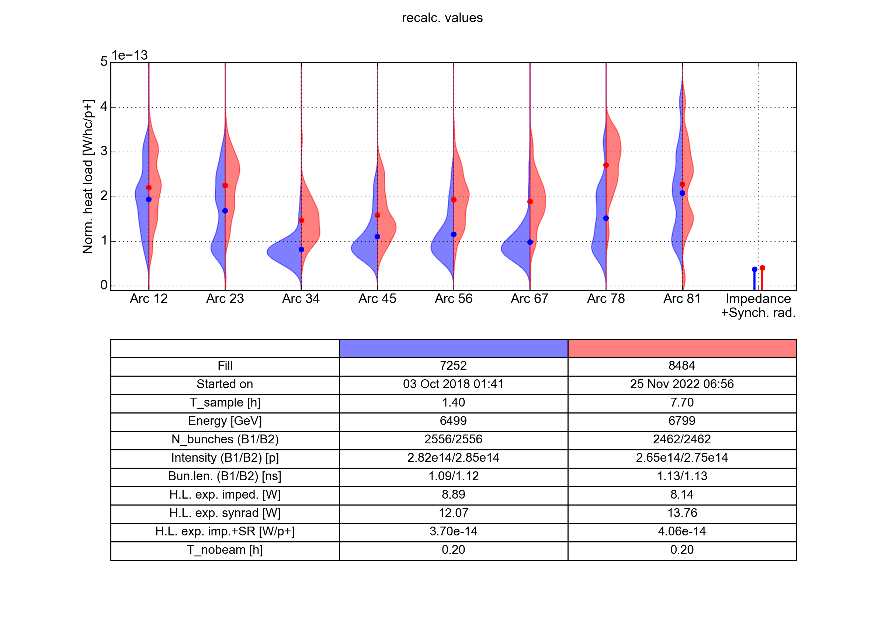
Comparison to 2018
S12 and S81 (worst sectors in Run 2) are very close to their 2018 states
Further surface degradation has almost certainly occurred in the other sectors
  Heat load in S78 significantly increased from already moderately high 2018 value
+80%
+15%
+35%
+10%
+60%
+85%
+80%
+45%
2018
2022
Comparison made with matching beam parameters; expect similar normalised heat load

Slide 6
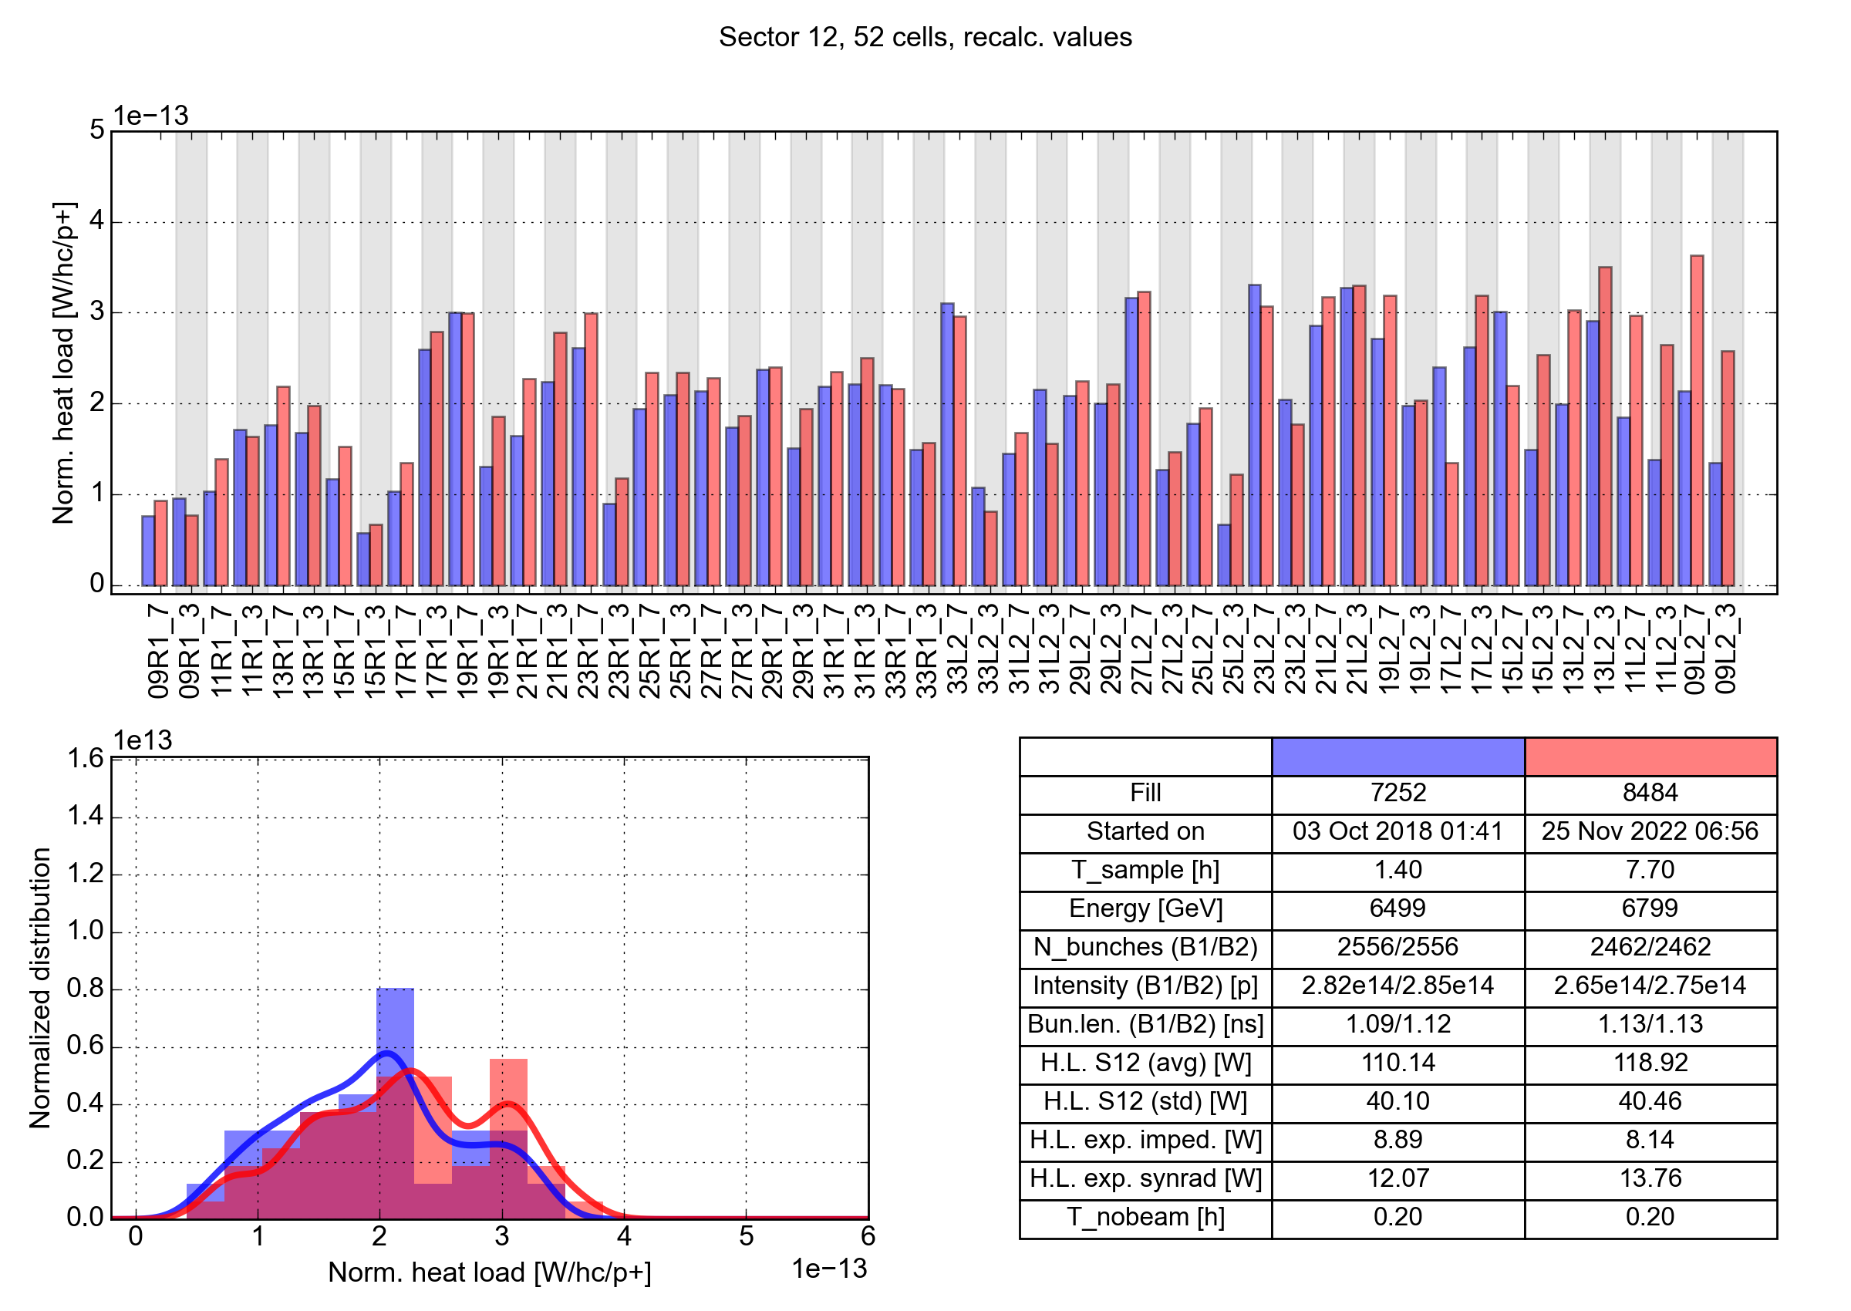
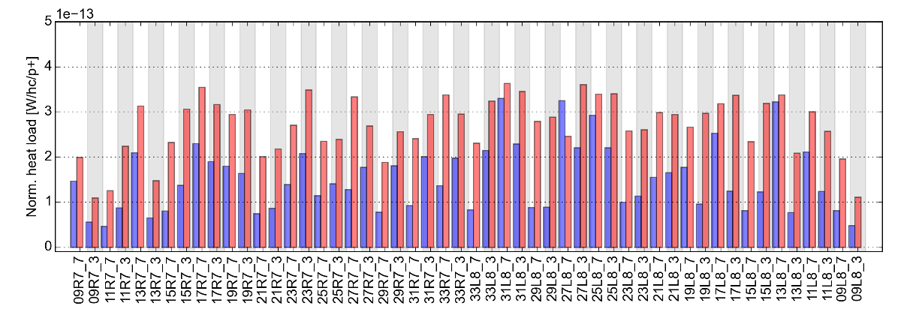
Comparison to 2018 – cell by cell
In S12 (and S81) only a few cells have changed significantly
In the other sectors a larger number of cells are affected
  In S78 nearly all cells have degraded
Sector 12
Highest cell in machine (S81)
2018
2022
Sector 78
Highest cell in machine (S81)
2018
2022
Comparison made with matching beam parameters: expect similar norm. heat load
Comparison made with matching beam parameters: expect similar norm. heat load

Slide 7
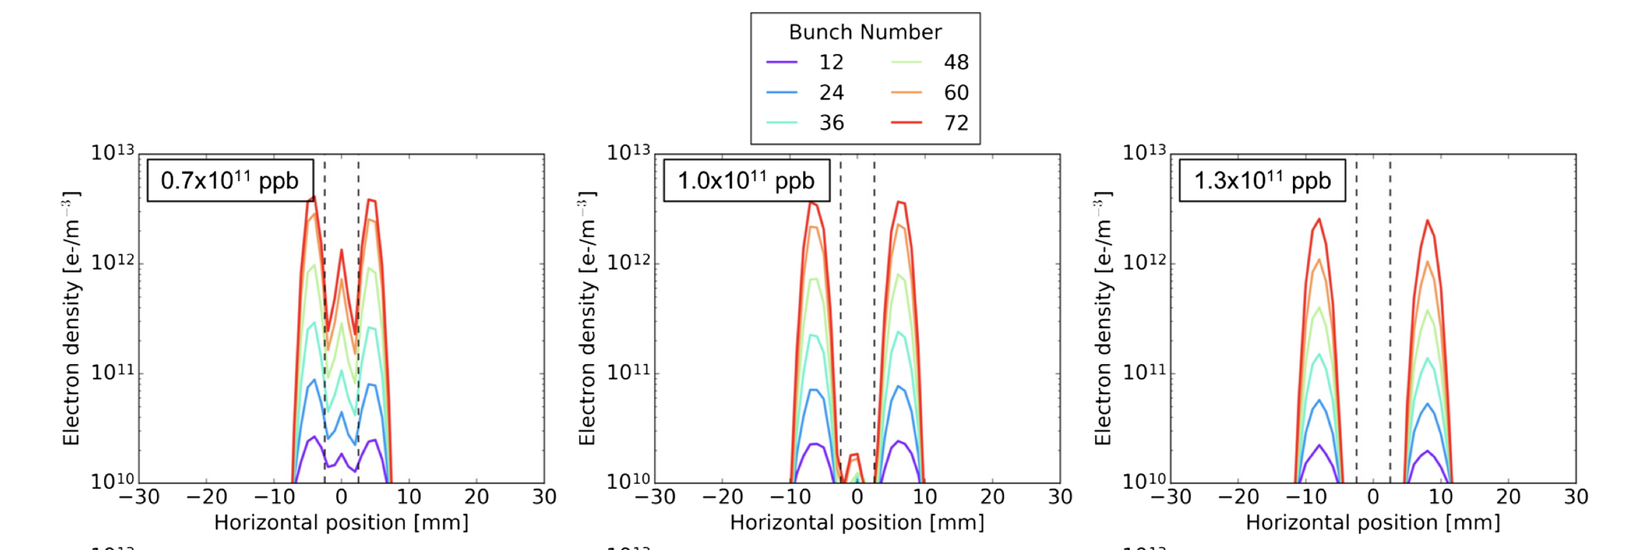
Beam stability
Beam screen degradation is clearly visible also on beam stability
Higher chromaticity (Q’=20-25) required in 2022 to mitigate weak instabilities from
e-cloud in quadrupoles at injection compared to Run 2 (Q’=15-20), despite expected alleviation from increased bunch intensity
Vertical instabilities at the end of stable beams due to growth of central dipole stripe with decreasing bunch intensity present at end of fills throughout 2022-2023, while in
Run 2 they disappeared within ~2 months
A. Romano et al, Phys. Rev. Accel. Beams 21, 061002

Slide 8
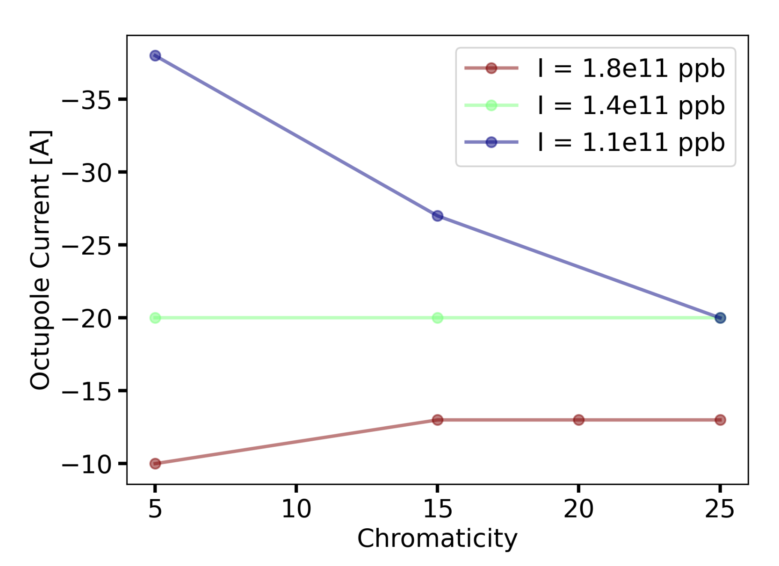
Stability measurements
Despite the degradation of beam stability, the increase in stability with increasing bunch intensity (predicted in simulations) has been confirmed in measurements
  The octupole strength needed to suppress instabilities at injection
  decreases with increasing bunch intensity
S. Johannesson, Measurements of e-cloud stability threshold, Electron cloud meeting #86

Slide 9
Outline
LHC e-cloud status
  2022 summary
Impact on intensity reach
  The e-cloud simulation model
  Mitigation with filling pattern
  Scenarios for HL-LHC
Other studies
  Incoherent e-cloud effects
  Build-up studies in interaction region
  Coherent tune shifts from e-cloud

Slide 10
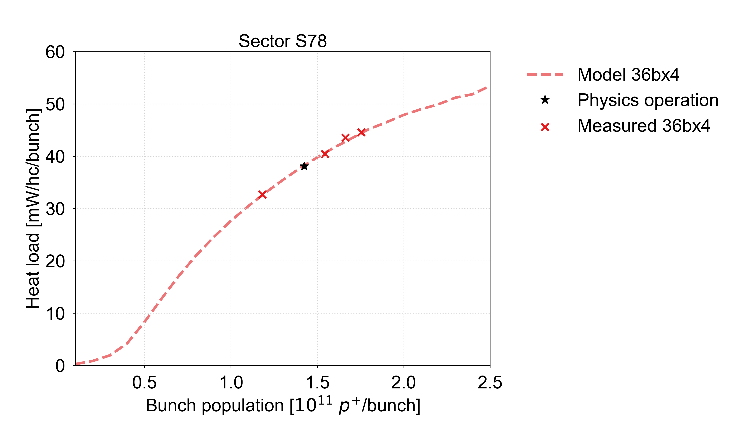
Comparison to measurements
The cell-by-cell SEY, inferred by comparing measured cell-by-cell heat loads to matching simulation data, are used to estimate the heat load scaling with intensity
Several assumptions are made on the underlying model
  Uniform SEY distribution within half-cell
  Enhanced photoemission compared to expectation for scrubbed Cu surface
The estimated heat load dependence on intensity agrees well with measurements
for 25 ns beam with up to 1.8e11 p/b

Slide 11
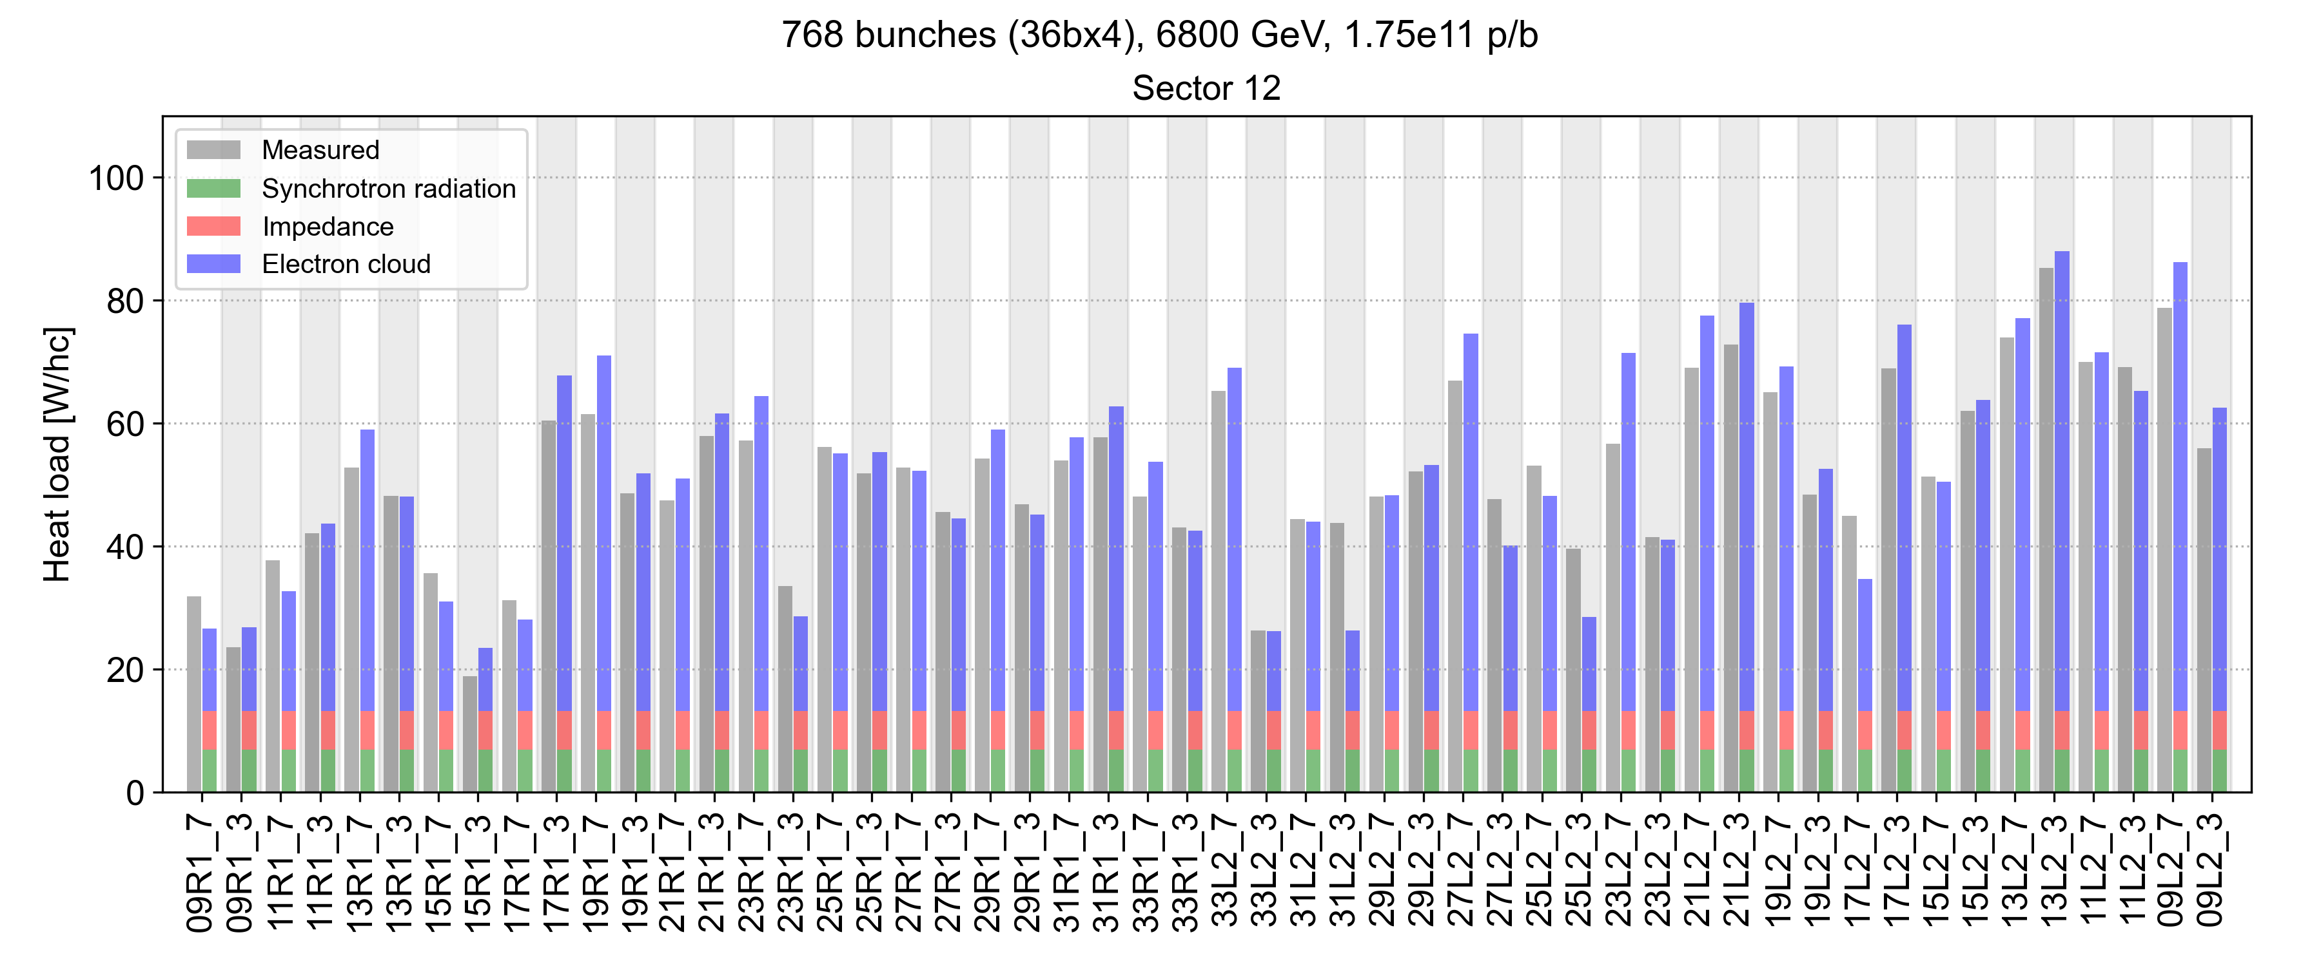
Comparison to measurements
The cell-by-cell SEY, inferred by comparing measured cell-by-cell heat loads to matching simulation data, are used to estimate the heat load scaling with intensity
Several assumptions are made on the underlying model
  Uniform SEY distribution within half-cell
  Enhanced photoemission compared to expectation for scrubbed Cu surface
The estimated heat load dependence on intensity agrees well with measurements
for 25 ns beam with up to 1.8e11 p/b
and also reasonably on the cell-by-cell level

Slide 12
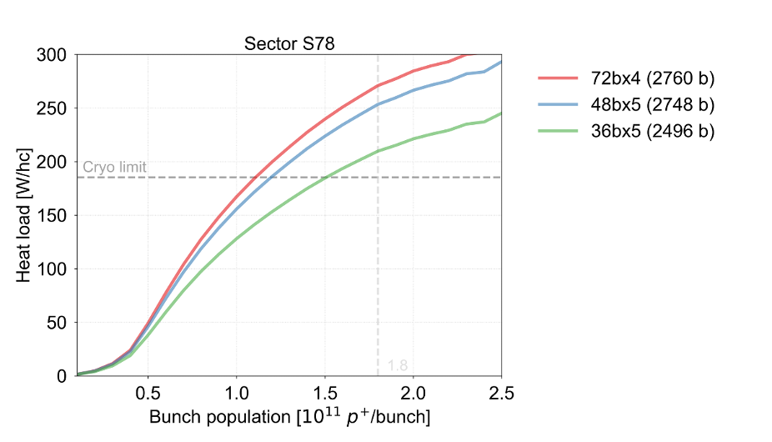
Intensity reach
The intensity reach for different filling schemes is determined by the limitation in S78
The 25 ns beams are limited to less than 1.5e11 p/b or 2200 bunches at 1.8e11 p/b
 | N bunches | Intensity
4x72b | 2760 | 1.1e11
5x48b | 2748 | 1.2e11
5x36b | 2496 | 1.5e11

Slide 13
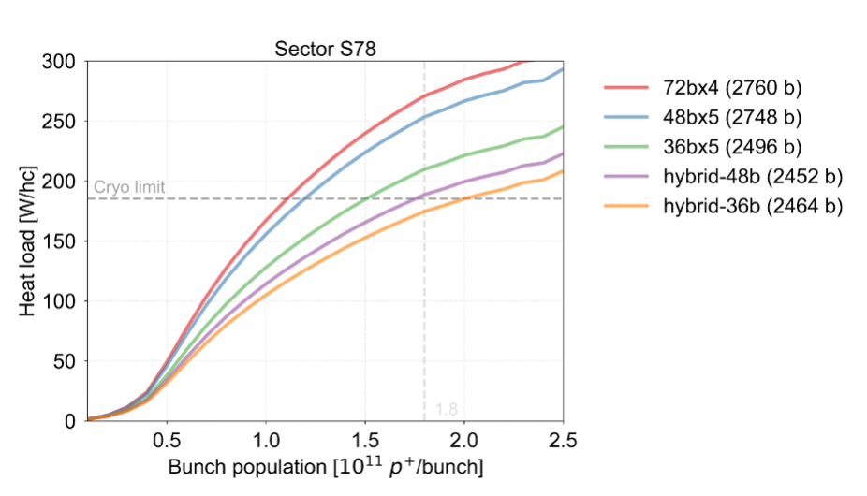
Intensity reach
The intensity reach for different filling schemes is determined by the limitation in S78
The 25 ns beams are limited to less than 1.5e11 p/b or 2200 bunches at 1.8e11 p/b
Hybrid filling schemes can partially mitigate the limitation
  Scheme with ~2450 b. (1x8b4e + 5x36b) allows to go up to and beyond 1.8e11 p/b
  Provide higher luminosity thanks to the higher achievable bunch intensity
 | N bunches | Intensity
4x72b | 2760 | 1.1e11
5x48b | 2748 | 1.2e11
5x36b | 2496 | 1.5e11
h-48b | 2452 | 1.75e11
h-36b | 2464 | 2e11
Int. lumi/day [fb⁻¹]
0.80 | -27%
0.93 | -15%
1.10 | ref
1.19 | +8%
1.24 | +13%
Lumi estimates (LPC calculator) with µ=54, L_{lev}< 2e34 cm⁻² s⁻¹

Slide 14
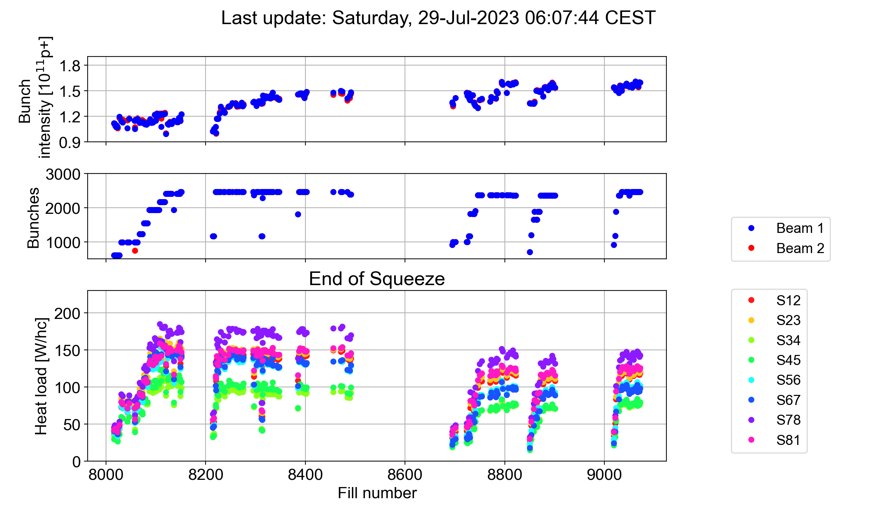
Mitigation in 2023
With the hybrid scheme, the heat load is reduced by >20% compared to 2022
With the intensity limited to 1.6e11 p/b there is plenty of margin for cryogenics
  Mitigation with hybrid schemes validated (once more) in operation

Slide 15
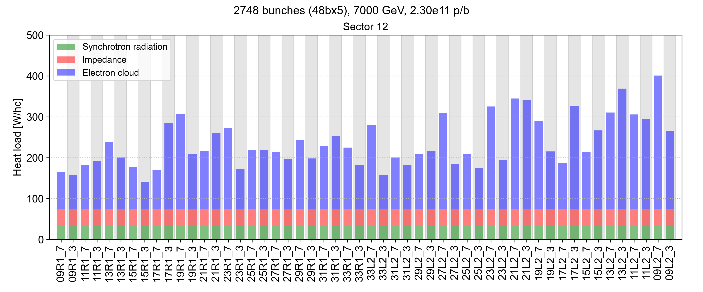
Expected heat load for HL-LHC
Estimated cell-by-cell heat loads with 2748b, 2.3e11 p/b with 5x48b, at 7 TeV
  For the worst cells (with estimated SEY > 1.4) predict heat loads above 400 W
  For the best cells (with estimated SEY ~ 1.1) predict heat loads around 150 W
L. Mether, Heat load estimates for Run 4, Beam-induced heat load task force meeting, Sep 2023

Slide 16
Expected heat load after treatment
Estimated cell-by-cell heat loads with 2748b, 2.3e11 p/b with 5x48b, at 7 TeV
  For the worst cells (with estimated SEY > 1.4) predict heat loads above 400 W
  For the best cells (with estimated SEY ~ 1.1) predict heat loads around 150 W
For coated cells, e-cloud contribution is estimated at 25 W with SEY ~ 1.1
  Assuming a factor 3 reduction in photoemission yield of a-C compared to Cu
  To be confirmed after treatment process selection is finalised
L. Mether, Heat load estimates for Run 4, Beam-induced heat load task force meeting, Sep 2023

Slide 17
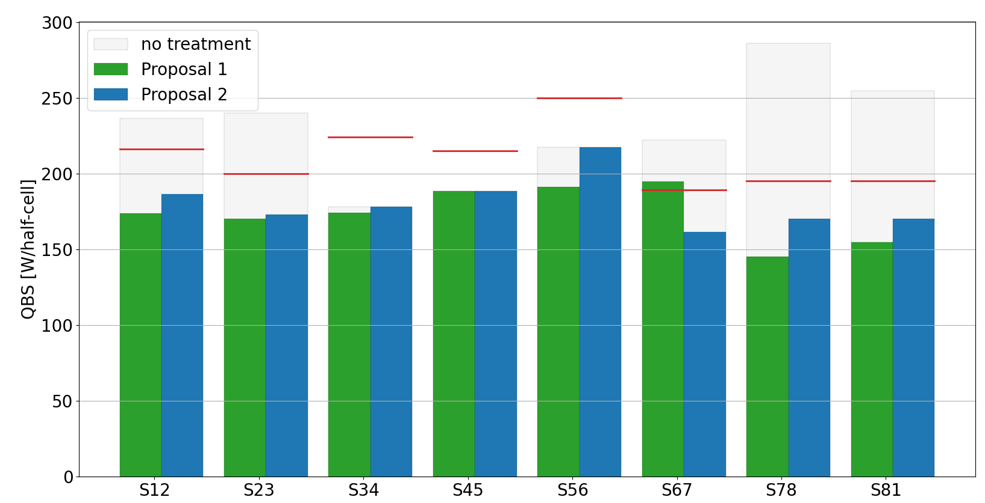
Half-cell selection & heat load margin
First proposed half-cell selection optimised to gain similar heat load margin in all sectors
Proposal 1 (top 100 cells): S67 heat loads above the cryo capacity limits
Proposal 2 (optimised): > 25 W/half-cell of margin in each sector (~10-15%)
Future cryo capacities
33 W
Without LHCb+ project at P8
30 W
46 W
27 W
27 W
25 W
25 W
28 W
13
20
0
0
0
21
27
19
+3
+2
+3
-4
-4
15
18
1
0
7
6
32
21
# treated hc
B. Bradu, First proposal of half-cells to be treated, Beam-induced heat load task force meeting, Sep 2023

Slide 18
Achievable performance for HL-LHC
The HL-LHC baseline scenario is possible only after beam screen treatment (BST)
  Further degradation of beam screens in untreated cells and sectors may still limit the performance, e.g. if S56 or S45 degrades to the current level of S78
With the current state of the beam screens, the number of bunches would be limited to at most ~2300 using hybrid schemes
The 8b+4e beam is always a fall-back solution in case of severe further degradation
  Compatible with degradation of full sector to level of worst half-cells today
Scenario | Beam | N bunches | 8b+4e | BST | LS3 degradation | Int. lumi/day [fb⁻¹]
Baseline | 5x48b | 2748 | - | Yes | No | 3.4 | ref
Degraded S56 | Hybrid | 2590 | 17% | Yes | Yes | 3.2 | -6%
Degraded S45 | Hybrid | 2460 | 32% | Yes | Yes | 3 | -12%
No BST | Hybrid | 2320 | 47% | No | No | 2.8 | -18%
Worst case | 8b+4e | 1972 | 100% | No/Yes | Yes | 2.4 | -30%
Scenario | Beam | N bunches | 8b+4e | BST | LS3 degradation | Int. lumi/day [fb⁻¹]
Baseline | 5x48b | 2748 | - | Yes | No | 3.4 | ref
Degraded S56 | Hybrid | 2590 | 17% | Yes | Yes | 3.2 | -6%
Degraded S45 | Hybrid | 2460 | 32% | Yes | Yes | 3 | -12%
Rough luminosity estimates with LPC calculator, assuming µ=130, n_{b}=2.3 x 10¹¹ p, L_{lev}= < 5e-34 cm⁻² s⁻¹
Rough luminosity estimates with LPC calculator, assuming µ=130, n_{b}=2.3 x 10¹¹ p, L_{lev}= < 5e-34 cm⁻² s⁻¹

Slide 19
Outline
LHC e-cloud status
  2022 summary
Impact on intensity reach
  The e-cloud simulation model
  Mitigation with filling pattern
  Scenarios for HL-LHC
Other studies
  Incoherent e-cloud effects
  Build-up studies in interaction region
  Coherent tune shifts from e-cloud

Slide 20
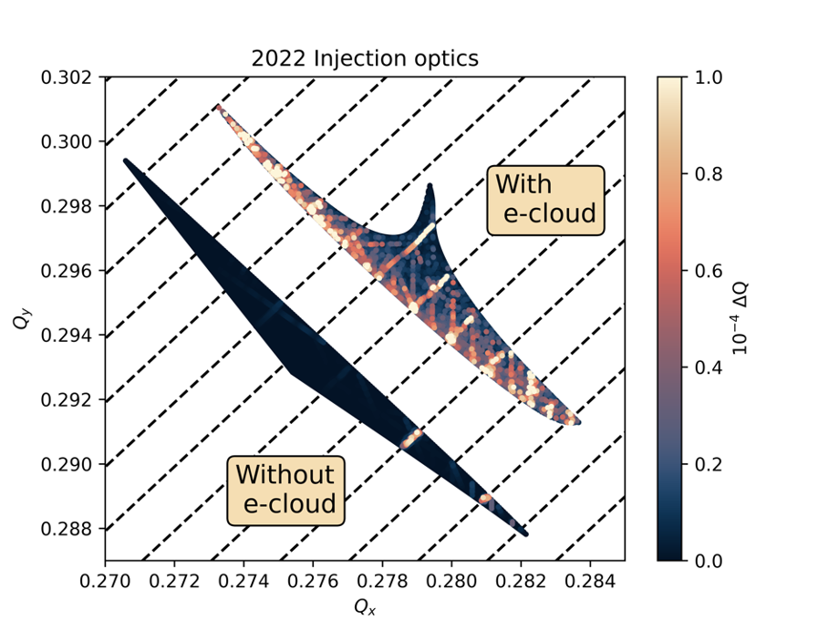
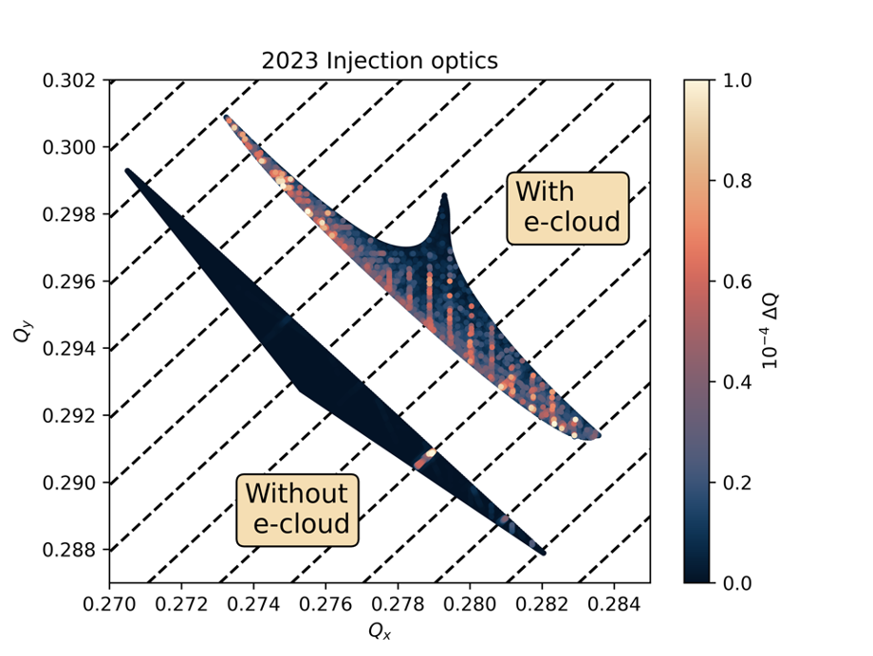
Incoherent e-cloud effects at injection
Electron cloud in main quadrupoles drives emittance growth at injection
Synchro-betatron resonances have been identified as cause
(2Q_{x} – 2Q_{y} + mQ_{ζ} = 4)
LHC Injection optics modified in 2023 to correct octupolar resonances from:
  Lattice cctupoles (in arcs)
  Electron clouds in quadrupoles
  Synchro-betatron resonances are greatly reduced in simulations
K. Paraschou et al, HB2023

Slide 21
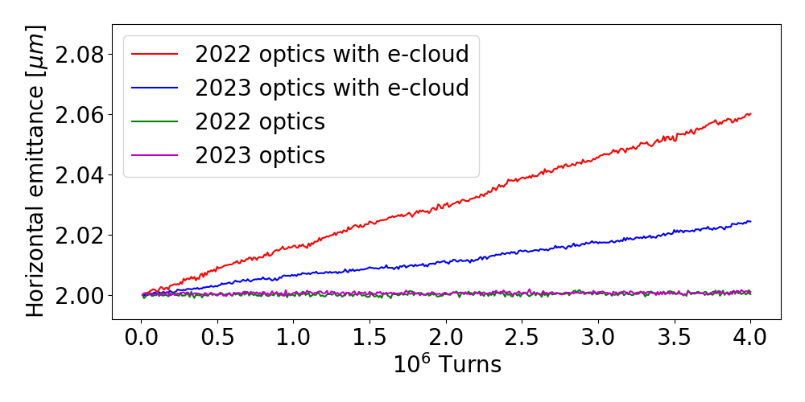
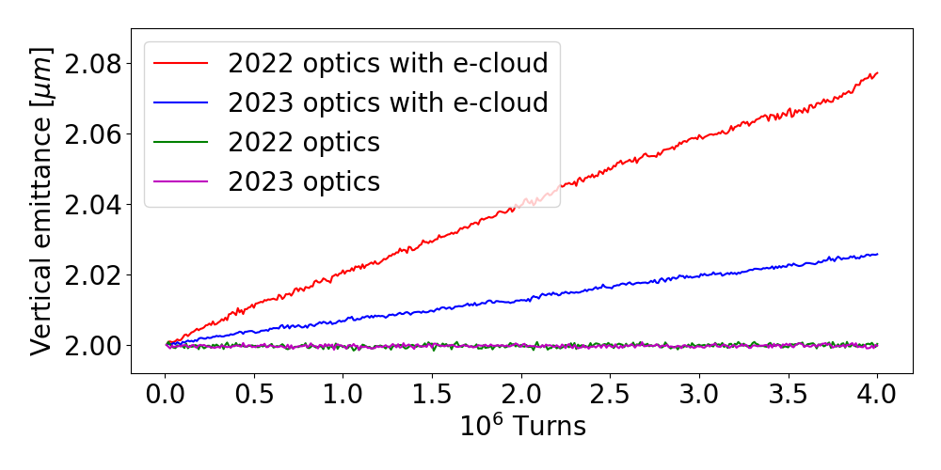
Incoherent e-cloud effects at injection
Electron cloud in main quadrupoles drives emittance growth at injection
Synchro-betatron resonances have been identified as cause
(2Q_{x} – 2Q_{y} + mQ_{ζ} = 4)
LHC Injection optics modified in 2023 to correct octupolar resonances from:
  Lattice cctupoles (in arcs)
  Electron clouds in quadrupoles
  Synchro-betatron resonances are greatly reduced in simulations
  Simulations of emittance growth shows significant improvement between 2023 and 2022 optics
  Experimental measurements are pending
K. Paraschou et al, HB2023

Slide 22
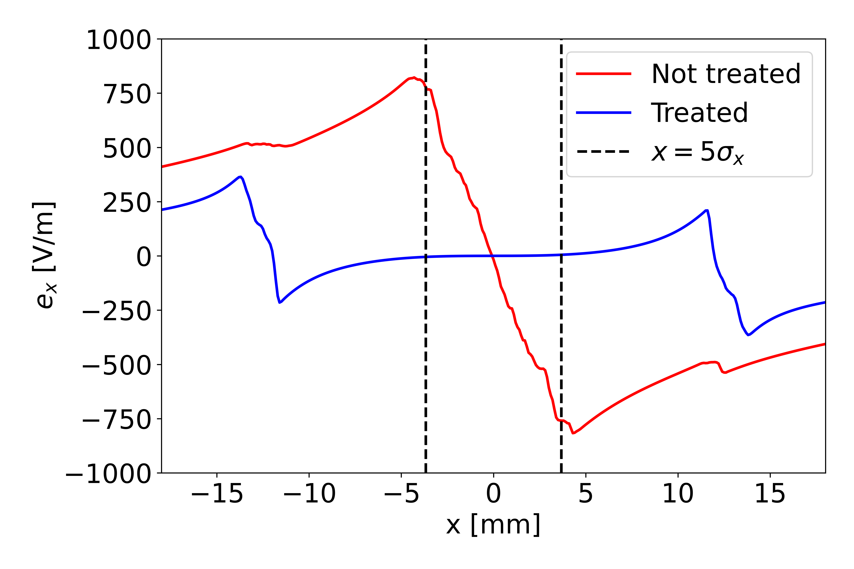
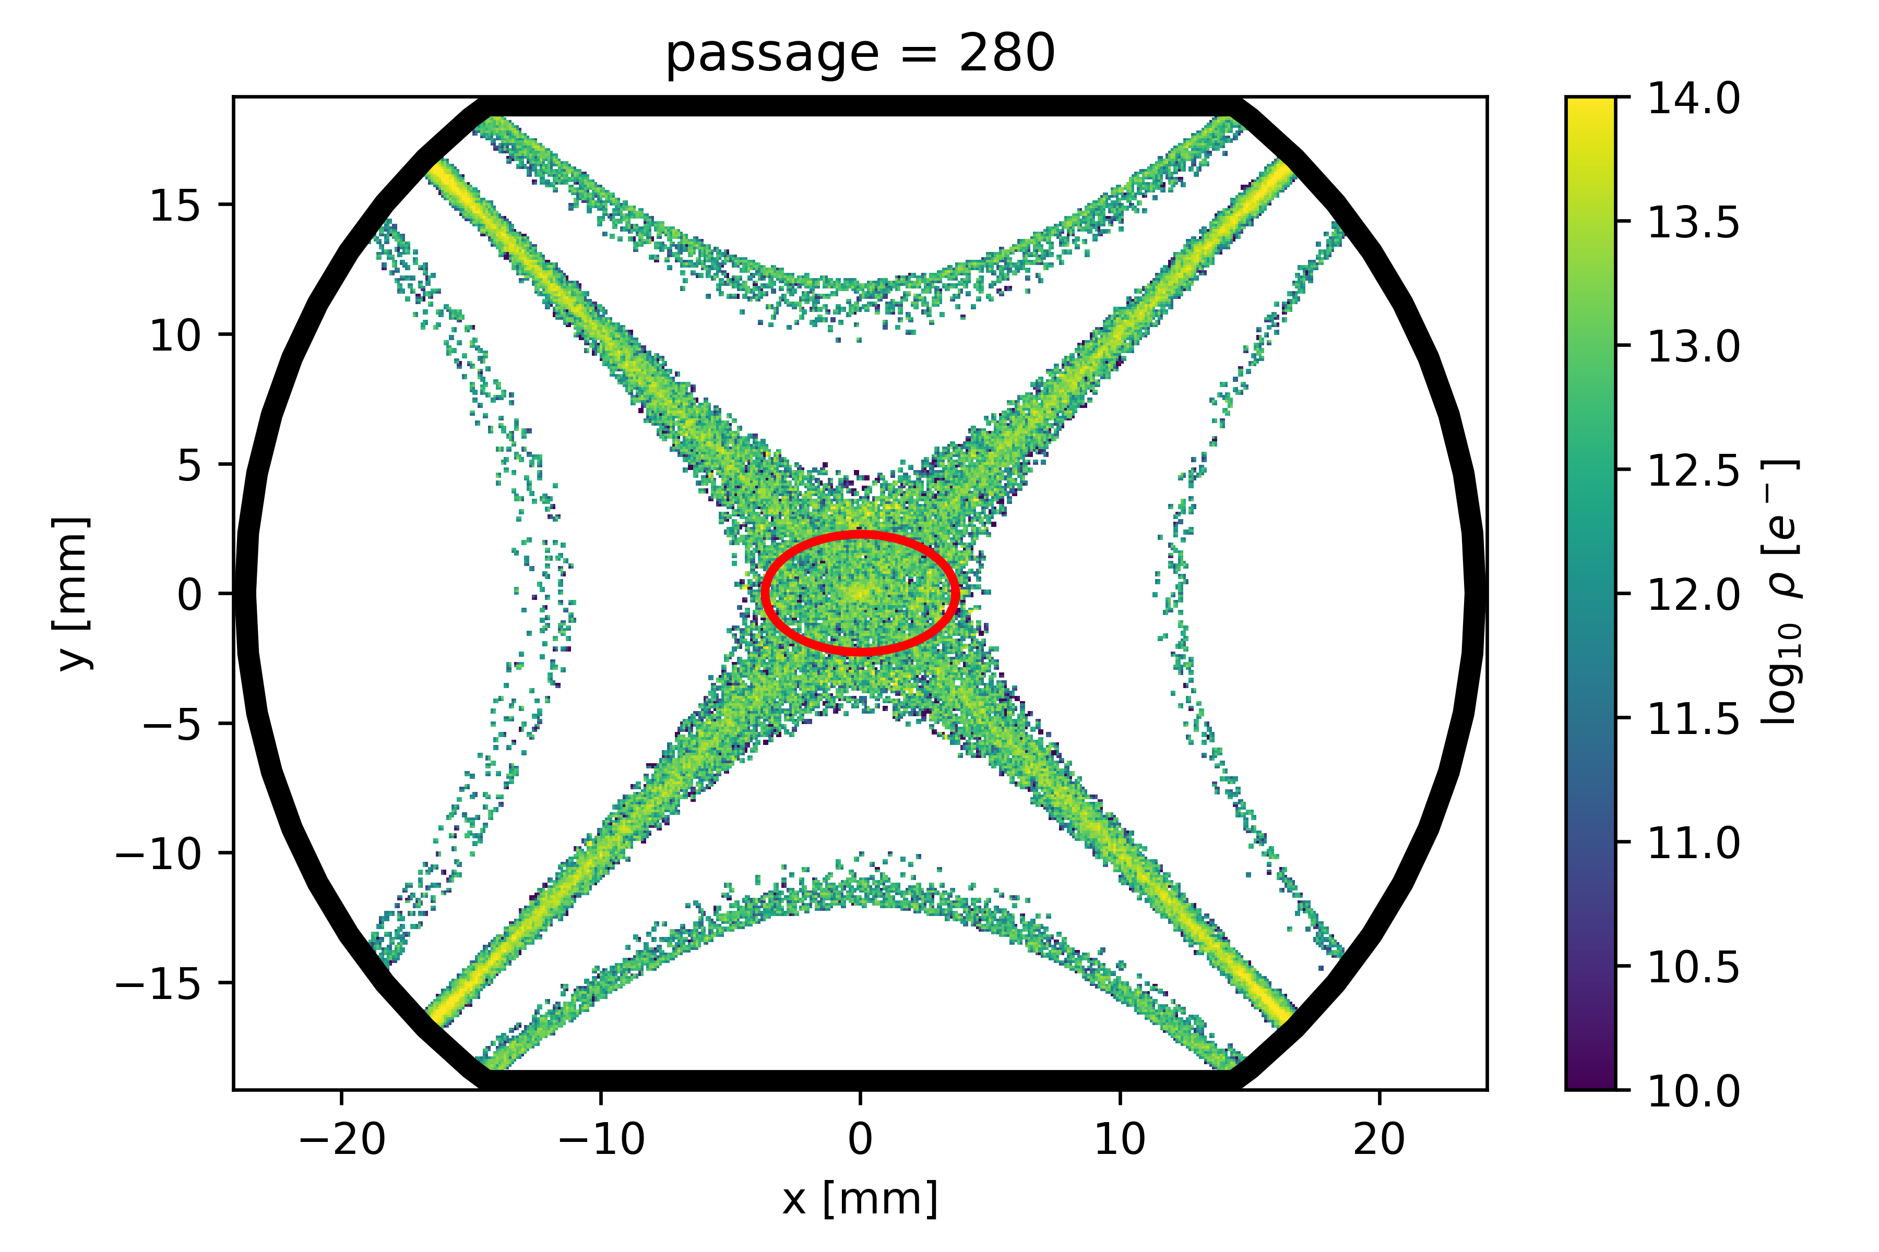
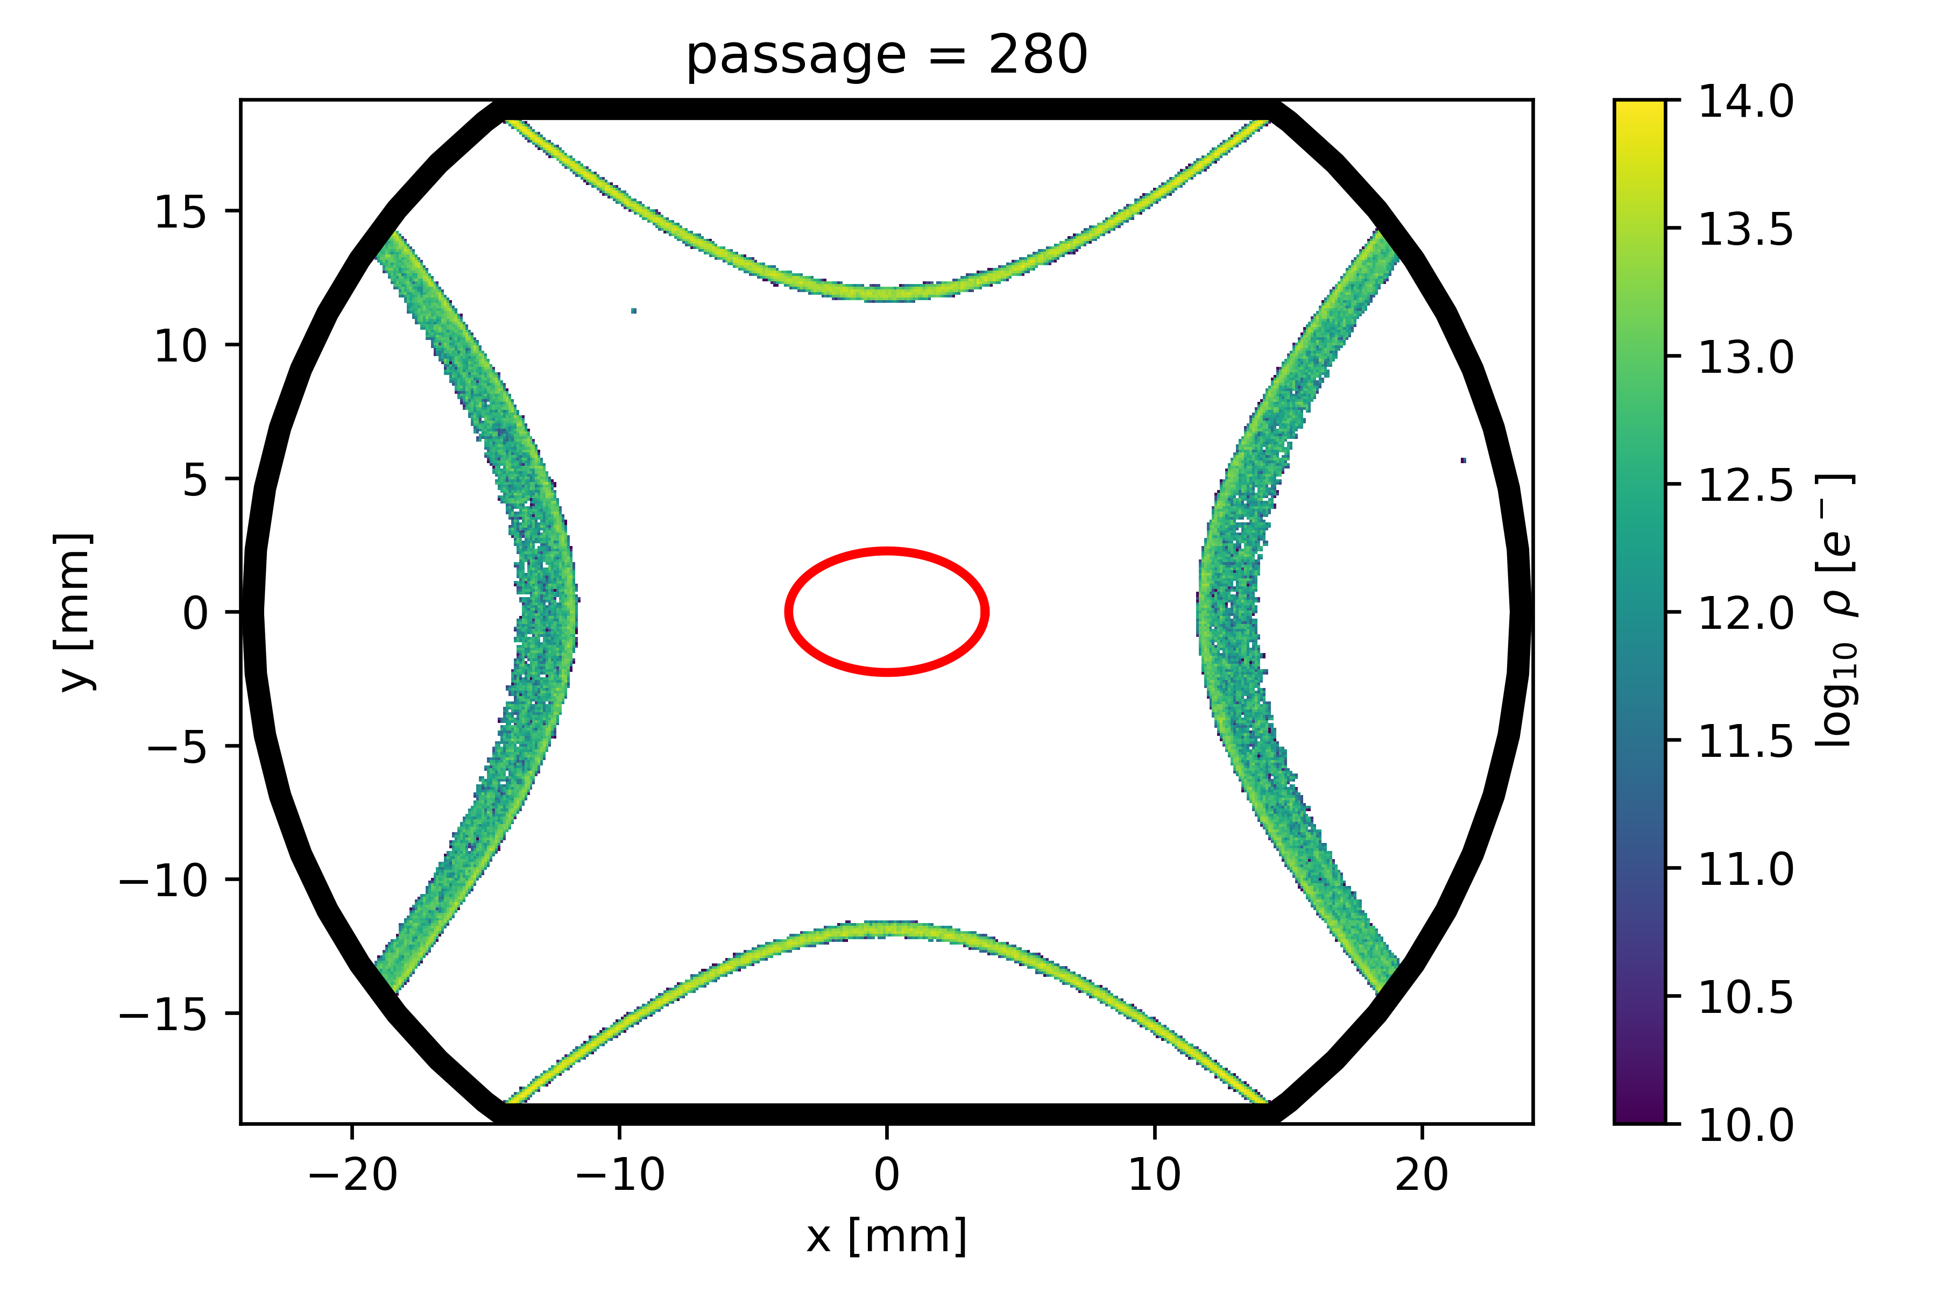
E-cloud build-up studies
Treatment of Q5 quadrupoles in IR1/5
Treating only corners is validated in simulations
  Electrons close to the beam do not multiply
  Non-linearities of e-cloud forces are strongly suppressed
Treatment
at corners
Build-up studies of MQXFS (skew quadrupole corrector) in ITR1/5
No heat-load if coated with a-C as planned

Slide 23
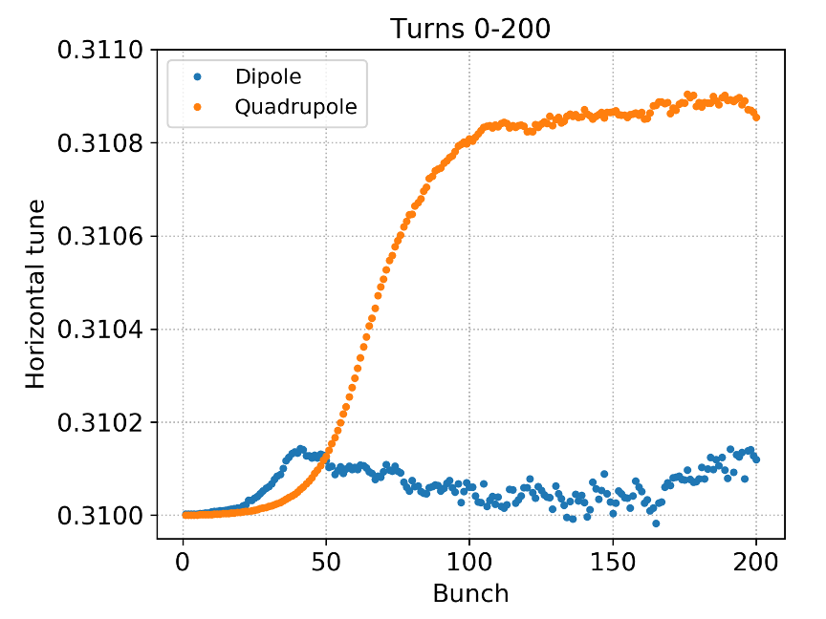
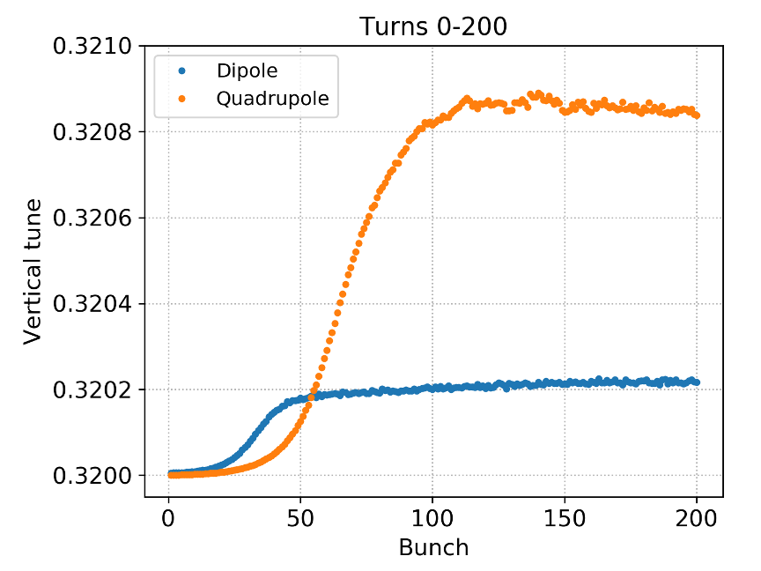
Coherent tune shift from e-cloud
Mitigation of crab cavity fundamental mode impedance using RF feedback with betatron comb filter requires tunes to be well controlled to within 5e-3
See L. Giacomel at Special Joint HiLumi WP2/WP4 Meeting, March 2023
Coherent tune shifts from e-cloud have been estimated with self-consistent coupled-bunch simulations for a conservative case of SEY = 1.5
  The combined tune shift from arc dipoles and quadrupoles is at most around 1e-3
  Within the tolerance for comb filter mitigation, but takes up 20% of budget

Slide 24
Conclusion
Beam screen treatment is necessary to enable baseline HL-LHC scenario
  For a first proposal of half-cell selection, the estimated heat load margin
  is 25-30 W/half-cell in most sectors (with 5x48b trains)
  Even after beam screen treatment, further degradation due to LS3 in untreated cells can limit performance, although to a lesser extent
  In case of further degradation or no treatment, hybrid schemes allow to optimise performance
Other results
  LHC injection optics modified to reduce emittance growth due to octupolar resonances based on simulations – experimental verification pending
  E-cloud suppression for LESS treatment of beam screen corners in Q5 (IP1&5) has been confirmed in simulations
  Coherent tune shifts from e-cloud at flat top are within the tolerance required for RF comb filter mitigation of crab cavity fundamental mode impedance, but should be considered in total balance

Slide 25
Thank you for your attention!

Slide 26
Spare Slides

Slide 27
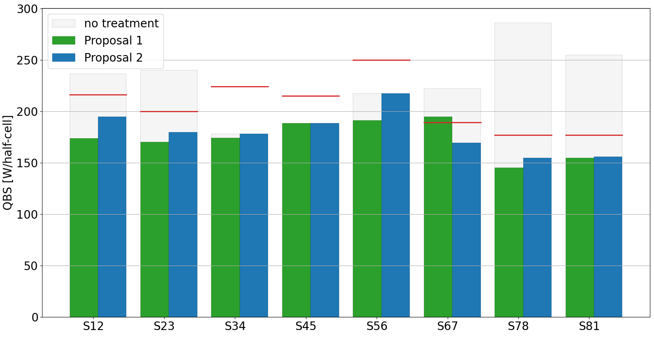
Heat load after treatment
Proposal 1 (100’s top) : S67 heat loads above the cryo capacity limits
Proposal 2 (optimized): >20 W/hc of margin in each sectors (~10%) + all constraints satisfied
B. Bradu - First inventory proposal of half-cells to be treated during the LS3
Future cryo capacities
33 W
21 W
46 W
27 W
20 W
With LHCb+ project at P8
20 W
22 W
21 W
10
18
0
0
0
18
31
23
15
18
1
0
7
6
32
21
# treated hc

Slide 28
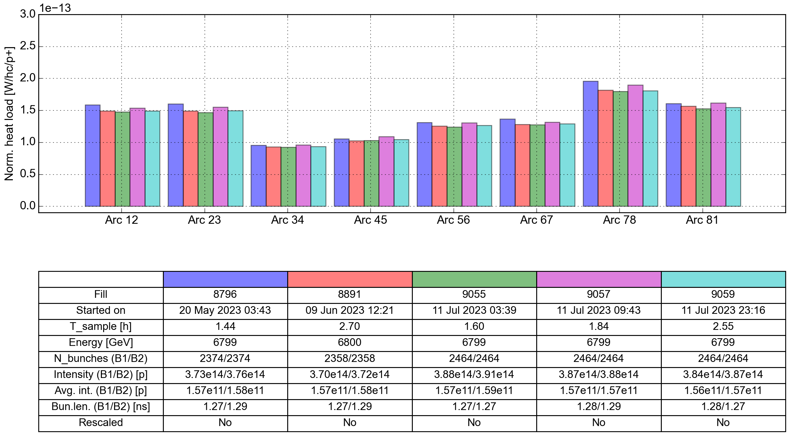
Heat loads in 2023
Scrubbing is difficult to estimate, due to fluctuations in measured heat load

Slide 29
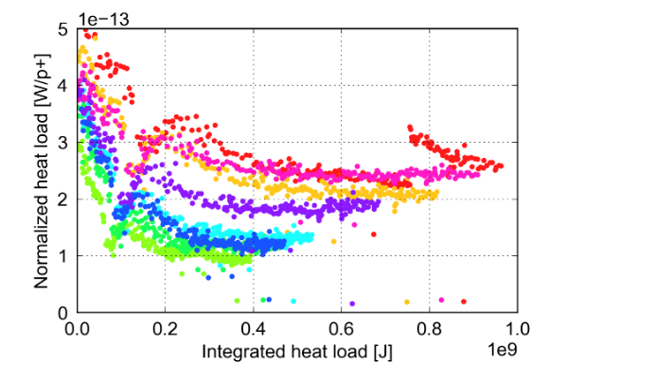
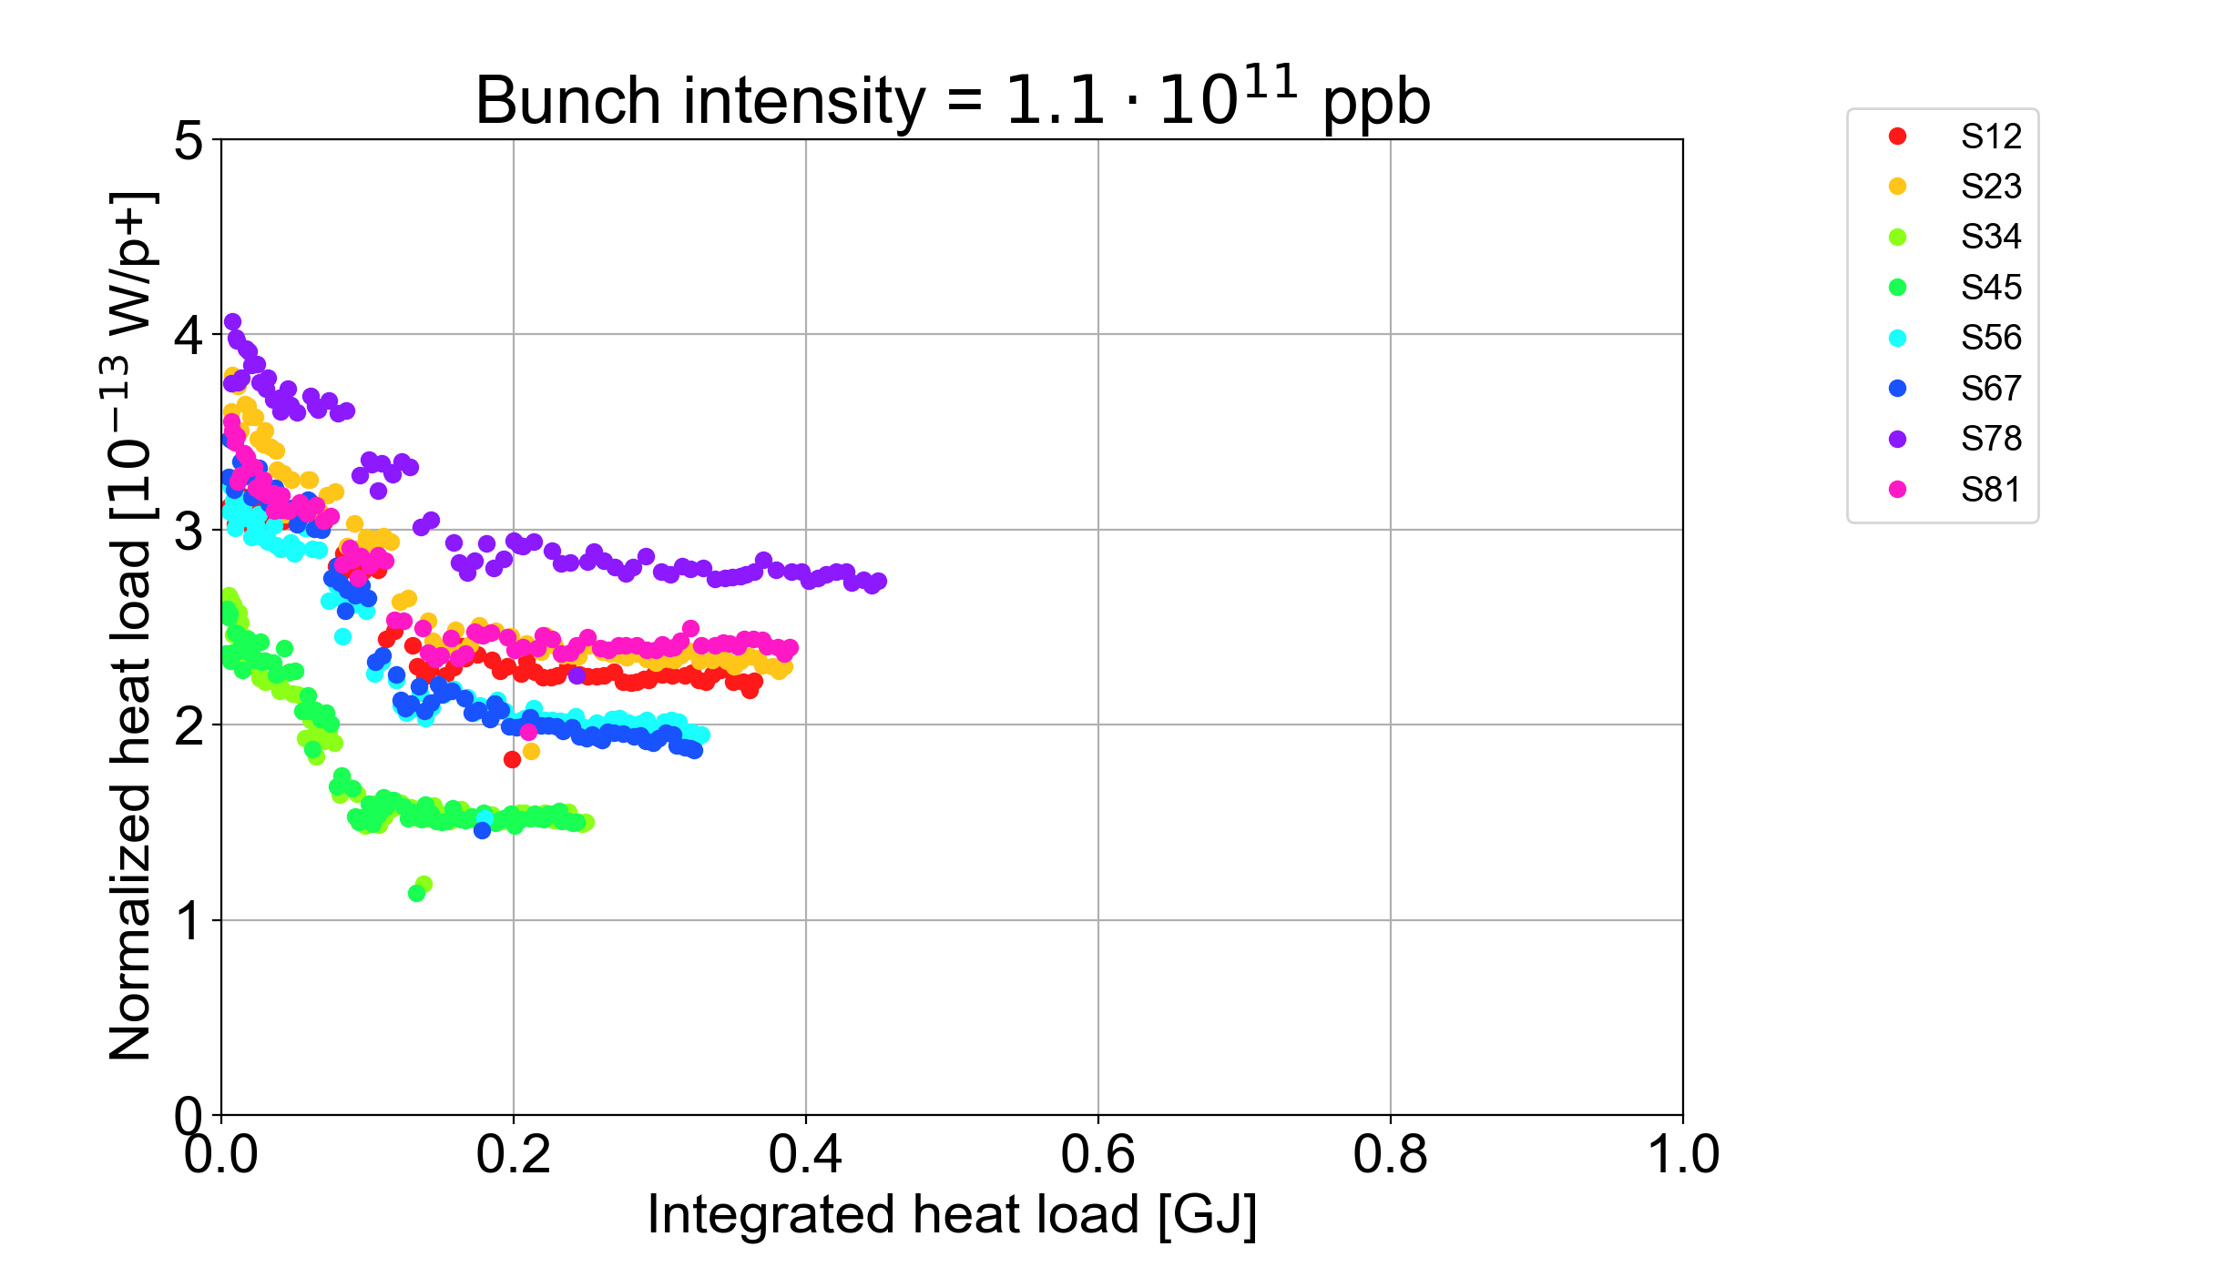
Scrubbing evolution during physics
Accumulated heat load dose in 2022 similar to that achieved by mid-2016 in Run 2
Scrubbing seems to be slowing down in all sectors
Different scrubbing rate among the sectors:
  S12, S34, S45 and S81 show very little evolution
  S56 and S67 still seem to be scrubbing
Physics fills with > 600 bunches
Run 2 (2015 – start 2017)
Run 3

Slide 30
Cell-by-cell heat load comparison
2018
2022

Slide 31
Cell-by-cell heat load comparison

Slide 32
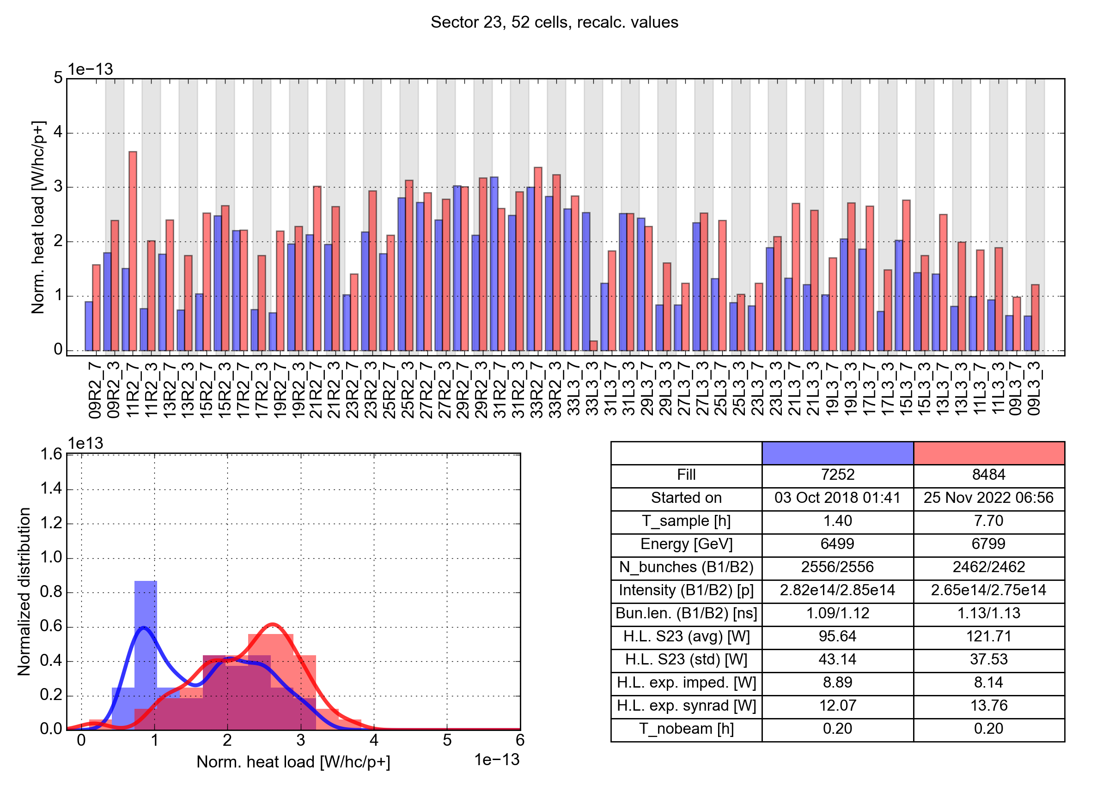
Cell-by-cell heat load comparison

Slide 33
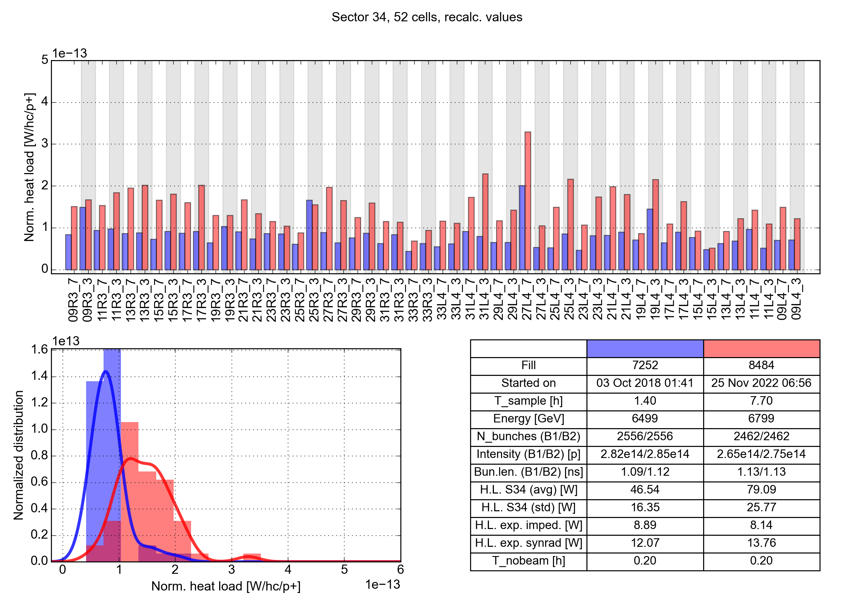
Cell-by-cell heat load comparison

Slide 34
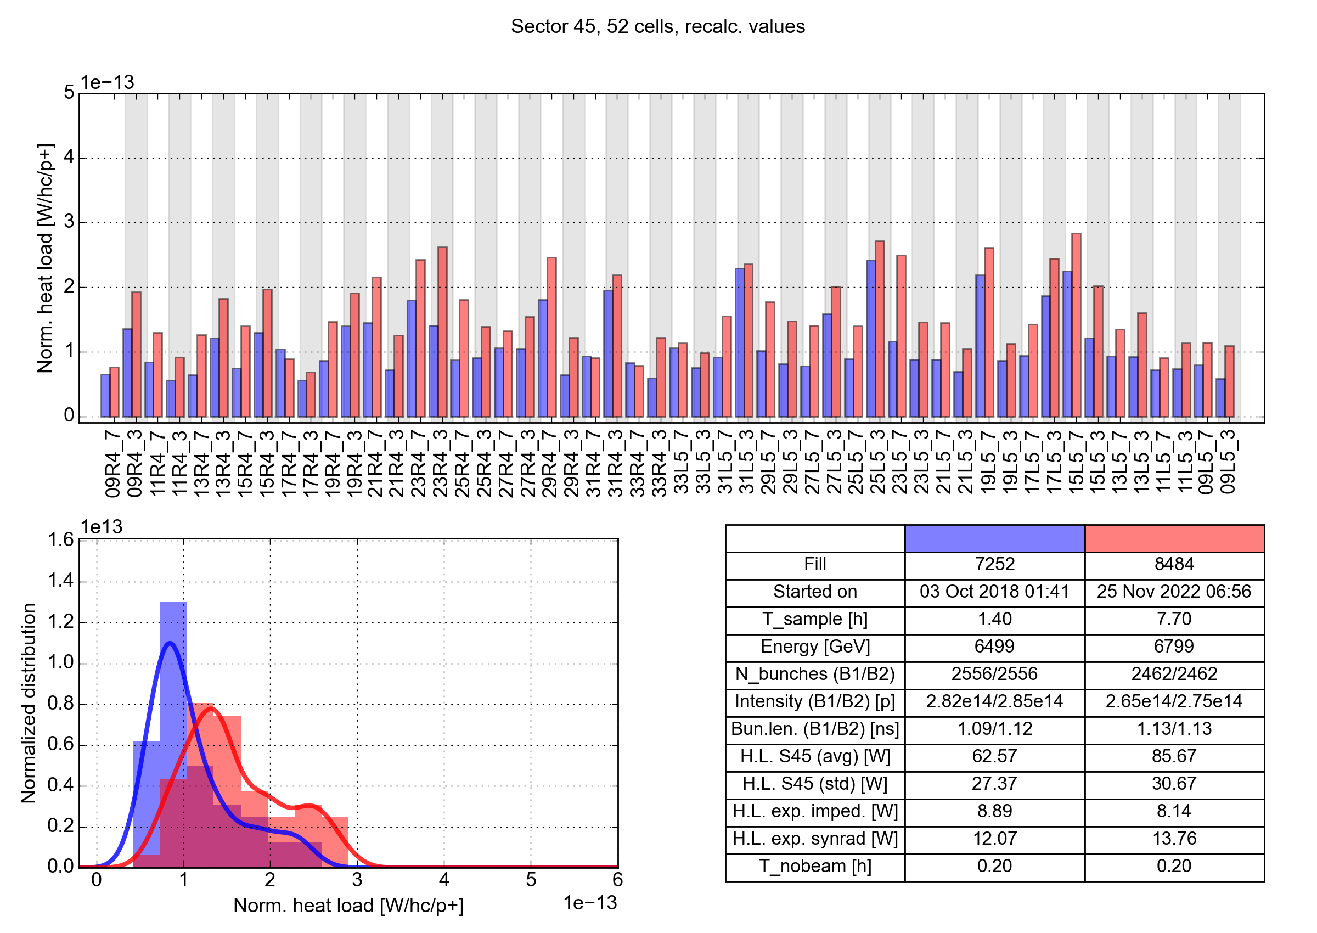
Cell-by-cell heat load comparison

Slide 35
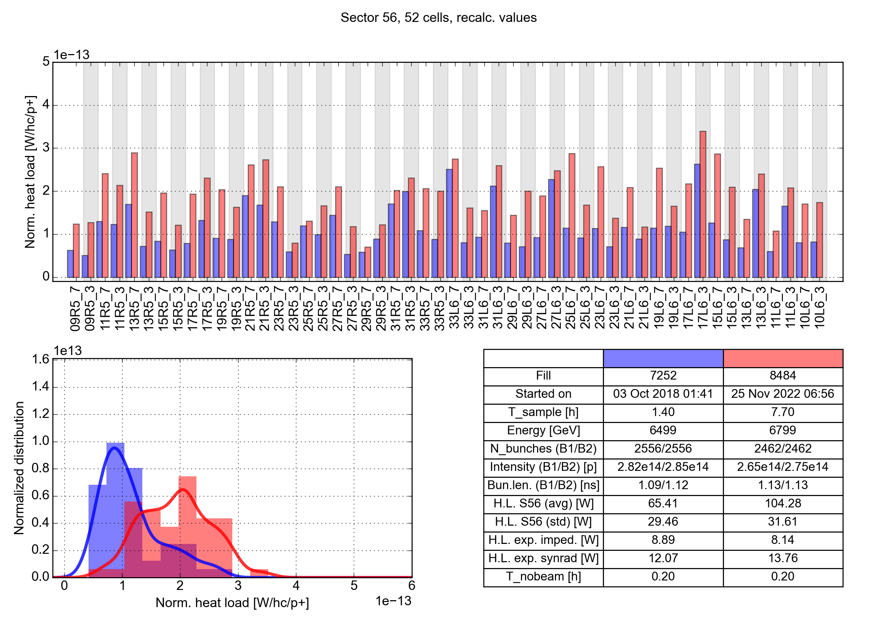
Cell-by-cell heat load comparison

Slide 36
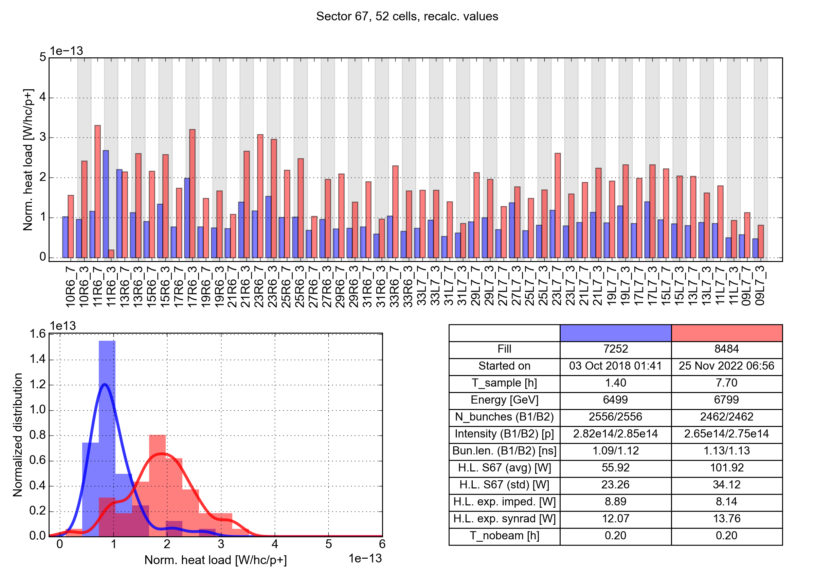
Cell-by-cell heat load comparison

Slide 37
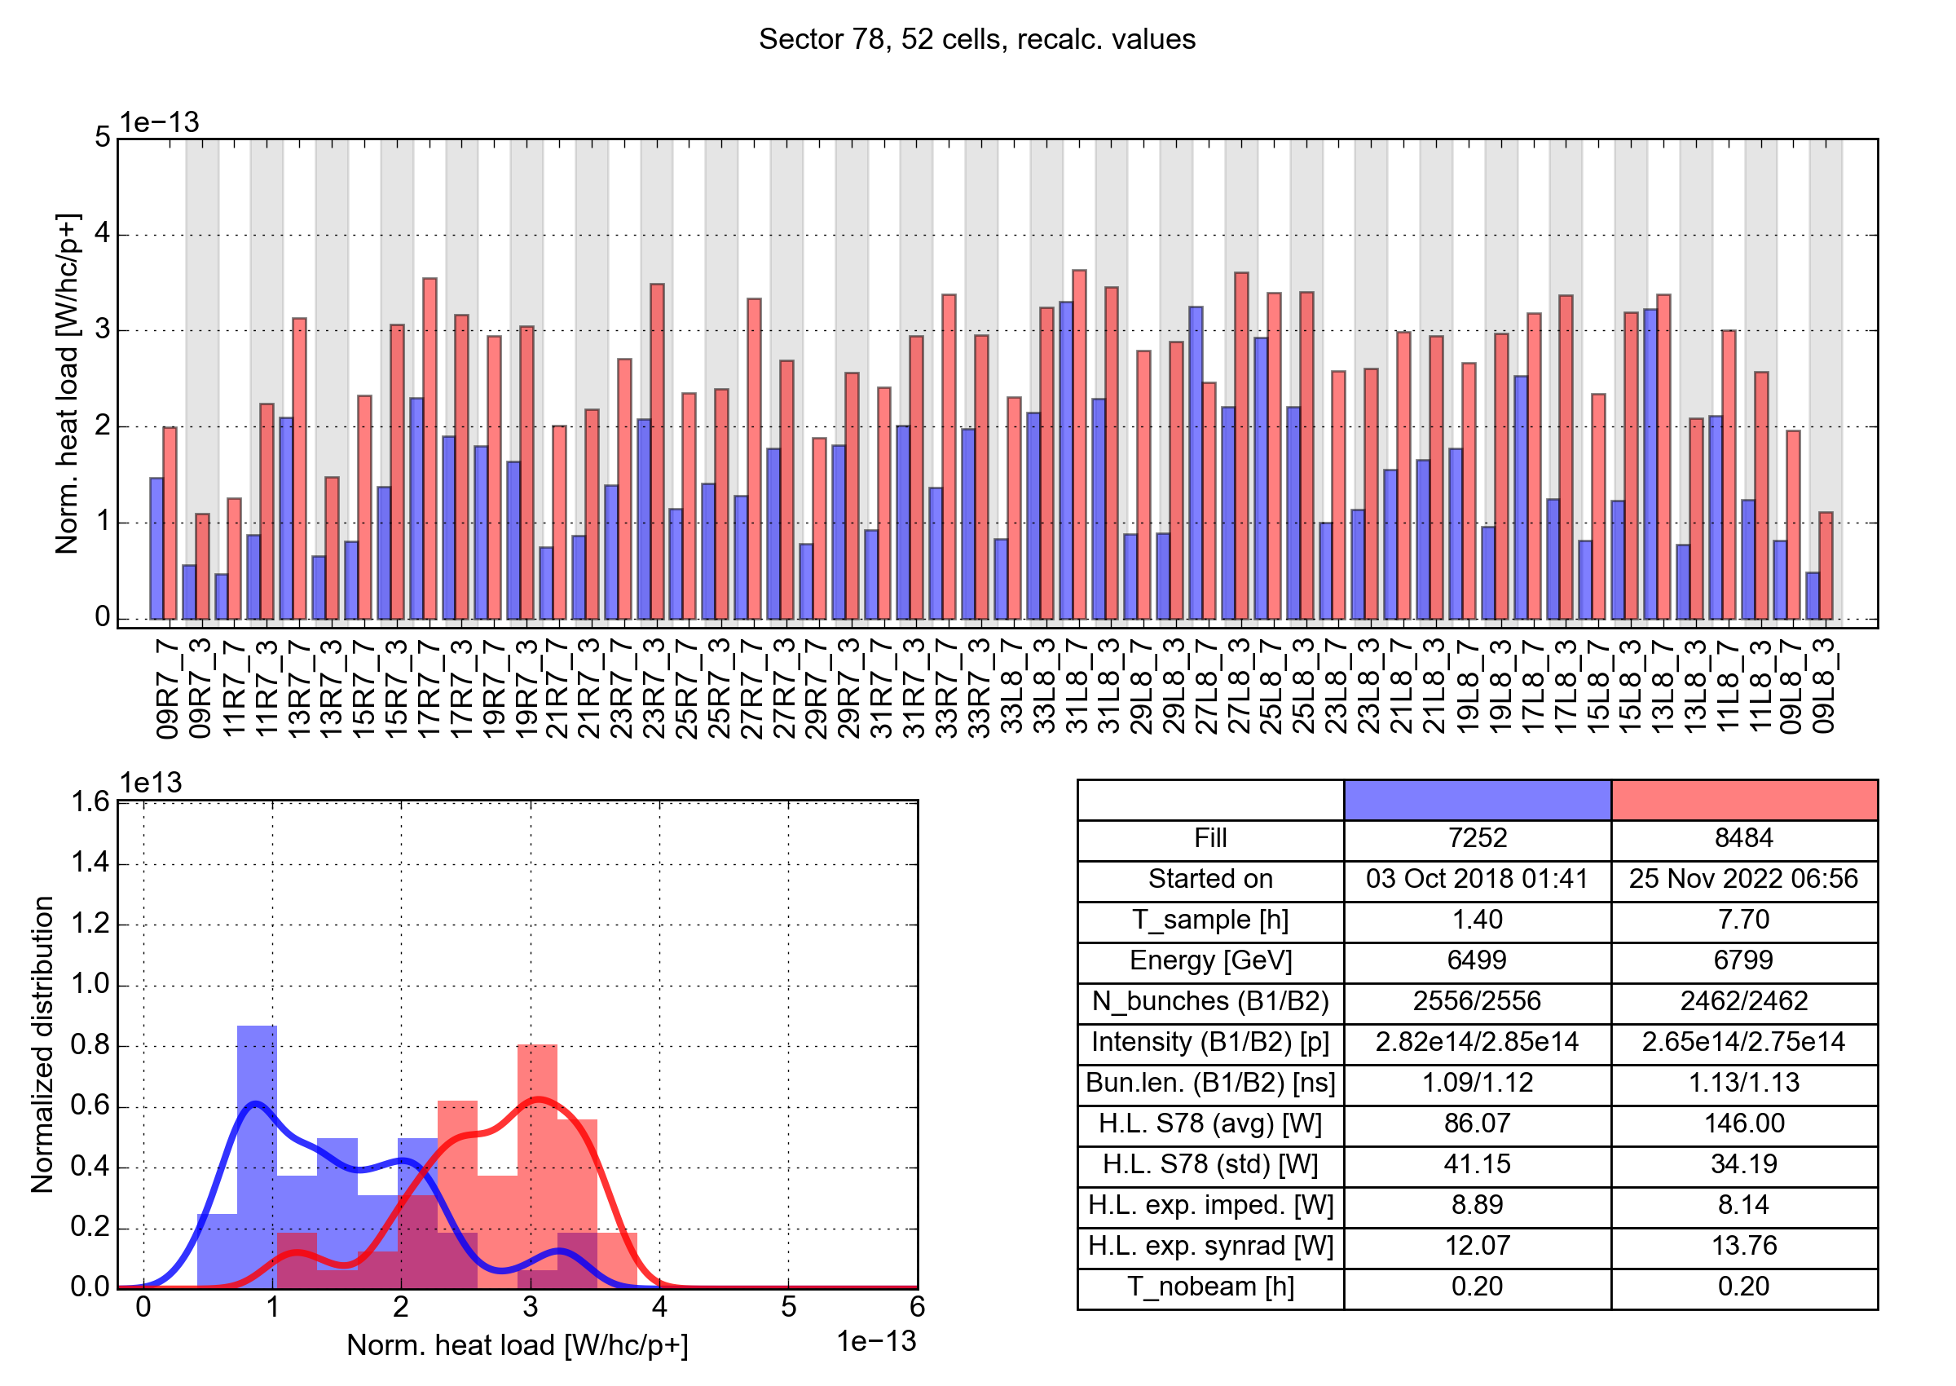
Cell-by-cell heat load comparison

Slide 38
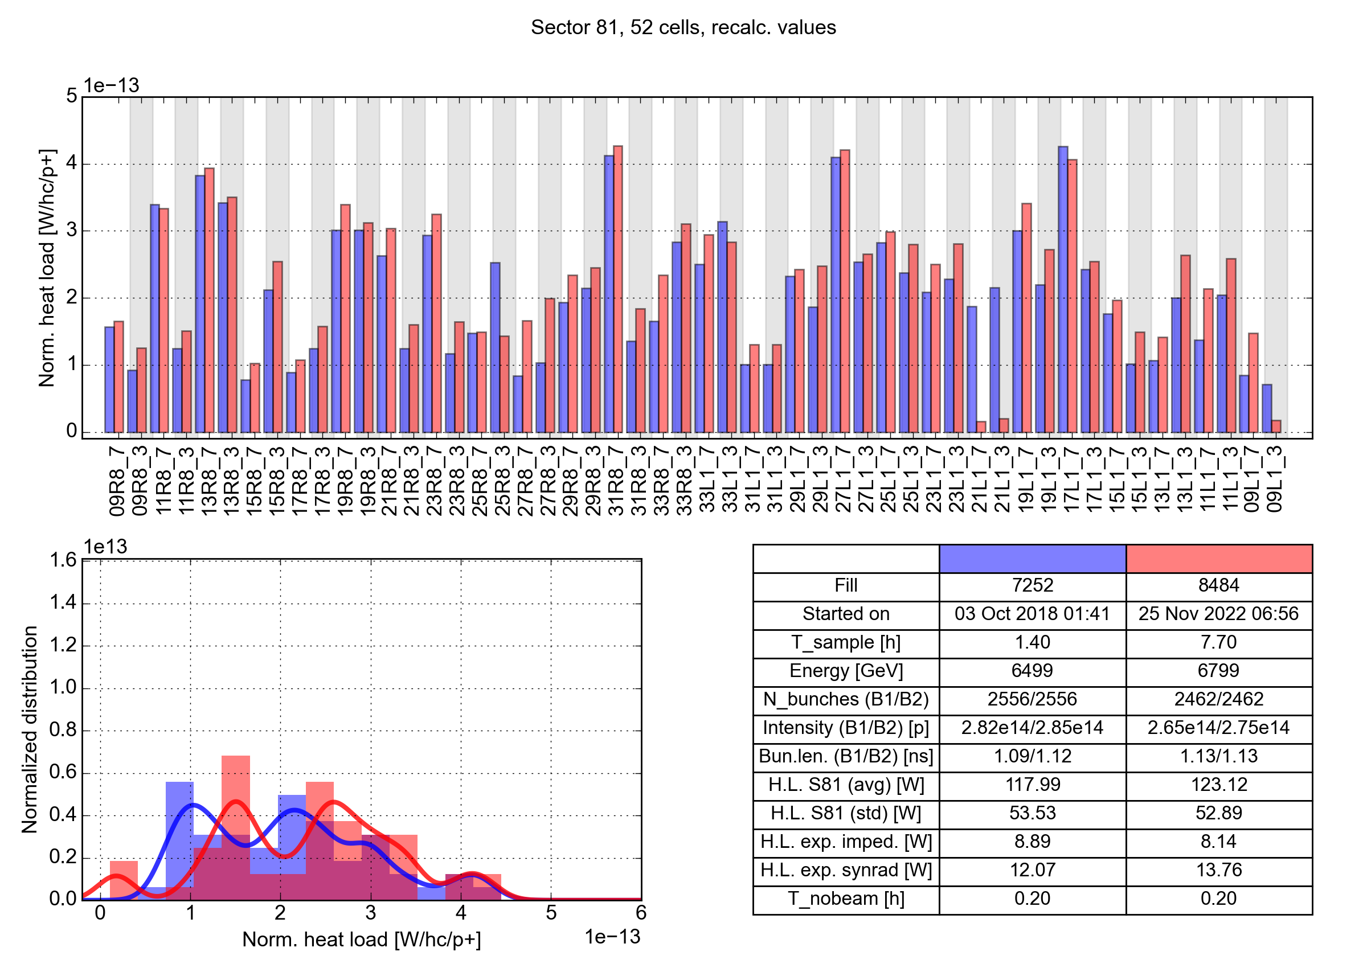
Cell-by-cell heat load comparison

Slide 39
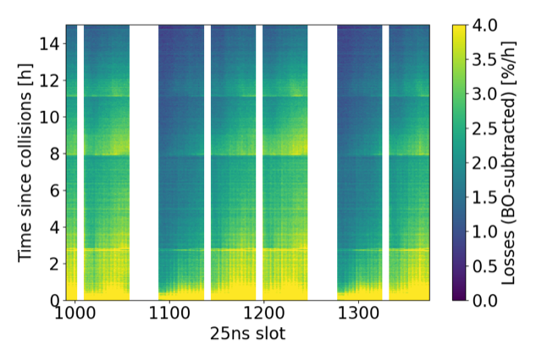
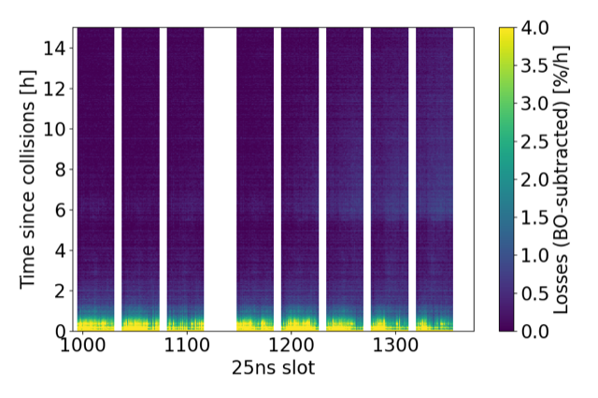
Beam degradation in collision
During Run 2, slow beam losses at tail of trains were systematically observed in collision
Caused by e-cloud in the Inner Triplets, enhanced by the large beta functions
In 2022, we saw much less of such losses
Possibly due to i.a. more relaxed settings for the crossing angle and smaller emittances
Similar beam quality for most of stable beams
Can compare fills at different times to find similar bunch intensities and lengths
Fill 7721 2018, B1
Fill 8491 2022, B1

Slide 40




E-cloud simulation model
The e-cloud heat load can be estimated based on the SEY, which is inferred by comparing heat load measurements to simulations with matching beam and machine parameters
Bunch length, emittance, energy,
filling scheme
Arc elements:
Magnetic field, beta functions
Photoemission parameters
SEY
Bunch intensity
PyECLOUD simulations
Measurements:
Bunch intensity,
cell-by-cell heat load
Cell-by-cell SEY
(machine model)
Heat load vs bunch intensity, SEY database
Heat load scaling with intensity

Slide 41
E-cloud simulation model
The e-cloud heat load can be estimated based on the SEY, which is inferred by comparing heat load measurements to simulations with matching beam and machine parameters
Bunch length, emittance, energy,
filling scheme
Bunch length, emittance, energy,
filling scheme
Bunch length, emittance, energy,
filling scheme
Arc elements:
Magnetic field, beta functions
Photoemission parameters
SEY
Bunch intensity
PyECLOUD simulations
Measurements:
Bunch intensity,
cell-by-cell heat load
Cell-by-cell SEY
(machine model)
Heat load vs bunch intensity, SEY database
Heat load vs bunch intensity, SEY database
Heat load vs bunch intensity, SEY database
Heat load scaling with intensity
Heat load scaling with intensity
Heat load scaling with intensity

Slide 42
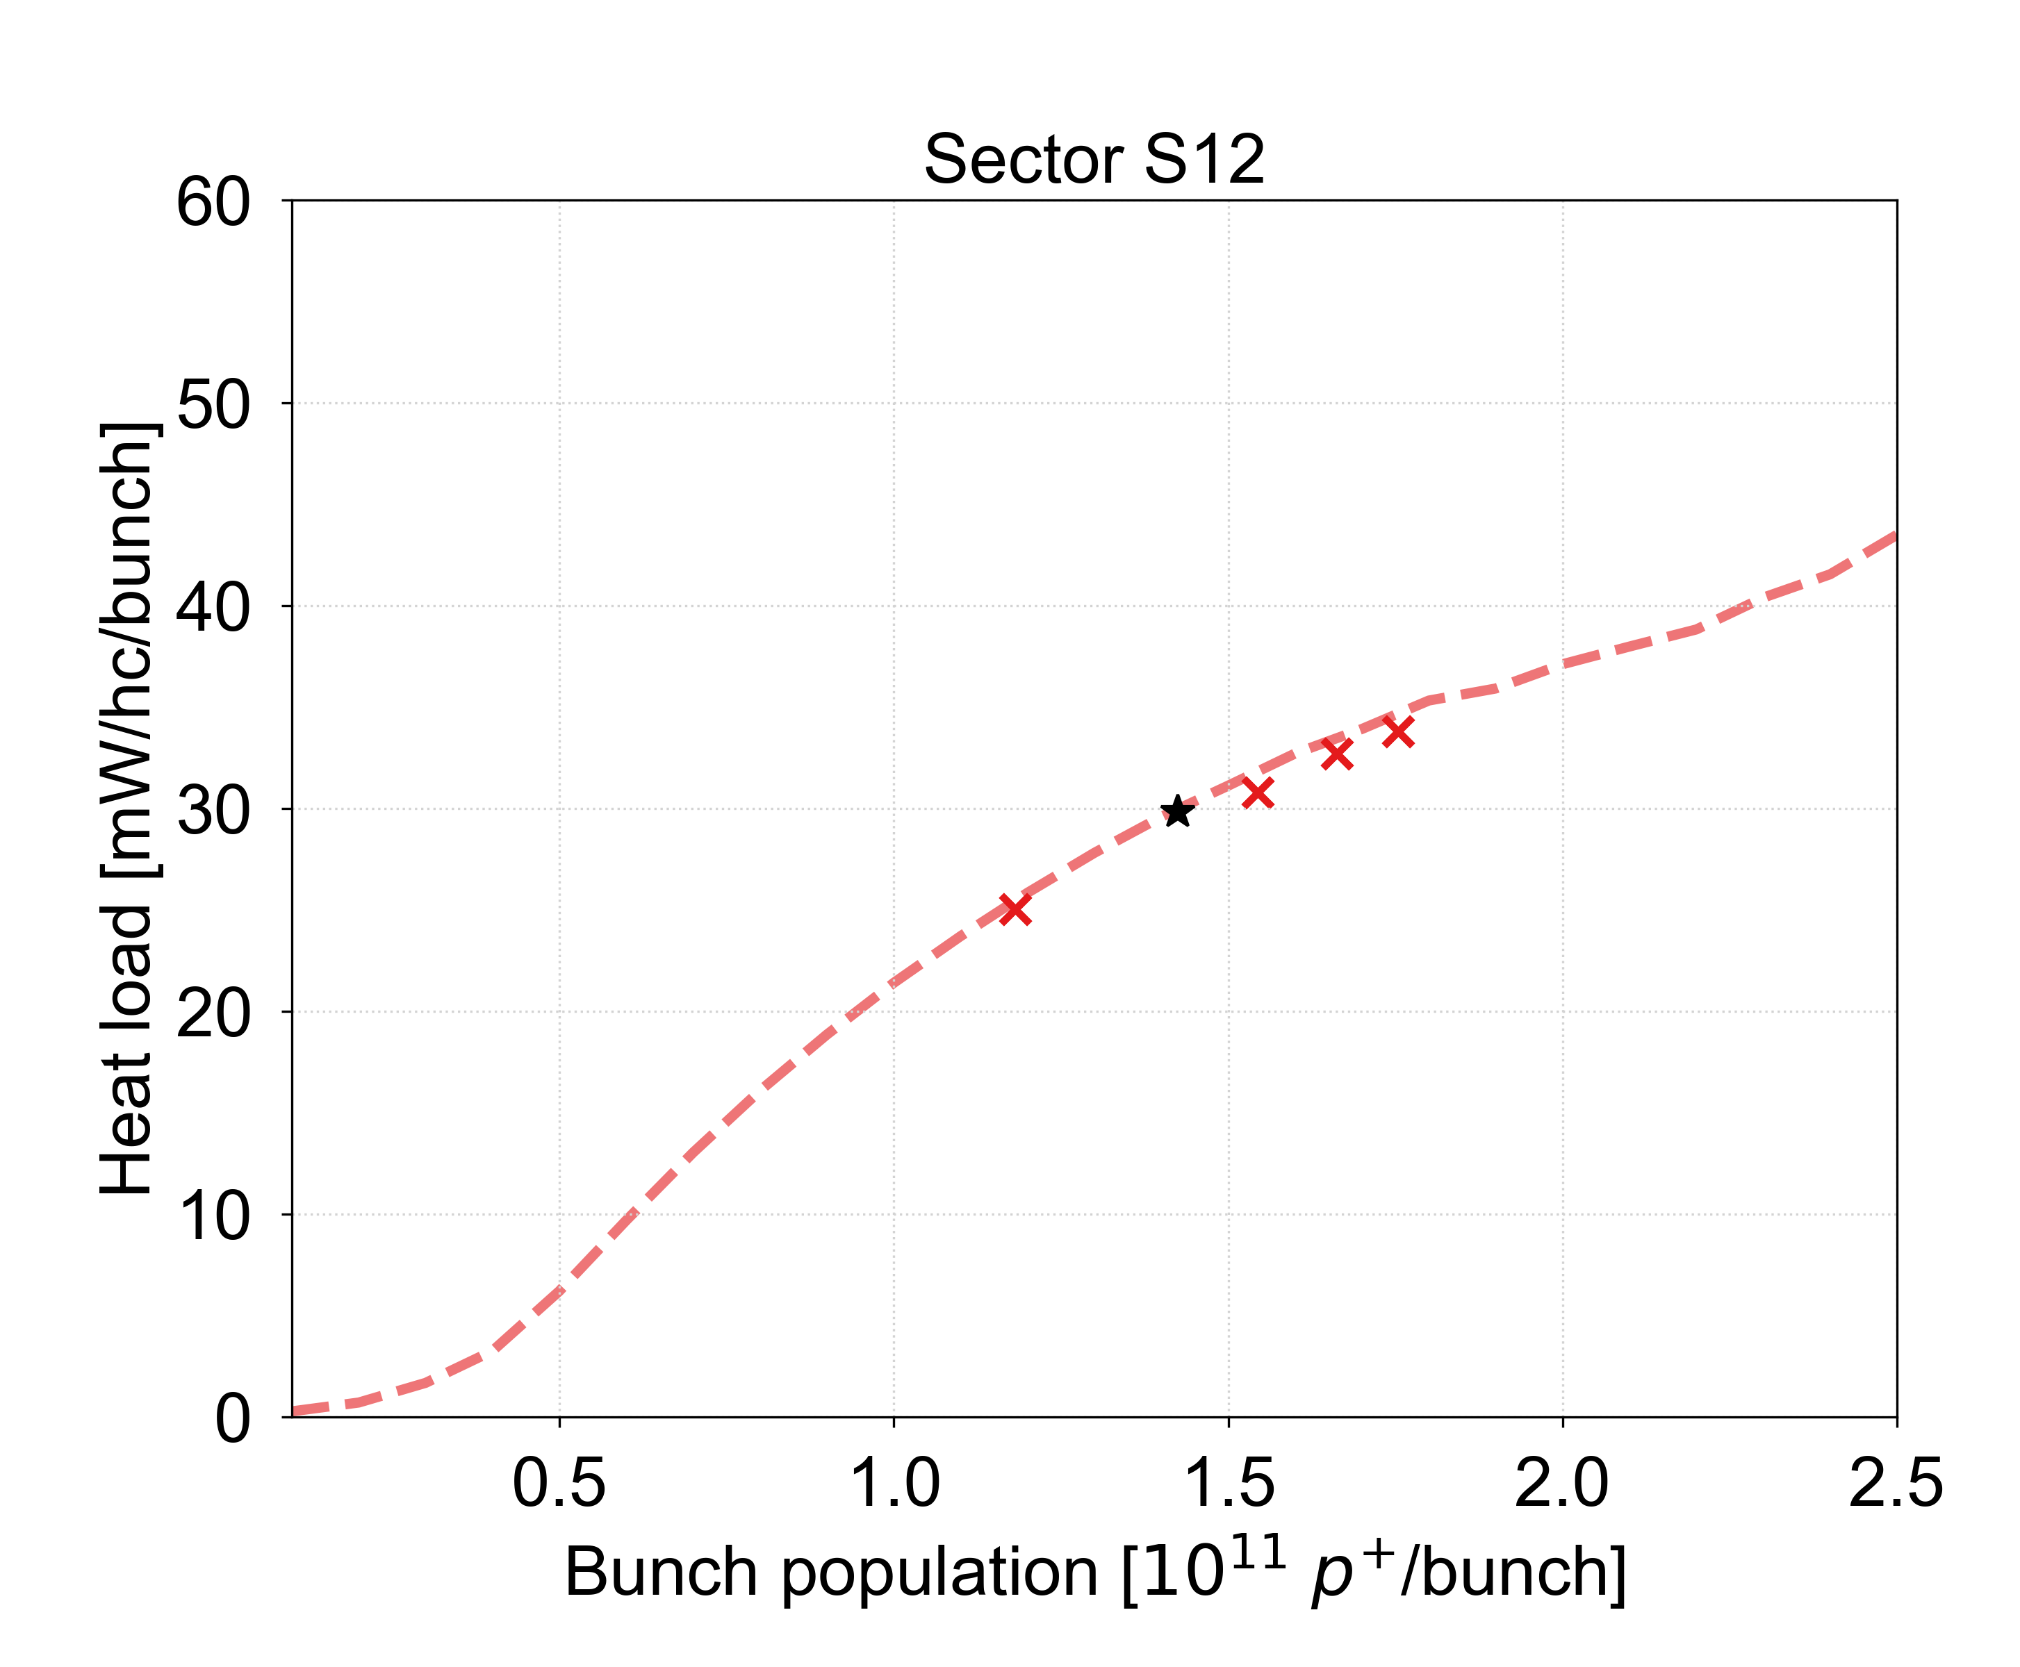
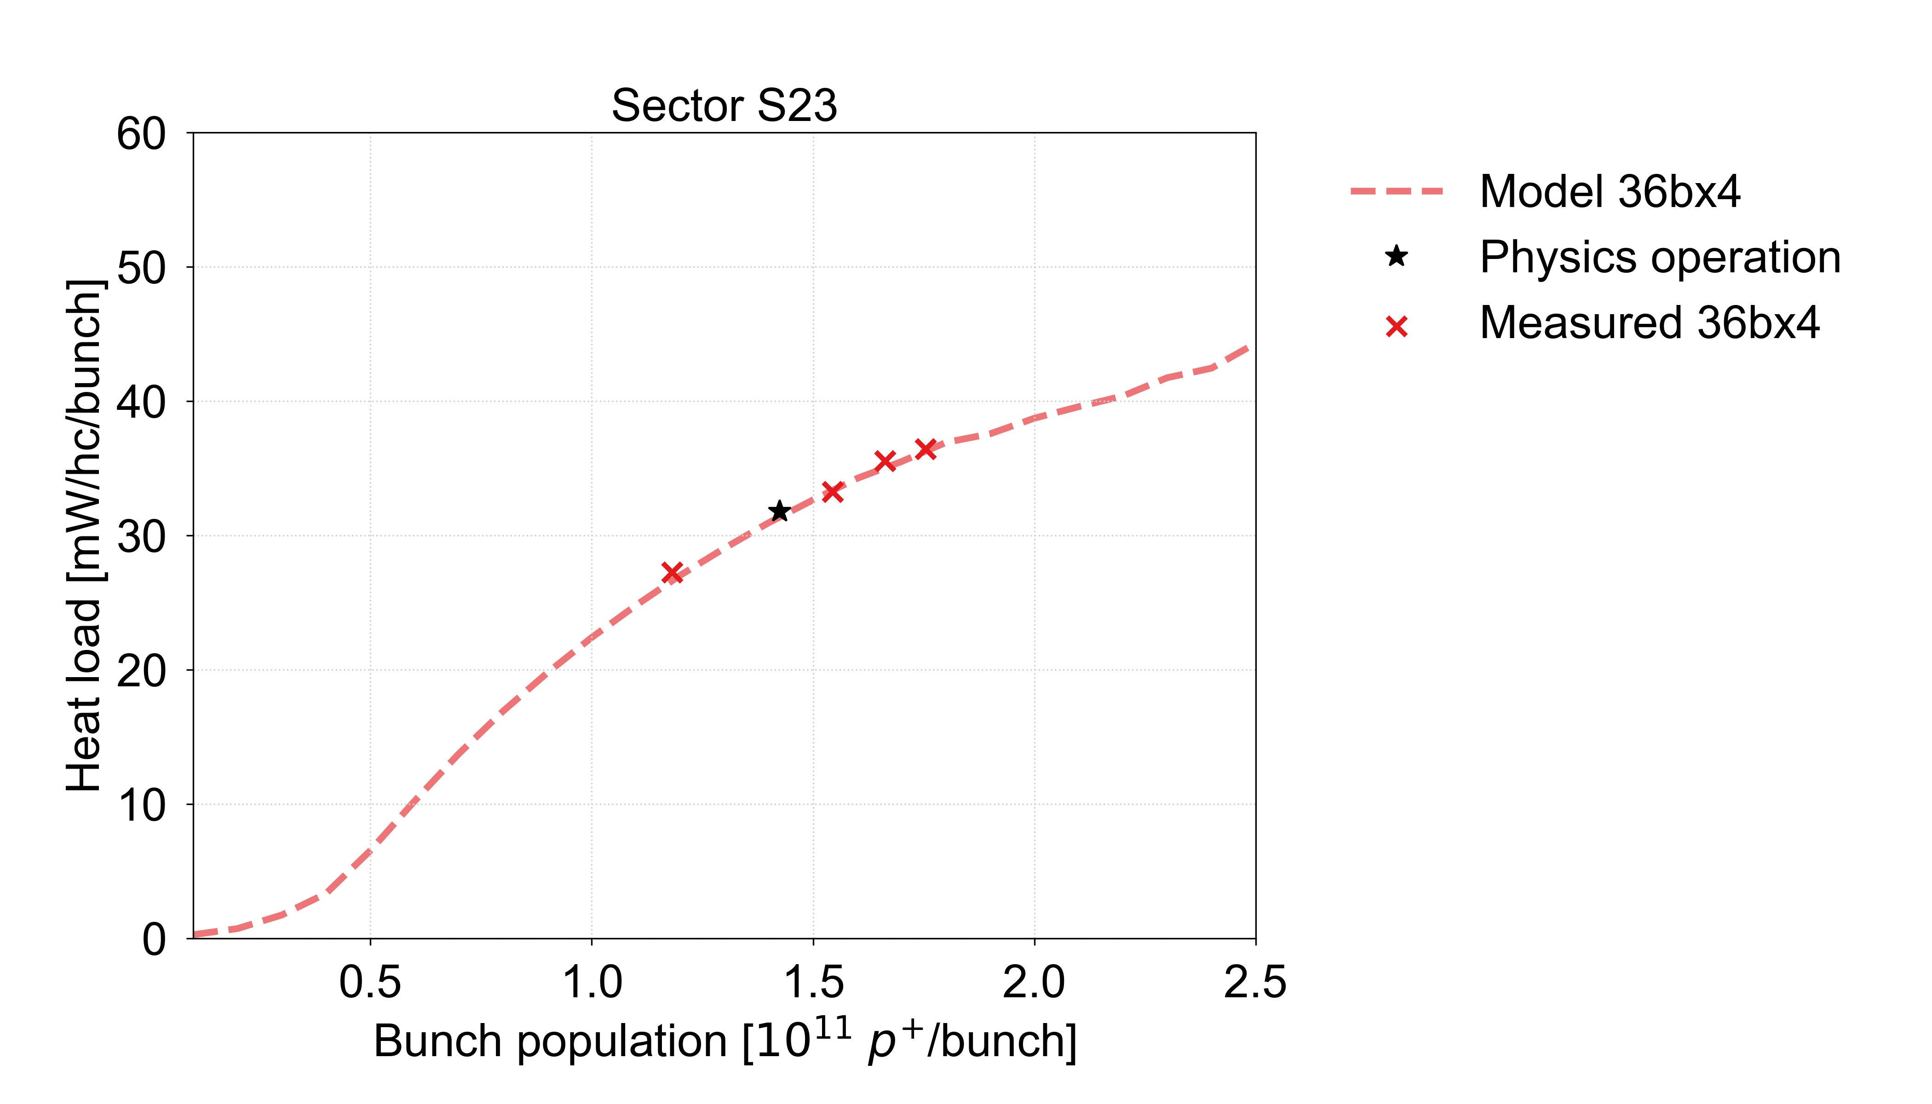
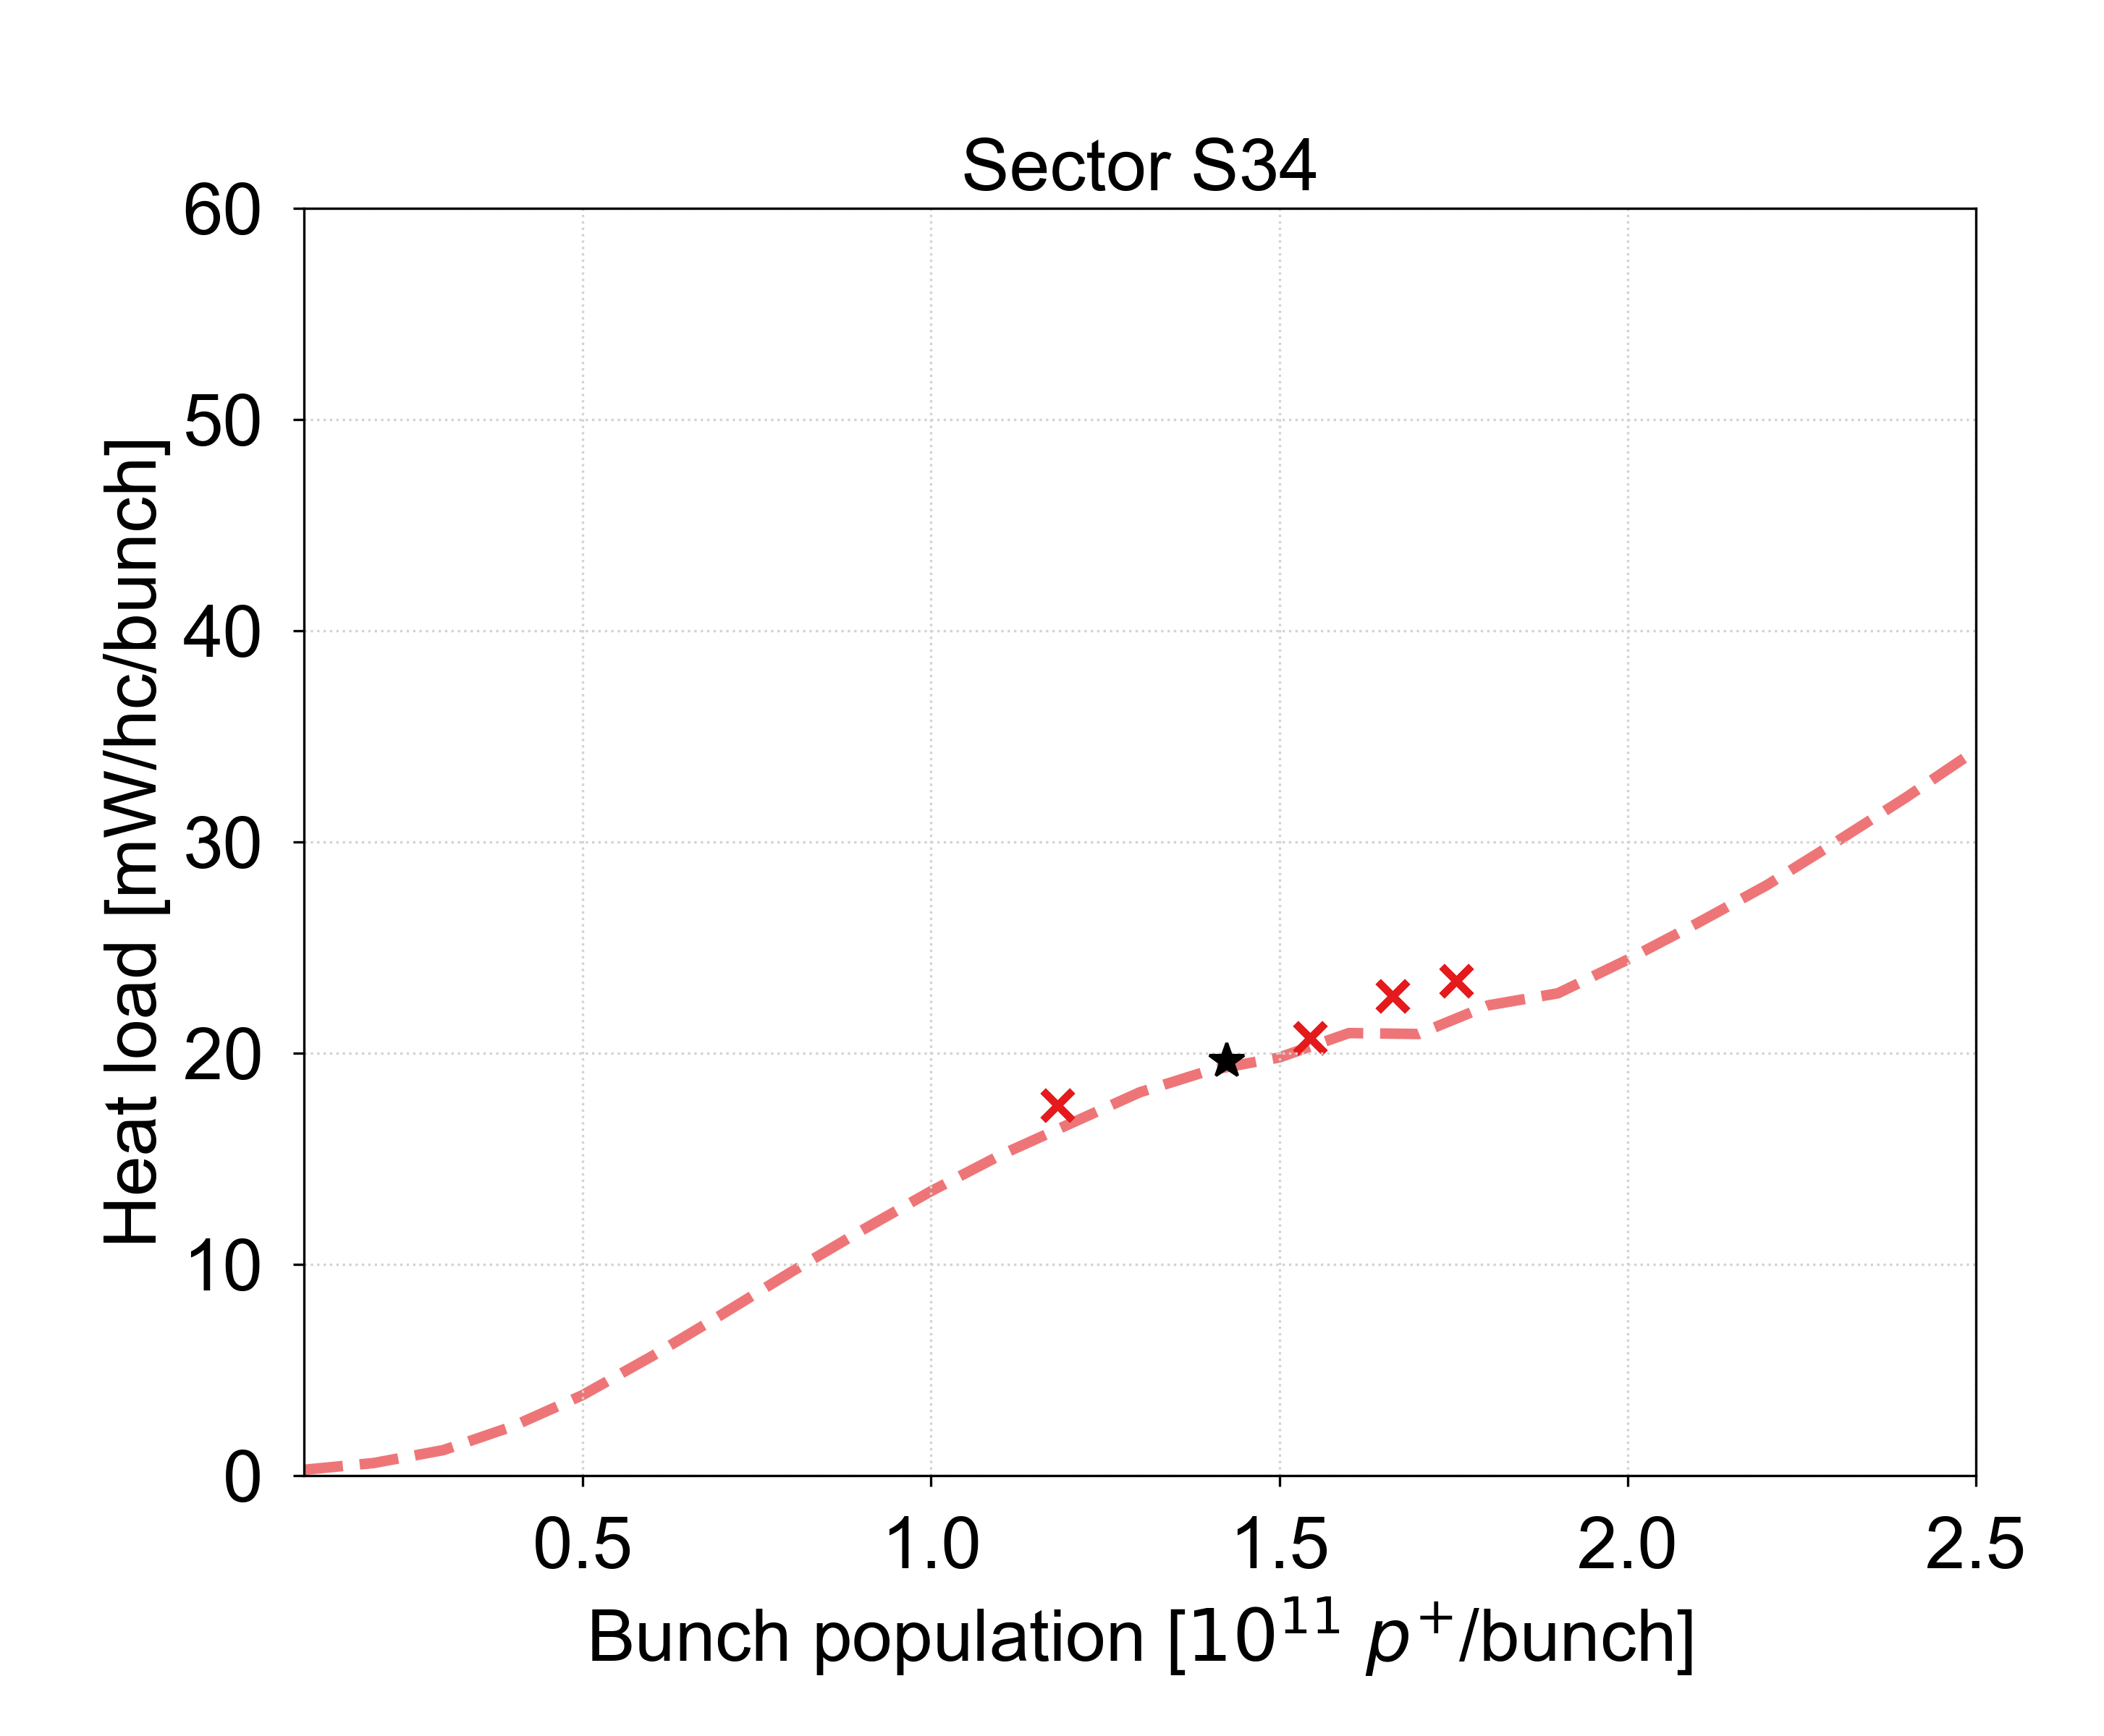
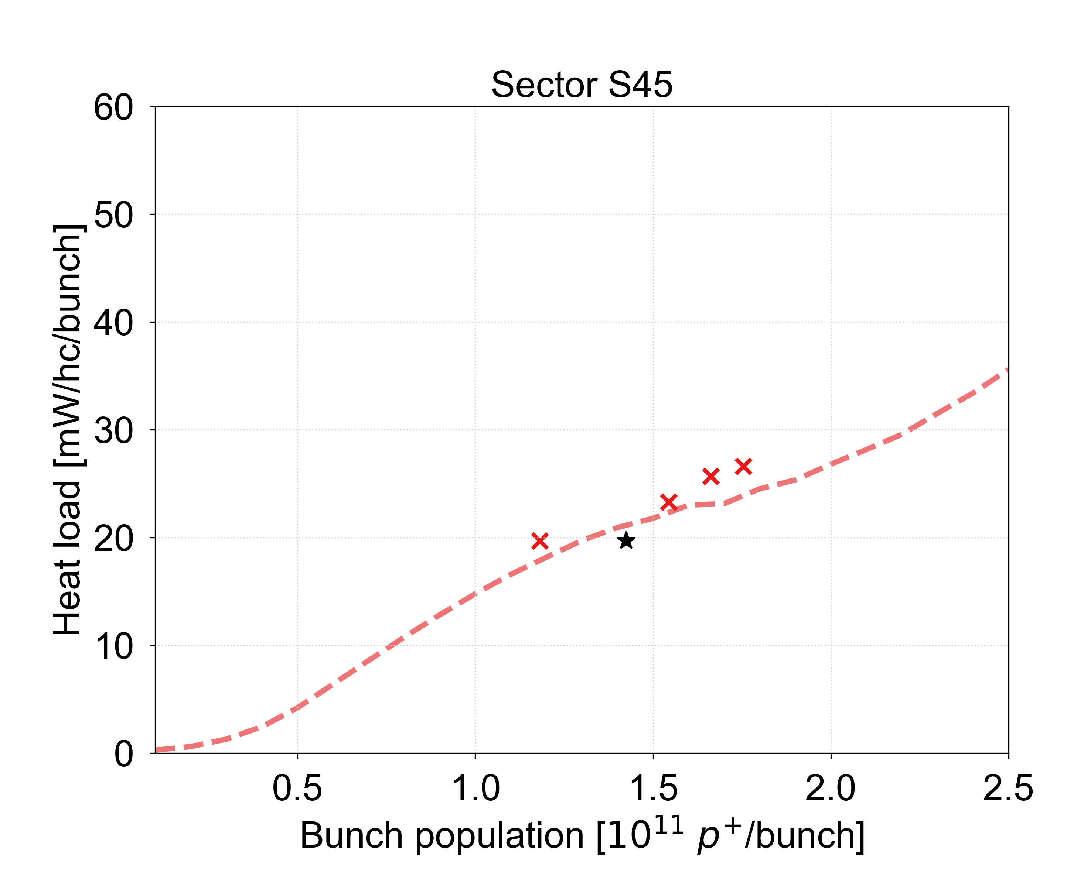
Comparison to model
Good agreement between model and measurements found in all sectors

Slide 43
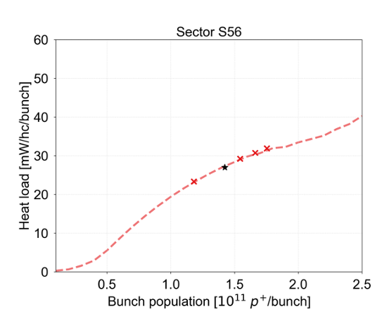
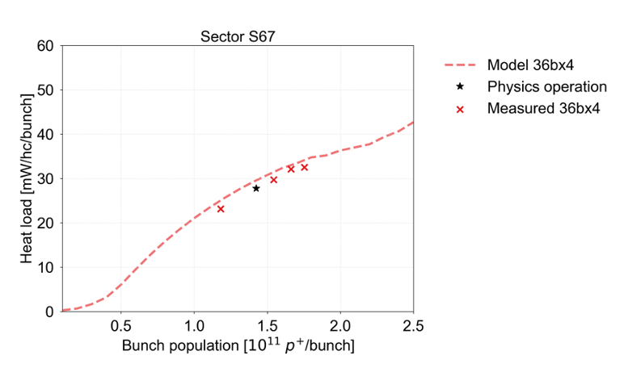
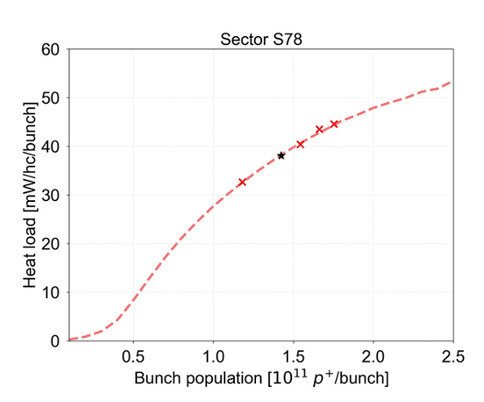
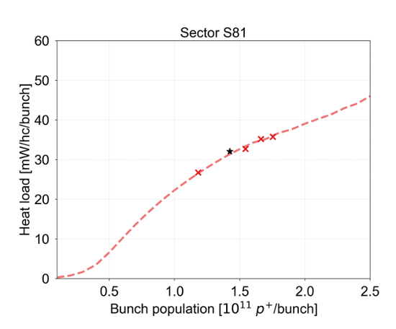
Comparison to model
Good agreement between model and measurements found in all sectors

Slide 44
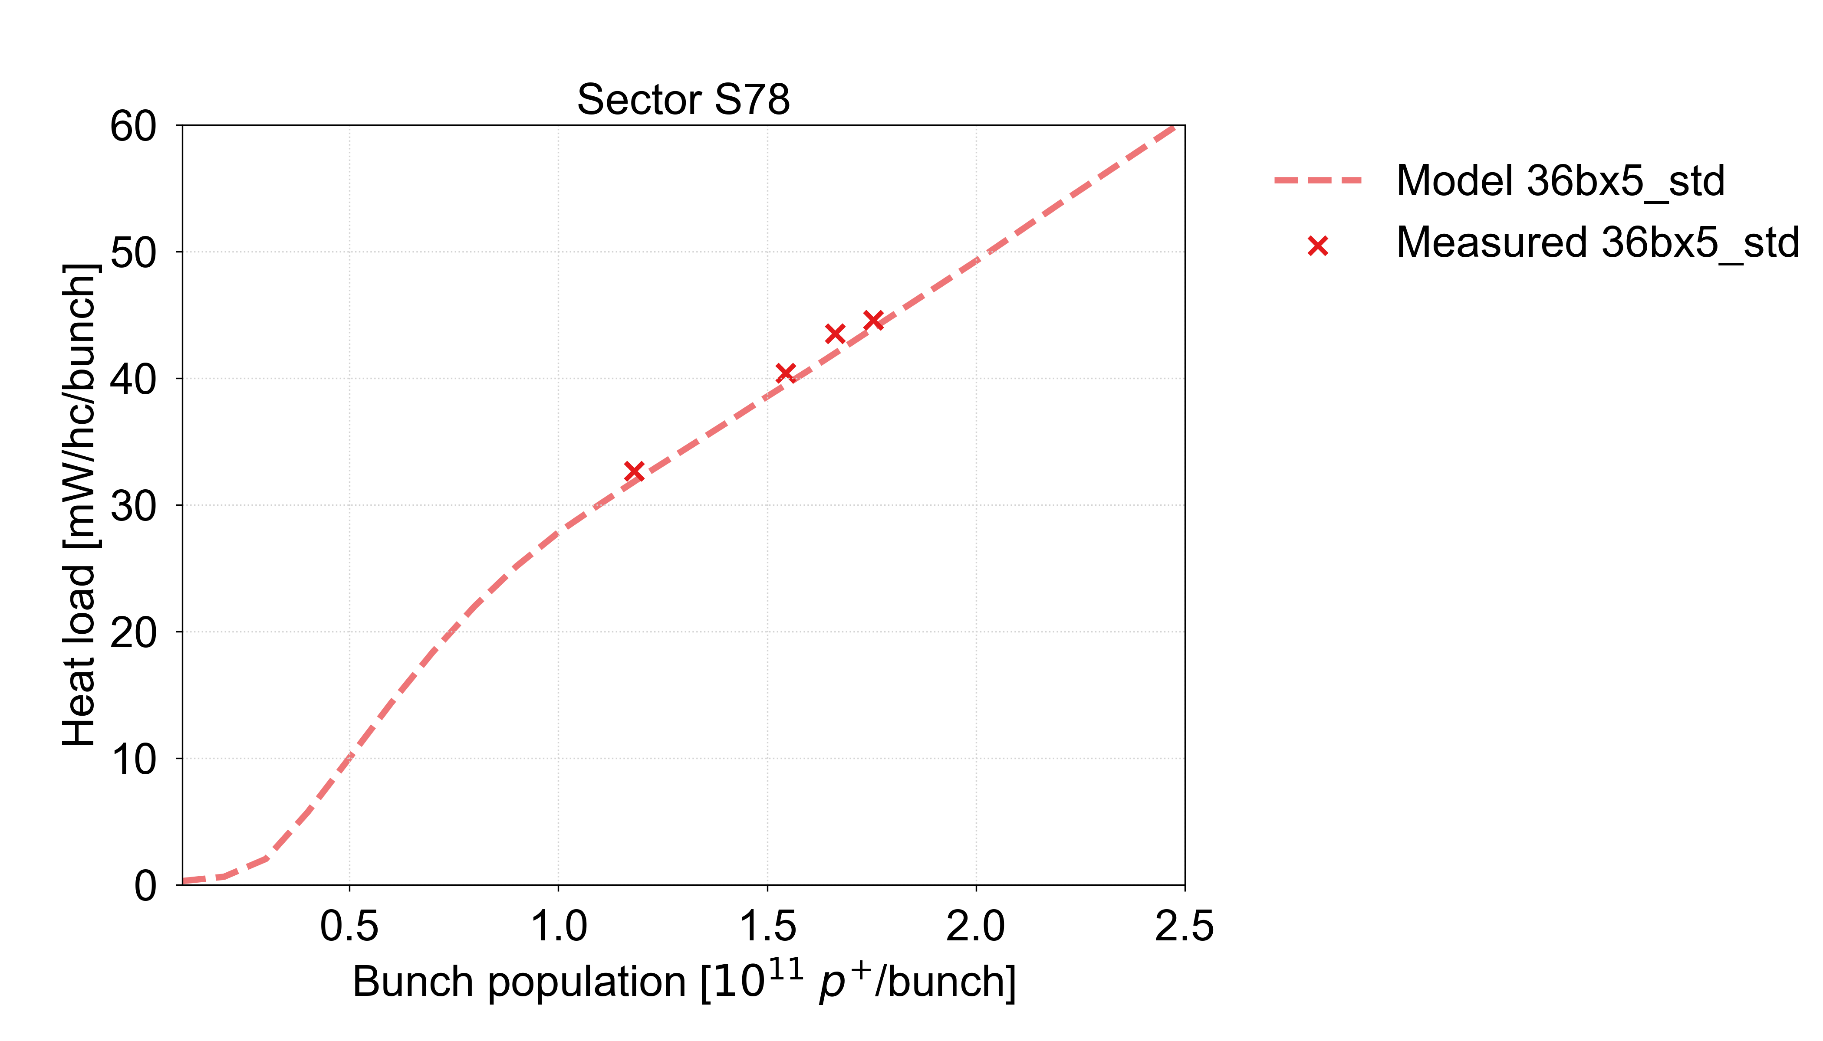

E-cloud fit model
When making the SEY fit from simulations, we are making an assumption on the distribution of the SEY within the half-cell
For the estimates presented here, we assume a uniform SEY within the half-cells
  Provides the best fit to data, with SEY values close to lab measurements
Effort to improve fitting method based on recent measurements of heat load scaling with intensity and bunch train pattern is ongoing
→ for future estimates
Uniform SEY
Heat load only from dipoles
S78 average SEY estimate: 1.36
S78 average SEY estimate: 1.54
SEY in highest heat load cells: 1.46
SEY in highest heat load cells: 1.72
Simulations with enhanced photoemission

Slide 45
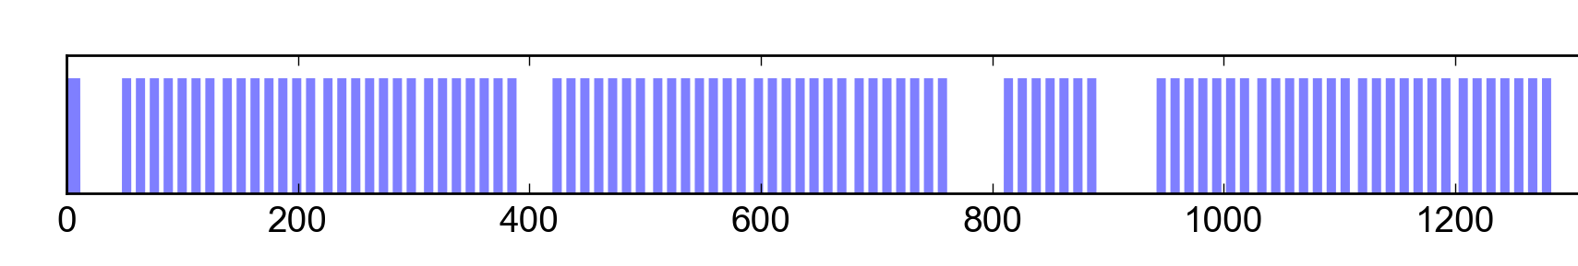
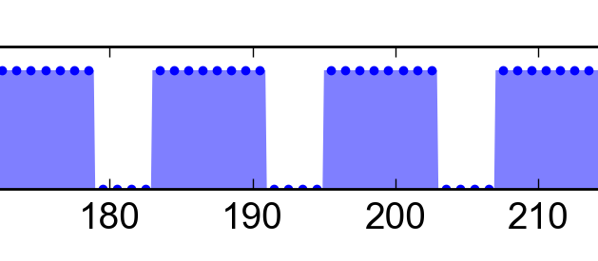
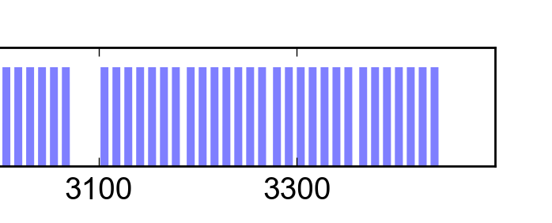
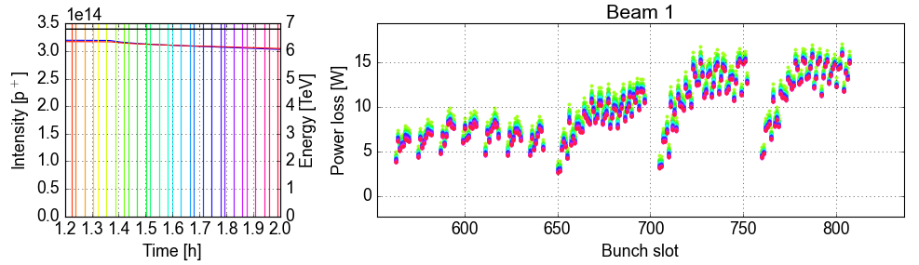
Mitigation with bunch train pattern
A saturated e-cloud builds up in ~20 bunch passages
→ with shorter trains, a smaller fraction of bunches interact with the full e-cloud
The 8b+4e scheme introduces gaps already on the rising slope of the build-up
→ significant reduction of e-cloud effects
The best compromise for maximising performance while limiting the heat load is obtained with hybrid schemes, mixing 25 ns and 8b+4e beams
8b+4e filling scheme
Number of bunches limited to ~2000
8b
4e
8b
4e
8b
4e
8b
RF stable phase measurement
56b 8b+4e
3 x 48b

Slide 46
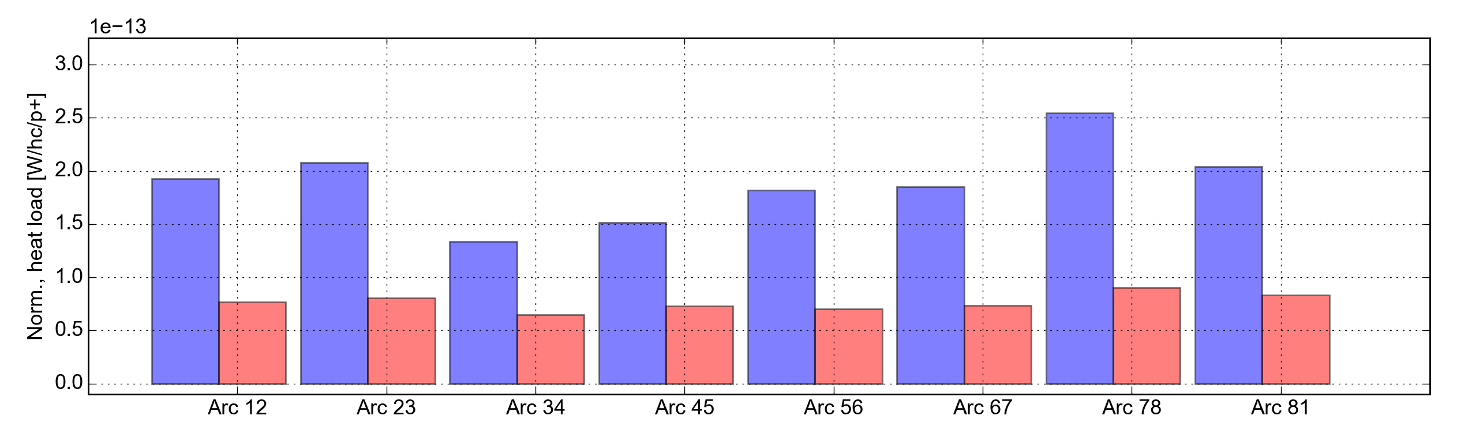
8b+4e filling scheme
The 8b+4e scheme introduces gaps already on the rising slope of the e-cloud build-up
The cloud never reaches full saturation level: significant reduction of e-cloud effects
Already used in operation during parts of Run 2
Strong e-cloud reduction confirmed up to 1.7e11 p/b in 2022 MD
  ~50-65% reduction of total heat load in the different sectors
8b+4e filling scheme
Number of bunches per beam limited to ~2000
8b
4e
8b
4e
8b
4e
8b
4x36b, 1.76e11
8b+4e, 1.71e11
48b(400ns)48b
60%
61%
52%
61%
60%
64%
59%
51%

Slide 47

Hybrid filling schemes
The best compromise for maximising performance while keeping the heat loads within limits is obtained with hybrid schemes, mixing 25 ns and 8b+4e beams
The fraction of 8b+4e beam can be tuned to adapt to the cooling capacity, to maximize the achievable number of bunches
A scheme with hybrid trains created in the SPS was successfully tested in the LHC this year (see also talk by H. Bartosik)
15% reduction of heat load per bunch in S78, larger in other sectors
8b+4e
25 ns
2365 b, 28% 8b+4e
5x36b
15%
Hybrid
18%
19%
24%
23%
16%
20%
24%

Slide 48
Cell-by-cell estimates: S12
For the best cells (with estimated SEY ~ 1.1) we predict heat loads around 150 W
  75 W from impedance and synchrotron radiation + 75 W from e-cloud
For the worst cells (with estimated SEY > 1.4) we predict heat loads above 400 W

Slide 49

Cell-by-cell estimates: S23
For the best cells (with estimated SEY ~ 1.1) we predict heat loads around 150 W
  75 W from impedance and synchrotron radiation + 75 W from e-cloud
For the worst cells (with estimated SEY > 1.4) we predict heat loads above 400 W
Missing cells are omitted due to faulty sensors

Slide 50

Cell-by-cell estimates: S34
For the best cells (with estimated SEY ~ 1.1) we predict heat loads around 150 W
  75 W from impedance and synchrotron radiation + 75 W from e-cloud
For the worst cells (with estimated SEY > 1.4) we predict heat loads above 400 W
Missing cells are omitted due to faulty sensors

Slide 51

Cell-by-cell estimates: S45
For the best cells (with estimated SEY ~ 1.1) we predict heat loads around 150 W
  75 W from impedance and synchrotron radiation + 75 W from e-cloud
For the worst cells (with estimated SEY > 1.4) we predict heat loads above 400 W
Missing cells are omitted due to faulty sensors

Slide 52

Cell-by-cell estimates: S56
For the best cells (with estimated SEY ~ 1.1) we predict heat loads around 150 W
  75 W from impedance and synchrotron radiation + 75 W from e-cloud
For the worst cells (with estimated SEY > 1.4) we predict heat loads above 400 W
Missing cells are omitted due to faulty sensors

Slide 53

Cell-by-cell estimates: S67
For the best cells (with estimated SEY ~ 1.1) we predict heat loads around 150 W
  75 W from impedance and synchrotron radiation + 75 W from e-cloud
For the worst cells (with estimated SEY > 1.4) we predict heat loads above 400 W
Missing cells are omitted due to faulty sensors

Slide 54

Cell-by-cell estimates: S78
For the best cells (with estimated SEY ~ 1.1) we predict heat loads around 150 W
  75 W from impedance and synchrotron radiation + 75 W from e-cloud
For the worst cells (with estimated SEY > 1.4) we predict heat loads above 400 W
Missing cells are omitted due to faulty sensors

Slide 55

Cell-by-cell estimates: S81
For the best cells (with estimated SEY ~ 1.1) we predict heat loads around 150 W
  75 W from impedance and synchrotron radiation + 75 W from e-cloud
For the worst cells (with estimated SEY > 1.4) we predict heat loads above 400 W
Missing cells are omitted due to faulty sensors

Slide 56
Comparison to measurements for 1.75e11 p/b
The SEY estimates are based on physics fills with bunch intensity ~1.45e11 p/b
To get an idea of the accuracy of the predictions on the cell-by-cell level, we can compare the predictions to measurements with the highest intensity taken so far
Sector 12: +3% difference between prediction and measurement for sector average

Slide 57

Comparison to measurements for 1.75e11 p/b
The SEY estimates are based on physics fills with bunch intensity ~1.45e11 p/b
To get an idea of the accuracy of the predictions on the cell-by-cell level, we can compare the predictions to measurements with the highest intensity taken so far
Sector 23: +2% difference between prediction and measurement for sector average

Slide 58

Comparison to measurements for 1.75e11 p/b
The SEY estimates are based on physics fills with bunch intensity ~1.45e11 p/b
To get an idea of the accuracy of the predictions on the cell-by-cell level, we can compare the predictions to measurements with the highest intensity taken so far
Sector 34: -5% difference between prediction and measurement for sector average

Slide 59

Comparison to measurements for 1.75e11 p/b
The SEY estimates are based on physics fills with bunch intensity ~1.45e11 p/b
To get an idea of the accuracy of the predictions on the cell-by-cell level, we can compare the predictions to measurements with the highest intensity taken so far
Sector 45: -14% difference between prediction and measurement for sector average

Slide 60

Comparison to measurements for 1.75e11 p/b
The SEY estimates are based on physics fills with bunch intensity ~1.45e11 p/b
To get an idea of the accuracy of the predictions on the cell-by-cell level, we can compare the predictions to measurements with the highest intensity taken so far
Sector 56: -2% difference between prediction and measurement for sector average

Slide 61

Comparison to measurements for 1.75e11 p/b
The SEY estimates are based on physics fills with bunch intensity ~1.45e11 p/b
To get an idea of the accuracy of the predictions on the cell-by-cell level, we can compare the predictions to measurements with the highest intensity taken so far
Sector 67: 0% difference between prediction and measurement for sector average

Slide 62

Comparison to measurements for 1.75e11 p/b
The SEY estimates are based on physics fills with bunch intensity ~1.45e11 p/b
To get an idea of the accuracy of the predictions on the cell-by-cell level, we can compare the predictions to measurements with the highest intensity taken so far
Sector 78: 0% difference between prediction and measurement for sector average

Slide 63

Comparison to measurements for 1.75e11 p/b
The SEY estimates are based on physics fills with bunch intensity ~1.45e11 p/b
To get an idea of the accuracy of the predictions on the cell-by-cell level, we can compare the predictions to measurements with the highest intensity taken so far
Sector 81: +4% difference between prediction and measurement for sector average

