Slide 1
WP2 – Transverse impedance and stability
Lorenzo Giacomel, Nicolas Mounet, Xavier Buffat, Chiara Antuono, Adnan Kurtulus, Benoît Salvant, Leonardo Sito, Eskil Vik
Acknowledgements: Carlotta Accettura, David Amorim, Nicolò Biancacci, Giuseppe Bregliozzi, Roderik Bruce, Federico Carra, Colas Droin, Riccardo De Maria, Luca Gentini, Sofia Kostoglou, Christophe Lannoy, Björn Lindström, Elias Métral, François-Xavier Nuiry, Yannis Papaphilippou, Stefano Redaelli, Markus Rognlien, Giovanni Rumolo, Guido Sterbini, Rogelio Tomás, Wilhelmus Vollenberg, Carlo Zannini
HL-LHC Collaboration Meeting, Vancouver, Canada – 20/04/2023

Slide 2

WP2 – Transverse impedance and stability
Introduction & context
Review of impedance studies & model updates
Overview of machine development (MD) studies during Run 3
Transverse stability situation

Slide 3
Context
Transverse impedance is a source of bunch intensity limitations in the current LHC machine at top energy.
One of the main contributions: collimators
  very close to the beam
  initially, all primaries (TCPs) and secondaries (TCSs) were in CFC (poorly conductive material) ⟶ large resistive-wall impedance
  also significant geometric impedance (tapers)
  ⟶ partial upgrade of TCPs and TCSs during LS2 (MoGr, Mo-coated for TCS), more to come in LS3.
Most critical part of the cycle: flat top
  after ramp (collimators are closed), just before collapsing beam separation (which provides large beam-beam tune spread, hence large Landau damping)
  ⟶ only octupoles provide the required Landau damping at flat top.

Slide 4
Impedance studies
Some impedance contributions reviewed:
  Beam Gas Vertex: impedance studied (input to BGI/BGV review – see L. Giacomel, H. Guérin & I. Karpov, 209th WP2 meeting, 18/10/2022)
  ⟶ impedance is acceptable – but BGV not in baseline anymore (following BGV/BGI review)
  Beam-beam Long-Range Wire Compensator: preliminary studies (see B. Salvant, WP2/WP13 HL-LHC Satellite Meeting, 23/09/2022)
  → Impedance significant but no showstopper
  Vacuum valves between TCLMB mask and Q4: studies done (see L. Giacomel, 215th WP2 meeting, 20/06/2023)
  → Impedance increase not acceptable
  → New manual FRAS table decided, to avoid aperture change and cavity-like structure
  Absence of Cu coating in Y-chambers: studies done (see L. Giacomel, 215th WP2 meeting, 20/06/2023)
  → not fundamental importance, stainless steel can be used.
  Note: geometric impedance was already optimised in the past.

Slide 5
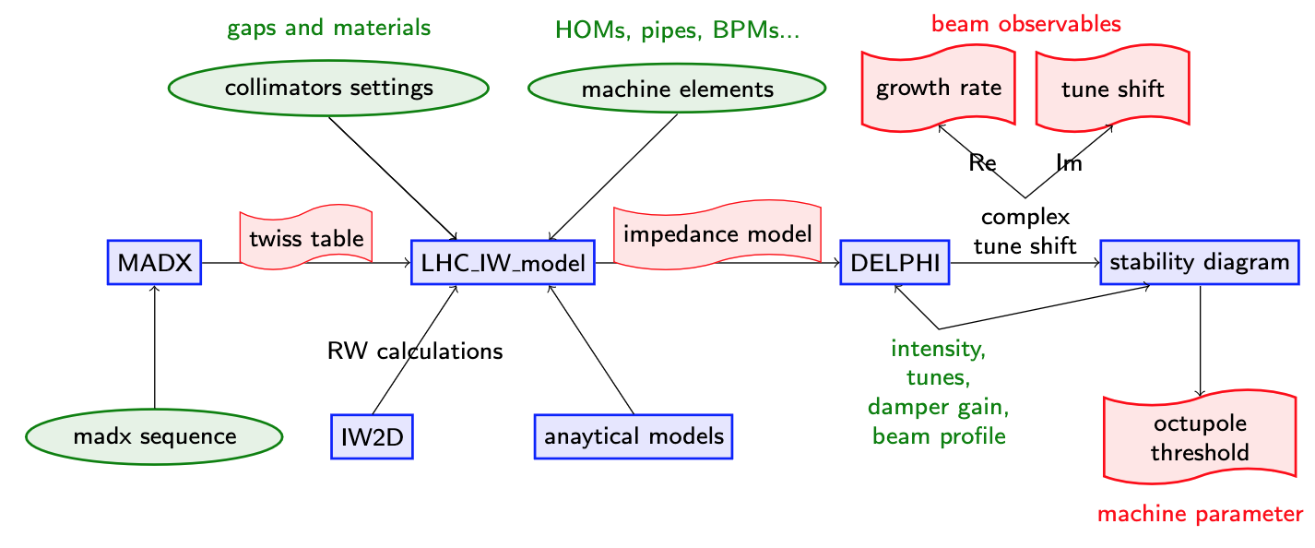
Updated of code infrastructure
Model fully re-implemented using a new code infrastructure: PyWIT (https://gitlab.cern.ch/IRIS/pywit)
Lots of code development involved, including on IW2D (for resistive-wall).
LHC/HL-LHC models now in https://gitlab.cern.ch/IRIS/lhc_pywit_model/

Slide 6
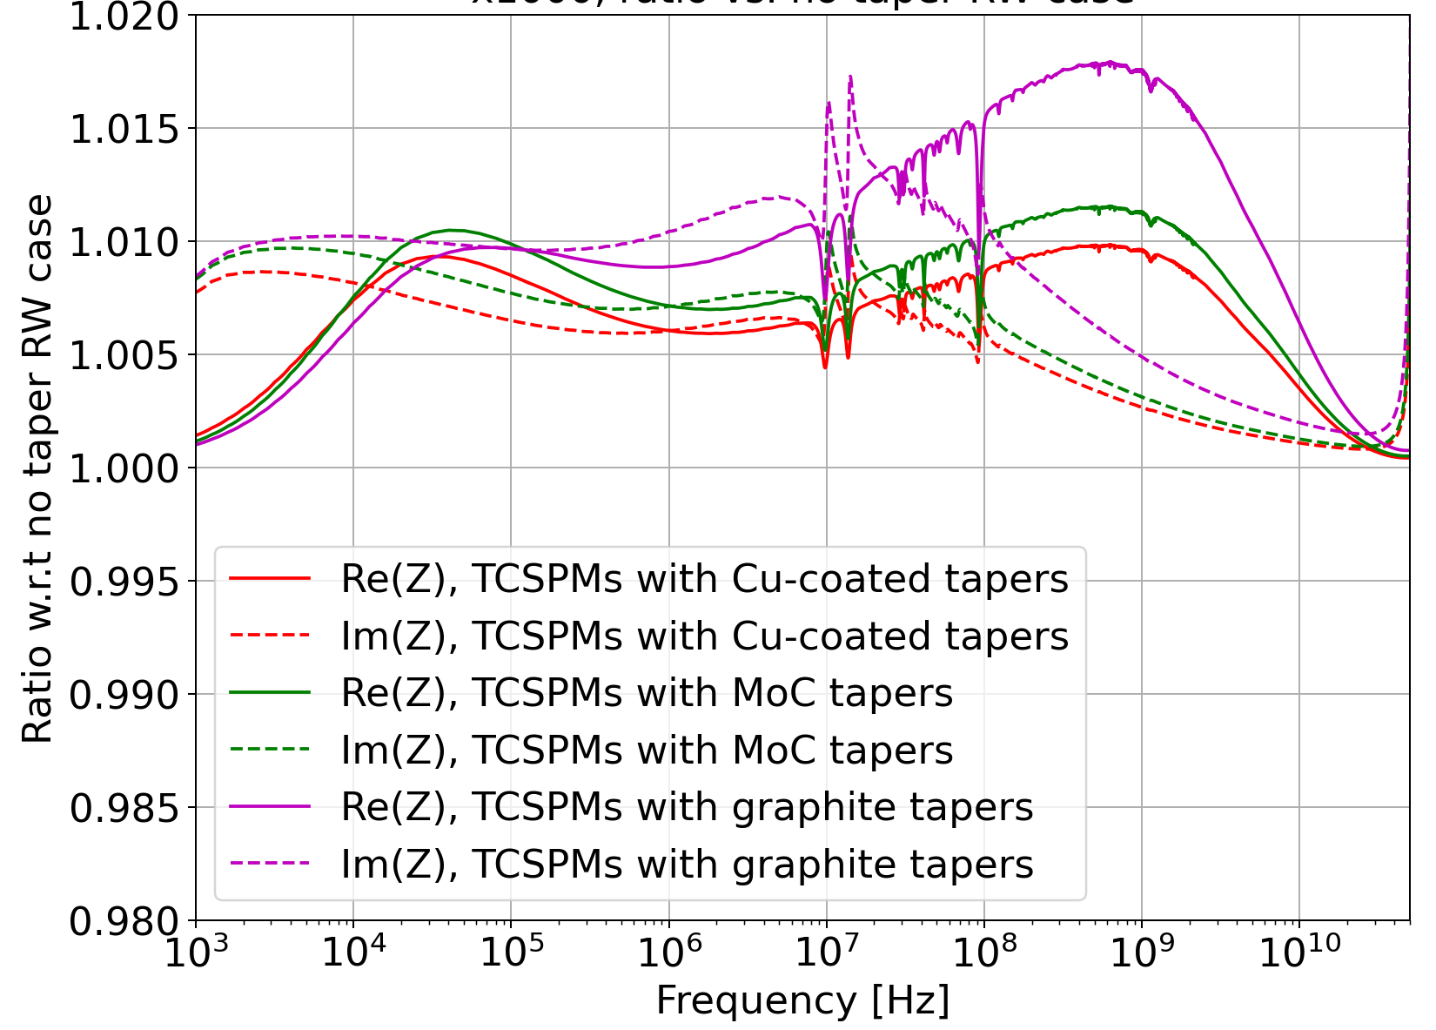
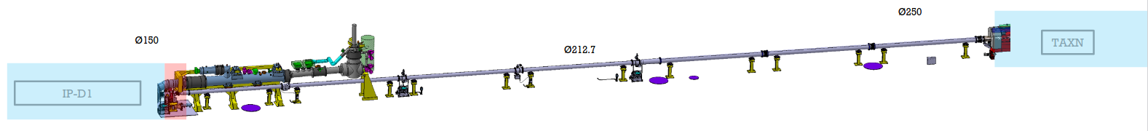
Update of impedance model
Main updates to impedance model:
  New collimator materials – mainly Cu-coated graphite TCSPMs but not only – overall impedance decrease by almost 1%.
  Resistive-wall effect of collimator tapers (detrimental, but model more accurate) - impedance increase of ~1% (would get 2% with graphite tapers in TCSPMs
  Crab cavities fundamental mode (detrimental – see next slides)
  ~160 m of stainless-steel warm pipe close to the triplets (0.1% impact)

Slide 7
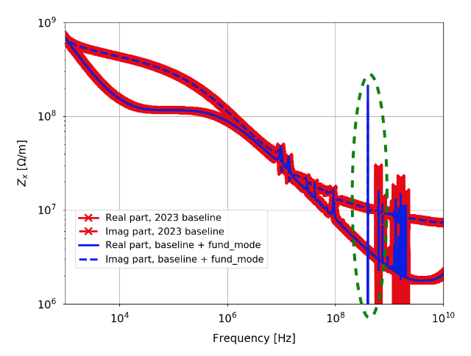
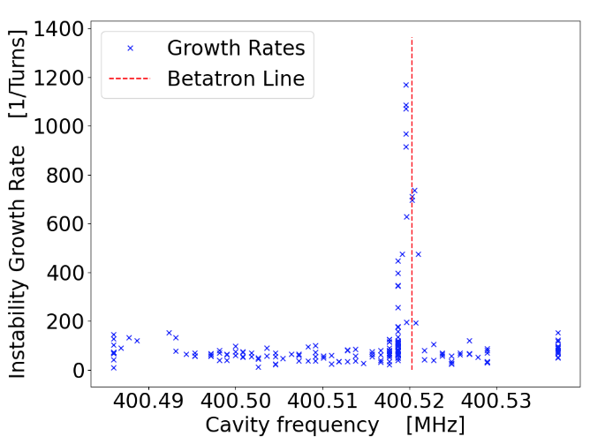
Crab cavities impedance
Fundamental mode has a strong effect on transverse impedance:
Effect also studied and
confirmed in a crab
cavity SPS MD:
L. Giacomel,
211th WP2 meeting, 17/01/2023
L. Giacomel, WP2/WP4 meeting, 22/11/2022

Slide 8
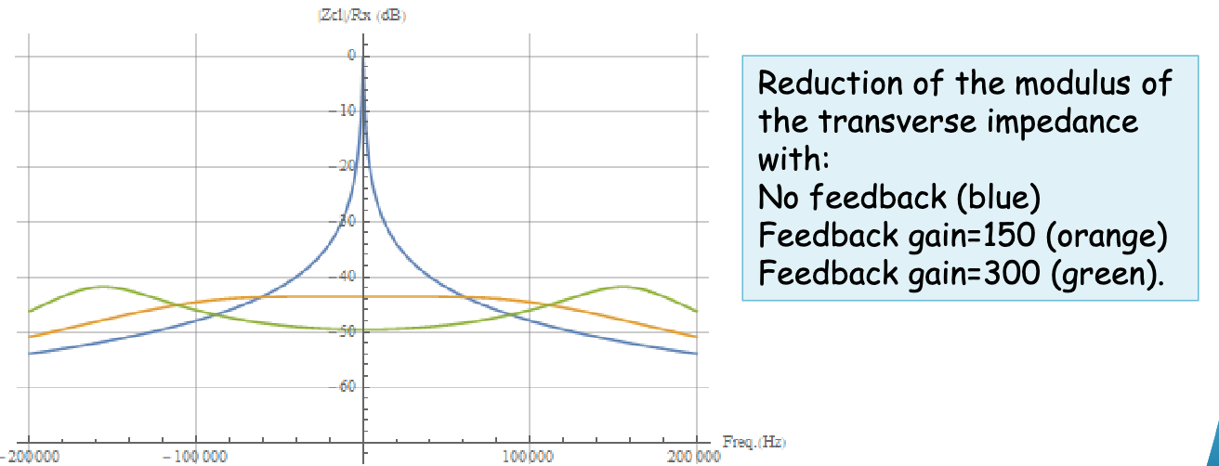
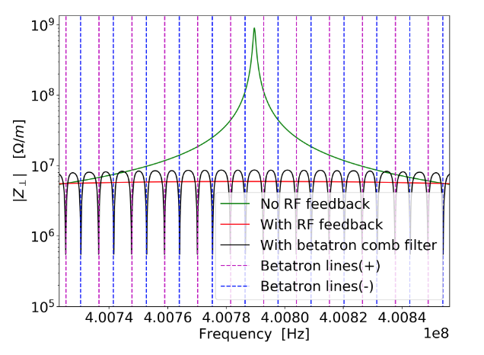
Crab cavities: impedance mitigation
Gain of standard RF feedback cannot be increased further:
... but a comb filter can reduce impedance effects by acting at the right frequencies (betatron lines):
P. Baudrenghien, WP2/WP4 meeting, 22/11/2022
Impact of mode decreases by an order of magnitude, but assumes tune known within ±5.10⁻³
⟹ Still some uncertainty.
⟹ Bunch-by-bunch tune shift MD planned for 2024.
If comb filter is not used, flat optics can also reduce the octupole current.
L. Giacomel, WP2/WP4 meeting, 21/03/2023

Slide 9
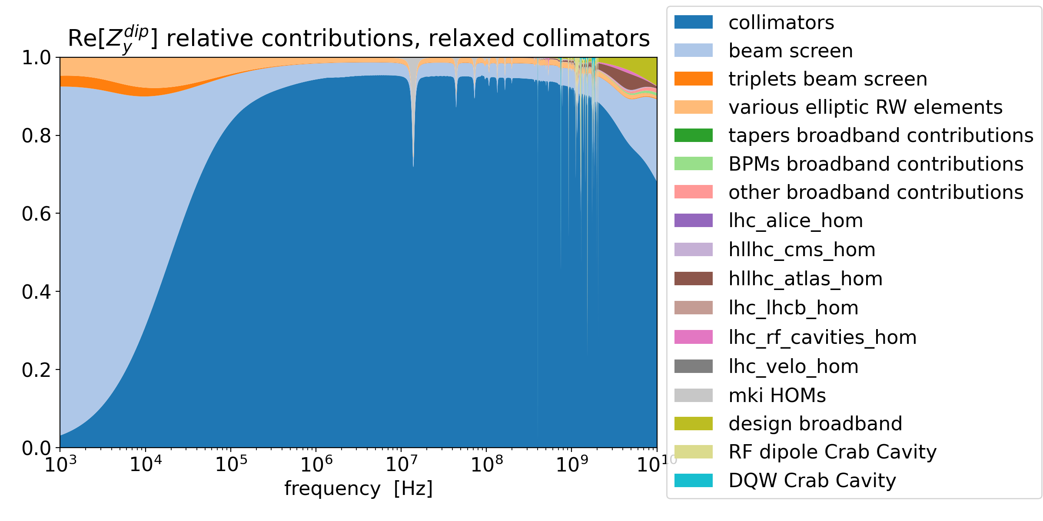
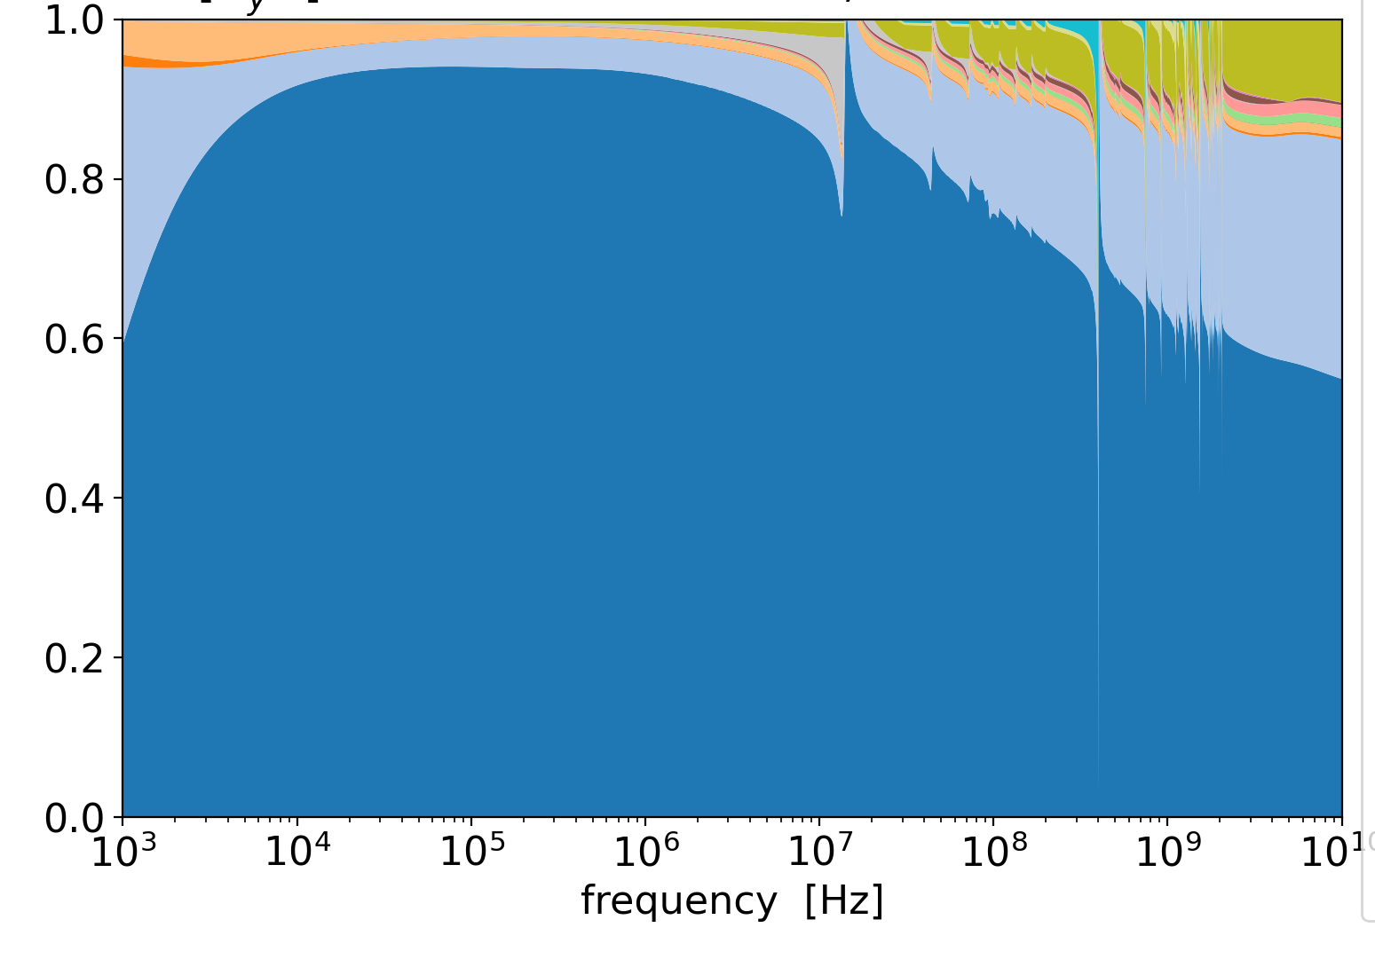
HL-LHC impedance contributions
Breakdown of all impedance contributions (relaxed collimator settings, vertical plane):
Imag. part
Beam screens
Collimators
Real part
Beam screens
Collimators

Slide 10
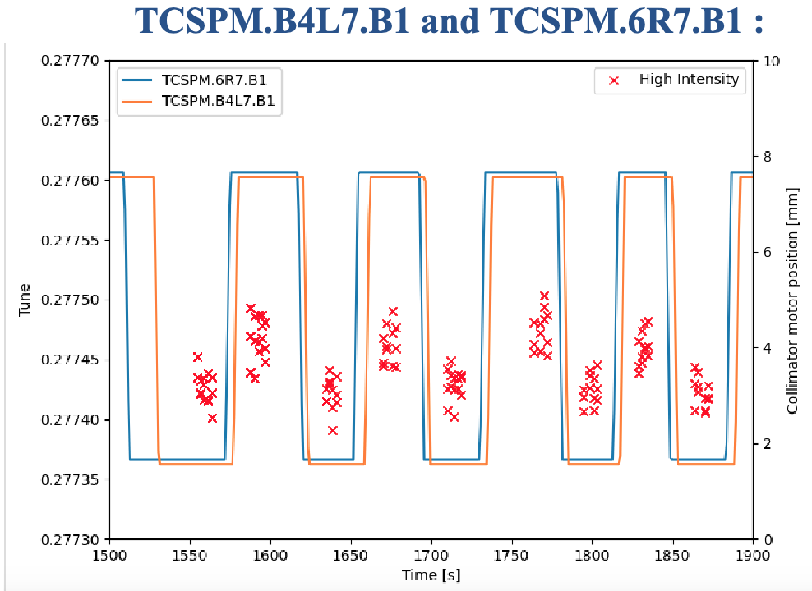
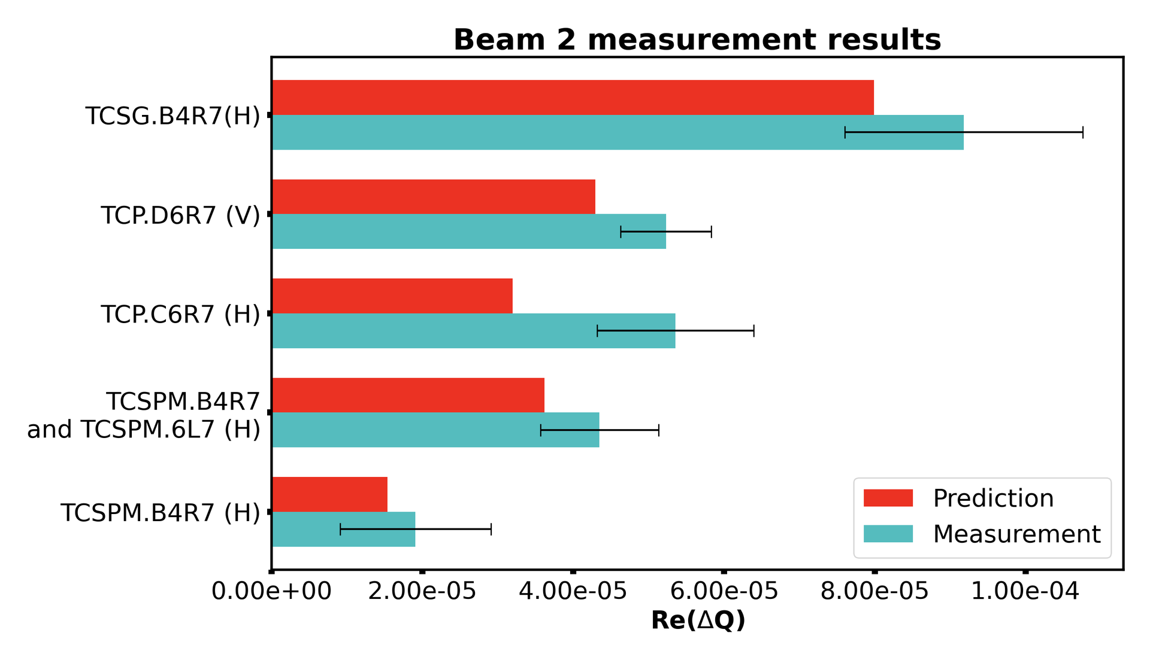
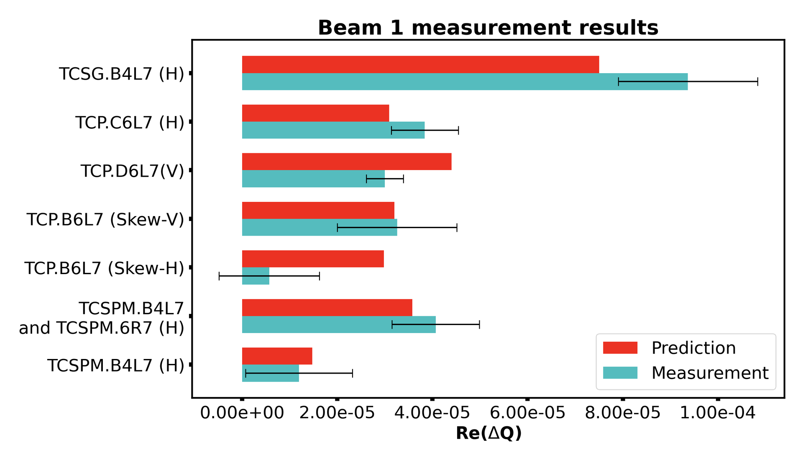
LHC machine development studies
Tune shift from collimators measured during LHC Run 3:
Back-and-forth motion of the jaws to check tune shift from impedance of single collimators
Adnan Kurtulus, ABP-CEI meeting 15/12/2022
Impact of LS2 upgrade

Slide 11
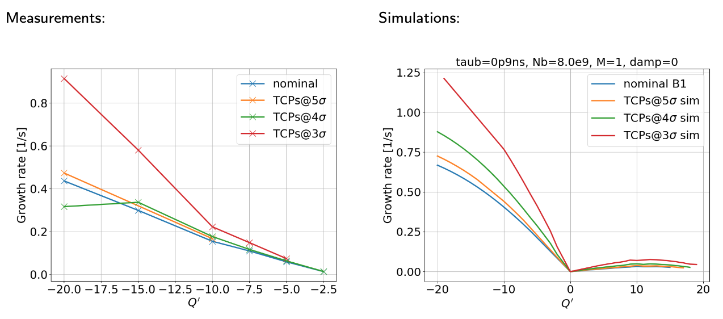
LHC machine development studies
To probe the real part of the impedance: measurements of instability growth rates at injection
⟹ As for real tune shifts, relative agreement between measurements & model.

Slide 12
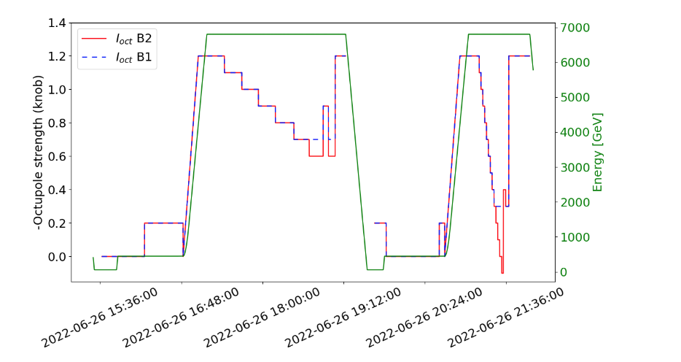
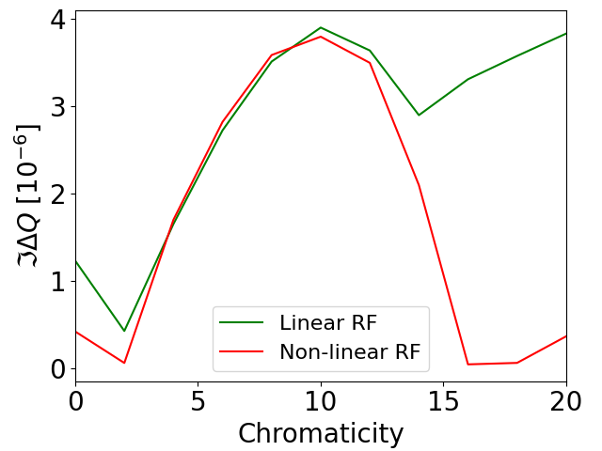
LHC machine development studies
Stability main quantity of interest: Octupole threshold
  Latency effect (slow vs fast octupole decrease):
  Octupole threshold vs Q’
  (latency not included):
⟹ octupole must be ~twice higher when staying a long time at the same octupole current (S. Furuseth & X. Buffat, Eur. Phys. J. Plus 137, 506, 2022)
Subject of intense studies – impact of non-linear bucket
X. Buffat

Slide 13
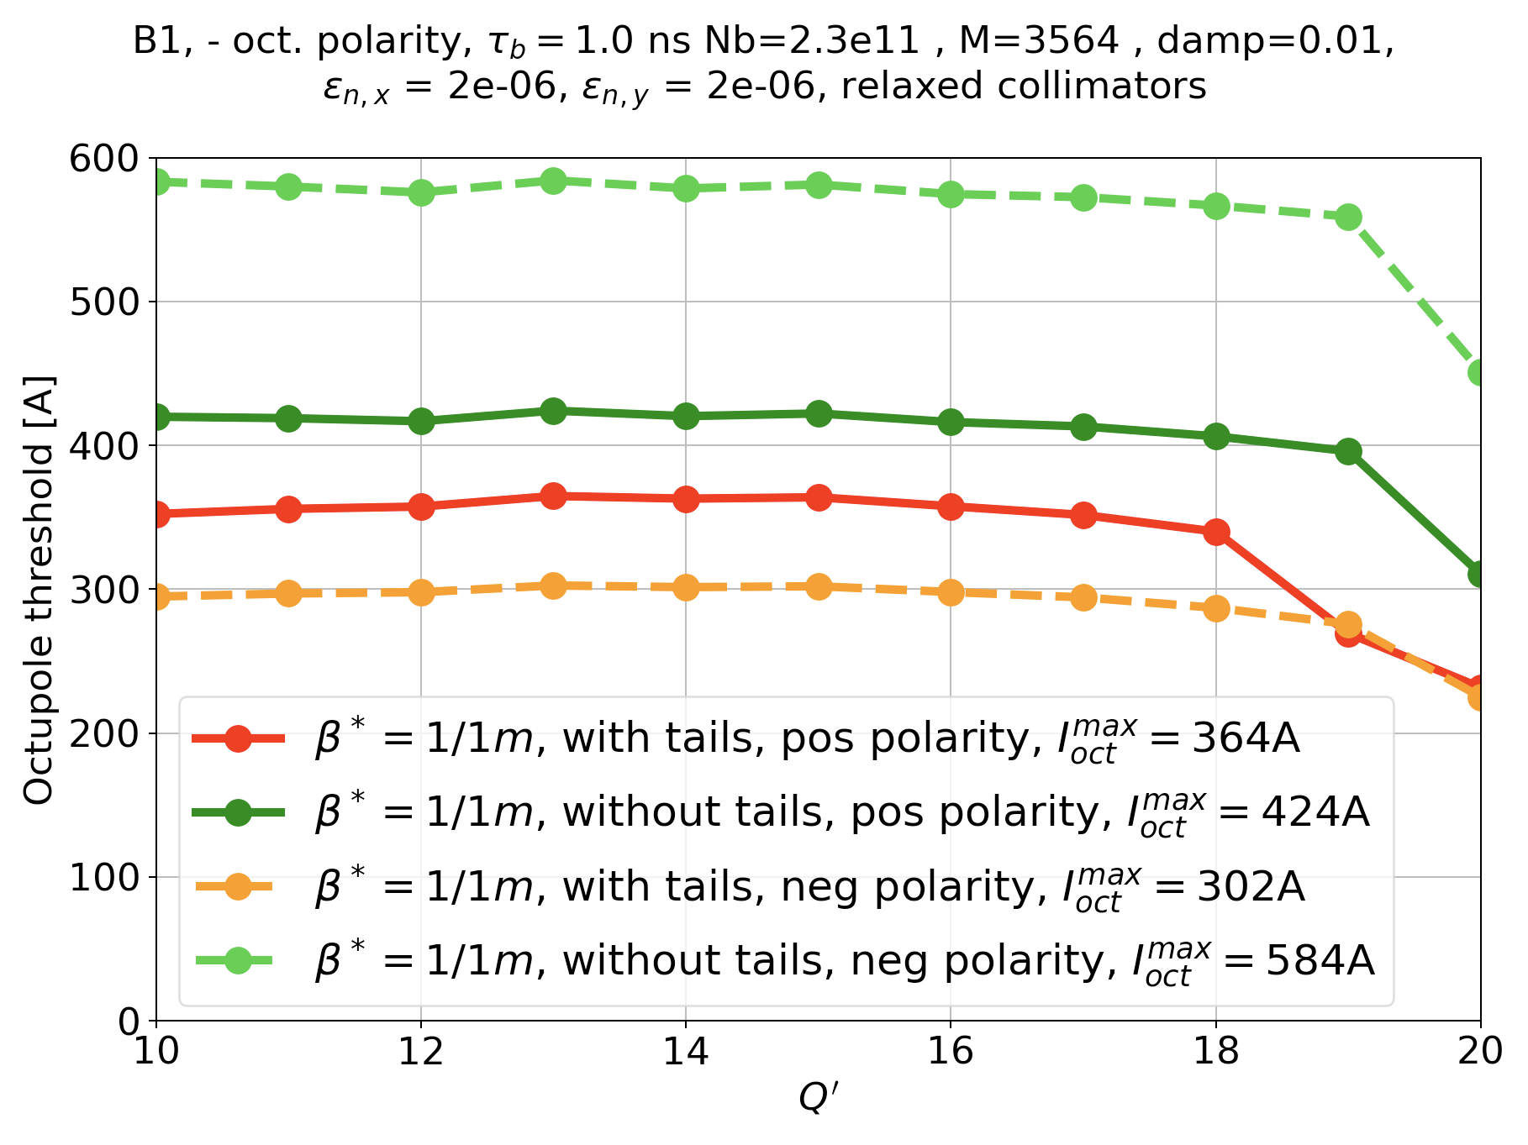
HL-LHC overall transverse stability
The model for transverse tails has been reviewed:
  In the past tails assumed absent (parabolic bunch in transverse, tails cut at 3.2σ) – uncertainties on beam from LHC injectors (after LHC Injector Upgrade – LIU) + HEL
  Now: LIU beam known to have tails, no HEL ⟶ Gaussian tails assumed.
  It also means that negative octupole polarity is back in the game (better stability diagram in principle, but some compensations with long-range beam-beam):
⟹ ~16% improvement with tails
⟹ with tails, negative polarity is better than positive, overall.
Note: here we assume the crab cavities comb filter is used.

Slide 14
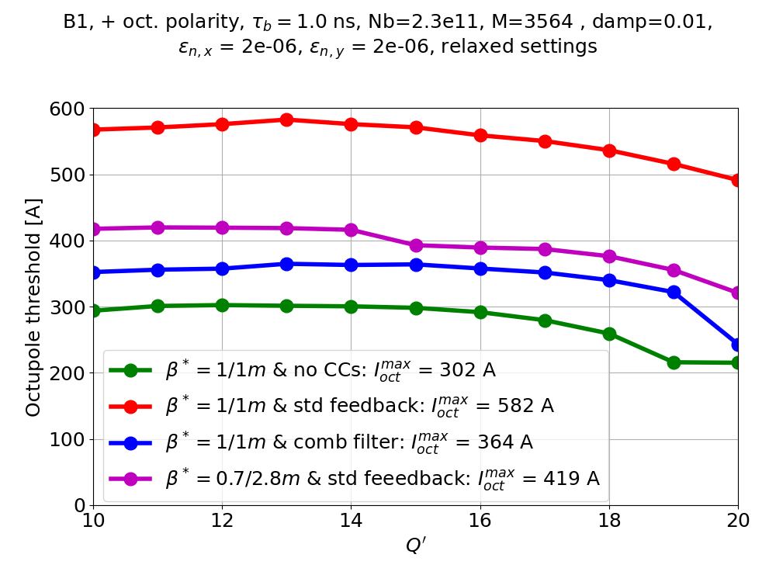
HL-LHC overall transverse stability
Impact of crab cavities fundamental mode and mitigation options:
⟹ Without any additional mitigation, huge impact of CCs (+280 A)
⟹ comb filter is the best mitigation (80% reduction)
⟹ std RF feedback with flat optics is a good backup option (60% reduction).
Note: the flat optics case also features a telescopic index (S. Fartoukh, PRST-AB, 16, p. 111002, 2013), but we have rescaled the octupole currents to a telescopic index of 1.

Slide 15
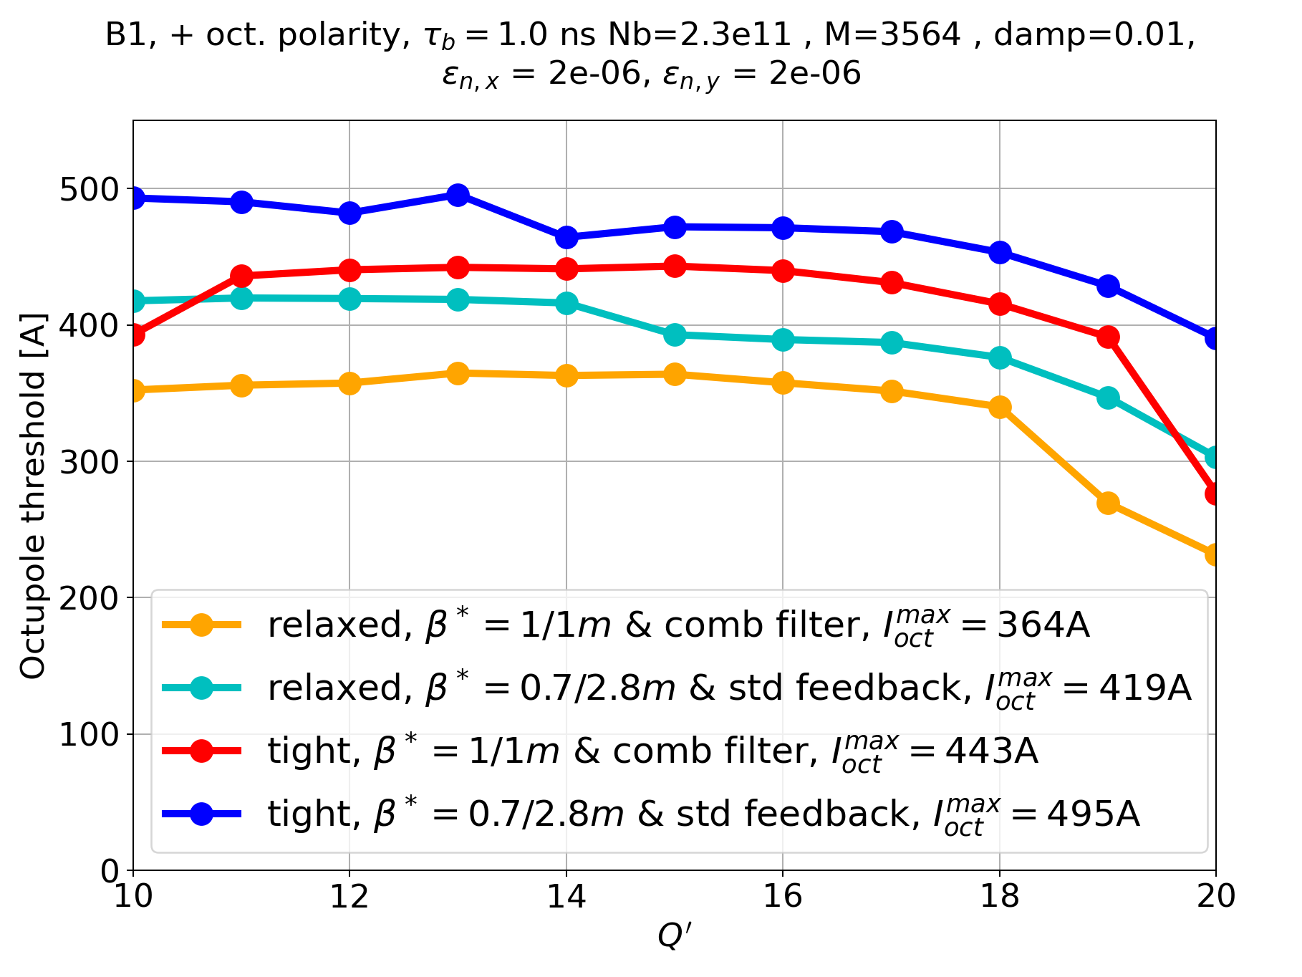
HL-LHC overall transverse stability
Collimator settings were assumed “relaxed” in the latest scenario for run 4 (8.5 σ for TCPs), but tight settings (slightly larger than run 2 & 3 – 6.7 σ in TCPs) are also on the table:
⟹ Tight settings give less stability, but are still manageable
⟹ it also depends on dynamic aperture: large octupole currents might be an issue (see S. Kostoglou, C. Droin, G. Sterbini, et al)

Slide 16
Summary and outlook
Impedance of HL-LHC received a number of updates, including a complete change of code infrastructure.
Latest developments on collimators were included (Cu-coated TCSPMs, coated tapers).
Crab cavity fundamental mode could have a strong impact on stability, but two mitigations were found:
  Best option: comb filter (still to be tested)
  Good backup option: RF feedback with flat optics
LHC MDs provided data on impedance (tune shifts, growth rate, octupole threshold) – in many cases in ~agreement with models
  in particular, latency effect on Landau damping is confirmed,
  no degradation observed for new TCSPMs (from e.g. radiation).
Gaussian tails of the beams from the injectors are clearly beneficial, and put the negative polarity back on the table, for even more stability.
Studies ongoing to
  decrease the collimator impedance (IR7 optics, possibly also IR3),
  understand better the effect of the longitudinal bucket non-linearities,
  simulate accurately multibunch effects (crab cavities; 8b4e / hybrid filling schemes).

Slide 17
Appendix

Slide 18
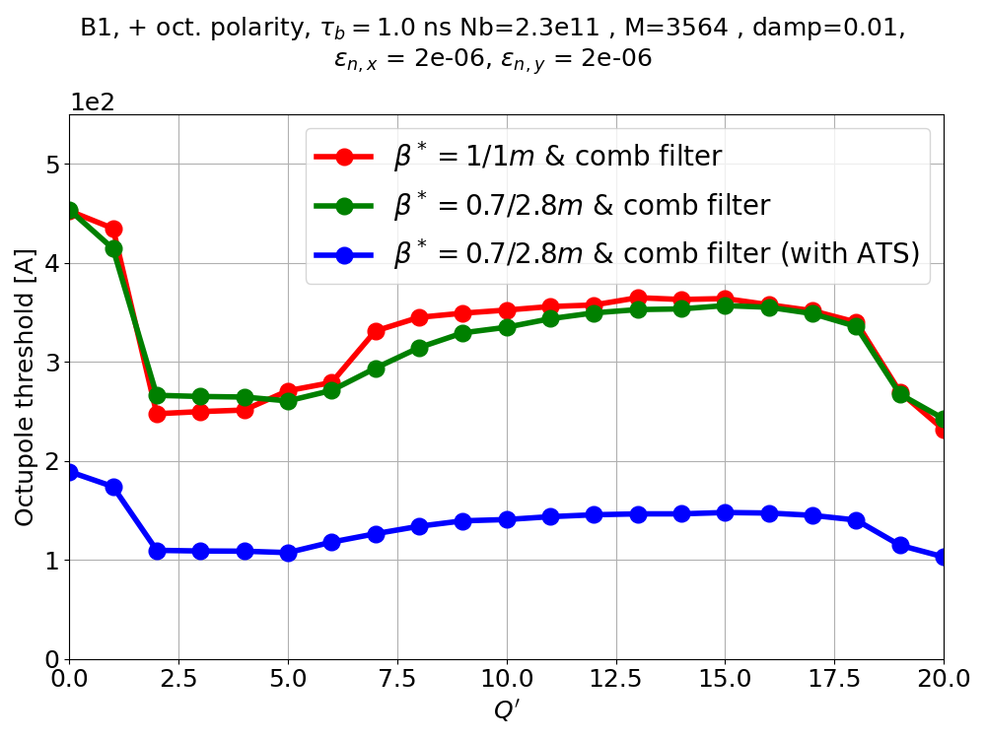
HL-LHC overall transverse stability
Impact of optics choice:
Here there is no rescaling of the flat optics case (telescopic index is left unchanged)

Slide 19
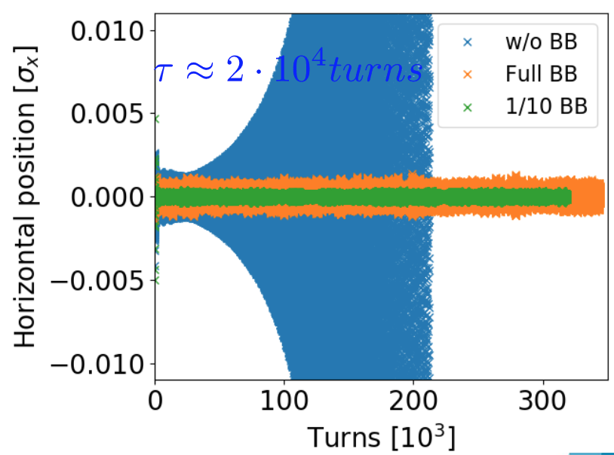
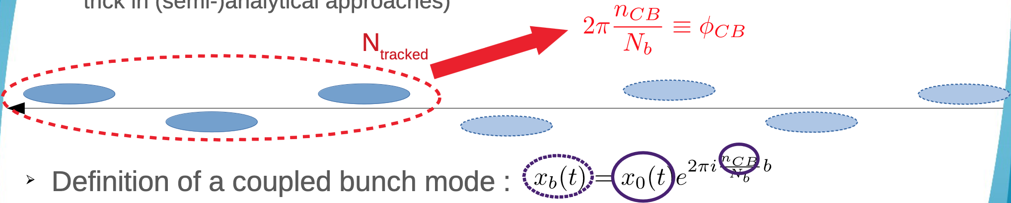
Crab cavities: noise & amplitude feedback
Heavy simulation effort to understand if Landau damping from beam-beam effects sufficient to damp instabilities from CC amplitude feedback used to mitigate noise issue (800 MHz demodulation)
Designing a faster approach to simulate multibunch instabilities:
Multibunch simulations in collisions with Xsuite, including beam-beam, feedback & impedance effects
⟹ instability from feedback stabilized by beam-beam
… but 400 MHz demodulation preferable (no instability in the first place).
X. Buffat, WP2/WP4 meeting, 21/03/2023

