Slide 1
SPS DQW Module: MDs 2023 & Outlook
HL-LHC WP4/WP2/WP13
CERN
Big thanks: WP9, WP12, SPS operations and many others
28 September 2023

Slide 2
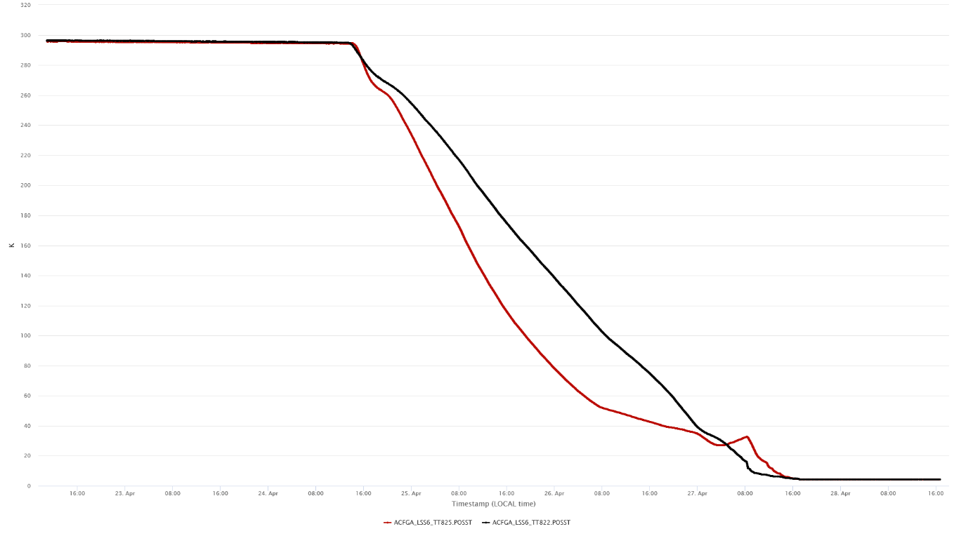
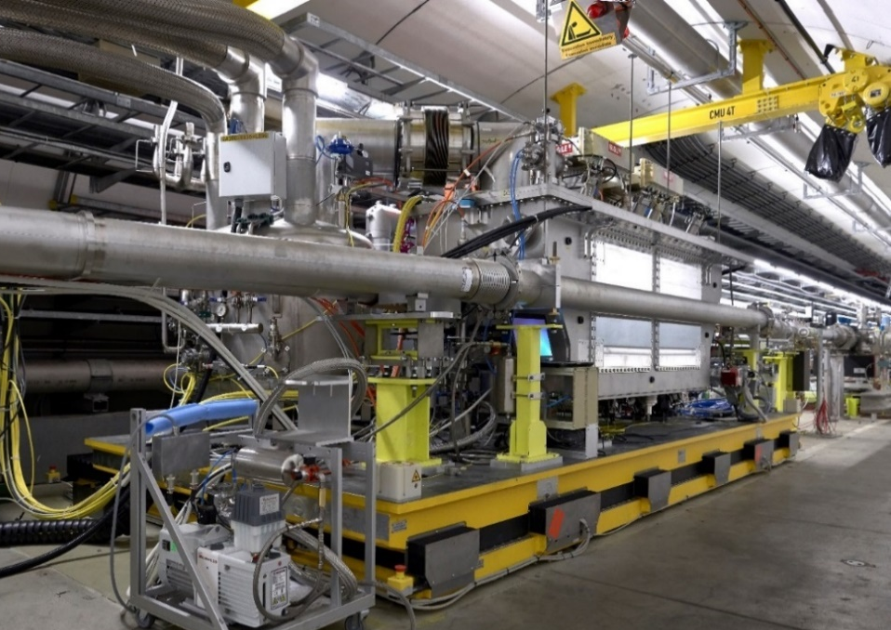
DQW-SPS MDs, 2023 Experience
4 MDs performed in 2023 (May 2 – Jul 27)
  MD 1-2: high intensity setup & instability studies
  MD 3-4: CC amplitude noise & emittance growth
  MD 5: RF-ON sequence with high intensity (72b & 8b4e)
300K
C1
C2
4.5K
23-Apr
28-Apr

Slide 3
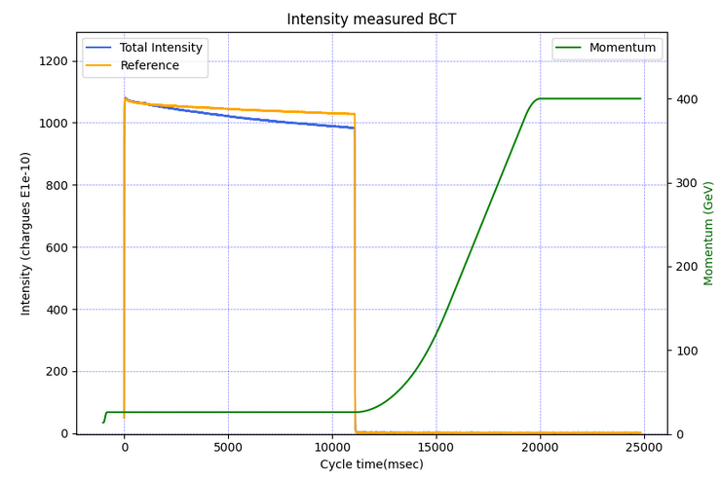
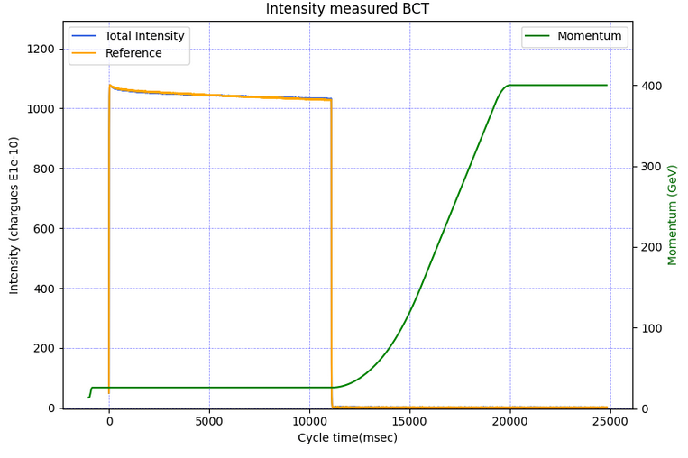
MD 1: Slow losses with high intensity
When cavities are counter-phased with the same voltage, the effect of the slow losses are fully suppressed, indicating an aperture restriction with crabbed beam
C1 & C2 at 1 MV, Arbitrary phase
C1 & C2 at 1 MV, Counter-phased

Slide 4
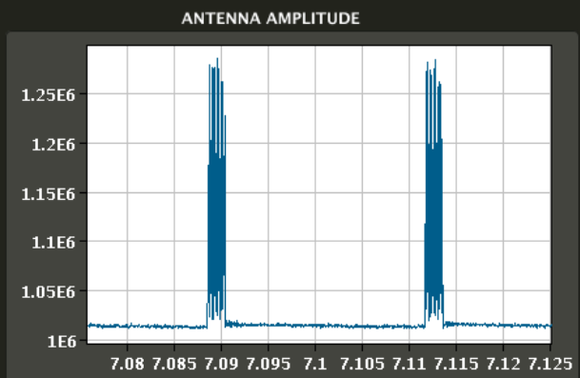
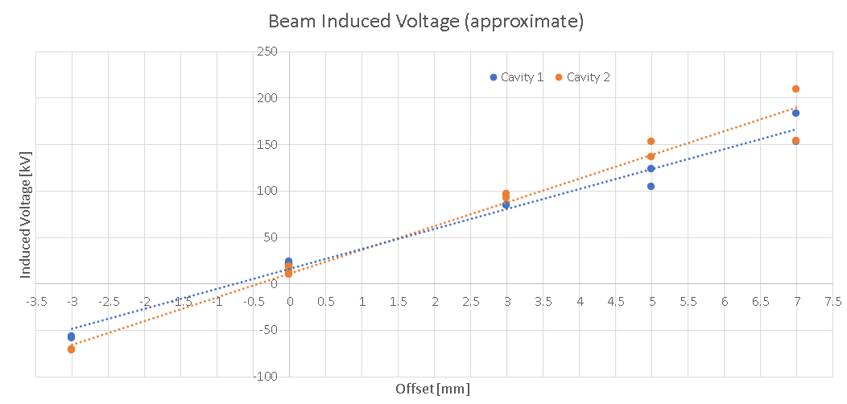
MD1: Orbit Scan in Cavities & Centering
Beam passage
Cavity voltage

Slide 5
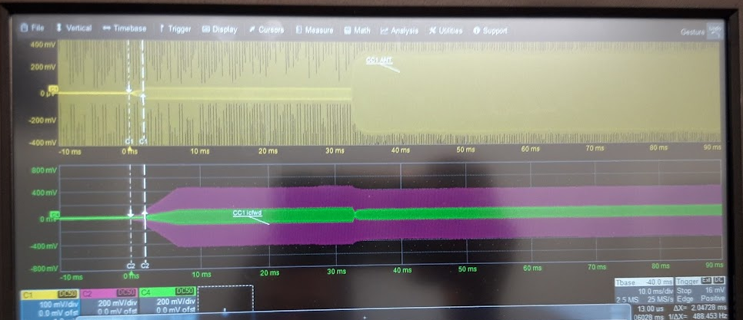
MD 1: RF sequence with 72b, 1.1e11 p/b
Standard sequence is have RF-ON with beam circulation. But voltage ramp doesn’t follow RF power ramp. Mitigation found with RF-ON before beam in SPS.
Suspect some multipacting and/or ecloud like effect
RF-ON after beam circulating
RF-ON before beam circulating
Plot missing
but the effect is not important

Slide 6
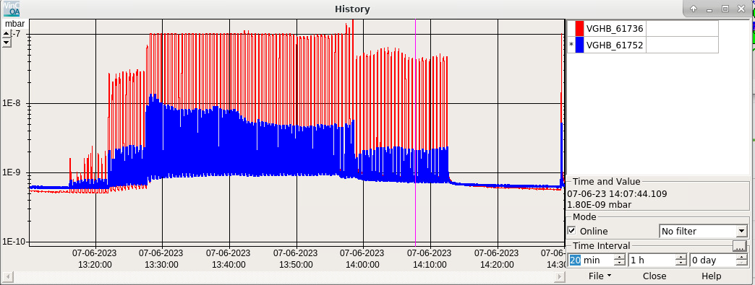
MD 2: Beam Vacuum with trains
Vacuum activity left/right of CM seen starting 48b and higher
12-24b
36b
48b
72b

Slide 7
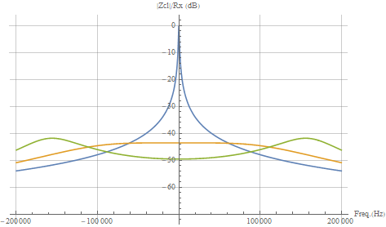
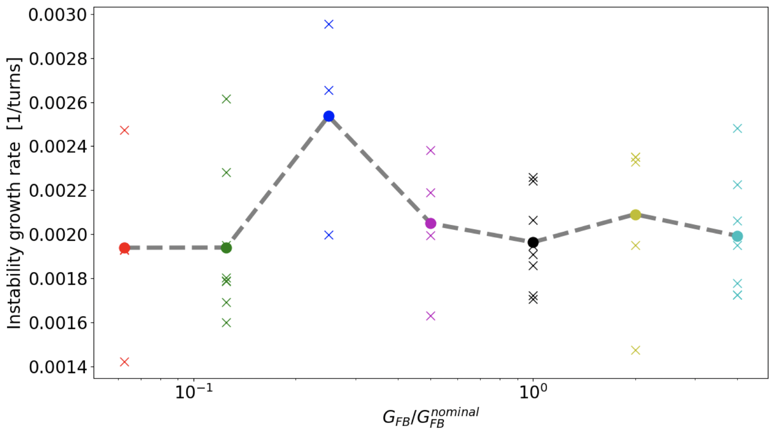

MD 2: Instability study with FB gain
Direct RF feedback to reduce the impedance at the fundamental mode ($\sim 1 GΩ/m$)
Direct RF feedback gain was scanned from the nominal value down to 1/100th and up to x4 higher
Effect on beam stability doesn’t scale as expected and not conclusive (see L. Giacomel)
Gain = 0
Gain = 150
Gain = 300

Slide 8
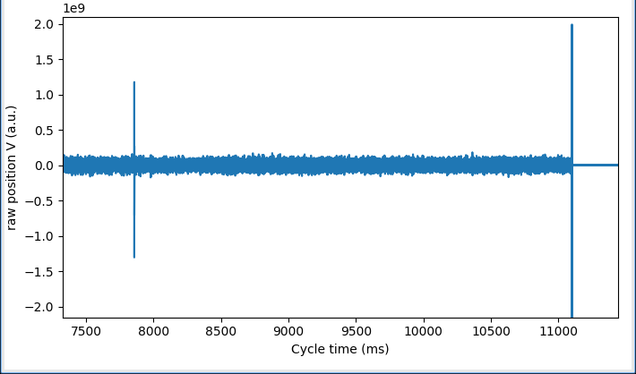
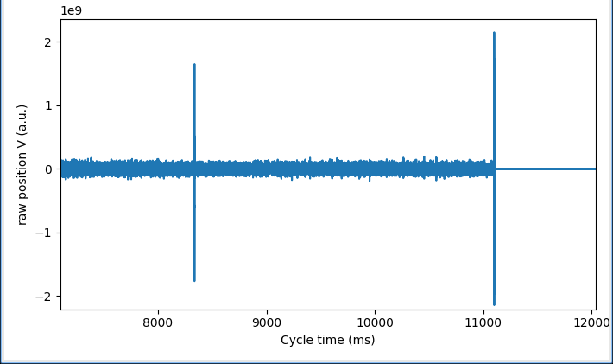
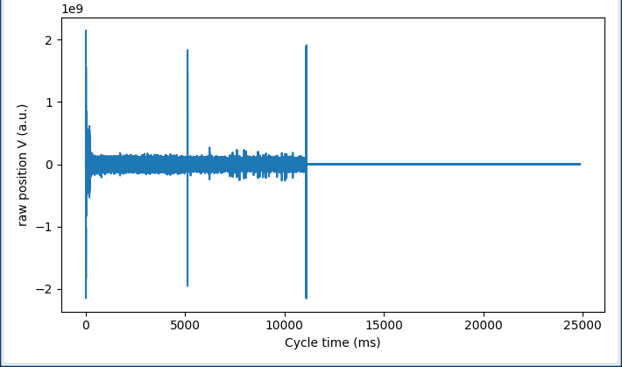
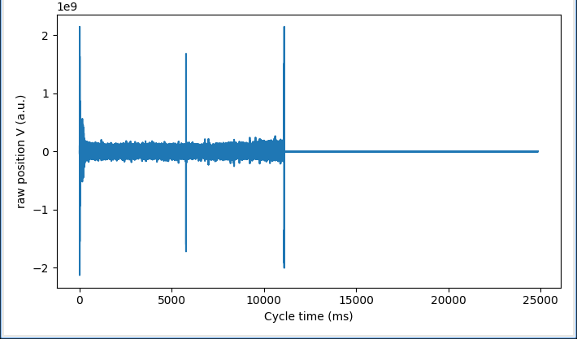
MD 2: Machine Protection
Abrupt phase changes were made on-demand but with RF feedback off to avoid tripping the amplifiers (C1 & C2 counter-phased)
Slow losses at the level when cavities are not counter-phased was observed when phase change > 60 deg
Analysis underway with MP (see previous talk)
10 deg
20 deg
60 deg
90 deg
BBQ data

Slide 9
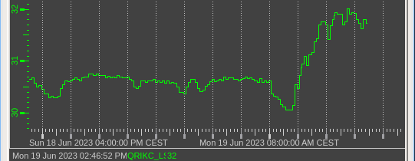
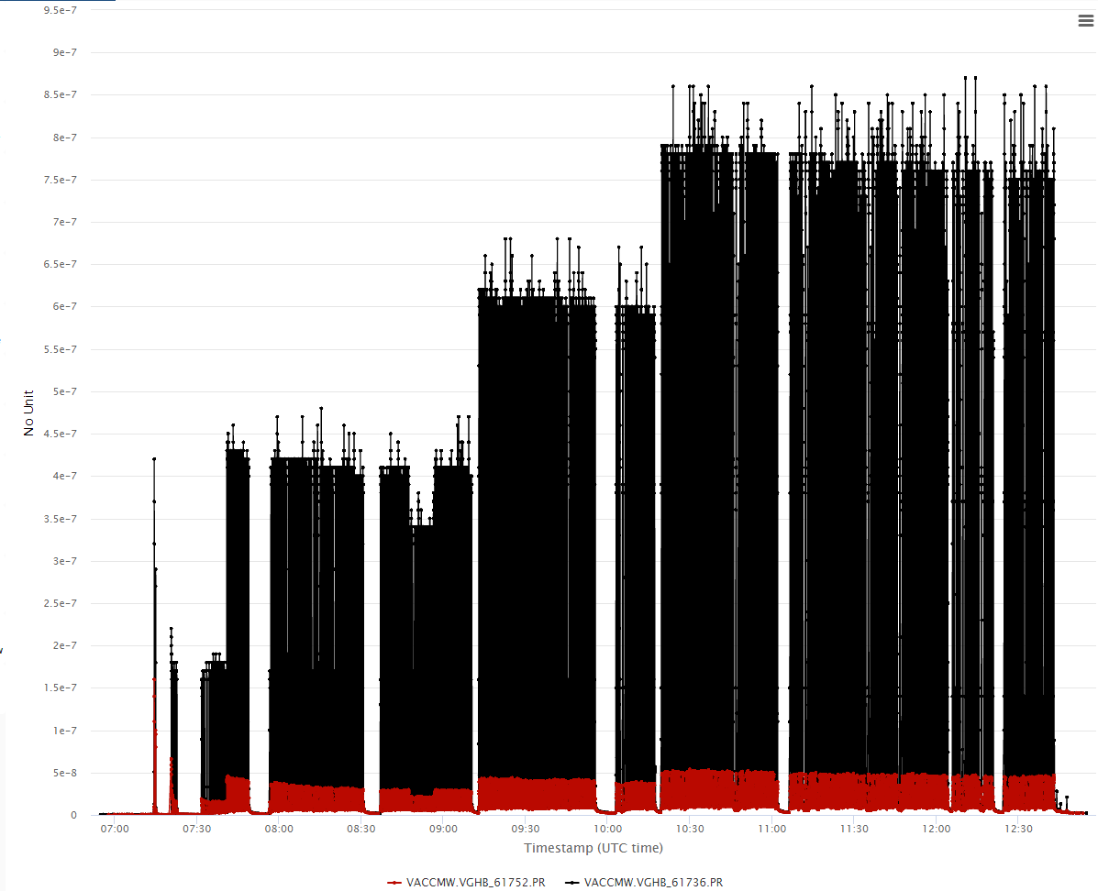
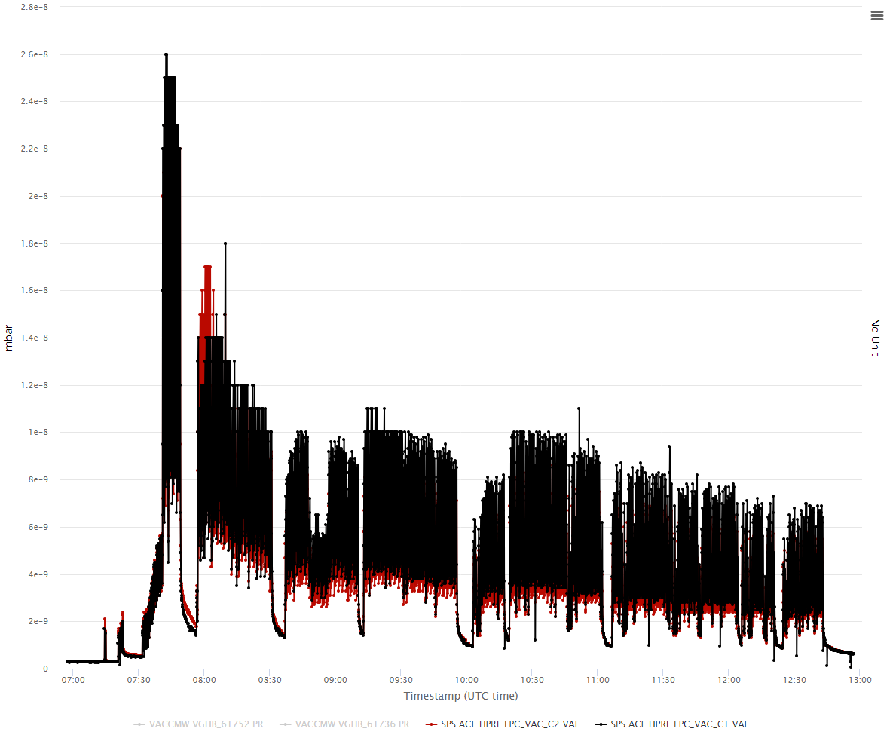
Heat load during COLDEX MD
1.5 mb
< 2 W
Beam vacuum left/right of cryomodule
Cav 1 & 2 vacuum

Slide 10
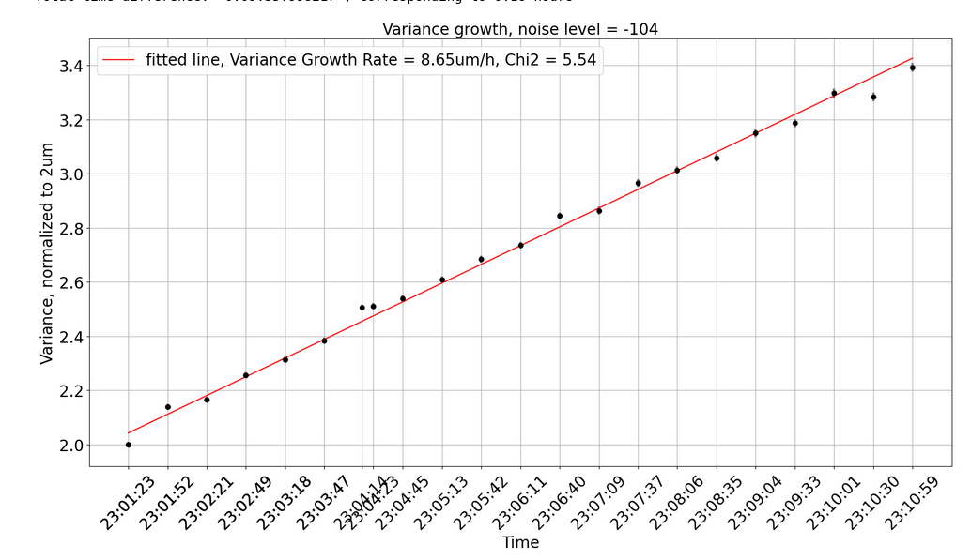
MD 3 & 4: Emittance growth
Emittance growth with amplitude noise using BSRT. Absolute calibration of the BSRT w.r.t wire scanners still missing ?
Reduction of growth rate with/without octupoles is 40% with amplitude noise, although no reduction was expected (to be compared to 400% with phase noise)
BSRT data

Slide 11
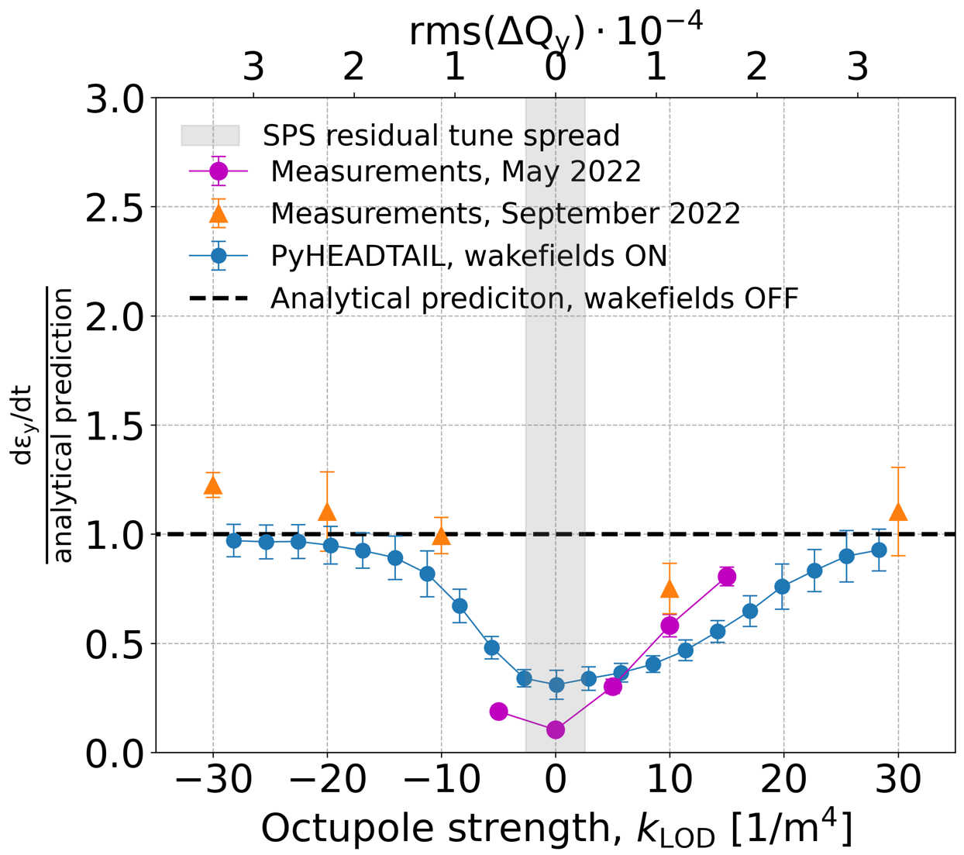
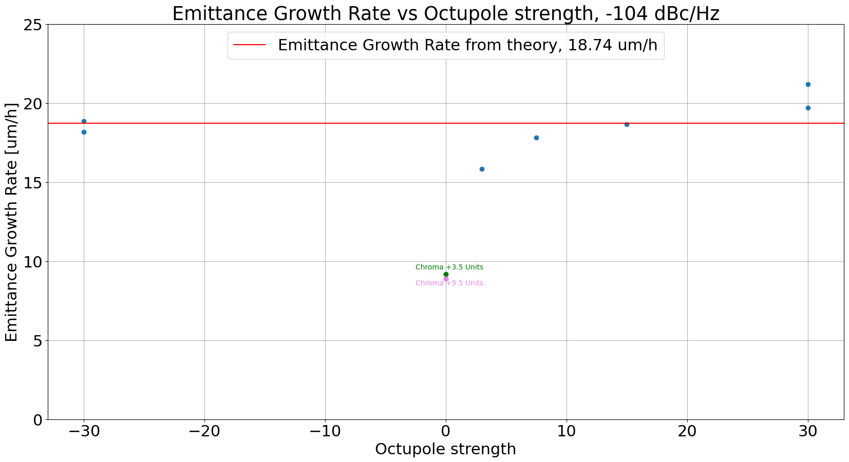
Emittance Growth (Phase & Amplitude Noise)
2022 (phase noise)
2023 (amp noise)
(A. Fornara et al.)
(N. Triantafyllou, thesis)

Slide 12
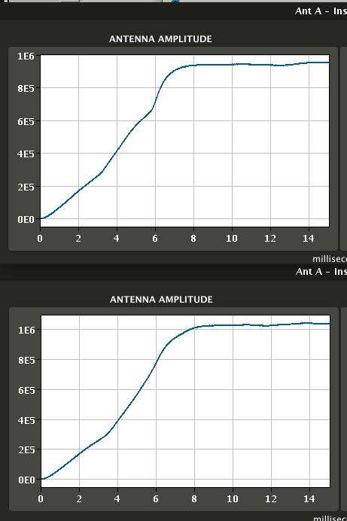
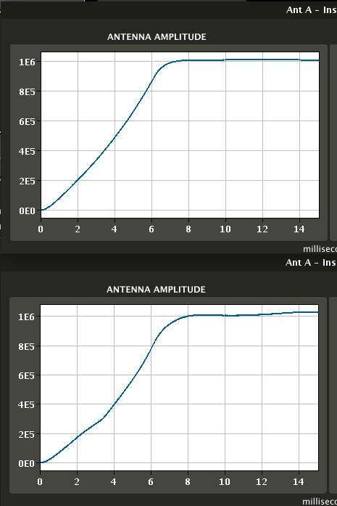
MD 3 & 4: Voltage Ramp on C1 & C2
Problems detected on C1 amplifier triggered a replacement of the tube. Since, the ramp on C1 is smooth w/o kinks. Retuning on C2 to adjust the voltage/power ramp for 2024
Cav 1
Cav 1
Jun 2023, MD
Jul 2023, MD
Cav 2
Cav 2

Slide 13
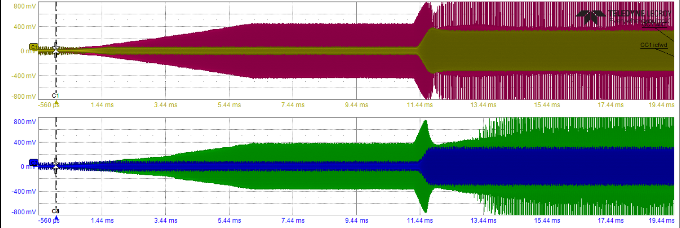
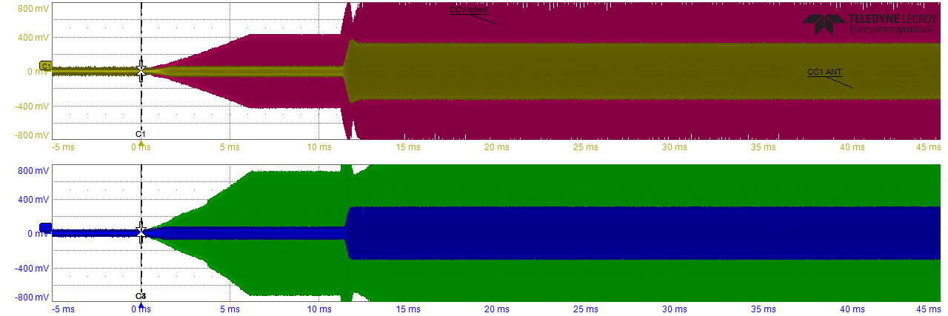
MD 5: RF-ON with 8b4e vs. 72b
The drive sent to amplifier (red/green) ramps in 7 ms
The cavity voltage (beige/blue) “saturates” at few hundreds kV. The RF fdbk is closed at +12 ms resulting in an abrupt increase in drive (TX power) and the voltage then “jumps” to the demanded 1 MV (The Frev spikes in TX drive after fdbk closure result from amplification of beam signal picked up by antenna).
The effect varies from shot-to-shot and suspected due to “multipacting” like effects. Not conclusive if 8b4e is better
8b4e
72b

Slide 14
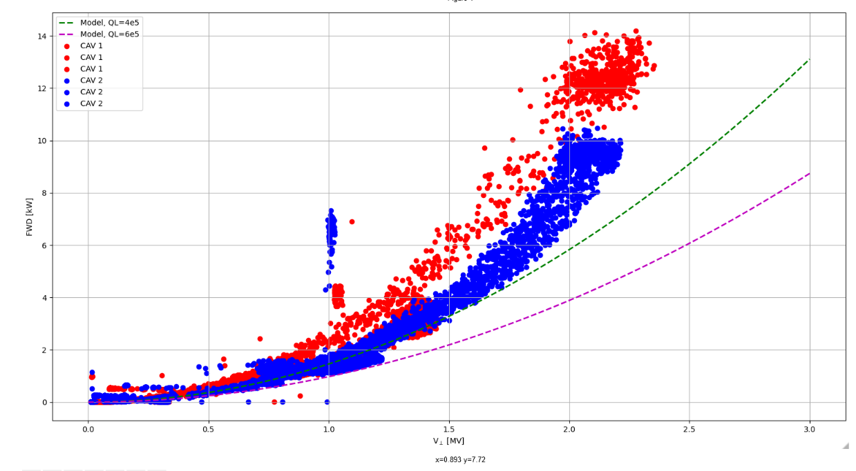
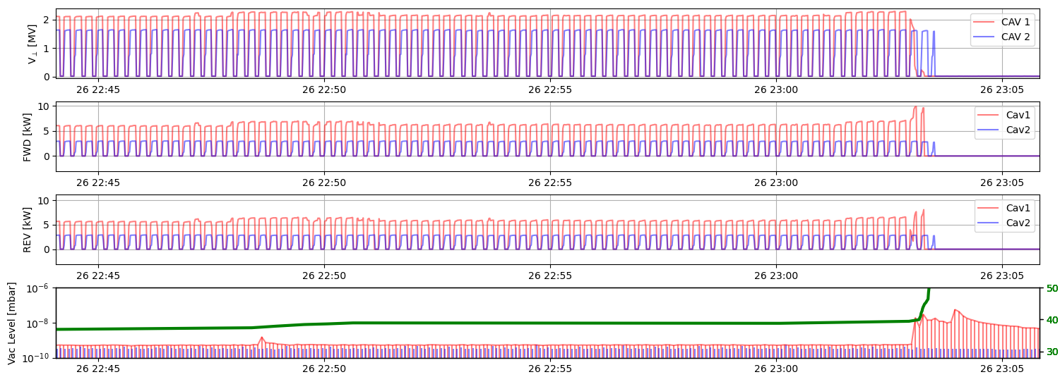
Pushing the Voltage with RF Conditioning
Performed RF conditioning with PLL on both cavities, settings not perfected yet for PLL to follow the cavity tune
At end-Jul we could pulse the cavities above 2 MV for an extended period, so promising improvement from 2022
2.3 MV

Slide 15
Some comments
Total of 4 MDs performed (high intensity batches at injection & emittance growth with amplitude noise)
  Slow beam losses with high intensity batches was due to aperture vetical restrictions, solved by counter-phasing the cavities
  Observed perturbations on the RF sequence due to the presence of the beam. Mitigation by injection after RF-ON
  Data acquired for fast phase changes in open-loop for benchmarking
Many important tests to be done with RFD module to probe the impedance effects with high intensity beams and operational aspects

