Slide 1

HT measurements & outlook for HL-LHC
T. Levens, T. Lefevre, M. Krupa, A. Schlögelhofer (CERN SY-BI)
S. Gibson, A. Arteche, M. Bossman (RHUL)
13th HL-LHC Collaboration Meeting, 25–28 September 2023, Vancouver

Slide 2
Introduction
Existing high-bandwidth “Head-Tail” monitors installed in SPS + LHC
  Measurement of transverse instabilities (LHC+SPS)
  Measurement of crab-cavities (SPS)
Limited in bandwidth & resolution by imperfections of pick-up, hybrid, cables and digitizers
Existing LHC HT pick-ups generally at bad phase advances with respect to the future CC locations
  Will need new pick-ups in optimal locations for CC diagnostics
  Optimal locations studied by WP2…

Slide 3
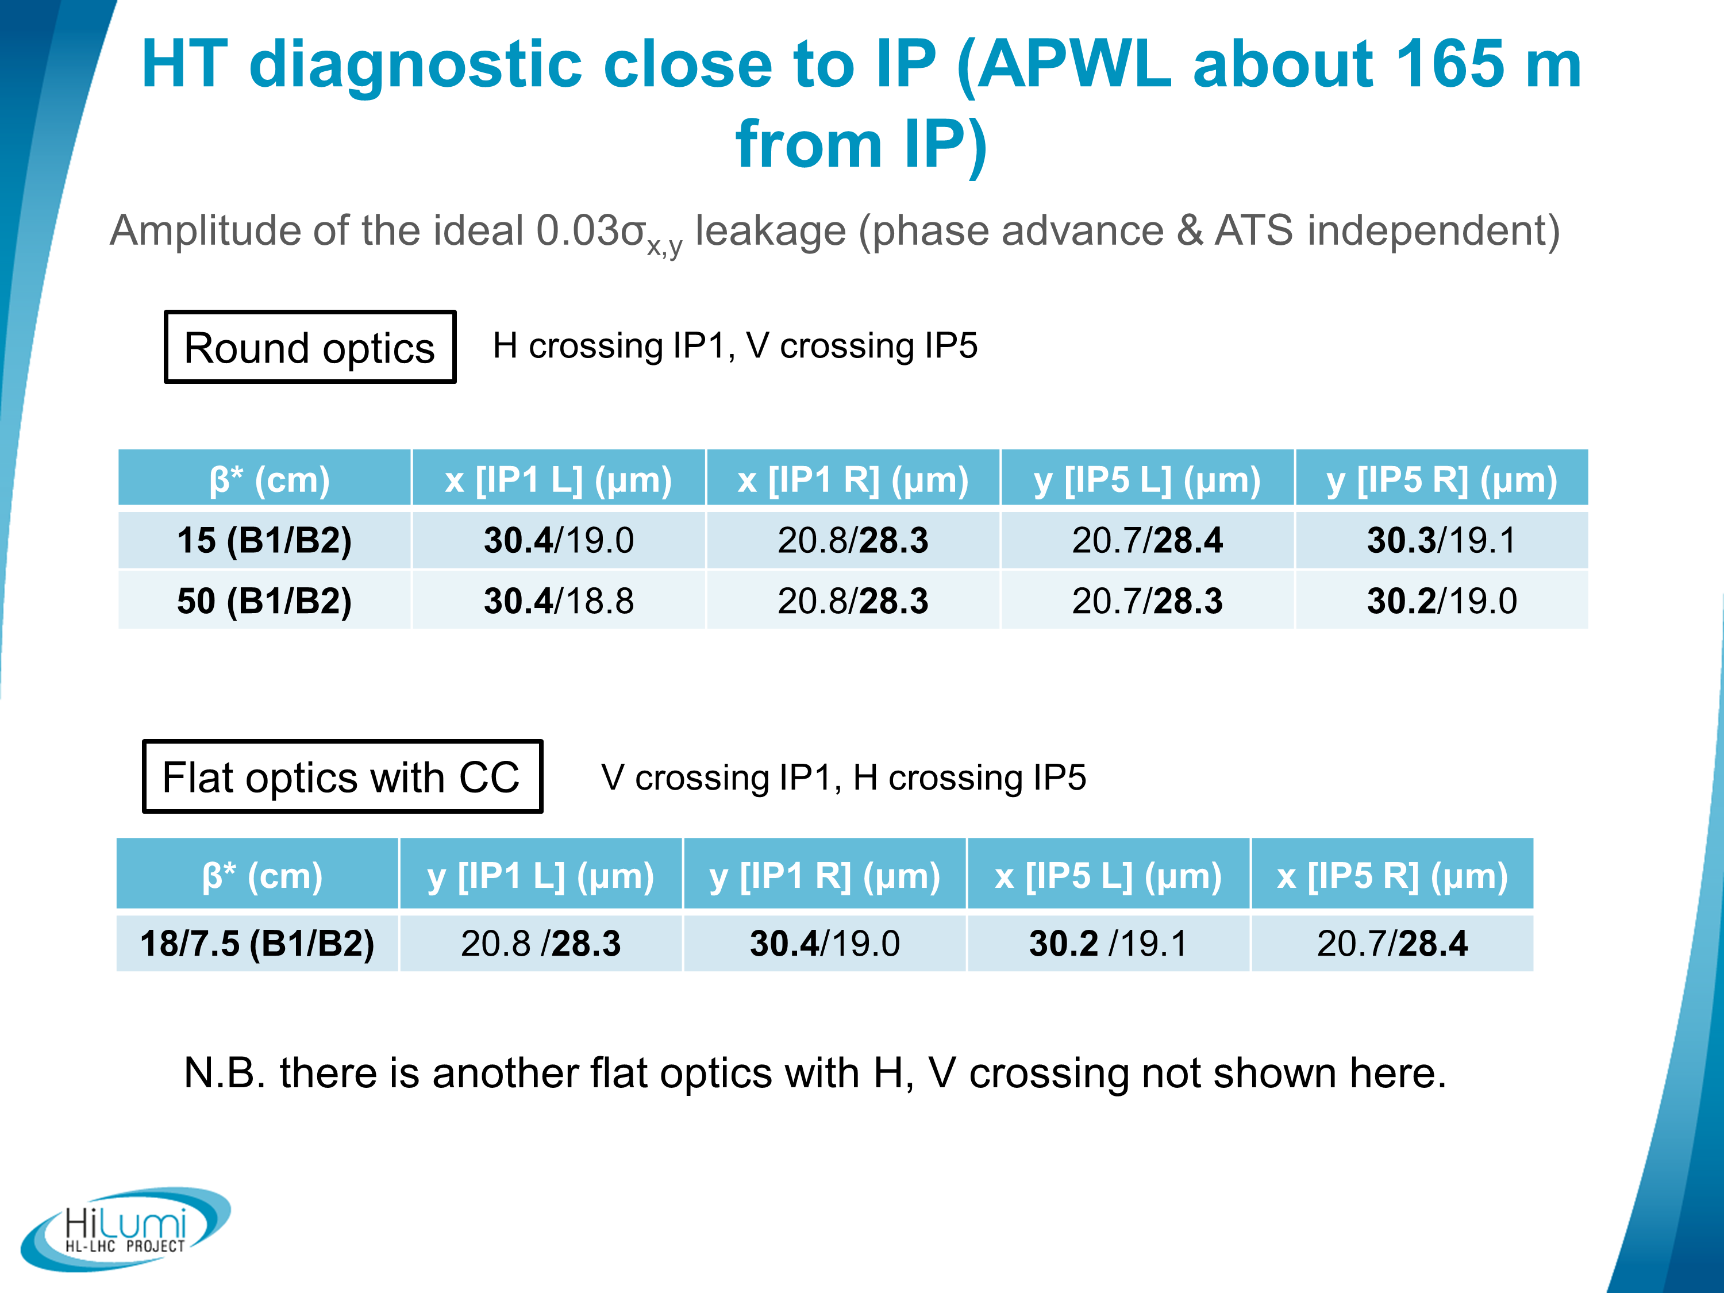
i.e. beside the CC
Approx. 30um residual signal in all cases
R. De Maria, S. Kostoglou, Special Joint HiLumi WP2/WP4/WP13 Meeting (https://indico.cern.ch/event/1044711/)

Slide 4
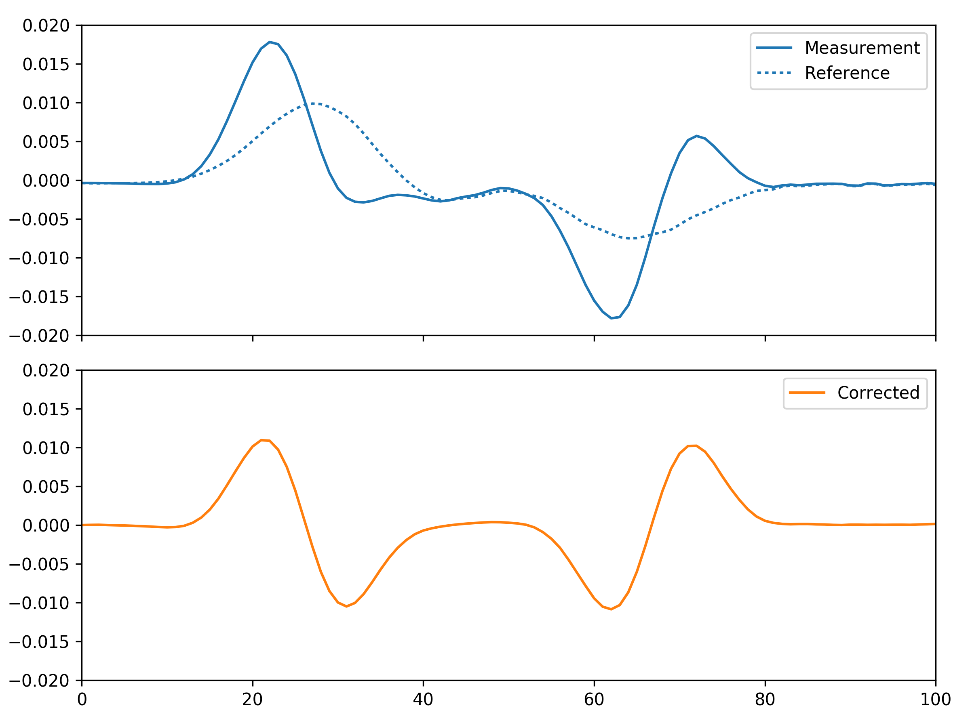
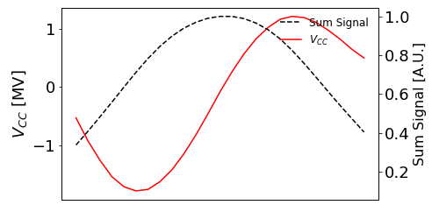
Head-Tail correction for CC
Well phased CC results in a static intra-bunch position offset at the HT pick-up
Residual HT baseline signal from beam position offset plus systematic effects from hybrids, etc
In SPS, baseline correction has been performed by taking a reference measurement in each cycle with the cavities un-phased (or off)
  Works well in SPS but is not technique that is easy to implement in long fills in HL
  Hoped to study stability of baseline during 2023 LHC run… maybe in 2024 ☺

Slide 5
Limits of traditional Head-Tail
With optimal BPM locations (IP1/5) need to measure ~30um signal
  Note: we are still missing a spec from WP2/WP4 on resolution requirement!
Given existing HT, 30um corresponds to a ~3mV signal
Baseline signals of ~20mV from hybrid imperfections
  Current HT scopes have ~175uVrms noise for these signal levels
  ~10% of signal level
Reminder: no FRAS foreseen for these BPMs, can expect mm offset between beam and BPM electrical center!
  Resulting in an additional ~200mV baseline from the beam offset
  Current HT scopes have ~750uVrms noise for these signal levels
  ~25% of signal level
There is possibly some improvement from newer high-speed ADCs
  But cannot expect an orders of magnitude improvement
Electro-Optical (EO) techniques are under study for potential of further improvements

Slide 6
Electro-Optical BPMs
Electro-Optical (EO) BPMs are being studied by WP13, in collaboration with RHUL, as a potential upgrade for higher bandwidth
  Using birefringent crystals to modulate a laser signal in response to the bunch’s EM field
  Fiber coupled interferometer utilises the coherence of light to suppress common mode signal
  Difference signal measured directly at photodetector

Slide 7
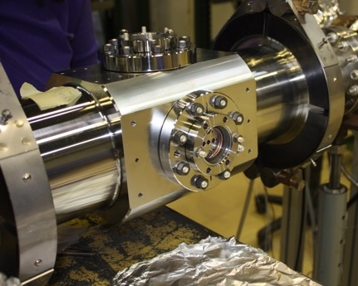
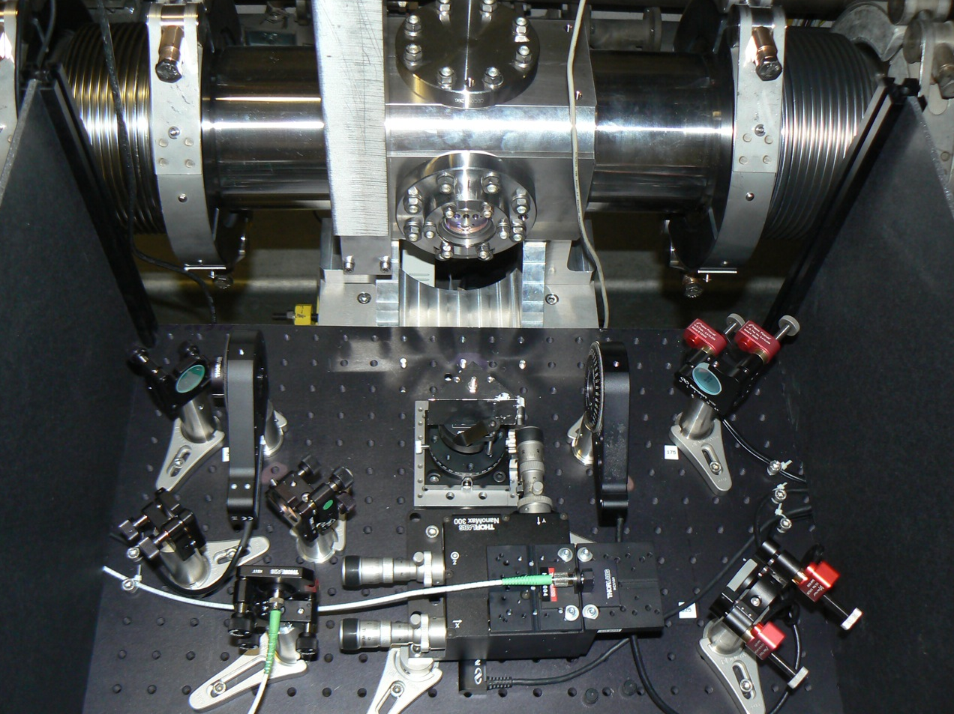
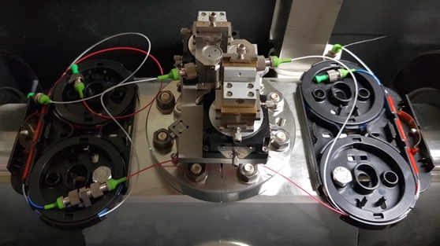
EO-BPM development history
2016: Original SPS design using bulky free-space optics with a polariser/analyser
2018: Installation of a compact interferometric design in SPS
2021: Optimised fully fiber-coupled waveguide design
2021: Beam tests in HiRadMat
2022: Beam tests in CLEAR
© RHUL

Slide 8
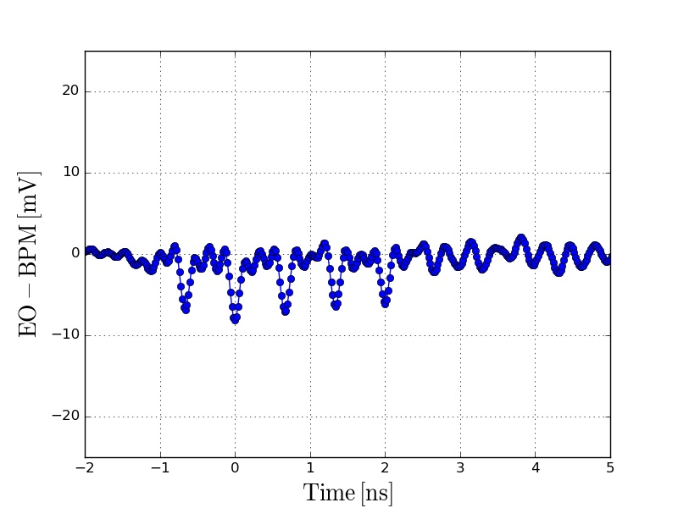
EO-BPM tests summary
HiRadMat (2021)
CLEAR (2022)
First single shot measurements with proton beams with in-air prototype and EO interferometer
Mechanical translation of BPM body to allow “beam position” scans
Test of time resolution with short (5ps) electron bunches, acquisition with 33 GHz oscilloscope and optical probe
Preliminary results show time resolution is within the required <50ps specification.
666ps

Slide 9
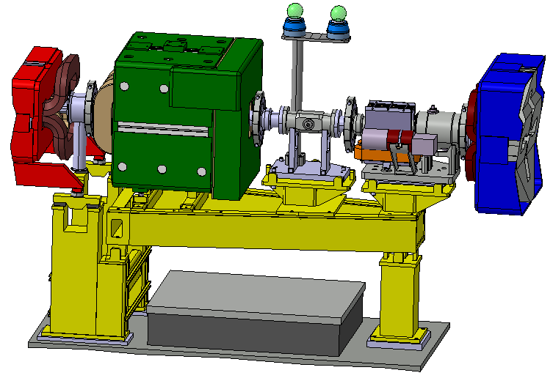
2nd SPS EO-BPM test installation
(As presented at the 2022 meeting)
HL-LHC EO-BPM prototype will be installed in SPS
  Benefit from reuse of existing fiber infrastructure in SPS LSS4
Beam tests planned during 2023
  Focusing on resolution and
  long-term stability of the EO-BPM
  Benefit from possible 2023 crab-
  cavity tests as a validation step
Technical review at end of 2023
  Decision to install EO-BPMs or
  “traditional” strip-lines in HL-LHC
Integration of EO-BPM on SPS girder GHY.42101 (EN-ACE)

Slide 10
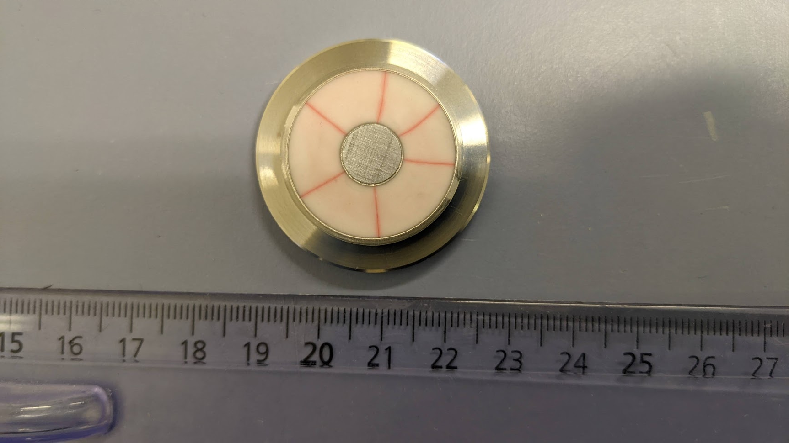
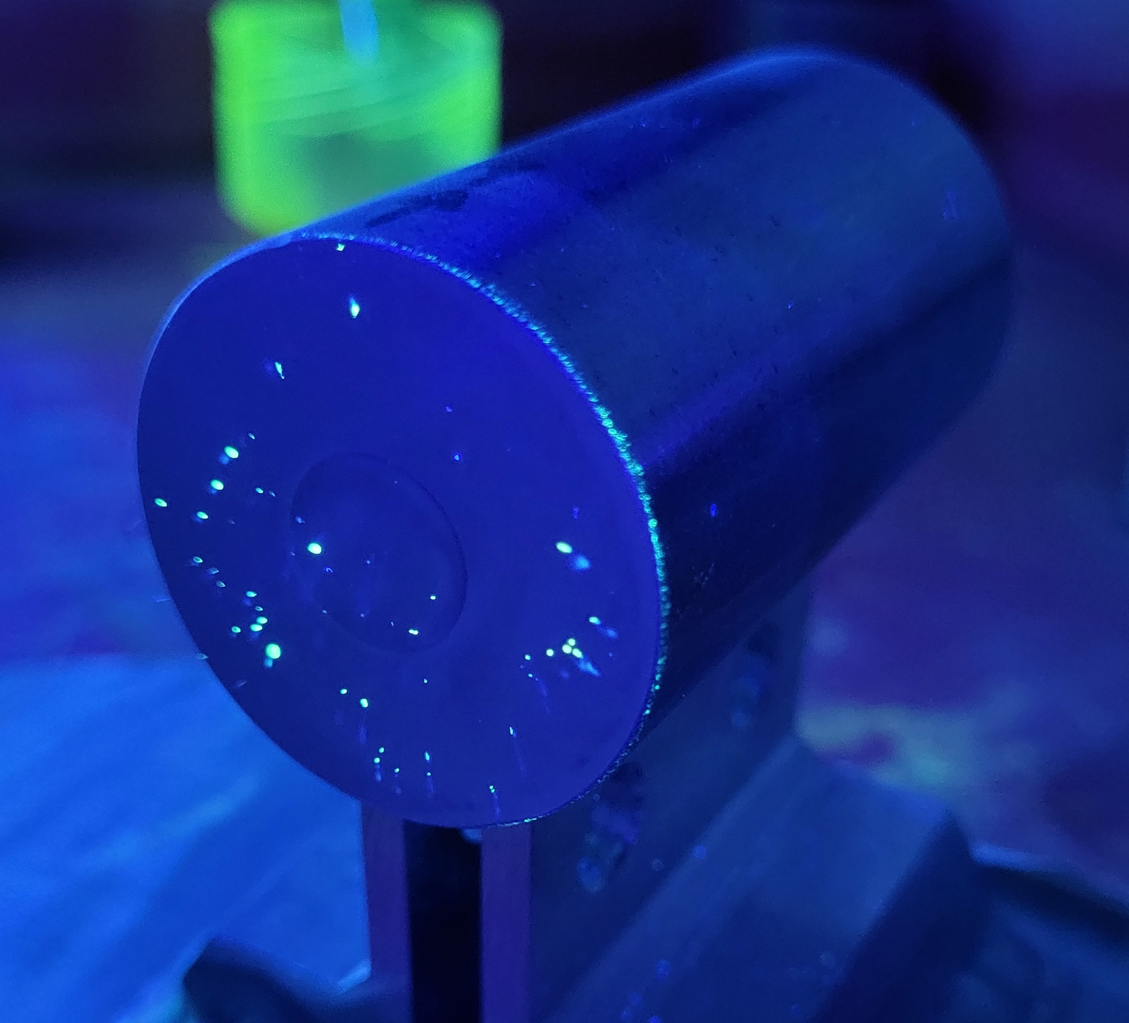
Issues with EO-BPM production
Long lead time on ceramic washers and delays lead to delivery only in late 2022
First brazing attempt: cracked ceramics
  Minor adaptation of geometry of Kovar parts to improve the situation
In addition, defects (pores) were found in Kovar stock at CERN
  Again, long lead time of replacement material
Successfully (?) brazed parts finished in mid-2023 and welded to the body…

Slide 11
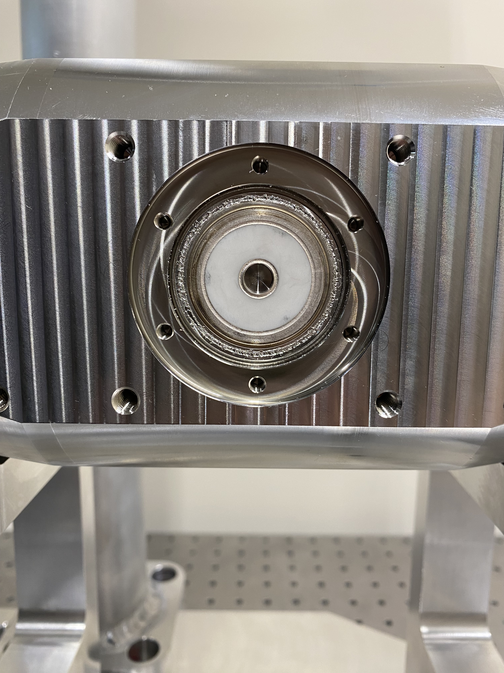
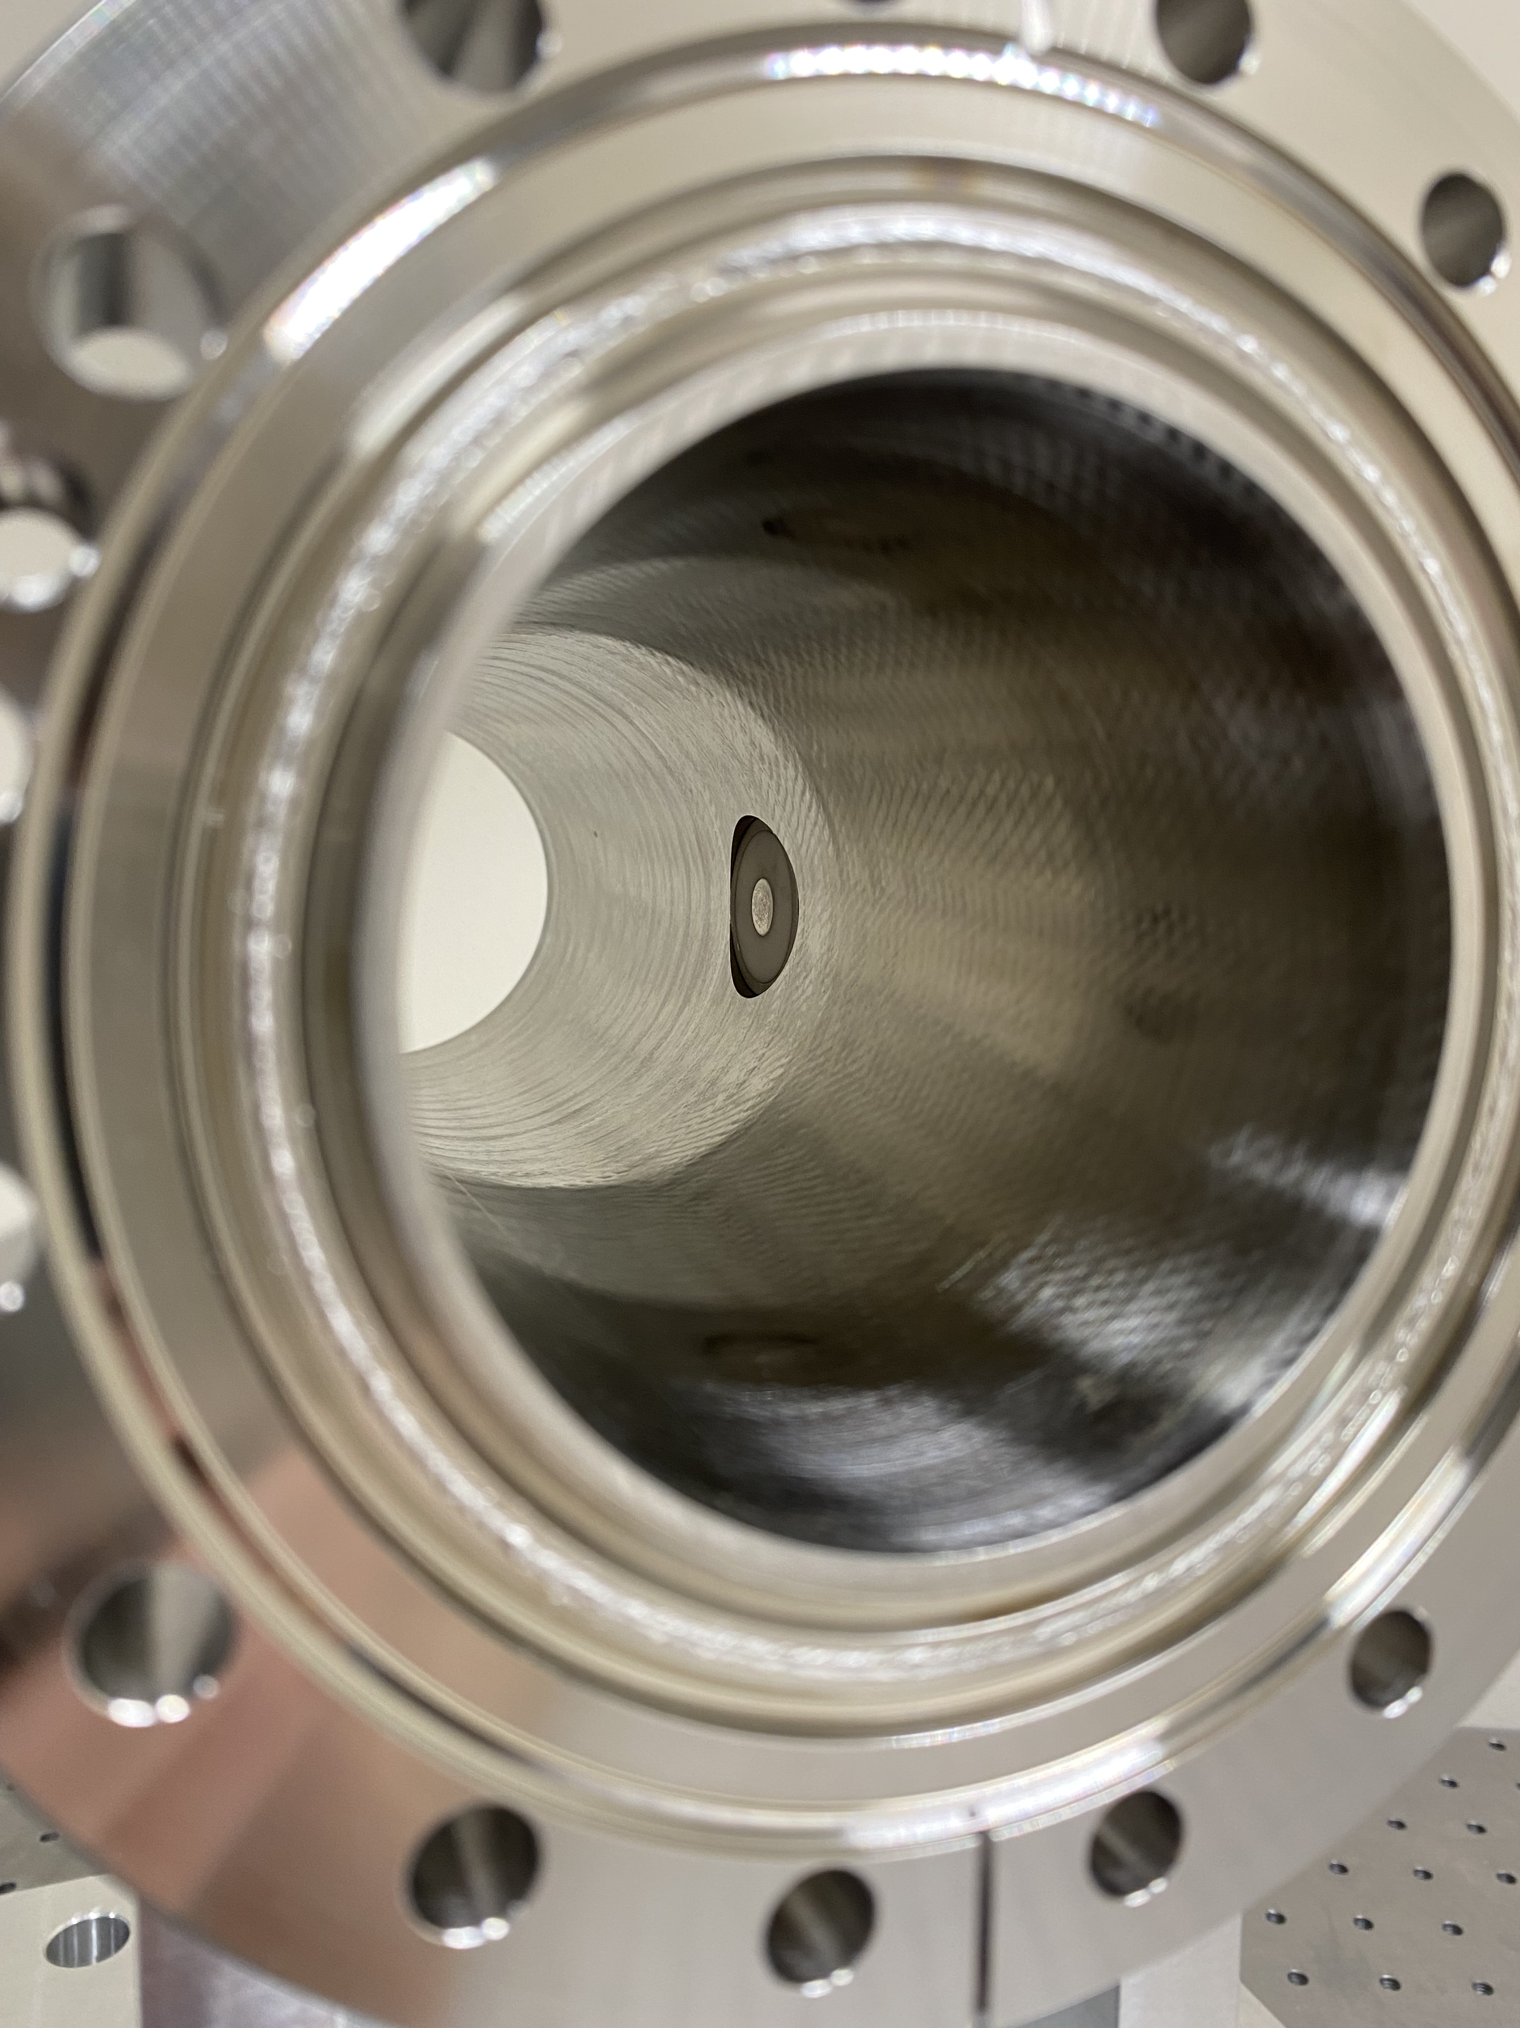
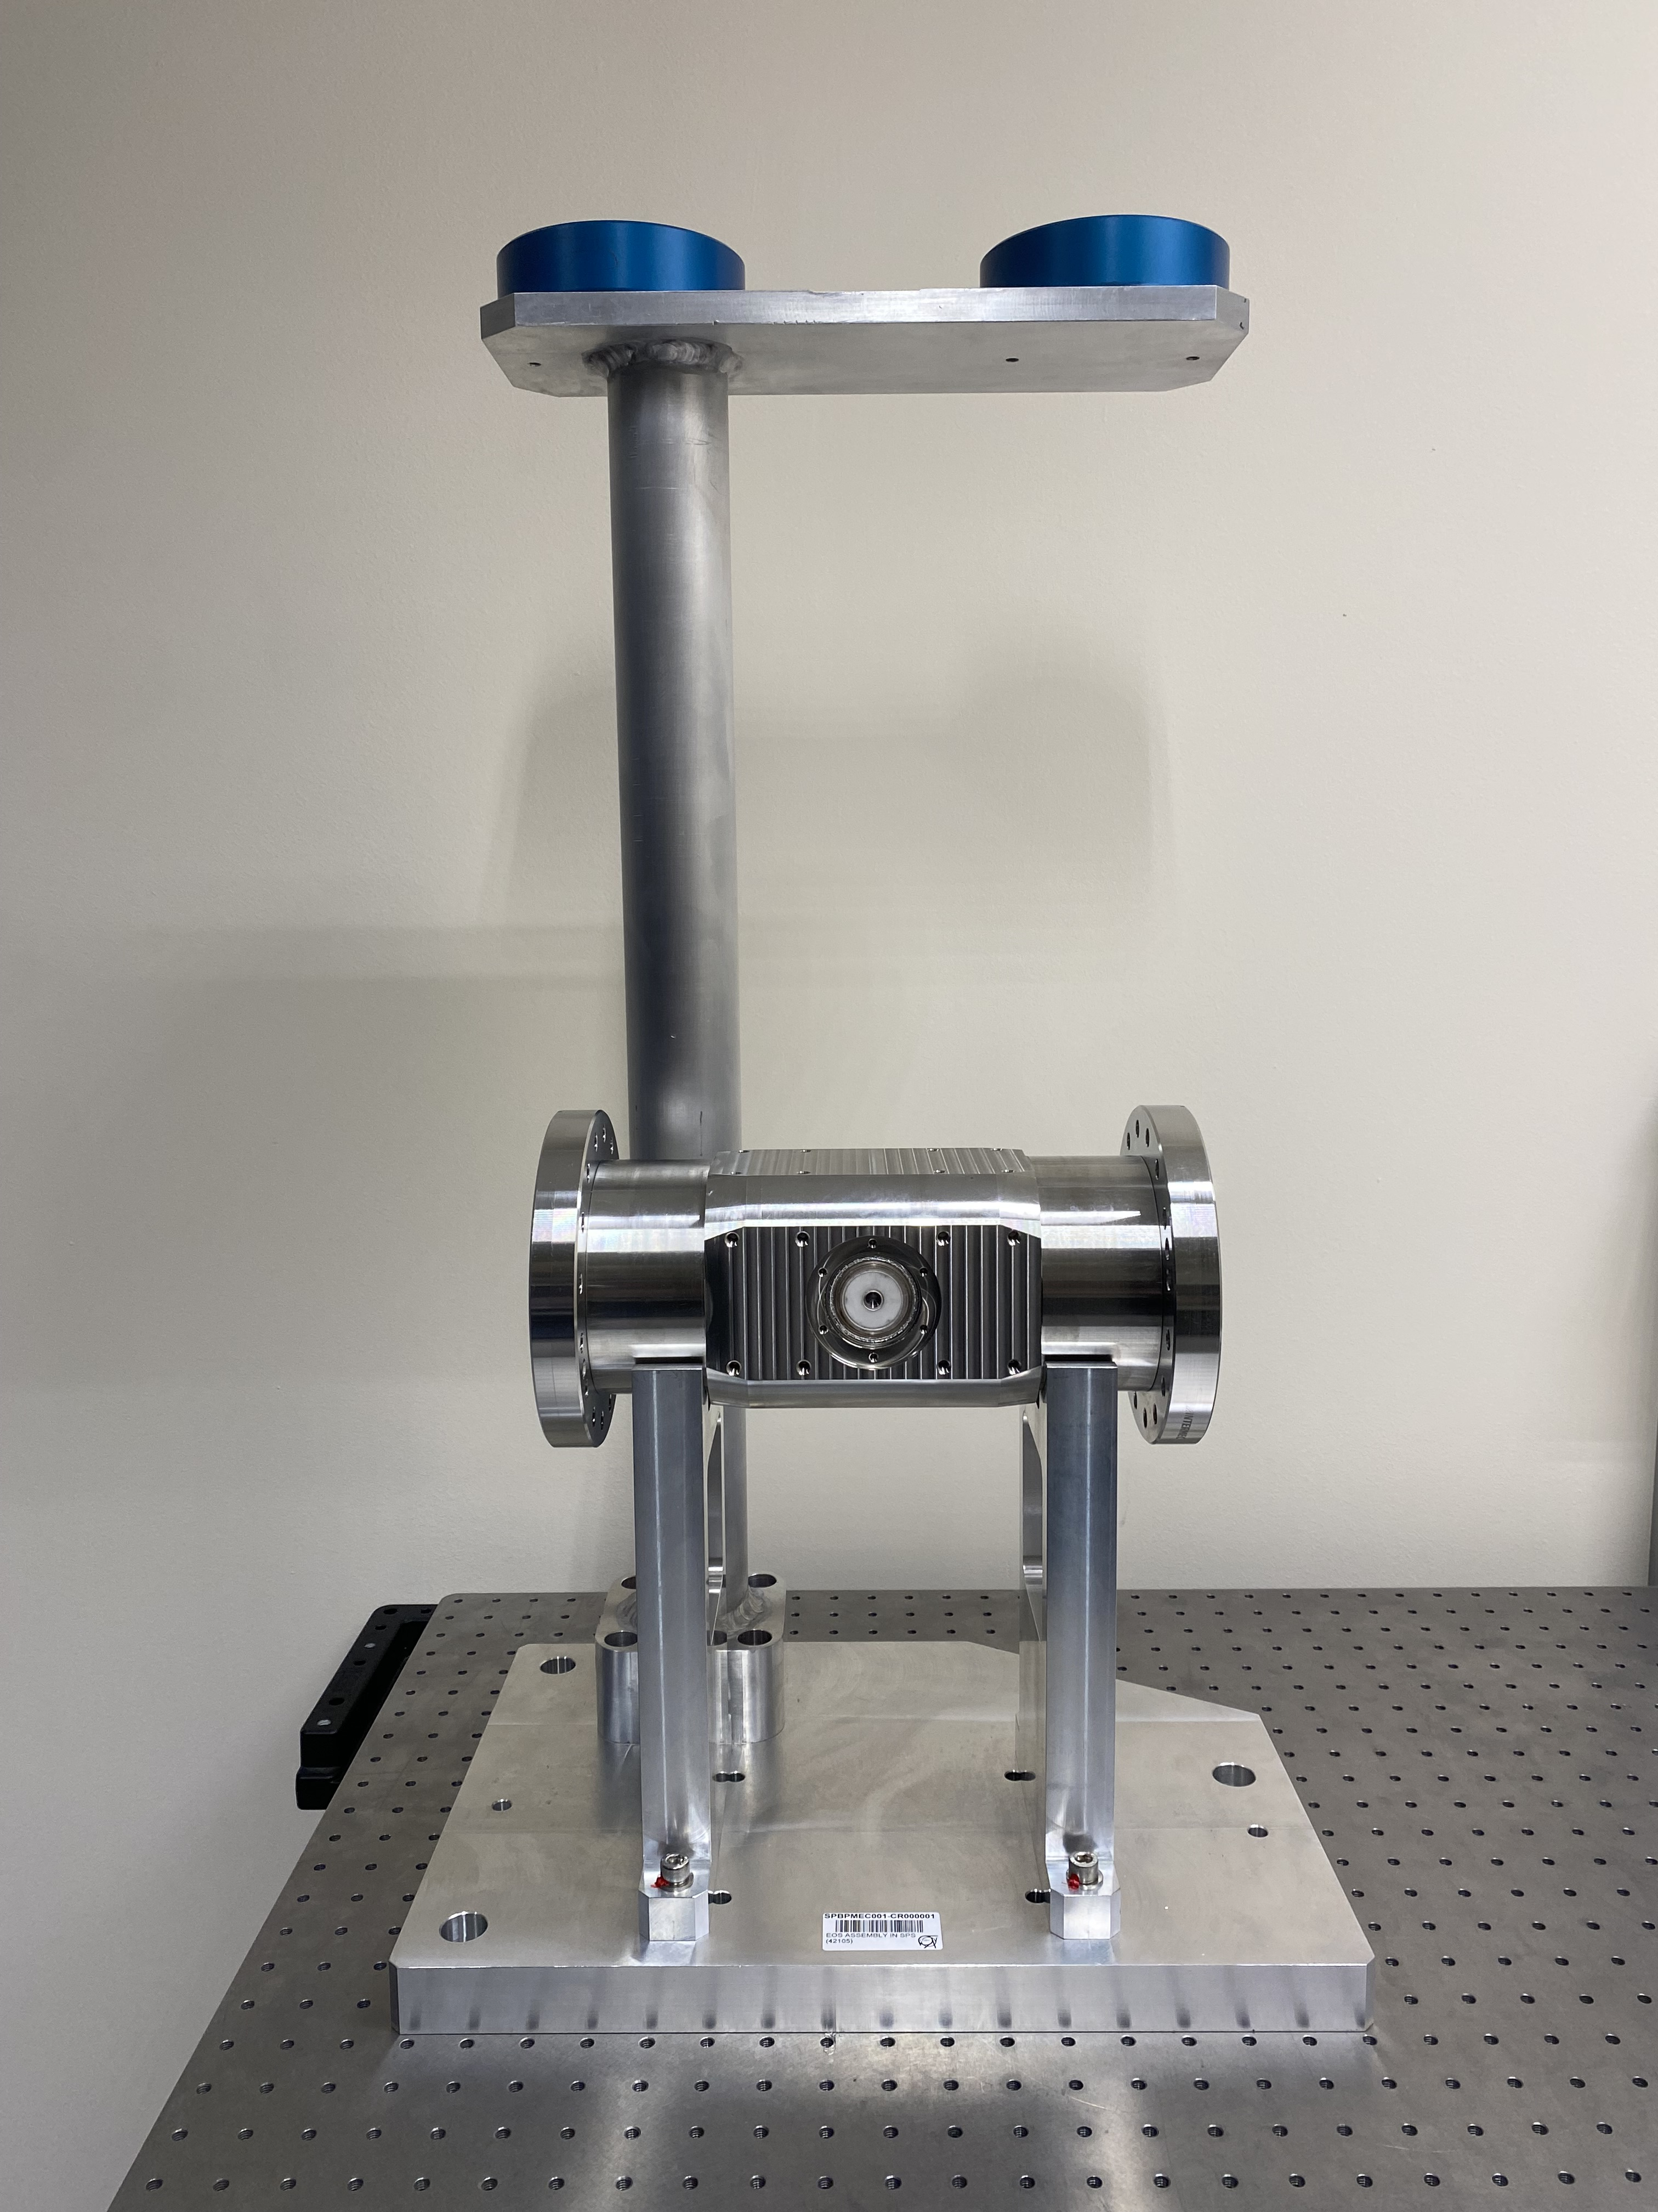
EO-BPM prototype assembly
x

Slide 12
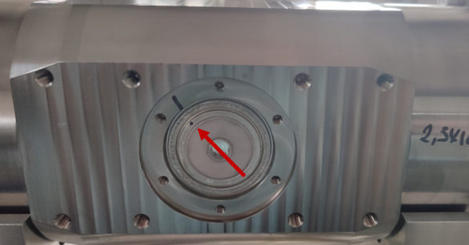
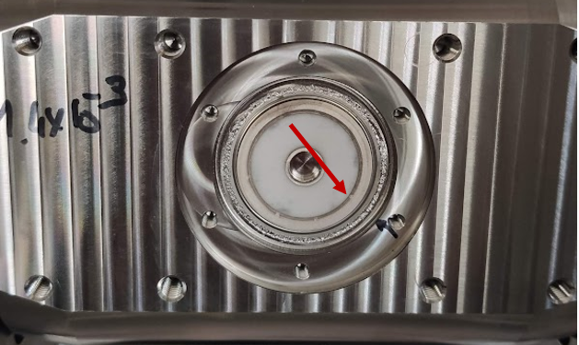
Issues with EO-BPM production (pt. 2)
Last week: leaks were found on both buttons during vacuum acceptance tests
Work ongoing now to understand the source of the leaks
  Seems to be localised to brazing
Additional parts are available:
  3 brazed buttons
  1 body
Still some possibility for installation in YETS 23-24 but schedule is very tight
Need to make a go/no-go decision soon for EO-BPM installation
  Ideally should be done after the SPS tests
  Any further installation delays make this difficult

Slide 13
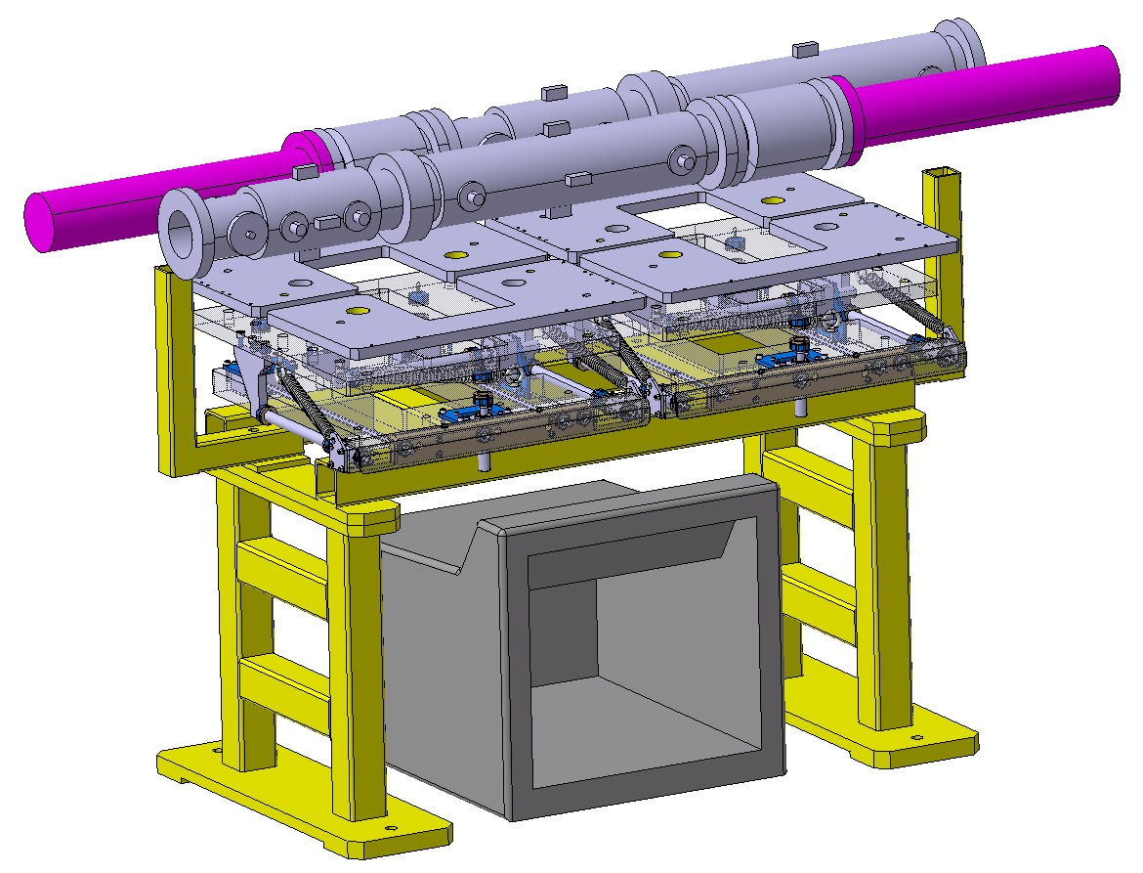
Stripline for CC
Design of a traditional strip-line BPM is being done in parallel to the EO-BPM
Backup in case the EO-BPM is not a viable option
Space reservation and integration proceeding with this design as it has a longer length
  Possibility to substitute it by a shorter EO-BPM
More details in the next talk by M.Krupa

Slide 14
BI R&D into EO spectral decoding techniques
Study in BI for FCC using EO intensity modulators with spectral decoding techniques using commercial EO-modulators
See: A. Schlögelhofer, Optical Fibre Sensing at CERN (31st August 2023)

Slide 15
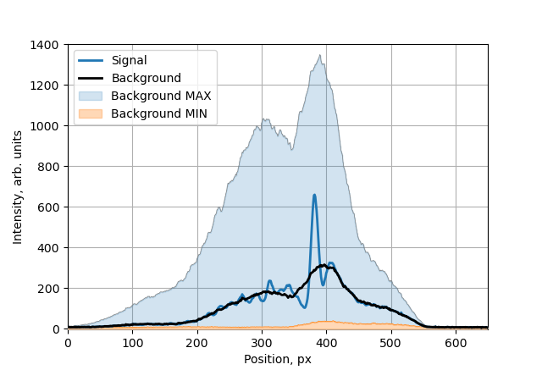
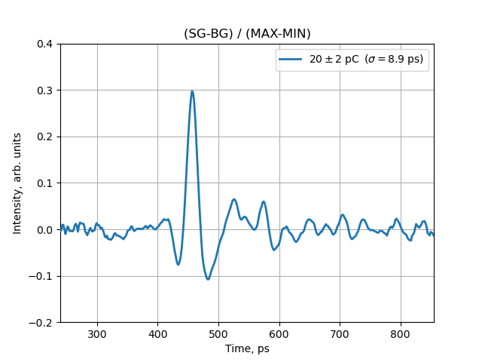
BI R&D into EO spectral decoding techniques
Initial results at CLEAR show very high potential with pulse response < σ = 10 ps
See: A. Schlögelhofer, Optical Fibre Sensing at CERN (31st August 2023)

Slide 16
Applicability to HL-LHC
Initial proposal to test these techniques for HL-LHC:
Additional post stretching allows use of slower ADCs
5 GSPS (14 bit) → eq. 100GSPS
-or-
500 MSPS (16 bit) → eq. 10GSPS
Similar to CLEAR setup

Slide 17
Summary
Traditional Head-Tail techniques on the limit for HL-LHC
  Measurement of 30um residual crabbing is very challenging!
EO-BPMs under development with RHUL as potential upgrade
  Issues during manufacturing → installation in SPS was not possible in YETS 22-23
  Further vacuum leaks were recently discovered → not yet clear if installation in YETS 23-24 is possible
  Any futher delay will make the go-no decision for installation in HL-LHC too late
Novel new EO techniques are also being investigated to overcome limits of traditional HT
  Allowing slower (higher resolution) ADCs for the same equivalent resolution
  Possibility for continuous data acquisition (not possible with current HT)
  Procurement of suitable laser for test with LHC beam conditions started
  Early stage of R&D

Slide 18

Thank you…
This project has received funding from the European Union’s Horizon 2020 Research and Innovation programme under GA No 951754 & 101004730.

