Slide 1

Machine protection studies
Cédric Hernalsteens, R. Calaga, Daniel Wollmann

Slide 2
Outline
Assumptions and past works
Phase jump and phase slip
Phase jump MD in the SPS
Mitigations and conclusions

Slide 3
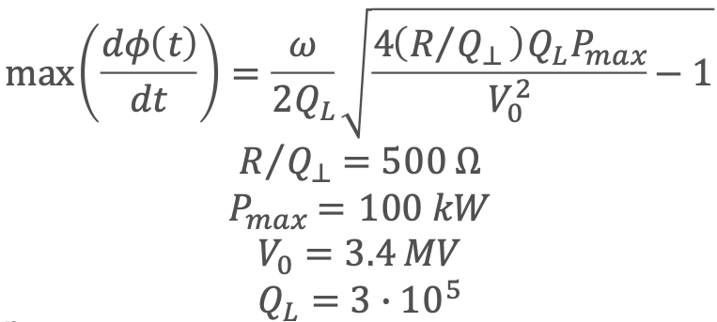
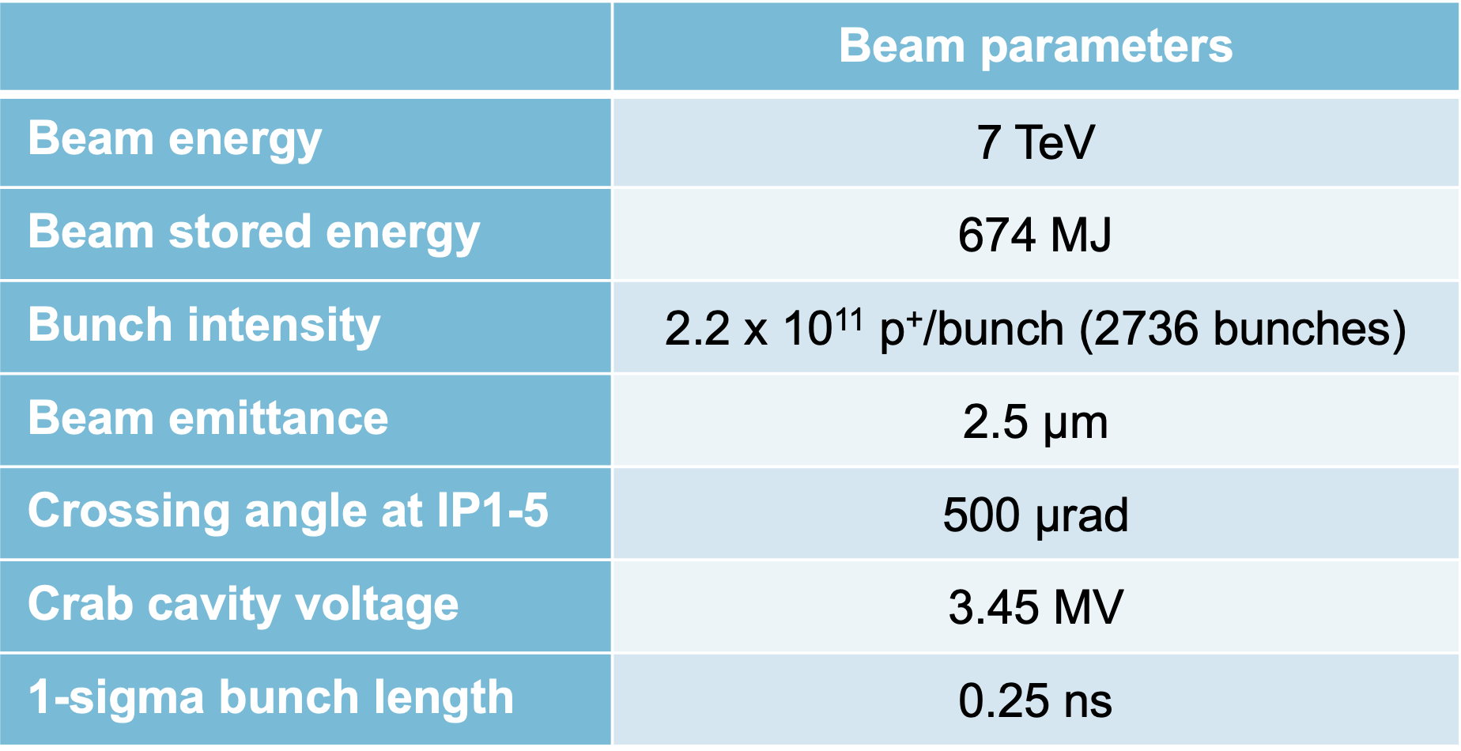
Assumptions and past work
Three failure cases identified
  Phase slip
  Phase jump
  Voltage drop
Maximum theoretical phase shift per turn of 44 degrees
  Simulation results [1] identified the phase slip case as most critical,
  by 1.6 sigma within two turns after the start of the failure → up to 2 MJ lost after 10 turns.
  Mitigation: phase advance from CC to TCP must be lower than 35 degrees to remain below the 1 MJ within 3 turns
Experience from the SPS test stand indicated that the phase shift per was further limited to 30 degrees [1]
  Phase slip is most critical, up to 1.12 MJ lost after 10 turns (0.8 MJ after 3 turns)
  Mitigation: phase advance between crab cavities and primary collimators must be lower than 60 degrees
Courtesy B. Lindstrom
HL-LHC layout v1.5 with round optics (β* 15 cm)
Collimator settings: TCP @ 6.7 sigma and 8.5 sigma
(1) Machine protection challenges for Run 4”, Chamonix, 2023

Slide 4
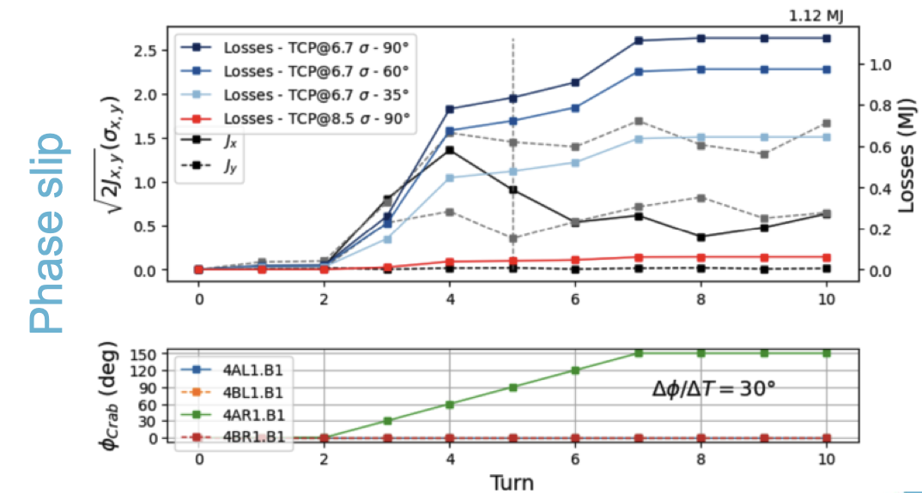
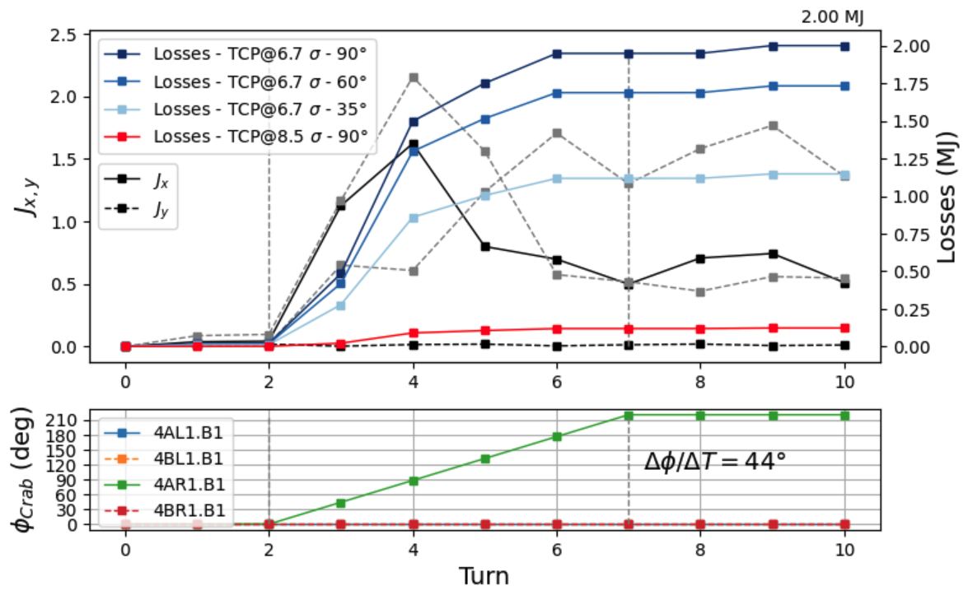
Phase slip – Simulation results
IP1 is slightly more critical with maximum losses for a phase slip failure of
4AR1.B1
Phase advance from CC to TCP should be limited to avoid exceeding the
1 MJ limit (within 3 turns) defined for machine protection
  Assuming theoretical limit for the maximum phase shift per turn (44 degrees): lower than 35 degrees
  Using recent estimate from SPS test stand experience (30 degrees): lower than 60 degrees

Slide 5
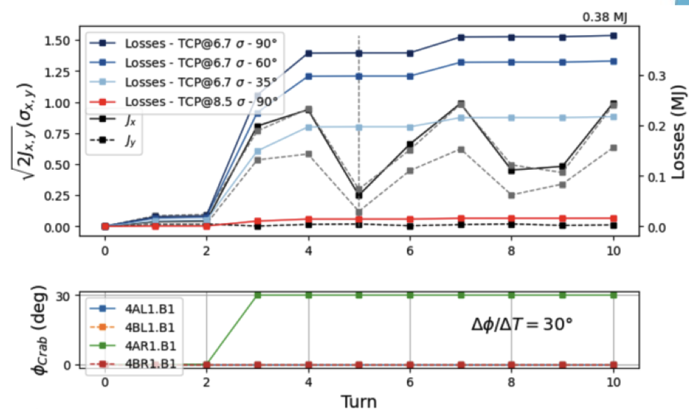
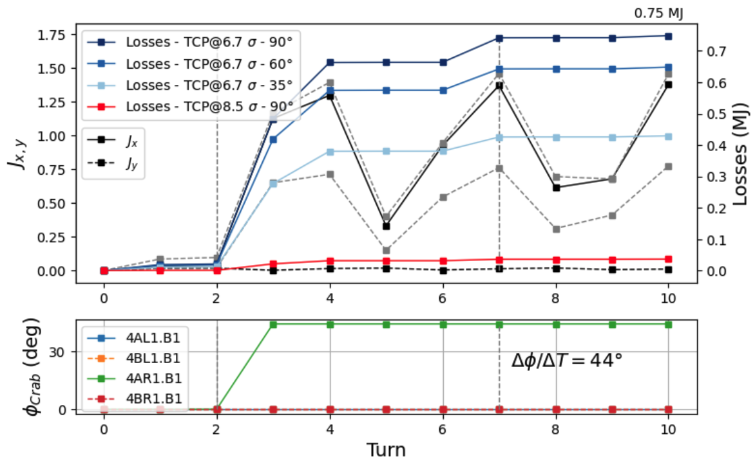
Phase jump – Simulation results
Case similar to the 2023 SPS MD (see next slides)
Maximum losses after 10 turns of 0.75 MJ
[1]
(1) Machine protection challenges for Run 4”, Chamonix, 2023

Slide 6
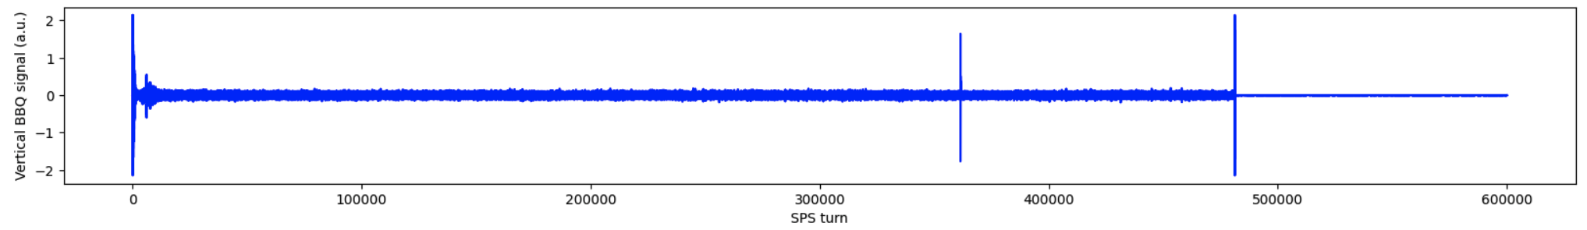

SPS MD
SPS MD on 7 June 2023 included phase jump tests with beam to measure the effect on the beam and attempt to infer the maximum allowed phase shift per turn.
Phase jump provoked on cavity 2 (cavity 1 at constant phase) with the feedback of, at constant voltage of 1 MV, at flat bottom with the cavities counter-phased (so-called “transparent mode”).
Data collection
  Turn by turn BBQ data
  Closed-orbit (1 ms sampling rate)
  Beam intensity (5 ms sampling rate)
  Did not recover synchronised head-tail monitor data
Injection
Kick from C2 phase jump
Dump

Slide 7
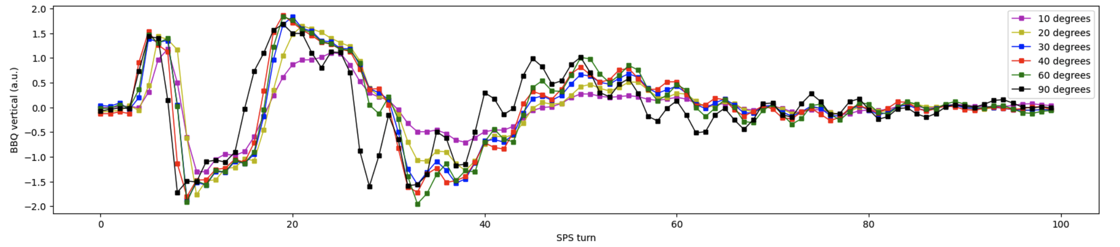
SPS MD – Turn by turn dynamics
Phase jump of 10, 20, 30, 40, 60 and 90 degrees with RF feedback off
BBQ signal show similar response amplitude and dynamics for phase jumps from 20 to 90 degrees. The amplitude for the 10 degrees jump is ~30% lower.
  Cannot distinguish the different dynamic behaviour between the different phase shifts → non conclusive

Slide 8
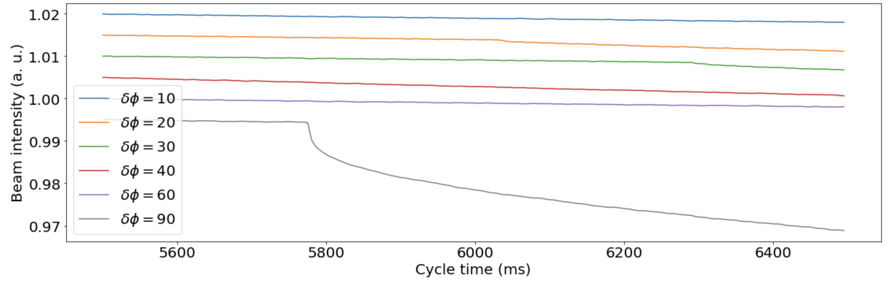
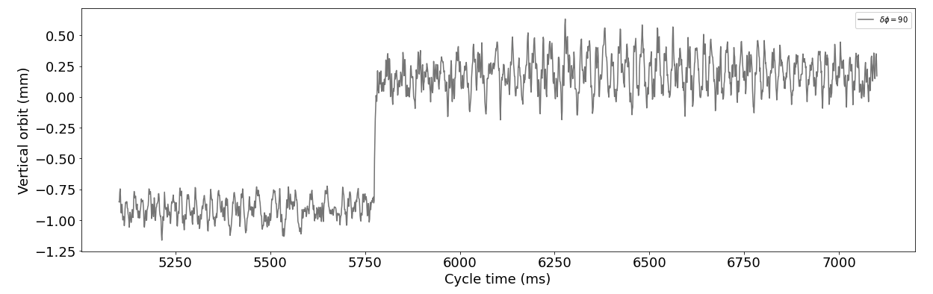
SPS MD – Orbit jump and beam losses
Beam losses were observed for the 20, 30 and 90 degrees jump
Beam loss data could not be retrieved for the 40- and 60-degrees phase jump
Clear indication of hitting the aperture limit for the 90 degrees case
Corresponding closed-orbit jump of ~ 1mm

Slide 9
Conclusions
Non-conclusive results from 2023 SPS MD
Measurements do not provide additional input on the dynamics of the failure case due to the limited time resolution of the BPMs (1 ms) and BLMs (5 ms) in the SPS → Simulations remain the best way to predict the criticality of the failure cases.
The maximum achievable phase change per turn must be reviewed: theoretical limit 44-degree versus 30-degree limit observed experimentally in 2022. In case of 44 degrees the losses would increase to 2 MJ within 10 turns.
Future experimental studies on crab cavity failure cases (phase slip, quench) in the SPS require improved turn-by-turn diagnostics of the orbit and beam losses.
  Use timing event to trigger phase jump
  Trigger turn-by-turn recording of BPMs
  Trigger turn-by-turn recording of LHC type BLMs in the SPS

Slide 10
References and prior works
  T. Baer, Very Fast Losses of the Circulating LHC Beam, their Mitigation and Machine Protection, CERN-THESIS-2013-233
  B. Yee-Rendon et al., Fast crab cavity failures in HL-LHC, CERN-ACC-2014-0107
  A. Santamaria Garcia, Experiment and Machine Protection from Fast Losses caused by Crab Cavities in the High Luminosity LHC, CERN-THESIS-2018-142
  B. Lindstrom, Criticality of fast failures in the High Luminosity Large Hadron Collider, CERN-THESIS-2020-318
B. Lindstrom, ColUSM #157, 2022
D. Wollmann, S. Redaelli, Chamonix 2023

Slide 11
Backup

Slide 12
Optics at the location of the crab cavities
For reference
Crab cavity | Beta X | Beta Y
4AL1.B1 | 3617.6 | 3666.4
4BL1.B1 | 3574.7 | 3545.1
4AR1.B1 | 3665.5 | 3618.4
4BR1.B1 | 3544.2 | 3575.5
4AL5.B1 | 3632.1 | 3706.7
4BL5.B1 | 3597.6 | 3608.5
4AR5.B1 | 3706.4 | 3632.2
4BR5.B1 | 3608.2 | 3597.6

Slide 13
Collimator gaps
 | Collimator | Sigma | Gap (mm)
Run III | TCP.D6L7.B1 | 5.7 | 1.09
 | TCP.C6L7.B1 | 5.7 | 1.51
HL-LHC v1.4 | TCP.D6L7.B1 | 6.7 | 1.09
 | TCP.C6L7.B1 | 6.7 | 1.51
HL-LHC v1.5 | TCP.D6L7.B1 | 8.5 | 1.38
 | TCP.C6L7.B1 | 8.5 | 1.91

Slide 14
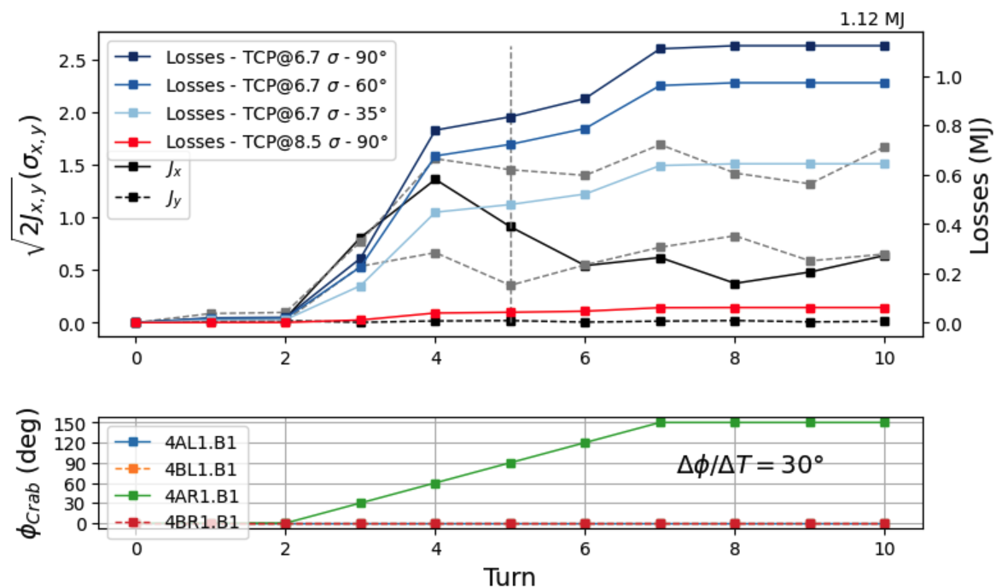
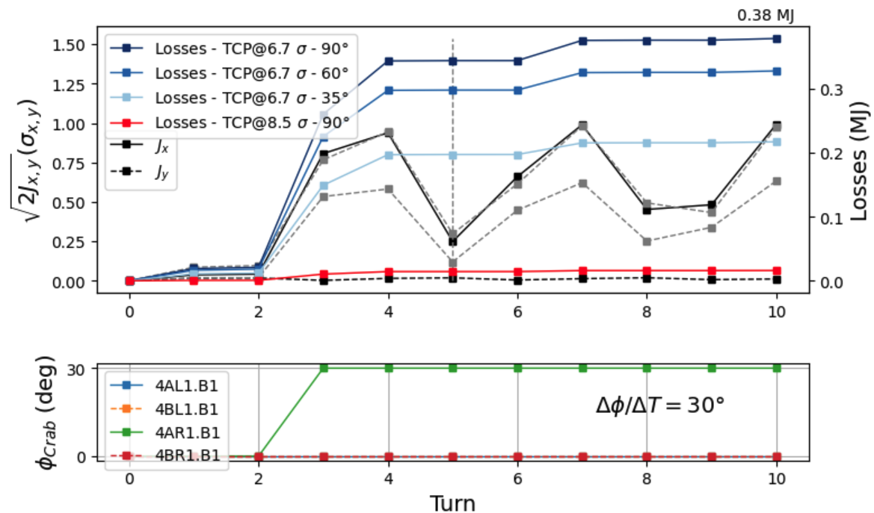
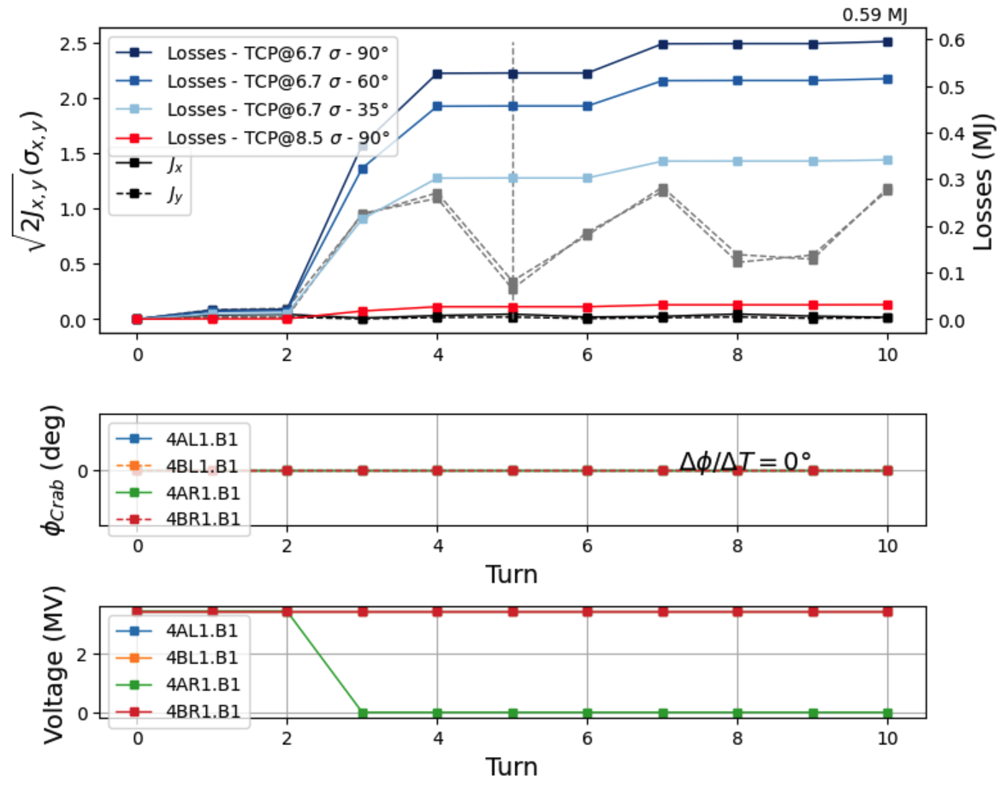
Crab Cavity failure: worst cases 4AR1.B1
Phase slip
  Phase change in one crab cavity over 5 turns by 30 degree per turn
  Shift of centre of bunch by 1.4 sigma within two turns after the start of the failure
  Up to 1.12 MJ lost after 10 turns (0.8 MJ after 3 turns)
Phase jump
  Phase change of 30 degree in one turn
  Shift of centre of bunch by 1.0 sigma within two turns after the start of the failure
  Up to 0.38 MJ lost within 10 turns (0.35 MJ after 3 turns)
Voltage drop
  Drop of voltage to zero within one turn
  Up to 0.59 MJ lost within 10 turns (0.5 MJ after 3 turns)
Phase slip
Phase jump
Voltage drop

