Slide 1


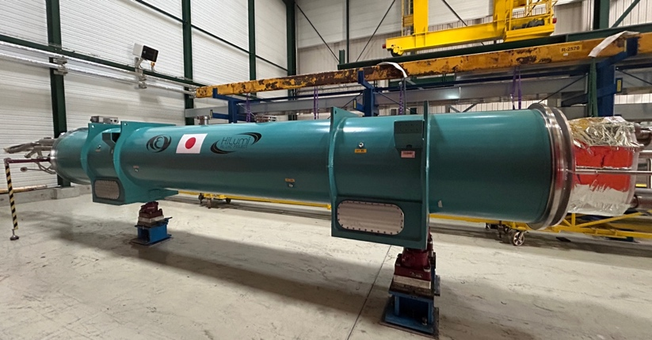
Status of D1 Construction and Test
Tatsushi NAKAMOTO, KEK
On behalf of CERN-KEK Collaboration for D1 Construction for HL-LHC
13th HL-LHC Collaboration Meeting, Vancouver, Canada, Sept. 27, 2023

Slide 2
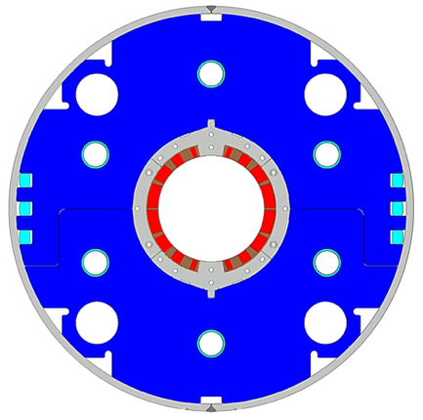
Japanese Contribution to HL-LHC: D1 magnets
Beam separation dipole (D1) by KEK
  Design study of D1 for HL-LHC within the framework of the CERN-KEK collaboration since 2011.
  150 mm single aperture, 35 Tm (5.6 T x 6.3 m), Nb-Ti technology.
  Development 2-m long model magnets (3 units) at KEK
Deliverables for HL-LHC
  1 full-scale prototype cold mass (LMBXFP)
  6 series cold masses (LMBXF1-6)
7 units x 7-m long cold masses

Slide 3
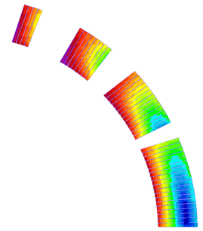
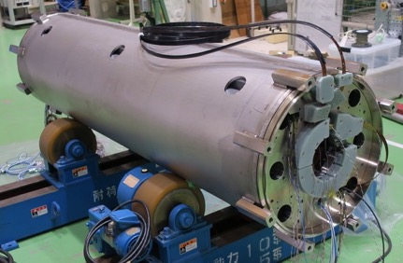
Design parameters
GFRP
wedge
Collar
 | prototype, series production (7m)
Coil aperture | 150 mm
Field integral | 35 T m
Field (3D) | Nominal: 5.60 T, Ultimate: 6.04 T
Peak field (3D) | Nominal: 6.58 T, Ultimate: 7.14 T
Current | Nominal : 12.11 kA, Ultimate 13.23 kA
Operating temperature | 1.9 K
Field quality | <10⁻⁴ w.r.t B₁ (R_{ref}=50 mm)
Load line ratio (3D) | Nominal: 76.5%, Ultimate: 83.1% at 1.9 K
Differential inductance | Nominal: 4.0 mH/m
Conductor | Nb-Ti: LHC-MB outer cable
Stored energy | Nominal: 340 kJ/m
Magnetic length | 6.26 m
Coil mech. length | 6.58 m
Magnet mech. length | 6.73 m
Heat load | 135 W (Magnet total) 2 mW/cm³ (Coil peak) > 25 MGy
Radiation dose
Shell
Nb-Ti/Cu coil
Yoke
QPH
Insulation
Brass shoe
4
8
12 ton
13
4 blocks
44 turns
19
Large-aperture single layer coil → Mechanical support of a coil is challenging
Three 2 m model magnets were developed at KEK.

Slide 4
Powering Tests of Full-scale D1 Magnets
MBXFP1: June – Sep. 2021
  The magnet reached 106 % of I_{nom} but training up to the ultimate current (108 % of I_{nom}) was NOT demonstrated due to test facility limitation.
  The coil cross section was NOT fully optimized since the cable thickness was deviated from the original one for the 2-m models.
MBXF1: April – June 2023
  Upgrade of test facility allowing the powering tests up to the ultimate.
  The coil cross section for the series magnet was redesigned and the improved FQ is qualified by the MFM of MBXF1.
MBXF5: Oct. – Dec. 2023
  The cold powering test has been suspended due to the trouble of the test facility.
  The revolution indicator of the cold turbine has been repaired. Commissioning is being carried out until Oct. 6. Cooling of MBXF5 is anticipated at Oct. 9.
MBXF2: early 2024

Slide 5
Upgrade of Test Facility

Slide 6
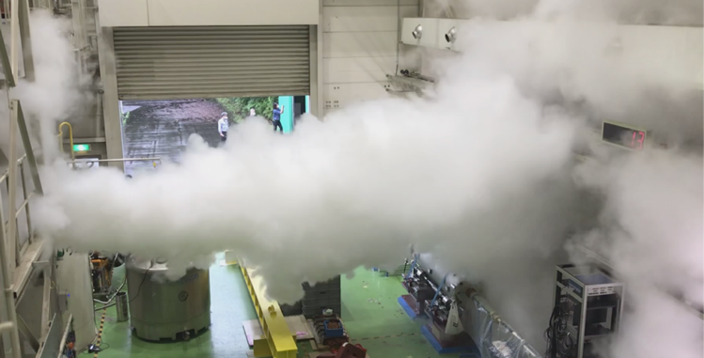
Remaining Issues in KEK Test Facility after MBXFP1 Powering Test
Training quench up to the ultimate current (13.2 kA) was NOT demonstrated in the powering test of MBXFP1 due to limitation of the test facility…
Original energy extraction using dump resistors of 25 mΩ or 50 mΩ up to the cold powering test of MBXFP1.
  25 mΩ: Insufficient energy extraction resulted in incomplete helium gas recovery.
  50 mΩ: The maximum voltage exceeded the allowable limit of 600 V for the
  DCCB of the power converter. Training test above 106% of the nominal
  current could not be performed.
Targets of new facility
  Maximum voltage below 600 V at the ultimate current.
  Magnet dissipation energy below the safety limit of 1.5 MJ.
  Increase of helium gasbag capacity.
To satisfy these targets, new energy extraction using varistors and the additional helium gasbag were implemented before the cold test of MBXF1.

Slide 7
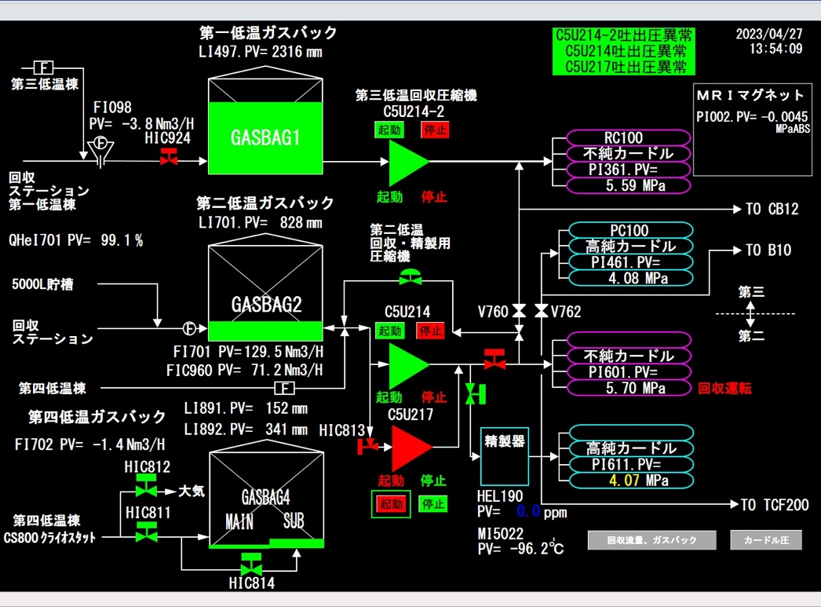
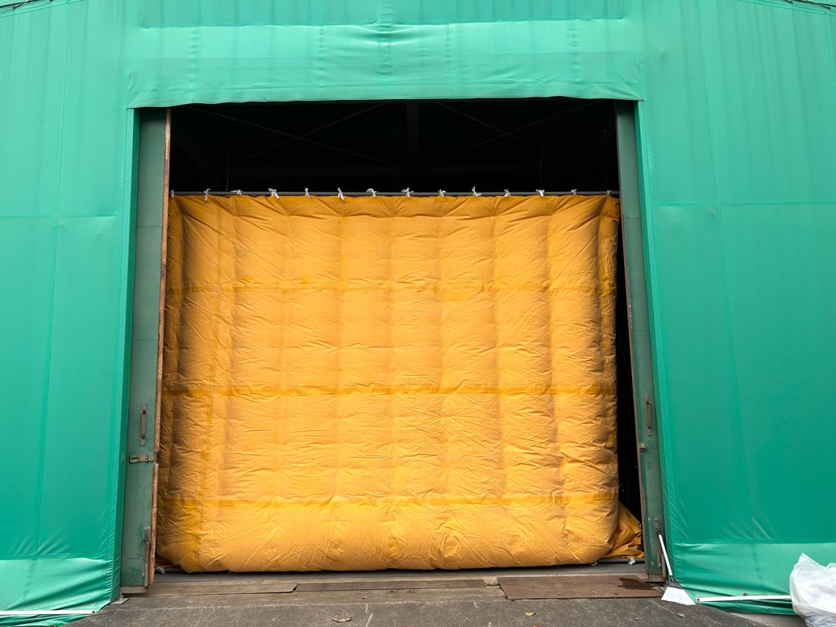
Additional Helium Gas Storage Bag
New Helium gasbag (#40-sub, 40 m³):
  construction and system commissioning completed in March 2023.
In operation for MBXF1 powering test.

Slide 8
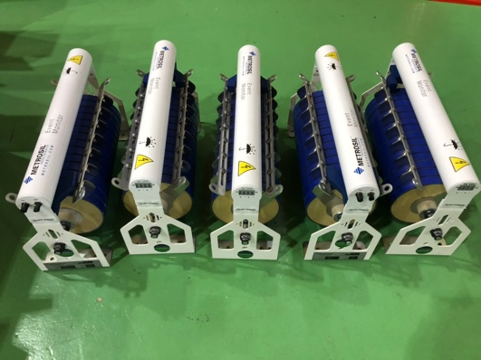
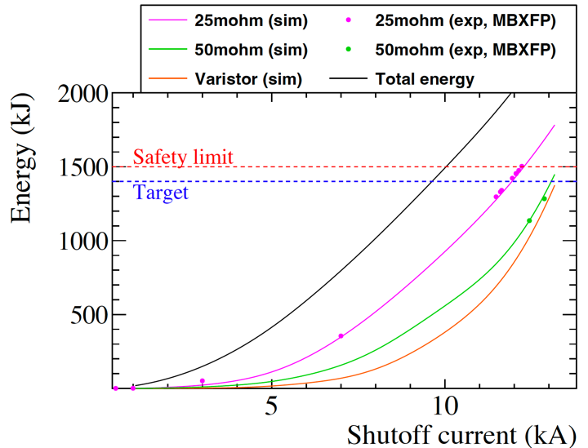
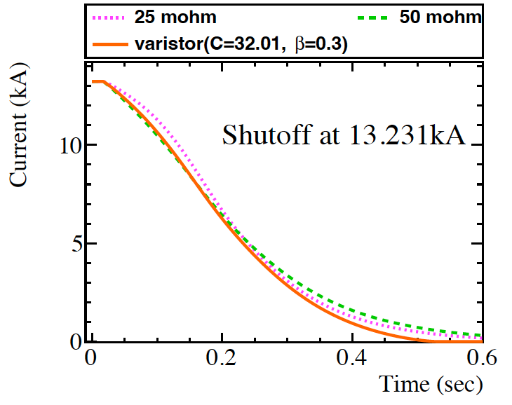
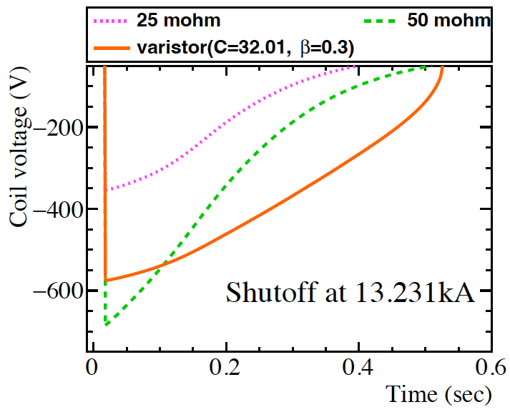
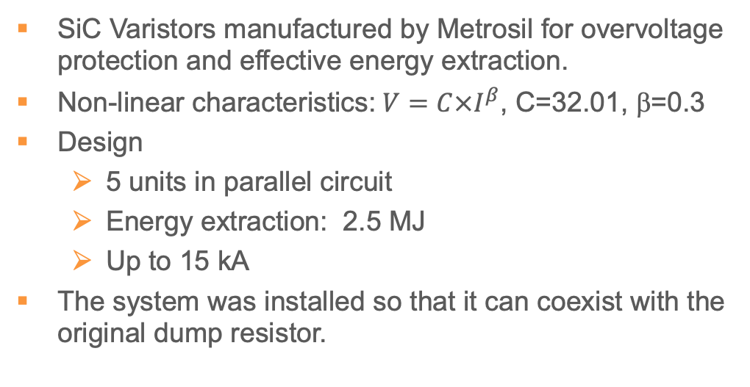
New EE with Metrosil Varistors
SiC Varistors manufactured by Metrosil for overvoltage protection and effective energy extraction.
Non-linear characteristics:$V=C×I^{β}$, C=32.01, β=0.3
Design
  5 units in parallel circuit
  Energy extraction: 2.5 MJ
  Up to 15 kA
The system was installed so that it can coexist with the original dump resistor.

Slide 9
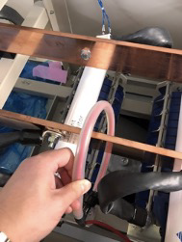
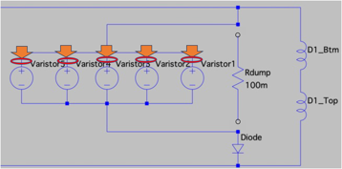
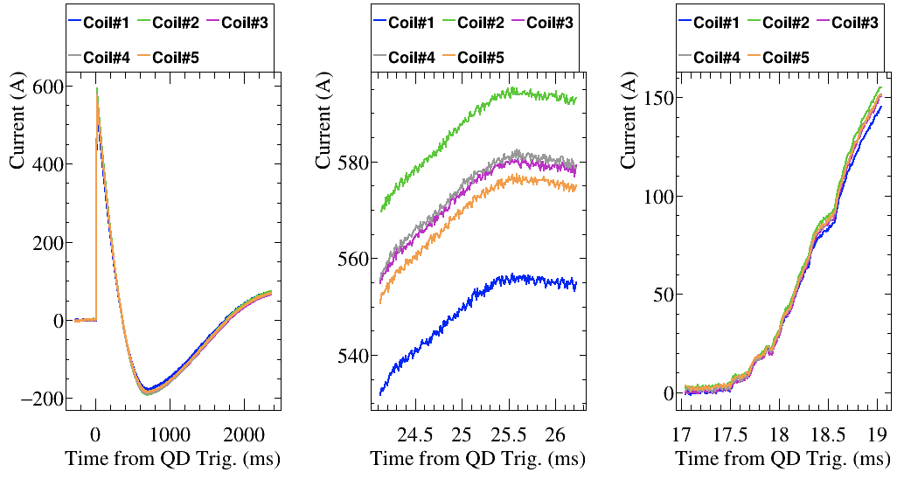
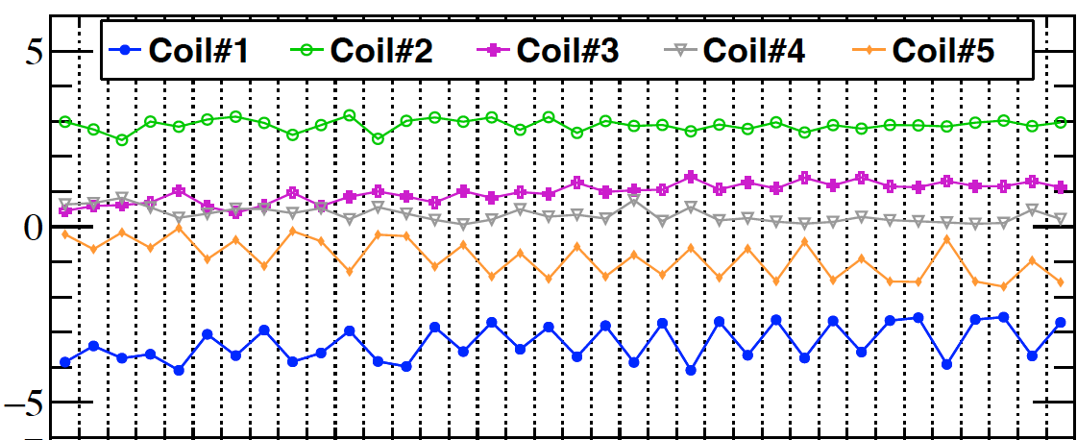

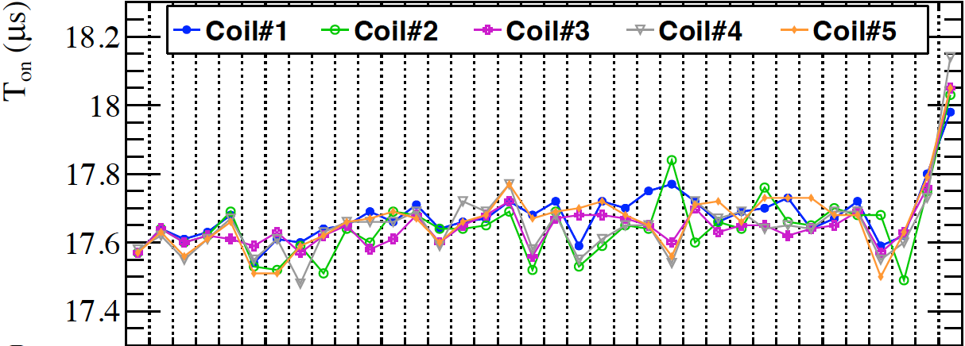
Validation of EE System with Varistors
Signals from Rogowski coils and temperature of SiC disks has been monitored every shutoff/quench event to check indication of imbalance.
Before powering to higher current, we performed 3kA shutoff to check reproducibility.
Current imbalance?
Turn-on time?
Turn-on time
Peak current
A typical dumped current waveforms reconstructed by Rogowski coils and integrators.
Run #
Current imbalance at peak was found to be reproducible within ± 4%
Turn-on time among the varistor units : < 0.3 msec.
Stable operation of Varistors was confirmed.

Slide 10
Test Results of MBXF1
- Training Quench -
The detailed reports at WP3 meeting
https://indico.cern.ch/event/1290076/

Slide 11
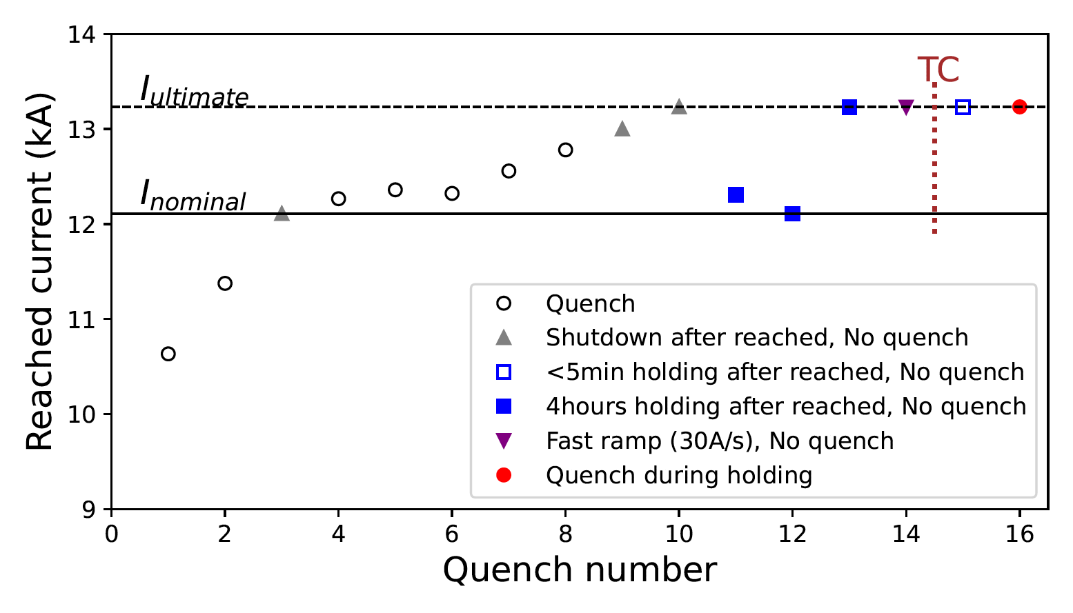
Quench Training of MBXF1
Temperature: 1.9 K
Ramp rate: 12 A/s or 30 A/s
Quench detection: 0.1 V, 10 msec
Quench protection: QPH and varistor
Quench start location: quench antenna
Nominal current (I_{nominal}, 12.11 kA) : 2 quenches
Ultimate current (I_{ultmate}, 13.231 kA) : 7 quenches
Furthermore NO quench was required to reach I_{ultmate} after the thermal cycle
The last quench at I_{ultmate} occurred during the long holding test (4 hours)
First achievement of the ultimate current rating for the full scale magnet
with an excellent training memory

Slide 12
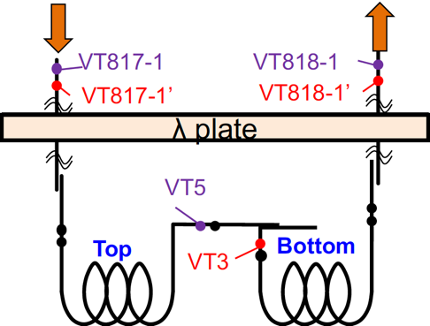
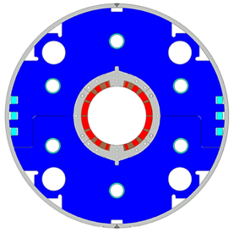
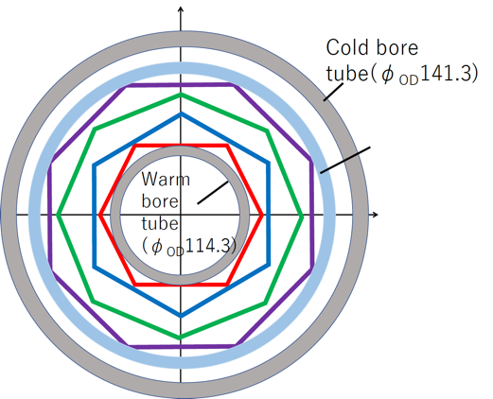
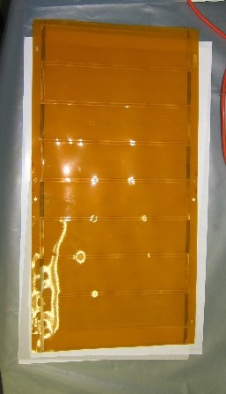
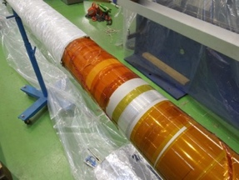
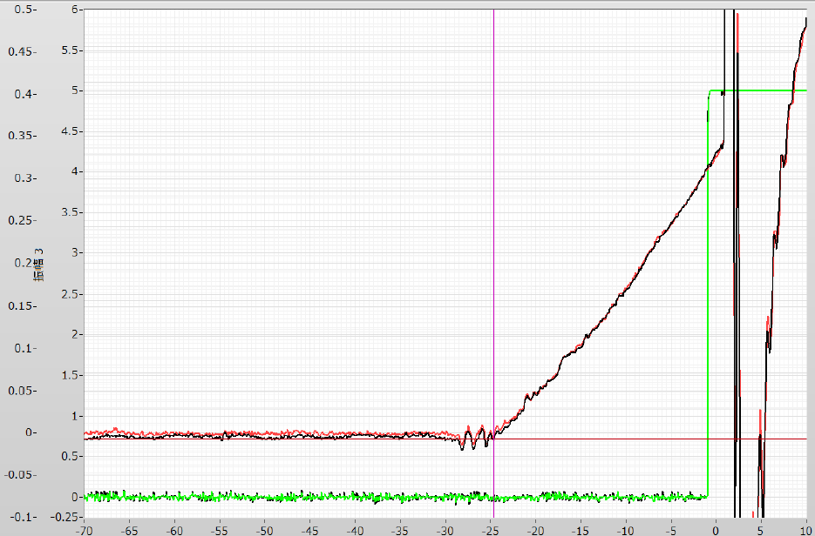
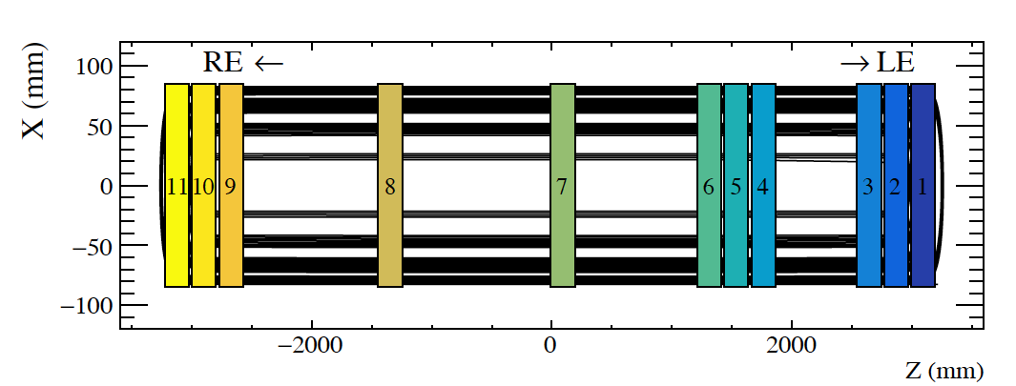
Quench Localization Analysis
Voltage taps
Quench Antenna
Localize either the top or bottom coil
Localize both longitudinal and azimuthal position
363
Vbal1 = (<VT817-1> – <VT5>) – (<VT5>-<VT818-1>)
Skew octupole (8S)
Normal octupole (8N)
Skew sextupole (6N)
Normal sextupole (6S)
Vbal2 = (<VT817-1’> – <VT5>) – (<VT5>-<VT818-1>)
180
QD trig.
0.4
0.3
Balance voltage (V)
Vbal1,2
0.2
0.1
0
-60
-40
-20
0
11 antennas are distributed along the magnet axis
Time (ms)

Slide 13
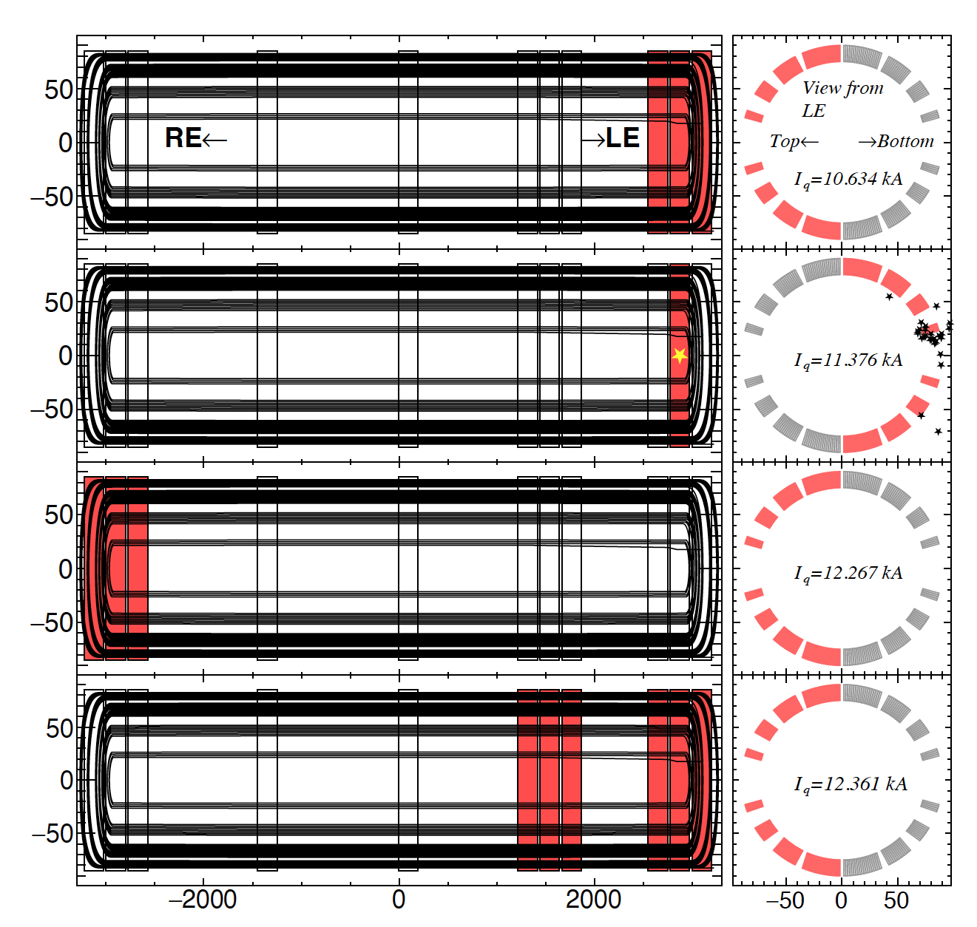
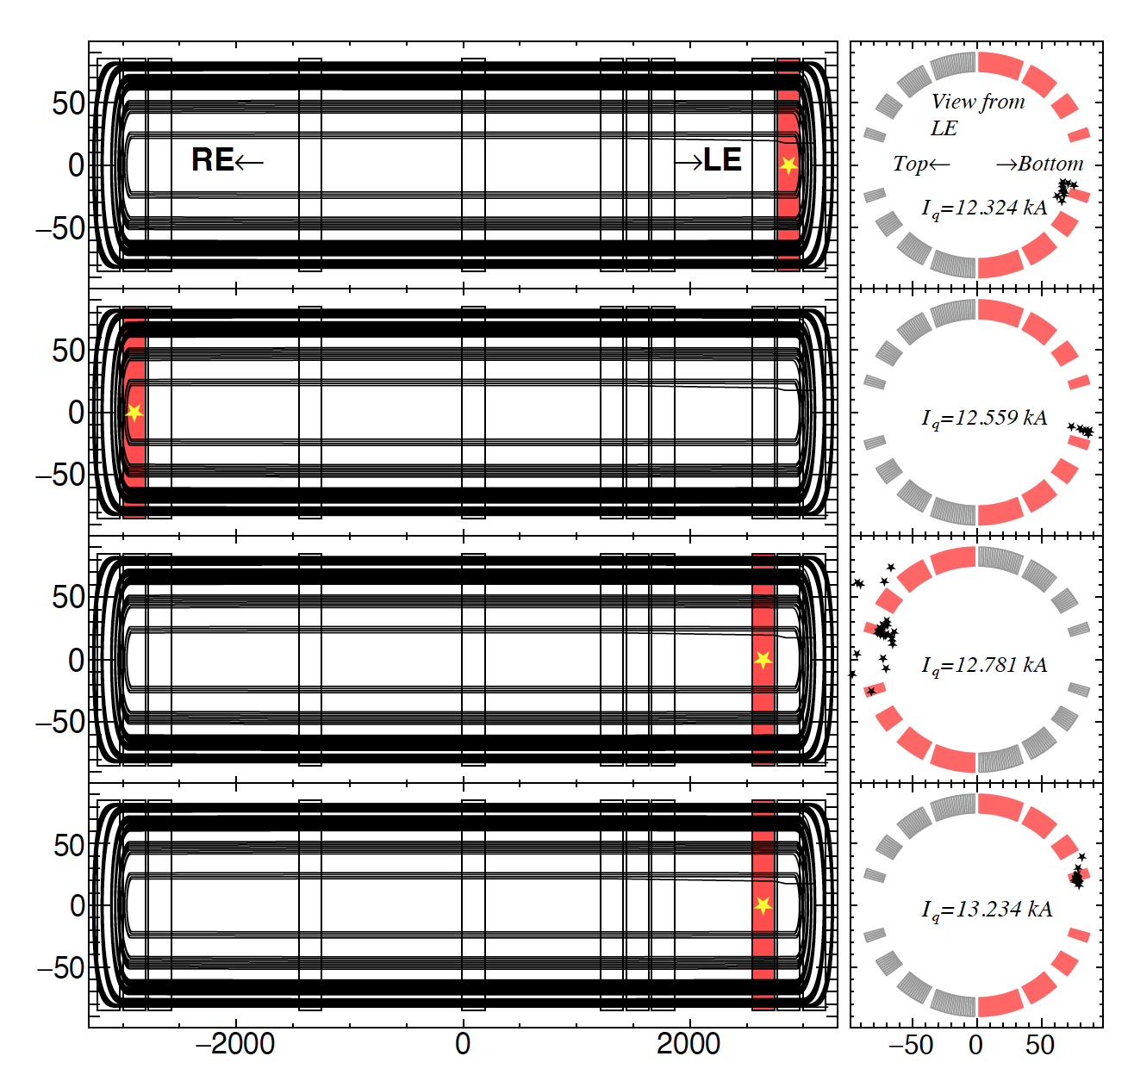
Quench Location
#1
#5
Identified
#2
Identified
#6
Identified
#3
#7
Identified
#4
#8
Identified
Quench location changed event by event, indicating the magnet has no specific weak point

Slide 14
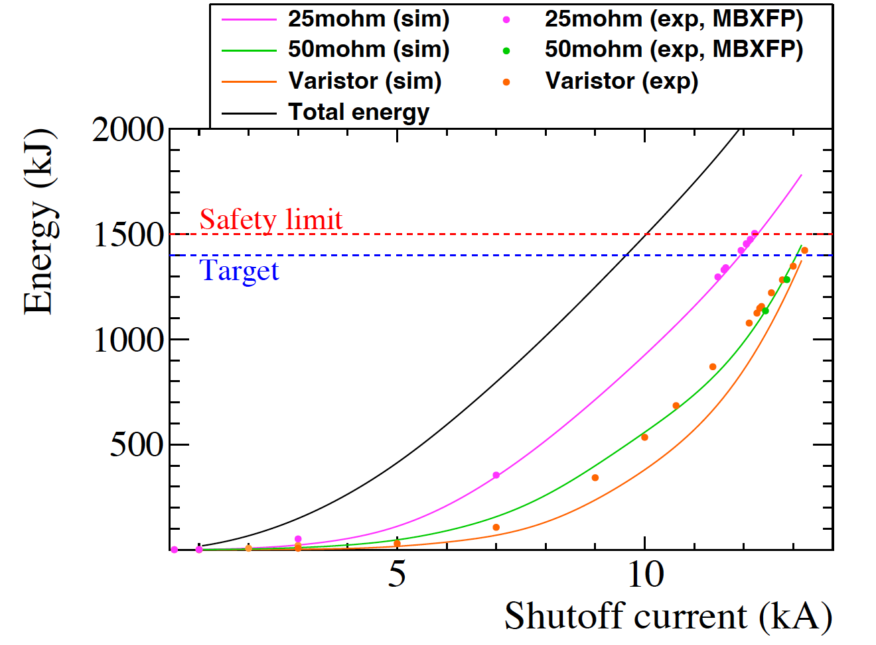
Energy Curve / Helium Gas Recovery
Capacity of He gas bag
Shutdown
at I_{ultimate}
Varistor: discrepancy observed between the simulation (design) and measured data but an amount of energy dissipated in the magnet is always below ~1.4 MJ
All evaporated helium gas was successfully recovered.

Slide 15
Test Results of MBXF1
- Field Quality -

Slide 16
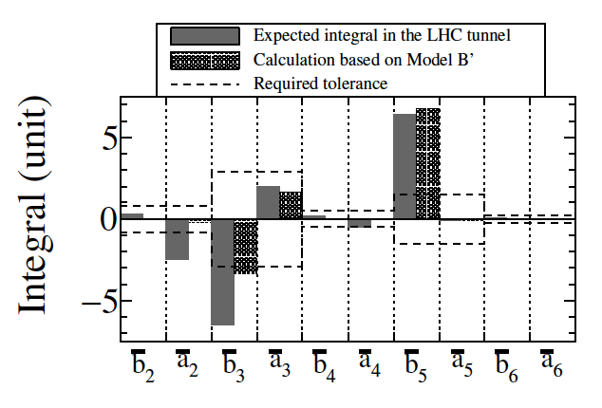
Remarks on the MBXFP1 Test – Field Quality
K.Suzuki et al. IEEE TASC vol.32, no.6 Sept 2022, 9000407
 | Parameters for MBXFP | Parameters for Series
φ1 | 1.1238 | 1.1680
φ2 | 28.0254 | 27.8471
φ3 | 50.6798 | 50.3830
φ4 | 71.1408 | 70.7156
α2 | 27.3545 | 27.5527
α3 | 52.2239 | 52.5639
α4 | 68.7646 | 70.3048
Azimuthal insulation thickness (mm) | 0.1297 | 0.1297
MBXFP1:
  Compromised model was adopted due to the time restriction etc.
  Measured b₃ and b₅ are out of tolerances.
The series magnet (MBXF1-)
  We completed design study and optimized parameters are adopted.

Slide 17
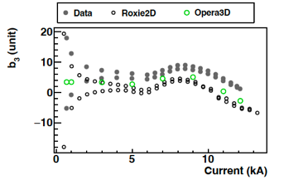
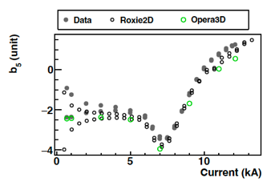
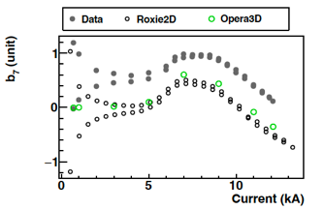
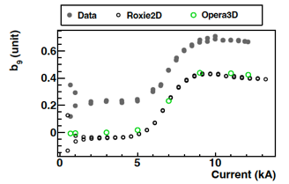
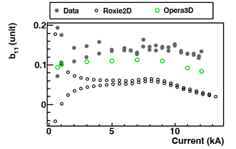
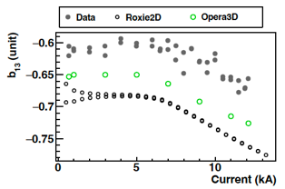
DC loop at the Z center for allowed normal (n=3-13)
- MBXF1 -
Measured b₃ differs from the calculation by < 4 unit at I_{nominal} (12.11 kA).
For other allowed multipoles, measurement agrees with the calculation within 0.5 unit.

Slide 18
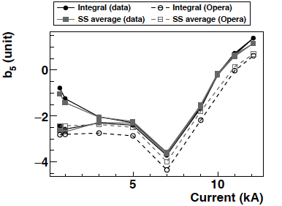
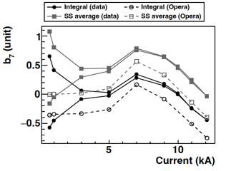
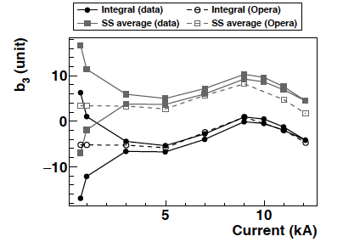
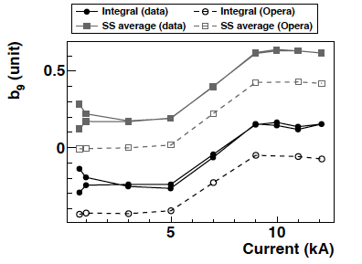
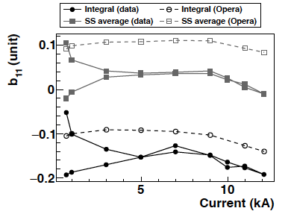
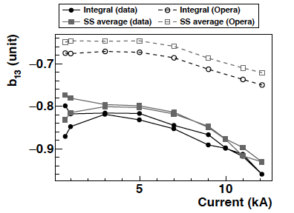
Integral DC loop for allowed normal (n=3-13)
- MBXF1 -

Slide 19
FQ table of MBXF1 for I_{nominal} (12.11kA)
RE: -3353 mm - -2853 mm
SS: -2853 mm - 2648 mm
LE: 2648 mm - 4148 mm
Central: -250 mm - 250 mm

Slide 20
Effect of Ferromagnetic Environment on FQ of D1
w/o Cryostat | KEK pit | CERN cryostat
Horizontal bench | Vertical test stand - Off-centered by 150mm | Used for design - Centered*
(*) Actual cryostat is off-centerd by 54mm
but not taken into account for our design
b₃ vs longitudinal pos.
~6 units

Slide 21
b₃ Summary
Error band defined by comparison between proto. and simulation

Slide 22
b₅ Summary

Slide 23
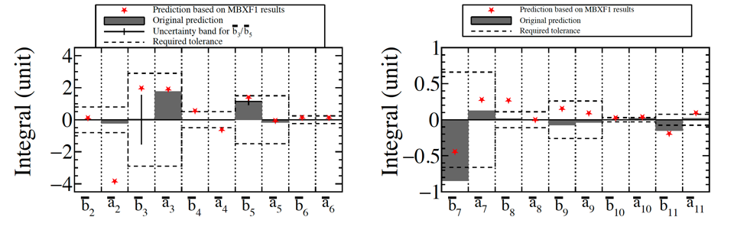
Predicted FQ (Integral) in the LHC cryostat
- MBXF1 -
Note: difference of ferromagnetic environment between KEK test stand and LHC cryostat.
From the obtained field quality in the KEK cryostat, we estimated the actual field quality predicted in the LHC cryostat.
  Requirements will be fulfilled in most of the harmonics.
MFM of the D1 prototype cold mass at SM18 will be crucial to confirm the effect of the LHC cryostat on FQ.

Slide 24
Summary of Construction of D1 Cold Mass

Slide 25
Flow of D1 Cold Mass Production
PV: Pressure Vessel
5 cap welding for prototype,
installation of tubes (BT, HXT)
final splice, instrumentation
end-cover & extremities welding
alignment & support welding
1 coil winding
2 insulation, collaring
HITACHI
3 yoking
inspection incl. pressure test (@ 2.5 MPa)
HITACHI
4 shell & end-ring welding, end-plate, splice. Alignment target welding, cap welding for series, alignment meas.
KEK
SSW
Rotating coil
warm MFM
HP: readiness of shipping, documents.
CERN HP
vertical cold test
KEK
shipping to CERN
Training Quench
MFM at cold
CERN
SSW
Rotating coil
Cryostating
Horizontal cold test
warm MFM

Slide 26
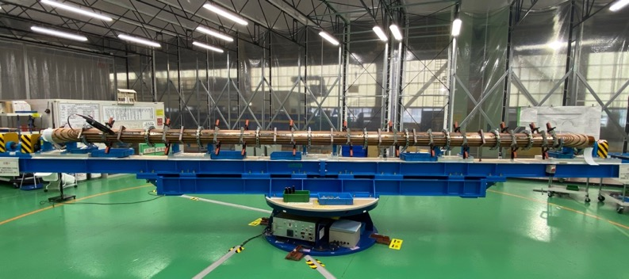
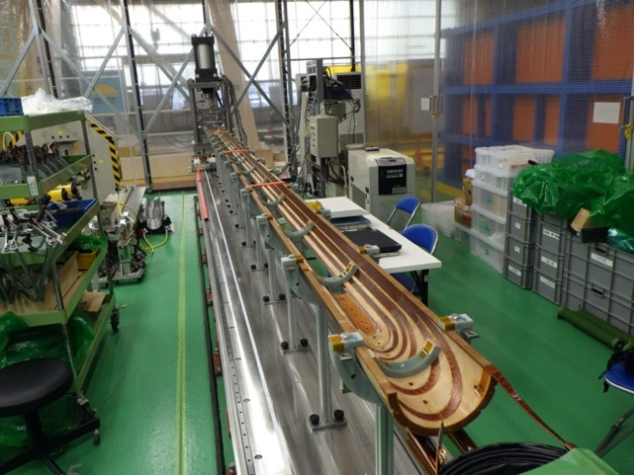
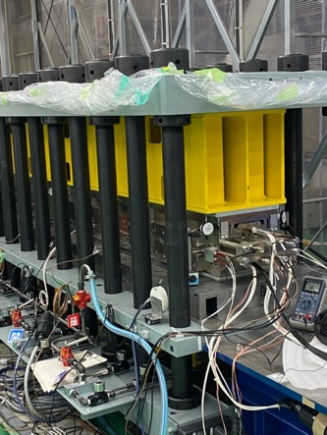
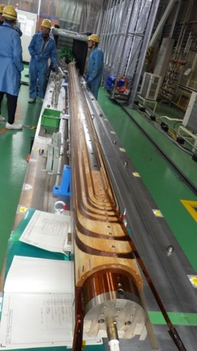
Manufacturing of D1 Magnet
Coil size measurement system
Control of the coil size is crucial for the D1
- to attain the sufficient preload for the training performance, and
- not to exceed the mechanical limit of insulation.

Slide 27
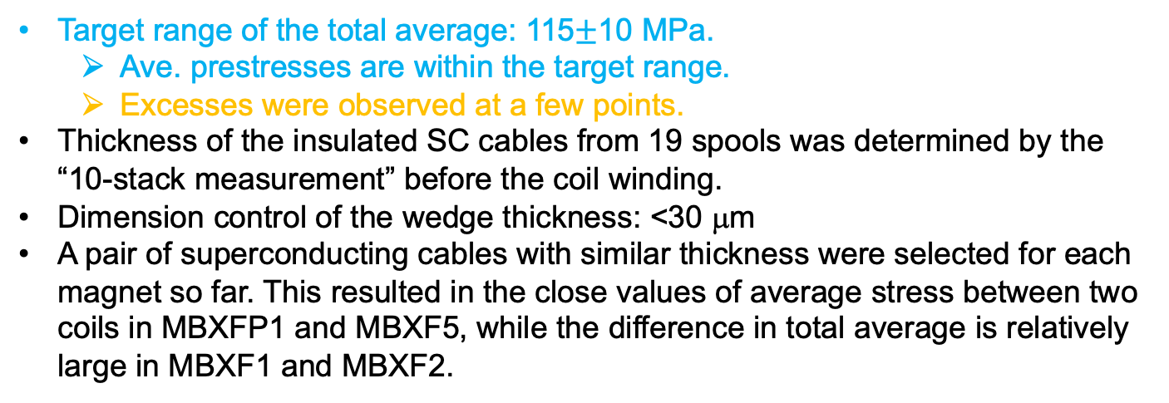
Summary of results of coil size measurement
Magnet | Coil | Average 20 pts (MPa) | Max value (MPa) | Min value (MPa) | Standard deviation (MPa) | Cable thickness (44 stack) wrt S2-4 cable (mm)*
MBXFP1 Tested | LPT-1 | 112 | 116 | 106 | 2.0 | 0.262
 | LPB-1 | 110 | 113 | 108 | 1.4 | 0.256
MBXF5 | LT-1 | 122 | 125 | 119 | 1.5 | 0.418
 | LB-1 | 122 | 125 | 118 | 1.8 | 0.422
MBXF1 Tested | LT-2 | 117 | 120 | 114 | 1.3 | 0.397
 | LB-2 | 125 | 128 | 112 | 1.6 | 0.403
MBXF2 | LT-3 | 123 | 127 | 119 | 1.9 | 0.321
 | LB-3 | 117 | 122 | 114 | 1.9 | 0.327
Target range of the total average: 115$±$10 MPa.
  Ave. prestresses are within the target range.
  Excesses were observed at a few points.
Thickness of the insulated SC cables from 19 spools was determined by the “10-stack measurement” before the coil winding.
Dimension control of the wedge thickness: <30 μm
A pair of superconducting cables with similar thickness were selected for each magnet so far. This resulted in the close values of average stress between two coils in MBXFP1 and MBXF5, while the difference in total average is relatively large in MBXF1 and MBXF2.

Slide 28
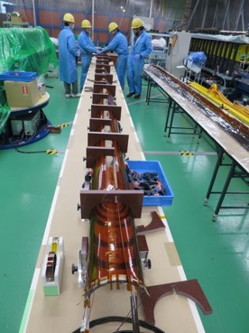
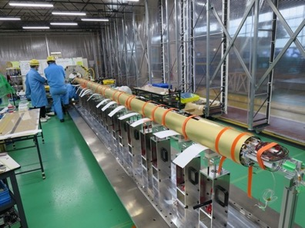
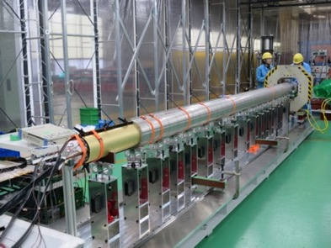







Manufacturing of D1 Magnet
QPH, ground insulation
wrapping
Top/bottom coil assembly
Brass shoe assembly
Collaring
Collared coil on bottom yoke
Yoking
Removal of collaring mandrel
Shell welding
Welding of alignment markers
End ring welding

Slide 29





Manufacturing of D1 Magnet
Axial compression on SC coils
Splice work and bus-leads

Slide 30
Flow of D1 Cold Mass Production
PV: Pressure Vessel
5 cap welding for prototype,
installation of tubes (BT, HXT)
final splice, instrumentation
end-cover & extremities welding
alignment & support welding
1 coil winding
2 insulation, collaring
HITACHI
3 yoking
inspection incl. pressure test (@ 2.5 MPa)
HITACHI
4 shell & end-ring welding, end-plate, splice. Alignment target welding, cap welding for series, alignment meas.
KEK
SSW
Rotating coil
warm MFM
HP: readiness of shipping, documents.
CERN HP
vertical cold test
KEK
shipping to CERN
Training Quench
MFM at cold
CERN
SSW
Rotating coil
Cryostating
Horizontal cold test
warm MFM

Slide 31









Manufacturing of D1 Cold Mass
Extremities welding
SC bus leads and “spider”
Insertion of CBT
Insertion of HXs
Welding of end-dome, end cover
IFS assembly
Completed D1 cold mass
Welding of saddles

Slide 32
Non-Conformities
Closed
In work
Welding Qualification
  EDMS 2469433: Invalid Qualification Result of Fatigue Pre-cracking Requirement for 4 K Fracture Toughness Test of PQR2 HAZ Specimen for the D1 Cold Mass Manufacturing, Non-critical
MBXFP1
  EDMS 2426526: Deformation of SC cable due to over-tension, Non-critical
  EDMS 2437654: Small crack at GFRP ramp-box of LPT-1 Coil, Non-critical
  EDMS 2443118: Insulation Damage after Curing of D1 Prototype Bottom Coil, Non-critical
  EDMS 2464985: Partial Damage of Ground Insulation, Non-critical
  EDMS 2581587: Weld Defect of the D1 Cold Mass Prototype (end-cover), Non-critical
  EDMS 2595209: Crane Incident at KEK, Non-critical
  EDMS 2731453: Partial peeling of surface insulation of cryo-heater wire for MBXFP1, Non-critical
  EDMS 2753741: Partial peeling of surface insulation of QPH wire for MBXFP1, Non-critical
  EDMS 2753742: Weld Defect of Joint G-2 of MBXFP1, Non-critical
  EDMS 2753743: Weld Defects of Joints I-L2 and I-R2 of MBXFP1, Non-critical
  EDMS 2753744: Weld Defect of Joint D of MBXFP1, Non-critical
  EDMS 2753745: Out of Tolerance of the Length of the D1 Cold Mass Prototype, Non-critical
  EDMS 2753746 Out of Tolerance of the Transversal Positions of the Extremity Pipes of the D1 Cold Mass Prototype, Non-critical
MBXF5
  EDMS 2753776: Insulation damage of inner surface of MBXF5 coils, Critical
  EDMS 2913654: Weld Defect of the D1 Cold Mass (MBXF5): B-2 Joint, Non-critical
MBXF1
  EDMS 2955218: Cable deformation at coil end after cold test in MBXF1
MBXF2
  EDMS2863016: Insulation damage in the top coil for MBXF2, Non-critical
  EDMS2912993: Insulation damage of the bottom coil for MBXF2, Non-critical
Coil
Welding
Wiring
Welding
Removal of collaring mandrel
Welding
Test/Coil
Coil

Slide 33




Major NC in Manufacturing of MBXF5
Recall
EDMS 2753776
LT-1 and LB-1 coils for MBXF5 were completed.
  Estimated coil pre-stress: Good.
    LB-1: L120.7 (L) & 122.9 (R), LT-1: 121.7 (L) & 122.2 (R) (unit: MPa).
    EDMS 2724784
All components for the magnet were already fabricated.
Collaring and yoking processes were successfully done in June 2022.
NC: potential coil insulation damage was found after removal of the collaring-mandrel. EDMS 2753776.
  Investigation is underway.
Flat rollers
Spacers more than plan were removed from the RE side and the coil were exposed to the flat-rollers…

Slide 34
Repair of MBXF5 Coils
EDMS 2753776
Closed
After repair of the damaged insulation
Electrical soundness of the repaired coils was validated by electrical test (coil resistance, inductance, impulse test at 1.3 kV).

Slide 35

Cable deformation at coil end of MBXF1 after cold test
EDMS 2955218
Height: 1~1.5mm
Insertion of Go/No-go gage (OD: 146.2mm) was confirmed.
After the cold test of MBXF1 at KEK, the inner bore of the magnet was visually inspected. As a result, cable deformation towards the coil bore was found at both coil ends, around the innermost turn of the coil block (CB)-1B.
This cable deformation was probably caused by Lorentz force during excitation. The same issue occurred in all the 2 m-long model magnets, but no noticeable cable deformation was observed in the full-scale prototype (MBXFP1) thanks to the modification.
There is a concern that a smaller inner coil diameter can cause trouble in the insertion work of a cold bore tube (CBT).
https://indico.cern.ch/event/848426/ https://indico.cern.ch/event/897298/

Slide 36
Repair Work
EDMS 2955218
KEK is planning to place back the deformed cable mechanically.
A proof-of-principle test was conducted using a CBT welding mandrel and MBXFS2 with the cable deformation (~1 mm) per coil.
The cable was successfully placed back and the vertical inner diameter was increased by 0.7 mm at an estimated vertical force of 22 kN.
Electrical inspection showed no detectable change.
New tooling developed for the repair work
  Max. force: 40 kN
  Stroke: 13 mm
  Longitudinal positioning wrt end plate.
Repair will start in this week.

Slide 37
Status of Construction
MBXFP1: Delivered to CERN in April 2023. Horizontal cold test in October is planned.
MBXF5: After a major NC with coil insulation damages, the magnet was successfully recovered and completed in June 2023. The cold powering test has been suspended due to the trouble of the test facility. The powering test is anticipated in Oct. 2023.
MBXF1: The test result of the cold powering test looks good. The final cold mass assembly at Hitachi is underway. Delivery to CERN as the first series cold mass is anticipated in May 2024.
MBXF2: Coil winding was already started in February 2023 and magnet assembly (yoking) is underway.
MBXF3: Coil winding will be started in October 2023.
MBXF4: Coil winding is planned in 2024.
MBXF6: The deliverables in JFY2023 will be the whole parts needed for the coil winding and the magnet assembly, but NOT including the actual manufacturing work at Hitachi. The coil winding is foreseen in April/May 2024.

Slide 38
Summary
Powering test of MBXF1
  Quench performance
    2 quenches to I_{nominal} and 7 quenches to I_{ultimate}
    No quench was needed to reach I_{ultimate} after the thermal cycle
    No helium loss thanks to the system upgrades
  Field quality
    Comparison of the central field shows Δb_{n≠3} < 0.5 units and Δb₃~4 units.
    The magnetic design in a series magnet was confirmed to be tuned well.
    We expect almost all the harmonics will be within the requirements.
Through the manufacturing experience of the D1 cold mass prototype (MBXFP1), the manufacturing and inspection process have been established.
  Many lessons learnt…
A good collaboration with Hitachi.
Control of the coil parts (wedges, shims, end-spacers) is very crucial for the good training performance.
  Reproducibility of coil fabrication has been confirmed.
Non-conformities
  Major NC of the insulation damages of MBXF5 was closed.
  KEK and Hitachi have a mutual concern about the coil fabrication process causing the several NCs. Preventive actions have been considered and implemented.

