Slide 1




Status of CCT corrector construction and test
Yingzhe Wang
13th HL-LHC Collaboration Meeting, Vancouver (Canada), 25-28 September 2023

Slide 2



Progress of series production
 | Coil name | Winding method | Location | Coil stand-alone performance (4.2 K) | Magnet performance at 4.2 K
MCBRD01 | MCBRD_CB01 | Wet wind | CERN | 530 A | Both apertures reached ultimate current 422 A, and passed 4-hour stability test
 | MCBRD_CB03 | Direct wind |  | 410 A (training stopped due to the availability of the test station)
 | MCBRD_CB02 | Direct wind | CERN | Failed to reach the design current
MCBRD02 | MCBRD_CB04 | Wet wind | CERN | 422 A (training stopped due to the availability of the test station) | Both apertures reached ultimate current 422 A, and passed 4*1 hour stability test
 | MCBRD_CB06 | Wet wind |  | 530 A
MCBRD03 | MCBRD_CB09 | Direct wind with new channel size | CERN | 530 A | Both apertures reached ultimate current 422 A, and passed stability test
 | MCBRD_CB12 | Direct wind with new channel size |  | 526 A (25 quenches)
 | MCBRD_CB14 | Direct wind with new channel size | BAMA | 530 A (30+34 quenches), put in quarantine
MCBRD04 | MCBRD_CB13 | Direct wind with new channel size | IMP | 530 A (20+33 quenches) | Both apertures reached ultimate current 422 A, and other tests will be implemented in the middle of Oct.
 | MCBRD_CB17 | Direct wind with new channel size | IHEP | 524 A (47 quenches) | -
MCBRD05 | MCBRD_CB18 | Direct wind with new channel size | IHEP | The stand-alone test of CB18 and CB19 will be implemented in the middle of Oct. | -
 | MCBRD_CB19 | Direct wind with new channel size | IHEP |  | -
 | MCBRD_CB20 | Direct wind with new channel size | BAMA | Ready for VPI
MCBRD_CB10, 11, 15, 16 |  | Shipped to CERN for fabrication

Slide 3
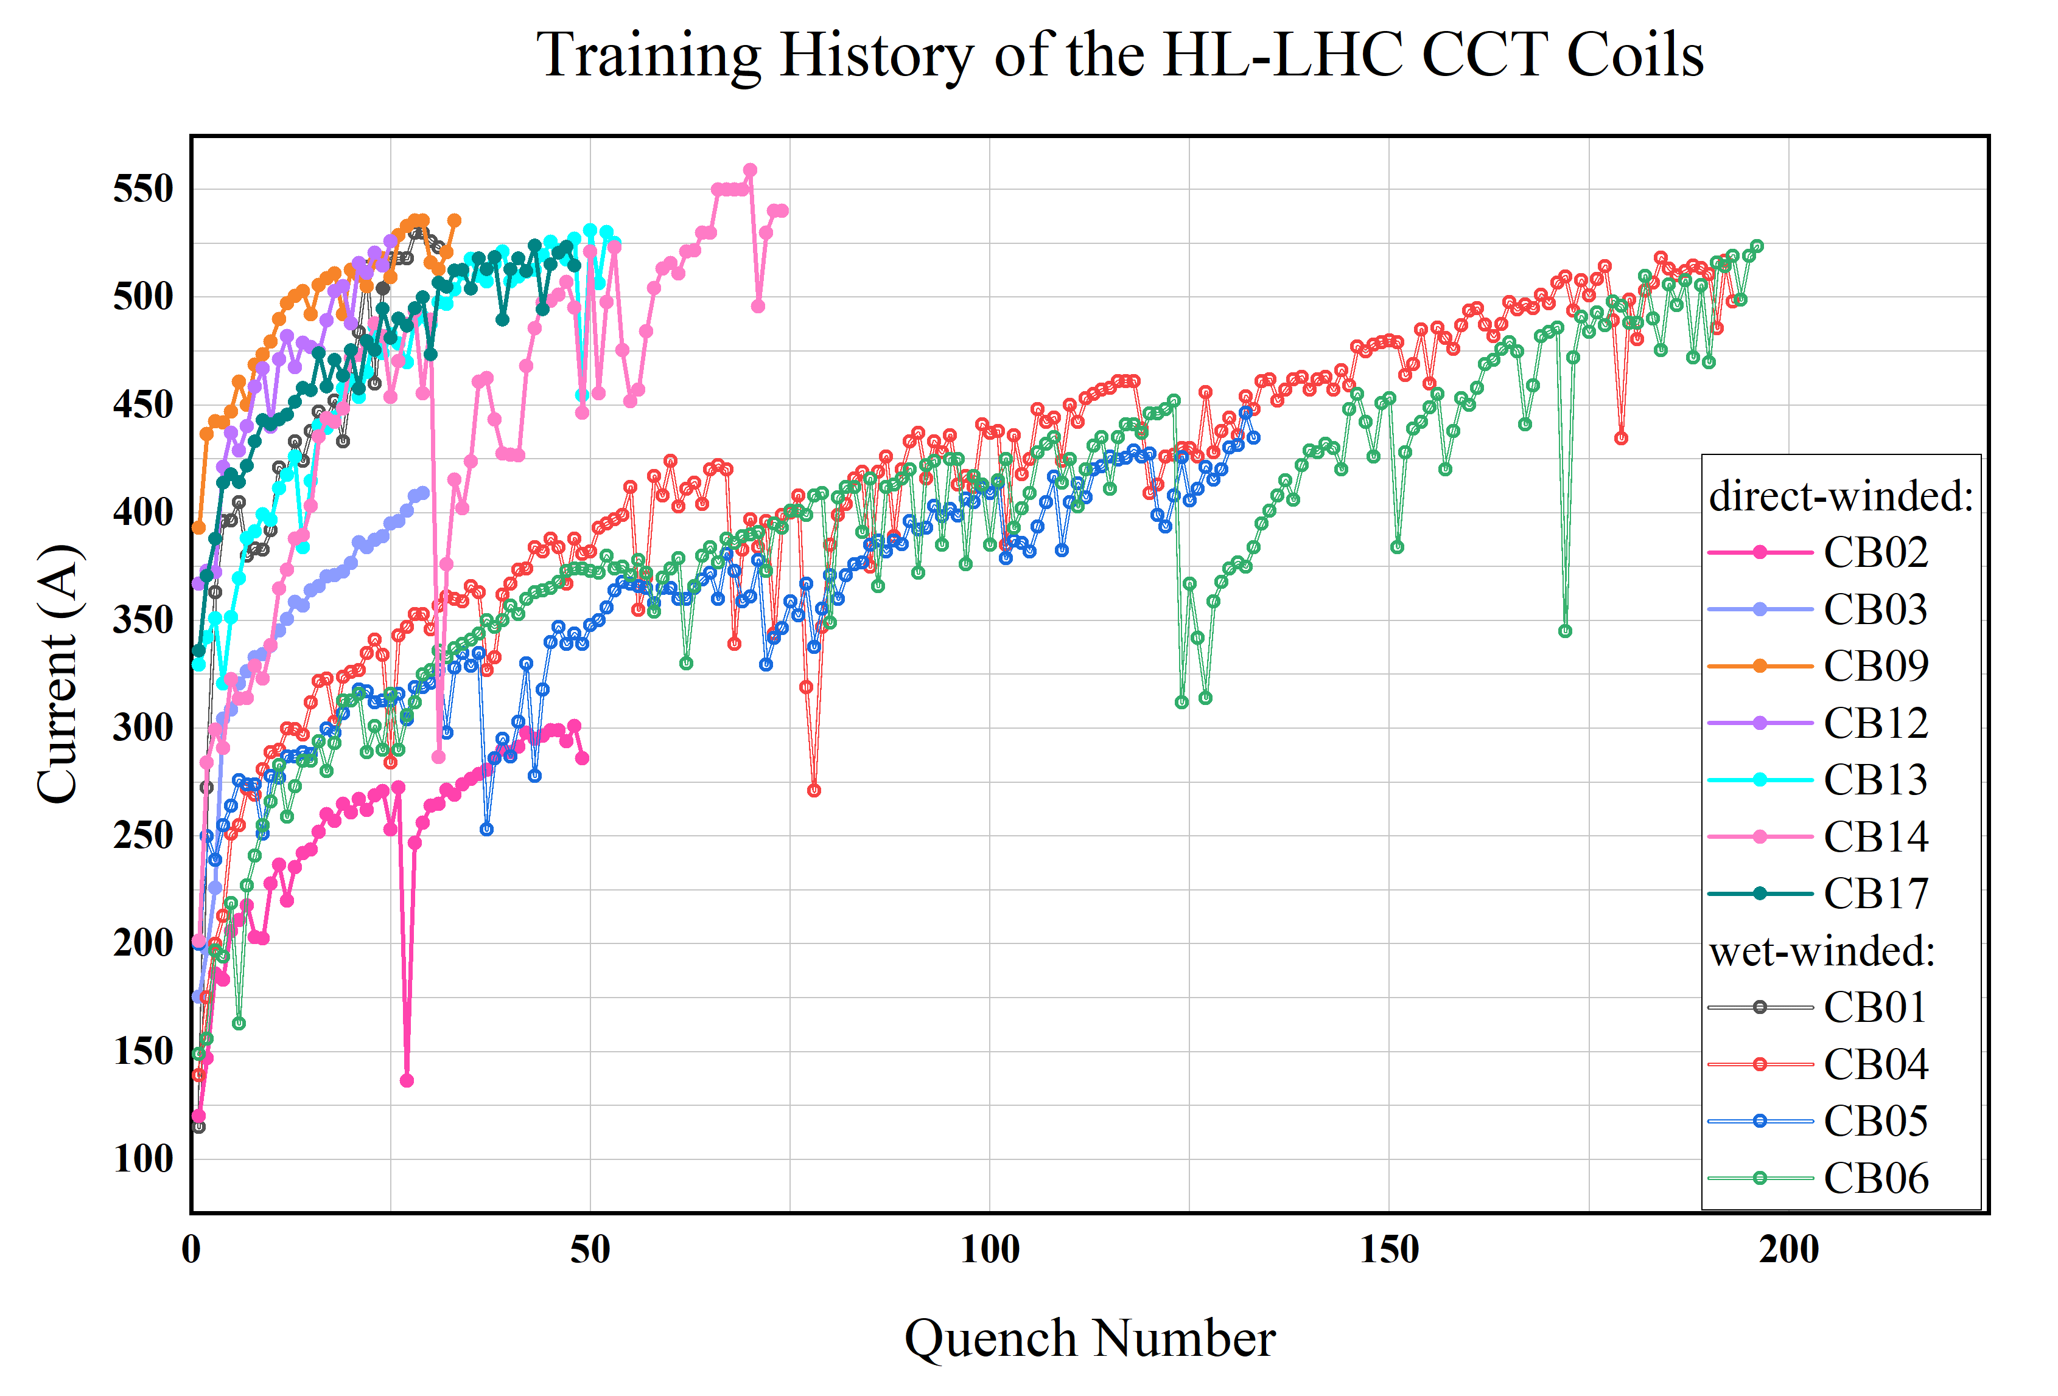
Stand-alone test results of all Apertures
530A

Slide 4
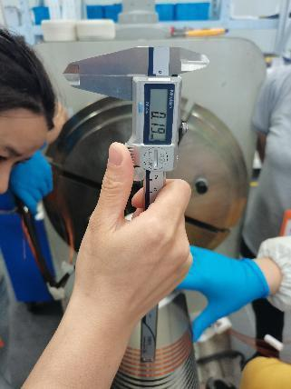
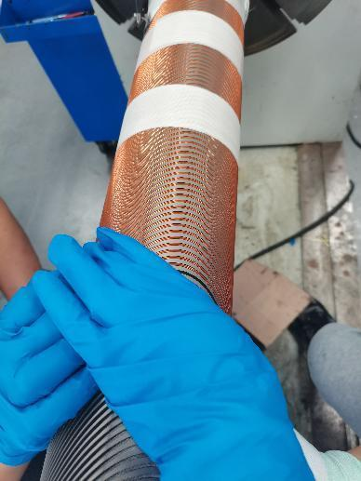
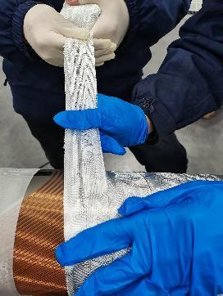
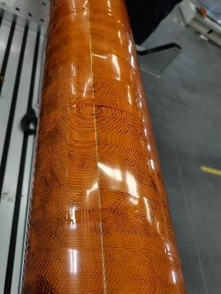
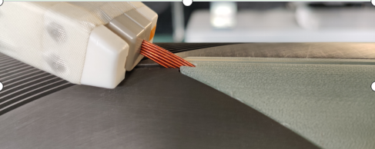
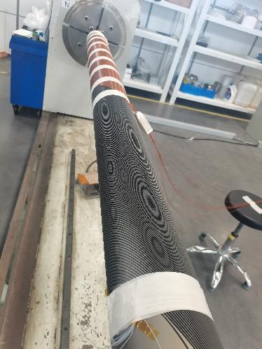
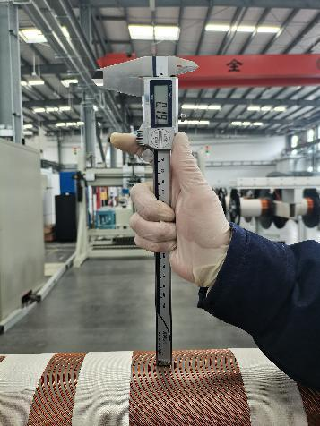
Manufacture of CB14

Slide 5
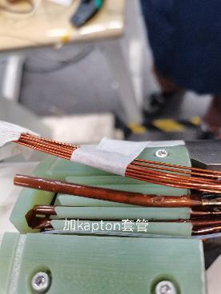
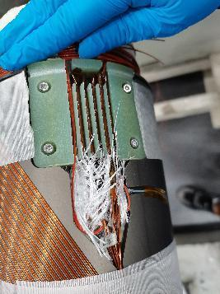
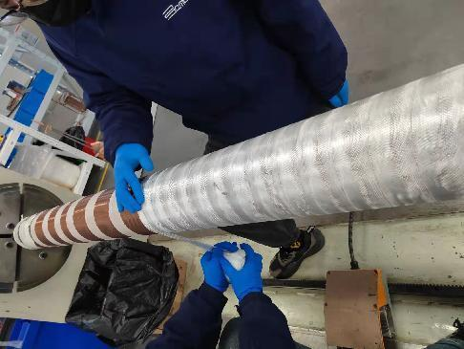
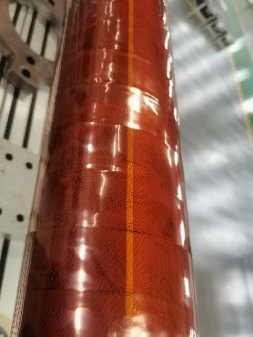
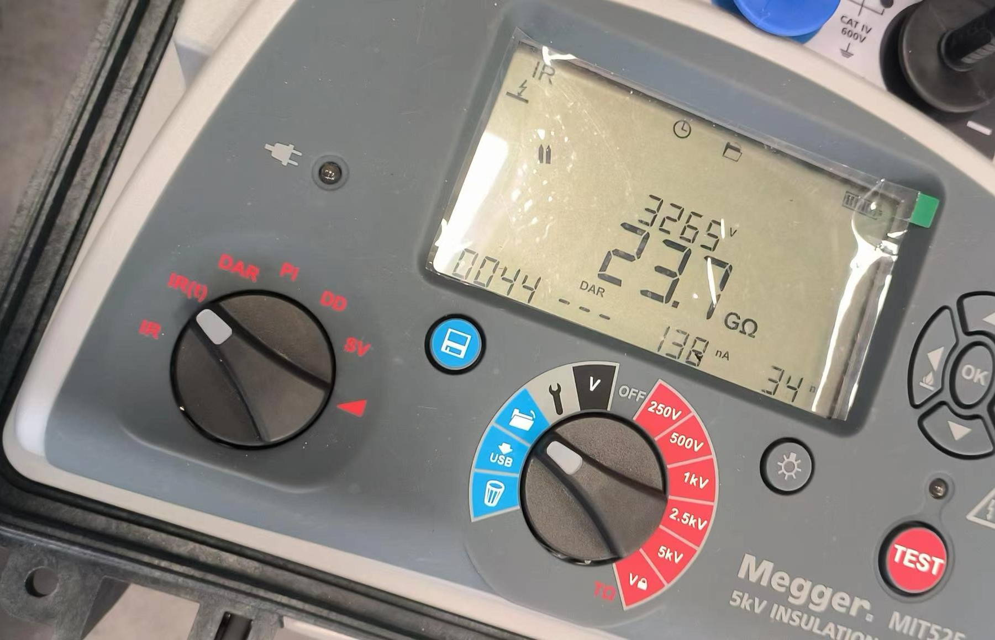
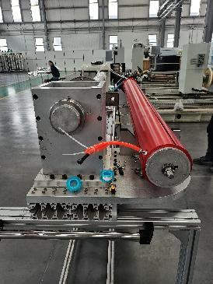
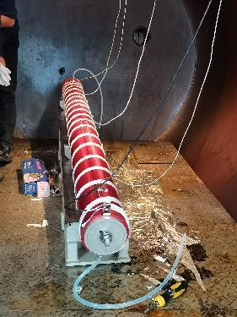
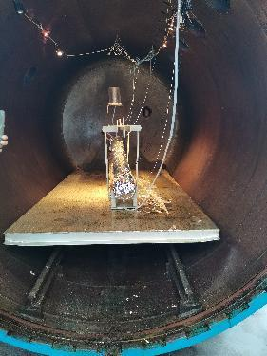
Manufacture of CB14

Slide 6
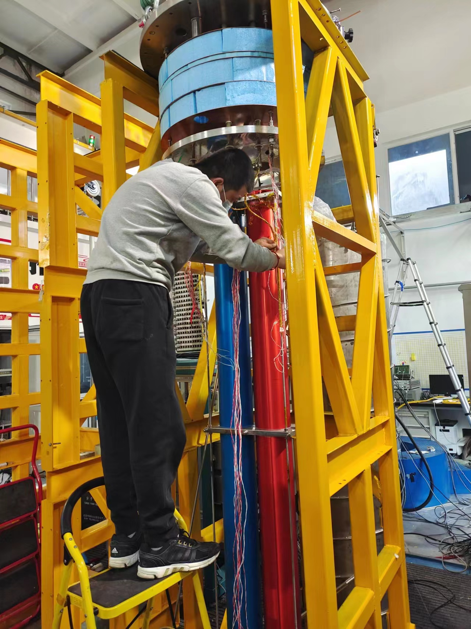
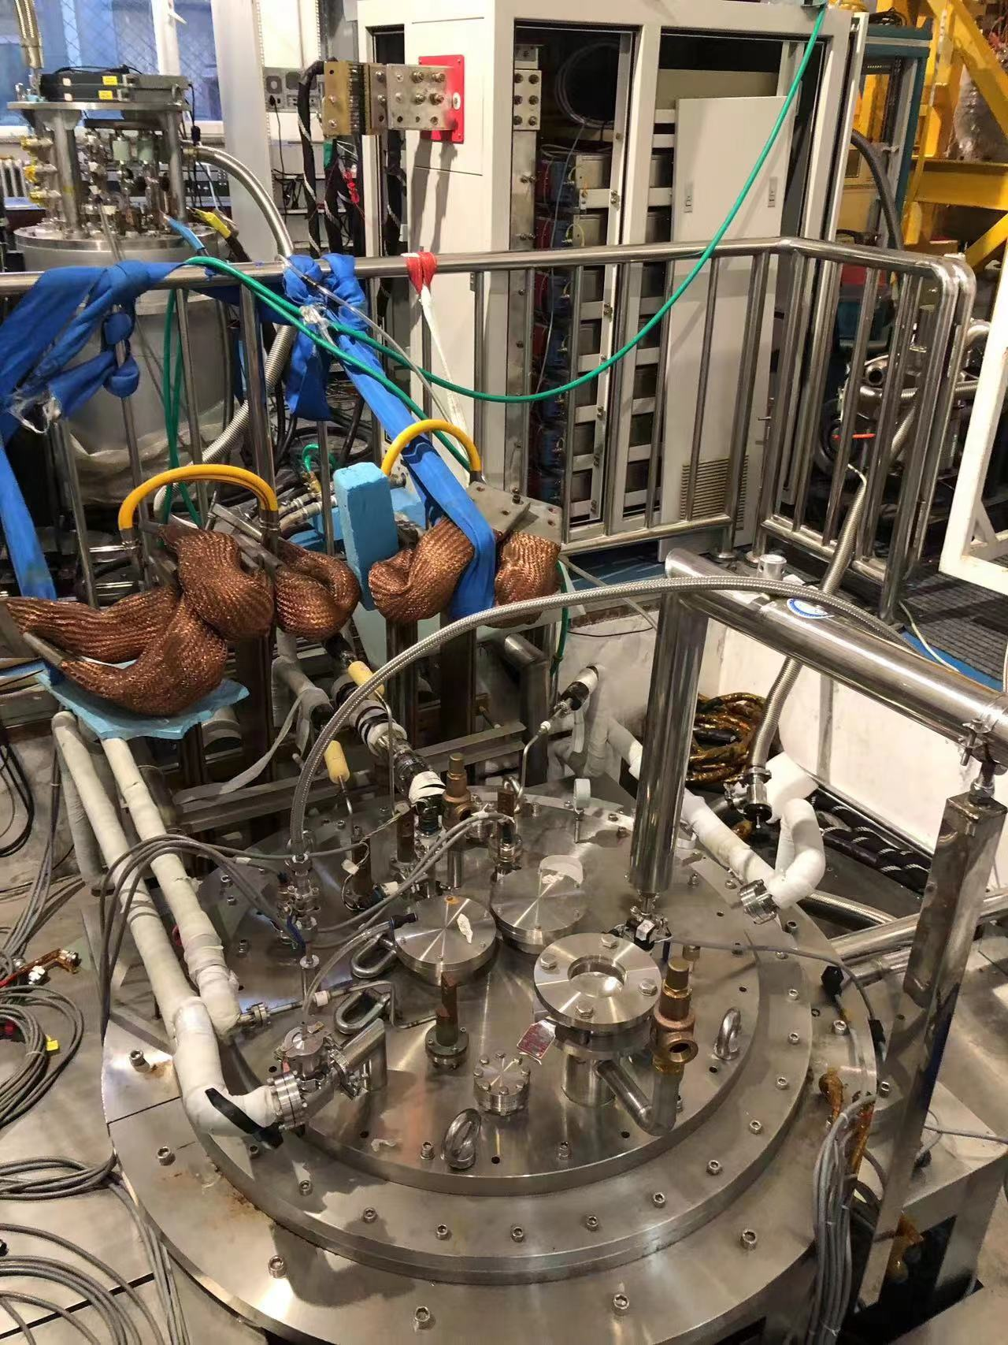
Stand-alone test of CB14 at IHEP

Slide 7
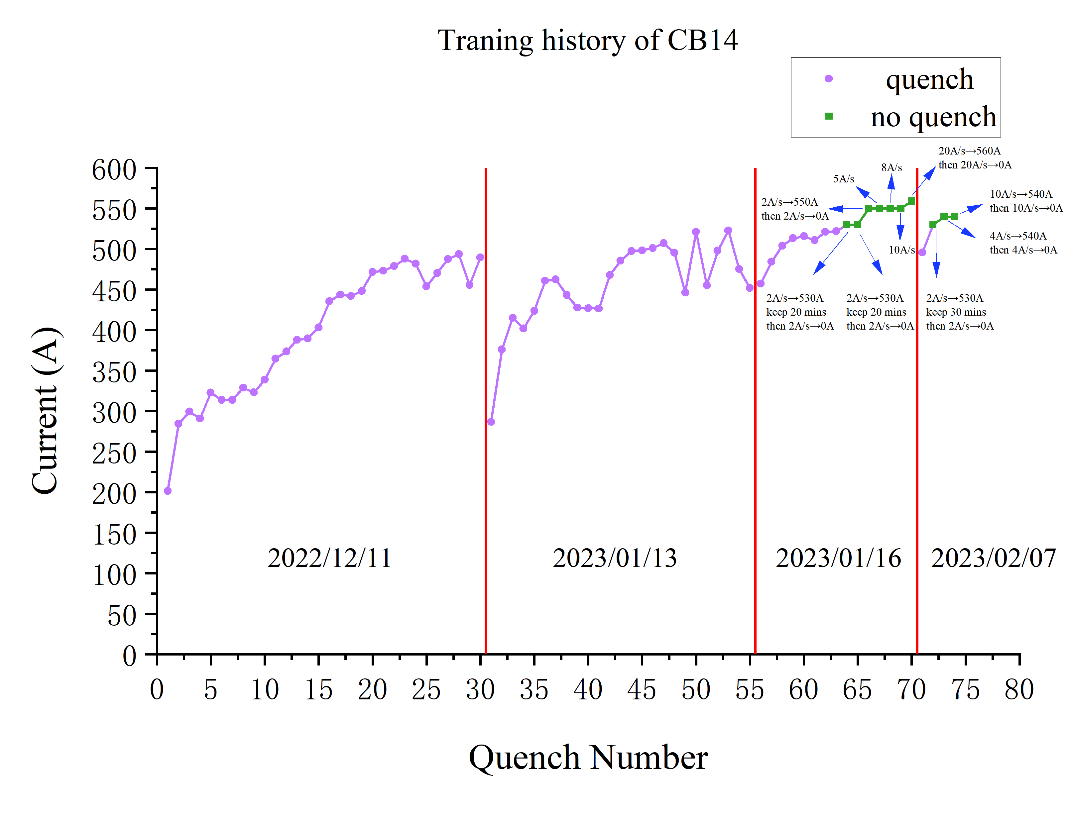
Stand-alone test of CB14
Changes:
Changes of the operators.
The inlet pipeline between mix tank and impregnation furnace (exposed in the air ~10℃) didn’t use any thermal insulation.
It takes a longer time (6~7h) of injection compared with CB09 ~ CB13 (3~4h).
Detraining

Slide 8
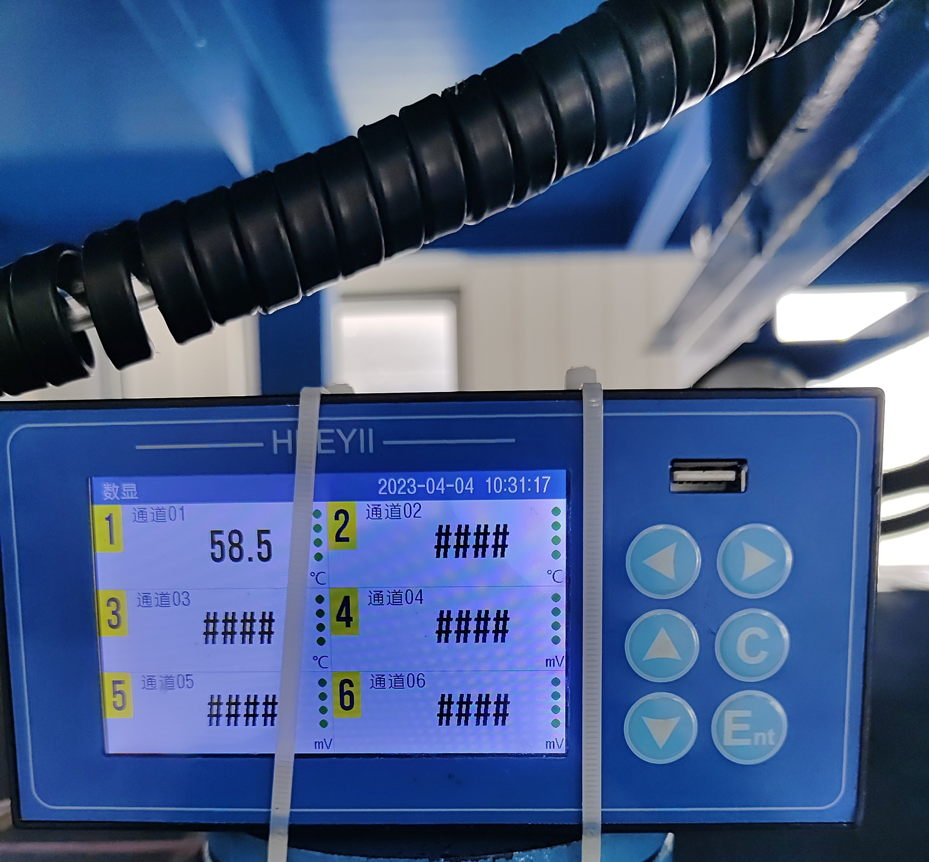
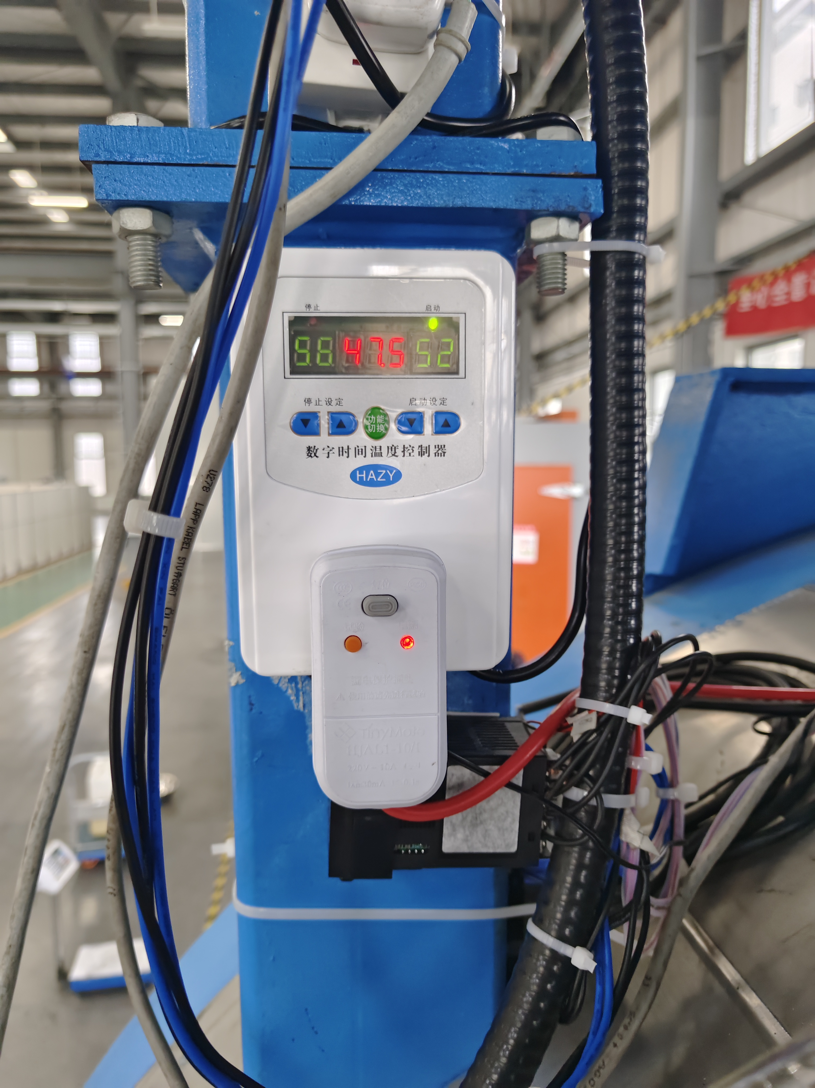
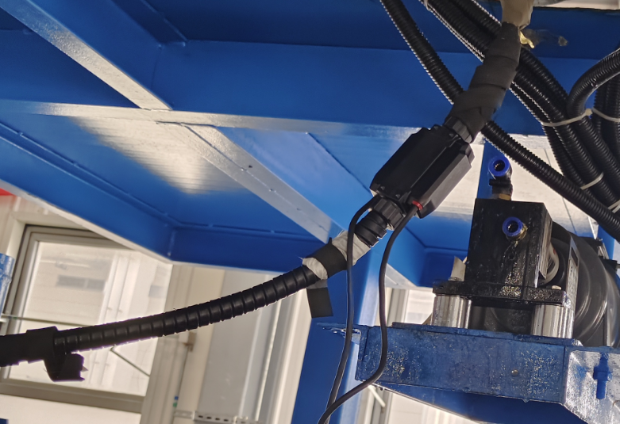
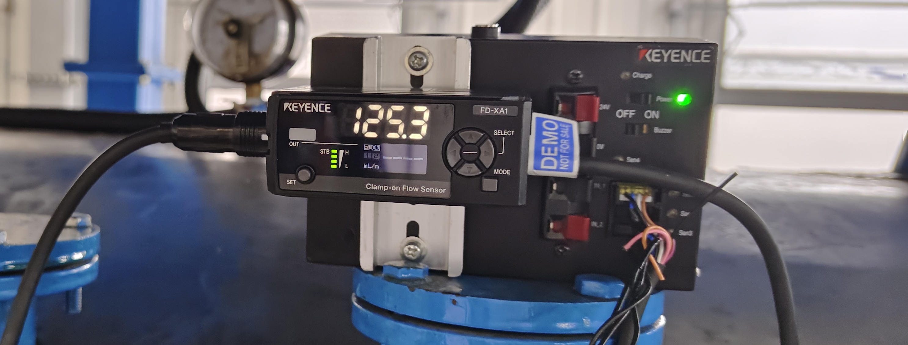
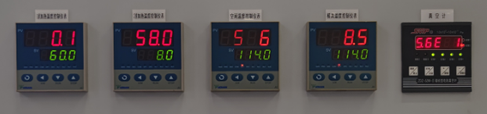
Corrective action of the VPI station
Inlet pipeline
Thermal insulation
Heating belt
Ultrasonic flow meter
T controller for the inletpipeline:52-58
T controller for the mold
60.1 - 58.0 - 58.6 - 58.5

Slide 9
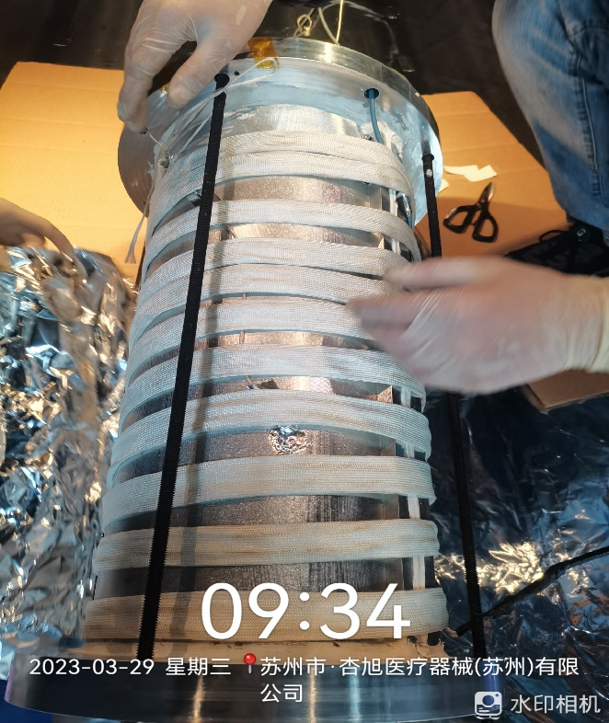
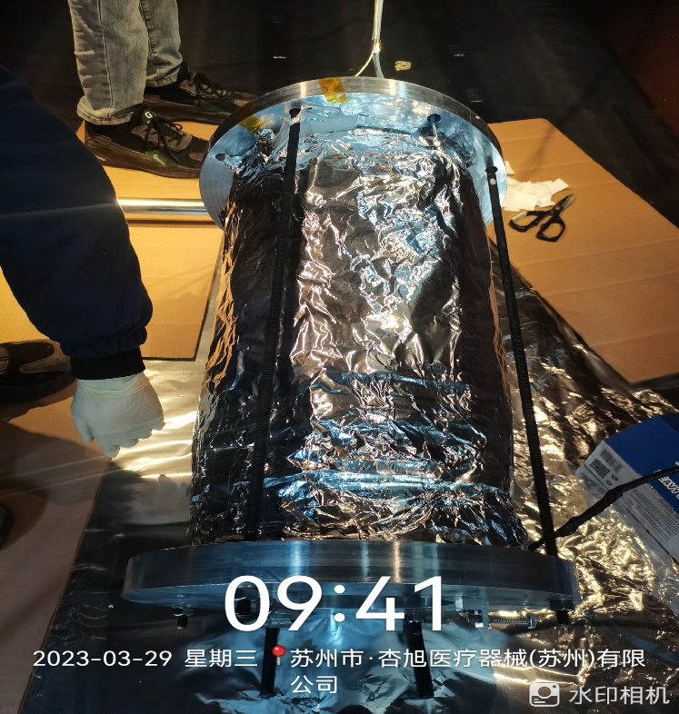
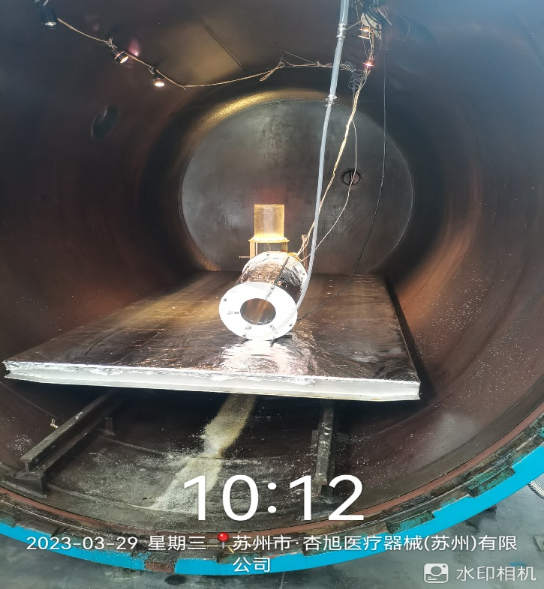
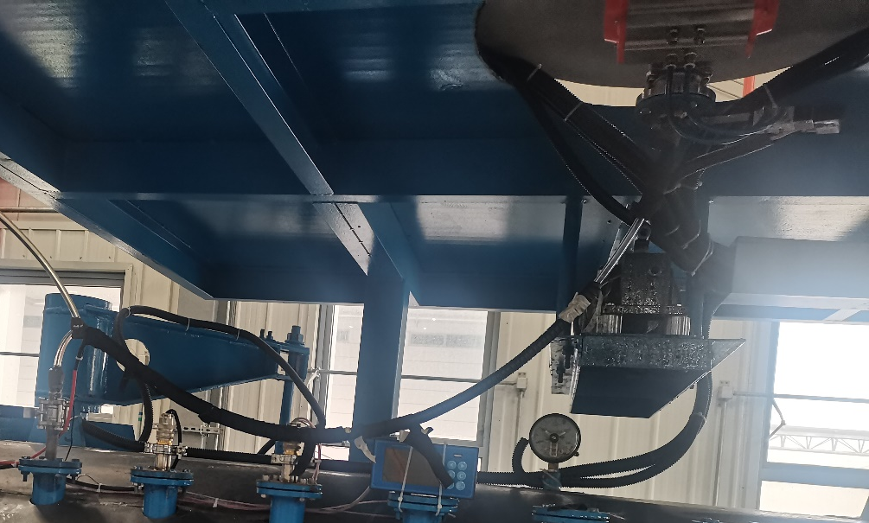
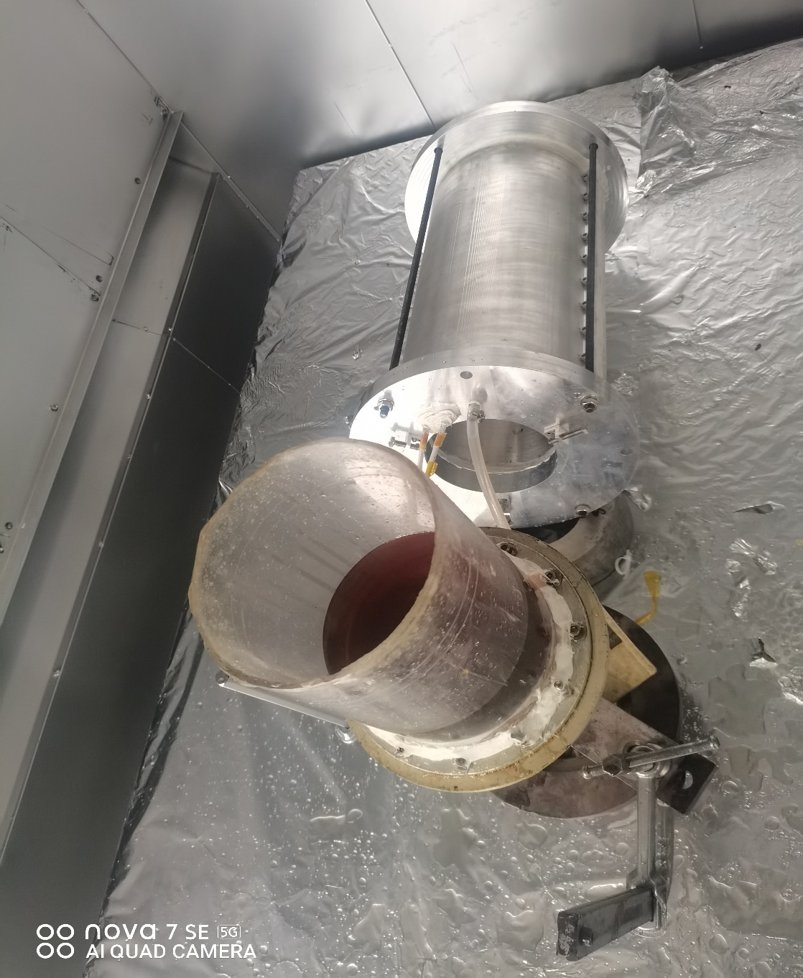
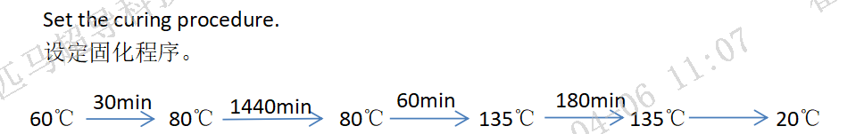
Qualification of the VPI system
Thermal insulation for the inlet pipeline
We use a 0.5m quadrupole CCT magnet as a qualification of the VPI system after applying the corrective actions.
This magnet will be tested this week.

Slide 10



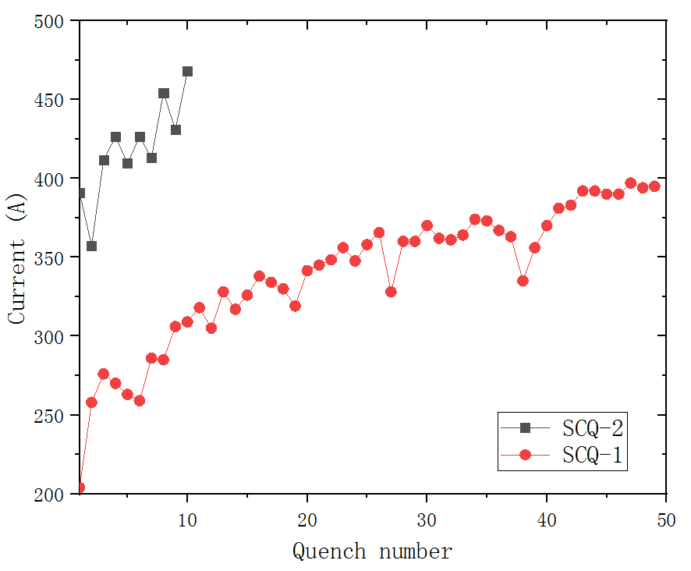
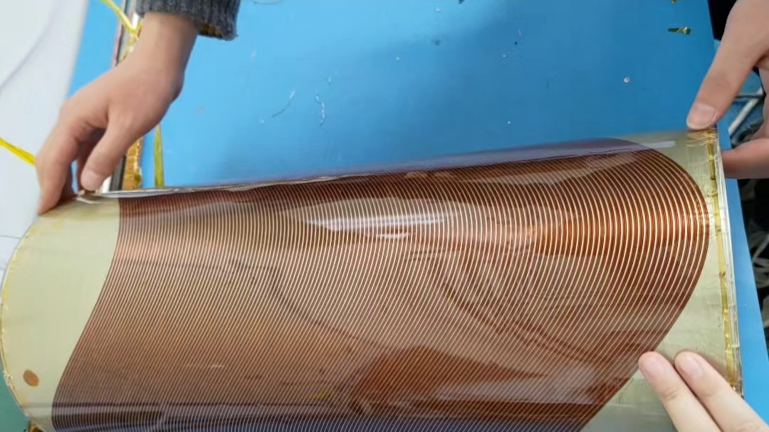
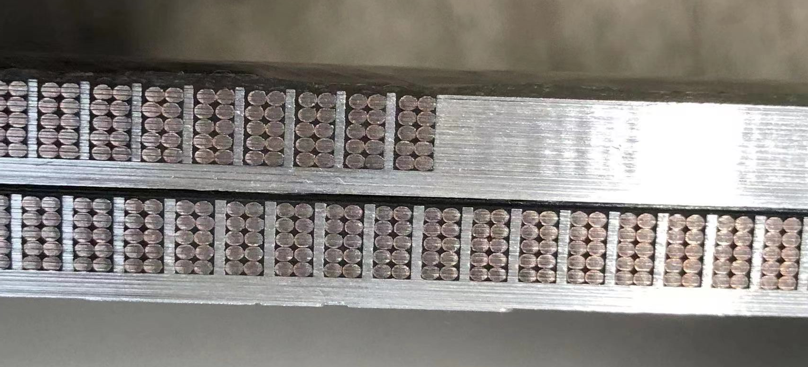
Performance of SCQ-CCT coils
SCQ-1
Well impregnated magnet SCQ-1 experienced long training
With the modified channel size, the training performance of SCQ-2 significantly improved.

Slide 11
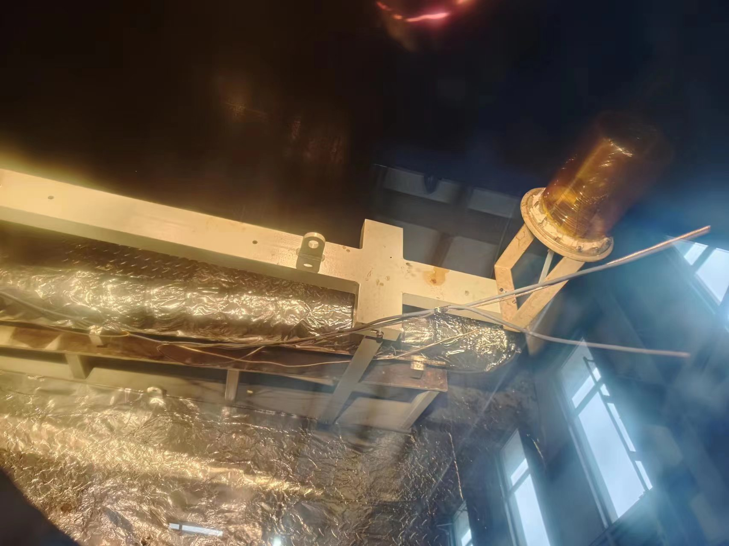
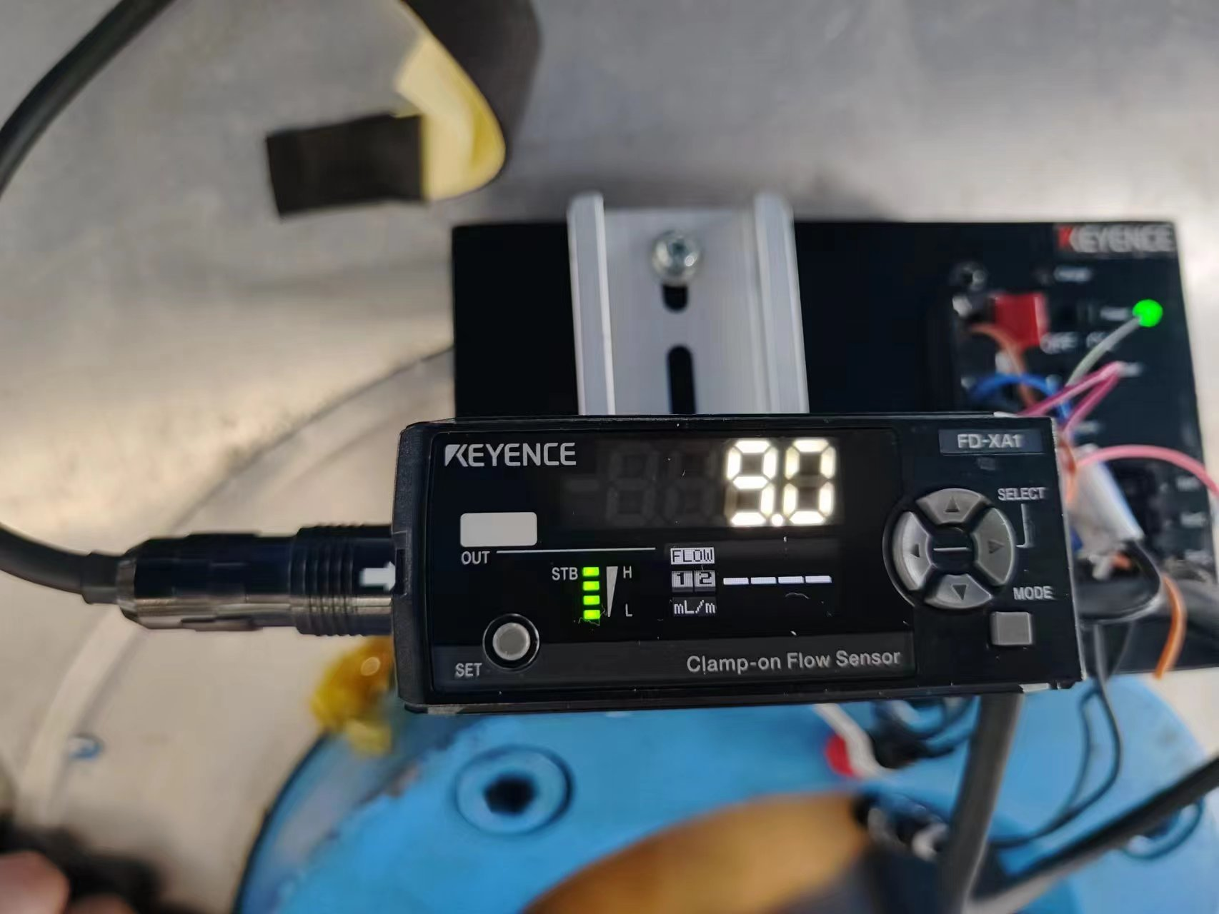
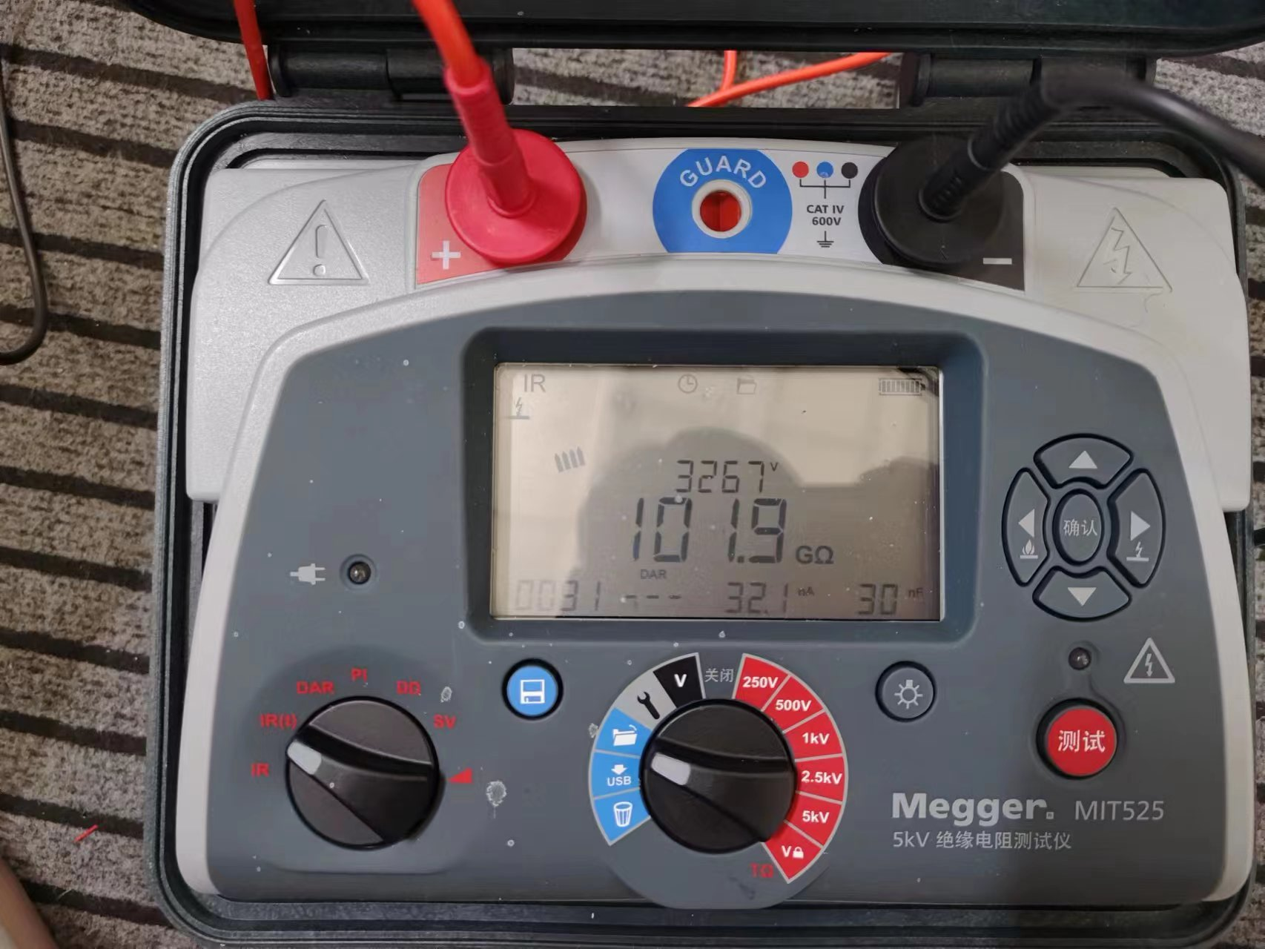
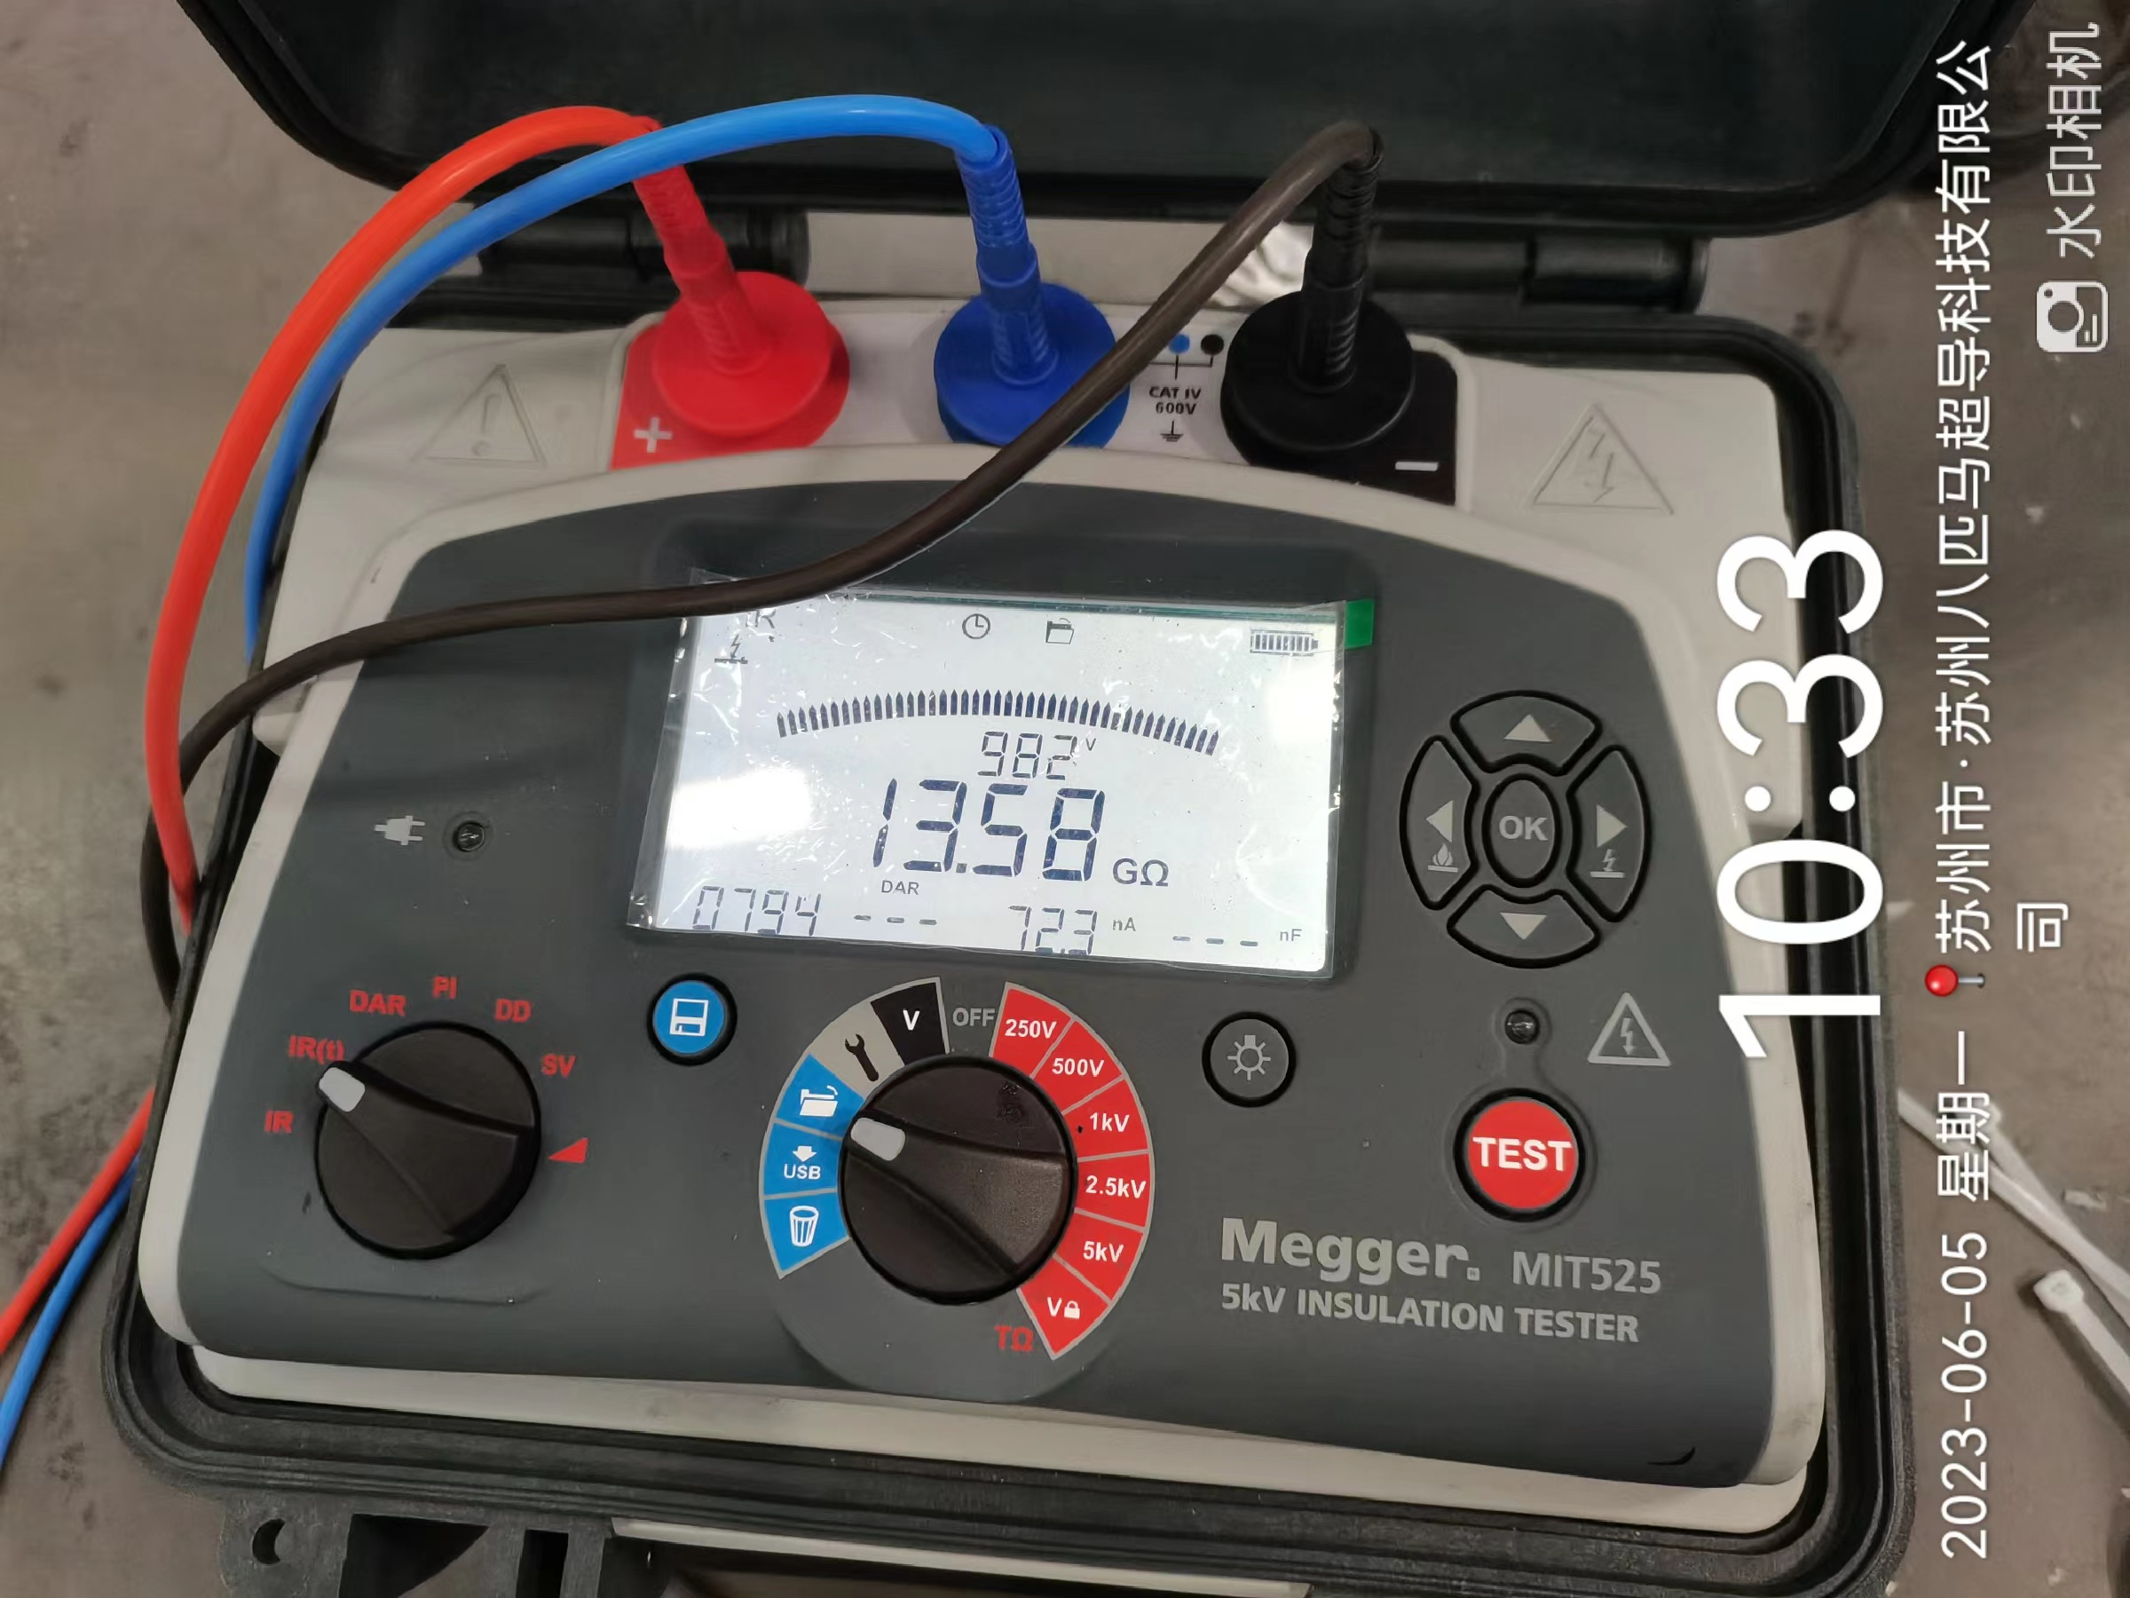
VPI for CB17
Equipment | Object | Function | Voltage/ Current | Test Time | Resistance
Megger MIT 525 | Coil to ext. tube | IR | 512V/5.82nA | 30 s | 88.0 GΩ
 | Coil to ext. tube | IR | 1026V/10.4nA | 30 s | 98.4 GΩ
 | Coil to ext. tube | IR | 1544V/16.5nA | 30 s | 93.8 GΩ
 | Coil to ext. tube | IR | 2052V/22.3nA | 30 s | 92.2 GΩ
 | Coil to ext. tube | IR | 2557V/20.8nA | 30 s | 123.2 GΩ
 | Coil to ext. tube | IR | 3267V/32.1nA | 30 s | 101.9 GΩ

Slide 12
Stand-alone training of CB17
524A

Slide 13
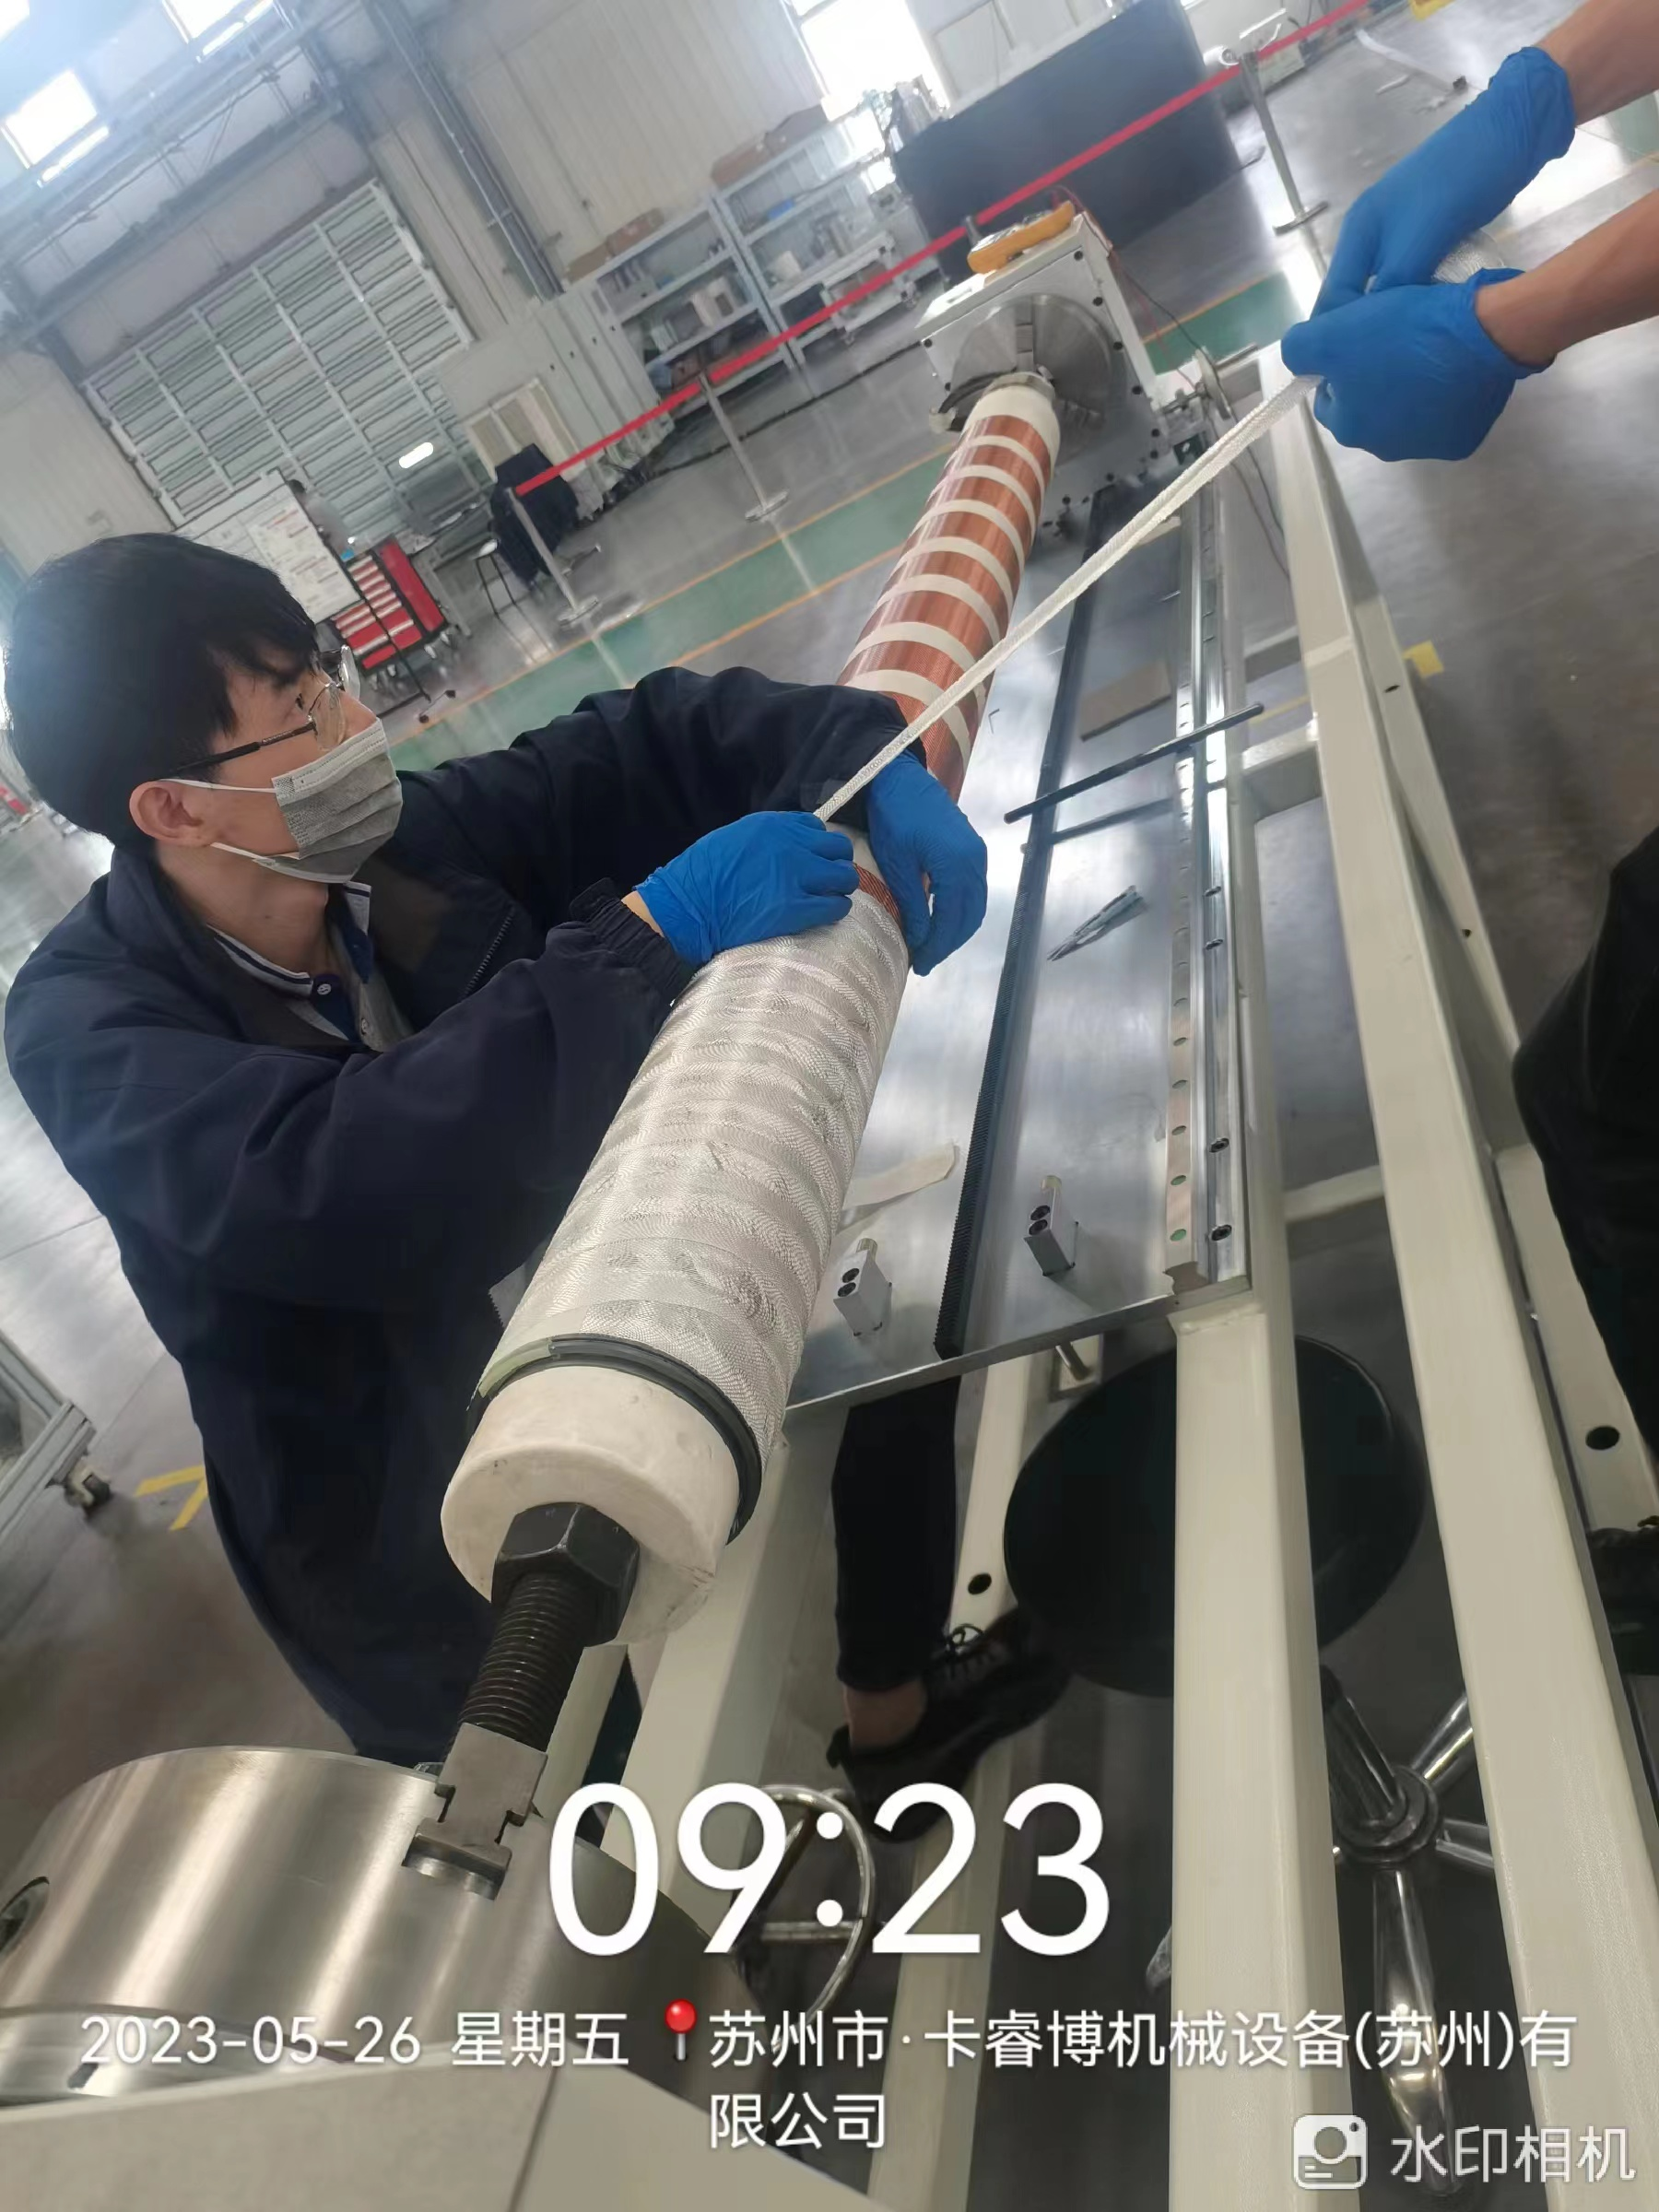
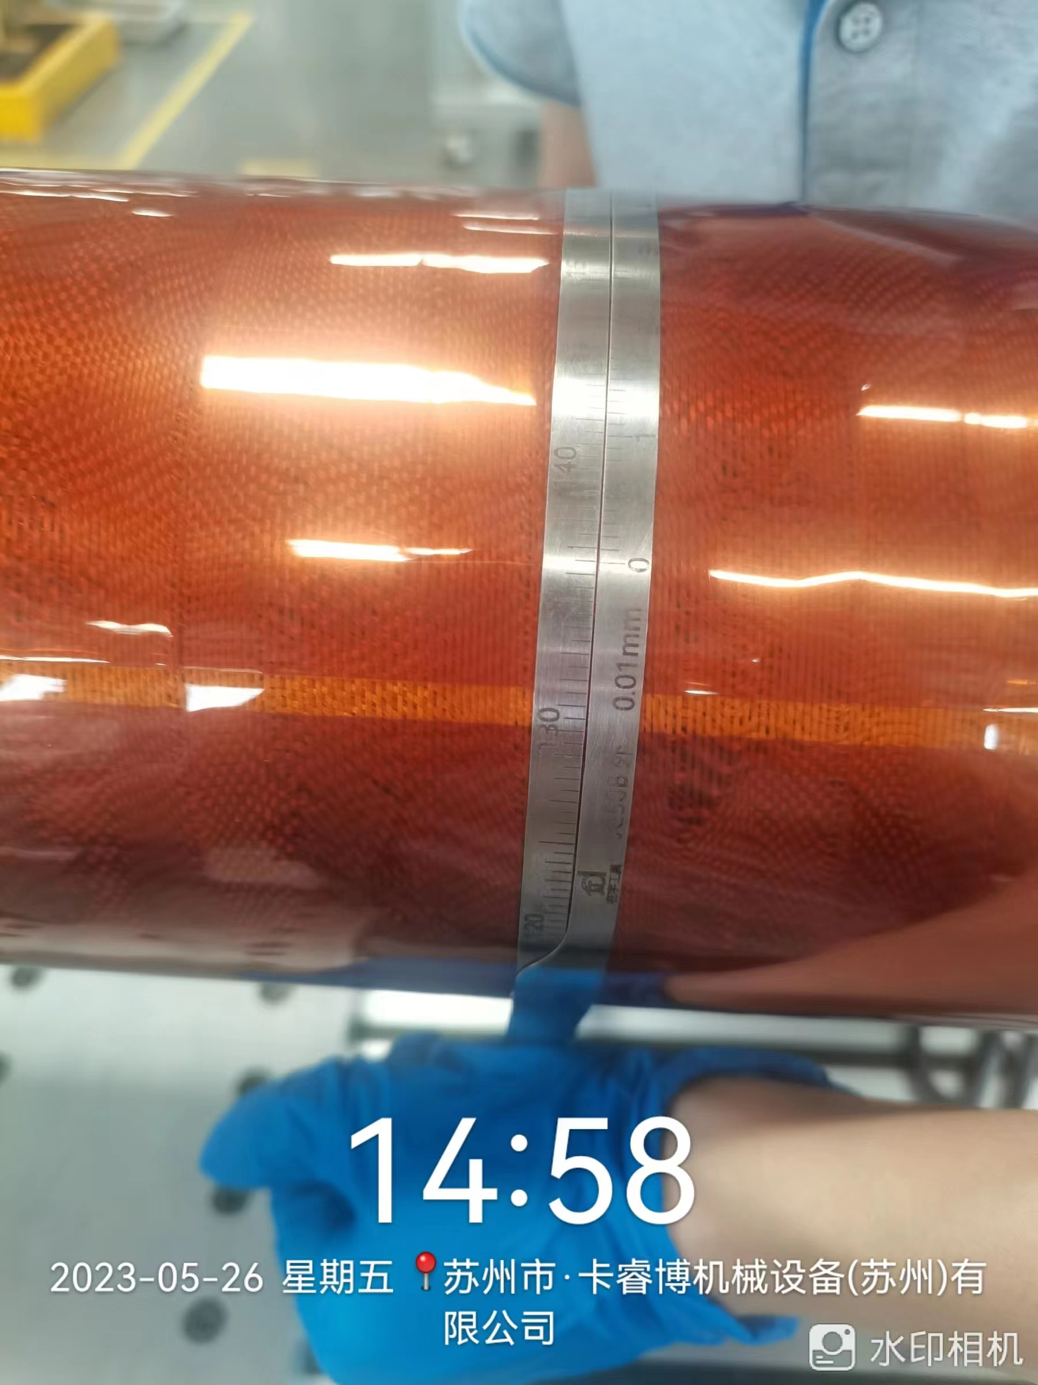
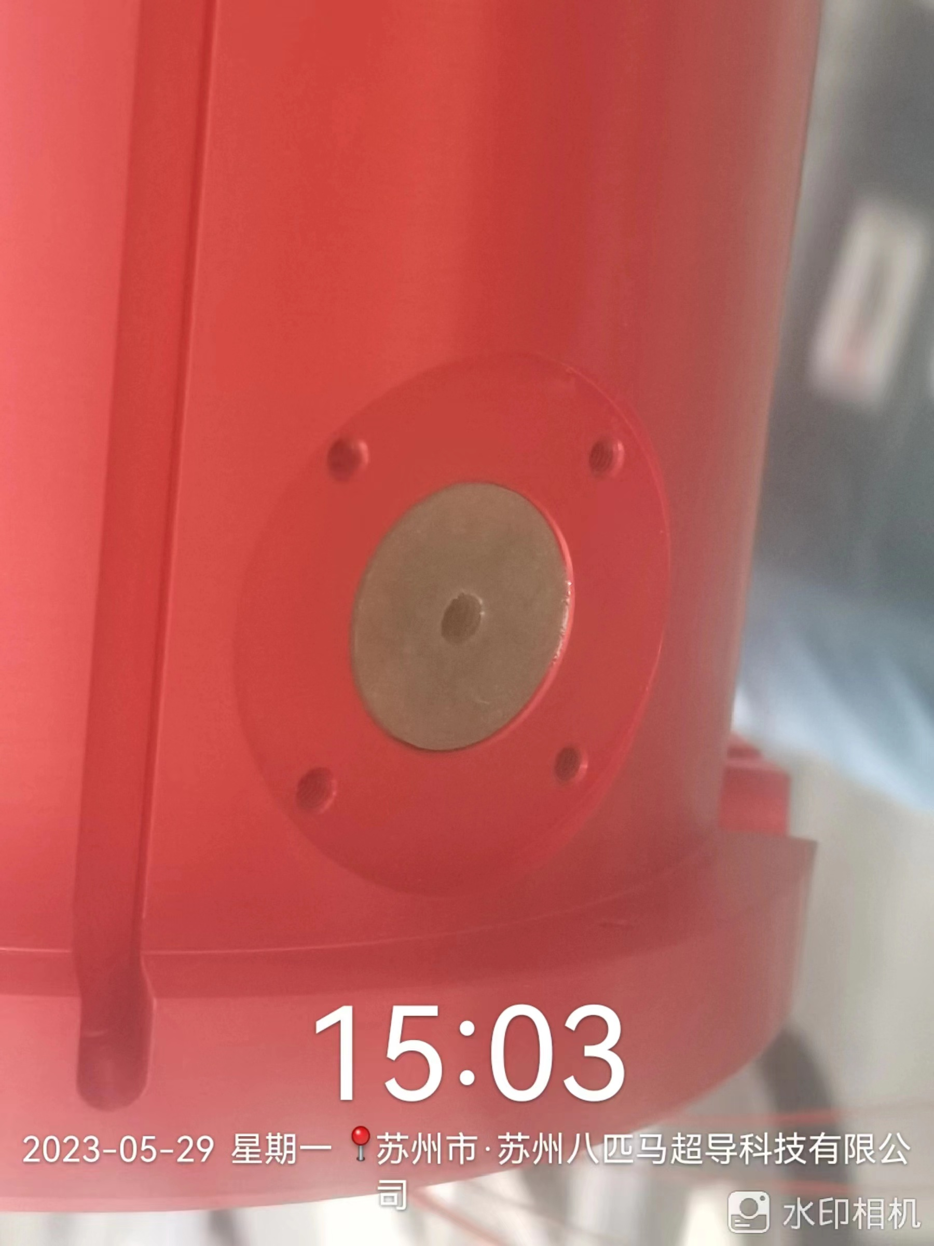
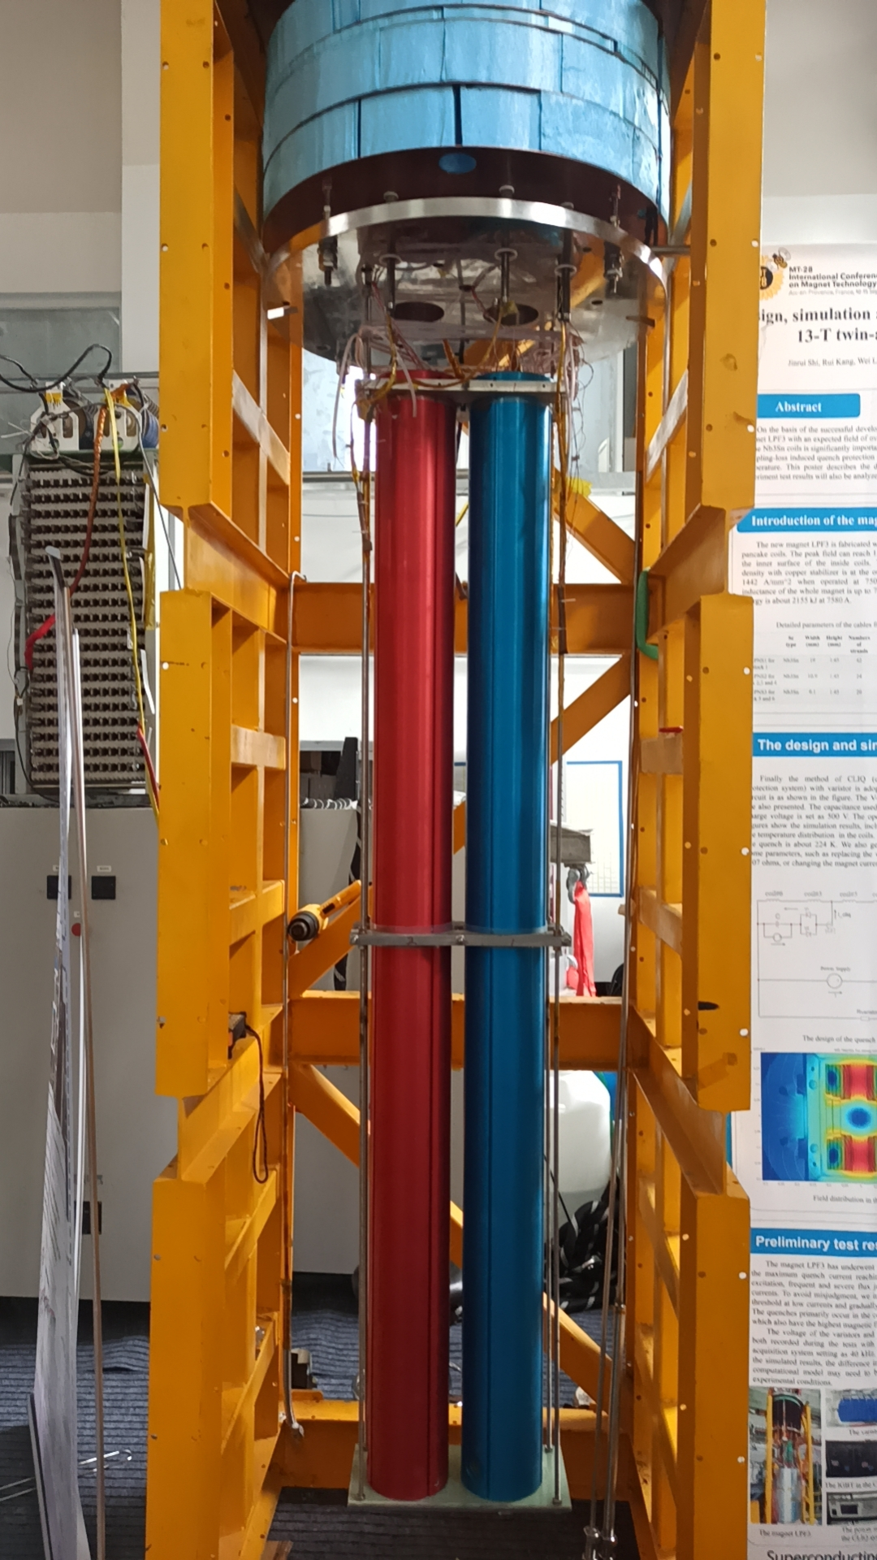
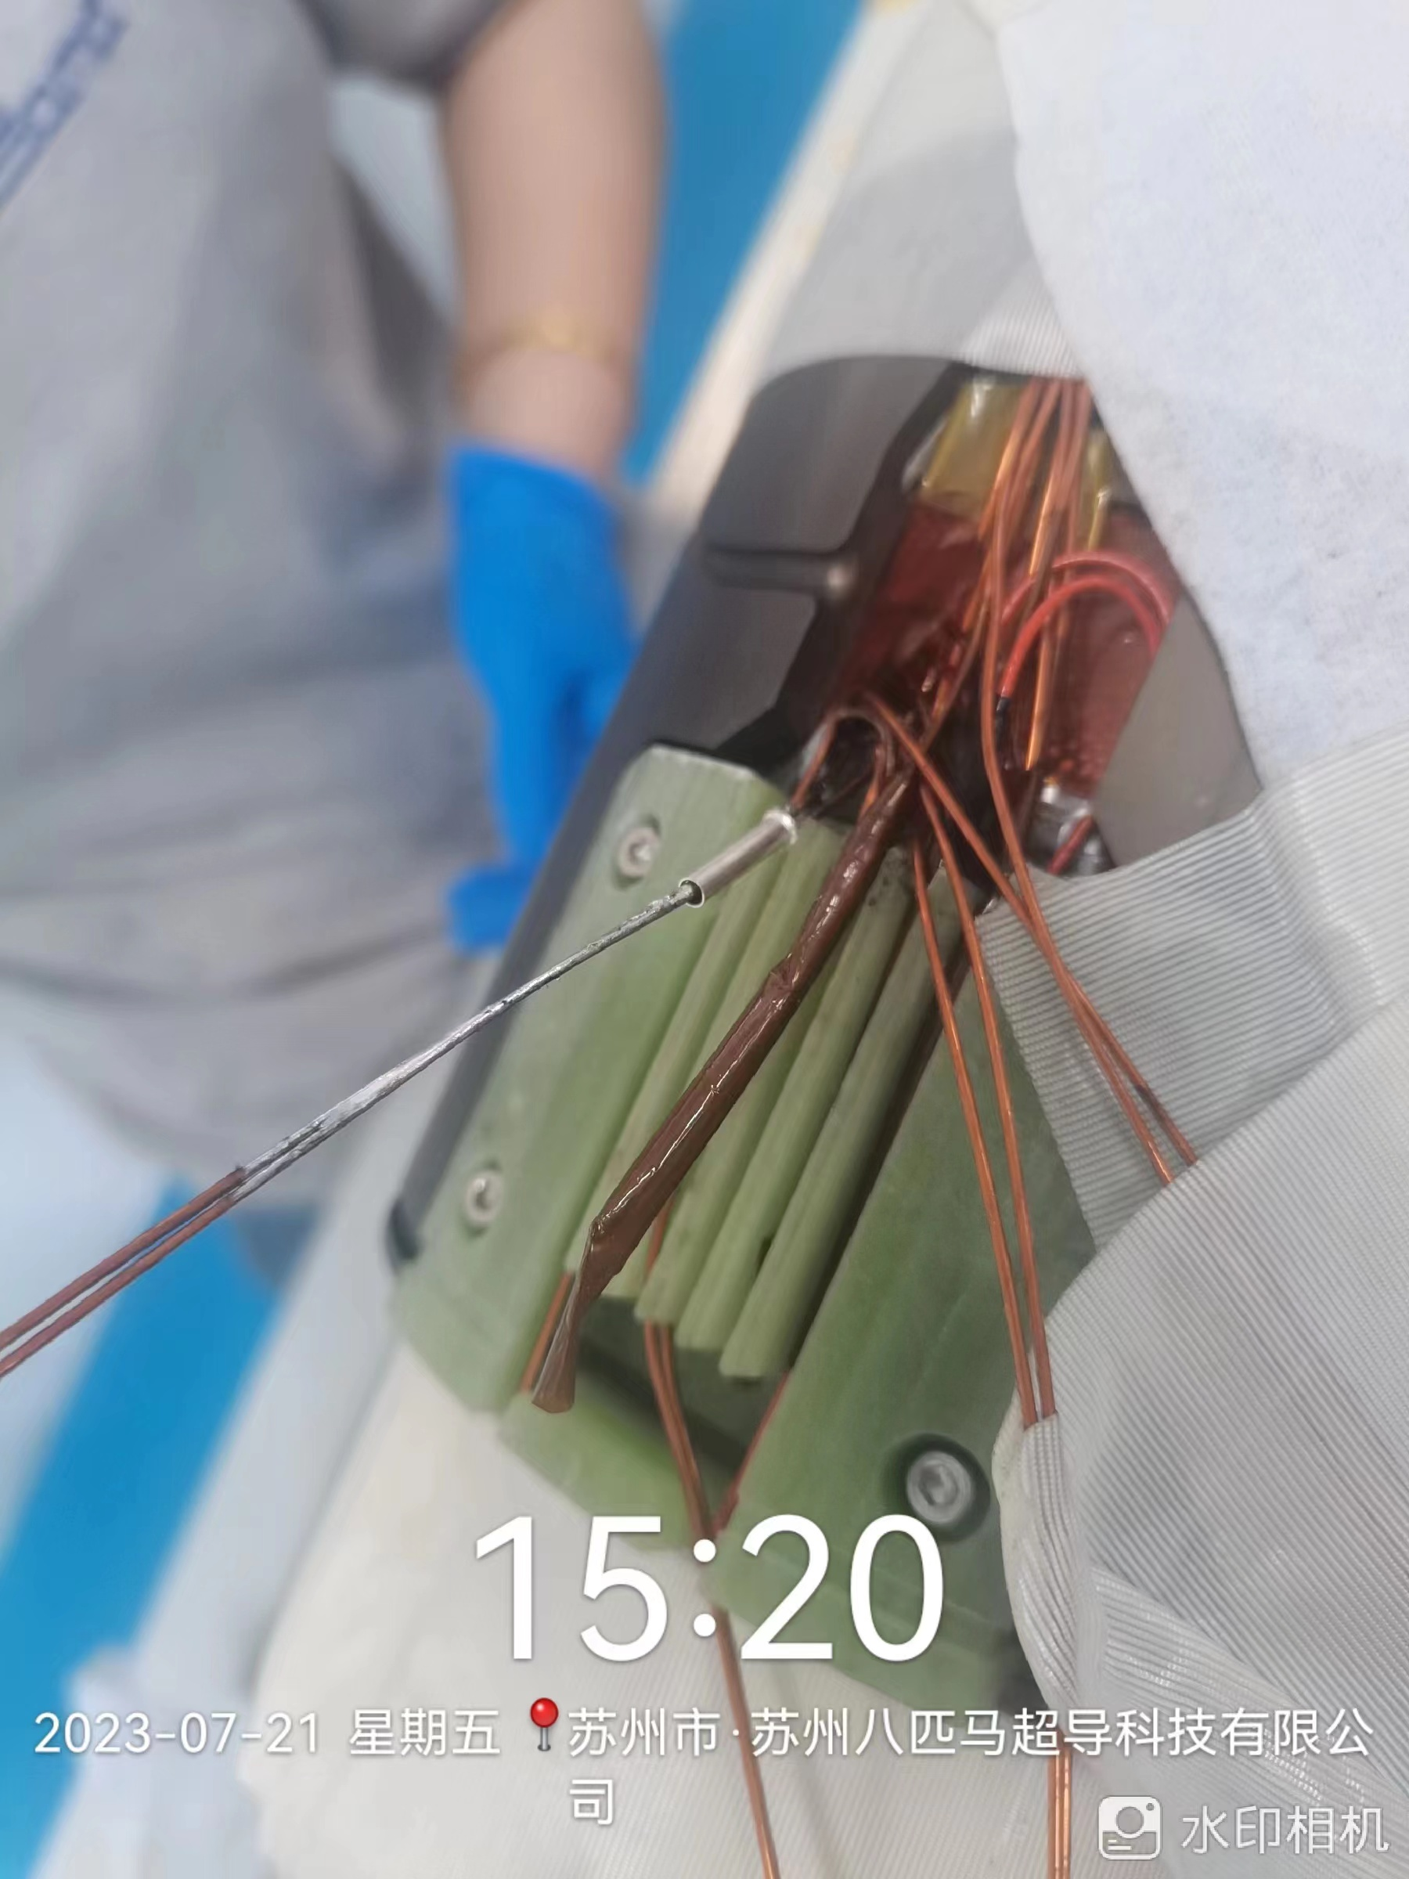
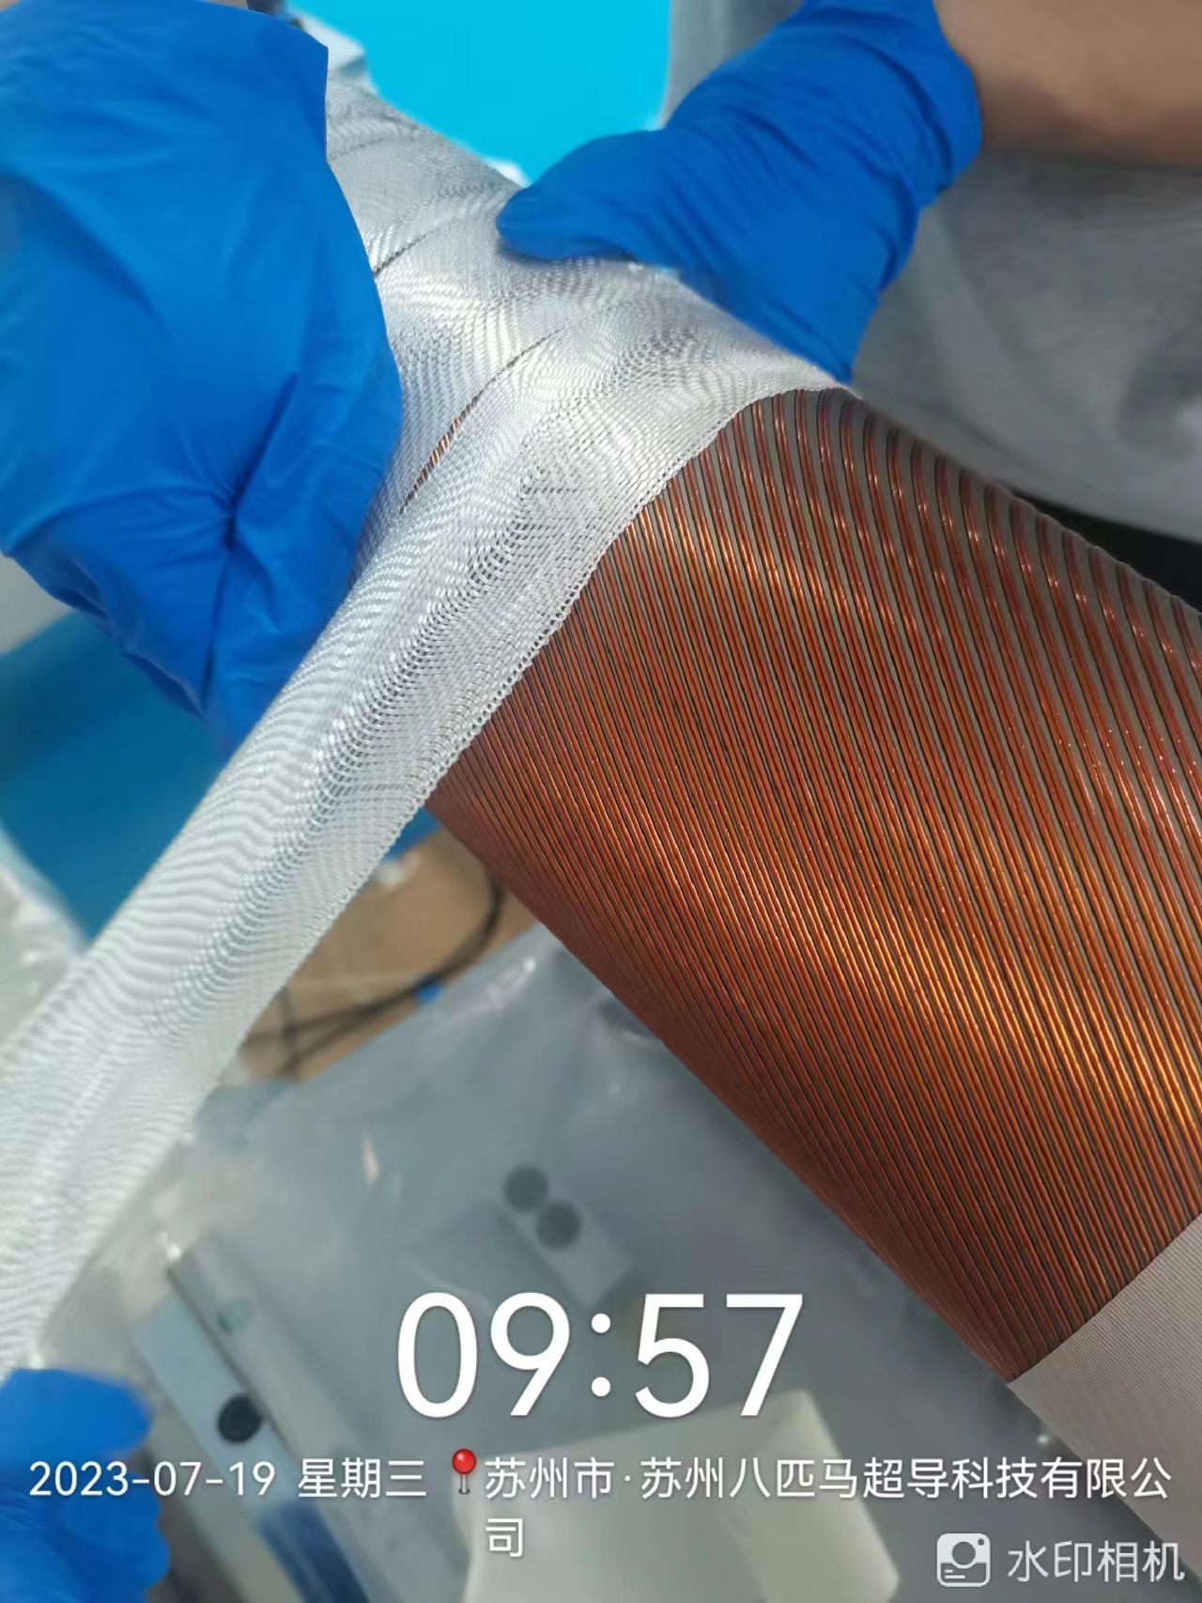
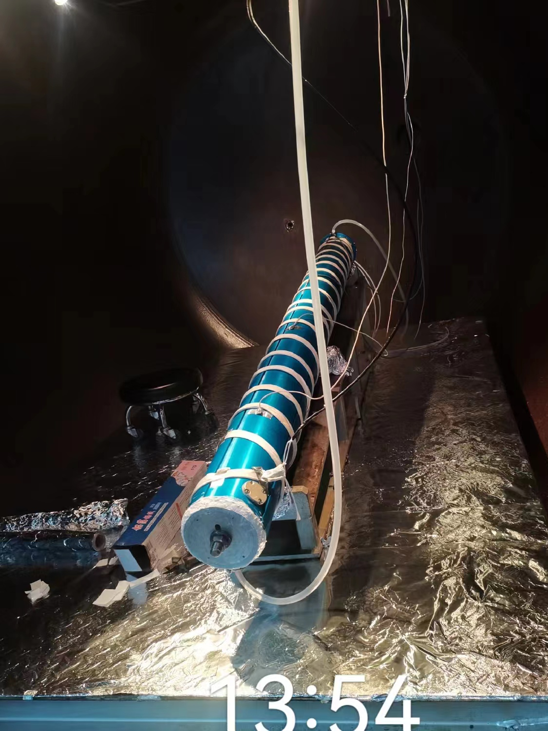
Manufacture of CB18
Manufacture of CB19

Slide 14
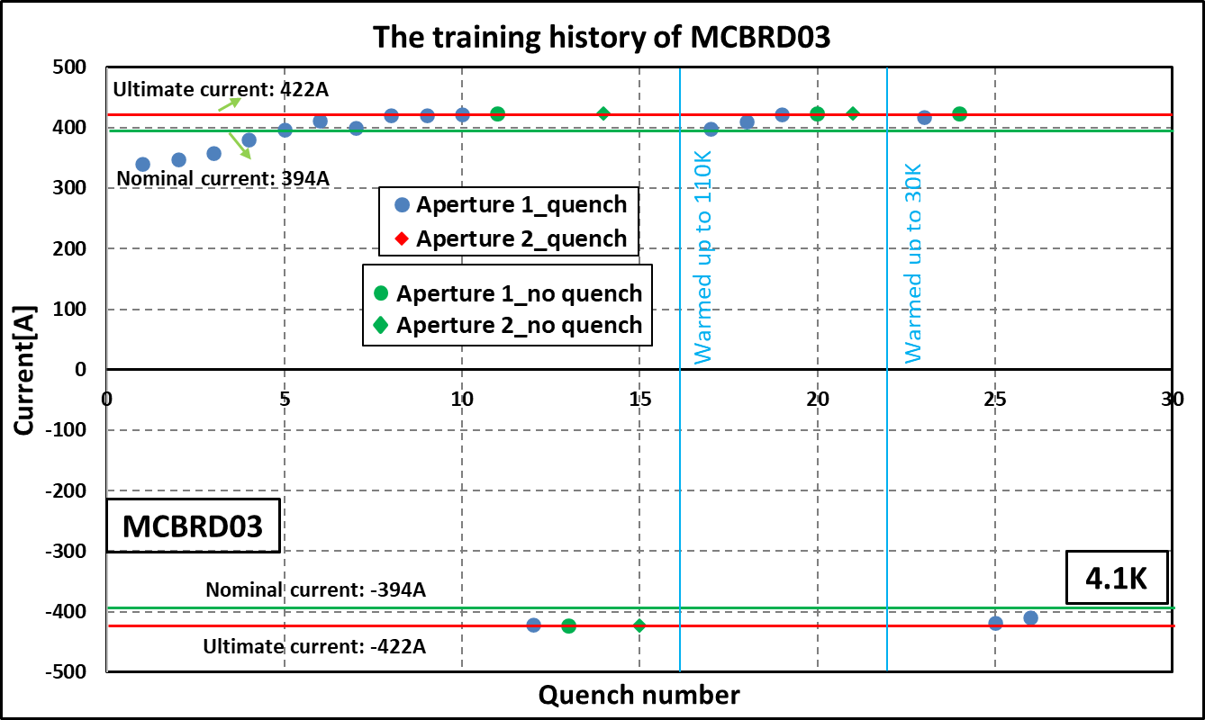
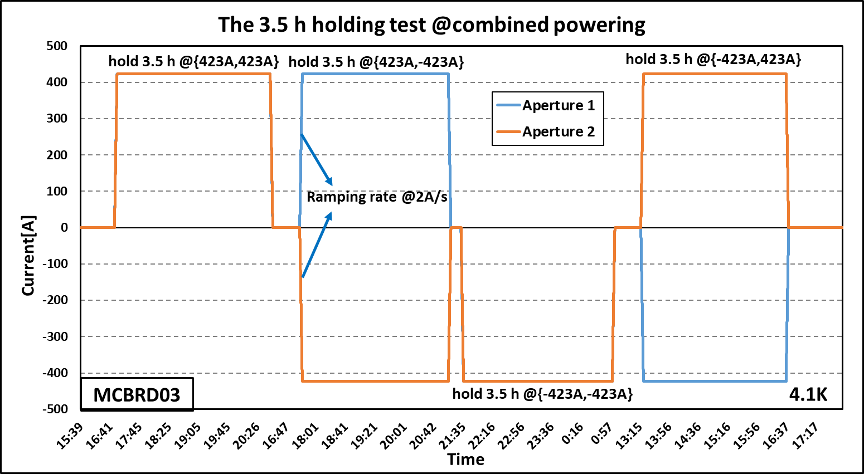
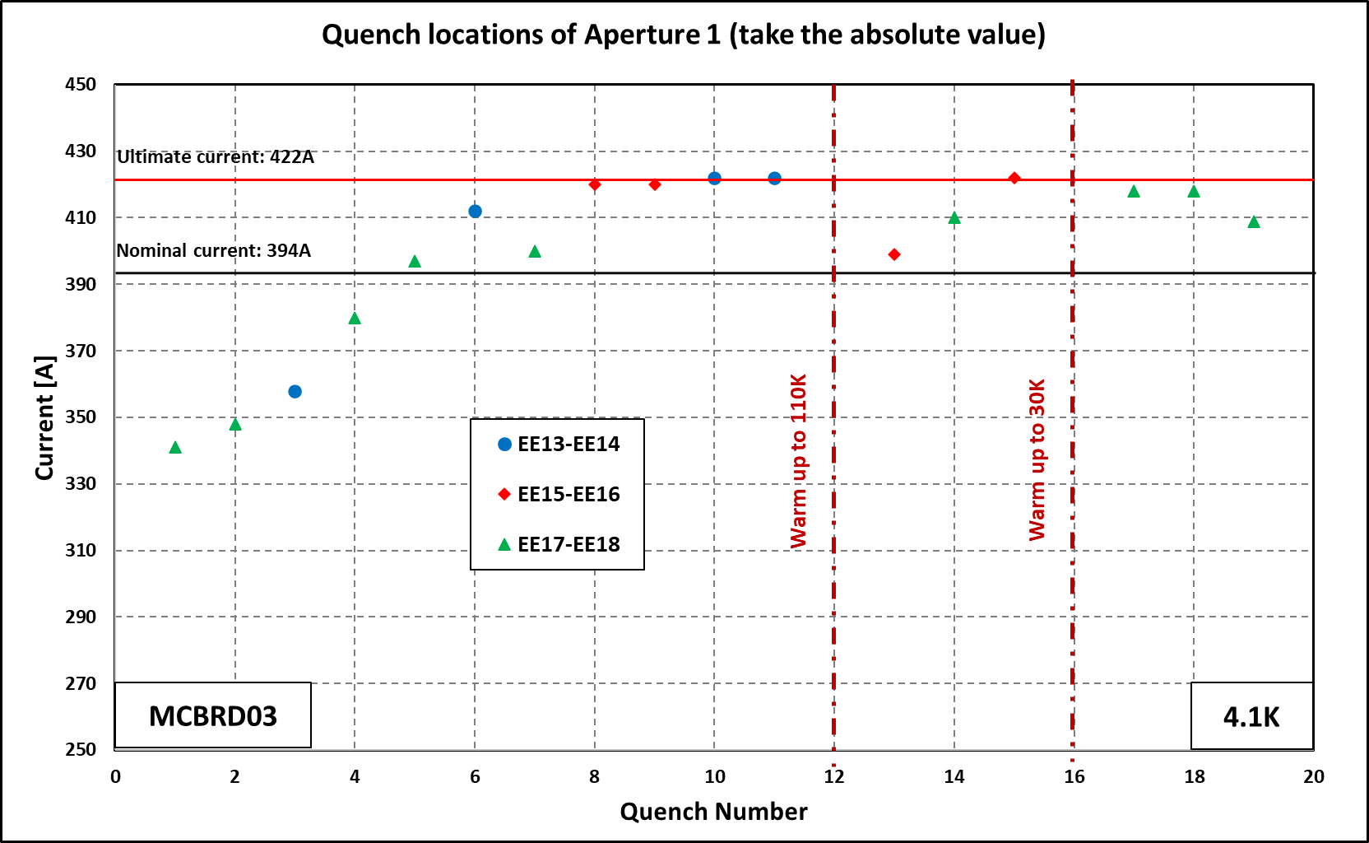
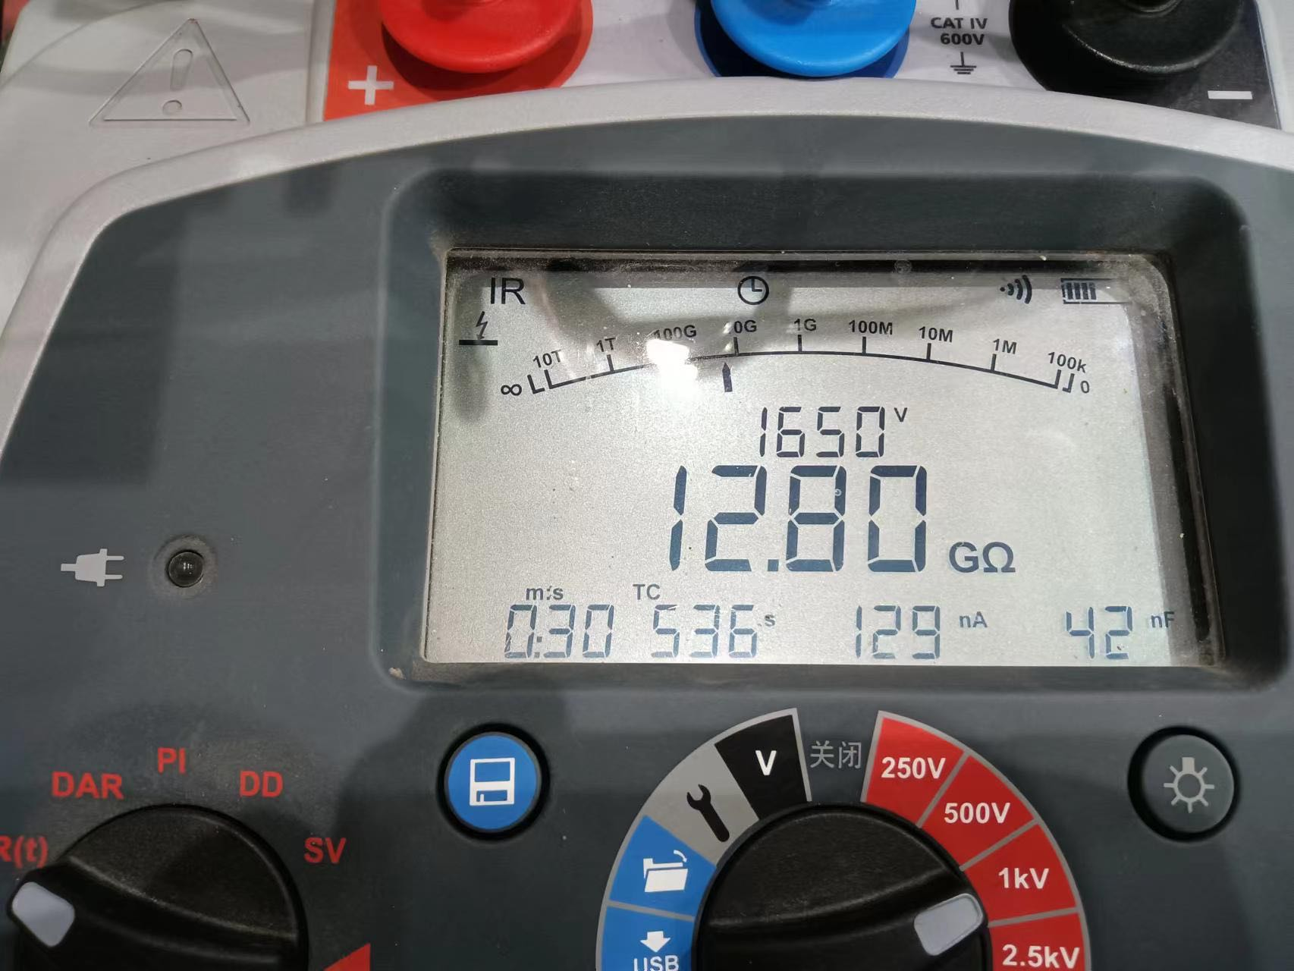
Training history of MCBRD03 (1st test)
AP1(CB12，25 quenches 526A) reached ±422A after 11 quenches.
AP2(CB09, 33 quenches 530A; after thermal cycle ＞500A) reached ±422A without any quenches.

Slide 15
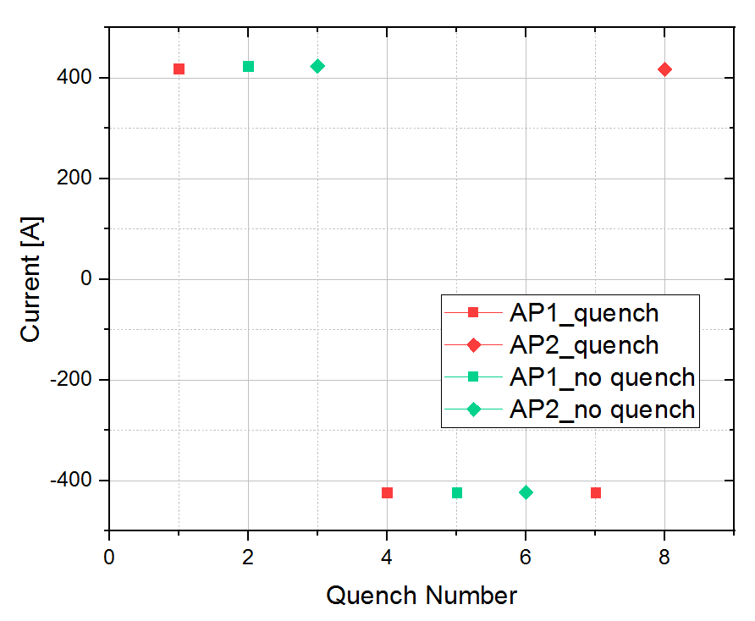
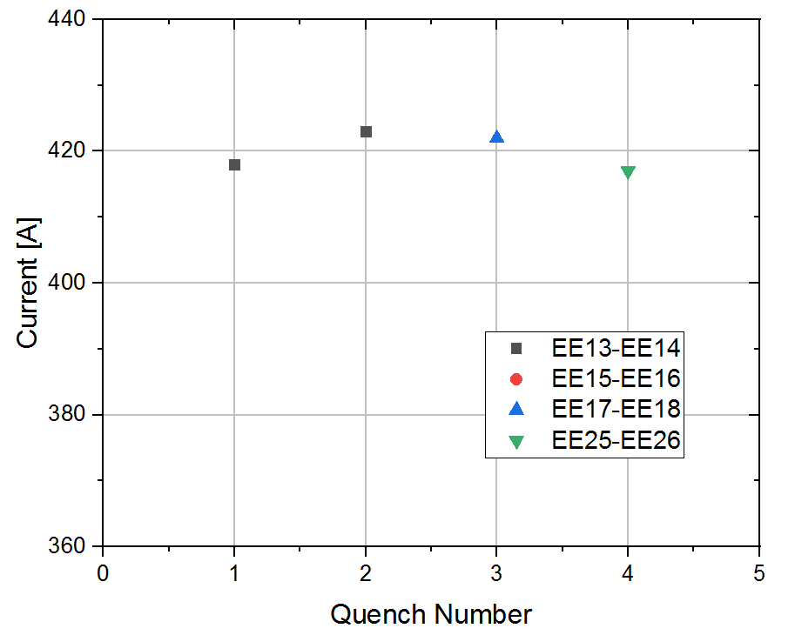
Training history of MCBRD03 (2nd test)
Both Apertures reached the nominal current without any quenches after thermal cycle.
Ultimate current : 422 A
Nominal current : 394 A
4.1 K
Nominal current : -394 A
Ultimate current : -422 A
Training history and quench location of the 2nd test

Slide 16


Field Quality of MCBRD03
Multipoles (individual powering)

Slide 17


Field Quality of MCBRD03
Crosstalk-transfer function (combined powering)
Crosstalk- Multipoles (combined powering)

Slide 18
Training history of MCBRD04 (1st test)
AP1(CB17，47 quenches 524A) reached ±422A after 15 quenches.
AP2(CB13, 53 quenches 530A) reached ±422A with 10 quenches.

Slide 19
Summary
4 series CCT magnets have been fabricated. All of them reached the ultimate current and passed the field quality test. The 5th magnet is under fabrication.
The 4th magnet to be delivered in late Oct or early Nov. The 5th magnet to be assembled in Nov, tested and delivered in late Dec 2023 or early Jan 2024
Production rate for the rest of series magnets: every 3 month per magnet
Components for 2 CCT magnets have been shipped to CERN from IHEP, to verify the performance with components from China and CERN fabrication process.

Slide 20
Thanks for your attention

