Slide 1


HL-WP3 MCBRD production status at CERN
Arnaud Foussat
MSC TE/MSC-SMT
On behalf of CERN-IHEP collaboration
HL LHC week annual meeting
https://indico.cern.ch/event/1293138/
2023-06-28

Slide 2
Outline
HL-WP3 MCBRD D2 orbit correctors scope
MCBRD11,12 features, background
Components QC tests
Series electrical diagram
MCBRD11,12 Series coils production, acceptance tests, setbacks & lessons
Electrical insulation of Coils to floating formers (MPE-MSC)
Update schedule
Summary

Slide 3

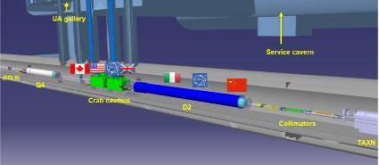
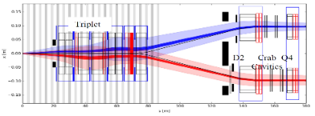
HL-WP3 MCBRD D2 orbit correctors scope
Recombination dipole orbit correctors as part of the HL-LHC Work Package 3 based on Canted Cosine Theta (CCT)
The MCBRD magnets constitute the D2 orbit correctors (8 MCBRD series units + 4 spares) – IHEP responsible
Completed MCBRDP4 @ CERN last 08/2022, tested successfully.
Decision to start two series magnets MCBRD11,12 production at CERN 927 lab from Q1-2023 using IHEP components.
MCBRDs
Parameters @ nominal current (7 TeV operation) | D2 MBRD | MCBRD
Material | Nb-Ti | Nb-Ti
# apertures | 2 | 2
Distance between apertures [mm] | 188 | 188
Aperture [mm] | 105 | 105
Field [T] | 4.50 | 2.60
Integrated field [T.m] | 35 | 5
Nominal Current [kA] | 12.328 | 0.394
Stored energy [MJ] | 2.26 | 0.143

Slide 4
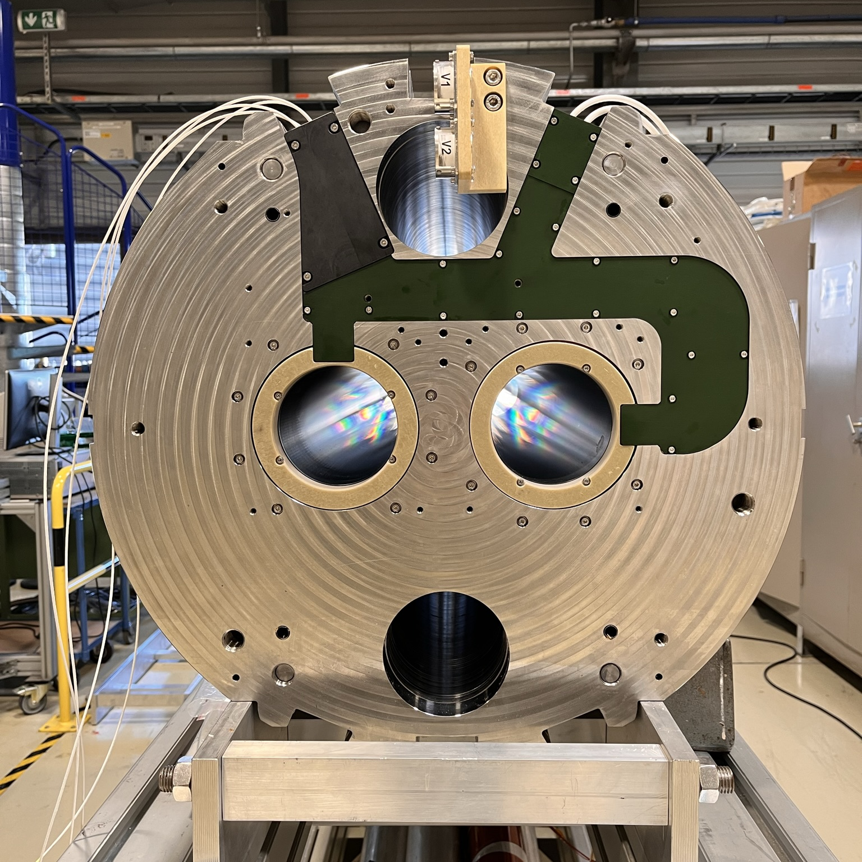
Series MCBRD features
Last MCBRDP4 built in 2022 per the series magnet requirements. (EDMS 2051870 ), including recent series instrumentation consolidation.
MCBRD11,12 follow the series manufacture features
Parameters | Unit | Value
Aperture size | mm | 105
Magnetic length | m | 1.93
Nominal field | T | 2.59
Nominal integrated field | T.m | 5.0
Nominal current | A | 394
Ultimate current | A | 422
Short sample current at 1.9 K | A | 767
Short sample current at 4.2 K | A | 650
Loadline fraction at 1.9 K (WST) |  | 53 / 47 %
Strand diameter | mm | 0.825
Cu/no_Cu (WST wire) | - | 1.95 ( 1.3)
Strand critical current at 4 T | A | 700
Nominal strand current density | A/mm² | 737
Nominal superconductor current density | A/mm² | 1695
Nominal differential inductance per aperture | mH | 970
Nominal stored energy per aperture | kJ | 74.9
CCT skew angle | deg | 30°
No. of turns per layer |  | 365
Slot size in former (mm) (IHEP depth) |  | 2.1 × 5.2 ( 4.9)
Number of CCT layers / Strands in channel |  | 2 / 5 x 2

Slide 5
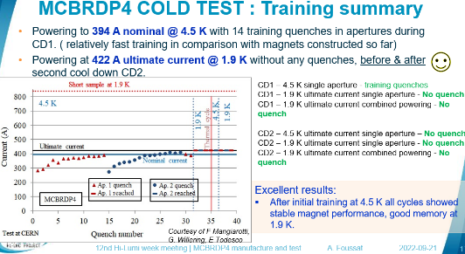
Background
Since last MCBRDP4 prototype made at CERN and successful cold test as reported at last HL-LHC annual meeting, it was decided to support the IHEP series production activities and launch MCBRD11-12 fabrication at CERN.
All components were provided by IHEP CN sub-suppliers ( from Q1-2023).
  20 kms of WST insulated wires
  6 tons of iron laminations
  8+4 Alu formers, ext. tubes anodized
https://indico.cern.ch/event/1161569

Slide 6
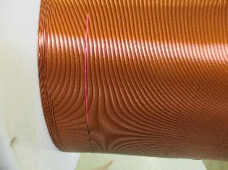
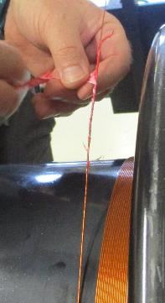
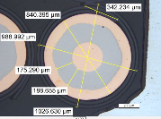
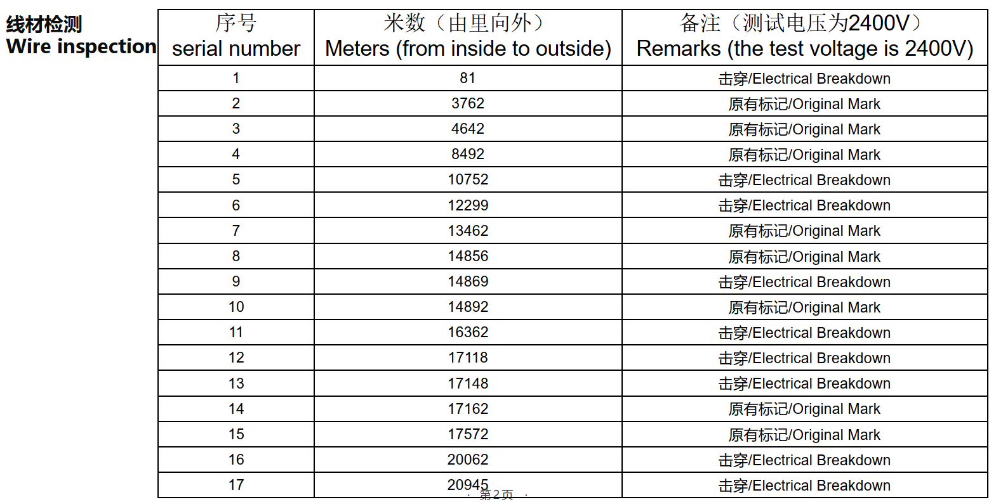
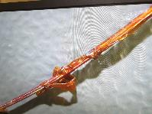
WST sc insulated wires delivery (MCBRD11-12)
Last delivery of single 20 kms UL of WST SC NbTi insulated wire by IHEP from Q4-2022.
Original traveller shown several identified defects in the PI insulation (65 microns thick), rechecked by IHEP, then at CERN.
Standard repair procedure is applied at CERN on line.
Fig. 1- Type of defects QC marked on SC supply UL

Slide 7
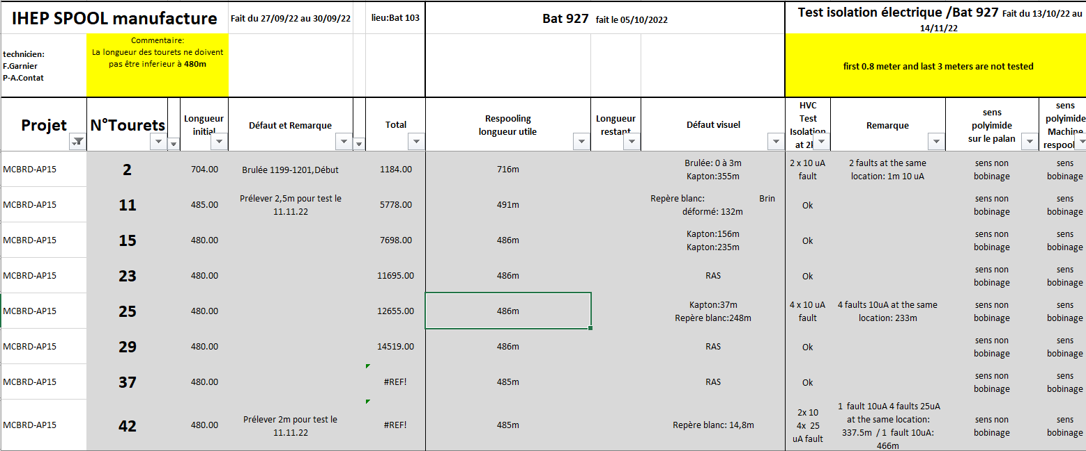
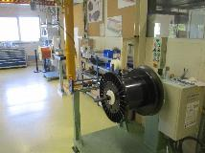
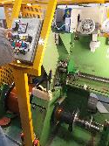
WST wires Hi-pot re-test & respooling at CERN
Spool splitting work at CERN, cleaning and rewind of 44 individual ULs spools ( 480 m each) involved Hi-pot test at 2 kV, revealing a few more defects than marked ones by IHEP supplier
Further re-check of the Ic(B), metallographic tests to exclude risk of elongation during heavy spool respooling: no apparent Ic degradation. (NC 2790885)
Fig.1 Initial respooling (B927), then splitting (B163).

Slide 8
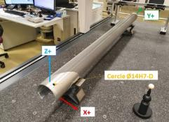
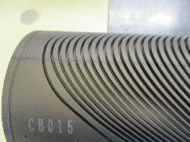
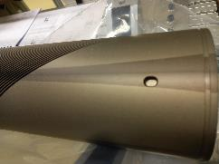
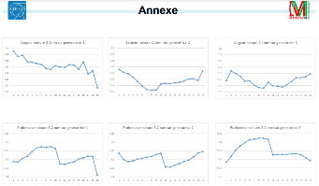
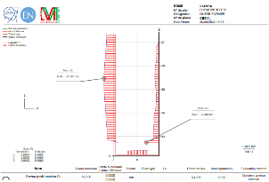
CMM on IHEP Al6082 formers, tubes
CB10,11,15,16 Alu formers received (8+4) inspected, dimensional checks at CERN:
  White spots on anodised surface, uneven change of contrast ( thickness variation)
  Inner/ Outer CB10-11 with mean depth 5.2 mm ( different profile from CERN)
  Inner/ Outer CB15-16 with mean depth at 4.9 mm (IHEP baseline)
  Nominal 2.1 mm width oversized by extra 40 microns
Fig. 1- CMM 3D metrology bench of IHEP formers
(CERN)

Slide 9
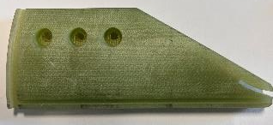

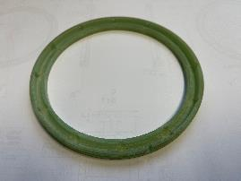
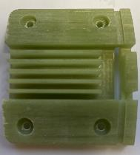
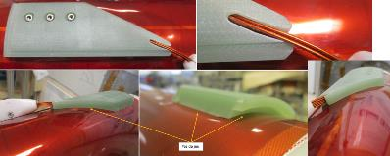
Auxiliary pieces
All GFRP pieces conform to IHEP drawings. Layer jump and connection boxes required slight outer radius correction to match insertion gaps.

Slide 10
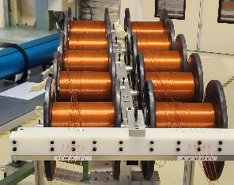
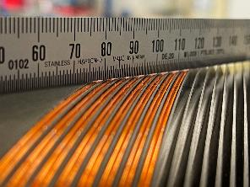
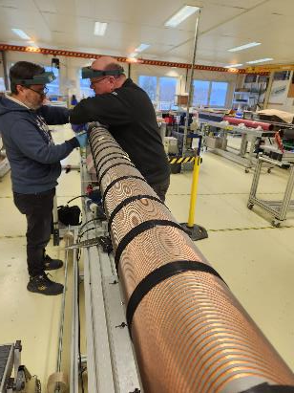
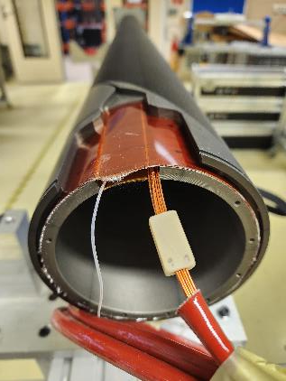
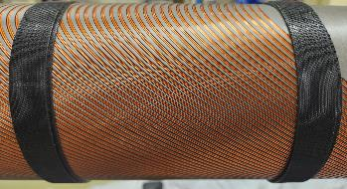
Winding activities
Winding process still broadly manual followed past qualified applied procedure on prototypes.
Validated on AP11, further setbacks on AP10,15, and AP16.

Slide 11
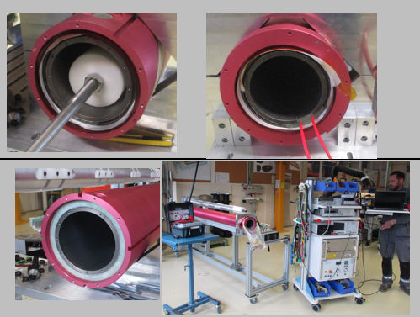
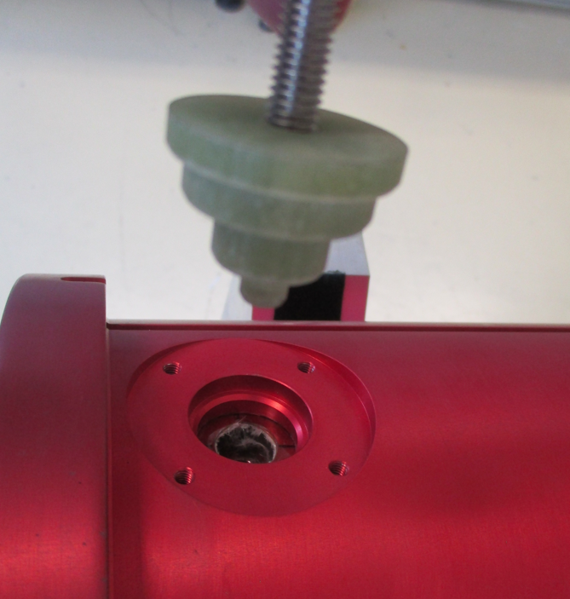
Aperture final preparation steps
Components dimensions compatible with common series CCT assembly procedure

Slide 12
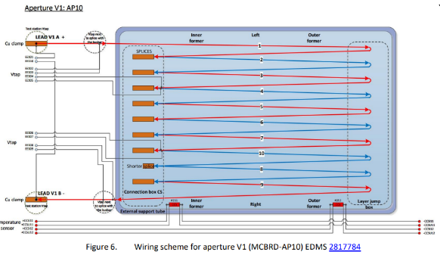
Series electrical diagram
The applied electrical diagram was updated for series (EDMS 2817784/1.0, used on MCBRD11, 12
  No central VTs, no CLIQ lead, no T-sensors.
All past MCBRD P03b, P04 prototypes & S02 were modified to comply with the series diagram.
IHEP confirmed diagram compliance of series from MBRD04 (V2)
EDMS 2817784/2.1

Slide 13
Coils winding production update schedule
Coil #ID number | Period
AP11 | Jan – Feb. 2023
AP10 | Mar. 2023 / Nov 23 - Jan 2024
AP16 | Apr. 2023 / Oct. - Nov. 2023
AP15 | July 2023 / on going - Oct. 2023

Slide 14
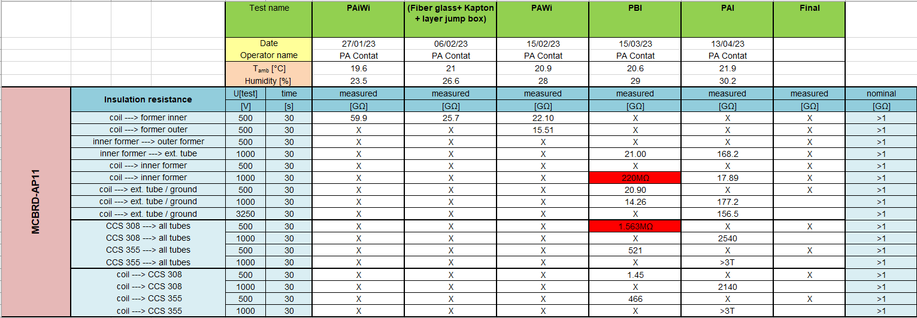
MCBRD12 AP11: Hi-pot & magnetic tests acceptance
Hi-pot test passed after impregnation (PAI), ready on shelves (QC Hi pot test to formers at dry is mainly for check). AP11 insulation similar to majority of coils
Magnetic test is conform

Slide 15
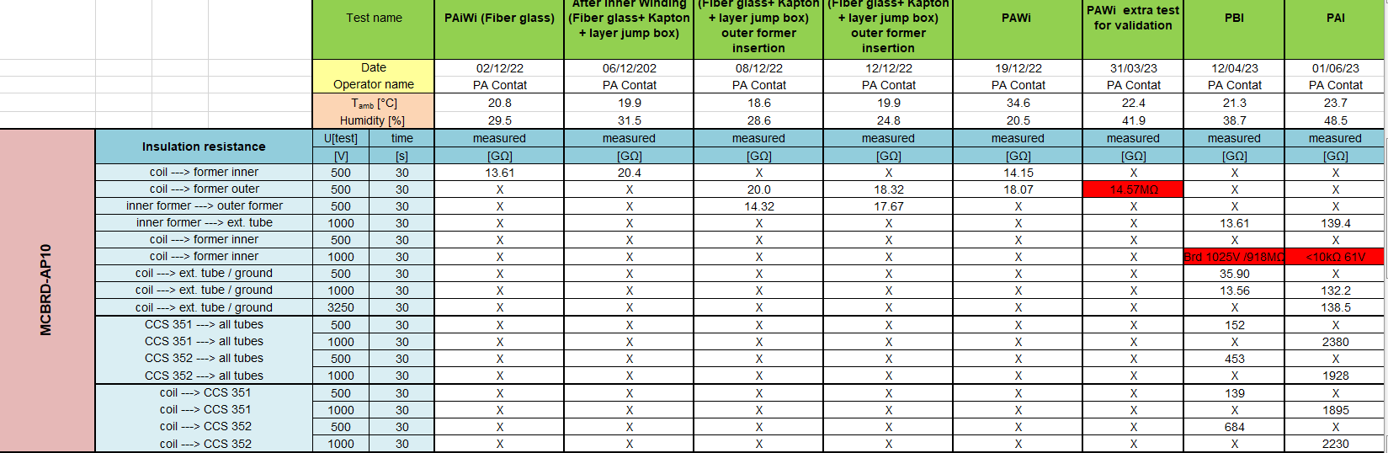
MCBRD12 AP 10: Hi-pot tests acceptance
AP-10 Hi-pot test shown unusual low insulation resistance level (10 kOhms) between coil and floating inner/outer former After impregnation (PAI) (EDMS NC 2907797).
See next localisation and frequency Z method confirmed fault value to floating former.
Note excellent ground insulation at 140 Gohms.

Slide 16
Root cause analysis, AP10 - Actions
A1- Splicing : AP10 suffered a first unusual issue of broken strand during splicing which required repair (NC 2818415)
A2- Post impregnation : The insulation resistance coil to formers of few MOhms did not increase after impregnation (PAI) like most of past coils to Gohms.
  Localization test on direct fault ( ∼10kOhms, post impregnation ), close to interconnection box, i.e not related to winding.
  Plausible root cause is loss of EE107 VTs worsening during tube insertion.
  As no feedback on possible fault time evolution, decision not to be installed.
Recovery actions :
  Production of new Alu formers, tube at CERN as replacement of AP10
  Use left CERN stock of sc insulated wires. Parallel order of a 10 kms reserve SC insulated wire ( enhanced bonding).

Slide 17
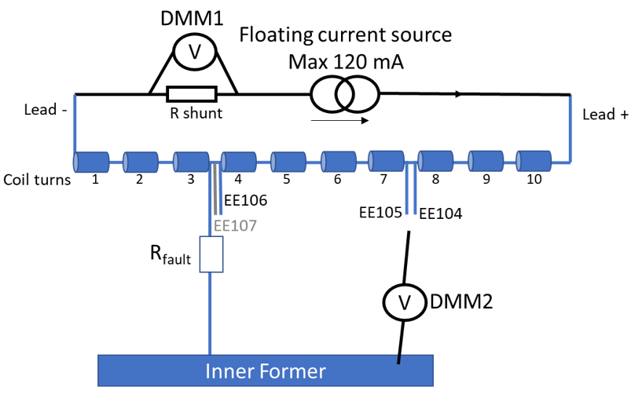
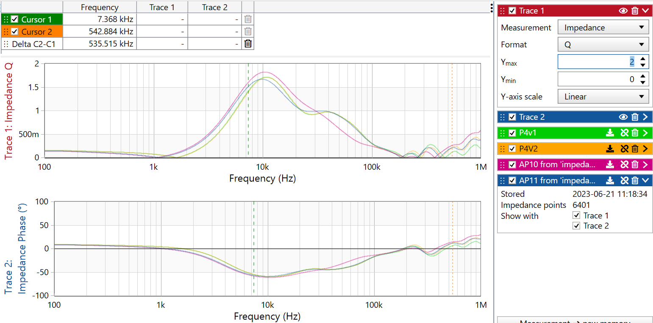
AP10 diagnostics
DC voltage fault localisation method allowed to locate direct short of 13 kΩ at about 6 cm from splicing box entrance, close to EE106 voltage tap. (EDMS 2918370, MPE report)
Z frequency measurement : insight from quality factor Q measurement vs. frequency showing clear deviations from the sane coils
Mateusz Bednarek, MPE
F.O Pincot, MSC

Slide 18
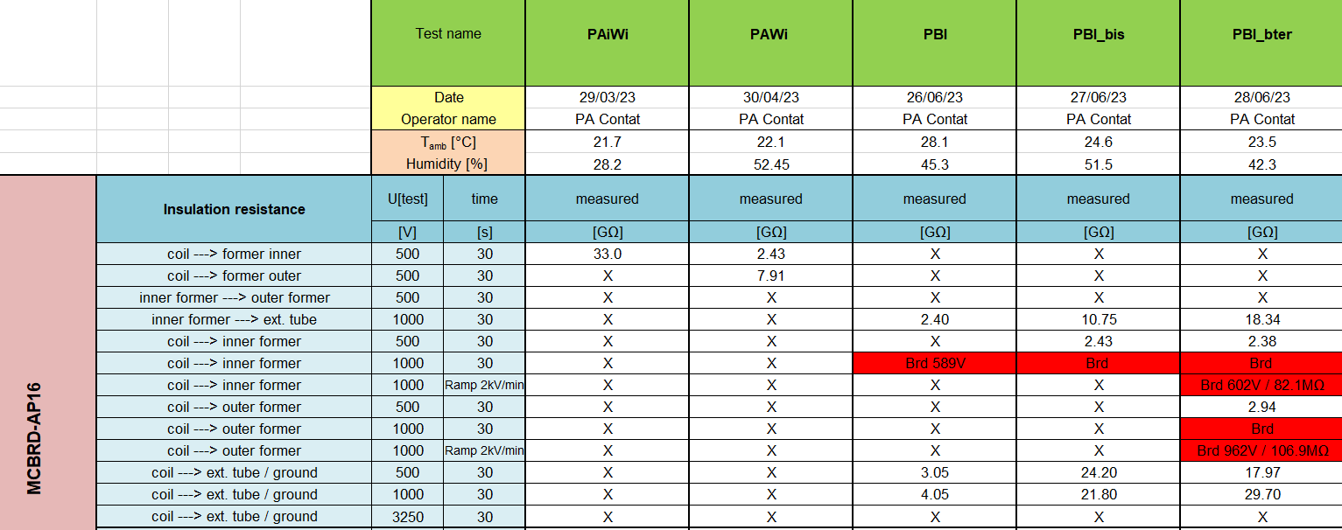
AP16 – Hi-pot test outcome- ( winding stage)
AP-16 Hi-pot test passed during winding (PAWI) but not before Impregnation (PBI).
Following experience from AP10, decision not to further impregnate, investigate ( on going) and rewind once root cause identified.

Slide 19
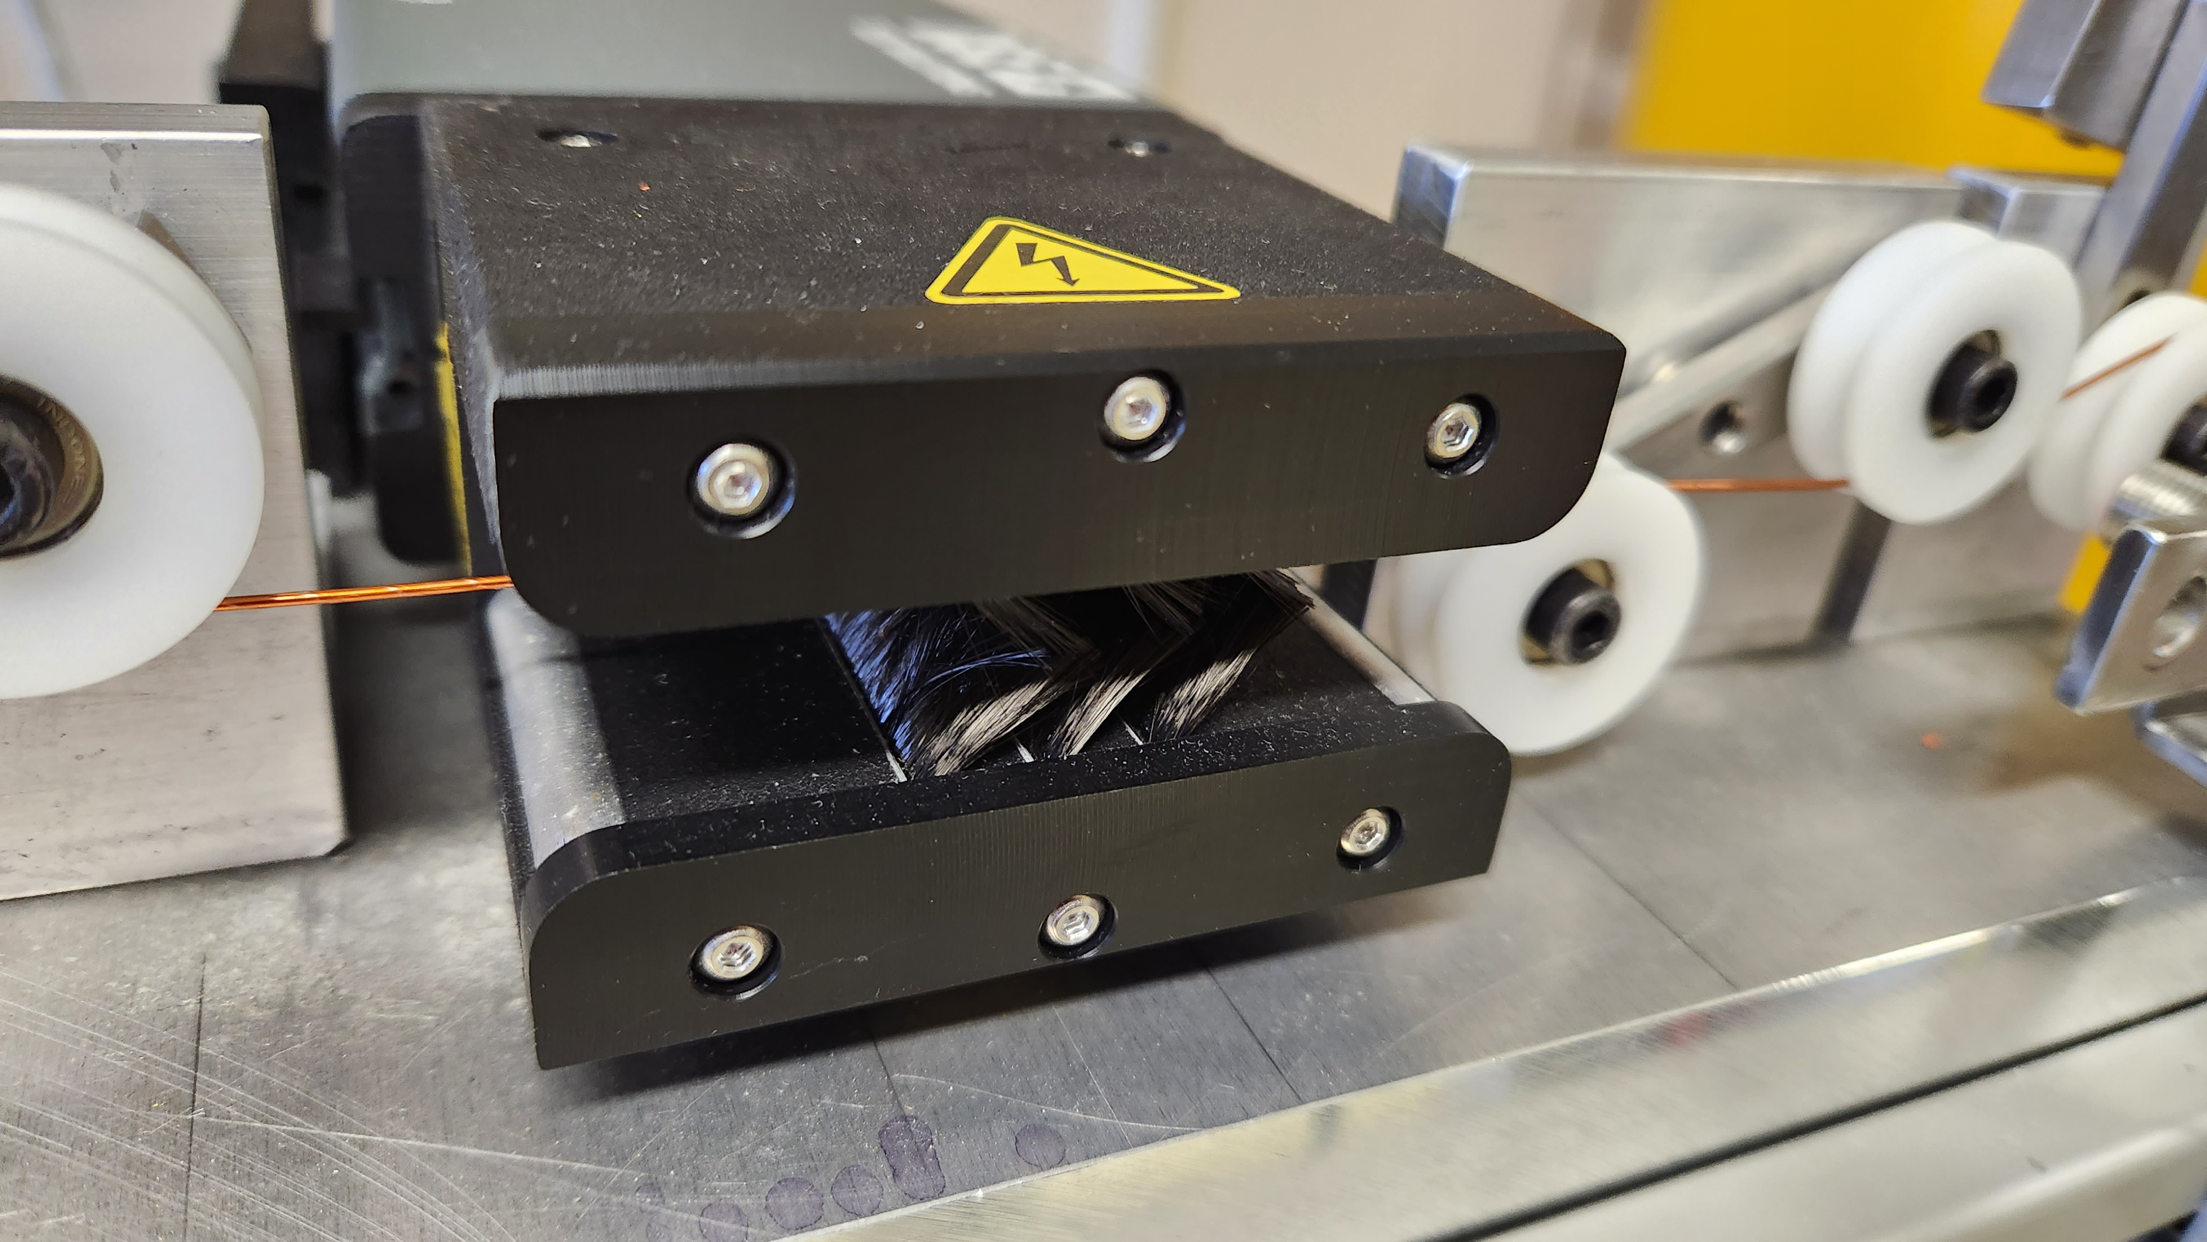
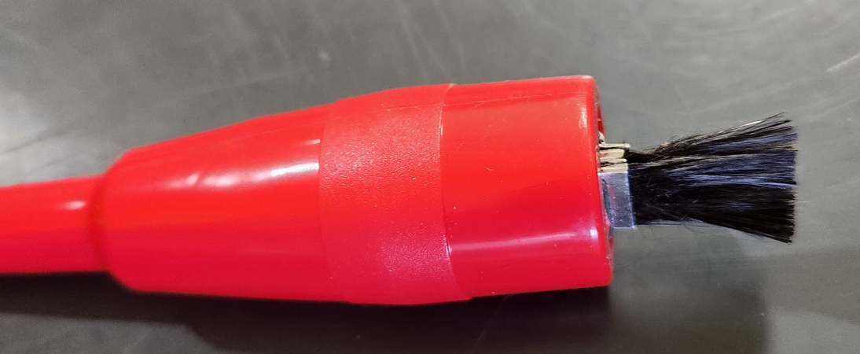
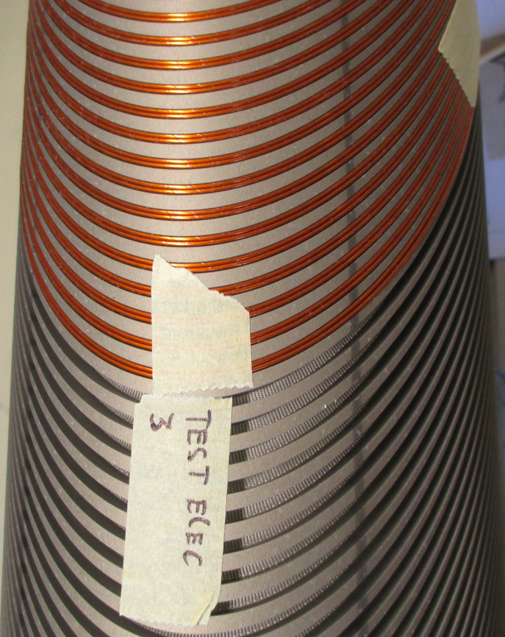
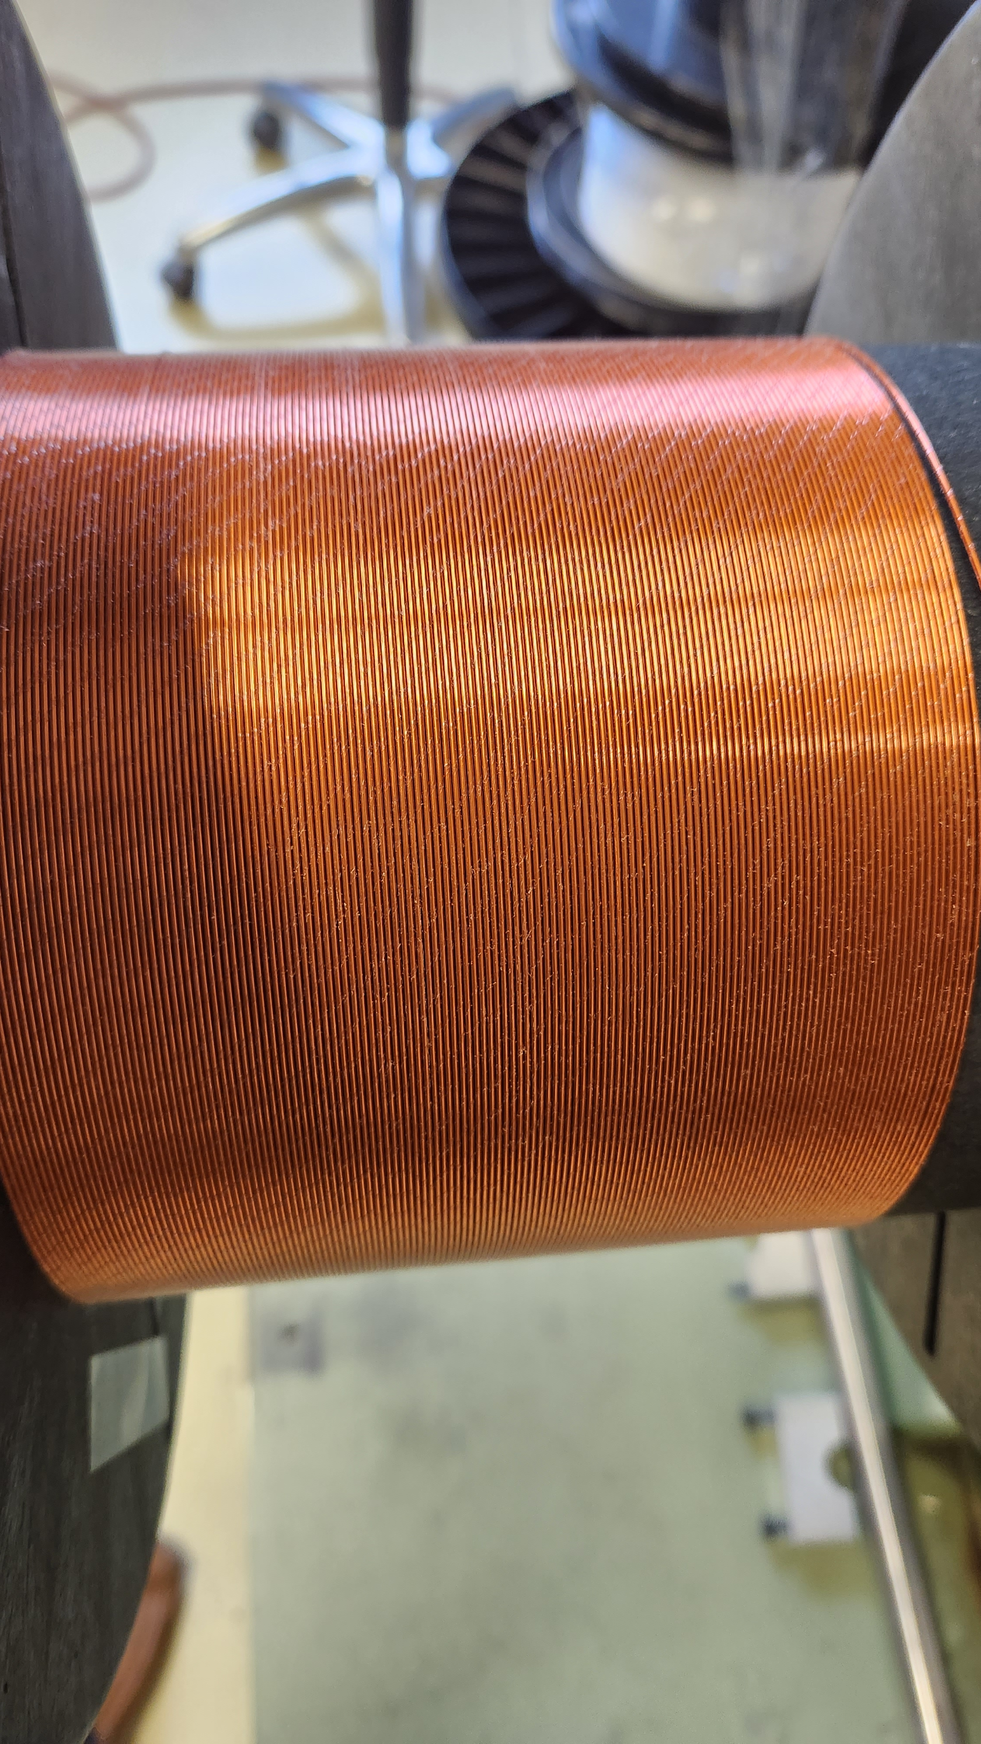
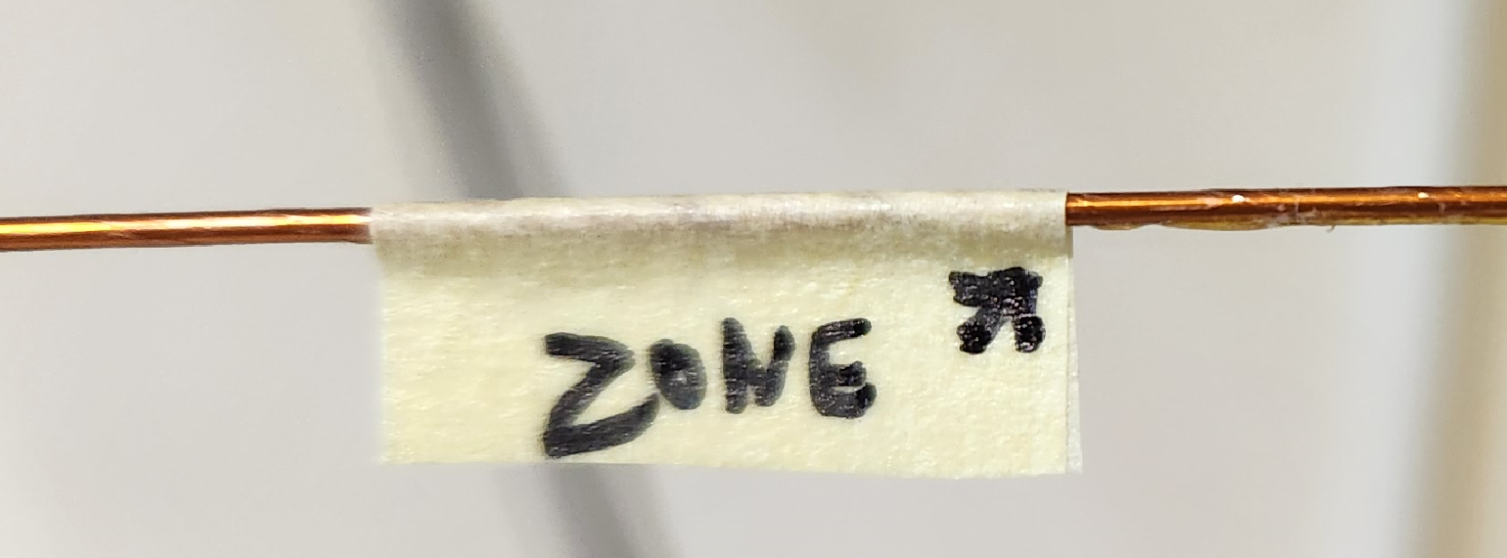
AP15 winding, root cause analysis, actions
First decision to add bottom extra 0.17 mm tck fiber glass at bottom like IHEP ( extra height and electrical barrier)
Additional QC intermediate Hi-pot tests on the manual winding process ( ∼ each 1/5th layer)
2/3 inner layer passed Hi-pot test, last section did not.
  Root cause analysis report EDMS 2936245 pinpoints occurrence of damage at each tip (50 cm) under 1kV test
  Only two bottom wires affected due to winding process, enhanced by low bonding of WST wire insulation (270 deg C cured, vs.400 degC on P4) and relative sharp former edge.
Actions:
  CERN 927 team developed an improved tooling with extra protection (next slide).
  Rewind started using SC CERN wires from stock with best curing temperature feature (310 degC).

Slide 20
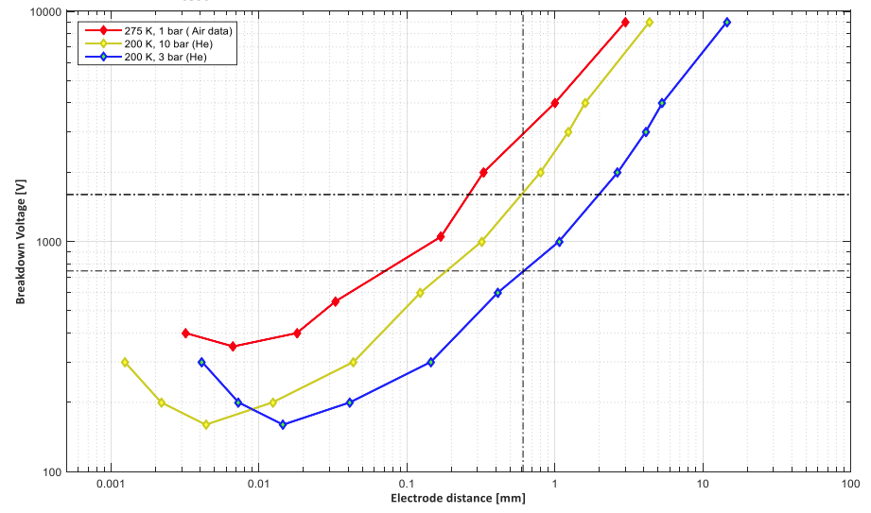
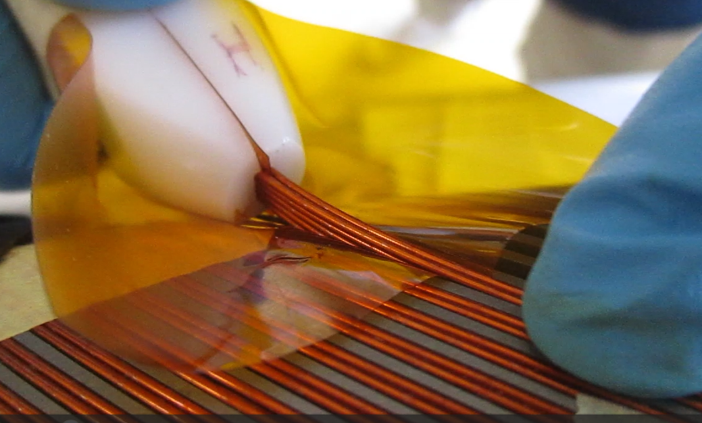
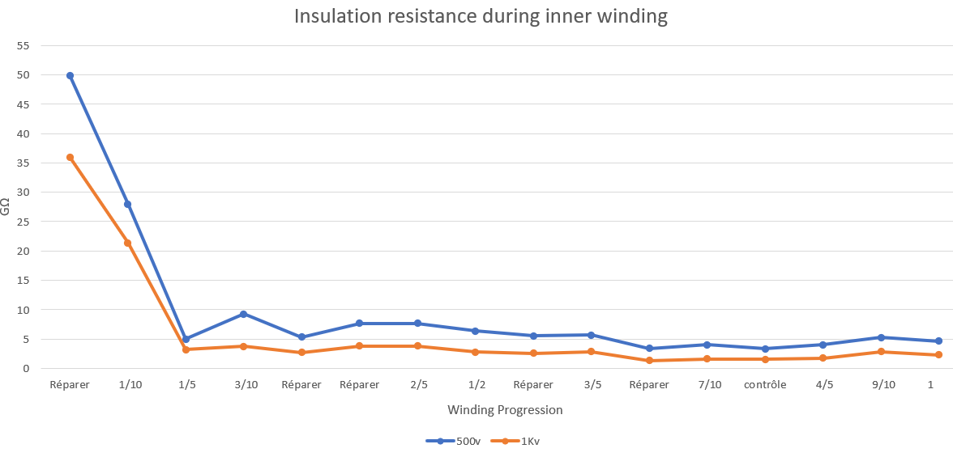
QC analysis and improvement of winding
  New PI sheet travelling funnel as protection of bottom wires insulation (Fig.1)
  Progressive Hi-pot testing during winding to check any porous insulation (Fig.2)
  Occurrence of breakdowns at ramps to 1 kV at respective 600 V or 900 V due to Paschen conditions in either possible 65 microns or 110 microns wide air gap. (Fig.3)
A
B
A
B
Fig. 1- New travelling PI protective sheet, 50 mic. thick guiding funnel
Fig. 2 - on going progressive Hi-Pot test coil to inner former on AP15 winding (09/2023)
Fig. 3 - Paschen curve in air, 1 bar, @273 K ( red line)

Slide 21
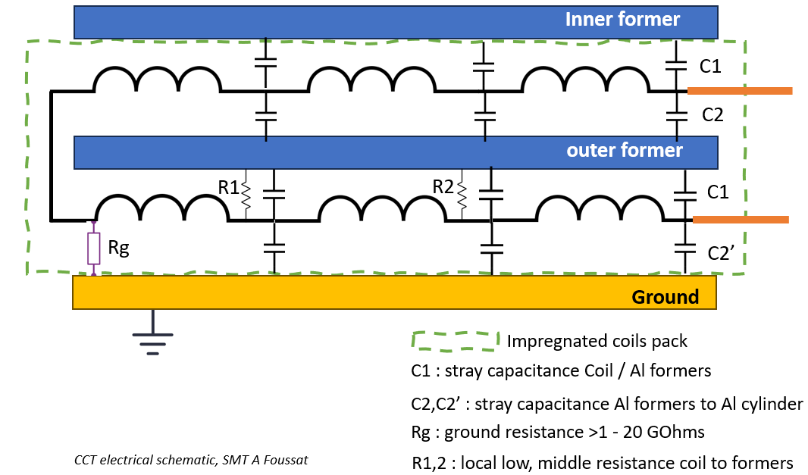
Electrical insulation of floating formers to Coils (MPE-MSC)
A- “Occurrence of one short coil to the formers on its own does not pose any problems for the operation unlike multiple shorts”
  What are acceptable double short values level of R1,R2 ?
  From quality assessment point of view, too weak insulation is a strong indication and can be a cause of rejection. ( note no information on fatigue)
B- Insulation faults to floating inner formers cannot be detected after magnet assembly. QC tests during manufacture like hi-pot test and Impedance measurements can intercept shorts at production.
C- Indications of Capacitive effect from floating formers ( ∼ 200 nF) during Hi-pot testing campaign of AP10: Charging from dV/dt hi-pot test history of several 10’s volts. To be further discussed with MPE to analyse pro & con’s, see if any measures to be taken. ( inner formers not accessible in MCBRDs)

Slide 22
Assembly schedule (next 6 months)
Milestones | Date
MCBRD 11, 12 components delivered at CERN | mid Feb. 2023
1st series magnet assembly at CERN (MCBRD12) | Nov. 2023
2nd series magnet assembly at CERN (MCBRD11) * | Feb 2024
Cold test at CERN (MCBRD12) | Dec. 2023 – Jan 24
Cold test at CERN (MCBRD11) | By April. 2024
* Need IHEP delivery of MCBRD11 structure by End September 2023.

Slide 23
Summary
The manufacture of MCBRD11, 12 has started with apertures production using IHEP delivered components following last proven MCBRDP4 procedures.
  Aperture AP11 is ready, approved for magnet assembly,
  Impregnated AP10 shown low electrical insulation to formers, rejection of coil. Production of new formers by December 23.
  Further setbacks providing several insights from AP15, AP16 winding in presence of weak wire insulation type, partial anodisation cases. Production back to track with adaptation of 927 winding tool. Target of first 2 coils readiness for assembly by November 23.
Last update series electrical diagram approved by IHEP as compliance set from MCBRD04
Large work of standardisation consolidation and repair in front ends carried out at CERN (180, 927 teams) on CERN prototypes (3,4) and first IHEP series 01, 02 then 03.
CERN Magnet assembly of MCBRD12,11 planned respectively by Dec 23, Feb 24 followed by cold test in SM18. ( last IHEP structure shipment by end Oct.)

Slide 24
Acknowledgment to active contributors from 927 SMT team
Carlos Fernandez, Frederic Garnier, Veronica Ilardi, Pierre Antoine Contat, Francois Olivier Pincot, Ruth Diaz Vez, Sabine Menu, Pietro A. Rizzo, Dominique Cote, Ahmed Benfkih, Cedric Urscheler, Sebastien Clement, Roland Piccin, Diego Perini, Ezio Todesco.
and our colleagues from IHEP supplying components:
Qingjin Xu, Yingzhe Wang

Slide 25
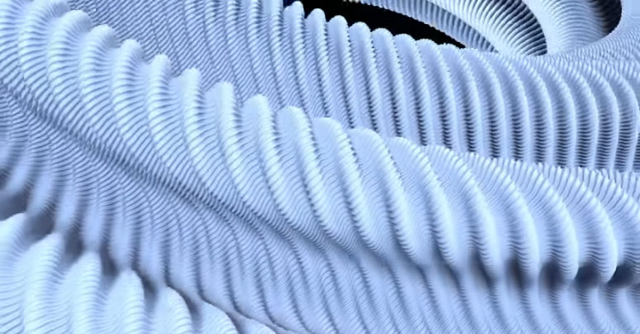

Thank you for your attention

Slide 26
BACK UP SLIDES

Slide 27
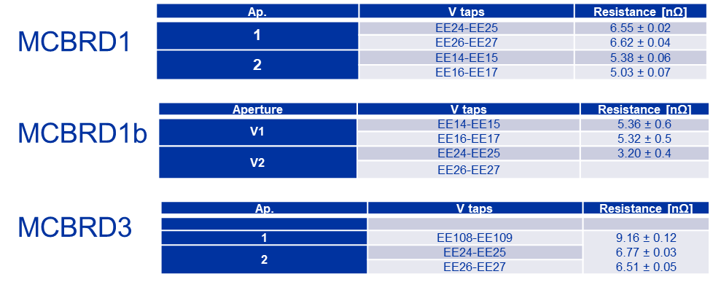
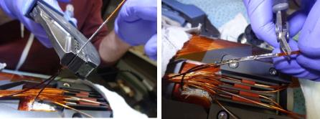
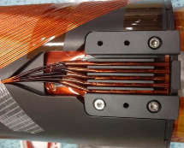
splicing resistance
MCBRD exhibit joint average resistances at 6 but some deviates on series up to 10 nOhms at nominal current. Some update design is being considered in future CCT to target 1-2 nOhms range. ( key for large joints number in CCTs)
Long series MCBRD : 9 splices per aperture
45 mm long
Crimping with “non insulated end-
sleeve “ (= tube)
Sn96Ag4 welding alloy
Flux MOB39
Polyimid sleeve for protection
G10 connexion box

Slide 28
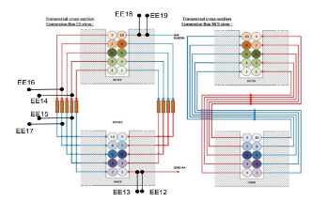
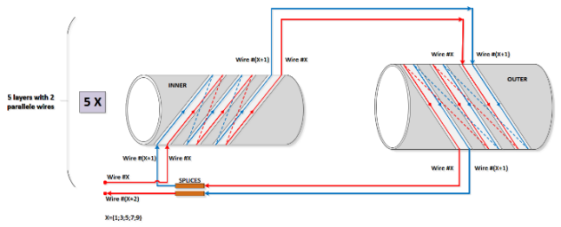
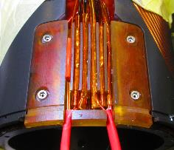
Inter layers series splicing
10 wires winding layers spliced in series in the connection box
  10 voltage taps wires and 9 SC wires splicing
  Crimping, Sn96Ag4 soldering and polyimide insulating
  Current design reaches joint resistances values of 7-8 nOhms at cold when procedure is applied.
Fig.1 Series splicing terminal connection box

Slide 29



VPI impregnation
CB 10,11 followed the VPI update CERN procedure EDMS 2002875
  Use of milking cycle turn out useful, N2 gas overhead pressure on tank
All apertures VPI impregnation followed same procedure and exhibit similar filling, hydraulic behavior as previous MCBRDP4 ( circ. 1h filling time, overhead pressure up 0.7 b in tank)
Capacitance monitoring had issues of grounding, partially good on AP10 ( under progress)
CB11

Slide 30


Splicing
Splicing executed according CERN procedure EDMS 2002873/1.1 .
NC 2818415 on AP10 : Broken wire MCBRD12-V1 - HCMCBRD_C015-CR000001
  An issue occurred due to misalignment of crimping tool;
  Solution: wires connection order could be adapted:
    outer wire 7 spliced with the inner wire 10 with 2 Vtaps.
    outer 10 is spliced with the short inner 8 without instrumentation.

Slide 31


Consolidation of CS front end
Following Hi-pot voltage limitation found below 1650V test value at cold on both MBRD01, MBRD02 during Q4-2022, baseline design was updated to minimize assembly risk.
Issuance of ECR 2797173,
MCBRD01: NC2755485, MCBRD02: NC2795912
Finding of damaged VT wires, braids during front end assembly, not all PI insulated wires.
A new routing was proposed to minimize wires crossings ( see next slide). All protective fibre glass sleeves have to be replaced, soldered joint consolidated with PI sleeves and thermo shrinkable sleeves.

Slide 32



Front end wires routing
Routing update decided of VTs and leads wires from MCBRD01, 02, 11, 12, P3, P4. localized in front end routing CERN agreed to update design to limit risk during assembly
    In-situ local machining of end plates
    Separation of VTs and Leads channels on double level to avoid successive crossing risk;
    Use of newly produced transparent Ultem® covers.
CERN decided to apply this update to all 6 magnets incl. P3b & P4

Slide 33


End plate machining
Local machining example on MCBRDP3b of the central channel in SS end plate for installation of new routing covers
End VTs splices
SC Leads wire routing

