Slide 1

Magnet installation and interconnection into the HL-LHC IT String
Sandrine Le Naour
CERN, TE-MSC
13th HL-LHC Collaboration Meeting, Vancouver (Canada), 25-28 Sept 2023

Slide 2
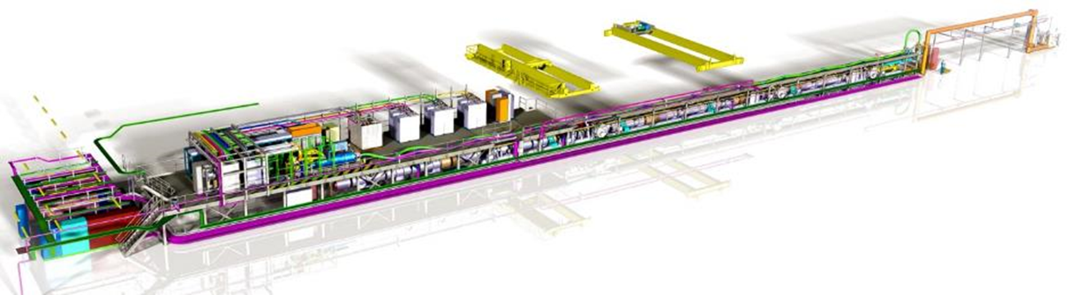
HL-LHC IT String
The IT String is a test bench to simulate a part of the IT region for the High Luminosity project. The scope is :
To develop and validate the installation sequences and procedures
To validate the collective behaviour of the powering system before the installation in the LHC
See M. Bajko presentation
on present status (25 Sept)

Slide 3
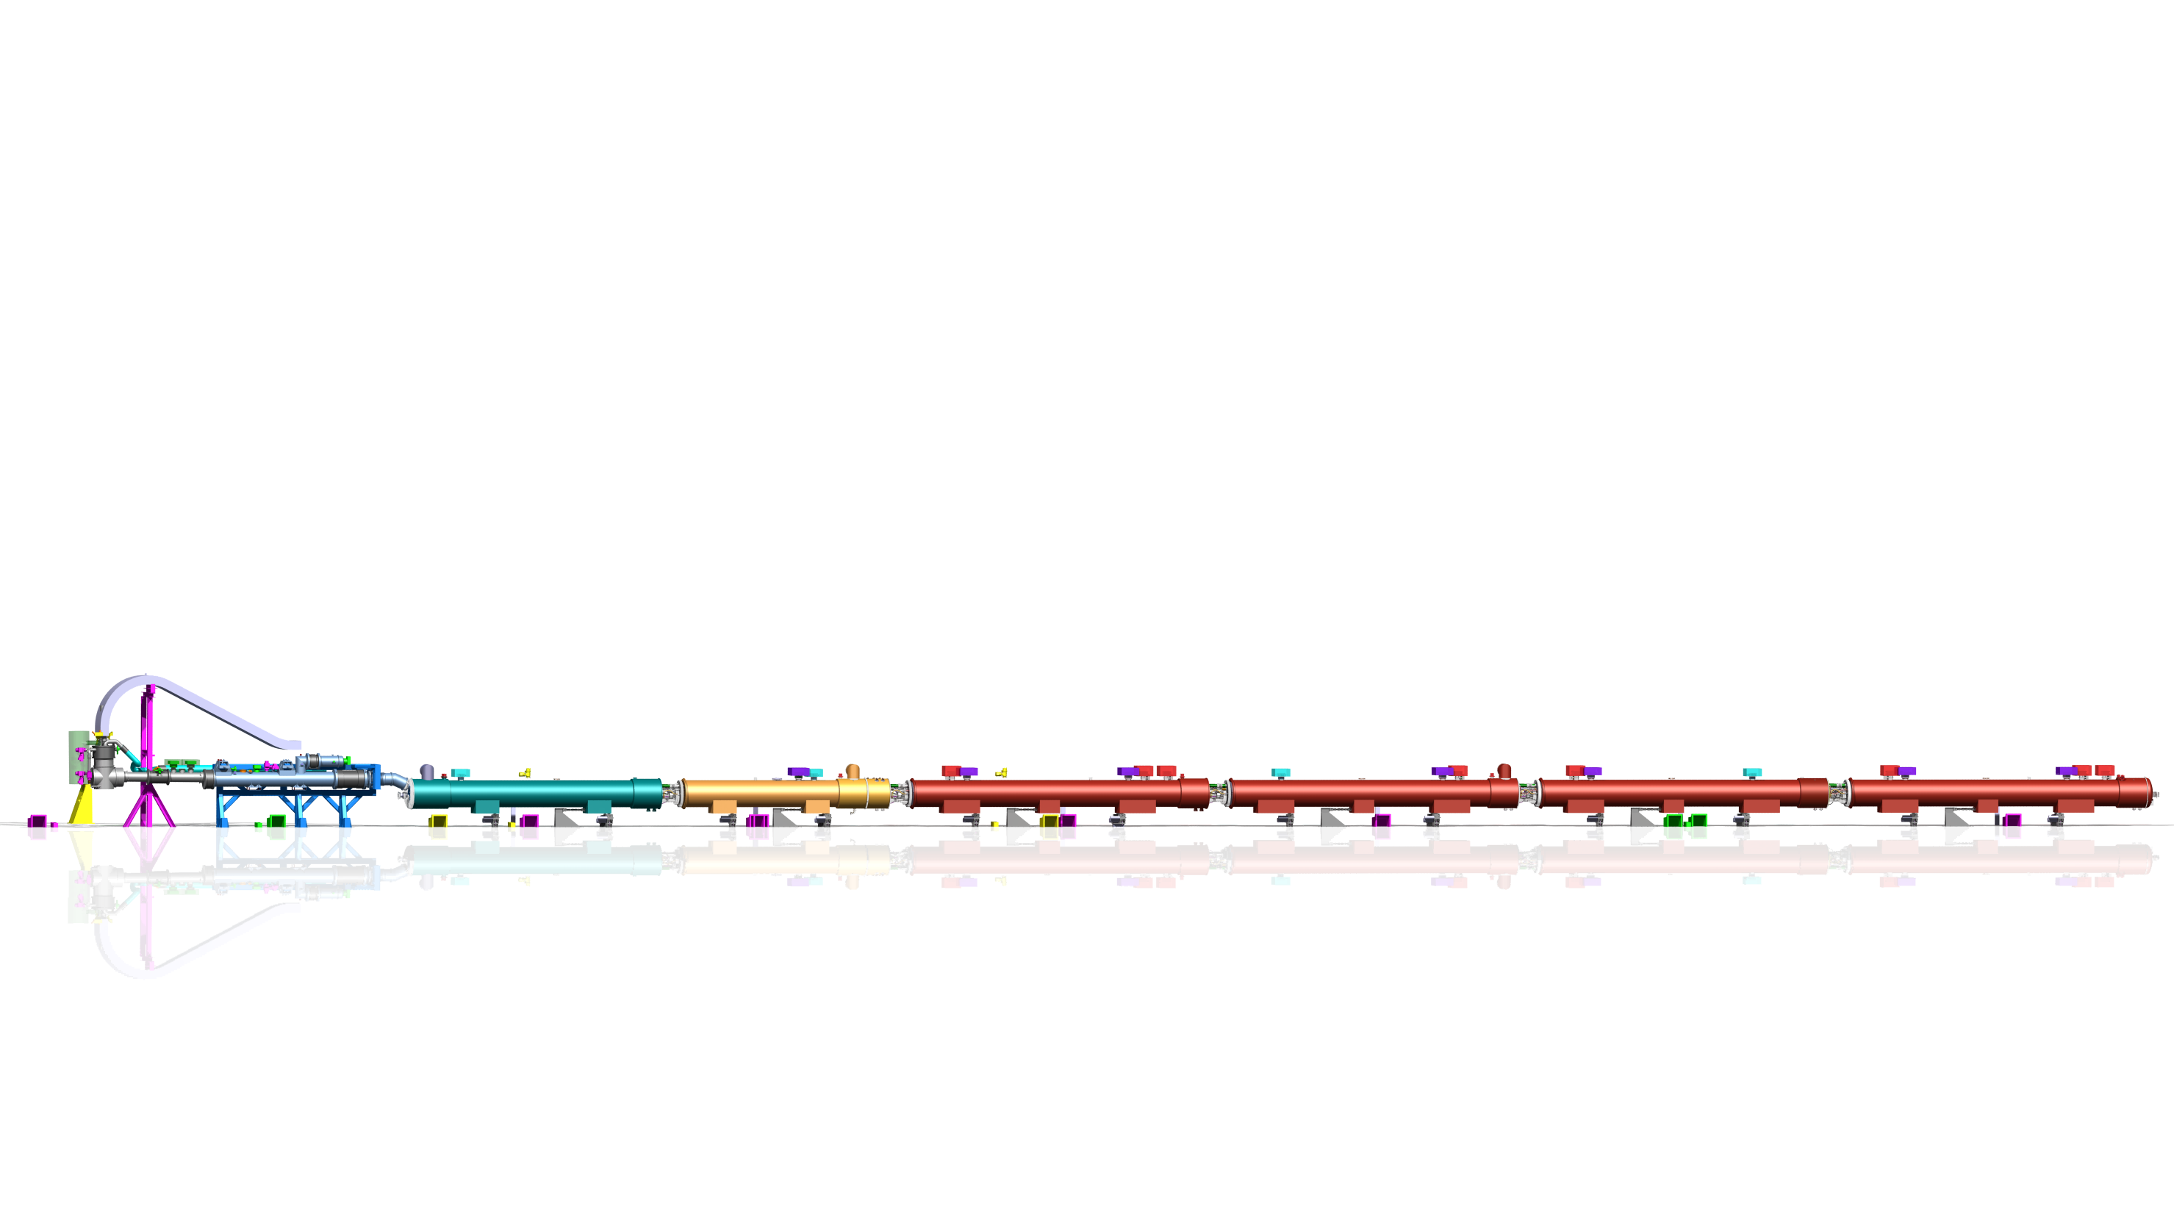



HL-LHC IT string magnets connection
The presentation will concern the magnet connection from the Q1 to the DFX (7IC) and the jumper connexion to the SQXL (3 Jumpers).
WP3 will provide (see WP3 contribution to WP16 document : EDMS 2188575 )
  the DCM and the cryo-magnets (proto or spare assemblies)
  the jacks and the anchors, installed by EN-ACE
WP6a will assemble and install the DFX (see WP6a contribution to WP16 document : EDMS 2188577). The DFX is in place prior the magnets installation
TE-MSC will be in charge of the cryo-magnets connection (see Summary of TE-MS contribution to WP16 document : EDMS 2755342)
DFX
DCM
D1
CP
Q3
Q2b
Q2a
Q1

Slide 4
Cryo-magnets for the IT String
The cryo-assemblies considered for the IT string are :
Q1 cryo-assembly with MQXFA05 and MQXFA06 (spare assembly)
Q2a cryo-assembly with MQXFBP3 and MCBXFBP2b (prototype assembly)
Q2b cryo-assembly with MQXFBP2b* and MCBXFBP1d** (prototype assembly)
  Quench performance limitation : *NCR 2638374, **NCR 2687264
Q3 cryo-assembly with MQXFA03*** and MQXFA04 (QH NCR: ***EDMS 2769128; ***EDMS 2883868)
Corrector package cryo-assembly with MCBXFAP1 and 9 High Order Correctors- (spare assembly)
D1 cryo-assembly with MBXFP1 (spare assembly)
DCM (D1-DFX Connection Module (spare assembly)
All magnets will be tested at 1.9K before the installation to the IT string. The Q3 cryo-assembly will be tested twice, at FNAL and at CERN for cross-checking.
After the test at cold and before the installation to the IT String, the MAB (Magnet Assessment Board) gives a cryo-magnet evaluation and recommendation if specific issues. According to WP3 schedule (EDMS 2645484), all cryo-magnets but CP are measured at 1.9K by spring 2024.

Slide 5
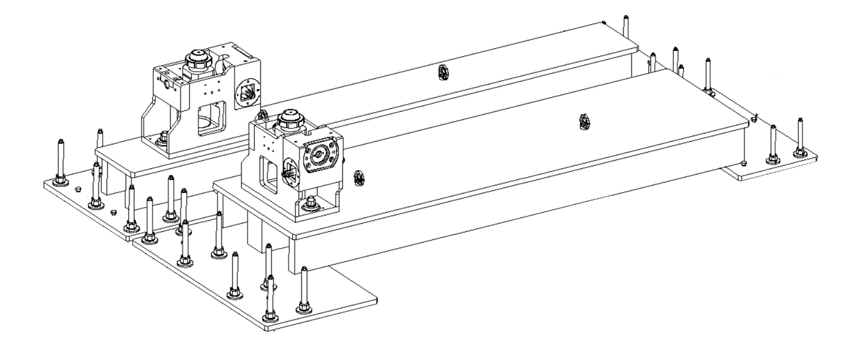
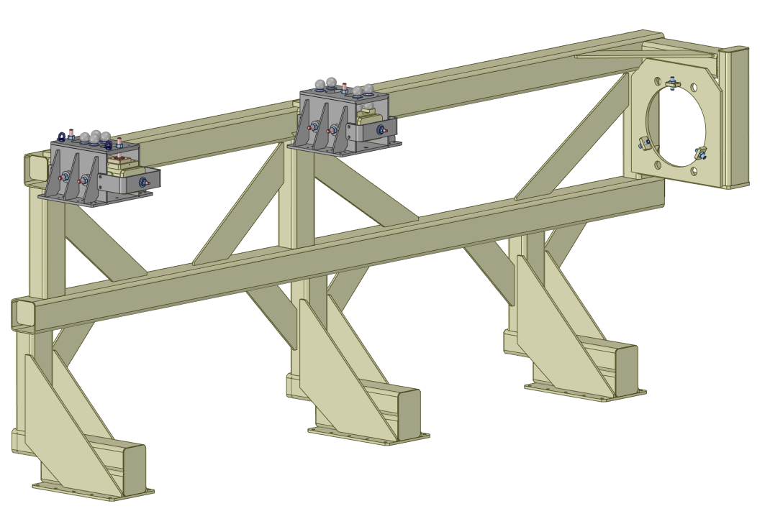
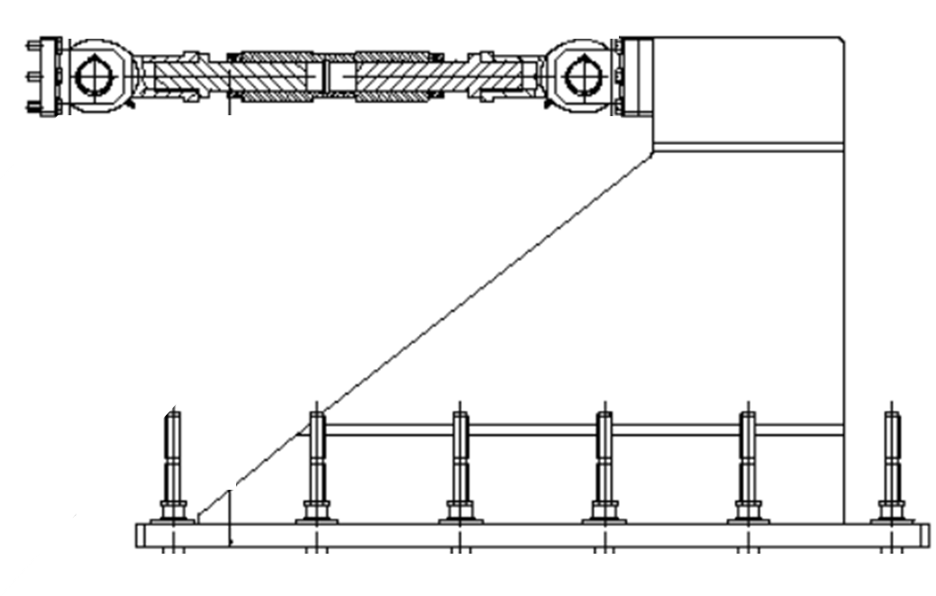
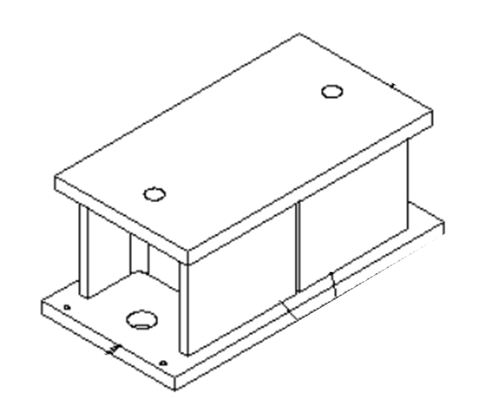
Cryo-magnets installation - support
All supports for the cryo-magnets and the DCM are at CERN or in production.
The support will be installed by EN-ACE and the integration drawing is available : LHCLJXS_001
The installation procedure is given in EDMS 2757081
Jacks : LHCHQHL_0001, LHCHQH C_0001 Received
Bridge over the gallery below Q3 : LHCLJXS_0034 In production
Shims (String heigh adjustment): LHCLJXS_0028 Received
Anchors for IT String (no shim) : LHCHQFXM0014 In production
DCM Frame (no shim) : LHCLDQD_0367 Received
Bridge for Q3
with the jacks
Shim
(0.19m heigh)
Anchor for IT String
DCM Frame

Slide 6

Cryo-magnets installation - Busbar
DFX
D1
CP
Q3
Q2b
Q2a
Q1
DCM not in place
1 cable
18kA busbar: 5 cables / 3 cables / 2 cables / /
2kA busbar 3 sets of 4 cables / 2 sets of 4 cables / 1 set of 4 cables /
Connected to the power converters via the SC link, seven 18kA cables and twelve 2kA cables arrive in the DCM to power the main magnets from Q1 to D1 and the MCBXF correctors.
Busbars must be installed before the magnet connection
  All magnets from D1 to Q2a must be installed and aligned
  DCM not in place for the insertion of the lines N (N1 and N2)
  N1 is a set of 5 cables for 18 kA supply (45 m long)
      2 connections in CP – Q3
      1 connection in Q3 – Q2b
  N2 is 3 sets of 4 cables for 2 kA supply (55 m long)
      4 connections in CP – Q3
      4 connections in Q3 – Q2b
    2 connections in Q2b – Q2a → One splice to end of Q1 busbar
    4 connections in Q2a – Q1

Slide 7
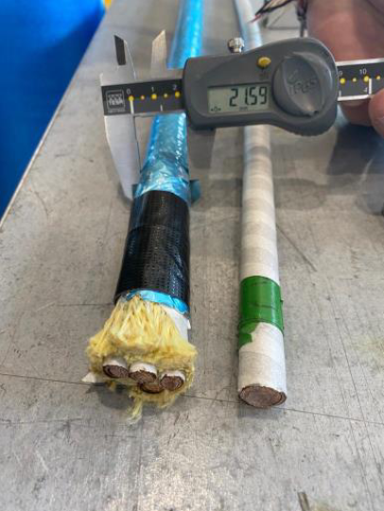
Line N procurement
18 kA Busbar Cable
  Issue on cable rigidity in 2022, fixed in Jan 2023 (wrapping load reduction of polyimide tape)
  Reception of 300m of cable in Feb 2023 with a correct flexibility
  200m of cable given for the DCM assembly
  Production of the set of 5 cables (Line N1) by TRATOS (amendment in Mar 23)
    Delivery of 1 set in Oct 2023 !
    Total production of 6 sets of cables (one spare only)
    Up to now no insertion test with SC cables, only with Cu cables on a short length mock-up (10m)
2 kA Busbar Cable
  Reception of 70 m of 1 set of 4 cables, end of May 2023 with an unexpected diameter (21.6mm)
  60 m of the cables set given for the DCM assembly
  Production of single set of 4 cables by TRATOS
    Delivery Oct 2023 !
    Line N2 assembly made at CERN
    Up to now no test insertion done with SC cables !
Set of 4 cables
for 2kA supply
1 cable for 18kA supply

Slide 8
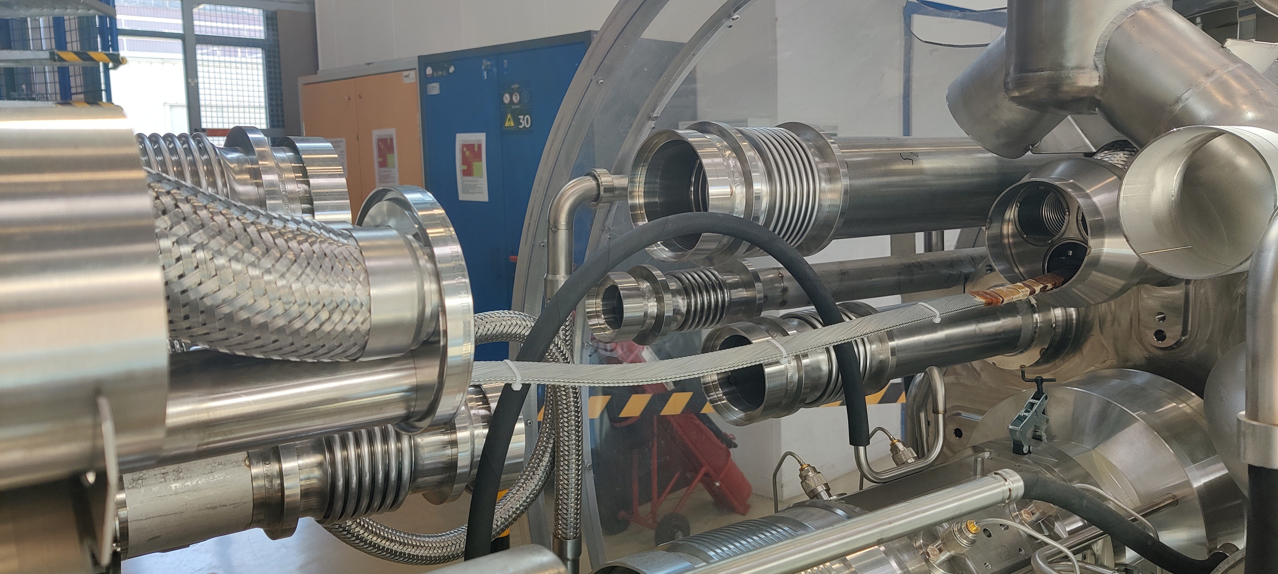
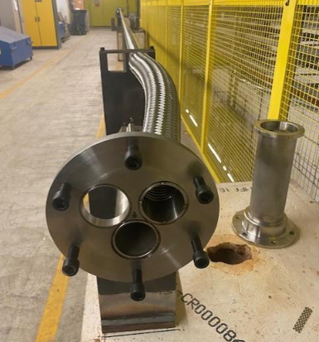
Line N insertion
Flange restriction
Each line N is inserted in an aperture of Ø 50 mm and in a flexible to run along the magnet
  Expected diam of N1 (18kA) : 45 mm (set of 5 cables)
  Expected diam of N2 ( 2kA) : 48 mm (3 sets of 4 cables)
Interconnection mock-up (bld 180)
Significant friction are expected along the tubes
In addition, a flange restriction appears in the interconnection
Once the cables are received at CERN, we are ready for insertion test with a long mock-up (30m long)
Ø 50 mm
N2
N1
M : magnet leads
Line N mock-up (TT2A)

Slide 9
Magnet interconnection sequence
DFX
DCM
D1
CP
Q3
Q2b
Q2a
Q1
Line N insertion
Q1 to D1connection
DCM installation and its connection
Jumper connection
Interconnection sequence was detailed in String day II review in sept 2022, only main steps are described in this presentation

Slide 10
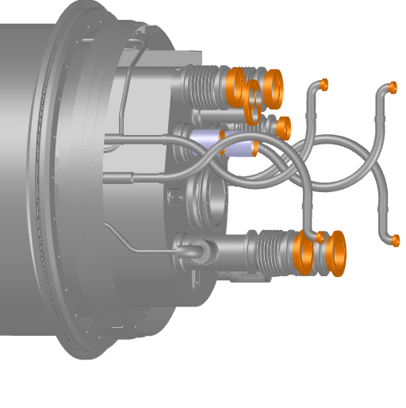
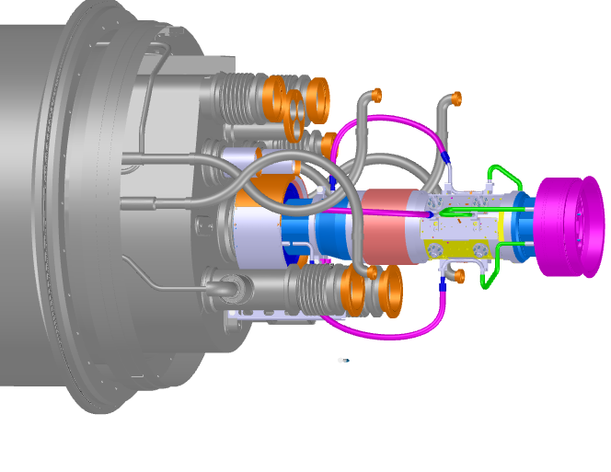
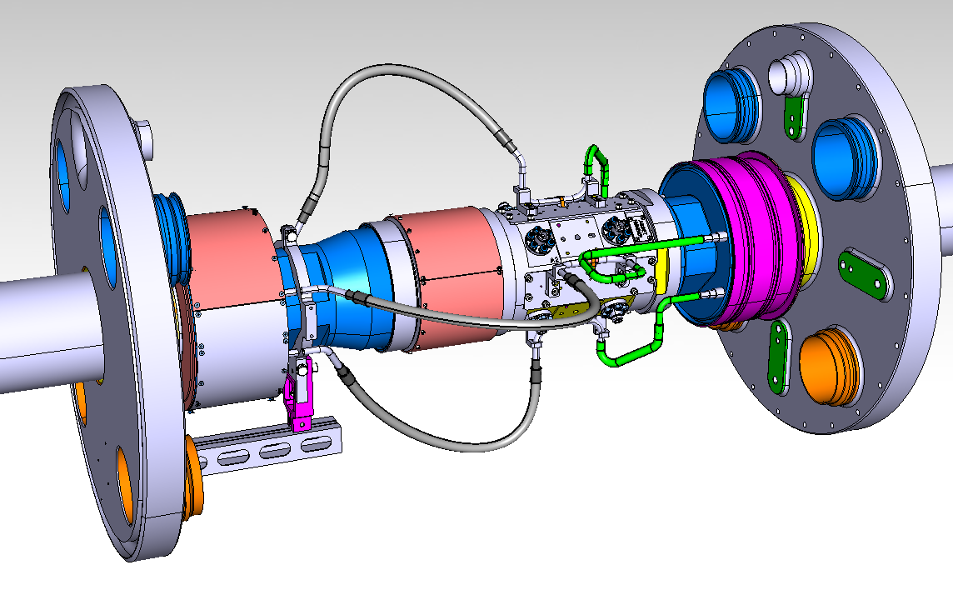
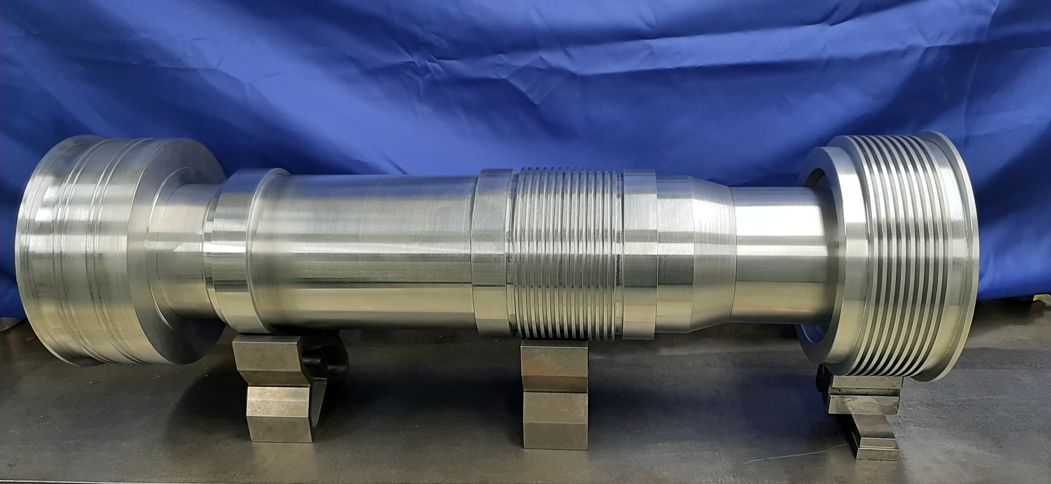
Q1 to D1connection : PIM installation
For the IT String, it was decided to not install beam screens, BPMs and PIMs, but they take a big volume in the interconnections.
To be as closed as possible to the conditions for the HL-LHC project magnet connection , we propose to install in 2 IC (CP-Q3 and Q2a-Q2b), dummy PIM-BPMs assembly. The assemblies will be fixed to the magnet cold bores. A system of sliding tubes with gimbles will allow thermal contraction and alignment movements. These dummy assemblies are provided by TE-VSC.
Courtesy TE-VSC
Core part of the dummy PIM-BPM assembly

Slide 11
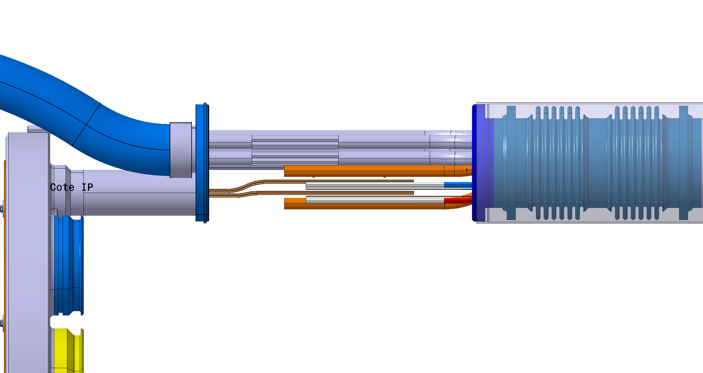
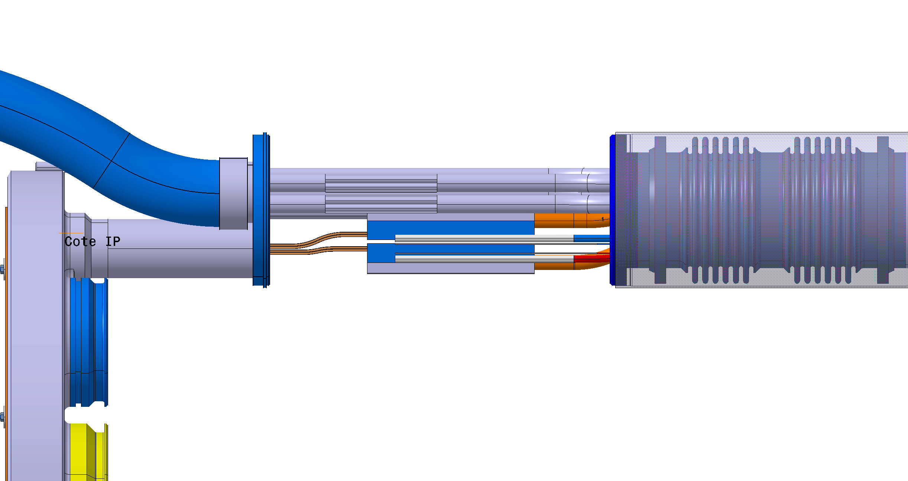
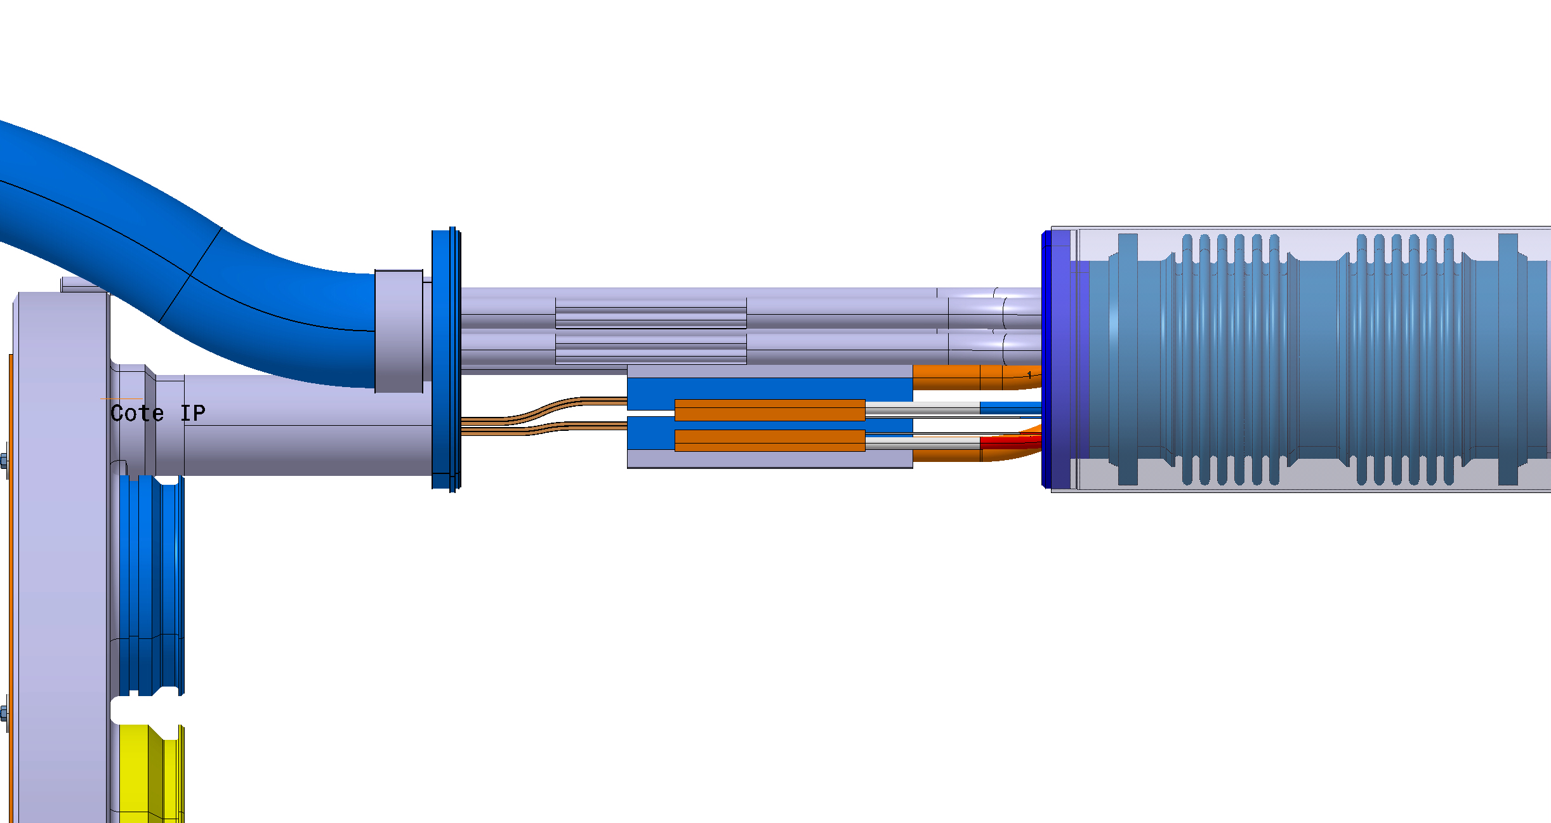

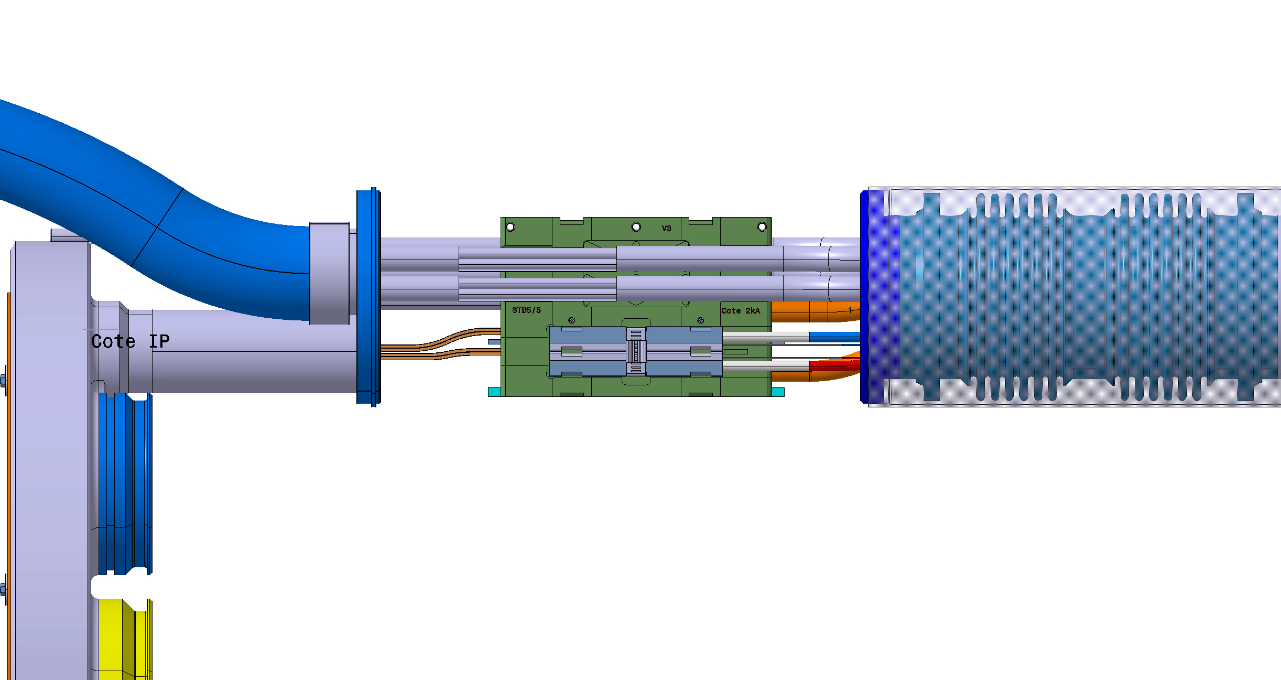
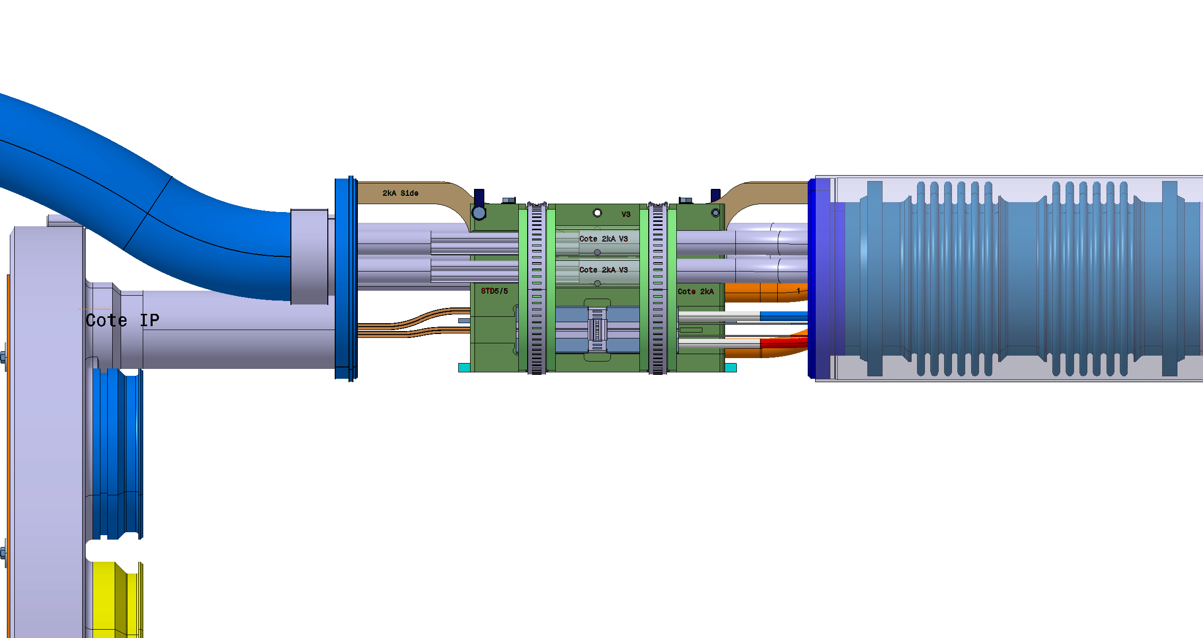
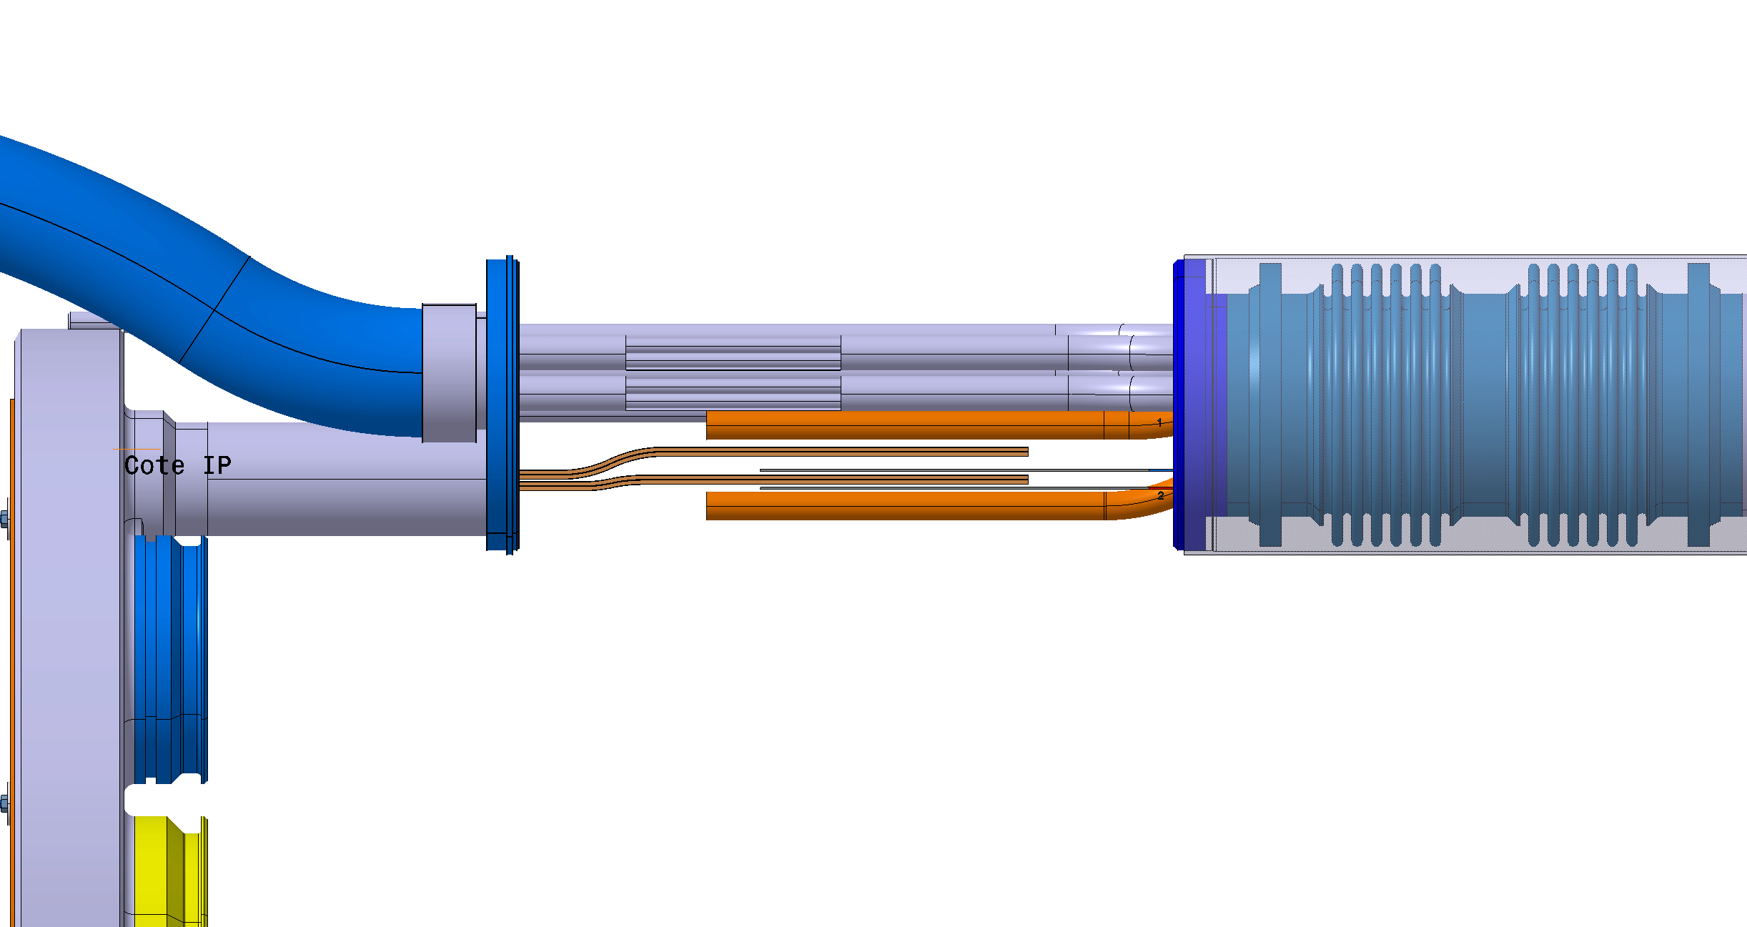
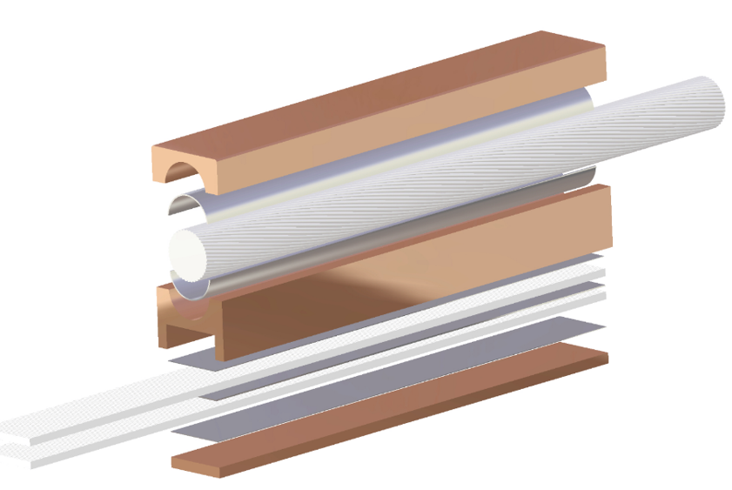
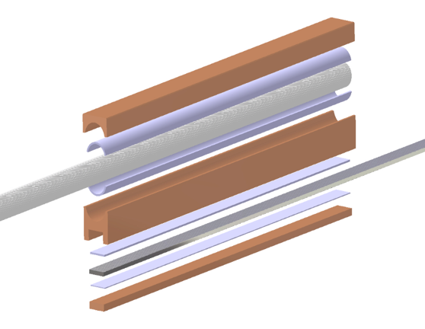
Q1 to D1connection : Splicing work
After the PIM installation, the next step is the M2N line connection with the splices soldering and the installation of insulation and fixe point components.
All splice soldering procedure are approved
  Ex: EDMS 2784612, EDMS 2784119 for splices type 1 and 5
All splice types are qualified.
  Electrical resistance at room and cryogenics temperature
  Mechanical test by EN-MME
Tools for soldering are available but need to be tested in real condition
To-do list
Installation procedures after test of lines N insertion and splicing exercise in real conditions
Finalising the tooling design and construction
Finalising the design of the insulation and fixe point components.
Production of the components
18kA & 2kA busbars for Q1, Q2
CP
Q3
Magnet leads
18kA & 2kA busbars to connect
Splice 18kA, type 5*
Splice 2kA,
type 1*
* Splice type from splice catalogue EDMS 2492410

Slide 12
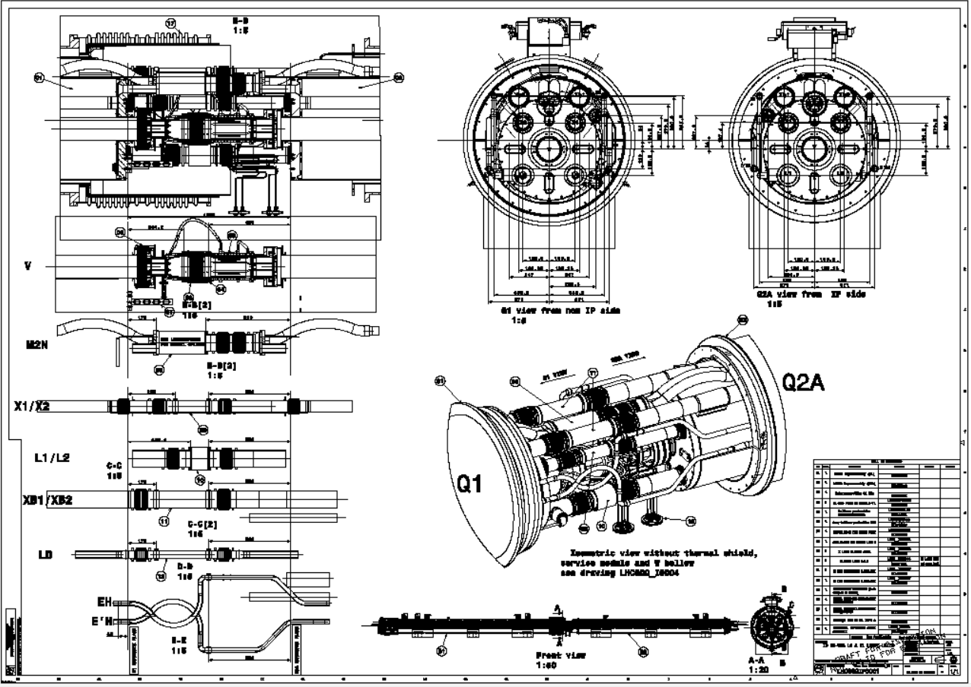
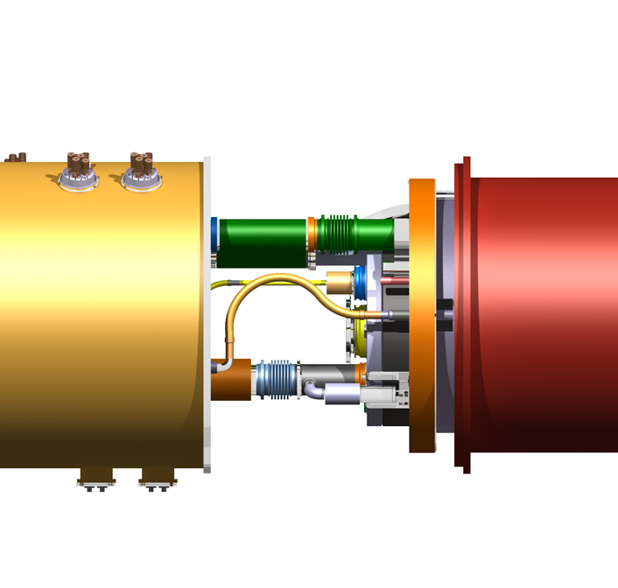
Q1 to D1connection : Cryo-lines welding
After the qualification of the splices and the visual inspection of the connection, the M2N line can be welded as well as all the cryogenics lines
Drawings of a first interconnection is done and in validation.
Drawings of the others IC are following
Launch the sleeves production before end of the year.

Slide 13
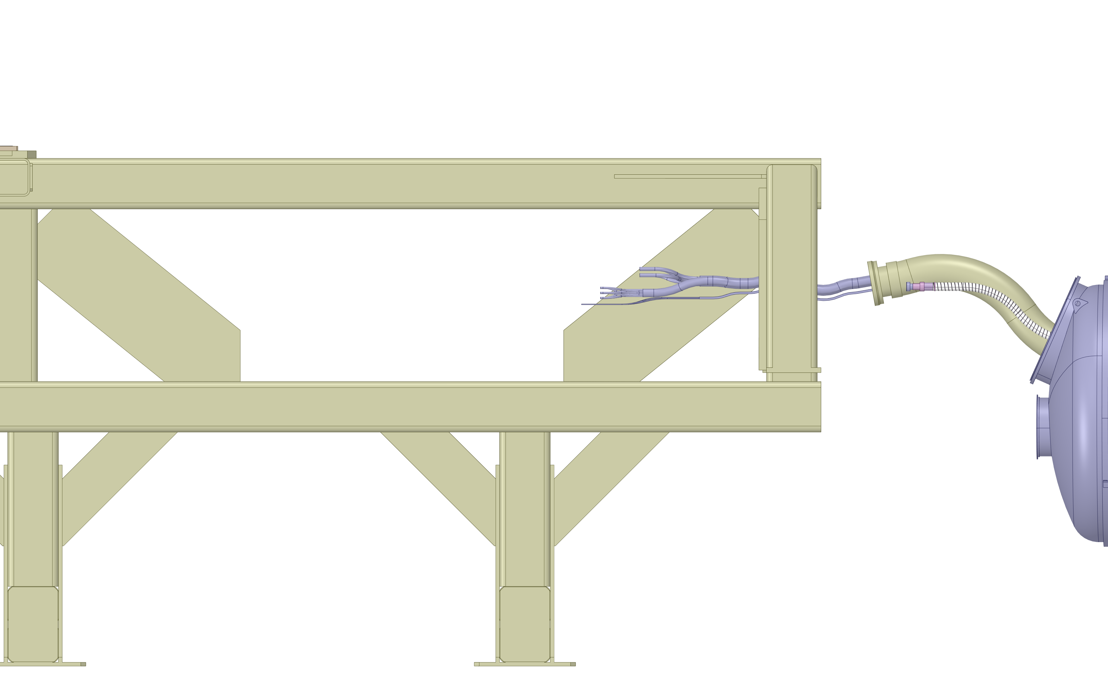
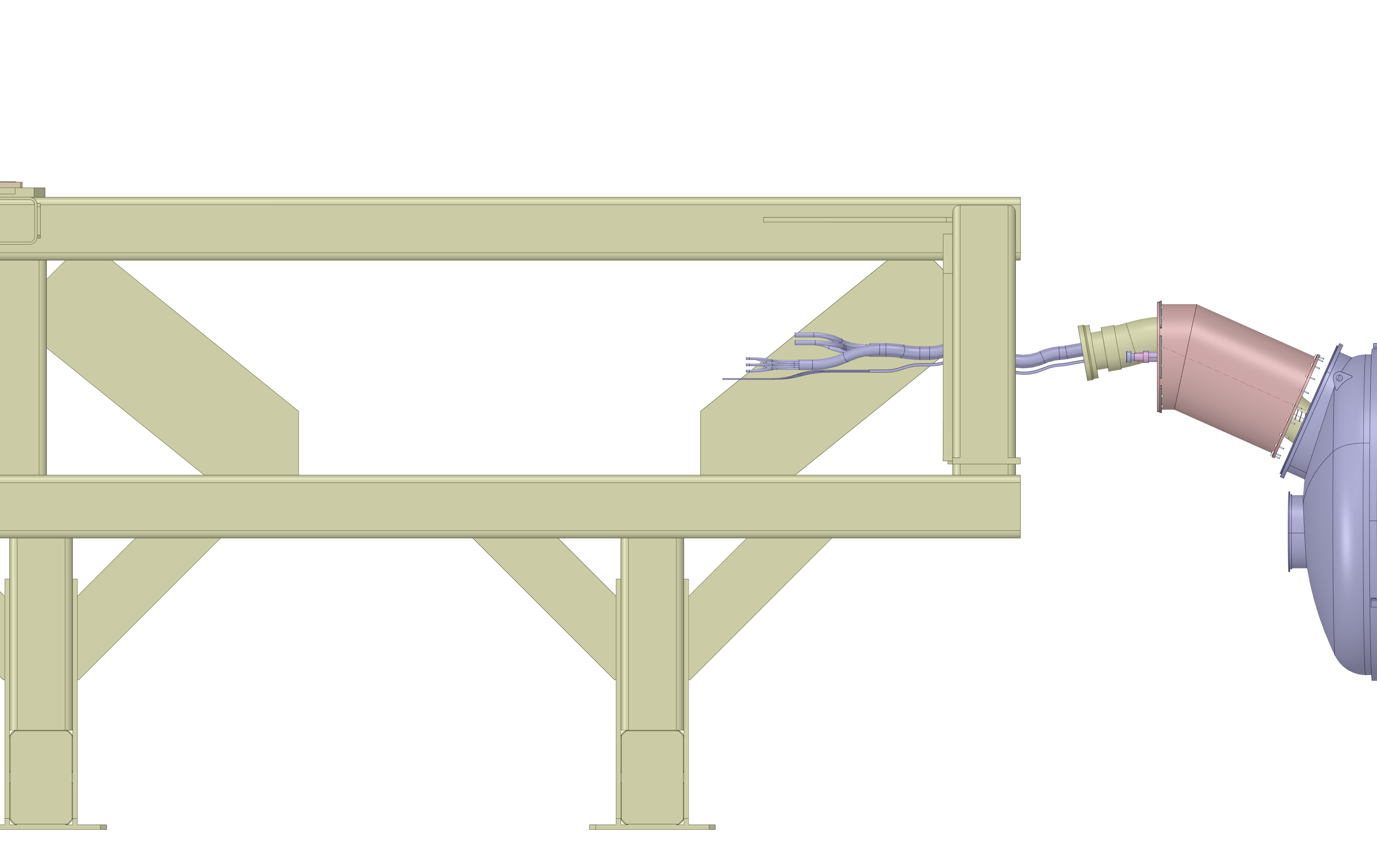
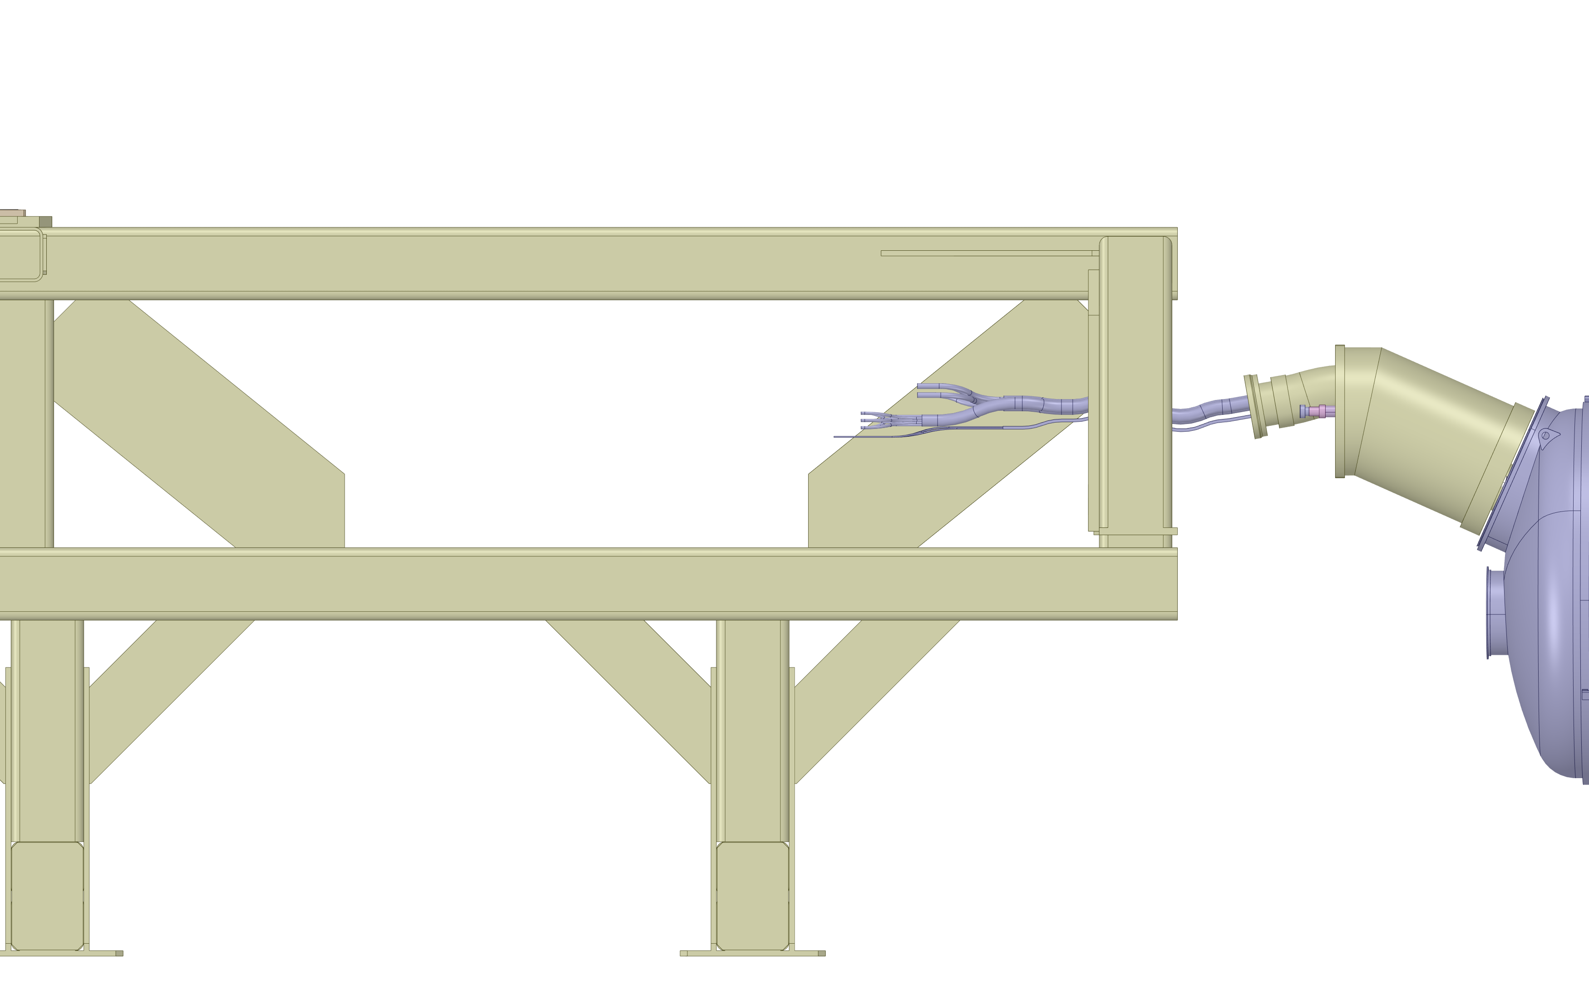
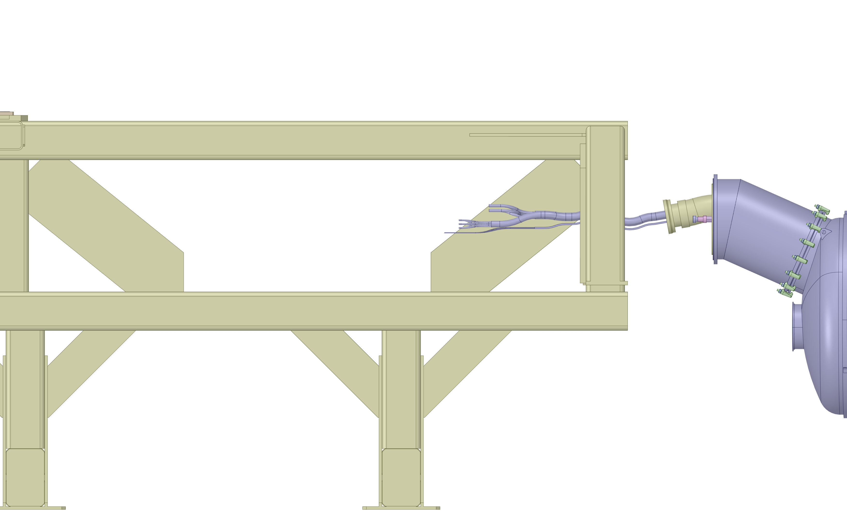
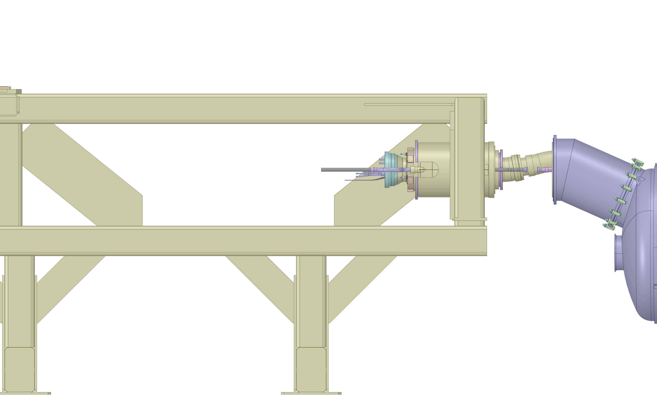

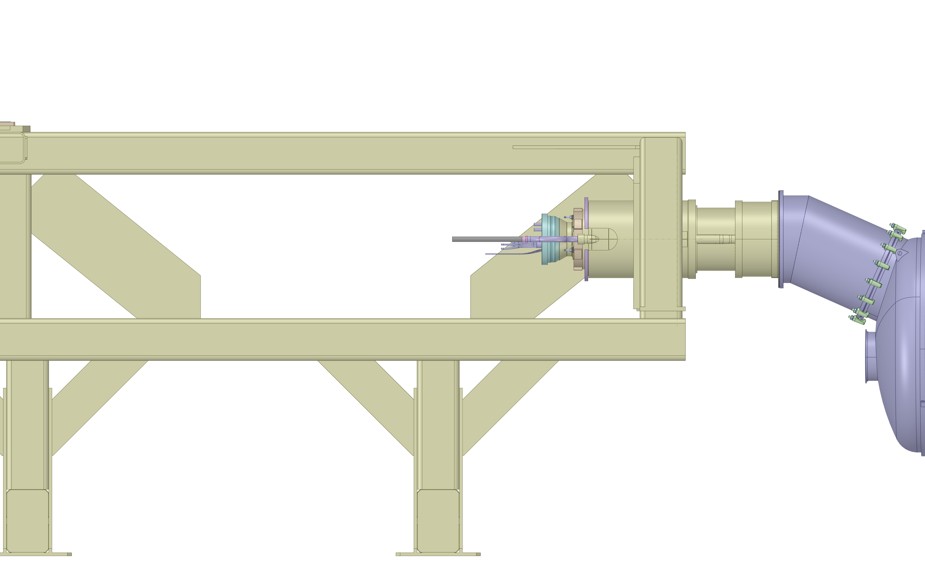
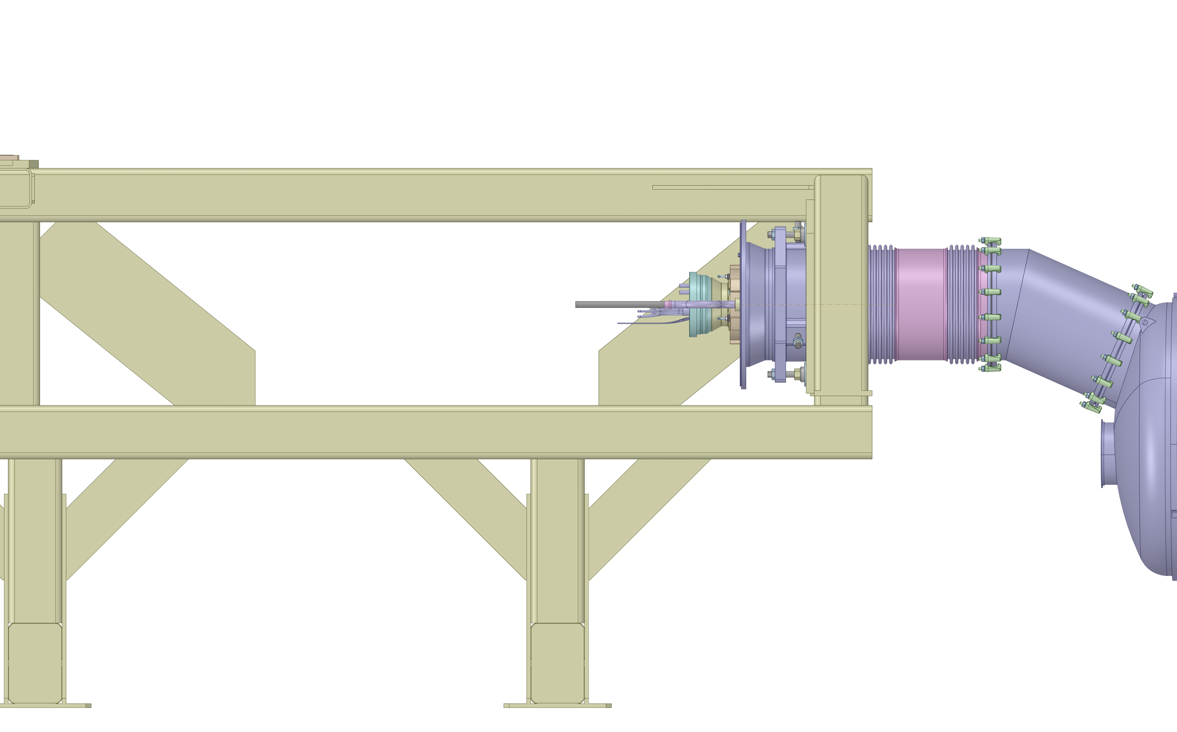
DCM installation
Installation of the DCM frame and the D1 module
D1
All components received
Installation procedure will follow
the DCM manufacturing

Slide 14
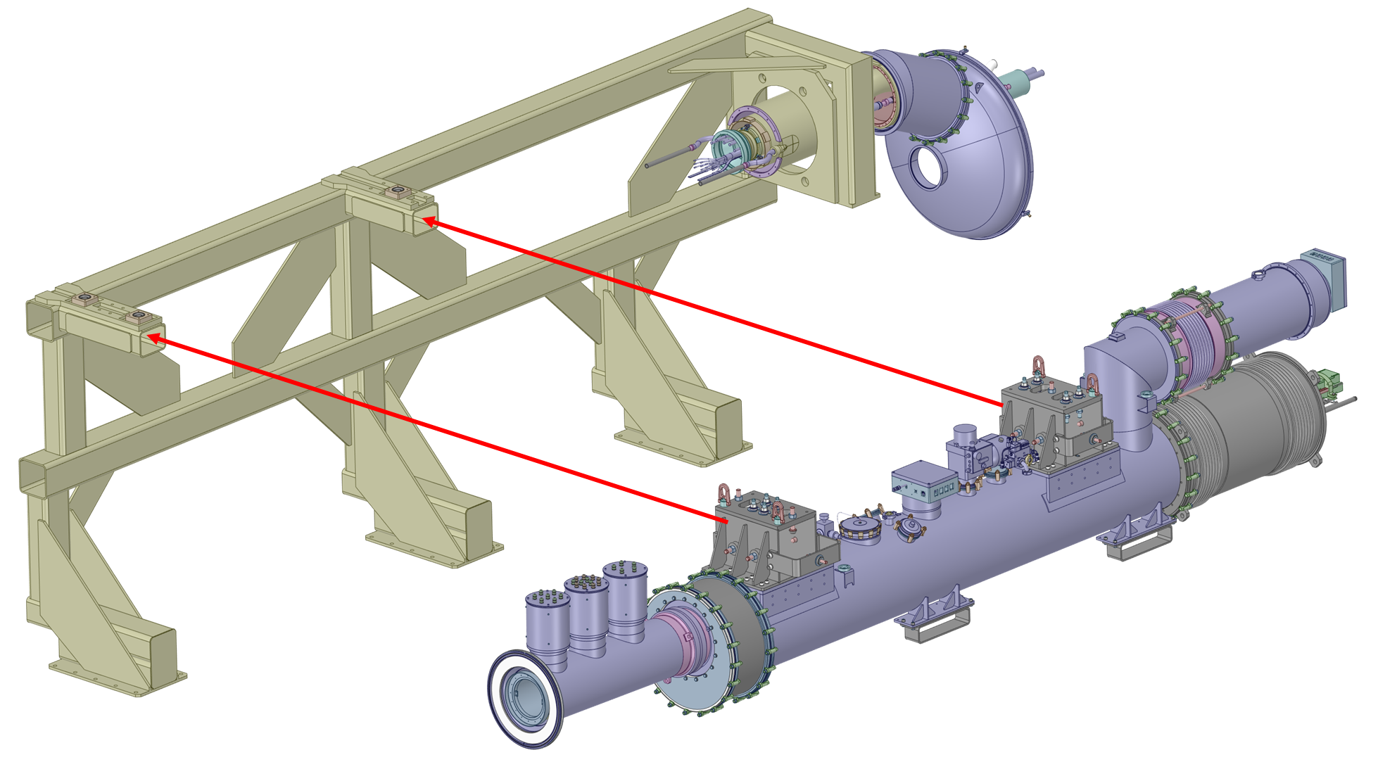
DCM installation
Installation of the DCM frame and the D1 module
Installation of the DCM

Slide 15
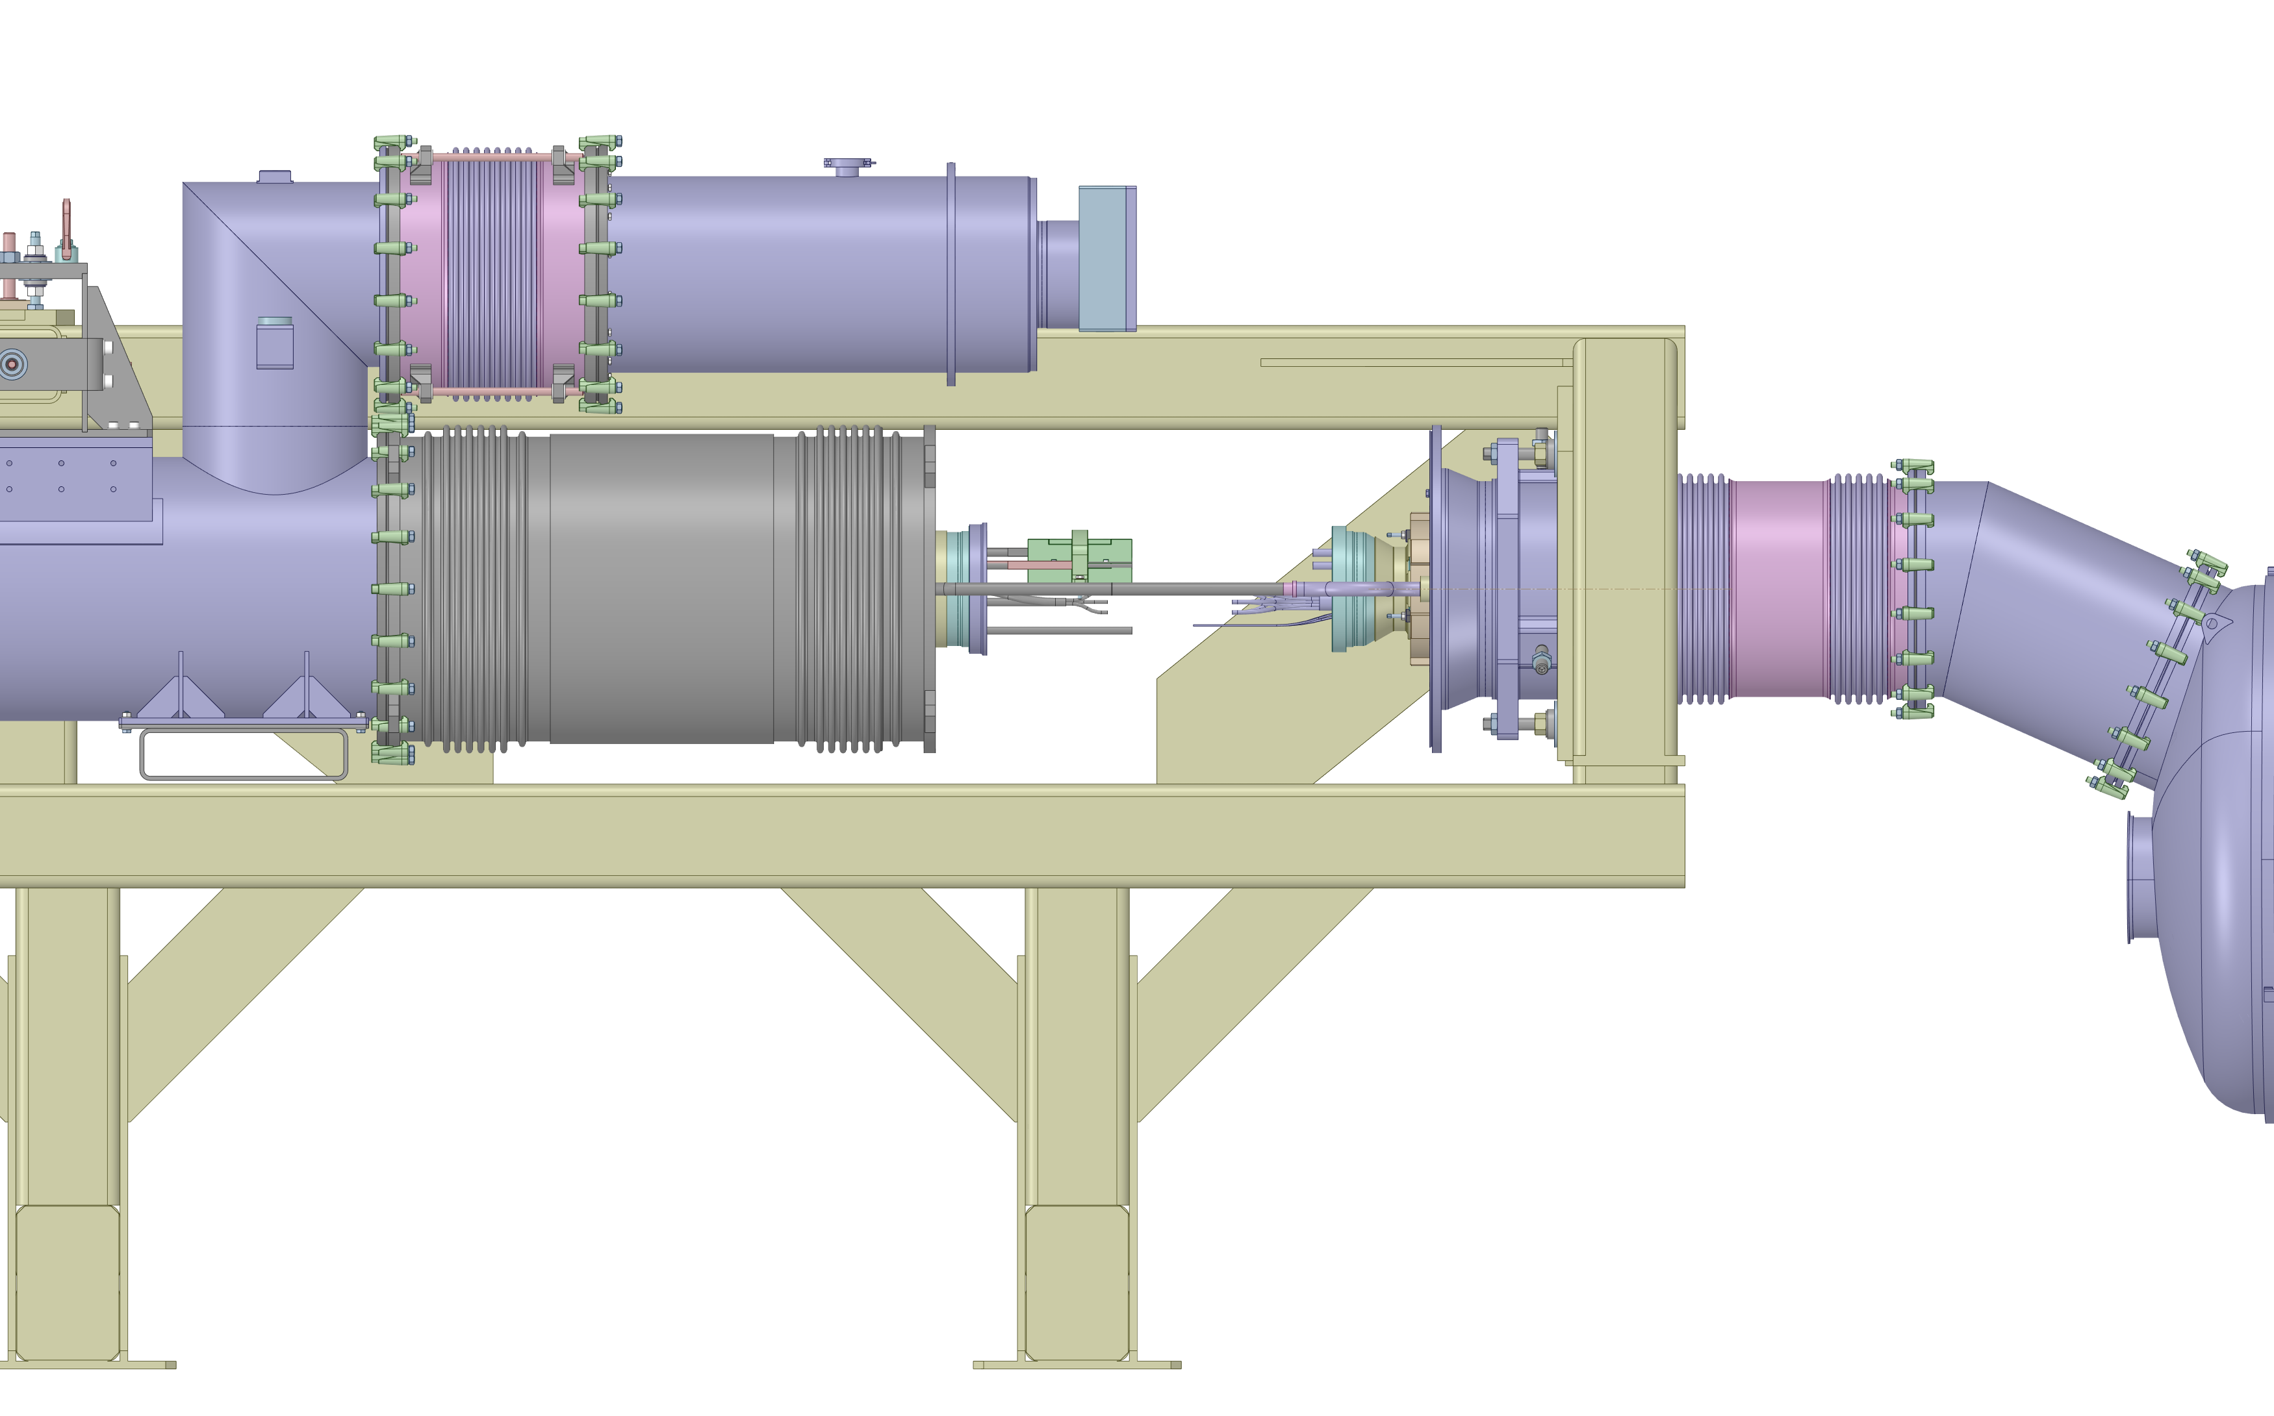
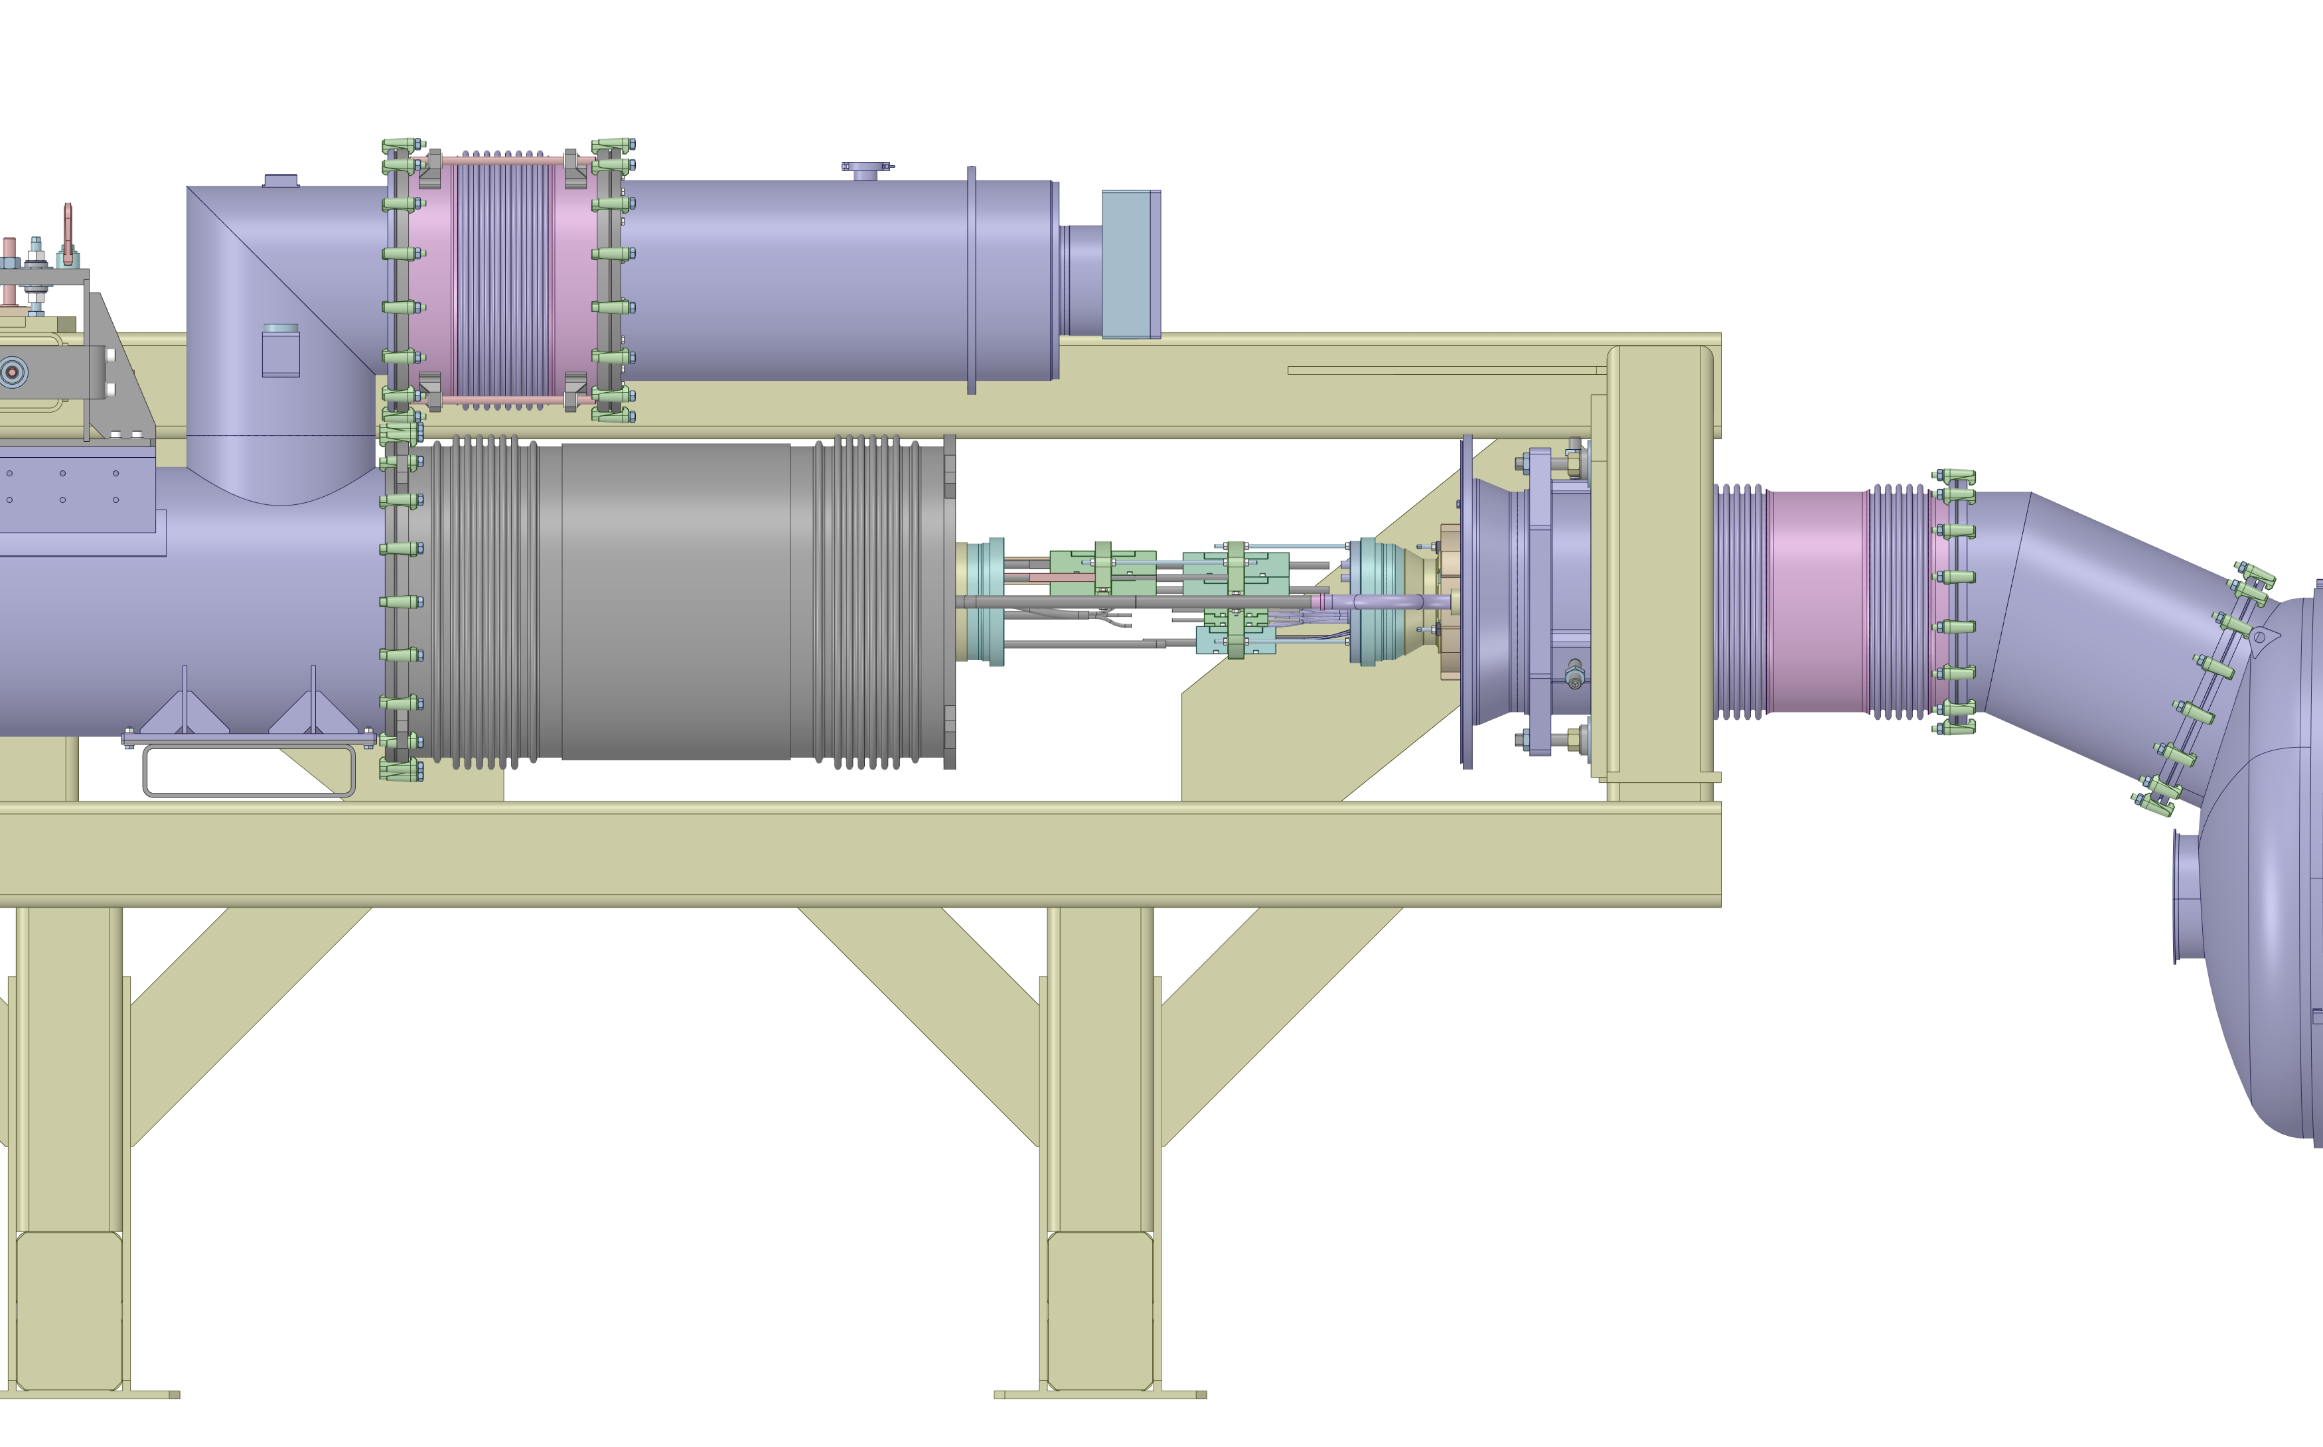
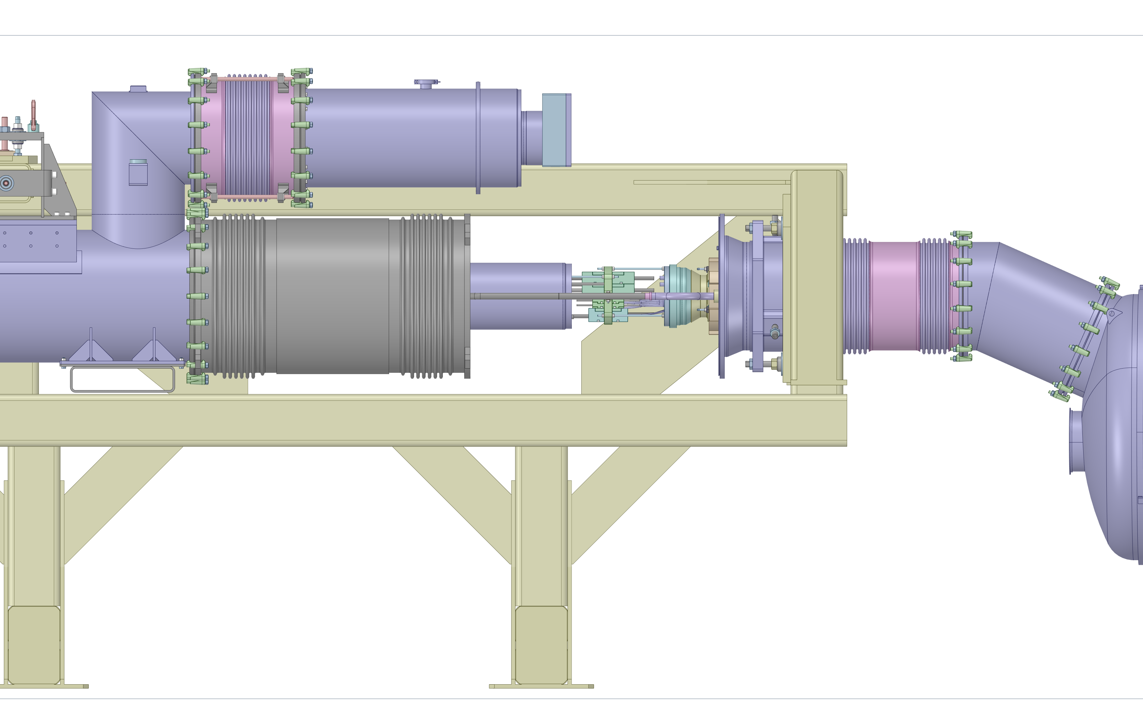
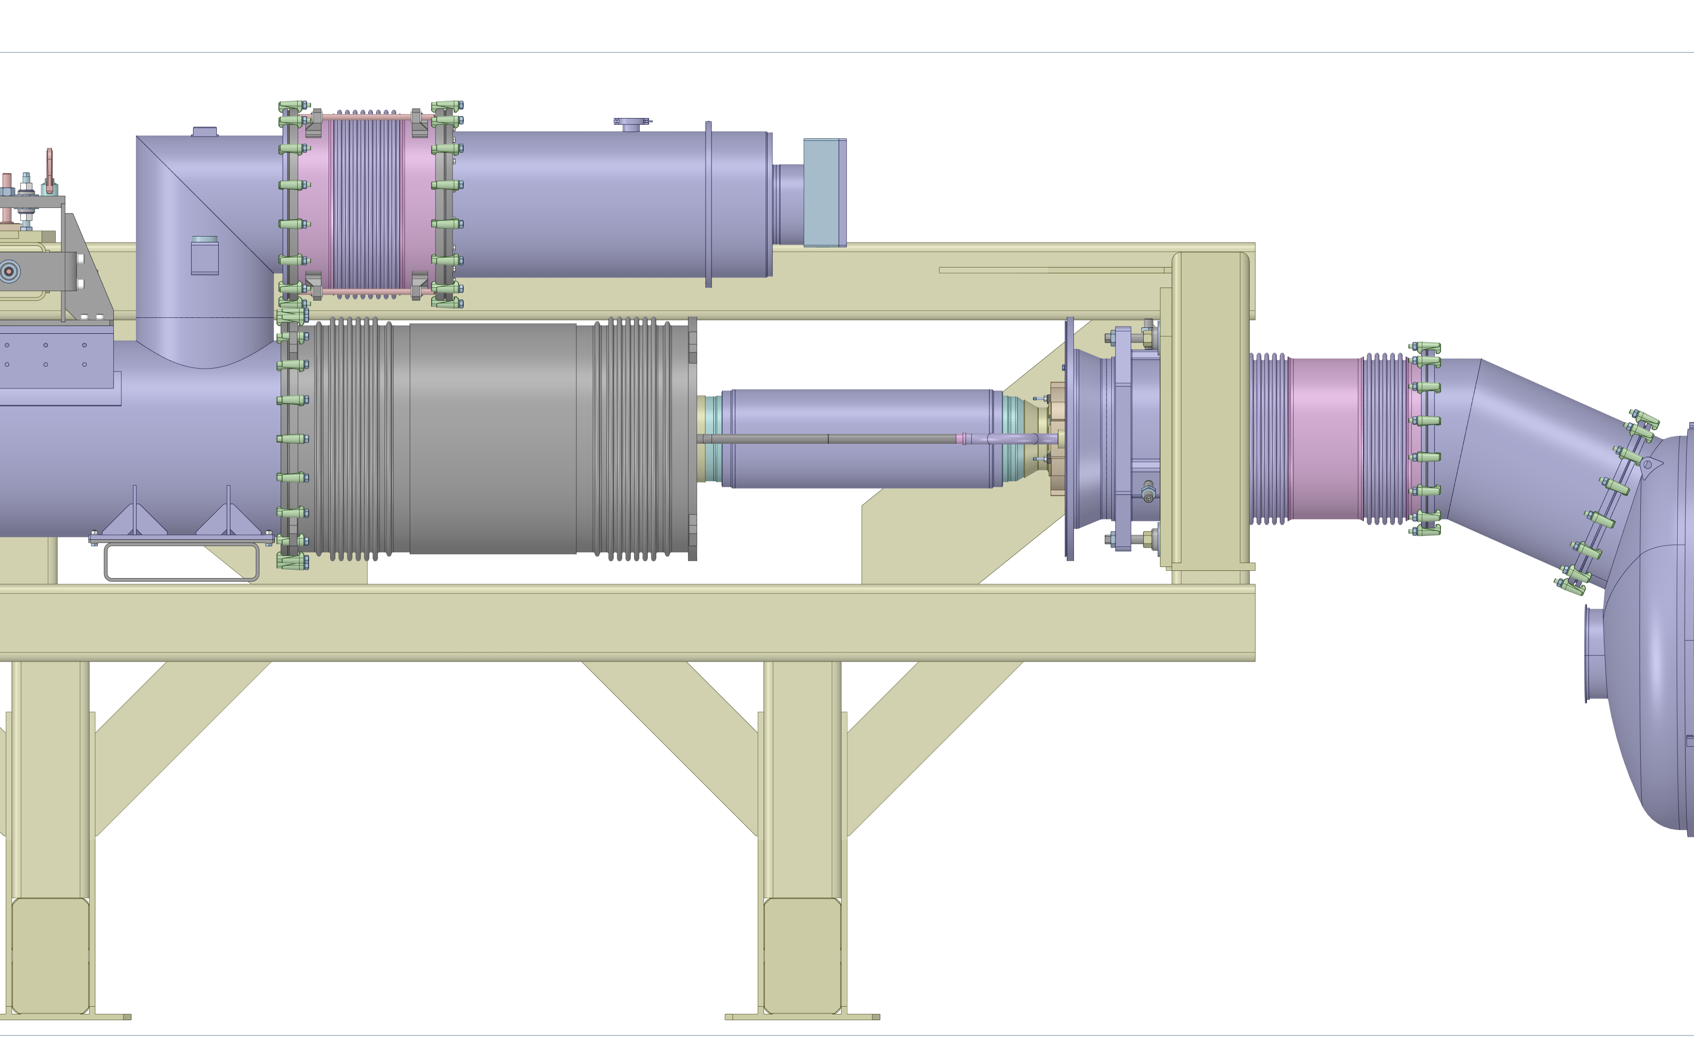
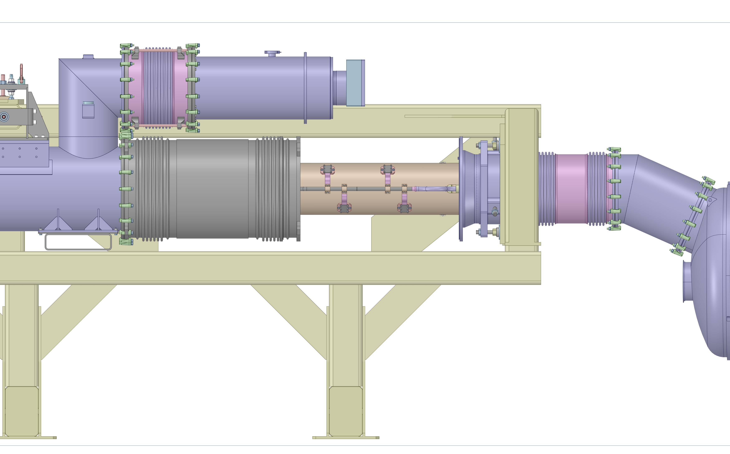
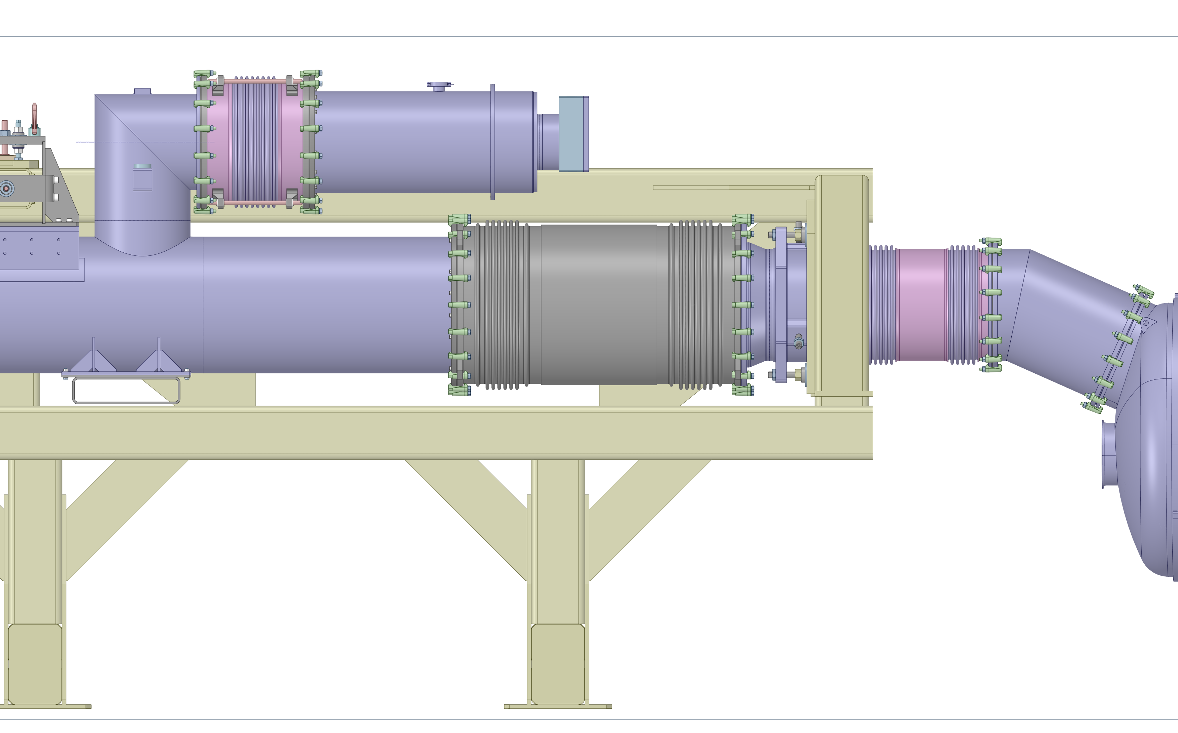
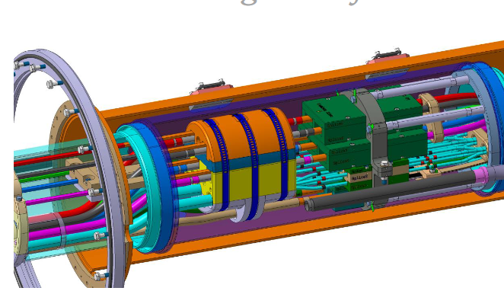
DCM installation
Installation of the DCM frame and the D1 module
Connection of the DCM
Installation of the DCM

Slide 16
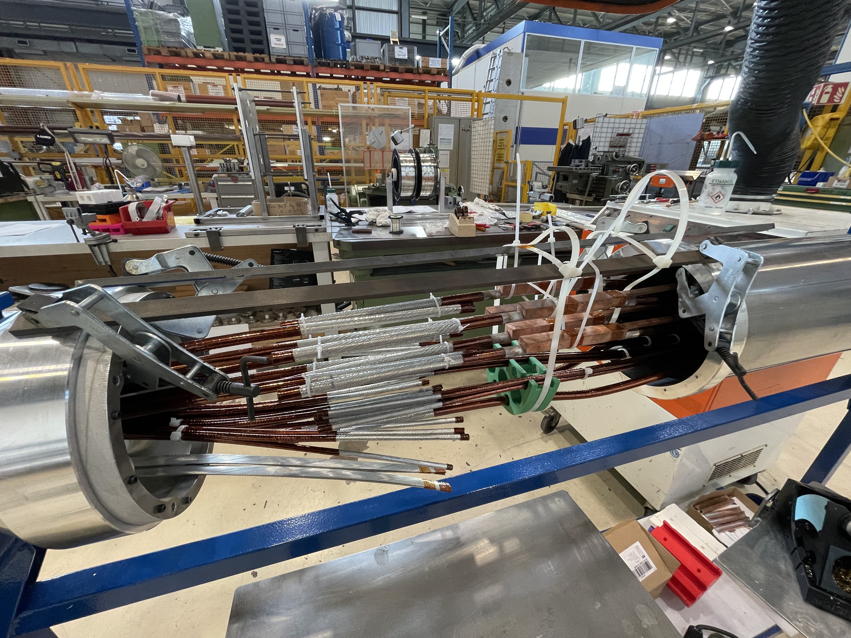
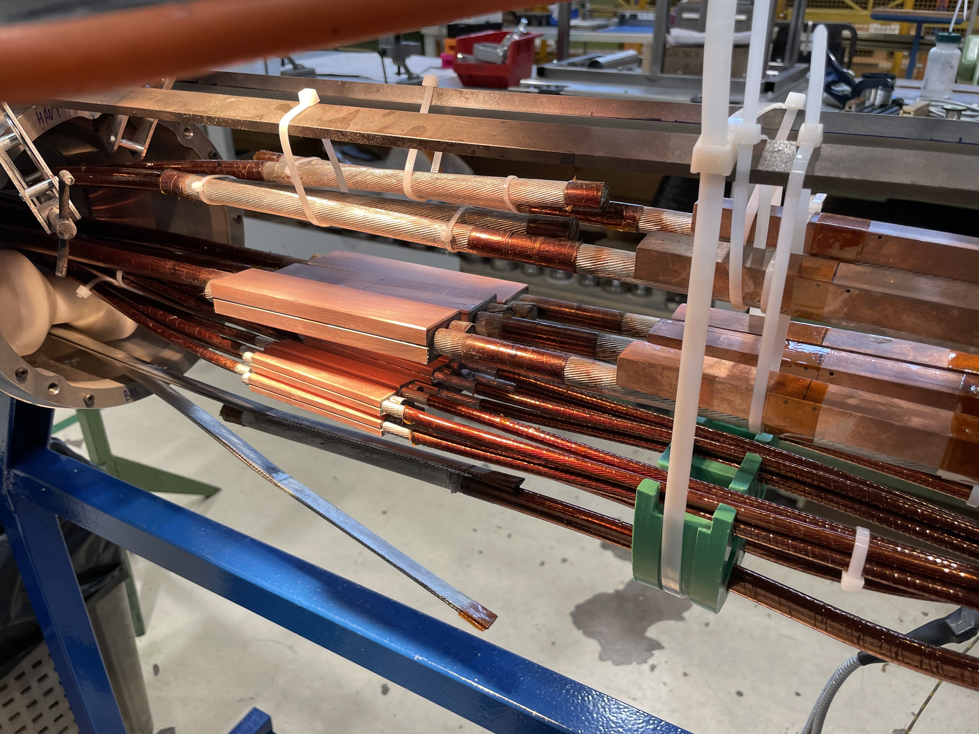
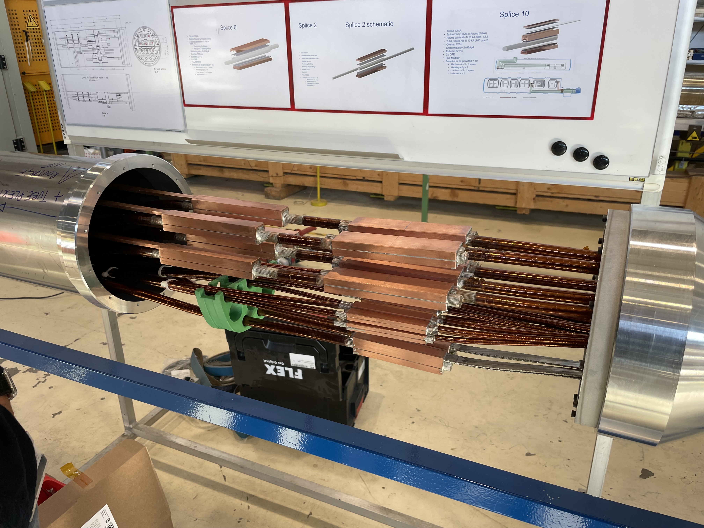
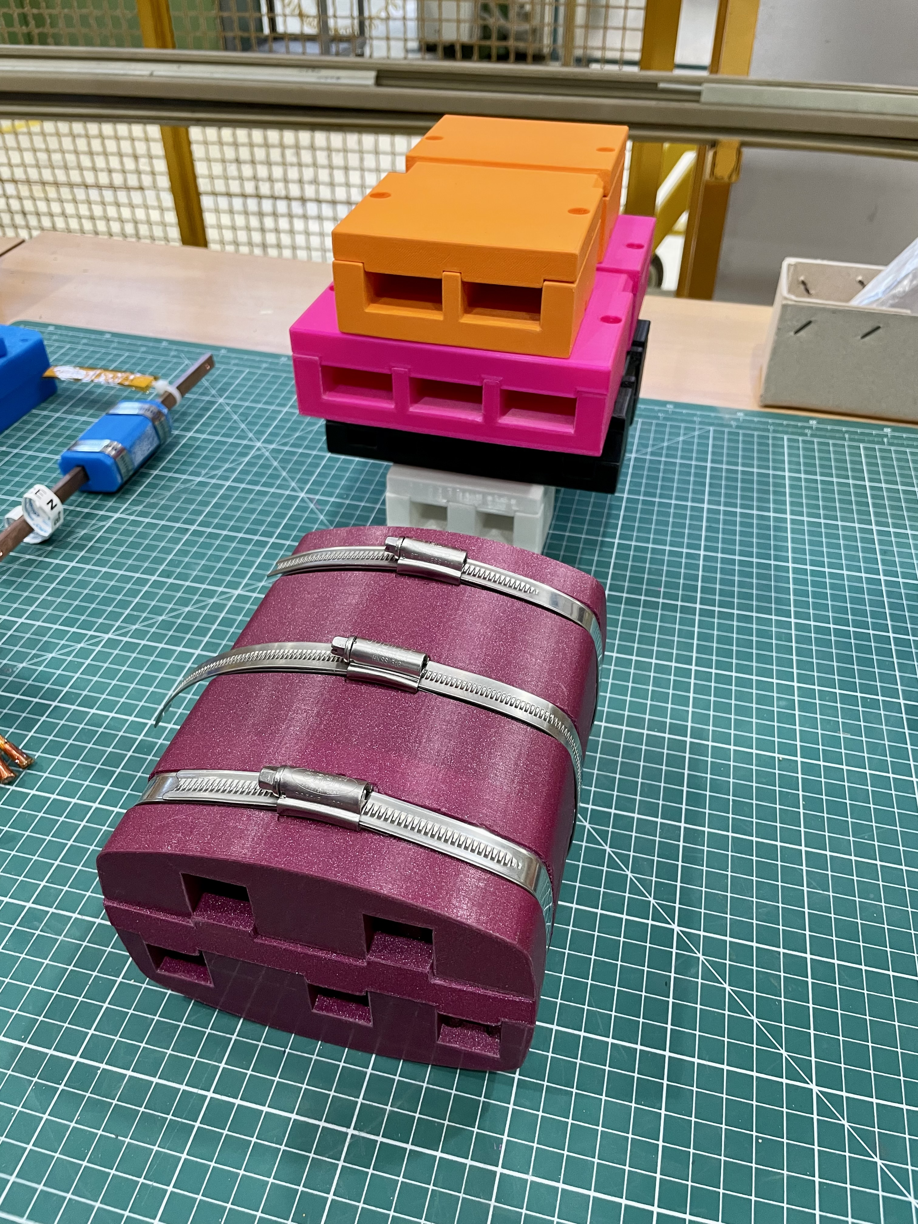
DCM connection
DCM interconnection mock-up
Progress of a splicing exercise

Slide 17
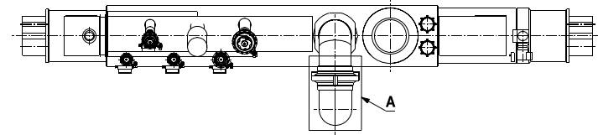
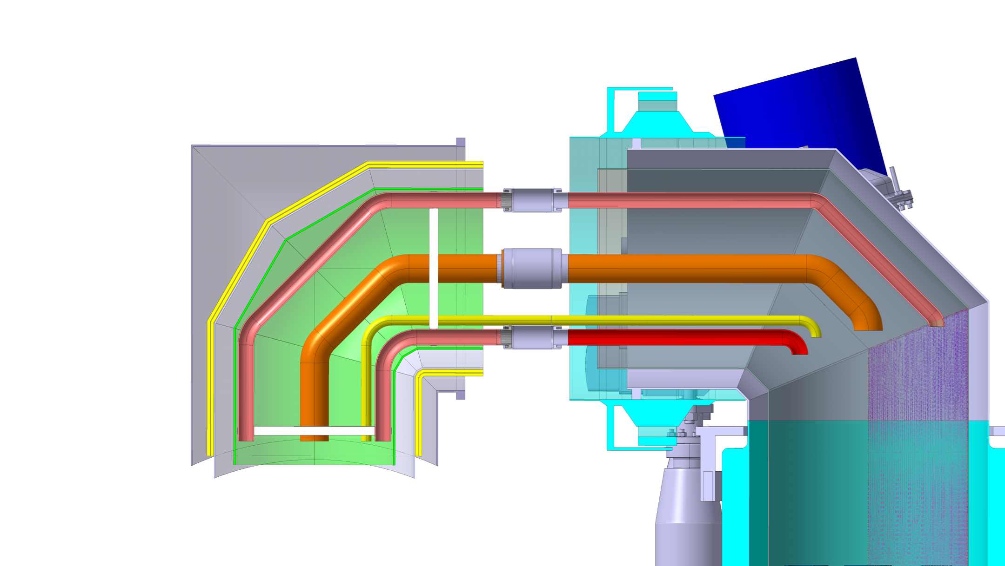
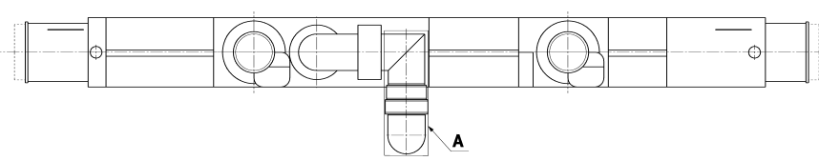
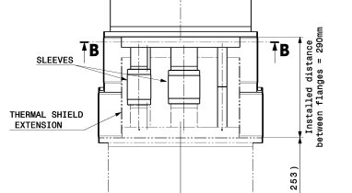
Jumper connection
Cryo-magnet side
148 mm
SQXL side
QXL service module
LHC-QXL-EC-0001
More room given for the
tunnel configuration
Base line configuration in SM18 but not feasible → no access to the flanges
290 mm

Slide 18
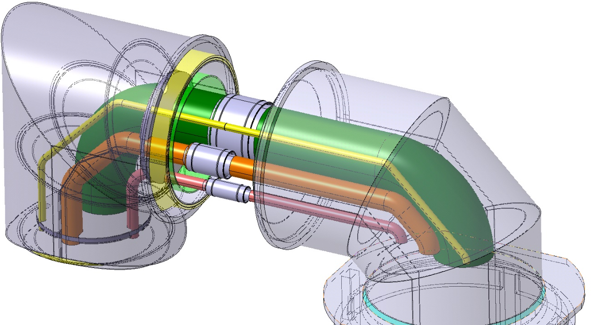
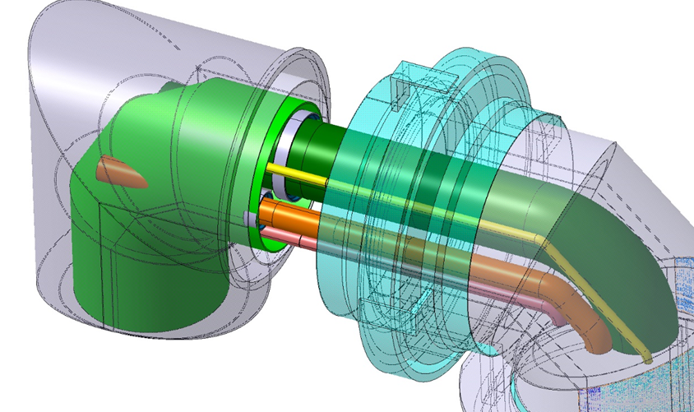
Jumper connection
We propose to change the IT string configuration, either with butt welds or with lip welds with flanges installed as close as possible to the magnet thermal shield
A mock-up of the jumper configuration was recently built to test the welding feasibility of the inner pipes

Slide 19
Quality assurance
During the interconnection of cryo-magnets, holding point for Quality Control (QC) steps are included.
Regular ElQA test to ensure the electrical integrity of the connection, with mandatory test after the lines N integration and before the M2N line closure.
Electrical resistance test at RT and visual inspection for each splice.
Visual inspection of the M2N line closure.
Visual inspection by EN-MME and helium local leak test for each weld. In addition, X-ray for each butt weld.
Visual inspection and document verification before W closing
Global leak test after W closure.

Slide 20
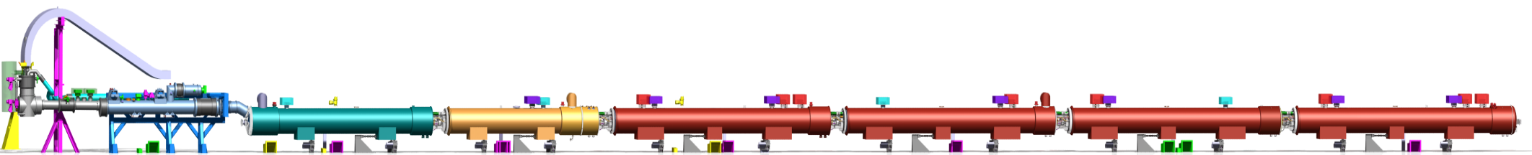
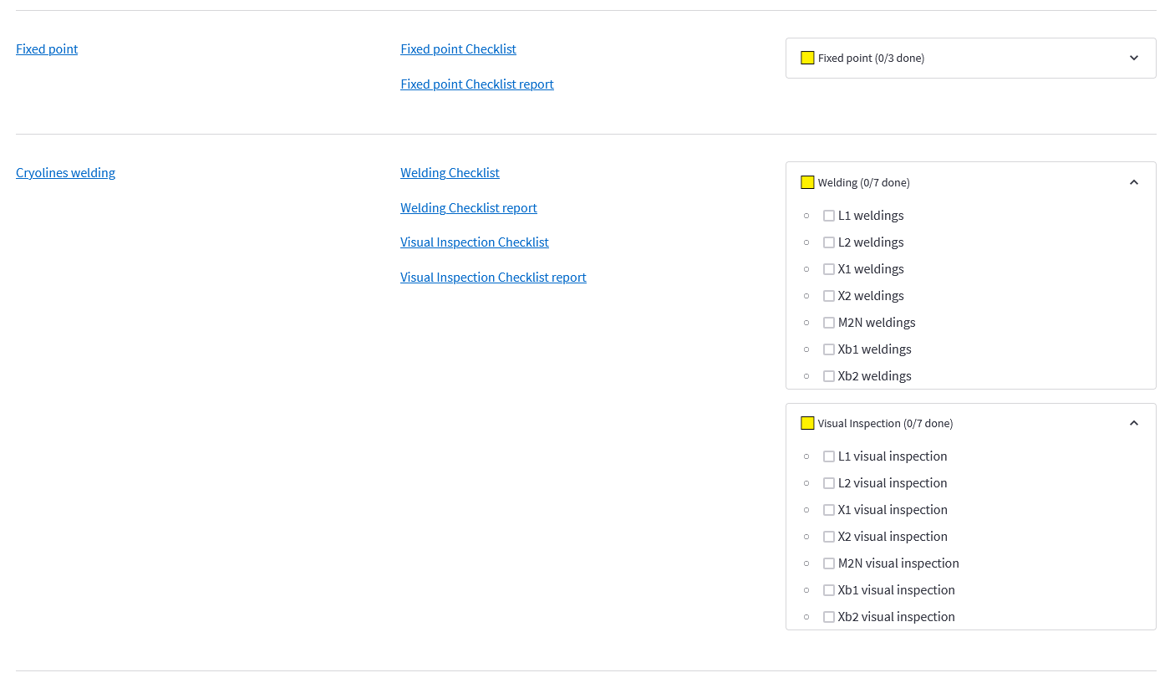

Activities and QC follow-up
Cell4
Cell3
Cell2
Cell1
DFX
DFXI
DCM
LDQD
D1
LBXFC
CP
LCXFC
Q3
LQXFF
Q2b
LQXFJ
Q2a
LQXFG
Q1
LQXFE
QDDIX.4SF
QDBIX.4SF
QBCIF.3SF
QCQIF.3SF
QQQIF.B2SF
QQQIF.A2SF
QQQIF.1SF
QQSJF.4SF
QQSJF.3SF
QQSJF.2SF
The activities and the QC steps will be followed up directly in EAM with a list of predefined work orders for each IC and jumpers.
A new web interface, similar to the eMIP, is in development by MSC (M. Bonora) in collaboration with EN-MME

Slide 21
Summary
Sequence of the magnet installation and connection for the IT String have been developed
  For the support of the DCM and cryo-magnets, all components are available by the end of the year. Q1 2024 for the anchors.
  The delivery of the cryo-magnets for WP16 is followed-up by WP3 (EDMS 2645484). The MAB will give assessment and recommendation for each cryo-assembly after the magnet test on the horizontal test bench.
For the magnet connection, the procurement of the busbar cables is planned for Oct 2023. Due to the delay, insertion test with final cables is not yet done, delaying also the finalisation of the tooling and component design.
The splice soldering procedures are approved, and all splice types are qualified.
Interconnection drawings are in progress. Sleeves production launch by the end of 2023.
Procurement of the interconnection components should be completed in Q1 2024.
Jumper connection procedure is in study, and welding test is being performed on a mock-up.
Web Interface tool is in development to follow-up the activities and QC of the interconnection.
Still lots of work to do, and a good progress was made this year. A first version of the installation procedures is expected in Q2 2024.

Slide 22

Thank you for your attention
Special Thanks to
Rosario Principe
Hervé Prin
Delio Duarte Ramos
Federico Crisci
Nicolas Bourcey
Matthias Bonora
for their precious help

