Slide 1
BBLR compensation in Run 3:
Bunch-by-bunch losses and wire operation
P. Bélanger, G. Sterbini, D. Kaltchev, R. Baartman
On behalf of the BBCW team
Special thanks to:
K. Paraschou, H. Bartosik and M. Rufolo for their invaluable inputs,
G. Iadarola for xsuite and the help with simulations,
M. Hostettler for the implementation of the wire in operation and LHC operation during MD with G. Trad,
The collimation team for the help with crossing angle reduction (C.E. Montanari, B. Lindstrom, M. D'Andrea, S. Redaelli, M. Giovannozzi)
13th HL-LHC Collaboration Meeting : https://indico.cern.ch/event/1293138/contributions/5469244/

Slide 2
Introduction
Experimental Framework
Machine Development
2023 Operation

Slide 3
Historical collaboration
J.-P. Koutchouk et al.
Wires in the SPS
Since 2004
W. Fischer et al.
Wires in RHIC
2006
C. Milardi et al,
Wires in DAΦNE
Since 2006
F. Zimmermann et al.
Specification of the
LHC wires, 2013
1st Workshop on (HL-)LHC
Wire Compensation
December 2015
Experiment in the LHC
2017-2018
Run 3, BBCW operation
2022-2023
1997
V. Shilsev et al.
e⁻ Q-compression
2000
J.-P. Koutchouk
DC wires for LHC
2008
U. Dorda
PhD Thesis
2012
T. Rijoff
M.Sc.Thesis
2015
S. Fartoukh et al.
PRST-AB 18, 121001
March 2017
2nd Workshop on (HL-)LHC
Wire Compensation
September 2022
HL-LHC Satellite Meeting, BBCW
1999
Y. Papaphilippou, F. Zimmermann
PRST-AB 2, 104001
2004
B. Erdeley, T. Sen
FERMILAB-TM-2268-AD
2007
H. J. Kim, T. Sen
PAC07-THPAN114
2016
A.S. Patapenka et al.
NAPAC2016-TUPOB17
2023
P. Belanger et al., IPAC paper on Wire MD
September 2023
HL-LHC Collaboration Meeting

Slide 4
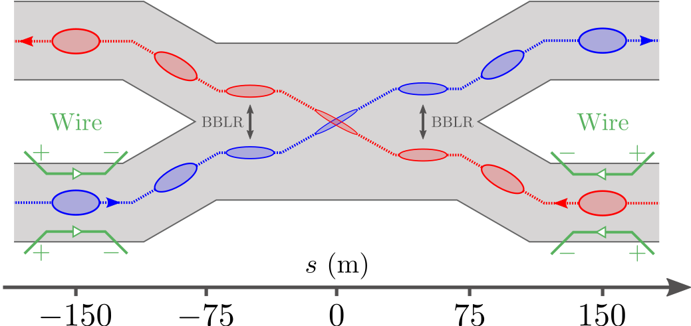
Beam-Beam Long-Range compensation
Beam-beam interactions:
  Head-on: necessary for luminosity production
  Long-range: lead to undesirable tune-spread
BBLR is akin to multipolar error:
  Leads to beam losses
  Reduction of dynamic aperture
  Reduction of integrated luminosity
  Strongest source of non-linearities!
Can be compensated with DC wires (BBCW)
Run 3, embedded in the collimators of IP1 + IP5
Double-wire configuration to target octupolar terms
“If the optics and layout conditions (β-aspect ratios, wire distance, etc.) cannot be met, wire currents and distances should be used for cancelling the LR leading order effect, i.e. octupole-like tune-spread.”
Y. Papaphilippou - BBLR 2015 workshop (https://indico.cern.ch/event/456856/contributions/1968793)

Slide 5
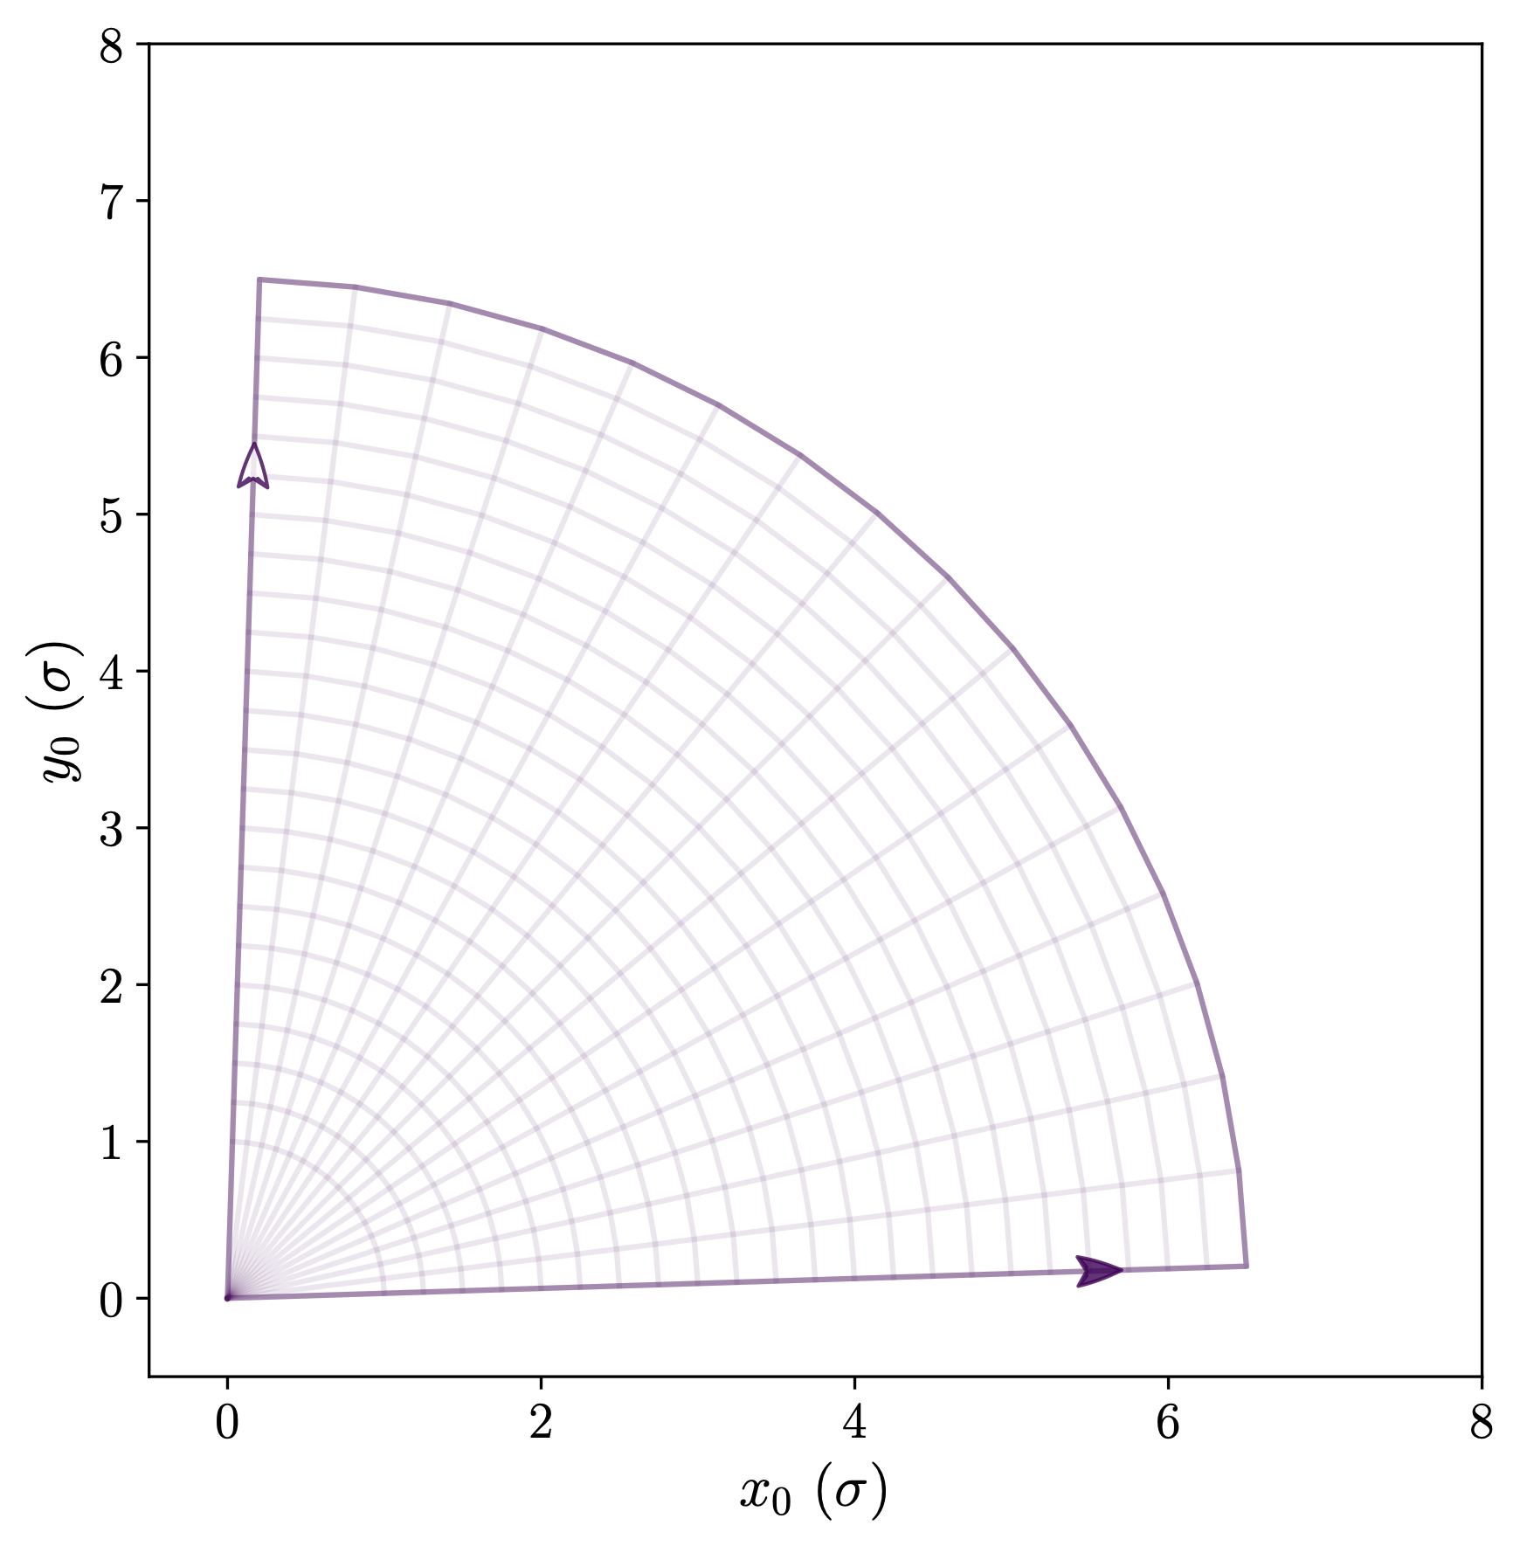
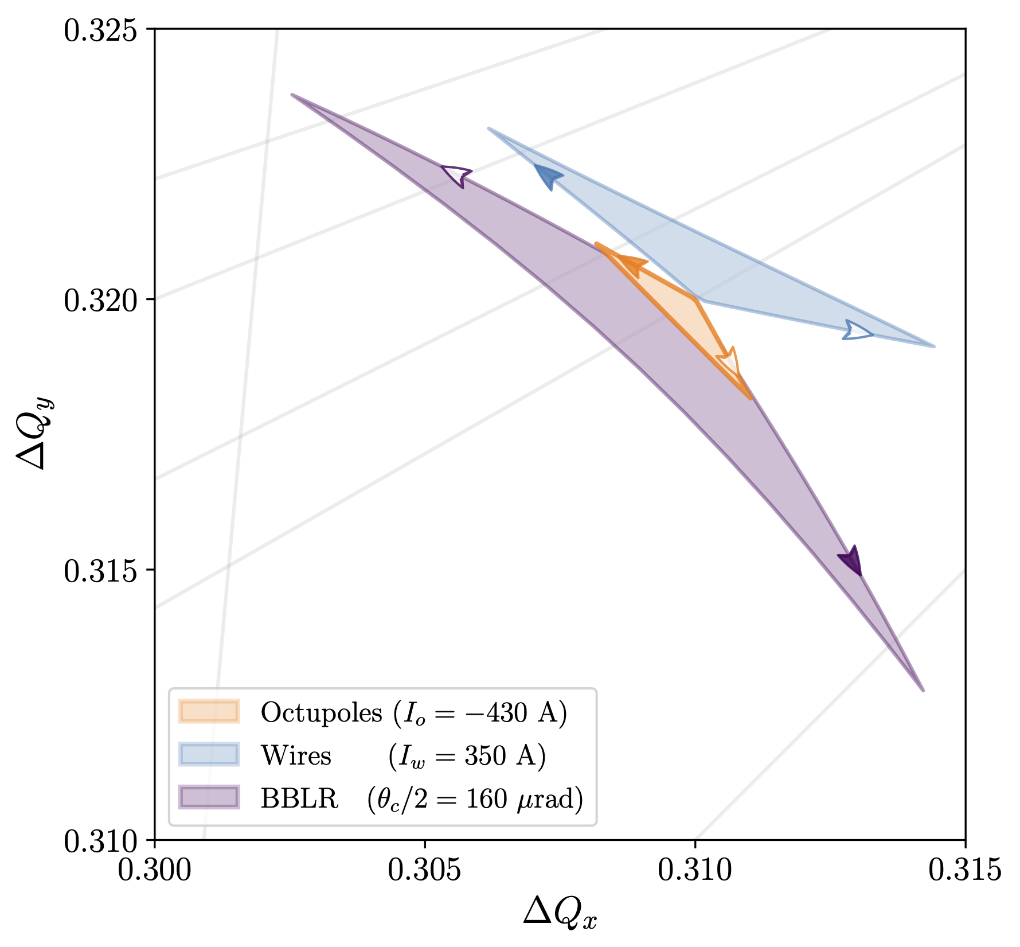
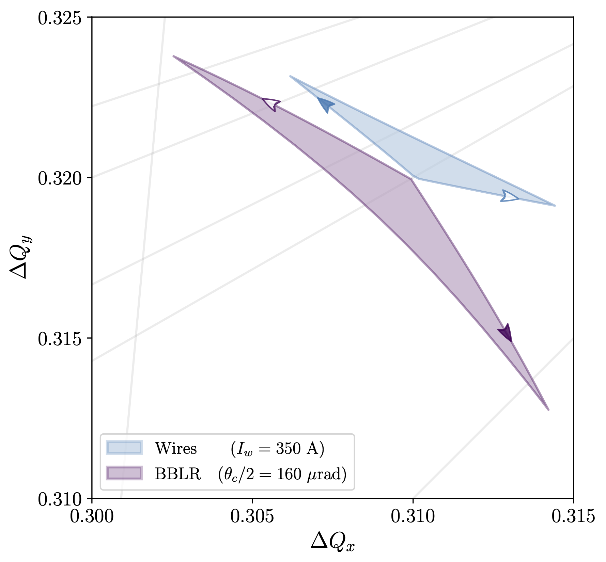
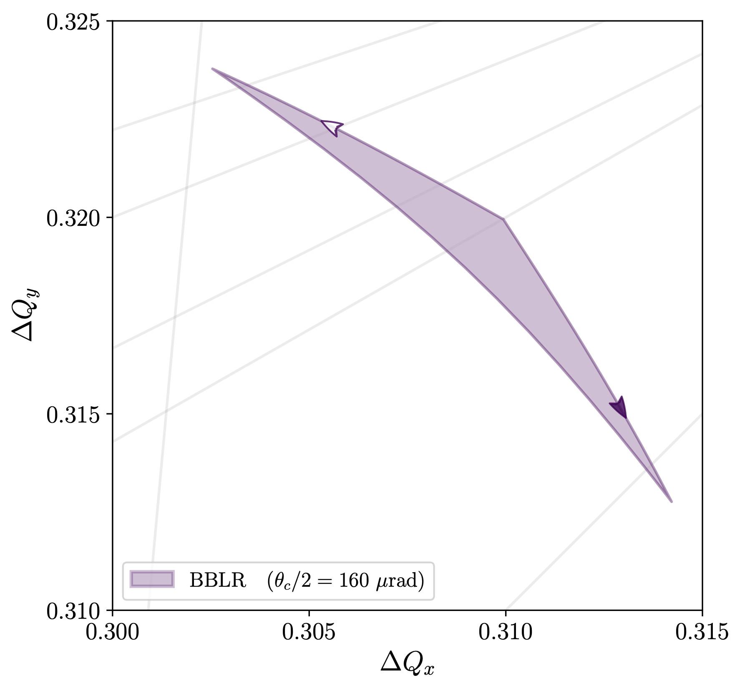
Footprint compression
Deviation from a linear machine measured with Resonance Driving Terms (RDTs)
  Chaos, diffusion, and ultimately beam losses
Detuning (subset of RDTs) can be visualized in the tune diagram as a footprint
Lateral “wings” of BBLR need to be compressed to avoid resonances
Wires naturally compensate laterally
  Note: non-optimal 𝛽_{x} /𝛽_{y} yields tilt
Octupoles powered negatively compensate laterally, but enhance along the diagonal (not dramatic)
@ 1.4 x 10¹¹ p/b

Slide 6
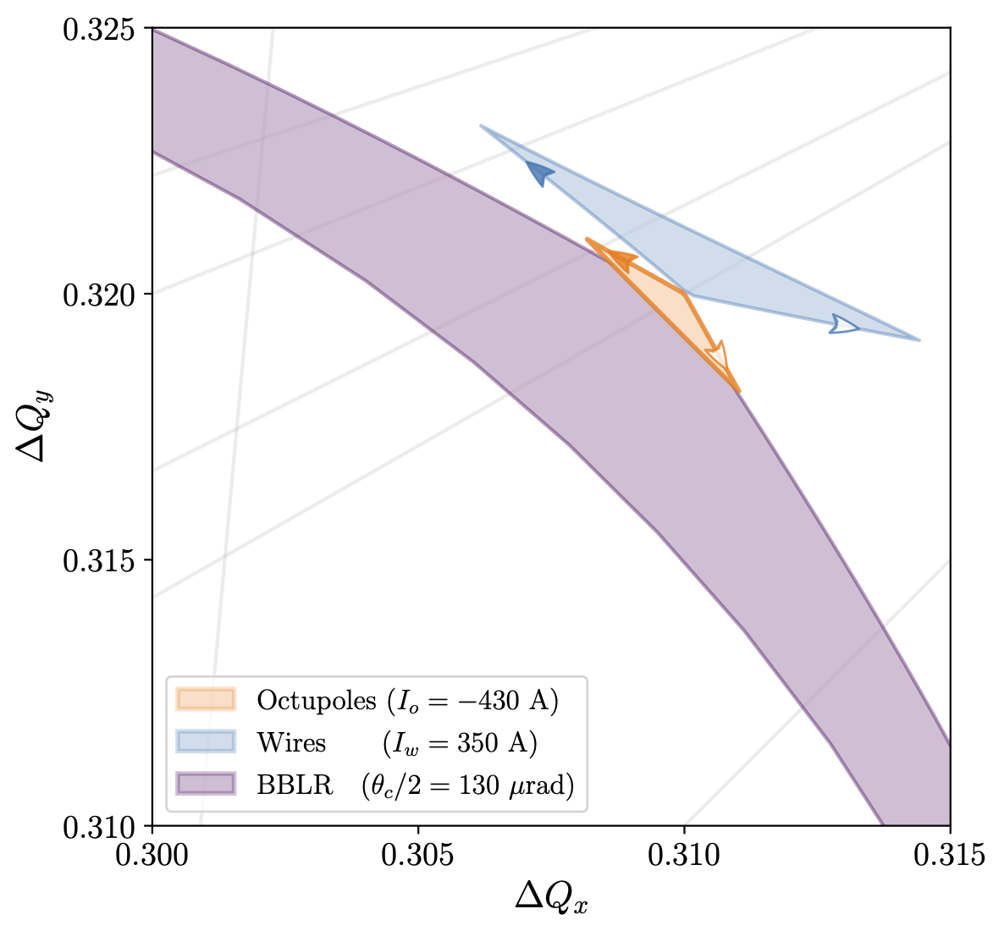
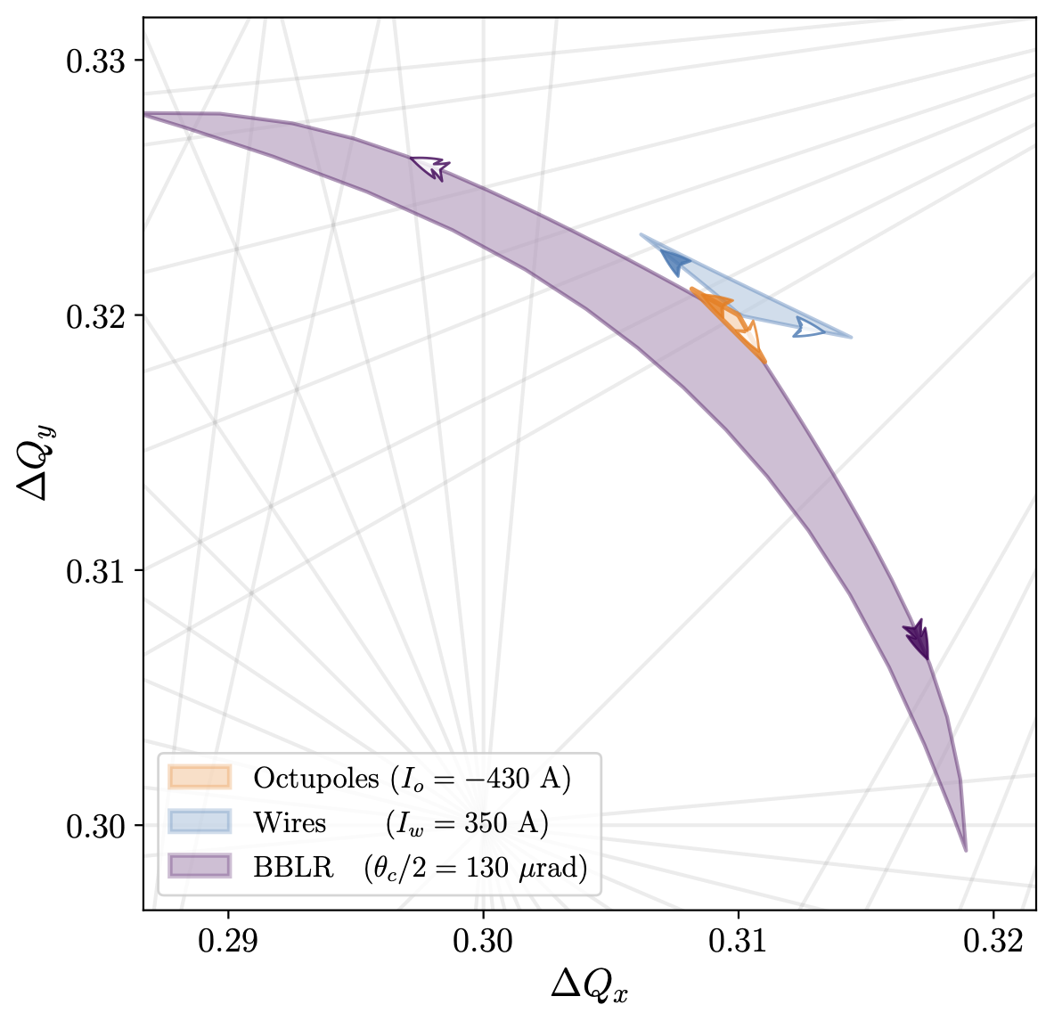
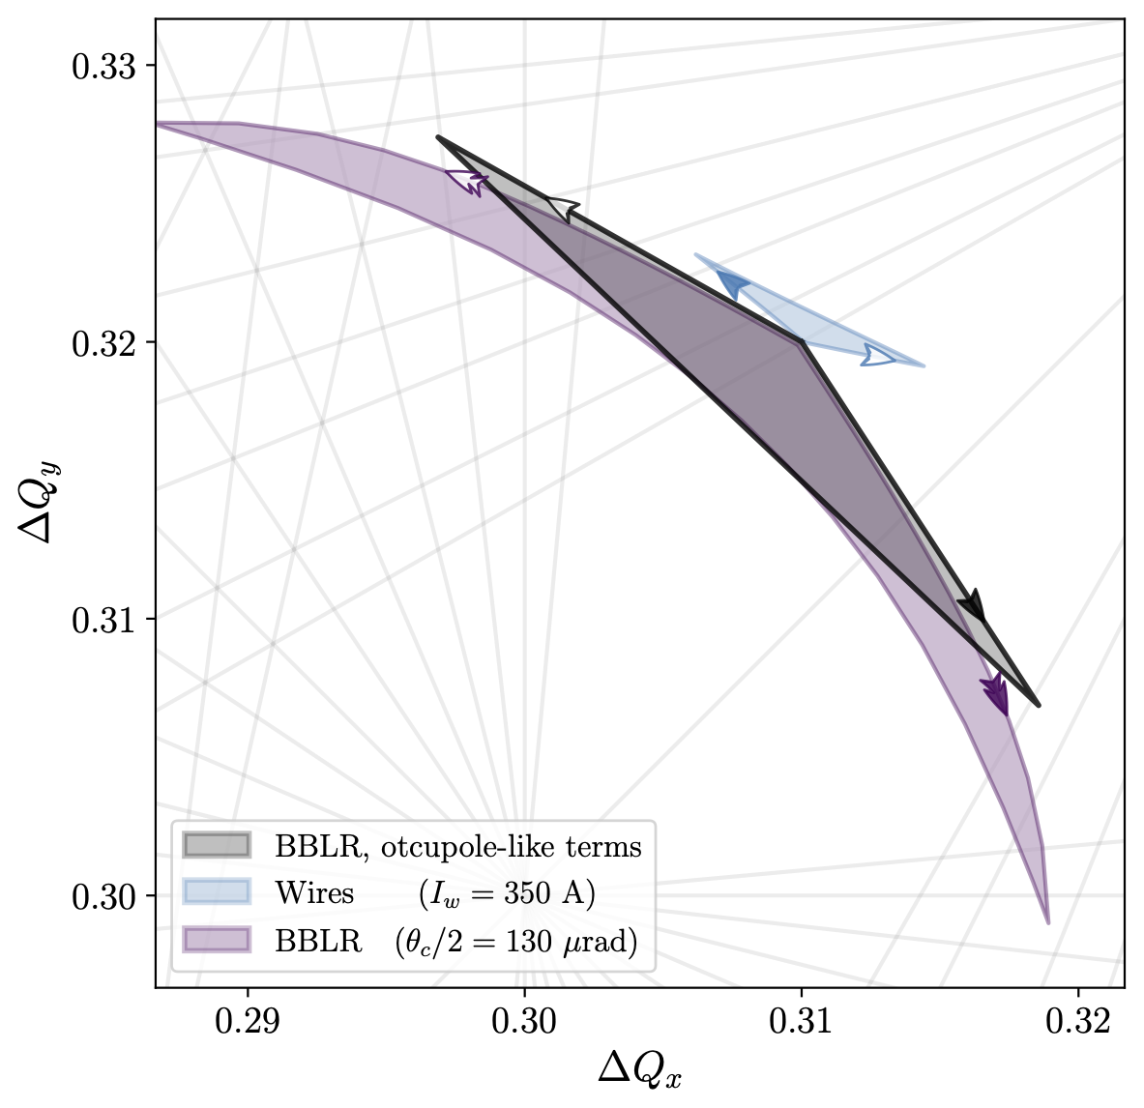
Beam-Beam Limit?
Footprint becomes significantly larger with reduction of crossing angle
Technologically still within reach with standalone wires (proposed for HL)
  450 Am of current instead of 350 Am (factor 1.3)
  Compensation of all RDTs (not only octupolar)
  Possibility of a closer approach to the beam (scales as 1/d⁴)
160 urad
130 urad

Slide 7
Introduction
Experimental Framework
Machine Development
2023 Operation

Slide 8
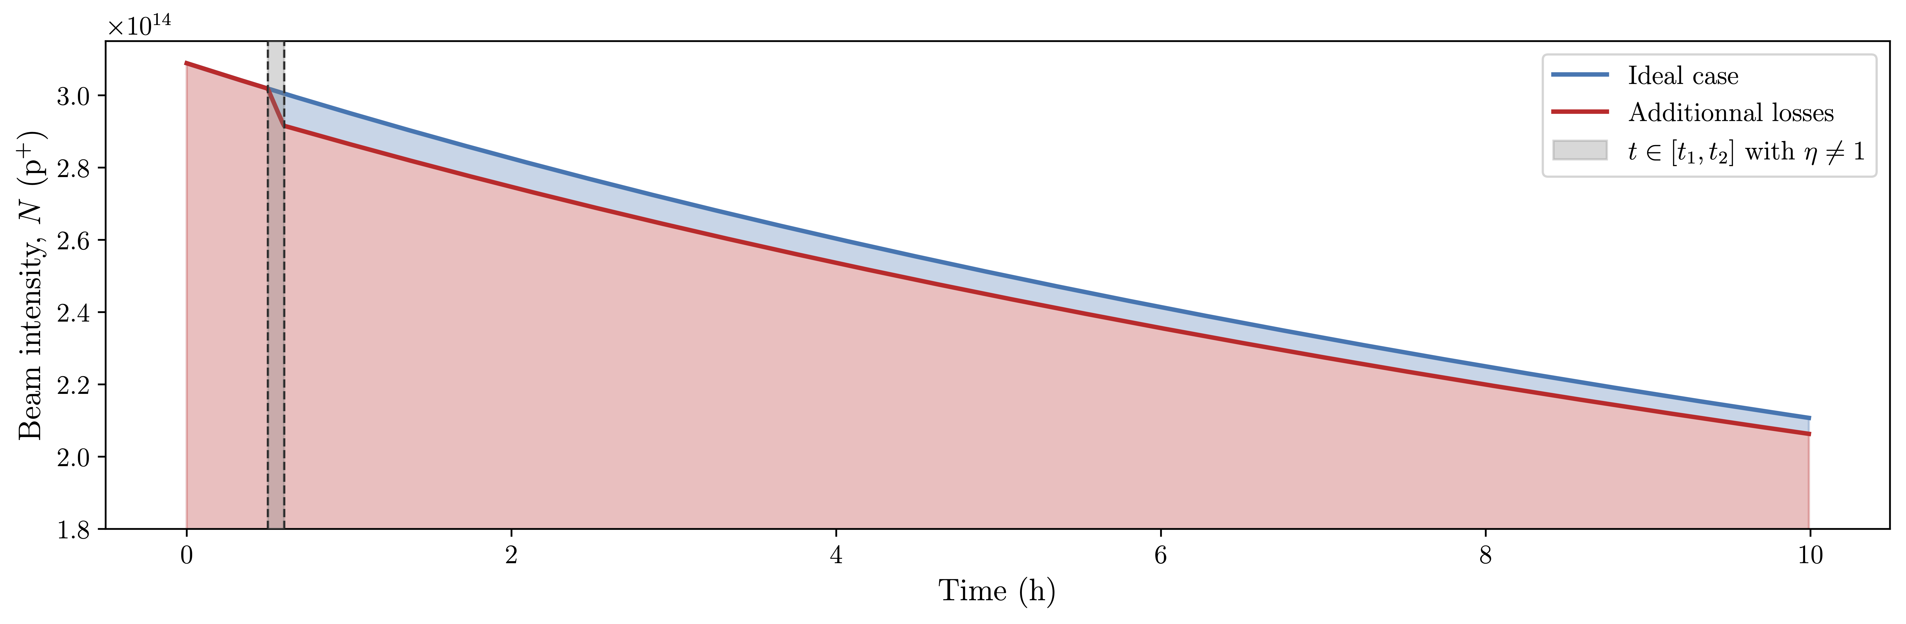
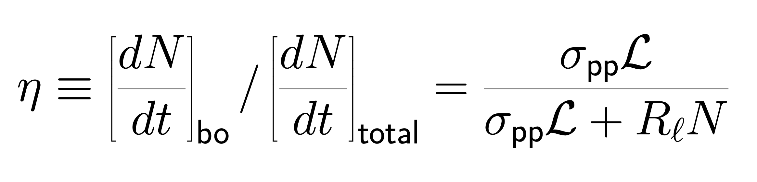
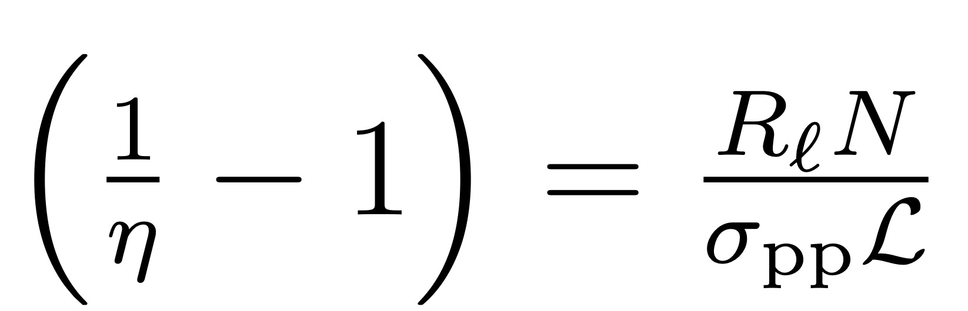
Figure of Merit for collider: burn-off efficiency
In a luminosity-leveled collider, the number of injected protons is critical, provided that they burn-off
Hence, protons lost early heavily impact the integrated luminosity of a fill
Burn-off Efficiency: ratio of burn-off losses to total losses
  Directly quantifies the efficiency of the collider
  Single parameter which also contains luminosity-normalised losses:
  More interesting than beam lifetime

Slide 9
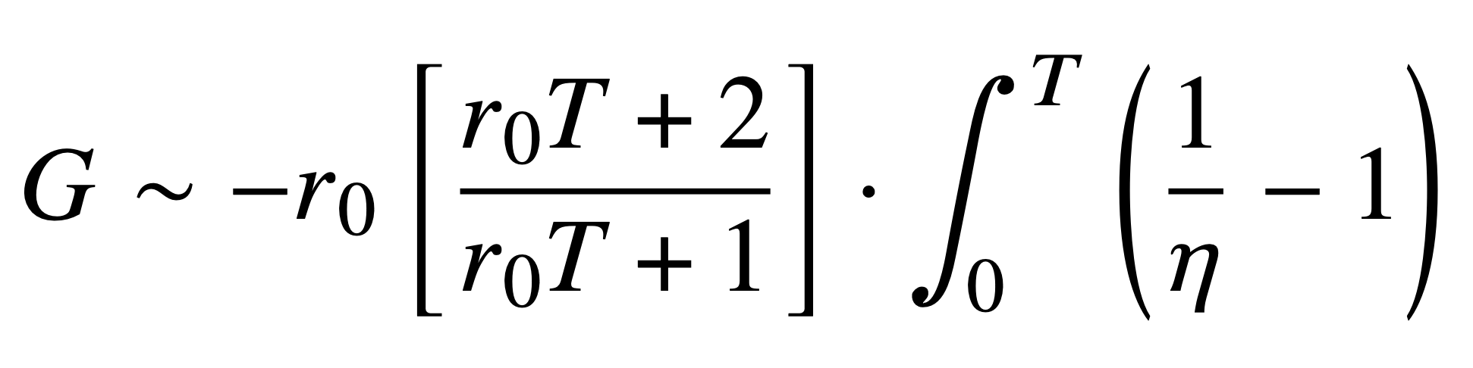
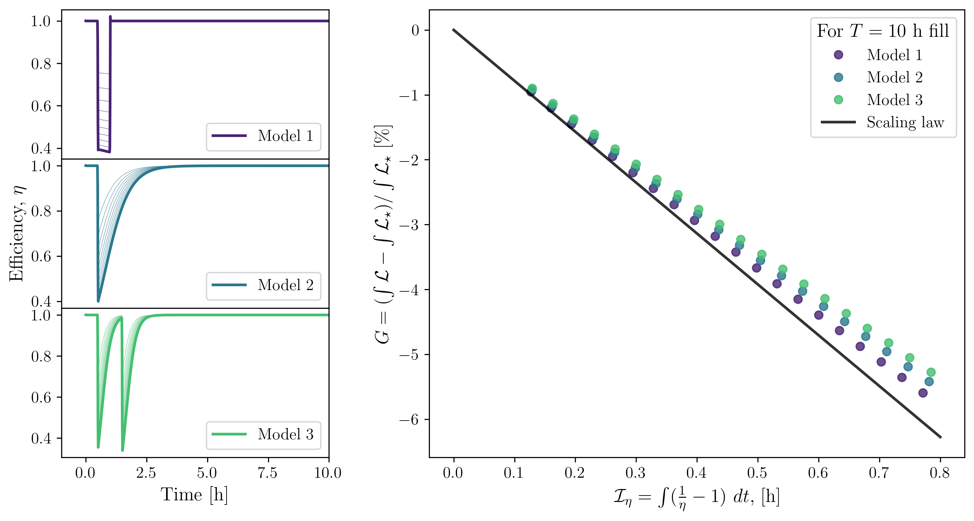
Figure of Merit for collider: burn-off efficiency
Integral of efficiency linked to Relative Gain in integrated luminosity: (for short losses at the start of a fill)
If η = 0.5 for 30 minutes, reduction of integrated luminosity of −3 % for 10 h of proton-proton collisions
* Simple scaling law
lumi-normalized losses
Gain in luminosity
* General concept, applicable to any losses, not only BB.
Integral of lumi-normalized losses

Slide 10
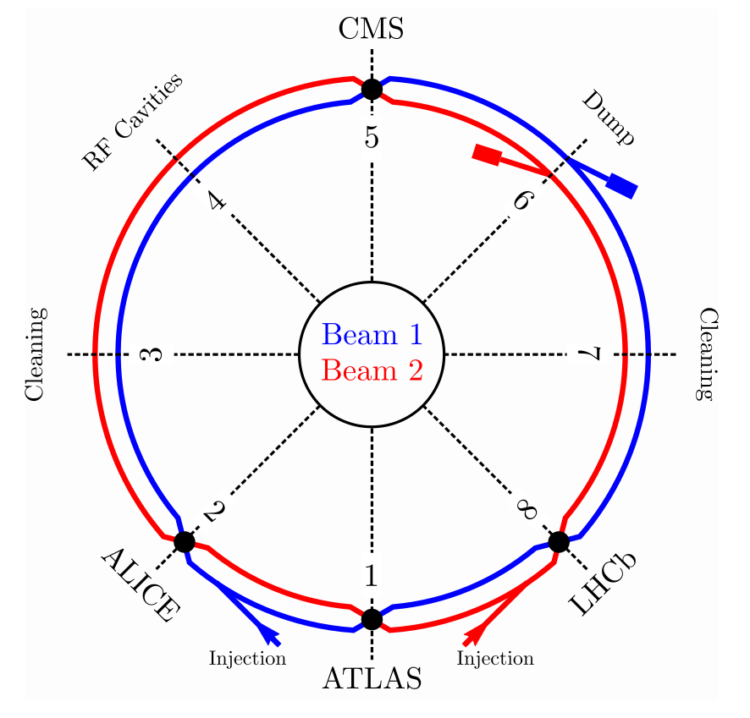
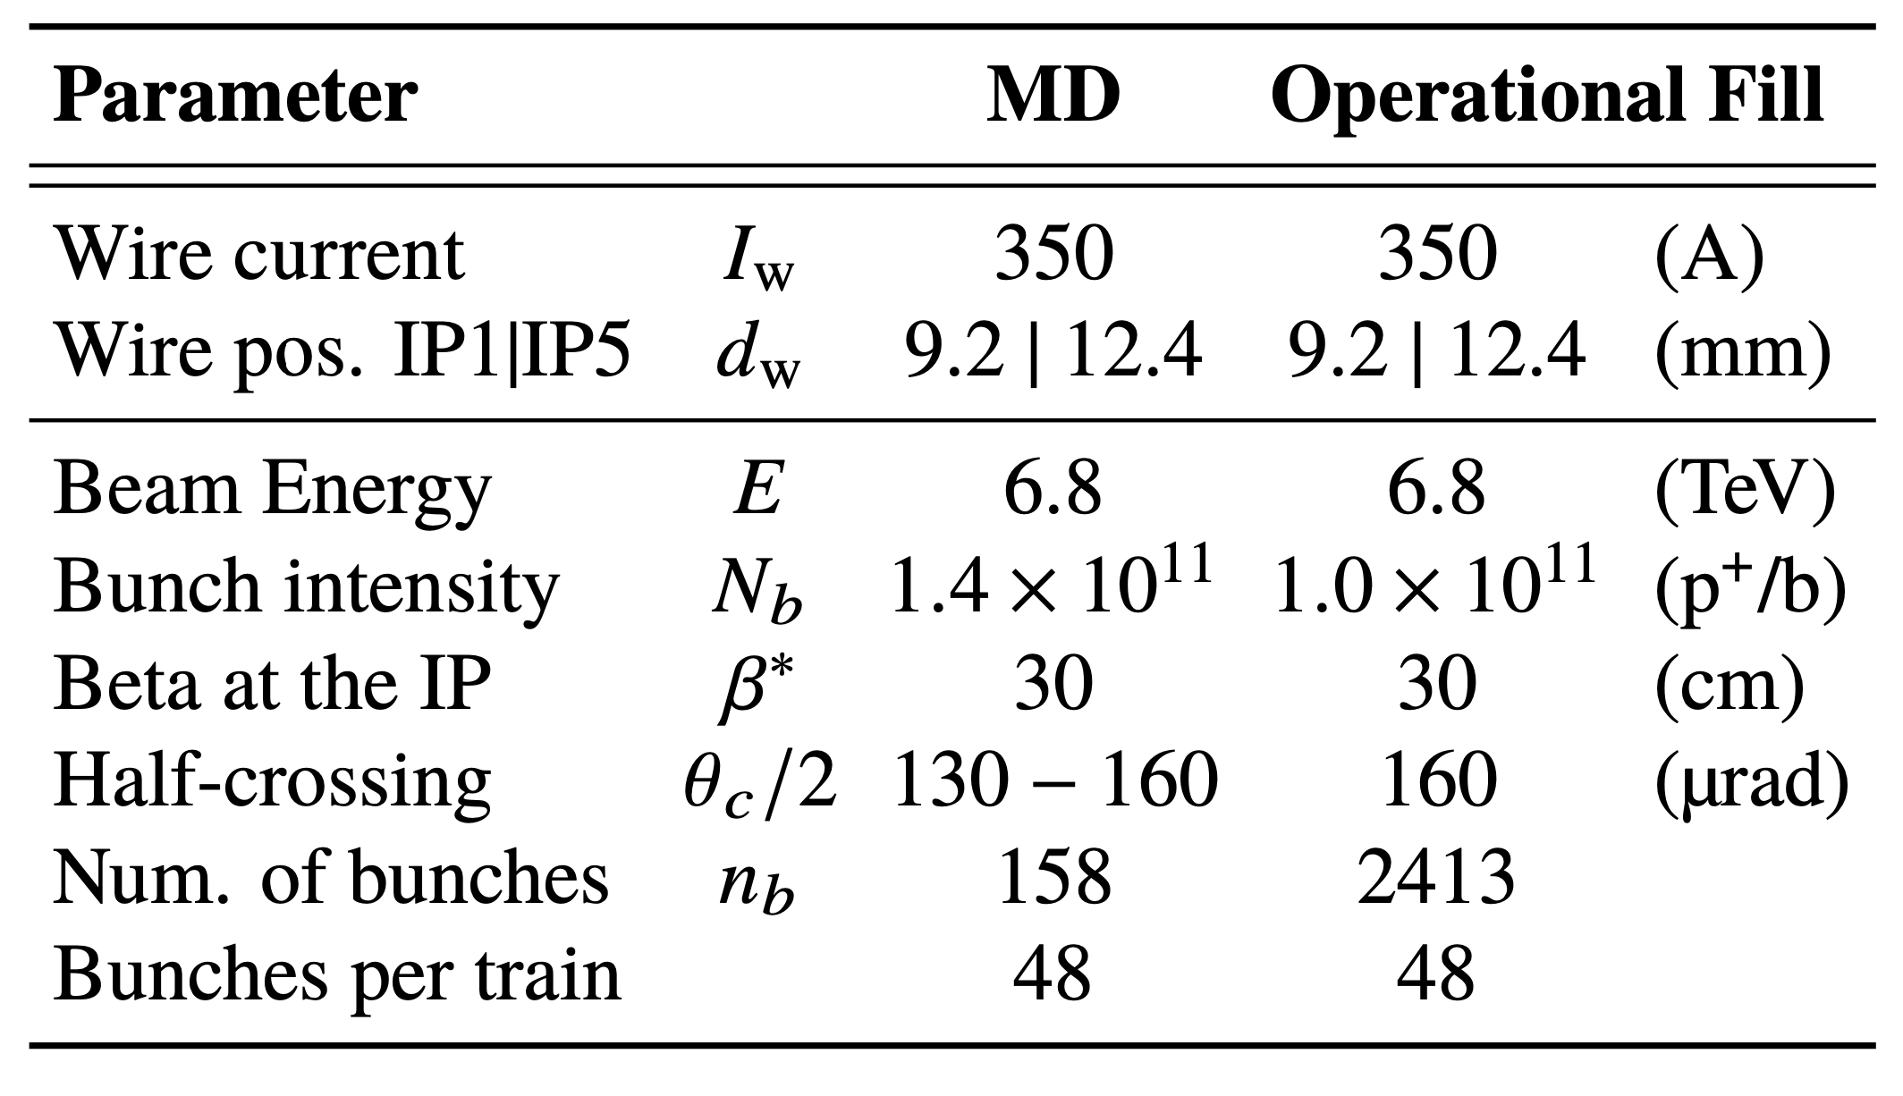
Run 3 BBCW hardware
BBCW embedded in IP1/IP5 TCT collimators
Demonstration hardware, used during MD and operation
Used in two-jaws configuration (octupolar corrector)
Only used at end of fill (𝛽* = 30 cm)

Slide 11
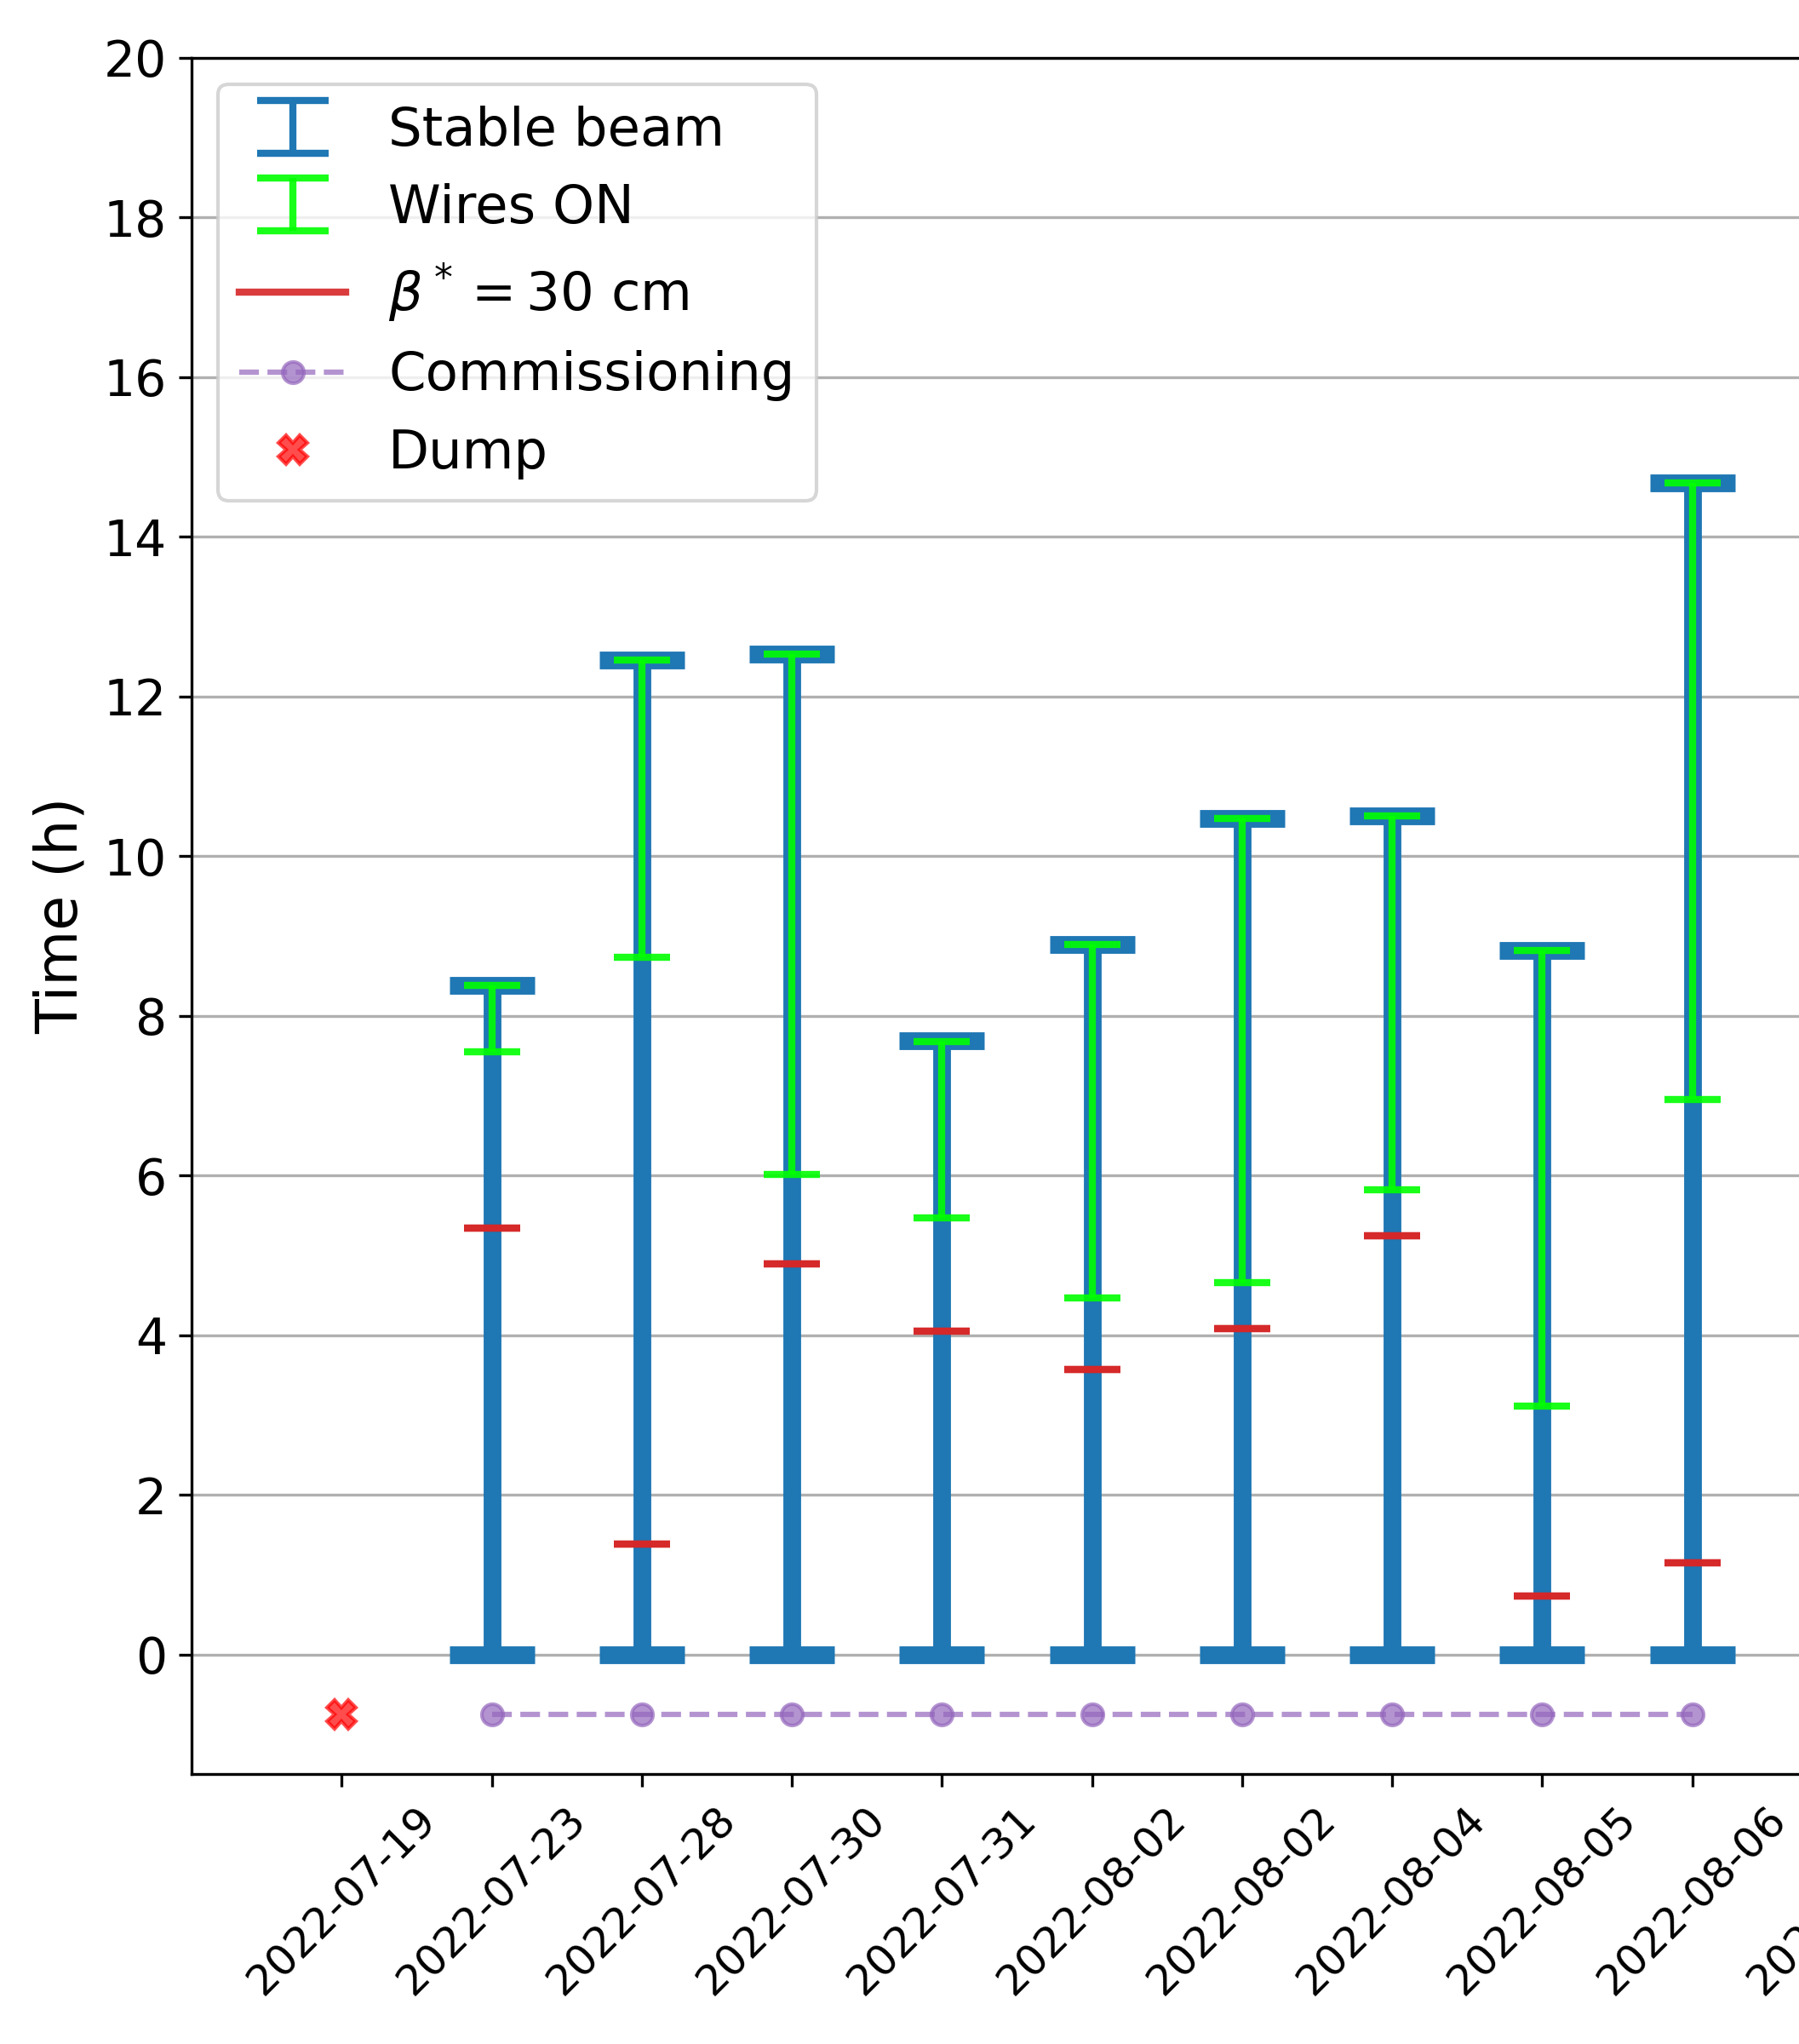
Commissioning and operation
Parasitic (end-of-fill) commissioning during intensity ramp-up
  5th axis alignment using the collimator alignment system
  Tune feed-forward system to compensate quadrupole effect
  Implementation of wire powering in LHC cycle
In 2022, used in 60+ fills, caused 6 beam dumps:
  No beam dumps from instabilities
  2 dumps from orchestration (IDLE power supply)
  4 dumps from excessive leakage current (earth fault)
  Beam 2 wires repaired and used for the rest of Run 3
  Beam 1 wires no longer operational
In 2023, used in 36 fills, caused 0 beam dumps:
  Discussions to repair B1 wires for 2024

Slide 12
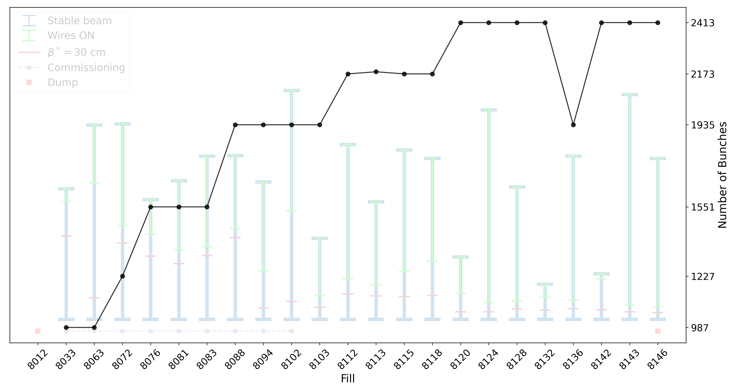
Commissioning and operation
*Done during intensity ramp-up!!
Parasitic (end-of-fill) commissioning during intensity ramp-up
  5th axis alignment using the collimator alignment system
  Tune feed-forward system to compensate quadrupole effect
  Implementation of wire powering in LHC cycle
In 2022, used in 60+ fills, caused 6 beam dumps:
  No beam dumps from instabilities
  2 dumps from orchestration (IDLE power supply)
  4 dumps from excessive leakage current (earth fault)
  Beam 2 wires repaired and used for the rest of Run 3
  Beam 1 wires no longer operational
In 2023, used in 36 fills, caused 0 beam dumps:
  Discussions to repair B1 wires for 2024

Slide 13
Introduction
Experimental Framework
Machine Development
2023 Operation

Slide 14
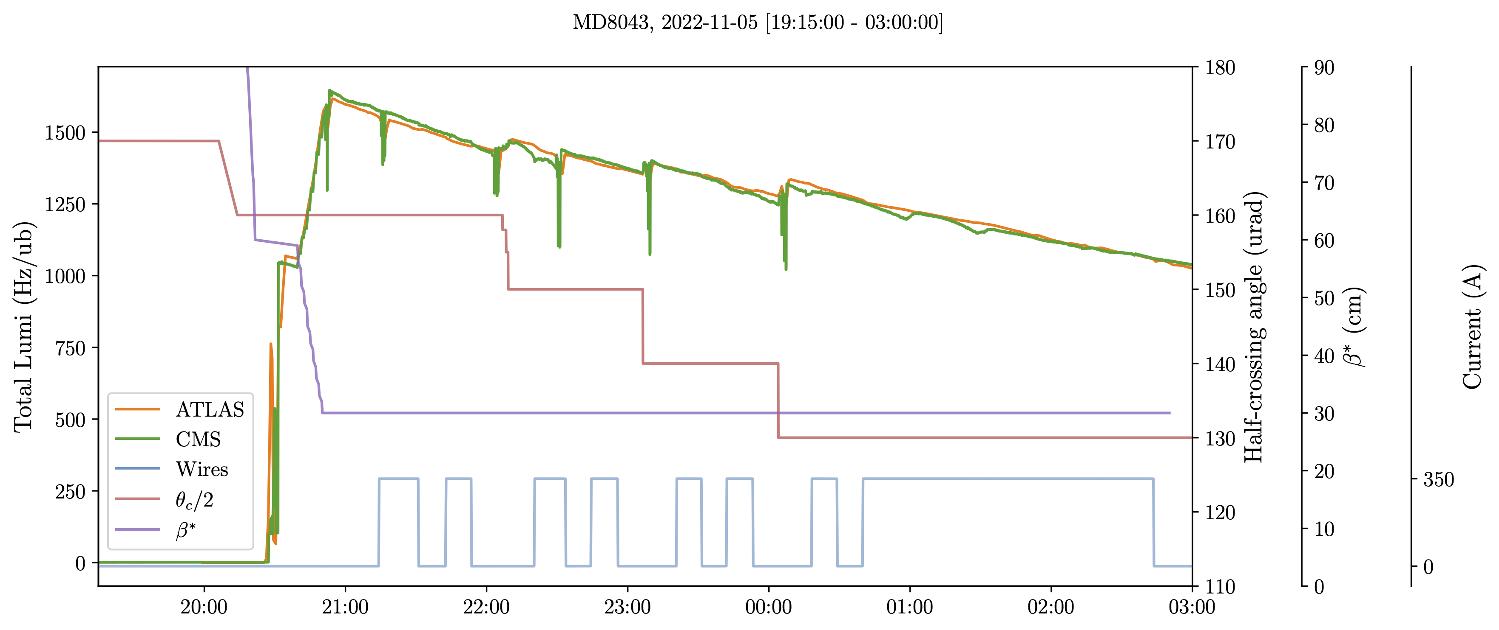
Machine Development (Nov. 2022)
Pushing for a high BB regime:
  Small crossing angle
  High bunch intensity
Cycling of BBCW ON/OFF, measuring bunch-by-bunch losses

Slide 15
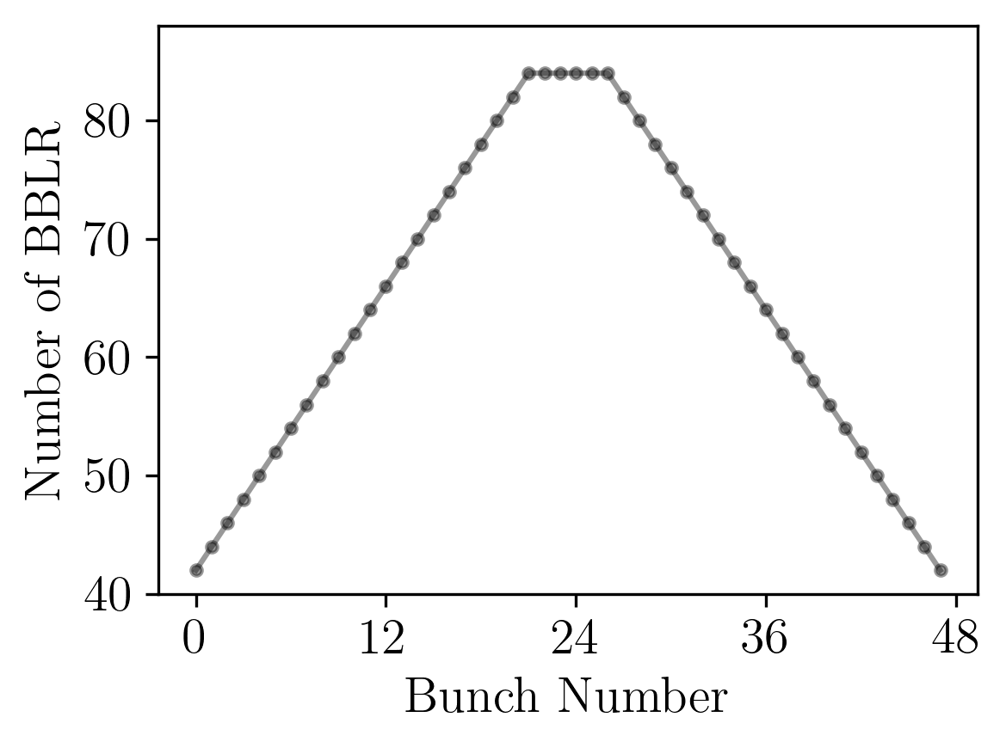
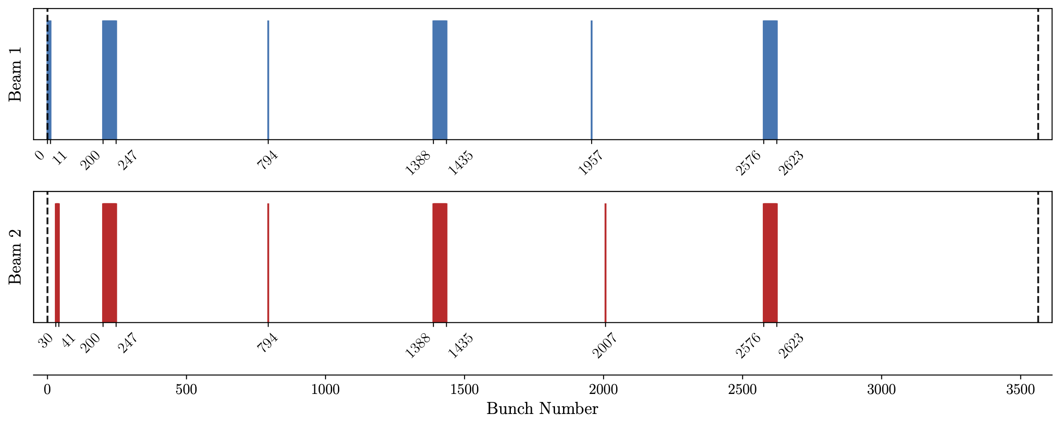
Machine Development (Nov. 2022)
Isolated 48b train
Filling pattern designed to
  Reduce e-cloud effects
  Isolate beam-beam effects, only IP1 and IP5 collisions/interactions
Rule of thumb: BB effects scale according to the number of BBLR
  Around 40 in IP1 and IP5 for the middle bunch of a train

Slide 16
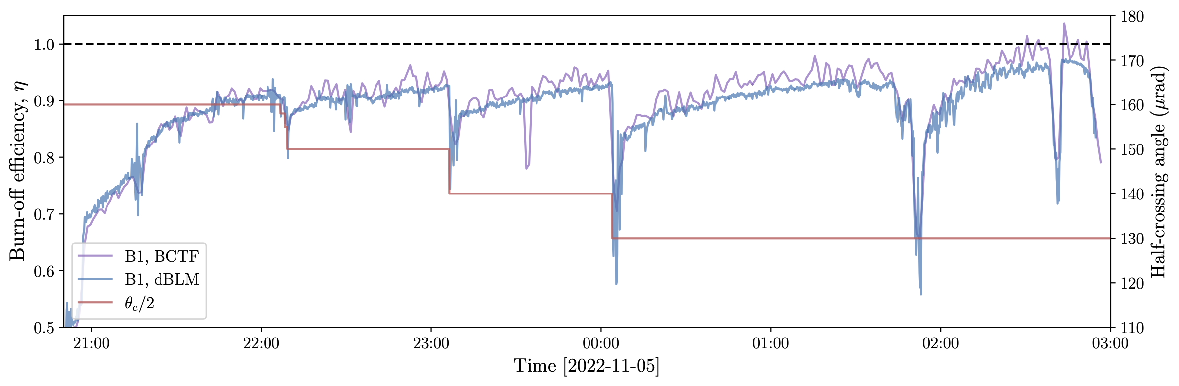
Measuring the efficiency
Bunch-by-bunch efficiency can be measured combining:
  Bunch-by-bunch luminosity
  Bunch-by-bunch losses
    Derivative of BCTF (noisy)
    Calibrated dBLM measurements

Slide 17
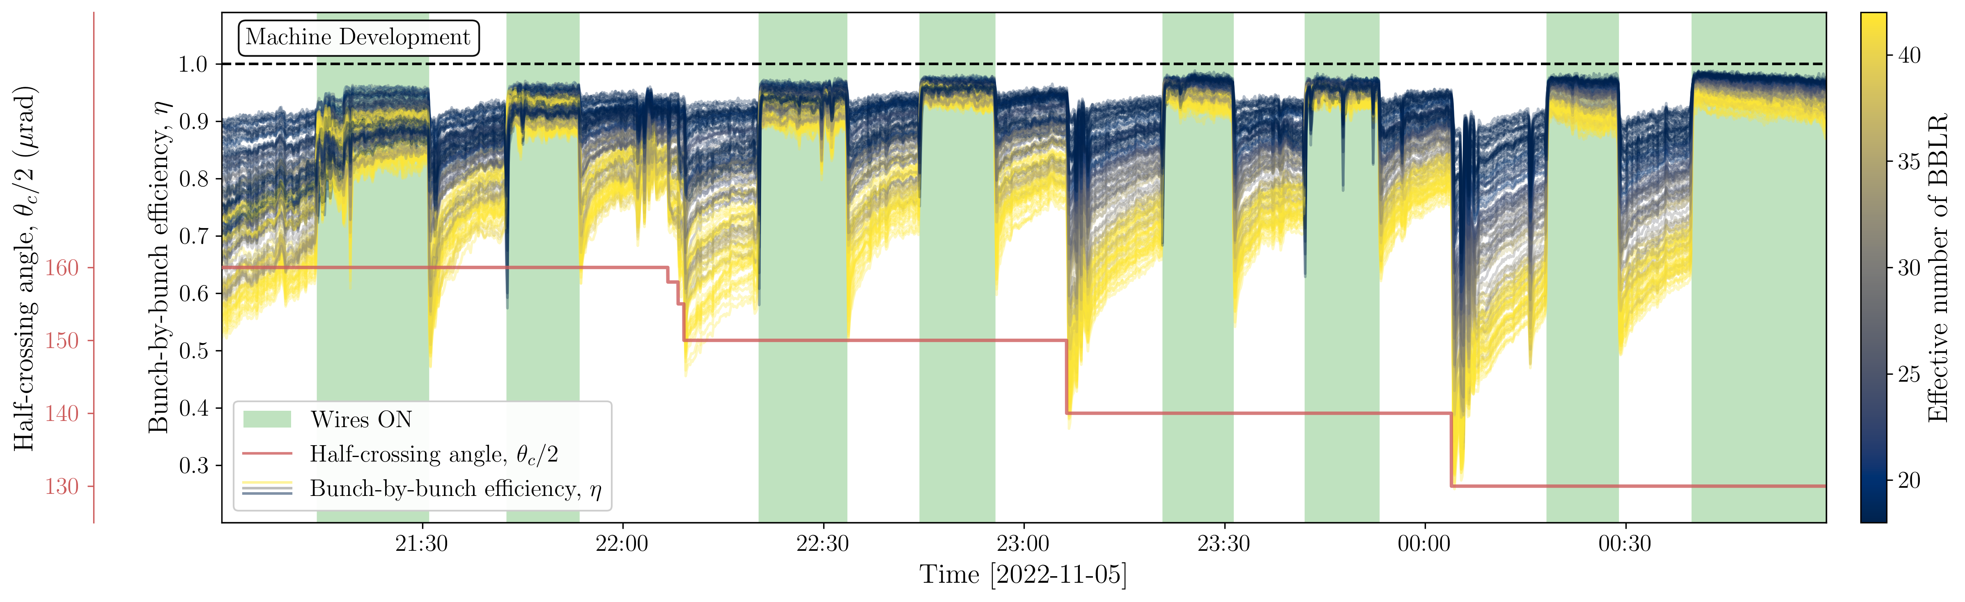
MD: successful BBCW compensation
Natural efficiency improvement on a time scale of about 30 – 60 min
  Come at the cost of significant and unrecoverable proton losses
Immediate efficiency improvement when powering the wires
  Reduces the bunch-by-bunch variation
  Other non-beam-beam losses remain in the machine

Slide 18
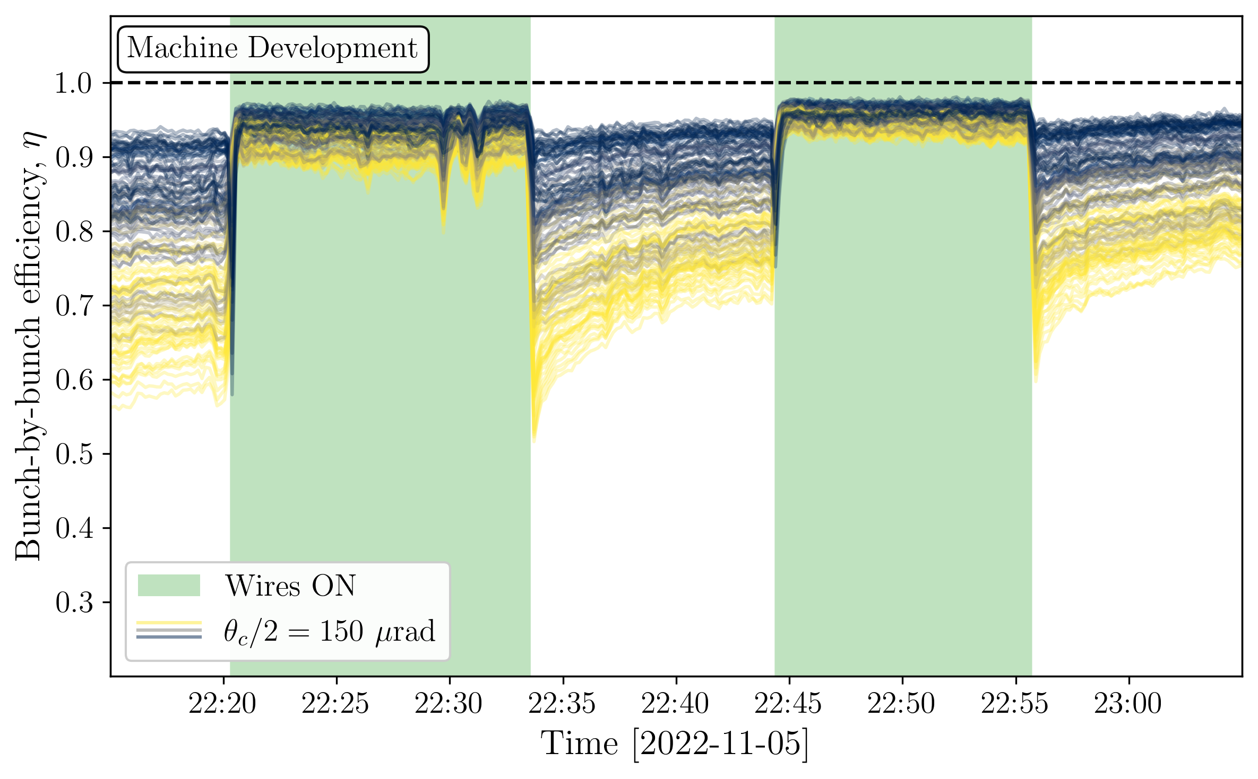
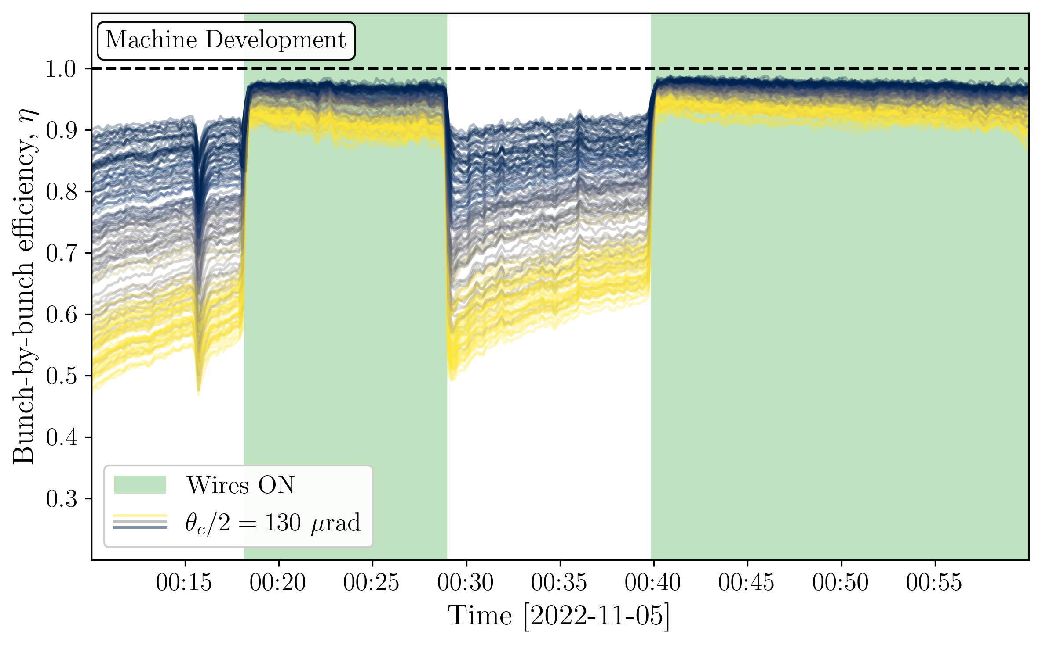
MD: successful BBCW compensation
150 urad
130 urad
Collimator
scrapping
At a given time, how do the losses from different bunches compare?

Slide 19
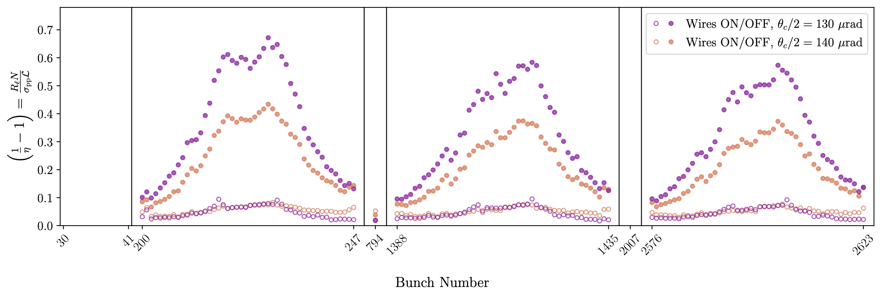
Bunch-by-bunch signature
Luminosity-normalized losses: implicitly includes variation of bunch intensity and emittance
With wires ON: reduction of the crossing angle does not affect the normalized losses
Clear signature observed: plateau at ¼ of the train and local maxima around the middle
At 130 μrad, more than 33% of beam losses do not contribute to luminosity production!

Slide 20
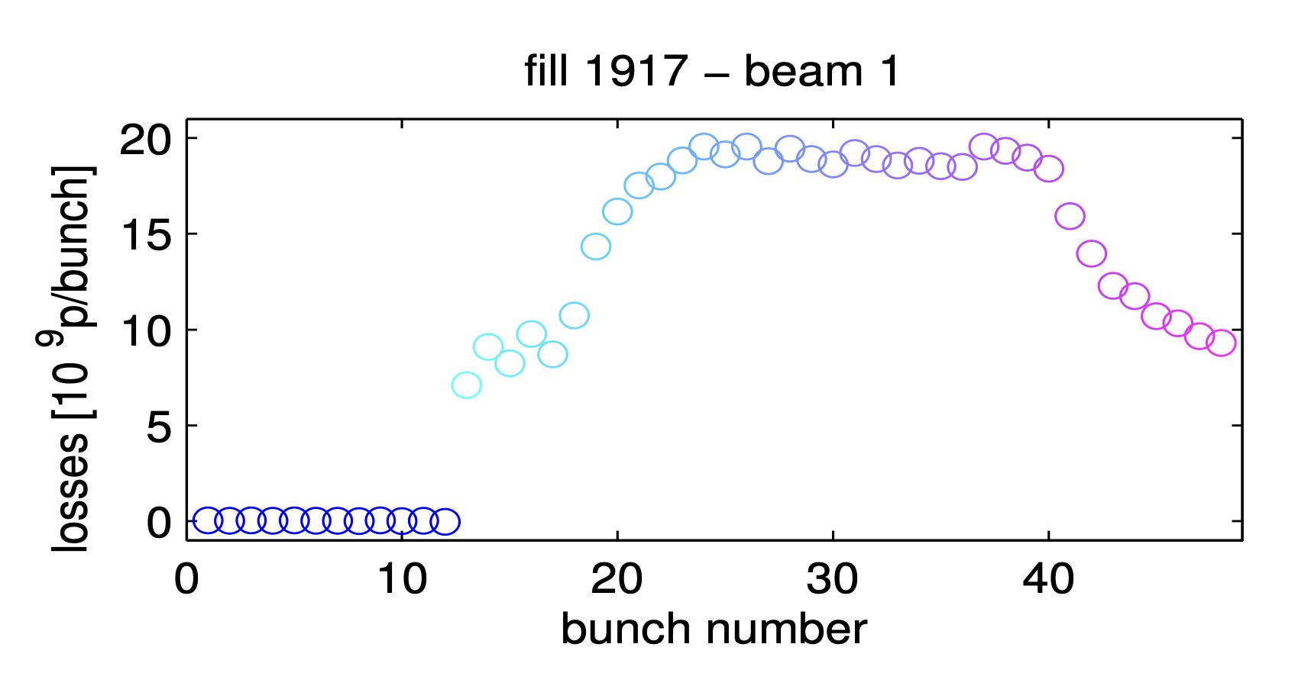
Bunch-by-bunch signature
Luminosity-normalized losses: implicitly includes variation of bunch intensity and emittance
With wires ON: reduction of the crossing angle does not affect the normalized losses
Clear signature observed: plateau at ¼ of the train and local maxima around the middle
A sight from the past, 6400 LHC fills ago!
W. Herr et al. (2013): “Long-Range Beam-Beam Effects in the LHC”

Slide 21

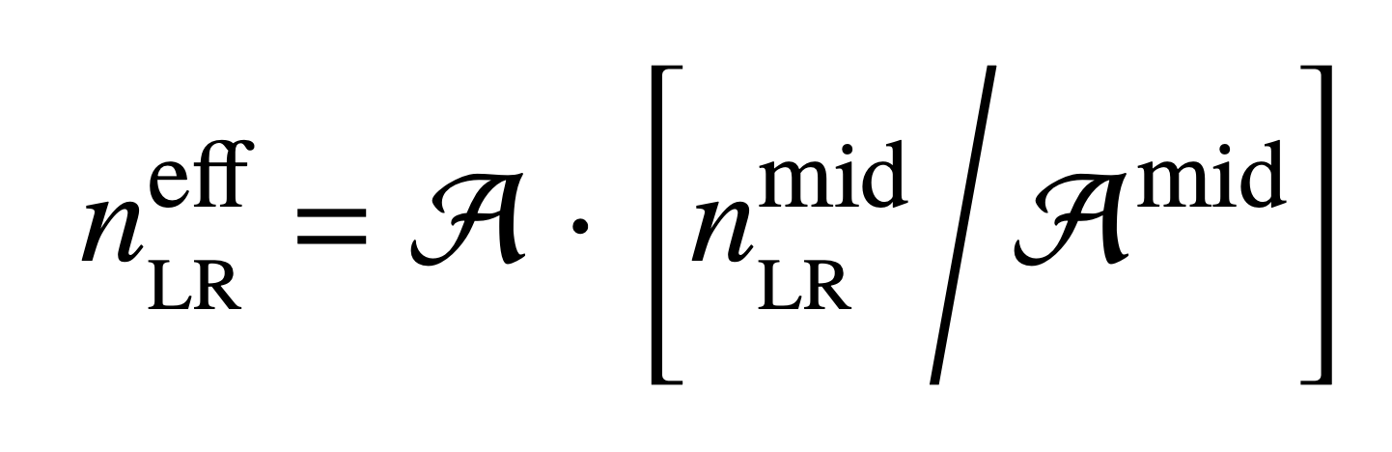
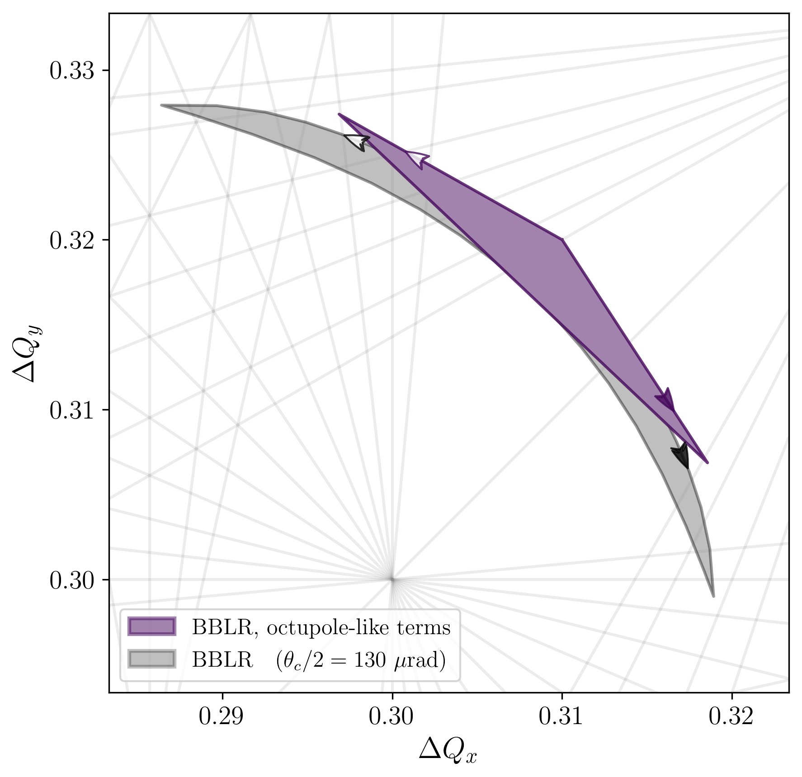
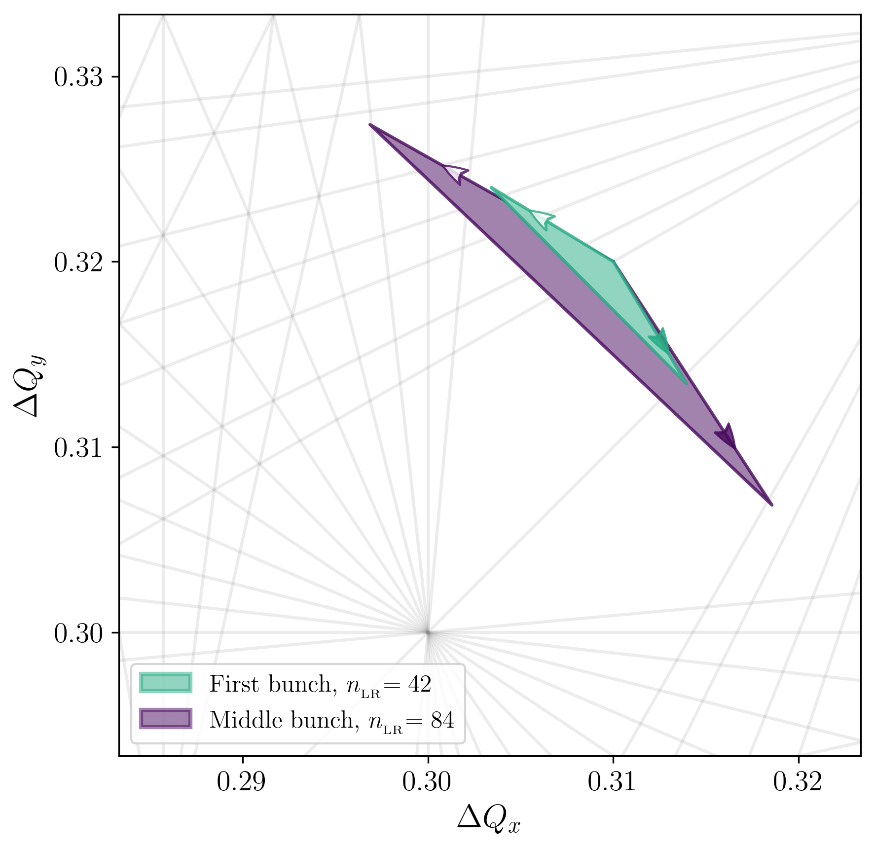
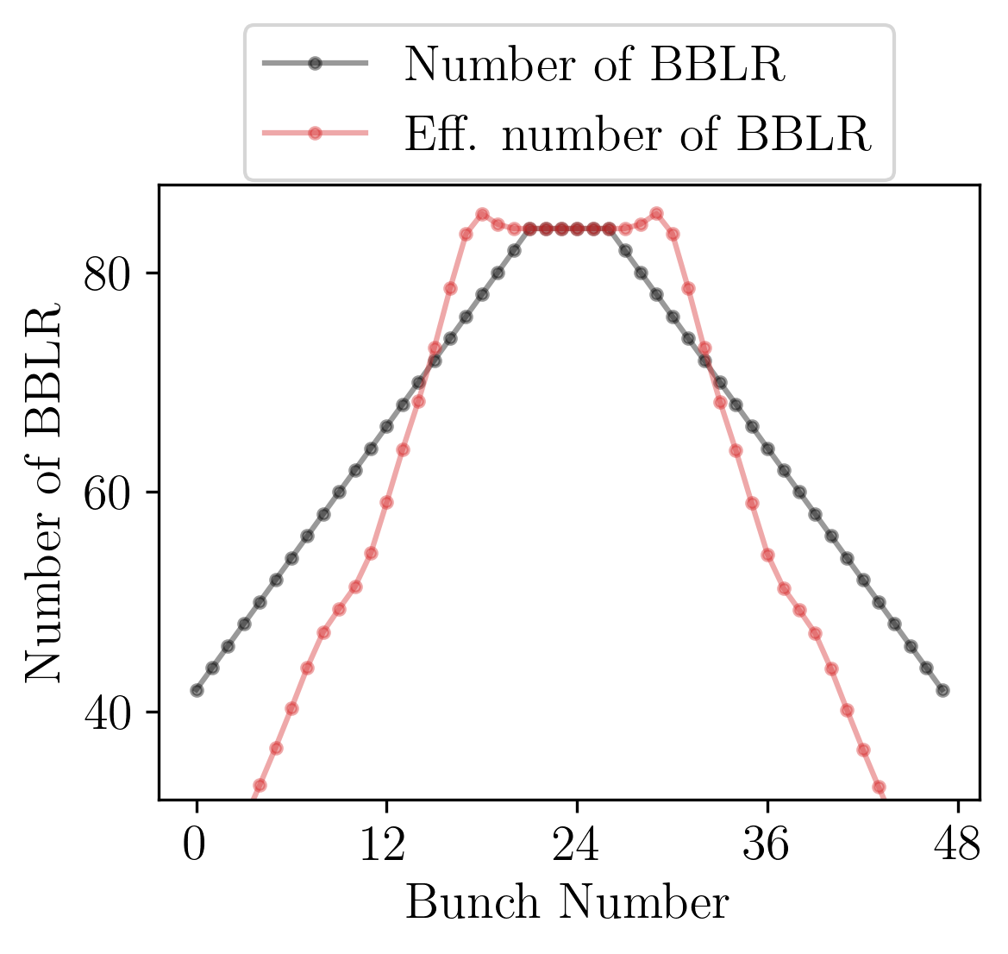
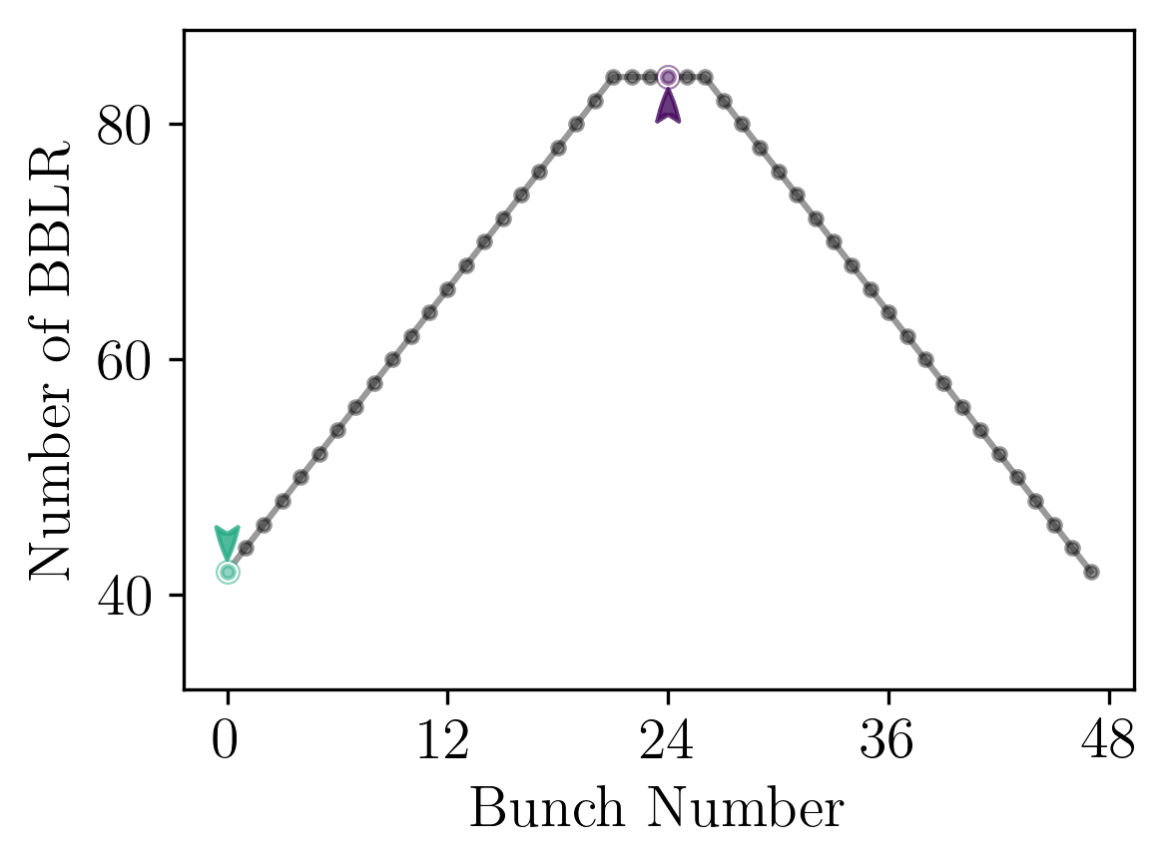
Evaluating BB Strength
Recall: BB effects scale according to the number of BBLR, rule of thumb
Not all BBLRs are equal (beta functions, beam-beam separation, etc.)
Detuning is a subset of RDTs, let’s estimate the BB strength via the area of the footprint
One recognizes the experimental b-by-b signature!

Slide 22
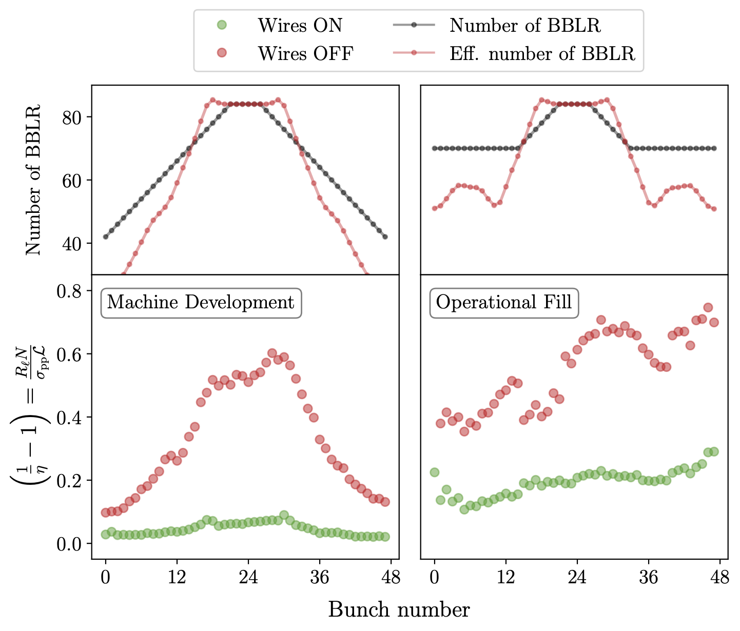
BB Strength and b-by-b signature
Fundamental link between RDTs, DA and beam losses still to be understood
Signature depends on the filling pattern
  Future MDs should aim at studying various patterns
Operational fills are less simple…
  Interaction in IP2 and IP8
  E-cloud effects

Slide 23
Introduction
Experimental Framework
Machine Development
2023 Operation

Slide 24
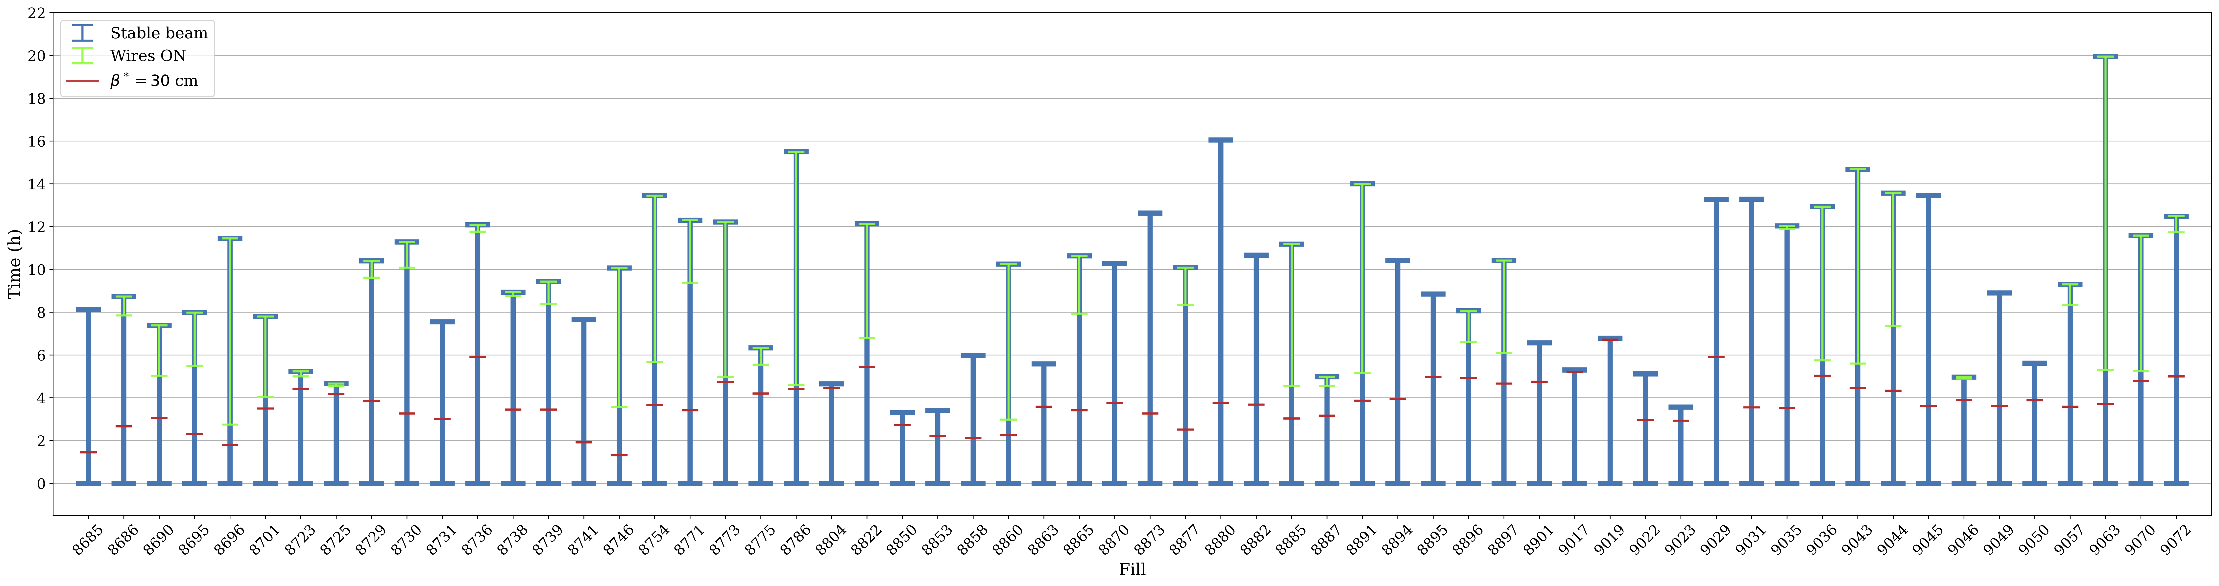
2023 Operational fills
Fills from 2023, with 𝛽* = 30 cm, >200 bunches and reaching stable beam:
  Wires ON : 36
  Wires OFF: 24
No beam dumps
Wires only turned on relatively late in the fills… significant number of protons already lost!
In general, not BB dominated regime

Slide 25
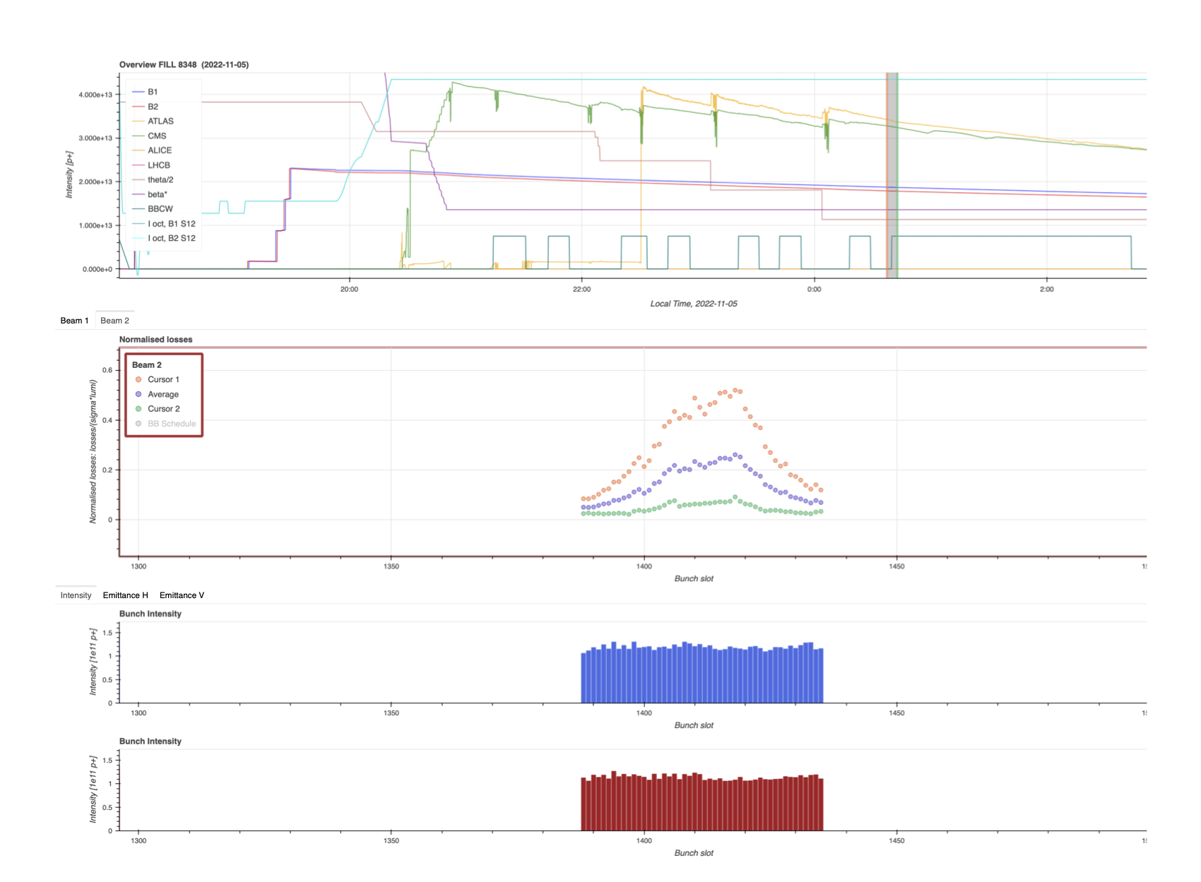
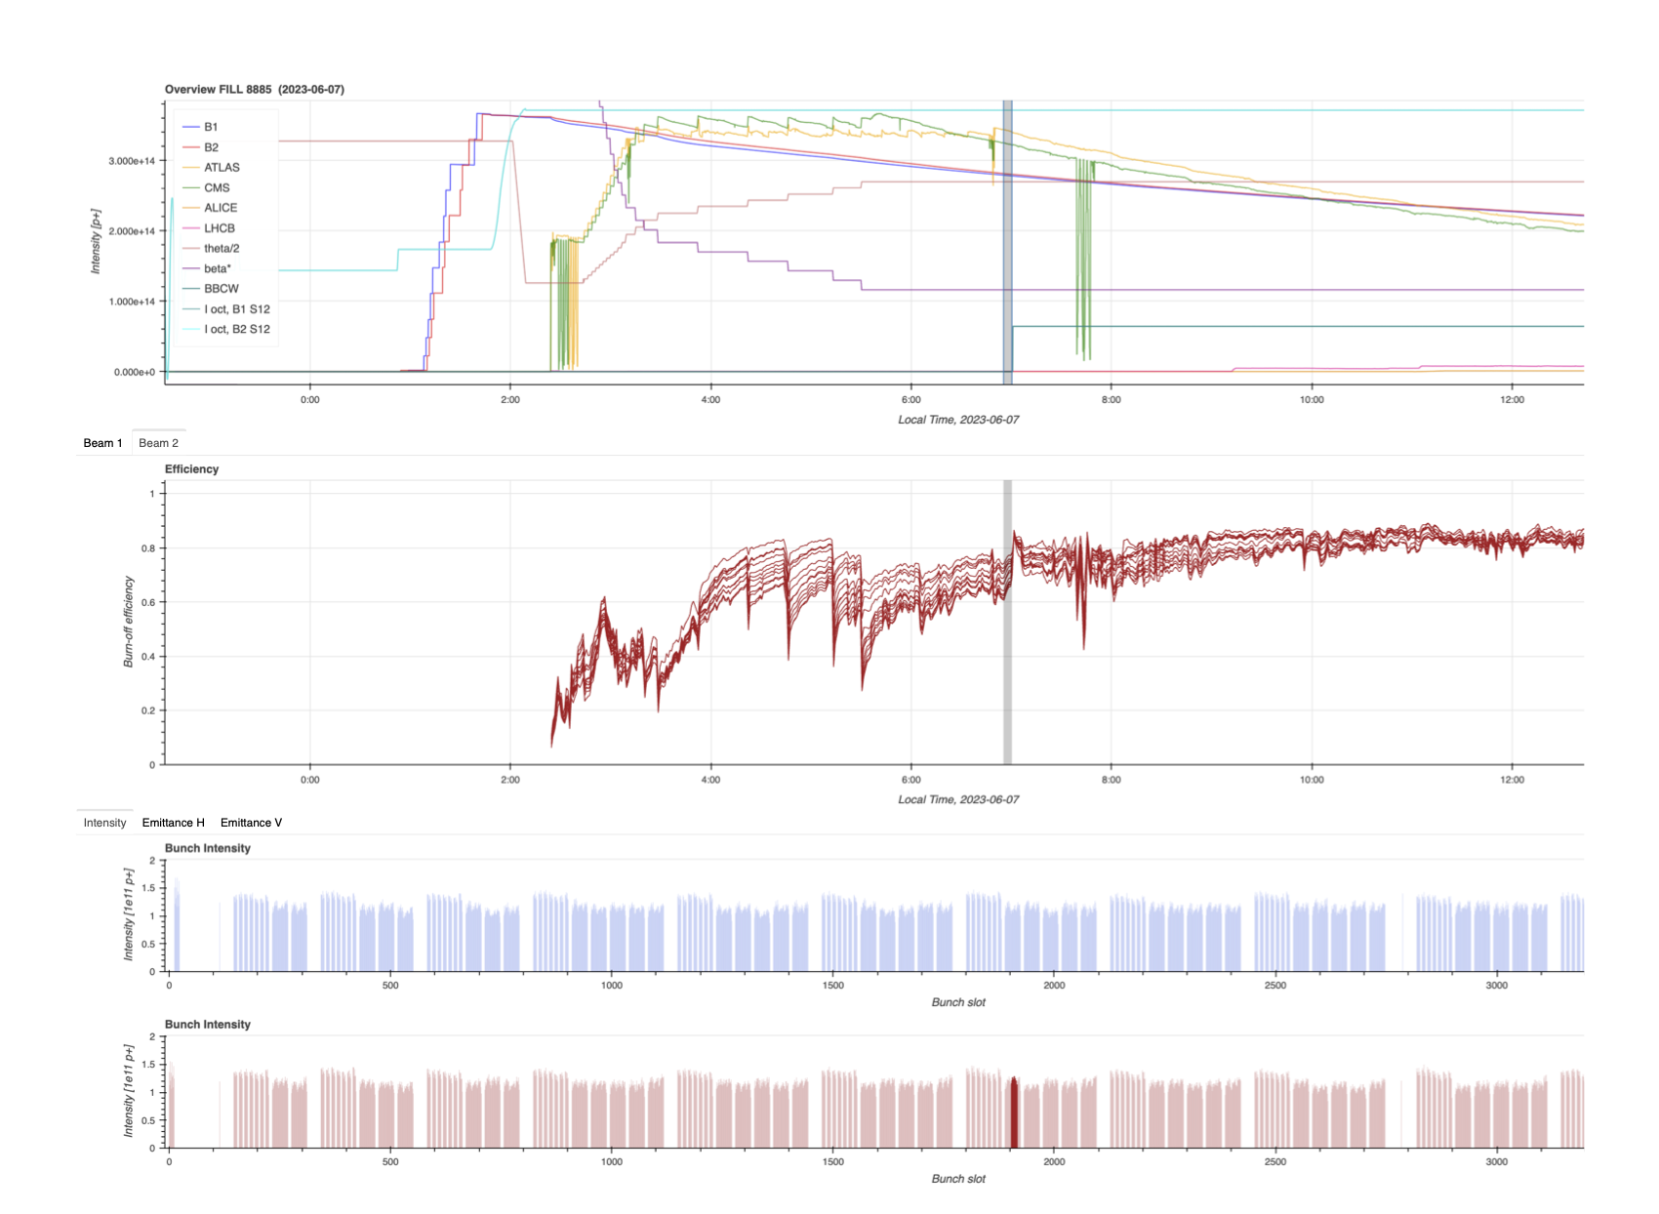
Monitoring effort
Put together a website to access fill data rapidly:
https://bblumi.web.cern.ch/Monitoring/
Interactive interface with bunch-by-bunch data
Should be pushed to a more centralized dashboard environment

Slide 26
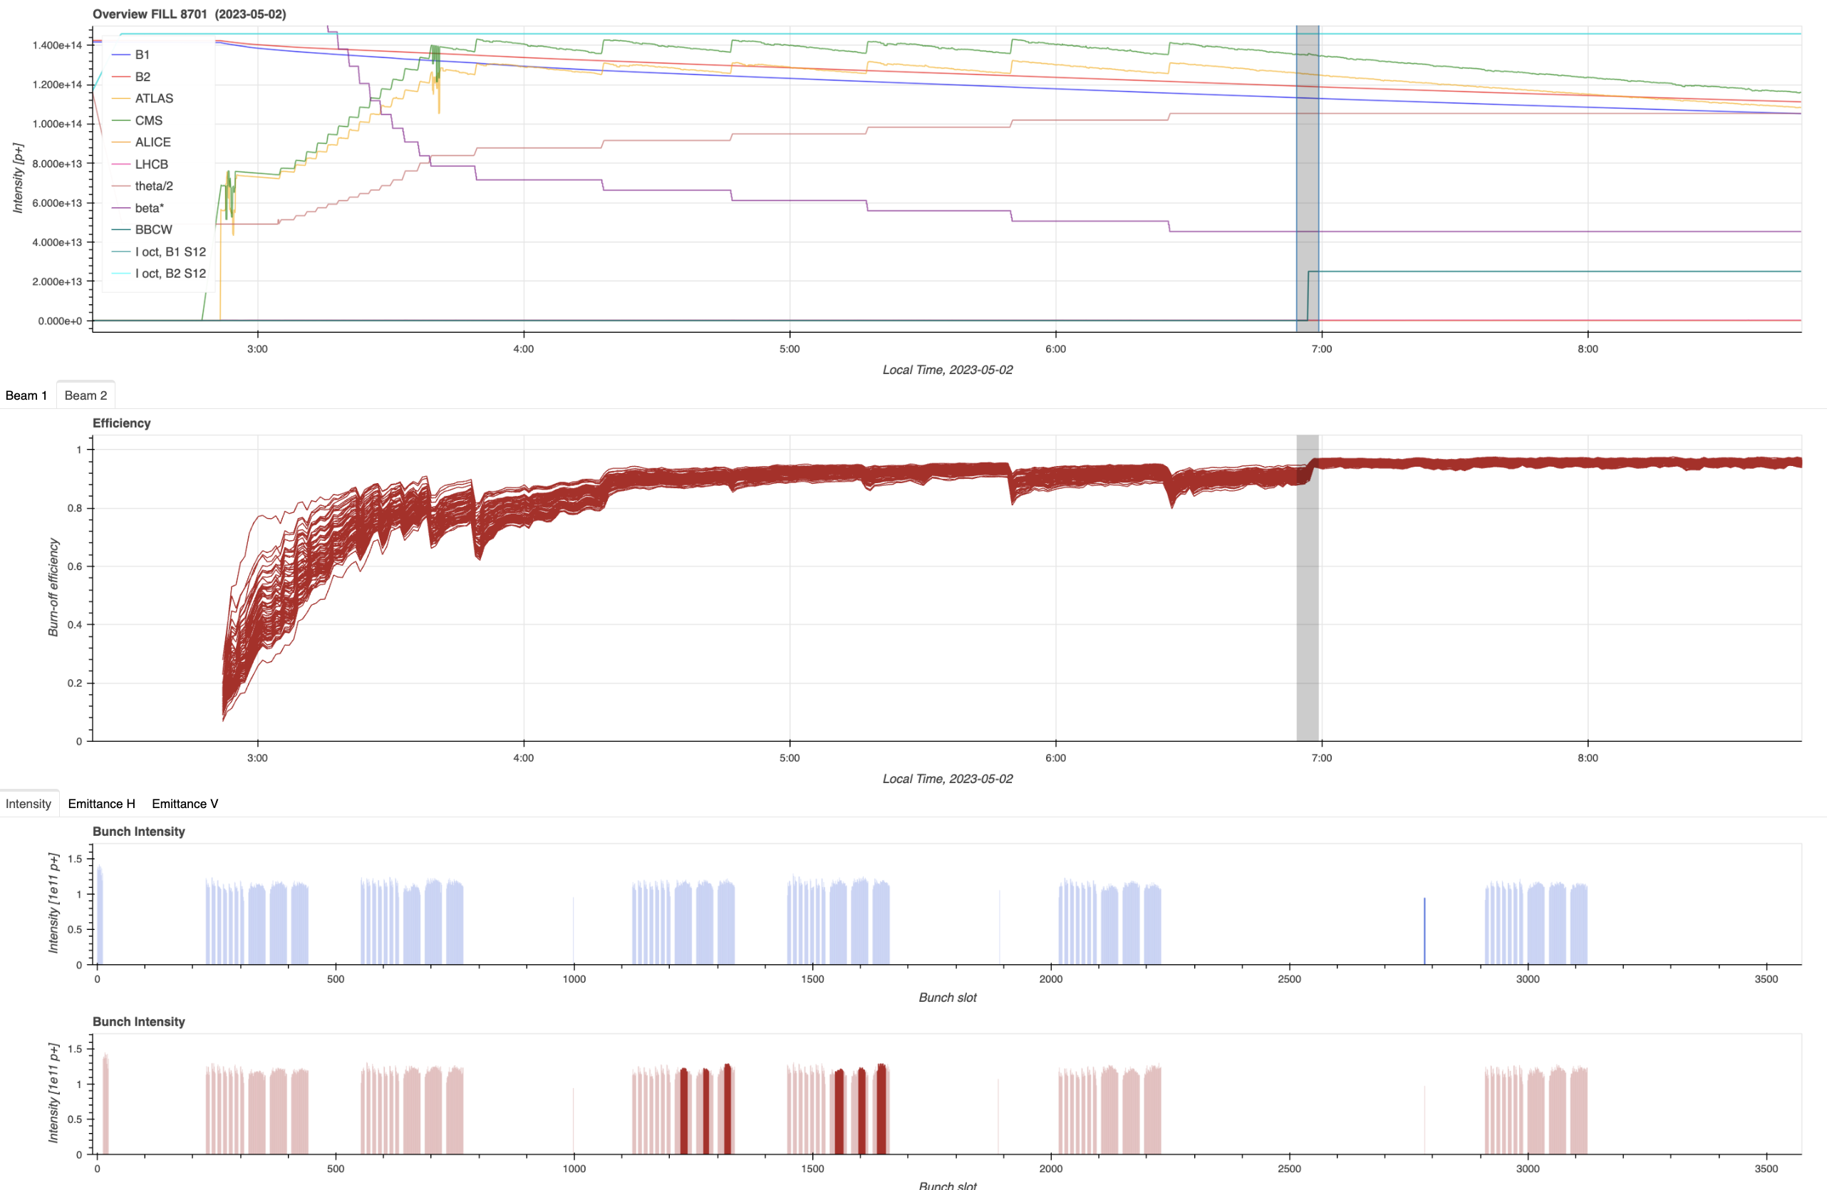
Natural cleaning of the machine

Slide 27
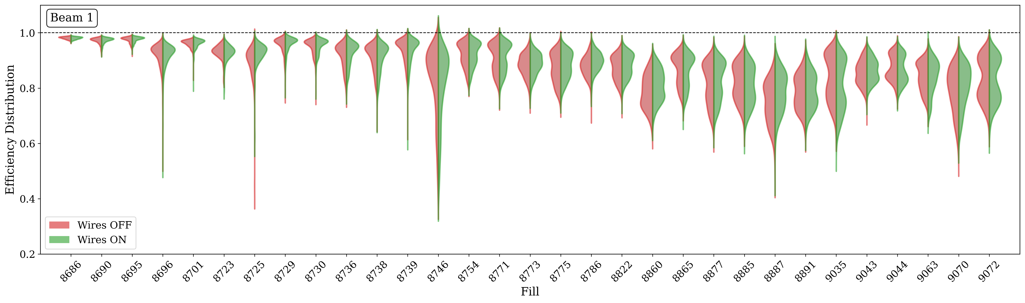
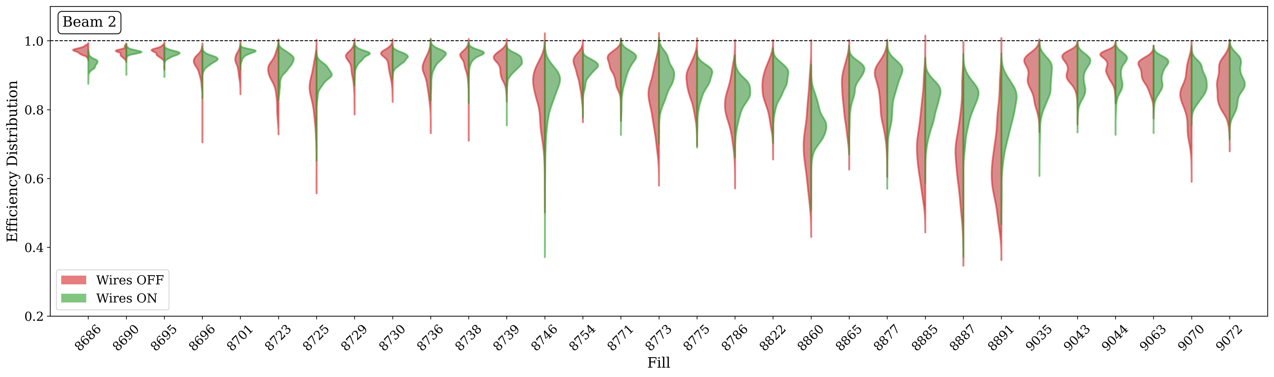
General trend: net positive impact

Slide 28
General trend: net positive impact
Beam 1: symmetric distributions
Efficiency is unaffected when powering the B2 wire
Beam 2: asymmetric distributions
Efficiency is improving when powering the wire
  Either net gain (5% on average, up to 20%)
  Or reduction of the bunch-by-bunch spread
  Fills 9035+, working point of the machine seems to change, TBD

Slide 29
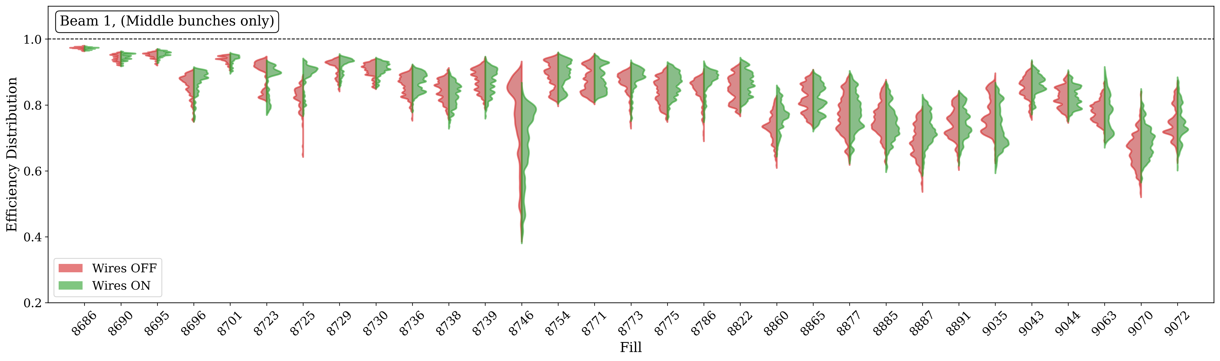
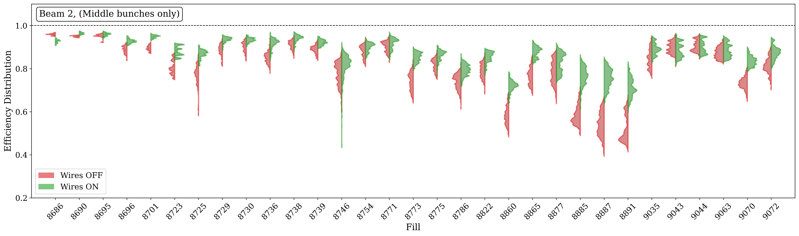
Trend for middles bunches (high beam-beam)

Slide 30
Summary
Figure of merit: Burn-off Efficiency
  Includes lumi-normalized losses
  Linked to the relative gain in integrated luminosity
  Measured from dBLM or BCTF
BBCW wires successfully compensate BB effects in Run 3, up to 130 μrad and 1.4x10¹¹ p/b
  Fundamental advantage over LHC octupoles, especially with small crossing angle (non-octupolar footprint)
  Can be enhanced further by approaching closer to the beam
Operation:
  Net positive impact in 2023, could be improved by powering earlier
  Monitoring effort, all data is readily available online
  B1 should be repaired for 2024, to be used in combination with B2
Machine Development:
  Showed a clear BB compensation for IP1 and IP5
  Highlighted a distinct bunch-by-bunch signature, in good agreement with effective signature from footprint studies
  Fundamental link between RDTs, DA and beam losses still to be understood
  Future MDs to study various bunch-by-bunch signatures?

Slide 31
Thank you!

