Slide 1

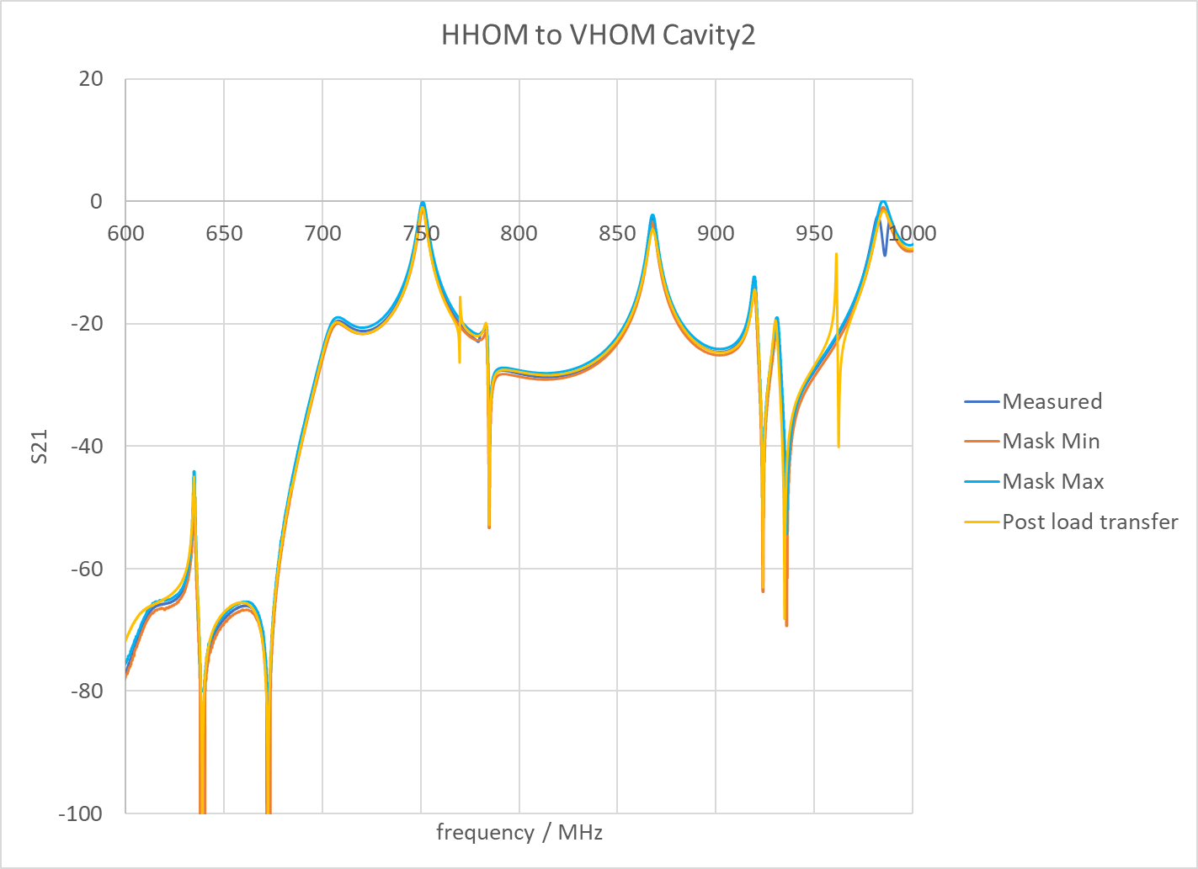
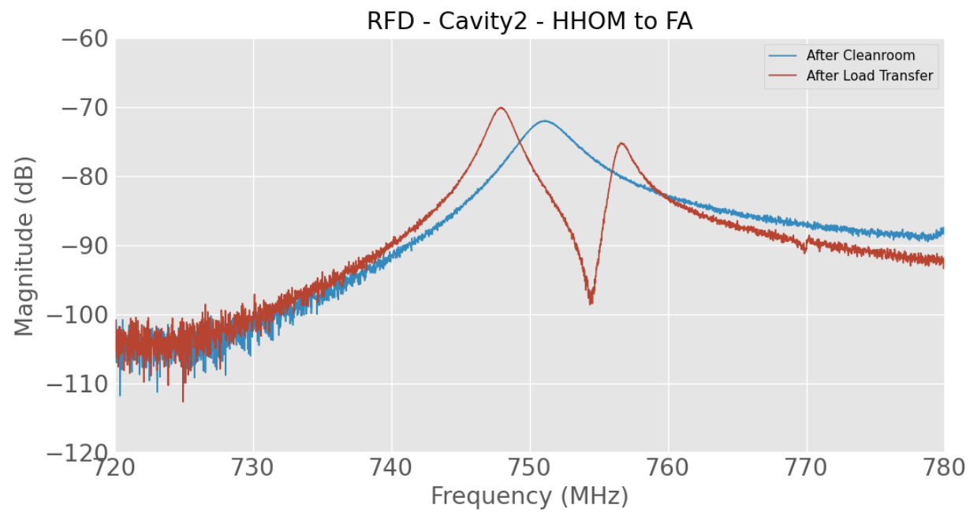
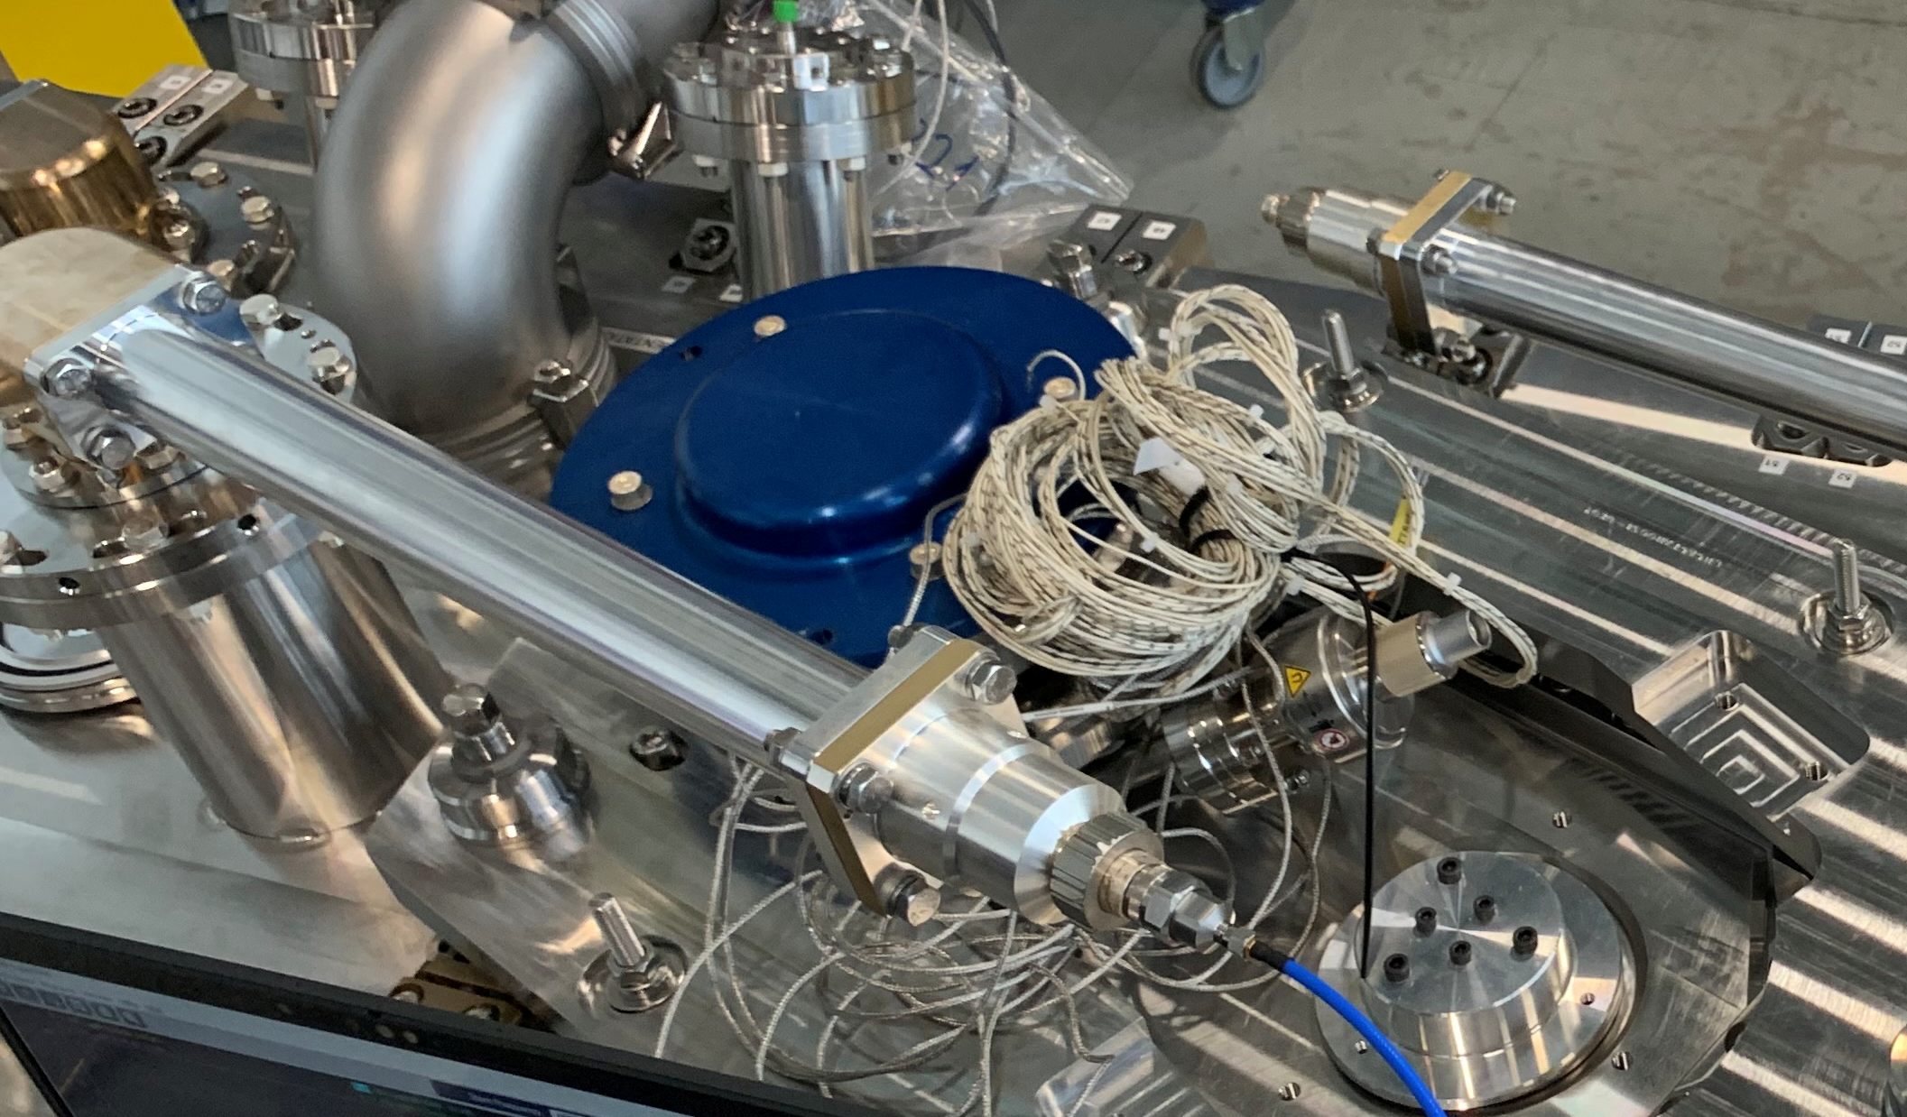
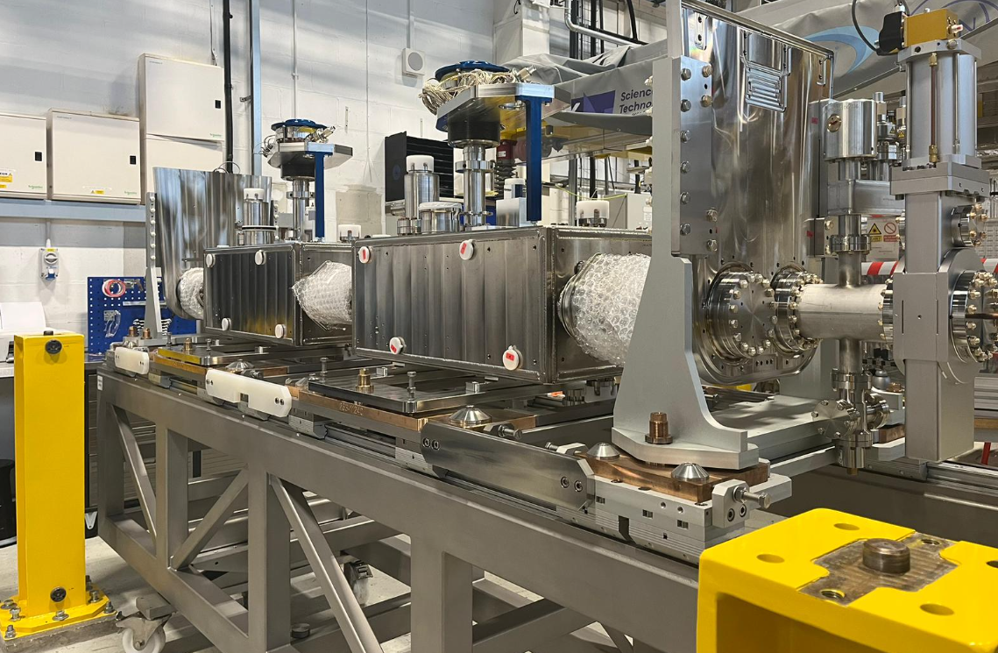
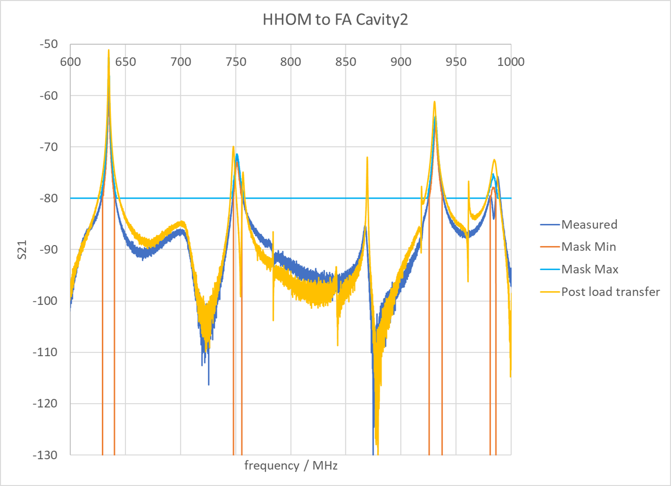


RFD Cryomodule…Warm Measurements
Measurements taken at warm during cryomodule assembly (courtesy of G. Burt)
There is almost no change between the measurements of the cavity string post-cleanroom and post-load transfer when measuring HHOM-VHOM up to 2 GHz
The 750 MHz mode is split in two in measurements involving the field antenna, but 400 MHz signal is fine
Notes:
Finally a quick nod to RFD measurements taken on the cryomodule at Daresbury recently. The HOM spectrum measured from the RFD HHOM to VHOM are stable. Observation of a very small change around 750MHz where one mode has now split and now appears as two modes, this is not explained but is not considered and issue at the moment.

Slide 2
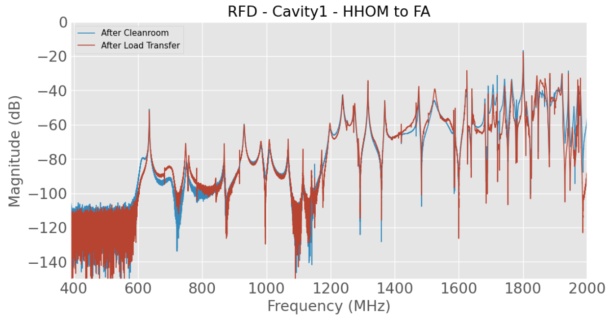
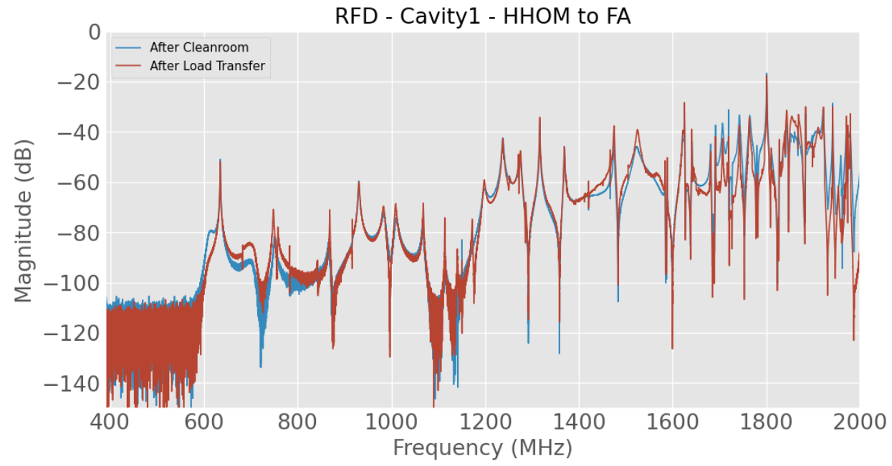
Cavity 1 & 2 – HHOM to FA

Slide 3
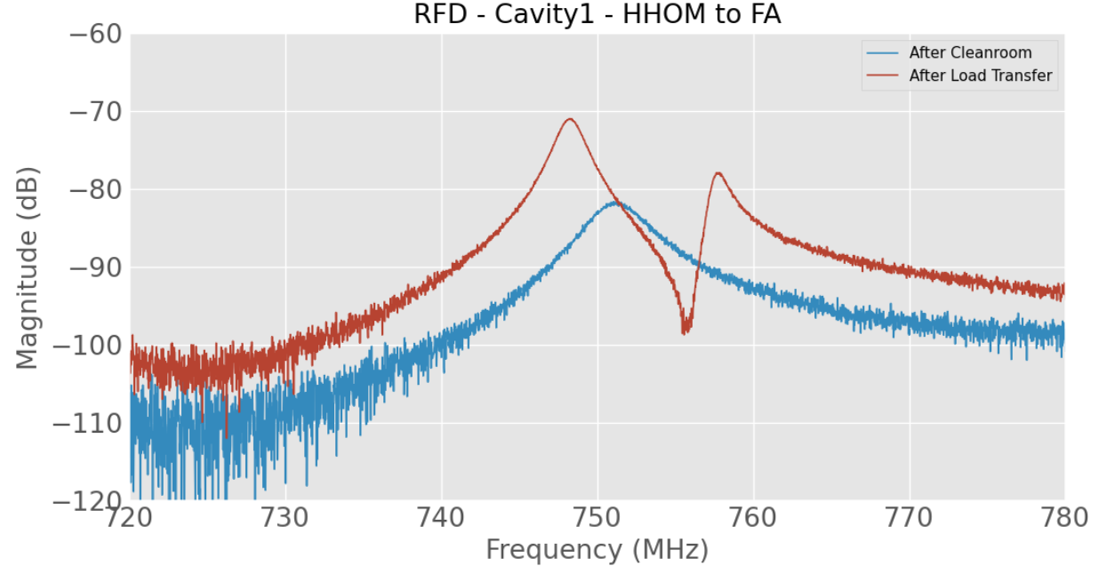
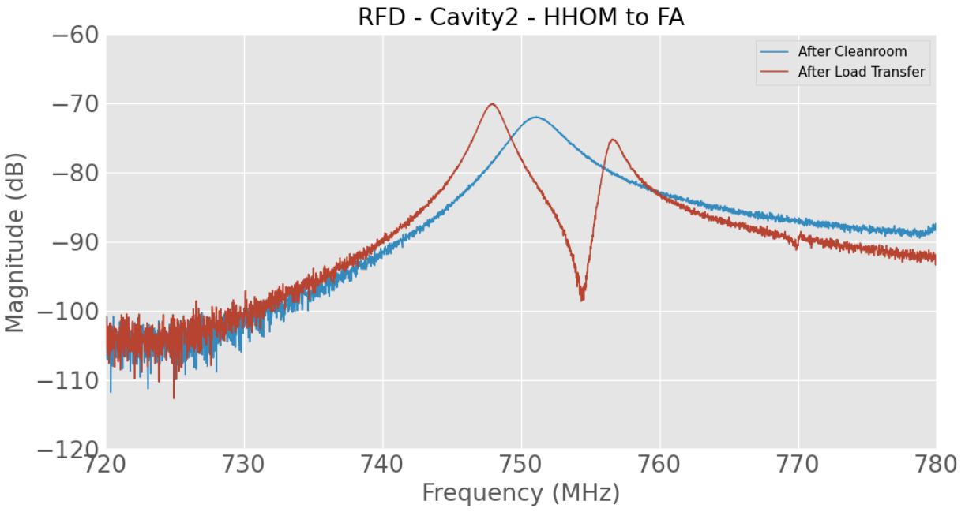
Cavity 1 & 2 – HHOM to FA - 750MHz

Slide 4
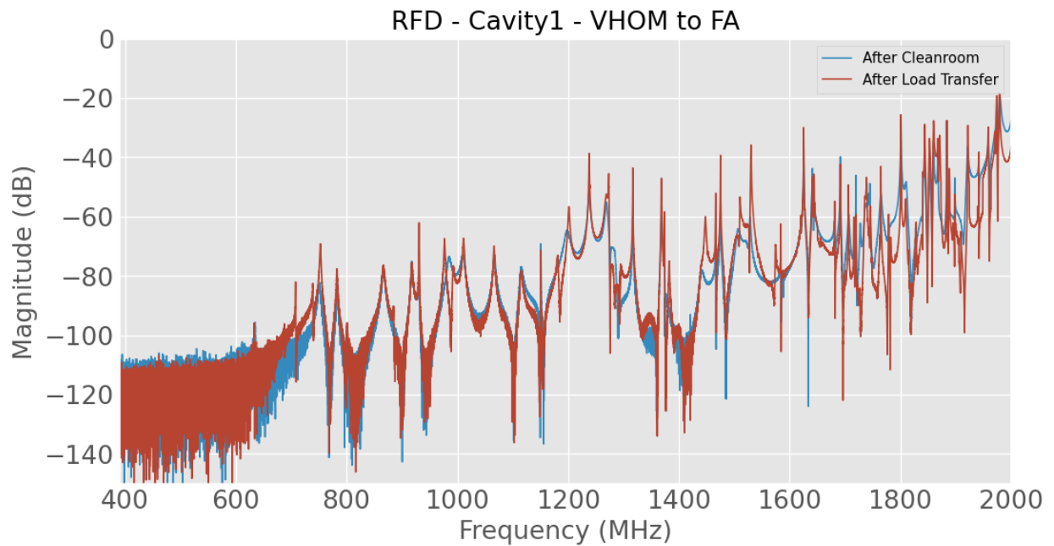
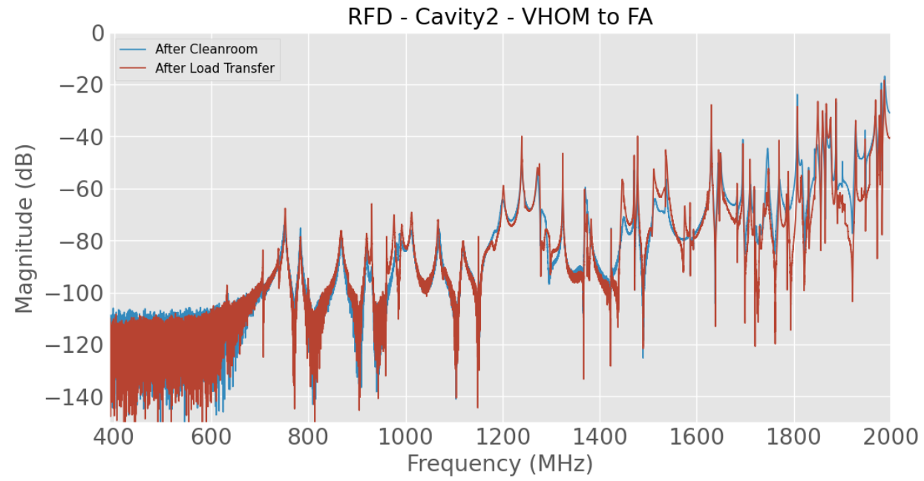
Cavity 1 & 2 – VHOM to FA

Slide 5
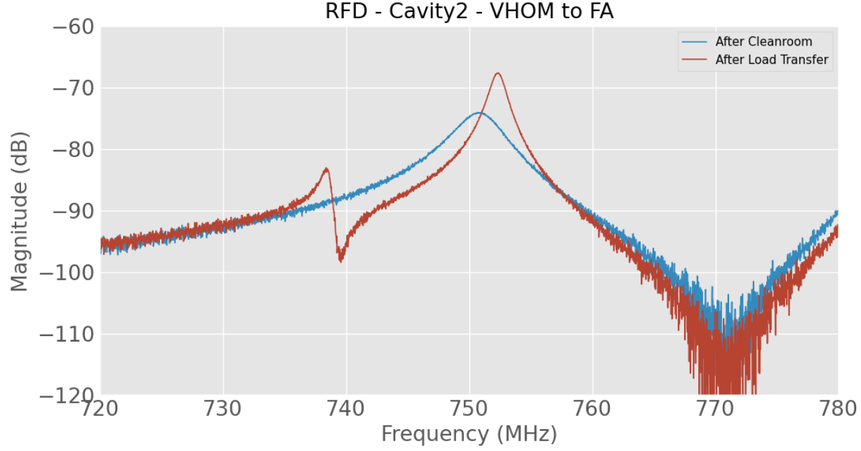
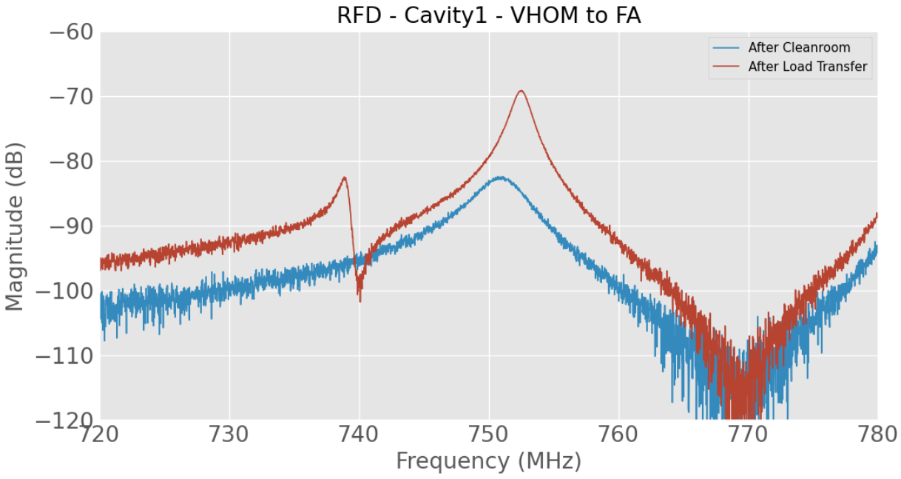
Cavity 1 & 2 – VHOM to FA - 750MHz

Slide 6
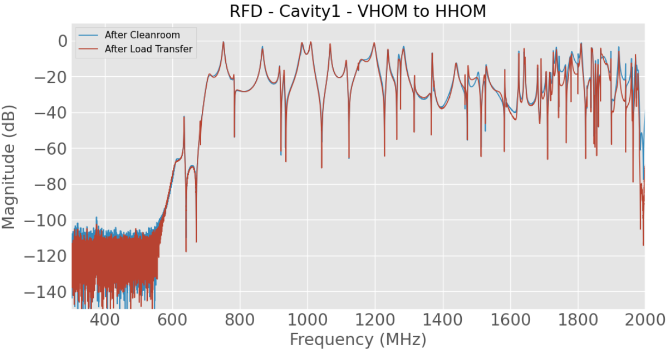
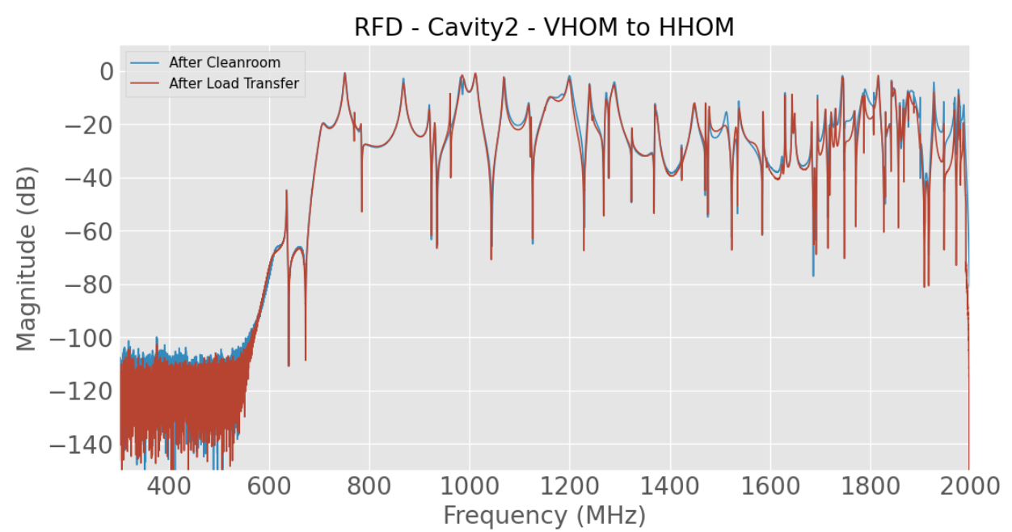
Cavity 1 & 2 – VHOM to HHOM

Slide 7
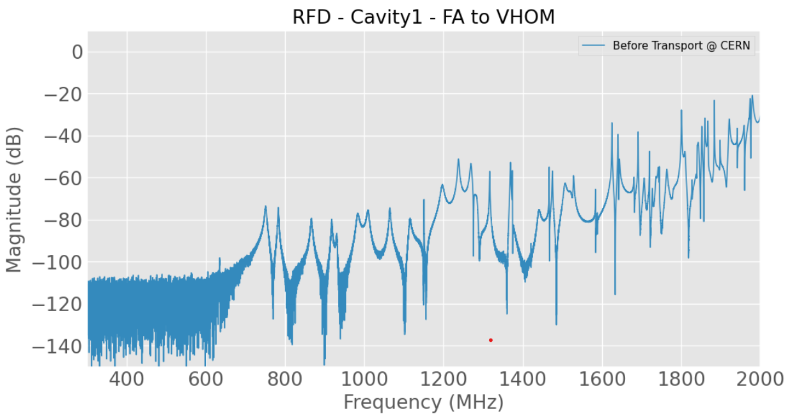
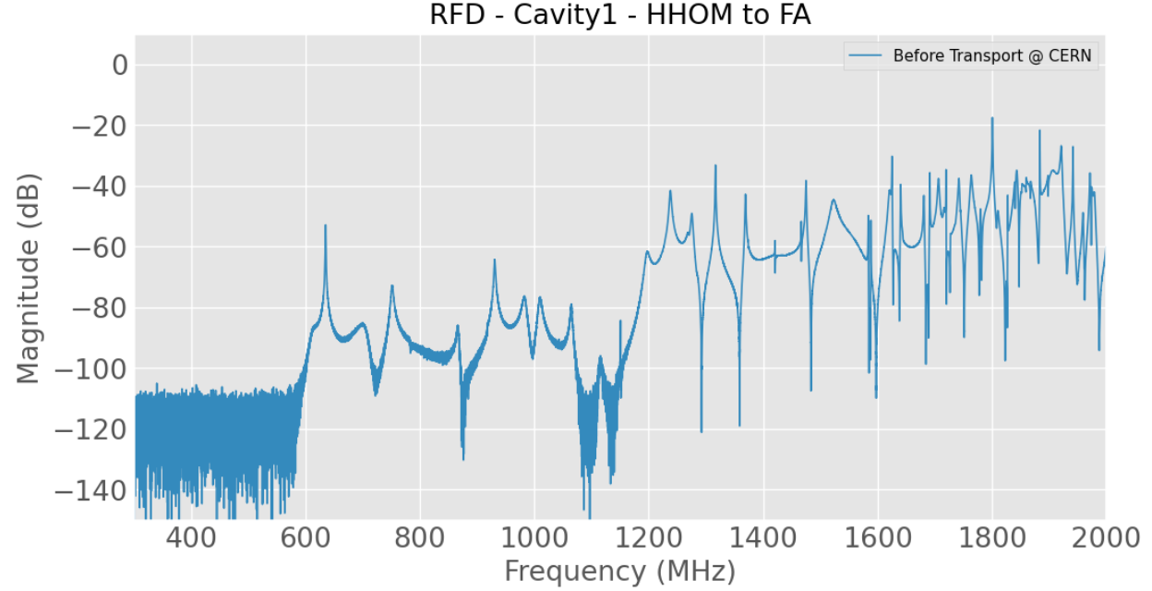
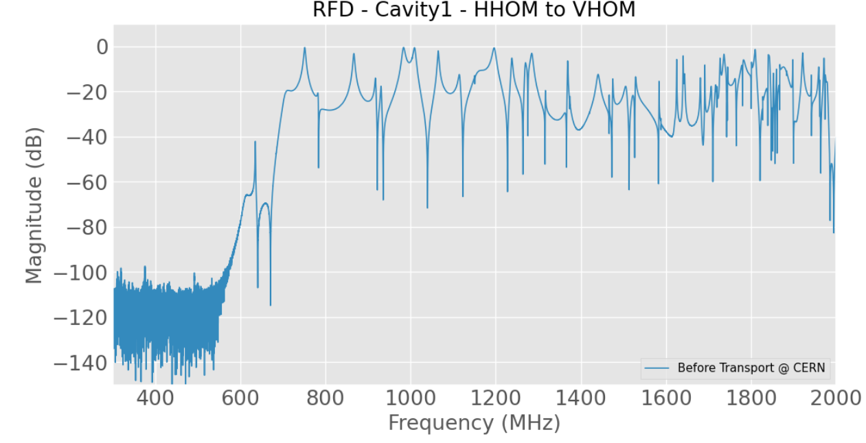
Cavity 1 – Warm measurements at CERN before transport -

Slide 8
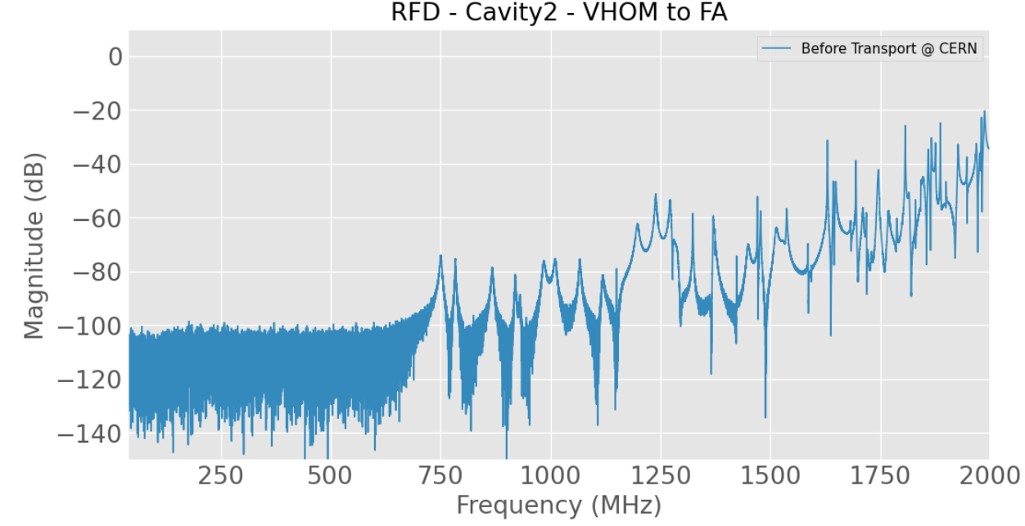
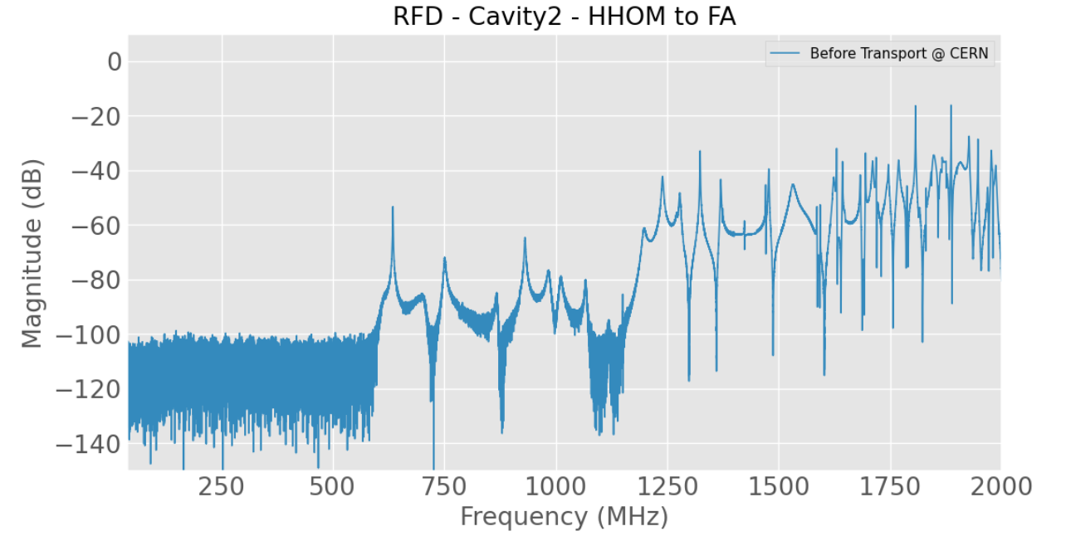
Cavity 2 – Warm measurements at CERN before transport -

