Slide 1



RFD-CM Drawing Status and Strategy
Ben Matheson
SRF

Slide 2
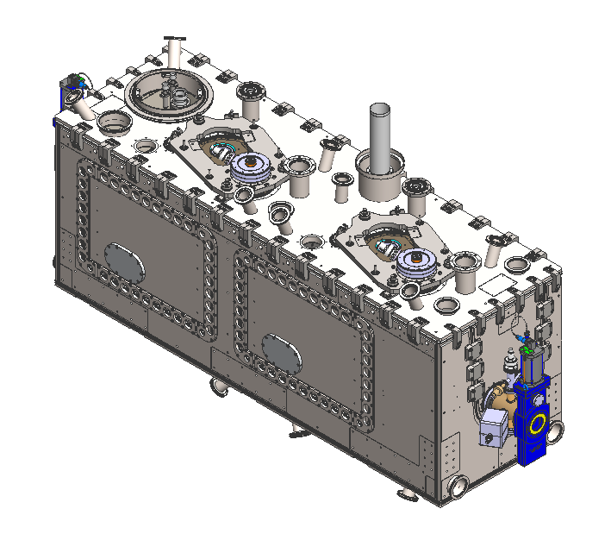
TRIUMF’s General CAD Strategy
TRIUMF uses SOLIDWORKS/PDM for 3D models, drawings, and CAD workflow.
We have created a new "XHL" number set exclusively for HL-LHC files.
For the cryomodule, we will create TRIUMF top level assemblies but use CERN’s models and drawings for sub-assemblies and parts.
Tooling will use a mixture of TRIUMF and UK/CERN models and drawings.
TRIUMF Top level model, XHL0100

Slide 3
CERN Sub-Assembly Status
The following table is a list of critical sub-assemblies required by TRIUMF.
Assembly | CERN Part Numbers | Status
Warm magnetic shield | ST1667814 | Unreleased. awaiting revision
Cryo lines and support | ST1633544 ST1720007 ST1720023 ST1762369 | Unreleased
Tuner System (tank side) | ST1063566 ST1441042 | Released, but revision change expected.
MLI 2K/50K | ST1555934* ST1759753* ST1731450 | 50K not released. 2K status is unknown
Thermal shield | ST1661462 | Unreleased
*There are currently two 2K MLI models in assembly step 8

Slide 4
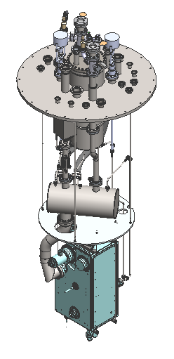
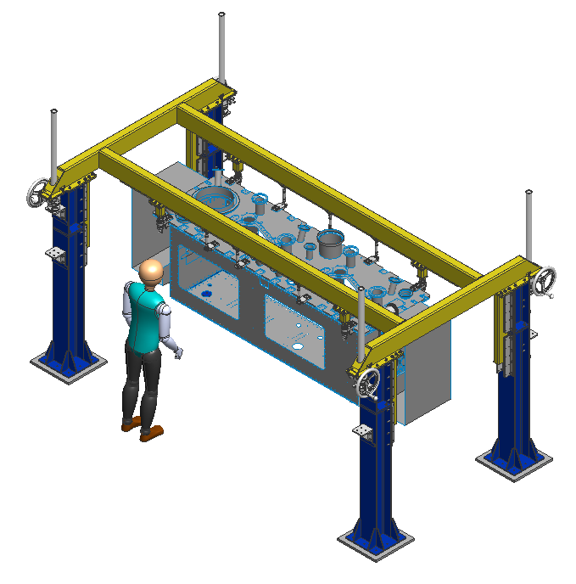
Tooling Status
Name | Number | Status
Cryostat insert | IRF5110 | Released. Assembly complete
Cavity Cold Test | IRF5087 | Released. Parts complete, ready for assembly
Dummy Cavity | IRF5673 | Drawings released, ready for manufacturing
String Assembly Cart | XHL0200 | TRIUMF drawings in final review. UK drawings ready for manufacture
Lid assembly frame | XHL0150 | Detailed design ongoing
Tank cart | N/A | Conceptual design ongoing
Cavity Handling Frame | N/A | Purchased Lifting cart received. Cavity attachment in conceptual design.

Slide 5
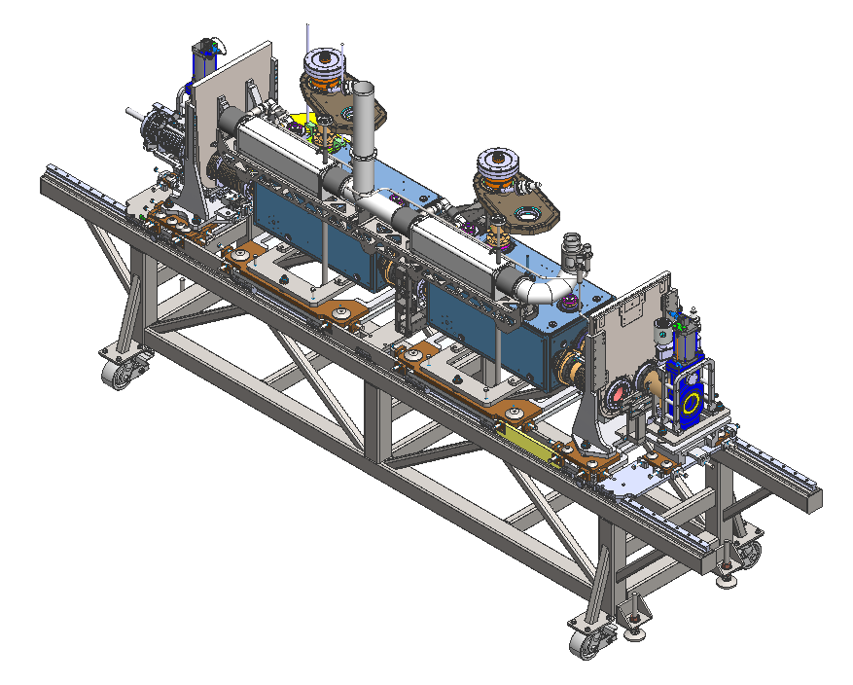
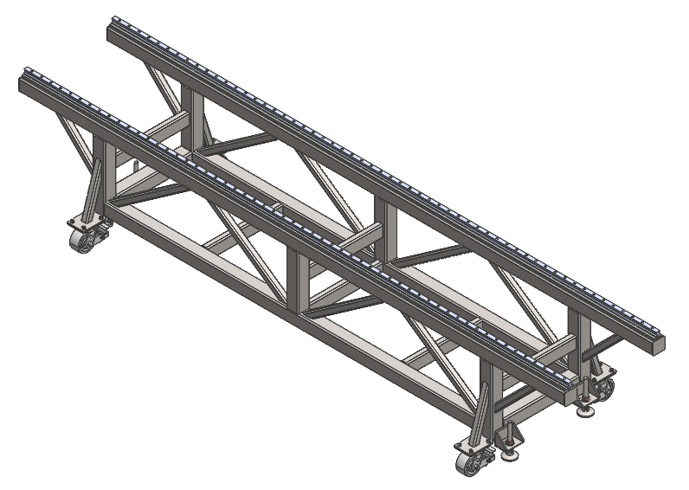
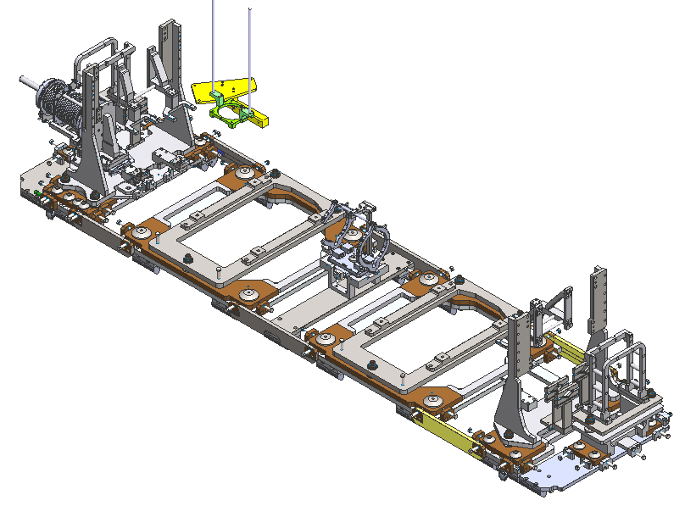
Tooling Status
String Assembly Cart example
Top level assembly complete but not released
Cart assembly is in final drawing review.
Upper fixtures have been provided by the UK and are ready for manufacturing.
(Big thanks to the Daresbury team!!)
Top Level Assembly
(XHL0200).
Cart Assembly
(XHL0201)

Slide 6
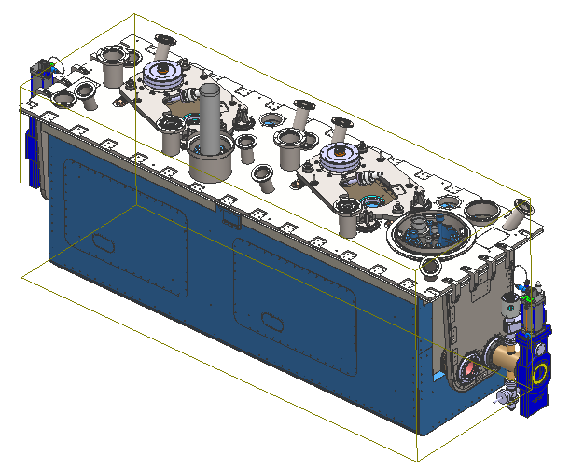
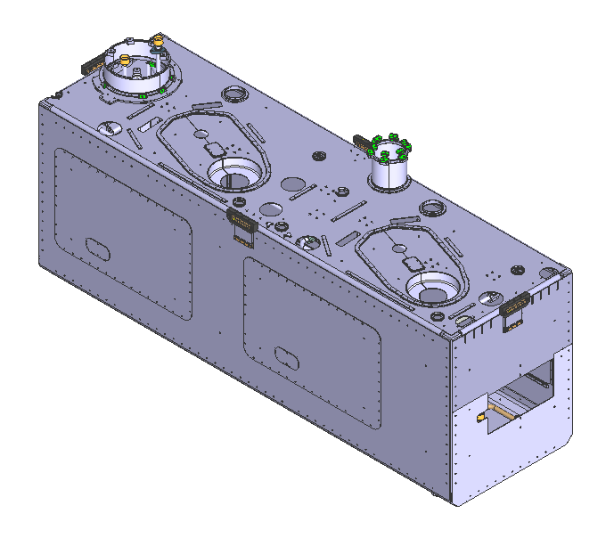

Importing CAD from CERN
Example Part: ST1661462 Thermal screen
3d models will be downloaded from CERN as step files and saved into SolidWork/PDM using the CERN ST numbers.
Models will be integrated into TRIUMF assemblies in such a way that they are easily replaceable.
Drawings will be downloaded as 2d PDFs from the Smarteam/PLM database.
Drawings will use the ST name and be saved in the same PDM location as the corresponding part file.

Slide 7
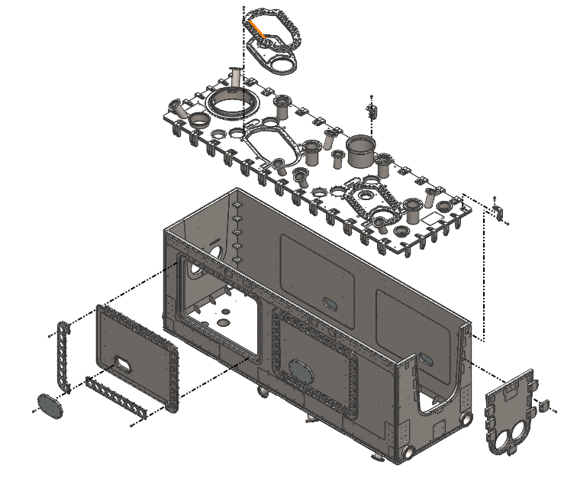
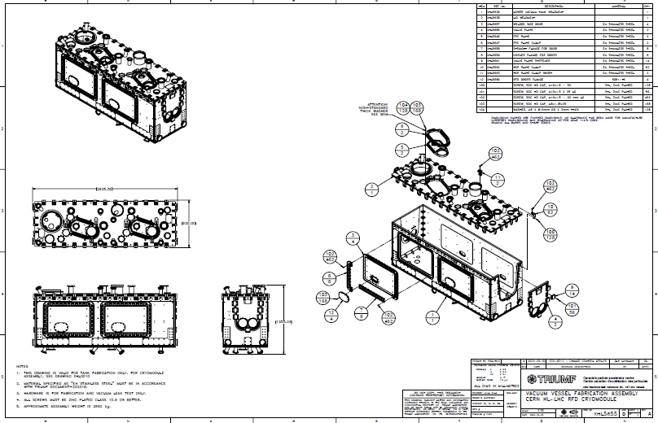
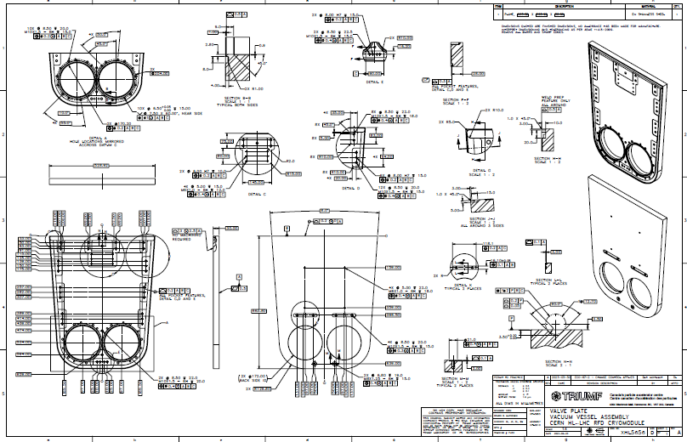
OVC Drawings
XHL5655 - VACUUM VESSEL FABRICATION ASSEMBLY
TRIUMF OVC drawings have been released and sent out for tender. A vendor has been selected and manufacturing will begin once material arrives.
Early on we decided that to have more control over the vendor we would create TRIUMF drawings for the OVC.
We found it very cumbersome converting CERN ISO drawings directly into TRIUMF ASME standard.
In hindsight, converting to ASME standards is unnecessary. If we did this again, we would use CERNs drawings directly.

Slide 8
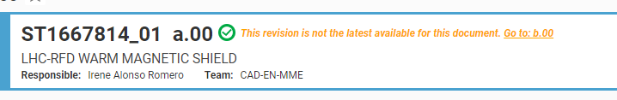
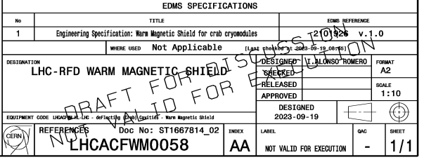
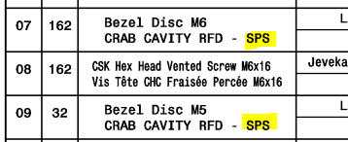
Challenges
Currently we do not have confidence in what is released and what is not released.
Example: Warm Magnetic Shield. We were under the impression that this was released. We are in the final stages of procurement, and need released drawings ASAP
CERN Design Workflow
The primary challenge TRIUMF faces is working with unreleased design workflows.
Ideally TRIUMF would not start manufacturing until we have a completely released cryomodule package.
We understand this is not feasible, but due to budget and timeline constraints, TRIUMF needs to begin manufacturing.
At the very least we need things to be released at the major sub-assembly level, with the understanding that any changes are a significant challenge for TRIUMF.
Critically we need all CERN part numbers fixed.
There are some minor components with SPS descriptions. Will these numbers change?

Slide 9
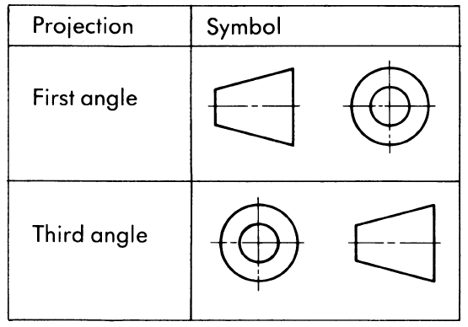

Challenges
1st angle vs 3rd angle projection
ASME vs ISO drawing standards
CERN’s drawings are made to ISO standard, TRIUMF drawings are based on ASME standards.
There are some differences, but both systems are intuitive and similar in symbology.
Again, care must be taken interpreting drawings.
CERN uses 1st angle projection, TRIUMF uses 3rd angle projection.
This affects the fundamental interpretation of drawings and could lead to critical errors.
Both systems are correct. Care must be taken interpreting drawings.

Slide 10
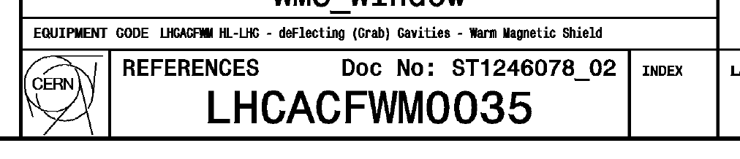
Challenges
ST drawing number
CERN LHC vs ST file naming
CERN uses a “ST” part number format for models and drawings, but drawings get an additional “LHC” (CDD) drawing reference number.
The LHC number is the primary reference in other documentation.
Downloaded step files use the ST naming format.
ST drawing numbers are not searchable in EDMS.
Both ST and LHC numbers are searchable in PLM/SmarTeam database and appear in drawing title blocks and BOMs.
LHC drawing reference number
To be correctly referenced in TRIUMF’s system, models and drawings must have the same file name.
We will use the ST file name for all models and drawings.

Slide 11
Challenges
Other minor challenges:
Different PDF quality between Smarteam/PLM and EDMS downloads
  EDMS PDFs are raster based, ST/PLM are vector based
  For most instances, vector format is preferred.
  See appendix slides 2 and 3
Only some files are available in PLM
  All files are available in SmarTeam database
PDFs download from SmarTeam database have unusable file names.
Cannot search ST numbers in EDMS

Slide 12
Summary
OVC drawings have been released. A vendor has been selected and manufacturing will commence soon.
Warm Magnetic Shield vendor has been selected. We need released drawings ASAP.
TRIUMF is waiting for released drawings of other major sub assemblies.
Our tooling designs are advancing. More focus on fabrication in the upcoming months.
There are challenges working with different ISO/ASME standards.
There are challenges working with CERN’s naming conventions and document management systems.

Slide 13
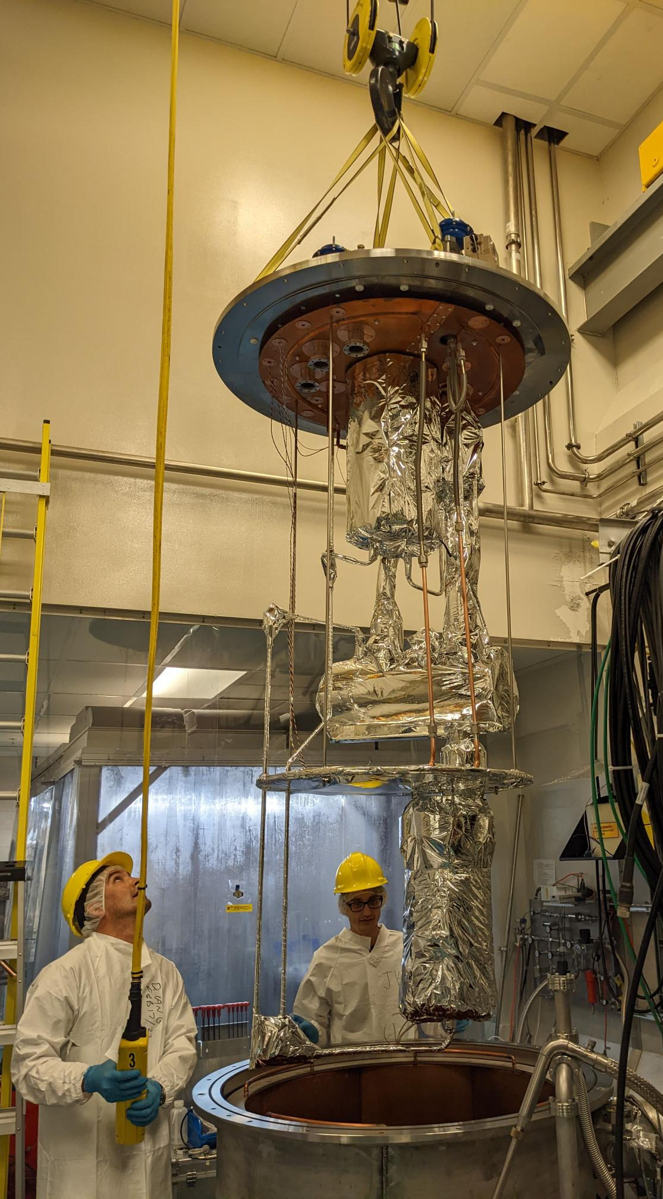
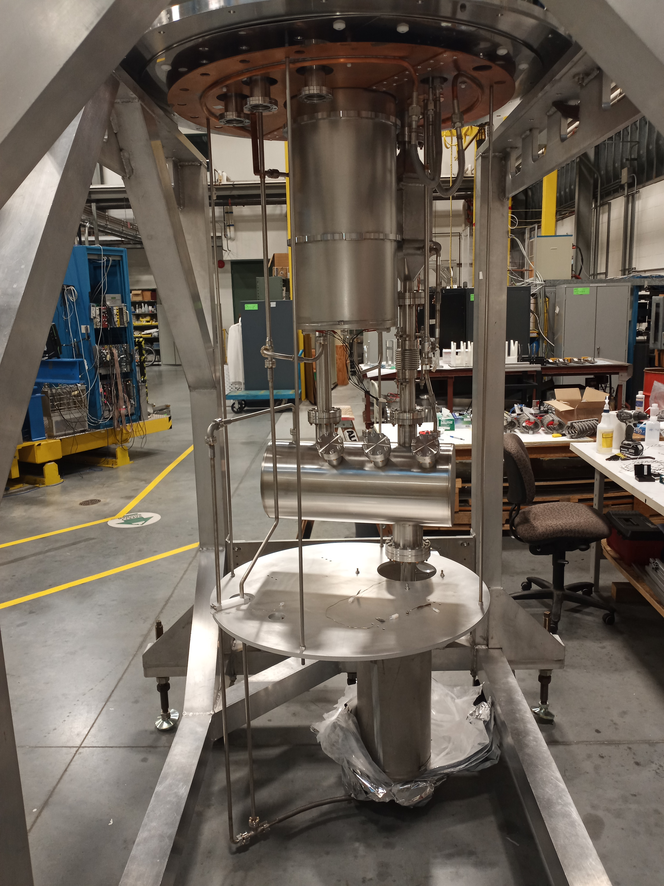




Thank you
Merci
www.triumf.ca
Follow us @TRIUMFLab

Slide 14
Appendix Slide 1
Workflow Challenge Example:
Example: Warm magnetic shield, ST1667814 (LHCACFWM0058)
Listed as released in excel file EDMS 2825848
EDMS and SmarTeam show “In Work” status (b.00 in ST)
Drawings shows “Change in the shape of one lateral plate”
2023-09-18
We were not aware of any changes to the lateral plate.
We do not know what this change is.
Note: TRIUMF has already gone out for tender with unreleased drawings with the understanding that any change will be minor.

Slide 15

Appendix Slide 2
PDF Downloads
File names as downloaded from SmarTeam. Note stings does contain correct ST number and revision
Files downloaded from EDMS require manual renaming to ST number

Slide 16
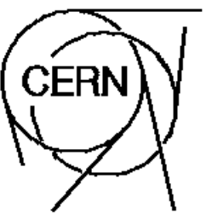
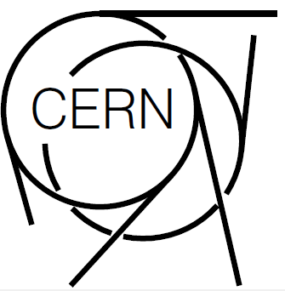
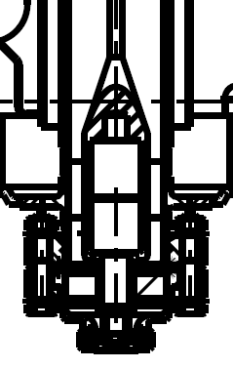
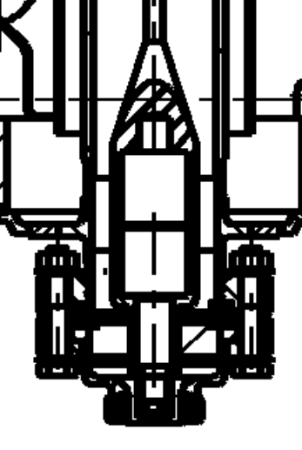
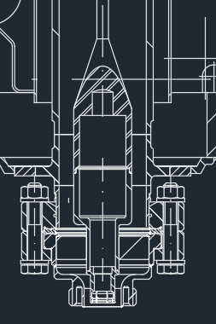
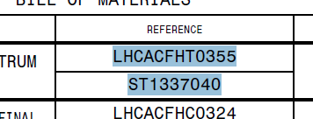
Appendix Slide 3
Raster based PDF (EDMS)
Vector based PDF (ST/PLM)
Raster vs Vector PDF Downloads
Cannot select text in raster based PDFs
In most cases vector format is preferred.
For large detailed drawings, neither raster or vector are ideal. For these drawings DXF can used.
DXF (ST)
Text is clear and selectable in vector format

