Slide 1



Production testing summary of the MQXFA magnets
Anis Ben Yahia
Brookhaven National Laboratory
13th HL-LHC Collaboration Meeting
Sept. 27th, 2023

Slide 2
MQXFA test history at BNL
11 magnets (not counting prototypes) - 12 tests:
 |  | HL-LHC collaboration meeting
MQXFA03 | 11-Nov to 19-Dec 2019 | 11th
MQXFA04 | 24-Aug to 7-Oct 2020
MQXFA05 | 5-Mar to 19-May 2021
MQXFA06 | 14-June to 2-July 2021
MQXFA07 | 11-Aug to 25-Aug 2021
MQXFA08 | 22-Oct 2021 to 11-Feb 2022 | 12th
MQXFA05 - Endurance Test | 21-Mar to 31-May 2022
MQXFA10 | 15-June to 9-Aug 2022
MQXFA11 | 8-Sep to 25-Oct 2022 | 13th
MQXFA08b | 6-Jan to 13-Mar 2023
MQXFA13 | 14-Apr to 2-Jun 2023
MQXFA14b | 7-July to 24-Aug 2023

Slide 3
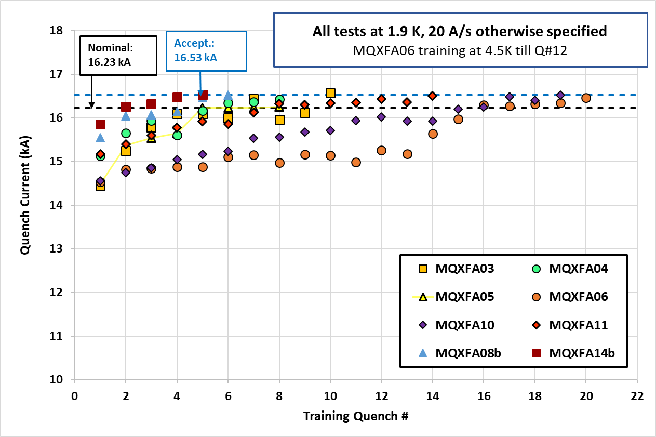
Vertical Test Overview
8 magnets met acceptance requirements:
  MQXFA03-06, 10-11, 08b and 14b
Successful endurance test on MQXFA05.
5 Thermal cycles
52 quenches (10 spontaneous + 42 induced)
79 power cycles (52 quenches + 27 cycles w/o quench) above 10 kA.

Slide 4
Outline
Quench test results
  MQXFA11
  MQXFA08b
  MQXFA13
  MQXFA14b
Magnetic measurement results
Summary

Slide 5
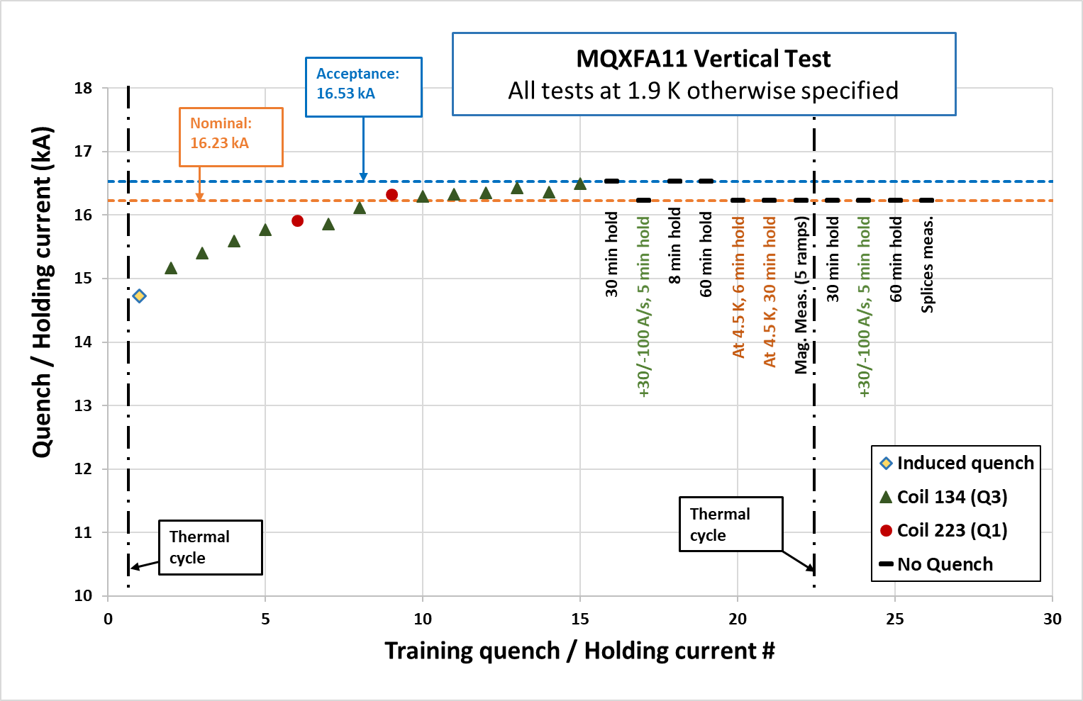
MQXFA11
Reached nominal + 300A after 15 quenches.
12 quenches were in coil 134 in quadrant 3 (first quench was a false trip on a spike).
11 ramps without quench (3 to nominal + 300 A).
After the thermal cycle, 4 ramps to nominal without quench.

Slide 6
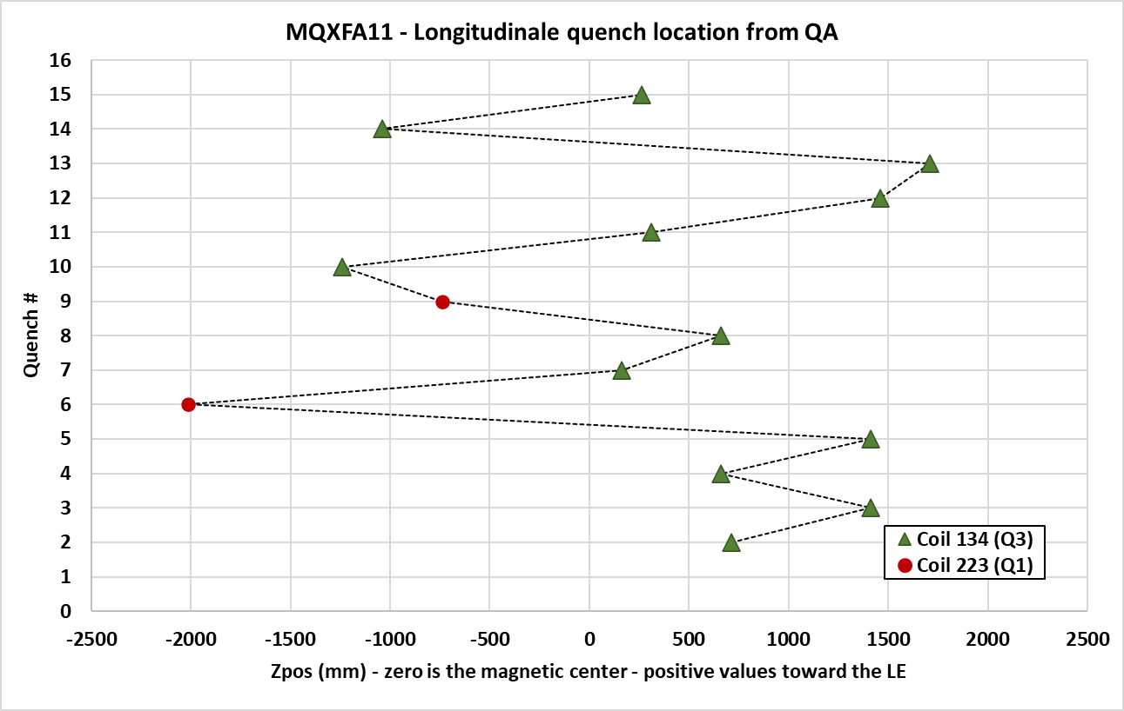
MQXFA11 – Quench localization from the Quench Antenna Array
13 out 14 quenches in the straight section.
No recurring quench location.
Return end
Lead end

Slide 7
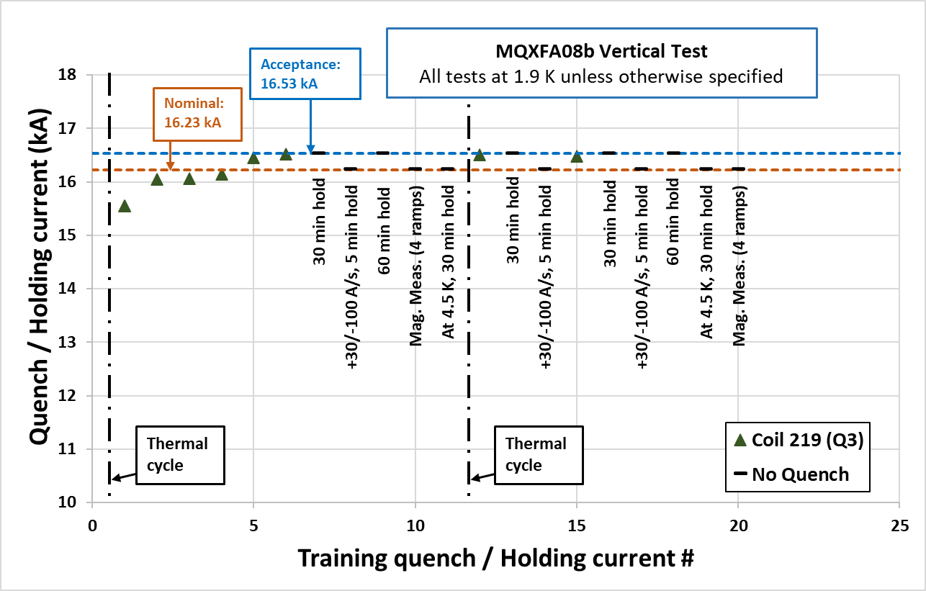
MQXFA08b
First re-assembly: built by replacing the limiting coil (213) in MQXFA08 by a new coil (219) in quadrant 3.
All quenches occurred in coil 219.
After the thermal cycle 2 additional quenches above nominal current (at 16.51 kA and 16.48 kA)

Slide 8
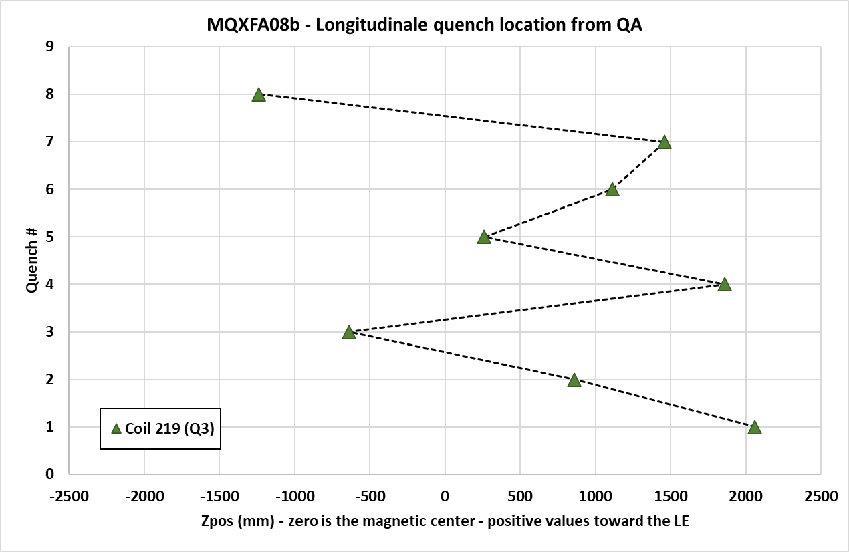
MQXFA08b – Quench localization from the Quench Antenna Array
First quench in the lead end of the coil.
Following quenches in the straight section (no recurring location).
Return end
Lead end

Slide 9
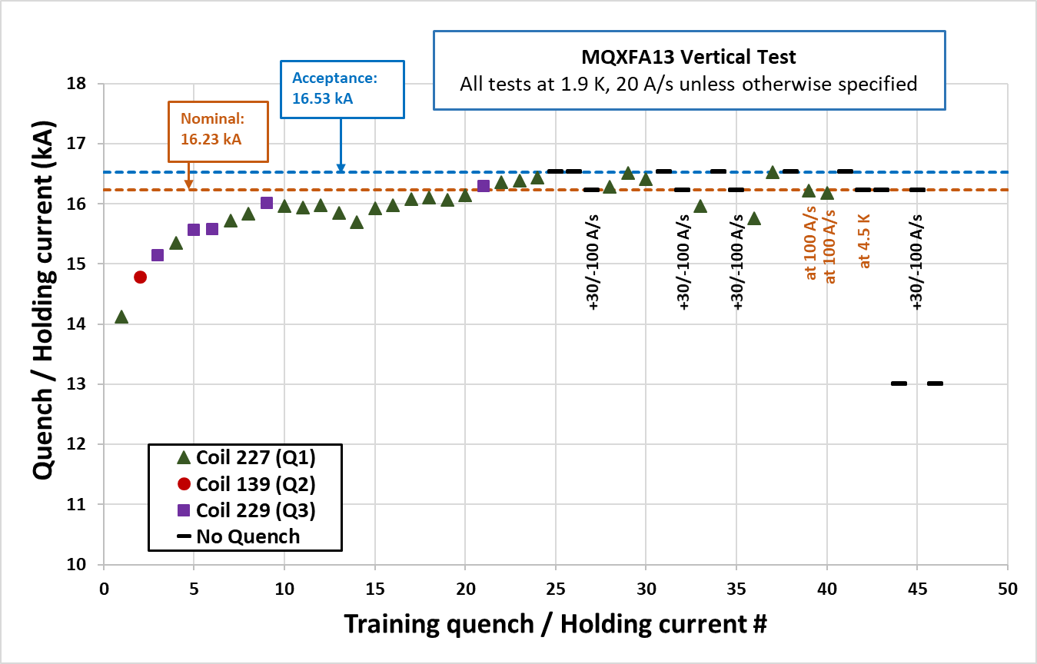
MQXFA13
Training “typical” up to quench #9.
Drop in quench current (315 A) between quench 10 and 14.
Training continued from quench 15.
Reached 16.53 kA on the 25th ramp.

Slide 10
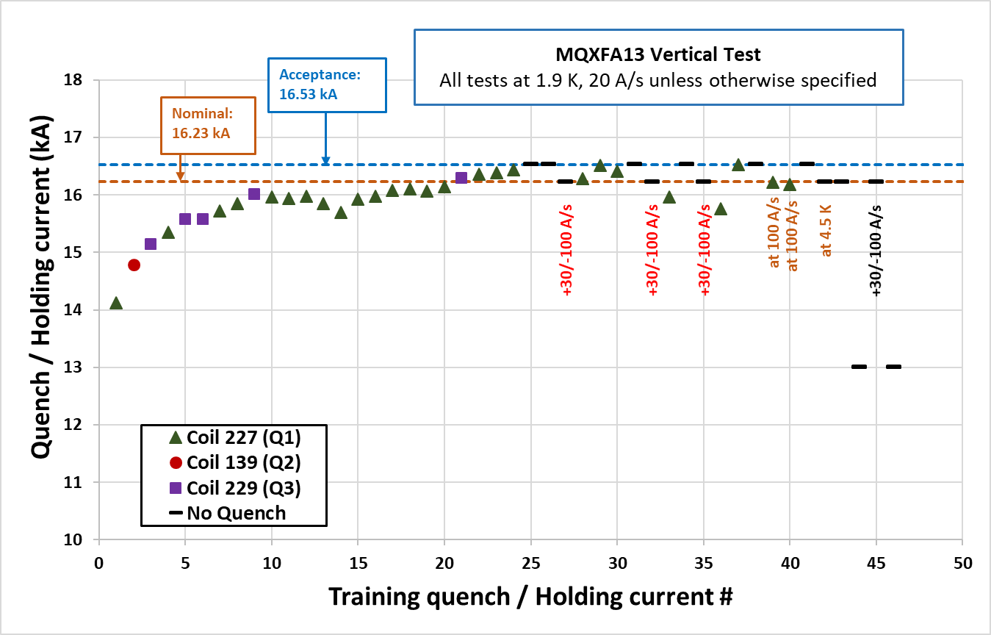
MQXFA13
Following the ramp at +30/-100 A/s, there was a drop in quench current in the subsequent ramp at 20 A/s.
Magnet trains back again to 16.53 kA.
Behavior was repeatable 3 times.
Ramps at 100 A/s showed lower quench current (16.22 and 16.21 kA).
All these quenches occurred in coil 227 (Q1.).

Slide 11
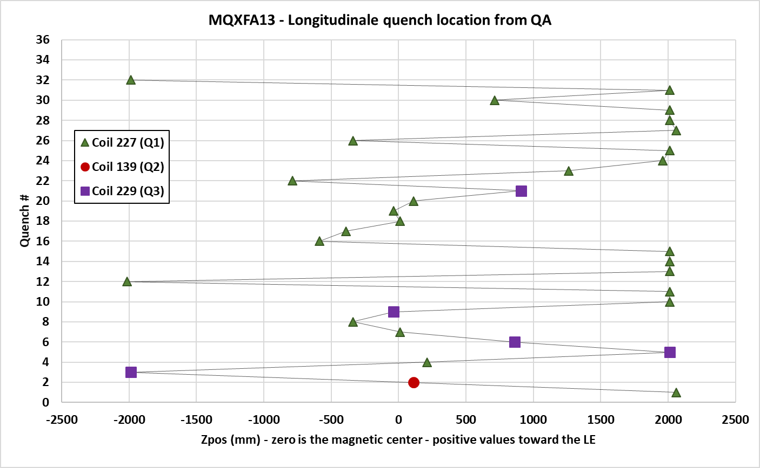
MQXFA13 – Quench localization from the Quench Antenna Array
Recurring quenches in the coil ends.
Quench 10 to14
Return end
Lead end

Slide 12
MQXFA13 – Quench localization from the Quench Antenna Array
Recurring quenches in the coil ends.
Quenches following the +30/-100 A/s ramp.
Return end
Lead end

Slide 13
MQXFA13 – Quench localization from the Quench Antenna Array
Recurring quenches in the coil ends.
Quenches at 100 A/s.
Return end
Lead end

Slide 14
MQXFA13
Analysis of CMM data showed that all MQXFA13 coils had small arc-length in the ends, with coil 227 the smallest ever.
FEM analysis of MQXFA13 as built showed risk of high strain with moderate prestress, and this issue may be prevented with higher local prestress.
MQXFA13 test was stopped in order to replace coil 227 and avoid damage to the other coils.
More details in:
  “MQXFA, magnet assembly and preload” by Dan Cheng.

Slide 15
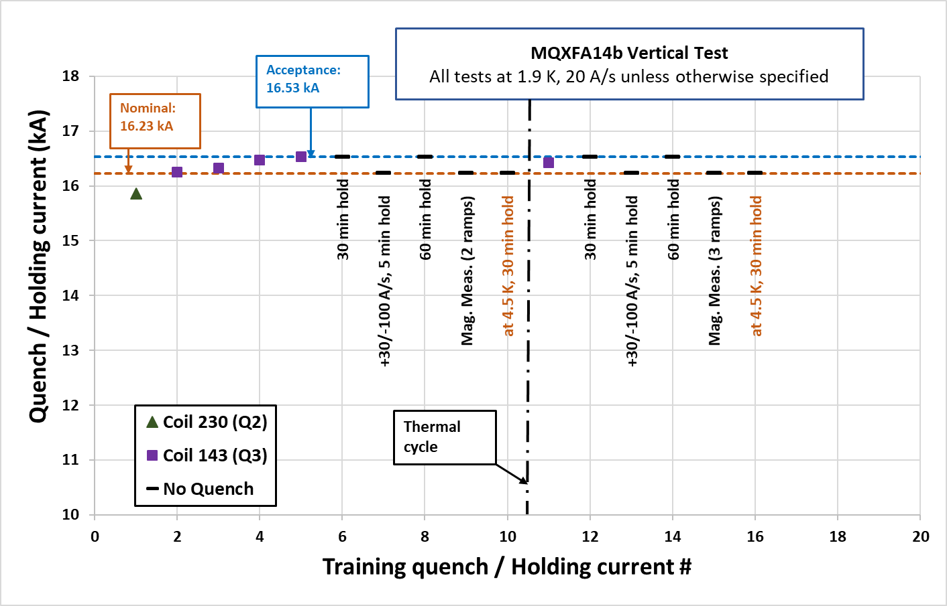
MQXFA14b
Assembled using revised MQXFA specifications and targets.
Achieved nominal + 300A after 5 quenches.
All quenches except the first were in quadrant 3 (coil 143).
After the thermal cycle
  One quench at 16.42 kA.
  7 ramps without quench (2 to nominal + 300 A).

Slide 16
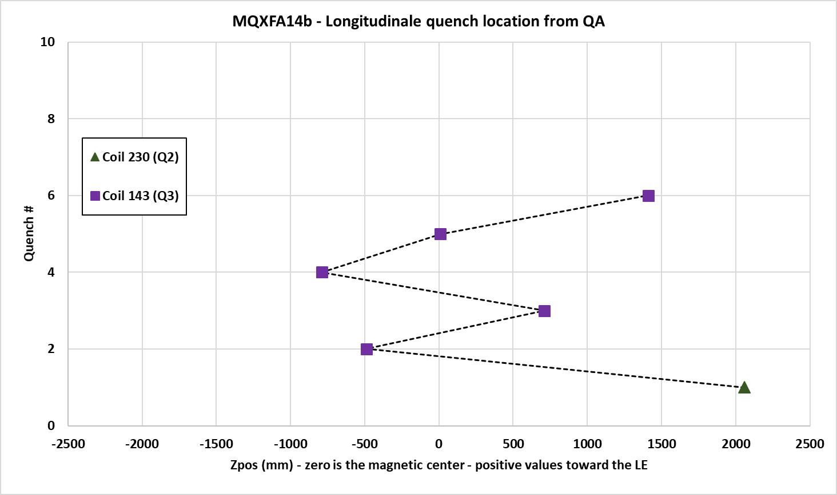
MQXFA14b – Quench localization from the Quench Antenna Array
No recurring quench location.
Return end
Lead end

Slide 17
Integrated Gradient and Field Quality
Average integrated gradient at 16.23 kA: 562.38 T
Correction factors applied to account for measurements taken at different currents as well as changes in the measurement setup and coil design.
More in:
  “Field quality and integrated gradient
  in MQXFA magnets and LQXFA/B01” by Joe Di Marco.

Slide 18
Magnetic Shims
Used in 5 magnets.
Implement based on warm measurements during magnet assembly at LBNL
Obtained correction is in agreements with expectations.
 | Calculated | Measured*
MQXFA05 | Δb₃ = 4.5; Δa₃ = -4.4 | Δb₃ = 4.5; Δa₃ = -4.5
MQXFA06 | Δa₃ = 3.9; Δa₅ = -0.8 | Δa₃ = 4.4; Δa₅ = -0.7
MQXFA10 | Δa₃ = 4.1; Δb₄ = -1.4 | Δa₃ = 2.7; Δb₄ = -1.4
MQXFA11 | Δa₃ = 4.9; Δa₅ = -0.6 | Δa₃ = 3.7; Δa₅ = -0.9
MQXFA14b | Δb₃ = 1.6; Δa₃ = 2.5 | Δb₃ = 1.8; Δa₃ = 2.8
(*) Based on the straight section averages

Slide 19
Summary
8 MQXFA magnets met requirements during vertical test.
MQXFA11:
  Successfully met vertical test requirements.
MQXFA08b:
  First successful test of an MQXFA magnet after replacing a coil.
  All quenches occurred in the new coil.
MQXFA13:
  Test stopped for replacing the coil showing ramp-rate dependence.
MQXFA14b:
  Assembled with revised specs and pre-load targets.
  5 quenches to reach acceptance current.
Magnetic field measurements:
  Within the expected bound (with the exception of few outliers).
  Correction from the magnetic shims in agreements with expectations.
All cold and warm high voltage withstand tests were successful.

Slide 20
THANK YOU

