Slide 1


Horizontal Test Results of LQXFA/B01 and Plans for testing LQXFA/B02
Guram Chlachidze
Fermilab
13th HL-LHC Collaboration Meeting
Vancouver, Canada 25-28 September 2023

Slide 2
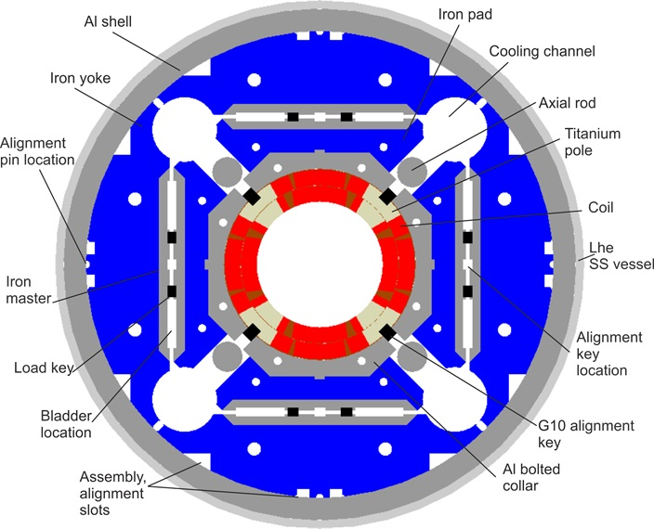
LQXFA/B01
LQXFA/B01 - the first pre-series cryo-assembly fabricated by HL-LHC AUP with MQXFA03 and MQXFA04 magnets
Voltage taps used only for quench
detection
Strip heaters on the outer coil layer
Dump delayed for 1000 ms
COIL 110
COIL 204
COIL 113
COIL 203
COIL 202
COIL 111
COIL 206
COIL 112
MQXFA03
MQXFA04
LHCLMQXF_E0001
13th HL-LHC Collaboration Meeting, Sep. 25-28, 2023
Notes:
COIL ARE fabricated

Slide 3
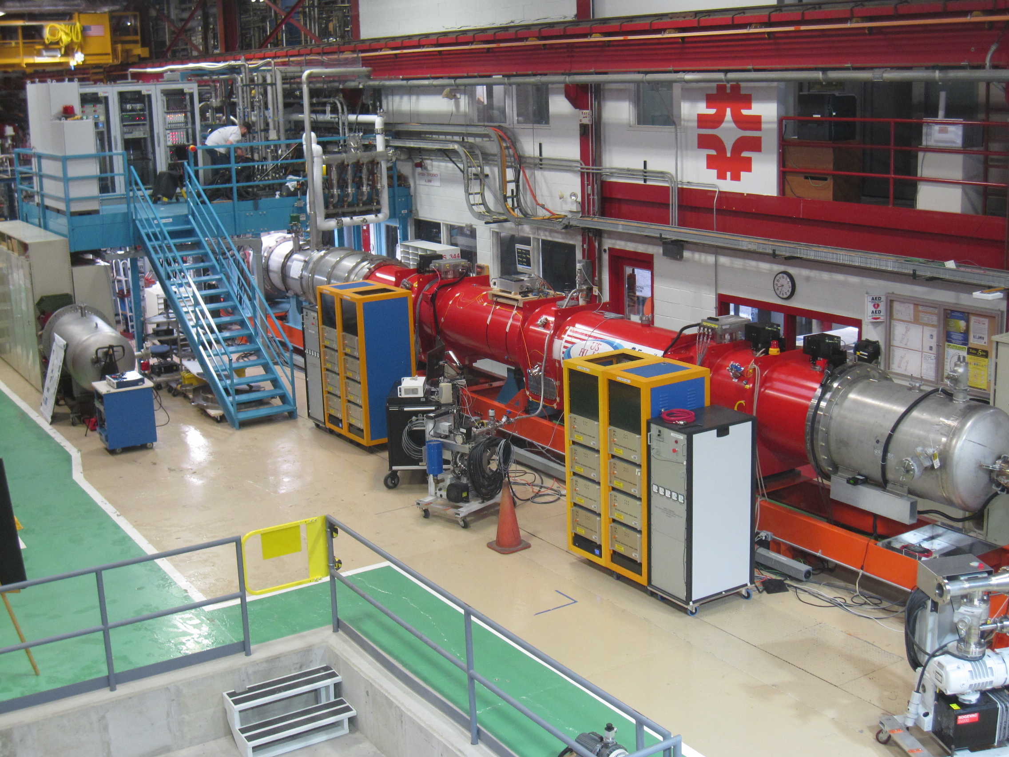
LQXFA/B01 at Fermilab’s horizontal test stand
Lead End
MQXFA03 (B)
MQXFA04 (A)

Slide 4
Initial Electrical Checkouts
Cryo-assembly was received at the test facility with one open heater (YT223 in MQXFA03) and one open voltage tap EE152
Room temperature insulation (Hipot) tests: no failures
  Coil-to-structure at 2.5 kV for Top plate leads w/o magnets
  Coil-to-ground at 368 V
  Quench heater-to-coil at 460 V

Slide 5
LQXFA/B01 controlled cooldown
19 days of cooldown: Mar 15 - Apr 3
  About 5 days of downtime due to various issues
  First week running with the 50 K temperature difference across the cold-mass
  GHe mass flow rate varied from 5 g/s to 18 g/s
Platinum RTDs 505/506 are installed on the CM end plates

Slide 6
LQXFA/B01 Controlled cooldown (2)
ΔT requirement between the GHe supply and the CM RE changed from 50 K to 80 K
  Delta T (meas) - difference between the temperature readings of the RTD sensors 505/506 located on the magnet ends
  Delta T (calc) is based on the magnet resistance measurements

Slide 7
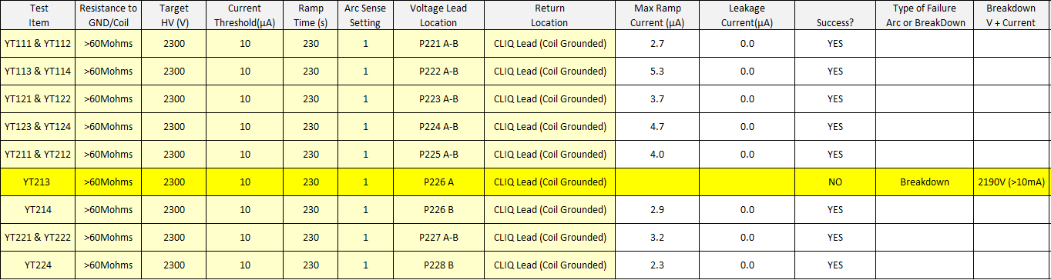
Cold Electrical Checkouts
Coil-to-ground at 1840 V
Quench heater-to-coil Hipot at 2300 V
MQXFA03: YT213A/B heater failed the Hipot test around 2190 V
No dead short to coil or ground, small current leakage at 200 V
Dummy load is used instead of YT213
No degradation of the heater to coil and heater to ground insulation observed after the thermal cycle

Slide 8
LQXFA/B01 Quench Performance in TC1
Magnets reached the acceptance current Inom+300 A w/o a quench, but with two trips in leads
  One of the Cu-SC lead joints in the top plate assembly exhibited higher resistance and the LHe level adjustments were required
Two attempts of the holding current test
  First trip at Inom+300 A=16530 A caused a minor detraining

Slide 9
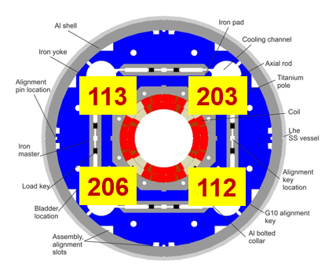
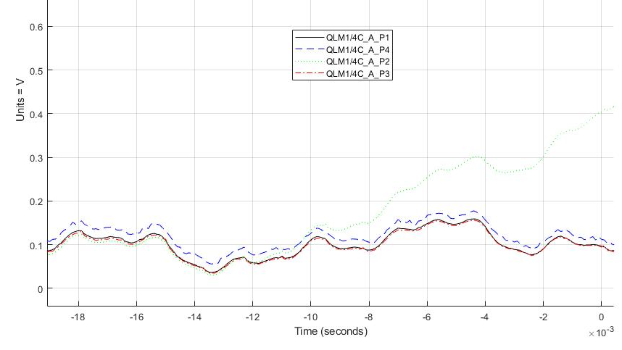
Quench in TC1
Only one spontaneous quench in magnets
  Quench at 16386 A, in MQXFA04 (Magnet A), coil 113 (P2)
  Quench Integral 27.8 MIITs (w/o external energy extraction)
(P2+P3) - (P1+P4)
P2

Slide 10
Splice measurements
Two additional splices were made in LQXFA/B01 power leads to add extra length for testing at Fermilab (and CERN)
  Lead length w/o the additional splice is sufficient for the tunnel installation at CERN
Additional splices
in LQXFA/B01 leads

Slide 11
Splice measurements (2)
Splice measurements were made at 1.9 K for currents up to 5 kA
  8-channel MUX system based on Keithley 2182A Nanovolt Meter
Two-splice segments are measured ~0.7±0.1 nΩ, and single splice
segments - less than 0.3±0.1 nΩ

Slide 12
Splice measurements (3)
Splices resistance values well below the required 1 nΩ
0.7±0.1 nΩ
0.3±0.1 nΩ
0.1±0.1 nΩ
Additional splices
in LQXFA/B01
0.1±0.1 nΩ
0.1±0.1 nΩ

Slide 13
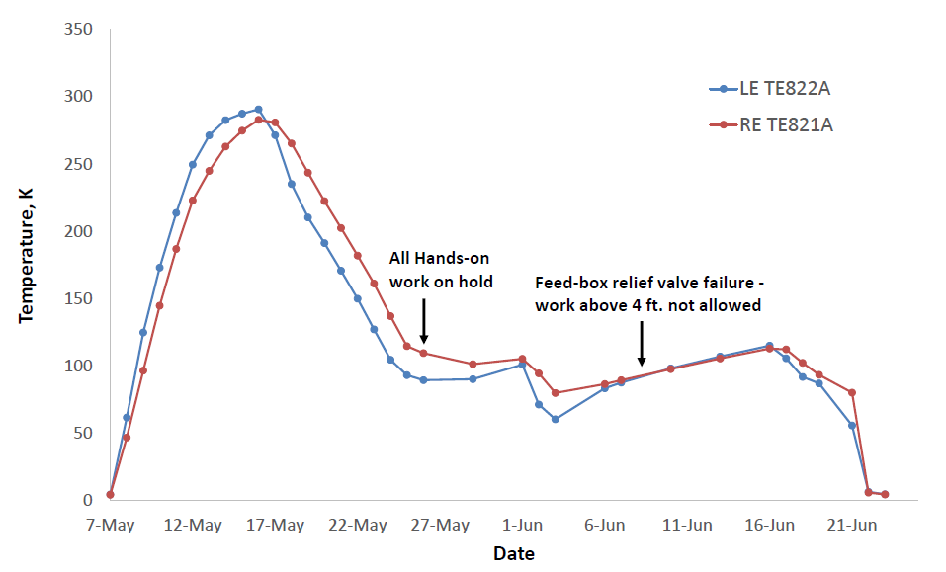
Warmup and cooldown for TC2
Controlled warmup just over 1 week. Cooldown was interrupted few times
Cernox RTDs TE821/822 installed in the CM shell openings

Slide 14
Cooldown in TC1 and TC2
First cooldown used for optimizing the controlled cooldown parameters
  Two weeks are expected for 1.9 K cooldown. Further improvement requires upgrade of the heat exchanger in the Helium return line
Cernox RTDs TE821/822

Slide 15
LQXFA/B01 Quench Performance in TC2
The acceptance current reached w/o a quench.
  Only one spontaneous quench in TC2 at 16525 A in MQXFA03, coil 111 (P4), QI 27.6 MIITs
The holding current test failed after 75 min due to the same LHe stability issue (no trip thanks to PLC interlock modification)
  High ramp rate test (with 150 A/s ramp down) successfully done

Slide 16
Plans for Testing LQXFA/B02
Improvements of the cryogenic system components are planned before LQXFA/B02 test
  Inspect and fix Feed box helium supply valves
  Replace failed flowmeter and plastic rotameters
  Upgrade valve actuators
  Improvements will be prioritized and executed as test schedule allows
Root cause of the liquid helium instability is understood
  No additional investigation is required
The Cu-SC lead joint repair will increase robustness to the LHe level fluctuations in future
Second liquefier maintenance to be completed by the end of October
LQXFA/B02 test prep work to be completed in November

Slide 17
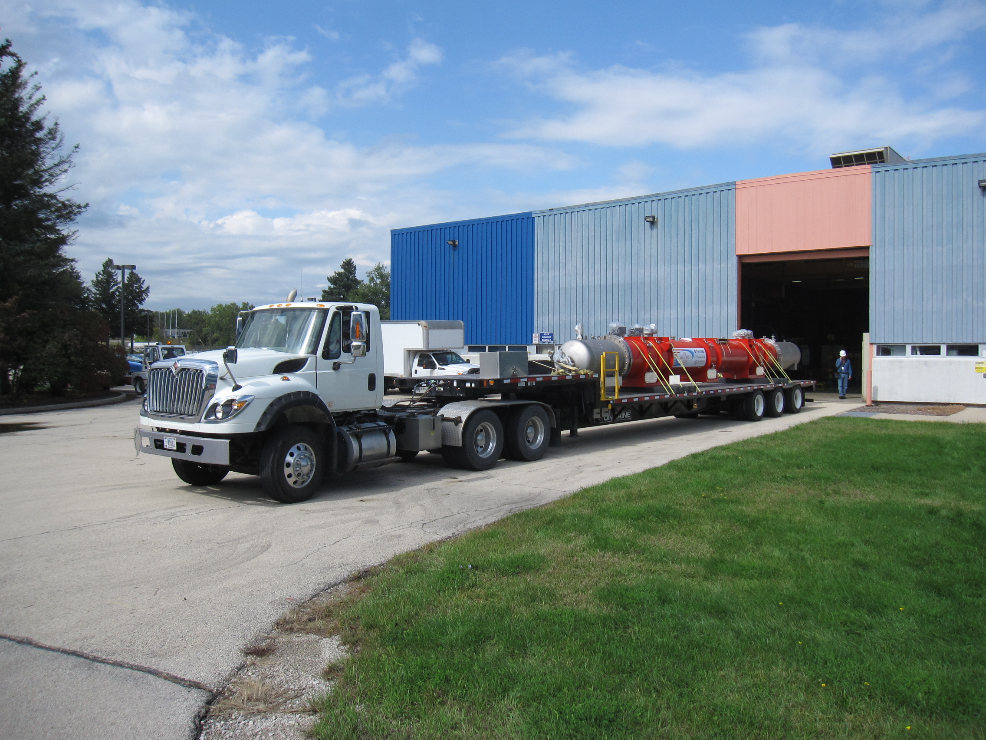
LQXFA/B01 leaving the Magnet Test Facility
13th HL-LHC Collaboration Meeting, Sep. 25-28, 2023

Slide 18
Conclusions
The first pre-series cryo-assembly LQXFA/B01 successfully tested at Fermilab’s horizontal test stand
    The test facility upgrades successfully commissioned with a cryo-assembly for the first time
    Liquid level instabilities and power supply issues, as well as Lab-wide safety pause made the commissioning and test longer than expected
    The cryogenic issues were identified and fixed, allowing the completion of the horizontal test
LQXFA/B01 test goals are achieved
    Only two spontaneous quenches in magnets - one per magnet
    Nominal and acceptance currents are reached at 1.9 K
    Nominal current was reached at 4.2 K
    Ramp down at 150 A/s was validated
    Nominal current was successfully held for 5 hours
13th HL-LHC Collaboration Meeting, Sep. 25-28, 2023

Slide 19
Backup Slides

Slide 20
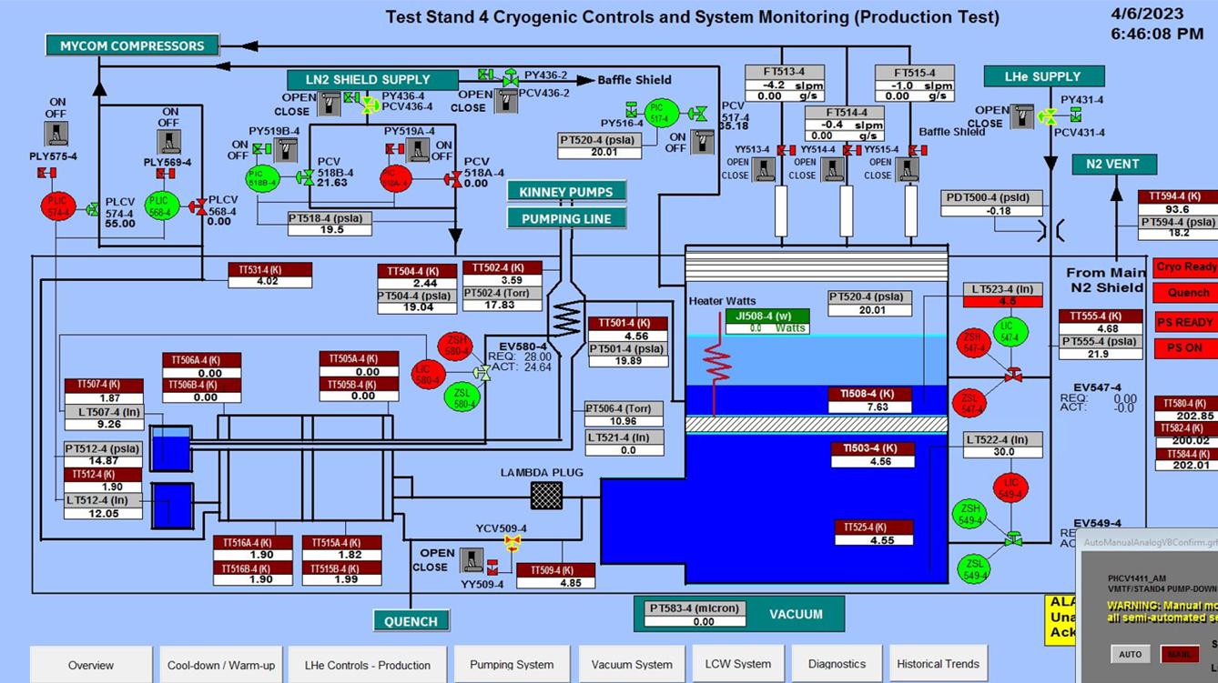
LQXFA/B01 Test Status (2)
On Apr. 6, LQXFA/B01 was cooled down to 1.9 K
Test Stand overview screen

Slide 21
