Slide 1
MQXFS Test Results
Susana Izquierdo Bermudez and Franco Mangiarotti on behalf of MQXF team
28/09/2022 13th HL-LHC Collaboration Meeting

Slide 2
Acknowledgement
US HL-LHC Accelerator Upgrade Project (AUP)
  BNL: K. Amm, M. Anerella, A. Ben Yahia, H. Hocker, P. Joshi, J. Muratore, J. Schmalzle, H. Song, P. Wanderer
  FNAL: G. Ambrosio, G. Apollinari, M. Baldini, J. Blowers, R. Bossert, R. Carcagno, G. Chlachidze, J. DiMarco, S. Feher, S. Krave, V. Lombardo, C. Narug, A. Nobrega, V. Marinozzi, C. Orozco, T. Page M. Parker, S. Stoynev, T. Strauss, M. Turenne, D. Turrioni, A. Vouris, M. Yu
  LBNL: D. Cheng, P. Ferracin, J. Ferradas Troitino, L. Garcia Fajardo, E. Lee, M. Marchevsky, M. Naus, H. Pan, I. Pong, S. Prestemon, K. Ray, G. Sabbi, G. Vallone, X. Wang
NHFML: L. Cooley, J. Levitan, J. Lu, R. Walsh
CERN
  G. Arnau Izquierdo, J. Axensalva, A. Ballarino, M. Bajko, T.A. Bampton, C. Barth, S.T. Becle, R. Berthet, N. Bourcey, B. Bordini, T. Boutboul, A. Cherif, M. Crouvizier, A. Devred, N. Eyraud, L. Favier, L. Fiscarelli, J. Fleiter, K. Kandemir, M. Guinchard, L. Grand-Clement, O. Housiaux, S. Izquierdo Bermudez, S. Luzieux, F. Mangiarotti, A. Milanese, A. Moros, P. Moyret, S. Mugnier, C. Petrone, J.C. Perez, D. Perini, M. Pozzobon, H. Prin, R. Principe, D. Pugnat, K. Puthran, P.M. Quassolo, E. Ravaioli, J.P. Rigaud, P. Rogacki, S. Russenschuck, T. Sahner, S. Sgobba, S. Straarup, E. Todesco, S. Triquet, A. Vieitez Suarez, G. Willering

Slide 3
Preamble
What is new with respect the 12th HL-LHC collaboration meeting (link here)?
  Pre-load experiment in MQXFS7
  Mini-swap quench heater validation in MQXFS8
Link 8th
Link 9th
Link 10th
Link 11th
Link 12th
Today

Slide 4
Outline
MQXFS7 pre-load experiment
MQXFS8
Conclusions

Slide 5
Outline
MQXFS7 pre-load experiment
MQXFS8
Conclusions

Slide 6
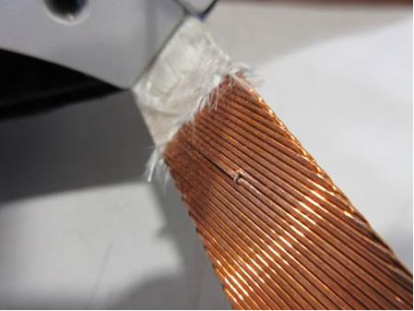
High preload experiment: MQXFS7
MQXFS7 history:
  Short model built with 4 virgin coils:
    Two coils with final series conductor (RRP 108/127) and external quench heaters (113&114).
    One coil (211) PIT 192 with bundle, and a broken strand in the splice region
    One coil (207) PIT 192
The broken strand in 211 coil
  MQXFS7 reached performance (2021).
  MQXFS7b validated the new welding procedure for MQXFB cold masses (no coupling of the SS vessel to the magnet after cool down)
  In MQXFS7c, the SS vessel was removed, and the azimuthal pre-load was increased by 15-20 MPa
  MQXFS7d demonstrated that the machining of a hole in the yoke for the implementation of MQXFB fixed point does not impact magnet performance.
  In MQXFS7e, validated the new pre-load procedure for MQXFB magnets to limit the peak stress during loading
  The goal of MQXFS7f/g/h/i is to determine what is the maximum level of preload before impacting magnet performance

Slide 7
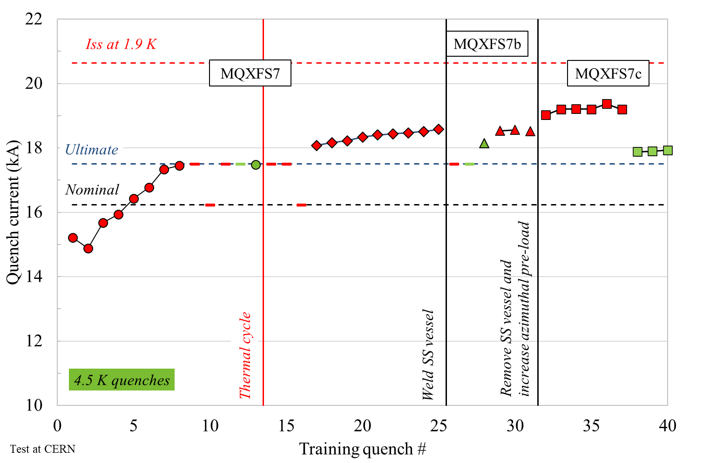
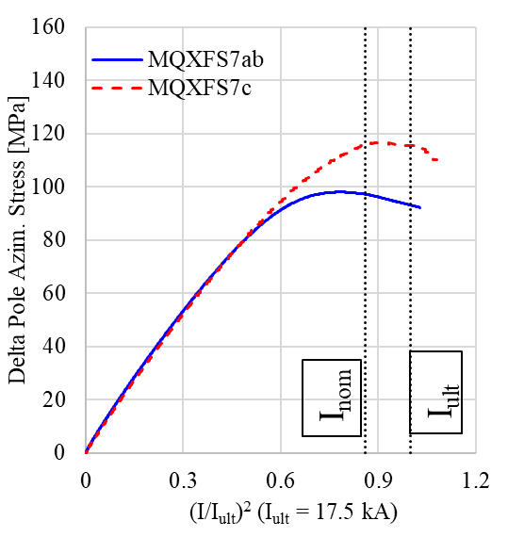
MQXFS7/7b/7c
MQXFS7 reached nominal and ultimate current at 4.5 K. Good memory after thermal cycle
The welding of the SS vessel in MQXFS7b did not impact the magnet performance
MQXFS7c, assembled with 15-20 MPa higher coil pre-load, reached higher current at 1.9 K with a similar performance at 4.5 K. The behavior is consistent with MQXFS6 experience: larger preload is beneficial to reach 90% of short sample at 1.9 K. We reached 97 % of the short sample limit at 4.5 K.
Data: Salvador Ferradas Troitino, Franco Mangiarotti
Pole unloading S7 vs S7c

Slide 8
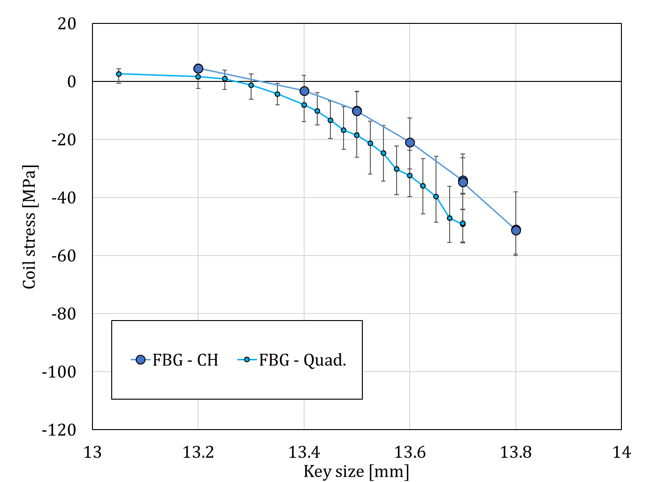
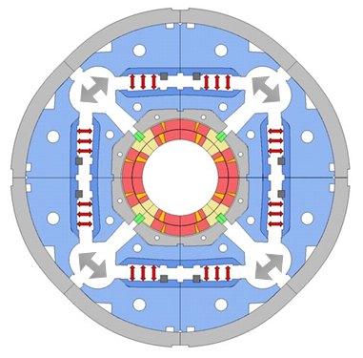
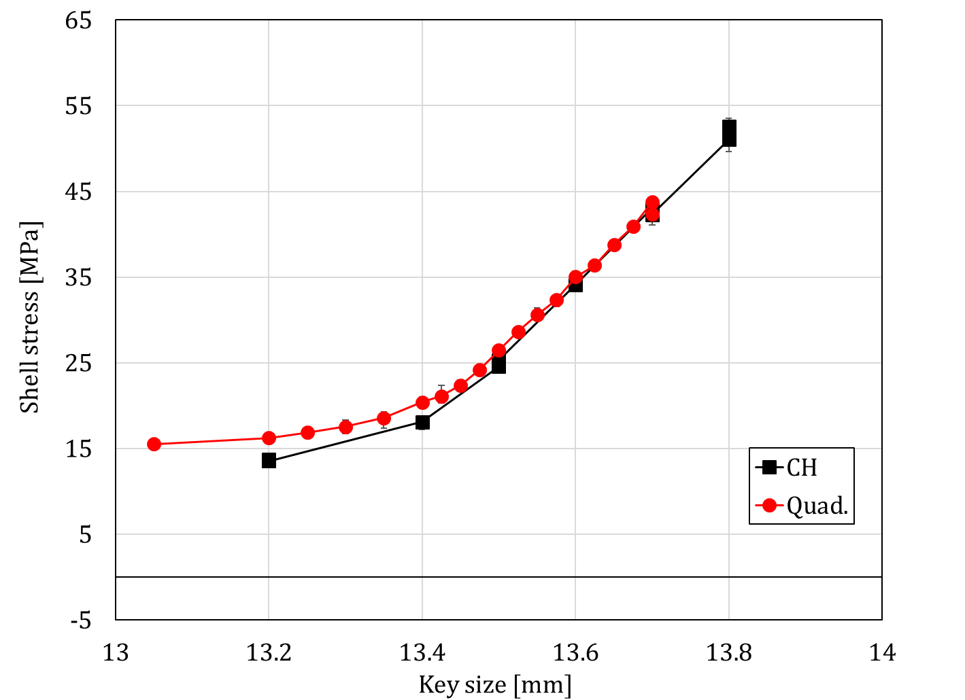
MQXFS7e
A new loading procedure was developed for MQXFB magnets to limit the peak stress in the coil during loading using auxiliary bladders in the cooling hole channels
Loading quadrant by quadrant or all quadrant at the time using cooling channels (CH) we expect for a given key size:
  The same Al-shell stress
  ≈ 10 MPa lower pole stress
This is a frictional effect that was predicted by the FE model. According to the FE model, the stress state at cold is independent of the loading process (friction effect during loading ‘resets’)
For MQXFB magnets, starting from MQXFB02 we modified the target RT per-load target to 70 ± 10 MPa (it was 80 ± 8 MPa) to account for this effect.
Data: Michael Guinchard, Keziban Kandemir Sylvain Mugnier
Analysis: Jose Ferradas Troitino

Slide 9
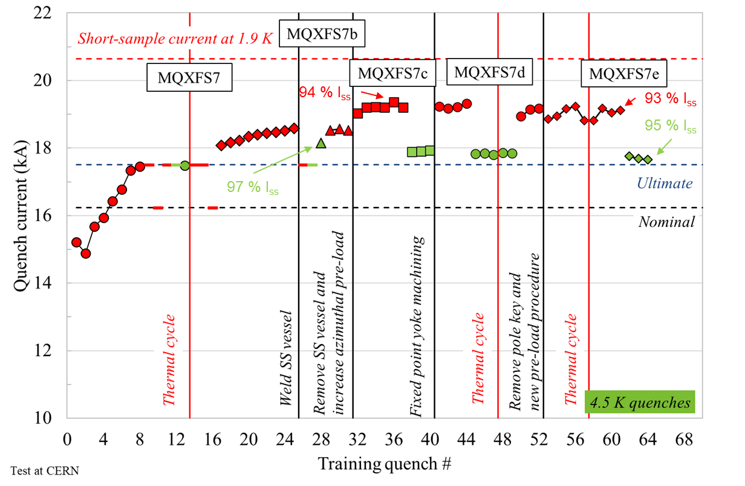
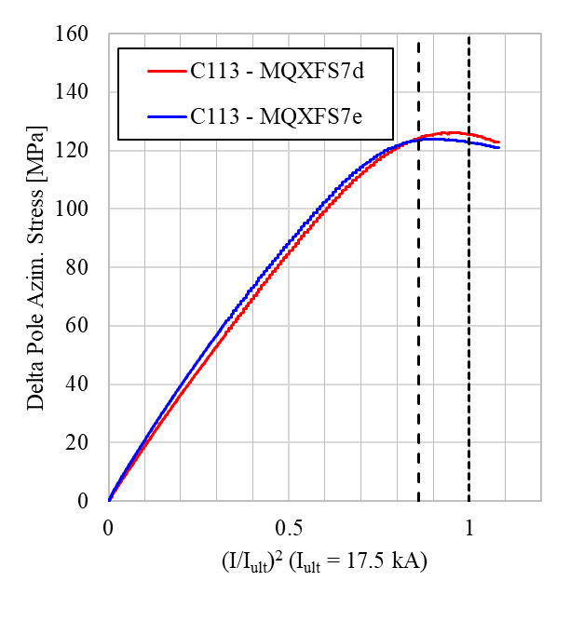
MQXFS7e
The quench performance of MQXFS7e is similar to MQXFS7d: the new loading procedure does not have a detrimental effect in the magnet performance
As expected from the FE model, the coil stress at cold is independent of the loading process (friction effect during loading ‘resets’) → MQXFS7d and MQXFS7e have identical pole unloading behavior
Next steps: Gradual increase (∆ 15-10 MPa) of the coil pre-load up to performance degradation limit
Data: Salvador Ferradas Troitino, Franco Mangiarotti
Pole unloading in coil 113 S7d vs S7e

Slide 10
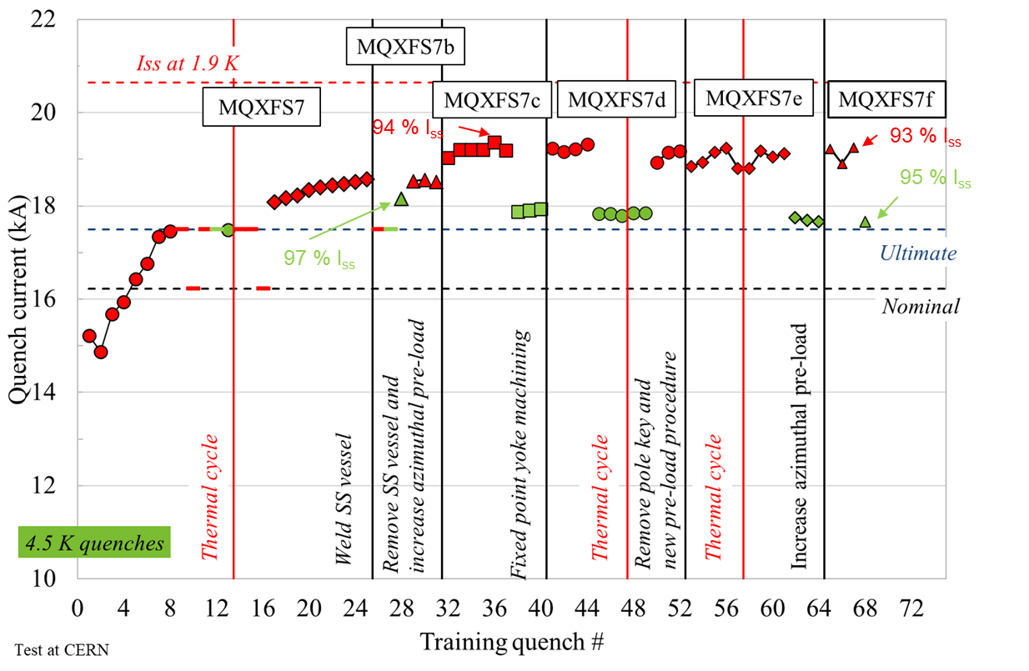
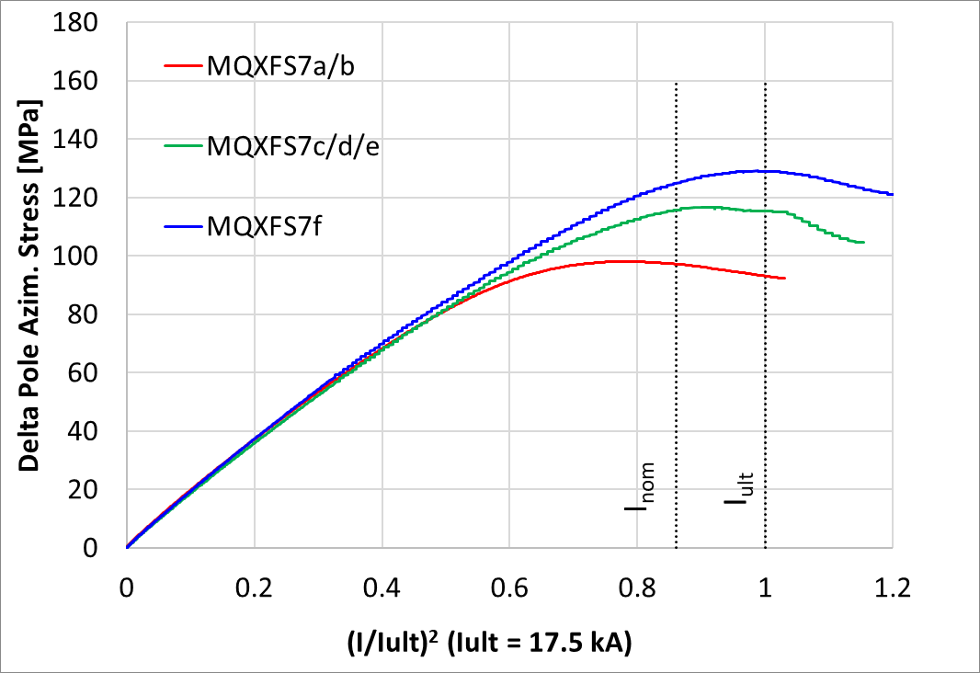
MQXFS7f
In MQXFS7f, key thickness was increased from 13.8 to 13.9 mm (required bladder pressure 350 bars)
RT pre-load went smoothly. At cold:
  Similar performance to MQXFS7e, the measured increase of azimuthal pole stress is in line with expectations (pole azimuthal stress at cold 130 MPa)
Pole unloading, data courtesy EN-MME
Data: Salvador Ferradas Troitino, Franco Mangiarotti

Slide 11
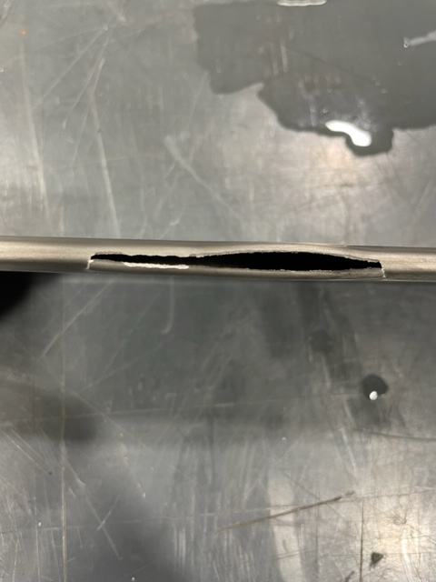
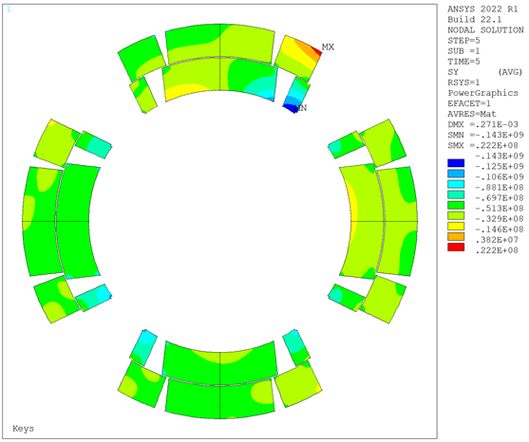
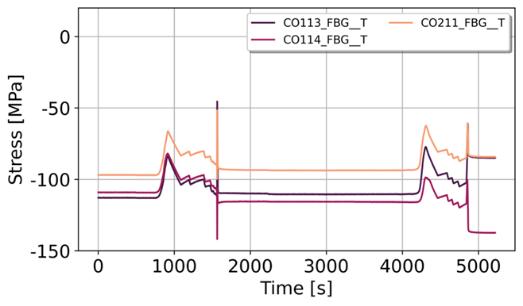
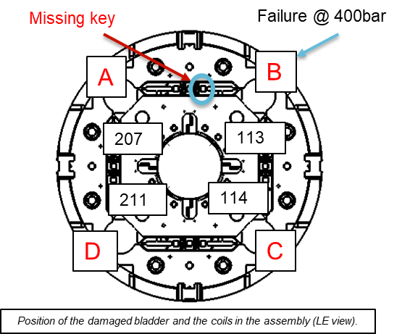
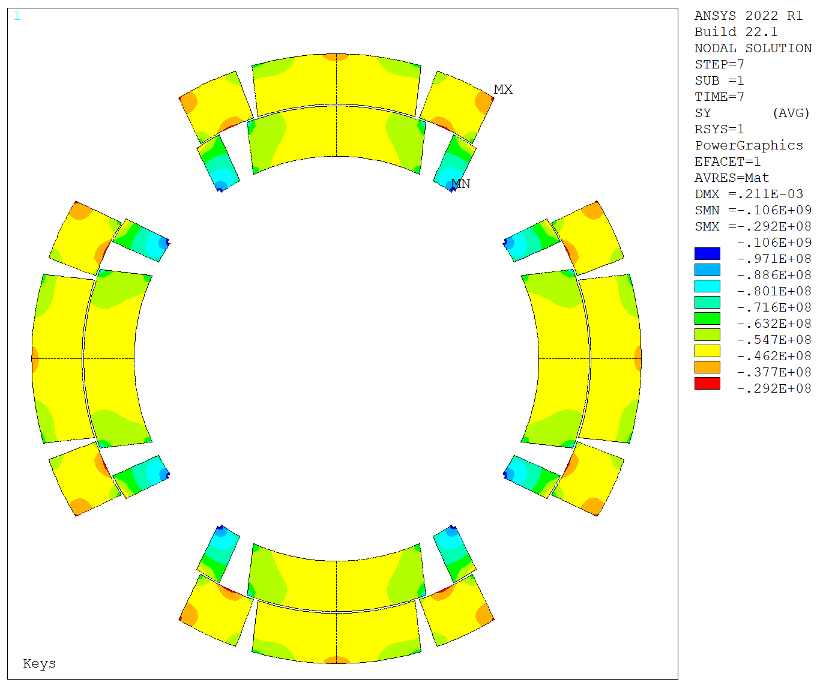
MQXFS7g
In MQXFS7g, key thickness was increased from 13.9 to 14.0 mm
Bladder failure at 400 bars when inserting the last 14 mm key
  Root cause: Tubular bladders re-used from MQXFS8 (flattened) → from MQXFS7g assembly, we don’t re-use bladders
  One key missing after bladder failure→ measured peak az. stress ~ 145 MPa. Large coil imbalance upon completion of the pre-load.
Key
missing
Bladder failure
Peak ~ 145 MPa
Δ ~ 40 MPa
Ref.
2D FE simulations for the failure case
(P. M. Quassolo)

Slide 12
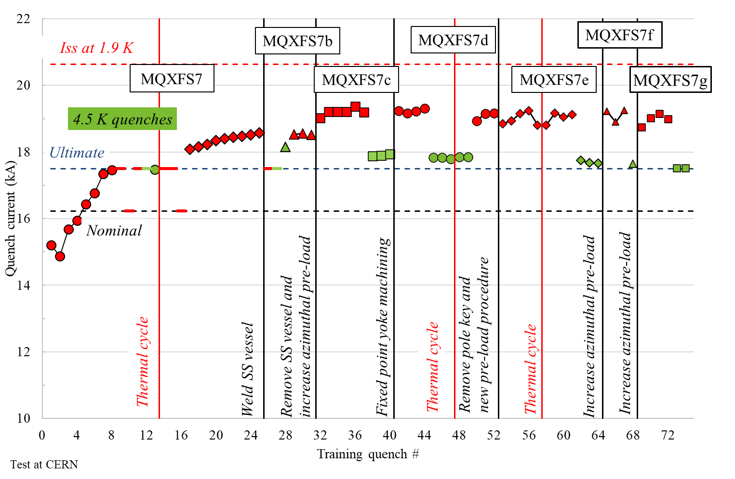
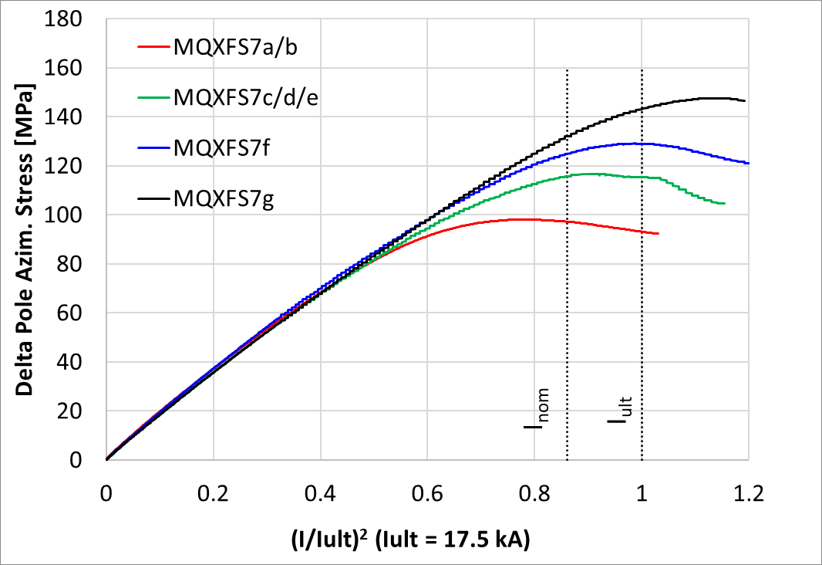
MQXFS7g
In spite of the bladder failure, MQXFS7g reached similar level of current both at 1.9 K and 4.5 K.
The measured increase of azimuthal pole stress is in line with expectations (pole azimuthal stress at cold 150 MPa)
Pole unloading, data courtesy EN-MME
Test Eng.: Franco Mangiarotti

Slide 13
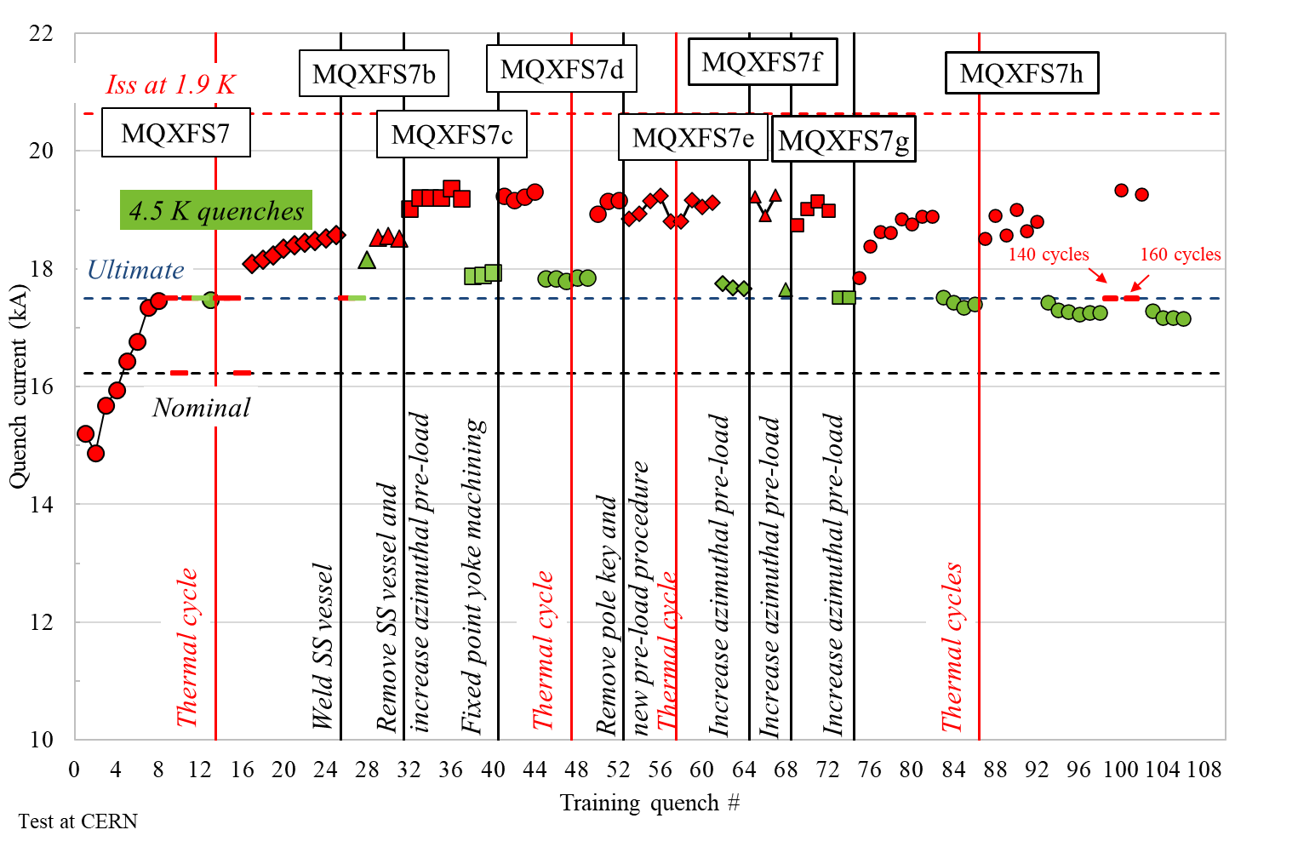
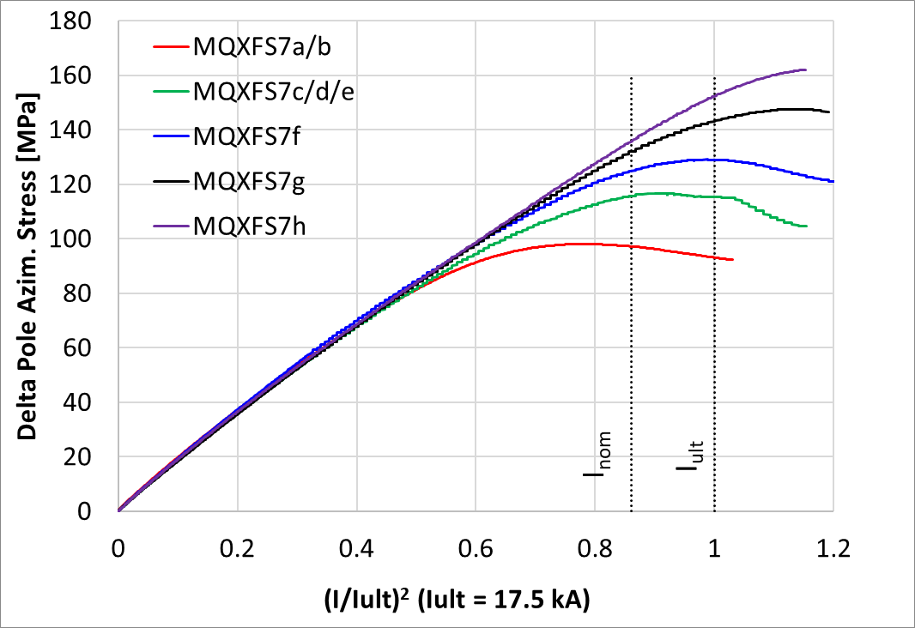
MQXFS7h
In MQXFS7h, key thickness was increased from 14.0 to 14.1 mm (required bladder pressure 440 bars)
RT pre-load went smoothly. At cold (pole azimuthal stress ≈ 190 MPa) :
  1st Thermal Cycle:
    Loose about 1 kA of memory, but re-training at 1.9 K to similar current levels
    Small drop on the quench current at 4.5 K
  2nd thermal cycle (mainly to verify memory): a bit more erratic behavior at 1.9 K and slight decrease on the quench current at 4.5 K. After 300 cycles to ultimate current, 19.4 kA at 1.9 K (94 % I_{ss})
Pole unloading, data courtesy EN-MME
Test Eng.: Franco Mangiarotti

Slide 14
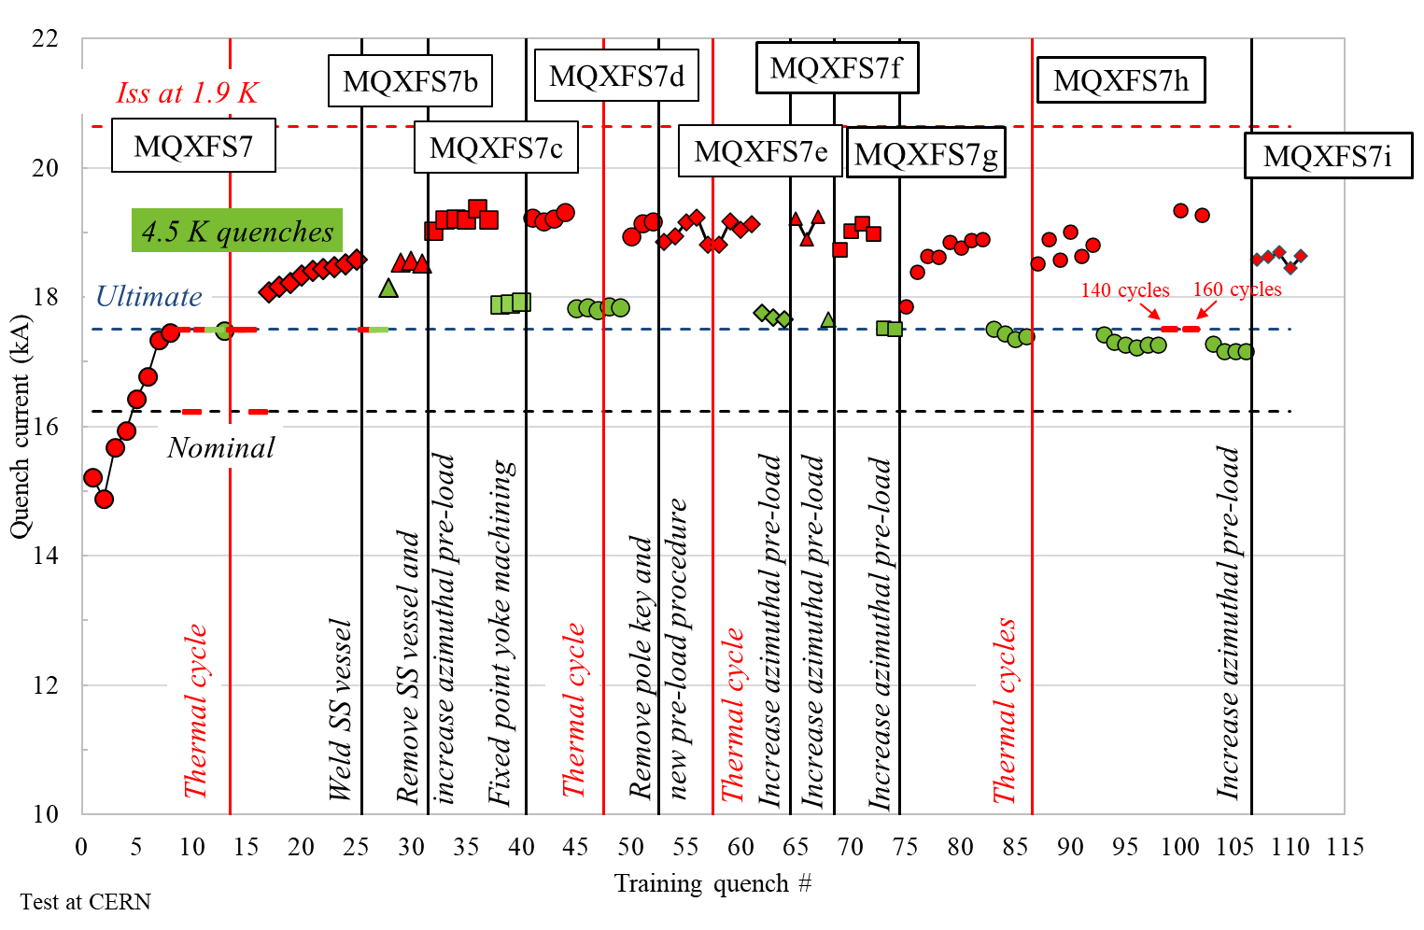
MQXFS7i
In MQXFS7i, key thickness was increased from 14.1 to 14.2 mm (required bladder pressure 550 bars). RT pre-load went smoothly.
Cold powering test just started. Maximum reached current at 1.9 K 450 A below the maximum reached the previous cycle, but the magnet is still training. 4.5 K test in the coming days

Slide 15
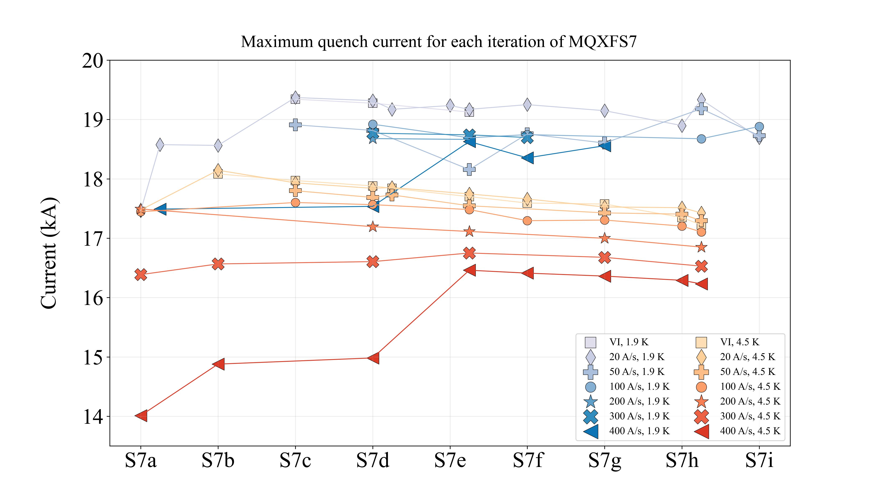
MQXFS7 maximum quench level
S7a/b: 95 MPa
S7c/d/e: 115 MPa
S7f: 130 MPa; S7g: 150 MPa; S7h: 170 MPa ; S7i: 190 MPa

Slide 16
Outline
MQXFS7 pre-load experiment
MQXFS8
Conclusions

Slide 17
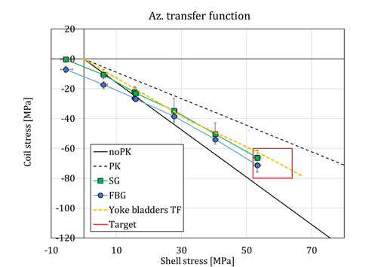
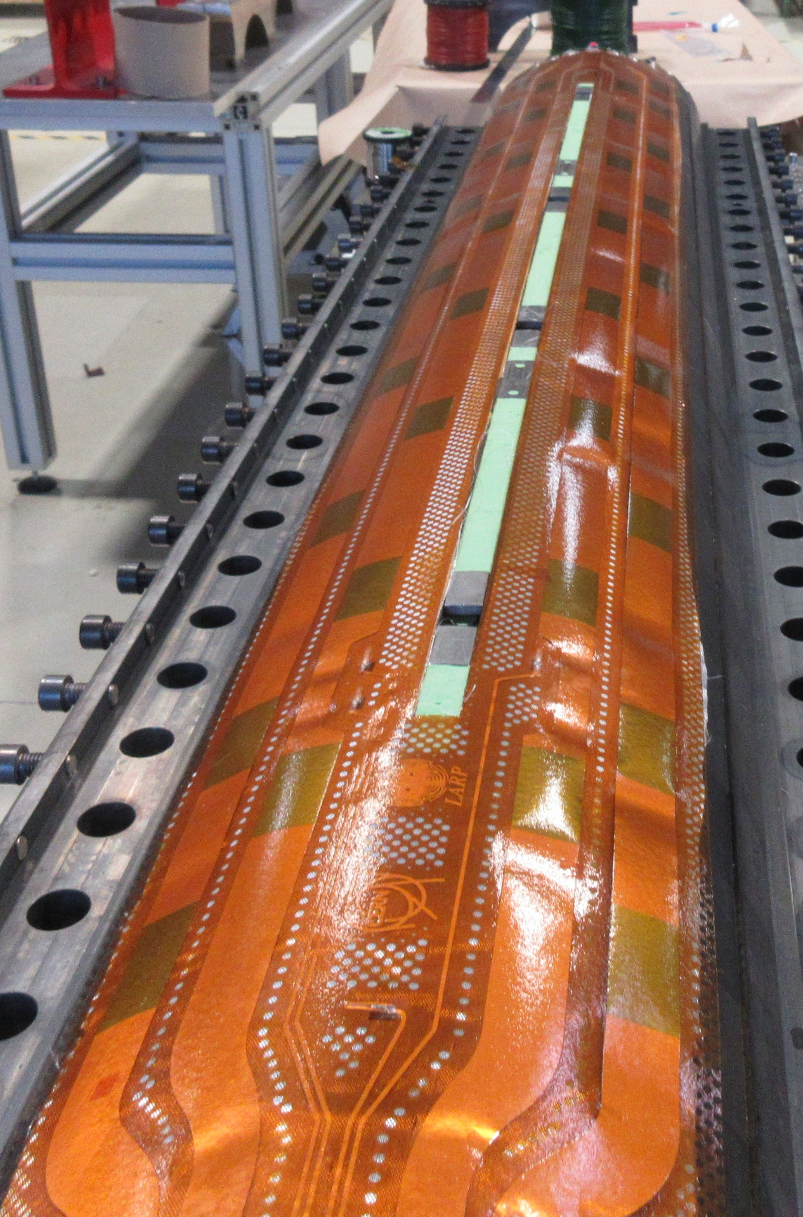
MQXFS8 – Magnet features
MQXFS8 features
  Short model built with 2 virgin coils; 2 coils already tested:
    Two virgin coils with final series conductor (RRP 108/127) and mini-swap quench heaters (115&116).
    Two coils PIT 192 with bundle already tested in MQXFS6b-d
The goal main goal of MQXFS8 is to qualify the mini-swap quench heaters (see EDMS 2646046)
  As a secondary goal, we want to prove our capability to mix virgin and already tested coils
‘New’ loading target and procedure, as MQXFB02, with bladders in the cooling hole channels
‘Encapsulated’ quench heaters, qualified to 8 kV before installation in the coil instead of 3.7 kV
Additional 0.055 mm glass between heater and coil
Penelope Quassolo

Slide 18
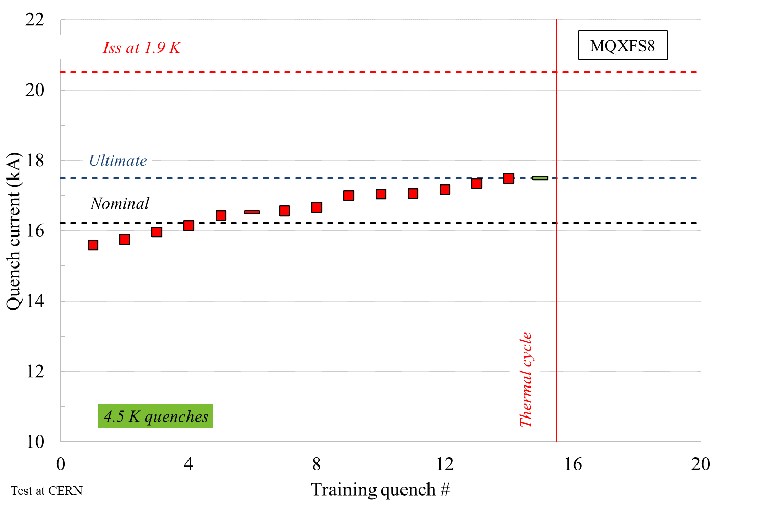
MQXFS8 – Quench performance
Target current (I_{nom} + 300 A) reached after 5 quenches
14 quenches to reach ultimate current (17.5 kA).
  Stable operation at I_{ult} and 4.5 K
The magnet will be pushed to its maximum current in the next thermal cycle

Slide 19
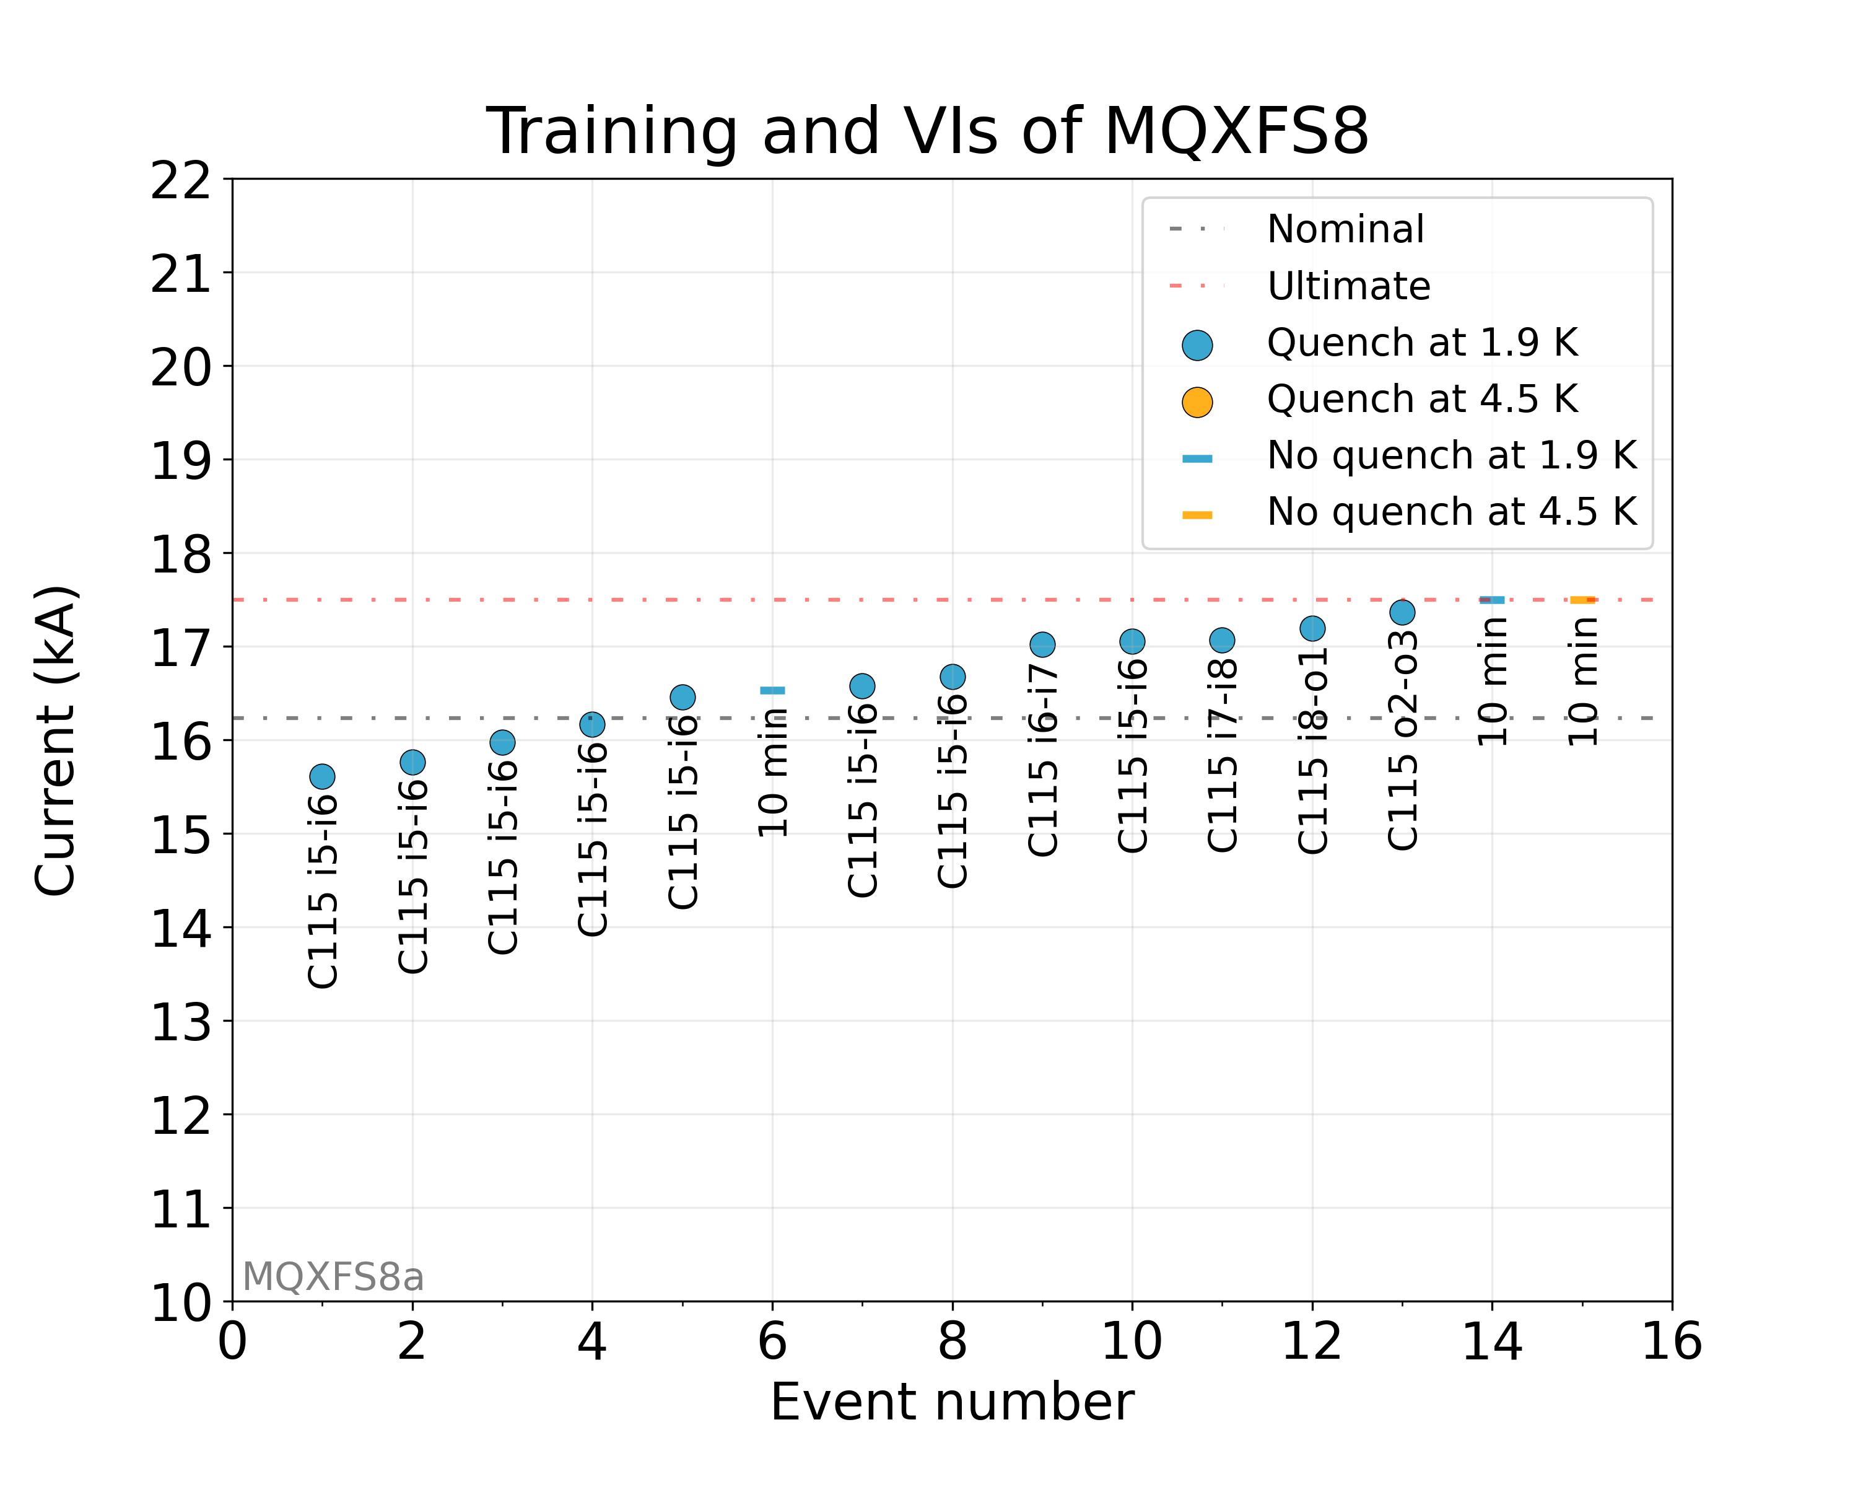
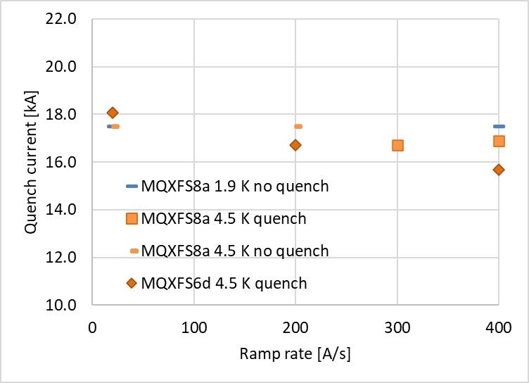
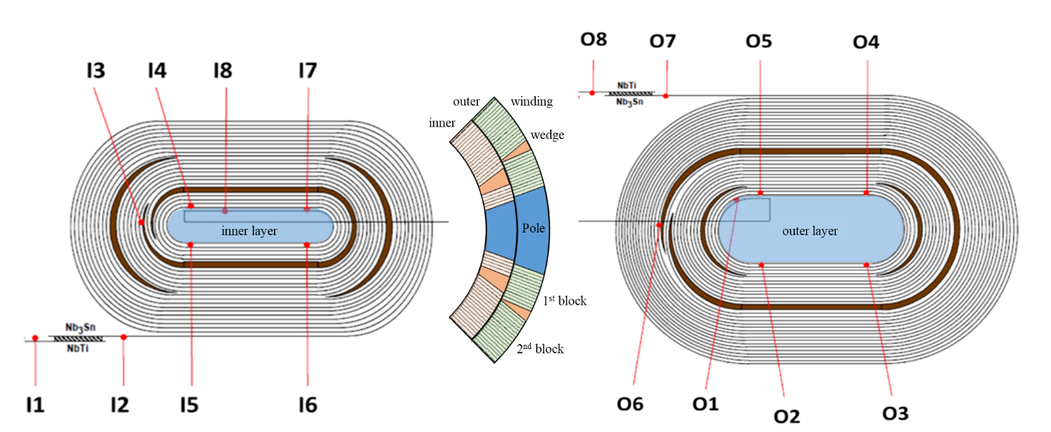
MQXFS8 – Quench performance
All quenches in coil 115 (virgin coil), mostly pole turn inner layer
We are able to reach ultimate current at 200 A/s at 4.5 K
  Quench current at 400 A/s higher than in MQXFS6d (two shared coils)

Slide 20
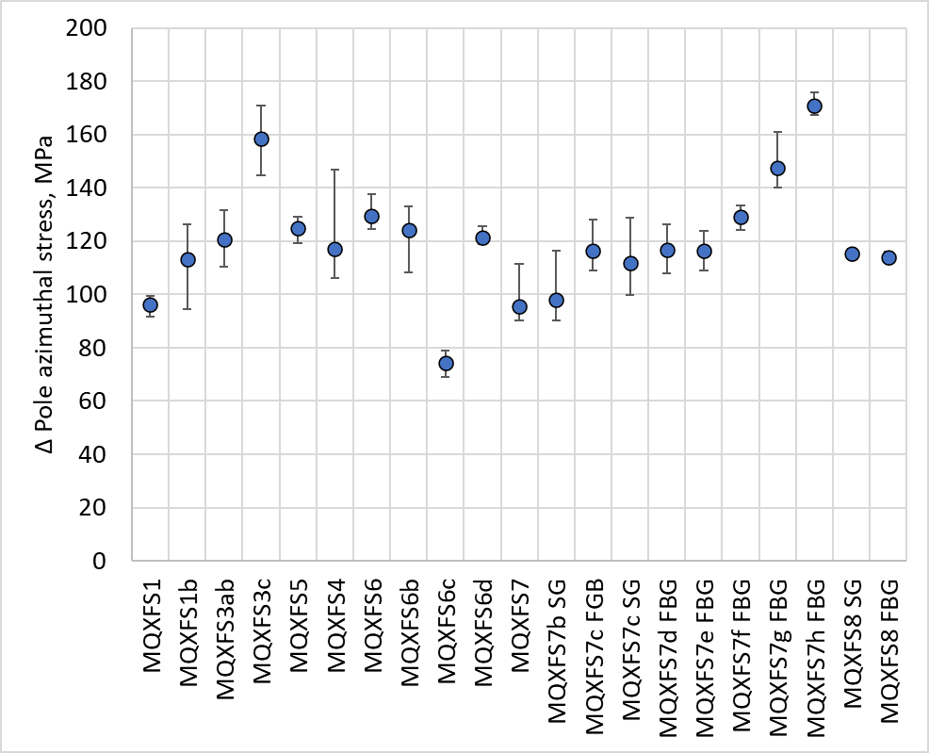
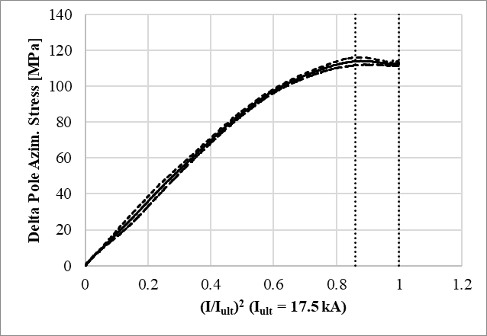
MQXFS8 - Mechanics
Rather ‘nominal’ magnet from the mechanical point of view
I_{nom}
I_{ult}

Slide 21
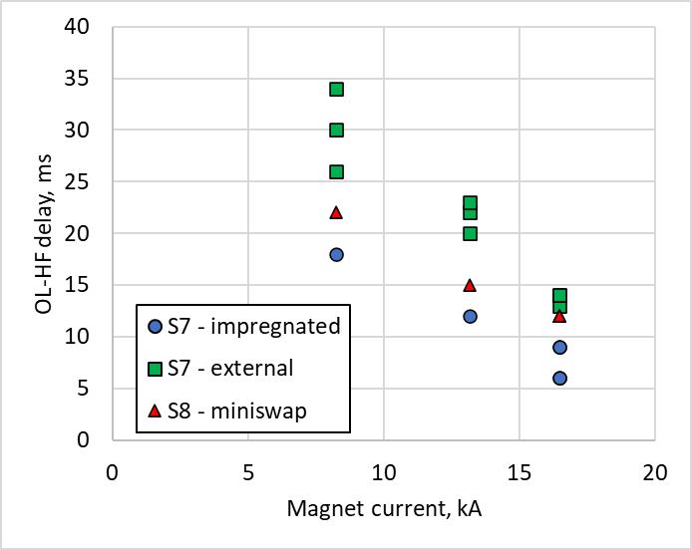
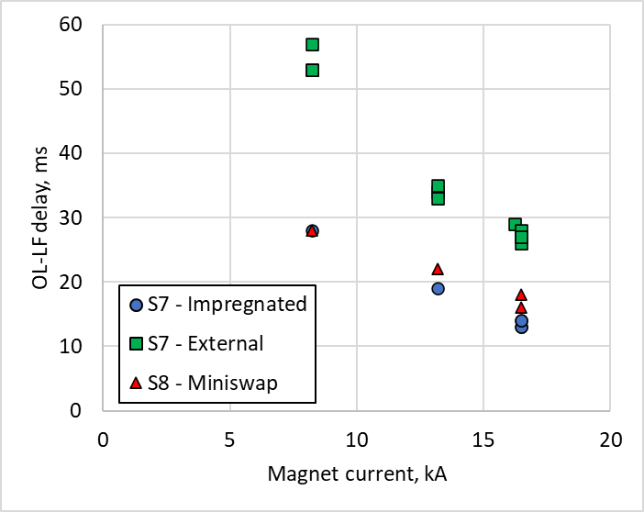
QH performance - delay
14 quenches done, ~50 more do to in the next cool down
First results: QH delay with the mini-swap close to expectations. At Inom:
  High Field expected 14 ms, measured 12 ms
  Low Field expected 19 ms, measured 18 ms

Slide 22
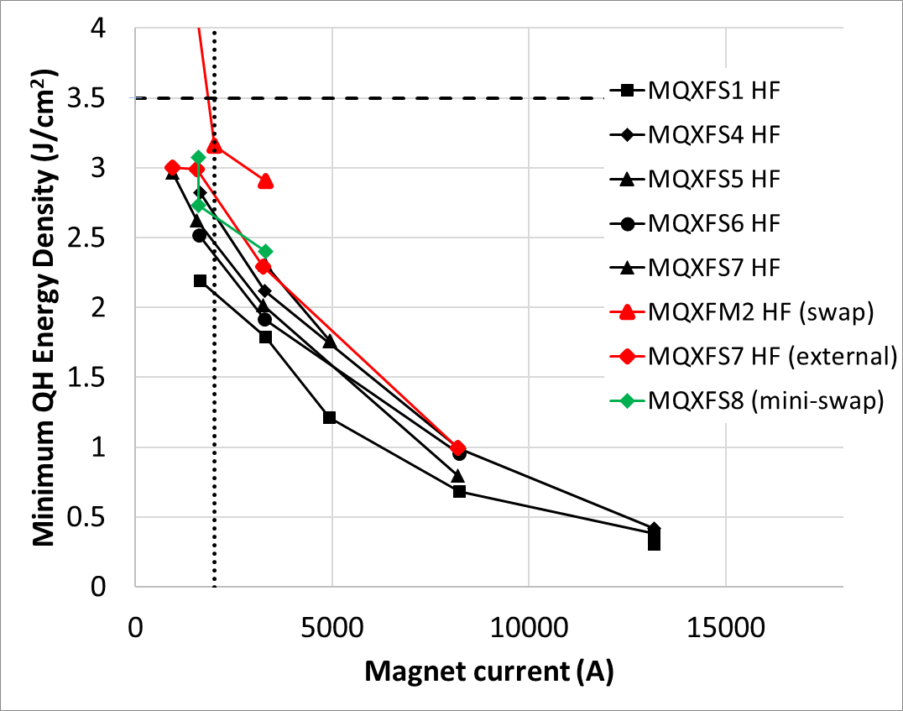
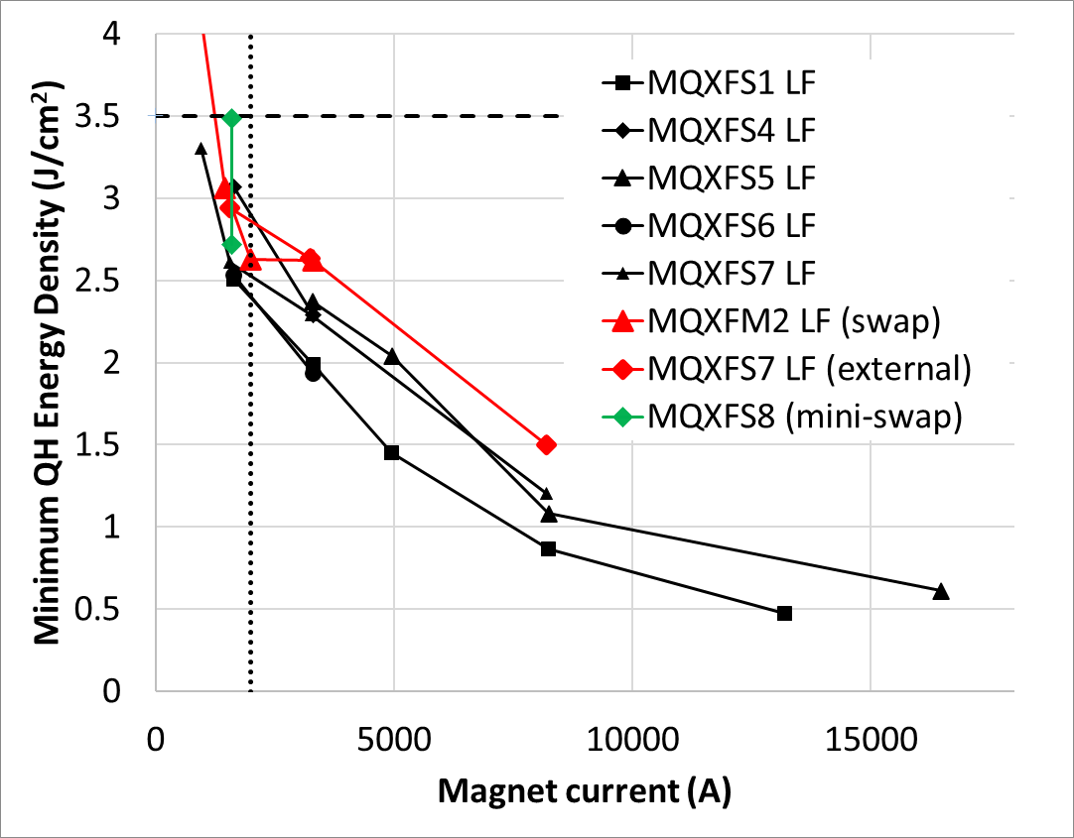
QH performance – min. quench energy
At 1.6 kA, mini-swap QH effective to provoke a quench
  Nominal Energy Density = 3.5 J/cm²
  Minimum Energy Density = 2.5 – 2.7 J/cm² (to initiate a quench at 2 kA)

Slide 23
Outline
MQXFS7 pre-load experiment
MQXFS8
Conclusions

Slide 24
Conclusions
7 years after the test of the first MQXFS at CERN, short magnets are still providing very useful feedback
Based on MQXFS7 pre-load experiment, small impact on performance at 1.9 K up to a level of pole azimuthal stress of 190 MPa (MQXFS7i)
  Small drop on the maximum current at 4.5 K (3 %), but not clear if it is only related to the increase of azimuthal preload. Tests at 4.5 K in MQXFS7i expected in the coming days.
After competition of MQXFS7 experiment we will proceed with MQXFS4 (final conductor, RRP 108/127) implementing lessons learnt from MQXFS7.
MQXFS8 reached ultimate current at 4.5 K, the magnet will be pushed to its maximum current in the next thermal cycle.
Protection studies in MQXFS8 coils with mini-swap quench heater layout are in line with expectations.

Slide 25
Additional slides

Slide 26
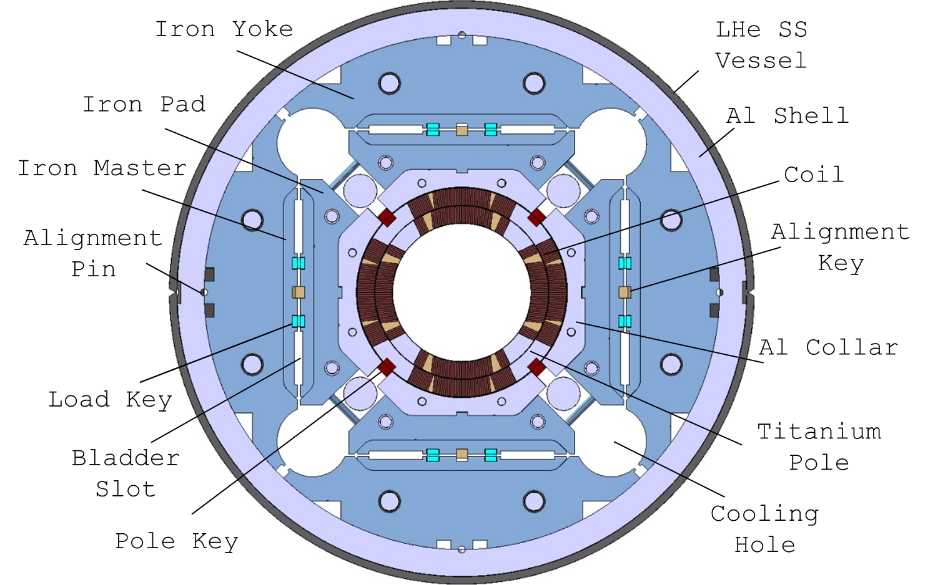
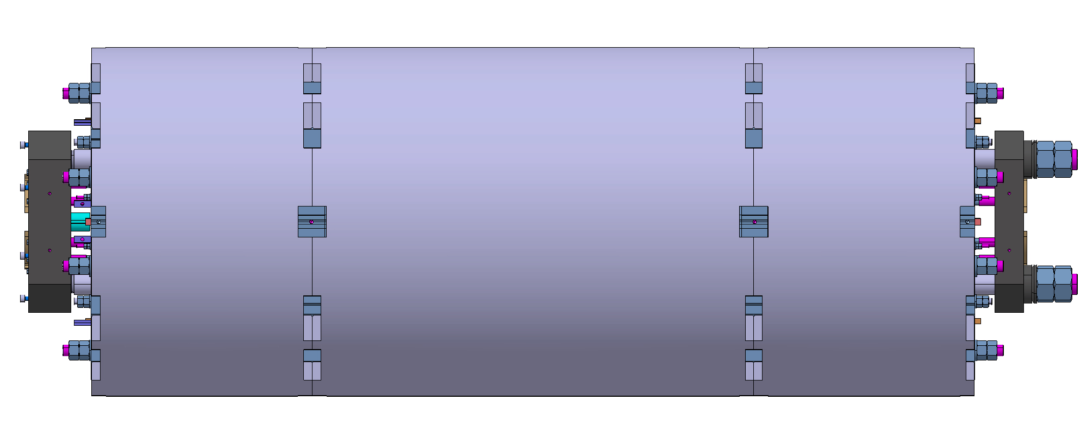

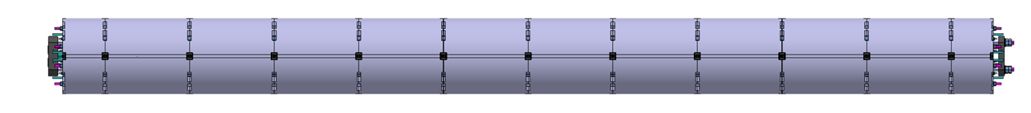
Magnet design
Target: 132.2 T/m; 150 mm coil aperture, 11.3 T B_{peak}
Q1/Q3 (by US-AUP Project), 2 magnets MQXFA with 4.2 m L_{m}
Q2a/Q2b (by CERN), 1 magnet MQXFB with 7.15 m L_{m}
Joint short model development program (MQXFS) to validate the design
Different lengths, same design, very similar assembly procedure and loading target
SS vessel mechanically decoupled from the magnet → results discussed here are mainly without the contribution of the SS Shell
MQXFS
(1.2 m)
MQXFA
(4.2 m)
MQXFB
(7.15 m)

Slide 27
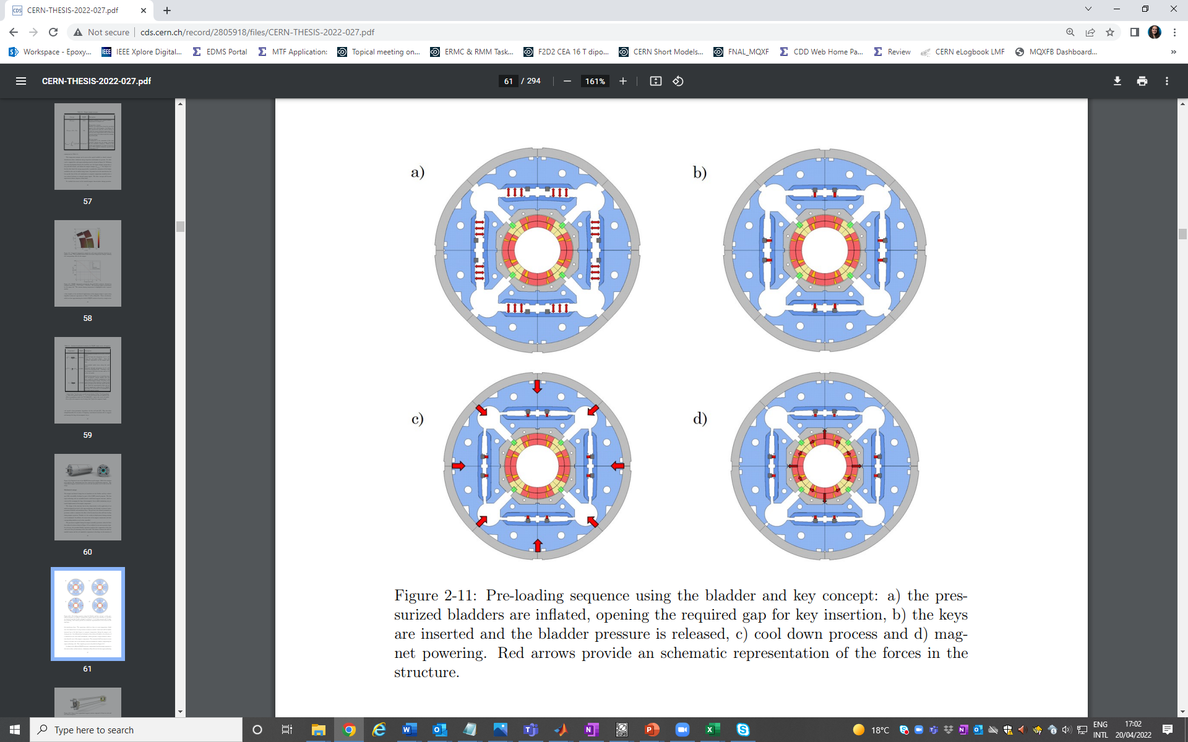
Magnet assembly
 | Bladder pressurization* | Key insertion | Cool down | Powering
 | Open enough clearance to insert the keys (key size + ≈ 0.2-0.3 mm clearance) | Insert the keys to set the RT pre-load level | Increase of pre-load due to the diff. of thermal contraction between aluminum and iron | Coil un-loading due to electromagnetic forces
F_{θ}/F_{em} shell | -- | 40 % | 87 % | 93 %
F_{θ}/F_{em} pole | -- | 40 % | 87 % | 10 %
*Depends on the bladder procedure, numbers reported here correspond to the new MQXFB baseline procedure (all bladders at the time including auxiliary bladders in the cooling holes)

Slide 28
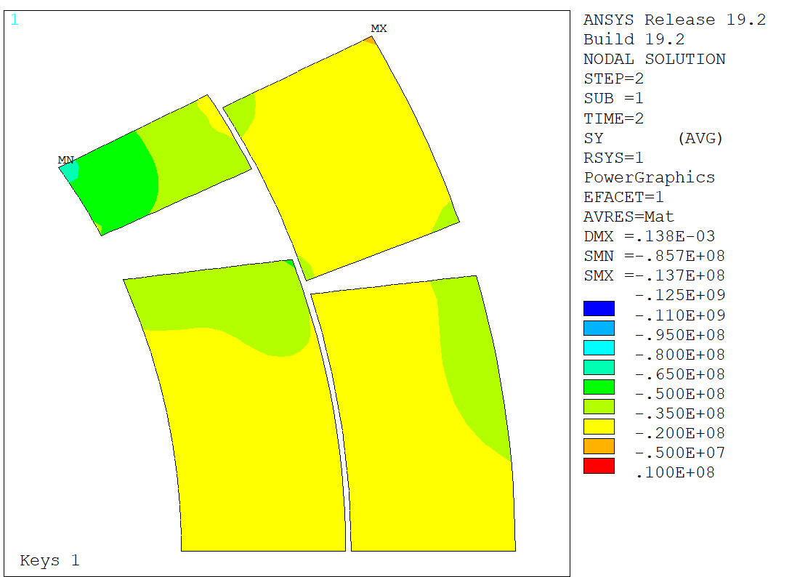
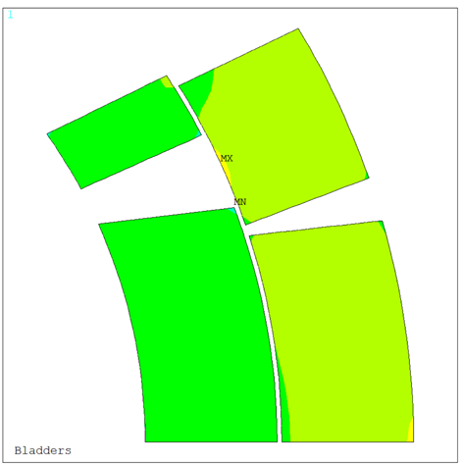
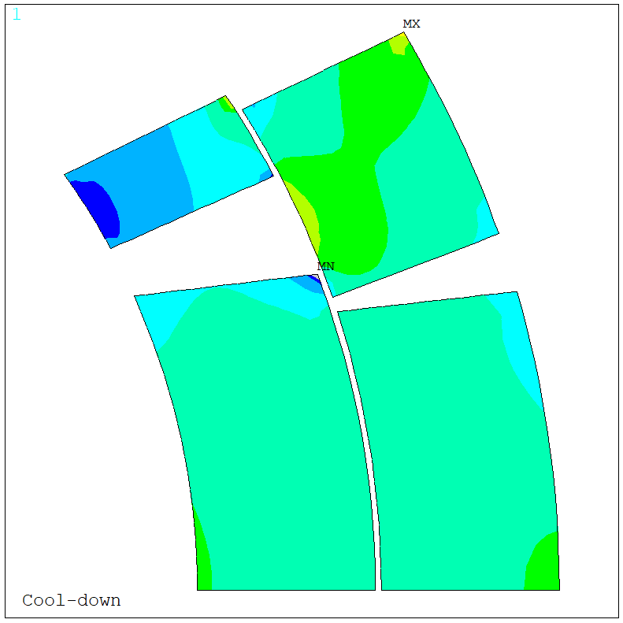
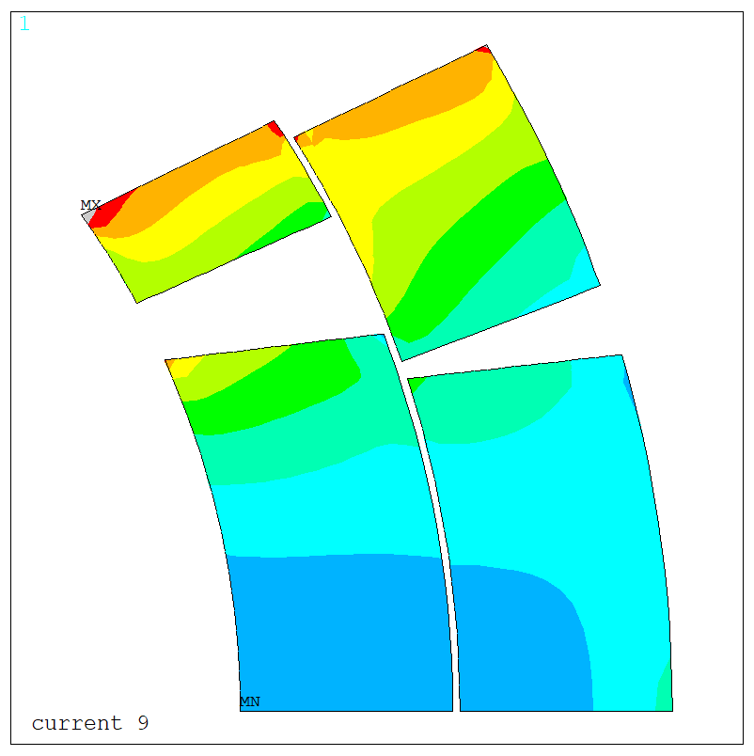

Coil stress for target pre-load
 |  | Bladder pressurization | Key insertion | Cool down | Powering (16.23/17.5 kA)
 |  | Open enough clearance to be insert the keys (key size + 0.2-0.3 mm) | Insert the keys to set the RT pre-load level | Increase of pre-load due to the diff. of thermal contraction between aluminum and iron | Coil un-loading due to electromagnetic forces
σ_{θ} coil, MPa | Ave Pole turn IL | -58 | -52 | -97 | -6/-2
σ_{θ} coil, ave | Peak Pole turn IL | -72 | -86 | -113 | -14/-8
 | Peak Coil | -72 | -86 | -124 | -109/-120
$$σ_{θ}$$
Pole
125 MPa
IL
OL
Mid-plane
0 MPa
Stress map and stress values for the new procedure, loading with auxiliary bladders in the cooling holes.
Nominal assembly with 80 MPa pole compression at warm, 110 MPa at cold
Uncertainty due to material properties and assembly tolerances ± 15-20 MPa

Slide 29
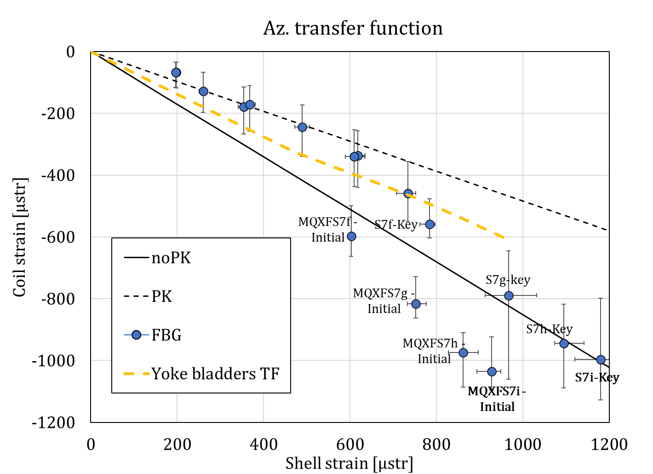
TF

Slide 30
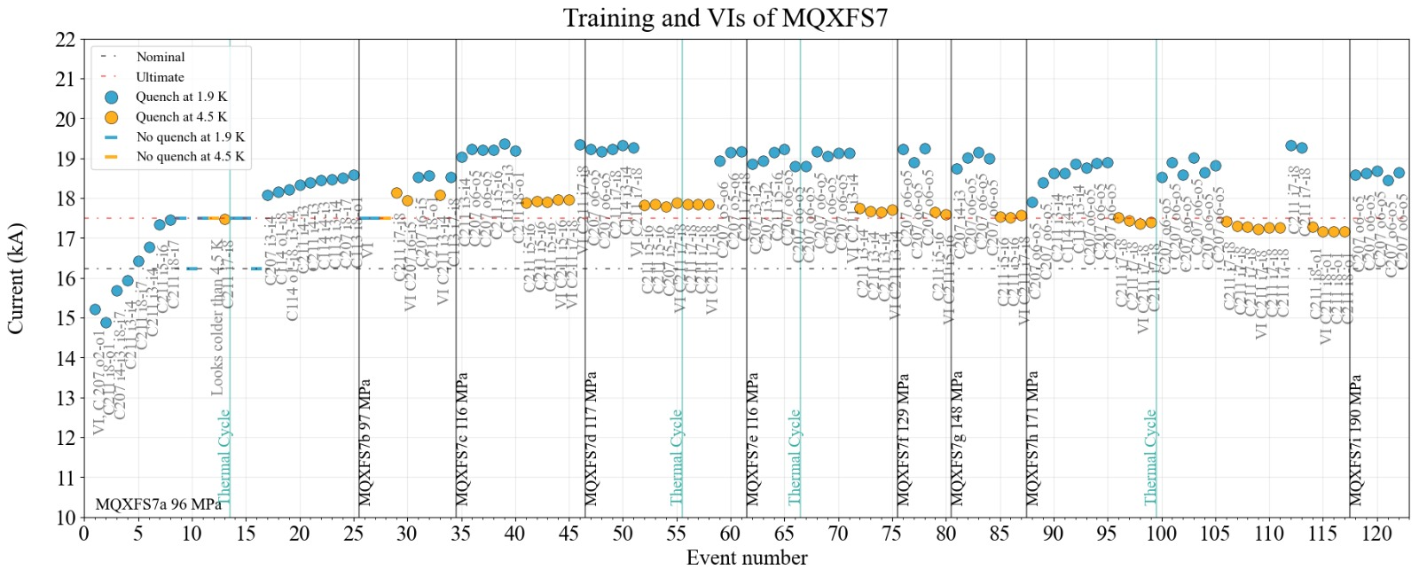

Slide 31
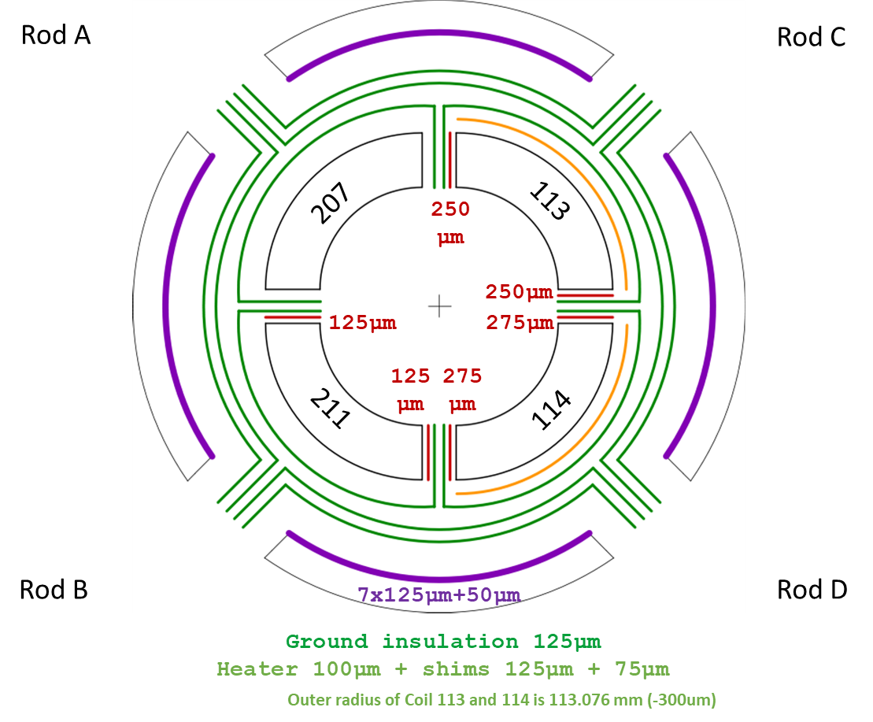
S7 – Frankenstein magnet

Slide 32
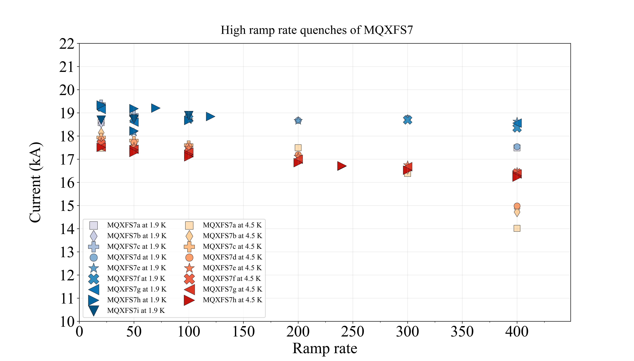

Slide 33
CD2
CD1

Slide 34
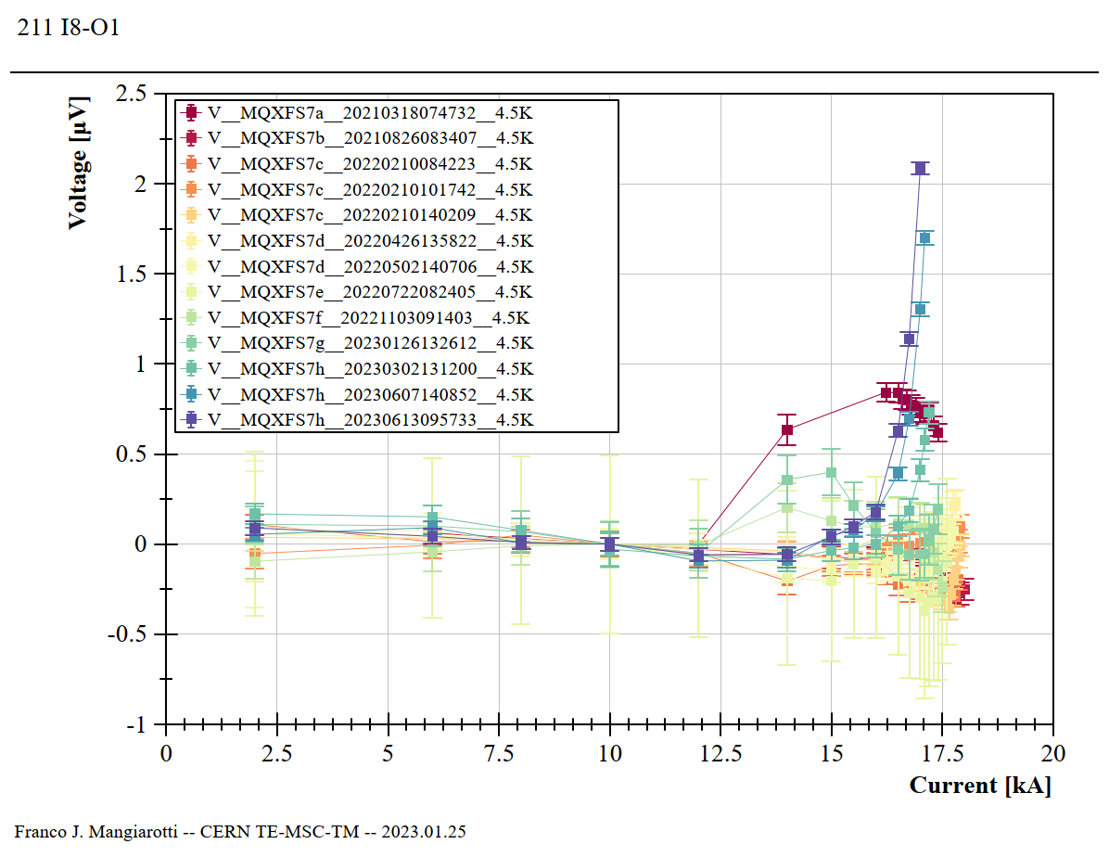
7h CD2 this week
7h CD2 last week
7h CD1

Slide 35
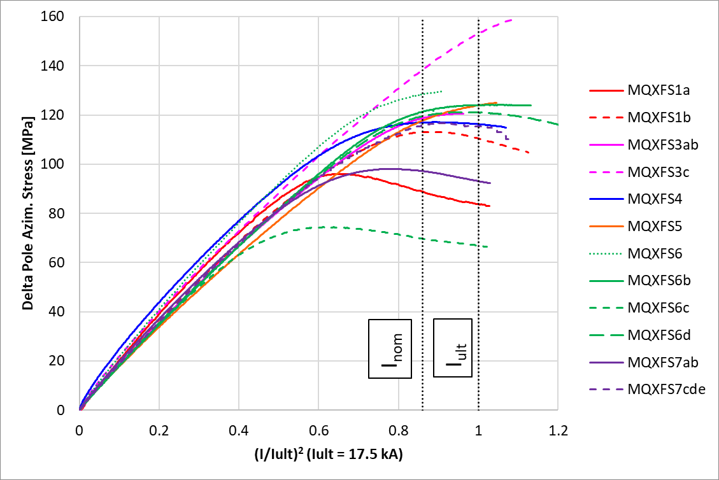
Delta pole stress during powering

Slide 36
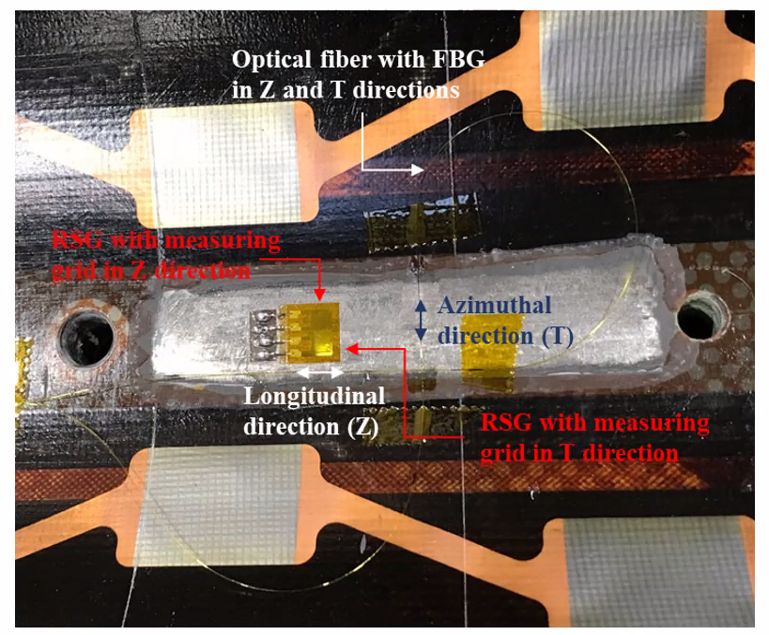
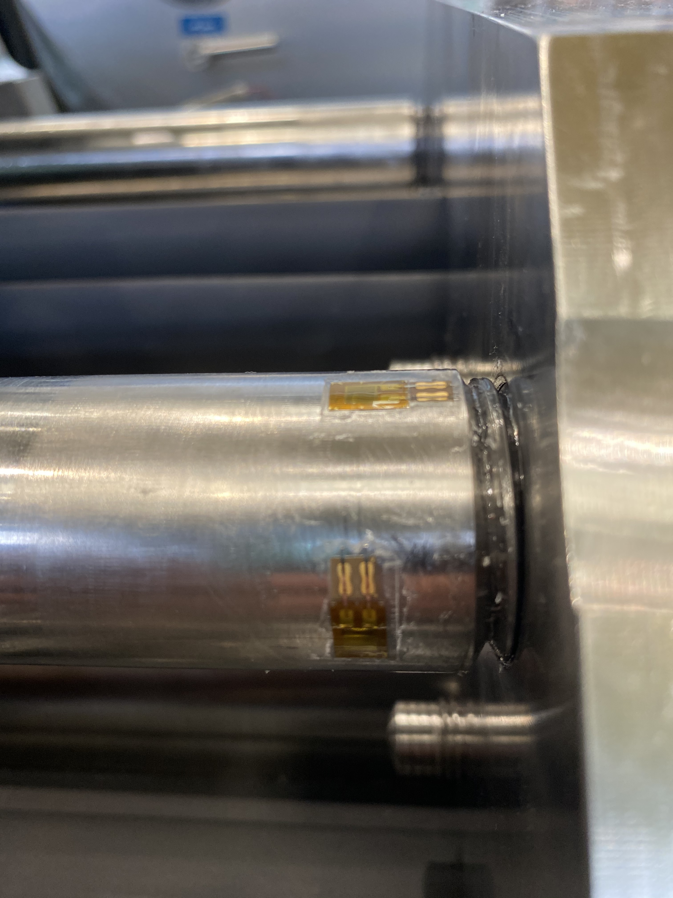
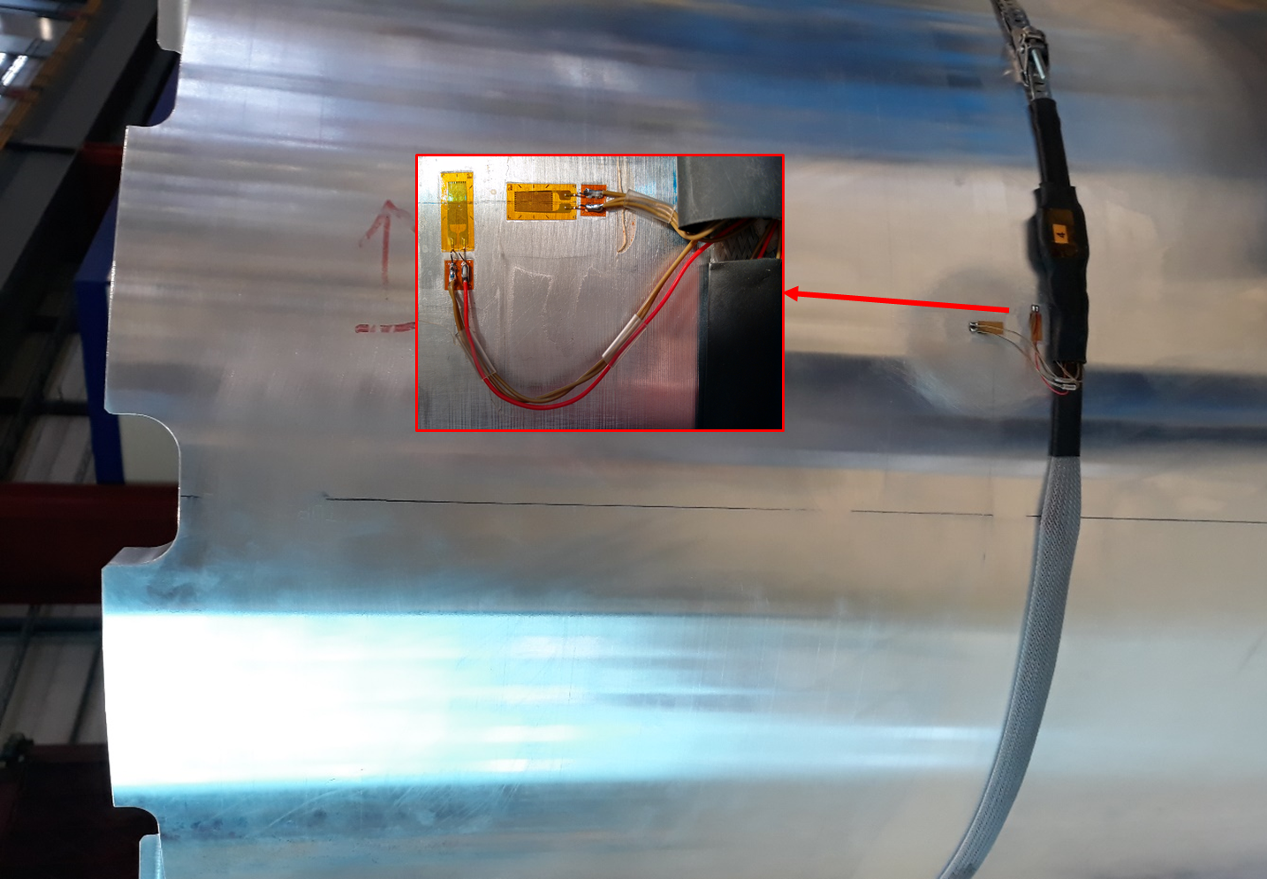


Mechanical instrumentation
Coils instrumented with strain gauges and FBGs
Mechanical behavior monitored. Strain is measured in:
Rods
Aluminum shell
Coil titanium pole
Measurements are performed in the middle of the magnet
Al-shells instrumented with strain gauges
Rods instrumented with strain gauges
$$σ_{θ}=\frac{E}{\left(1−v^{2}\right)}(ε_{θ}+vε_{z})$$
$$σ_{z}=\frac{E}{\left(1−v^{2}\right)}(ε_{z}+vε_{θ})$$

Slide 37


Mechanical instrumentation
Coils instrumented with strain gauges and of FBGs
Al-shells instrumented with strain gauges
The strain is measured in the coil titanium pole. The peak stress in the coil during loading and cool down is in the IL pole turn, very close to the stress in the Ti pole (measuring location)
Rods instrumented with strain gauges
MQXFS, one longitudinal measuring location
MQXFB, three longitudinal measuring locations

Slide 38

FE Model
Aluminum
E (4.3 K / 293 K) = 79 / 70 [GPa]
v = 0.34
CTE (4.3 K – 293 K) = 1.45 e-5
Iron
E (4.3 K/ 293 K) = 224 / 213 [GPA]
v = 0.28
CTE (4.3 K – 293 K) = 6.82 e-6
Coil equivalent
E (4.3 K / 293 K) = 20 [GPA]
v = 0.3
CTE (4.3 K – 293 K) = 1.35 e-5
Titanium
E (4.3 K/ 293 K) = 130 [GPA]
v = 0.3
CTE (4.3 K – 293 K) = 6.03 e-6
Stainless steel
E (4.3 K/ 293 K) = 210 / 193 [GPA]
v = 0.28
CTE (4.3 K – 293 K) = 9.83 e-6
G10
E (4.3 K/ 293 K) = 30 [GPA]
v = 0.3
CTE (4.3 K – 293 K) = 2.44 e-5
Aluminum bronze
E (4.3 K/ 293 K) = 120 / 110 [GPA]
v = 0.3
CTE (4.3 K – 293 K) = 1.08 e-5
G10 (Rotated)
E (4.3 K/ 293 K) = 30 [GPA]
v = 0.3
CTE (4.3 K – 293 K) = 0.846 e-5
38

Slide 39

Coil stress

