Slide 1

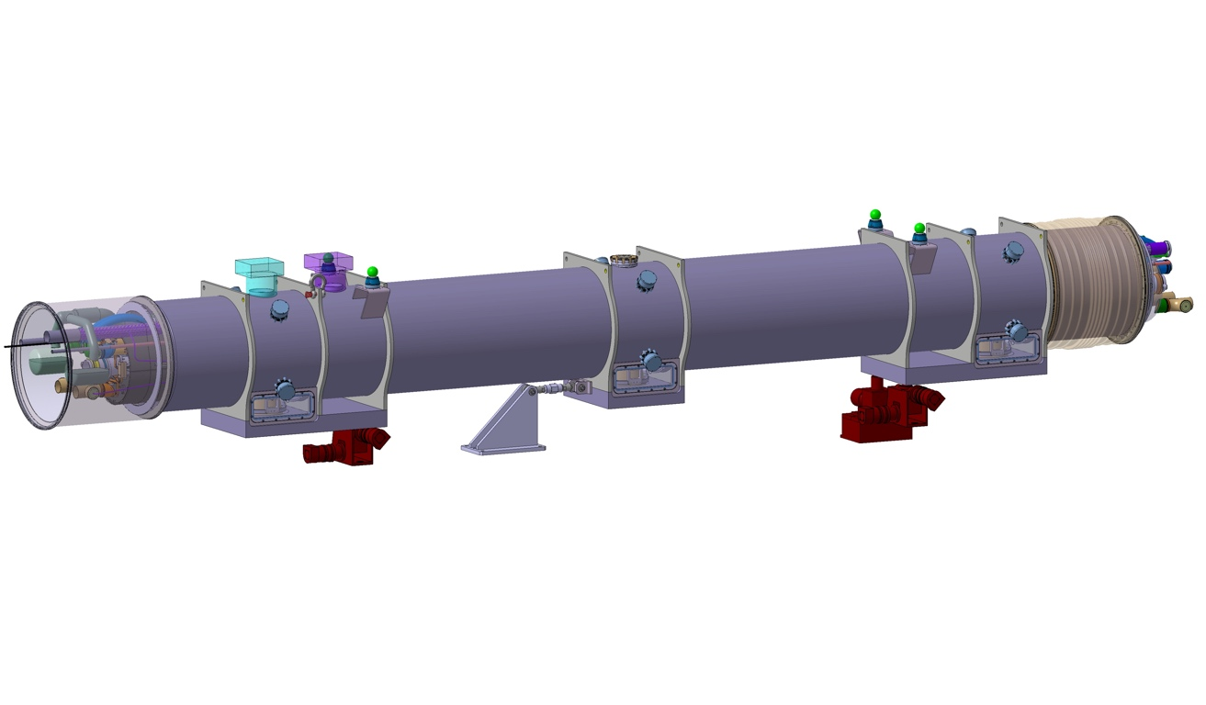
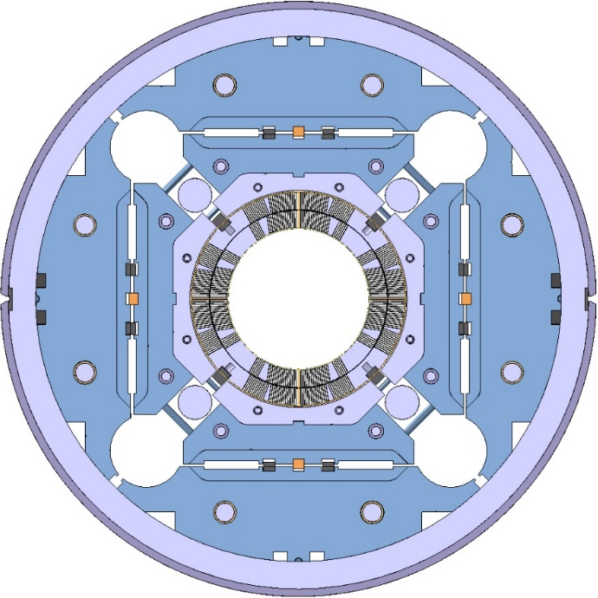
Field quality and integrated gradient in MQXFB
Lucio Fiscarelli, Susana Izquierdo Bermudez, Piotr Rogacki, Mariano Pentella, Carlo Petrone, Franco Mangiarotti, Guy Deferne, Ricardo Beltron,
and all TE/MSC/TM&LMF colleagues
13th HL-LHC Collaboration Meeting, Vancouver 25-28 September 2023

Slide 2
Content
Magnetic measurement systems
Standard magnetic tests
Available measurements
Main results:
  Transfer function
  Field quality
Additional results

Slide 3
Measurement systems and standard tests

Slide 4
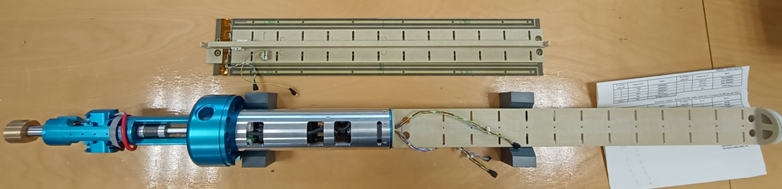
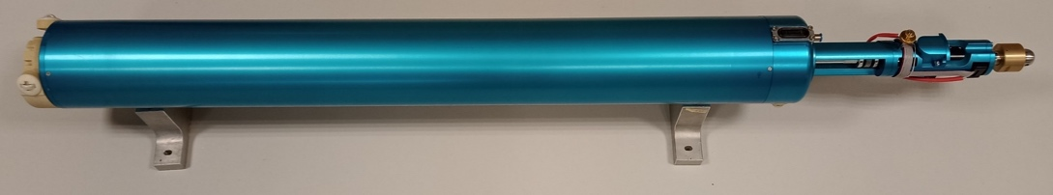
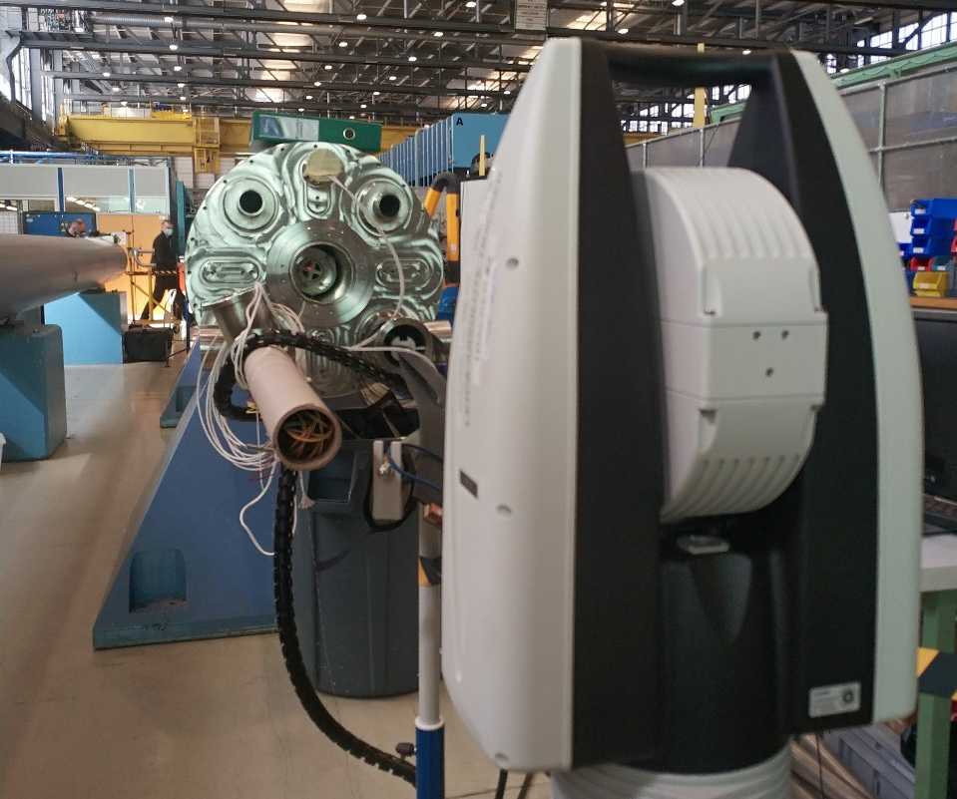
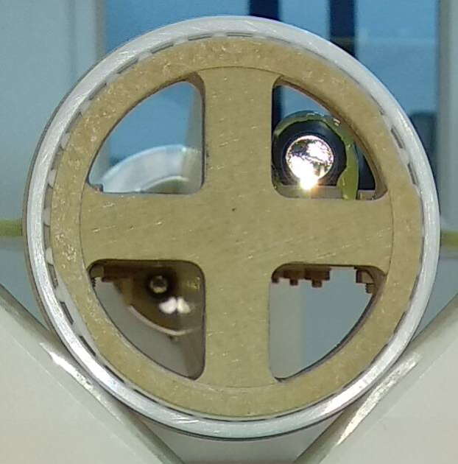
Measurement system at ambient temperature
Rotating coil scanner
  Measurement length 600 mm
  13 positions to cover the MQXFB
  Measurement radius 50 mm
  PCB for the coils
  On-board tilt sensor and optical targets
A full scan of the 8-m-long magnet takes 1.5 hours approximately
Development of a rotating-coil scanner for superconducting accelerator magnets, https://doi.org/10.5194/jsss-9-99-2020

Slide 5
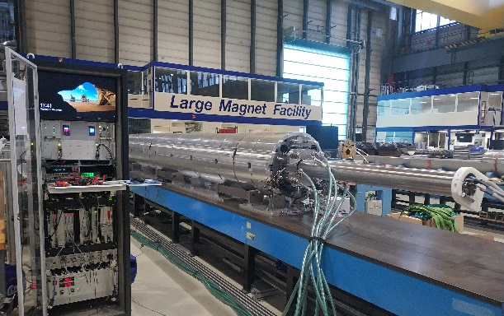
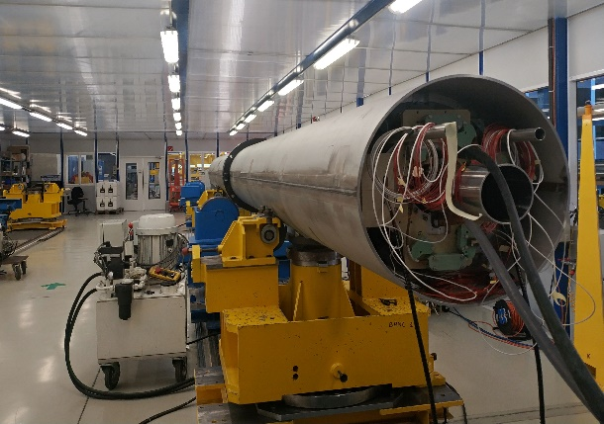
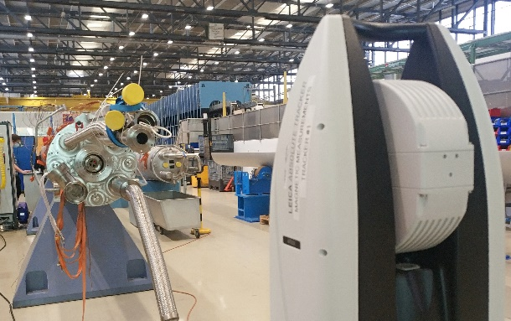
Magnetic tests at ambient temperature
  Check during magnet assembly
  Coil-pack
  Centering
  Loading
  Alignment during cold-mass assembly
  Angular alignment before welding of end covers and feet
  On the final cold-mass assembly
  Final measurement and alignment wrt reference points

Slide 6
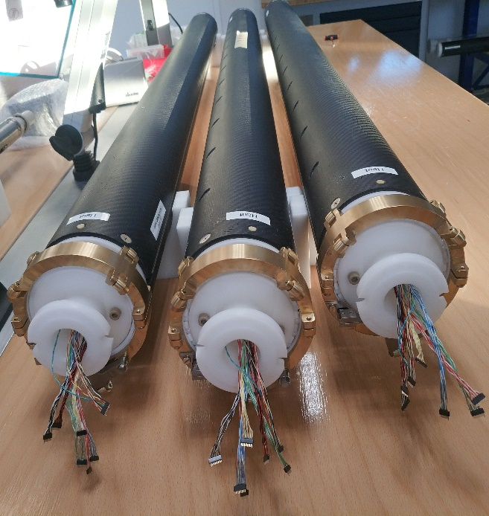
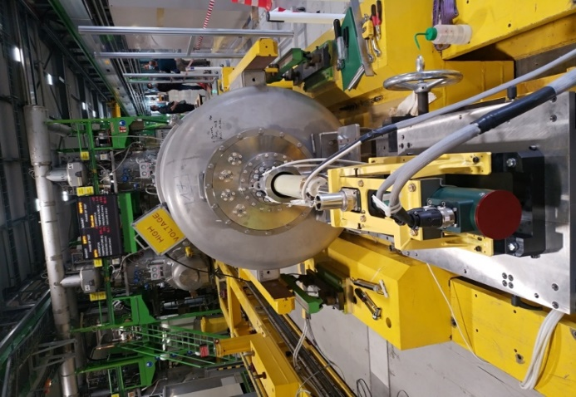
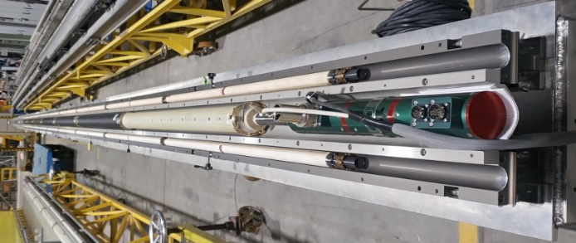
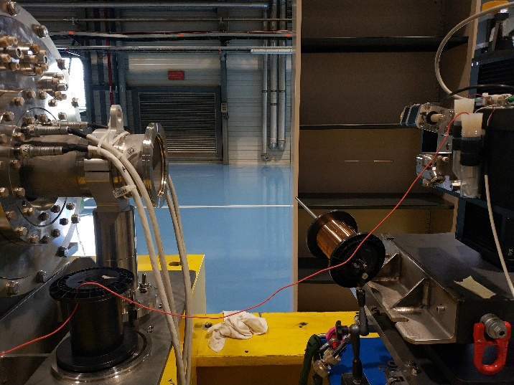
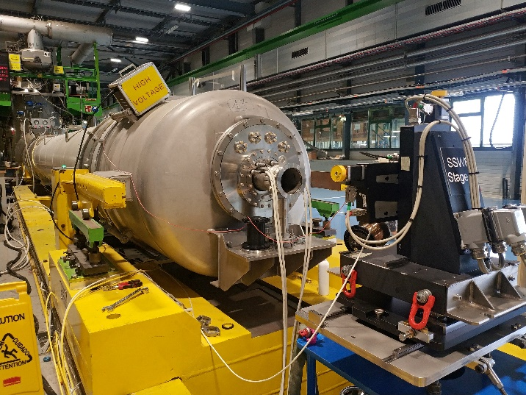
Measurement systems at cryogenic temperature
Rotating-coil chain
  6 segments measuring in parallel
  Length 1.3 m each
  Radius 50 mm
  PCB for the coils
  Composite material for the structure
Single stretched wire
  X-Y tables
  Wire tension control
  Positioning accuracy ~1 μm

Slide 7
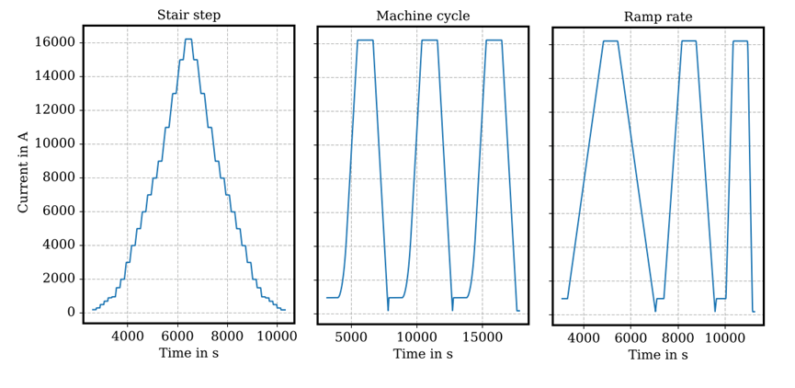
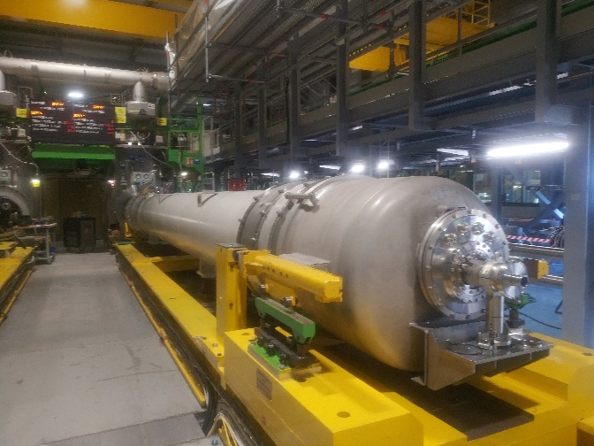
Magnetic tests at cryogenic temperature
  Powering cycles by using rotating coils
    Stair step
    Machine cycles
    Variable ramp-rate
  TF calibration and alignment at nominal by using the stretched wire

Slide 8
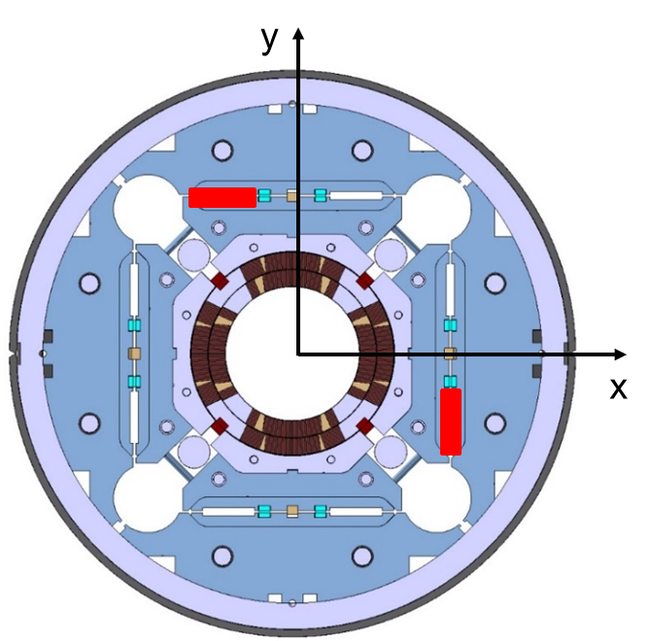
Magnetic shimming
The field quality of the MQXF magnets can be fine tuned by inserting iron blades in the loading slots.
The position and the dimension of the iron blades can be computed based on:
  The results of magnetic measurements at ambient temperature during magnet assembly
  Numerical calculations to predict the effect
Computed correction using 9x58 mm shims in the bladder slots
Order | b_{n} | a_{n}
3 | 1.90 | -1.90
4 | 0.00 | 0.52
5 | 0.27 | 0.27

Slide 9
Main results

Slide 10
Performed measurements
 | MQXFBP1 | MQXFBP2 | MQXFBP3 | MQXFB02 | MQXFB03 | MQXFB04
Ambient temperature
Coil pack | ✔ | ✔ | ✔ | ✔ | ✔ | ✔
After centering | ✔ | ✔ | ✔ | ✔ | ✔
After loading | ✔ | ✔ | ✔ | ✔ | ✔
Cold-mass before | ✔ | ✔ | ✔ | ✔ | ✔
Cold-mass after | ✔ | ✔ | ✔ | ✔
Final cold-mass |  | ✔ | ✔ | ✔
At 1.9 K
Stair-step cycle |  | ✔ | ✔ | ✔ | ✔
Machine cycle |  |  | ✔ | ✔ | ✔
Ramp-rate cycle |  |  | ✔ | ✔ | ✔
Stretched wire at nominal | ✔ | ✔ | ✔ | ✔

Slide 11
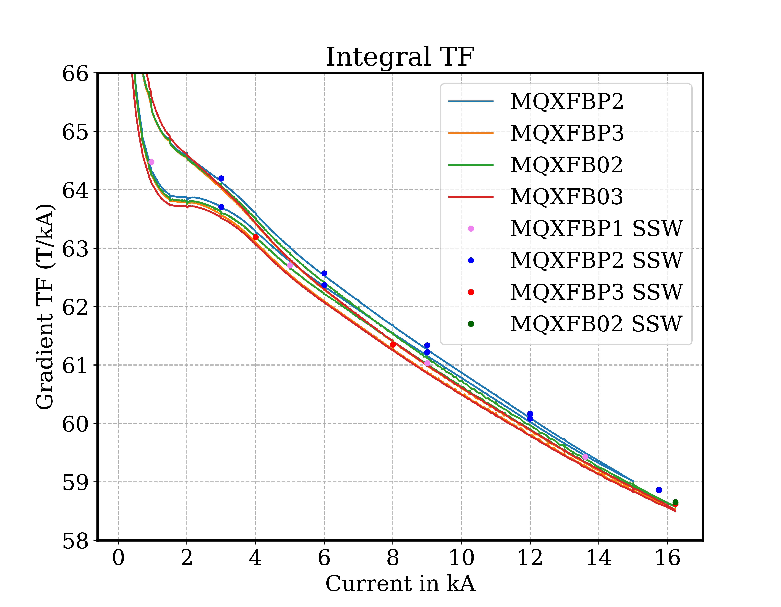
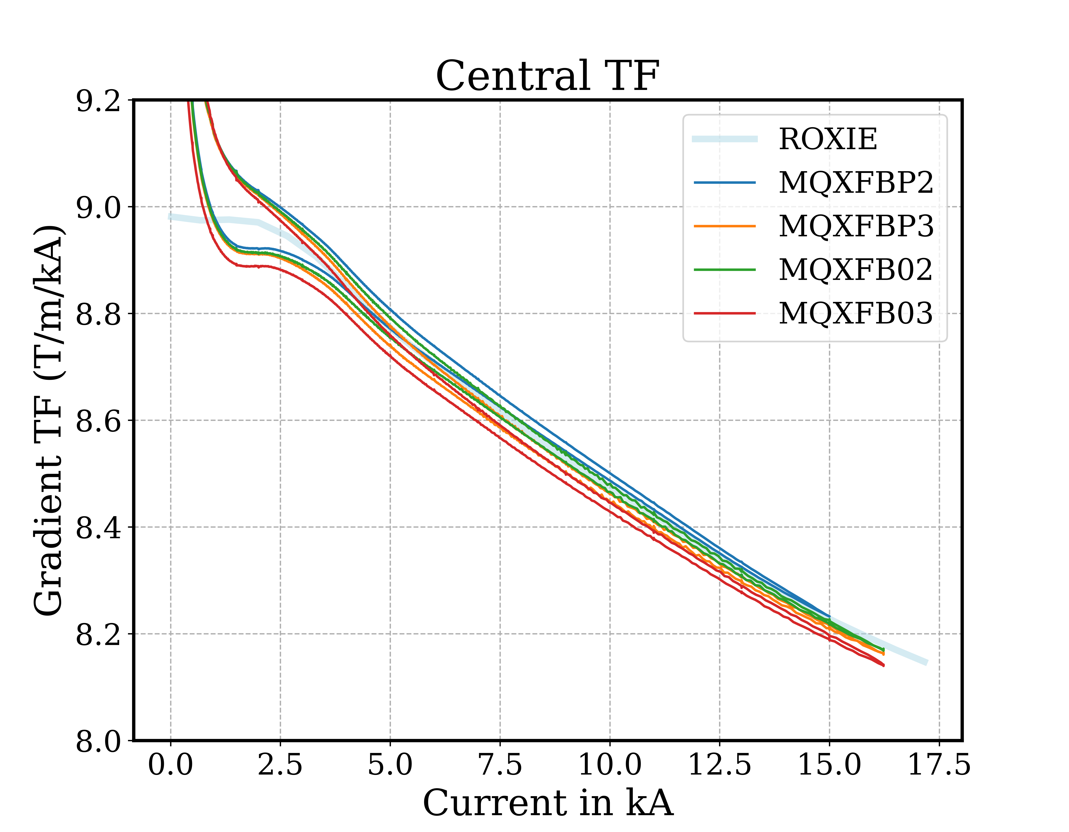
Transfer function vs current
Integral TF accurately measured with stretched wire at few points.
Integral and local TF measured continuously with rotating coils.

Slide 12
Transfer function
Transfer function of integral gradient (T kA⁻¹)
MQXFB | P1 | P2 | P3 | 02 | 03 | 04 |  | Average | Max-min
At ambient temperature
After coil pack insertion | 63.098 | 62.992 | 62.949 | 63.053 | 62.988 | 62.965 |  | 63.016 | 24
After centering | 63.238 | 63.122 | 63.087 | 63.204 | 63.103 |  |  | 63.151 | 24
After loading | 63.394 | 63.359 | 63.328 | 63.407 | 63.458 |  |  | 63.389 | 20
Cold-mass before cold test |  | 63.400 | 63.539 | 63.457 | 63.407 |  |  | 63.451 | 22
Cold-mass after cold test | 63.432 | 63.524 | 63.610 | 63.598 |  |  |  | 63.541 | 28
Final cold-mass |  | 63.646 | 63.459 | 63.586 |  |  |  | 63.564 | 29
At 1.9 K and nominal current
At 1.9 K with rotating coils |  |  | 58.526 | 58.579 | 58.500
At 1.9 K with stretched wire | 58.562* | 58.708* | 58.620 | 58.649 | 58.582** |  |  | 58.624 | 25
∆ to average at amb. temp. | 1 | -5 | -10 | 3 | 11
∆ to average at 1.9 K | -11 | 14 | -1 | 4 | -7
* Extrapolated from a measurement at lower current. ** Measured with rotating coil then cross calibrated.
  The integrated gradient at the nominal current of 16230 A is 951.47 T (35 units more than specification). The integral gradients of all magnets measured so far are within 25 units.

Slide 13
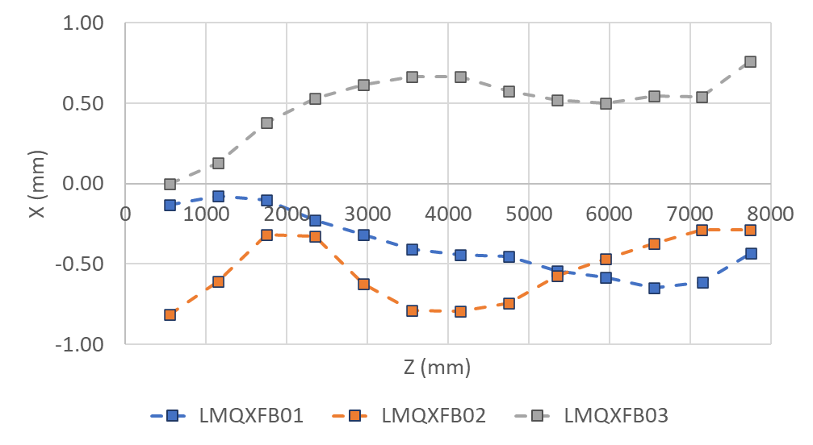
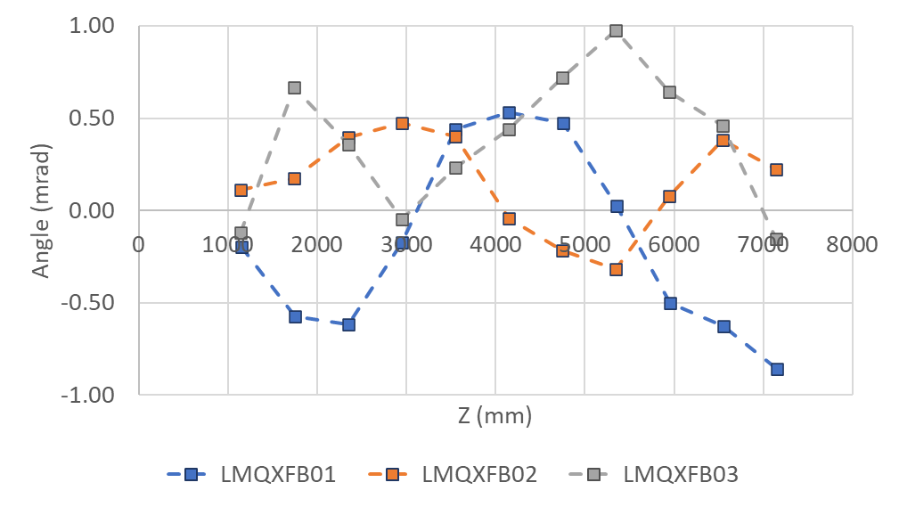
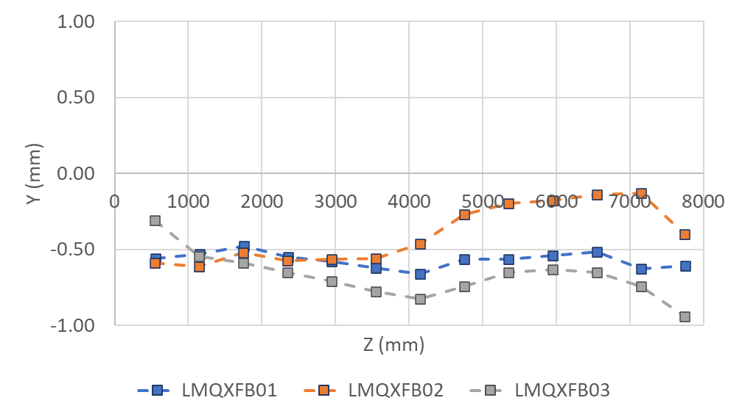
Field direction and magnetic axis
(final cold-masses at ambient temperature)
LMQXFB | 01 | 02 | 03
Integrated angle (mrad) | -0.27 | 0.10 | 0.30
Integrated x (mm) | -0.39 | -0.54 | 0.50
Integrated y (mm) | -0.57 | -0.39 | -0.68
  Field direction and magnetic axis under control

Slide 14
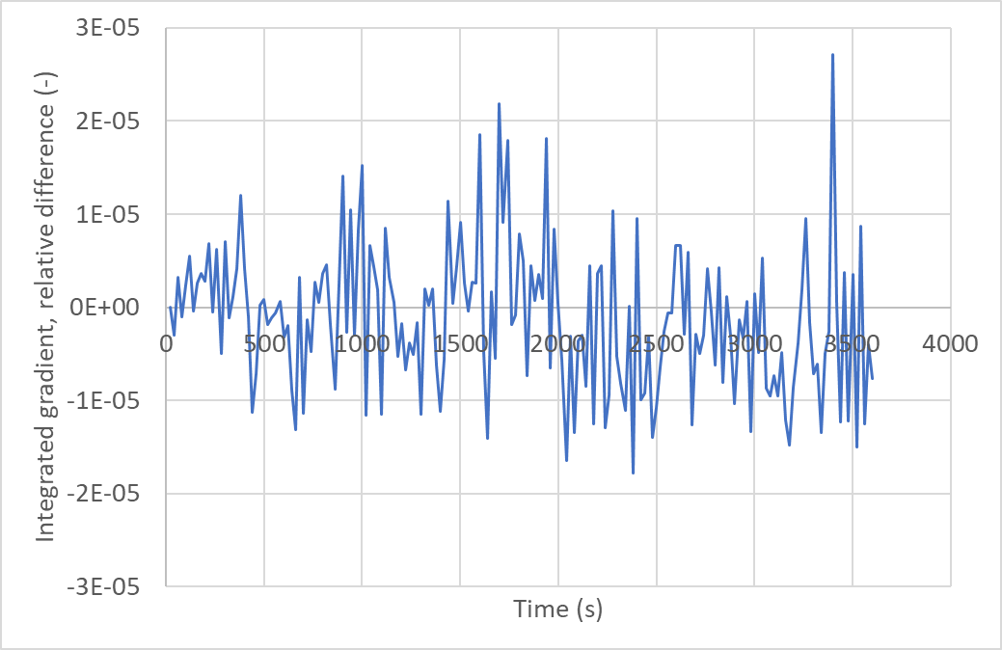
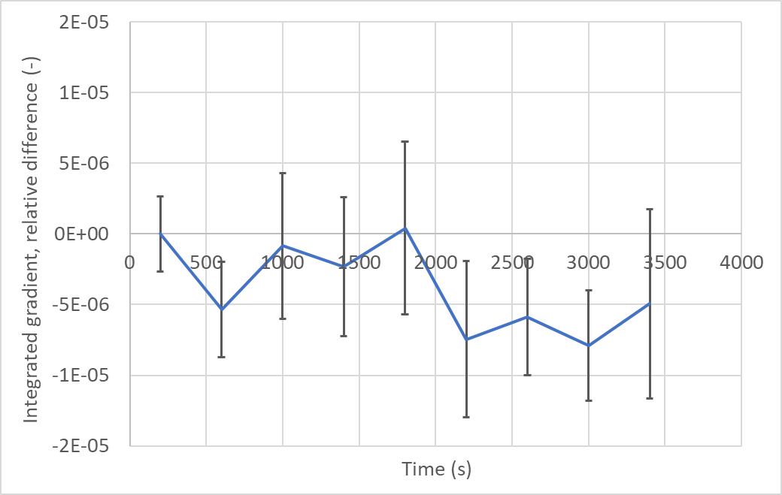

Stability of main field at nominal
Plateau of 1 hour measured with stretched wire
  Average of 20 measurements
  Error bars ±3 sigma
Field stability better than ±0.5 10⁻⁵
(limited by measurement precision)

Slide 15
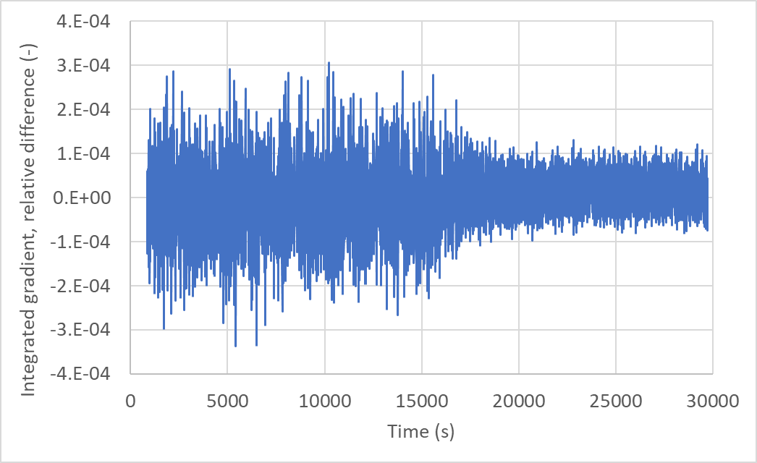
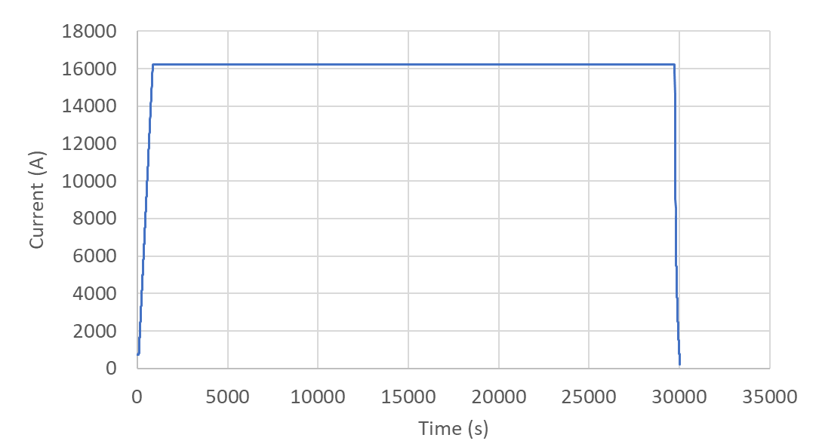
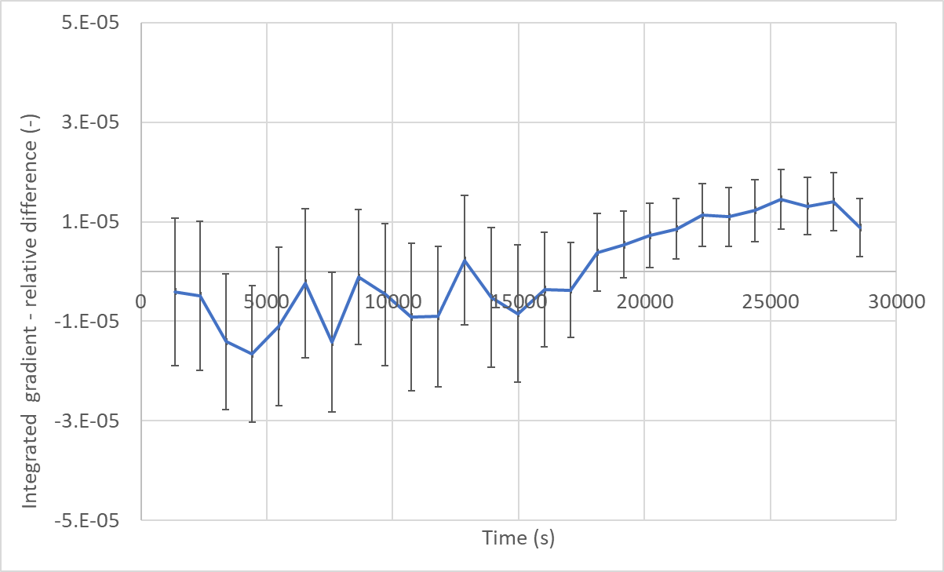
Stability of main field at nominal
  Plateau of 8 hours at nominal with rotating coils
  Average of 100 measurements
  Error bar ±3 sigma
  Field stability better than ±1 10⁻⁵
  (limited by the measurement precision)

Slide 16
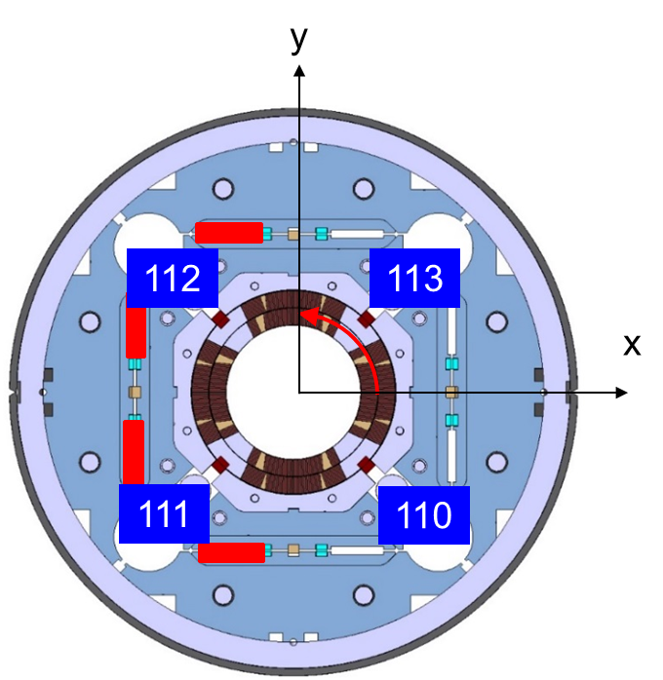
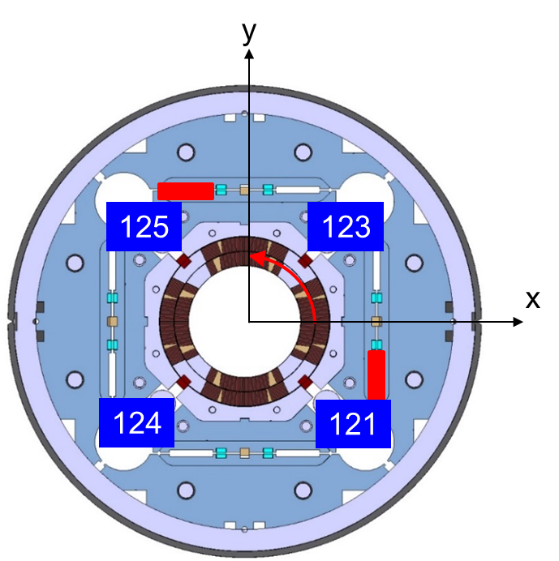
Magnetic shimming
MQXFBP2
Computed correction
Order | b_{n} | a_{n}
3 | -3.37 | 0.00
4 | 0.00 | 0.00
5 | -0.11 | 0.00
MQXFB02
Computed correction
Order | b_{n} | a_{n}
3 | 1.90 | -1.90
4 | 0.00 | 0.52
5 | 0.27 | 0.27

Slide 17
Integral field quality at nominal
 | MQXFBP2* |  | MQXFBP3 |  | MQXFB02 |  | MQXFB03 |  |  | Average |  |  |  | STD
n | bn | an | bn | an | bn | an | bn | an |  | n | bn | an |  | n | bn | an
3 | 1.11 | -1.71 | -1.08 | -0.23 | -0.15 | 0.46 | 1.61 | 0.27 |  | 3 | 0.37 | -0.30 |  | 3 | 1.22 | 0.98
4 | 0.93 | 1.25 | 0.40 | -0.88 | -0.39 | -0.79 | 1.04 | 0.55 |  | 4 | 0.49 | 0.03 |  | 4 | 0.65 | 1.04
5 | -0.20 | 1.43 | 0.23 | -1.50 | 1.21 | 0.97 | -1.01 | 0.47 |  | 5 | 0.06 | 0.34 |  | 5 | 0.92 | 1.29
6 | 0.32 | -0.04 | -0.95 | -0.27 | 0.15 | 0.22 | -1.39 | 0.57 |  | 6 | -0.47 | 0.12 |  | 6 | 0.83 | 0.36
7 | 0.26 | -0.27 | -0.67 | 0.61 | -0.47 | 0.04 | -0.08 | 0.15 |  | 7 | -0.24 | 0.13 |  | 7 | 0.41 | 0.36
8 | 0.02 | 0.06 | 0.17 | 0.25 | -0.19 | 0.16 | 0.02 | 0.13 |  | 8 | 0.00 | 0.15 |  | 8 | 0.15 | 0.08
9 | 0.23 | -0.11 | 0.08 | -0.14 | -0.24 | 0.05 | -0.01 | 0.06 |  | 9 | 0.02 | -0.03 |  | 9 | 0.20 | 0.10
10 | -0.34 | 0.03 | -0.41 | -0.03 | -0.18 | 0.01 | -0.54 | 0.01 |  | 10 | -0.37 | 0.00 |  | 10 | 0.15 | 0.02
11 | 0.01 | -0.03 | -0.09 | 0.06 | 0.01 | 0.00 | -0.01 | -0.02 |  | 11 | -0.02 | 0.00 |  | 11 | 0.05 | 0.04
12 | 0.06 | 0.01 | -0.05 | 0.00 | -0.01 | 0.02 | -0.02 | 0.07 |  | 12 | -0.01 | 0.03 |  | 12 | 0.05 | 0.03
13 | -0.05 | -0.03 | -0.02 | 0.00 | 0.00 | 0.01 | 0.00 | 0.00 |  | 13 | -0.02 | 0.00 |  | 13 | 0.02 | 0.02
14 | -0.92 | 0.03 | -0.90 | 0.01 | -0.87 | 0.01 | -0.85 | 0.01 |  | 14 | -0.89 | 0.02 |  | 14 | 0.03 | 0.01
15 | 0.00 | -0.01 | -0.01 | 0.00 | 0.01 | 0.00 | 0.00 | -0.01 |  | 15 | 0.00 | 0.00 |  | 15 | 0.01 | 0.01
  Field quality fully under control for both systematic and random components.

Slide 18
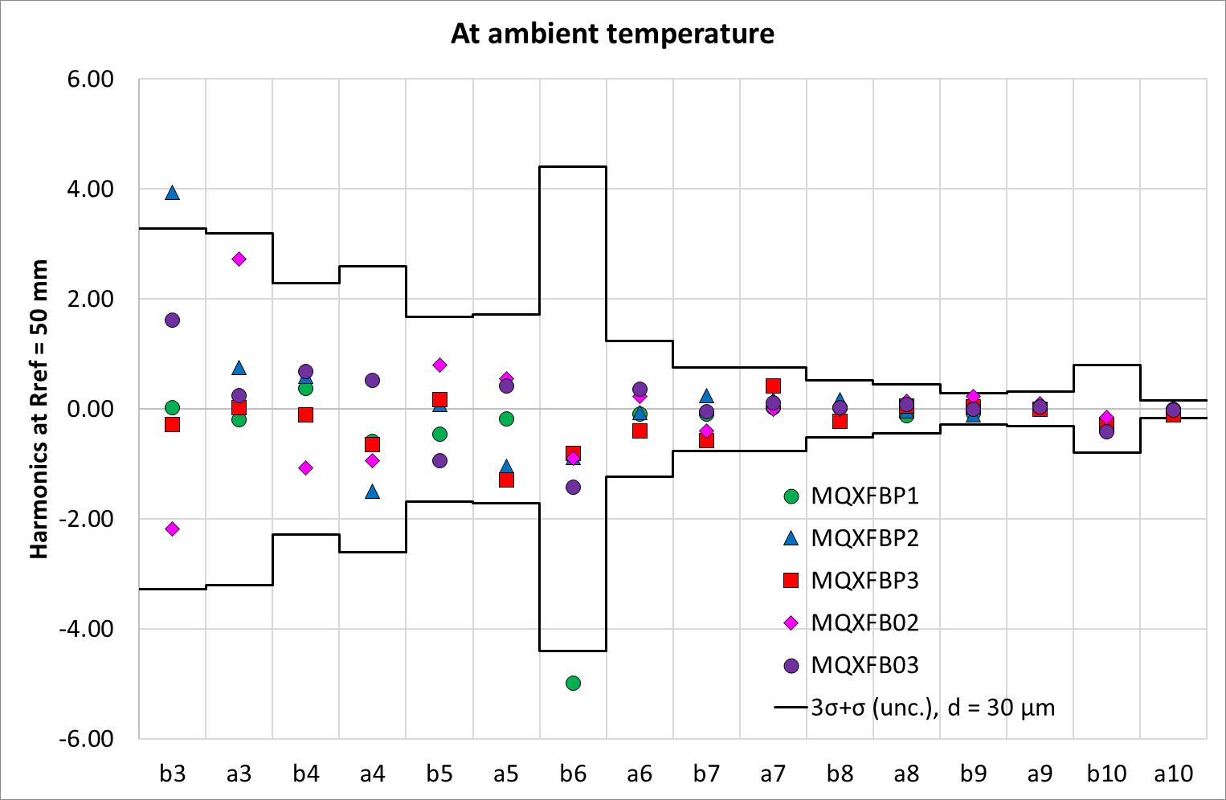
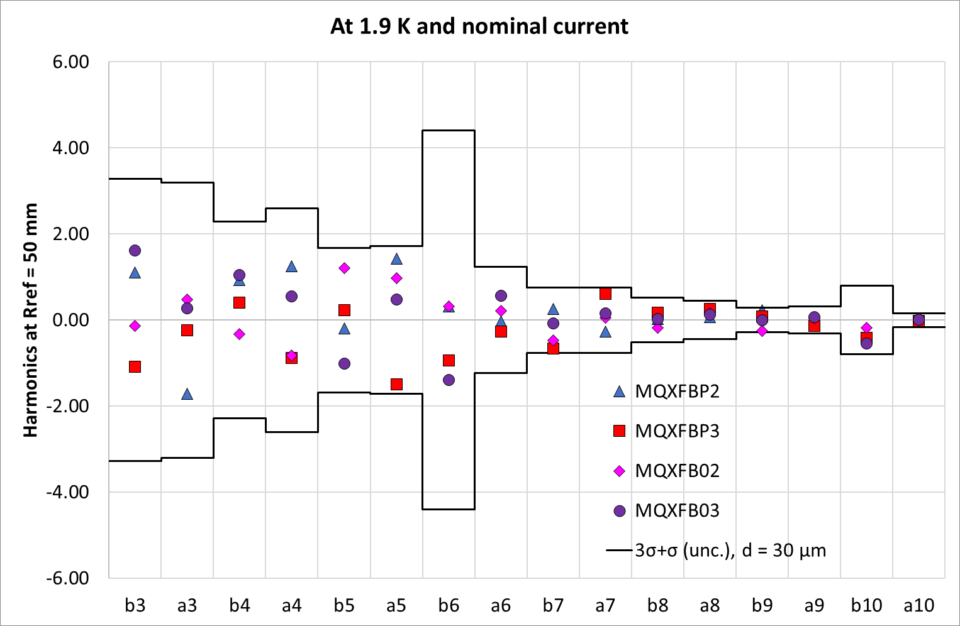
Integral field quality
  Multipole corrected by applying magnetic shimming
  Systematic b6 corrected by modifying the coil shims
  Field quality well within the expected range

Slide 19
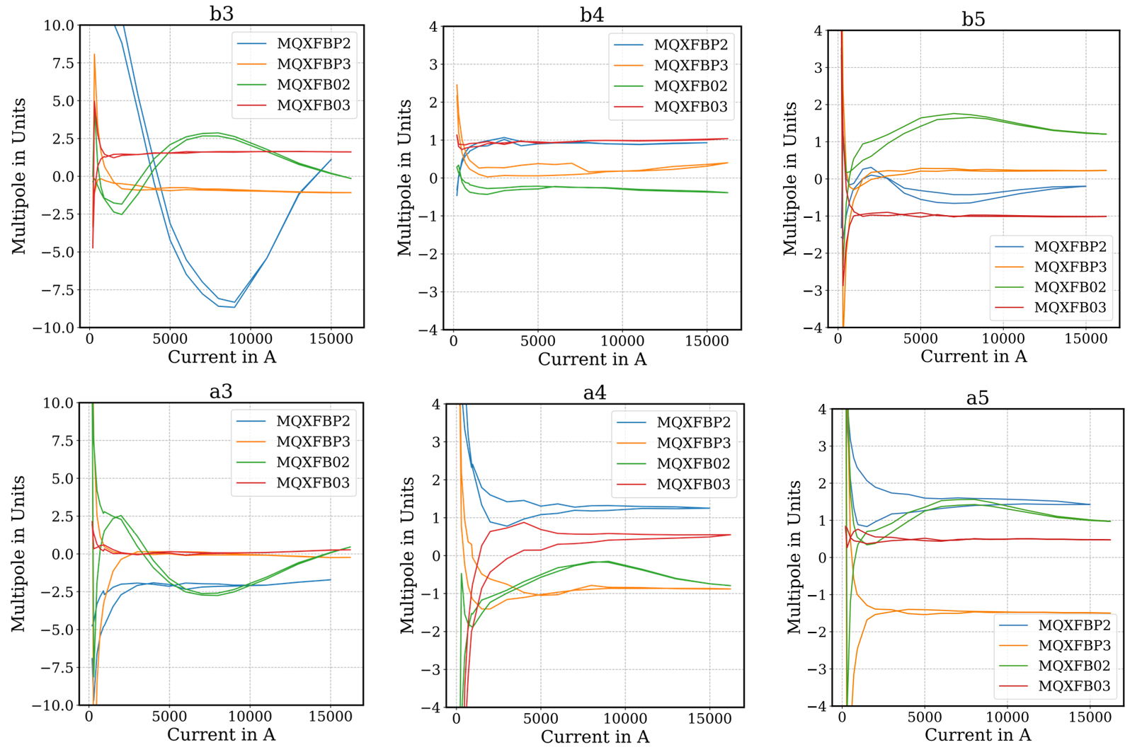
Multipoles vs current

Slide 20
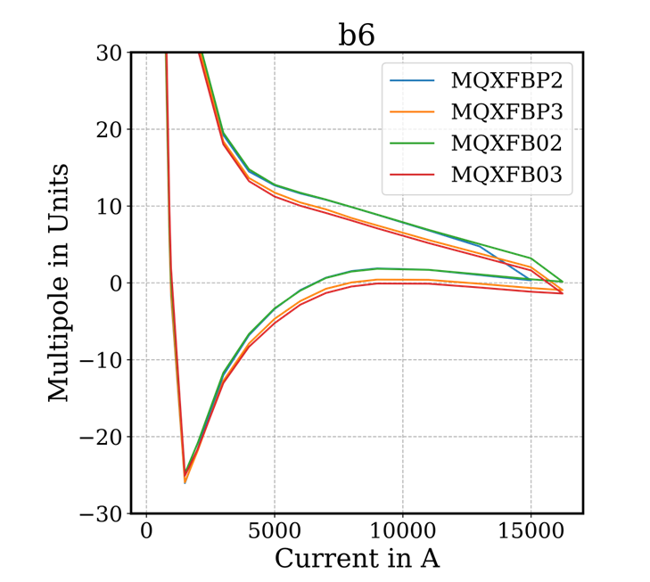
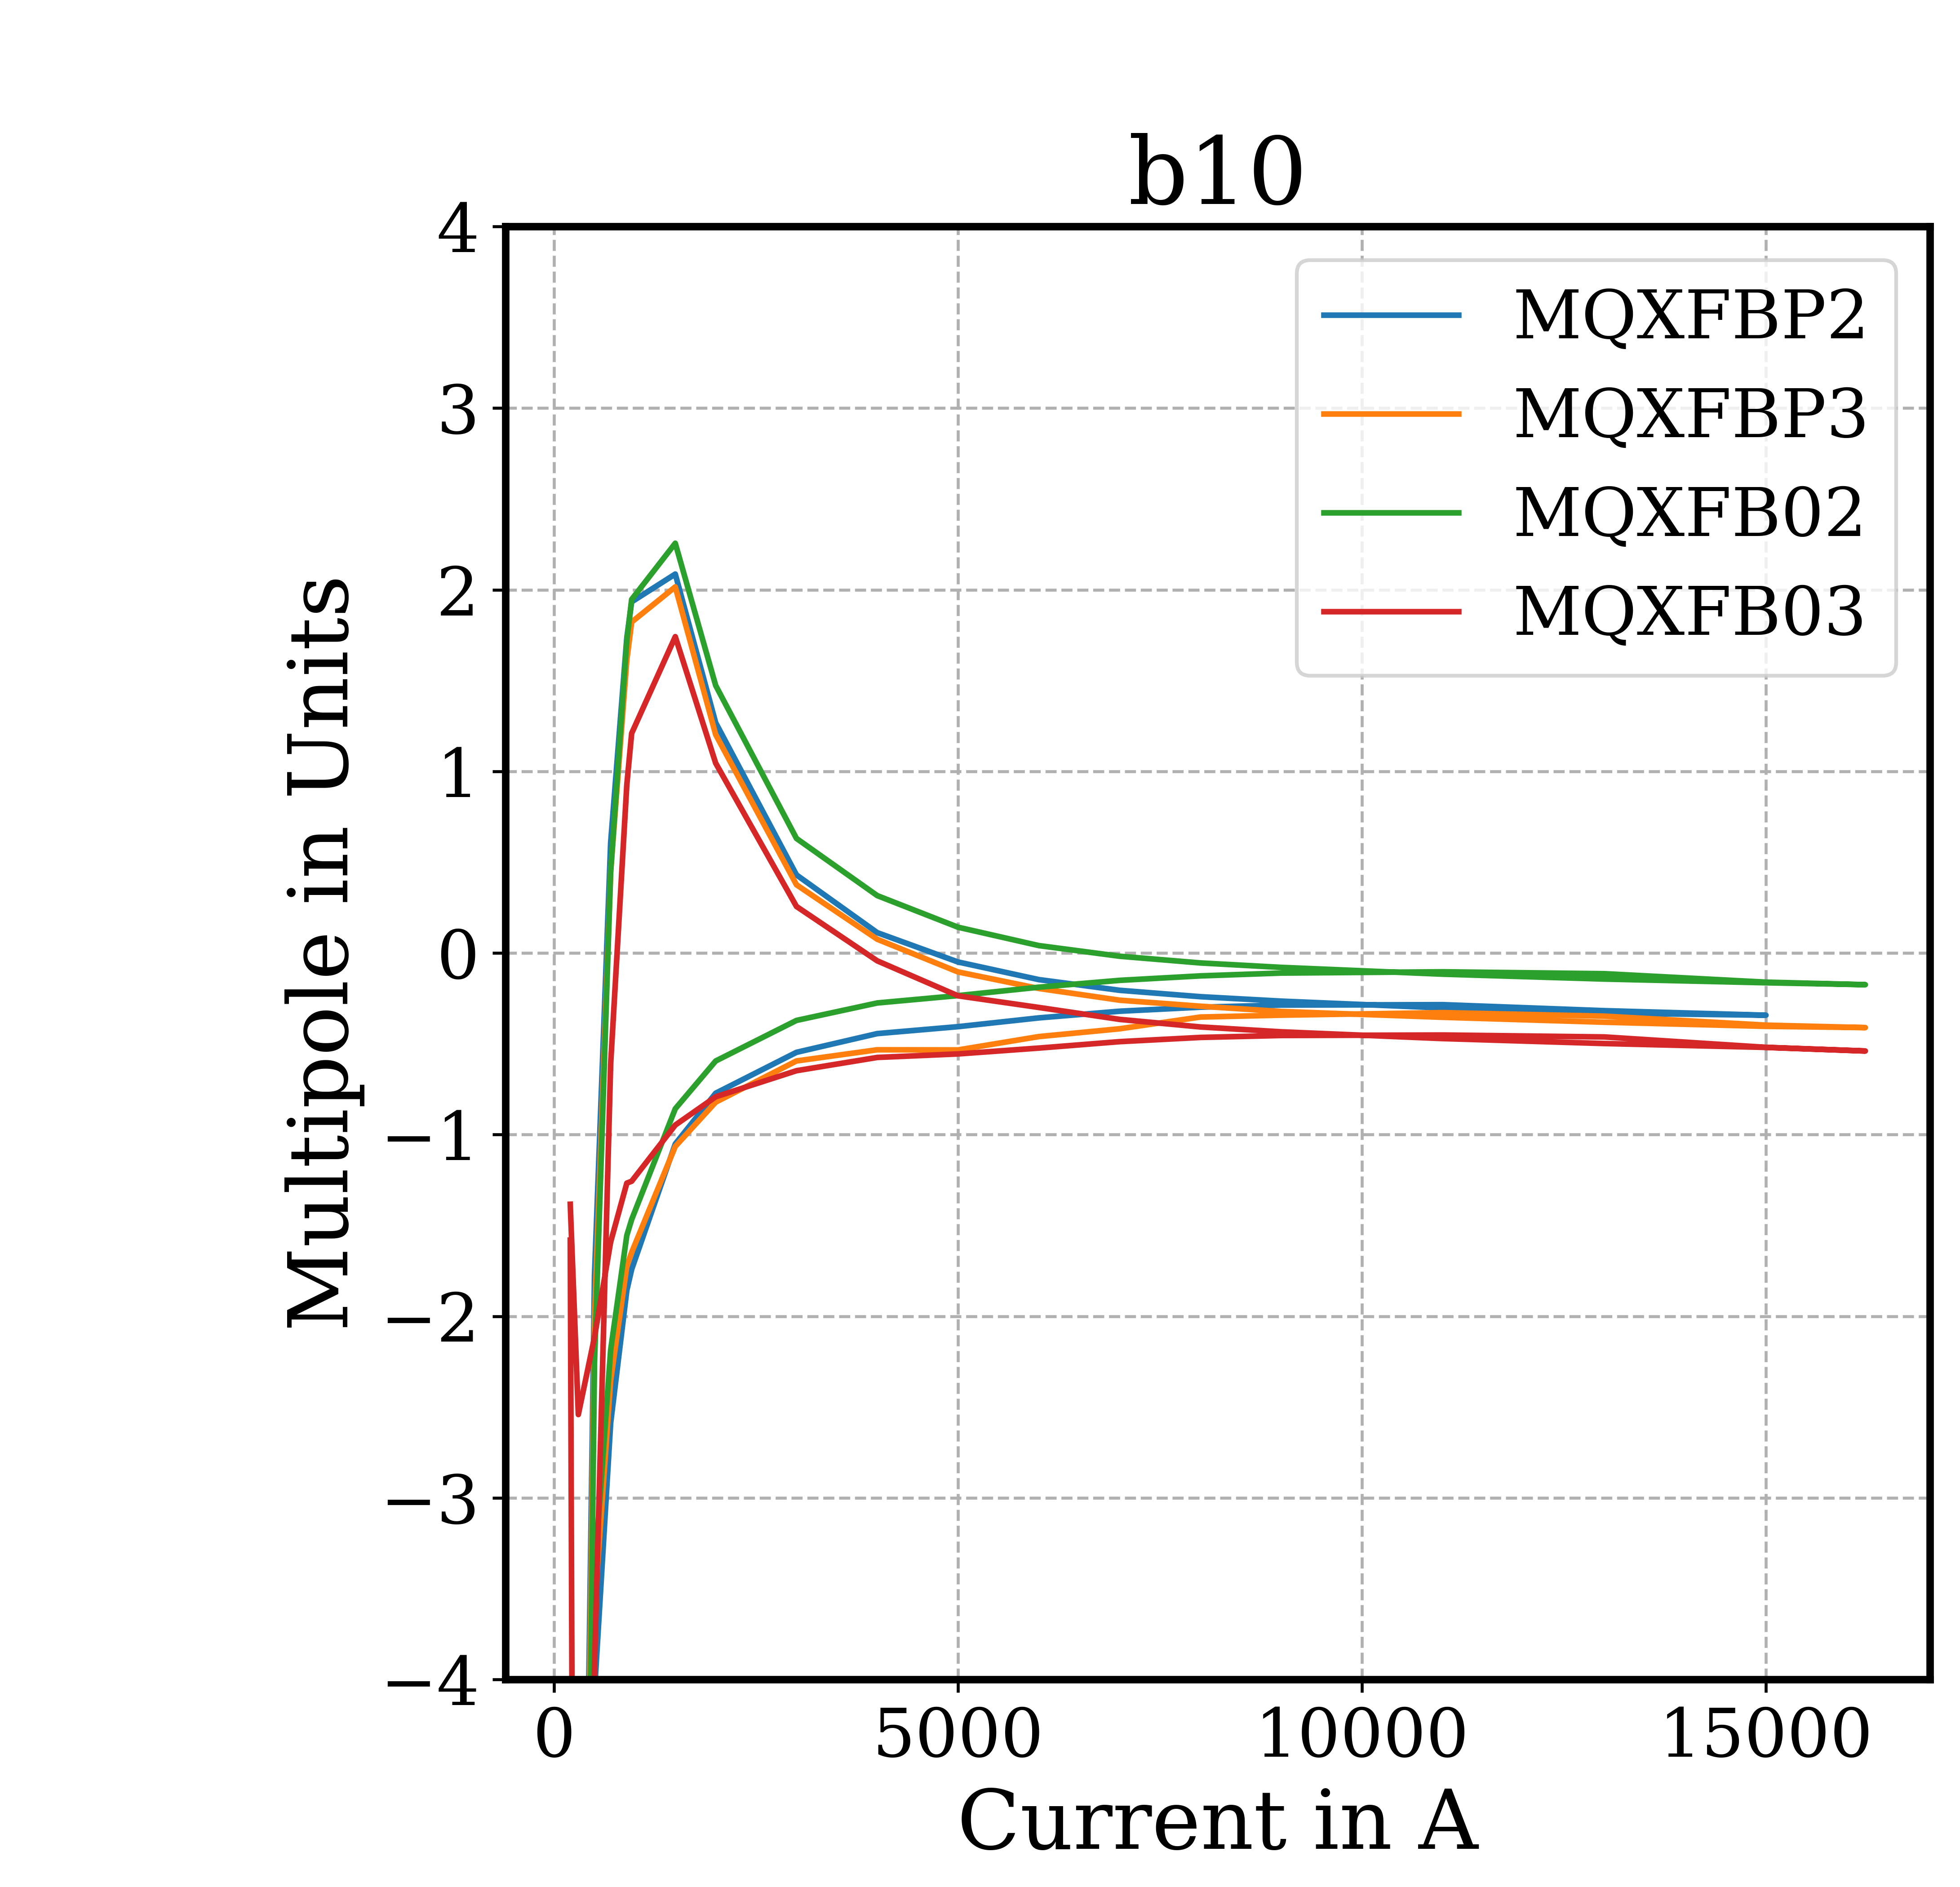
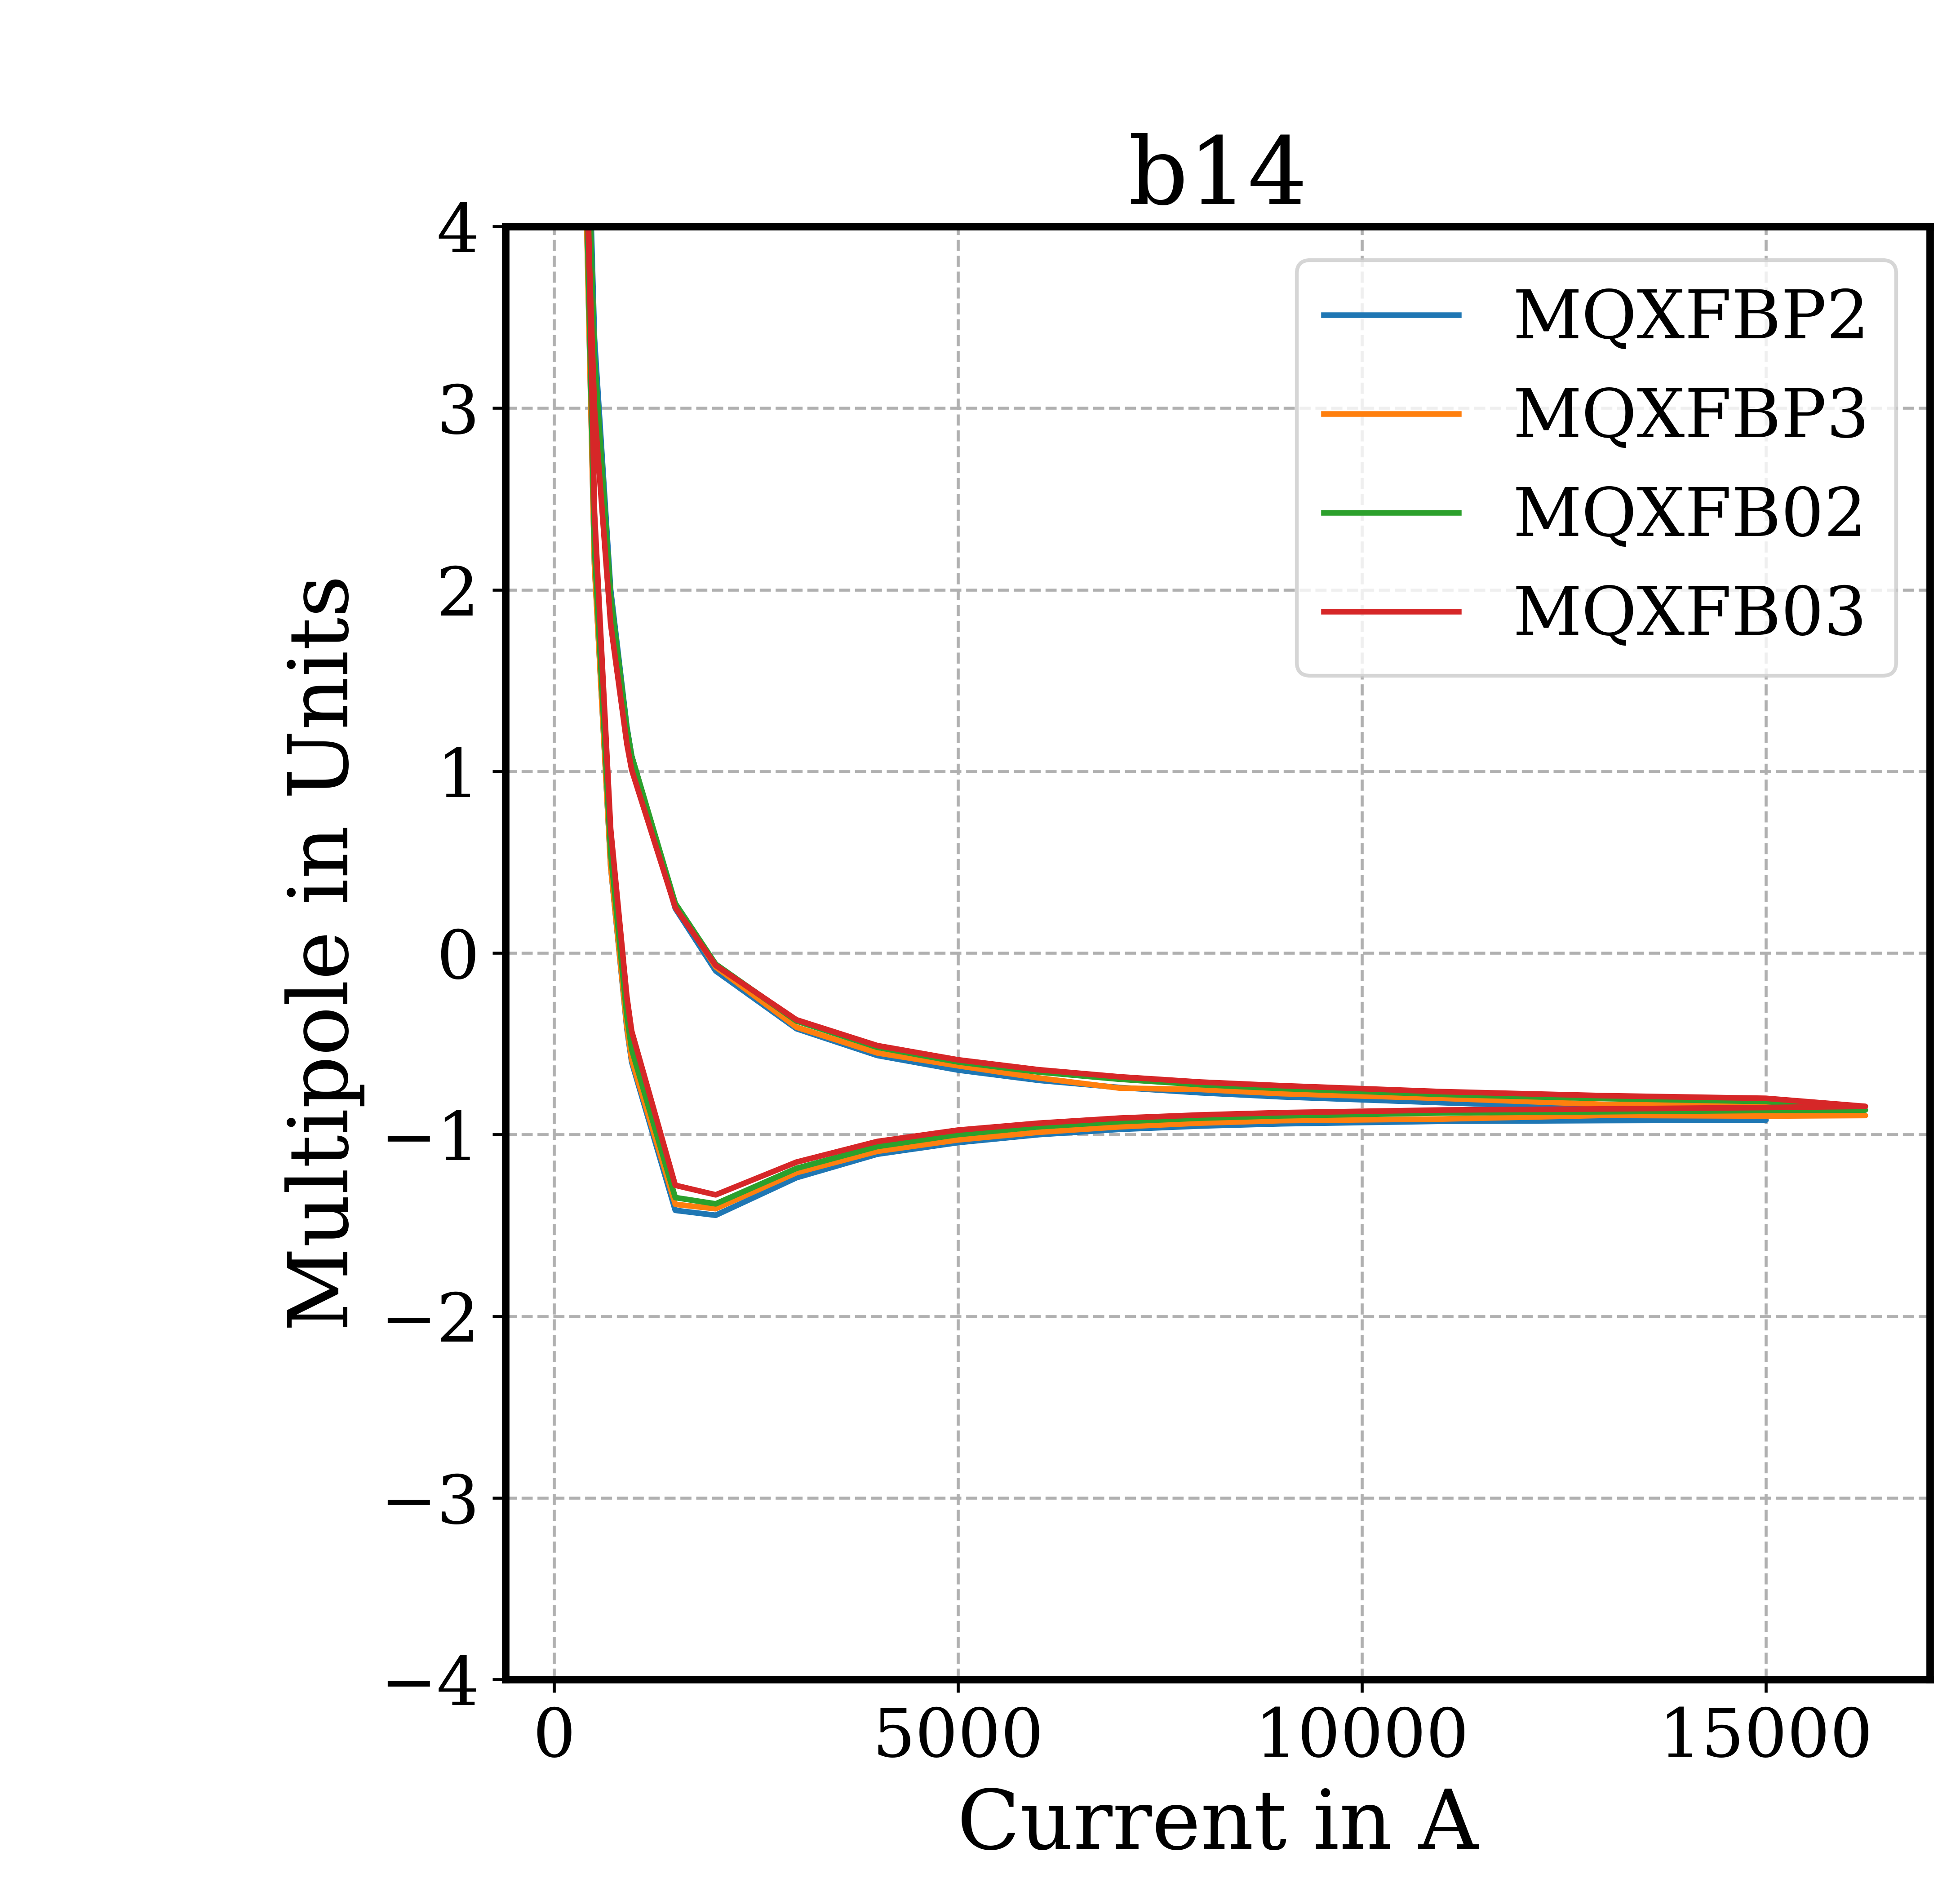
Allowed multipoles vs current

Slide 21
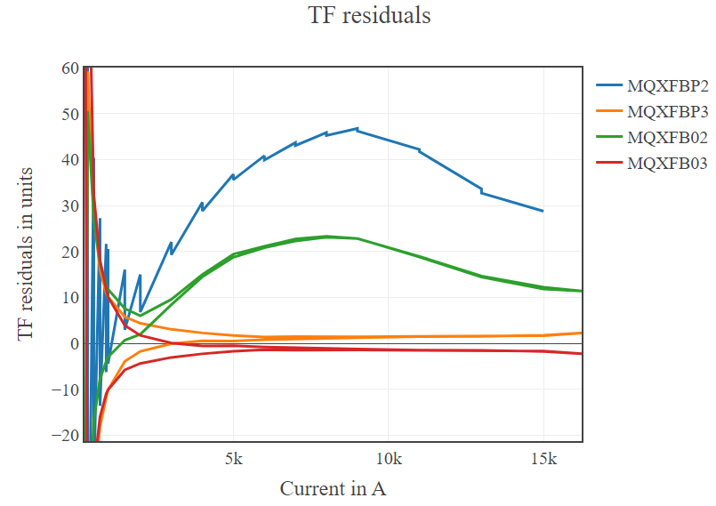
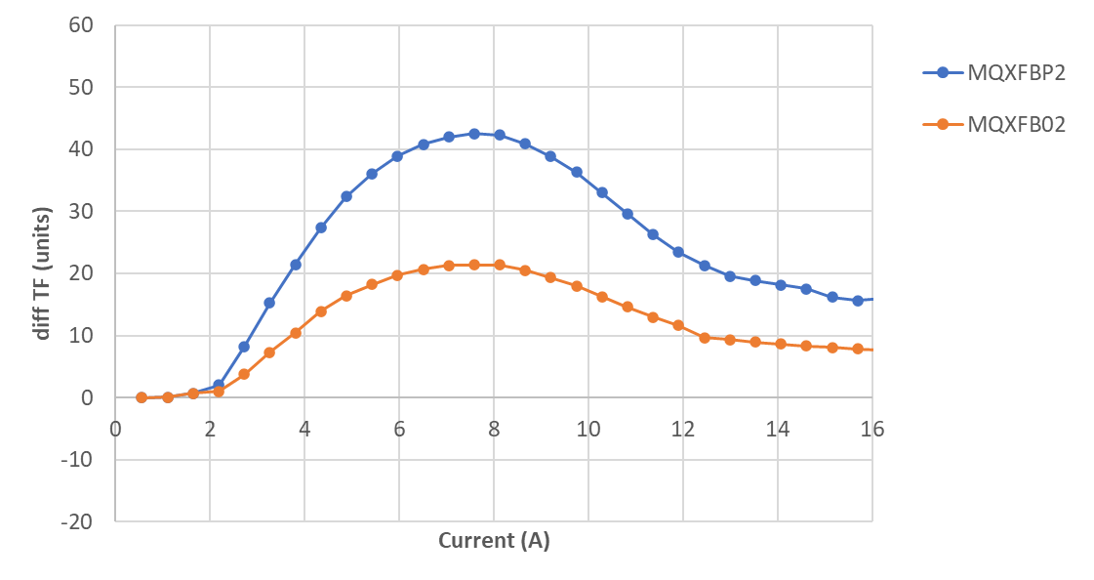
Effect of magnetic shimming on the TF
Calculations
Measurements
  Magnetic shimming has a slight effect on the main field (~10 units).
  To be taken into consideration when the shimming is evaluated.

Slide 22
Additional results
Not important for the MQXFB but interesting for the understating of NB₃Sn technology

Slide 23
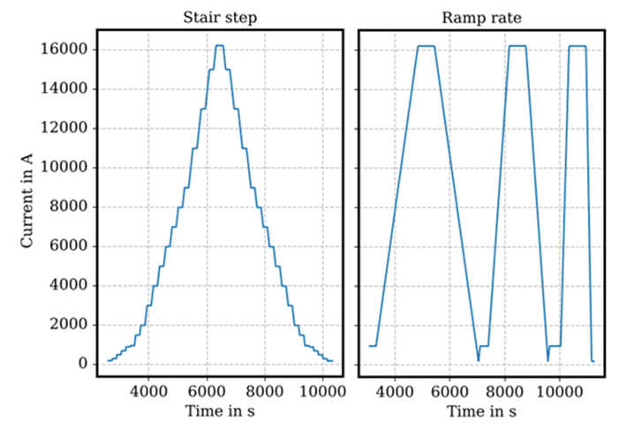
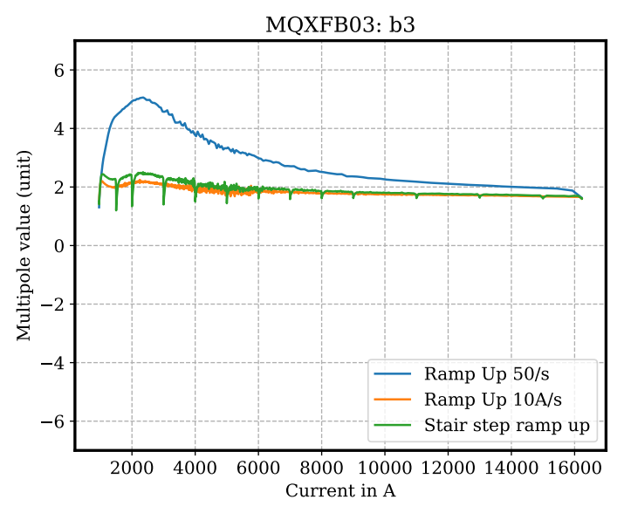
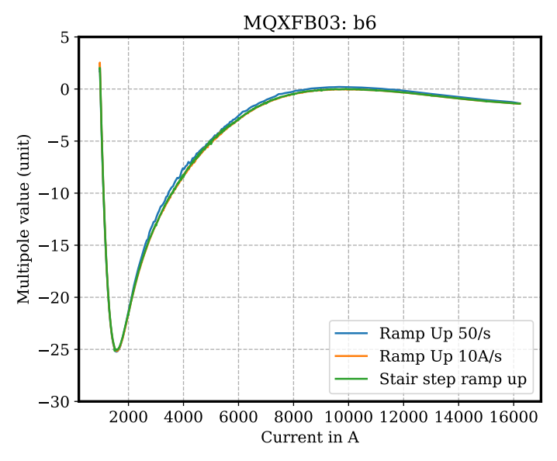
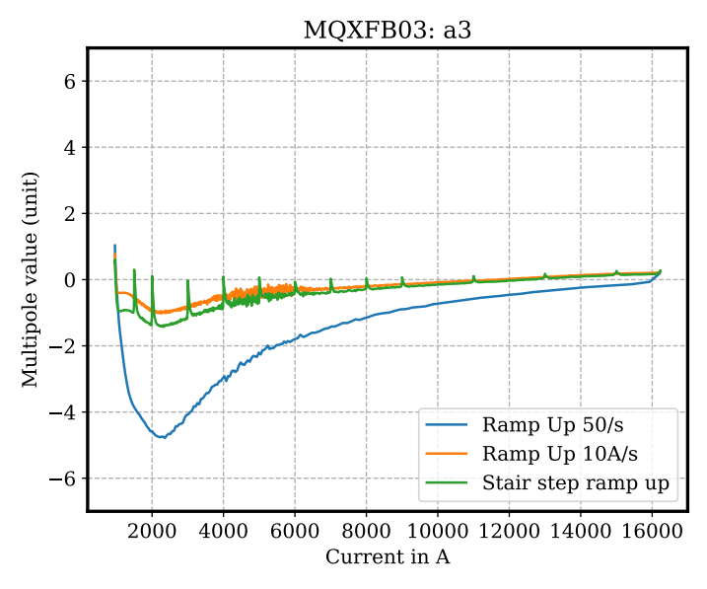
Ramp-rate effects
  Some dynamic effect due to induced currents are visible.
  The effect can vary from magnet to magnet and along the same magnet.
  Overall, it is a small effect (~1 unit).
  Much larger ramp rate to see significant effects
  (50 A/s vs 14 A/s)

Slide 24
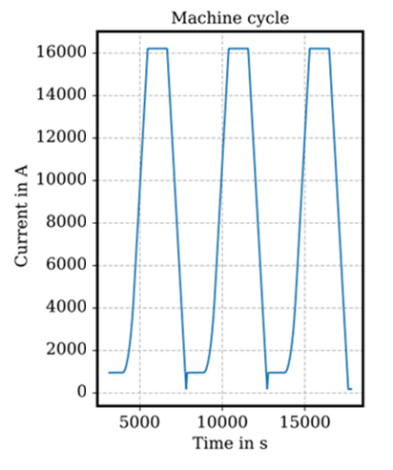
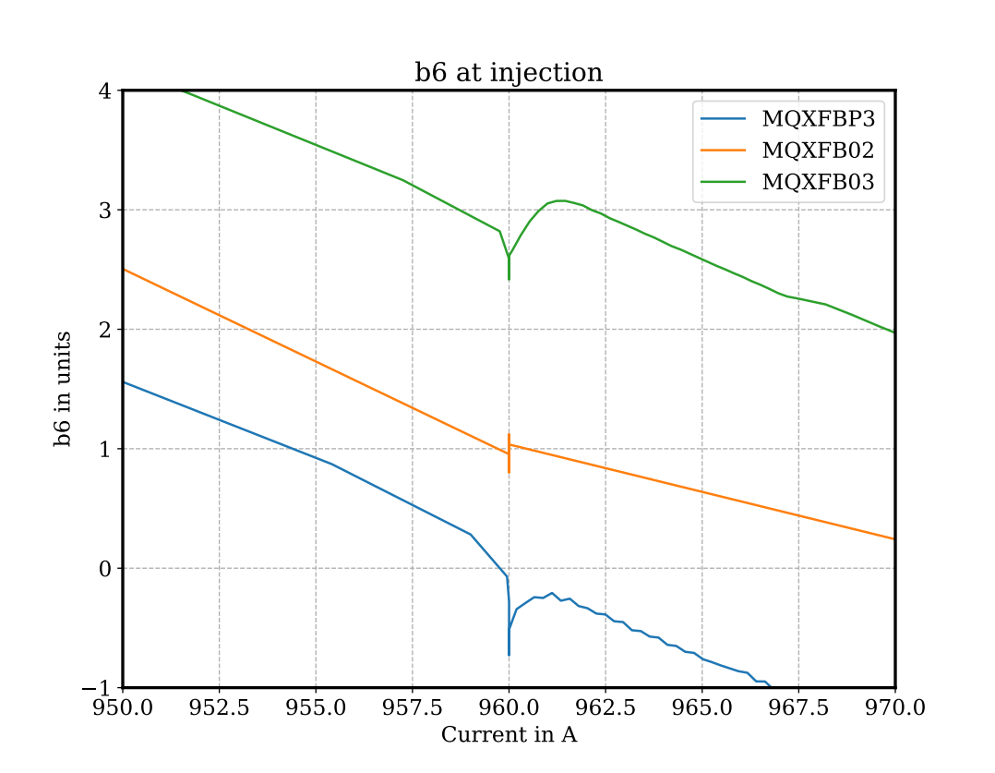
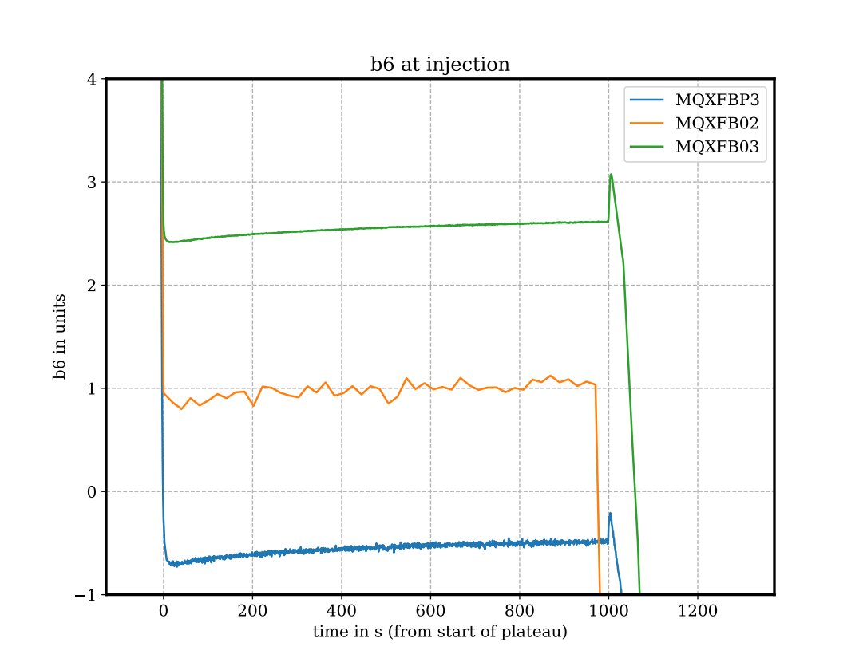
Dynamic effects at injection level
  The decay during the injection plateau, and the subsequent snapback, is ~10 times smaller than NbTi magnets.
Decay and Snapback in Nb3Sn Dipole Magnets
10.1109/TASC.2016.2633980

Slide 25
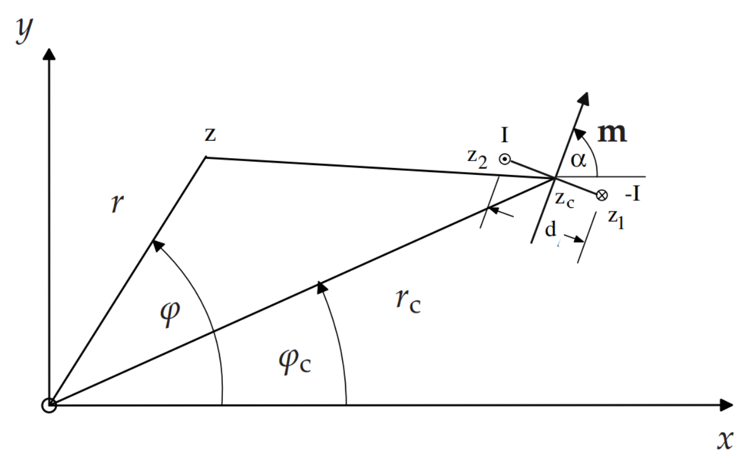
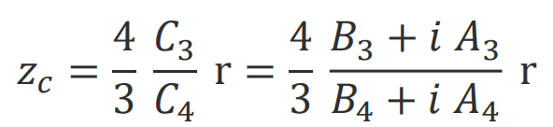
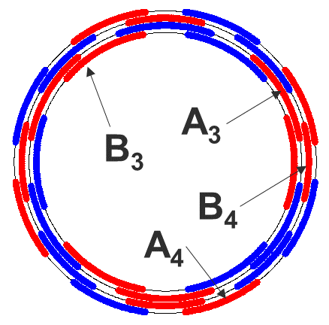
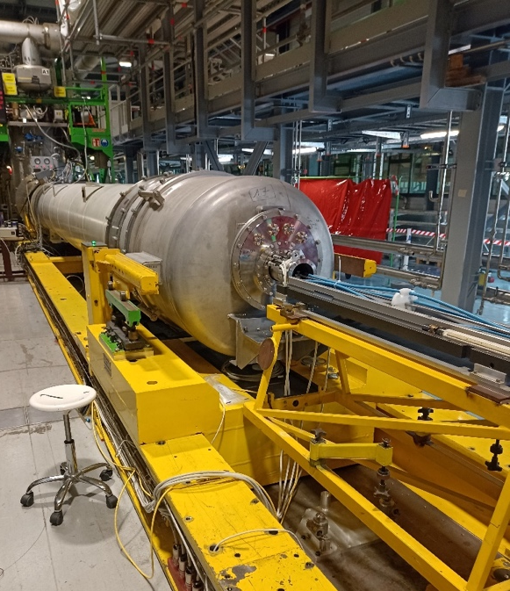
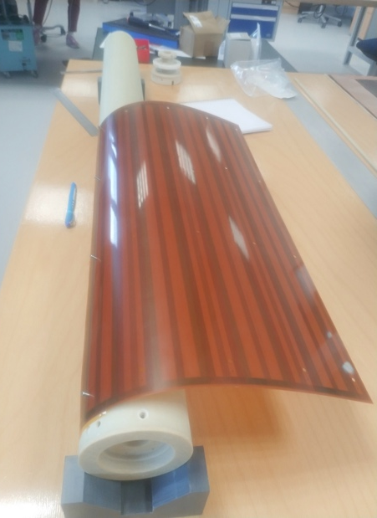
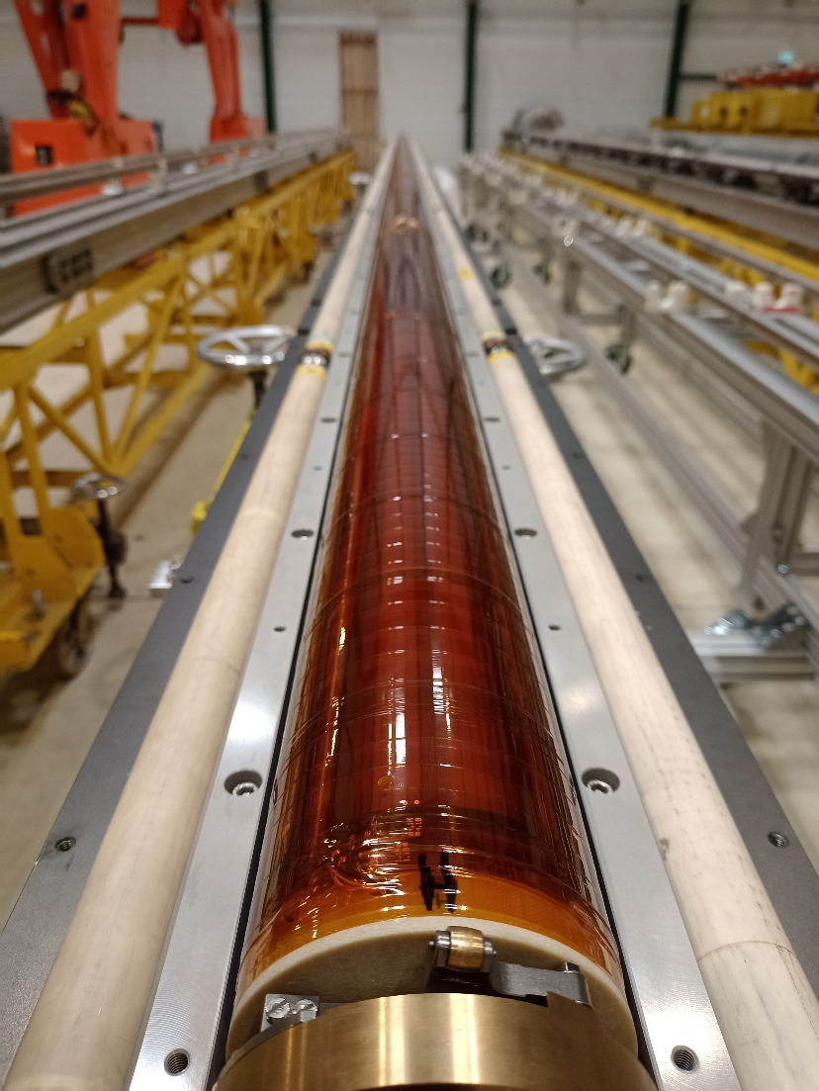

Quench antenna
Magnetic moment
600 mm
314 mm
Quench antenna development at CERN
Instrumentation and Diagnostics for Superconducting Magnets Workshop (IDSM)

Slide 26


Slide 27

Quench antenna to measure flux-jumps
  The instrument is suitable for the measurement of flux-jumps in terms of magnitude, direction, position, propagation, and impact on field quality (work in progress…).

Slide 28
Conclusions
Main results of magnetic tests on MQXFB’s
  5 magnets already measured at 1.9 K
  A comprehensive set of results is available
  Transfer function within 25 units
  Multipoles within specifications
Thank you!

