Slide 1



MQXFA fabrication status and schedule
Giorgio Ambrosio,
with contributions from the whole MQXFA team

Slide 2
Acknowledgement
US HL-LHC Accelerator Upgrade Project (AUP)
  BNL: K. Amm, M. Anerella, A. Ben Yahia, H. Hocker, P. Joshi, F. Kurian, J. Muratore, J. Schmalzle, , P. Wanderer
  FNAL: G. Ambrosio, G. Apollinari, M. Baldini, J. Blowers, R. Bossert, R. Carcagno, G. Chlachidze, J. DiMarco, S. Feher, S. Krave, V. Lombardo, C. Narug, A. Nobrega, V. Marinozzi, C. Orozco, T. Page, S. Stoynev, T. Strauss, M. Turenne, D. Turrioni, A. Vouris, M. Yu
  LBNL: D. Cheng, P. Ferracin, L. Garcia Fajardo, E. Lee, M. Marchevsky, M. Naus, I. Pong, S. Prestemon, K. Ray, G. Sabbi, G. Vallone, X. Wang
  NHMFL: L. Cooley, J. Levitan, J. Lu, R. Walsh
CERN: HL-LHC Project
  G. Arnau Izquierdo, A. Ballarino, M. Bajko, C. Barth, N. Bourcey, B. Bulat, M. Cruovizier, A. Devred, H. Felice, S. Ferradas Troitino, L. Fiscarelli, J. Fleiter, M. Guinchard, O. Housiaux, S. Izquierdo Bermudez, N. Lusa, F. Mangiarotti, A. Milanese, A. Moros, P. Moyret, C. Petrone, J.C. Perez, H. Prin, R. Principe, E. Ravaioli, T. Sahner, S. Sgobba, P. Tavares Coutinho Borges De Sousa, E. Todesco, J. Ferradas Troitino, R. Van Weelderen, G. Willering

Slide 3
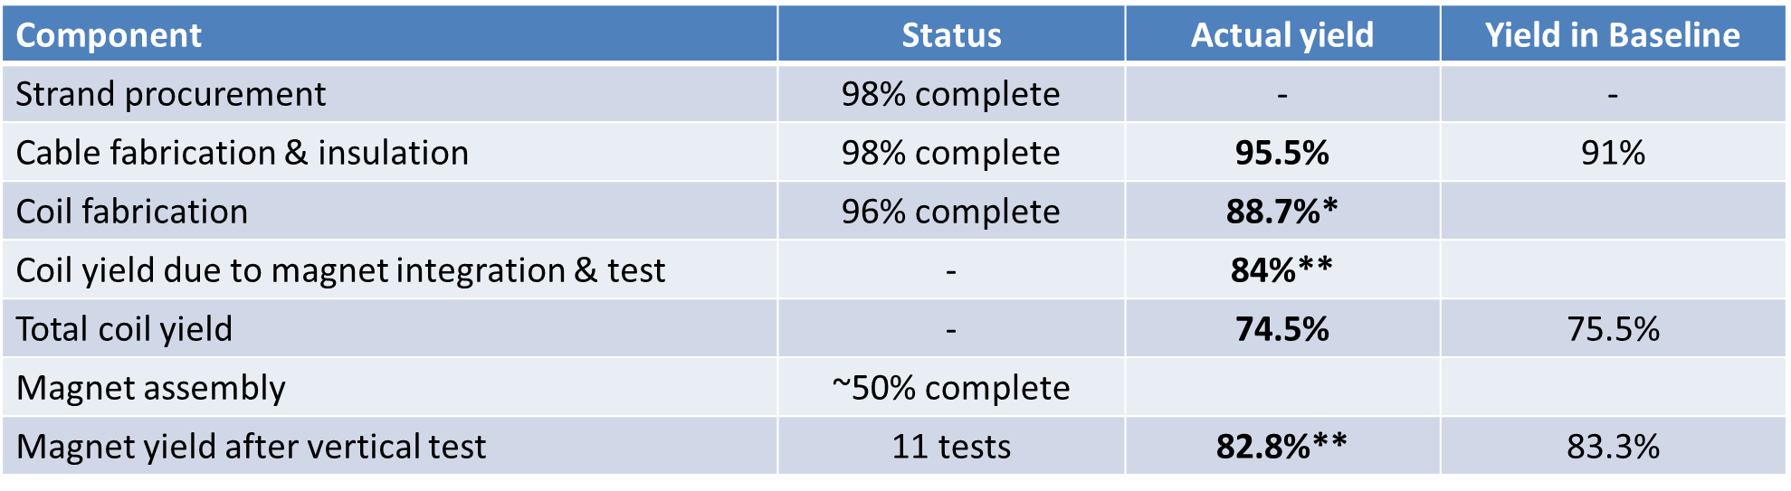
Outline
The Big Picture
Status and Inventory of each component
Additional magnet
Conclusions

Slide 4
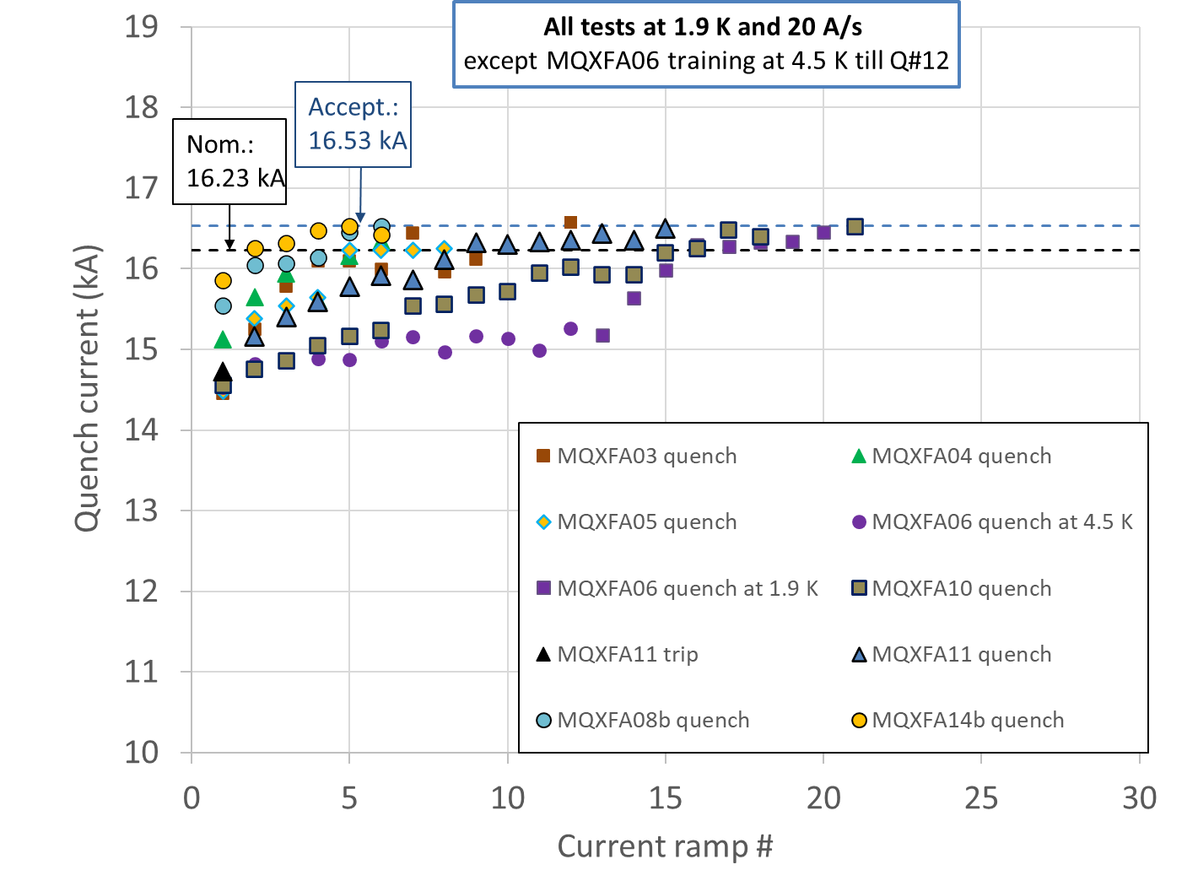
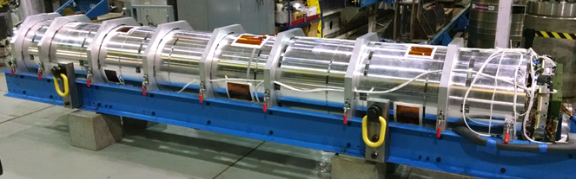
The Big Picture
MQXFA magnets
Tested: 11
Met Requirements: 8
Did not meet requir.: 3
Waiting for test: 1
Being assembled: 2
MQXFA at BNL after shipment from LBNL

Slide 5
Conductor Procurement & QC
Conductor delivery:
  ~98% conductor received (out of 260 km, including LARP proc.)
  Last shipment (40 km) expected in September 2023
  Some spools that were reworked received extra lubricant, and impacted cable stability (see next slide)
Status
  Strand verification 98% complete
  Cable qualification 100%
  Witness Sample tests ~94%
Inventory (after BL components are complete):
  60 km of strand to be received by B-OST (replacement)
  Dates under discussion, possibly ~end of 2024

Slide 6
Cable Fabrication & Insulation
Cable Fabrication & Insulation Status:
  Fabricated: 111 (+ 4 from LARP)
  To be fabricated: 2
Cable yield:
  Yield is 95.5% (4 rejected, 2 on-hold), vs. 91% assumed in Baseline
    Some cables (5) were on-hold because of strand lubrication issue causing cable mechanical instability
      Coil fabrication teams (at FNAL and BNL) were able to fix all popped strands and wind 4 coils
Inventory (after BL components are complete):
  6 cables (1 of them with excessive oil issue)

Slide 7
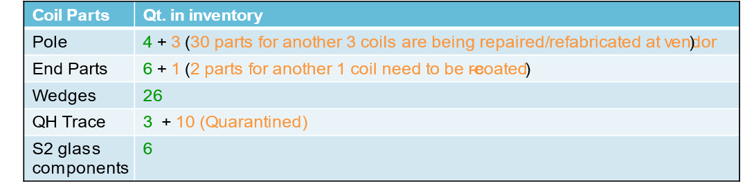
Coil Parts
All procurements have been completed
  With the exception of some parts that were rejected
Inventory (after BL components are complete):
  Full set for 6 coils after receiving repaired/re-fabricated parts

Slide 8

Coil Fabrication at FNAL & BNL
Coil fabrication is 95% complete (out of 106 coils)
*
*The actual yield includes the sum of the probabilities of using coils on hold (i.e. 2 coils with 50% probability of being used = 1 coil approved for use).
Coil fabrication yield was lower in first years of production
  For instance: ~80% in October 2020
Effect of learning curve is visible in ~second half of coil fabrication
Similar improvement is expected in coil yield for integration & test

Slide 9
Overall Coil Yield
Final coil yield will depend on yield after magnet integration and test
Improvement due to learning curve is expected
  More coils will be needed if expectation is not met
**MQXFA07 and MQXFA08 coils and magnets were fabricated under Covid restrictions. AUP project was re-baselined assuming that 66% of MQXFA07 and MQXFA08 limited performances were due to the impact of Covid restrictions. These issues assumed to be Covid impact were not included in the actual yield.
This yield assumes recovery of 33% coils on hold after integration and test

Slide 10
Coil Inventory
Inventory (after 20 magnets):
Some coils on hold are expected to be used
  Low risk coils
  A few coils previously on hold have already been used
  Some coils previously on hold are in MQXFA15
Other coils on hold will remain in inventory
  Mid and high risk coils
If needed, more coils may be fabricated using cables and parts in inventory, and budget in risk register for labor

Slide 11
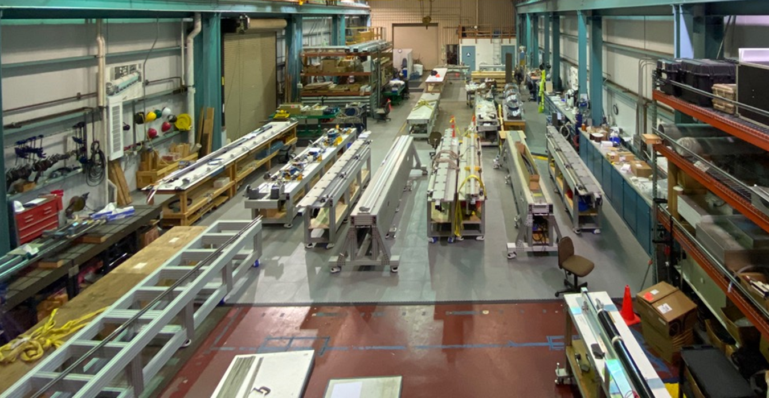
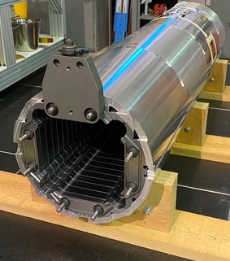
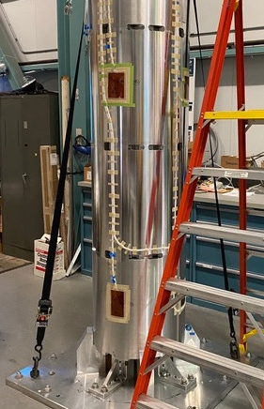
MQXFA Structure Proc. & Magnet Assembly
Procurement of main parts is complete
Two assembly lines at LBNL are fully operational
  staggered mode
15 magnets have been assembled
  11 tested (8 successful, 2 reworked, 1 to be reworked)
  2 disassembled for NCRs
  1 preload adjustment based on lessons learned from MQXFA13
  1 ready for test (MQXFA07b)
Assemblies of MQXFA16 and MQXFA17 are in progress.
FMEA performed for Magnet Assembly Travelers
More details on Thursday in MQXFA, magnet assembly and preload by Dan Cheng
Two MQXFA assembly lines at LBNL
MQXFA shell-yoke assembly in process

Slide 12
Plans and Schedule
Plans for magnet assembly:
  MQXFA07b is at BNL for test
  MQXFA15 preload adjustment in ~3 weeks after MQXFA16 is complete
  MQXFA16 & MQXFA17 have high priority for test in CA05 (no vertical test)
  MQXFA13b and MQXFA12b after them
  MQXFA09 was retired
    2 coils and structure reused in other magnets
    ➔ last magnet = MQXFA23
Working Schedule
  August update:

Slide 13
Additional MQXFA magnet
Negotiation in progress for acceptance by CERN of CA01 with an additional magnet
  MQXFA24
Coil fabrication could start tomorrow (after BCR is approved) because we have cables and coil parts in house
But it would “empty” the inventory
Therefore, we will have to add cables, coil parts, structure components and possibly strand (?)

Slide 14
Conclusions
The fabrication of MQXFA magnets by US-AUP is at peak production rate.
  Strand procurement, Cable fabrication, Coil fabrication are almost complete
  Magnet assembly is close to 50% complete
Three magnets out of eleven did not meet requirements during vertical test. Lessons were learned and changes implemented.
  Magnet yield is expected to increase
Cable yield is higher than starting assumption, whereas coil yield is lower. Baseline was changed accordingly.
  Inventory for 6+ additional coils
Last magnet to be completed around beginning of 2025

Slide 15
Back up Slides

Slide 16
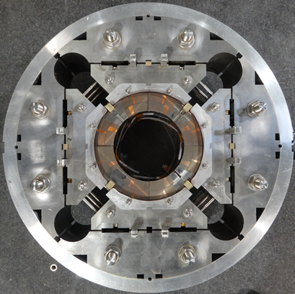
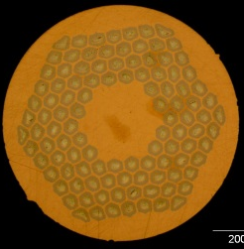
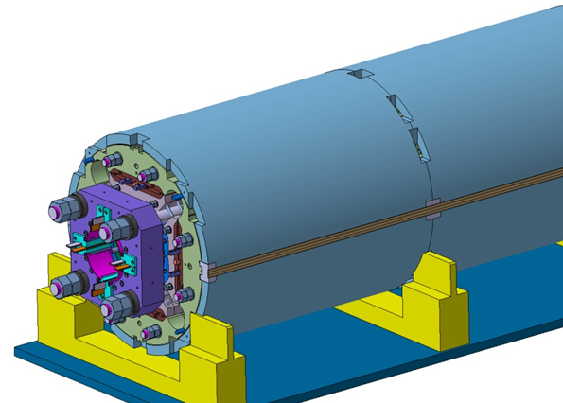
MQXFA/B Design
Parameter | Unit | MQXFA/B
Coil aperture | mm | 150
Magnetic length | m | 4.2/7.15
N. of layers |  | 2
N. of turns Inner-Outer layer |  | 22-28
Operation temperature | K | 1.9
Nominal gradient | T/m | 132.2
Nominal current | kA | 16.23
Peak field at nom. current | T | 11.3
Stored energy at nom. curr. | MJ/m | 1.15
Diff. inductance | mH/m | 8.26
Strand diameter | mm | 0.85
Strand number |  | 40
Cable width | mm | 18.15
Cable mid thickness | mm | 1.525
Keystone angle |  | 0.4
Nb₃Sn Conductor
RRP 108/127
P. Ferracin et al., “Development of MQXF, the Nb₃Sn Low-β Quadrupole for the HiLumi LHC ” IEEE Trans App. Supercond. Vol. 26, no. 4, 4000207
G. Ambrosio et al., “First Test Results of the 150 mm Aperture IR Quadrupole Models for the High Luminosity LHC” NAPAC16, FERMILAB-CONF-16-440-TD

Slide 17
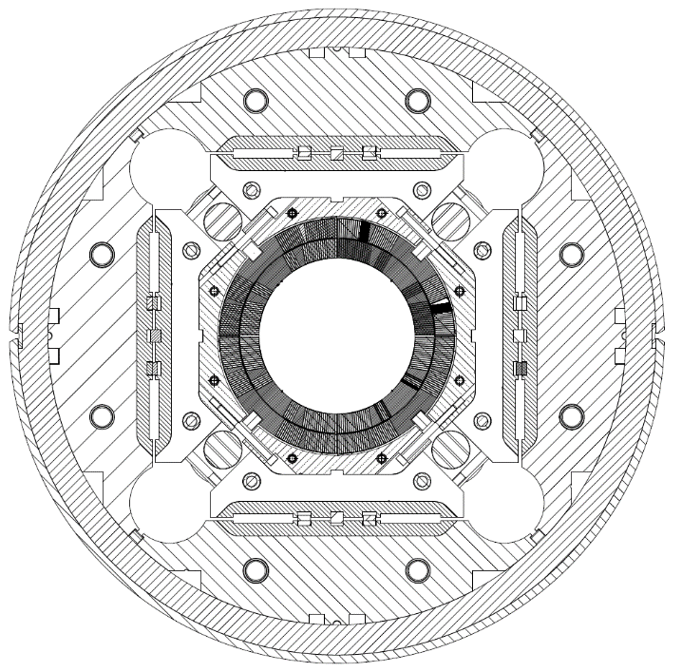
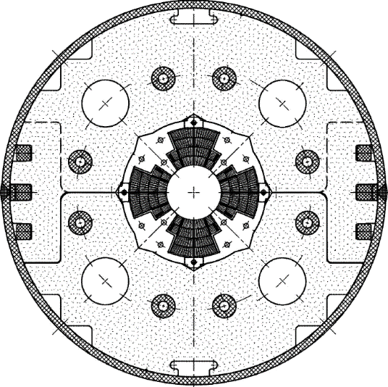
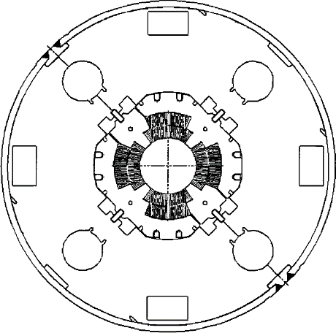
Low-β quadrupole magnets from LHC to HL-LHC
Cold mass OD from 490/420 to 630 mm
More than double the aperture: from 70 to 150 mm
~4 times the e.m. forces in straight section
~6 times the e.m. forces in the ends
State of the art quadrupoles at the time of LHC construction
MQXF
MQXA
MQXB
Same scale for all 3 plots

Slide 18
Status Summary
Coil fabrication yield was lower in first years of coil fabrication
  For instance: ~80% in October 2020
Effect of learning curve visible in ~second half of coil fabrication
Similar impact expected in coil yield for integration & test
*The actual yield includes the sum of the probabilities of using coils on hold (i.e. 2 coils with 50% probability of being used = 1 coil approved for use).
**MQXFA07 and MQXFA08 coils and magnets were fabricated under Covid restrictions. AUP project was re-baselined assuming that 66% of MQXFA07 and MQXFA08 limited performances were due to the impact of Covid restrictions. These issues assumed to be Covid impact were not included in the actual yield.

Slide 19
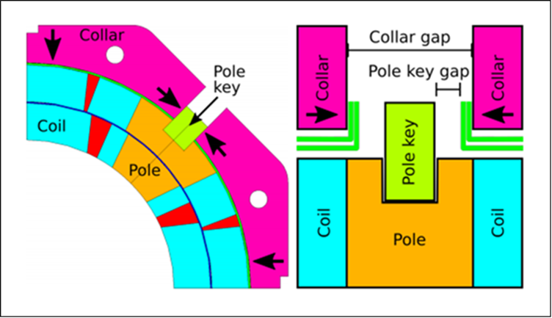
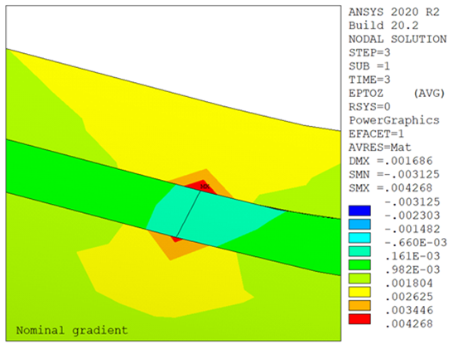
Lessons Learned from MQXFA07/08 NCR
MQXFA07 and MQXFA08 non-conformity analyses are complete (AUP doc-4293 & 4776; EDMS# 2777612)
  “Smoking gun” (broken Nb₃Sn filaments) was found through metallographic analysis by CERN team
Lessons learned:
  Asymmetry during assembly may be looked-in by prestress
  2D asymmetry may cause poor preload in the ends
  COVID restrictions contributed to these issues
All causes have been addressed for future magnets
Closed pole key gap in a coil may lead to poor longitudinal preload in the ends of that coil at edge to end-spacer transition

Slide 20
Lessons Learned from MQXFA13 NCR
MQXFA13 investigation is in progress
  metallographic analysis to be performed at CERN
Main suspect: Small arc-length in the ends of all coils caused low pre-load and high strain in the ends.
  Limiting coil had smallest arc-length of all tested coil
Preventive actions:
  Increased the maximum allowable stress during preload: from 110 to 120 MPa
  Target for minimum loading key size based on coil dimensions
More details on Thursday in MQXFA, magnet assembly and preload by Dan Cheng

