Slide 1
Towards MQXFB series coils
Nicholas Lusa
Arnaud Devred, José Ferradas Troitino, Susana Izquierdo Bermudez, Attilio Milanese, Penelope Matilde Quassolo, Simon Straarup, Ezio Todesco.
HL-LHC Collaboration Meeting, Vancouver

Slide 2
Acknowledgment
US HL-LHC Accelerator Upgrade Project (AUP)
  BNL: K. Amm, M. Anerella, A. Ben Yahia, H. Hocker, P. Joshi, J. Muratore, J. Schmalzle, H. Song, P. Wanderer
  FNAL: G. Ambrosio, G. Apollinari, M. Baldini, J. Blowers, R. Bossert, R. Carcagno, G. Chlachidze, J. DiMarco, S. Feher, S. Krave, V. Lombardo, C. Narug, A. Nobrega, V. Marinozzi, C. Orozco, T. Page M. Parker, S. Stoynev, T. Strauss, M. Turenne, D. Turrioni, A. Vouris, M. Yu
  LBNL: D. Cheng, P. Ferracin, J. Ferradas Troitino, L. Garcia Fajardo, E. Lee, M. Marchevsky, M. Naus, H. Pan, I. Pong, S. Prestemon, K. Ray, G. Sabbi, G. Vallone, X. Wang
NHFML: L. Cooley, J. Levitan, J. Lu, R. Walsh
CERN
  G. Arnau Izquierdo, J. Axensalva, A. Ballarino, M. Bajko, T.A. Bampton, C. Barth, S.T. Becle, R. Berthet, N. Bourcey, B. Bordini, T. Boutboul, A. Cherif, M. Crouvizier, A. Devred, N. Eyraud, L. Favier, L. Fiscarelli, J. Fleiter, K. Kandemir, M. Guinchard, L. Grand-Clement, O. Housiaux, S. Izquierdo Bermudez, S. Luzieux, F. Mangiarotti, A. Milanese, A. Moros, P. Moyret, S. Mugnier, C. Petrone, J.C. Perez, D. Perini, M. Pozzobon, H. Prin, R. Principe, D. Pugnat, K. Puthran, P.M. Quassolo, E. Ravaioli, J.P. Rigaud, P. Rogacki, S. Russenschuck, T. Sahner, S. Sgobba, S. Straarup, E. Todesco, S. Triquet, A. Vieitez Suarez, G. Willering

Slide 3
Outline
  Introduction
  Coil manufacturing observables
  New generation MQXFB coils
  Conclusions

Slide 4
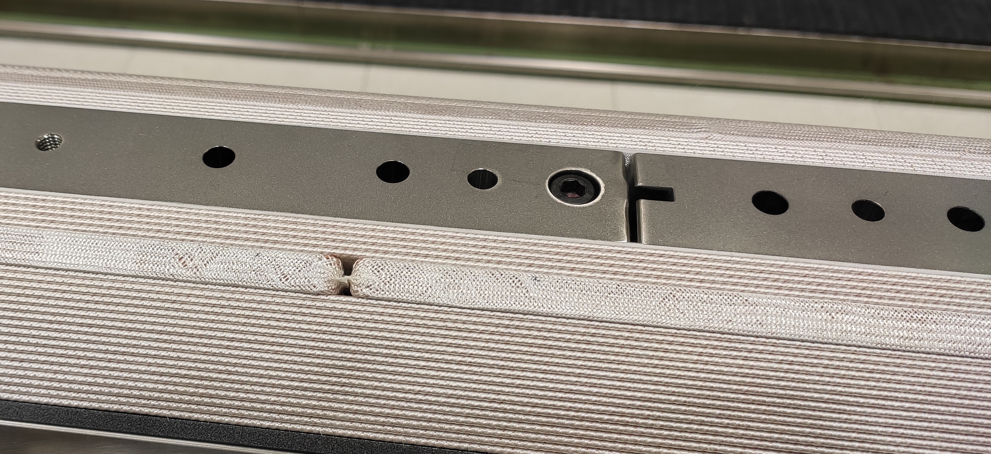
Introduction
MQXF magnets are the new inner triplets Nb₃Sn based for HL-LHC
  Nominal operation (7 TeV): 16.23 kA, 132.2 T/m; 11.3 T B_{peak}
  MQXFA (by US-AUP) with 4.2 m L_{m}
  MQXFB (by CERN) with 7.2 m L_{m}
  MQXFA and MQXFB share the same cross-section (joint short model
  development program ‘MQXFS’ to validate the design)
  MQXF coils are composed of 50 turns in two layers using a single unit length of S2 glass insulated cable.
  The cable is wound around several segmented Ti poles (heat treated and impregnated with the coil)
Pole-to-pole transition
Titanium pole
Insulated cable

Slide 5
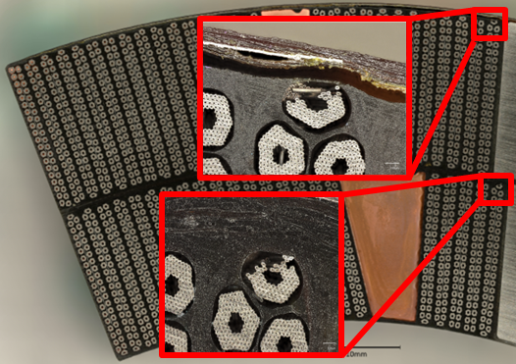
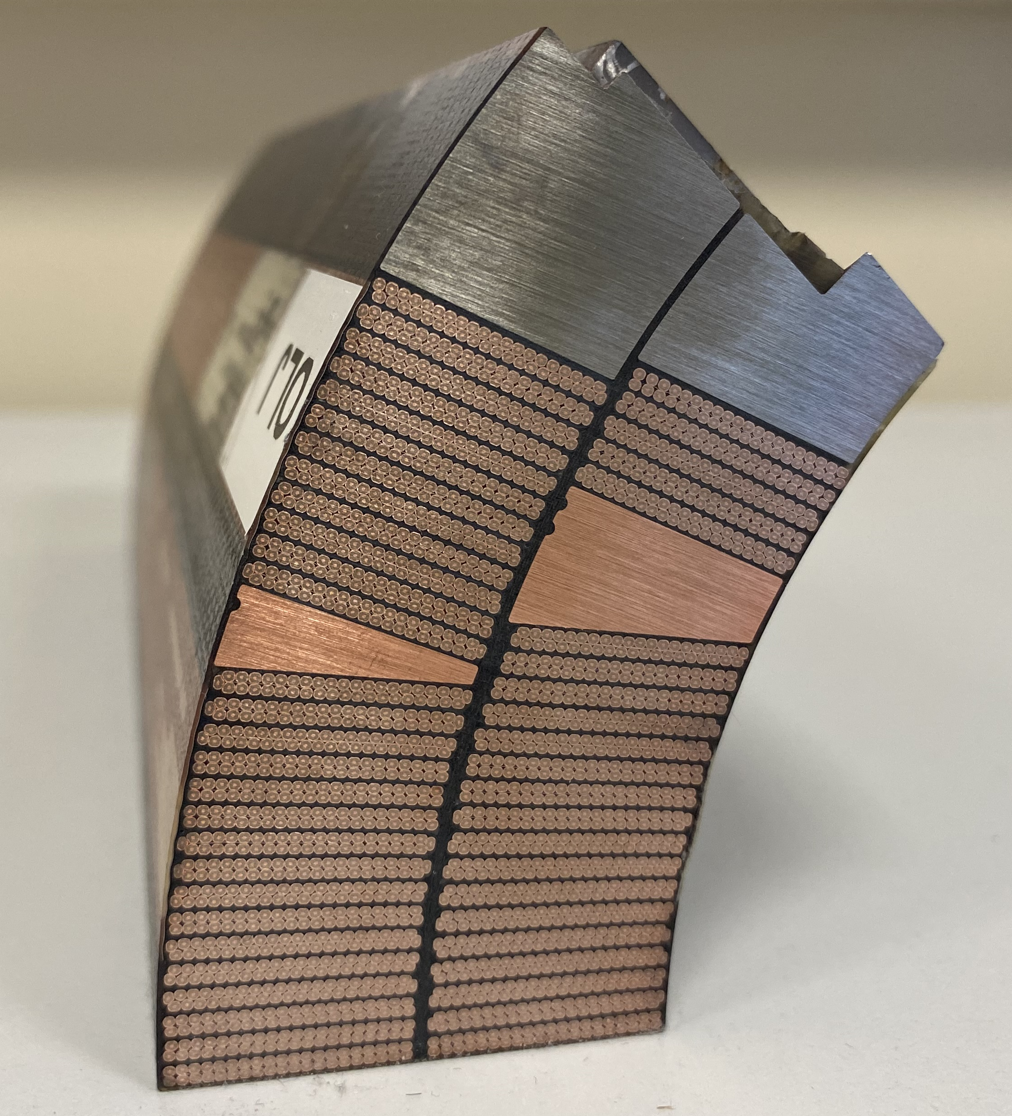
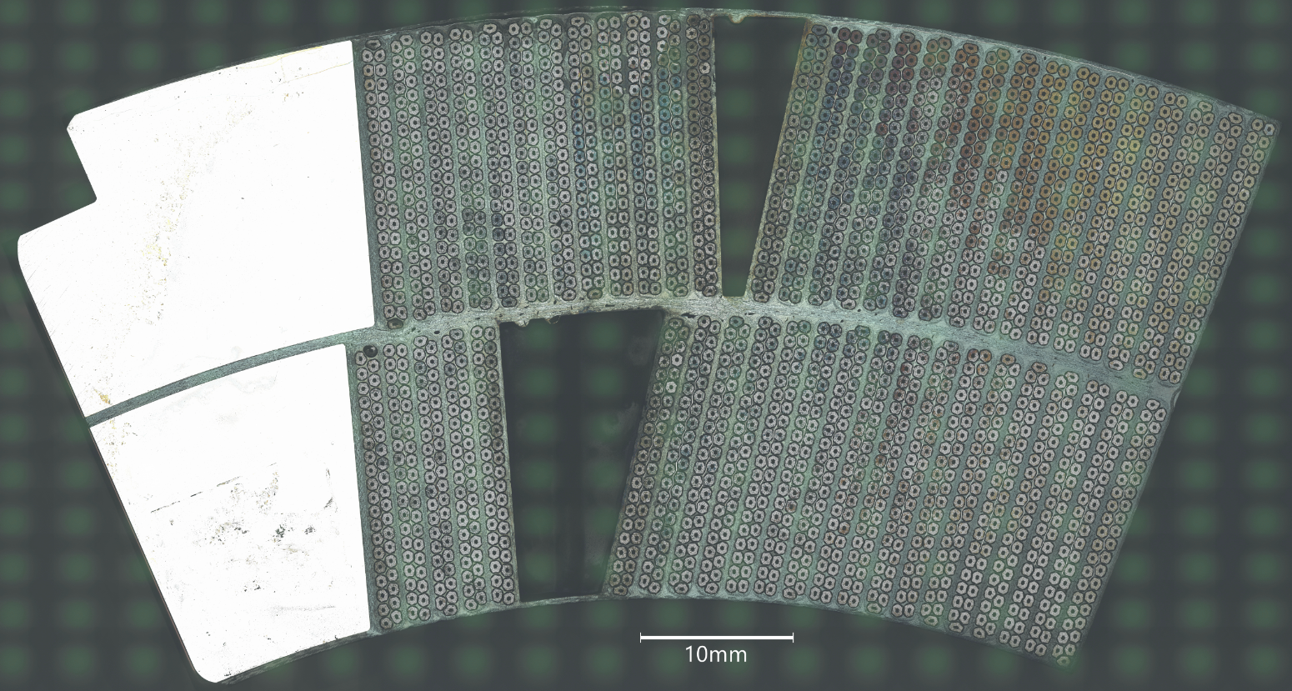
Introduction
MQXFBP1/BP2 were limited at 93% and 98% of the nominal current at 1.9 K (quench location in the IL pole turns near the magnet mechanical center)
MQXFBP3 and MQXFB02 reached I_{nom} + 300 A at 1.9 K but showed similar limitations at 4.5 K
Post-mortem inspections of MQXFBP1 limiting coil showed recurrent broken Nb₃Sn sub-elements in the IL pole turn close to pole-to-pole transitions
Post-mortem inspections were performed also in virgin coil CR126 showing similar defects
Pole turn inner layer
MQXFBP1 limiting coil CR108
Virgin coil CR126

Slide 6
Introduction
MQXFBP1/BP2 performance limitation prompted stopping the coil fabrication
Analysis of the possible root causes:
  Cold mass assembly
  Magnet assembly
  Coil fabrication
  MQXFBP3 → meets HL-LHC requirements (I_{nom} + 300 A at 1.9 K with ≈ 2 K of temperature margin)
    Implemented improvements from cold mass assembly
  MQXFB02 → meets HL-LHC requirements (I_{nom} + 300 A at 1.9 K with ≈ 2.8 K of temperature margin)
    Implemented also improvements from magnet assembly

Slide 7
Outline
  Introduction
  Coil manufacturing observables
  New generation MQXFB coils
  Conclusions

Slide 8
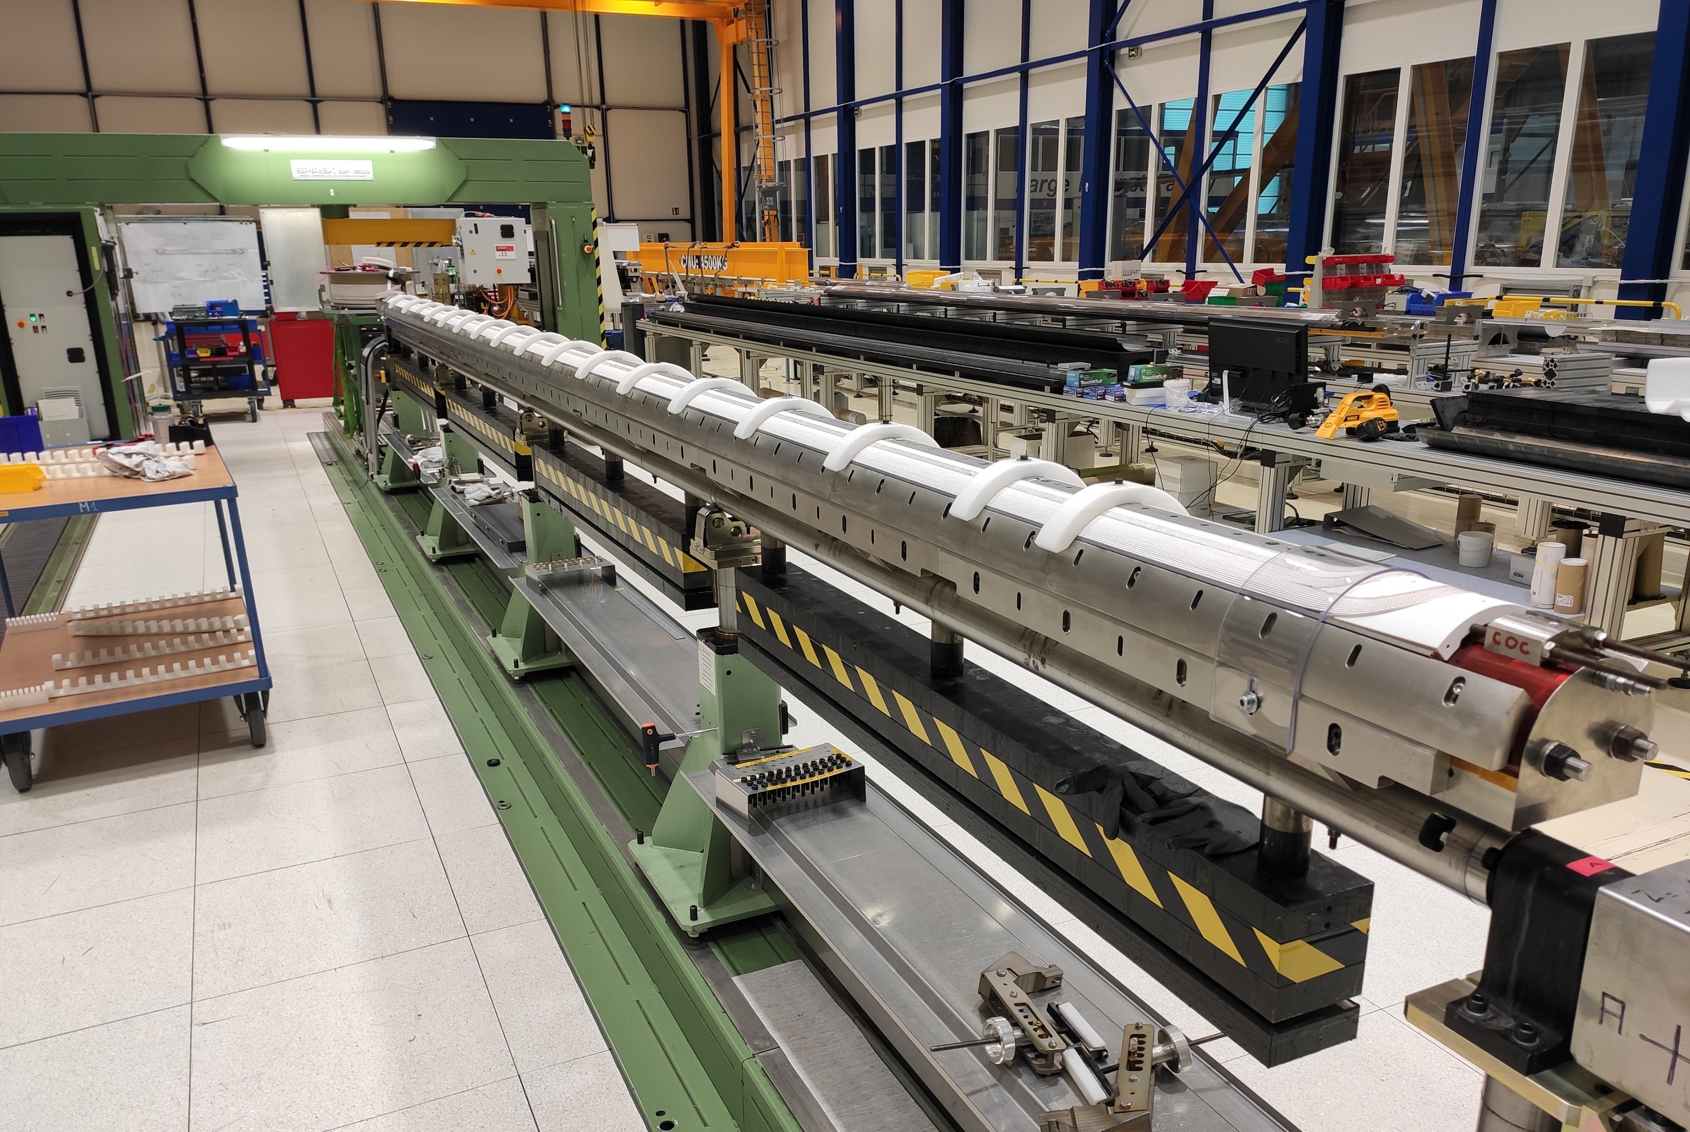
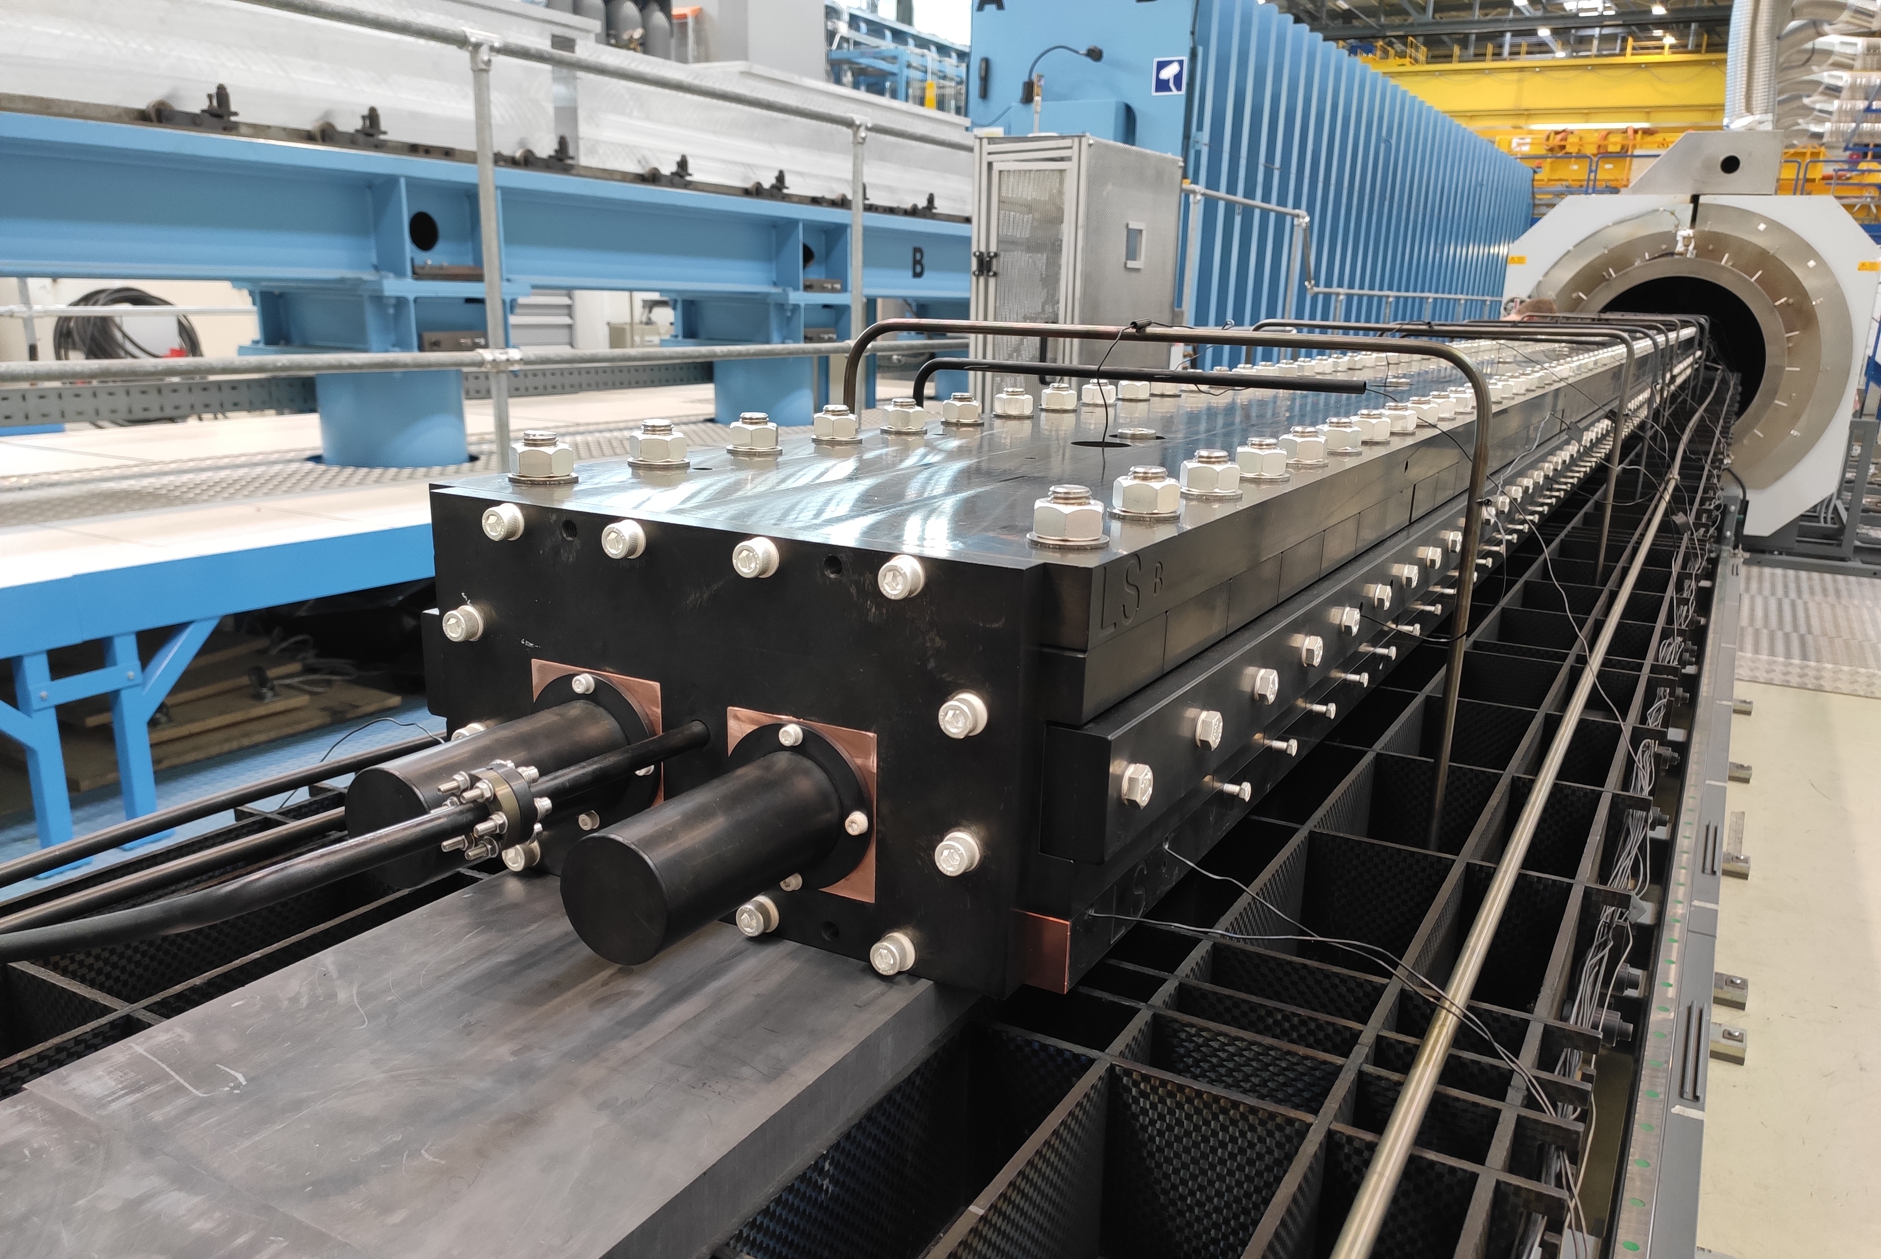
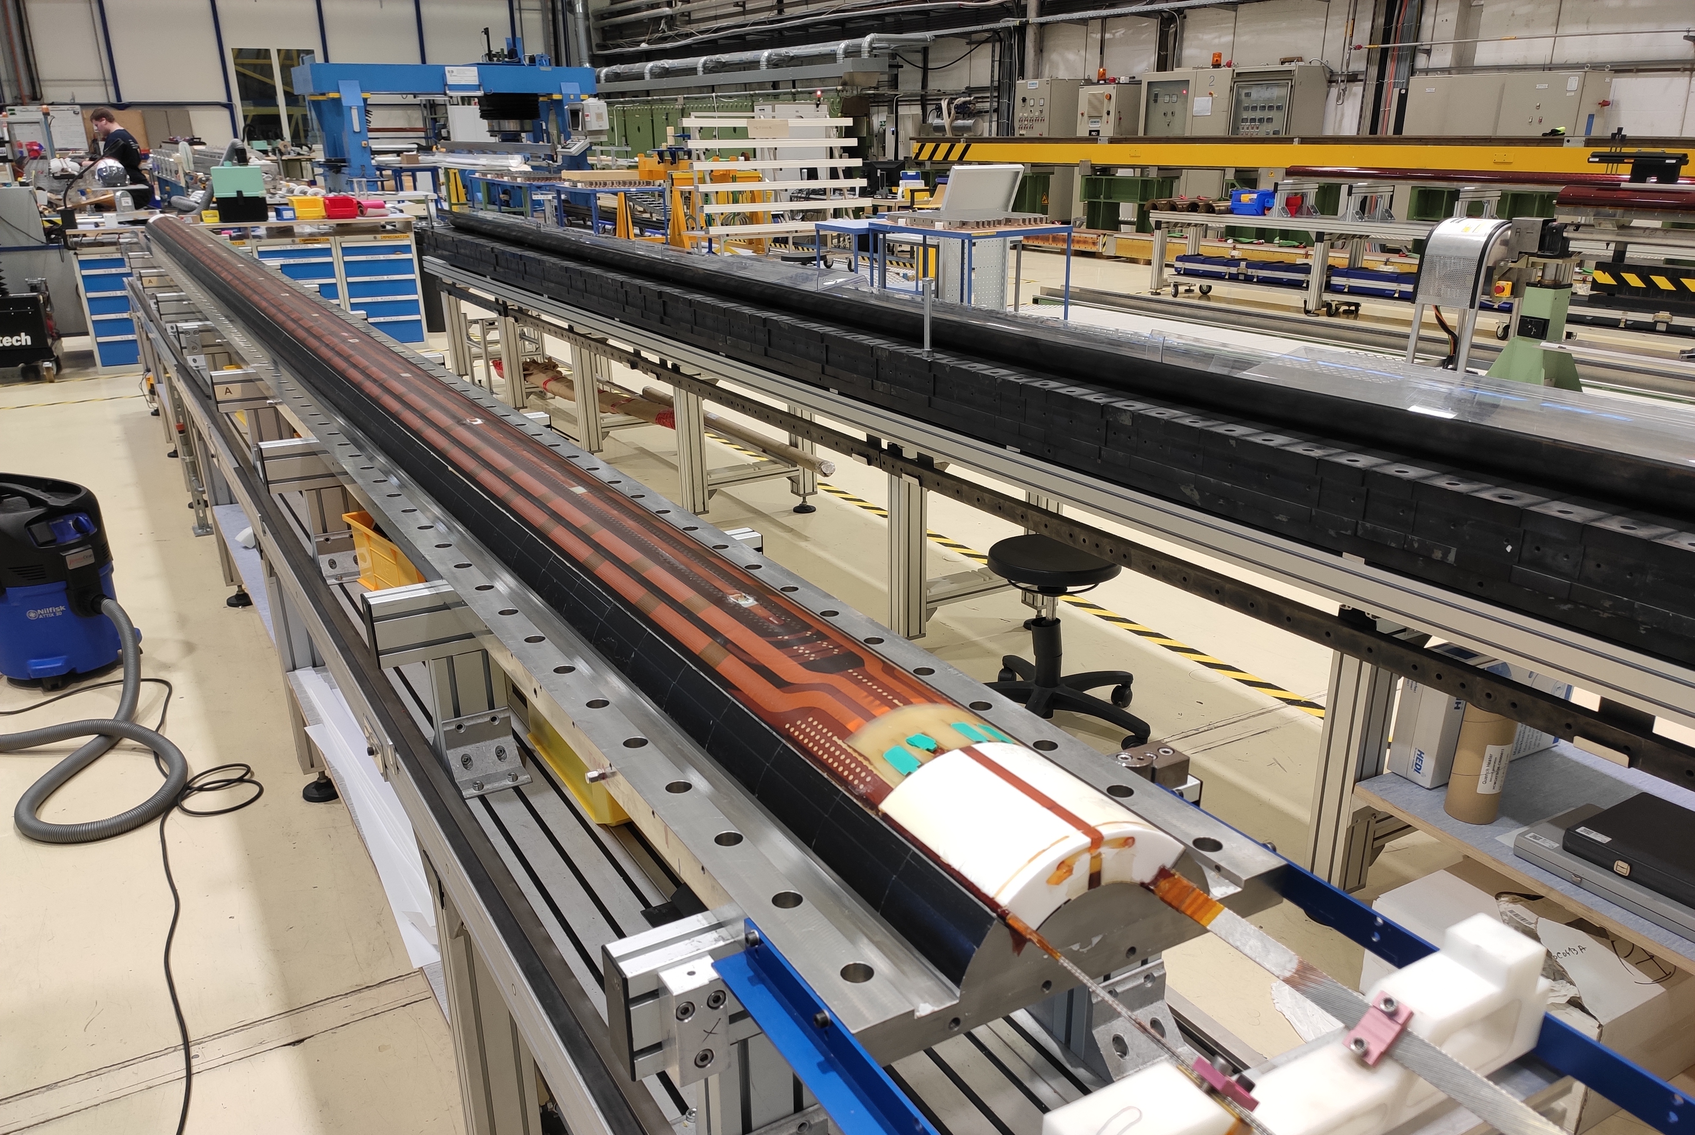
Coil manufacturing process
Manufacturing process divided in three main steps:
  Winding and curing
    IL winding and curing (with ceramic binder)
    OL winding and curing (with ceramic binder)
  Reaction heat treatment
  Vacuum pressure impregnation
1
3
2

Slide 9
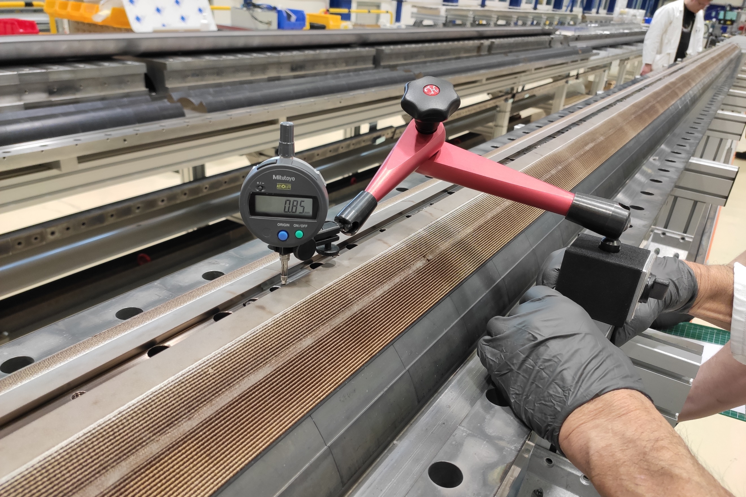
Coil manufacturing observables
Coil ‘hump’ after reaction
  Vertical deviation of the outer layer poles with respect to the base plate of about 1.5 mm observed after the opening of the reaction fixture
Vertical pole deviation along the length (reacted coil)

Slide 10
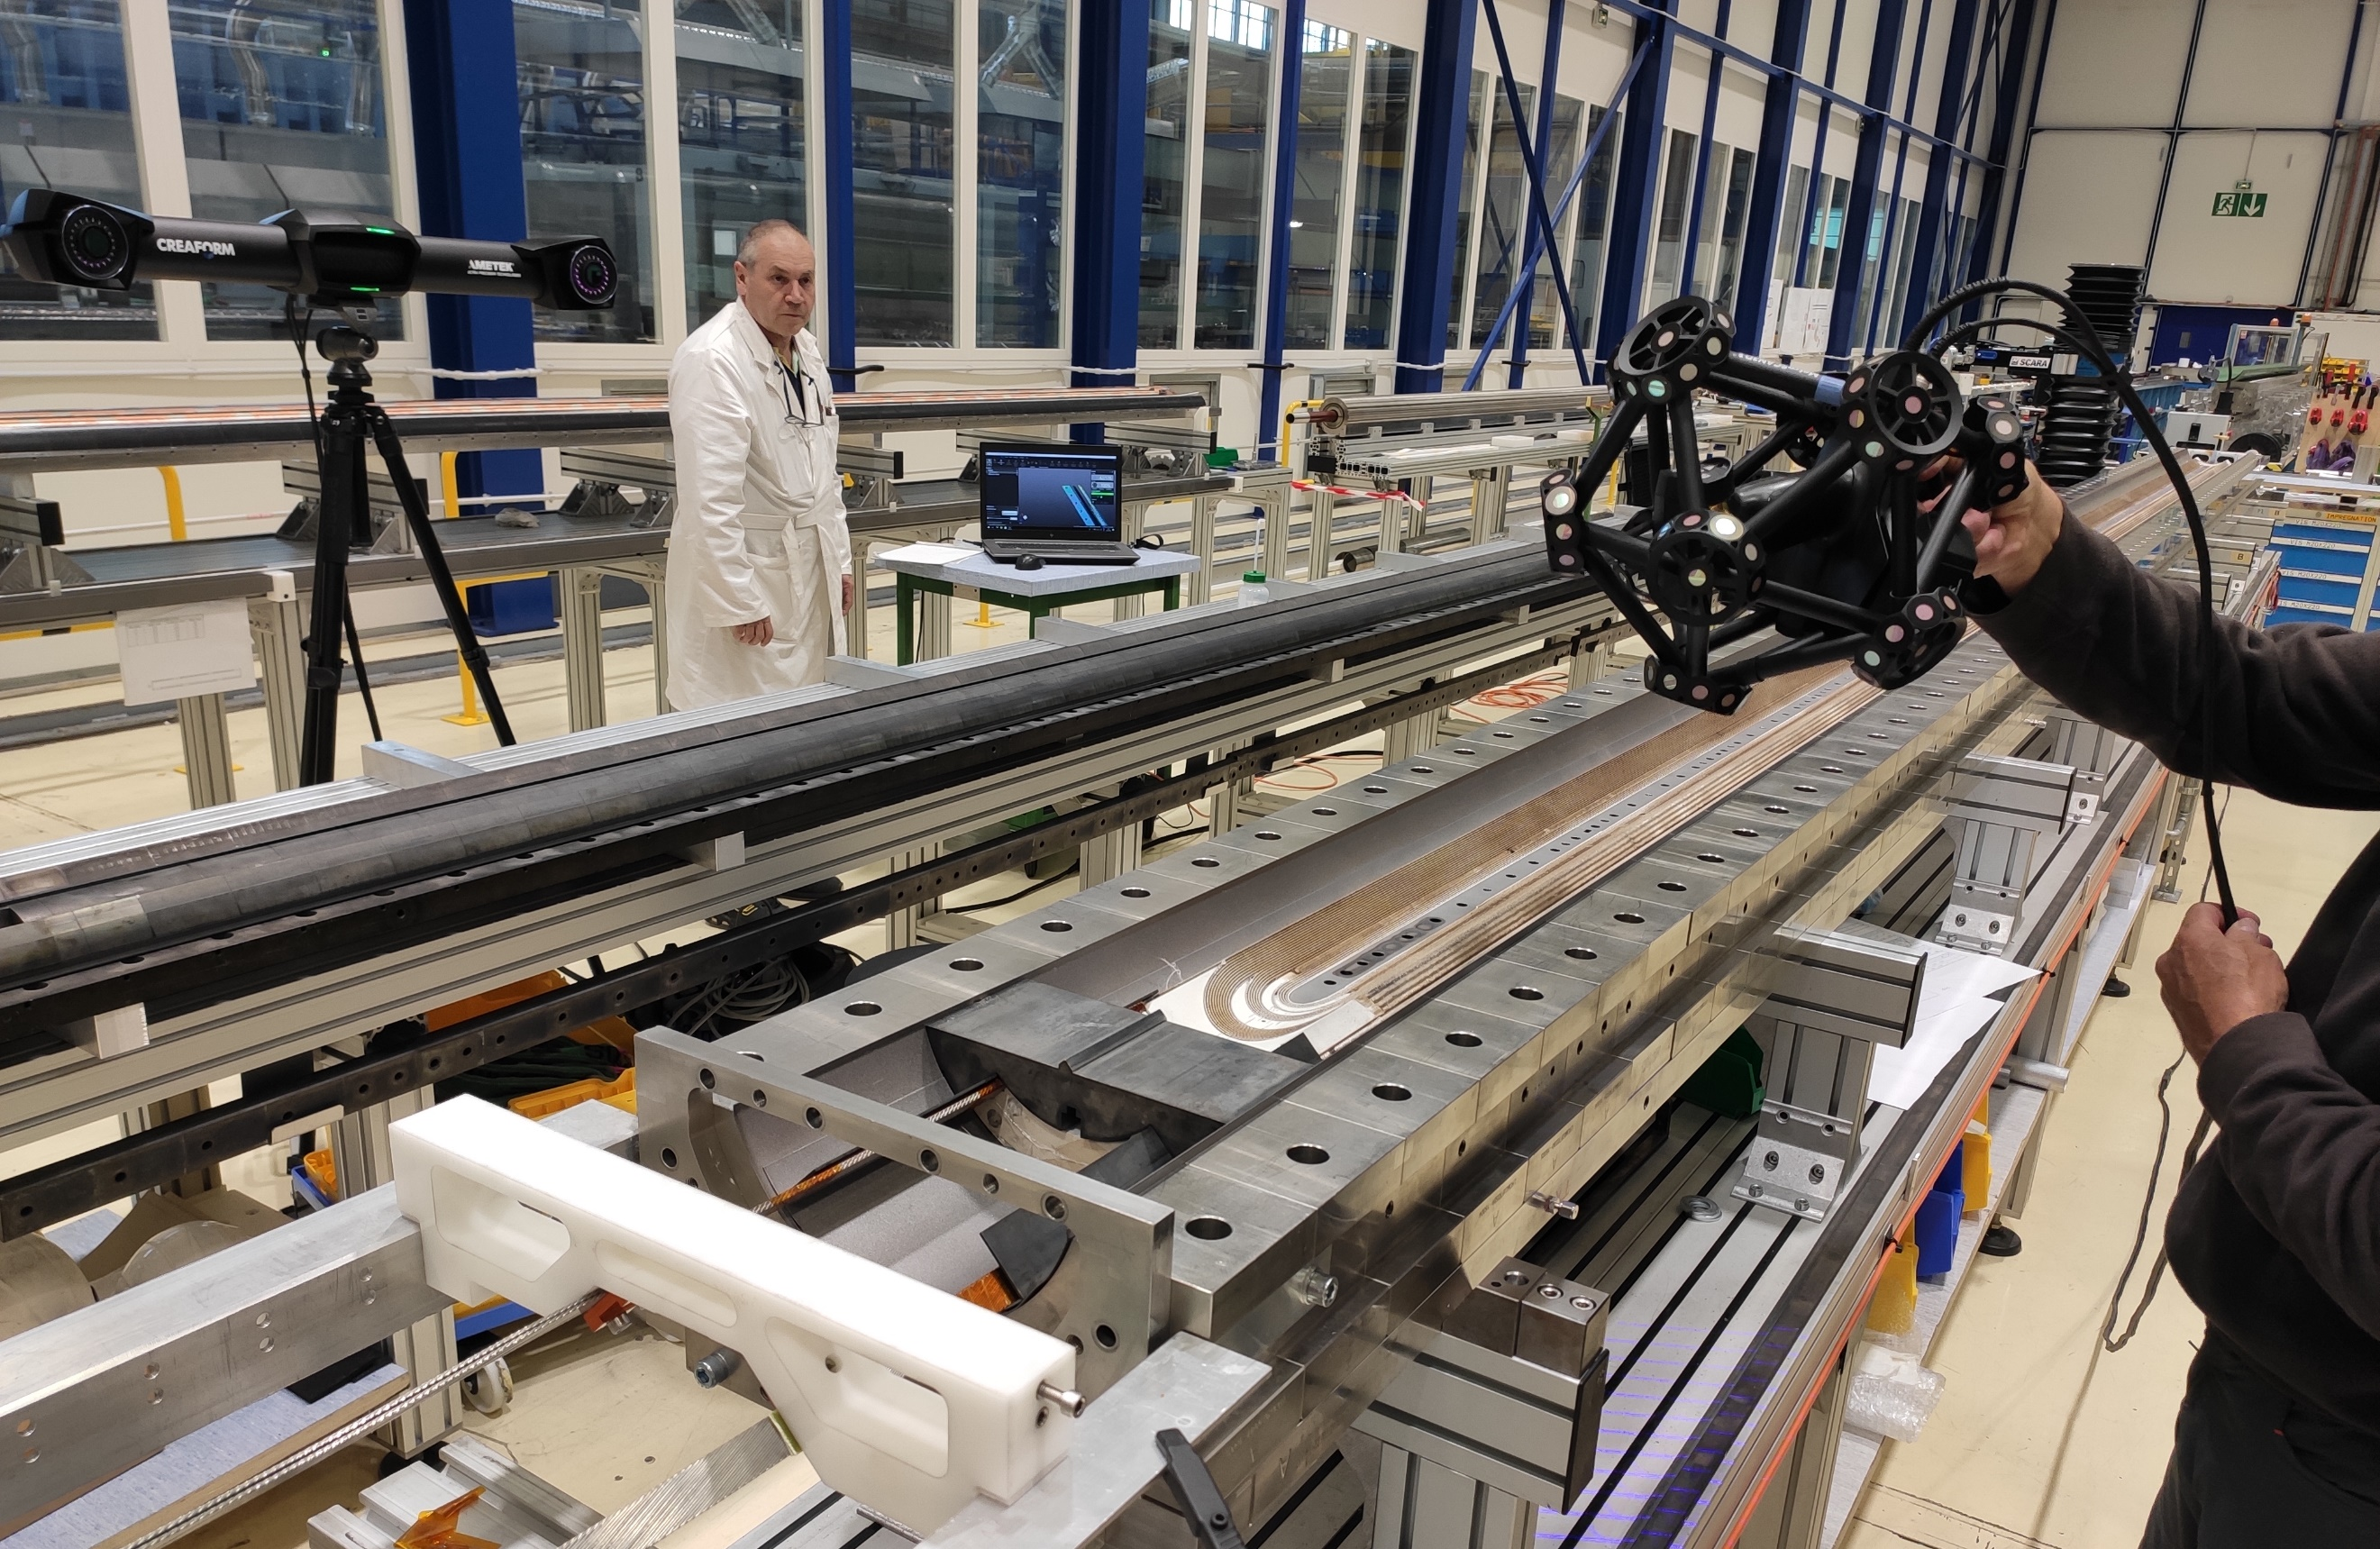
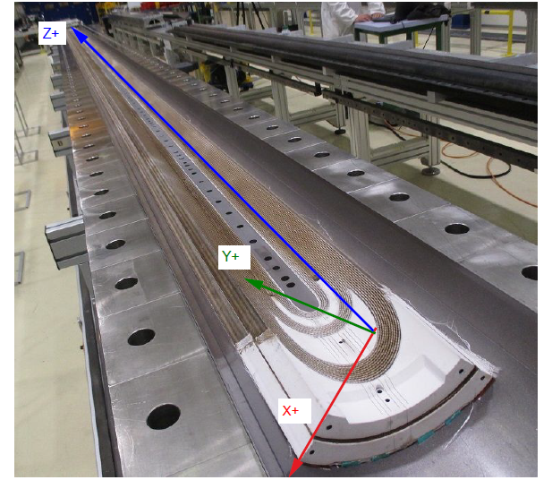
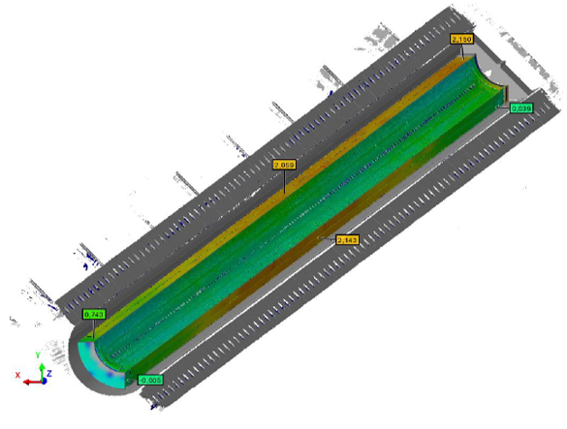
Coil manufacturing observables
Coil ‘hump’ after reaction
  When the coil is with the inner layer upwards in free state, an excess of about 1.5 mm is observed in the midplanes towards the longitudinal center
  Measurement done using MetraSCAN® 3D optical CMM scanner
Metrological 3D scan of the inner radius and midplanes after HT (reacted coil)
1.5 mm
1.5 mm

Slide 11
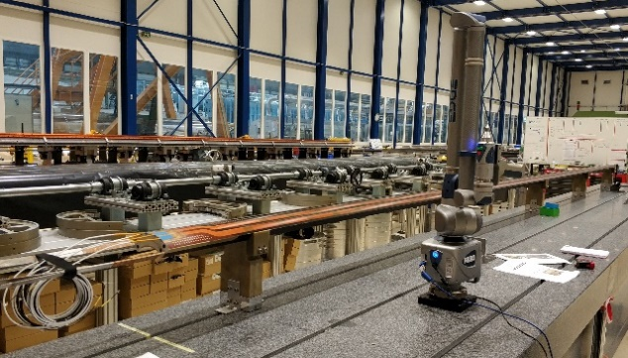
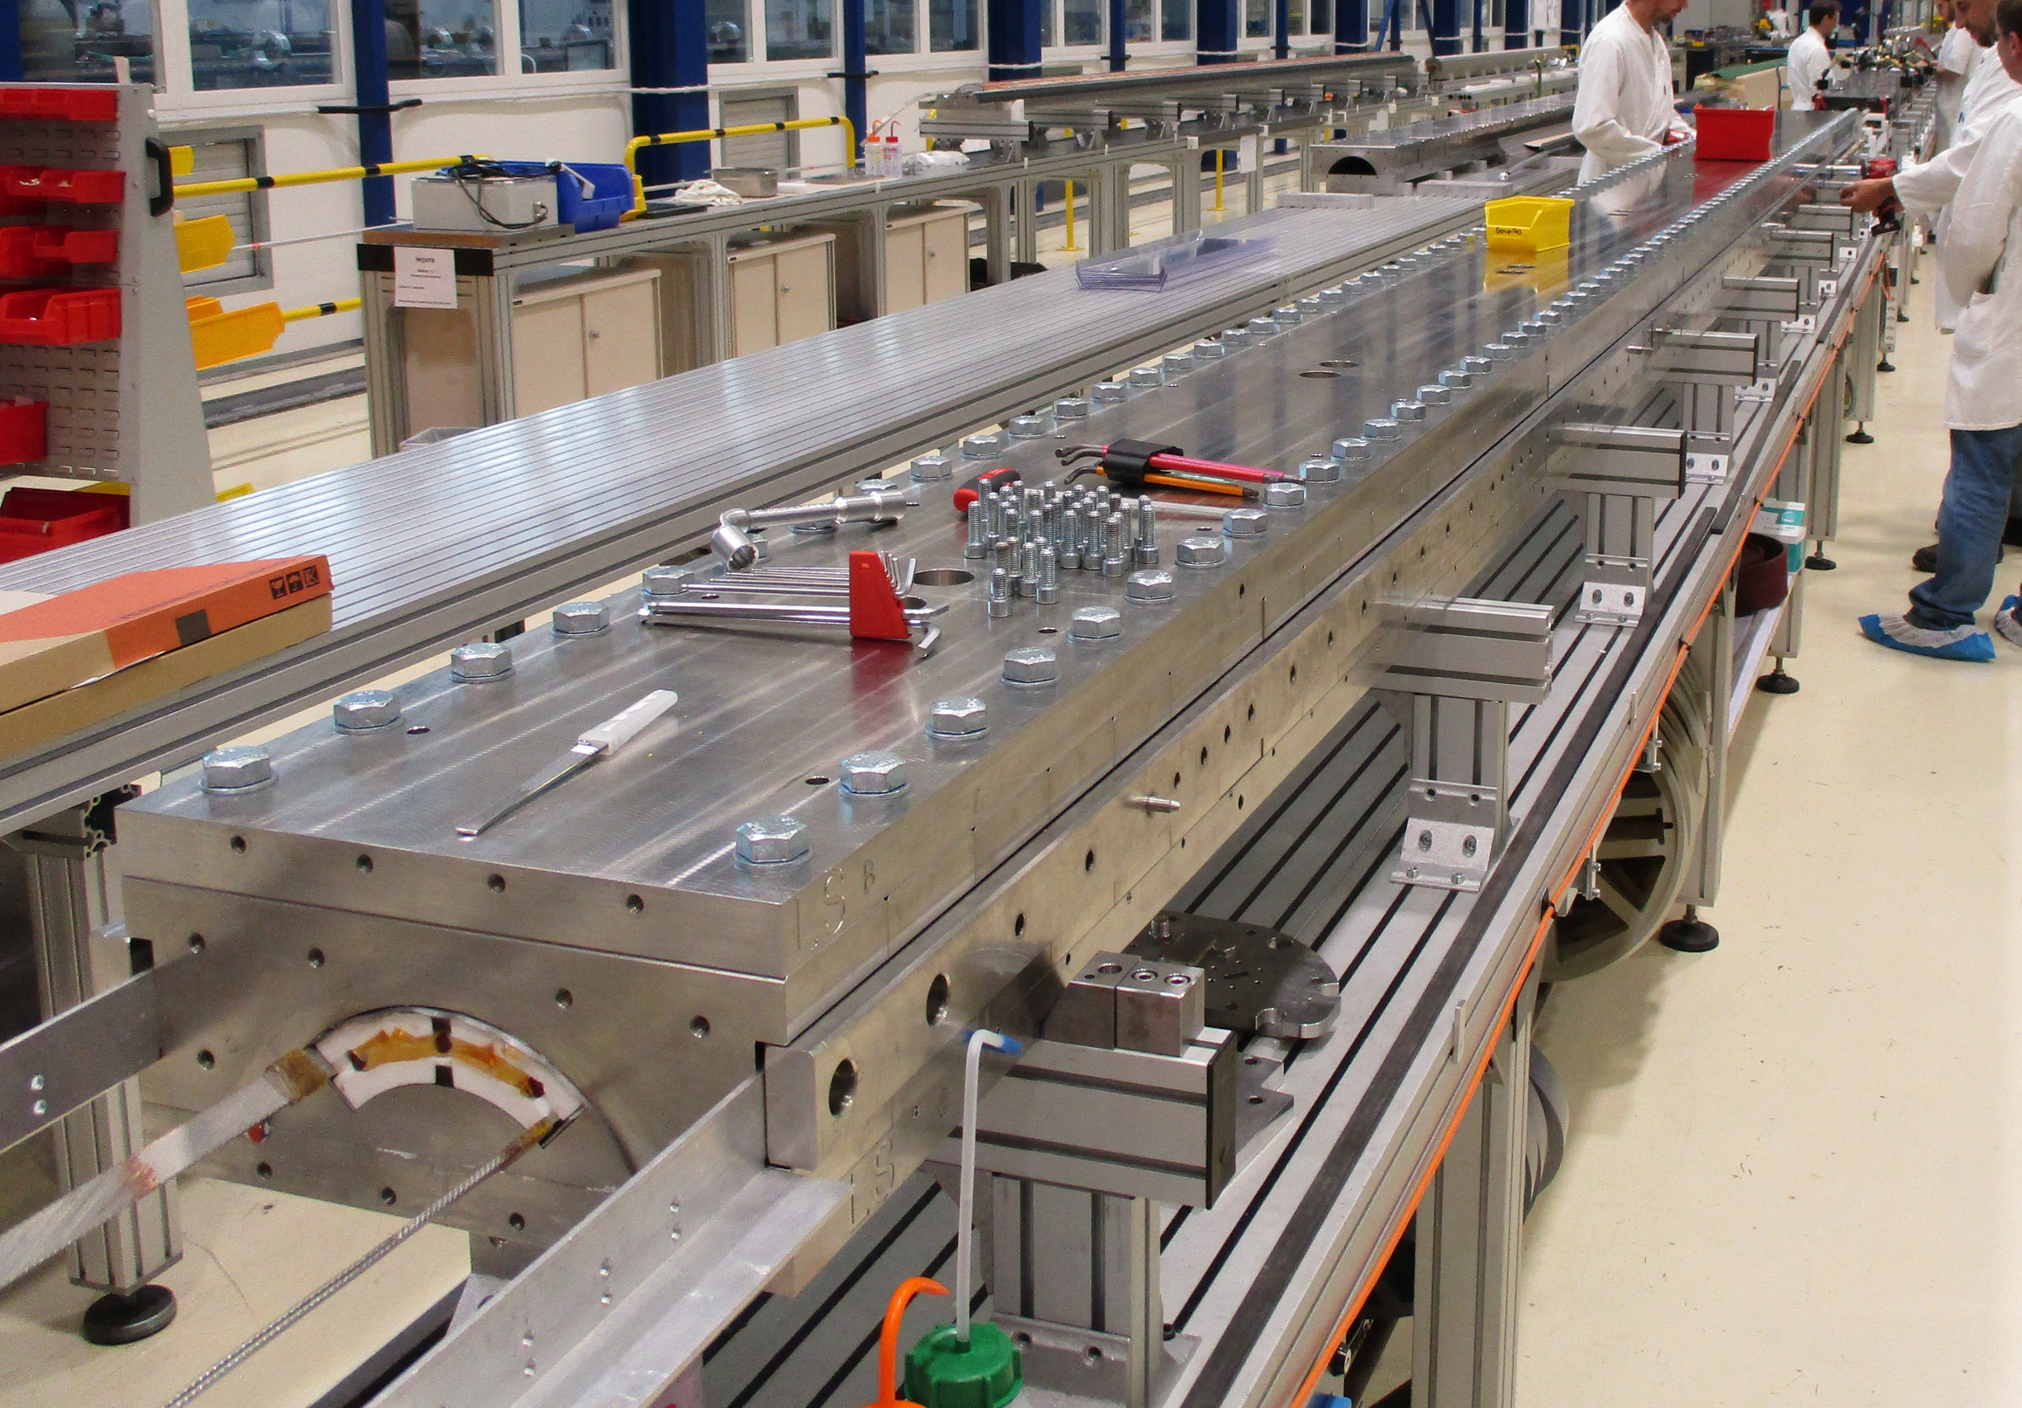
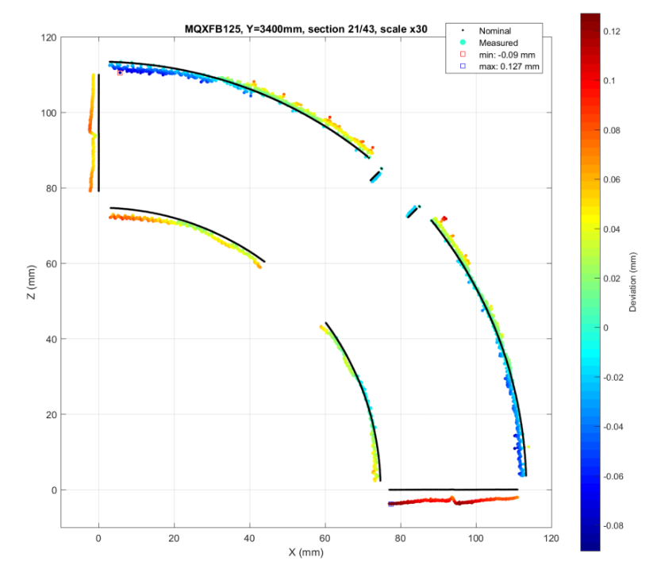
Coil manufacturing observables
Coil azimuthal size after impregnation
  The coil is azimuthally bigger in the middle of about 0.1 mm per midplane
  The coil is rigid enough to slightly deform the impregnation fixture, keeping the signature of a ‘fat’ coil towards the longitudinal center
Coil closed in the impregnation fixture
Metrology measurements of the impregnated coil
Azimuthal coil arc excess (impregnated coils)

Slide 12
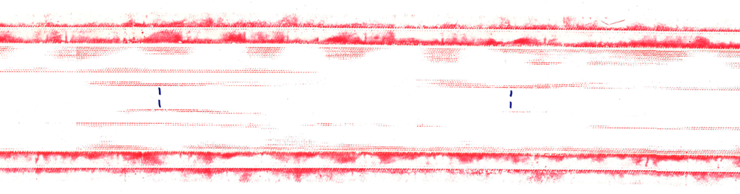
Coil manufacturing observables
Torque monitoring during impregnation fixture closure
  The torque needed to close the impregnation fixture gradually increased towards the longitudinal center of the coil
Stress regions in the vicinity of the pole-to-pole transitions
  Pressure sensitive film installed in the inner radius and midplanes of coil CR126 when preparing the coil for impregnation revealed stress concentrations close to the pole-to-pole transitions
Torque required to close the impregnation fixture (reacted coil)
Pressure sensitive film imprints (2.5 – 10 MPa) of the inner coil radius and midplanes during the closure of the impregnation fixture
mp
Inner radius
Pole (400 mm length)
mp

Slide 13
Outline
  Introduction
  Coil manufacturing observables
  New generation MQXFB coils
  Conclusions

Slide 14
New generation coils: modifications implemented
Possible mechanism
  The coil is a constrained state after RHT due to friction between coil and mold, the energy is released during the mold opening
  Effect length dependent (not observed in MQXFA and MQXFS coils)
Purpose → reducing the longitudinal, azimuthal and radial friction between coil and the reaction mold
  Modifications implemented in the manufacturing steps preceeding the RHT
The major modifications are:
  Pole gap increase from 2.0 mm/m to 3.4 mm/m (then optimised to 2.5 mm/m)
  Partial compensation of the curing cavity → reducing the azimuthal size of the unreacted coil
  Removal of the ceramic binder from the outer layer of the coil

Slide 15

New generation coils: results and measurables
Coil ‘hump’ after reaction and coil azimuthal size after impregnation
  New generation coils do not show any ‘hump’ from the OL (ends raise up to about 1 mm and straight part flat at about 0.7 mm) → similar to MQXFA
  3D scan of the inner layer of the coil in free state confirmed a more homogeneous geometry of the coil in the longitudinal direction
  New generation coils are more uniform along the length, azimuthally smaller and do not present any sign of a ‘fatter’ coil towards the longitudinal center
Vertical pole deviation along the length (reacted coil)
Metrological 3D scan of the inner radius and midplanes after HT (reacted coil)
Azimuthal coil arc excess (impregnated coils)

Slide 16
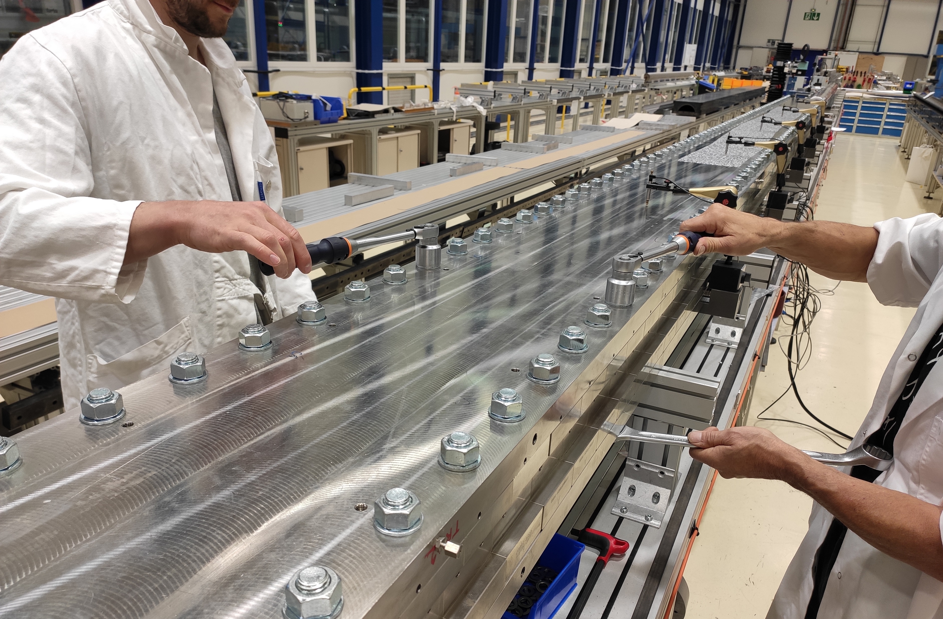
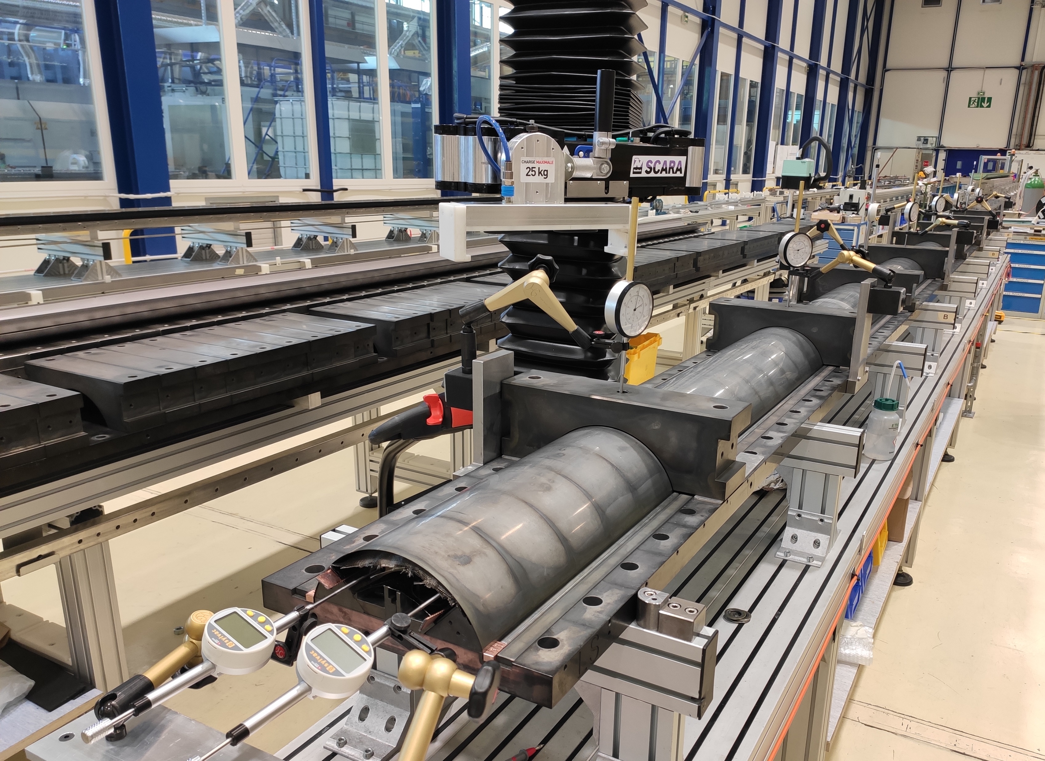
New generation coils: results and measurables
Torque monitoring during impregnation fixture closure
  The torque needed to close the impregnation fixture for new genration coils is uniform along the length and almost half w.r.t. coils cured with binder on both layers
Additional measurements:
  New generation coils exhibit lower pole gap reduction after reaction (0.74 mm/m in coils w/o OL binder vs 1 mm/m)
  New generation coils exhibit less elongation during the opening of the reaction fixture (0.9 mm/m in coils w/o OL binder vs 1.5 mm/m)

Slide 17
Outline
  Introduction
  Coil manufacturing observables
  New generation MQXFB coils
  Conclusions

Slide 18
Conclusions
MQXFB coils are the longest Nb₃Sn coils for accelerator magnets ever built
Coil manufacturing process was reviewed to improve MQXFB magnet performance
Evidences pointing to a constrained state of the coil after RHT
  Not observed in MQXFA and MQXFS coils
  Modifications aimed at reducing longitudinal, azimuthal and radial friction between coil and reaction mold
    Pole gap increase
    Partial compensation of the curing cavity
    Removal of the ceramic binder from the outer layer of the coil
New generation coil measurables point to a coil which is more ‘relaxed’ after RHT
  No coil ‘hump’ after reaction
  No bigger coil azimuthal size towards the middle after impregnation
  More homogeneous torque required to close the impregnation fixture
More uniform coil size along the length

Slide 19
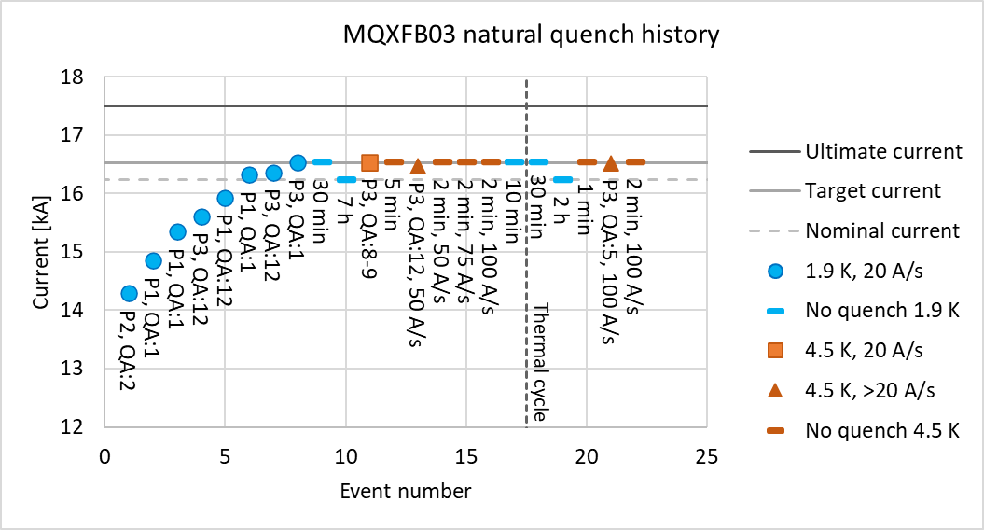
Conclusions
  10 new generation coils have been manufactured 4 of which have been assembled in magnet MQXFB03
Test of MQXFB03 is ongoing:
  Reached target current (I_{nom} + 300 A) both at 1.9 K and 4.5 K
  No signs of degradation in the pole-to-pole transitions
New generation coils
MQXFB03
Courtesy of F. Mangiarotti

Slide 20
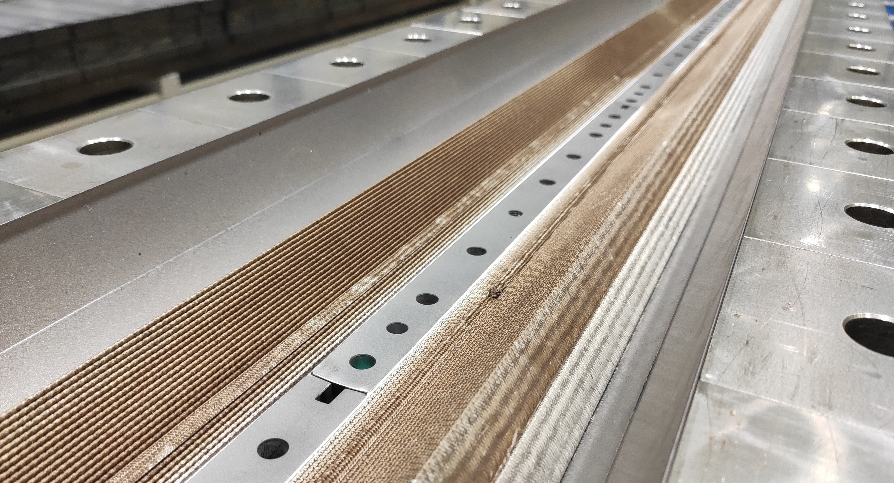
Thank you

Slide 21
Spare slides

Slide 22
Correlation between coil observables
  Coil ‘hump’ after reaction and coil ‘belly’ after impregnation seems to be correlated
  Coil ‘hump’ is confirmed by the torque monitoring during the impregnation fixture closure

Slide 23
New generation coils: results and measurables
Coil elongation upon reaction fixture opening
  Reacted coils gradually elongate on both ends during RHT fixture opening (from extremities to the middle)
  Coil and Ti poles move outwards during the opening → importance of pole gap
  New generation coils exhibit 40% less elongation → less friction effects (very limited statics on MQXFB coils with binder on both layers)
Coil # | LE side [mm] | RE side [mm] | Total elongation [mm] | Total/L_{m} [‰] | Manufacturing line
CR127 | 5.2 | 5.5 | 10.7 | 1.50 | CERN w/ binder
CR128 – CR137 | 3.2 ± 0.8 | 3.5 ± 0.7 | 6.7 ± 1.5 | 0.93 | CERN w/o OL binder
AUP146 – AUP147 | 3.3 | 0.5 | 3.8 | 0.88 | FNAL
AUP237 – AUP238 | 1.9 | 1.9 | 3.8 | 0.88 | BNL

Slide 24
New generation coils: results and measurables
Pole gap change
  Impacted by the removal of the ceramic binder from the OL of the coil
  New generation coils exhibit lower pole reduction after reaction
  MQXFB coils characterised by lower pole reduction after release of winding tension w.r.t. MQXFA
Pole gap change [mm/m] | After release of the winding tension |  | After reaction
 | Avg | σ | Avg | σ
MQXFA coils (92 coils) | 1.48 | 0.21 | 1.10 | 0.24
MQXFB coils w/ binder (20 coils) | 0.68 | 0.14 | 1.00 | 0.15
MQXFB coils w/o OL binder (10 coils) | 0.63 | 0.09 | 0.74 | 0.16

Slide 25
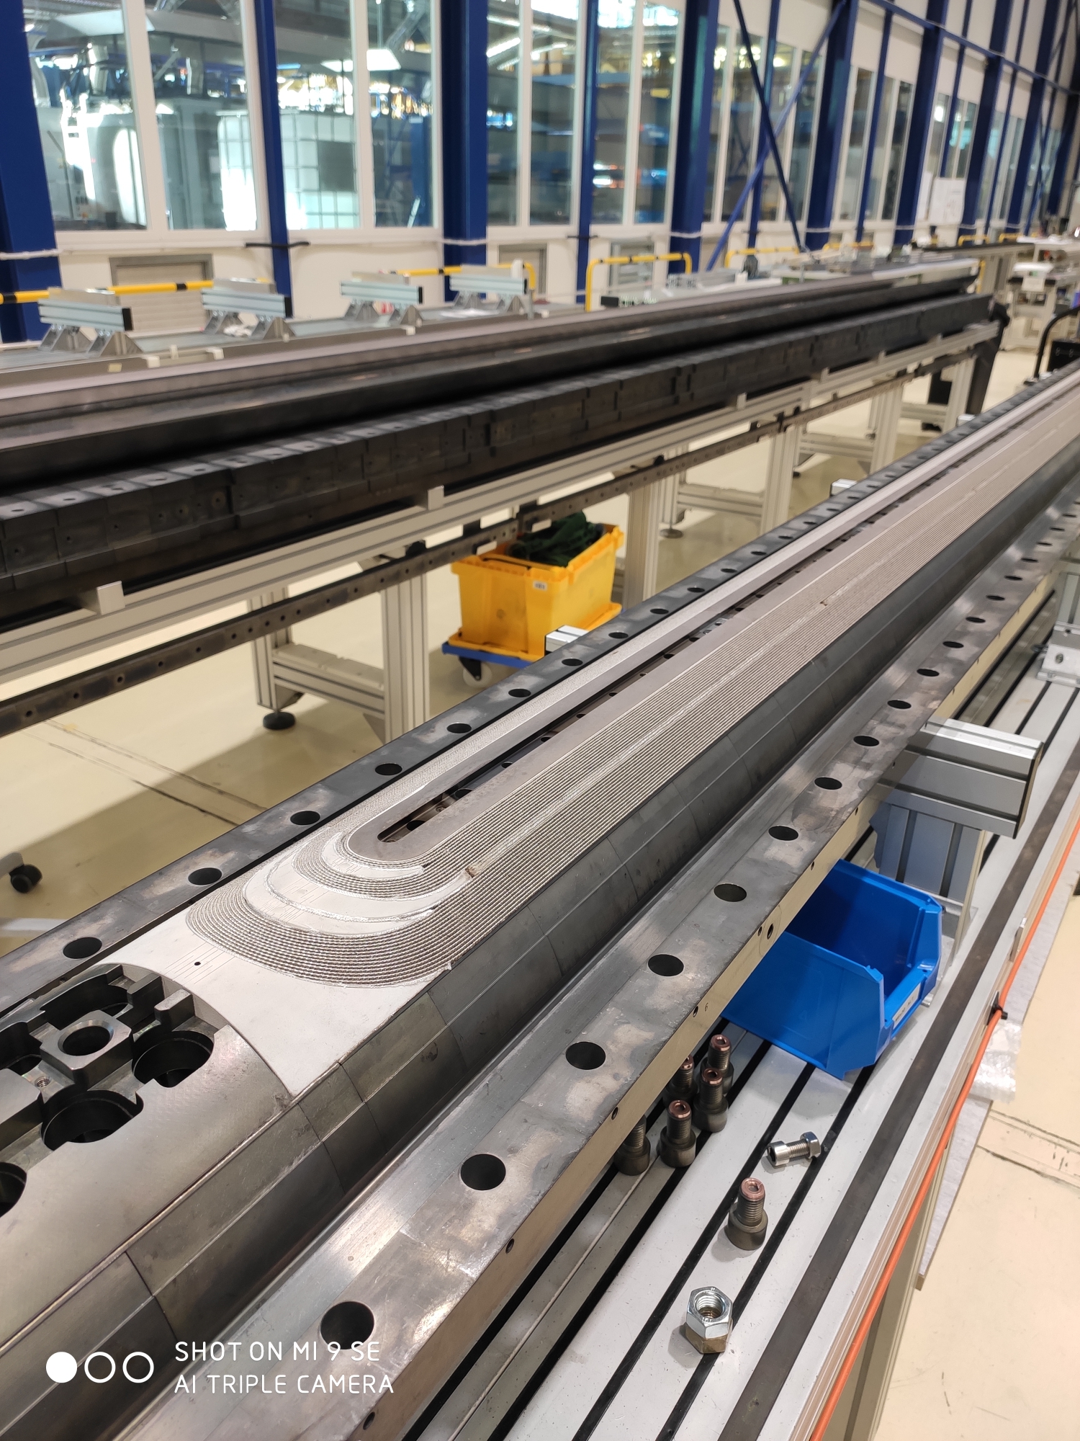
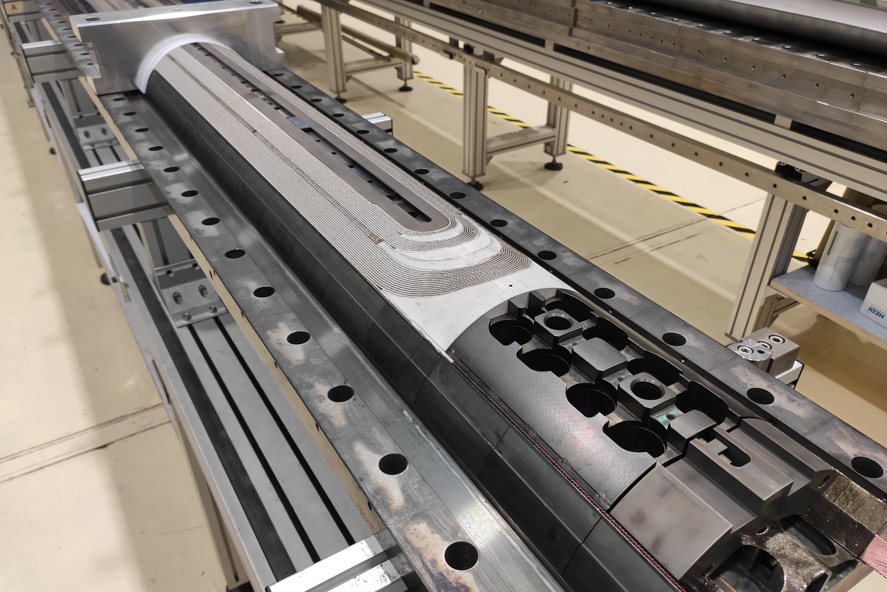
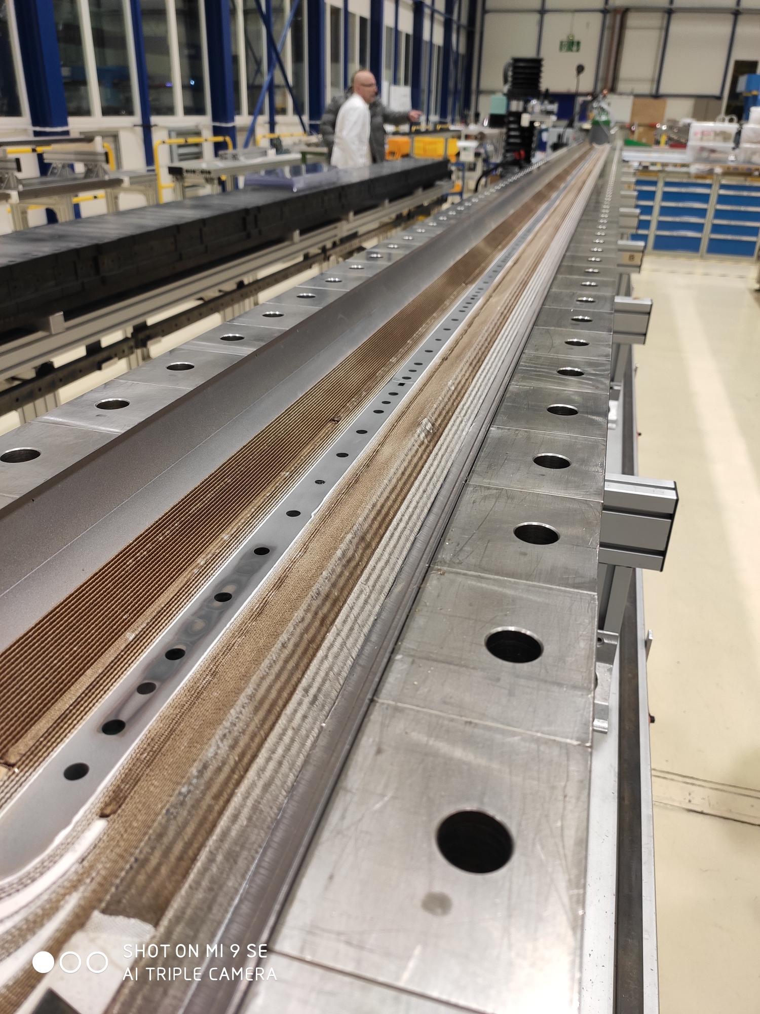
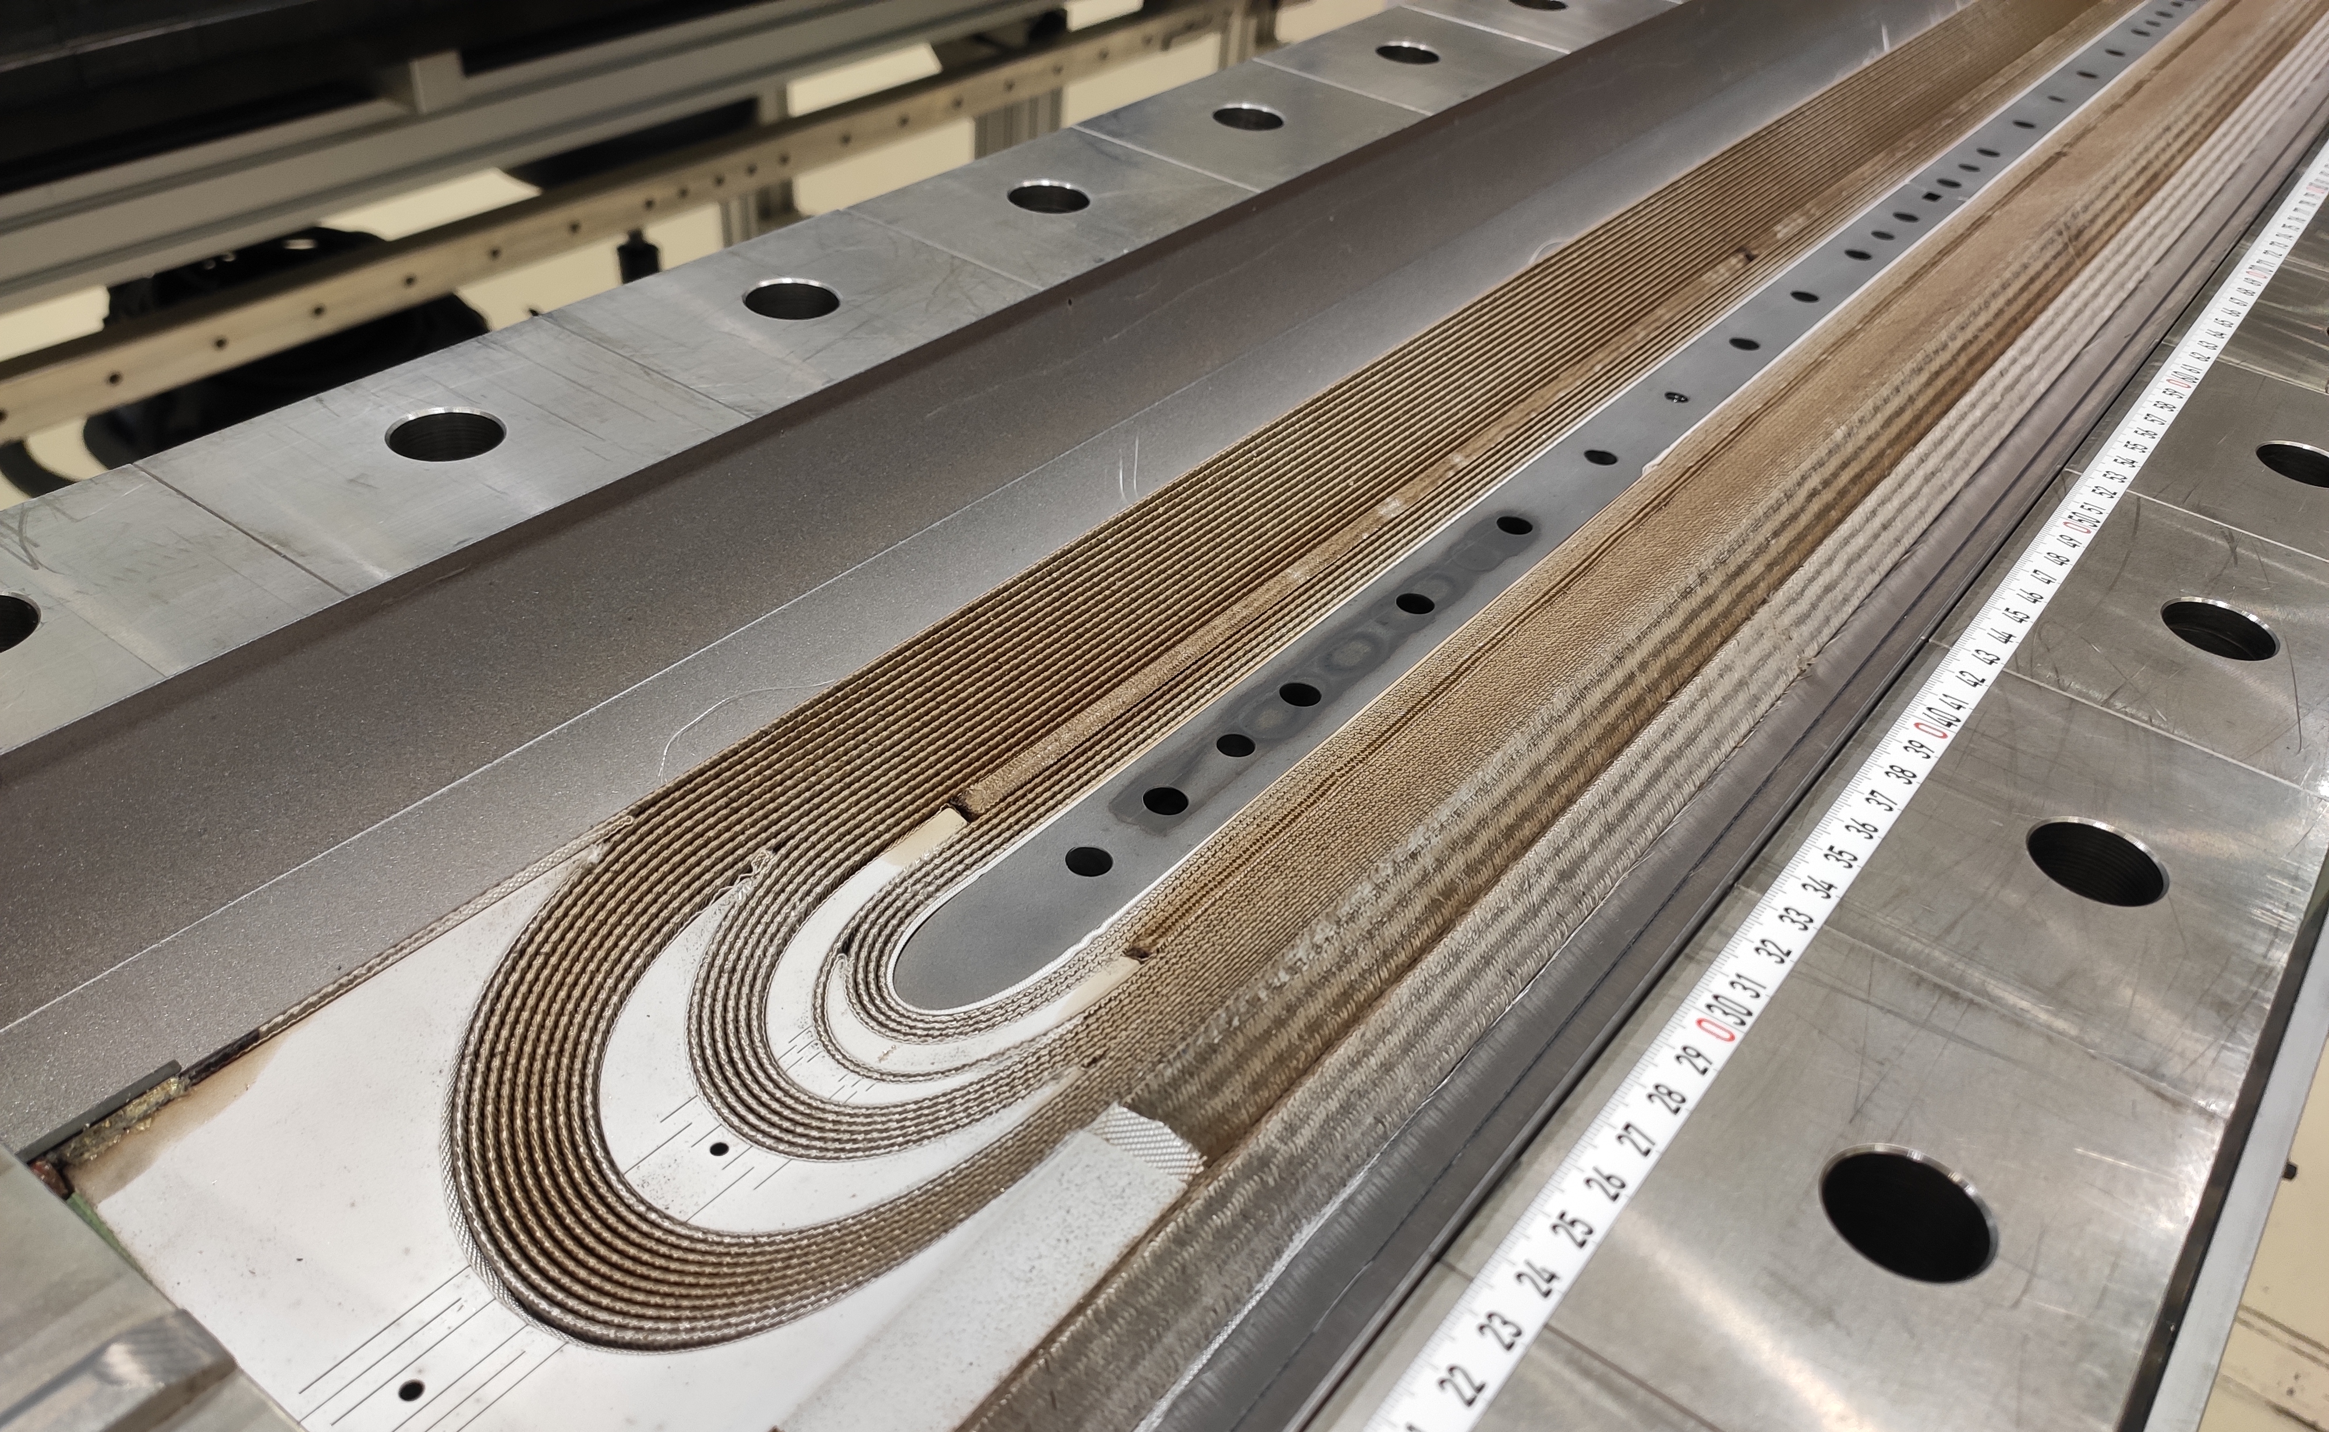
New generation coil aspect
CR128 OL
CR129 OL
CR129 IL
CR128 IL

