Slide 1
MQXFB assembly
S. Izquierdo Bermudez and Penelope Quassolo on behalf of the MQXF team
Acknowledgements: Stephane Triquet, Nicholas Lusa, Attilio Milanese, Juan Carlos Perez, Ezio Todesco, Arnaud Devred and all the MQXFB/A teams.
13th HL-LHC Collaboration Meeting, 25 September 2023

Slide 2
Acknowledgments
US HL-LHC Accelerator Upgrade Project (AUP)
  BNL: K. Amm, M. Anerella, A. Ben Yahia, H. Hocker, P. Joshi, J. Muratore, J. Schmalzle, H. Song, P. Wanderer
  FNAL: G. Ambrosio, G. Apollinari, M. Baldini, J. Blowers, R. Bossert, R. Carcagno, G. Chlachidze, J. DiMarco, S. Feher, S. Krave, V. Lombardo, C. Narug, A. Nobrega, V. Marinozzi, C. Orozco, T. Page M. Parker, S. Stoynev, T. Strauss, M. Turenne, D. Turrioni, A. Vouris, M. Yu
  LBNL: D. Cheng, P. Ferracin, J. Ferradas Troitino, L. Garcia Fajardo, E. Lee, M. Marchevsky, M. Naus, H. Pan, I. Pong, S. Prestemon, K. Ray, G. Sabbi, G. Vallone, X. Wang
NHFML: L. Cooley, J. Levitan, J. Lu, R. Walsh
CERN
  G. Arnau Izquierdo, J. Axensalva, A. Ballarino, M. Bajko, T.A. Bampton, C. Barth, S.T. Becle, R. Berthet, N. Bourcey, B. Bordini, T. Boutboul, A. Cherif, M. Crouvizier, A. Devred, N. Eyraud, L. Favier, L. Fiscarelli, J. Fleiter, K. Kandemir, M. Guinchard, L. Grand-Clement, O. Housiaux, S. Izquierdo Bermudez, S. Luzieux, F. Mangiarotti, A. Milanese, A. Moros, P. Moyret, S. Mugnier, C. Petrone, J.C. Perez, D. Perini, M. Pozzobon, H. Prin, R. Principe, D. Pugnat, K. Puthran, P.M. Quassolo, E. Ravaioli, J.P. Rigaud, P. Rogacki, S. Russenschuck, T. Sahner, S. Sgobba, S. Straarup, E. Todesco, S. Triquet, A. Vieitez Suarez, G. Willering

Slide 3
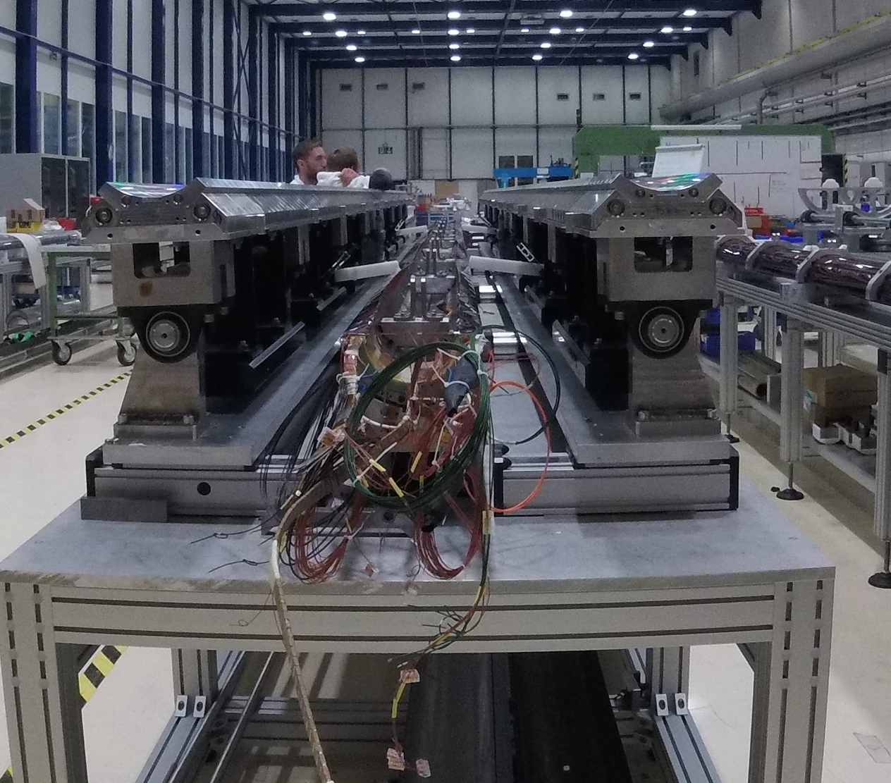
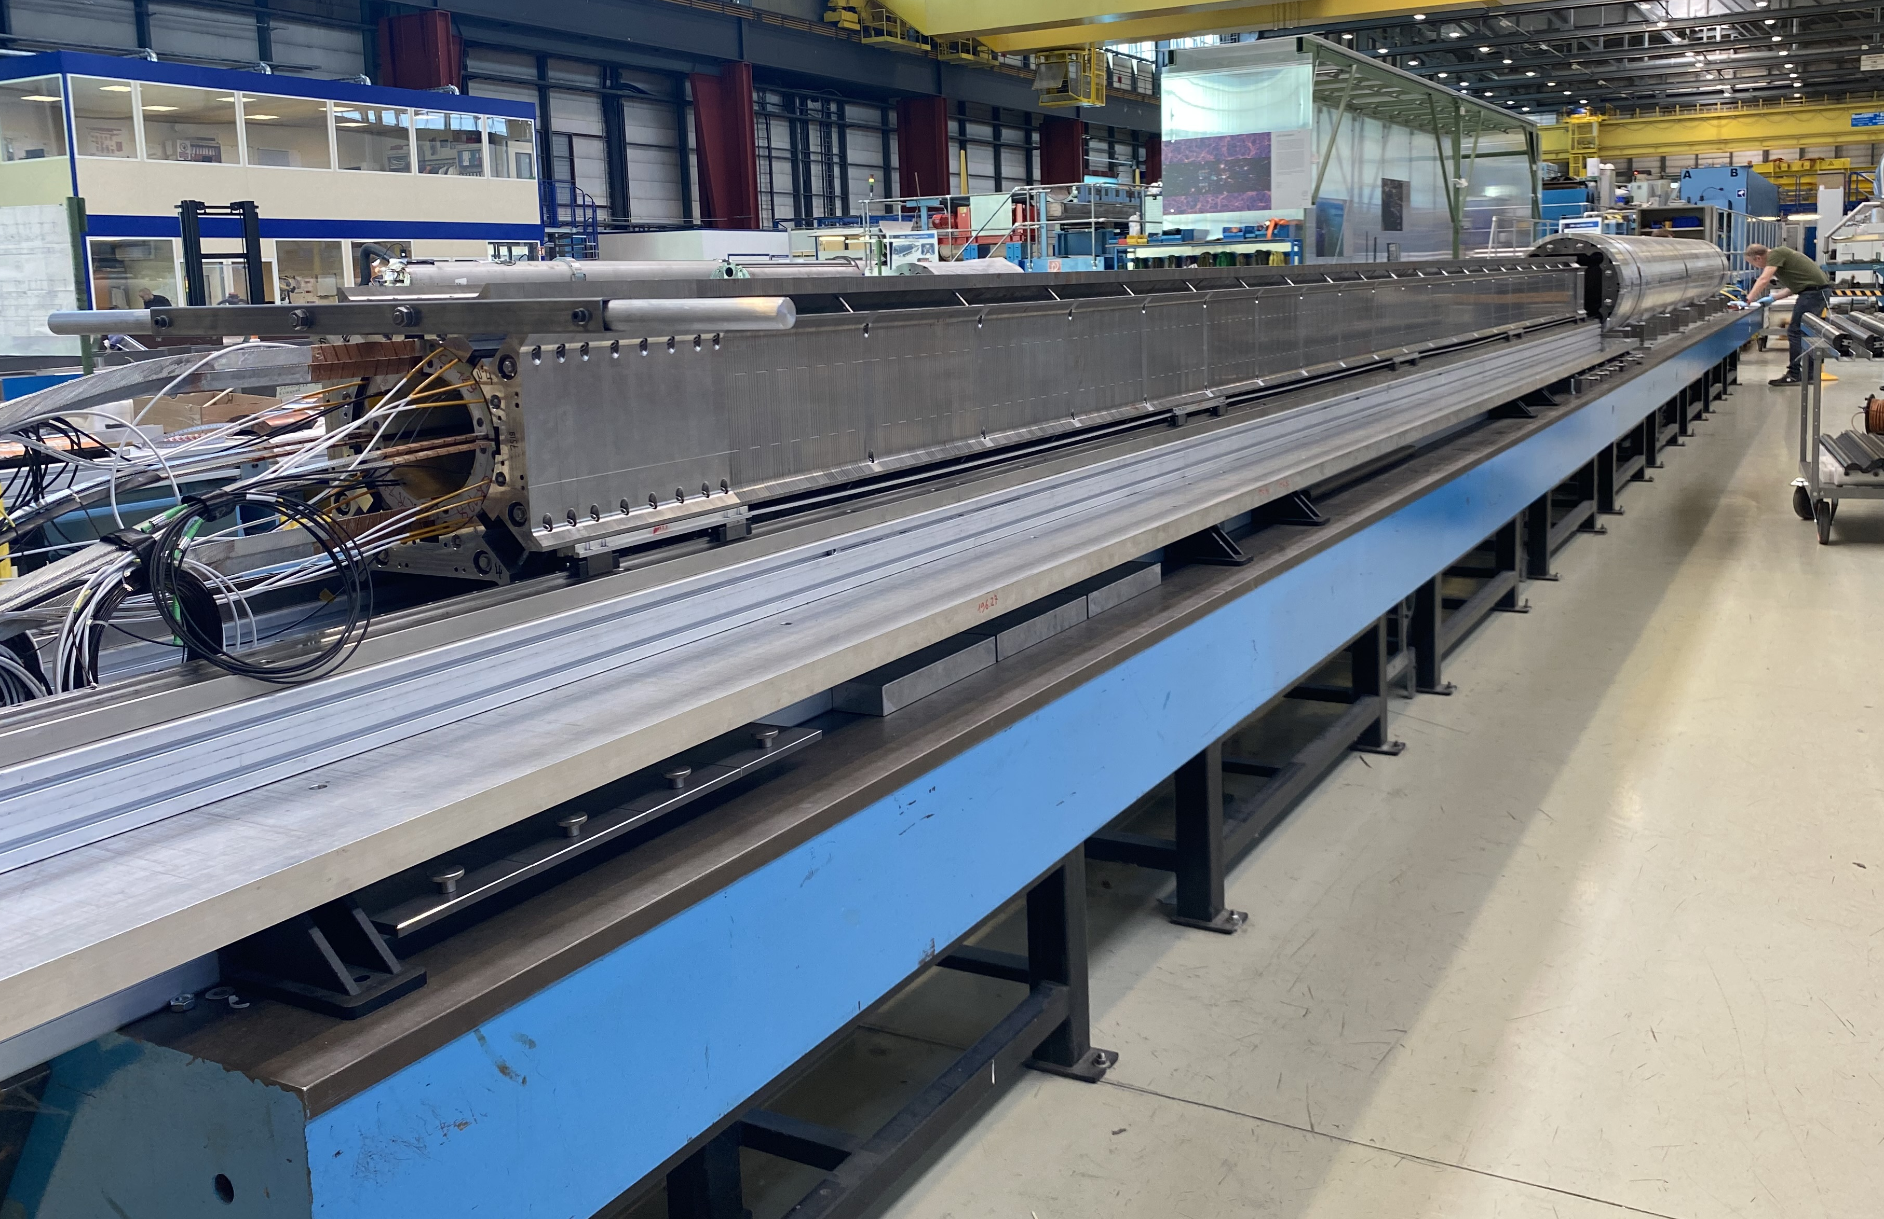
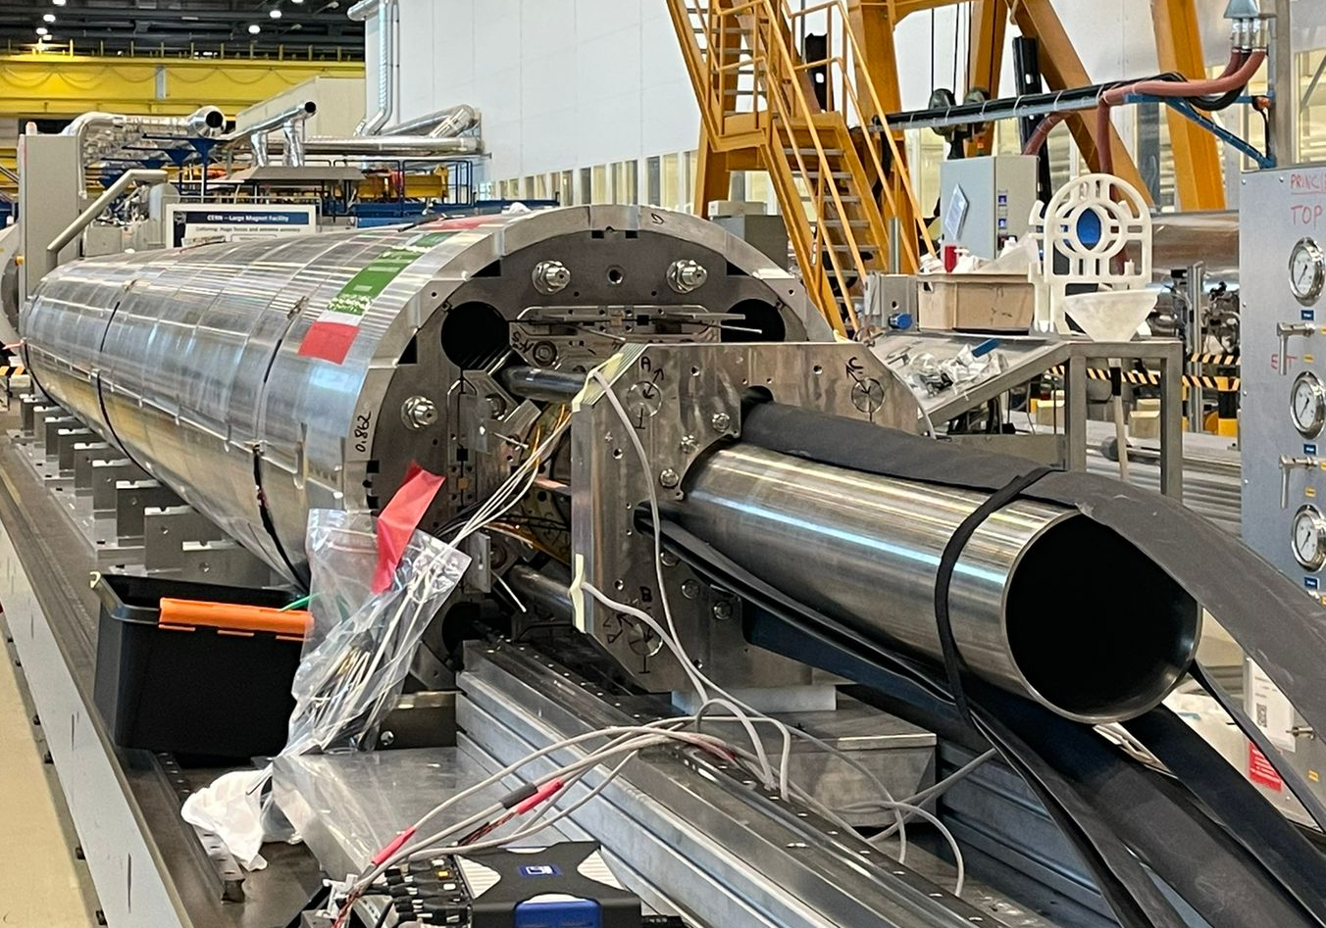
What is new from last CM?
Three magnets assembled last year, all following the new assembly procedure with auxiliary bladders in the cooling hole channels,
MQXFBMT4
October-November 2023
MQXFB03
April-May 2023
MQXFB04
Sept-October 2023

Slide 4
Outline
Magnets overview
Lessons learnt
Overview on assembly data
Conclusion

Slide 5
Outline
Magnets overview
Lessons learnt
Overview on assembly data
Conclusion

Slide 6
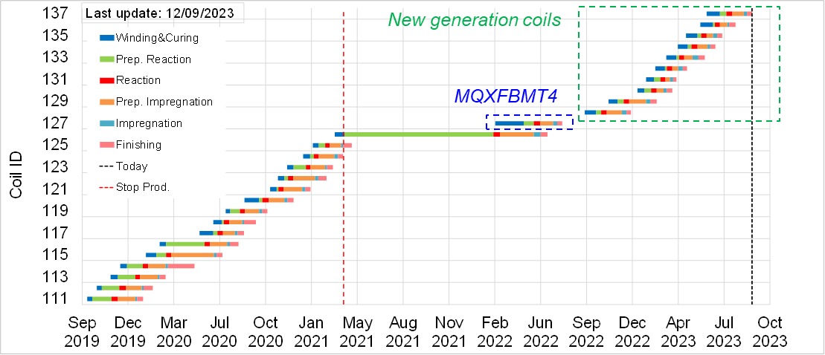
MQXFBMT4
Coils:
  104, 105 and 107: non-limiting coils from BP1, very early-stage production (2017-2018)
  127: first ‘transition coil’, minor modifications with respect to previous coils (larger gaps between poles, rounded edges..). Same observables (hump & belly) as the coils assembled in previous magnets (BP1-BP2-BP3-B02)
Goal:
  Improve our understanding on the phenomenology for conductor limitation, in case MQXFB03 coils do not reach performance (unknowns-unknowns) and we need to go back to the ‘old’ coil fabrication process
  Practice coil replacement. We follow AUP strategy for the shimming, based on the virgin coil geometry measurements (and not after cold powering test)

Slide 7
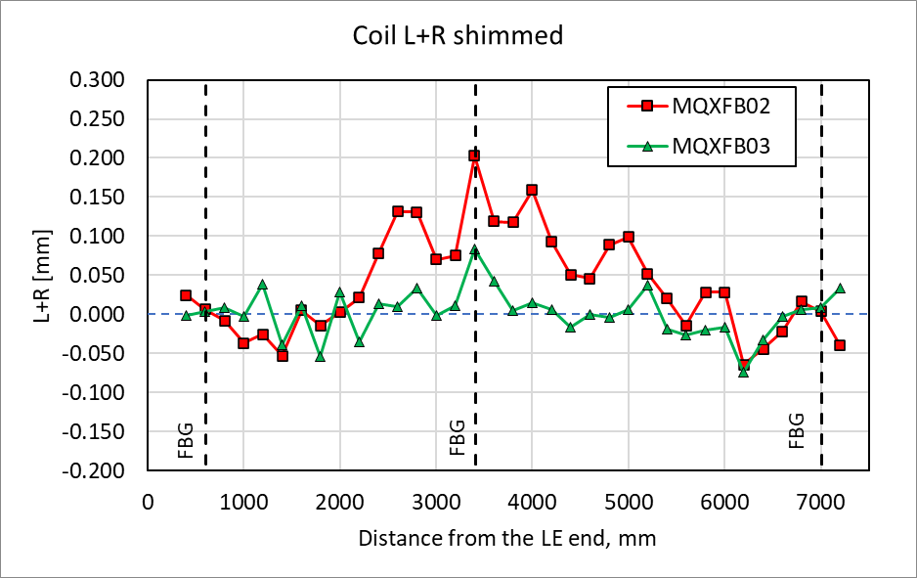
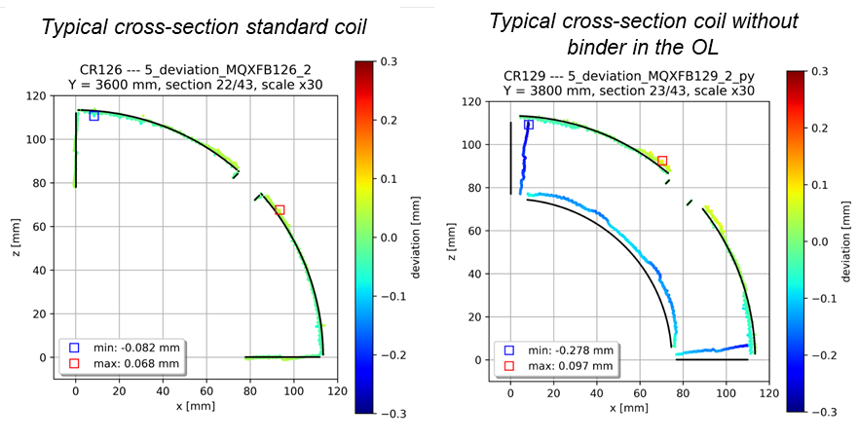
MQXFB03
Coils:
  128-129-130-131, the four first ‘New Generation’ coils (more info here)
Difference with respect to MQXFB02: coil geometry
  MQXFB03 coils are smaller than nominal, with no-belly
  MQXFB03 coils have a mid-plane angular deviation (the coil covers 89.6 degrees instead of 90 degrees)

Slide 8
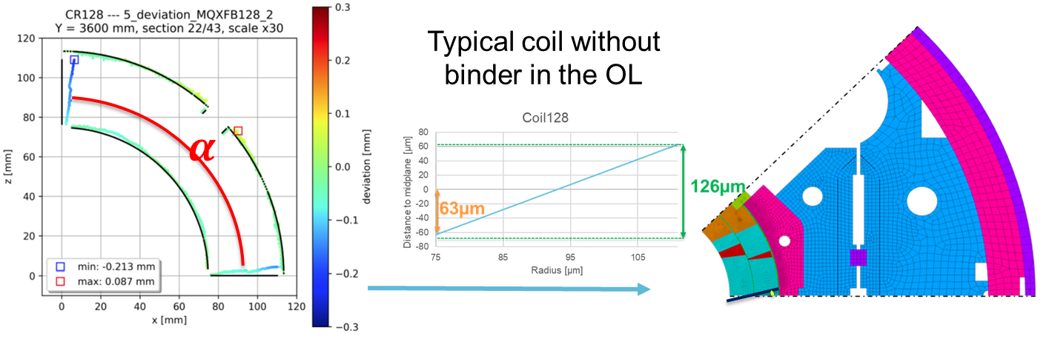
Assessment of the ‘new coil geometry’ impact
Under conservative assumptions, according to FEM, the 0.2 deg angular deviation corresponds to an increase of ≈ 15 MPa increase in the mid-plane stress (inner edge) under conservative assumptions according to FEM
Indico 1259143

Slide 9
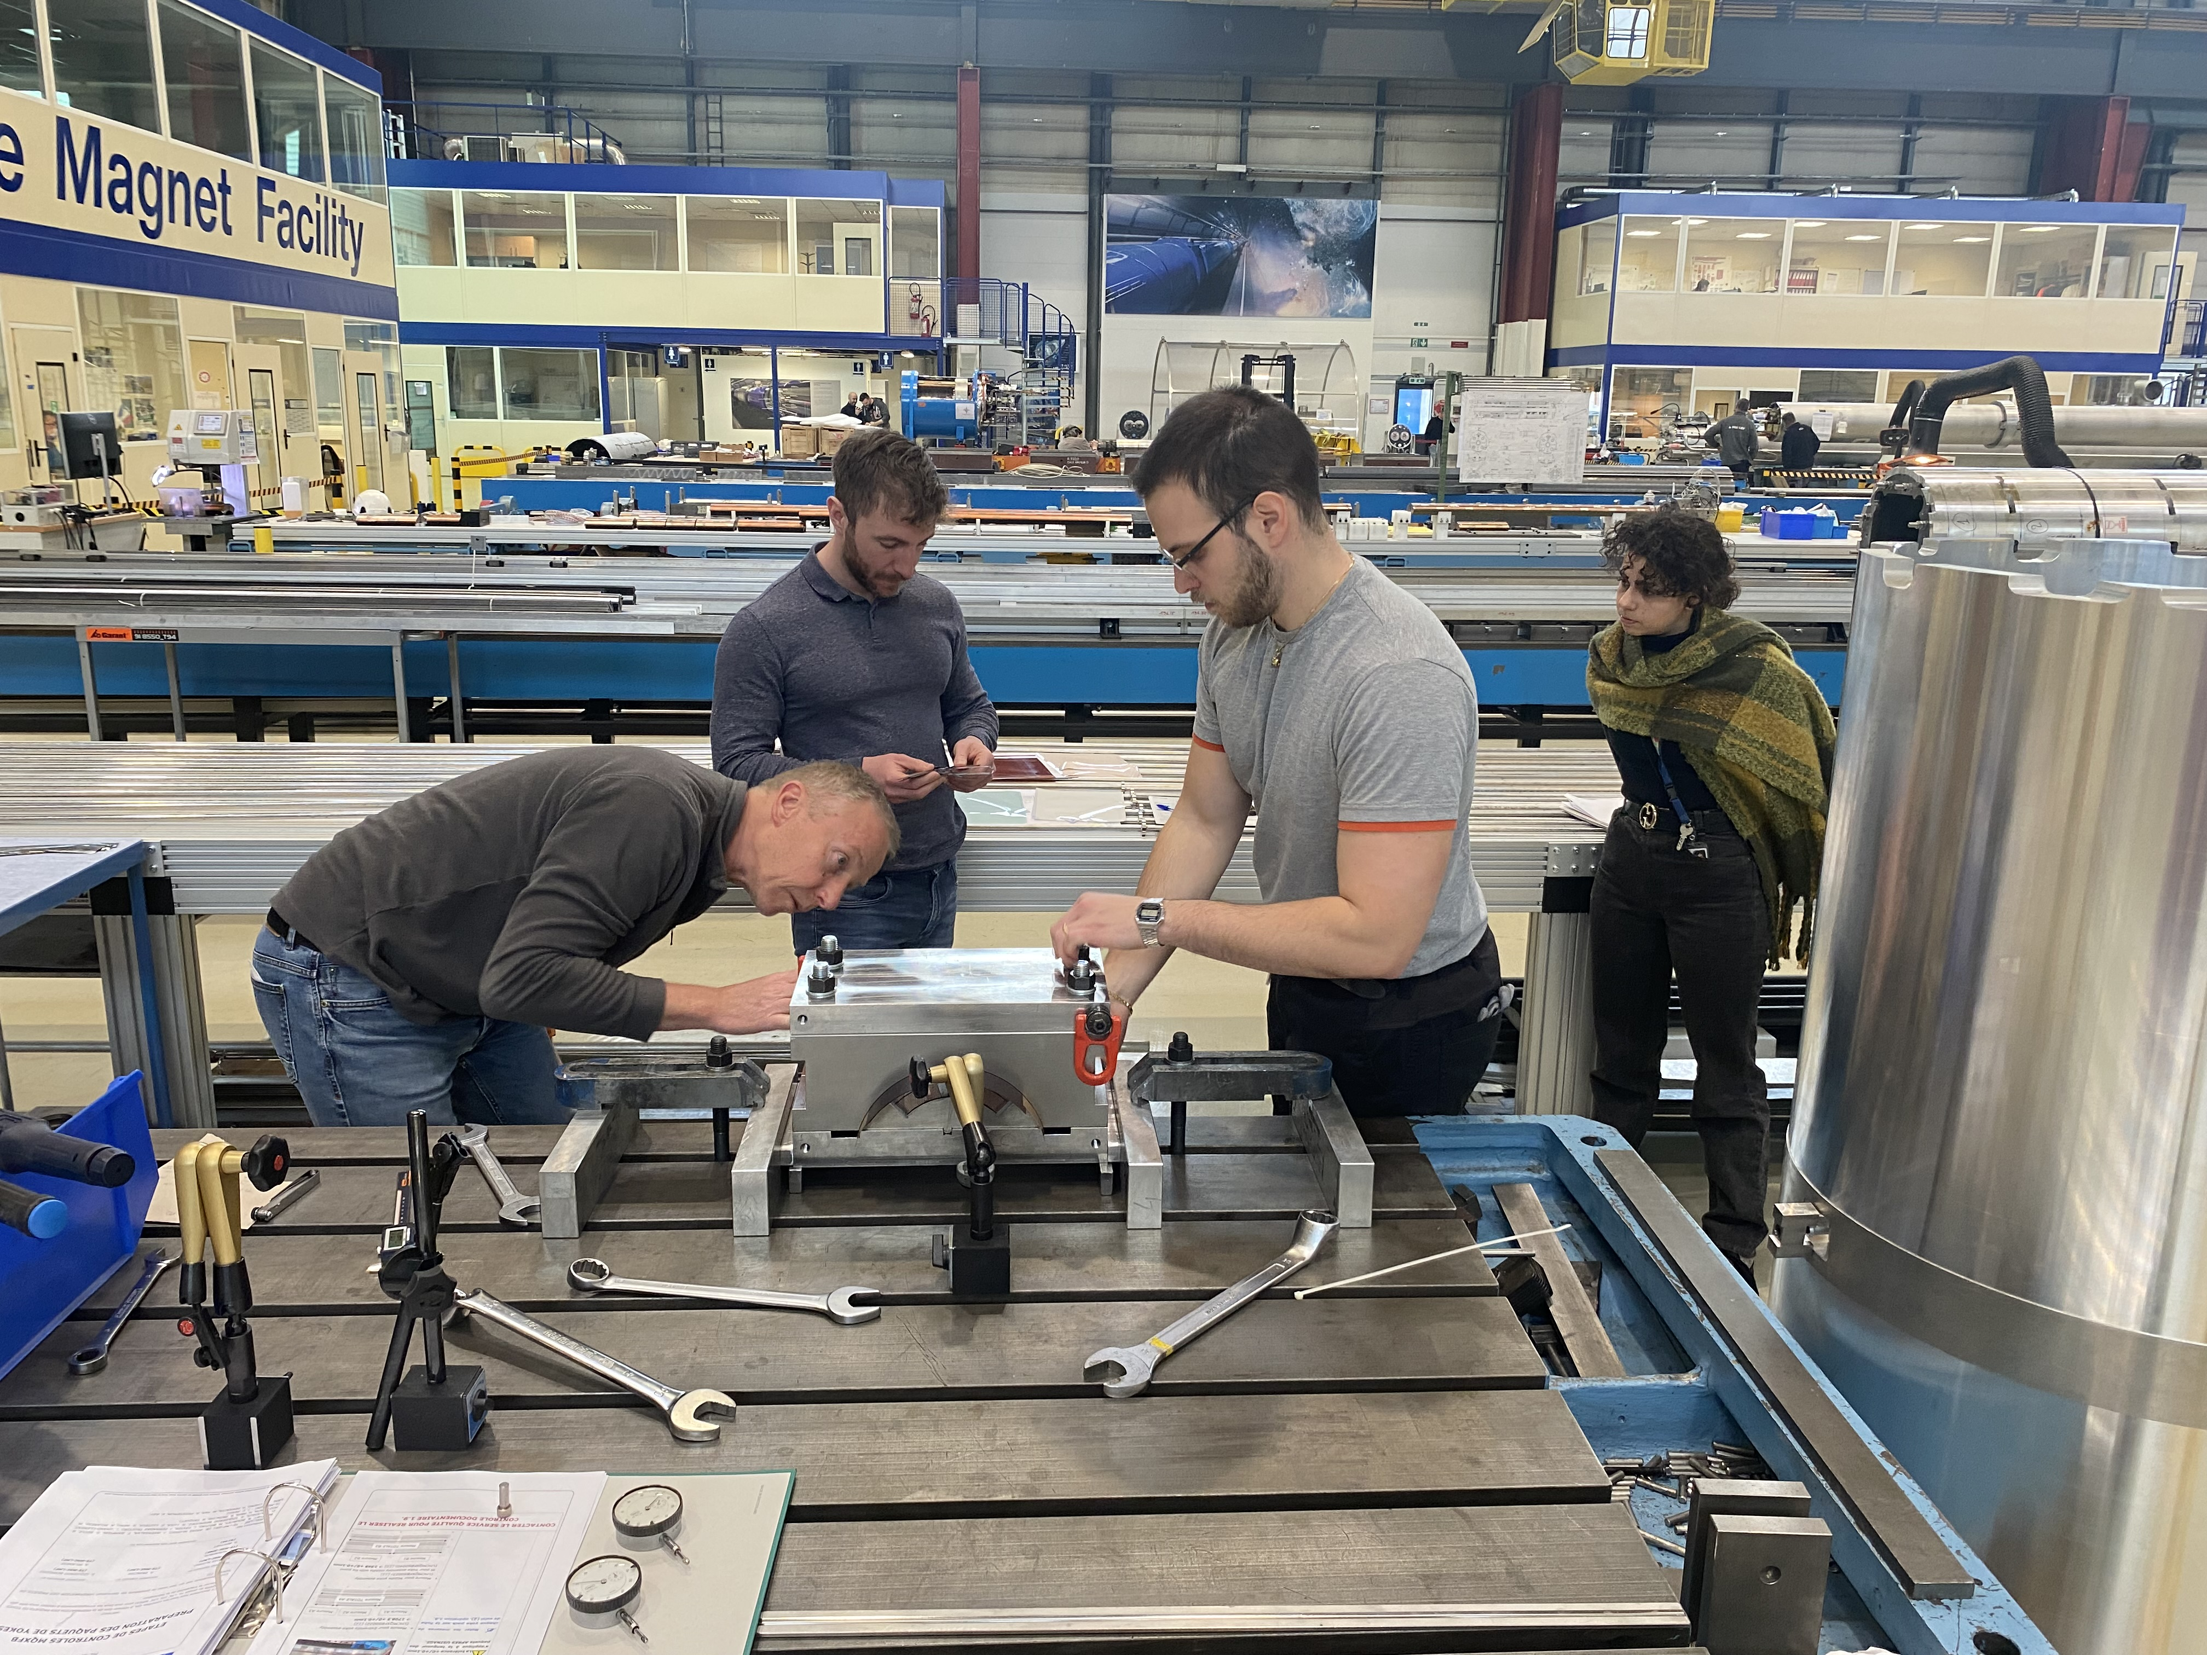
Assessment of the ‘new coil geometry’ impact
With the objective of better assessing the impact of the “new” coil geometry on the contact pressure between coils (mid-planes), we explored the use of a mock-up for compressive coil tests
Optimization of the test setup using a simplified 3D FE model. Contacts between the form-block and baseplate are open (checked with filler gauges)
All components have been measured using the FARO arm for the detailed preparation of the required shimming
  Torque applied = 250 Nm
  Target σ_{avg} (mid-plane) ~ 12 MPa
Difference in pressure distribution with the two geometries is minor, at the 10 MPa level or below
Based on these results, the difference in coil geometry is not compensated during assembly, and we target MQXFB02 pre-load level
Setup: Indico 1259143
Results: Indico 1262277

Slide 10
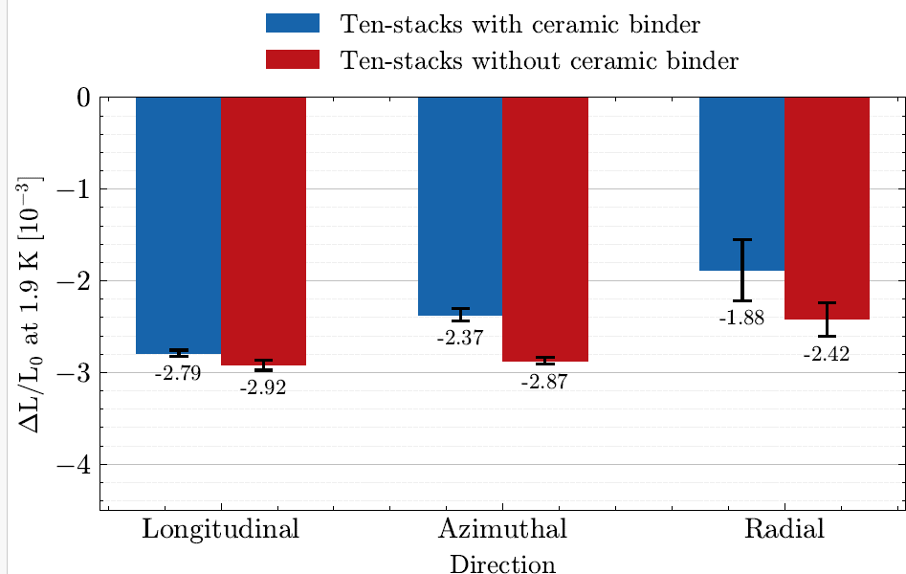
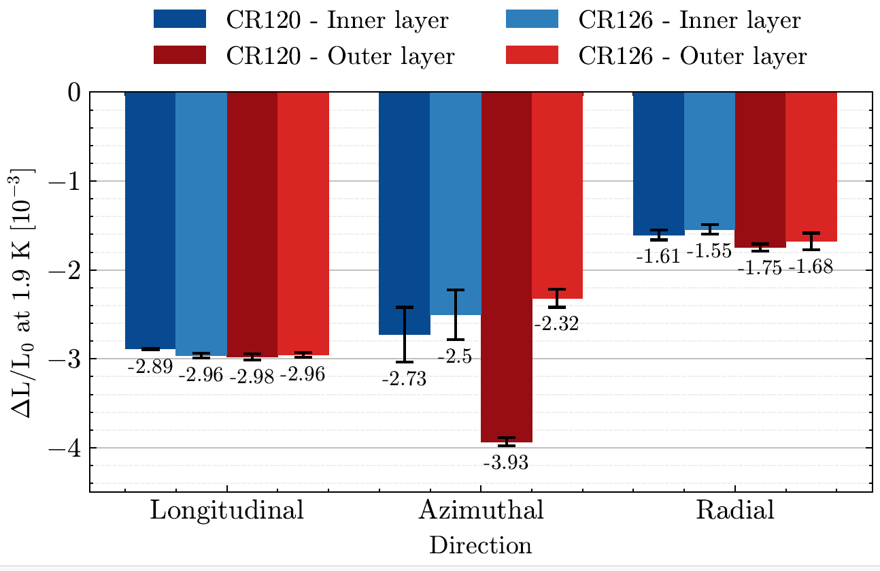
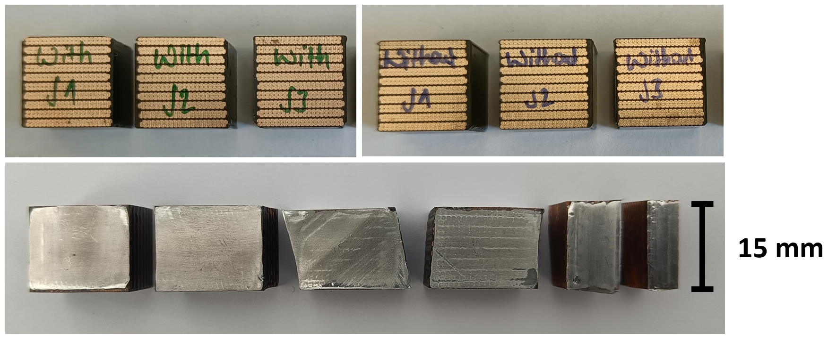
Assessment of the ‘new coil recipe’ impact
The ceramic binder has an impact on the mechanical strength of the S2-glass braided insulation → does it have an impact on the mechanical properties of the impregnated coil?
In parallel, a mechanical characterization on coil and ten-stack samples was launched.
  First measurements on coils show a large impact on thermal contraction in the azimuthal direction (4 mm/m wo binder vs 2.3-2.8 mm/m w. binder
  Measurements on ten stacks show a much smaller impact (2.8 mm/m vs 2.4 mm/m)
EN-MME
See S.Holl, Study on the thermal contraction behavior of state-of-the-art Nb3Sn superconducting magnet coils
in the longitudinal, azimuthal, and radial direction, submitted for publication, submitted for publication

Slide 11
MQXFB04
Coils: 132-133-134-135, the next four ‘New Generation’ coils (more info here)
Goal: repeat MQXFB03
New generation coils
MQXFB04
MQXFB03

Slide 12
Outline
Magnets overview
Lessons learnt
Overview on assembly data
Conclusion

Slide 13
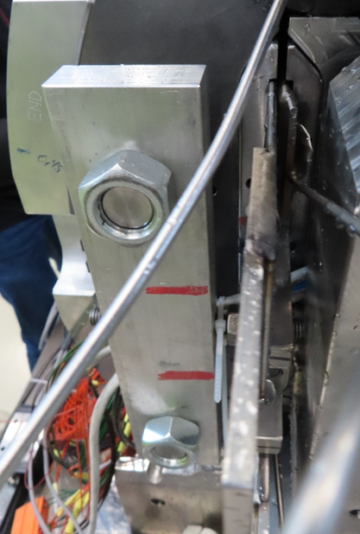
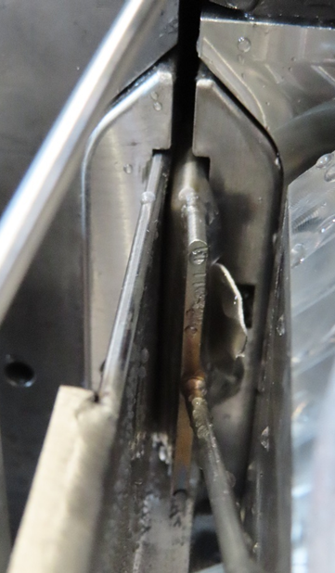
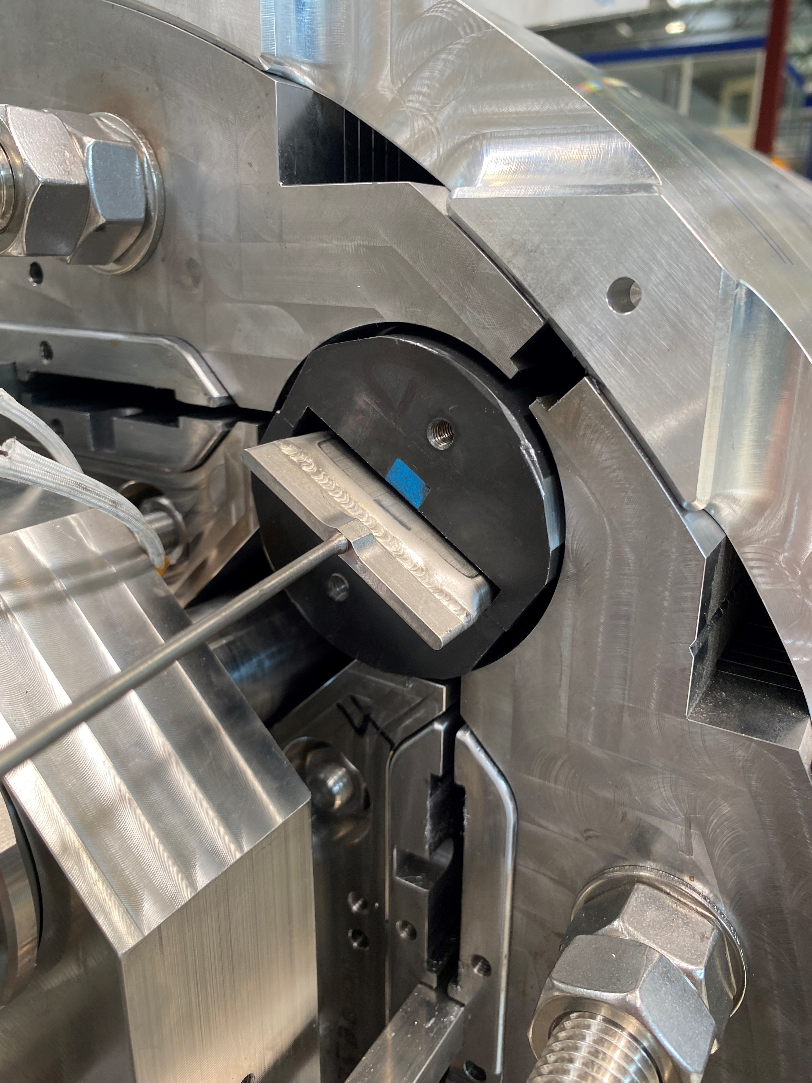
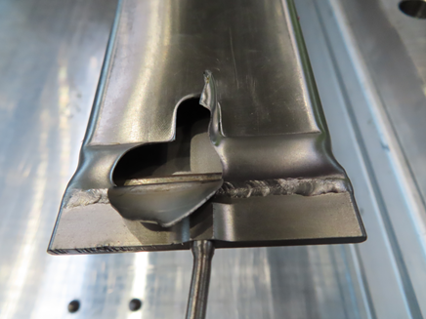
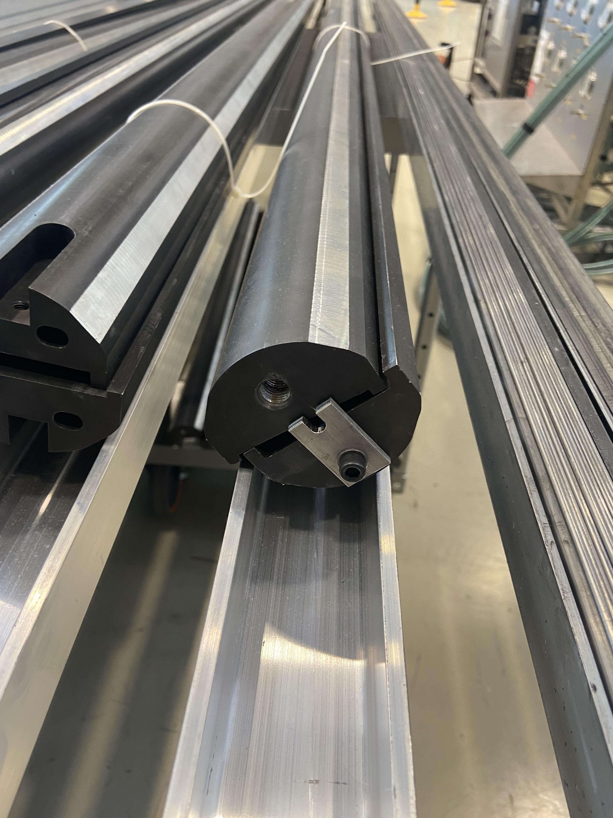
Bladder failure
Bladder failure in MQXFBMT4 (EDMS 2803022):
Failure mode indicates that the bladder was out of the masters (not supported). Positioning was checked before starting the loading. A second bladder was replaced preventively for the same reason.
Like MQXFBP1, MQXFBMT2 → FBG strain drift after failure. https://indico.fnal.gov/event/57918/
Improved layout from MQXFBMT4
Bladder failure in MQXFBMT4

Slide 14
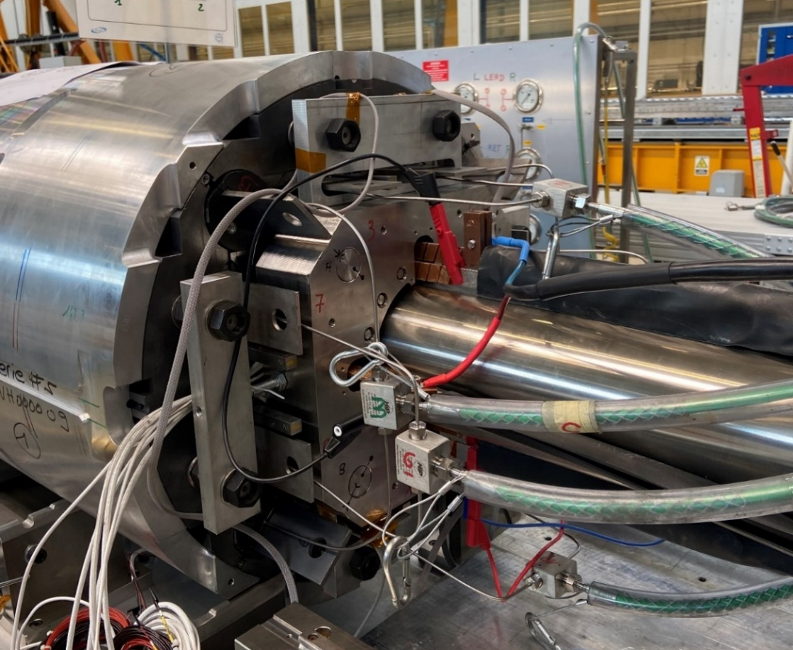
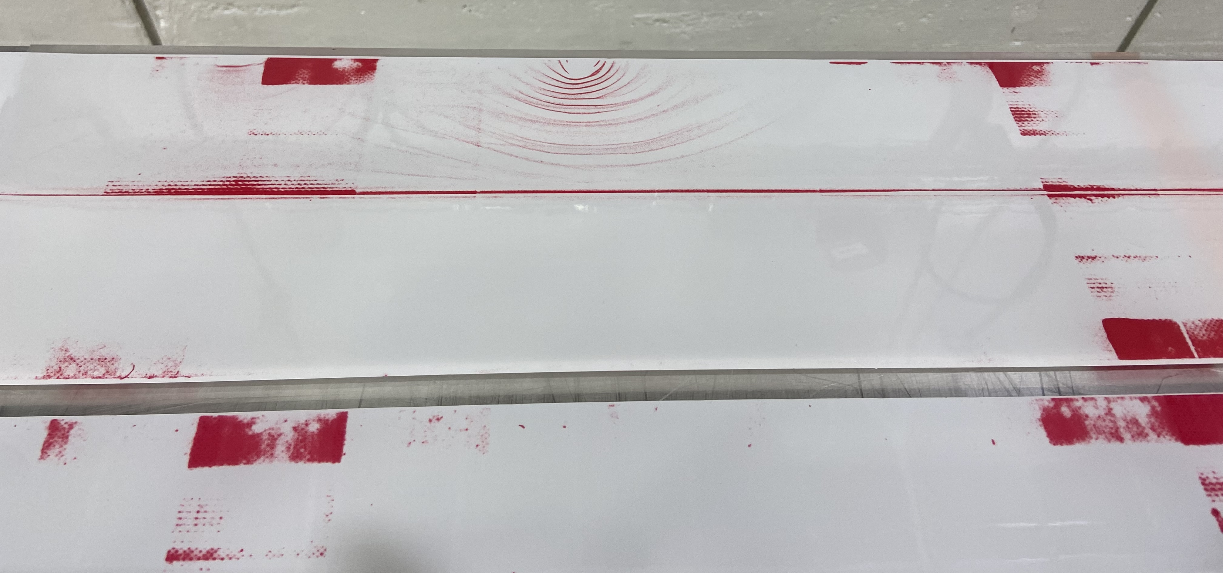
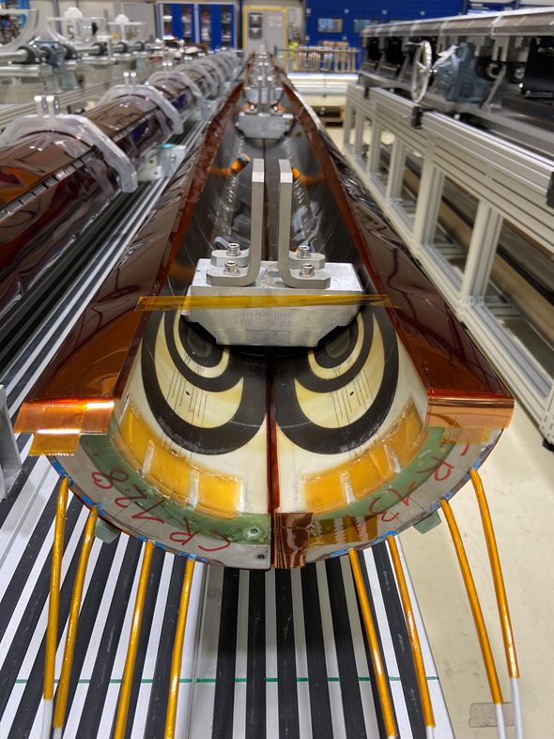
Other minor improvements
Ground insulation forming tool optimized to host smaller coils
Coil bumpers modified to host a cold bore tube with 0.5 mm insulation
Iteration on the end-plate alignment tooling
Master geometrical control before assembly
For a more exhaustive list, see https://indico.cern.ch/event/1327153/ and https://indico.cern.ch/event/1269409

Slide 15
Outline
Magnets overview
Lessons learnt
Overview on assembly data
Conclusion

Slide 16
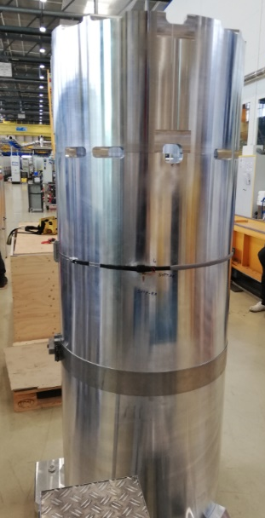
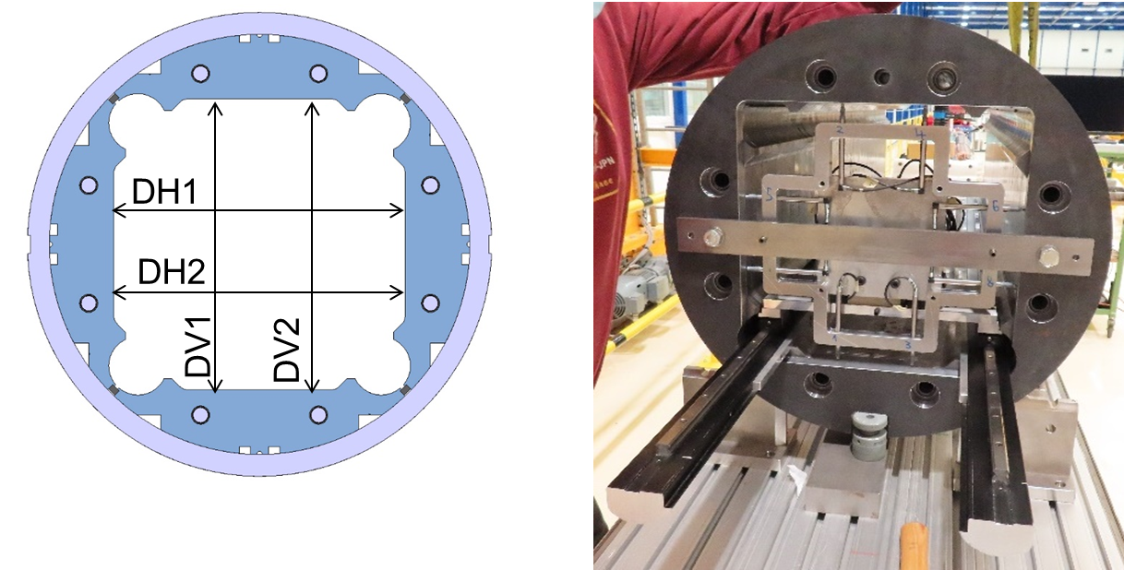
Yoke-shell modules
Monitored parameters:
  Shell strain
  Bladder pressure
  Yoke cavity size, defined as the average of the horizontal (DH1 + DH2)/2 or the vertical (DV1 + DV2)/2 dimensions
  Yoke uniformity, defied as the average of the vertical or horizontal cavity dimension in each cross-section with respect to the measured average vertical or horizontal dimension of the entire yoke shell module
  Yoke squareness, defied as the difference between the left and right (DV1 – DV2) or top and bottom (DH1 – DH2) dimensions

Slide 17
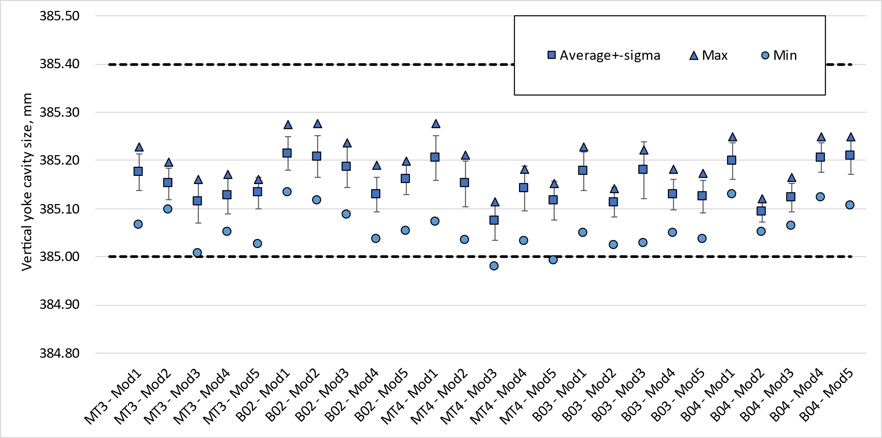
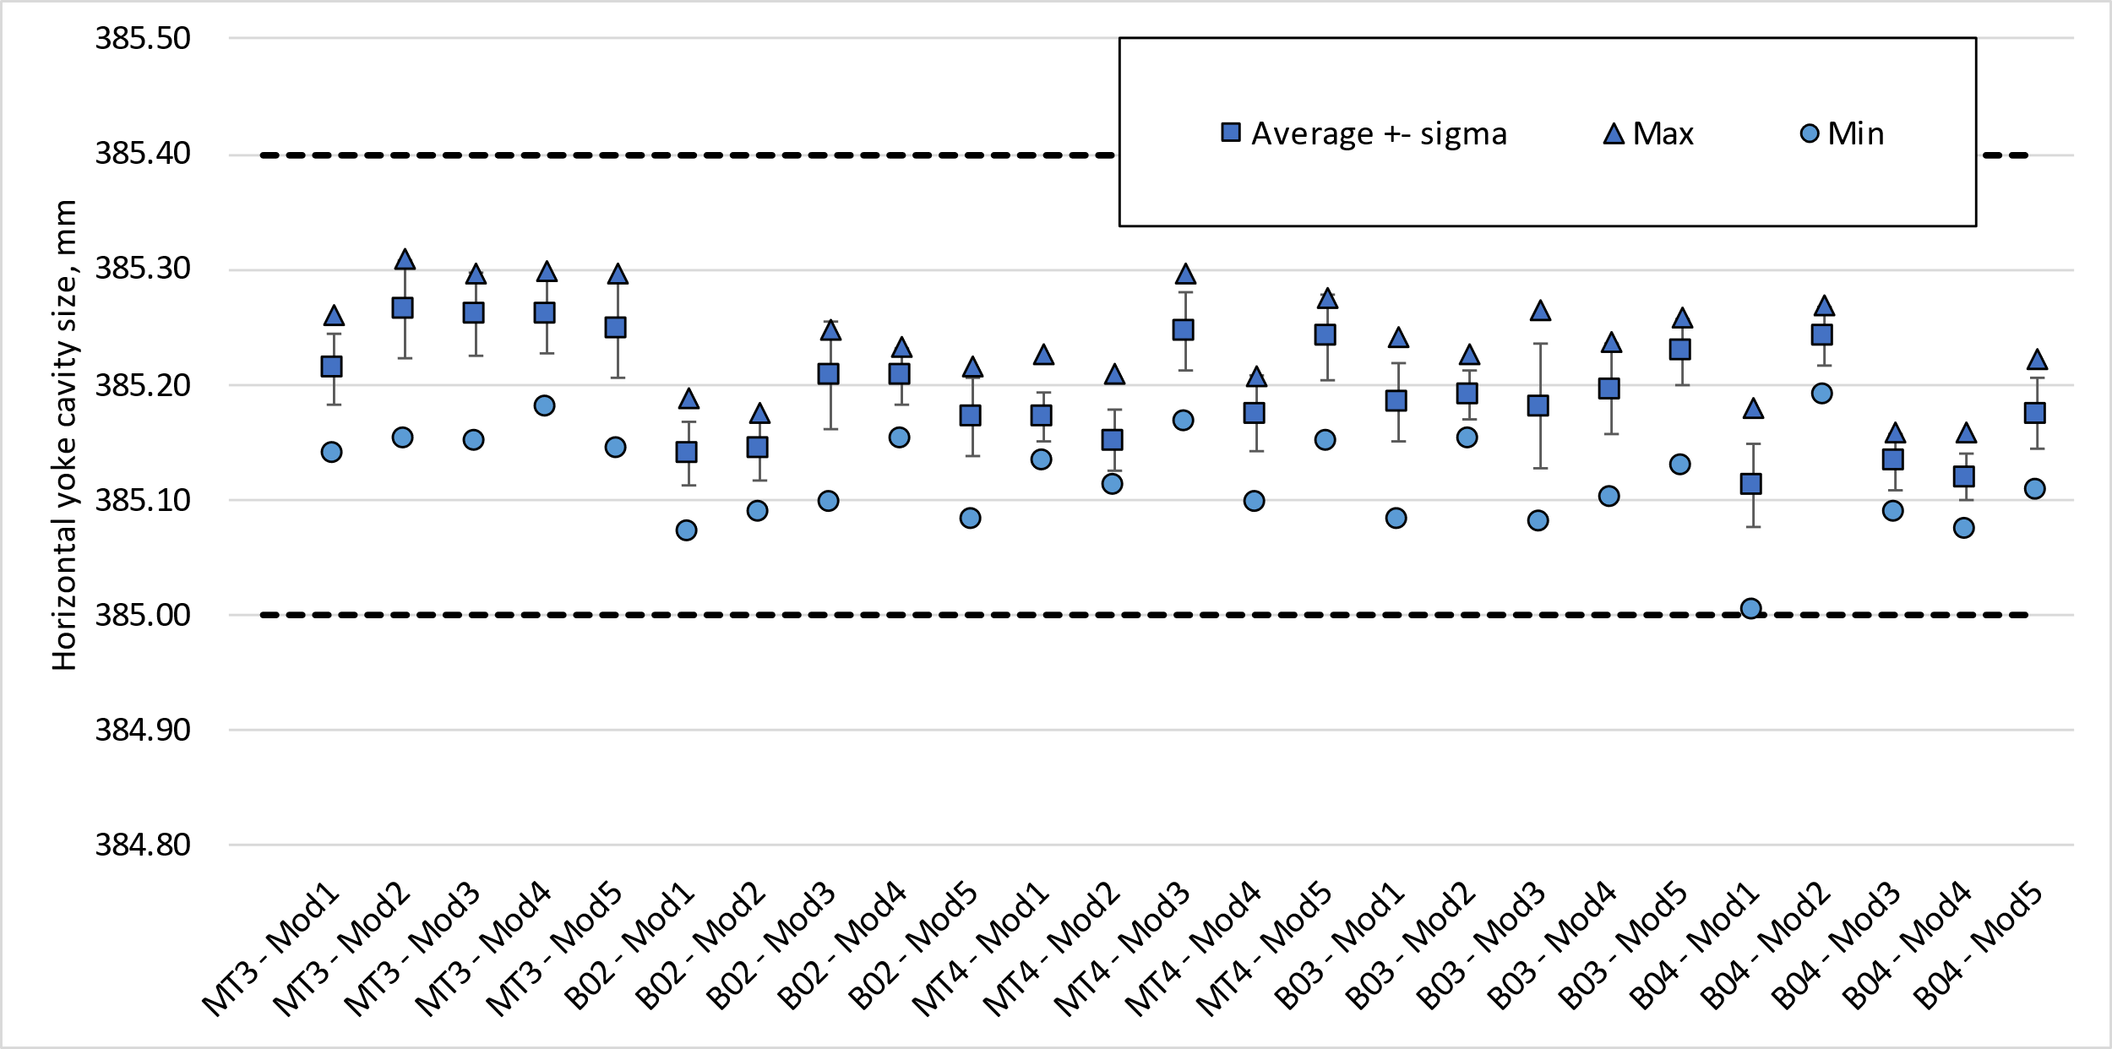
Yoke cavity size (vertical sub-assembly)
Yoke cavity size within targets
  The average vertical and horizontal yoke cavity dimensions at each cross-section shall be within +385.125 -0.125/+0.275 mm along the module length.

Slide 18
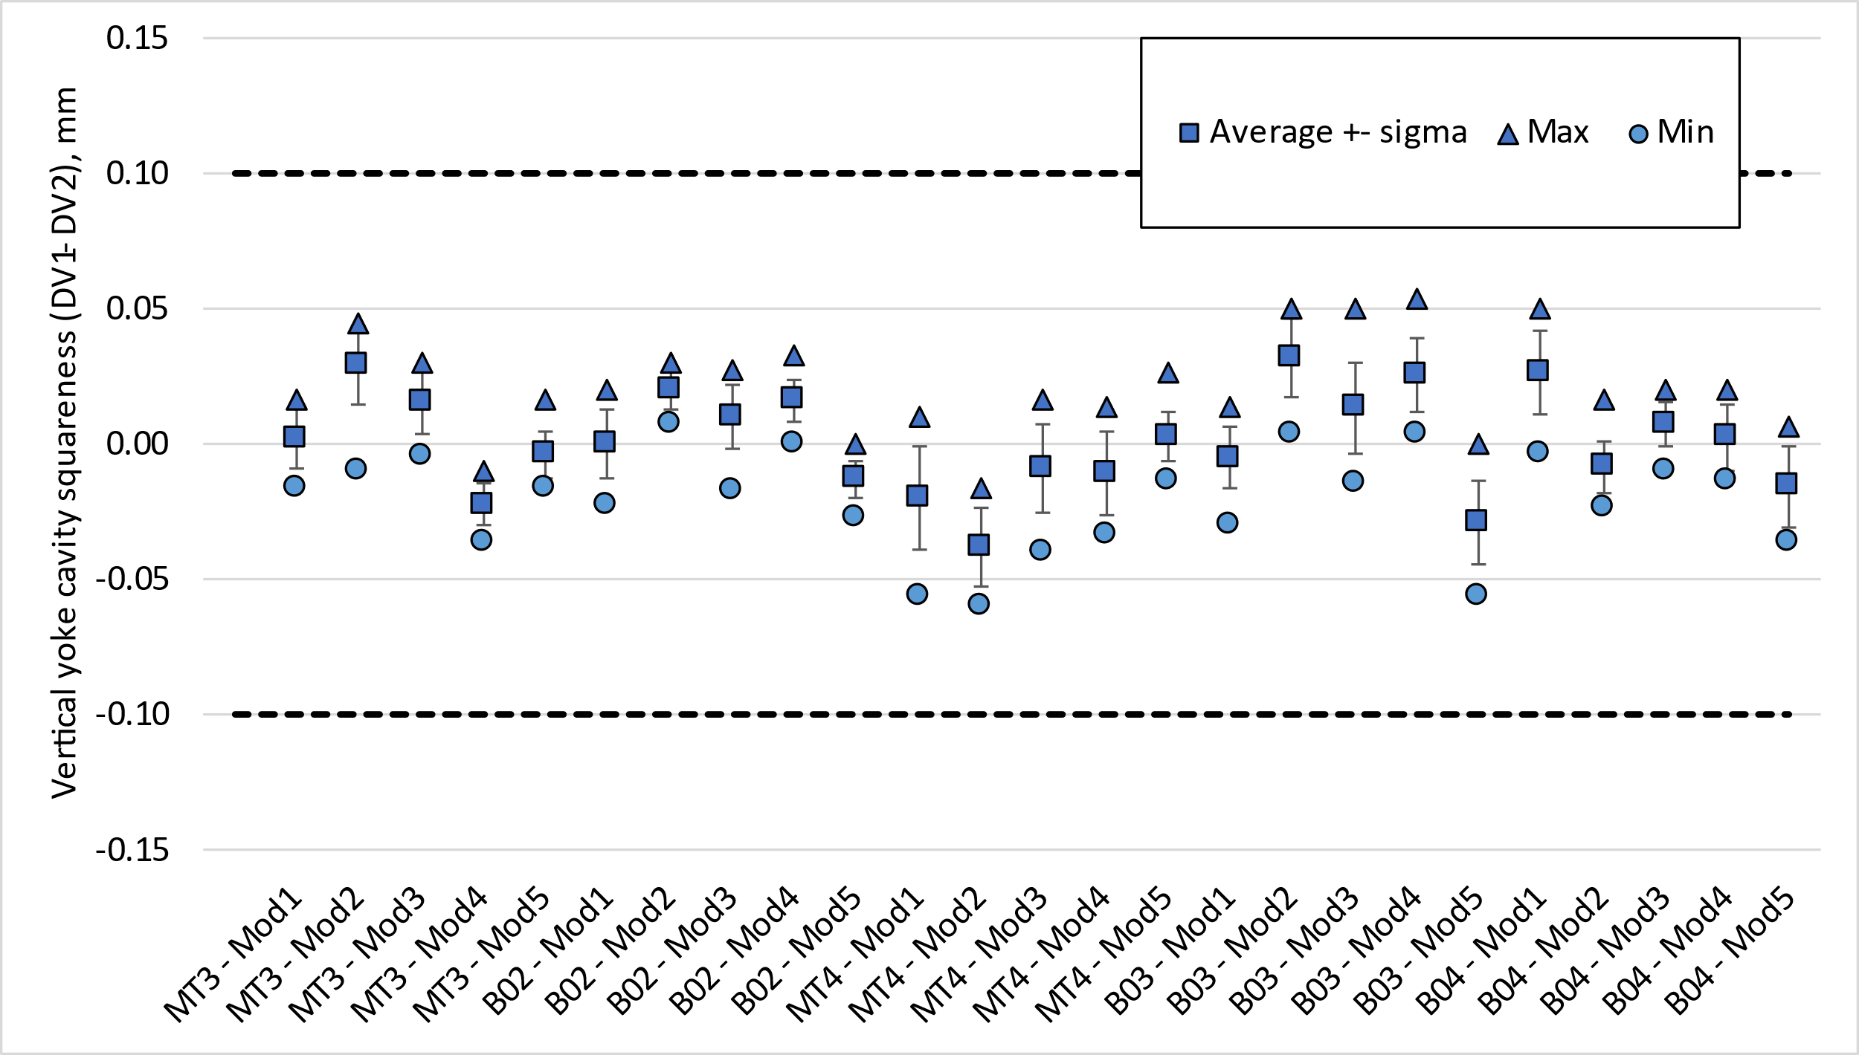
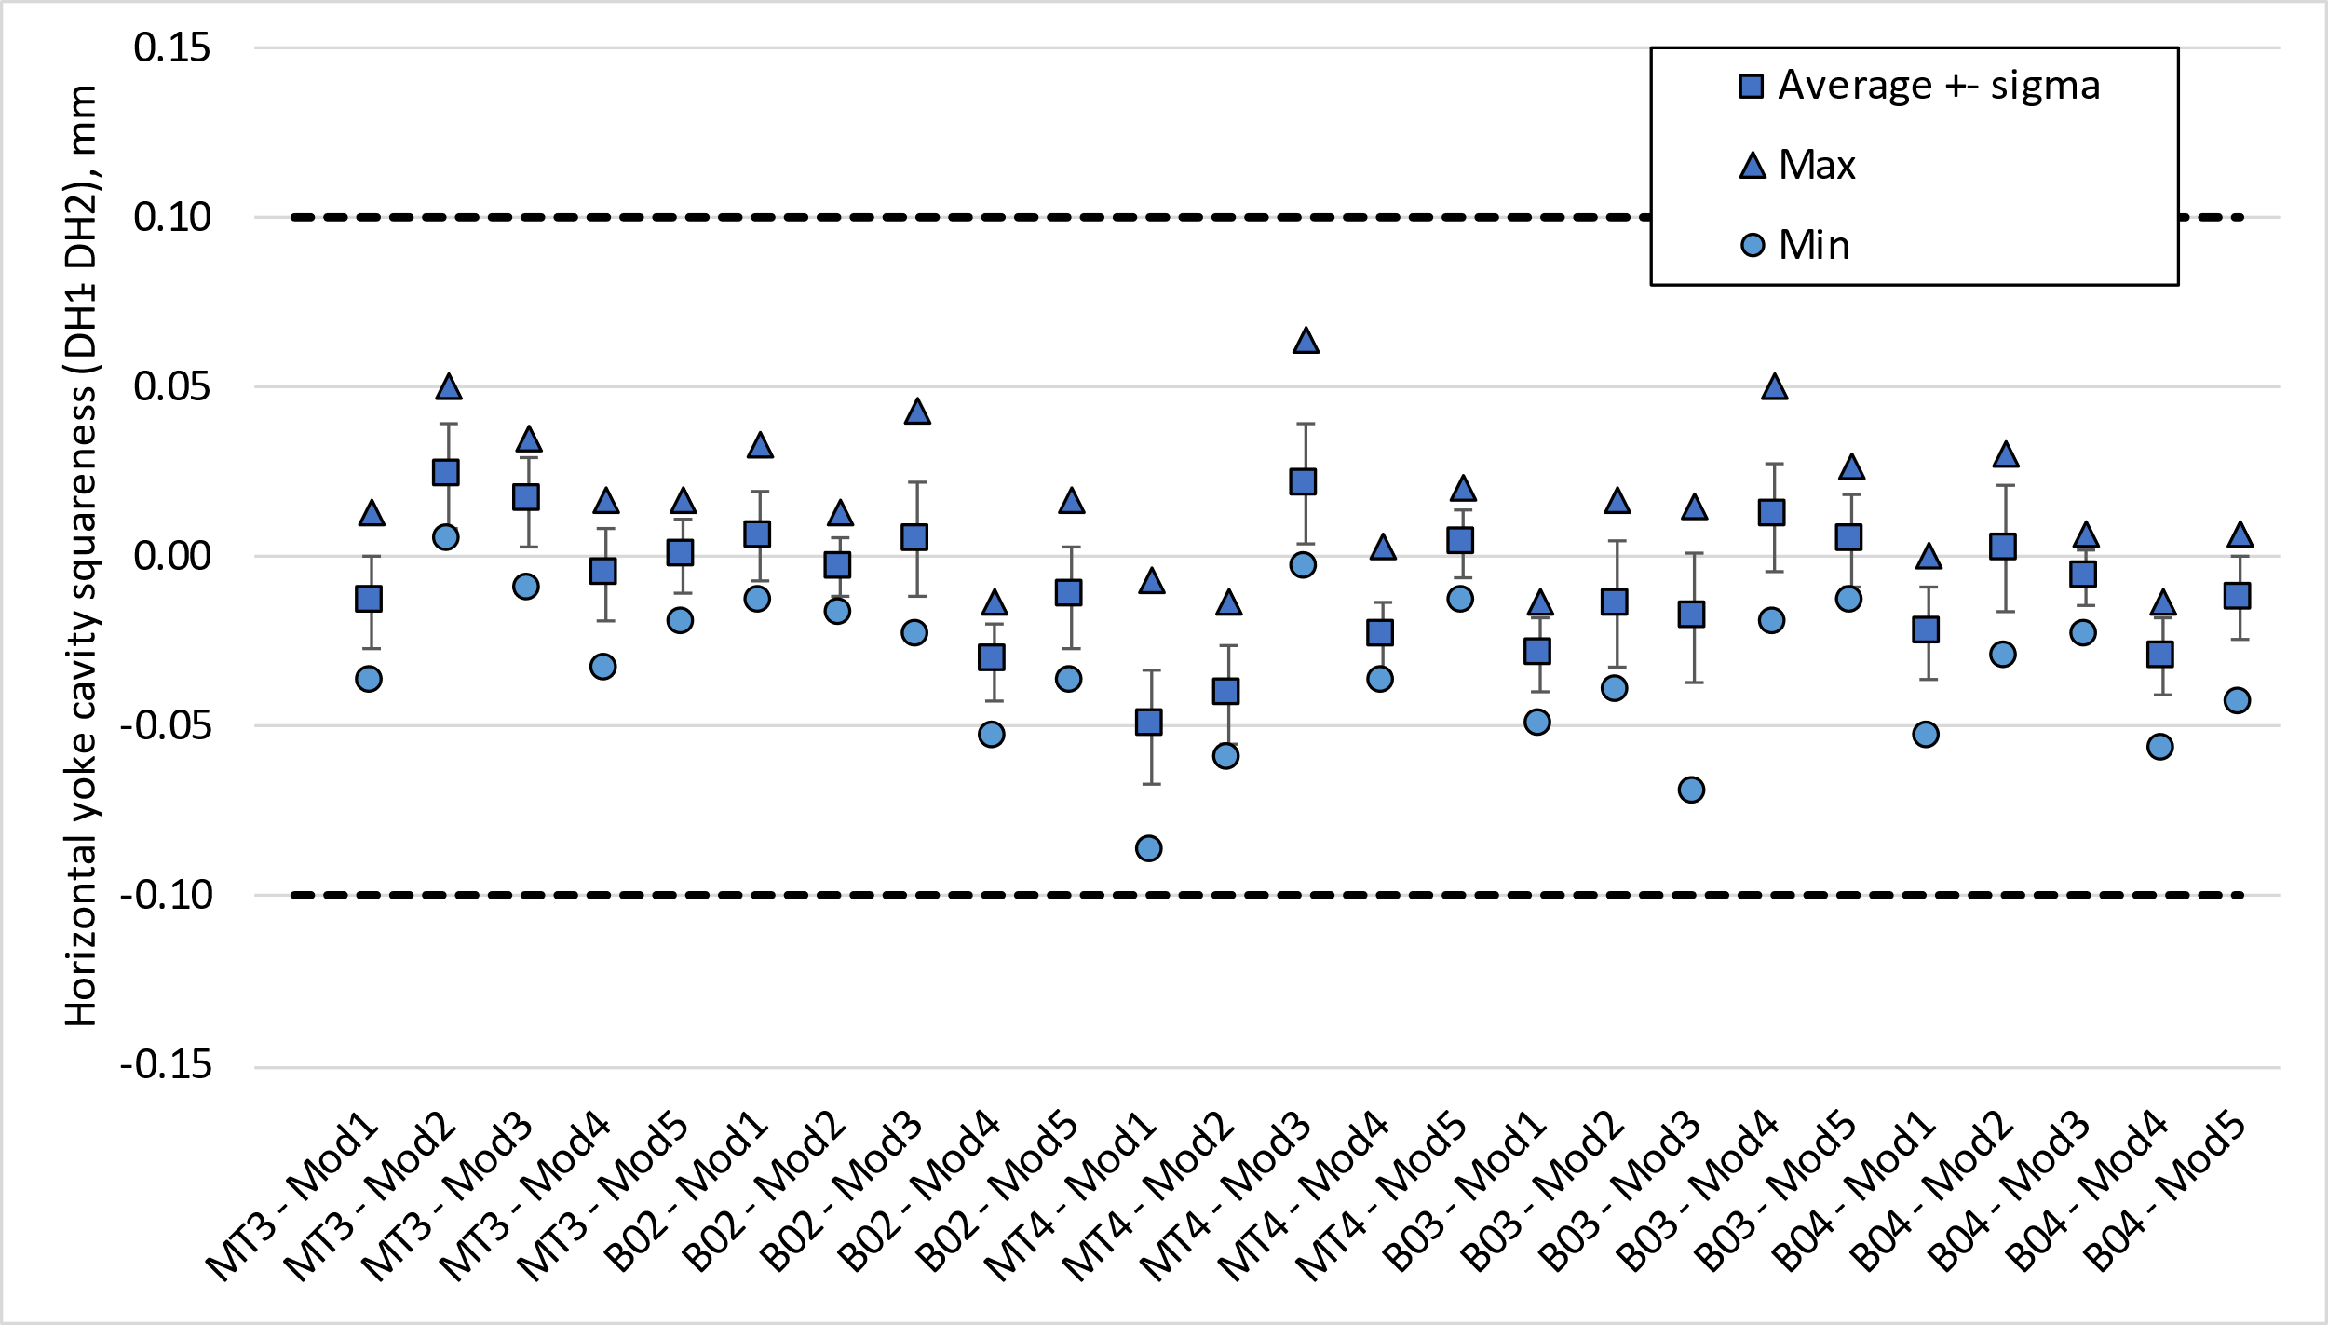
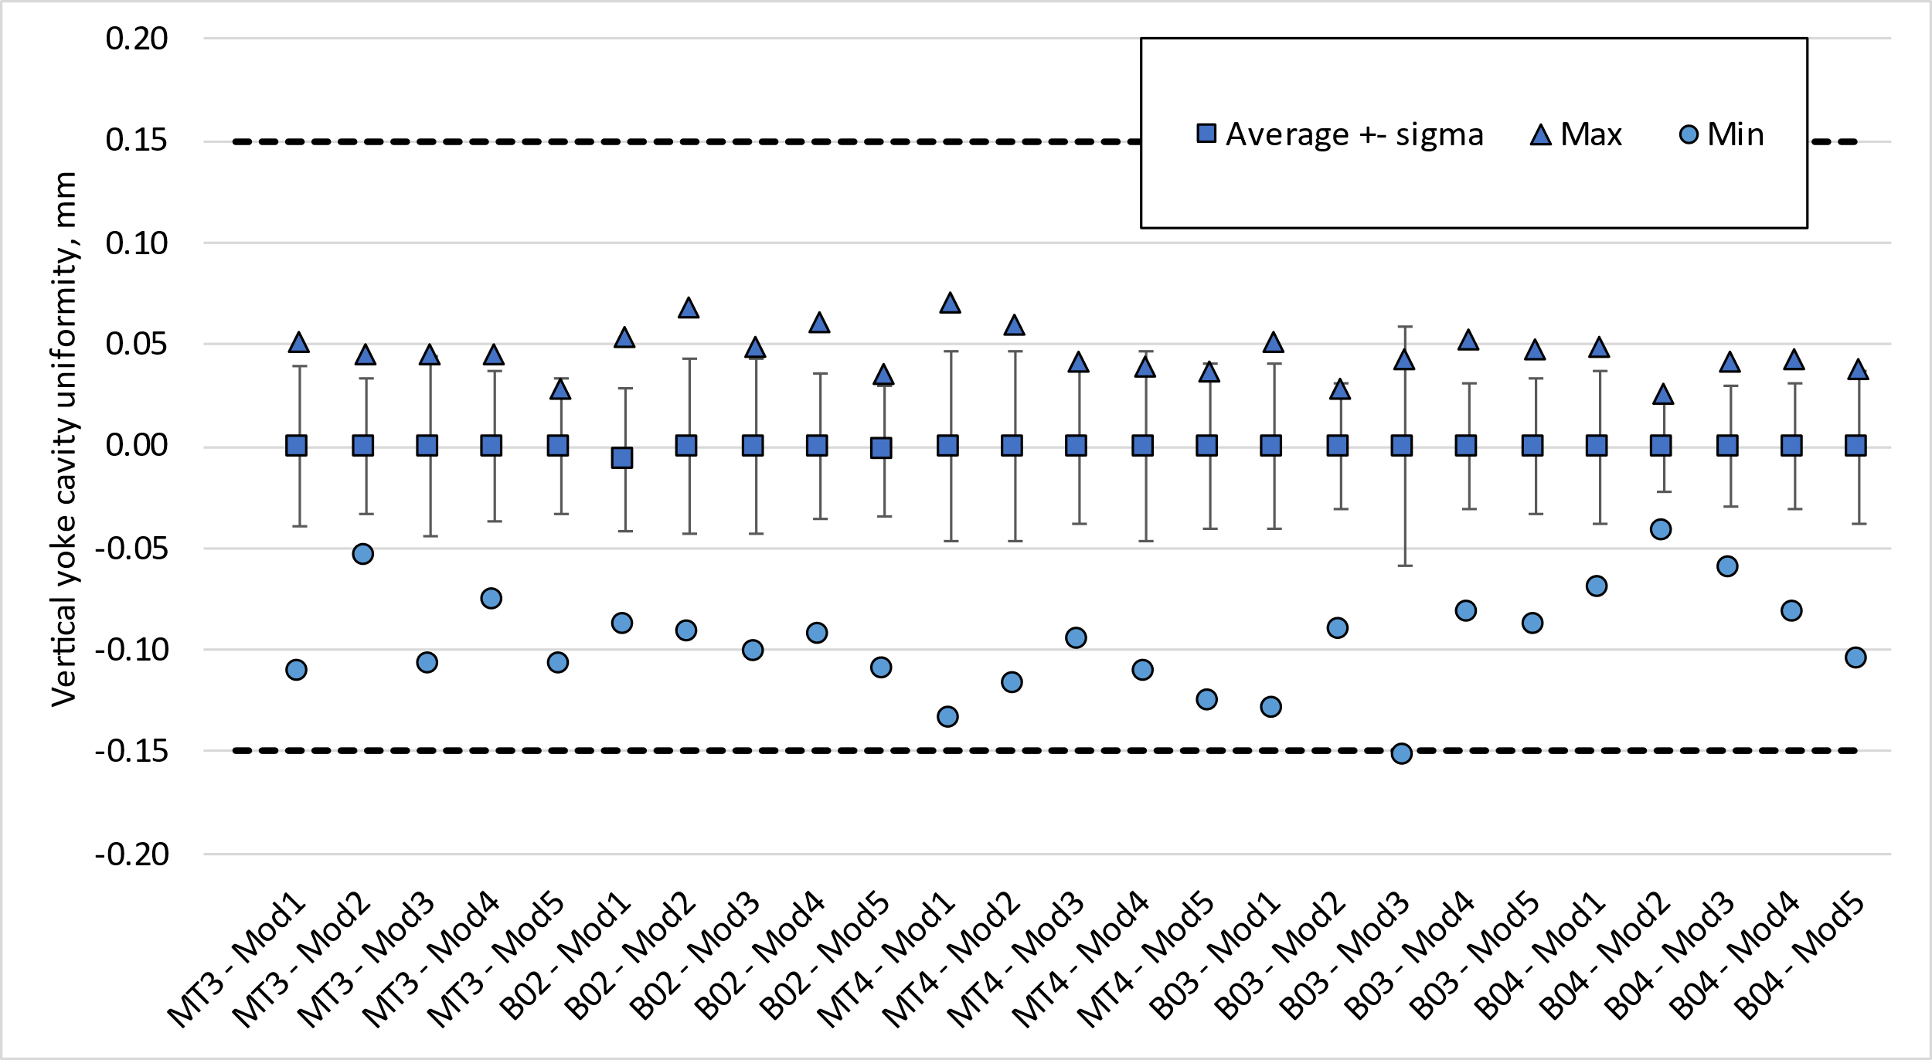
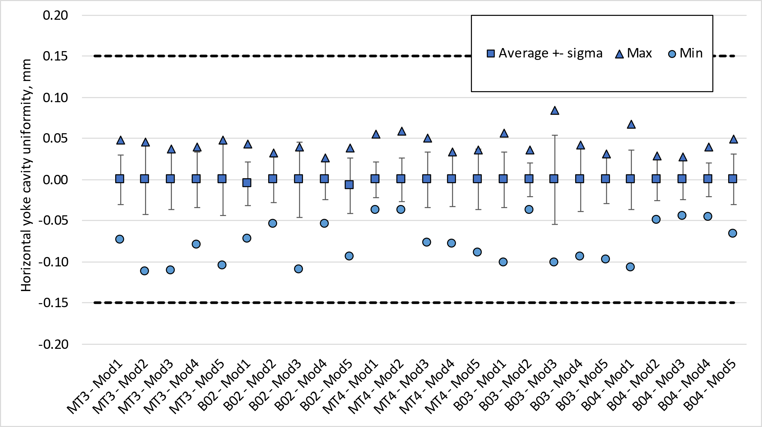
Yoke cavity size (vertical sub-assembly)
Squareness and uniformity
  The average vertical and horizontal uniformity at each cross-section shall be within -0.15/+0.15 mm.
  The average vertical and horizontal squareness at each cross-section shall be within -0.10/+0.10 mm.
DV1-DV2
DH1-DH2
Squareness
(DV1 + DV2)/2 – ave((DV1 + DV2)/2 )
(DH1 + DH2)/2 – ave((DH1 + DH2)/2 )
Uniformity

Slide 19
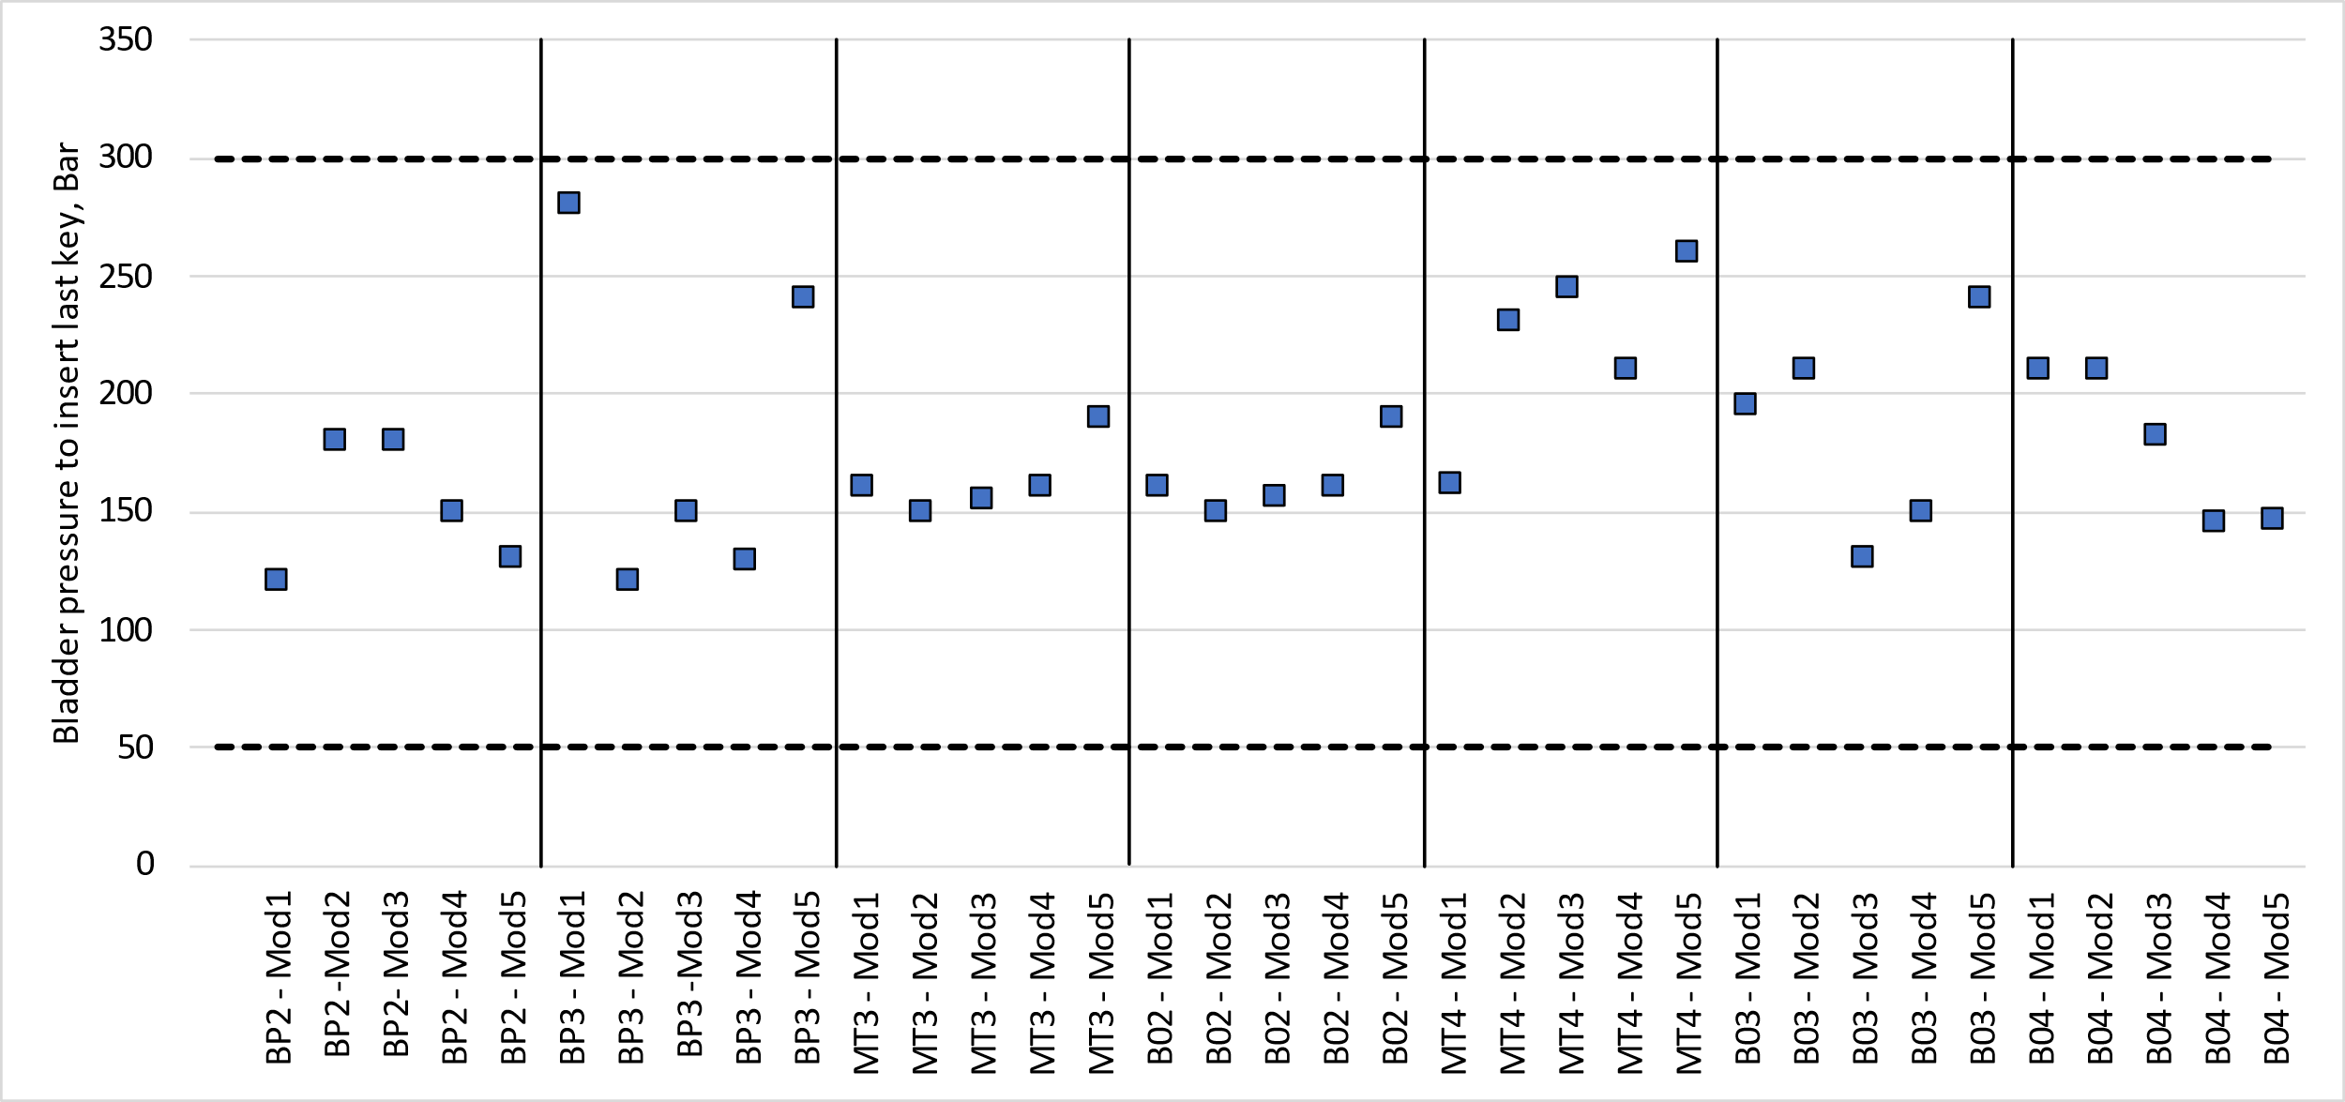
Vertical yoke-shell sub-assembly
Strain and bladder pressure within targets
  Yoke keys were 12.1 mm thick in all the cases below

Slide 20
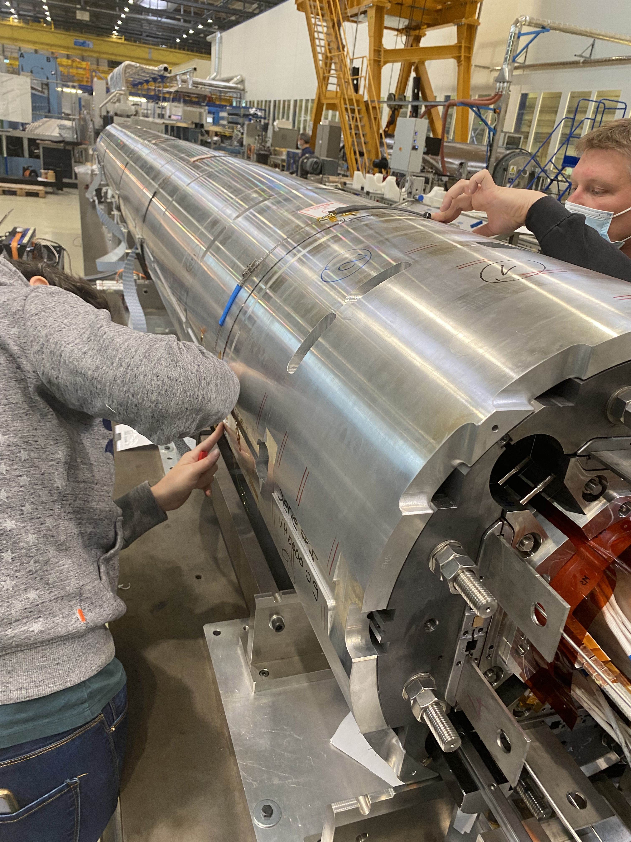
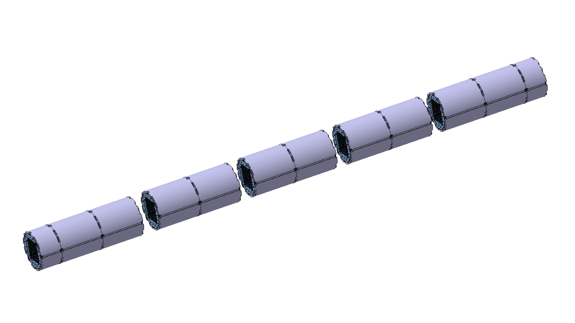
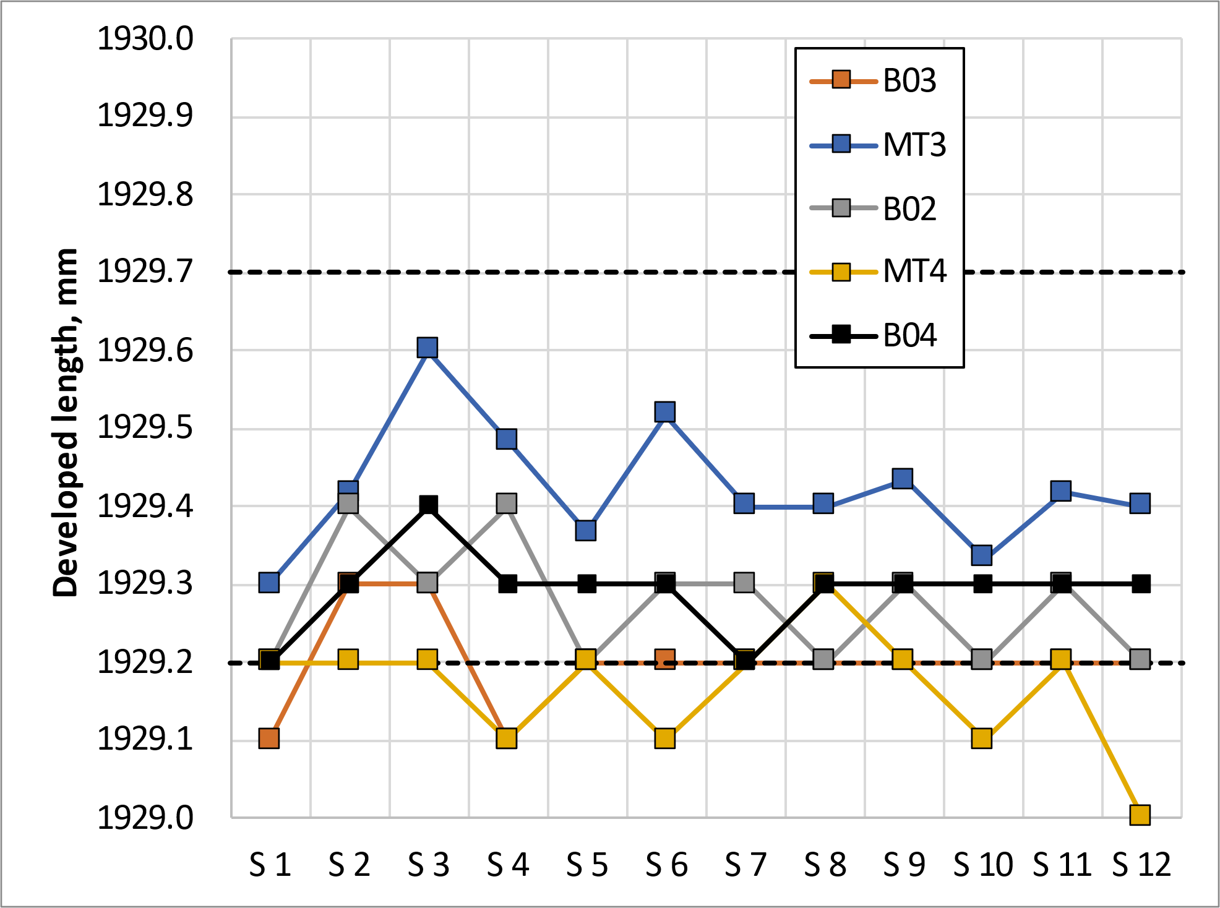
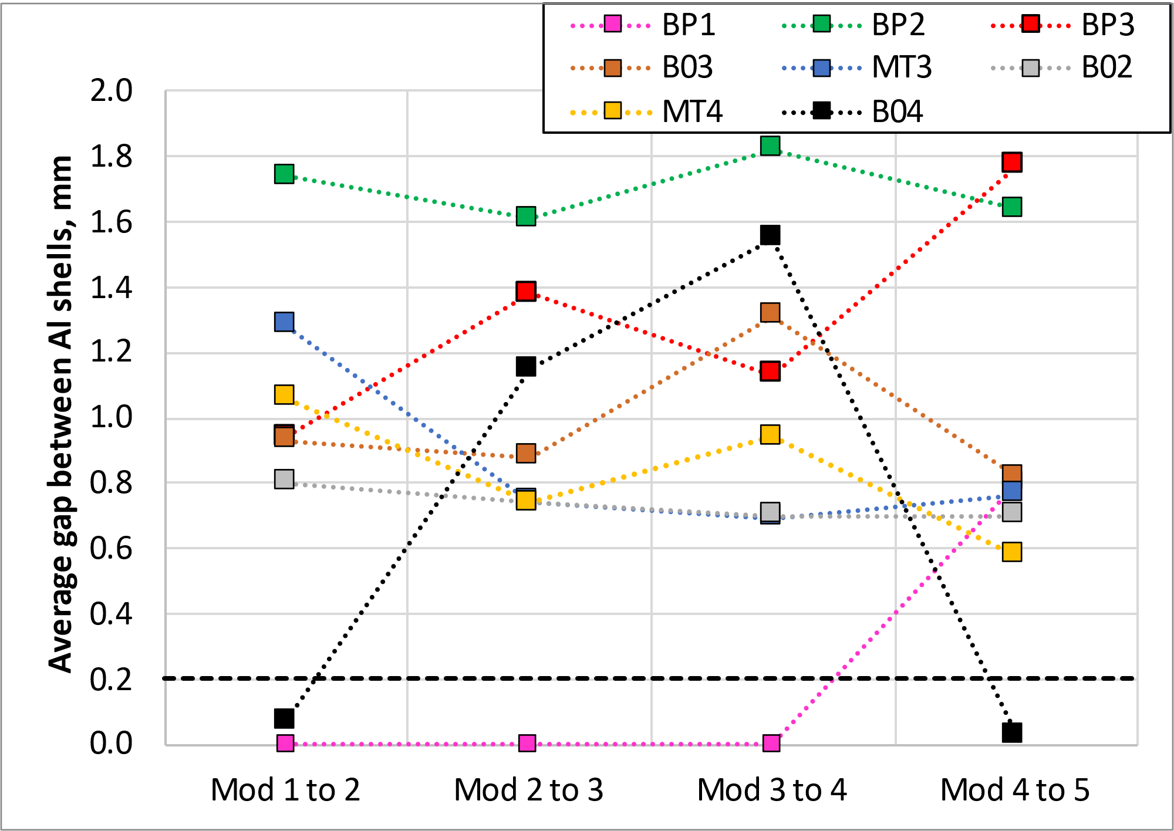
Horizontal yoke-shell assembly
The average developed length in the middle of each shell shall be 1929.4 -0.2/+0.3 mm.
  The developed length in relax state is 1928.9^{-0/+0.3} mm and the increase of circumference for 12.1 mm yoke key is 0.4 mm.
The minimum average gap between aluminium shells of adjacent modules shall be 0.2 mm
Yoke cavity is measured again once the modules are assembled, and shall be consistent with the vertical yoke-shell subassembly measurements
The total length of the structure shall be 7521 ± 5 mm

Slide 21
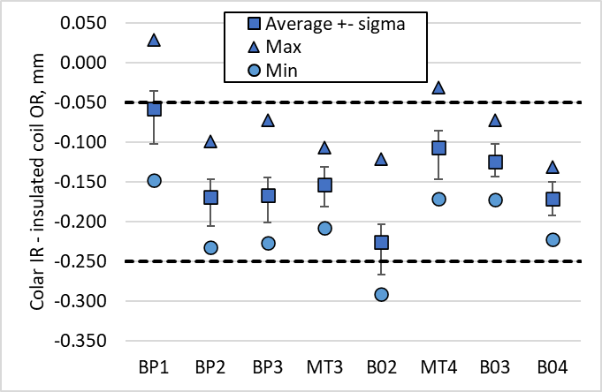
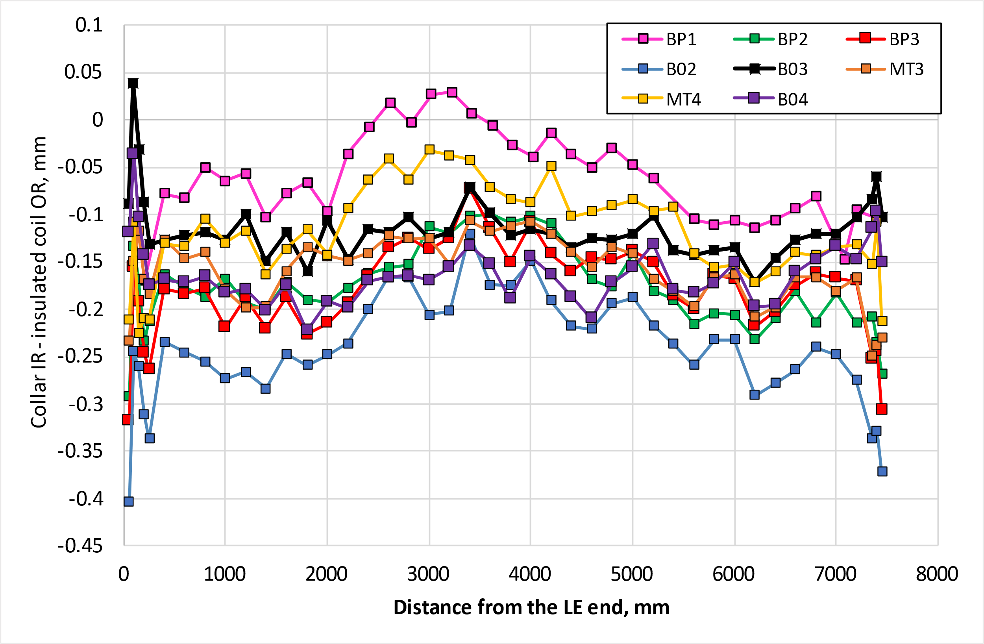
Coil pack radial size
The gap between collars and insulated coils with respect to the nominal dimension, considering for each z location the average among the four coils, shall be -0.125 mm -0.125 / +0.075 mm.

Slide 22
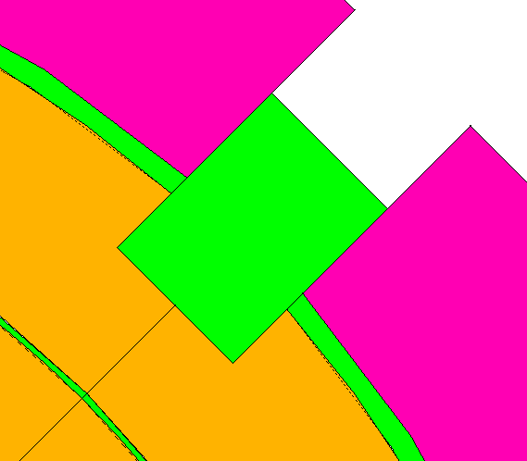
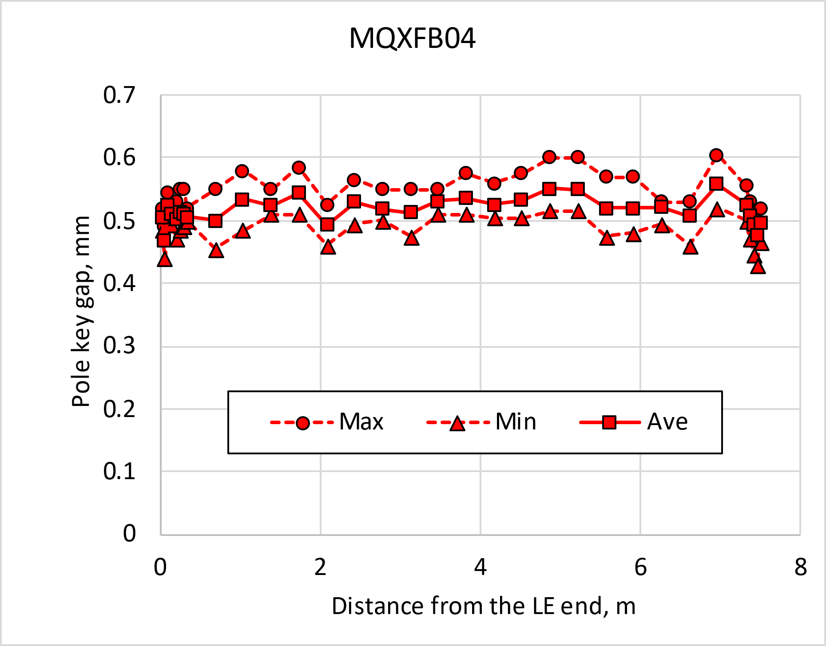
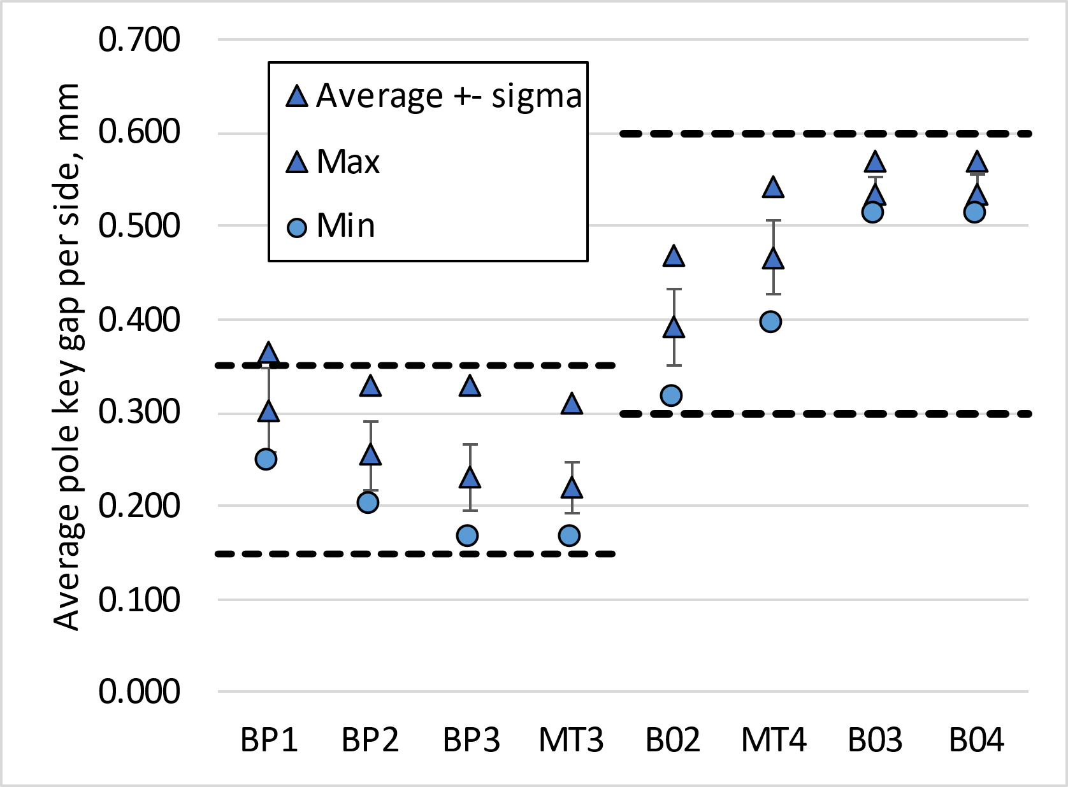
Pole-key gap
The average pole key gap (per side) along the magnet length shall be +0.400 ±0.100 mm in each quadrant.
The minimum pole key gap (per side) in any quadrant and in any longitudinal location shall be > +0.300 mm.
  From MQXFB02, pole keys are machined removing 250 µm on each side from the original key (lessons learnt from A07&A08)
  We have a more uniform pole key gap along the length than in previous assemblies (no coil belly)

Slide 23
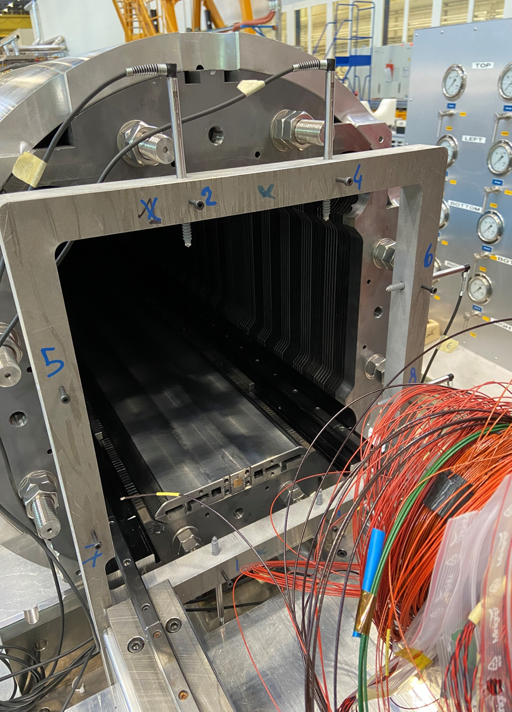
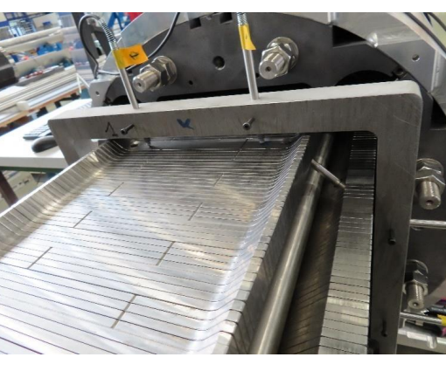
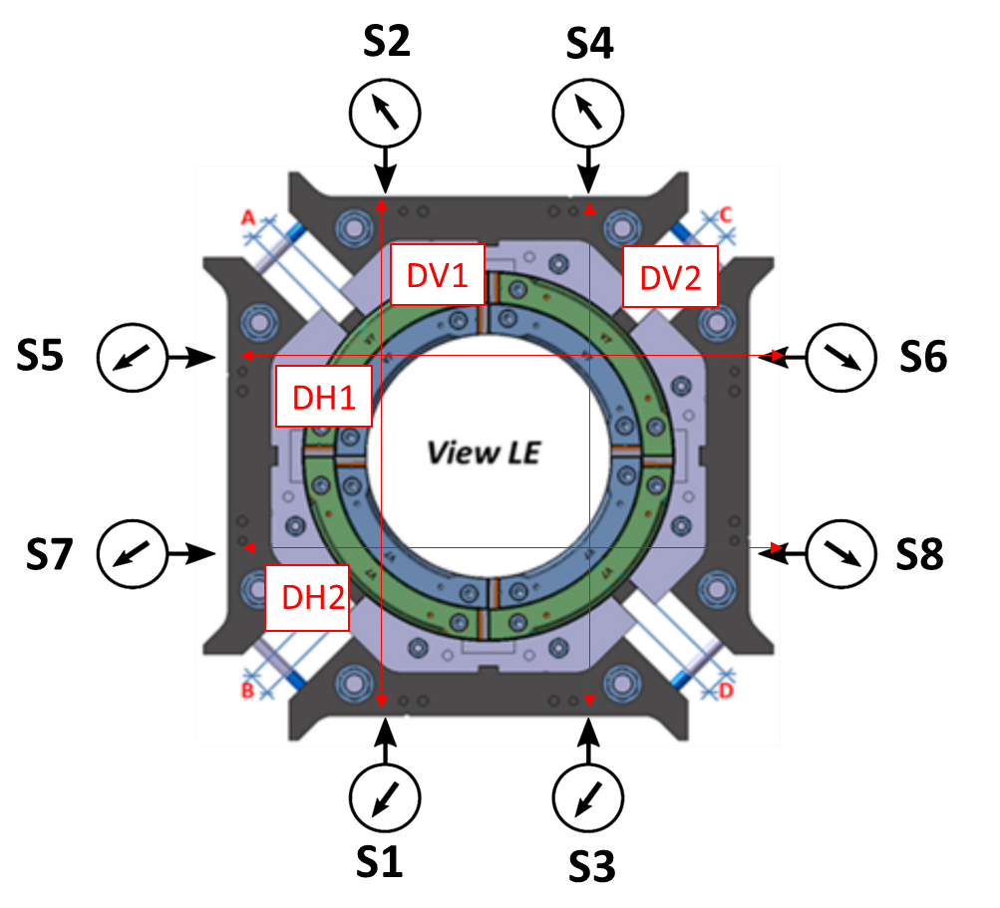
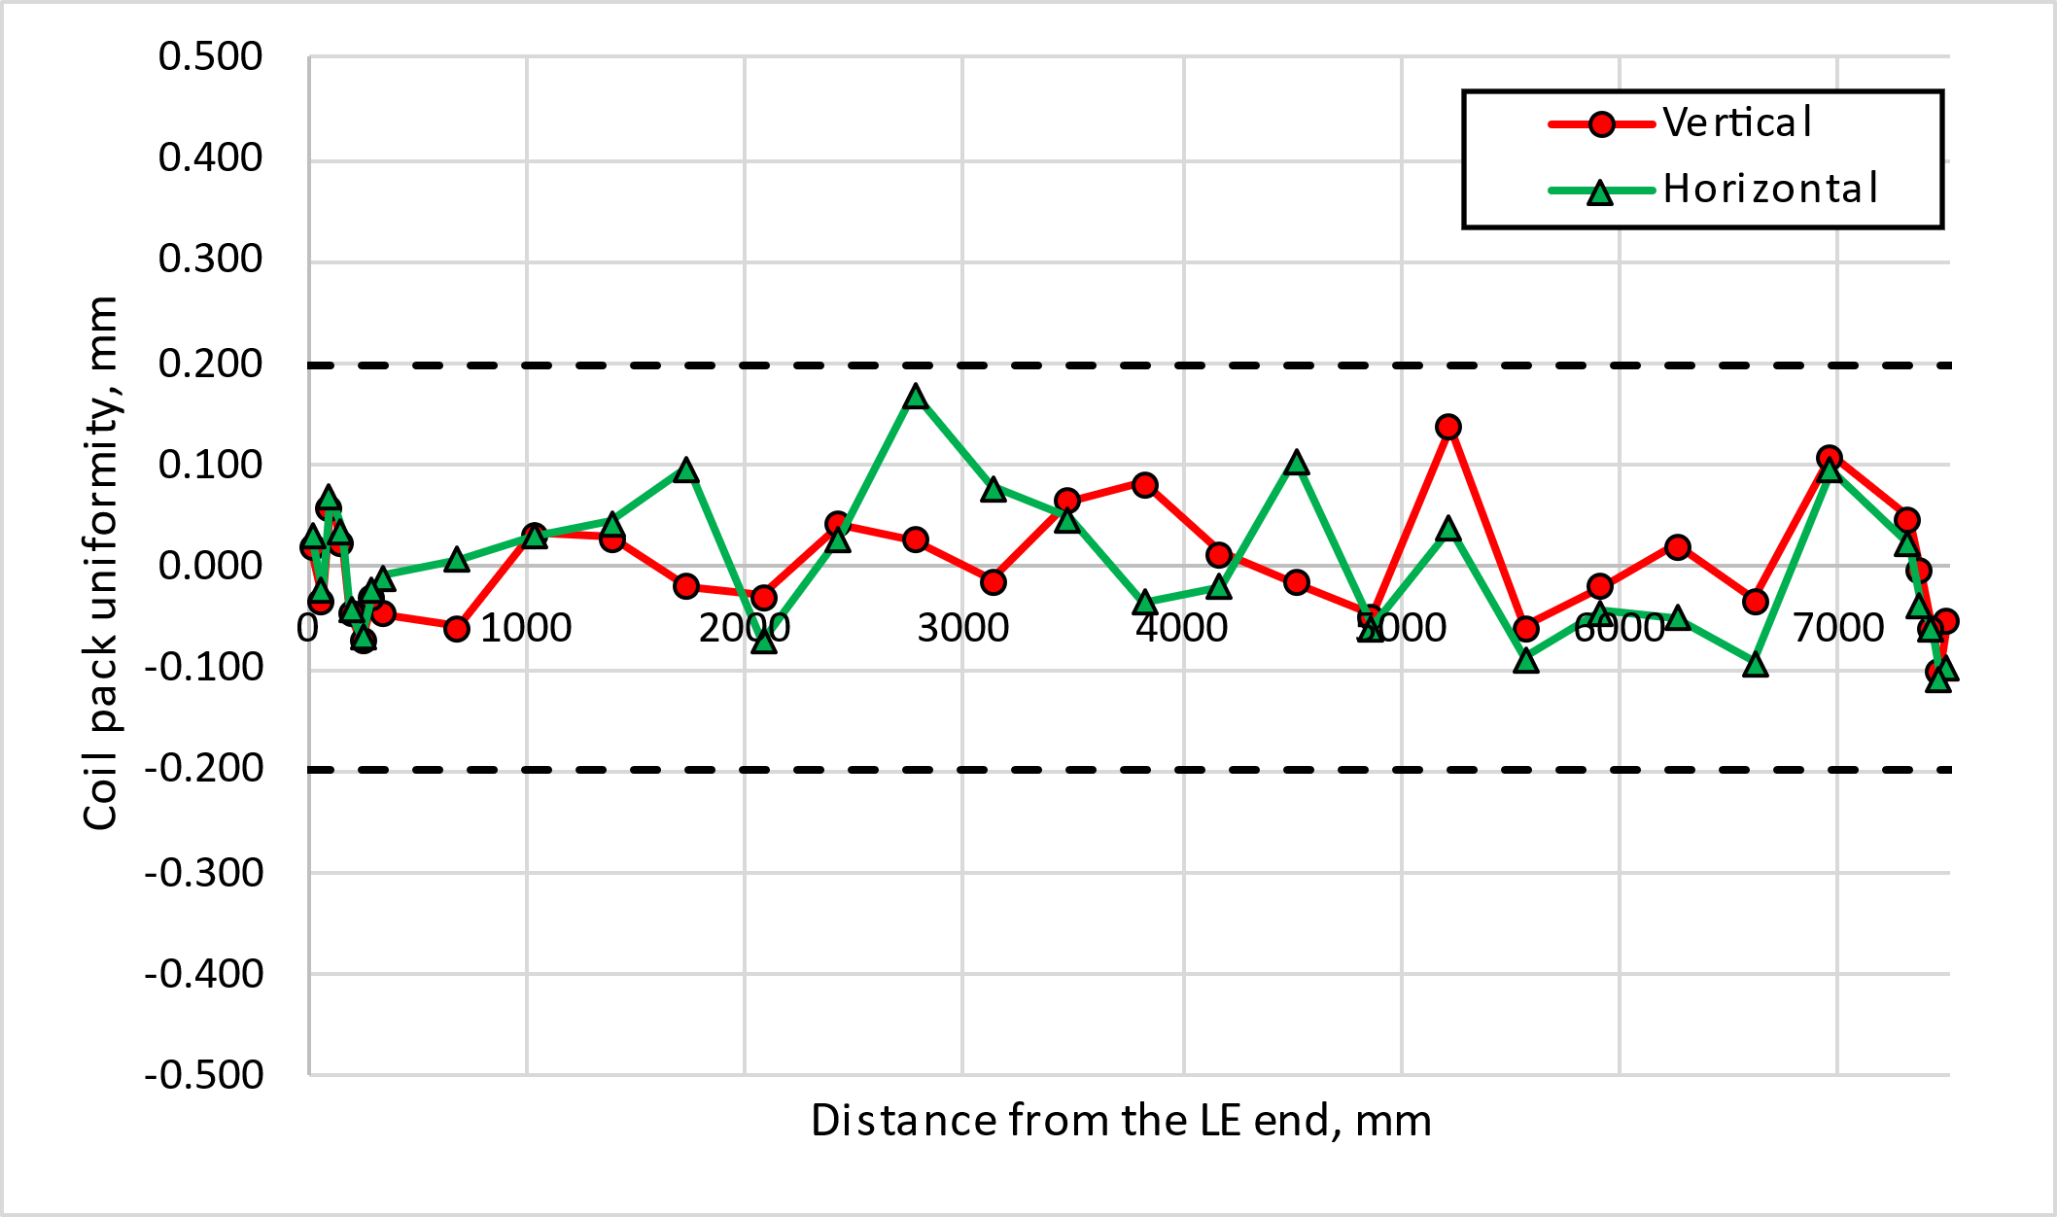
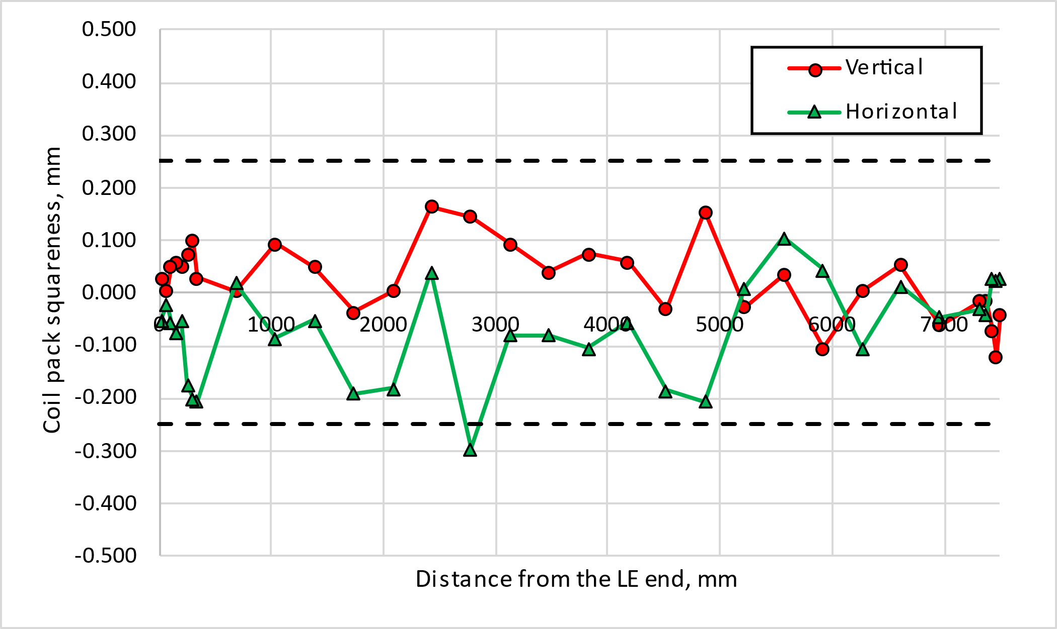
Coil pack geometrical measurements
For the coil-pack size, uniformity, and squareness the following ranges are set:
  The average vertical and horizontal dimension of the coil pack along the z axis shall be within 318.75 mm ± 0.250 mm
  The uniformity of the vertical and horizontal dimensions along the z axis shall be within ±0.200 mm
  The squareness of the vertical and horizontal dimensions along the z axis shall be within±0.250 mm

Slide 24
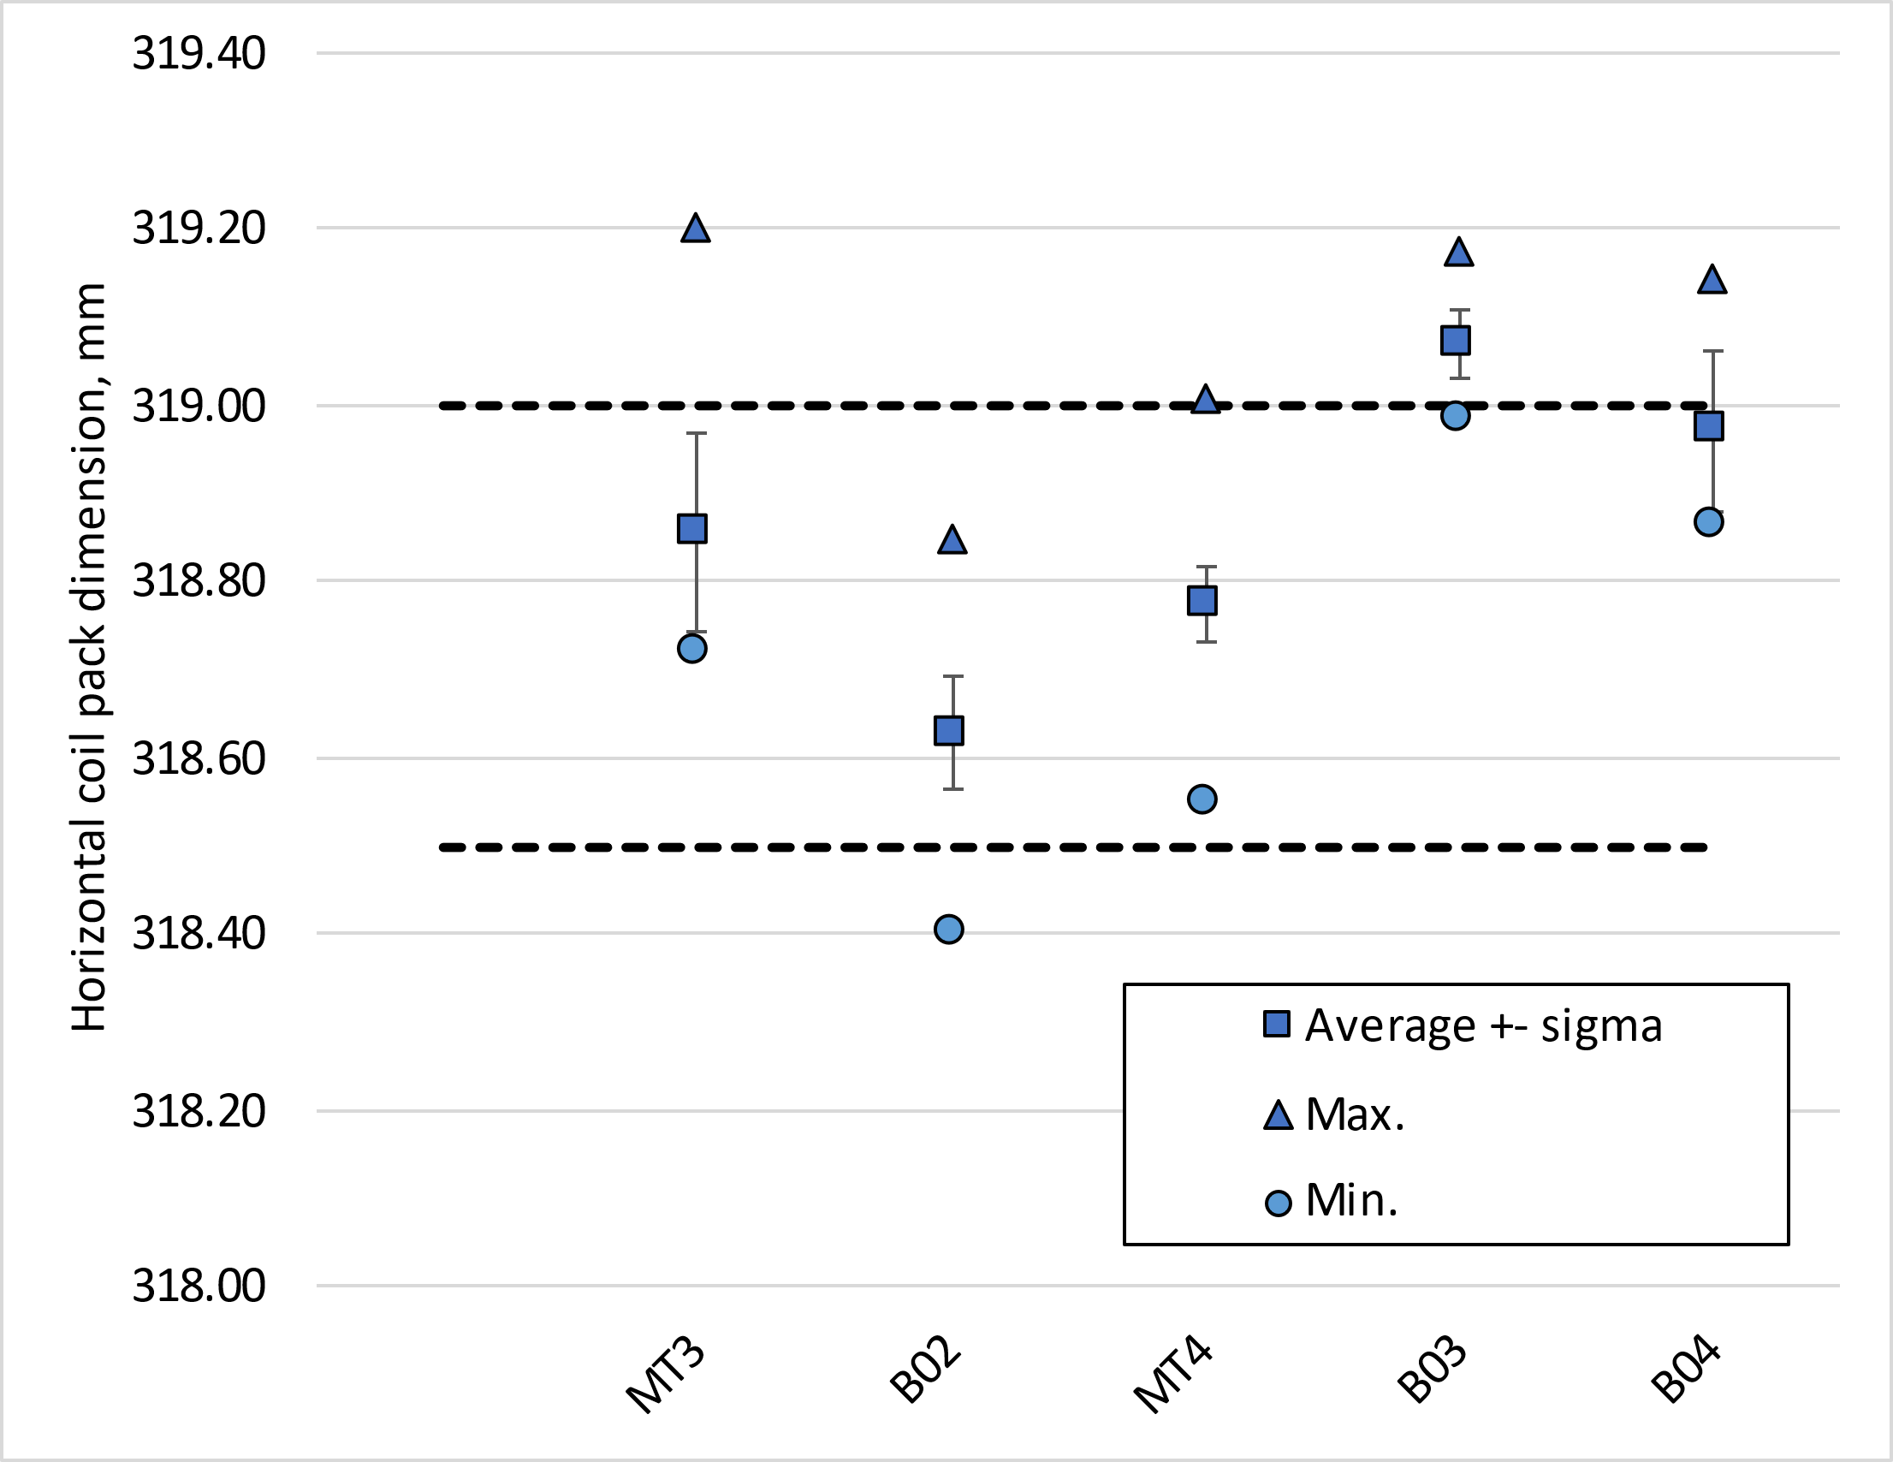
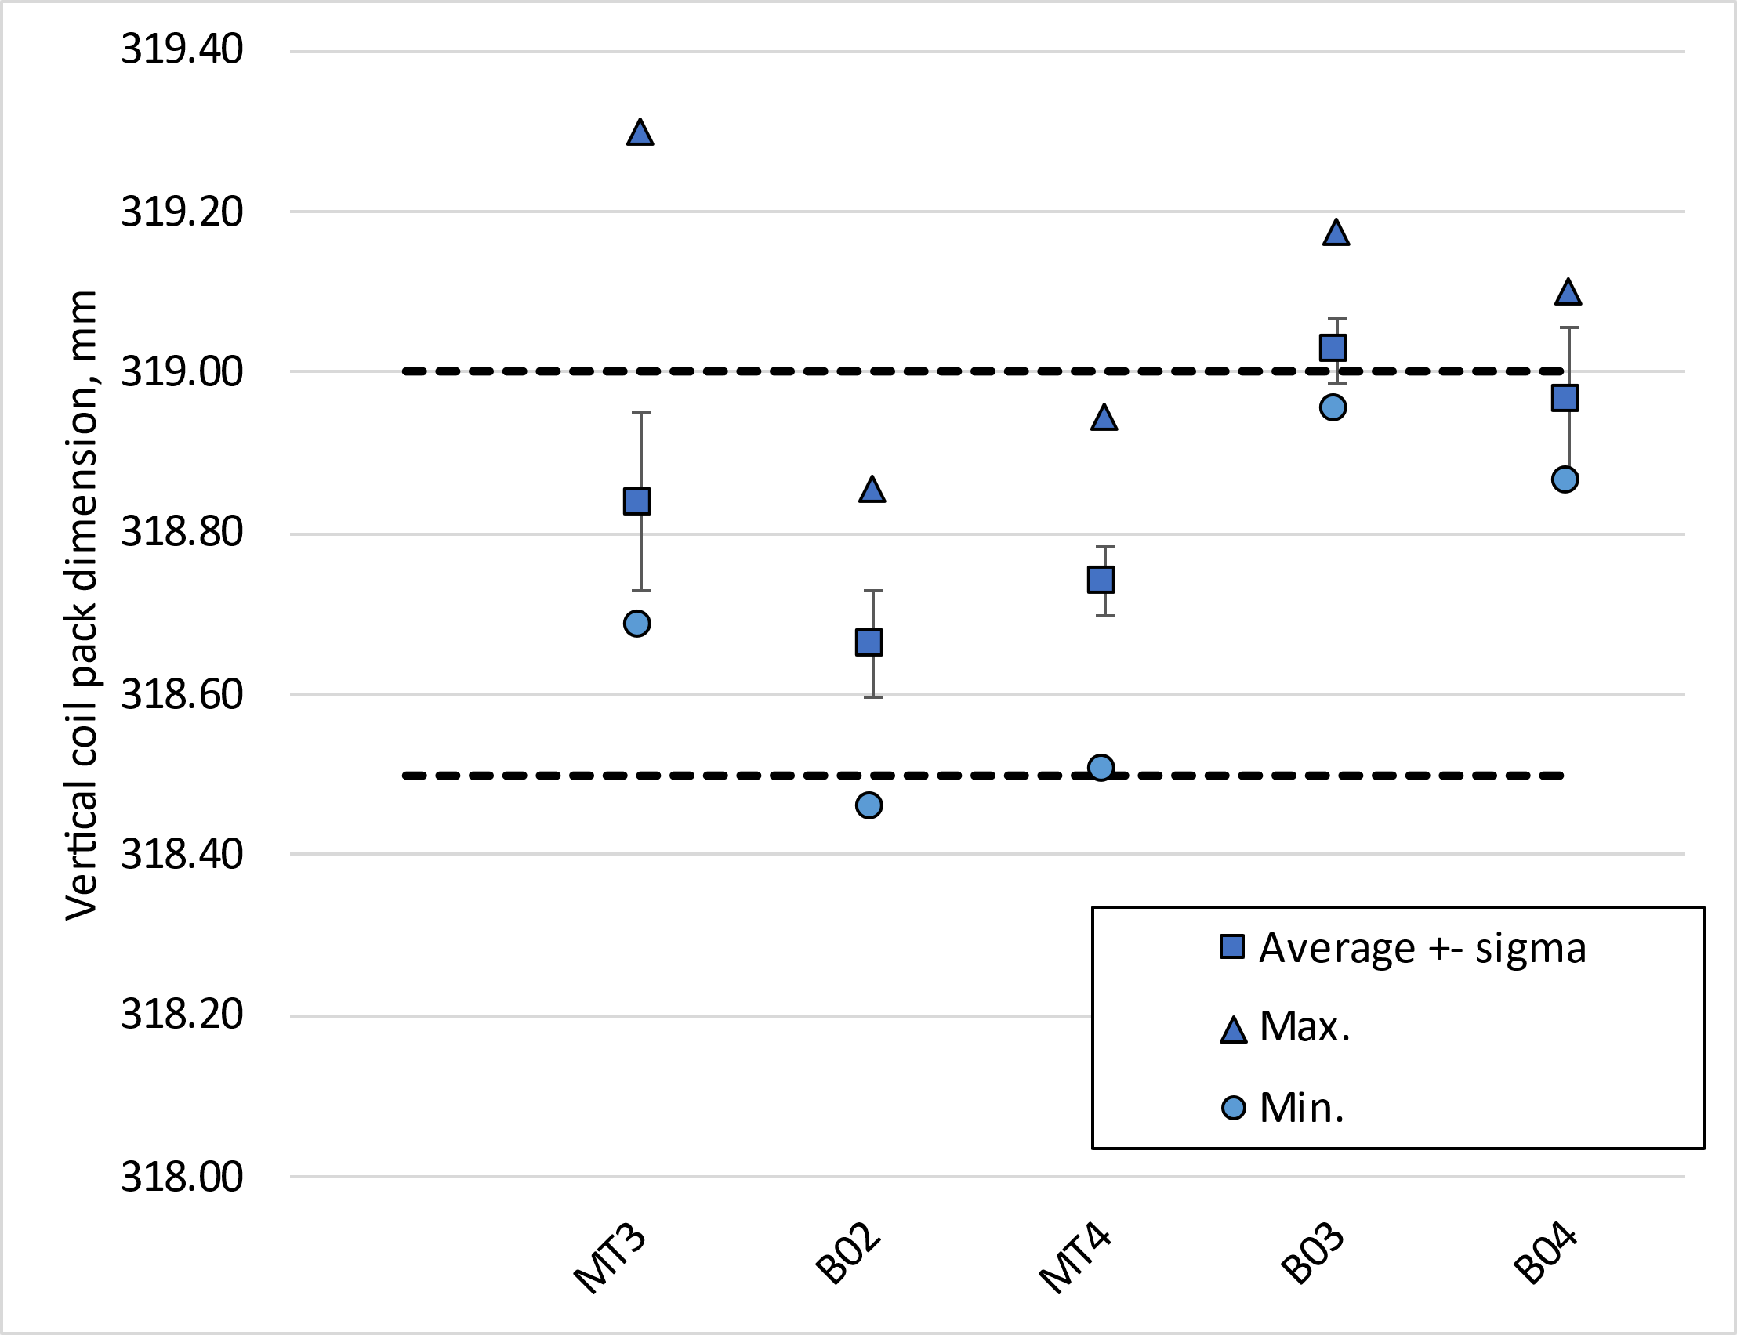
Coil pack size

Slide 25
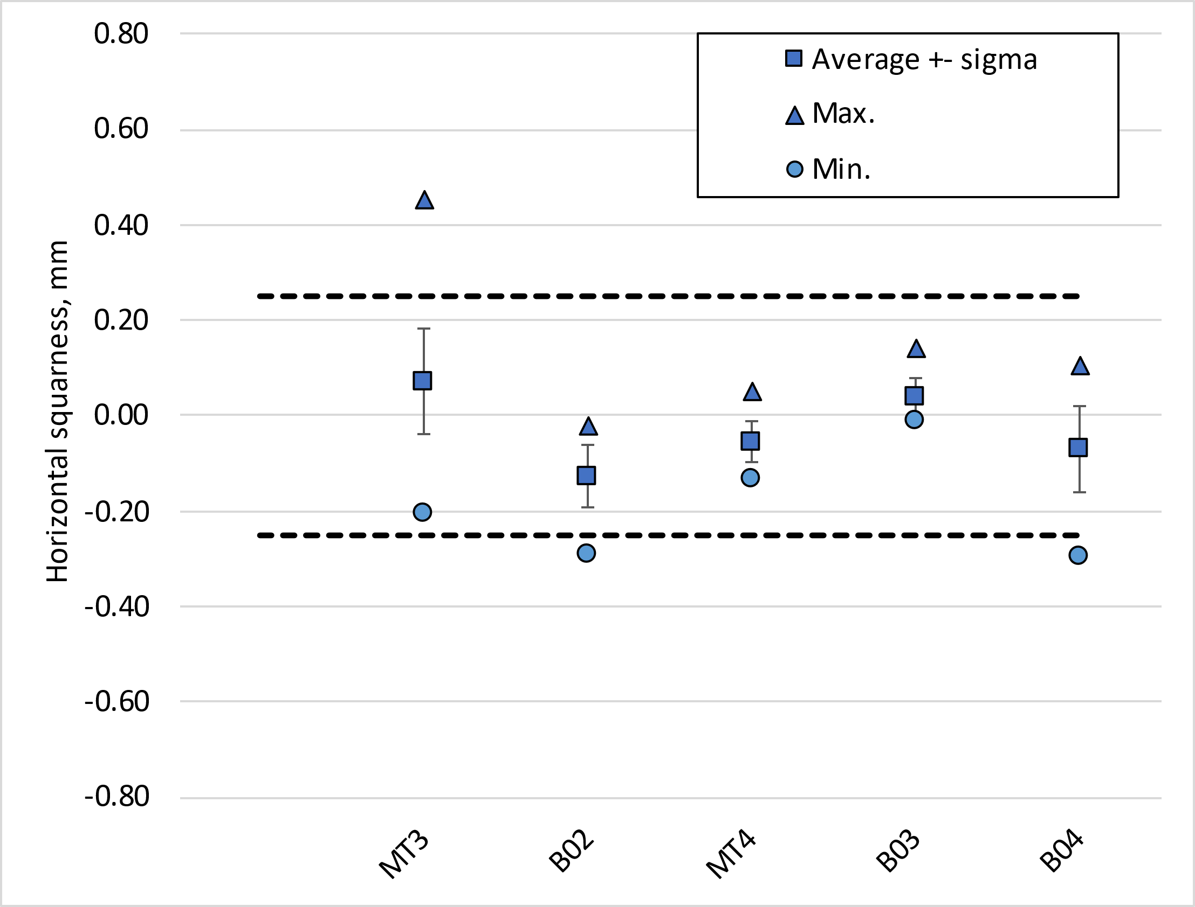
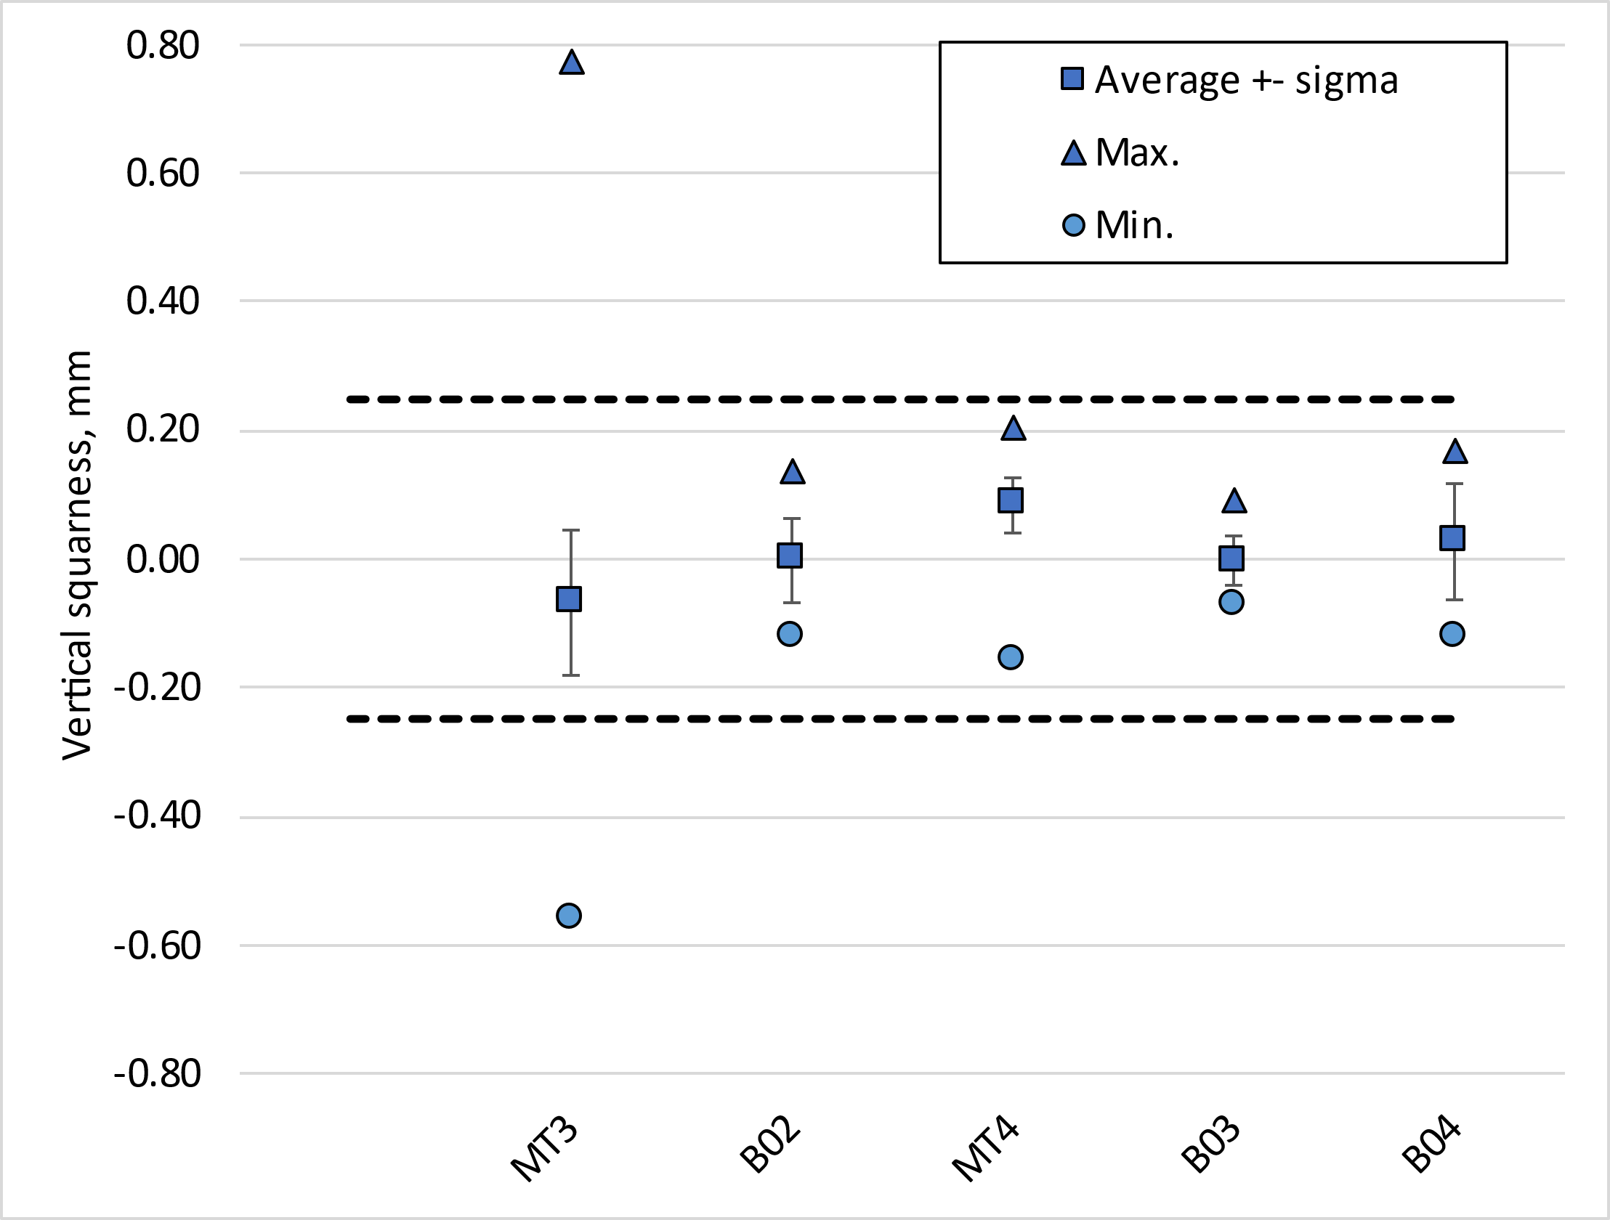
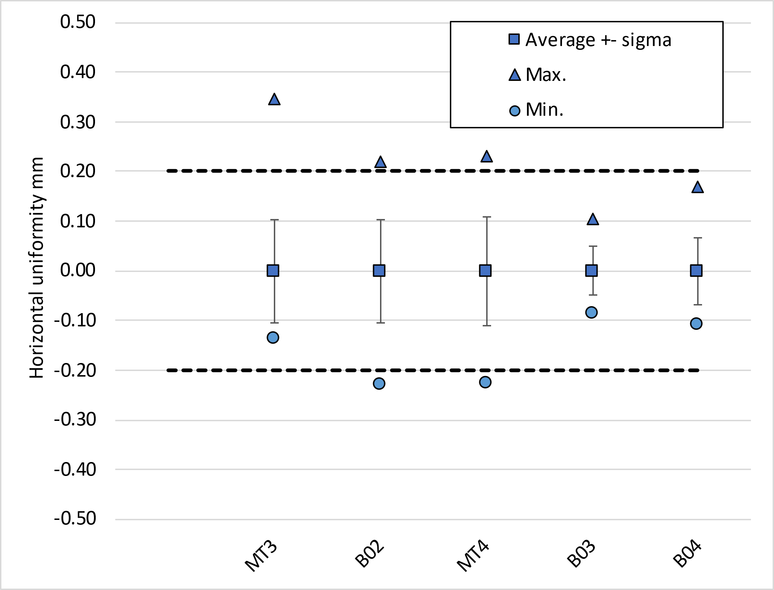
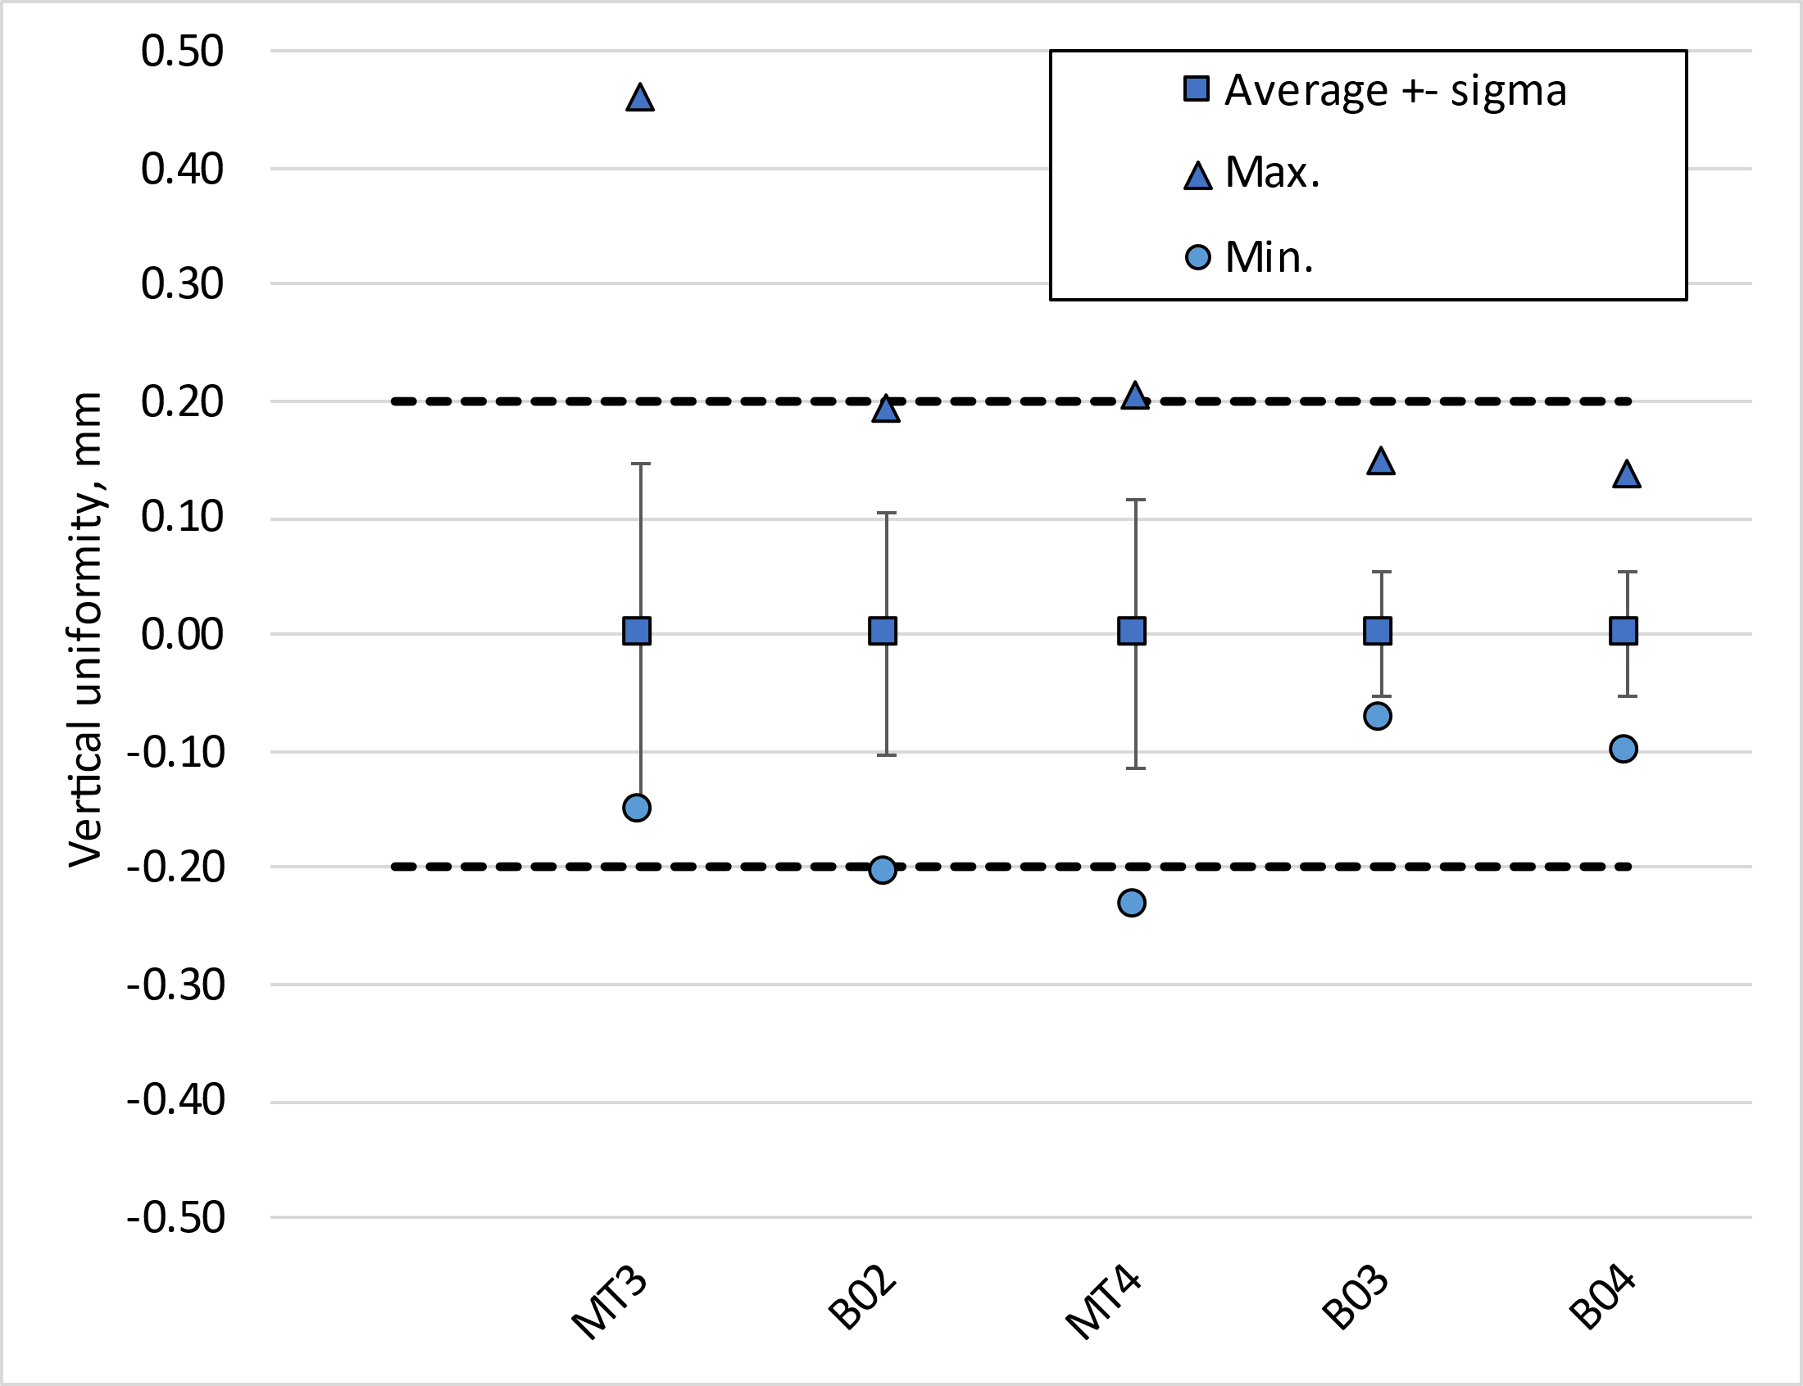
Coil pack squareness and uniformity

Slide 26
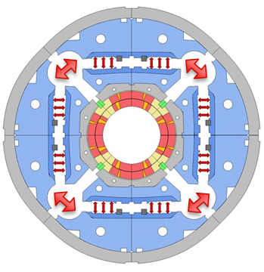
Azimuthal pre-load target
The allowable peak stress in the coil during loading is -100 MPa, achievable thanks to the new loading procedure with auxiliary bladders.
  This is a requirement, the measured pole stress in the coils shall not exceed this value
  The measuring location corresponds to the longitudinal position where we expect higher coil stress (see slide 4)
The target room temperature preload for MQXFB02 & B03:
  Average shell stress: 58 ± 6 MPa;
  Average pole coil stress: -70 ± 10 MPa
  Rod strain: 650 µε
  This is a target not a requirement, and in case the maximum allowable peak stress in the conductor (100 MPa) is reached, the average pre-load will be lowered accordingly to fulfill the peak stress requirement
With the new welding procedure, demonstrated in MQXFBP3&B02&B03, we expect no increase on the azimuthal stress of the coils during welding

Slide 27
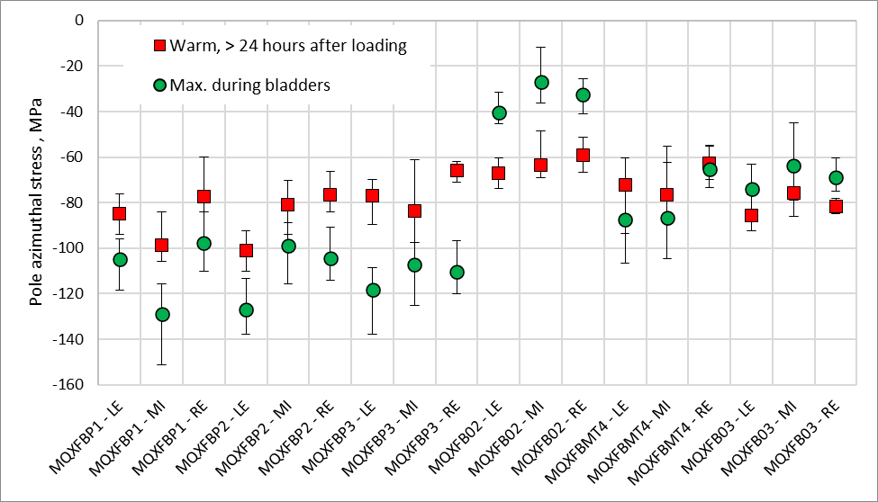
RT: Targets vs achieved
13.8 mm
13.8 mm
13.7 mm
13.8 mm
13.8 mm
13.6 mm

Slide 28

RT: Targets vs achieved
13.8 mm
13.8 mm
13.7 mm
13.8 mm
13.8 mm
13.6 mm

Slide 29


RT transfer function
So far, relatively good agreement between expected transfer function and measured transfer function
  In B02/MT4 we show the change of slope due to the new loading procedure
  In B03 we are closer to the original slope due to the ‘new coil geometry’

Slide 30

Cold: Targets vs achieved
At cold, MQXFB02 had 90-110 MPa pole azimuthal compression, corresponding to a pole un-loading around nominal current
For MQXFB03, we only have ‘clean’ measurements from the LE end, 85 MPa.
Data courtesy EN-MME

Slide 31

Bladder pressure
The other observable we have during assembly is the bladder pressure
  Assembly tolerances play a role, on some occasions, you need 20-30 bars to overcome a singularity in the structure
  Requirement: never exceed 400 bars

Slide 32

Axial pre-load
From BP2, all magnets loaded so far with the same axial pre-load (650 ueps at warm)
Small change of strain on the rods during powering → longitudinal stiffness of the structure is as expected, and overall behaviour is like what we have seen in MQXFS and MQXFA
MQXFB03 has similar behaviour to the previous magnets, although now the magnet is mostly quenching in the ends
Delta rods strain during powering MQXFB03

Slide 33




Azimuthal coil size variation along the length
Coil geometry significantly changed with the new coil fabrication procedure
Since we shim to the average coil size (excluding ends), ‘new coils’ result in magnets with higher pre-load in the ends → more radial friction
  We don’t plan to address this difference with any measure (AUP has concerns on radial pre-load in the ends, so a priori with the new coil geometry we go in the good direction)

Slide 34
Outline
Magnets overview
Lessons learnt
Overview on assembly data
Conclusion

Slide 35
Conclusions
The assembly of MQXFB magnets is well mastered, still, minor improvements have been implemented in recent magnets
In depth analysis of the possible impact of the new generation coil geometry, concluding that non-specific measures had to be taken at the assembly level to accommodate the new coils.
A detailed set of systematic measurements are performed during assembly, to intercept errors. They will also the base to assess the level of precision we can reach with this type of technology.

Slide 36


Slide 37
Additional slides

Slide 38



Coil end region B02 vs B03
The first measuring point is in the heater connection box, due to the presence of resin is a bit smaller than nominal
The second measuring point is in the metal part of the splice block, nominal dimension
And then slowly we are going to the coil dimension,
  for coils with binder in the OL, the coil is bigger than nominal → splice block sees ‘lower stress’ than the middle of the coil
  for coils without binder in the OL, the coil is smaller than nominal → splice block sees ‘higher stress’ than the middle of the coil

