Slide 1


SM18 test benches and first results for magnets and SC-link system in the final configuration
Gerard Willering
26 September 2023
13th HL-LHC Collaboration Meeting
Vancouver, Canada
Reporting for TE-MSC-TM
Stephan Russenschuck, Marco Buzio, Gaëlle Ninet, Guillaume Pichon, Stian Juberg, Franco Mangiarotti and all other members of the team
With many thanks to FSU support and all other teams involved.

Slide 2
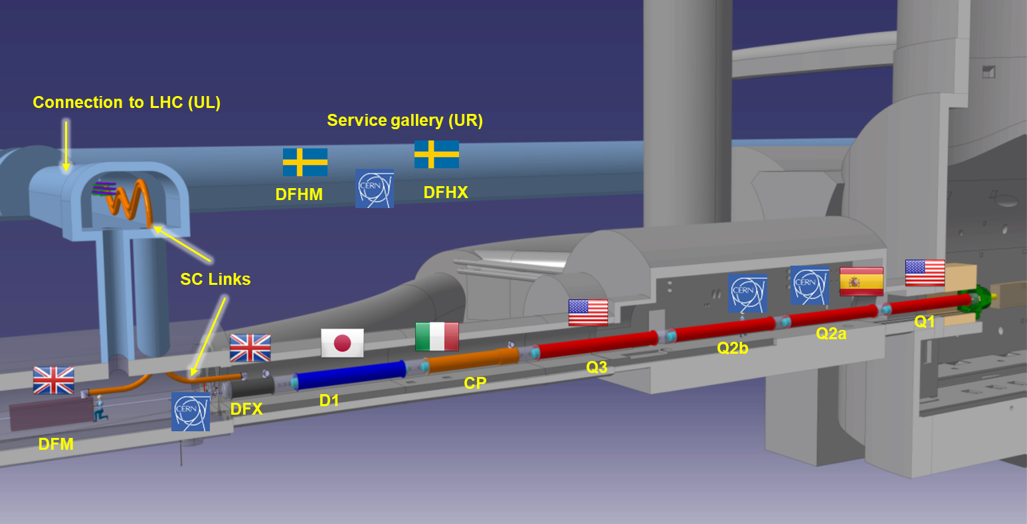
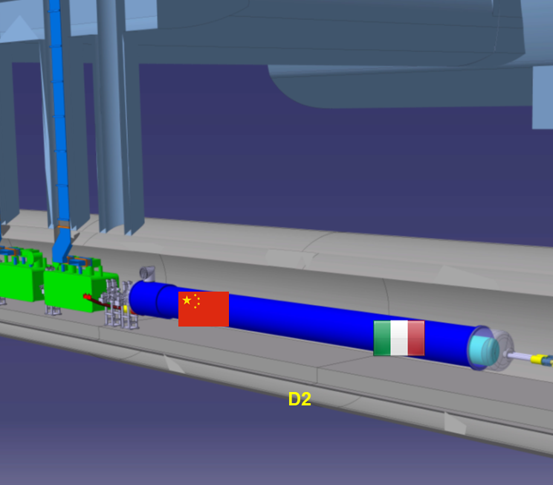
SC magnet and link tests for the HL-LHC in SM18
Q1, Q2a, Q2b, Q3, CP, D1, SC link, D2 + spares to be tested and qualified in the coming years.

Slide 3
Magnet test facility transformation
LHC era, early 2000’s
Series testing LHC main magnets (1600+ in a few years)
Very short test programs (a few quenches at 1.9 K)
No thermal cyles, no magnetic measurements.
Less diversity in powering circuits, protection, power converters, etc.
HL-LHC era, starting in 2018 with the first 11T long prototype test.
Larger varyity, but much less objects to test
Much stricter test requirements
Thermal cycles + 4.5 K testing for Nb₃Sn magnets
Anticryostat in each magnet for quench antenna + magnetic measurements
Larger variety in currents (2 kA circuit + 18 kA circuits)
SC-link assembly

Slide 4
Bench compatibility
Each bench is optimized for 1 type of magnet:
A1: MQXF test cryostat
A2: CP+ Q1/Q3
B1: LHC MB and MQ
B2: D1
C1: 11T
C2: D2
E1: spare
E2: spare
F1: Q2
F2: SC link

Slide 5
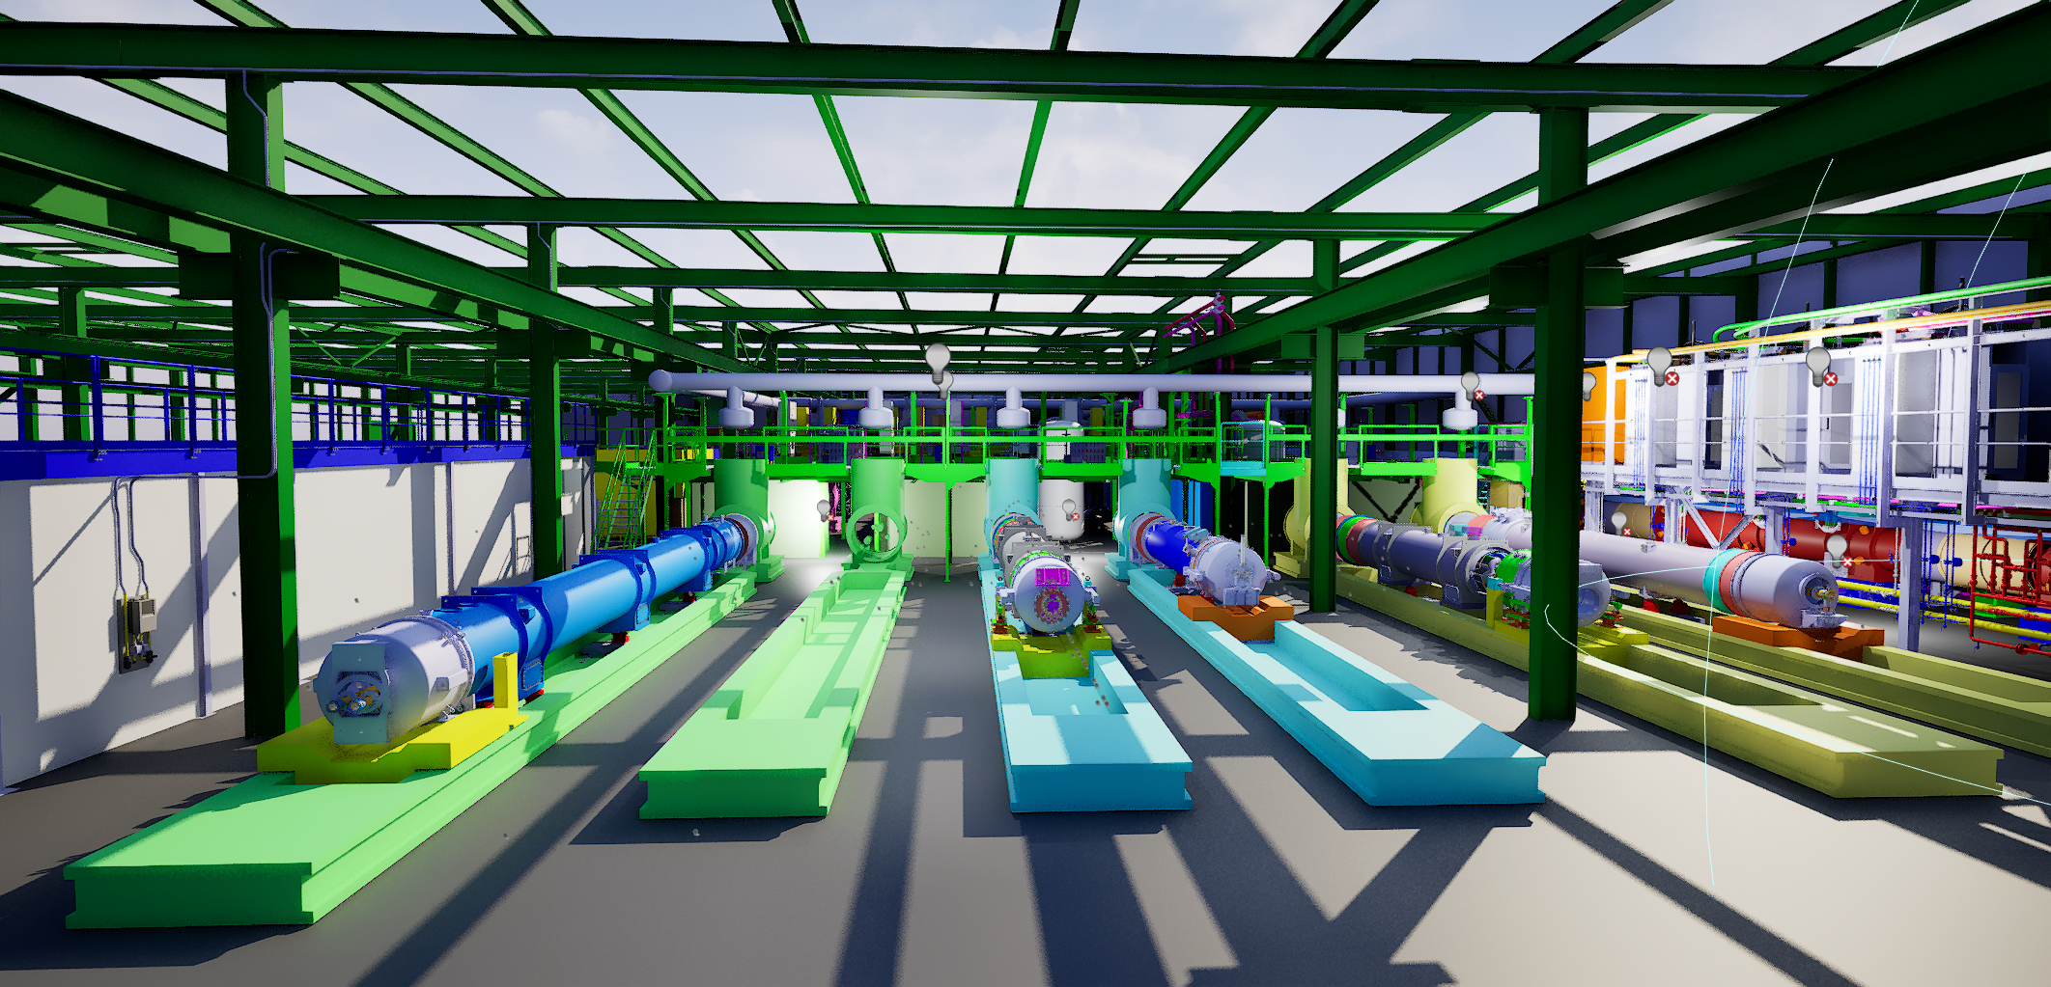
MQXF
Test cryostat
MB
CP
D2
D1
Image to be updated
Courtesy Antoine Kosmicki

Slide 6
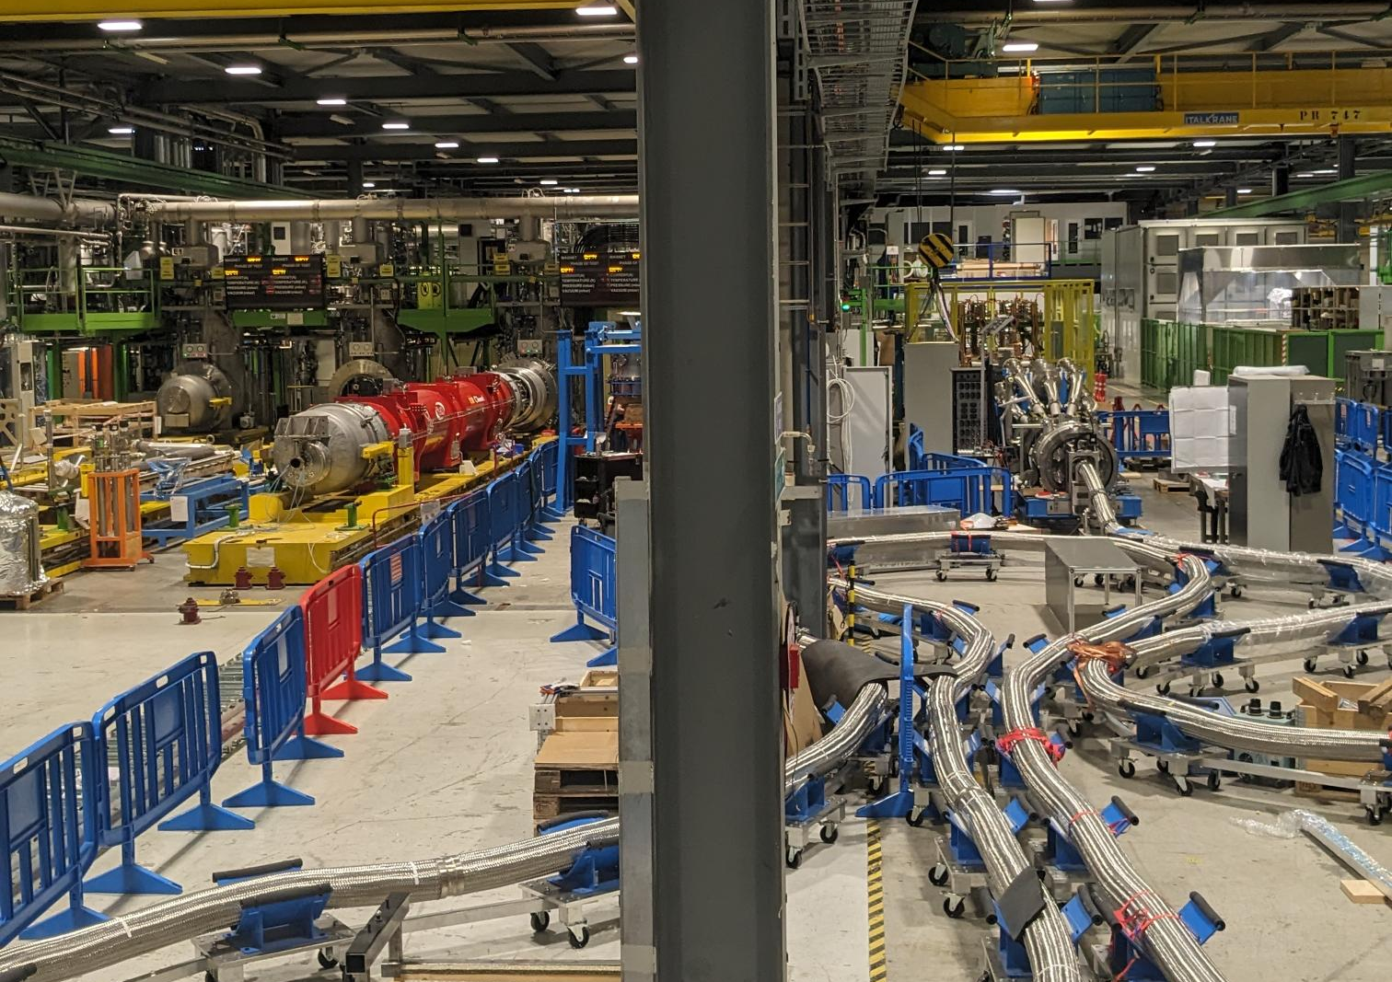
Last week’s view in SM18 on the F-benches
F1: Q2 magnet is on the bench, connected and in preparation.
Cool down in about 2 weeks.
F2: IT-SC-Link being assembled by WP6a in SM18.
Handover to test team when full assembly is completed.

Slide 7
Q2 on bench F1

Slide 8
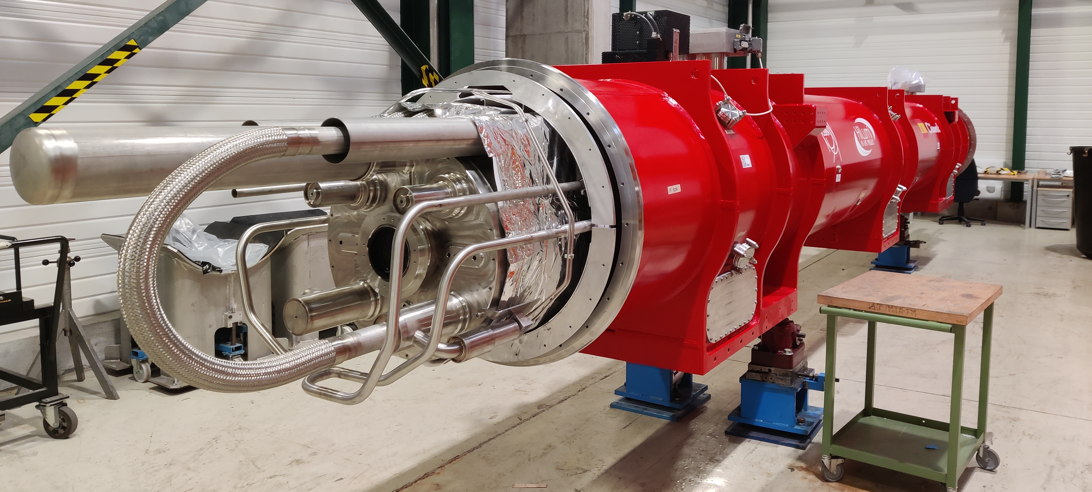
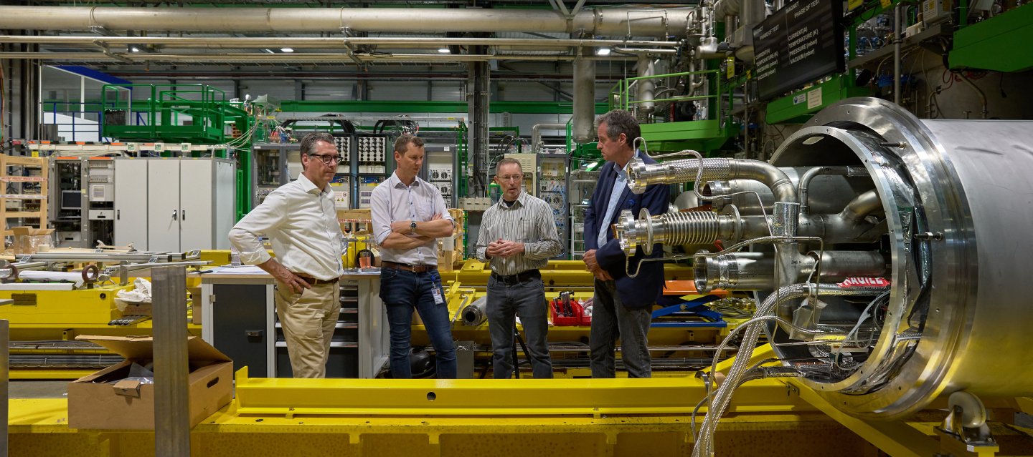
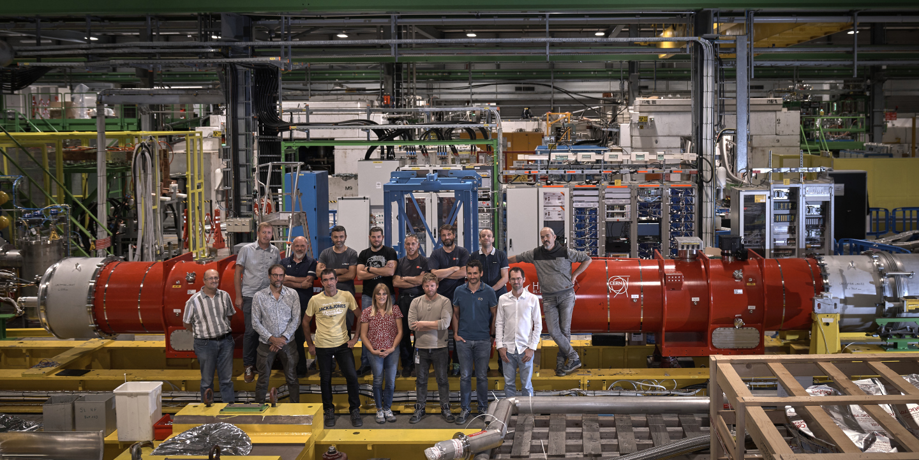
Q2 full assembly test
Q2 being prepared in SMS18
Shuffling module ready for short circuit commissioning test.
Commissioning test completed. Bench OK for powering.
Fresh photo from last week with the magnet on the bench with test operation team

Slide 9
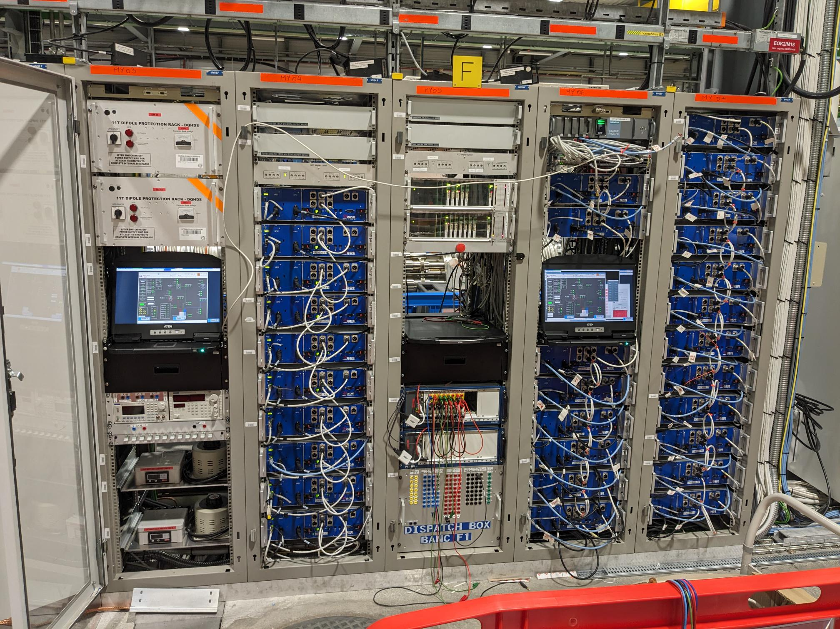
Cluster F1 as test bed for and use of enabling technology
Full uQDS system for protection and data acquisition.
Includes all network, database, logging and communication systems.
Major technology test bed, with SM18 users demanding more operation and control features than needed for the LHC.
Ready to power Q2 magnet, with support from QPS team.
uQDS for Q2 on F1
uQDS for SC-link on F2
See also presentation by Jens Steckert

Slide 10
Bench F1 as test bed for and use of enabling technology
2 kA vacuum energy extraction systems.
Already tested with MCBRD magnets in the D2 prototype, but now on the MCBXF magnets in the Q2, see presentation Mirko Pojer
Power converters
2 kA early prototype used in vertical bench.
CLIQ
Already widely used in SM18.

Slide 11
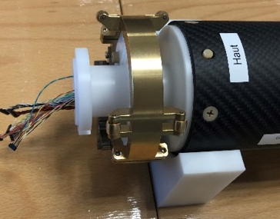
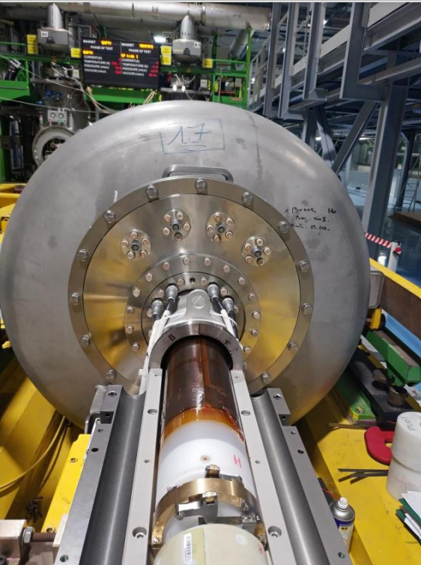
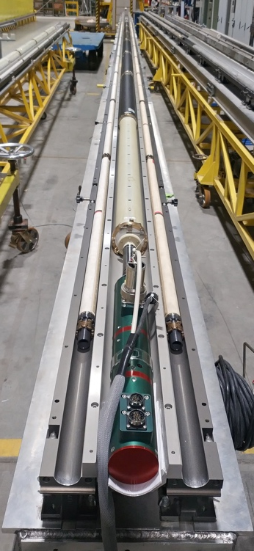
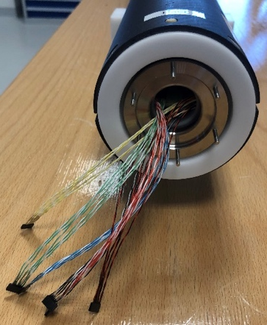
Advanced Instrumentation with magnetic measurements and Quench Antenna
Developments in the last years
New type of Quench Antenna with flexible PCB technology, measuring ‘harmonics’.
New magnetic measurement shafts.

Slide 12
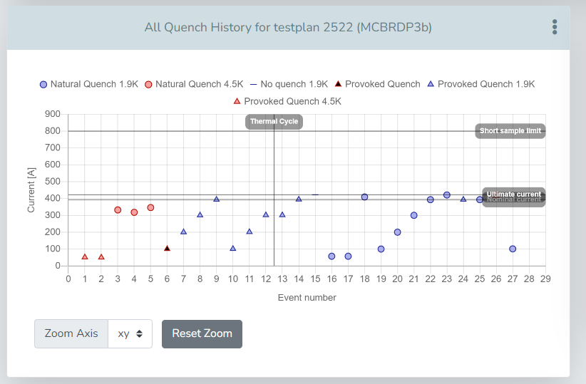
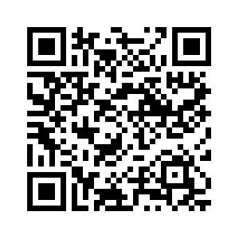

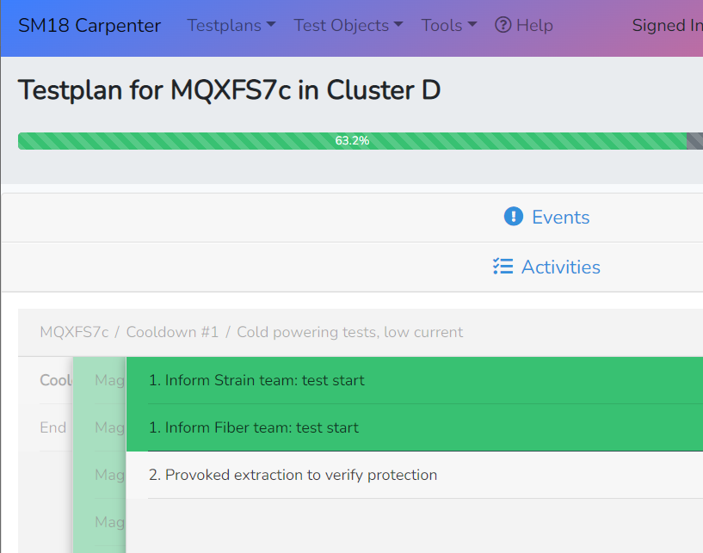
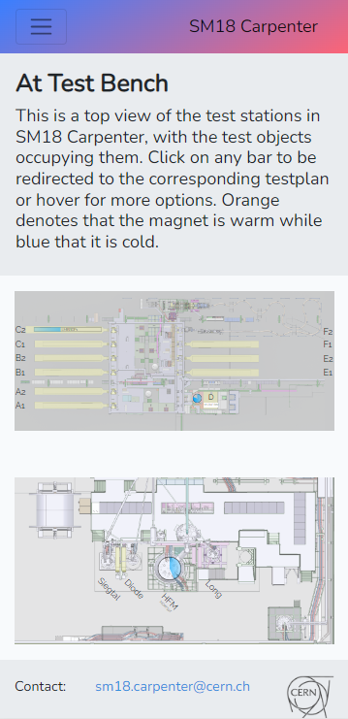
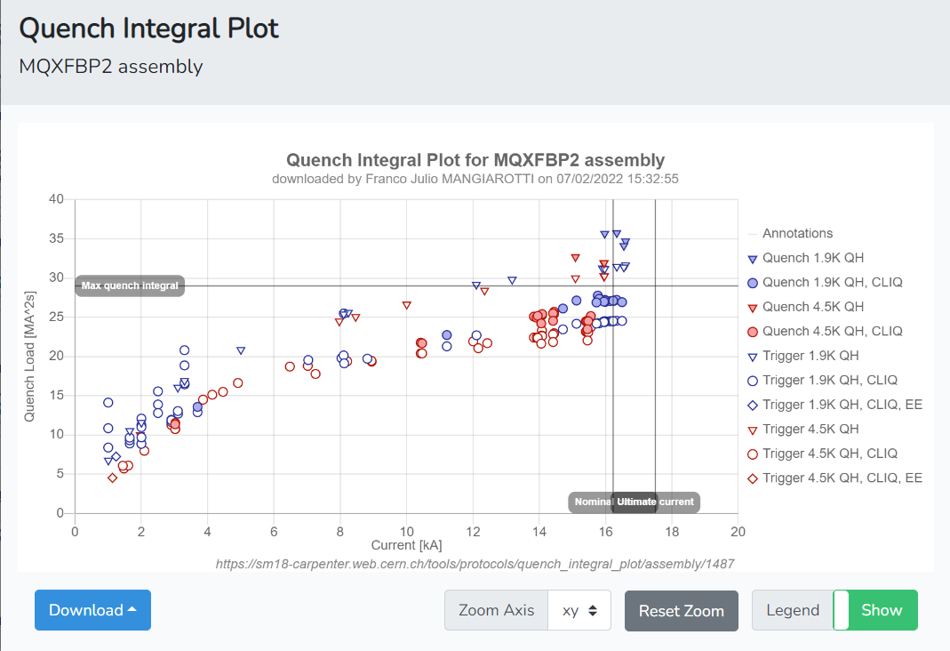
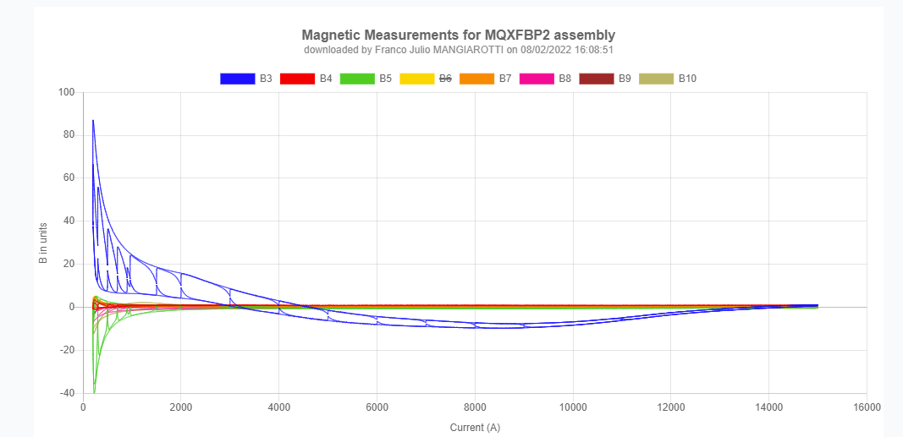
Test plan, test follow up and databases
Carpenter test follow up software fully developed, linked to database, automated protocols for test result plots. Important part of the Quality Assurance.
See more information here: https://indico.cern.ch/event/1125261/
12

Slide 13
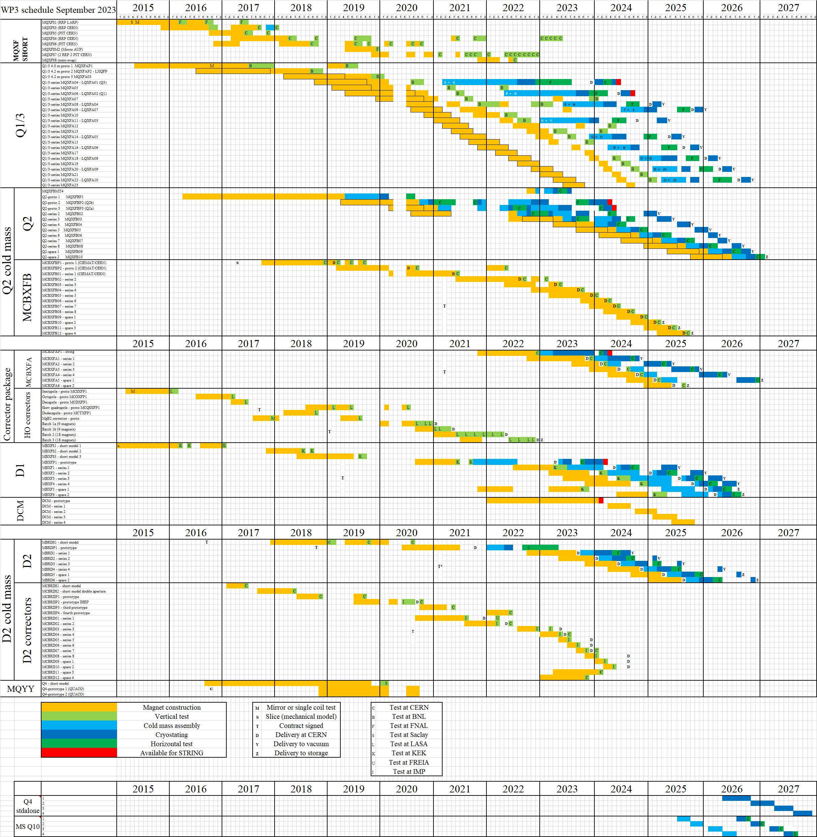
Q2 full assembly test - overview
The Q1 and Q3 assemblies consist of two 4-meter long MQXFA magnets.
4-meter magnets are tested individually in vertical position at BNL before being assembled and tested horizontally at FNAL.
The Q2 consists of a single 7-meter long MQXFB magnet + an MCBXFB corrector magnet. The 7 meter long magnet cannot be tested vertically and is tested therefore only in a cold mass.
MQXFB magnets tested so far were in the ‘test cryostat’ on bench A1. Results discussion, see presentation Wednesday.
8 Q2’s + 2 spares to be tested.
https://lhc-div-mms.web.cern.ch/tests/MAG/docum/hilumi/Schedule/schedule_09_2023.jpg

Slide 14
SC-link on bench F2

Slide 15
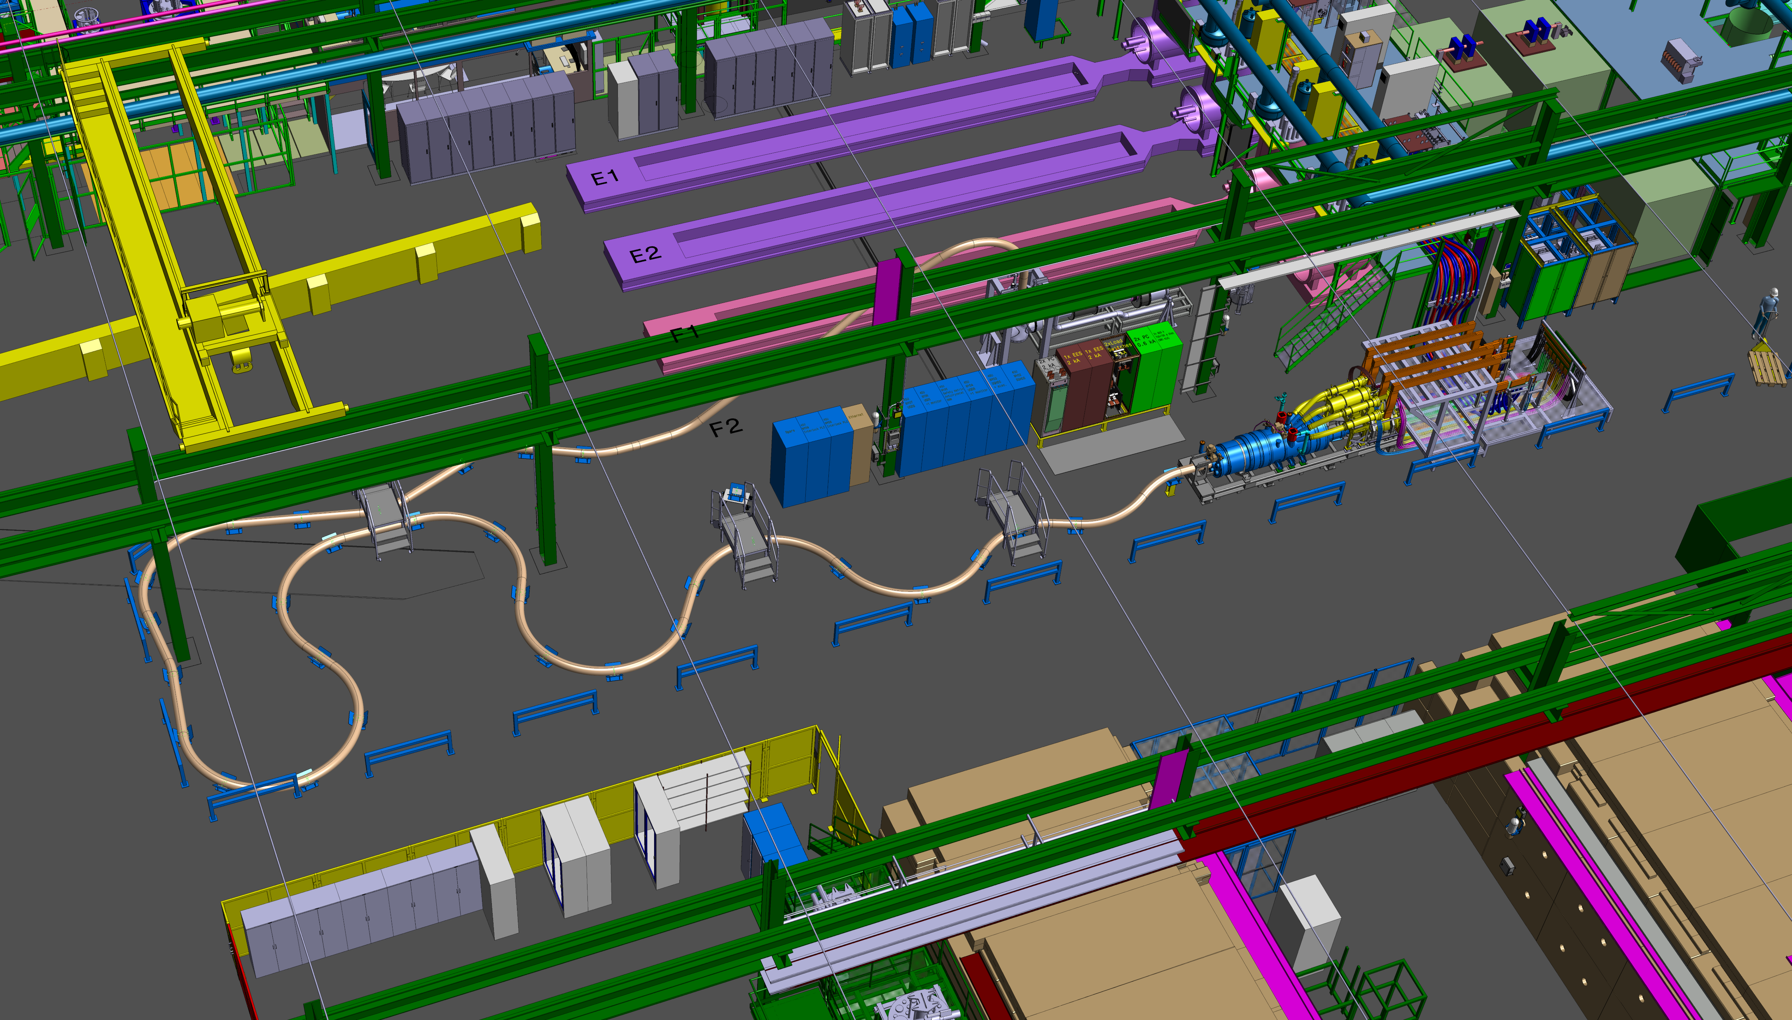
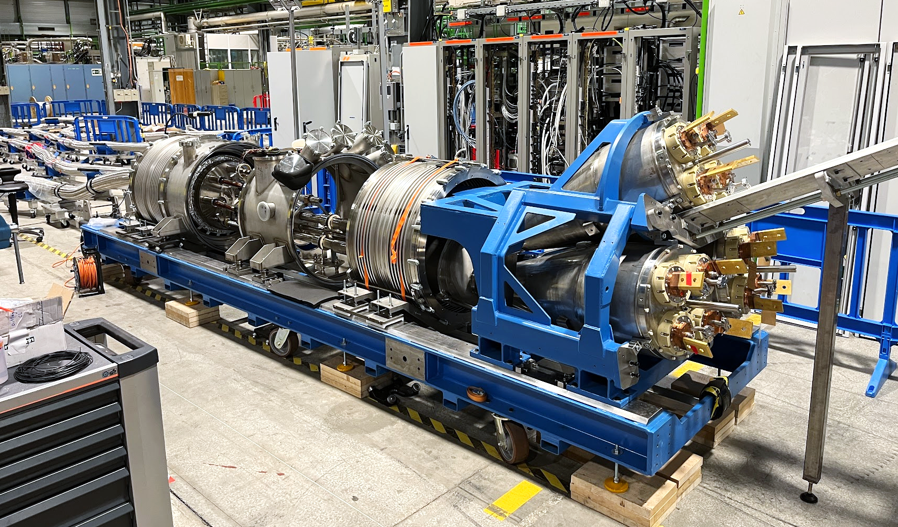
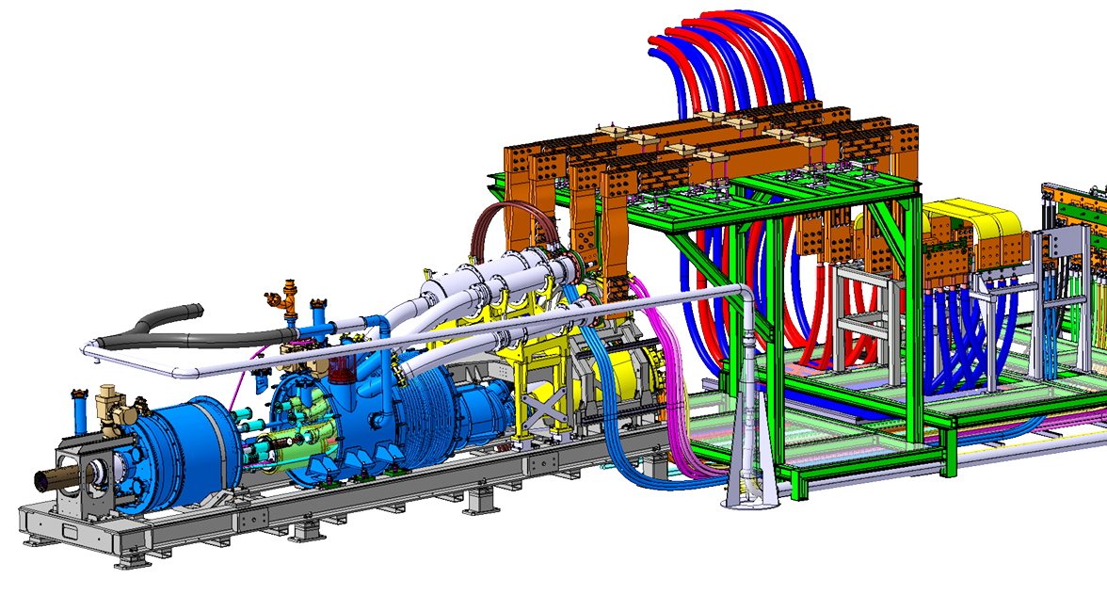
Bench F2 – SC link test bench
5 IT SC-link assemblies to test, then 5 MS SC-link assemblies to test.
See presentation Yann Leclercq for WP6a.

Slide 16
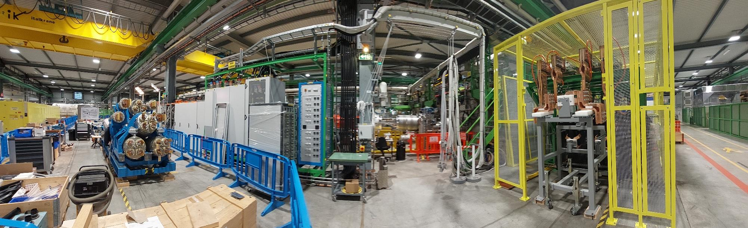
Bench F2 – Status
Patch Panel Interface (PPI)
commissioned successfully with new 18 kA and 2kA water- and air-cooled power circuits
2kA current lead terminations now in preparation with help of String mock-up (temporary configuration with standard rigid 300 mm² cable)
Instrumentation and cabling
DFHX/DFX cryo instrumentation cabling: preparations ongoing
20 × new uQDS crates installed and cabled
The first test will require more time due to commissioning of all systems.
Ready to connect SC-Link assembly.
PPI cage
DFHX
connection mock-up

Slide 17
D1 magnet on bench B2

Slide 18
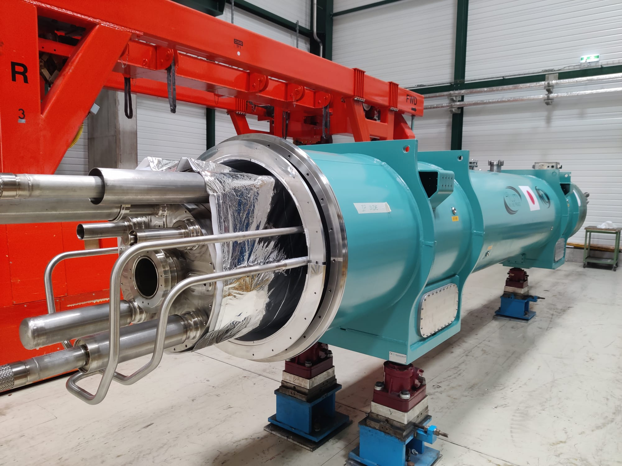
Test bench B2 - D1 test
First D1 proto assembly ready in SMS18
In preparation (connection pieces, electrical conformity checks, anti-cryostat installation)
Will be placed on test bench B2 in the coming weeks.

Slide 19
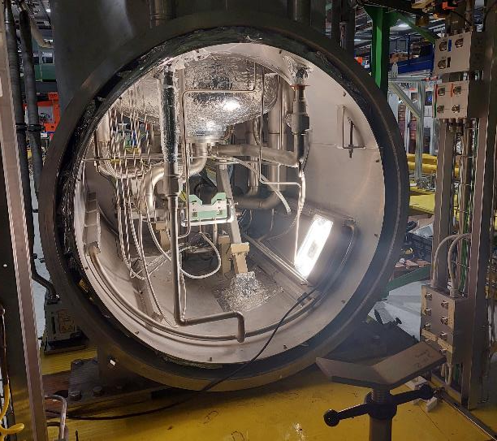
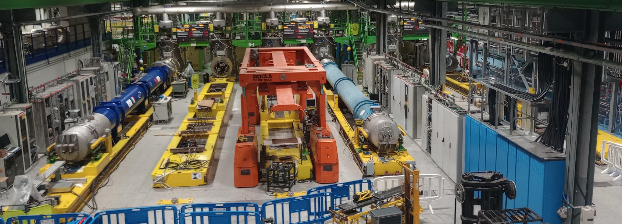
Test bench B2 - D1 test
D1 prototype magnet will be connected in ‘direct connection’, following magnets after bench upgrade with shuffling module.
Each magnet is tested vertical at KEK, full assembly horizontal test at CERN.
Single 13 kA circuit. Rather ‘simple’ circuit.
To be placed on bench B2
B2 test bench ready

Slide 20
D2 magnet on bench C2

Slide 21
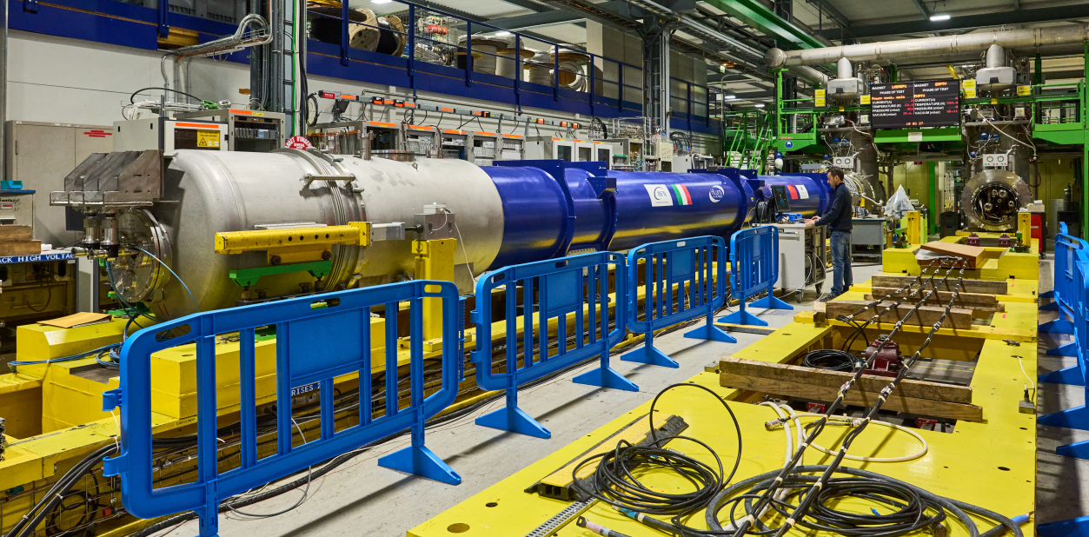
Bench C2: D2-Prototype tests
First full Hilumi cryo magnet assembly in test. Started in september 2022.
4 series and 2 spares to be tested from 2024 to 2026.
Prototype tested in ‘direct connection’. Following magnets will be tested after shuffling module installation.
D2 prototype tested on bench C2 in direct connection.
On the photo: Lucio performing magnetic measurements
https://lhc-div-mms.web.cern.ch/tests/MAG/docum/hilumi/Schedule/schedule_09_2023.jpg

Slide 22
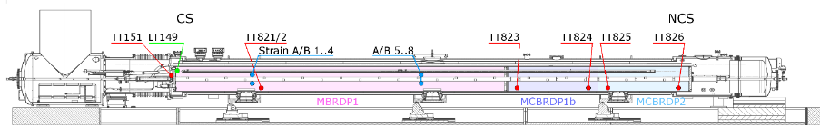
D2 prototype test results
Three magnets are in the cold mass:
MBRDP1 – INFN + ASG
MCBRDP1b – CERN first prototype
MCBRDP2 – IHEP first prototype
The main magnet was the first long prototype built after only one short model.
This assembly was not foreseen to be installed and not foreseen to be a spare magnet.
Very important for assembly testing and often less high-lighted in presentations:
Conformity checks of cabling, instrumentation, protection, connections, polarities, naming conventions, etc.
Multiple non-conformities (non-critical, but to be improved) were reported in collaboration with the QA team and solved by various teams.

Slide 23
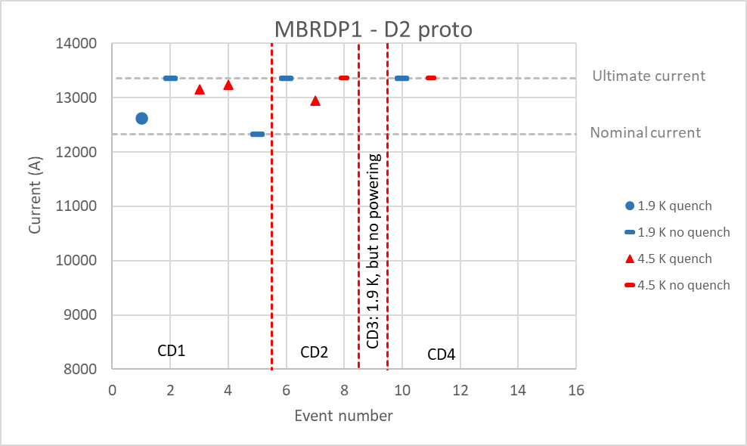
D2 prototype test results
Test plan EDMS 2707482
Test report EDMS 2821189
Non conformity reporting MTF HCLMBRDP001-CR000001
MBRDP1 magnet:
1 quench in 4 cool downs at 1.9 K above nominal current.
3 quenches in 4 cool downs at 4.5 K, all above nominal current.
No powering in cool down 3
No quench in cool down 4 up to ultimate at 1.9 K and 4.5 K
For more details on the test results, see also the presentation by Allesandra Pampaloni

Slide 24
D2 proto insulation test
MBRD Coil-ground requirement: 2060 V (during first cool downs test voltage reduced to 1000 V because of insulation damage during magnet production)
MBRD QH-Coil requirement: 2300 V
Corrector magnet – ground: 1620 V
 | Coil-Ground | QH-Coil | MCBRDP1b-ground | MCBRDP2-ground
CD 1 | 1000 V – OK | 1000 V – OK | 1620 V - OK | 1620 V - OK
CD 2 | 1000 V – OK | 1000 V – OK | 1620 V – OK | 1620 V, failed at 900 V and developed in low resistance short during warm up ~ 1.1 Ω
CD 3 | 1000 V – OK | 1000 V – OK | 1620 V – OK | ~ 1.1 Ω short to ground.
CD 4 | 2060 V, failed above 1600 V followed by repetitive breakdowns at ~ 1200 V | 2300 V - OK | 1620 V - OK | ~ 1.1 Ω short to ground. Localized to midpoint of one aperture where a CLIQ lead was connected. NC report, see EDMS 2812061
Good
Good
Not good
But likely outside of the magnet, to be confirmed
Not good

Slide 25
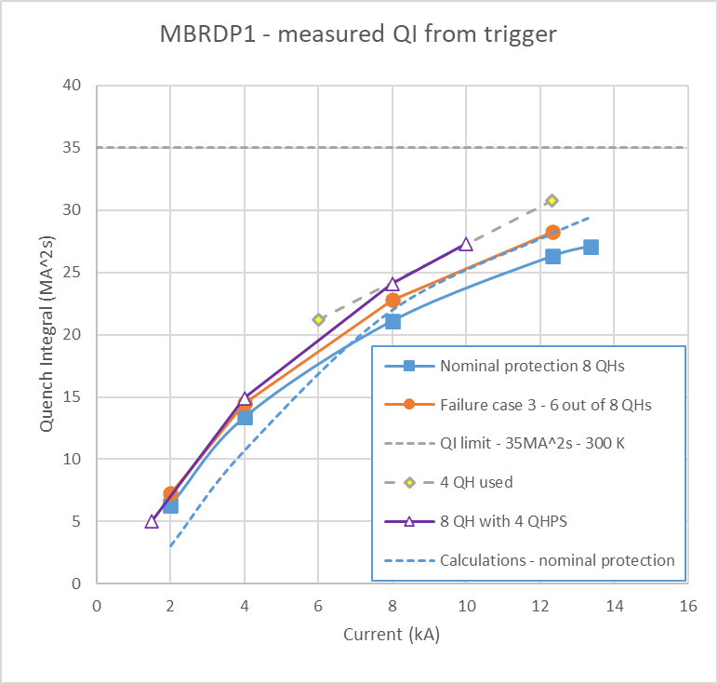
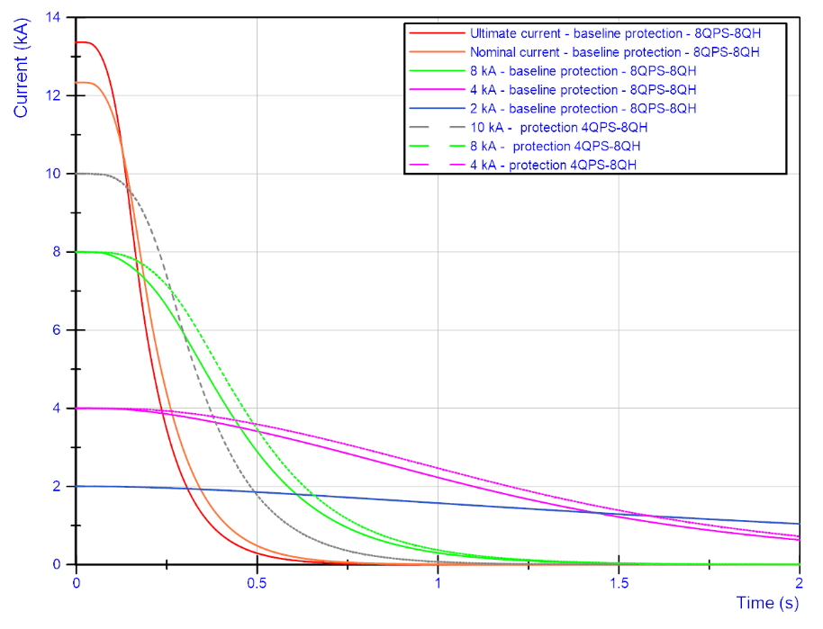
MBRD Protection studies
At nominal current, quench integral is lower in measurements than in simulations.
Comparison current decay between various discharges
Protection scheme and protection simulations were validated, including the failure case scenario.
Note: the quench integral is given here from the trigger moment. In a real quench case one should add the time from quench start to trigger. For the quench at 1.9 K at 12.63 kA this was 23 ms or 3.7 MA²s.

Slide 26
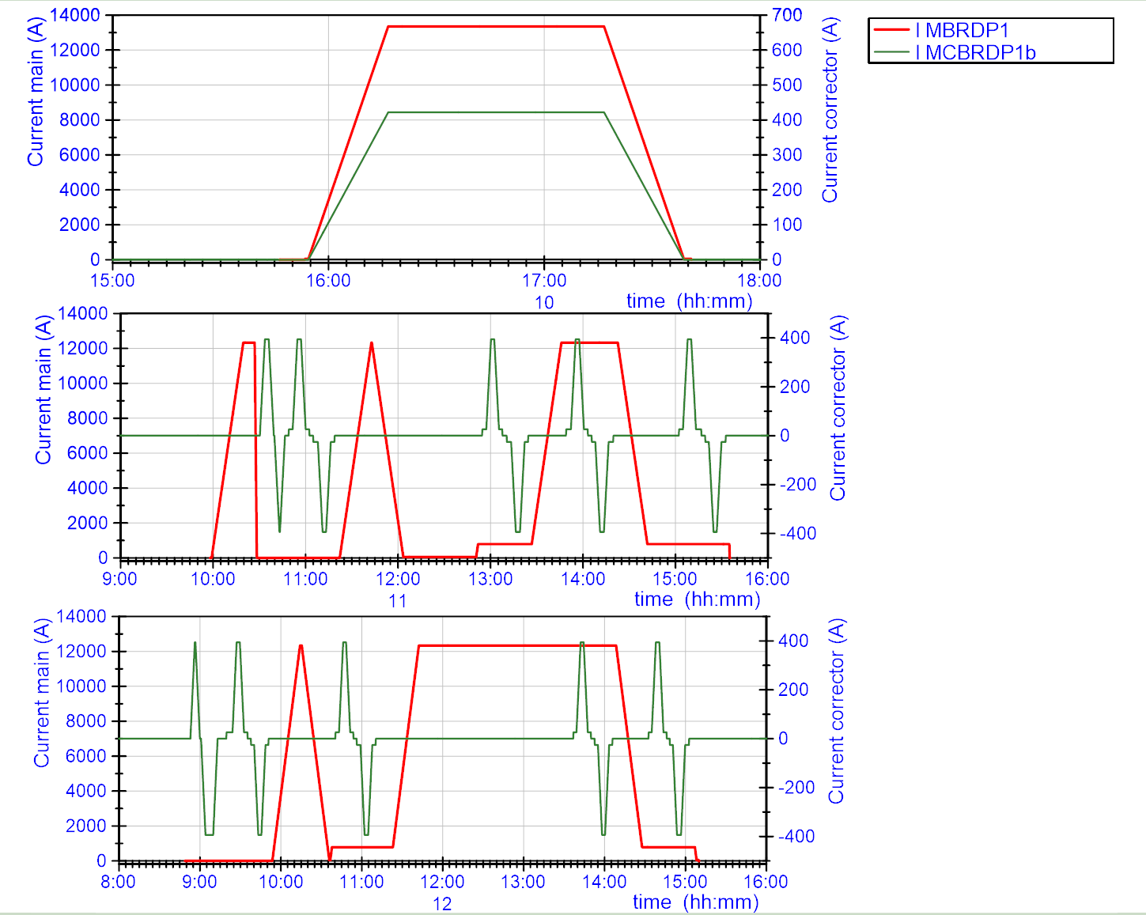
MCBRDP1b + MBRDP1 combined powering
Combined powering of the main magnet with the first corrector magnet to ultimate current was without quenches or surprises.
Magnetic measurement cycles done successfully at nominal current.

Slide 27
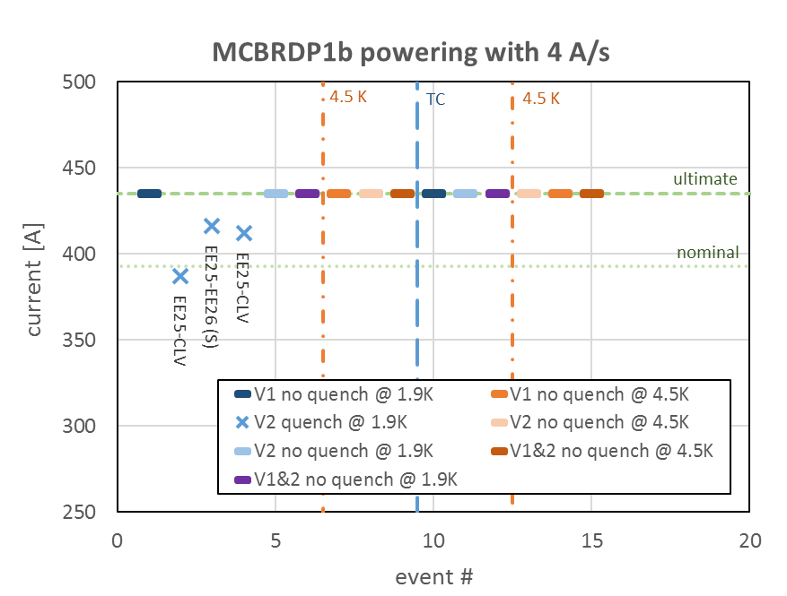
MCBRDP1b powering
For MCBRDP1b powering to ultimate current 422 A with both apertures in series was without quench.
No surprise given the test on the vertical bench.
See presentation by Arnaud Foussat
Reminder of training during vertical test MCBRDP1b
Aperture 1 was reused from MCBRDP1, while Aperture 2 was new.
Test report EDMS 2046092

Slide 28
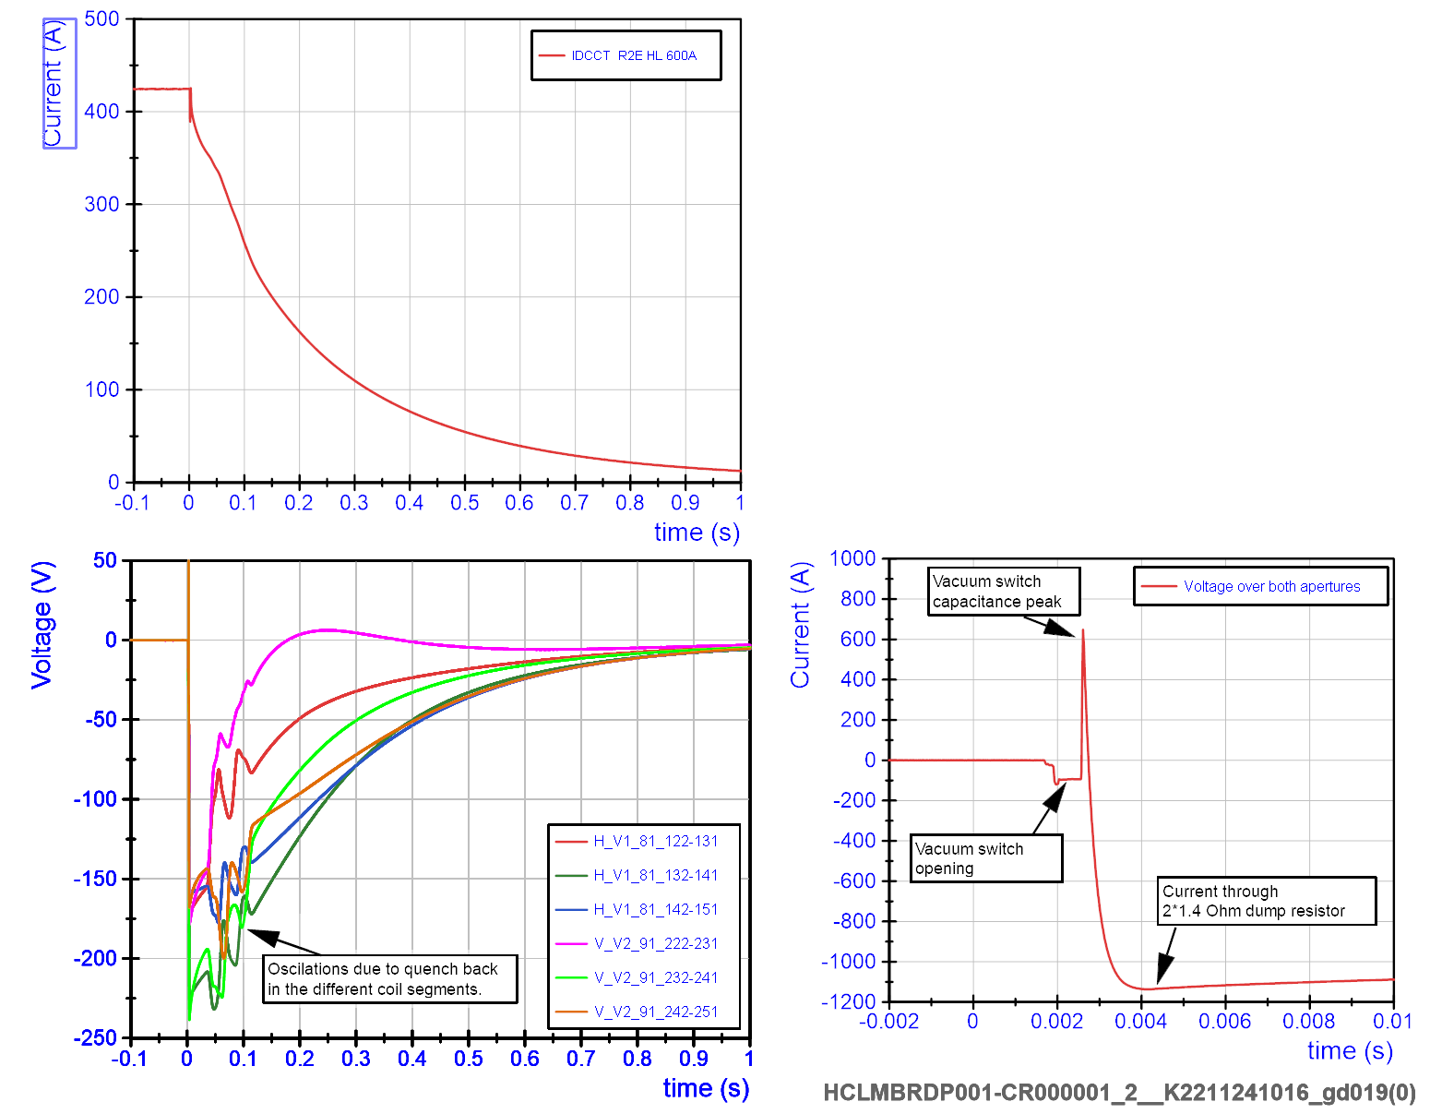
MCBRDP1b protection
Test specific layout:
2 apertures powered in series.
Two dump resistors with 1.4 Ohm each for the circuit (extraction voltage of ~1200 V)
Vacuum switches were used.
All functioning as expected.
Has a charged capacitor connected to the circuit, which requires additional attention during operation.
Good
Reference data is now available for new energy extraction system.

Slide 29
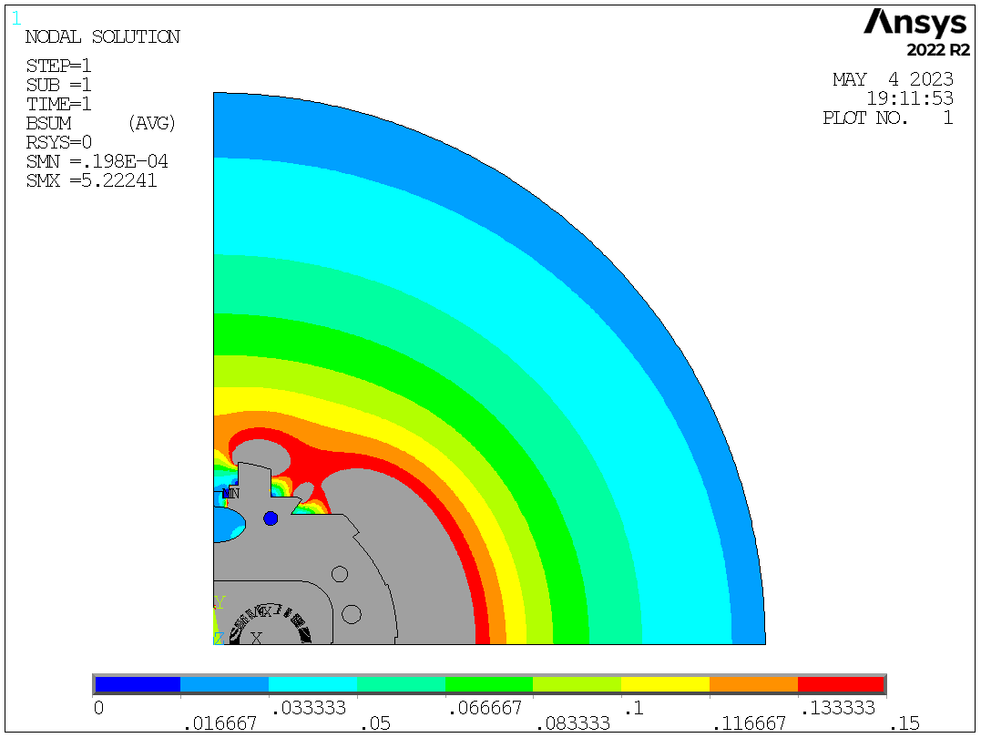
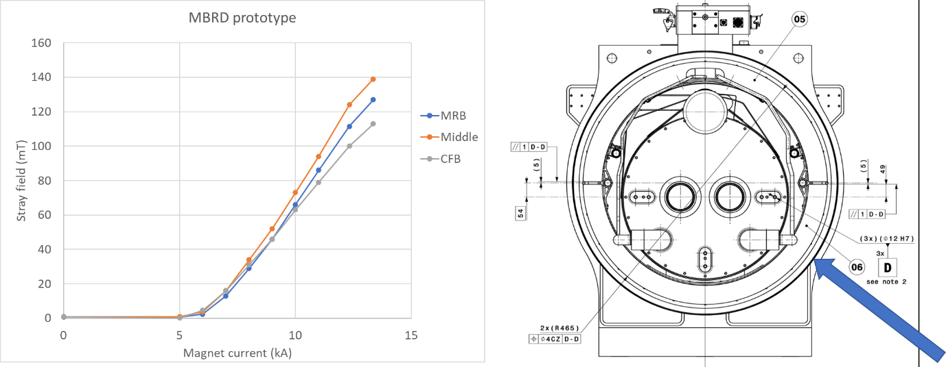
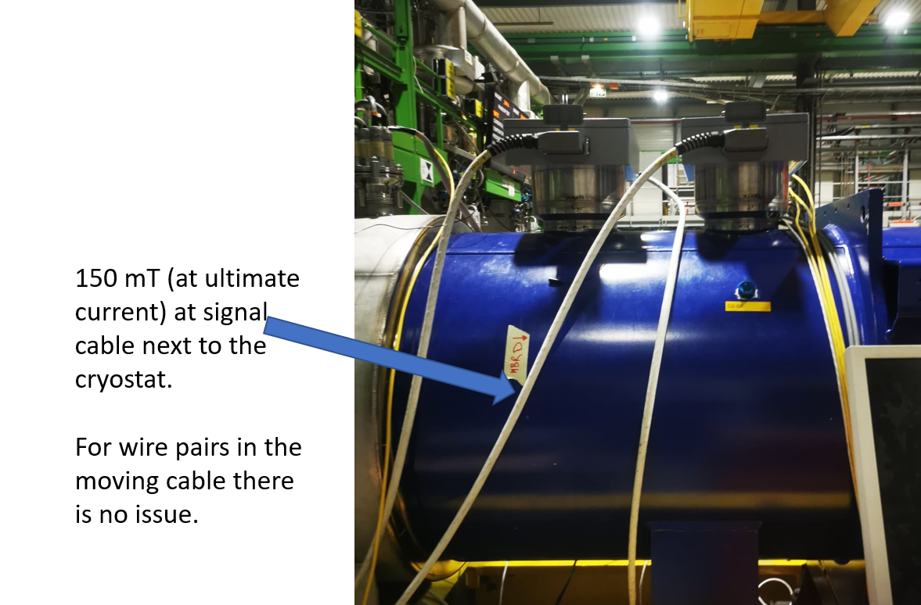
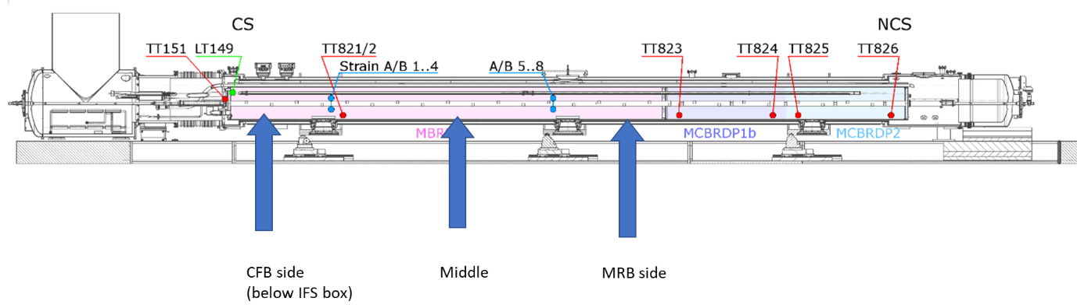
MBRDP1 stray field.
Up to ~ 150 mT next to the magnet at ultimate current.
Strong enough to lift a screwdriver
Moving the signal cable from IFS box does not trigger the standard magnet protection, but in the test configuration it can trigger the bus bar protection.
Not a problem, but good to have reference data, also to follow safety rules.
Field map courtesy Stefania Farinon
Good
Rough validation of calculations

Slide 30
Summary first D2 full assembly prototype tests
MBRD powering performance very good.
MBRD full insulation test had a break down outside the cold mass. To be investigated.
Protection is OK. QI a bit lower than expected. Reference data available.
Overall instrumentation and protection looks good.
MCBRDP1b overall performance is good.
MCBRDP2 was not powered due to insulation issue that was localized.

Slide 31
CP magnet on bench A2

Slide 32
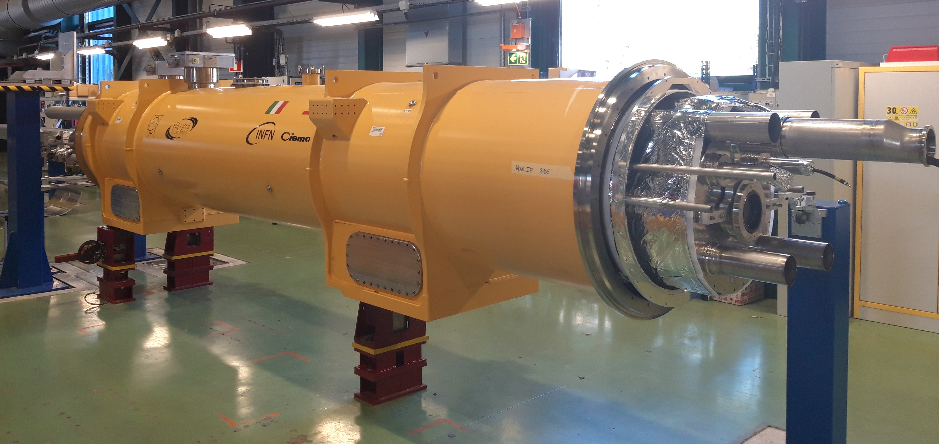
Corrector package test
Corrector package contains:
MCBXFA (2*2 kA)
High order corrector magnets (9 circuits up to 200 A)
1 CP prototype to test early 2024
4 CP series
1 CP assembly spare
CP Prototype in preparation at SMI2.
Photo courtesy: Delio Duarte Ramos
https://lhc-div-mms.web.cern.ch/tests/MAG/docum/hilumi/Schedule/schedule_09_2023.jpg

Slide 33
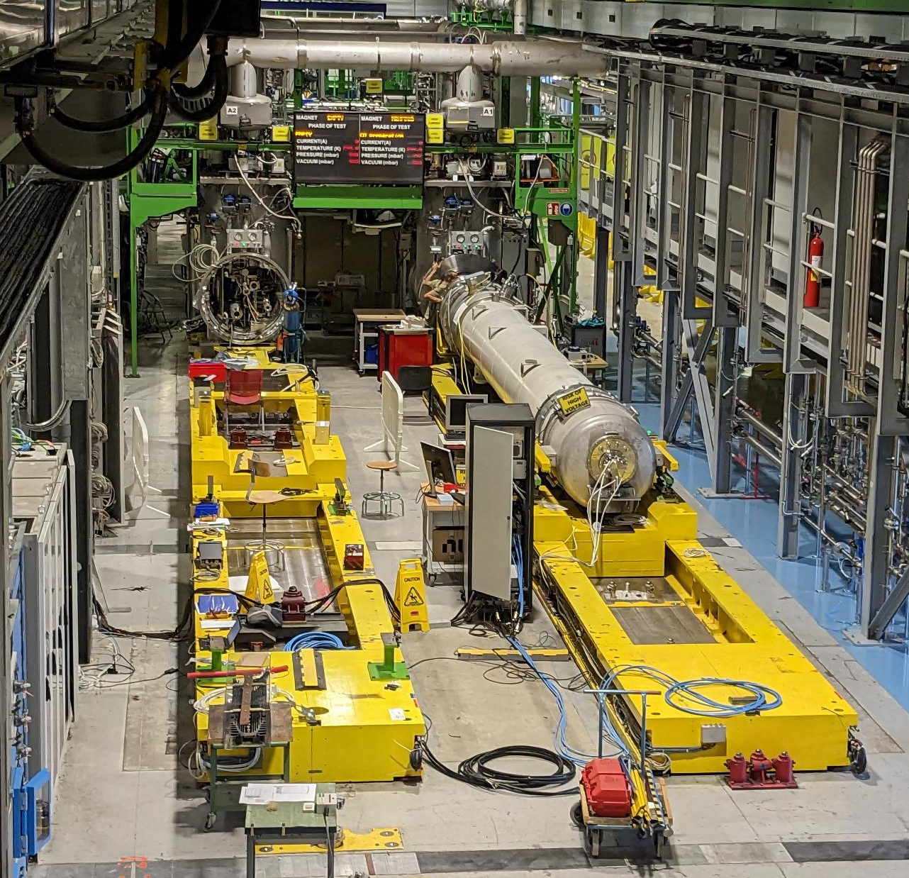
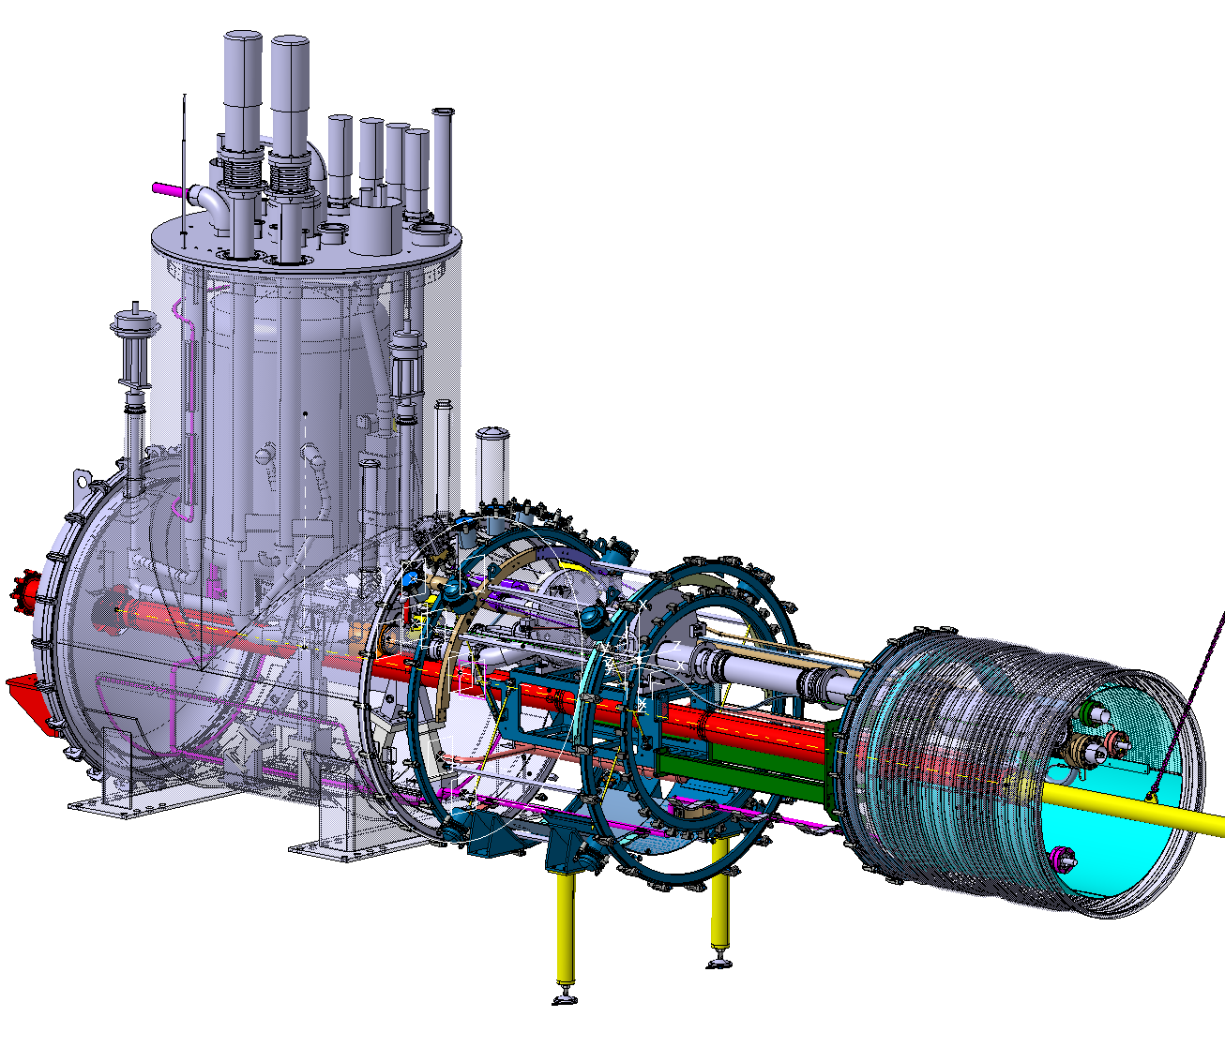
Corrector package test on bench A2
Bench A2
Q1/Q3 and CP
Bench A1
MQXFB test cryostat

Slide 34
Summary
Q2 full assembly is on bench F1. Test and commissioning in the coming weeks.
Bench F2 ready to test the first SC-link assembly, foreseen this year
D2 prototype test completed. Very good results for the main magnet, but also non-conformities to be addressed.
D1 prototype test imminent. Magnet and bench ready, to be connected in October.
CP test will be done after Q3 test and bench upgrade with shuffling module.

Slide 35
Thank you
The CERN SM18 test operation team ready for qualification tests of all HL-LHC magnets, here with the first Q2 assembly on bench F1.

Slide 36
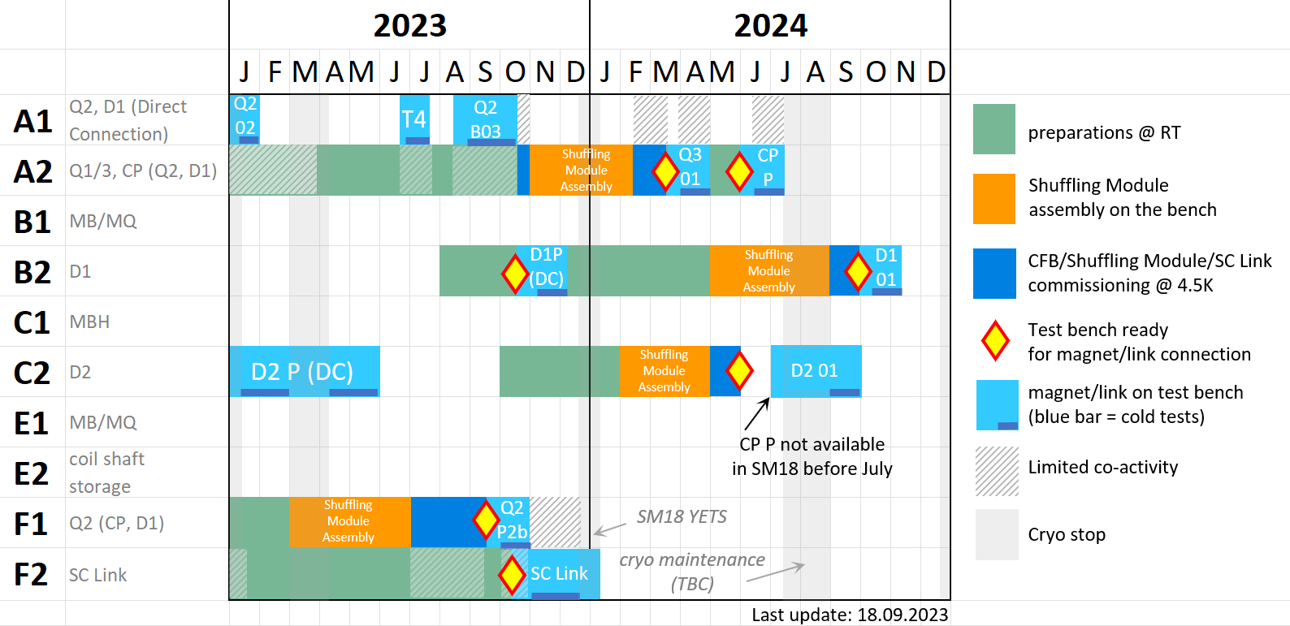
CERN SM18 Superconducting Magnet Test Facility – Upgrade schedule
Courtesy Marco Buzio

