Slide 1

UK Crab Cavity Project Structure
Niklas Templeton – STFC Daresbury Laboratory
On behalf of the UK Crab Cavity collaboration
13th HL-LHC Collaboration Meeting – Vancouver (CA) – 26 Sep ‘23

Slide 2
UK Crab Cavity Project Structure
Meetings & Organisation
Management Changes from RFD to DQW
Staffing Changes
Team Structure
Sub-team management
Parts Management

Slide 3
Phase I vs Phase II Management Changes
RFD SPS
DQW LHC
PM: Andy B-M (was Shrikant)
  Schedule, finance, status reports
Sponsor: Alan W
Technical Manager: Nik T
PM (HL-LHC-UK): Graeme B
WPL: Nik T
  Schedule, finance, status reports
Sponsor: Ian L

Slide 4
Meetings & Organisation
Meeting / Freq. / Chair / Traceability
Toolbox Meeting (1/wk) NT
  Tech Task Board
UK Project (1/2wks) NT + mins
  1 slide (2 min) updates
UK-CERN Technical (1/wk) NT
UK-CERN Project (1/2wks) NT + mins
Design sub-group (1/2wks) EJ + mins
Quality sub-group (1/2wks) CG
FAT sub-group (ad-hoc) AM
Marco 1-1 (1/2wks)
Sponsor 1-1 (1/mo.) + min
PM Board (4/yr)
UK Oversight Committee (2/yr)
CERN Steering Committee (1/yr)
MS To-do Task Planner

Slide 5
Staffing
Dec ‘22
Mar ‘23
 |  | FTE (yrs)
 | Role | 23/24 | 24/25 | 25/26
IL | 0-Sponsor | 5% | 5% | 5%
NT | 1-WPL | 50% | 50% | 50%
NT | 2-Lead Mech Eng | 40% | 40% | 10%
EJ | 2-Mech Eng | 70% | 50% | 10%
CG | 2-QA/Mech Eng | 70% | 70% | 50%
PC | 2-Design Eng | 40% | 30% | 10%
TS | 3-RF Eng | 7% | 7% | 7%
SP | 4-Cryo Eng | 20% | 20% | 10%
AM | 4-Cryo Tech | 0% | 20% | 10%
KM | 5-Snr Vac Eng | 20% | 20% | 10%
SW | 5-Vac Eng | 15% | 30% | 10%
PA | 6-Tech Man. | 10% | 30% | 20%
PH | 6-Tech Man. | 0% | 0% | 0%
LB/TH | 6-Senior Techs | 160% | 400% | 180%
- | 6-Techs | 80% | 100% | 90%
RC | 7-Survey | 25% | 50% | 25%
 | 8-Other | 25% | 70% | 45%
 | Total | 6.4 | 9.9 | 5.4
RL | Lanc Mech Eng | 100% | 100%
 |  | 7.4 | 10.9 | 5.4
 |  | FTE (yrs)
 | Role | 23/24 | 24/25 | 25/26
IL | 0-Sponsor | 5% | 5% | 5%
NT | 1-WPL | 70% | 70% | 30%
EJ | 2-Lead Mech Eng | 100% | 90% | 50%
JB | 2-Mech Eng | 50% | 50% | 10%
CG | 2-QA/Mech Eng | 90% | 90% | 50%
KC/LC | 2-Design Eng | 40% | 50% | 50%
TS | 3-RF Eng | 0% | 0% | 0%
AM | 4-Cryo Eng | 60% | 60% | 50%
IS | 4-Cryo Tech | 10% | 20% | 10%
KM | 5-Snr Vac Eng | 20% | 20% | 10%
SW | 5-Vac Eng | 20% | 30% | 20%
PA | 6-Tech Man. | 10% | 10% | 10%
PH | 6-Tech Man. | 10% | 10% | 10%
LB/TH | 6-Senior Techs | 160% | 400% | 180%
TBD | 6-Techs | 80% | 100% | 90%
RC | 7-Survey | 20% | 30% | 20%
 | 8-Other | 30% | 70% | 50%
 | Total | 7.8 | 11.1 | 6.5
RL | Lanc Mech Eng | 100% | 100%
 |  | 8.8 | 12.1 | 6.5

Slide 6
Change Request After RI Cavity Delays
Mar ‘23
Sep ‘23
 |  | FTE (yrs)
 | Role | 23/24 | 24/25 | 25/26
IL | 0-Sponsor | 5% | 5% | 5%
NT | 1-WPL | 70% | 70% | 30%
EJ | 2-Lead Mech Eng | 100% | 90% | 50%
JB | 2-Mech Eng | 50% | 50% | 10%
CG | 2-QA/Mech Eng | 90% | 90% | 50%
KC/LC | 2-Design Eng | 40% | 50% | 50%
TS | 3-RF Eng | 0% | 0% | 0%
AM | 4-Cryo Eng | 60% | 60% | 50%
IS | 4-Cryo Tech | 10% | 20% | 10%
KM | 5-Snr Vac Eng | 20% | 20% | 10%
SW | 5-Vac Eng | 20% | 30% | 20%
PA | 6-Tech Man. | 10% | 10% | 10%
PH | 6-Tech Man. | 10% | 10% | 10%
LB/TH | 6-Senior Techs | 160% | 400% | 180%
TBD | 6-Techs | 80% | 100% | 90%
RC | 7-Survey | 20% | 30% | 20%
 | 8-Other | 30% | 70% | 50%
 | Total | 7.8 | 11.1 | 6.5
RL | Lanc Mech Eng | 100% | 100%
 |  | 8.8 | 12.1 | 6.5
 |  | FTE (yrs)
 | Role | 23/24 | 24/25 | 25/26 | 26/27
IL | 0-Sponsor | 5% | 5% | 5% | 0%
NT | 1-WPL | 70% | 70% | 70% | 40%
EJ | 2-Lead Mech Eng | 100% | 90% | 90% | 50%
JB | 2-Mech Eng | 50% | 50% | 10% | 0%
CG | 2-QA/Mech Eng | 90% | 80% | 40% | 20%
KC/LC | 2-Design Eng | 40% | 50% | 50% | 0%
TS | 3-RF Eng | 0% | 0% | 0% | 0%
AM | 4-Cryo Eng | 60% | 50% | 40% | 20%
IS | 4-Cryo Tech | 10% | 10% | 20% | 10%
KM | 5-Snr Vac Eng | 20% | 10% | 20% | 10%
SW | 5-Vac Eng | 20% | 20% | 30% | 20%
PA | 6-Tech Man. | 10% | 10% | 10% | 0%
PH | 6-Tech Man. | 10% | 10% | 10% | 10%
LB/TH | 6-Senior Techs | 160% | 200% | 400% | 120%
AL | 6-Techs | 80% | 80% | 100% | 50%
RC | 7-Survey | 20% | 20% | 20% | 10%
 | 8-Other | 30% | 30% | 50% | 20%
 | Total | 7.8 | 7.9 | 9.7 | 3.8
RL | Lanc Mech Eng | 100% | 100%
 |  | 8.8 | 8.9 | 9.7 | 3.8

Slide 7
UK DQW Project Structure
HL-LHC-UK PM
Graeme Burt
Tech Oversight
Phil Atkinson
CC Sponsor
Ian Lazarus
WP Lead
Nik Templeton
New/Change
Leaving project
Specialist Support
Tech Manager
Paul Hindley
PM Support
Anna Vikhoreva
Riggers
Tooling & Procedure Lead
Ed Jordan
QA & Weld Lead
Carlos G
FAT Lead
Andy B-M
Lead Technician
Luke Bladen
Senior Technician
Tom Hanley
Survey & Alignment
Ryan Cash
Outside Manufacturing (Procurement)
Senior Mech Eng
James Bourne
Welder
John Hassall
Senior Vac Eng.
Stuart Wild
Cryo Tech
Ivan S
Technician
Abigail Lee
+2 Mech Tech’s (peak)
Mech Eng
Ricardo L
In-house Manufacturing
YII Mech Eng
Luke C
Vac Eng.
Ollie Poyton
Design Apprentice
Dan Skae
Mech Tech Apprentices
Vac Processing
Logistics
*Does not reflect STFC pay bands. Some staff are shared between multiple projects.

Slide 8
Project Management
HL-LHC-UK PM
Graeme Burt
Tech Oversight
Phil Atkinson
CC Sponsor
Ian Lazarus
PM Support
Anna Vikhoreva
WP Lead
Nik Templeton
Tech Manager
Paul Hindley
Riggers
Tooling & Procedure Lead
Ed Jordan
QA & Weld Lead
Carlos G
FAT Lead
Andy B-M
Lead Technician
Luke Bladen
Senior Technician
Tom Hanley
Survey & Alignment
Ryan Cash
Outside Manufacturing (Procurement)
Senior Mech Eng
James Bourne
Welder
John Hassall
Senior Vac Eng.
Stuart Wild
Cryo Tech
Ivan S
Technician
Abigail Lee
+2 Mech Tech’s (peak)
Mech Eng
Ricardo L
In-house Manufacturing
YII Mech Eng
Luke C
Vac Eng.
Ollie Poyton
Design Apprentice
Dan Skae
Mech Tech Apprentices
Vac Processing
Logistics
*Does not reflect STFC pay bands. Some staff are shared between multiple projects.

Slide 9
Build Leadership
HL-LHC-UK PM
Graeme Burt
Tech Oversight
Phil Atkinson
CC Sponsor
Ian Lazarus
PM Support
Anna Vikhoreva
WP Lead
Nik Templeton
Tech Manager
Paul Hindley
Riggers
Tooling & Procedure Lead
Ed Jordan
QA & Weld Lead
Carlos G
FAT Lead
Andy B-M
Lead Technician
Luke Bladen
Senior Technician
Tom Hanley
Survey & Alignment
Ryan Cash
Outside Manufacturing (Procurement)
Senior Mech Eng
James Bourne
Welder
John Hassall
Senior Vac Eng.
Stuart Wild
Cryo Tech
Ivan S
Technician
Abigail Lee
+2 Mech Tech’s (peak)
Mech Eng
Ricardo L
In-house Manufacturing
YII Mech Eng
Luke C
Vac Eng.
Ollie Poyton
Design Apprentice
Dan Skae
Mech Tech Apprentices
Vac Processing
Logistics
*Does not reflect STFC pay bands. Some staff are shared between multiple projects.

Slide 10
Quality Assurance (All)
HL-LHC-UK PM
Graeme Burt
Tech Oversight
Phil Atkinson
CC Sponsor
Ian Lazarus
PM Support
Anna Vikhoreva
WP Lead
Nik Templeton
Tech Manager
Paul Hindley
Riggers
Tooling & Procedure Lead
Ed Jordan
QA & Weld Lead
Carlos G
FAT Lead
Andy B-M
Lead Technician
Luke Bladen
Senior Technician
Tom Hanley
Survey & Alignment
Ryan Cash
Outside Manufacturing (Procurement)
Senior Mech Eng
James Bourne
Welder
John Hassall
Senior Vac Eng.
Stuart Wild
Cryo Tech
Ivan S
Technician
Abigail Lee
+2 Mech Tech’s (peak)
Mech Eng
Ricardo L
In-house Manufacturing
YII Mech Eng
Luke C
Vac Eng.
Ollie Poyton
Design Apprentice
Dan Skae
Mech Tech Apprentices
Vac Processing
Logistics
*Does not reflect STFC pay bands. Some staff are shared between multiple projects.

Slide 11
Quality Management
Ensuring EDMS & MTF requirements are met
Ensuring local ISO 9001 requirements are me:
  Awareness
  Processes & Procedures
  Competence
  Continuous Improvement
  Etc.
Driving Culture
EDMS & MTF Local Instructions ‘knowledge base’
WP Lead
Nik T
QA Lead
Carlos G
Non-Technical Support
Anna Vikhoreva
Howard Cheng
Peter Bates

Slide 12
Cryomodule Procurement
Technical Management / QA
Nik T
Ed J
Carlos
Andy B-M
Large Proc. Items | Responsible
OVCs | Ricardo (+ Carlos & Nik)
Warm Mag Shields | James Bourne (+ Nik)
Cryolines | Andy & Carlos (+ Ricardo)
Thermal Screens | Nik (+ Ed)
Cavity Support Systems | Ed (+Nik)
Stu W
James B
Ricardo
Non-Tech. Management (Low → High Value)
Diane (OM)
UKRI Proc.
Peter B
Howard
Jac (OM)
Lanc Proc.
Nick (OM)
Procurement Thresholds
<£2.5k Credit Card | <£10k Single Quote OK | <£115k Managed by OM | >£115k UKRI Proc.

Slide 13
Design Management
Assembly tooling & infrastructure
Design development & review
Check & approval of drawings
Nik & Carlos available supervision, support (& design if necessary)
Discussions on-going for JB replacement
Ed J
Nik T
James Bourne
Carlos G
Ricardo L
Luke C
Dan Skae

Slide 14
Parts Management
All incoming & Outgoing items managed by Carlos
All inventory & storage managed by Carlos & Luke
Abi, Luke & Tom to manage QC & processing
  Dimensions control
  Mock assembly
  Cleaning
  Degaussing
  BOM Kits
Storage
QC &
Processing
In / Out
Logistics
Carlos G
Luke B
Abigail L
Mech Techs & Apprentice
Tom H

Slide 15
Parts Management Process
Incoming Acceptance
Processing
Visual Inspection
NCR (concession, repair, return…)
Unique ID & Assy Step?
Incoming Item
Cleaning
Pack, label & Store by CM# & Step#
Dimension Control
QA Accepted?
Degaussing
Mock Assy

Slide 16
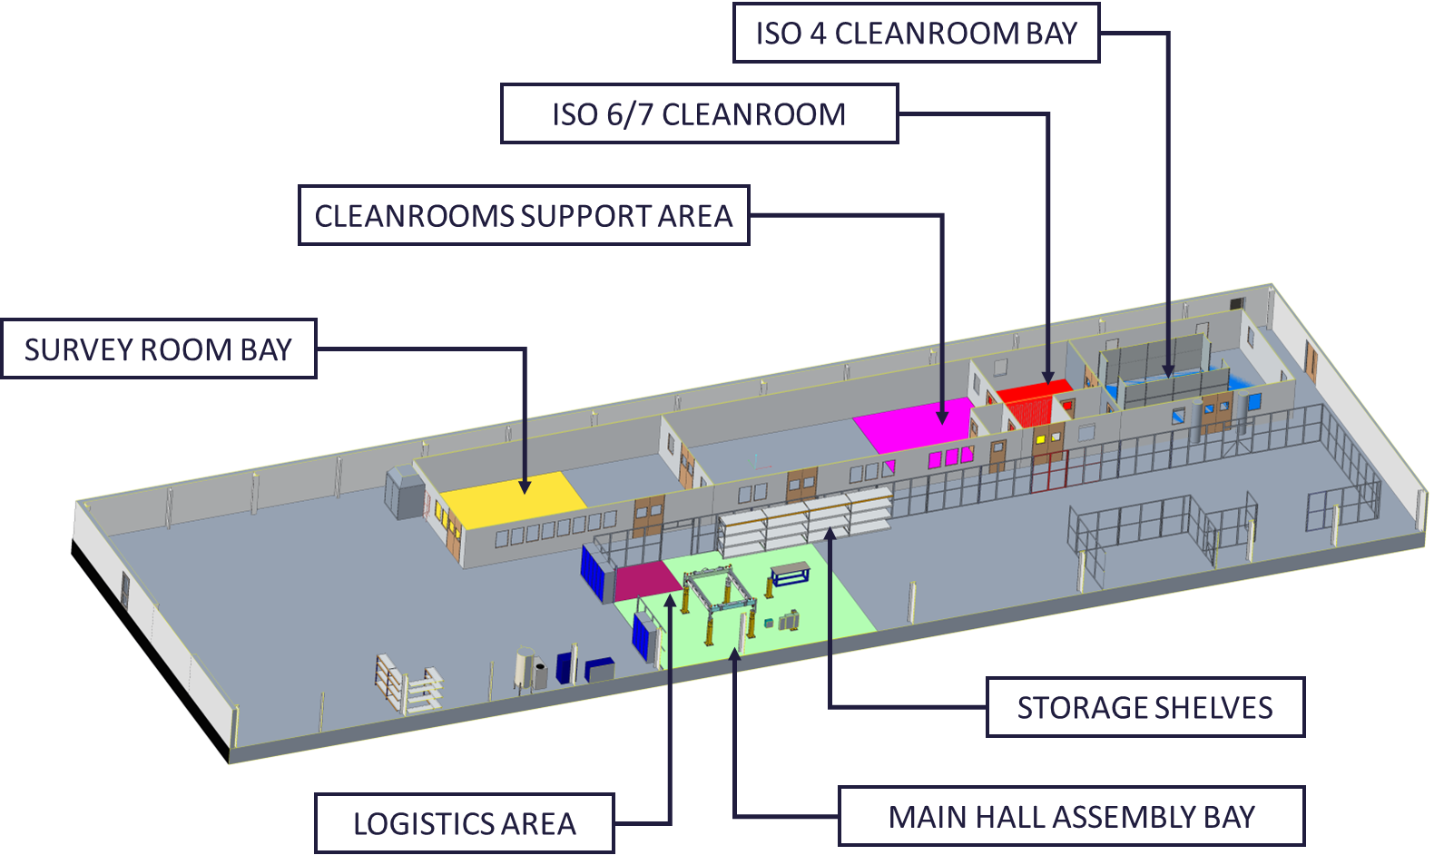
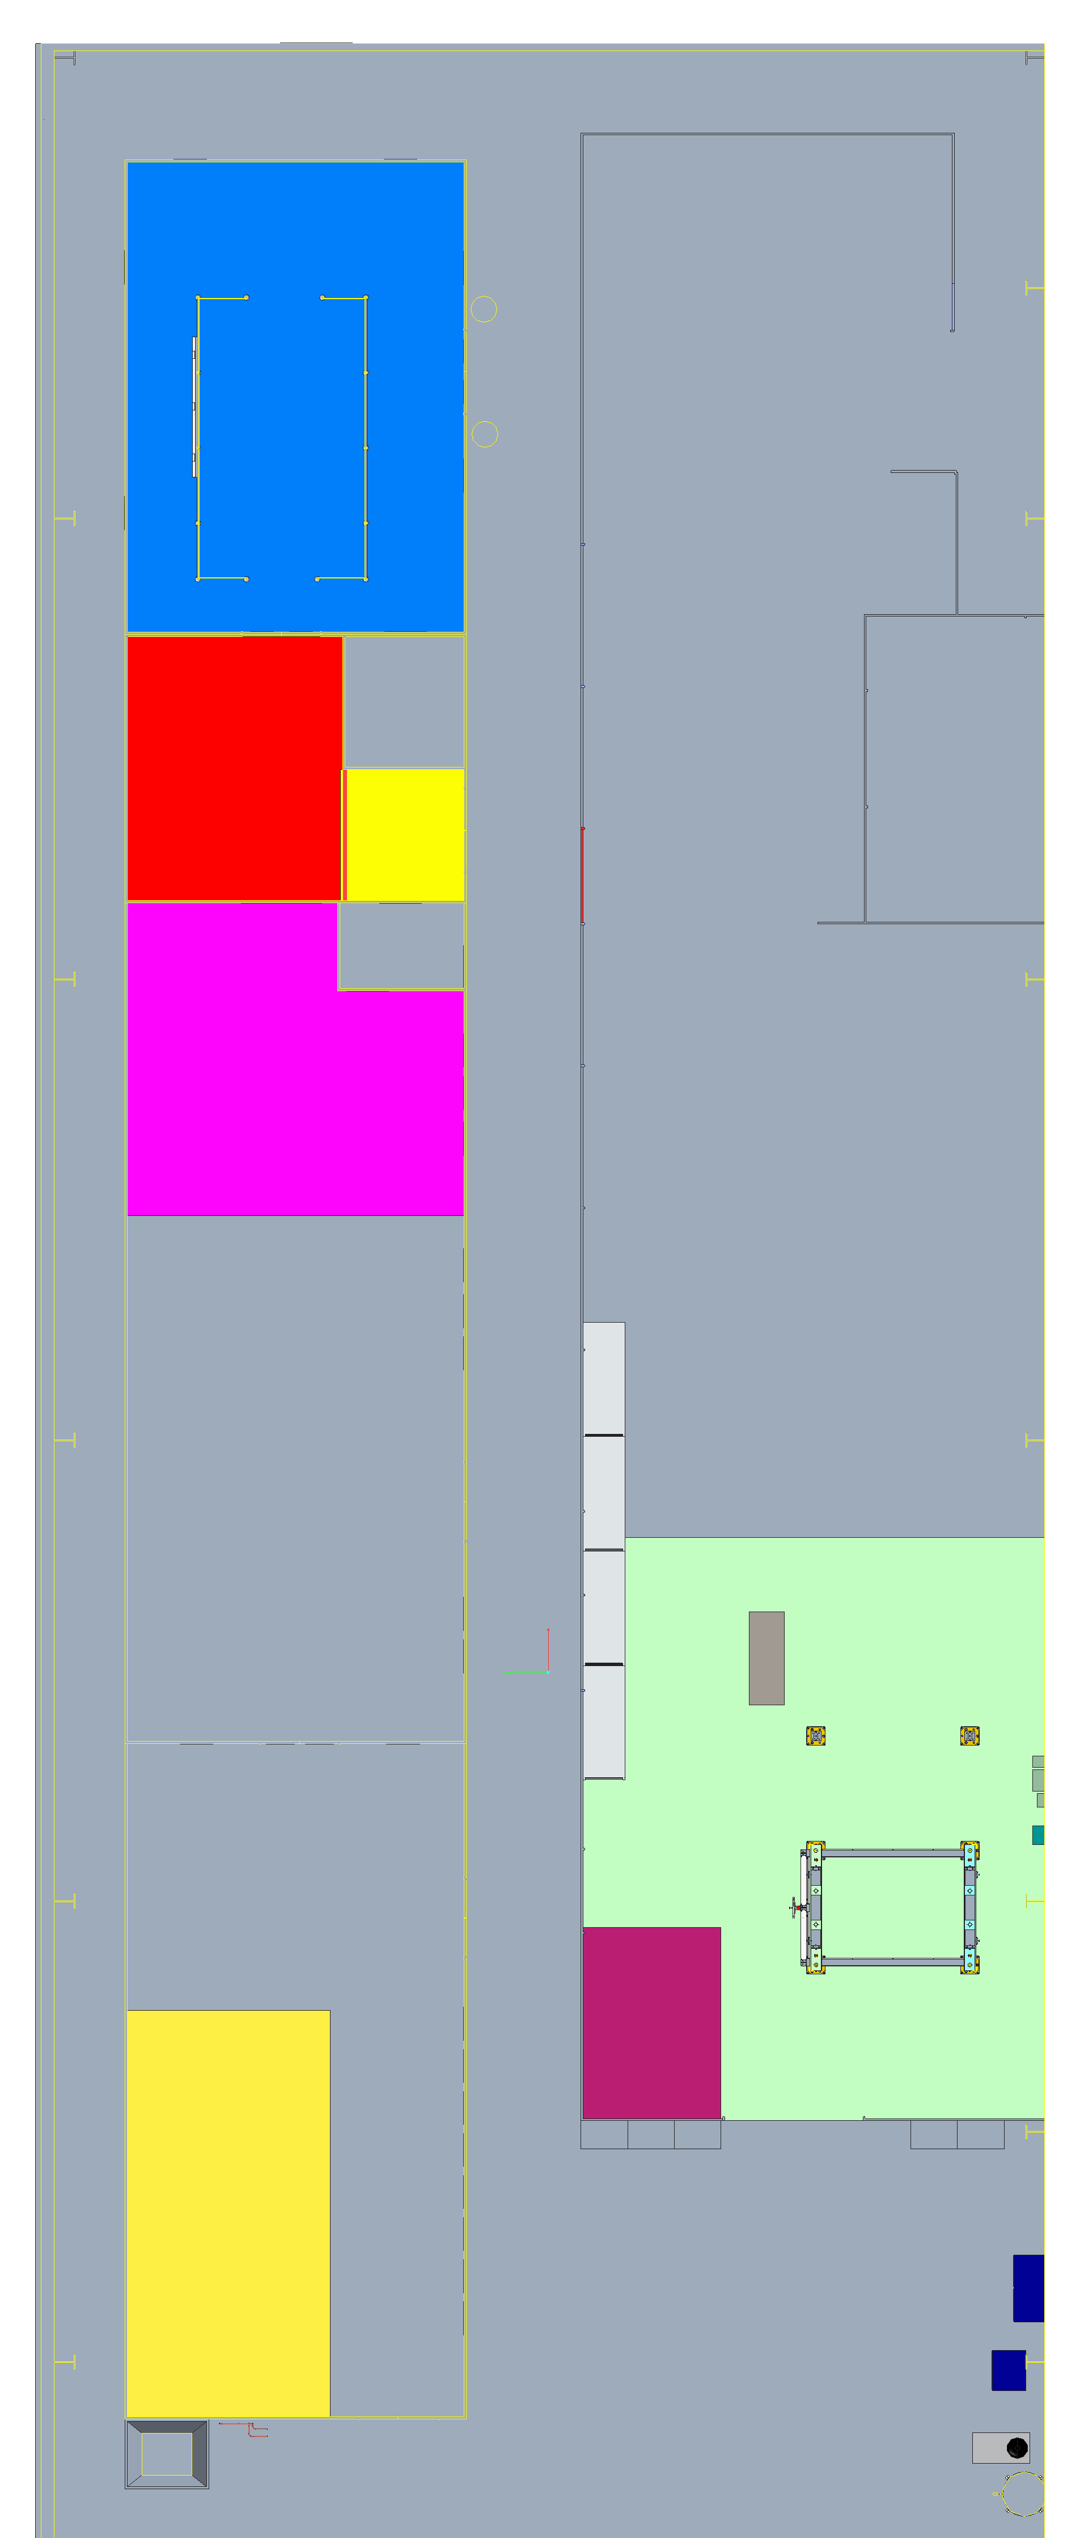
Infrastructure Layout

Slide 17
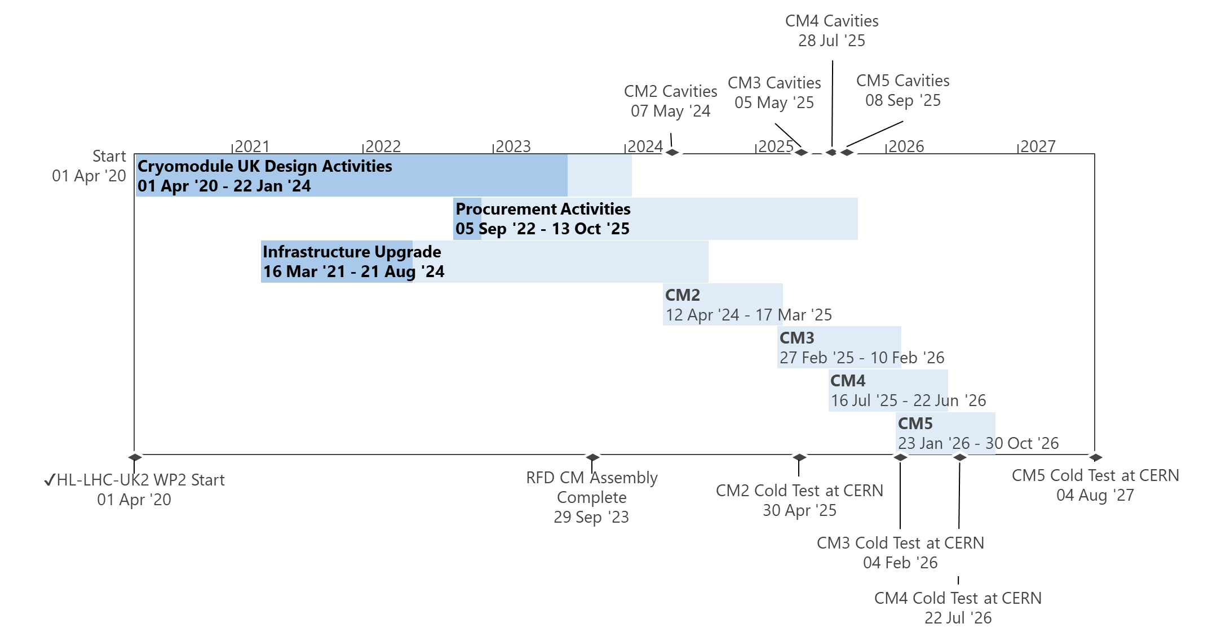
Assembly Management
Provisional Assembly Plan
CM2: Luke, Tom, Abi
CM3: (Luke) Tom, Abi, +1
CM4: Luke, +2
CM5: Tom, Abi, (Luke)
Engineering Oversight
Lifting
Survey & Alignment
Riggers
Ed
Nik
Mech Techs
Luke B
Tom H
Ryan
+2 (peak)
Abi L
Apprentices

Slide 18
Instrumentation, Qualification & Testing
All on-site vacuum, pressure and cold tests as part of qualification and outgoing acceptance
Instrumentation
Cryo
Andy B-M
Weld Qualification
Vacuum
Technician Support
Electricals
Ivan S
Stu W
Luke B
Tom H
Carlos G
Ollie P

Slide 19
Closing Remarks
Lots of improvements done & planned for series
  Parts Management is greatest opportunity
Clearer roles & responsibilities with sub-team management
QA is everyone's responsibility, & ALL needed for EDMS MTF requirements to be met
More effort = more staff budget
  More than £100k is a major change request
Even if accepted, additional staffing is not guaranteed

Slide 20

Thank You! Questions?

Slide 21
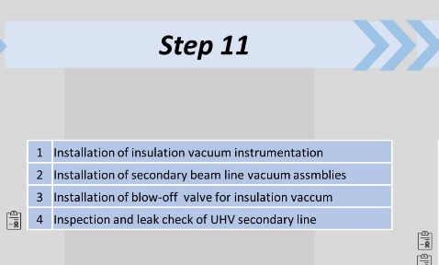
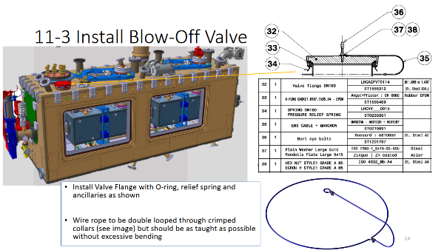
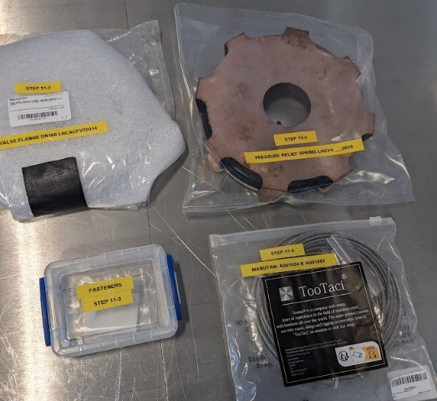
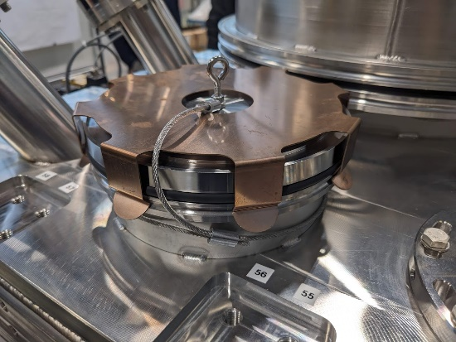
Assembly Procedures
Based on poster logic + tooling & infrastructure
To troubleshoot & de-risk technical tasks
‘BOM kits’ can be prepped by sub-step
Extremely valuable for LHC CC Cryomodules
Includes requirements, torques & sign-off checklists for travellers

Slide 22
UK DQW Schedule
RFD build delays impacted DQW progress
RI Cavity Delivery delays

