Slide 1


High Order Correctors end of production
Marco Statera
on behalf of the LASA team
INFN Milano – LASA
Emma Gautheron
CERN
13th HL-LHC Collaboration meeting
Vancouver – Sep 26^{h} 2023

Slide 2
OUTLINE
Scope: the High Order Correctors magnets
Design and production
Selected results
Lessons learned by series production
Conclusions

Slide 3
SCOPE - High Order Correctors
The High Order Corrector magnets mitigate the impact of the field errors of the focusing quadrupoles in the focusing sections of HL-LHC
The INFN-LASA follows the design, construction and test of the 5 prototypes of the High Order corrector magnets for the HL interaction regions of HL-LHC. KE2291
The INFN-LASA will follow the series production of the 54 HO corrector magnets for the HL interaction regions of HL-LHC. KE3085
INFN delivers the magnets, the vertical test of all magnets, and collaborates to the integration in the cold mass by CERN
INFN will follow up the installation, commissioning and deployment. KE5175

Slide 4
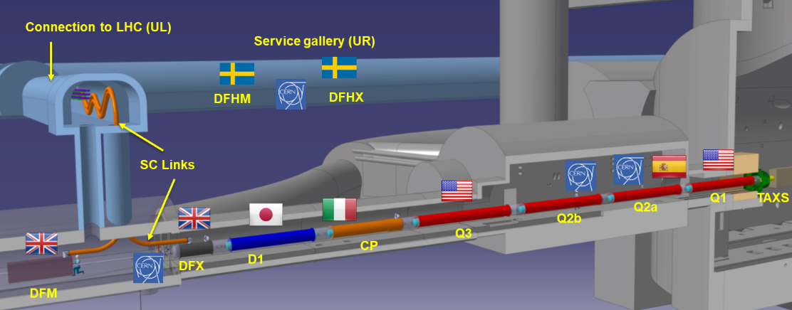



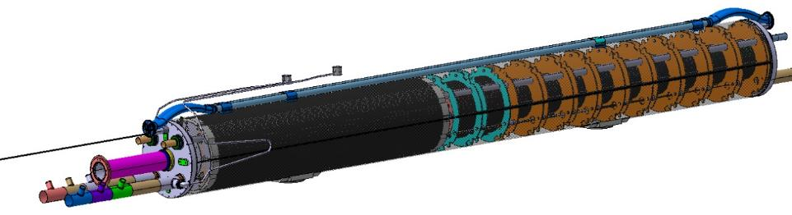

THE LOW BETA SECTION and the High Order Correctors
~70 m
a4
a3
a6
a5
b3
a2
b6
b5
b4
By H. Prin

Slide 5
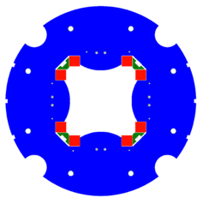
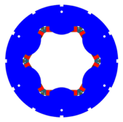
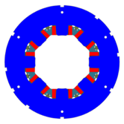
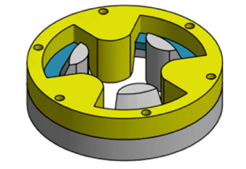
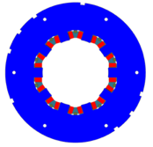
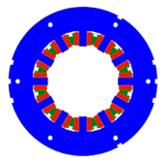
HO Corrector Magnets Zoo
MQSXF
MCSXF
MCOXF
Design
Construction & Test
5 protoptypes
54 series magnets
6P 8P 10P +50% Bdl
OD320
OD460
a3
b3
a4
b4
a2
MCDXF
MCTXF
Prototypes tested 2016-2020
NbTi SuperFerric design
Geometrical lengths:
200 mm - 580 mm
Quench protection
No energy extraction (but 4P)
60% margin @ 1.9 K
a5
b5
a6
b6
Round Coil Superconducting Magnet
MgB₂demonstrator

Slide 6
From prototypes to series production
First prototypes assembled at LASA
Long prototypes assembled in industry
Series production in industry
Confirmed critical issues
In house development
Early involvement of industry
RI vs company
Deep understanding of the (different) goals
Problem solving approach
People are the key
Easy on paper
Huge effort

Slide 7
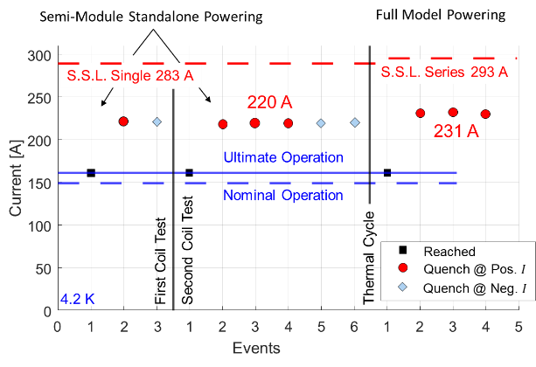
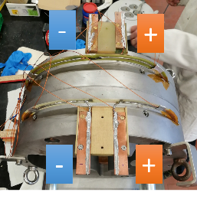
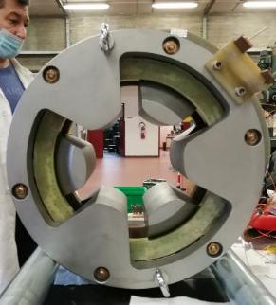
Exploring different designs
The development of the round coil magnet idea is a way to introduce HTS superconductors in accelerators
Not the best choice for HL but suitable for lower energy accelators and/or to operate at higher temperature
One way toward higher sustainability of accelerators (10 K – 20 K operaton)
conductor
iron
Full module
By R. Valente

Slide 8
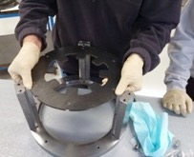
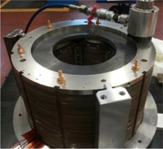
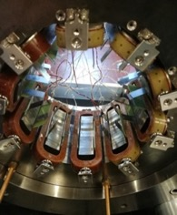
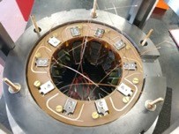
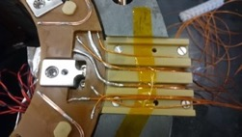
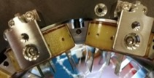
HOC ASSEMBLY
lamination
Procedure developed at LASA on prototypes
6P, 8P, 10P assembled at LASA
12P and 4P assembled in industry
alignment frame
Coil technology and magnet assembly procedure have been developed at LASA
Developing and transfering and QA are key point to pursuit reproducible results
coil
upper PCB
PCBs fixing
bridge
CuBe rods
lower PCB
Longitudinal support
wedge

Slide 9
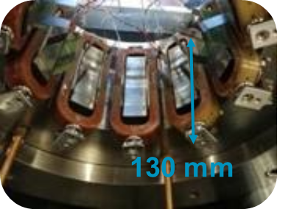
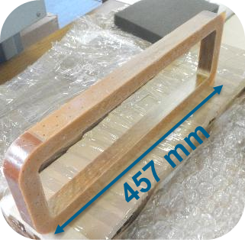
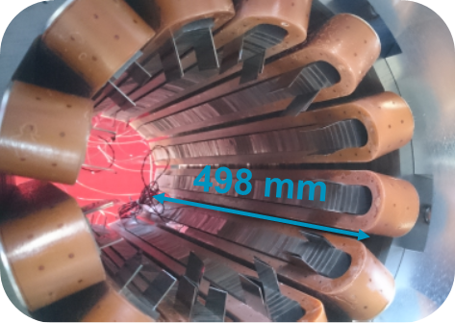
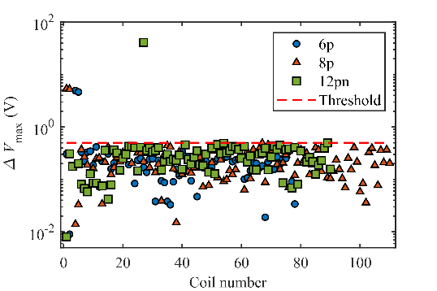
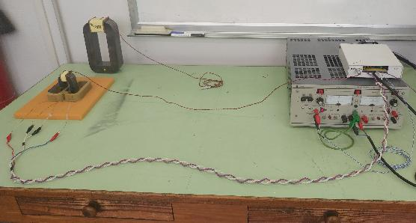
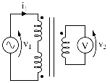
Quality Control of coils
Produced coils 508
29 NC (6%)
QC developed by LASA
Measurements in industry
The number of turns is checked through a custom measurement setup
Surge test at V₀ = 2 kV to detect internal insulation defects
Voltage to ground tests
Mechanical dimensions
Inter-turn short
One turn less

Slide 10
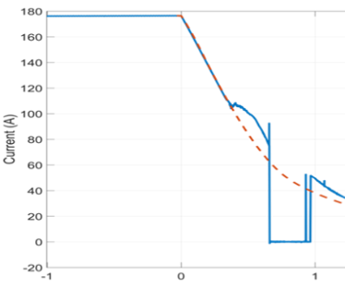
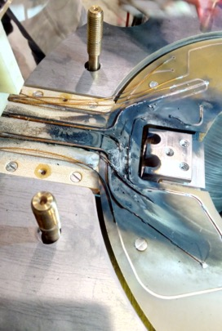
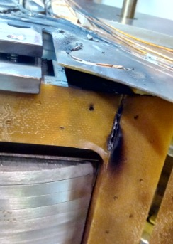
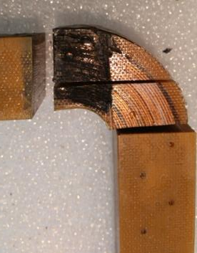
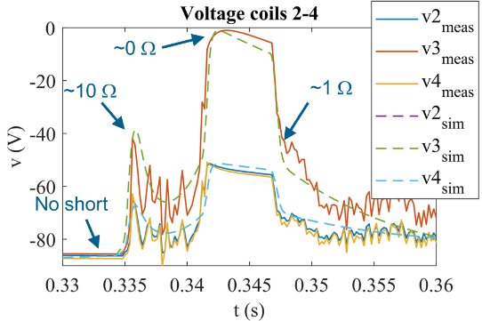
What happens if something goes wrong?
The quadrupole prototype had an issue on wire to wire insulation during coil construction
Analysis by Sorbi-Prioli-Mariotto
Mitigation: input wire additional protection layer and dedicated test during production

Slide 11
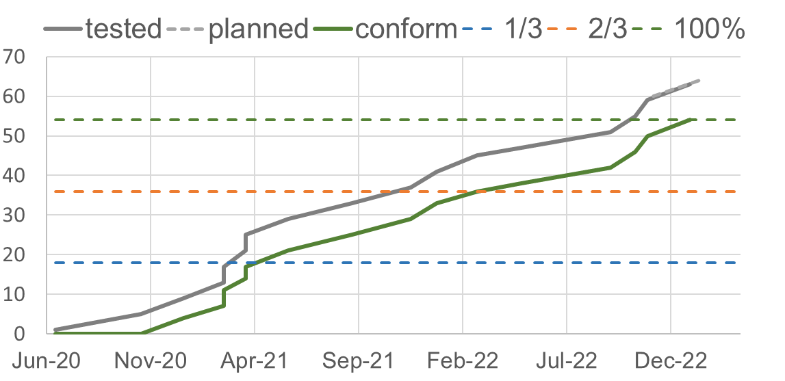
Production and test (magnets)
Contract signed in
Coils produced at SAES Getters Lainate (Milano, I)
Last coils delivered in July 2021
Magnets Assembled at SAES Rial Vacuum (Parma, I)
Last 10 produced magnets delivered to LASA in Oct 2021
End of tests Feb 2023
100%
Produced magnets
½ production
Legend
done/tested
Test ongoing
re-assembly
1 batch
Design iteration
Cryogenics delays

Slide 12

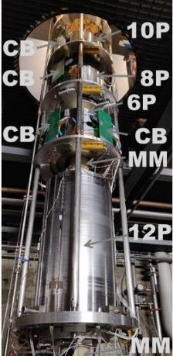
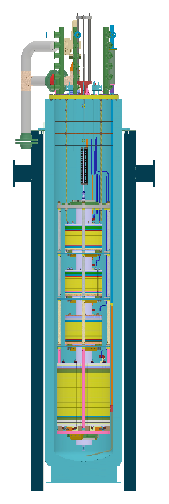
The test station
Four HO correctors cooled
  Each magnet powerd individually
  Magetic Measurements
New power converter 600 A
  Dump resistance 1 Ω or 1.5 Ω
  IGBT polarity switch by LASA
  IGBT for quench protection
Field probe for the series
  Each magnet measured individually
  No cross talk

Slide 13
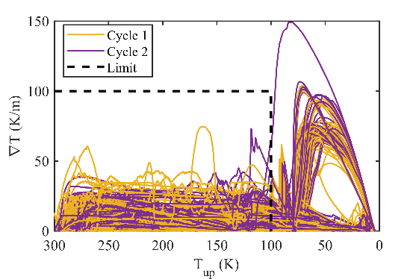
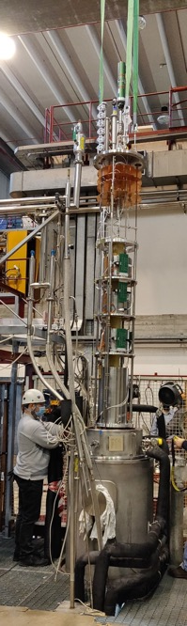
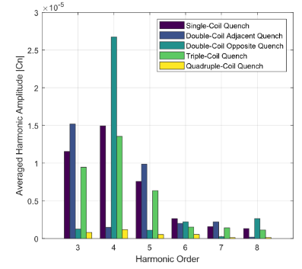
Measurements
Powering 100% (M. prioli)
Training (both polarities)
Endurance test 1h at ultimate
Magnetic field measurement 96%
(E. De Matteis, S. Mariotto)
Field integral 1% to 3% wrt simulations
Field integral reproducibility <0.1%
Field quality high reproducibility
Transfer function very good agreement with simulations, high reproducibility
Quenched coil recostruction via Magnetic Measurements (S. Mariotto)
Number of quenched coils
Position of the quenched coils
S. Mariotto and M. Sorbi. SuST, 35(1):015006, nov 2021.

Slide 14

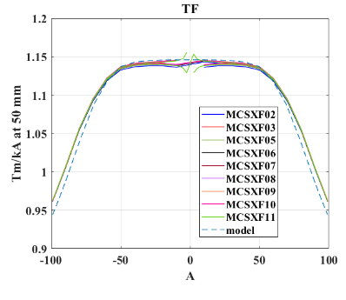
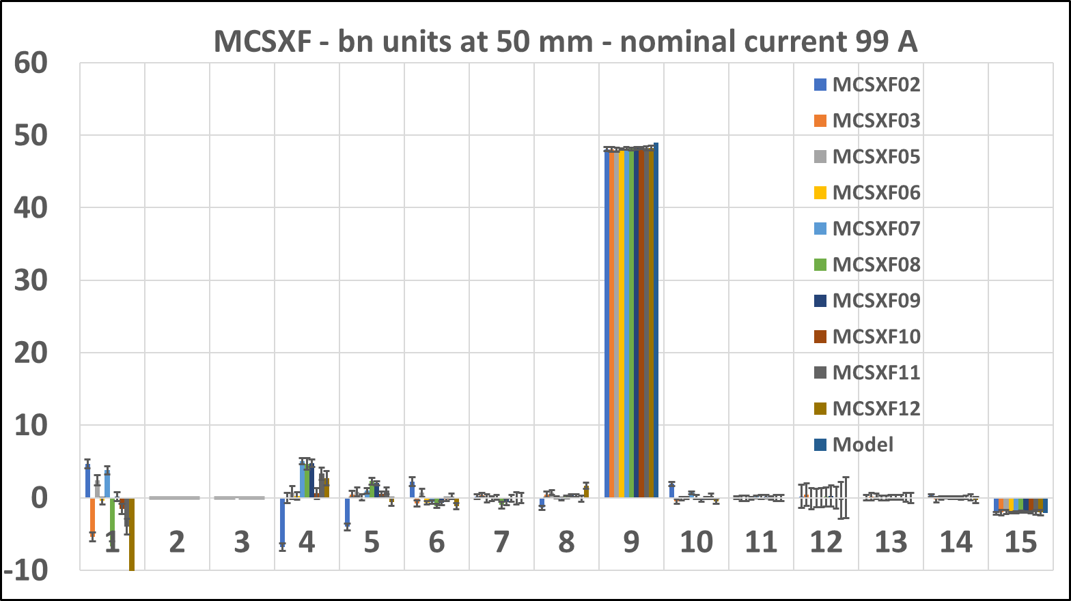
Magnetic measurements of HOC magnets
HOC magnets have been very challenging to measure:
  very important to have a good Magnetic Measurement system with software tools for a fast analysis
Assembly non-conformities detection and cross-check after re-assembly
Calculated
Reproducibility 0.2%
Allowed harmonics 100 U

Slide 15
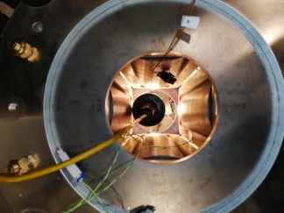
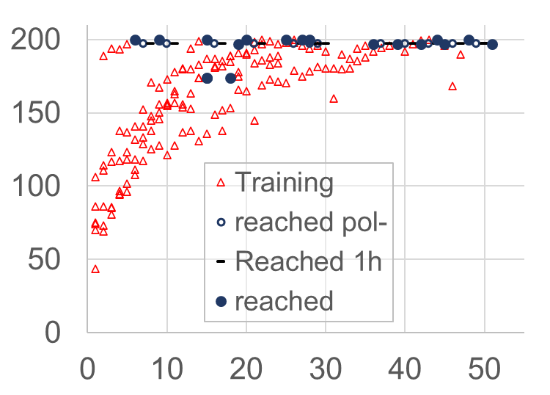
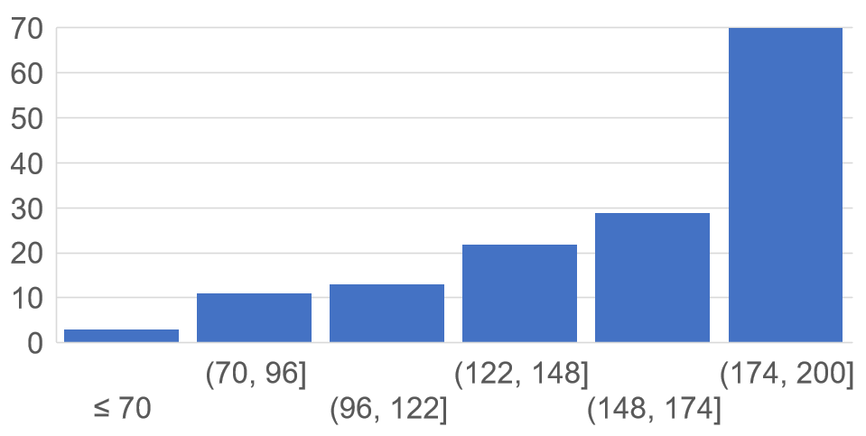
Training history of quadrupoles
Second assembly
Coils already trained
nominal current
49%
20%
ampere
15%
ampere
Half quenches above nominal current
Most quenches are coil training
event number

Slide 16



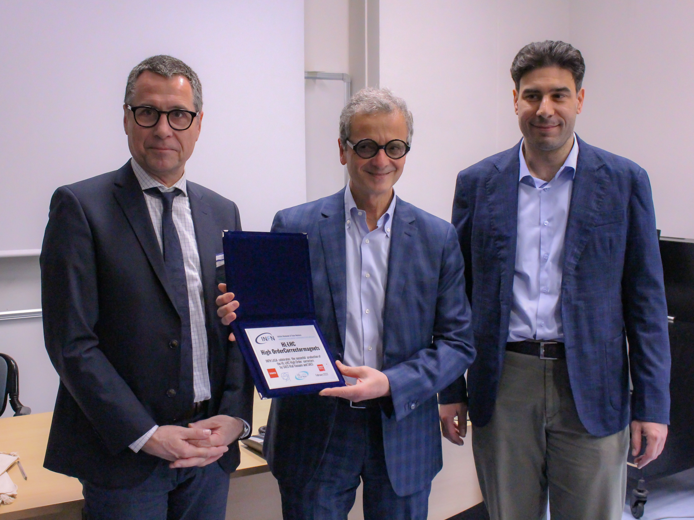
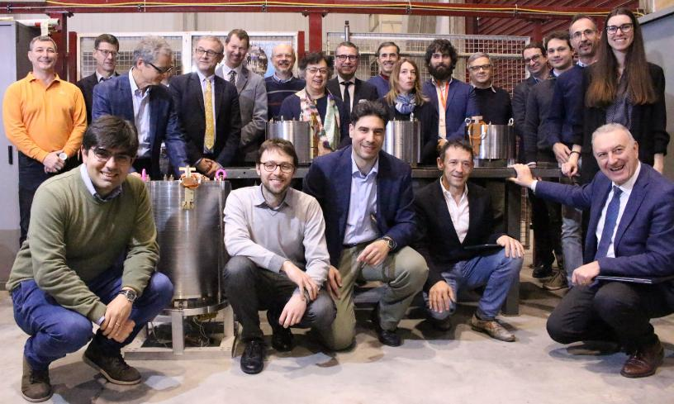
HL-LHC: HIGH-ORDER CORRECTOR MAGNETS ARRIVED AT CERN
https://home.infn.it/en/infn-news/5607-hlc-hl-high-order-corrector-magnets-delivered-to-cern
ANSA.IT ‘Cern, consegnati i magneti per la versione super di LHC’
https://www.ansa.it/canale_scienza_tecnica/notizie/fisica_matematica/2023/03/02/cern-consegnati-i-magneti-per-la-versione-super-di-lhc-_573bce19-c93e-41ca-9c60-1bed780725d0.html
Accelerating news
54 magnets: The High-Luminosity LHC receives its first in-kind contribution
The completion of the High Order Corrector Magnet project was only made possible by the collaborative efforts of INFN, CERN, and industry.
Ph. By A. Musso

Slide 17
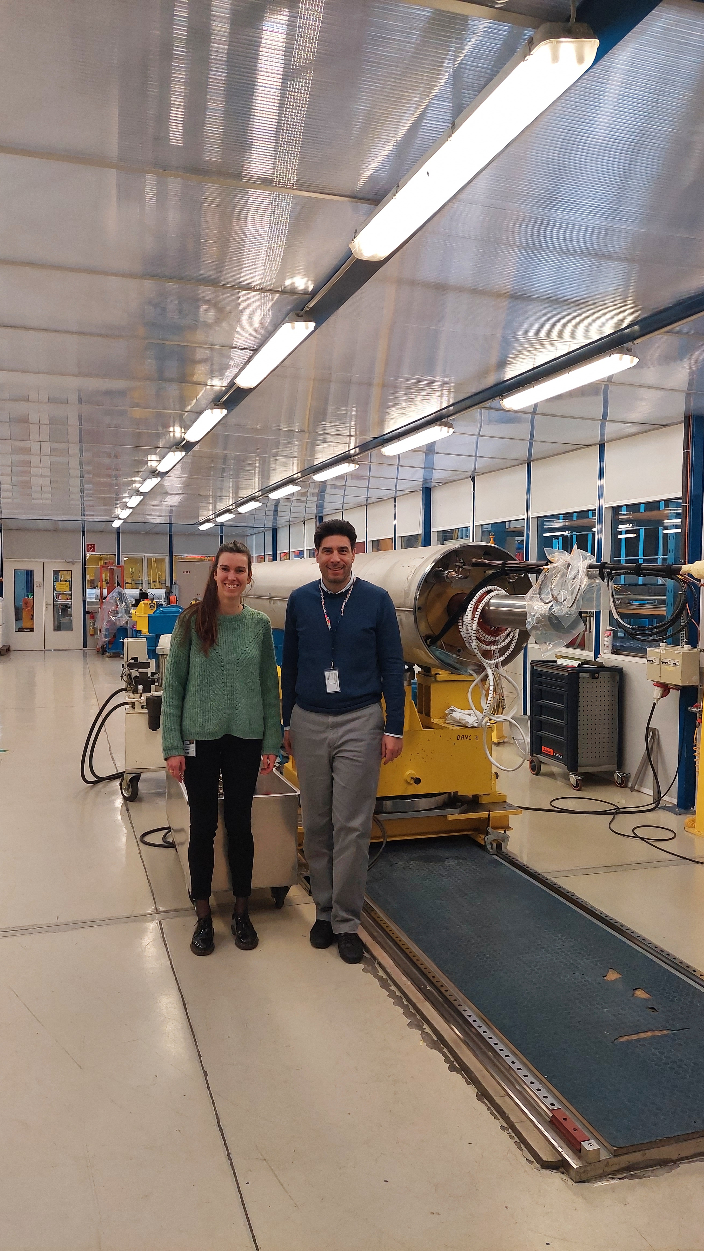
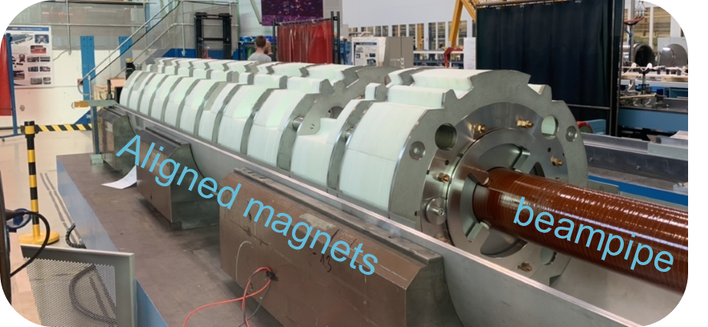
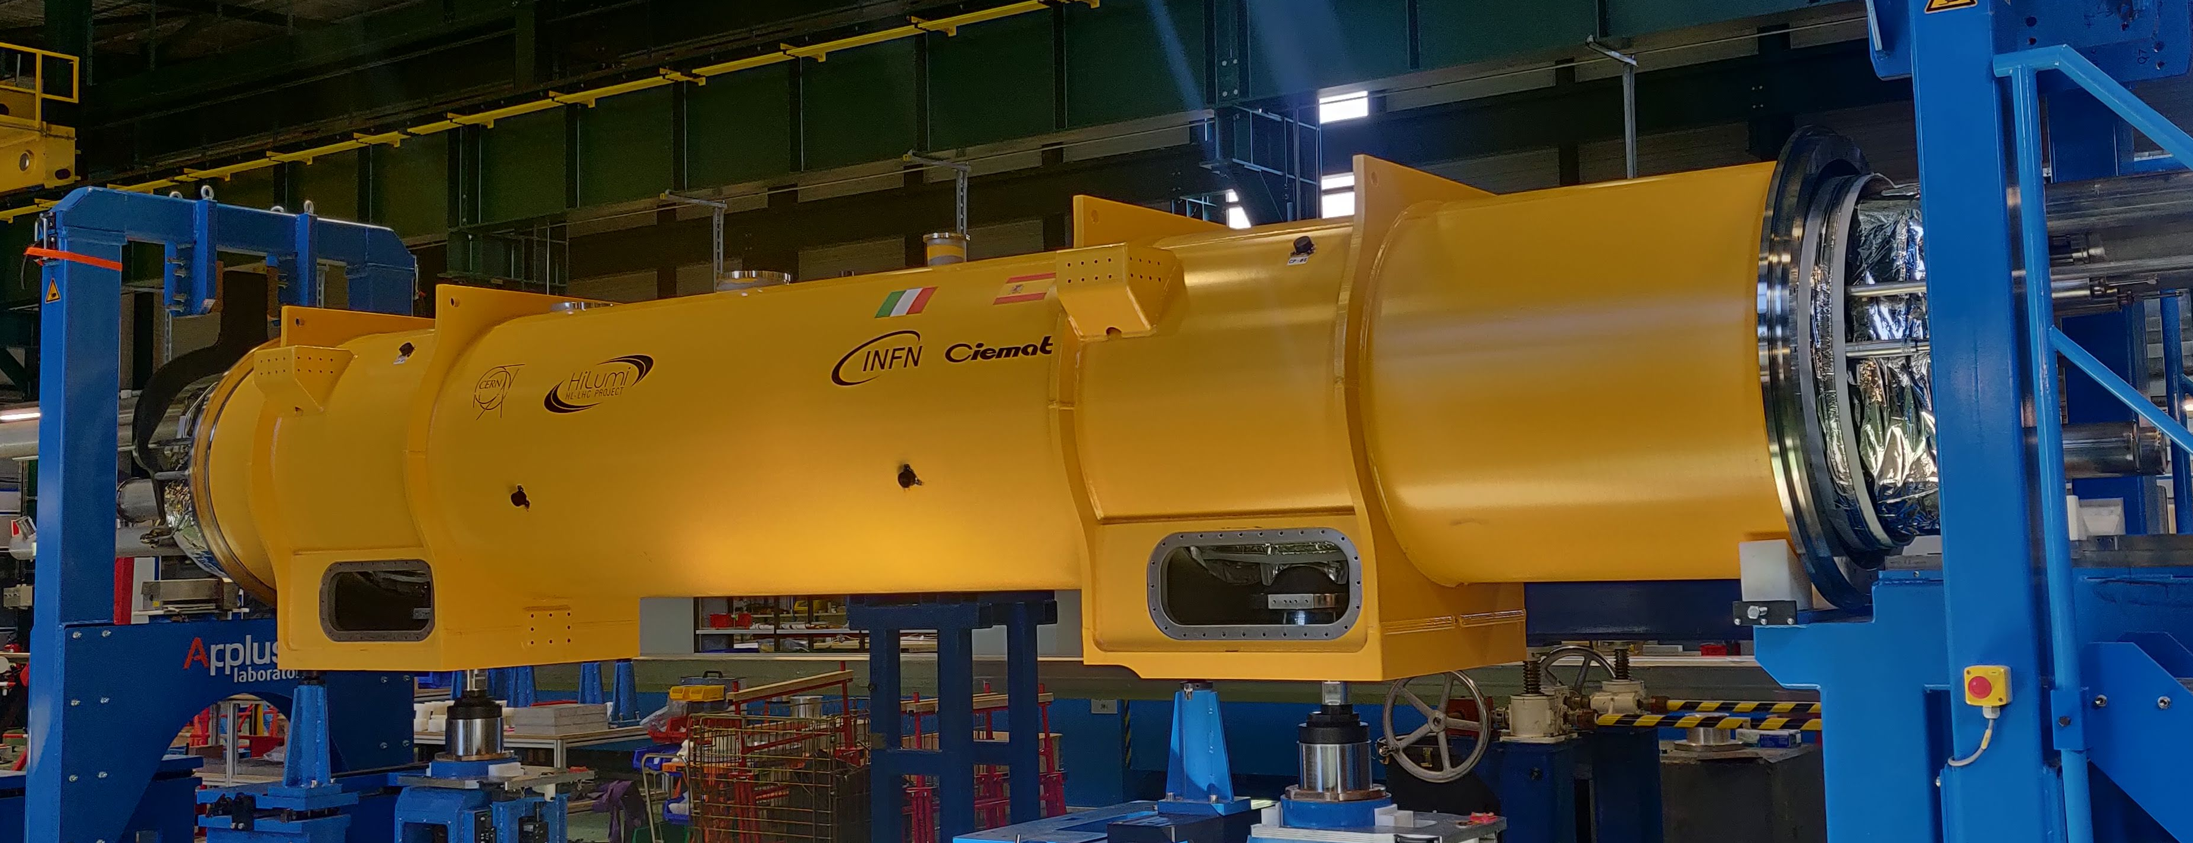
Integration

Slide 18
CONCLUSIONS
The corrector design is solid
Developed several techniques for coils, electrical connections, assembly, quench reconstruction, quality control…
Commissioned a multipolar accelerator magnet based on MgB₂ that is suitable with operation at 20 K
The in house development of technologies and the involvement of industry since prototype phase were good practices
The solution oriented interaction with company solved the issues raised during series production
Installation, commissioinign and deployment are ongoing

Slide 19
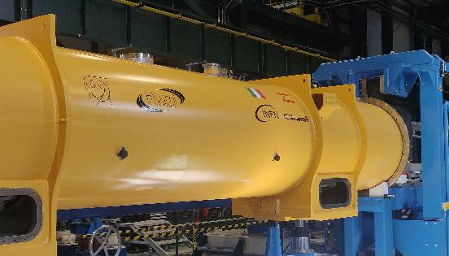


THANK YOU
LASA team
F. Broggi, E. De Matteis,
S. Mariotto, A. Paccalini, A. Pasini, D. Pedrini, A. Leone,
A. Palmisano, M. Prioli, M. Quadrio, M. Sorbi,
M. Statera, M. Todero, C. Uva, R.U. Valente
CERN A. Musso, E. Gautheron, E. Todesco
SRV M. Campaniello, M. Canetti, C. Santini, F. Gangini, P. Manini

