Slide 1
TS1 preparation

Slide 2
Two wire scanners ready
Installation of ferrite tiles(3 per tank?) foreseen
Modification of BA4 layout, WS in 41677 will be rotated and will become horizontal
ECR submitted
Intervention organized, estimated duration around 4 hours

Slide 3
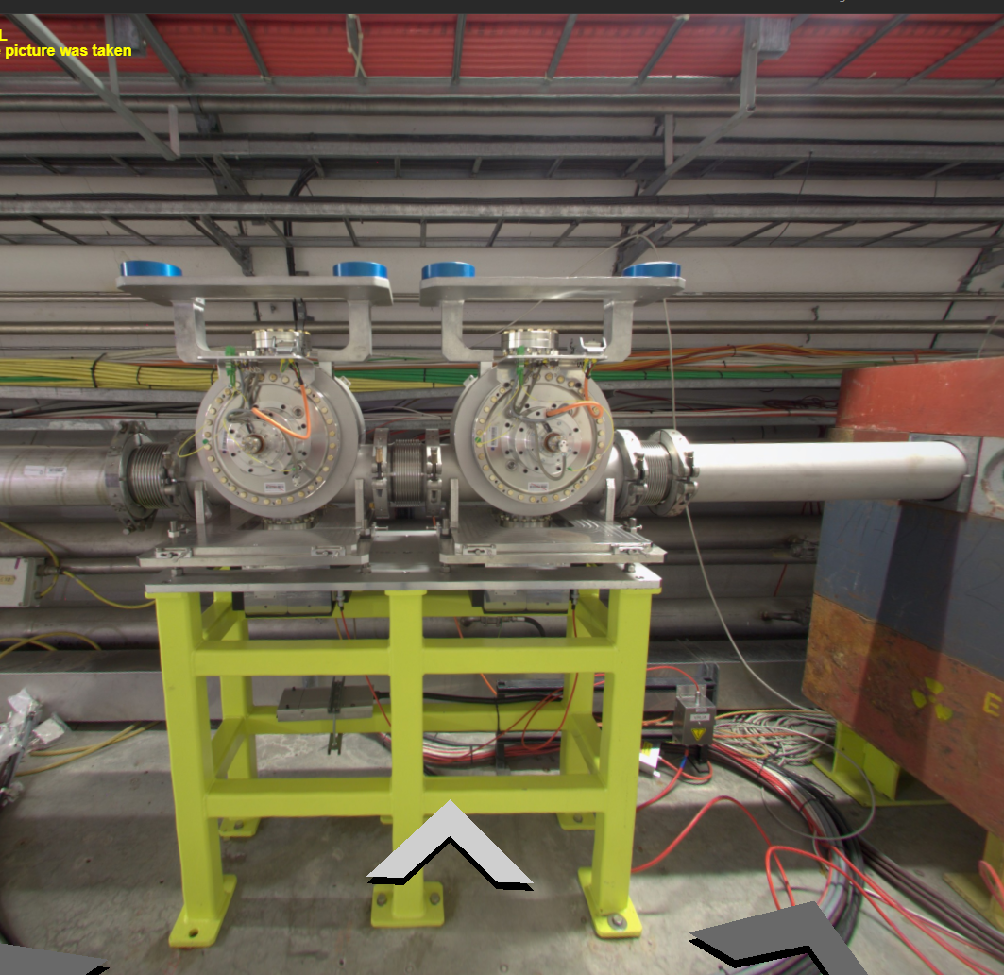
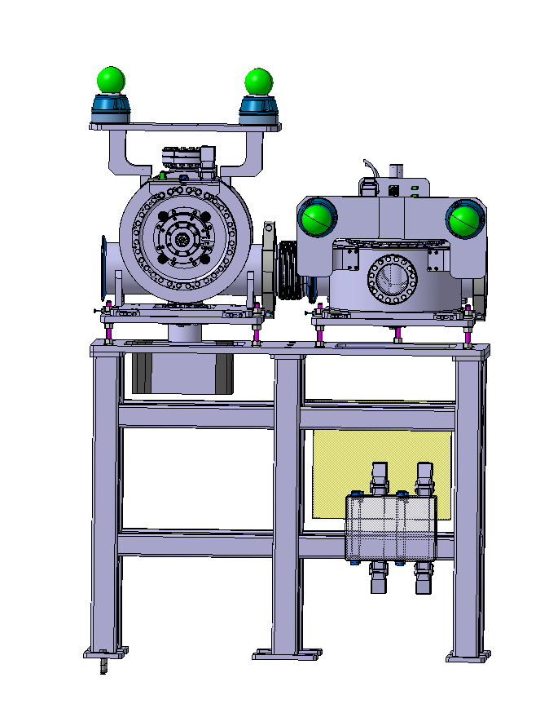
BA4 proposed configuration:
1 horizontal WS(41677) and 1 vertical WS(41678)
BA4 actual configuration: 2 vertical WS

Slide 4
