Slide 1
Ferrite heating analysis
SPS BWS Task Force – Giannis Papazoglou & Federico Carra – CERN-EN-MME
2023-06-08
EDMS: 2897472

Slide 2
Overview
Analysis for the Ferrite heating:
  ANSYS calculations using simplified model:
    Simplified geometry
    2 tiles of 60x60x5 mm^3 placed close to each other (modeled as single 120x60x5 mm^3)
    Intensities: 1.8e11 and 2.3e11 with and without scrubbing
    Transient analysis until steady state
Analysis for the wire heating:
  Analytical calculations for wire and tank grey body radiation only
  No conduction with forks and interaction with beam

Slide 3
Preliminary model

Slide 4
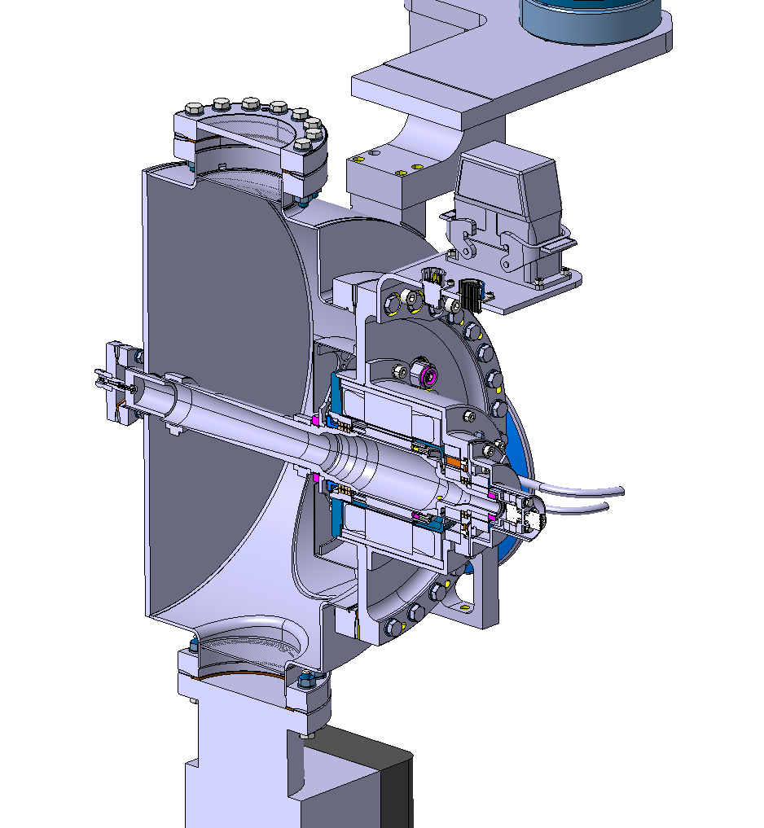
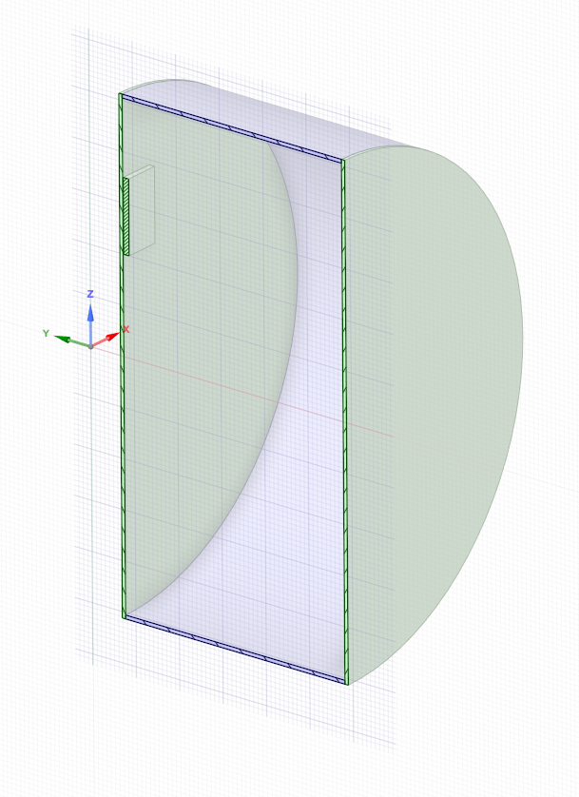
Design
Ferrite Block
Simplified Design

Slide 5
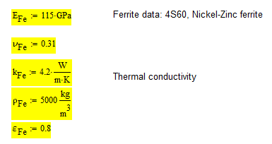
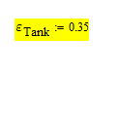
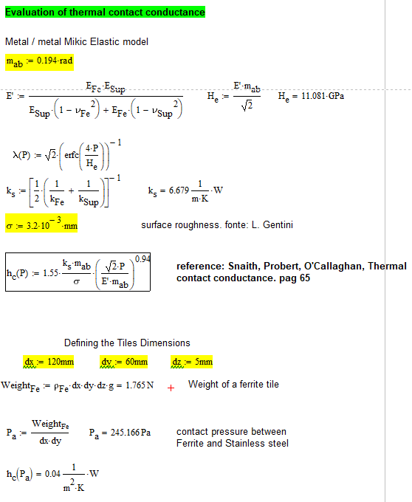
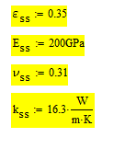
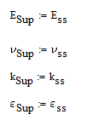
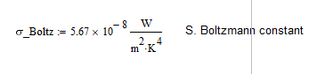
Housekeeping
Ferrite Properties
Tank Properties
Ferrite – Tank Contact
Constant

Slide 6
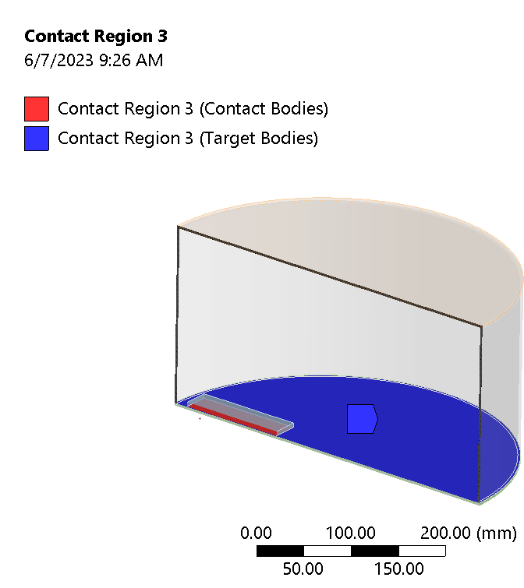
Boundaries
h_c = 4 e-2 W/(m^2*K)
Convection = 7 W/(m^2*K) (around the chamber to 22C ambient)
Emissivity Ferrite = 0.8
Emissivity tank = 0.35
T_0 = 22 deg C
Tile: 120x60x5 mm^3 = 36000 mm^3

Slide 7
Cases investigated
Intensities: 1.8 and 2.3 e11
Analyses: Steady State and Transient

Slide 8
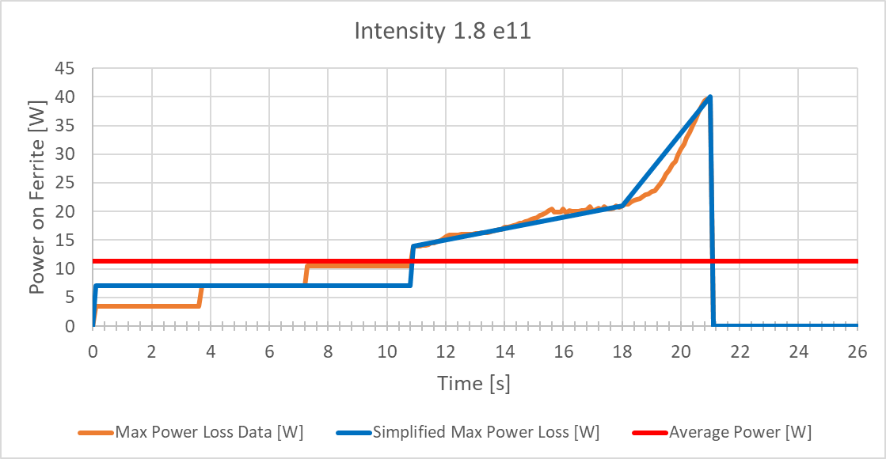
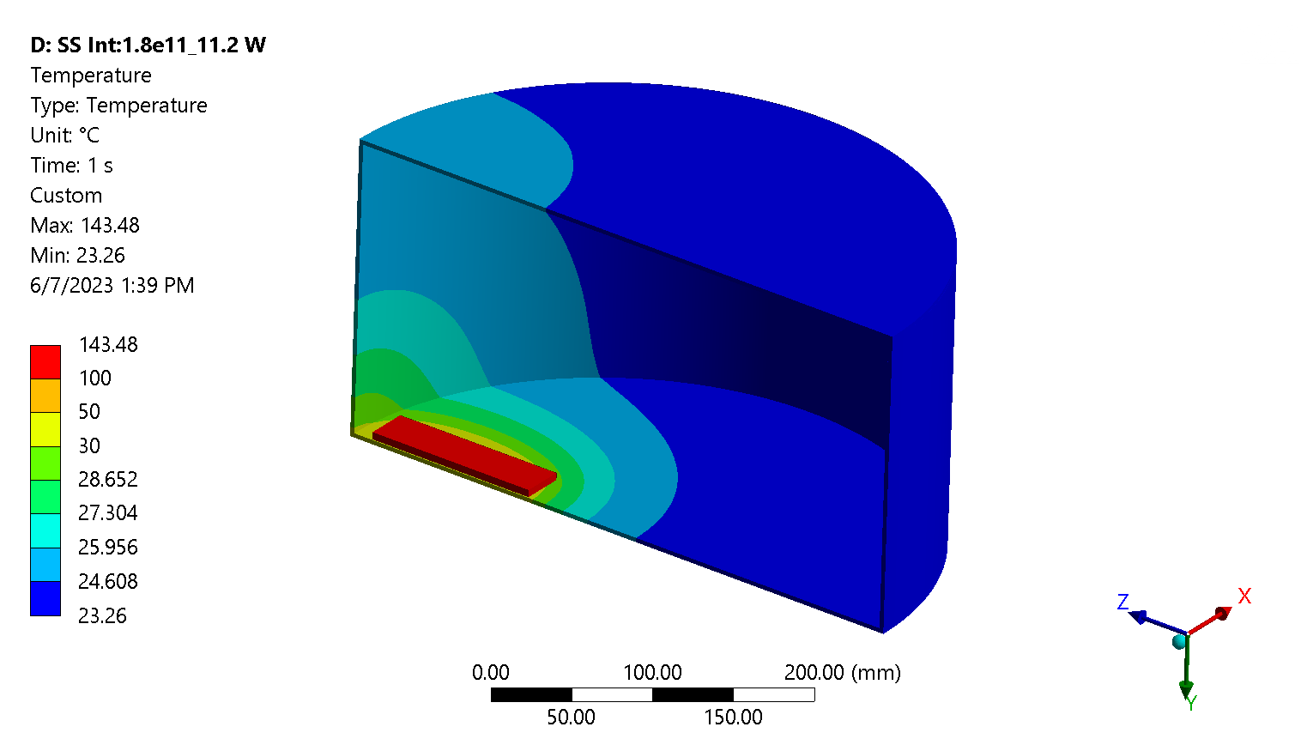
1.8e11 – Steady State
Cycle time: 26 s
  21s of beam
  5s P=0 between cycles
Average Power:
  Integration over one complete cycle
  P_av = 11.2 W → 3.1e-4 W/mm^3
Results:
  T_maxFer = 144 deg C
  T_maxTank = 35 deg C

Slide 9
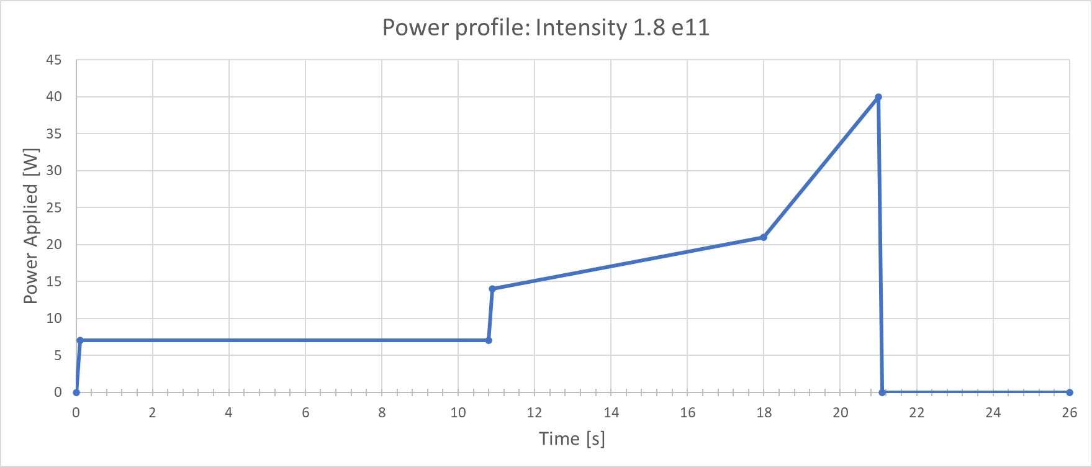
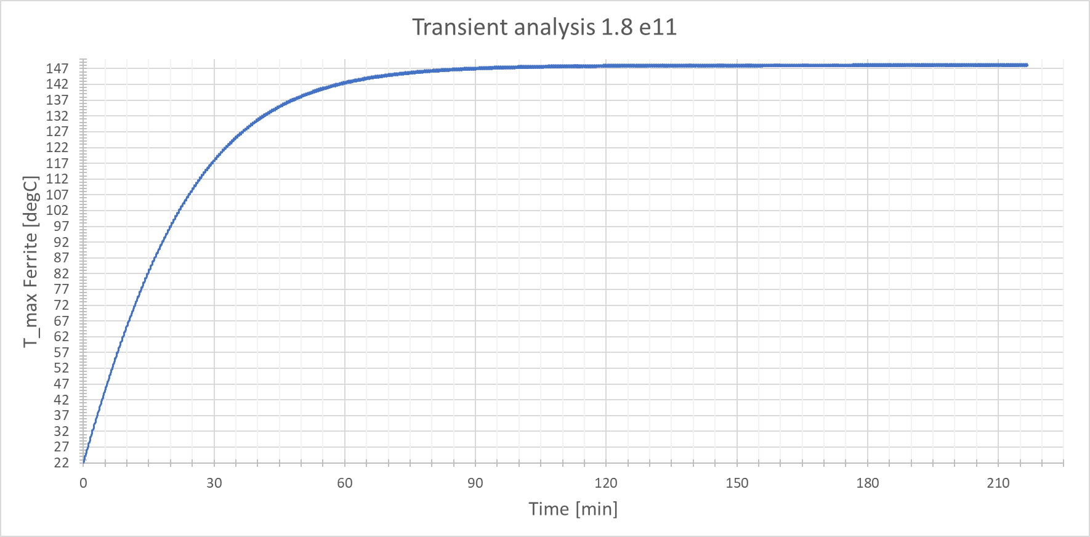
1.8e11 – Transient
Cycle time: 26 s
  Cycles: 500
  Total time simulated: 13000 s (~ 4h)
  Time steps: 3500
Power:
  Simplified version of the simulated power loss profile used
Results:
  T_maxFer = 147 deg C
  T_maxTank = 35.5 deg C
  Steady state ~ 2 h

Slide 10
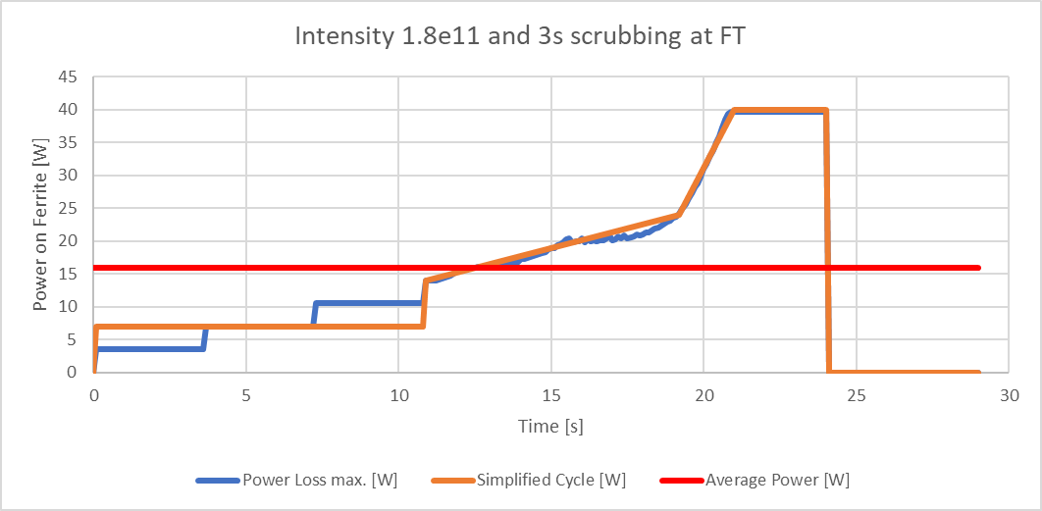
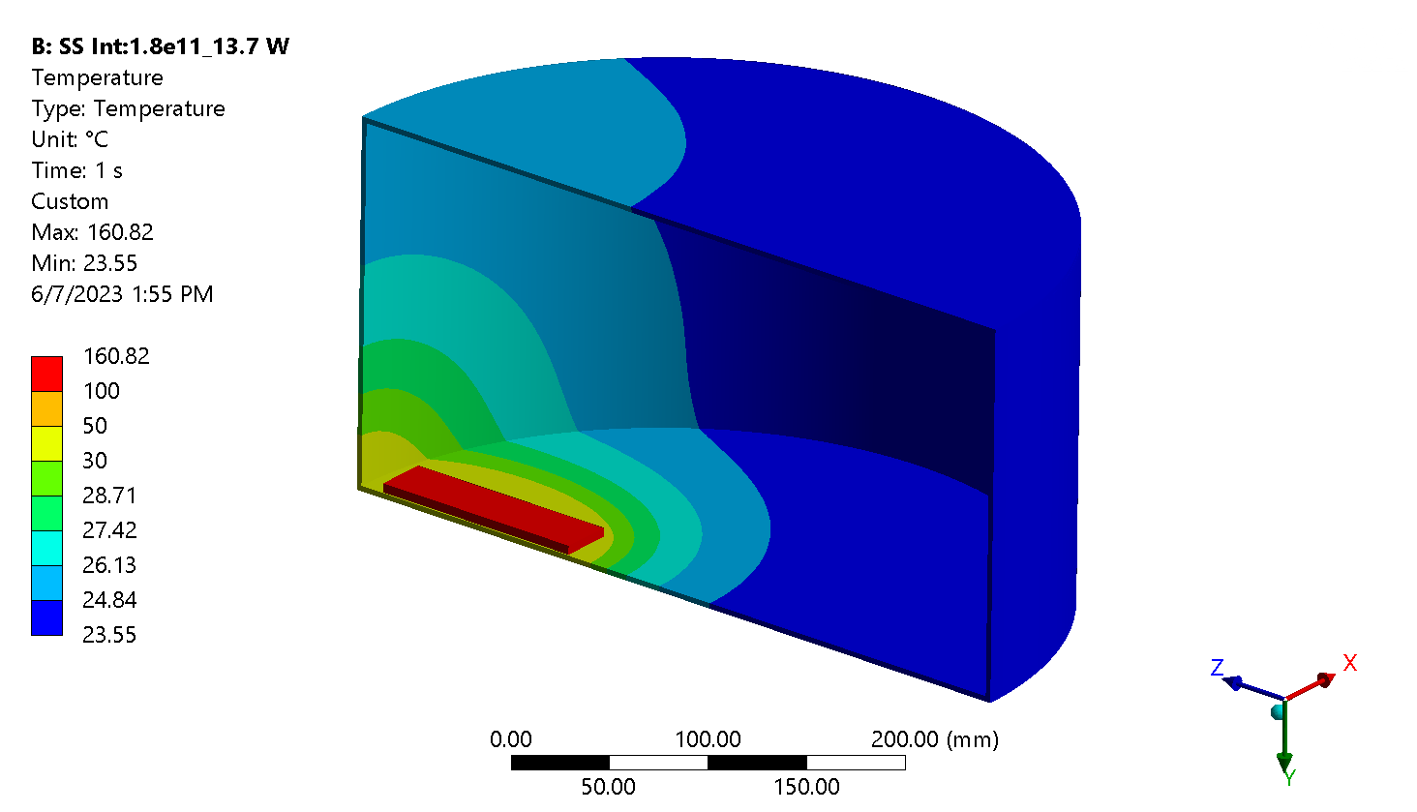
1.8e11 and scrubbing –
Steady State
Cycle time: 29 s
  24s of beam (3s scrubbing at P_max)
  5s P=0 between cycles
Average Power:
  Integration over one complete cycle
  P_av = 13.7 W → 3.82e-4 W/mm^3
Results:
  T_maxFer = 144 deg C
  T_maxTank = 35 deg C

Slide 11
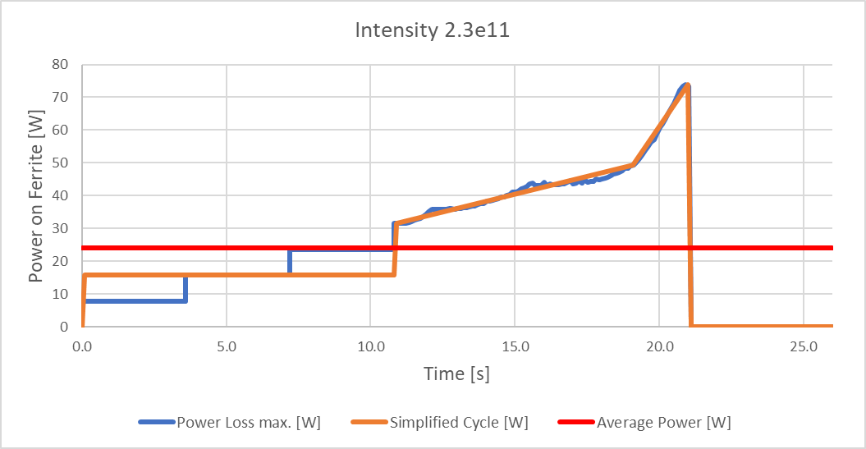
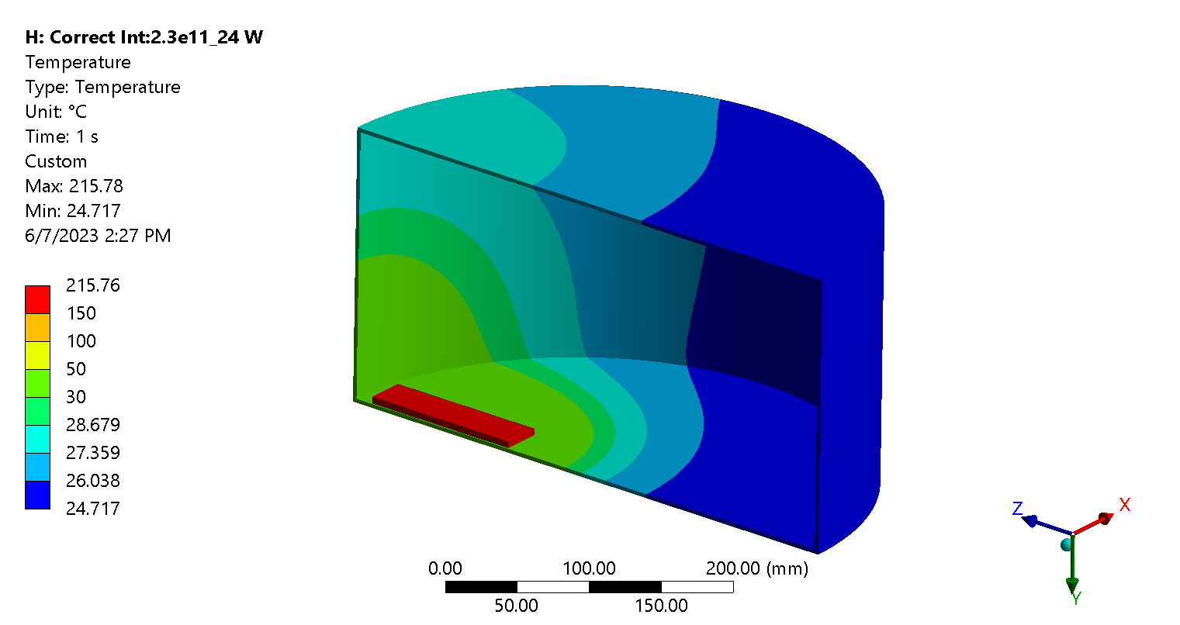
2.3e11 – Steady State
Cycle time: 26 s
  21s of beam
  5 s P=0 between cycles
Average Power:
  Integration over one complete cycle
  P_av = 24 W → 6.7 e-4 W/mm^3
Results:
  T_maxFer ~ 216 deg C
  T_maxTank ~ 49 deg C

Slide 12
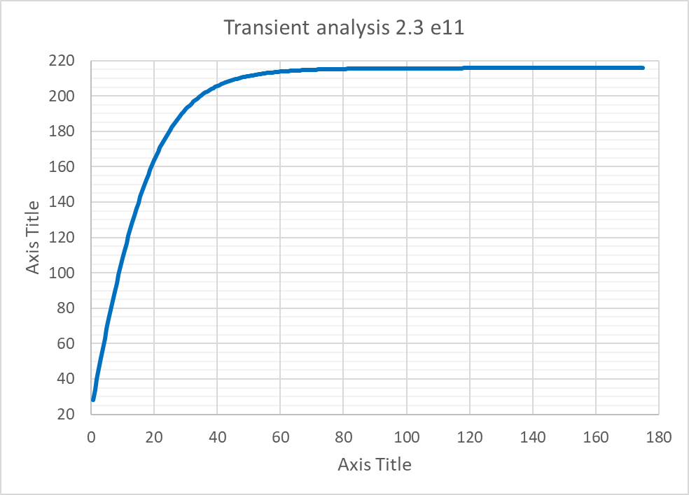
2.3e11 – Transient
Characteristics
  Steps: 70
  Total time simulated: 10500 s (~ 3 h)
Power:
  Constant 24 W used (no cycles) → Aim: Check the time to Steady State
Results:
  T_maxFer ~ 216 deg C
  T_maxTank ~ 49 deg C
  Steady state ~ 2h

Slide 13
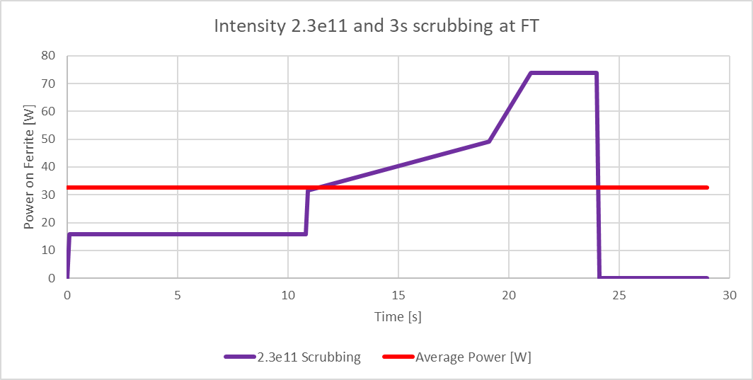
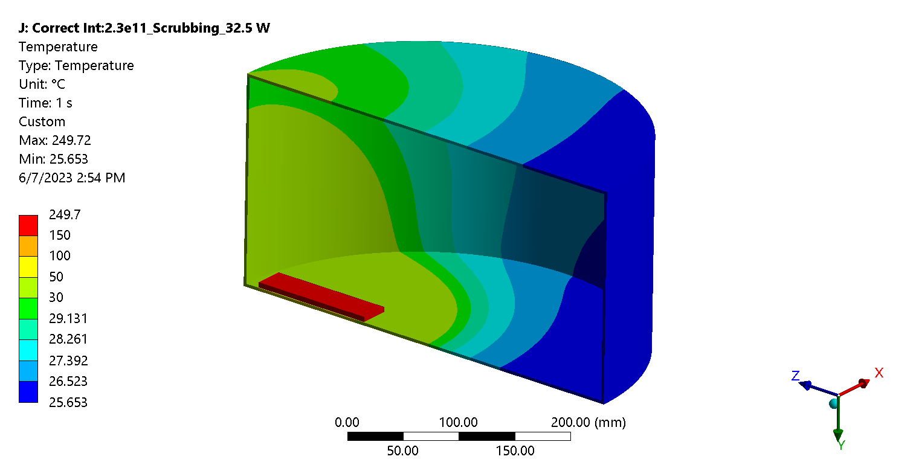
2.3e11 and scrubbing –
Steady State
Cycle time: 29 s
  24s of beam (3s scrubbing at P_max)
  5s P=0 between cycles
Average Power:
  Integration over one complete cycle
  P_av = 32.5 W → 9.03 e-4 W/mm^3
Results:
  T_maxFer = 250 deg C
  T_maxTank ~ 60 deg C

Slide 14
Wire analytical analysis

Slide 15
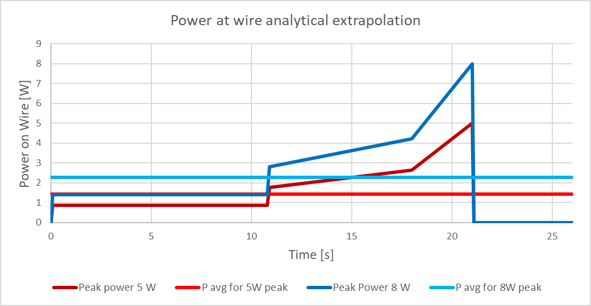
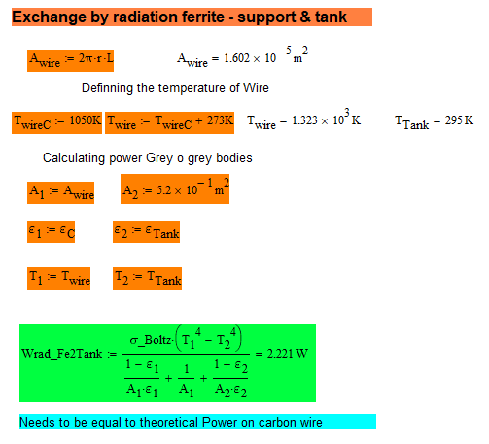
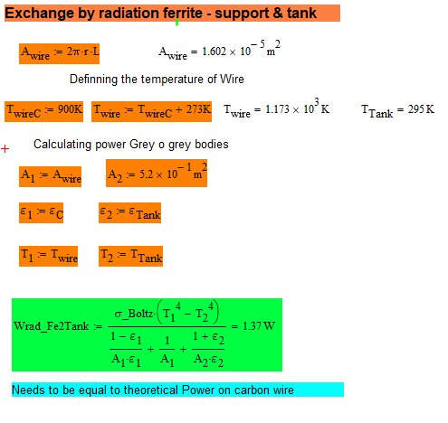
Wire heating
Power:
  Used only information of peak power at 5 W → Normalized on the timesteps for the Ferrite heating
  Average power:
    1.4 W (for peak 5 W) → 6 tiles
    2.3 W (for peak 8 W) → 2 tiles
Results:
  @ 1.4 W → T_wire = 900C
  @ 2.3W → T_wire = 1050 C
Limitations:
  Power assumptions semi-arbitrary
  No heating from the interaction with the beam
  No contact with the forks
T_wire = 1050 C
T_wire = 900 C

Slide 16
Other considerations
Currie Point of Fe ~ 375 C → We are well below this in all cases checked
Outgassing → Might be problematic as we see temperatures above 200 C for intensity 2.3 e11.
General:
  If we can increase the amount of Ferrite and spreading the power to it will be beneficial as the temperature will be less
Wires:
  Need data for power both at the time of the actual breakage and what it is foreseen.
  First analysis doesn’t show issues for carbon wires but the analysis is very simplified with many assumptions → conclusions better to be drawn with more data.

