Slide 1
Update on the power loss computations (II)
SPS BWS Task Force
Carlo, Christine, Thomas and Patrick (in 2017), Leo, Elena, Chiara, Niky, Alice, Rama, Giulia, Giovanni, Benoit
Many thanks to our colleagues from BI for the teamwork (William, Federico, Jonathan, Manfred) and to the IWG members for the help and advice

Slide 2
Outlook
Analysis of power deposed on the wire with the breakage conditions
Analysis of the power deposed on the wire and on the ferrites with different mitigation solutions

Slide 3
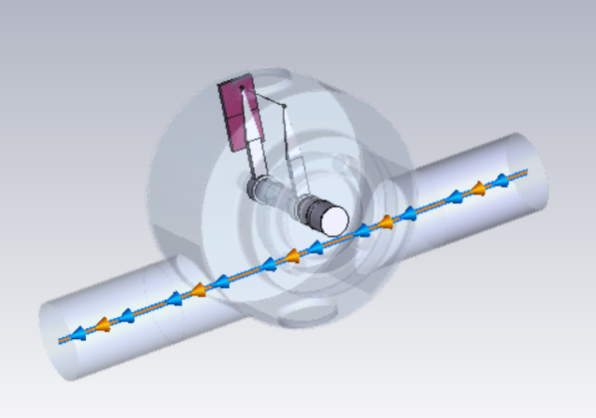
Breakage conditions
Intensity 1.8e11 p/b
4 trains of 72 bunches
Dedicated scrubbing (heavy duty cycle)
Bunch length at flat top ~1.58 ns
No Ferrites

Slide 4
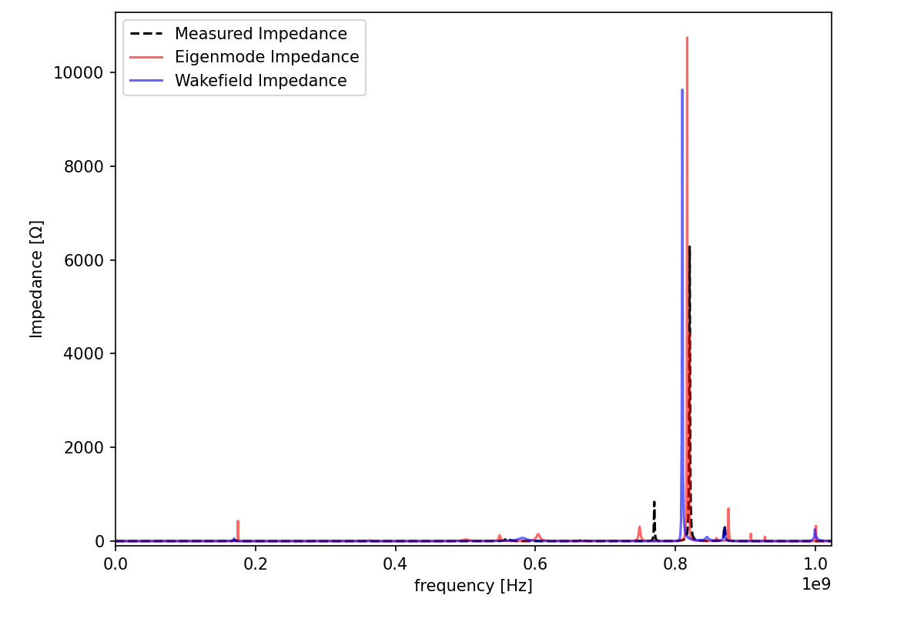
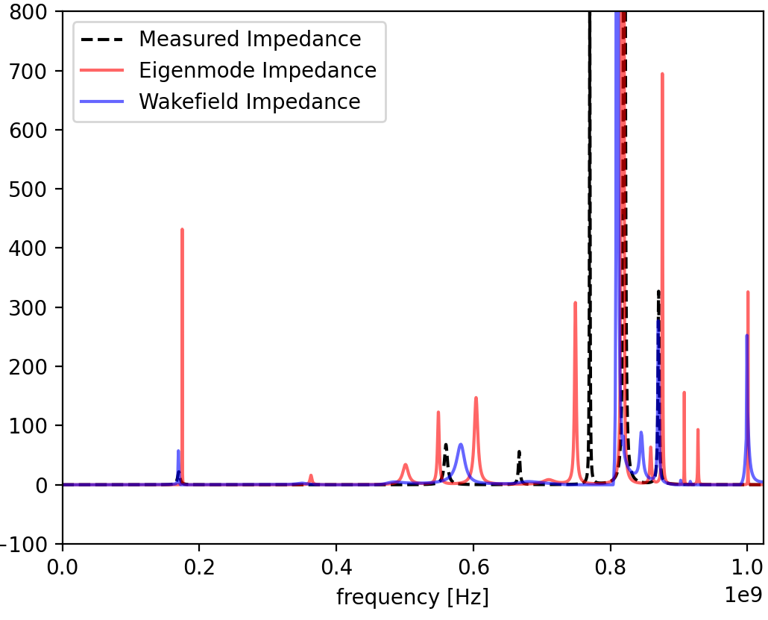
Impedance curves
Measurements vs Eigenmode vs Wakefield
Zoom
All impedance curves agree well, wakefield was used for power calculations, shown to be closer to measurements

Slide 5
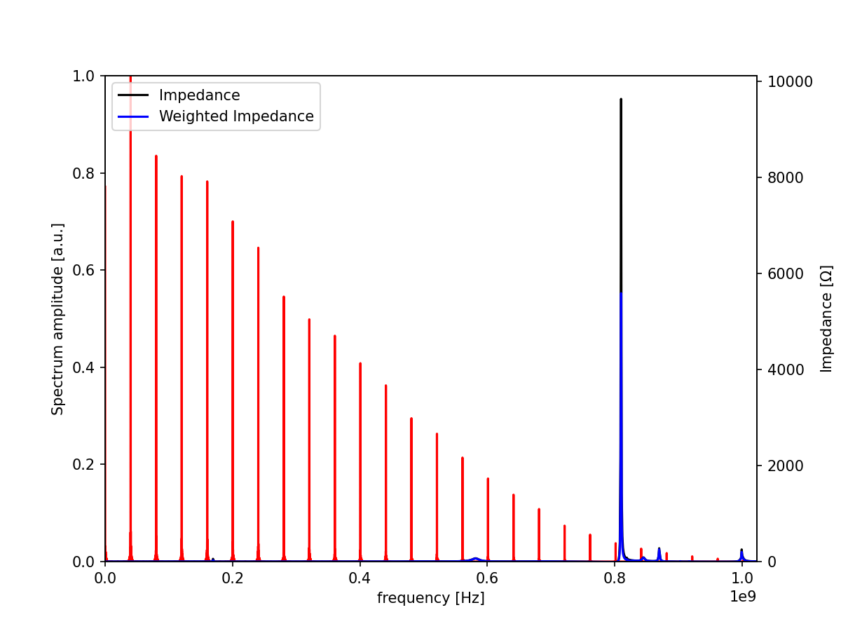
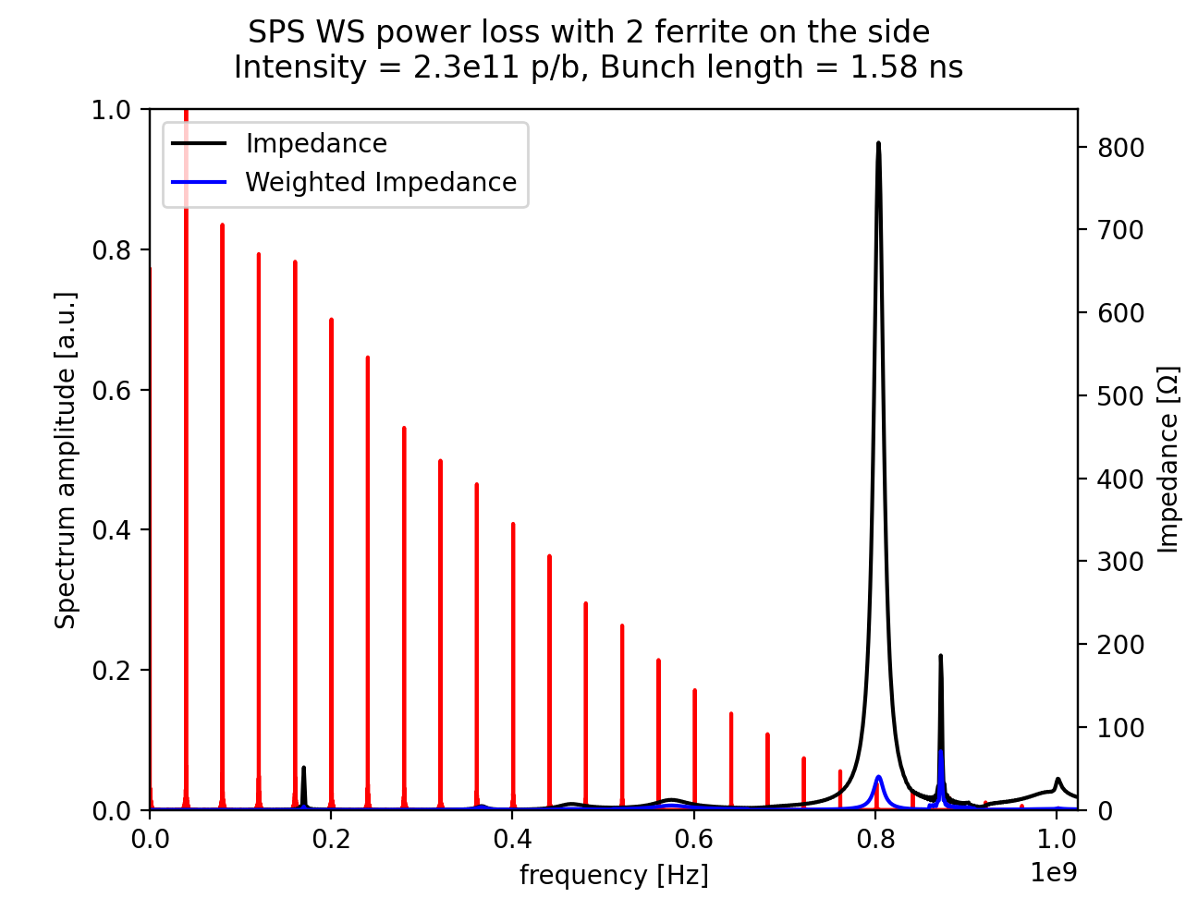
Power deposed on the wire
No ferrite, about 60% of total power on the wire
With ferrite, about 10% of total power is on the wire
impedance “seen” by the wire

Slide 6
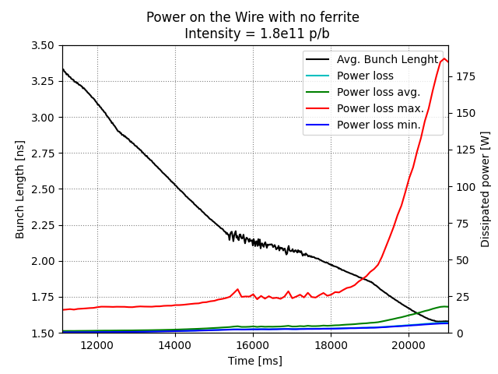
Power deposed on the wire
(breakage)
Big uncertainty between min/max due to narrow resonances
Value with highest occurrence: 17.5 W
We expect at least 6.5 W on the wire (1.8e11 p/b, flat top, 1.58ns bunch length) with the breakage conditions
To be safe, power loss with mitigation options should be below these values

Slide 7
Mitigation options
Case of 2 ferrite tiles on the side
Mitigation strategy (I) adding 2 ferrites on the side
Impedance curve with broader resonances
Less percentage of power on the wire
Calculations for LIU target intensity 2.3e11 p/b
  4 trains of 72 bunches
  Bunch length at flat top ~1.58 ns

Slide 8
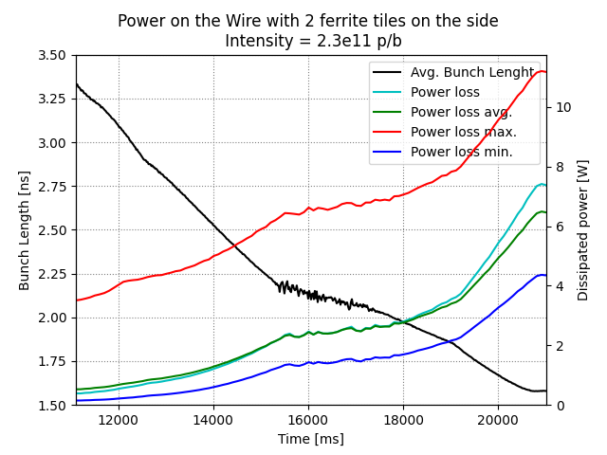
Power deposed on the wire
(2 ferrite tiles)
min/max closer due to broader resonances
Value with highest occurrence: 6.3 W
Maximum 11.2 W is above the 6.5 W minimum we had with breakage conditions
With ferrite, min/max discrepancy is mitigated, power on the wire is potentially lower on average

Slide 9
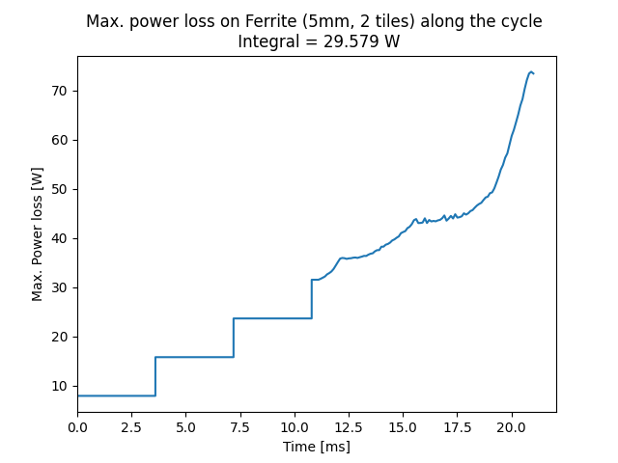
Power deposed on the ferrite
(2 ferrite tiles)
Power deposed on the ferrite will cause heating
Data sent to Giannis to compute thermal simulations:
  Max. power along the cycle for transient simulation
  Integrated power along the cycle for steady state simulations

Slide 10
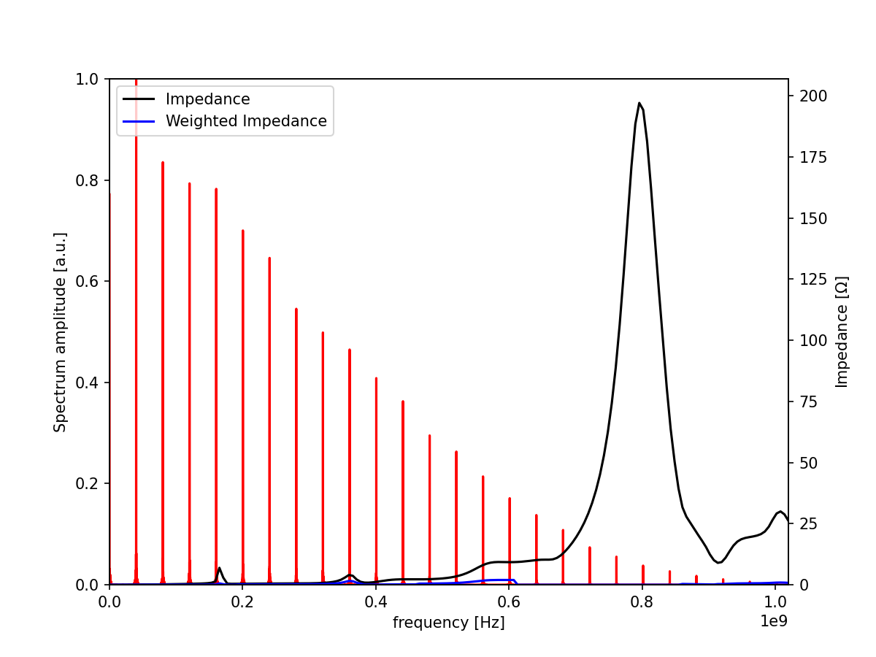
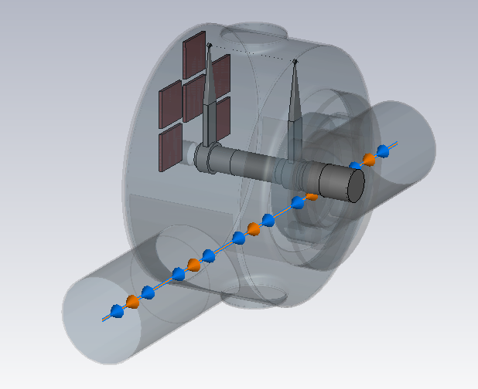
Mitigation options (II)
Case of 6 ferrite tiles on the side
Mitigation strategy (II) 6 ferrite tiles on the side
Impedance curve with much broader resonances
Calculations for 2023 target intensity 2.3e11 p/b
  4 trains of 72 bunches
  Bunch length at flat top ~1.58 ns

Slide 11
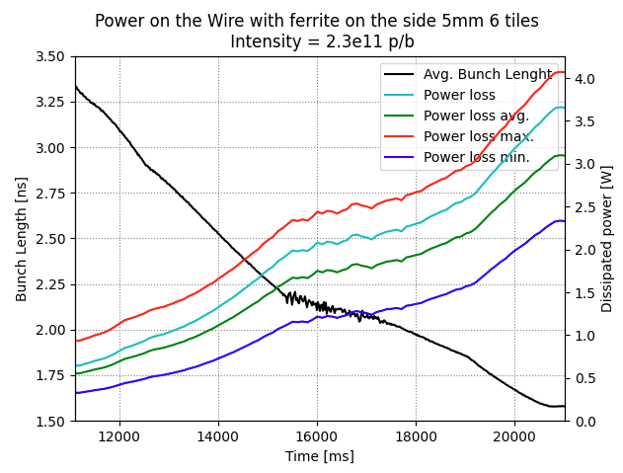
Power deposed on the wire
(6 ferrite tiles)
We are below the wire breakage conditions even for the worst-case scenario

Slide 12
Summary
Studied the breakage condition (no ferrite). Values for intensity 1.8e11 p/b at flat top deposed on the wire:
  Value with highest occurrence: 17.5 W
  Minimum 6.5 W → possible “breakage condition”
Comparison with possible mitigation solutions with LIU target intensity 2.3e11 p/b:
  2 ferrite tiles:
    Less power on the wire: highest occurrence: 6.3 W
    Below wire “breakage conditions” on average.
    Power dissipated on ferrite to thermo-mechanical experts
  6 ferrite tiles:
    Less power on the wire + minimum and maximum values closer (safer condition) highest occurrence: 3.1 W
    Below wire “breakage conditions” always.
    Thermal studies to be done

Slide 13
Thank you ☺
Update on the power loss computations (II)
Elena de la Fuente García (BE–ABP–CEI)

Slide 14
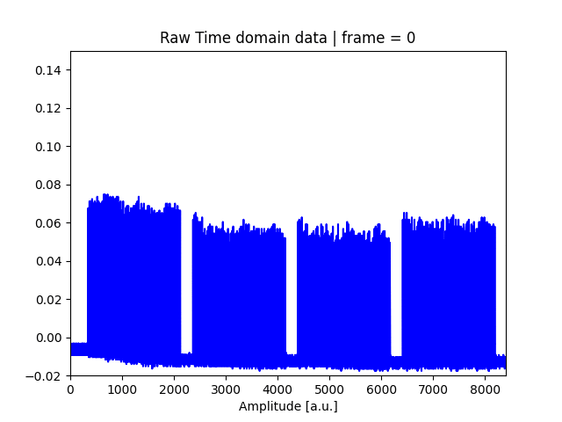
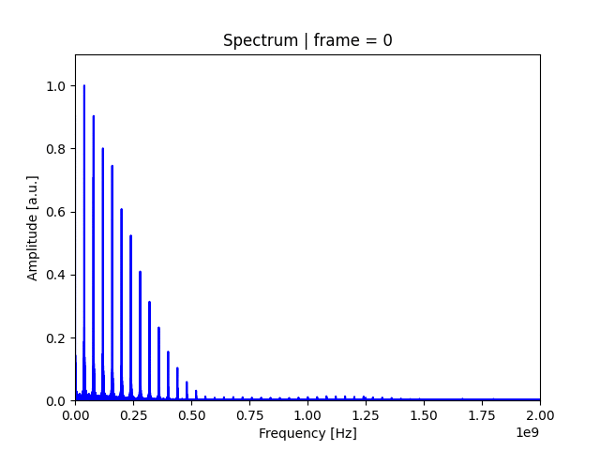
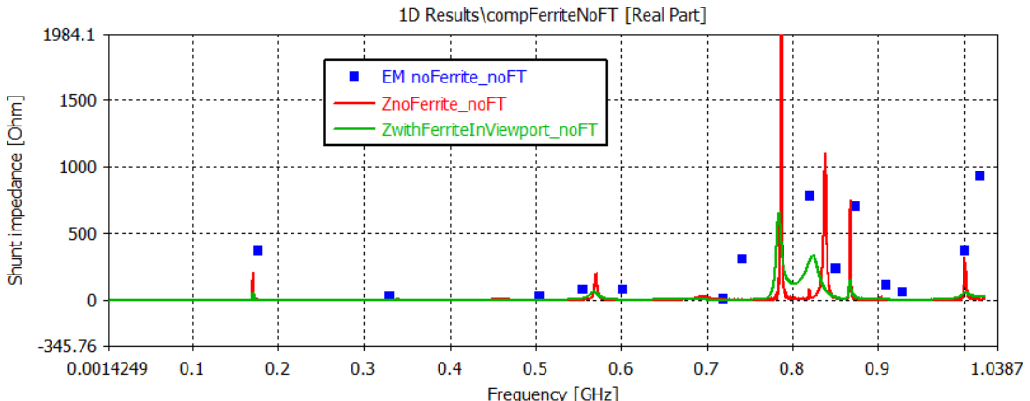
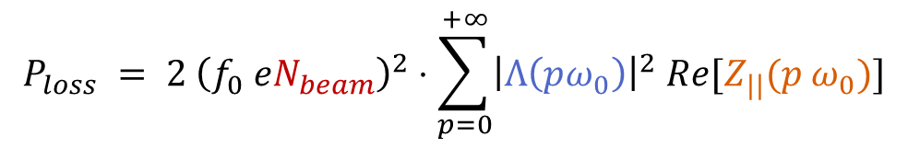
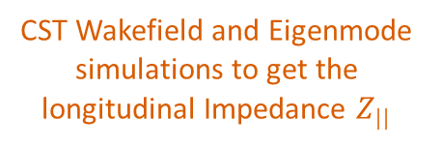
Backup: Power Loss calculation
CST Wakefield and Eigenmode simulations to get the longitudinal Impedance $Z_{||}$
Measurements of beam spectrum in time domain along the cycle
Post-processing*
Beam spectrum in frequency domain along the cycle
* Correct baseline, do FFT, normalize, apply transfer function
$$P_{loss} = 2 {\left(f_{0} eN_{beam}\right)}^{2}⋅\sum_{p=0}^{+∞}{{\left|Λ\left(pω_{0}\right)\right|}^{2} Re[Z_{||}(p ω_{0})]}$$
Implemented in BIHC python package
Beam Intensity
Spectrum
Impedance

