Slide 1
SPS Wire Scanner Impedance studies
Michael Sullivan
Thanks to Elena, Leonardo, Carlo, Benoit for power loss calculations

Slide 2
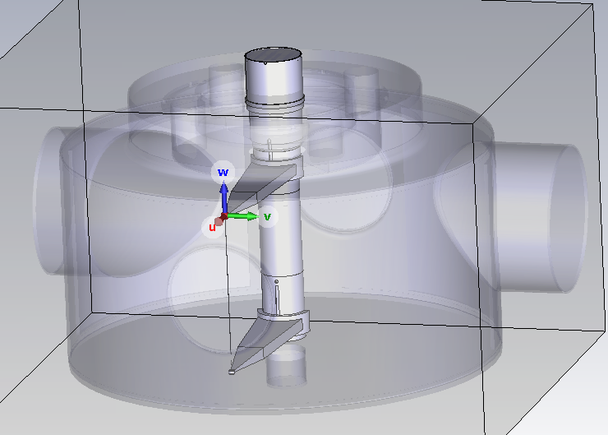
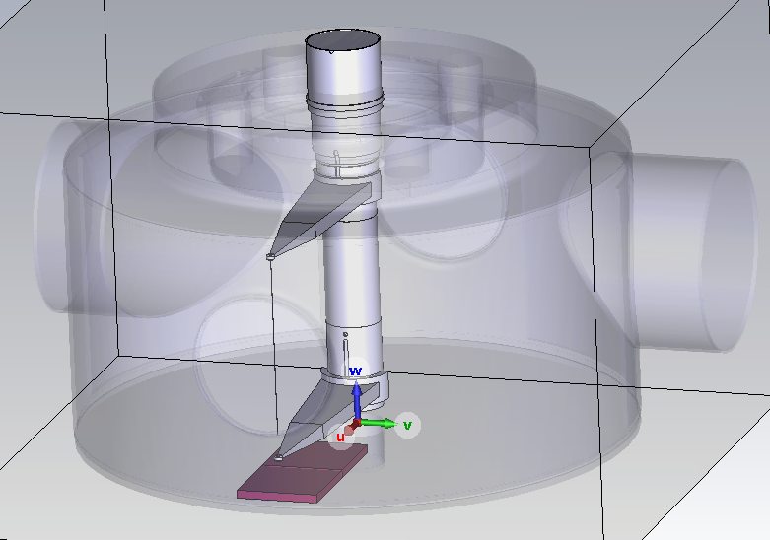
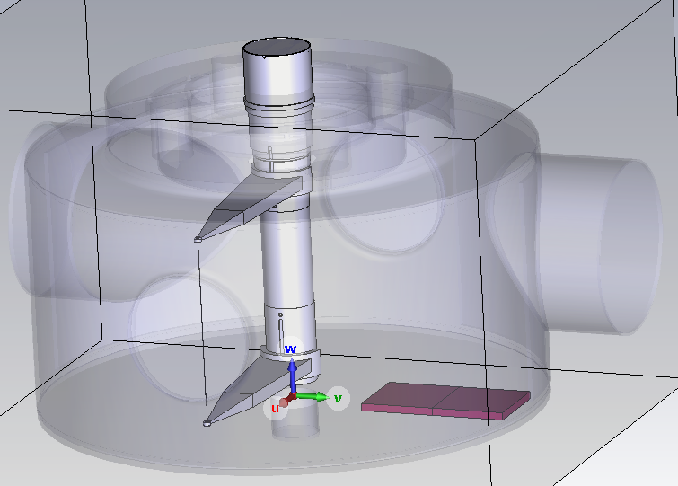
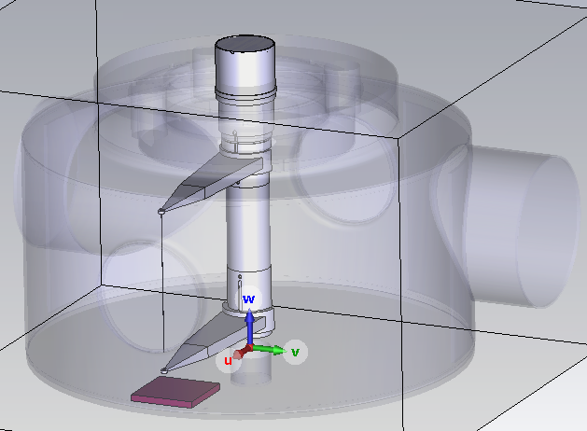
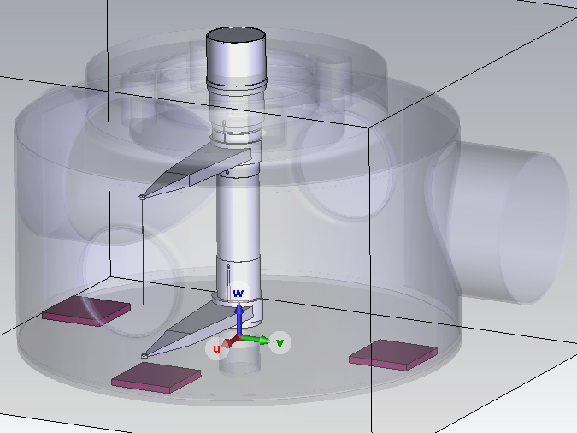
Mitigation Options – TT2111R Ferrites
Current 2023 Model
2 Tiles (0°)
2 Tiles (-90°)
1 Tile (0°)
3 Tiles (-90°, 0°, 90°)

Slide 3
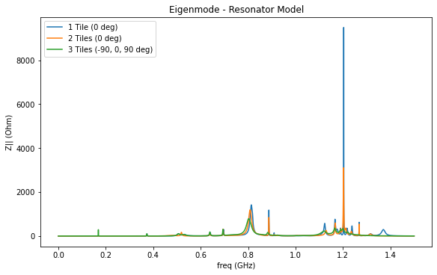
Mitigation Options – TT2111R Ferrites

Slide 4
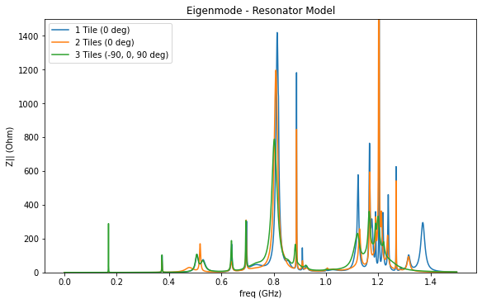
Mitigation Options – TT2111R Ferrites

Slide 5
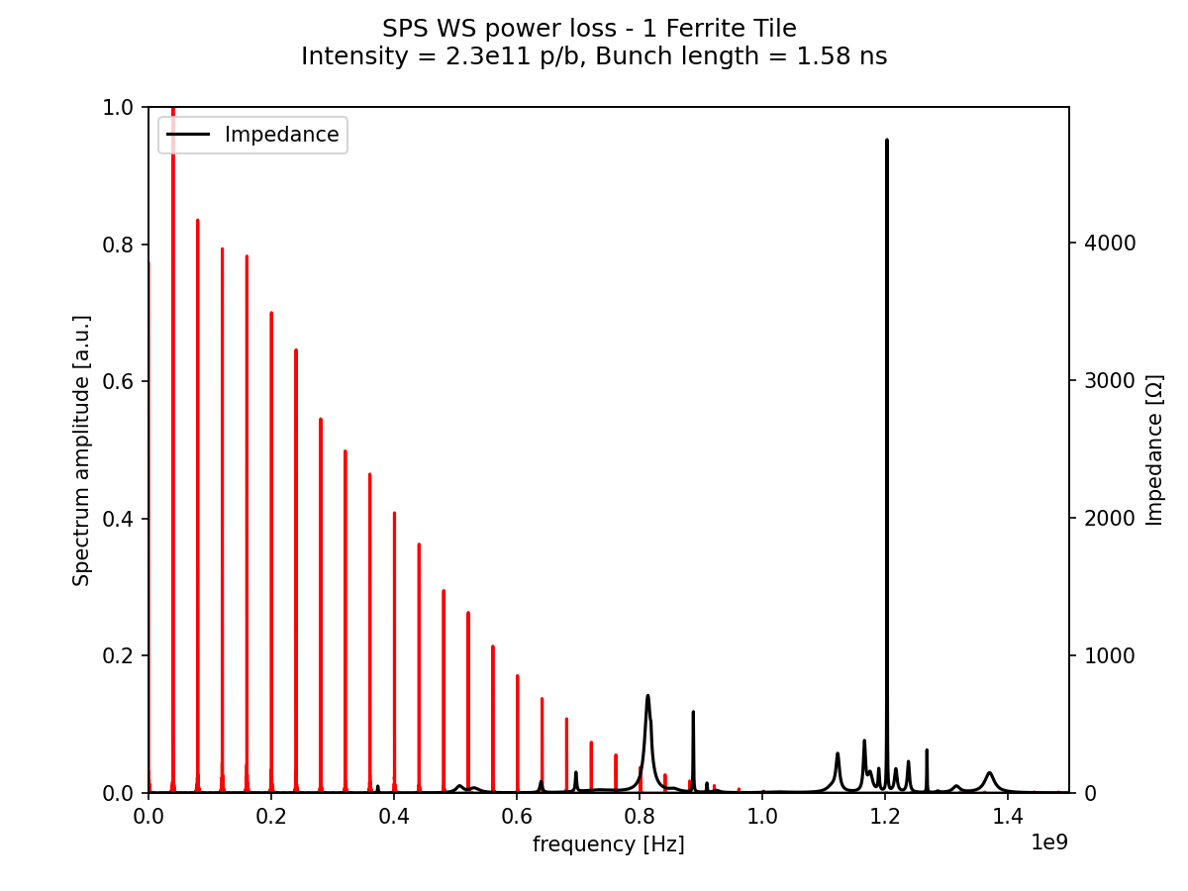
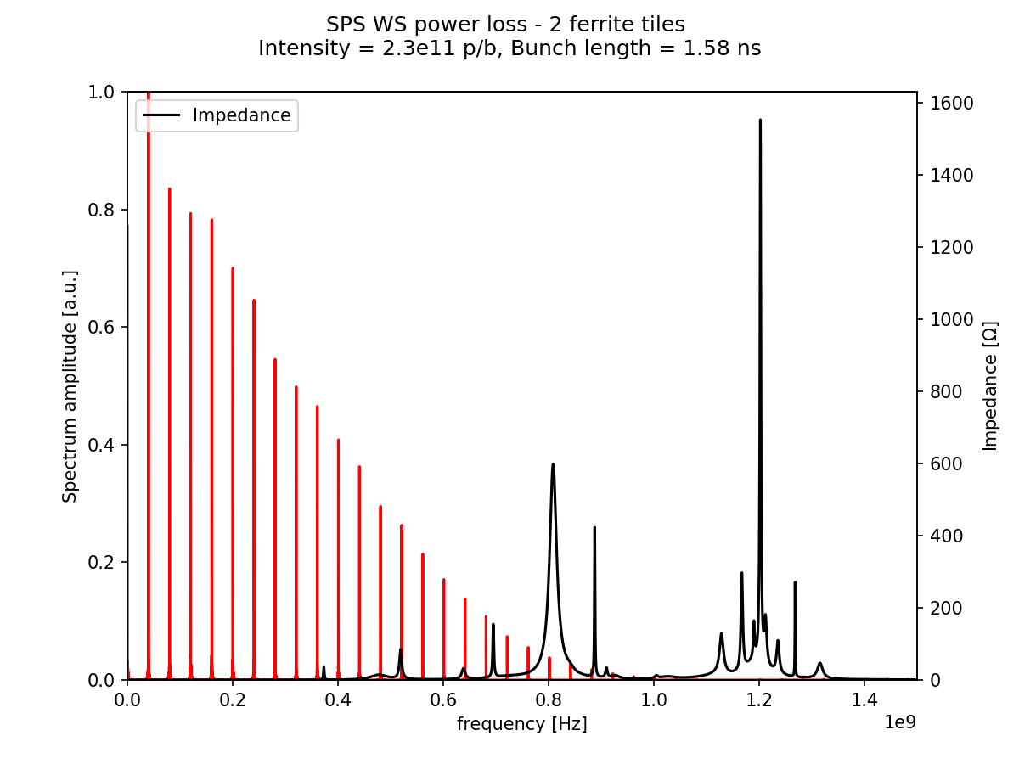
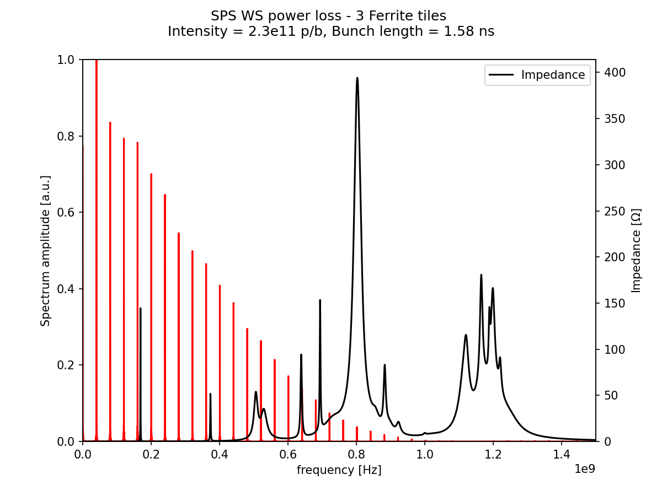
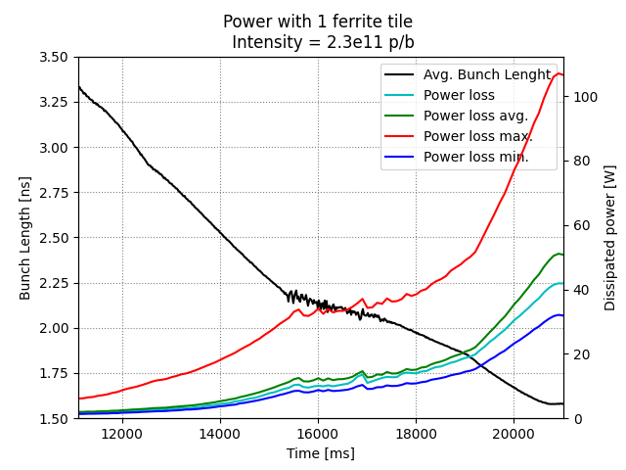
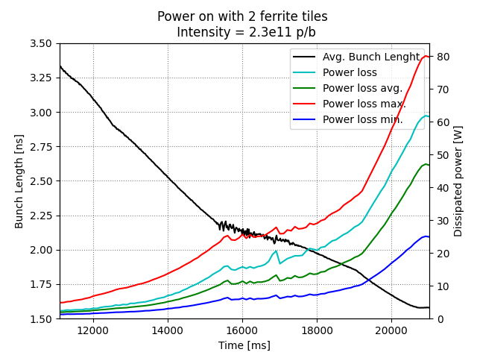
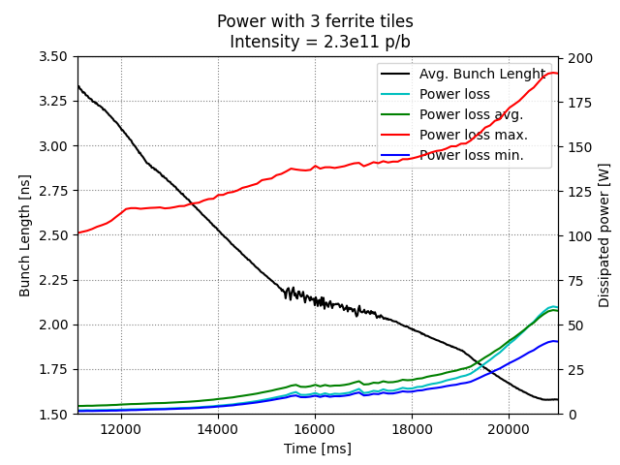
Mitigation Options – TT2111R Ferrites

Slide 6
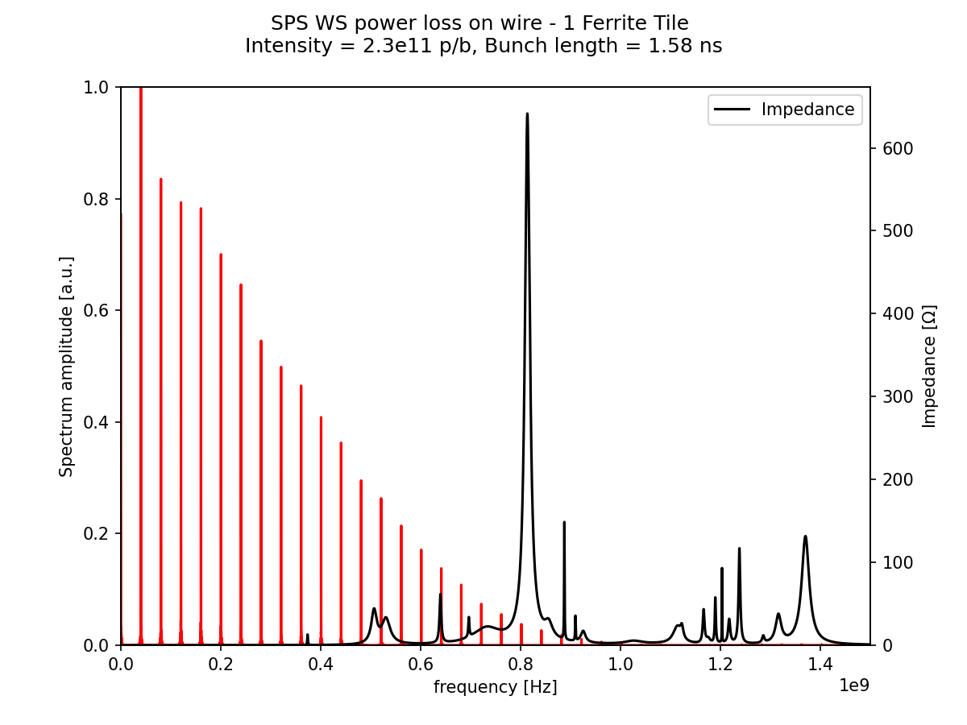
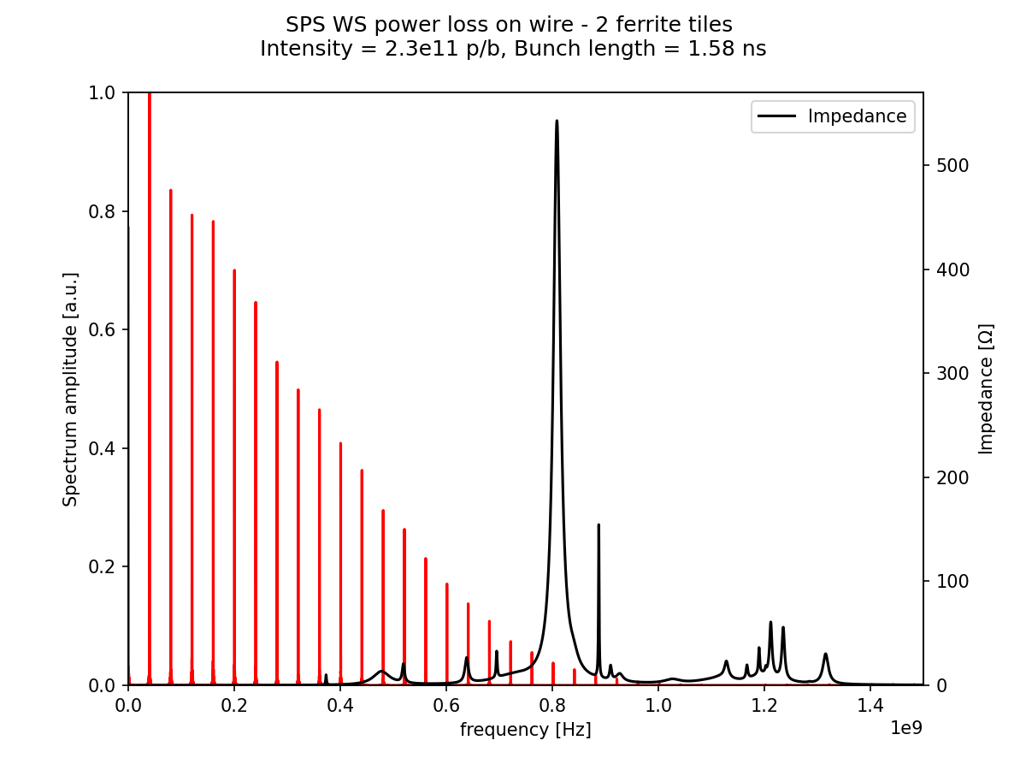
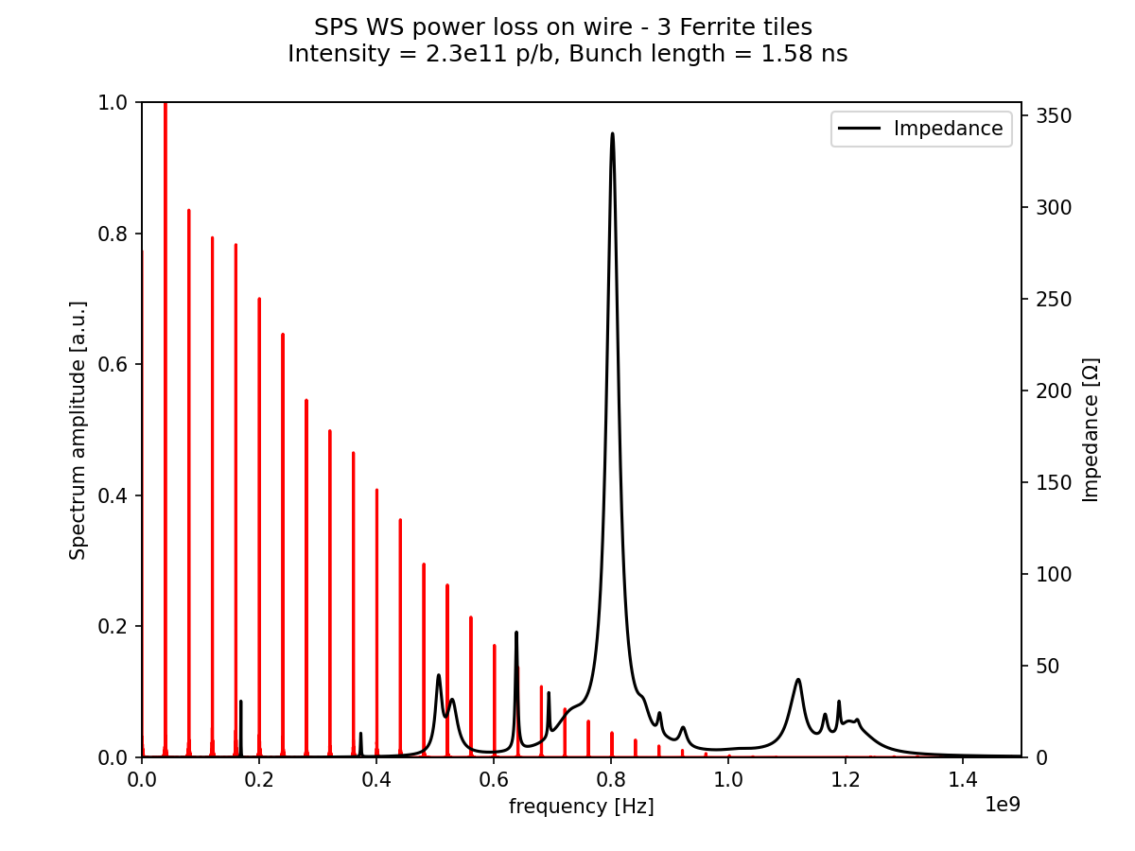
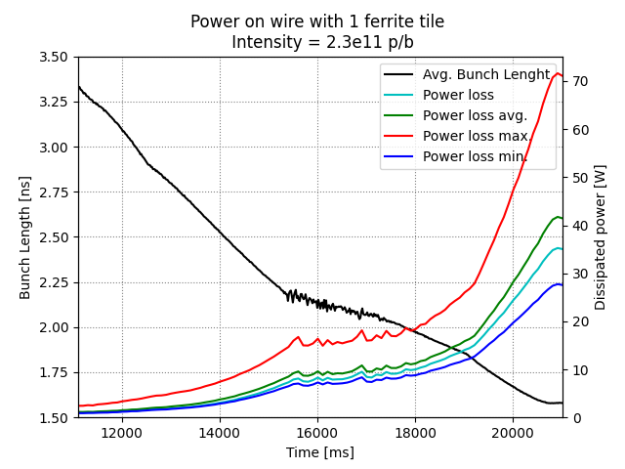
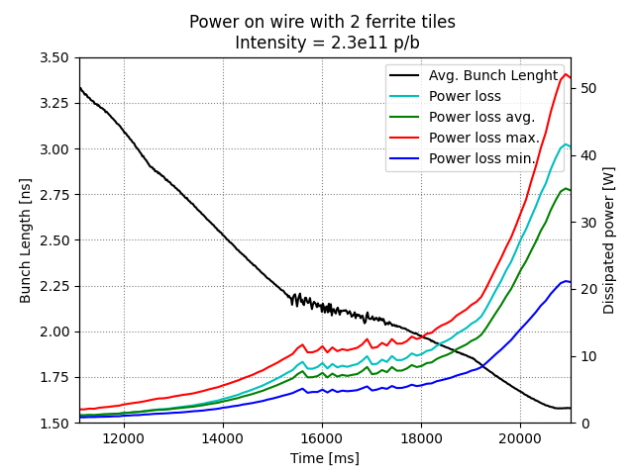
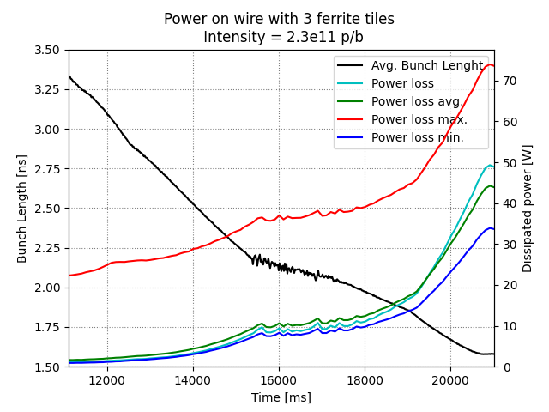
Mitigation Options – TT2111R Ferrites

Slide 7
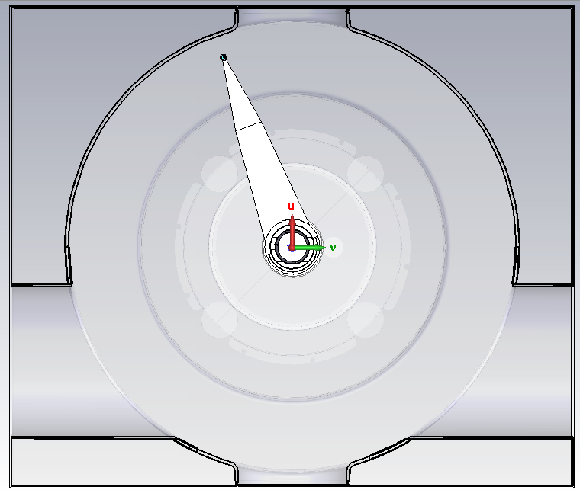
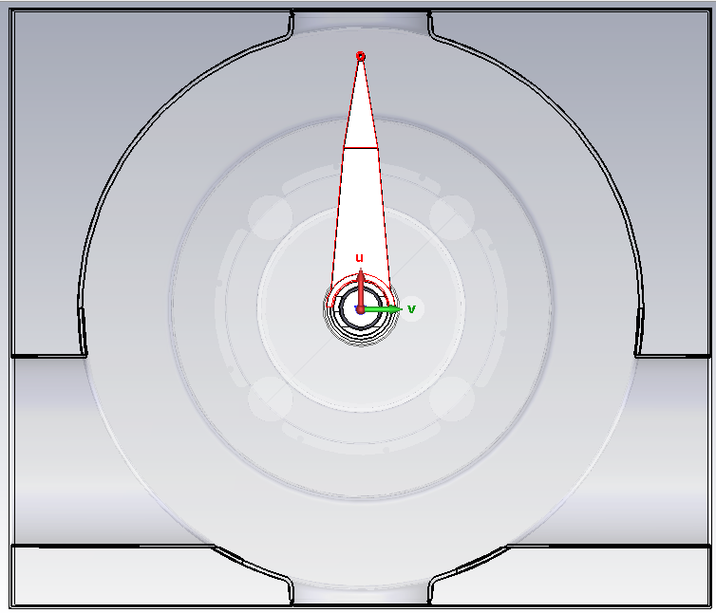
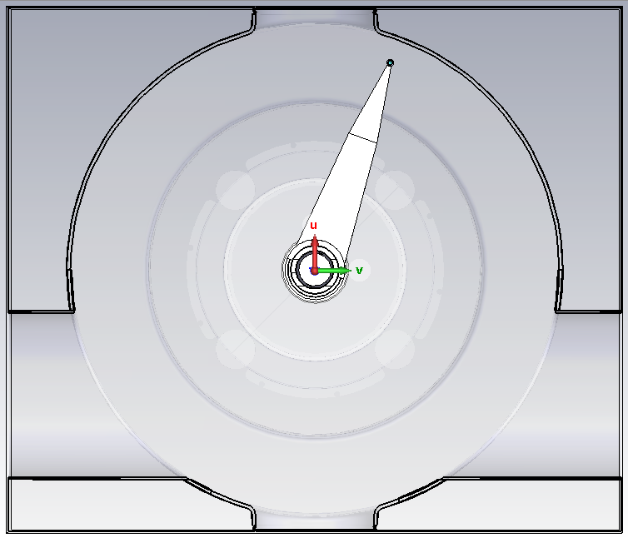
Mitigation Options – Fork Parking Position
Fork at -20°
Fork at 0°
Fork at 20°

Slide 8
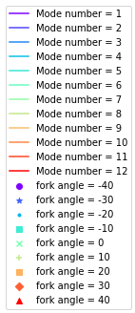
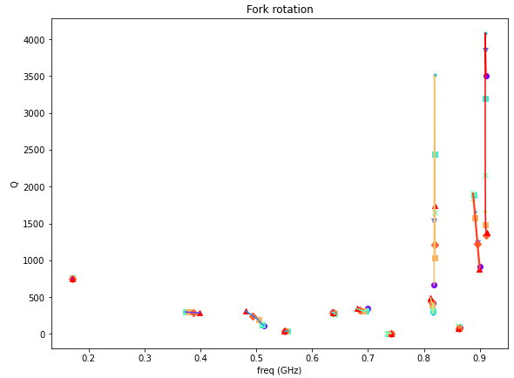
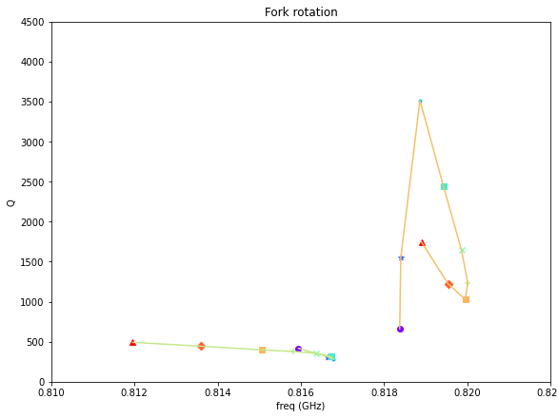
Mitigation Options – Fork Parking Position

Slide 9
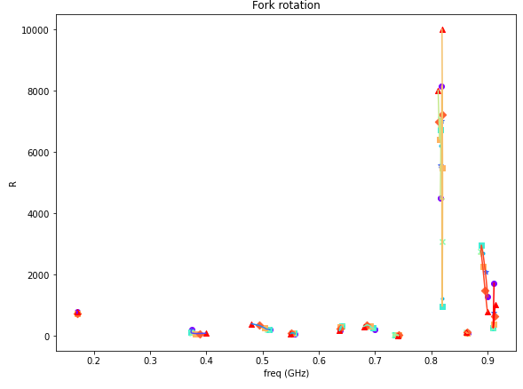
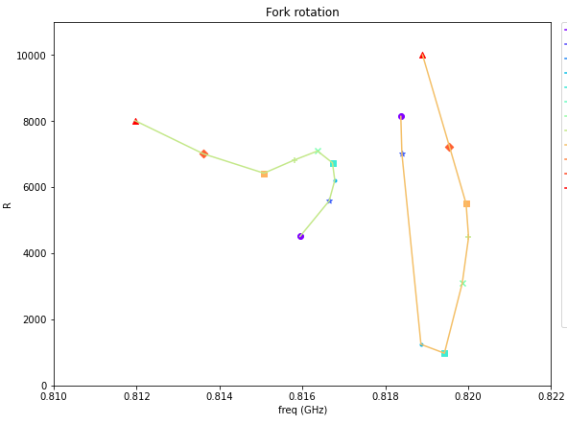
Mitigation Options – Fork Parking Position

Slide 10
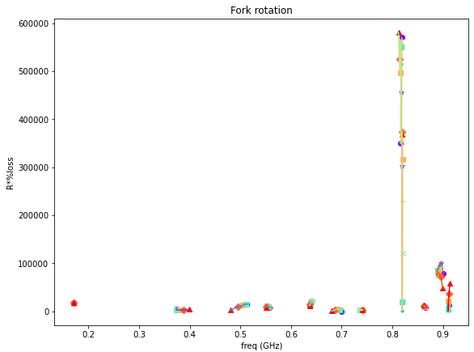
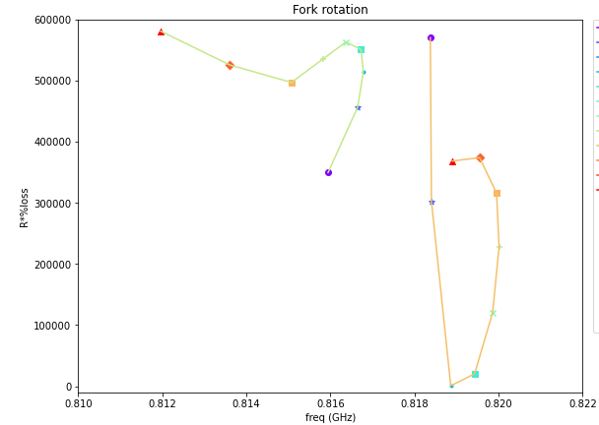
Mitigation Options – Fork Parking Position

Slide 11
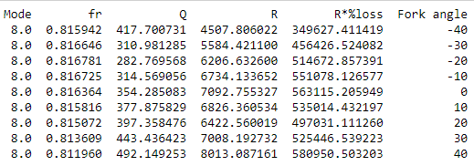
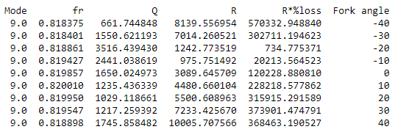
Mitigation Options – Fork Parking Position
The best fork angles for modes 8 & 9 are shown here.
Ideally, we want to reduce R*%loss (on wire) as this should reduce heating on the wire.
Options are given for both a negative and positive angle.
This will be concluded with a power loss calculation as the frequency shift and the sharpness of the resonance will potentially have a large effect on the heating.

Slide 12
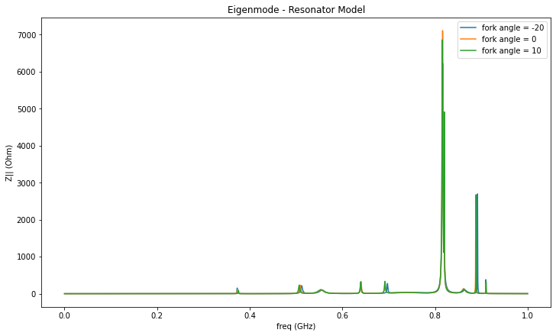
Mitigation Options – Fork Parking Position

Slide 13
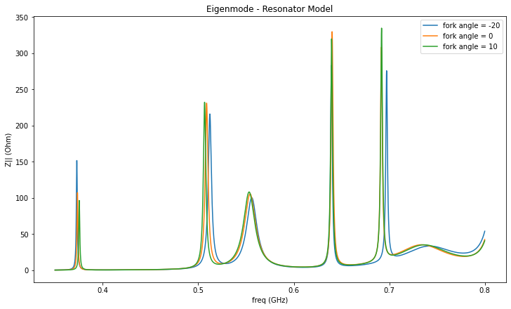
Mitigation Options – Fork Parking Position

Slide 14
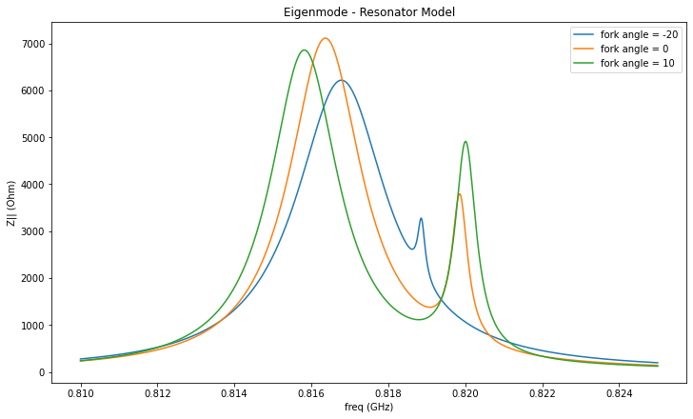
Mitigation Options – Fork Parking Position

Slide 15
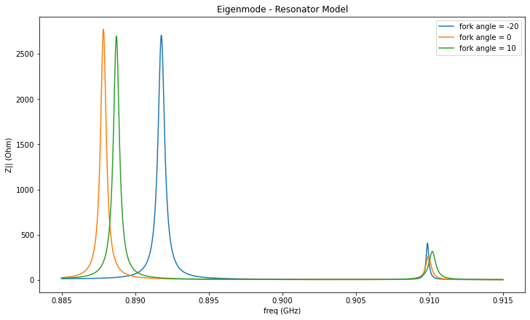
Mitigation Options – Fork Parking Position

Slide 16
Extra Slides

Slide 17
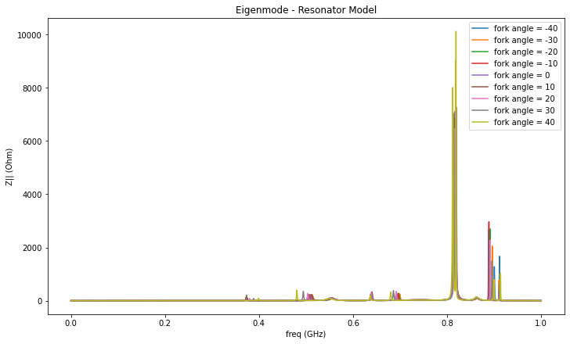
Mitigation Options – Fork Parking Position

Slide 18
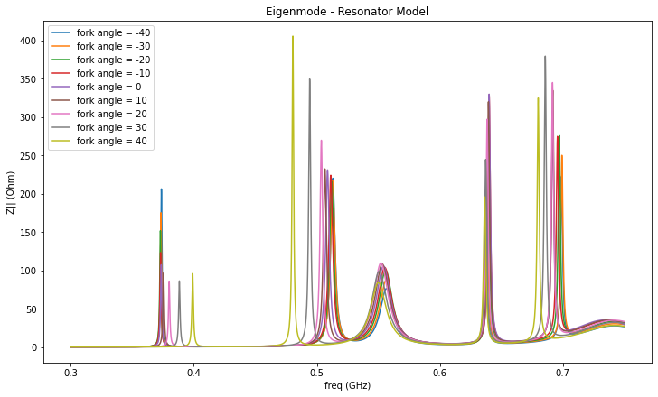
Mitigation Options – Fork Parking Position

Slide 19
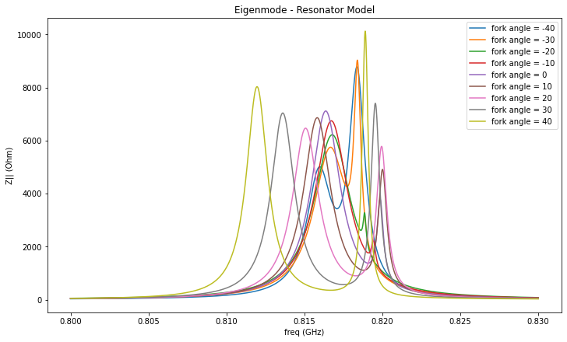
Mitigation Options – Fork Parking Position

Slide 20
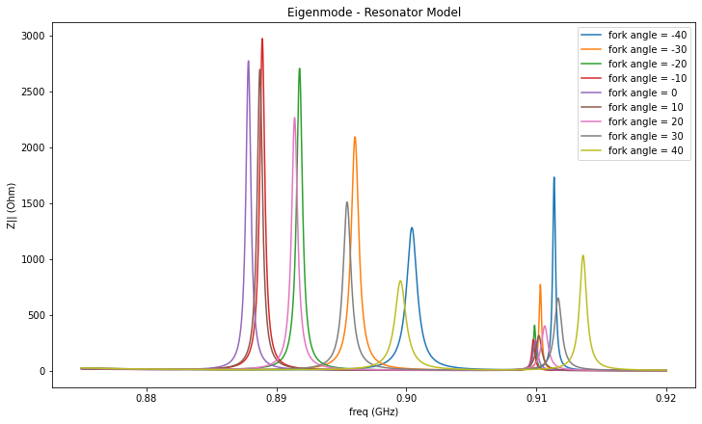
Mitigation Options – Fork Parking Position

