Slide 1
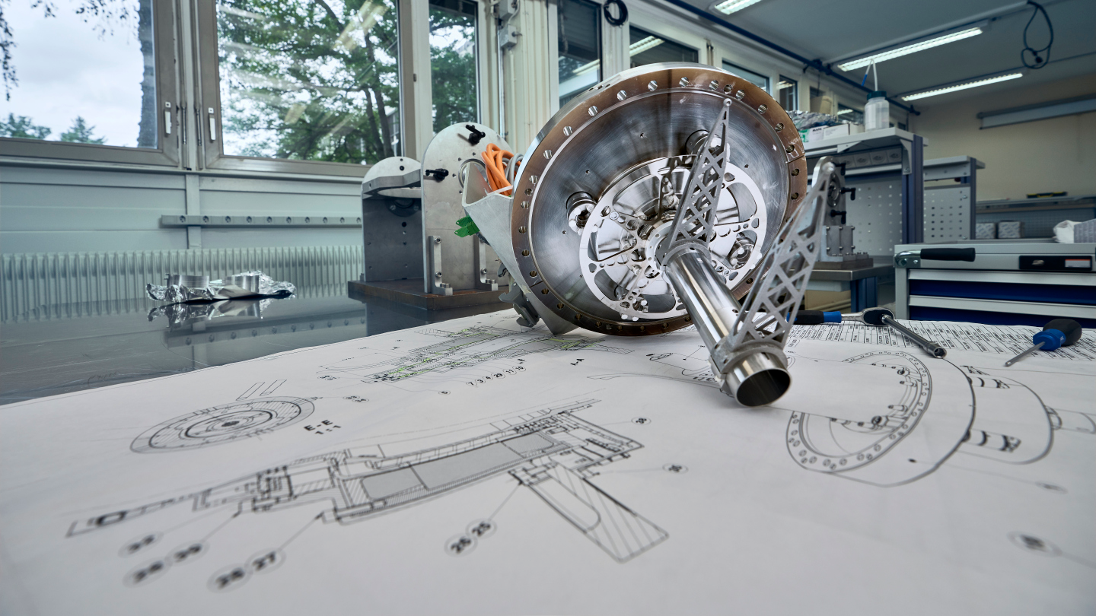
SPS Rotary Wire Scanner Request for an intervention in SPS-TS1
Ray Veness / SY-BI for the SPS BWS Task Force

Slide 2
Background
All 4 SPS wire scanners saw wire failures in a very short period
  All 4 (BA4, BA5) failed on April 12
  Both BA4 scanners replaced April 19
  Both BA4 scanners failed again April 21/22
Preliminary presentation to IEFC #327 by F.Roncarolo et al.
  https://indico.cern.ch/event/1272497/
Task force formed to coordinate activities related to these failures
  Mandate presented in IEFC #329 by R.Veness
    https://indico.cern.ch/event/1286143/
  First meeting May 5
  Weekly meetings held since then

Slide 3
Brief Summary of Task Force activities
Review of operating conditions that led to the wire failures
  Data from beam instrumentation logs
  Data from wire resistance measurements
Simulations of HOM heating modes
  Addition and optimisation of ferrites to mitigate heating in the wire
Measurements of modes in spare vacuum tanks
Post-mortem of the broken instruments
Thermal and thermo-mechanical FEA simulations
Discussions and preparations for TS1 intervention
  Preparation can calibration of instruments
  Preparation for the vacuum interventions

Slide 4
Proposed changes during SPS-TS1
Replace both the (currently vertical) BWSRC instruments in BA4
  Replacing the wires and calibrating in the lab such that the instruments are operational
Rotate the 41677 scanner tank to the horizontal plane
  Giving us both V and H scanners for operations in BA4
Add 3 ferrite blocks to each of the BA4 tanks
  Significant reducing coupled power to the wires
Add (if possible) Pt100 temperature sensors to the outside of the tanks
  Gain some indication of the ferrite temperatures
Connect cables to the HOM feedthroughs mounted on the shaft axis
  Gain additional diagnostics on the EM field distribution in the tanks
No intervention in BA5
  We do not have sufficient spare instruments with the SPS configuration
  Potential impact on dump and kickers from vacuum opening
ECR: LIU WS modification by W.Andreazza in circulation (EDMS xxx)

Slide 5
Potential issues
Venting of the BWS vacuum sector
  Recovery time for the kickers in the adjacent vacuum sector
Addition of the ferrites
  Requires in-situ spot welding in the vacuum chamber. VSC have developed this process and used it in fast pulsing magnets
Risk of a repeat of the failures in April
  Task force will prepare some guidelines for safe operating limits.

Slide 6
Thanks for your attention

Slide 7
Proposed mandate for the SPS Wire Scanner Task Force 2023
The Task Force (TF) will coordinate studies and actions related to the recent wire breakages in the SPS rotary scanners.
Specifically, it will investigate the causes, analyse the failed instruments, and coordinate mitigation measures, both in the instrument design and in operational parameters.
It will report to the IEFC Committee, whilst working closely with IWG and IPP.
The TF is time-limited. In the first instance, it will coordinate the preparation and implementation of possible mitigation measures to be implemented for SPS-TS1 in June. After this, the TF mandate will be reviewed.
The chair is Raymond Veness (SY-BI) and secretary is Nabil El-Kassem (SY-BI). Membership is drawn from the following groups: BE-ABP, BE-OP, EN-MME, TE-VSC, SY-ABT, SY-BI, SY-RF, plus IPP and IWG.

Slide 8
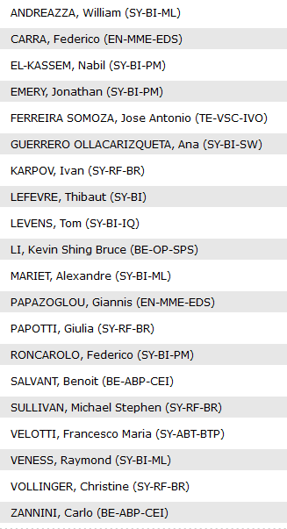
Current Task Force Core Members
Thanks everyone for your availability and reactivity!

