Slide 1


Initial Evaluations of the
Spilt Coil for the
Radio Frequency Magnetic Field (RFMF) Test Station
Jonathan Pavan, Lucio Rossi, Marco Statera
UMIL & INFN, LASA Milano, Polimi
MuCol WP8 Meeting #4 – 5 June 2023

Slide 2
From the last meeting
To allow to fit the 700 MHz system
Minimum free (room temperature) bore of the split coil
  500 mm → 550 min
  To allow to test cavities also at LN cooling (80K) 50 mm would be beneficial:
  → 600 mm design goal for the RT free bore
  50 mm space for thermal insulation between 300 K - 20 K
  → 700 mm minimum coil bore

Slide 3
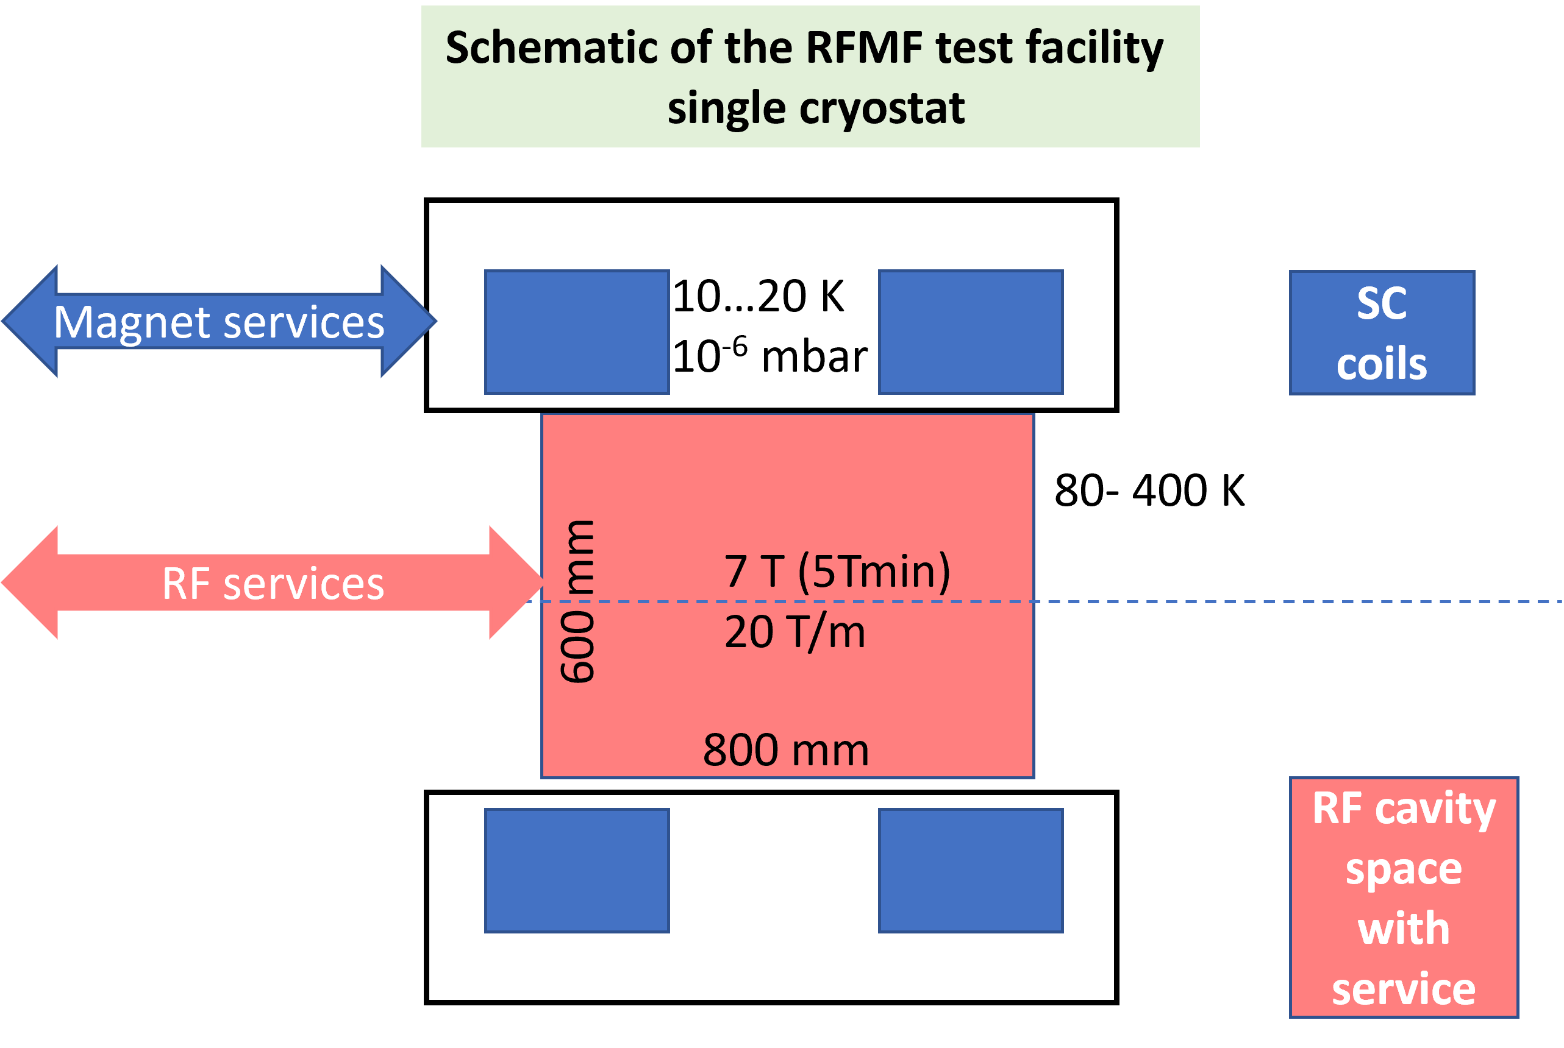
Split Coil in Single Cryostat
all RF services from side
Easier for magnets
Inter-coil forces reacted at cold

Slide 4
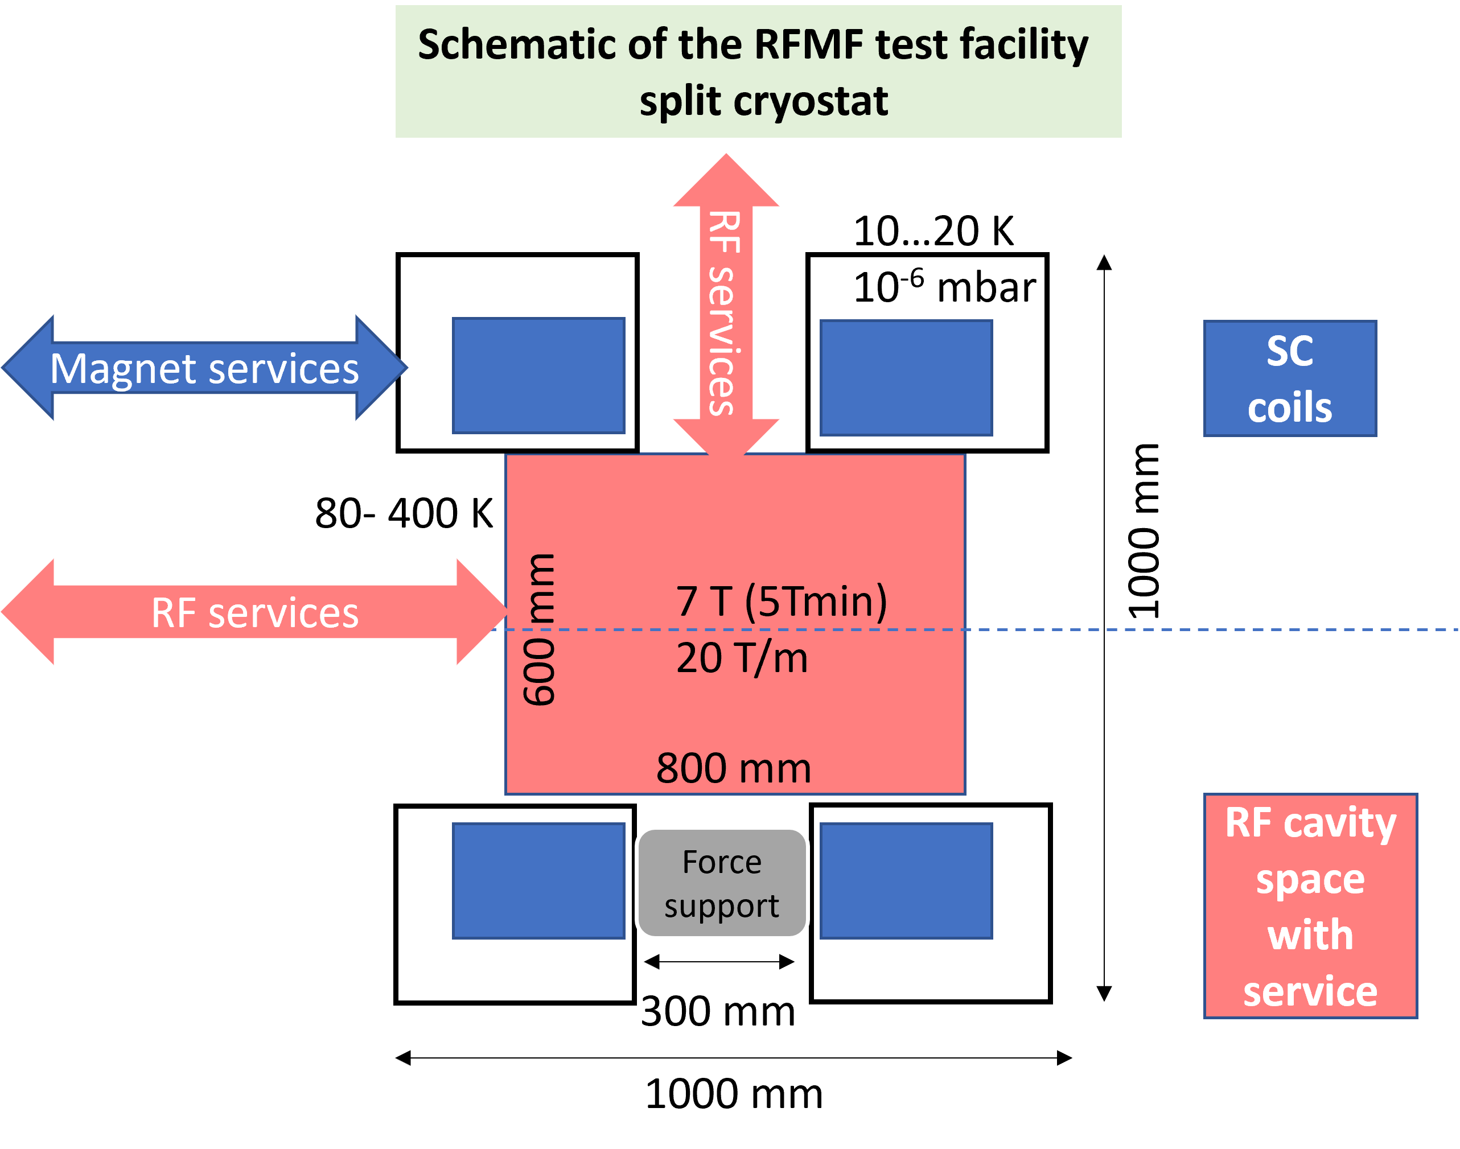
Split Coil in Split Cryostat
Split cryostat omplies to support inter-coil forces with two interfaces cold-warm → more thermal losses (difficult to manage for a cryogen-free system).
RF services can come through the midplane: is this a key feature for RF?
If not, the single cryostat has no advantages. Except it could be more similar to the Cooling Cell itself.

Slide 5
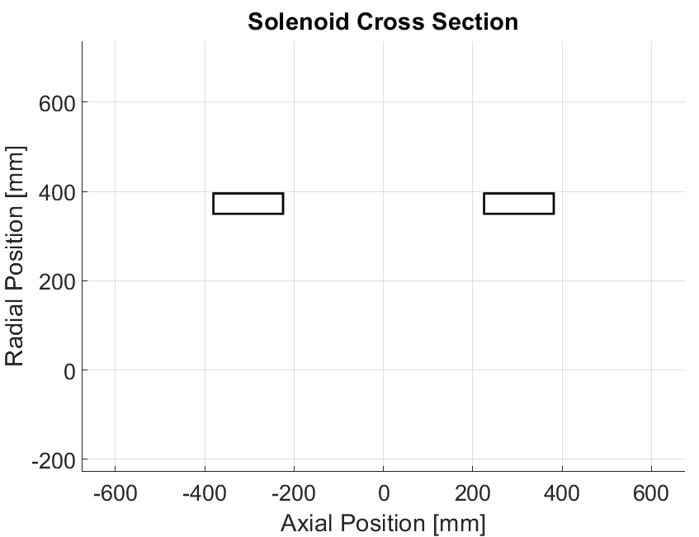




1° Configuration: 7 T central field
Same Polarity
Properties
Tape Thickness: 0,067 mm
Tape Width: 12 mm
Current Density: 621.8 A/mm²
Thickness to Length Ratio: 0,29 (similar to cell B1-Demonstrator 0,3)
LENGTH OF TAPE REQUIRED: 41,4 km
$$G=450 mm$$
$$L=156 mm$$
$$T=45,56 mm$$
$$R=350 mm$$

Slide 6
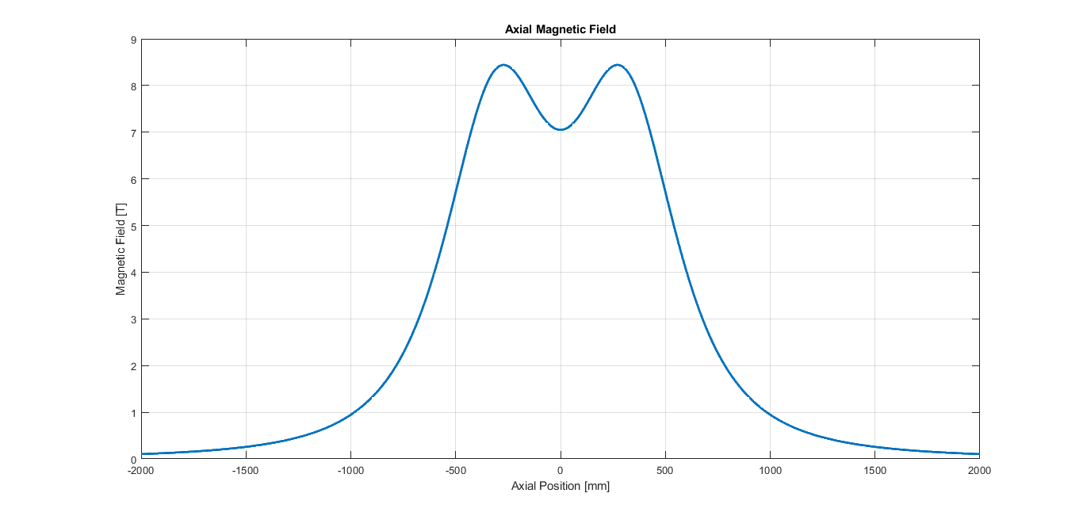
1° Configuration: Same Polarity
Properties
Maximum Bz: 8,4 T
Bz at Center: 7,0 T
Homogeneity: 20%
Inductance of 1 solenoid: 80,6 H
Mutual Inductance: 6,5 H
Magnetic Energy of 1 solenoid: 10 MJ
Magnetic Energy of system: 22 MJ

Slide 7
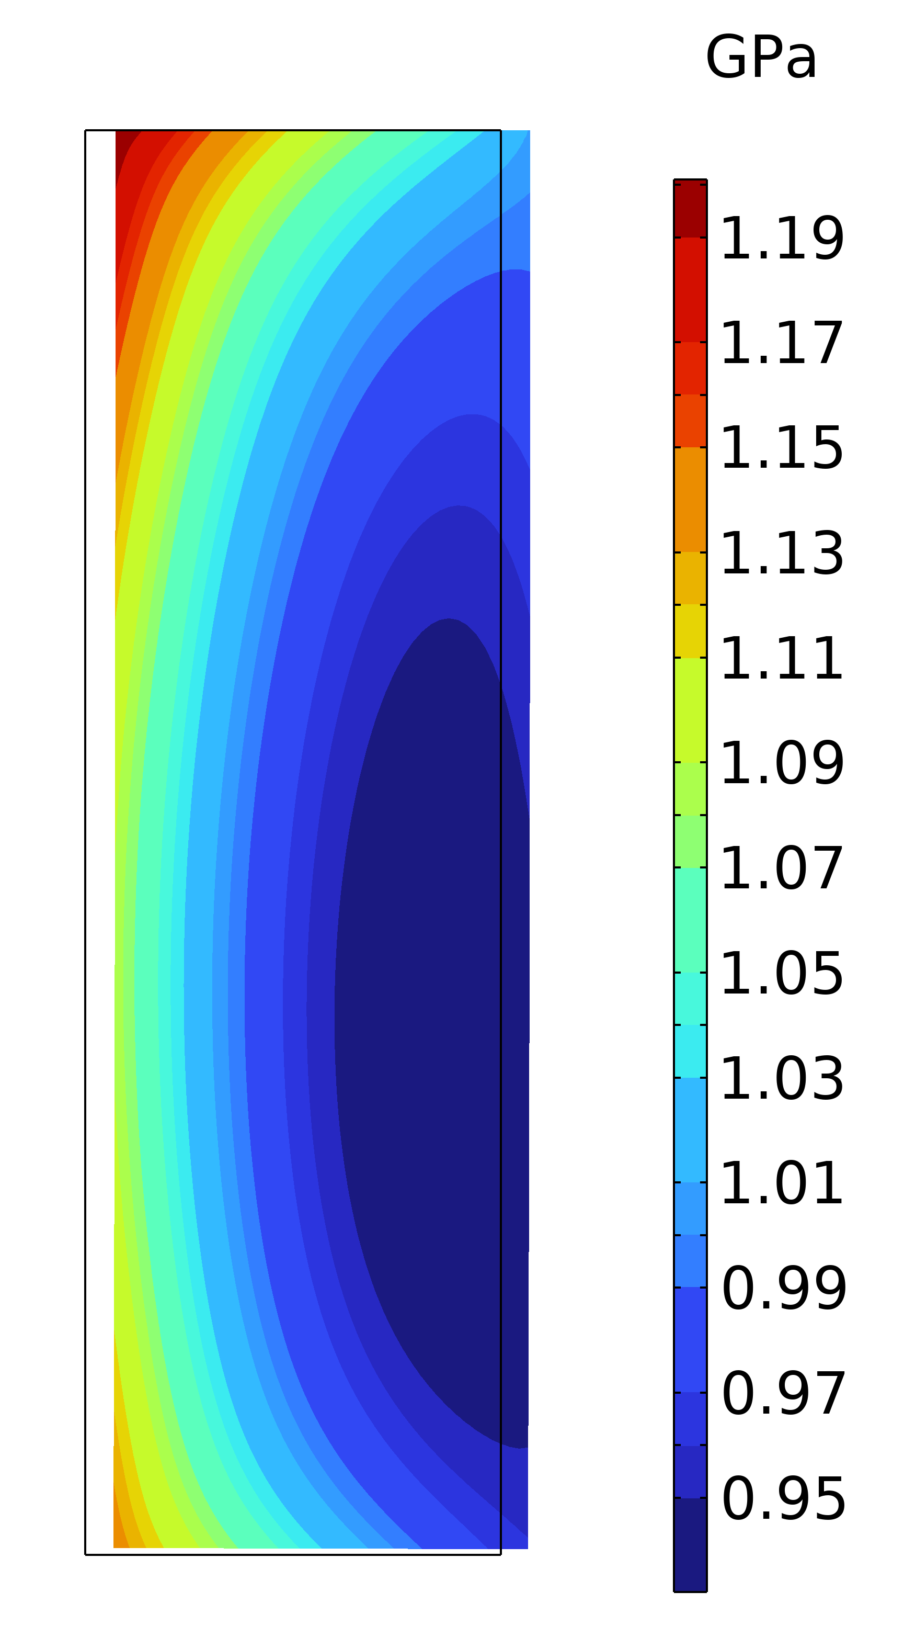
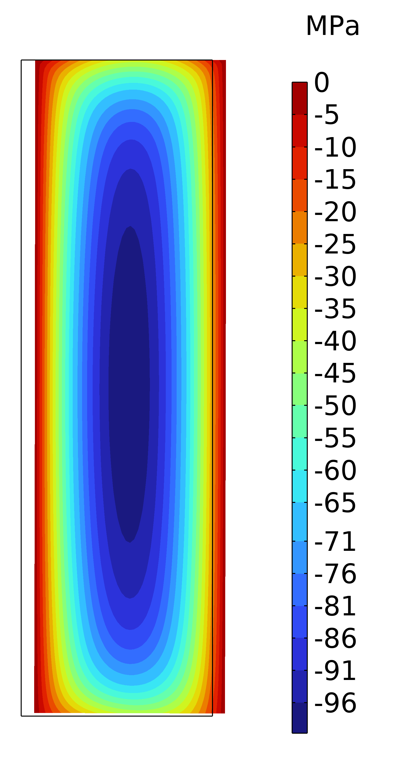
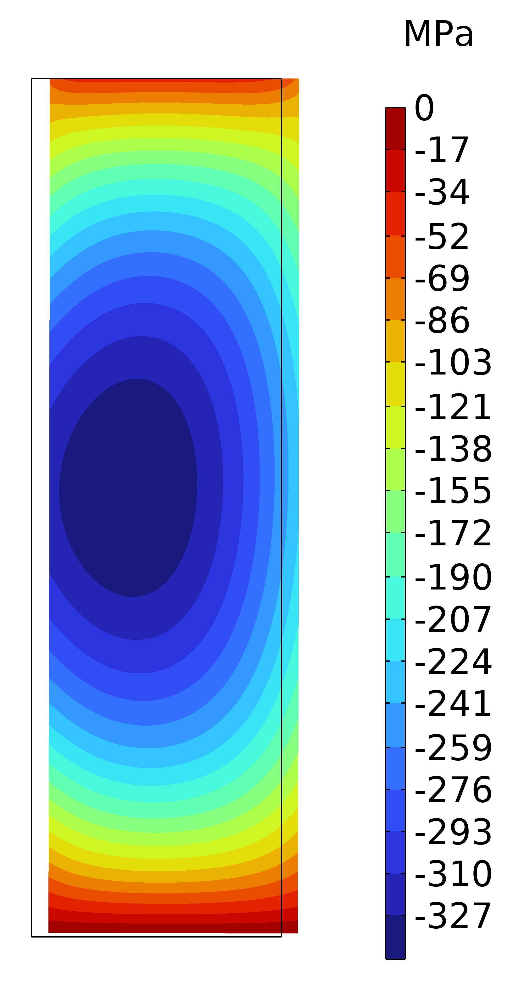



1° Configuration: Same Polarity
$$σ_{θ}$$
$$σ_{r}$$
$$σ_{z}$$

Slide 8
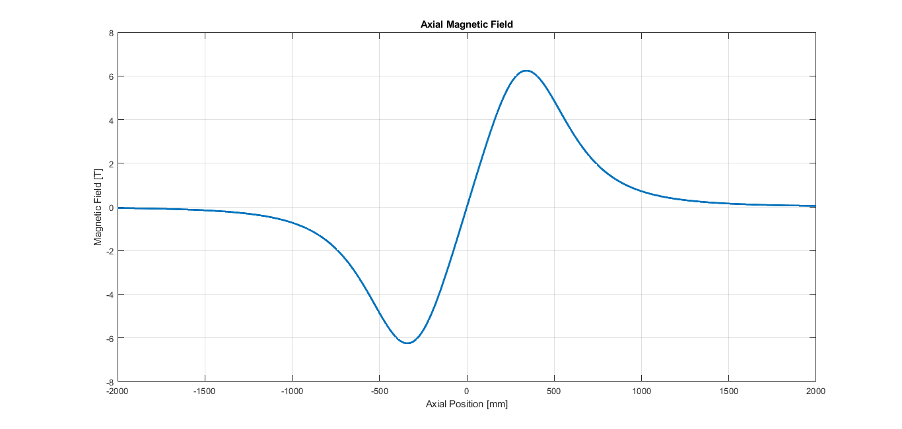
1° Configuration: Opposite Polarity
Properties
Maximum Bz: 6,2 T
Bz at Center: 0 T
Homogeneity: -
Inductance of 1 solenoid: 80.6 H
Mutual Inductance: 6,5 H
Magnetic Energy of 1 solenoid: 10 MJ
Magnetic Energy of system: 18,5 MJ

Slide 9
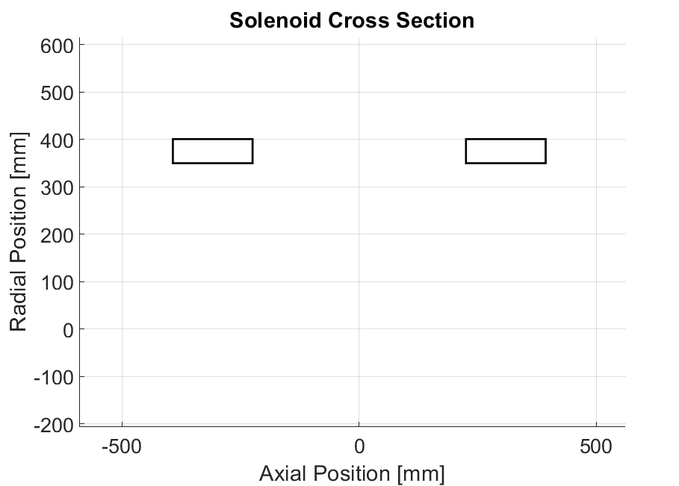




2° Configuration: Same Polarity
Properties
Tape Thickness: 0,067 mm
Tape Width: 12 mm
Current Density: 621.8 A/mm²
Thickness to Length Ratio: 0,3
LENGTH OF TAPE REQUIRED: 50,1 km
$$L=168 mm$$
$$G=450 mm$$
$$T=50,8 mm$$
$$R=350 mm$$

Slide 10
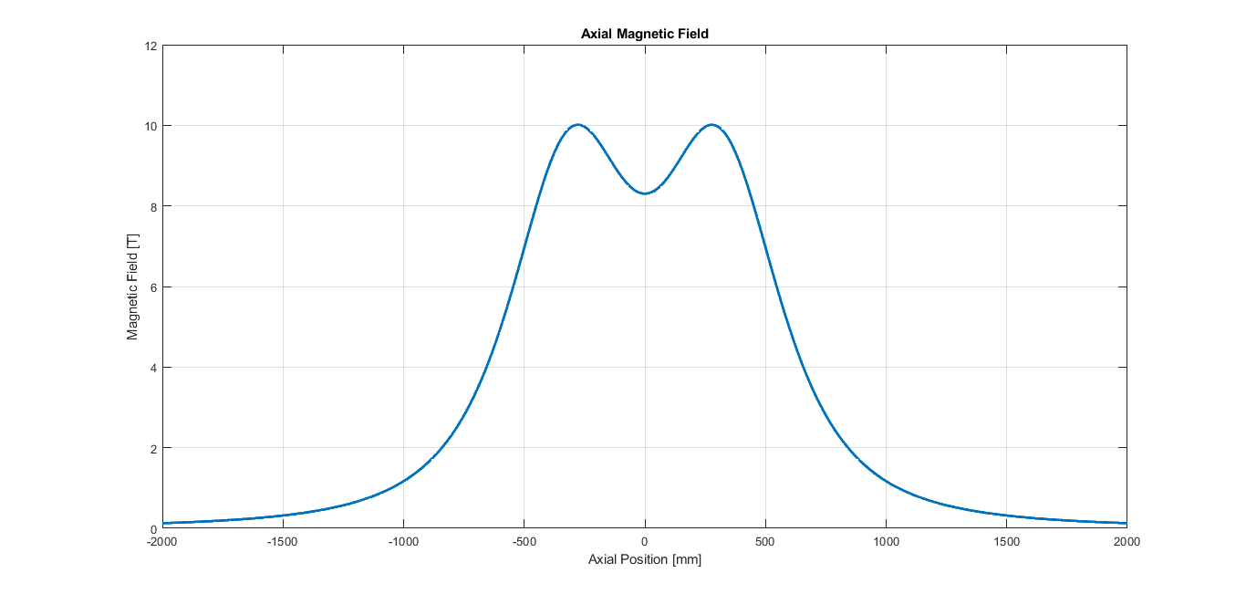
2° Configuration: 10 T Max field
Same Polarity
Properties
Maximum Bz: 10,0 T
Bz at Center: 8,3 T
Homogeneity: 20 %
Inductance of 1 solenoid: 113 H
Mutual Inductance: 9 H
Magnetic Energy of 1 solenoid: 14 MJ
Magnetic Energy of system: 30 MJ

Slide 11
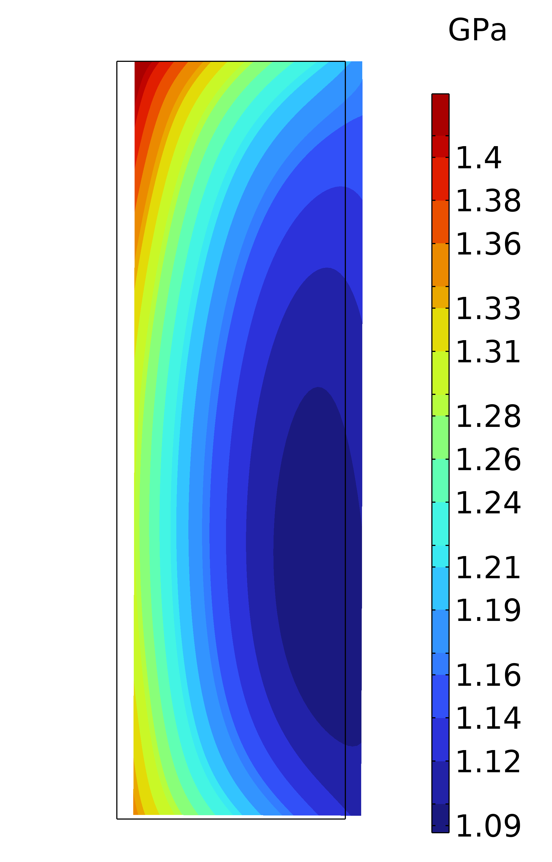
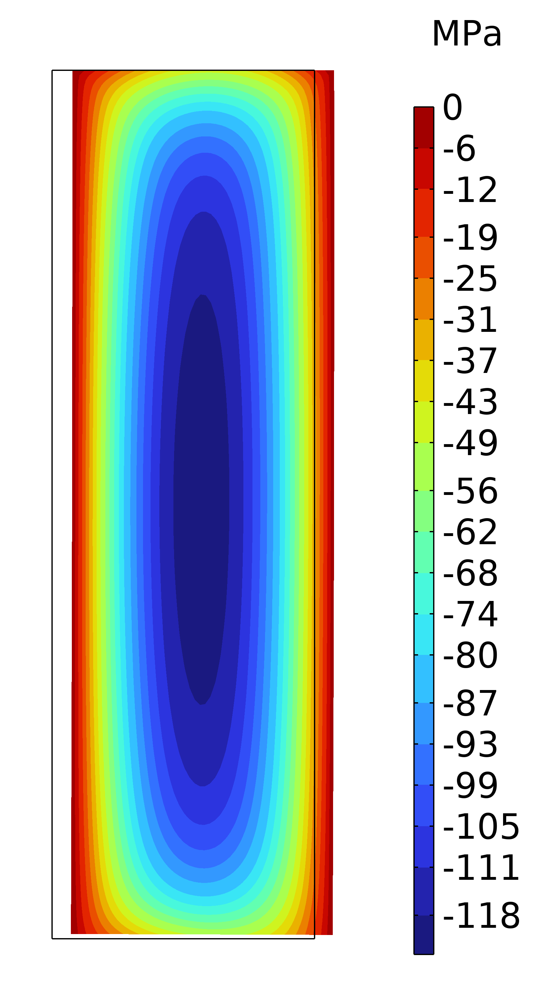
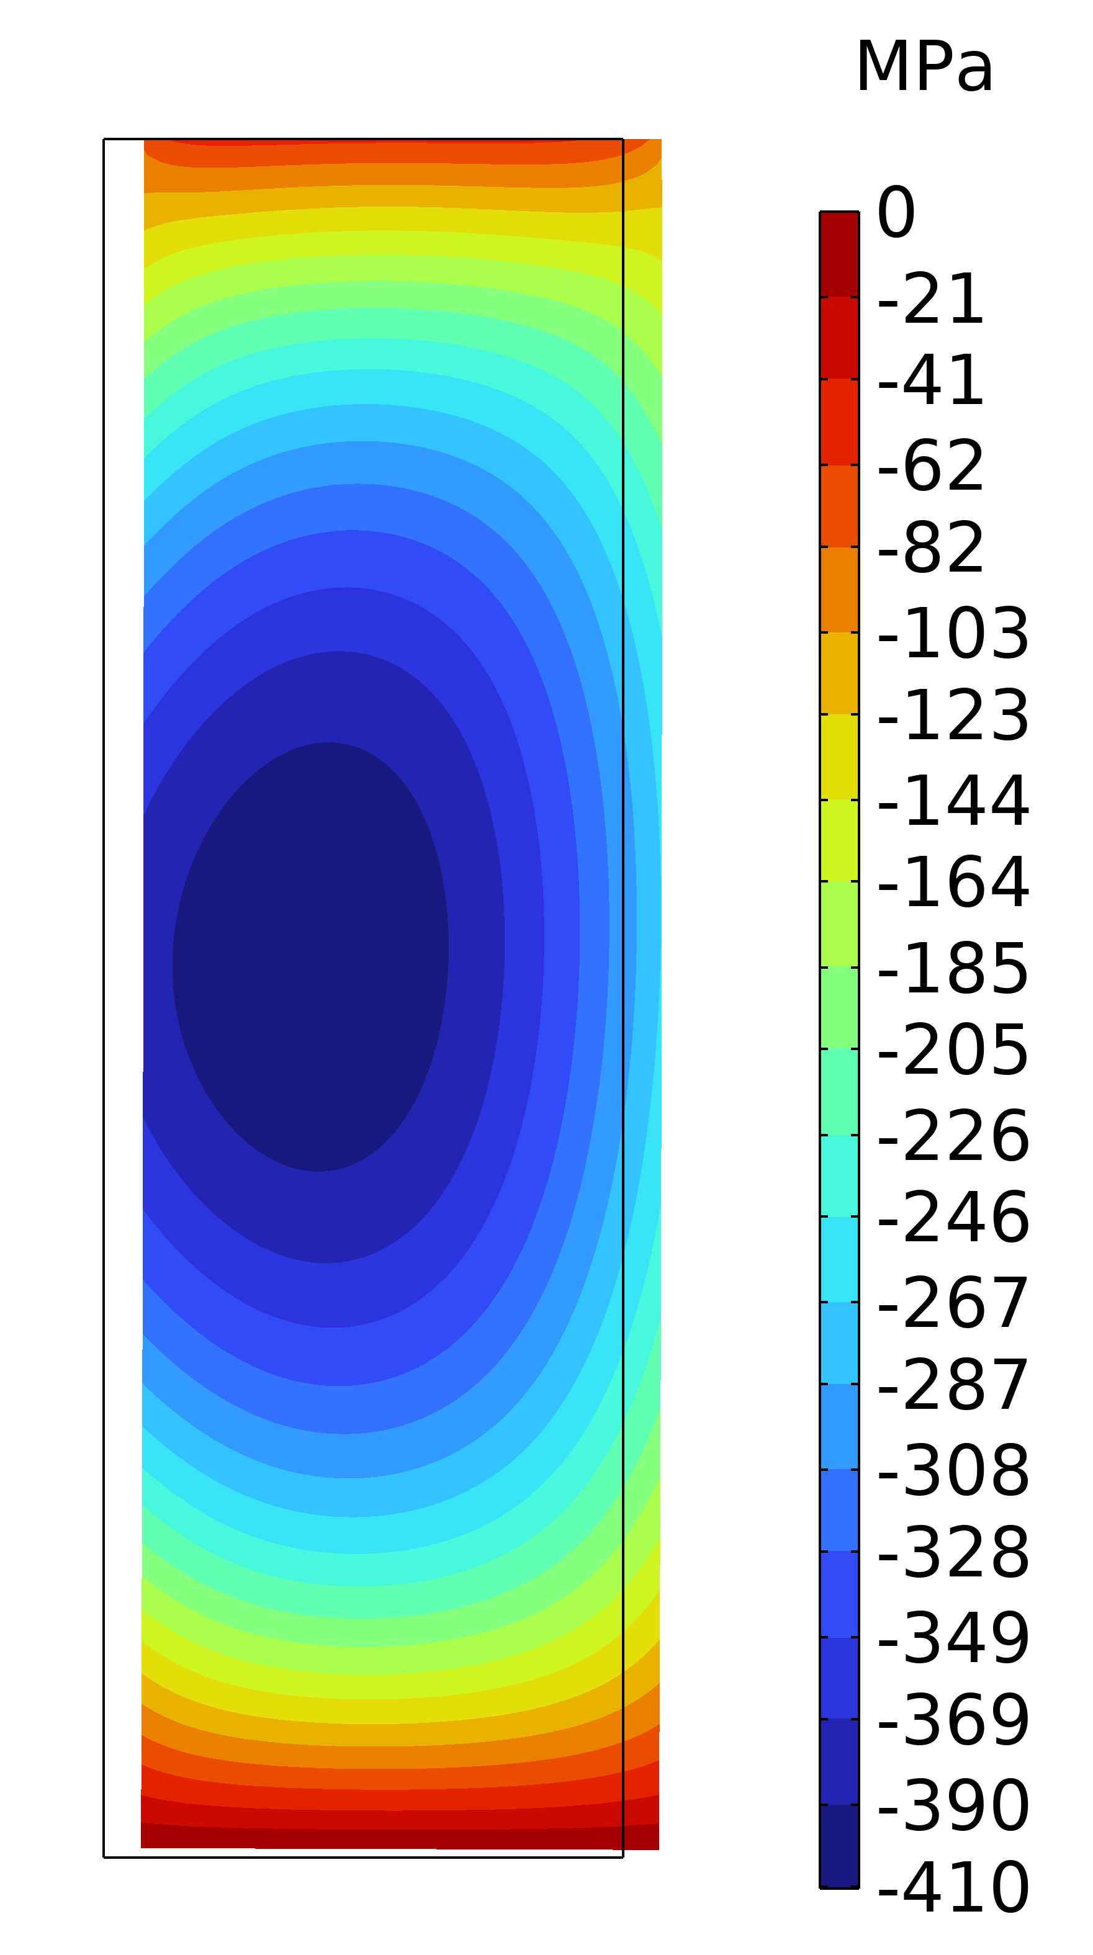
2° Configuration: Same Polarity
$$σ_{θ}$$
$$σ_{r}$$
$$σ_{z}$$

Slide 12
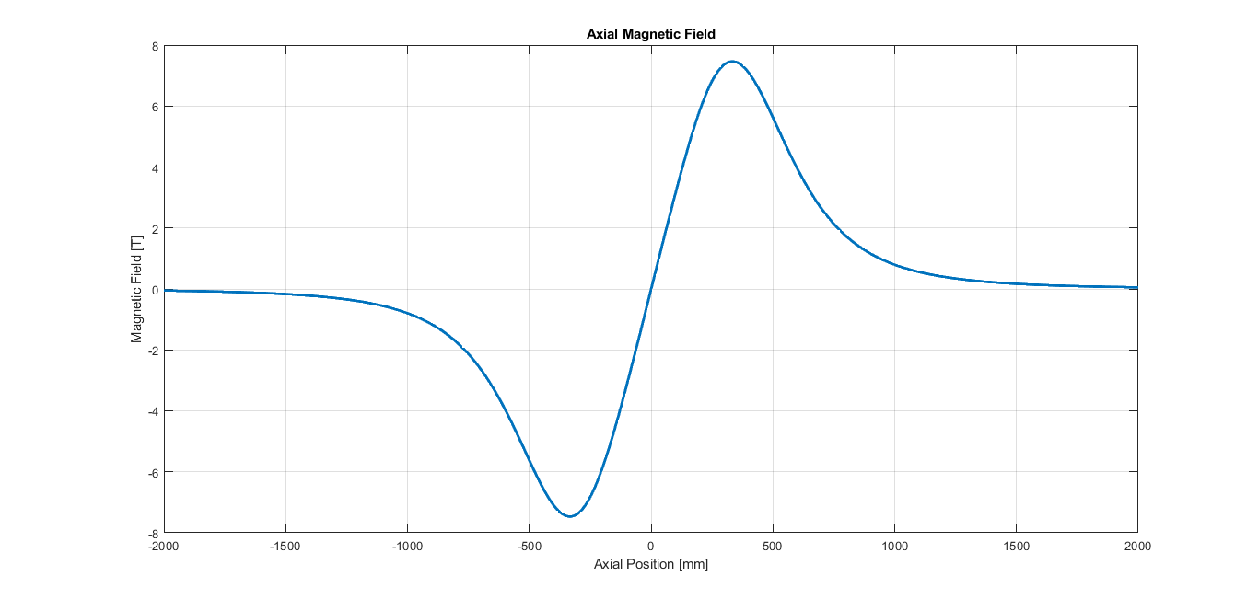
2° Configuration: Opposite Polarity
Properties
Maximum Bz: 7,5 T
Bz at Center: 0 T
Homogeneity: -
Inductance of 1 solenoid: 113 H
Mutual Inductance: 9 H
Magnetic Energy of 1 solenoid: 14 MJ
Magnetic Energy of system: 26 MJ

Slide 13
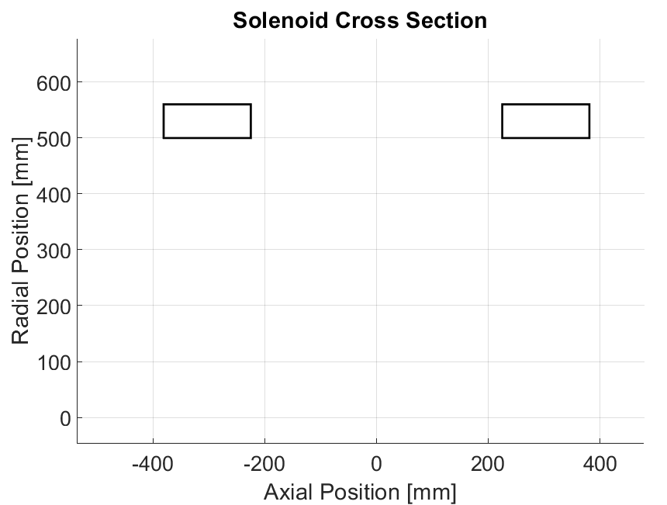




3° Configuration: high uniformity
Same Polarity
Properties
Tape Thickness: 0,067 mm
Tape Width: 12 mm
Current Density: 621,8 A/mm²
Thickness to Length Ratio: 0,38
LENGTH OF TAPE REQUIRED: 77,9 km
$$L=156 mm$$
$$G=450 mm$$
$$T=60,3 mm$$
$$R=500 mm$$

Slide 14
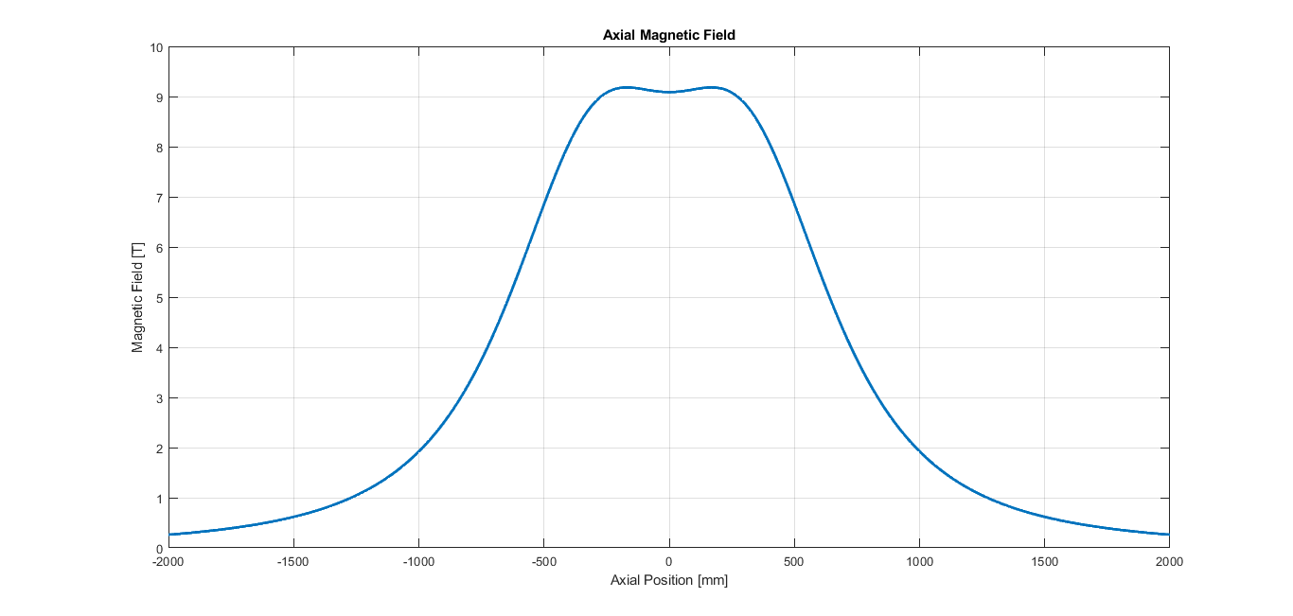
3° Configuration: Same Polarity
Properties
Maximum Bz: 9,18 T
Bz at Center: 9,08 T
Homogeneity: 1 %
Inductance of 1 solenoid: 226 H
Mutual Inductance: 30 H
Magnetic Energy of 1 solenoid: 28 MJ
Magnetic Energy of system: 64 MJ

Slide 15
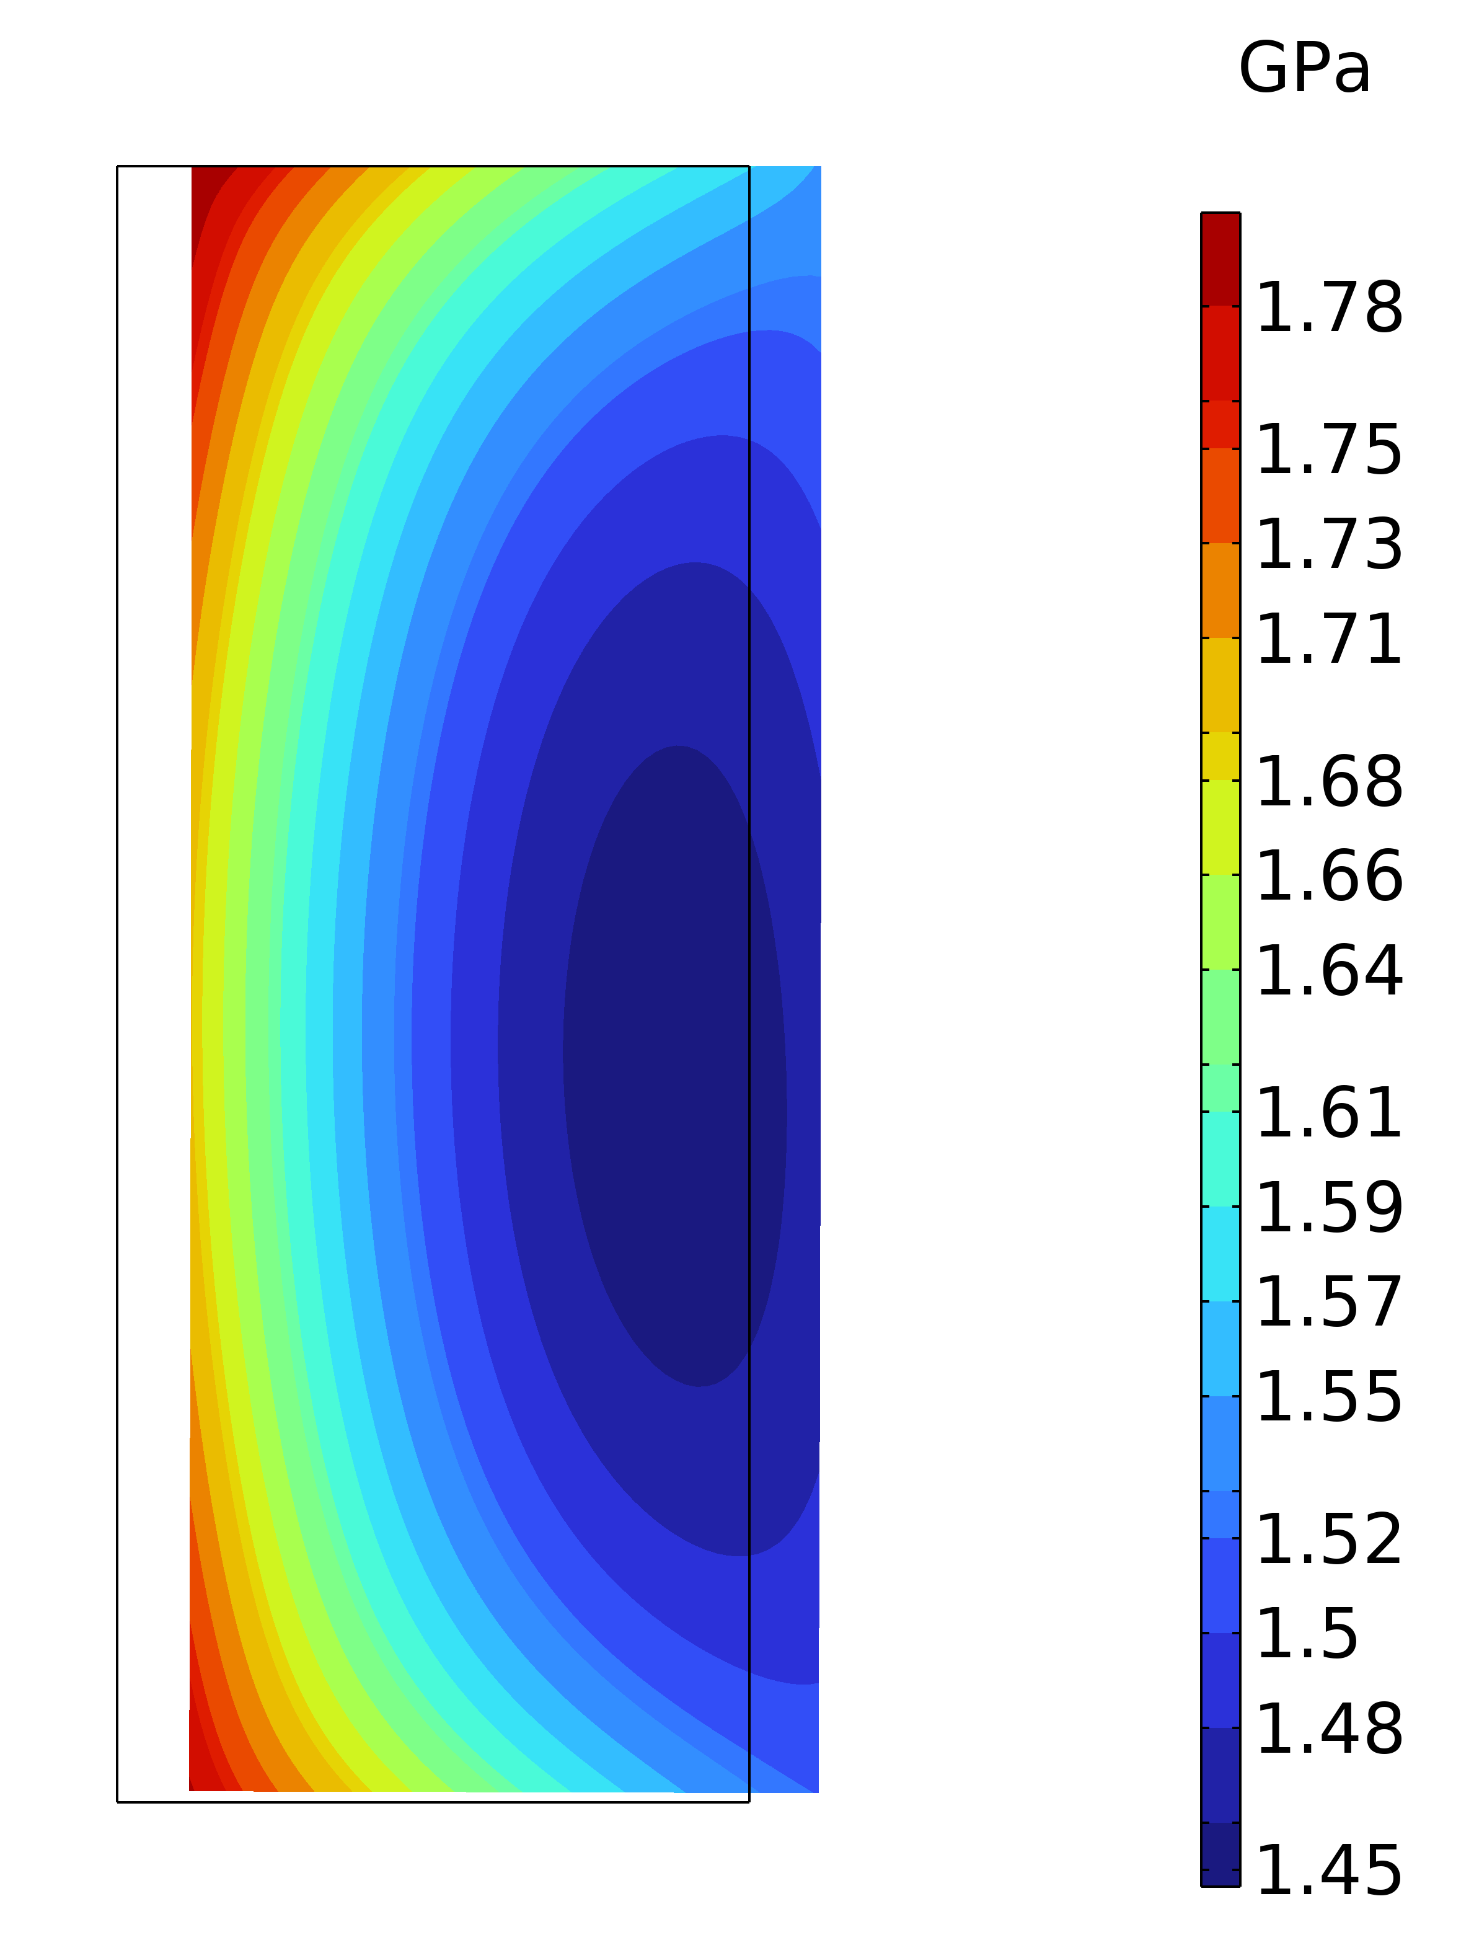
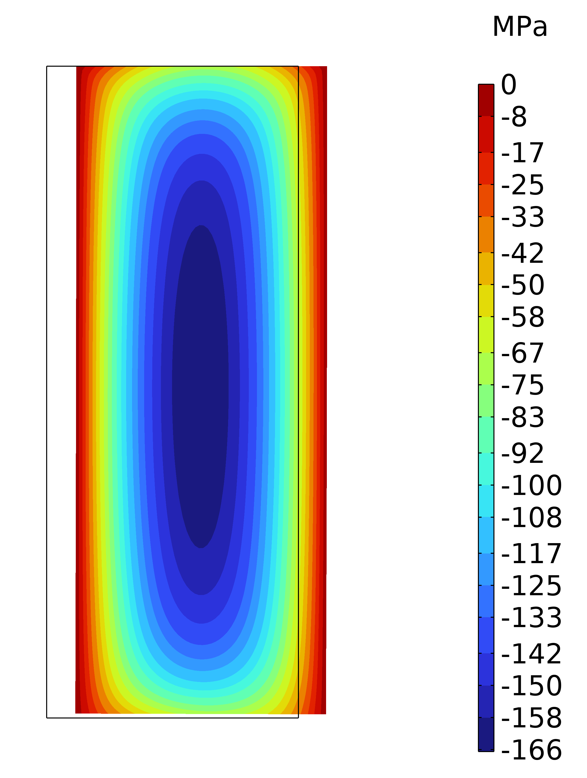
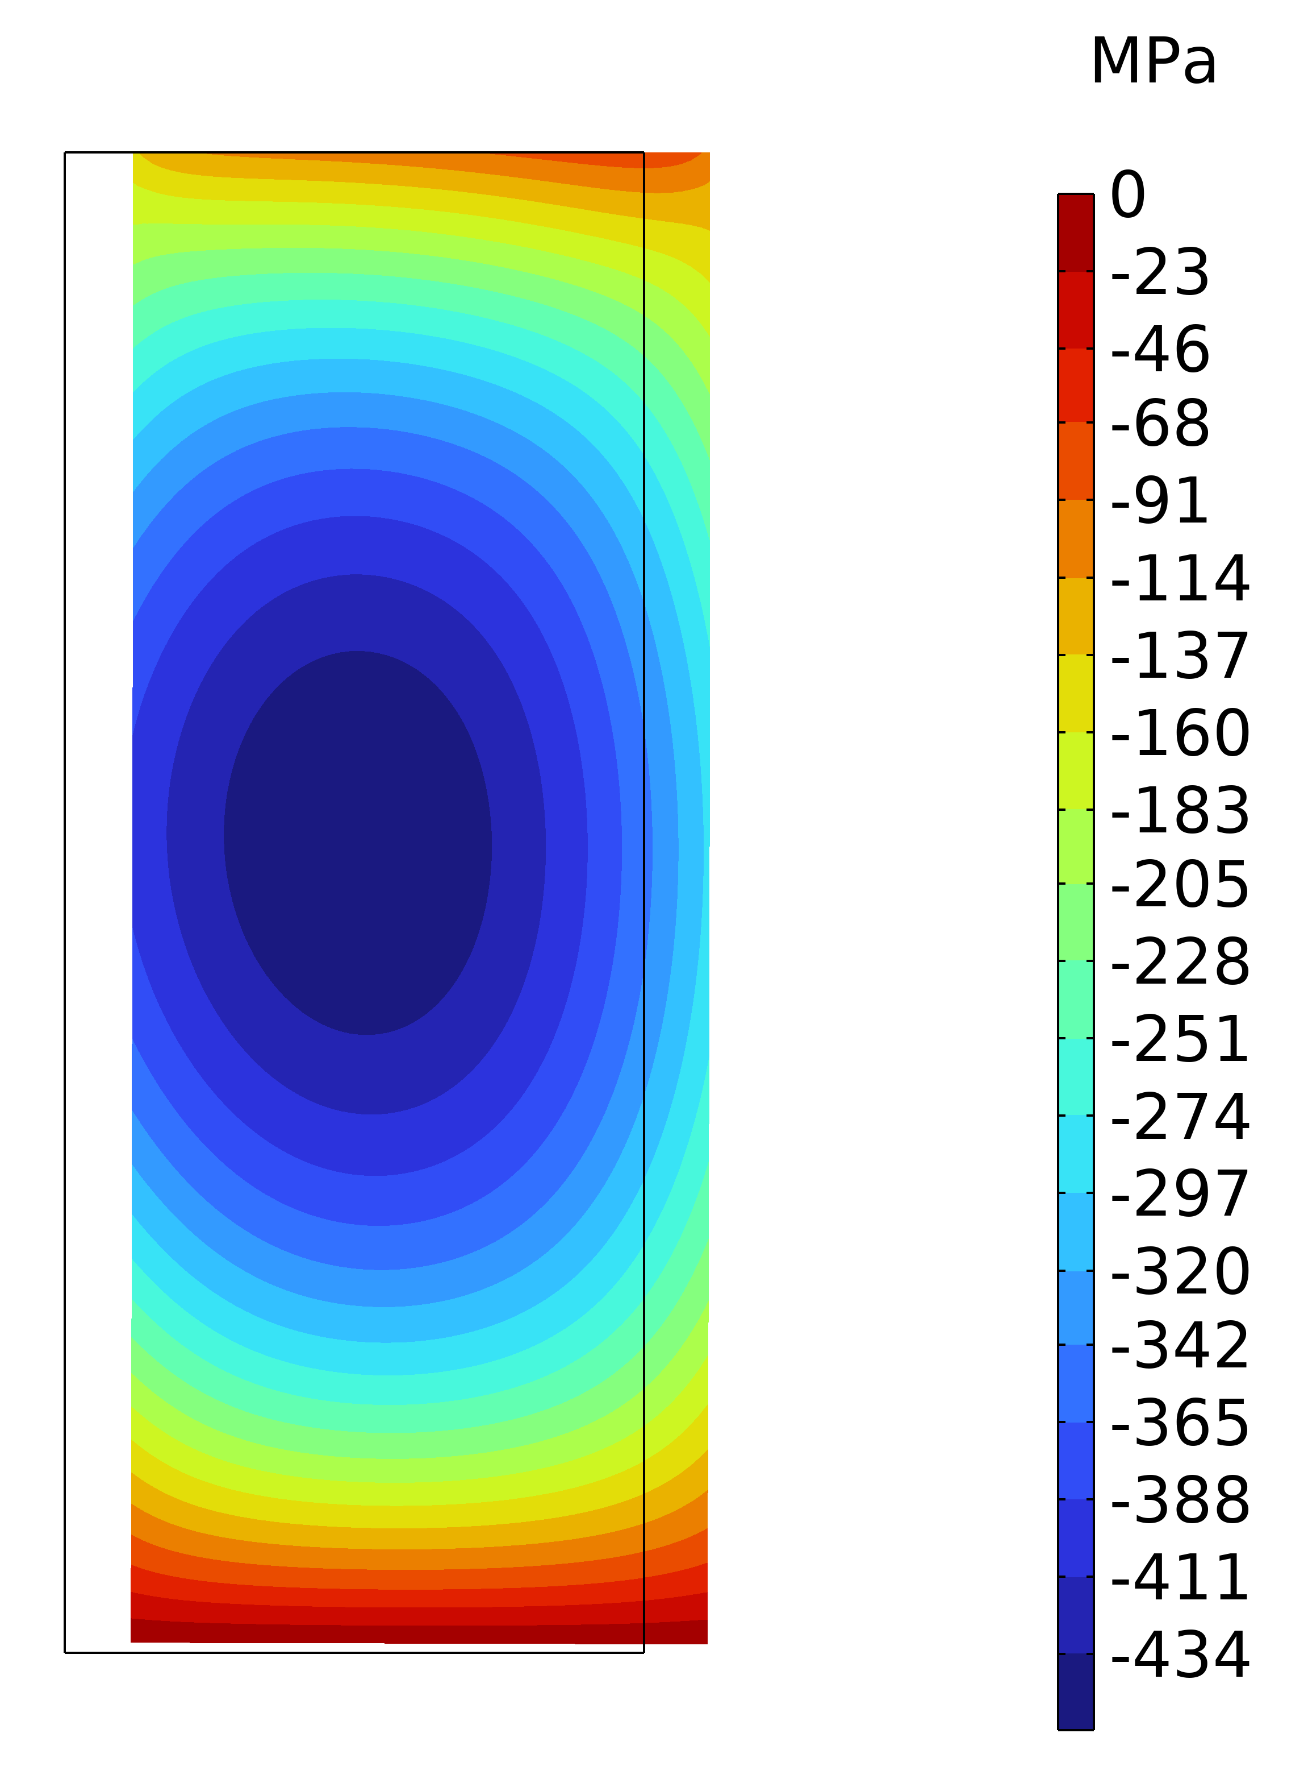



3° Configuration: Same Polarity
$$σ_{θ}$$
$$σ_{r}$$
$$σ_{z}$$

Slide 16
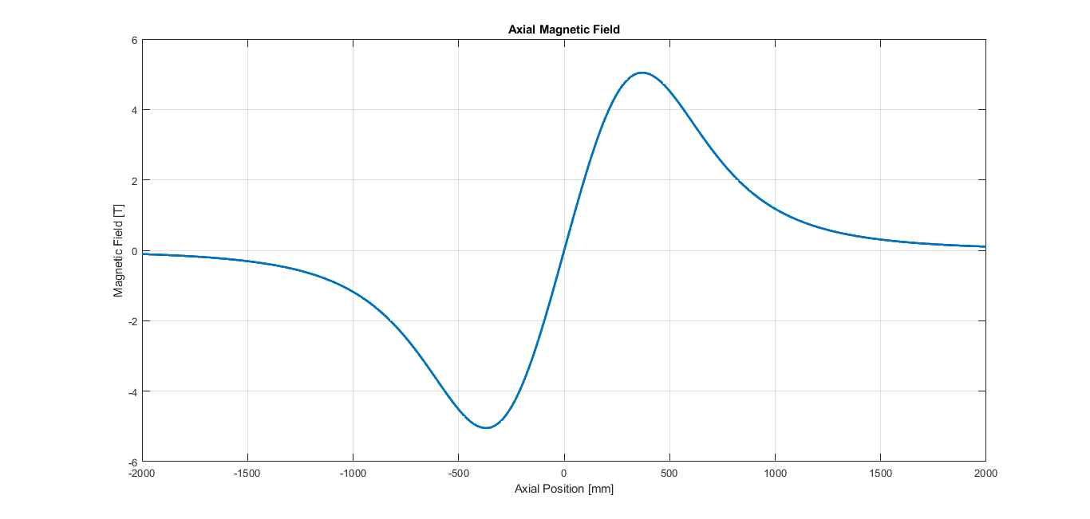
3° Configuration: Opposite Polarity
Properties
Maximum Bz: 5,04 T
Bz at Center: 0 T
Homogeneity: -
Inductance of 1 solenoid: 226 H
Mutual Inductance: 30 H
Magnetic Energy of 1 solenoid: 28 MJ
Magnetic Energy of system: 64 MJ

Slide 17
A few considerations
The work on magnet design just started…
Many assumptions can be refined (space for thermal insulation etc…)
Forced are still to be checked (I am more worried about forces rather than internal stresses)
The bottom line that the Magnetic Facility is expensive:
  45 km of REBCO tapes 12 mm cost about 3 MCHF (plus taxes)!!!
  The coil manufacturing 1 MCHF; the cryostat and services about 1 MCHF
  5 MCHF total cost (crude evaluation)
  A costing with LTS coil is probably useful (but we would miss the objective of having HTS tested for the Cooling Cell technology…).

