Slide 1
Antimatter
April Butler Azad Kirtay
Allen Lim Ia Khukhiashvili

Slide 2
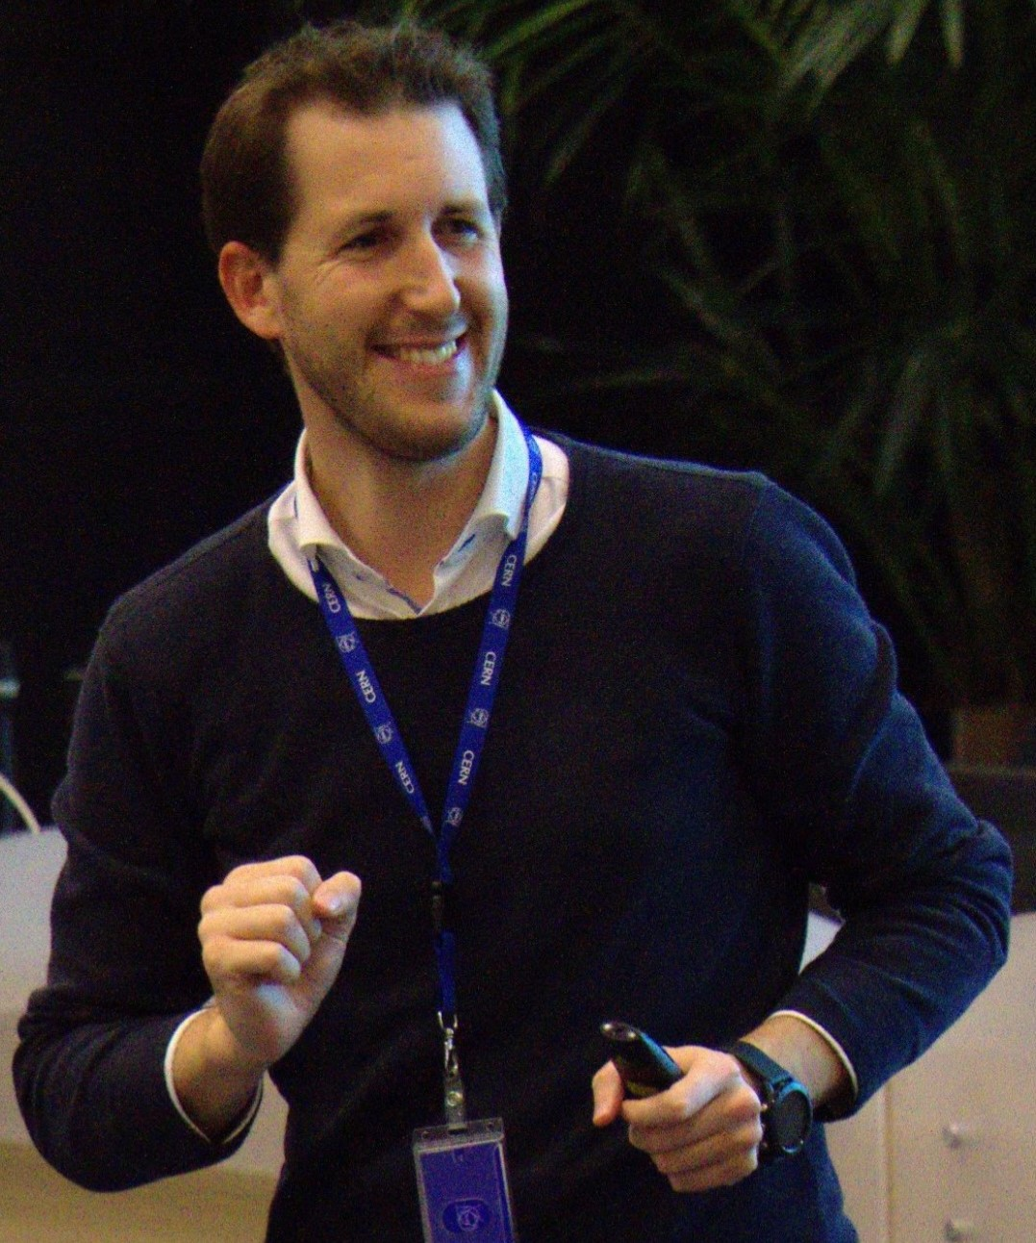
Find Jeff

Slide 3
Curriculum And Classroom Connections
The only curriculum where antimatter is included from our group is in Turkey’s Grade 12 Physics Curriculum. Turkish students are asked to explain the concepts of matter and antimatter. No formulas are utilized.

Slide 4
Curriculum And Classroom Connections
Despite this, due to the importance of our topic in our understanding of the universe and the Big Bang, we still want to include it in our lessons and discuss it whenever possible. This way, students may become interested in further researching it.

Slide 5
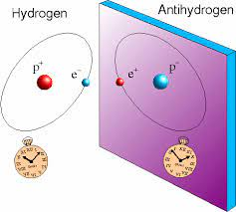
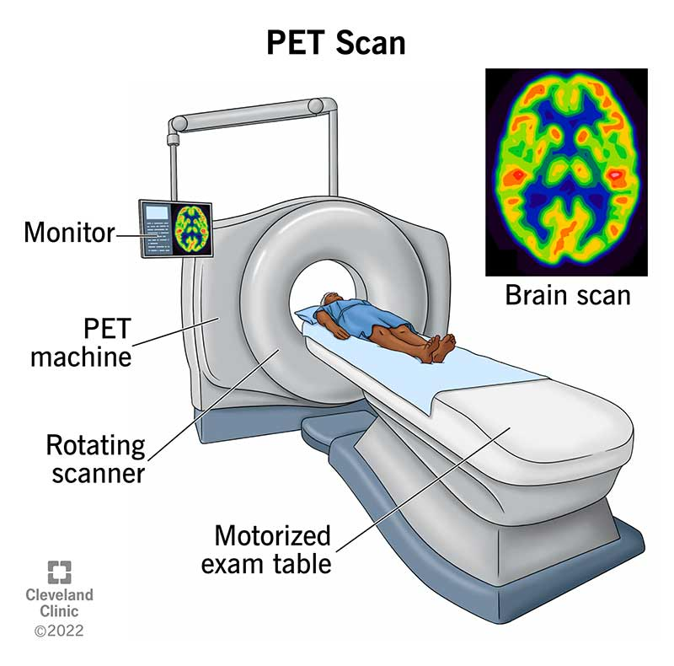
Key Ideas
Identify particles classified as antiparticles
Discuss current antimatter (antihydrogen)
Highlight practical applications of antiparticles/antimatter.

Slide 6

Key Ideas
Describe the problem with making and storing antiparticles/antimatter (antimatter trap)
Discuss the benefits of continuing research on antiparticles and antimatter.

Slide 7
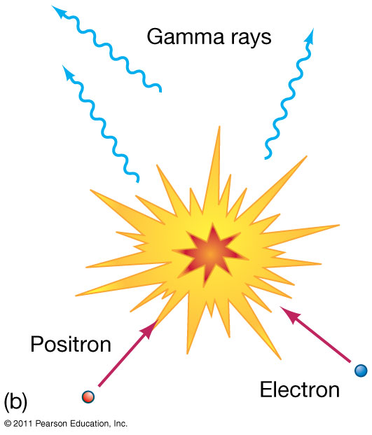
Potential Students’ Conceptions And Challenges
Particle
Antiparticle
Annihilation
Creation from energy

Slide 8

Potential Students’ Conceptions and Challenges
They may confuse dark matter and antimatter.
Misconceptions from movies and books.

Slide 9
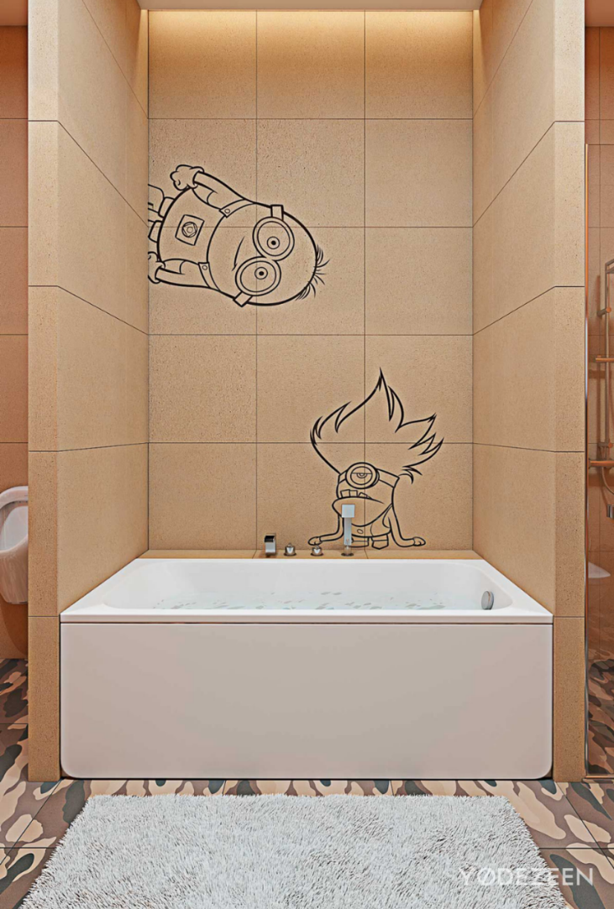
Best Practices
In our classes we should take every
opportunity to include particle physics and
antimatter examples.
Some areas where this could occur are in:
Gravity/freefall
Conservation laws - radioactive decay
Biology class - cross curricular connections

Slide 10
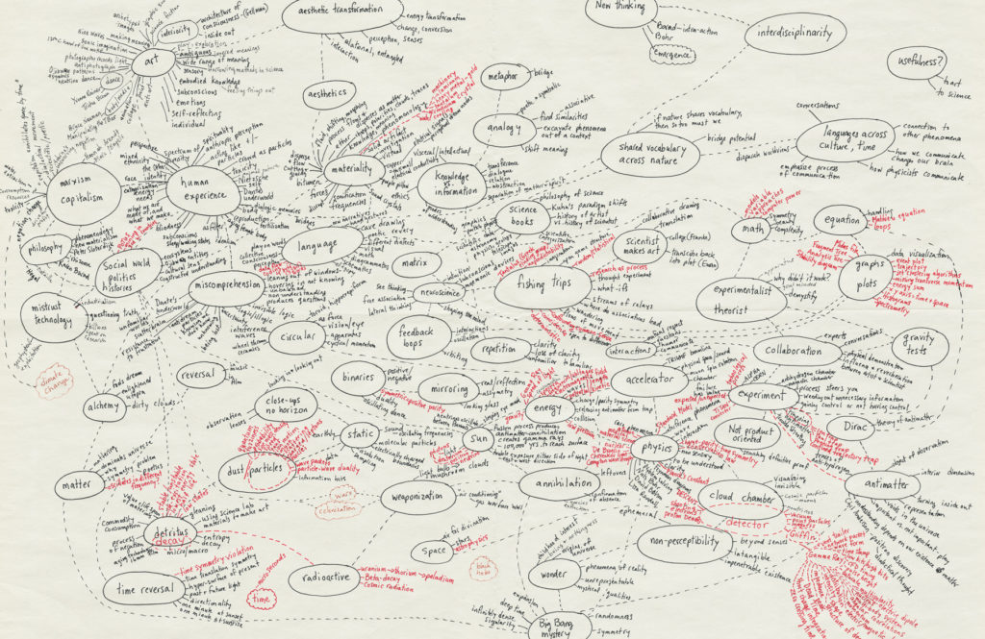
Concept Map- This is what we expect...

Slide 11
YEAH RIGHT!!!
Our apologies to Milena!!

Slide 12
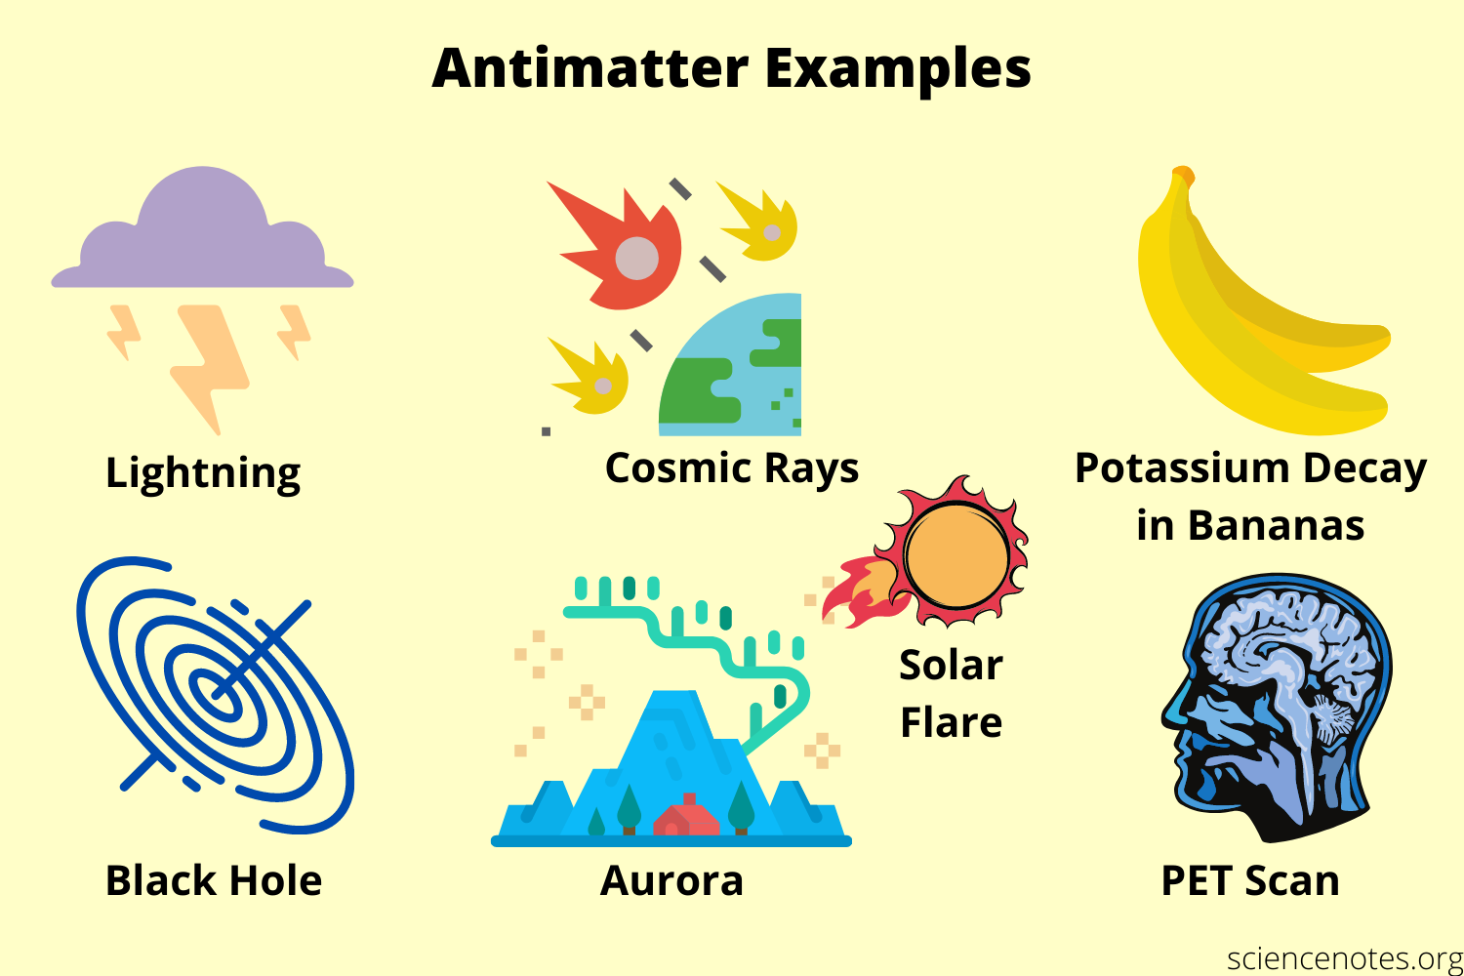
Helpful Material And Resources

Slide 13
Helpful Material And Resources
https://sciencenotes.org/what-is-matter-definition-and-examples/
https://sciencenotes.org/what-is-matter-definition-and-examples/
https://cds.cern.ch/record/2865978http://cds.cern.ch/record/1561098
https://www.britannica.com/science/antimatter
https://www.symmetrymagazine.org/article/april-2015/ten-things-you-might-not-know-about-antimatter?language_content_entity=und
https://science.nasa.gov/science-news/science-at-nasa/2011/11jan_antimatter
http://cern.ch/PER - go look for items

Slide 14
Thank you for your attention!!!

