Slide 1

Computing & Data Analysis

Slide 2
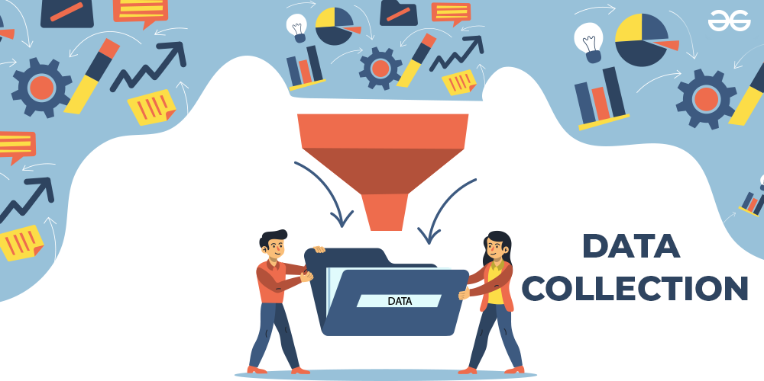
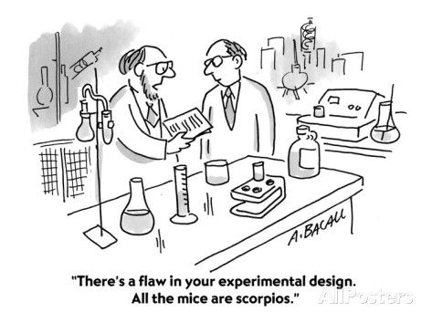
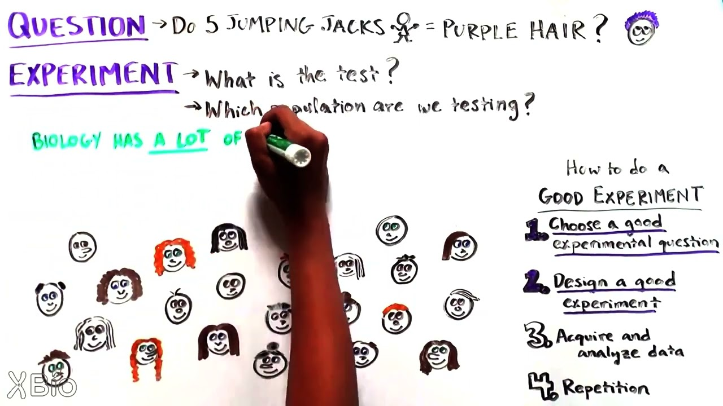
Key ideas for data analysis in the classroom
Notes:
2) Key ideas
Showcase the most important aspects of the topic that you consider to be key for a meaningful instruction
Good experimental design is needed in order to collect relevant data.
Relevant equipment to measure and record data. E.g for large data volumes the computers or cellphones can be used for collection and analysis.
Keeping track of uncertainties. Difficult in high school (time constraints) to properly use uncertainties and error bars.
Appropriate visual representation of data
Analysing the data
Need lots of data needed to draw conclusions.

Slide 3
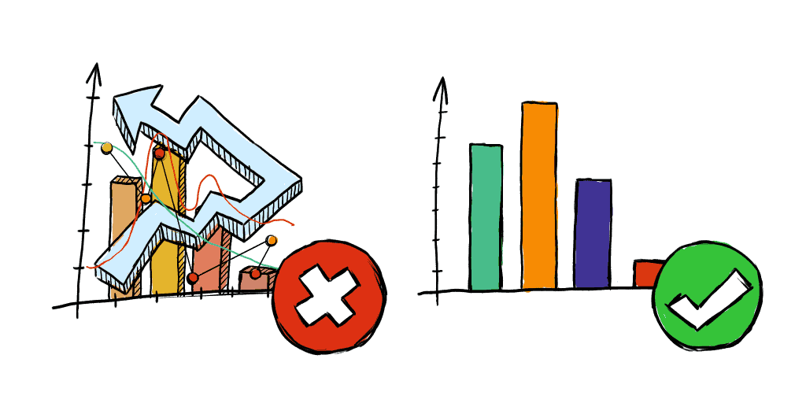
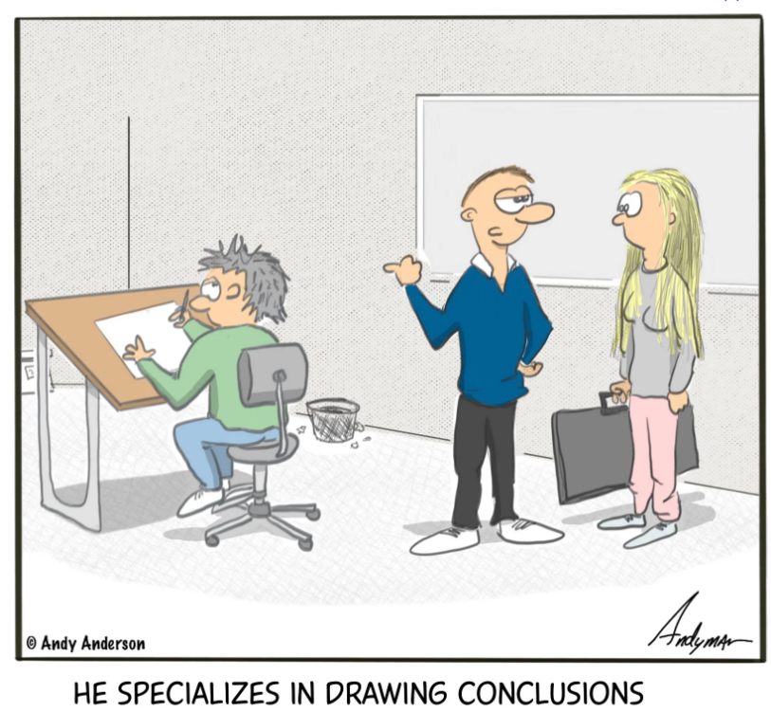
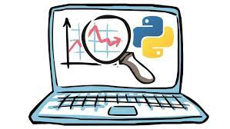
Key ideas for data analysis in the classroom
Notes:
2) Key ideas
Showcase the most important aspects of the topic that you consider to be key for a meaningful instruction
Need to collect lots of data establish some relationship.
Keeping track of uncertainties. Difficult in high school (time constraints) to properly use uncertainties and error bars.
Good experimental design is needed in order to collect relevant data.
Appropriate visual representation of data or results

Slide 4
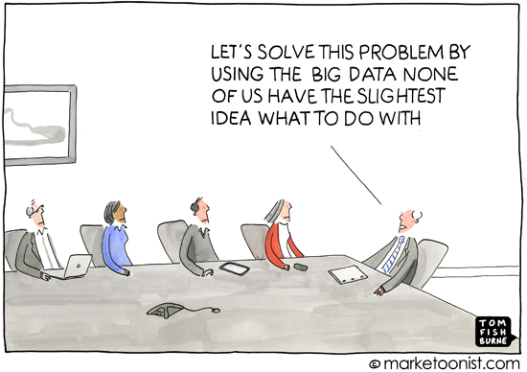
The not so easy side of computing and data analysis
Here are a few challenges for our students:
Identifying appropriate data analysis techniques
Using software like Excel to help create data tables, graphs, slopes, etc.
Noise reduction
Notes:
Identifying appropriate data analysis techniques (for example: graphing, finding slopes and equations, statistics, etc)
Using software like Excel to help create data tables, graphs, slopes, etc. (time for teaching these skills must be accounted for during the first few labs)
Noise reduction (Improper procedures to subtract out the noise in data can lead to a false sense of accuracy or false conclusions.) We are using “noise” in the broader sense here, and could refer to unwanted data. Compare the hardware and software trimming that is done at CERN to the much simpler “trimming” we may do in class such as ignoring not linear parts of a graph, or an outlying data point.

Slide 5
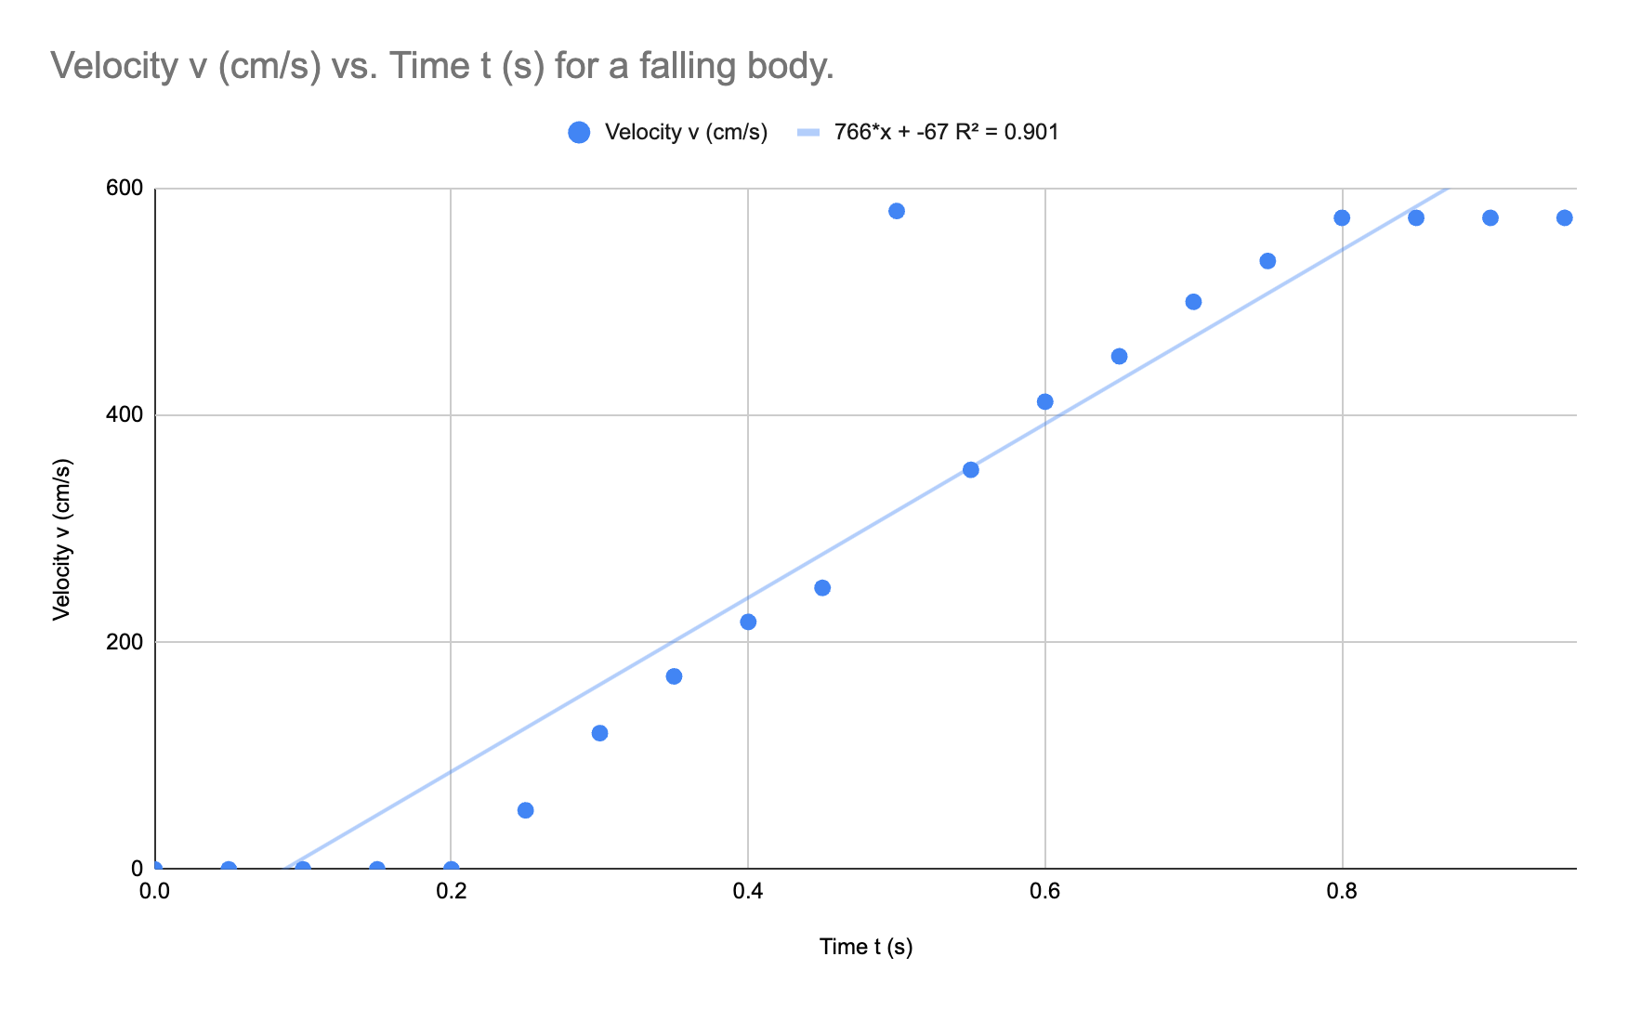
Example from a past student of Eric’s:
(Don’t worry, the student was severely punished!)
Notes:
Notes:
Here the student should have applied a “trigger system” here, and discarded the end ranges here, and the one outlier. This would have brought g to 975 instead of 766 cm/s^2

Slide 6




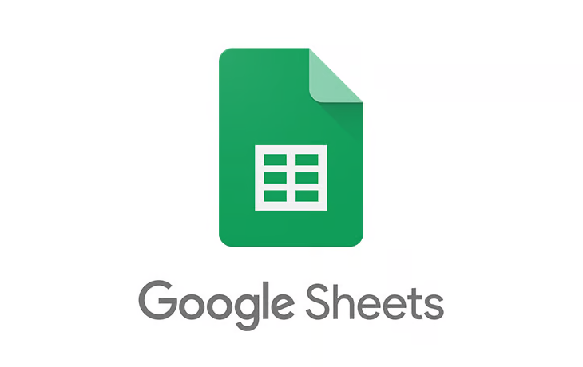
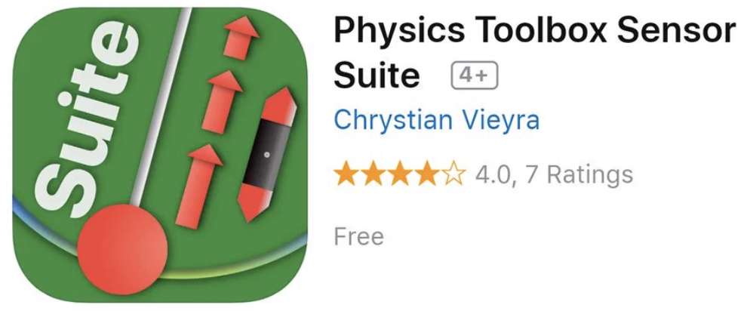
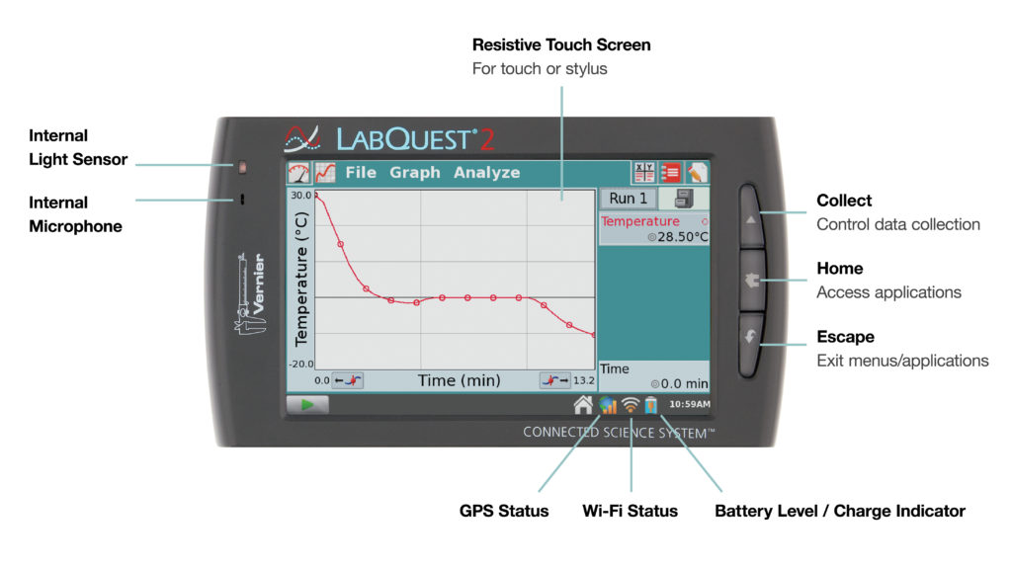
Useful resources to address some data analysis challenges
Notes:
4) Helpful material and resources
Reference any material that you find useful for your students and/or your colleagues
Apps: Phyphox, Physics toolbox
https://opendata.cern.ch/
Software: Excel, Google sheets, Tracker, TopCat

Slide 7
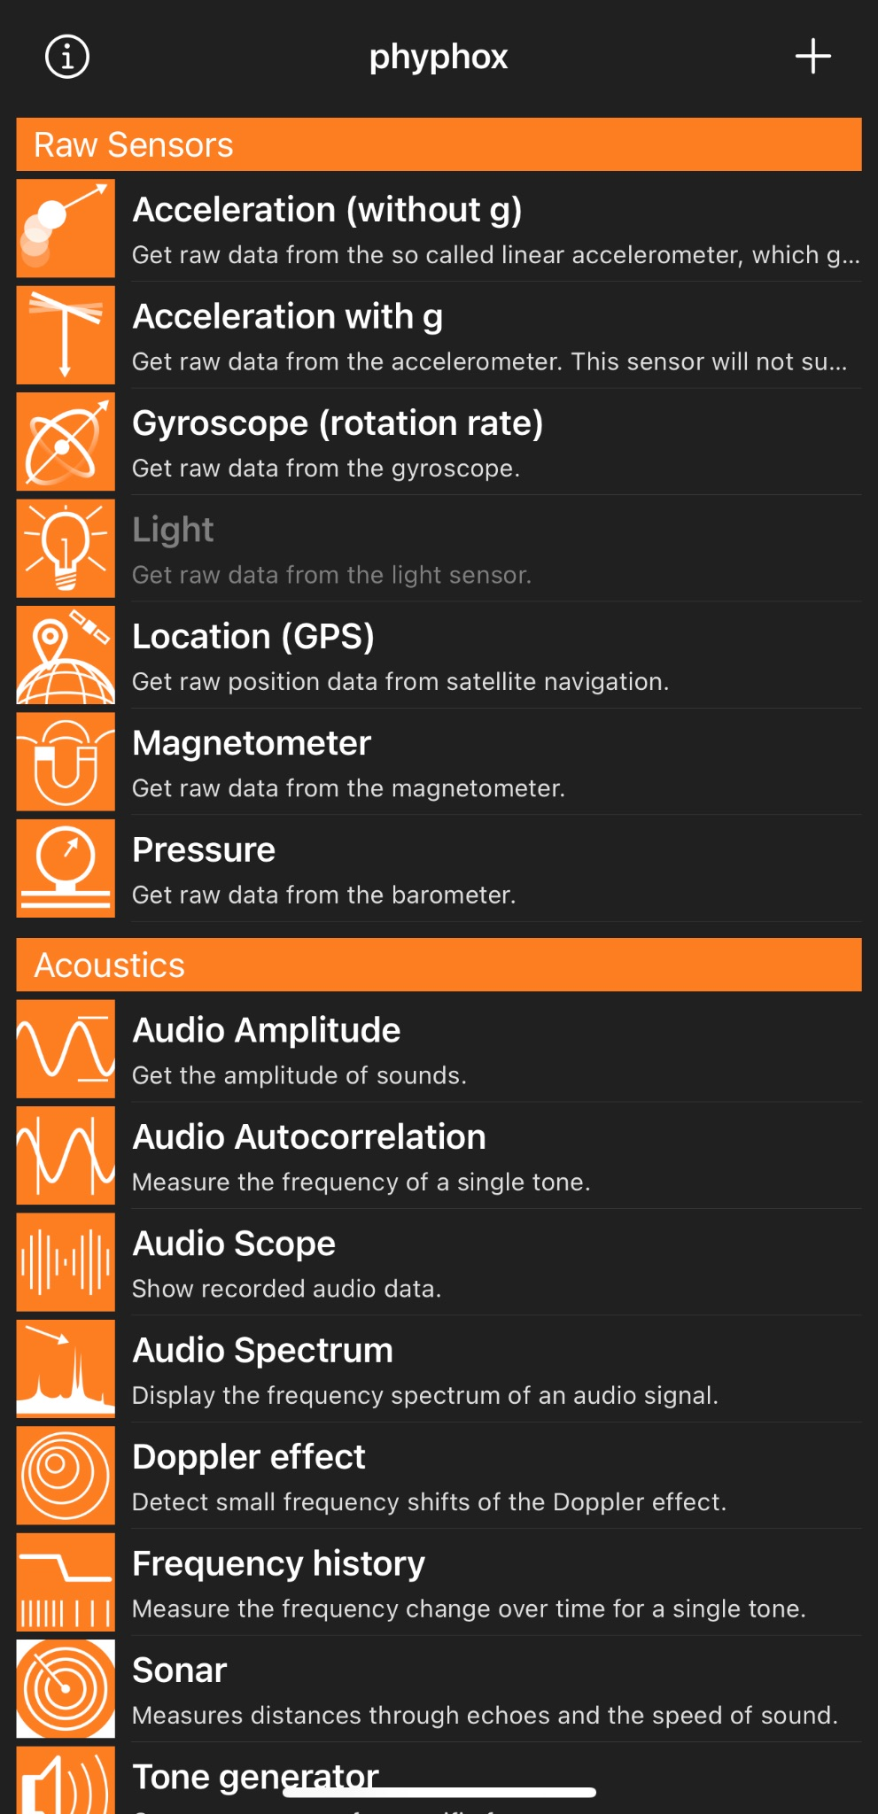
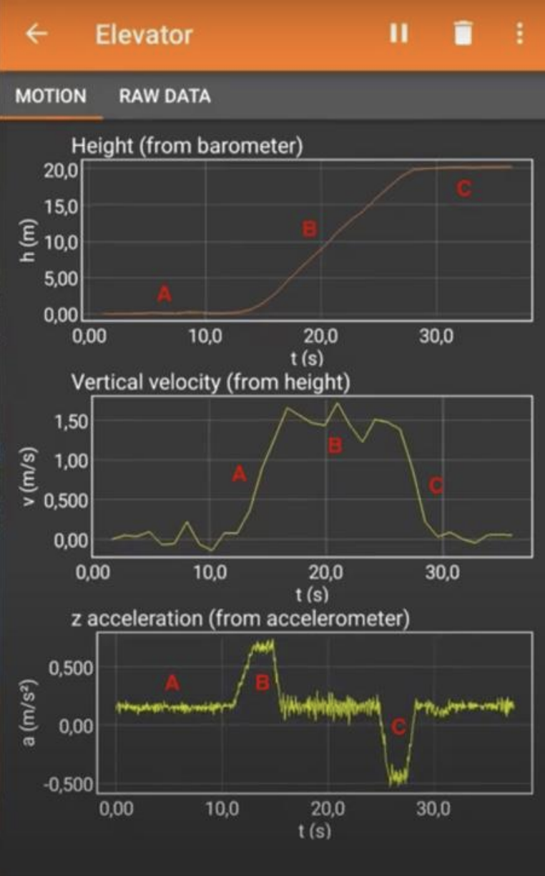
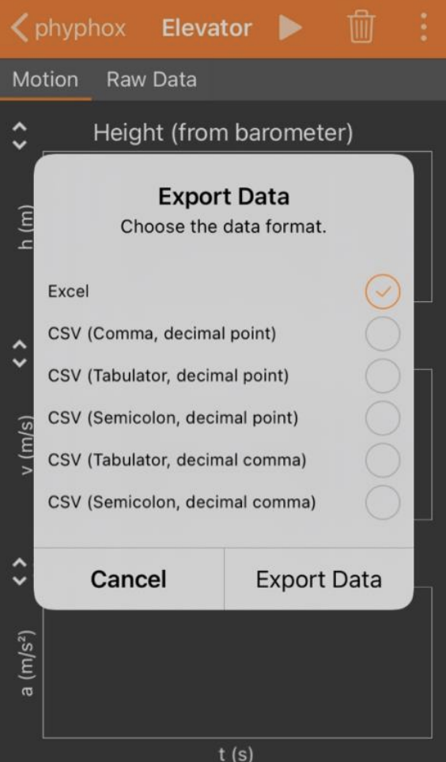

Slide 8
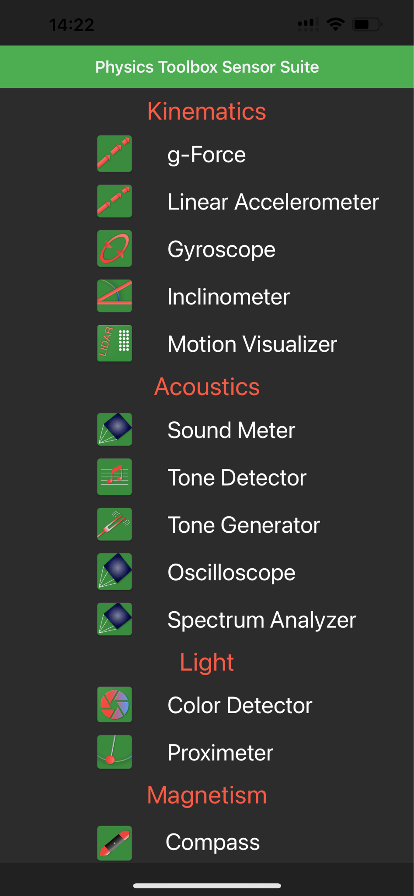
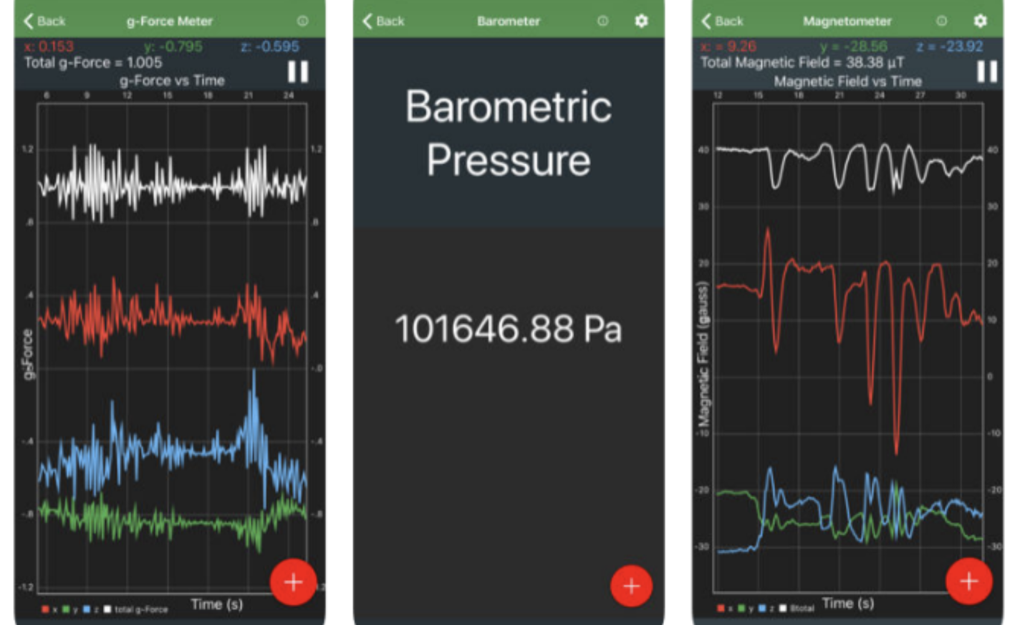

Slide 9
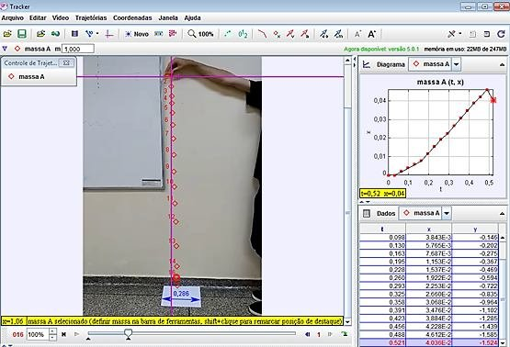
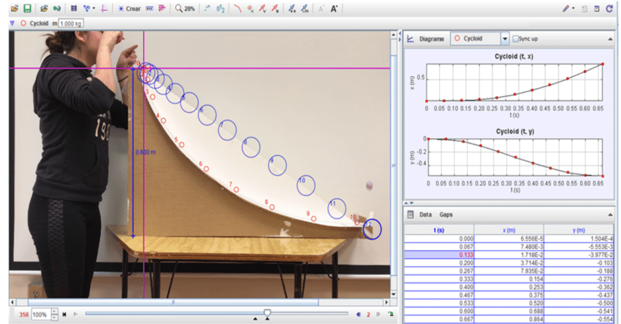
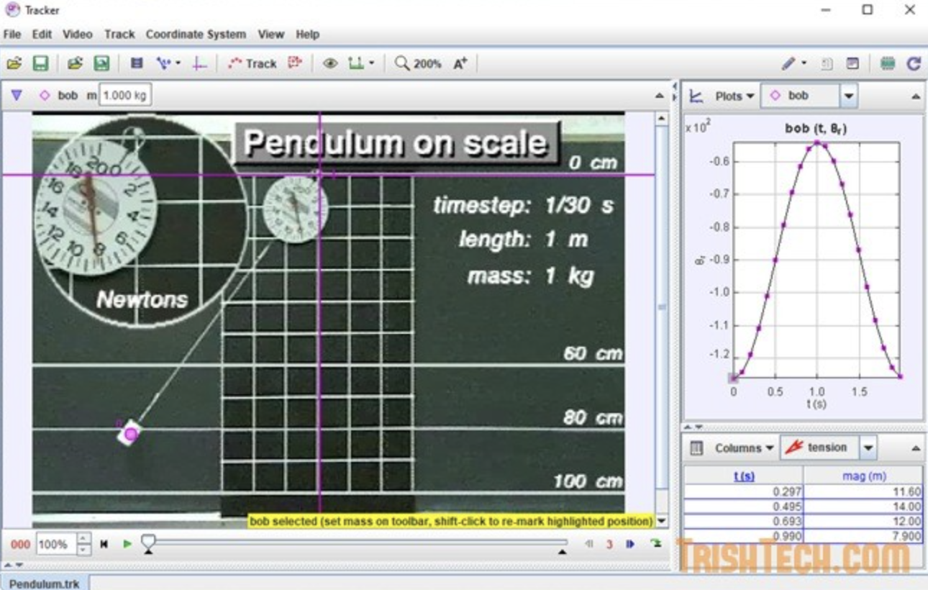
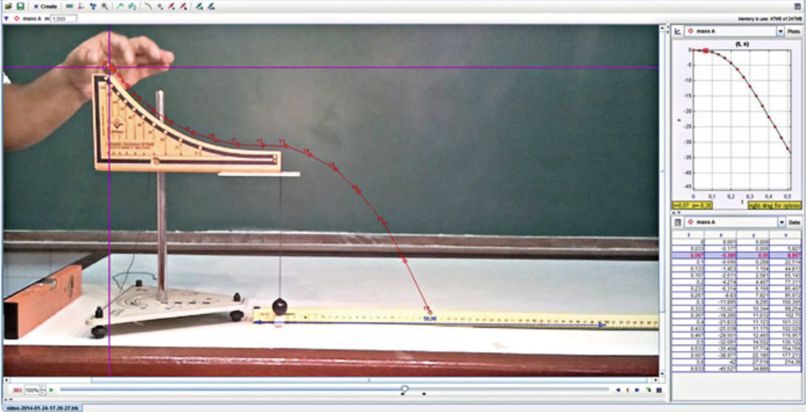

Slide 10
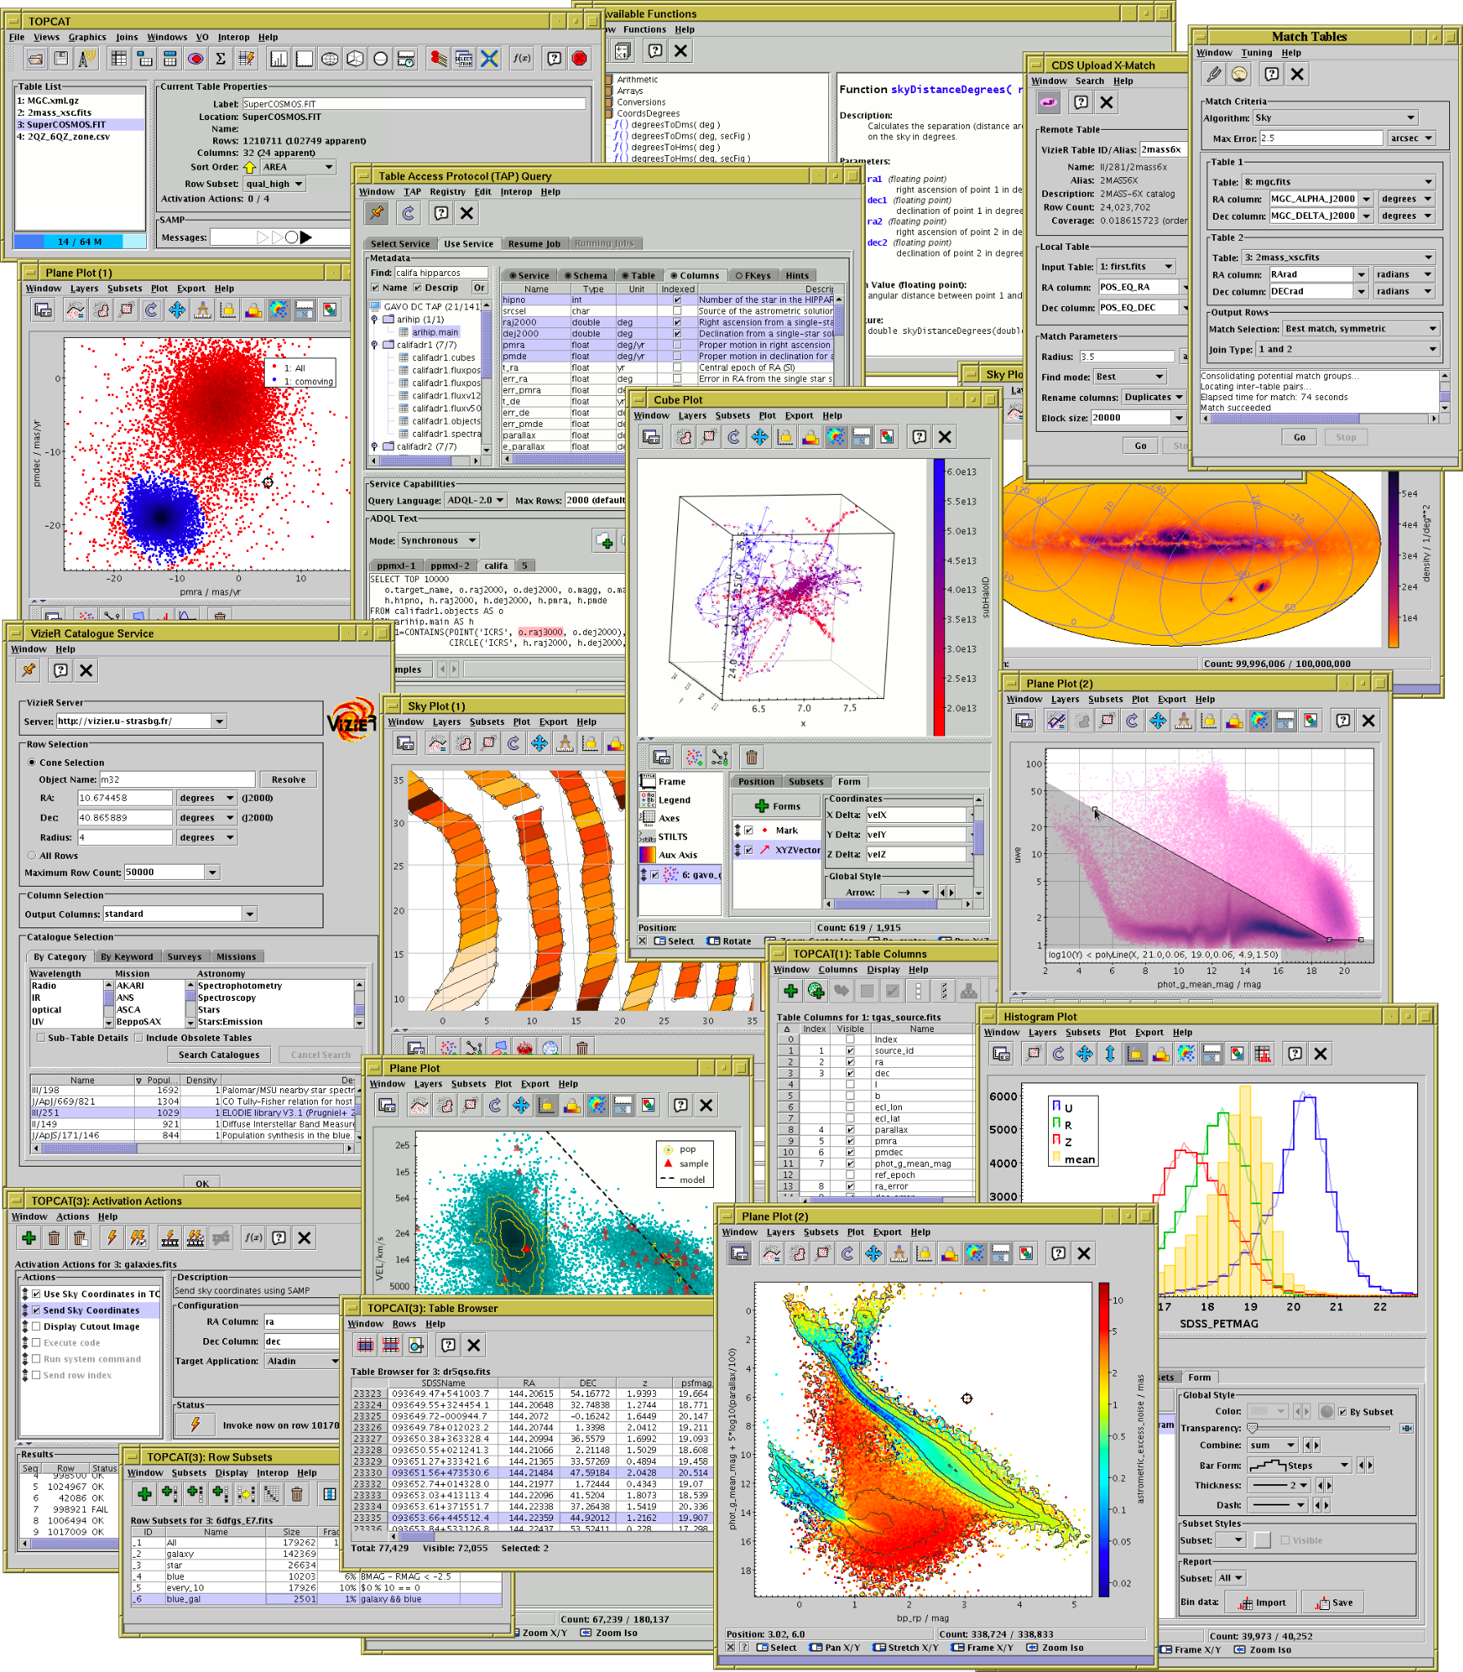
Tool for OPerations on Catalogues And Tables

Slide 11
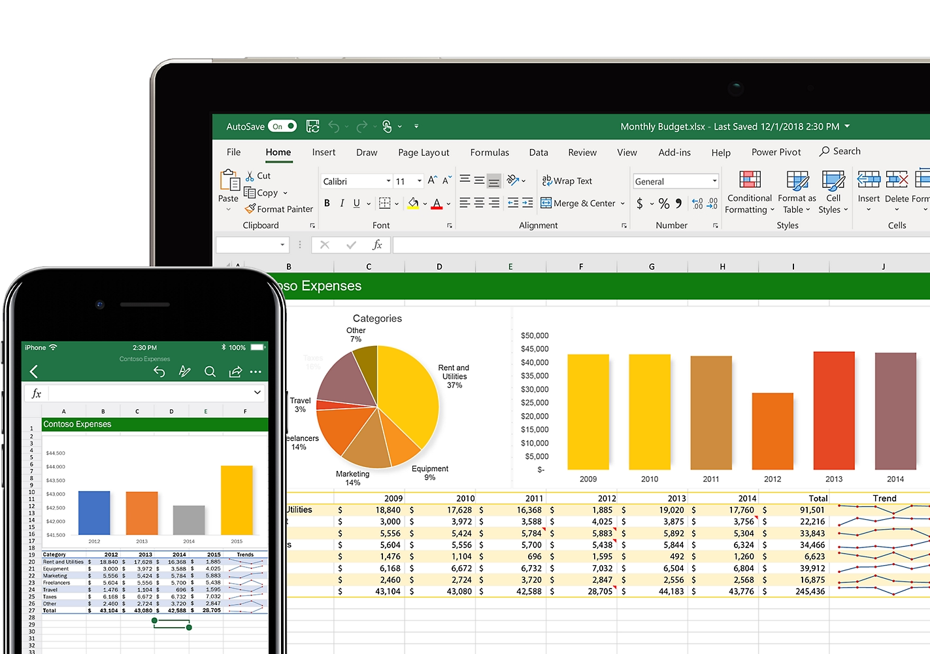
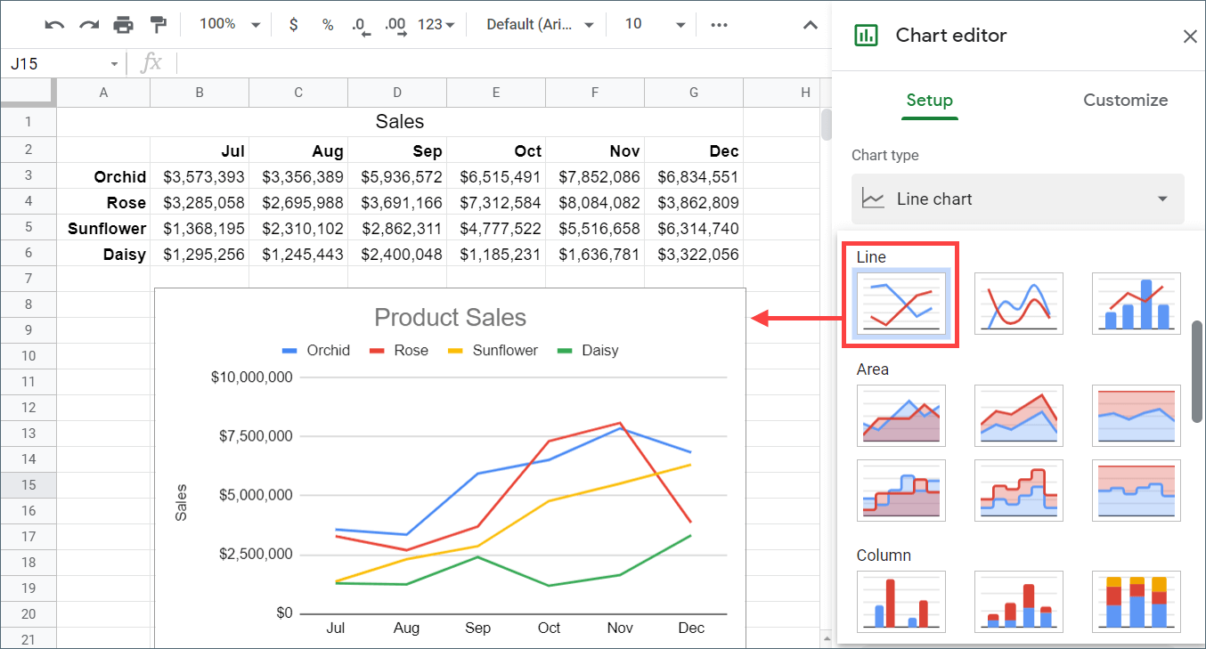

Slide 12
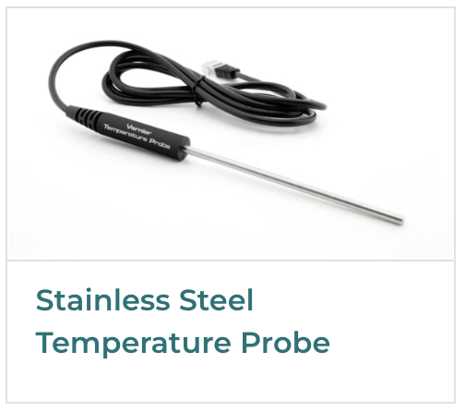
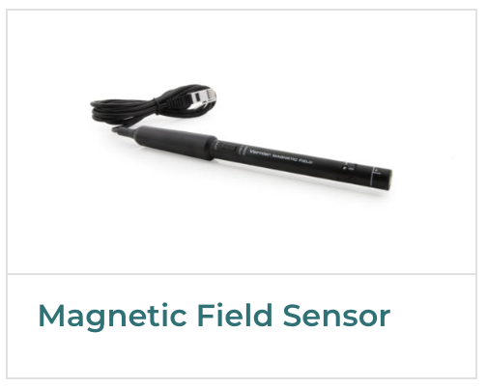
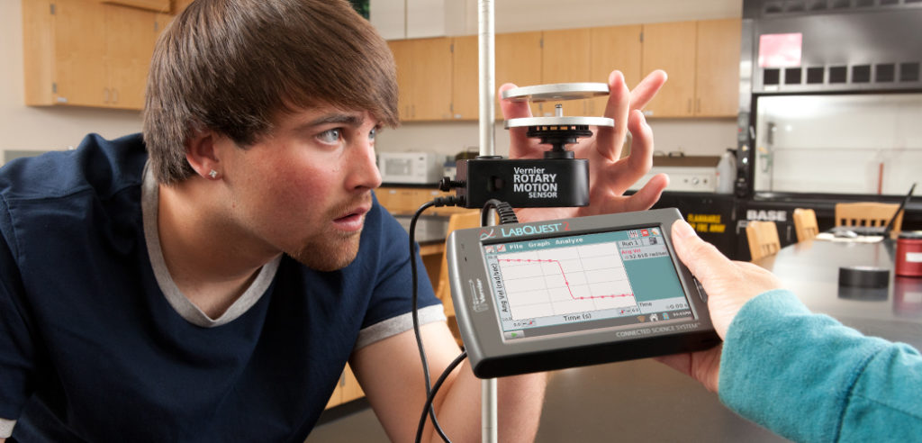
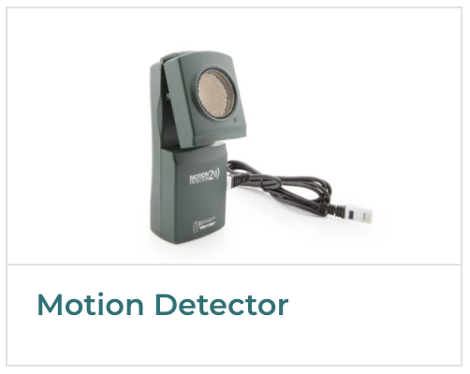
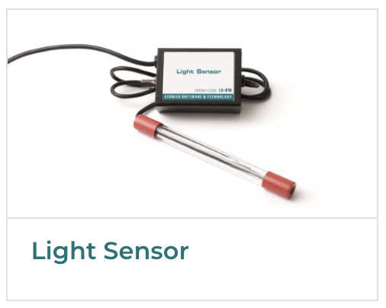
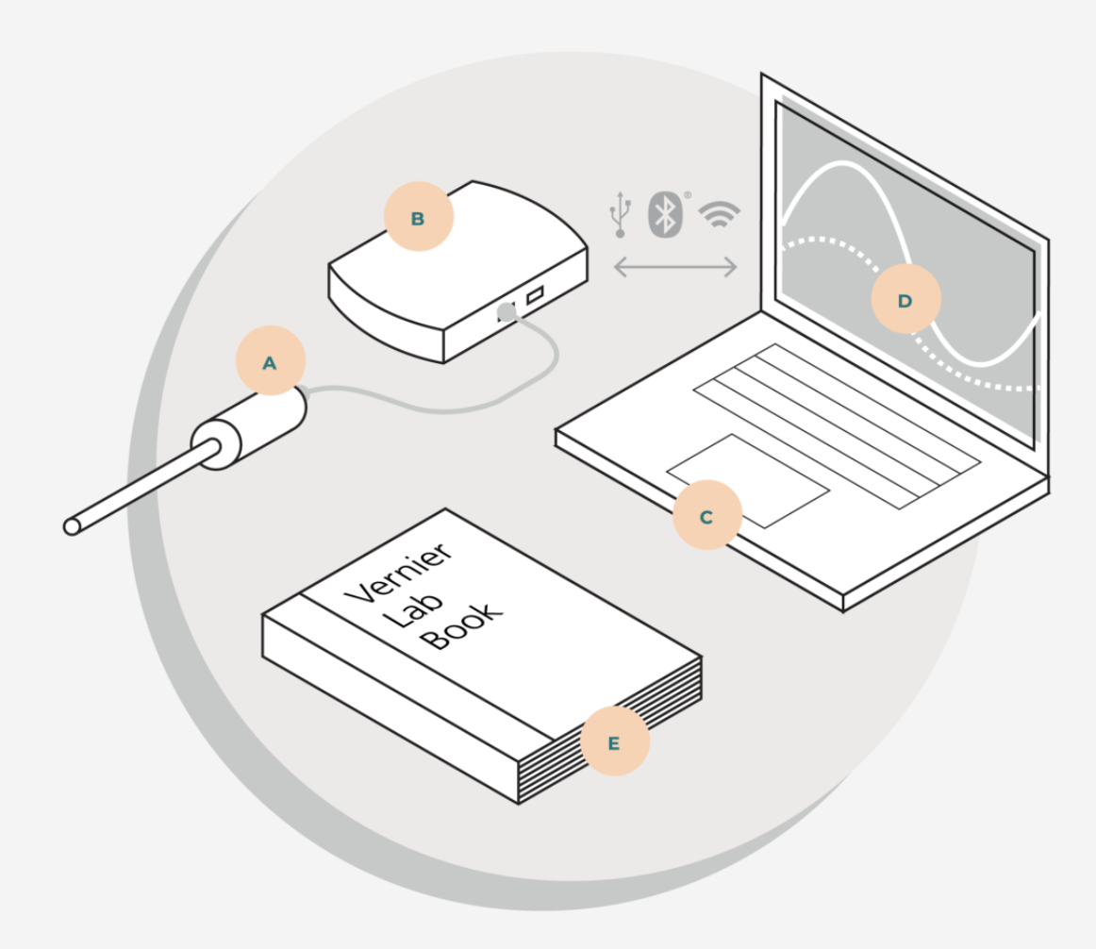
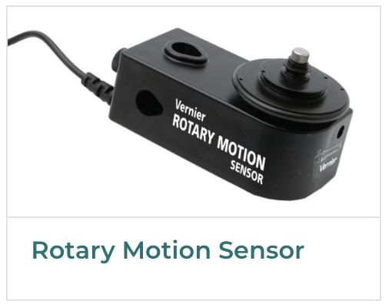
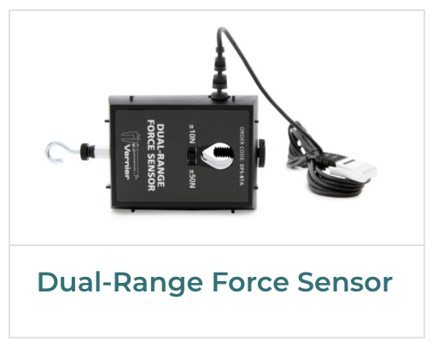

Slide 13
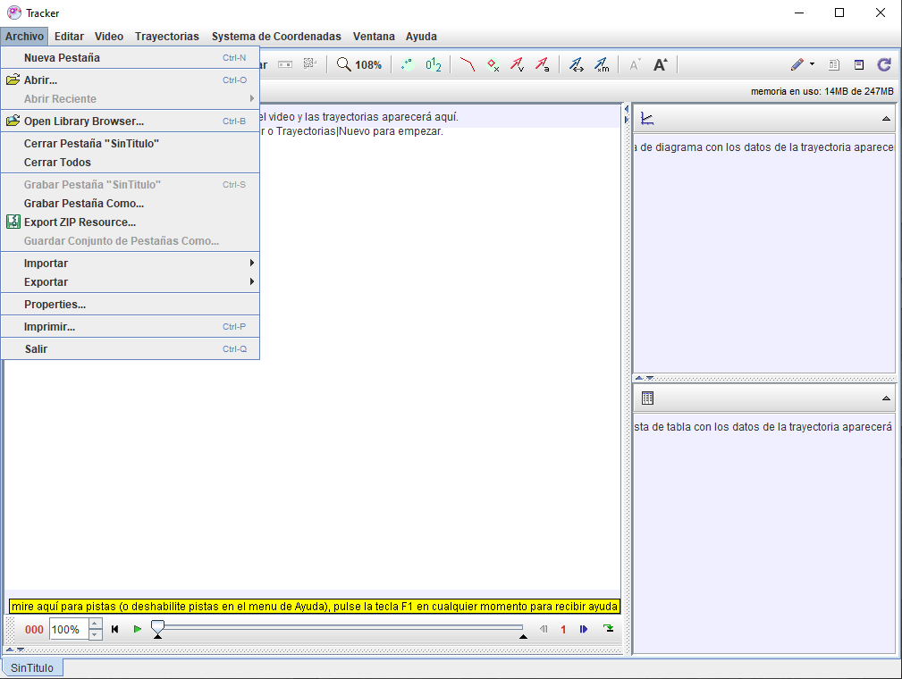
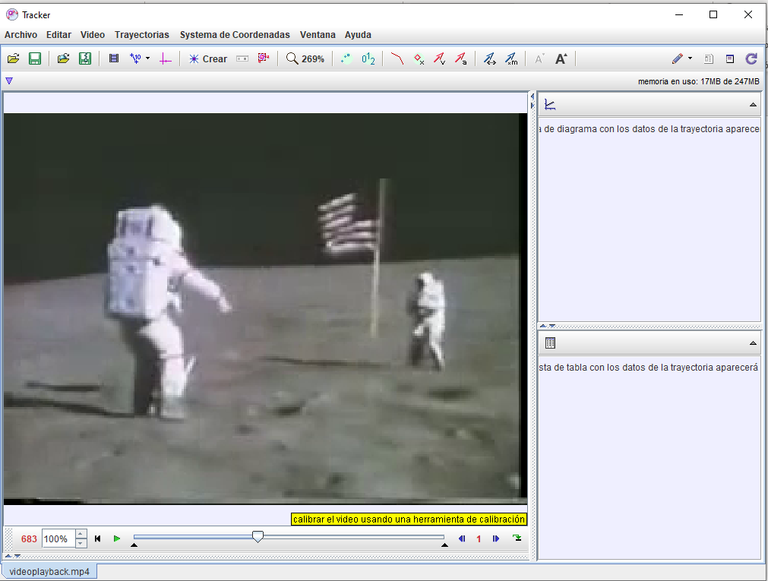
Using
at class
Open and upload a video you want to track. Define frames.

Slide 14
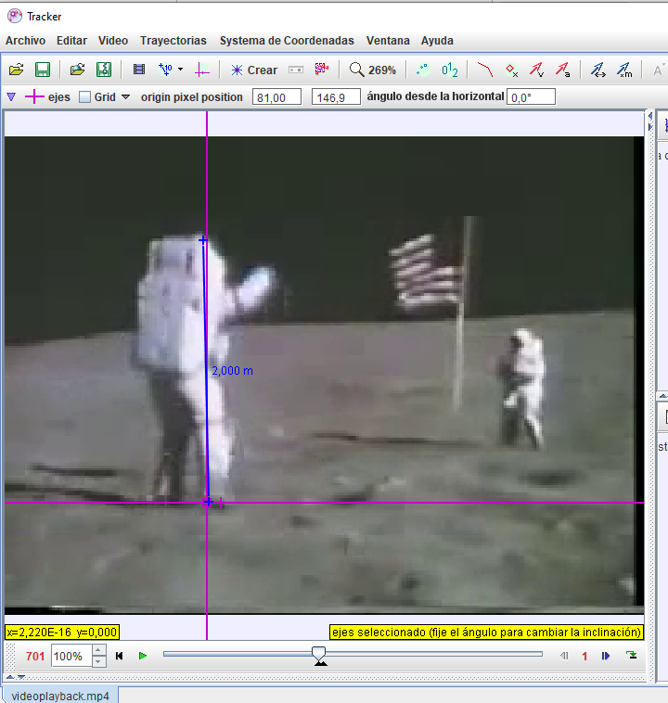
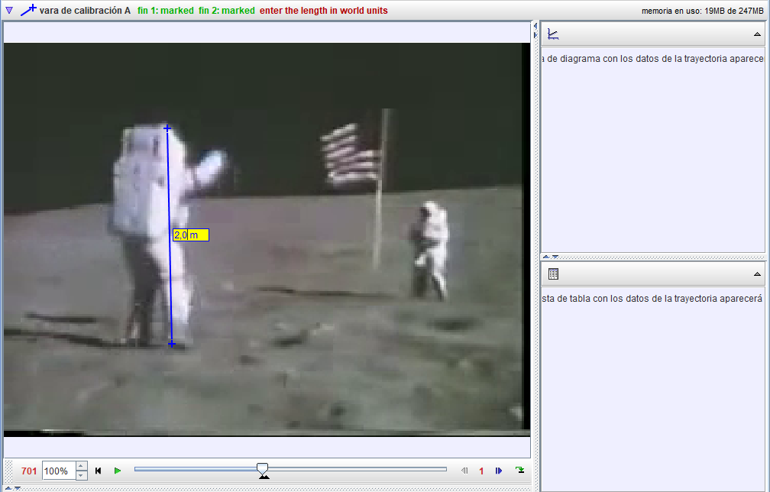
2. Add calibration bar. Define x and y axis

Slide 15
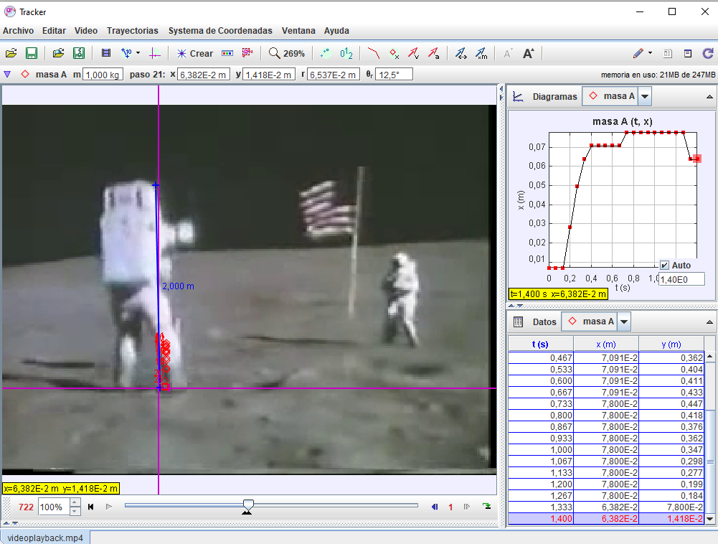
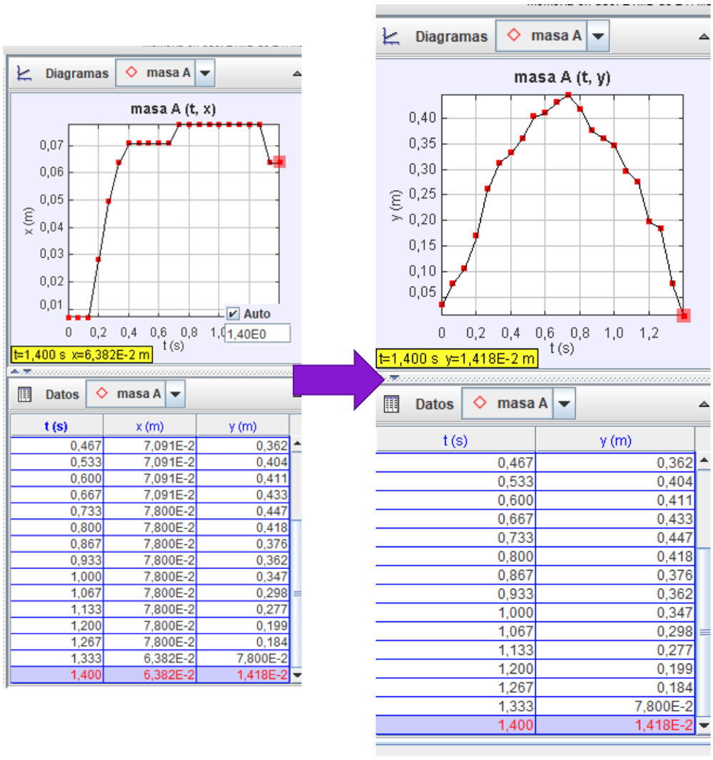
4. Data processing
3. Track

Slide 16
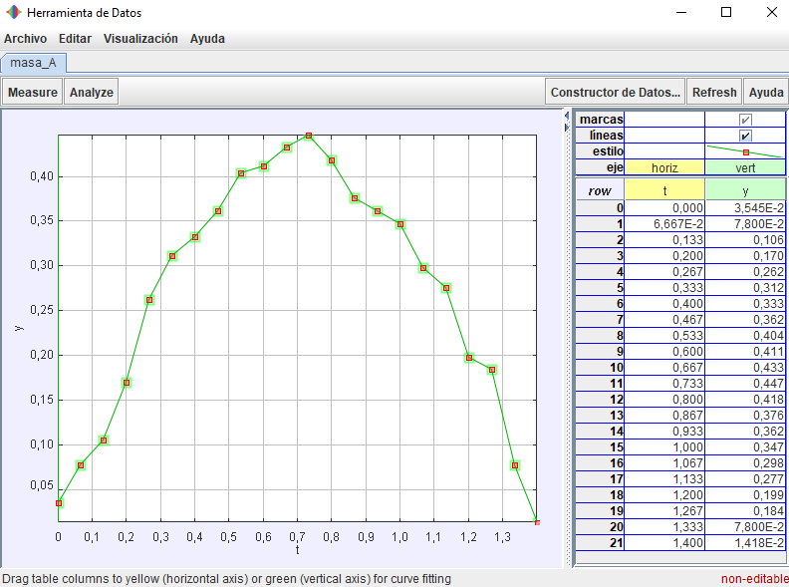
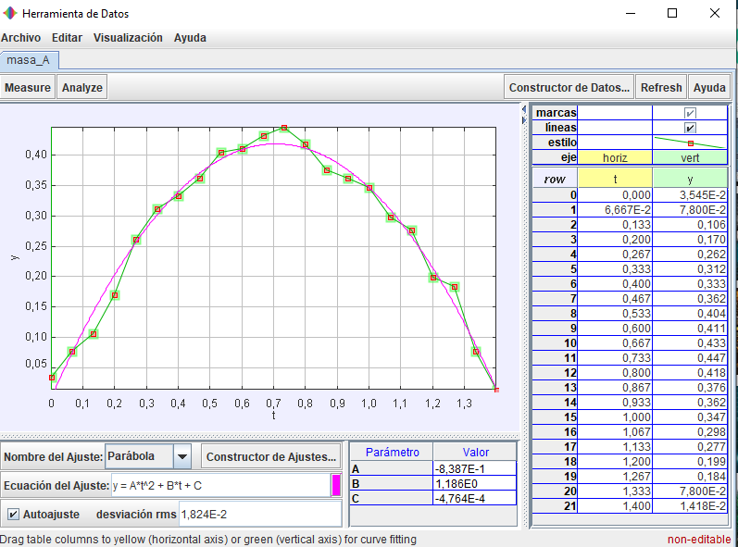
5. Analyse
y = y₀ + v₀t + ½ g t²
Moon’s gravity (experimental value): 0,08387 *2 = 1.677 m/s²
Moon’s gravity (theoretical value): 1.625 m/s²

Slide 17



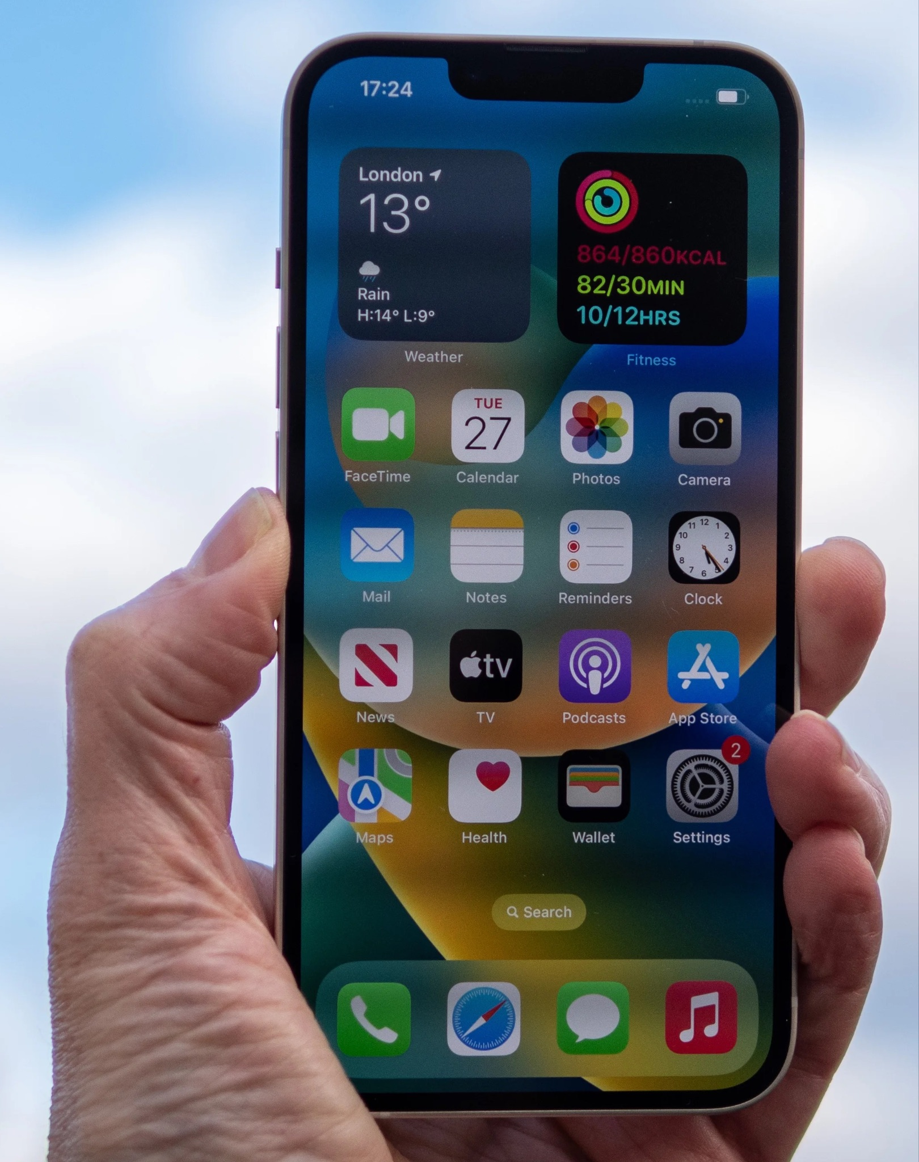
Best practice example - Law of Radioactive decay
Notes:
5) Best practice example
Summarise your findings through a brief outline of an instructional strategy
Including:
Peer review: examples: comparing each other’s data
Noise reduction could include: averaging across one data set (such as a “rough” plot of digital data), or averaging multiple results from different lab groups or classes.

Slide 18
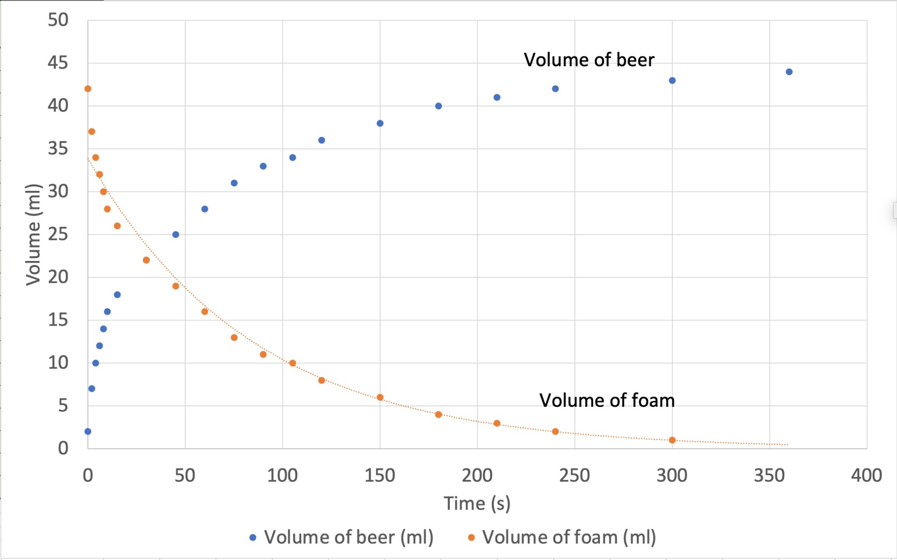
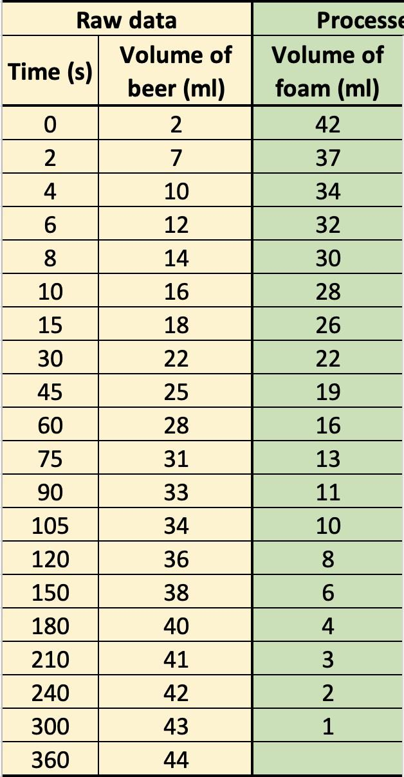
Data collection and analysis

Slide 19
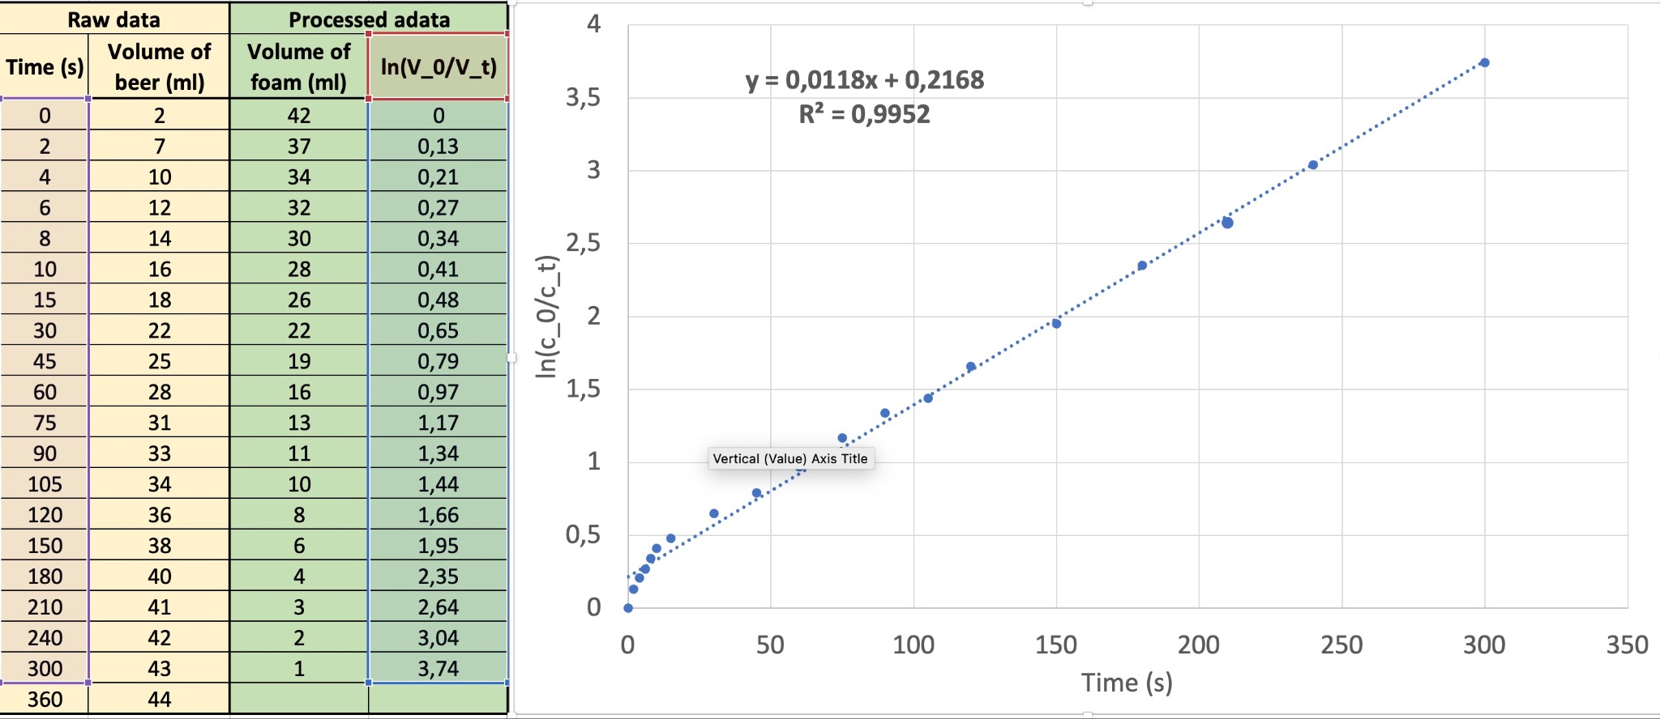
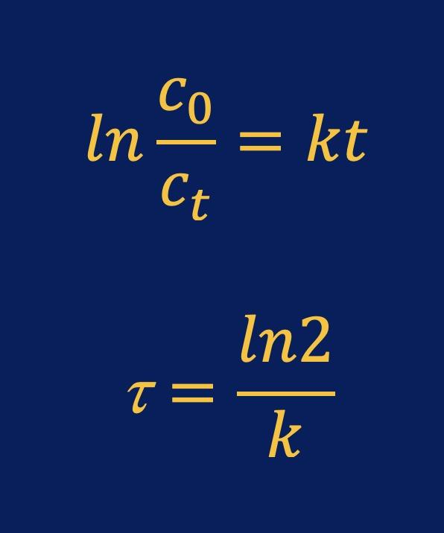
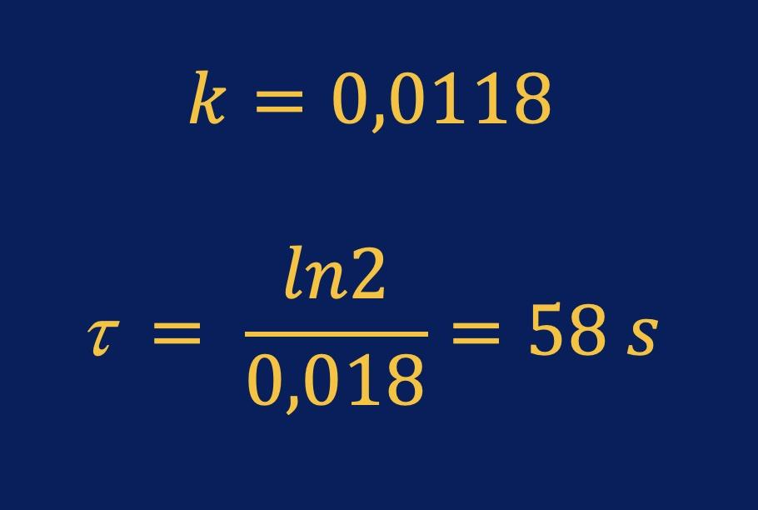
Advanced data analysis

Slide 20
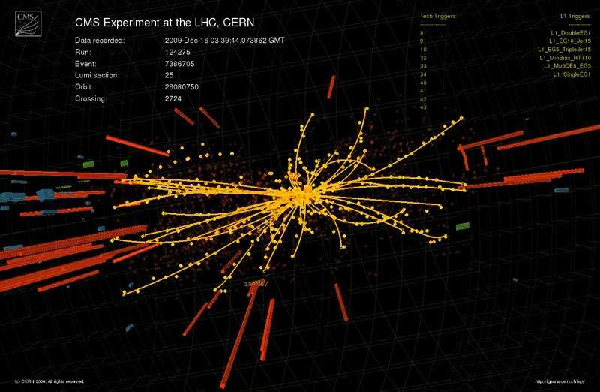
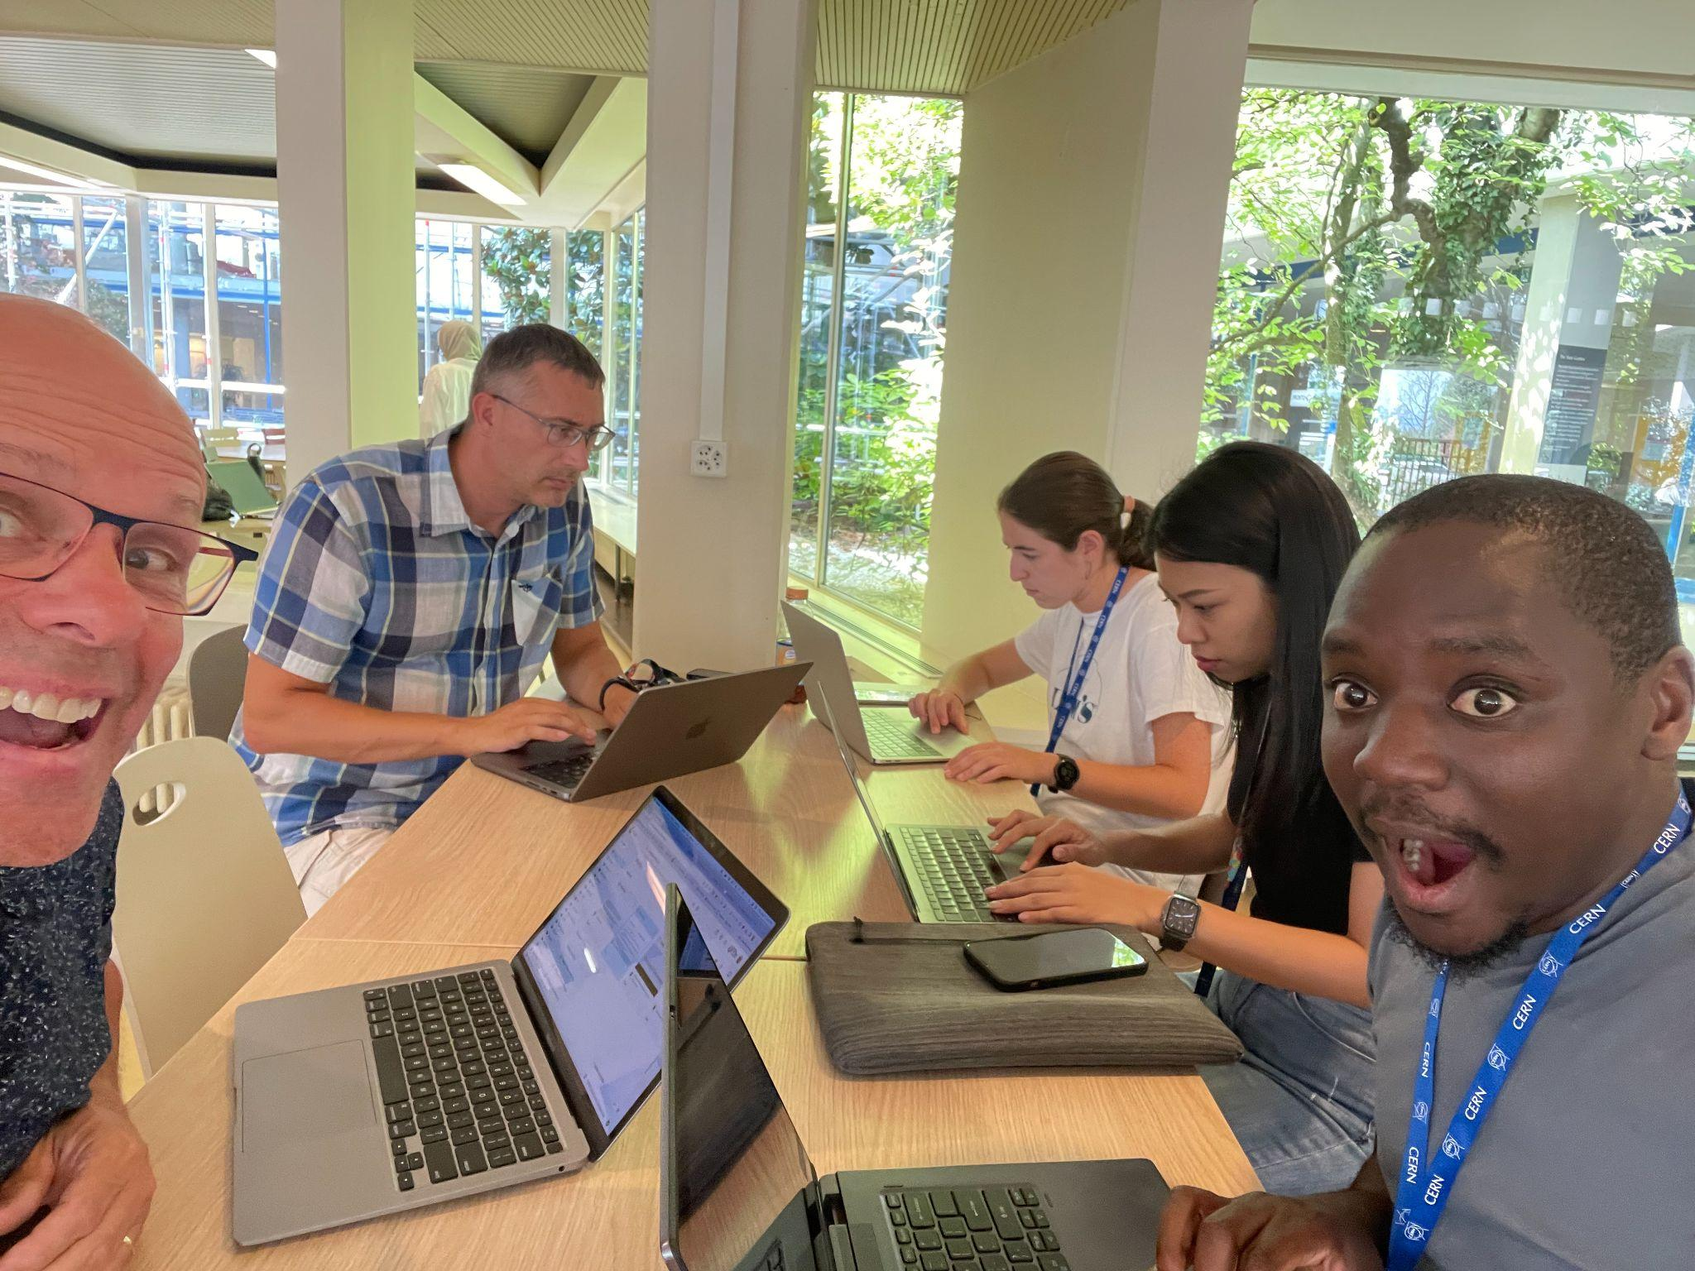
Thank you!

