Slide 1






Particle Accelerators
Hellen Federico Ragnhild Salman Greg

Slide 2

Agenda
Review our key takeaways about Particle Accelerators
Provide Appropriate Resources
Explain all components of the Accelerator Complex

Slide 3
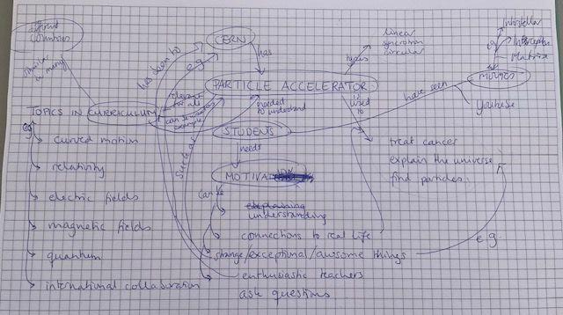
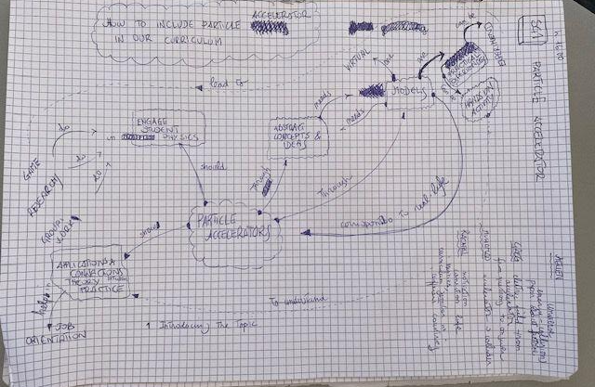
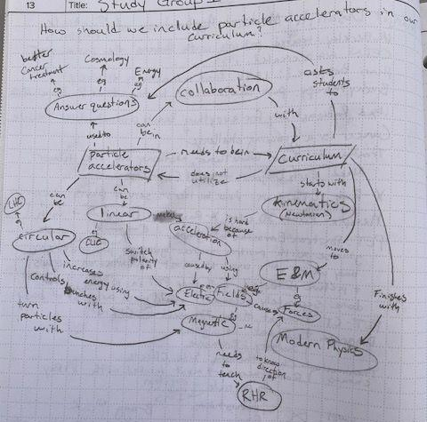
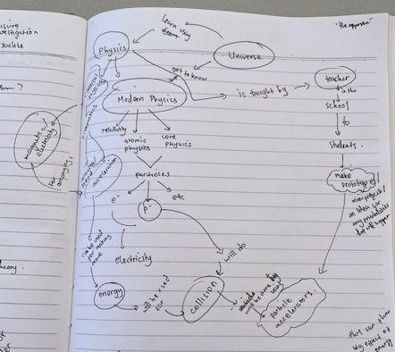
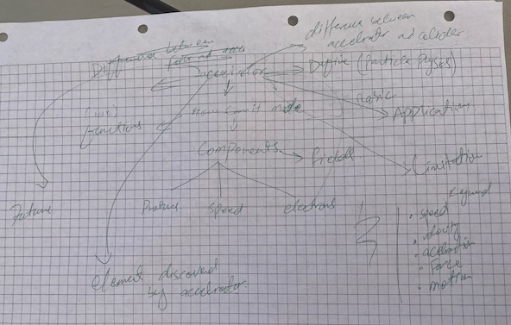
Particle Accelerators Through Concept Maps

Slide 4
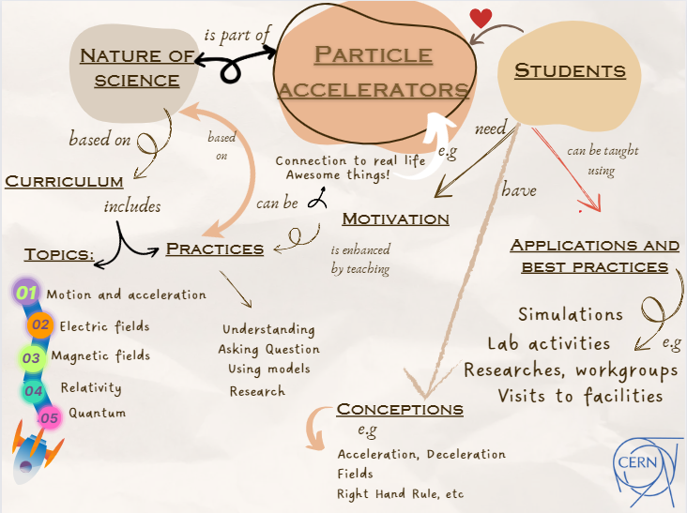

Slide 6
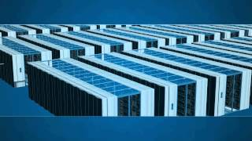

Best Practice: Use Particle Accelerators as a Example in Each Topic of the Curriculum
Kinematics:
Have students Ask Questions about LHC animation
  Velocity, Acceleration, Deceleration
Circular Motion:
Model a cyclotron with force probe and lengths of string

Slide 7
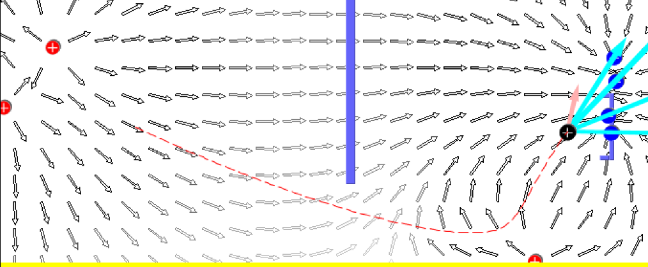
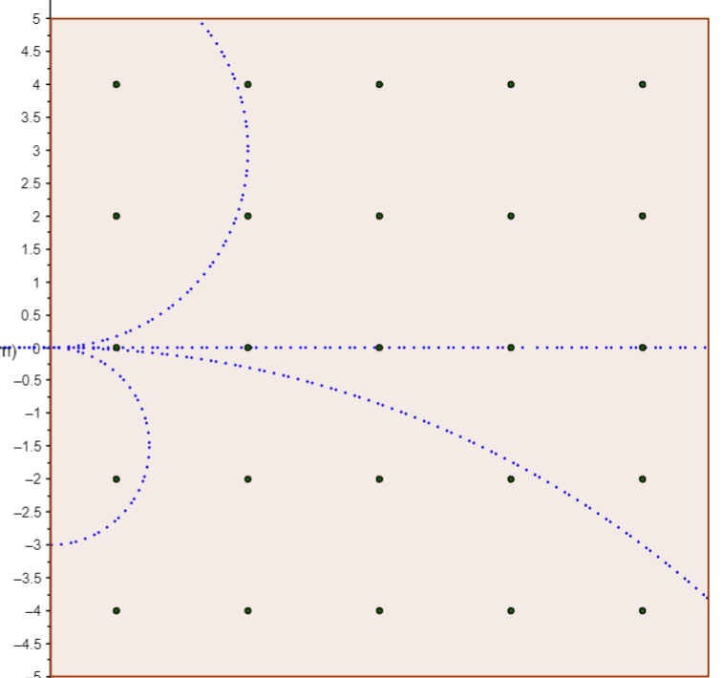
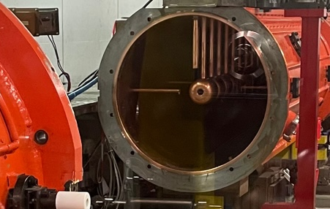
Best Practice: Use Particle Accelerators as a Example in Each Topic of the Curriculum
Electric Field:
Focus on Accelerating charges, not static
Magnetic Field:
Identify particles by their tracks to fill the LHC with the right particles
Waves:
Discuss radiofrequency cavity properties

Slide 8


Best Practice: Augmented Reality
acceleratAR can simulate particle accelerators
A Particle Source
Dipole
Dispersion
RF Cavity
Focusing Quadropole
FODO Cell
Materials:
Phone with AR app
printable cutouts

Slide 9
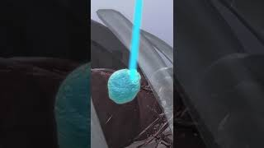
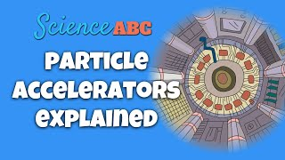
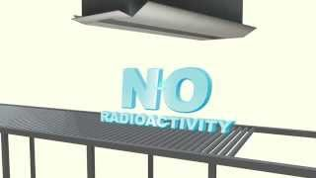
Best Practice: Visits to Facilities
Hospital - Department of nuclear medicine
Therapy via Bragg Peak L'adroterapia | Fisica e medicina
Diagnostic Technology Particle accelerators: why are they important
Factories
Material processing (semiconductors, …)
Preservation and Sterilization
Element analysis (geology, …)

Slide 10
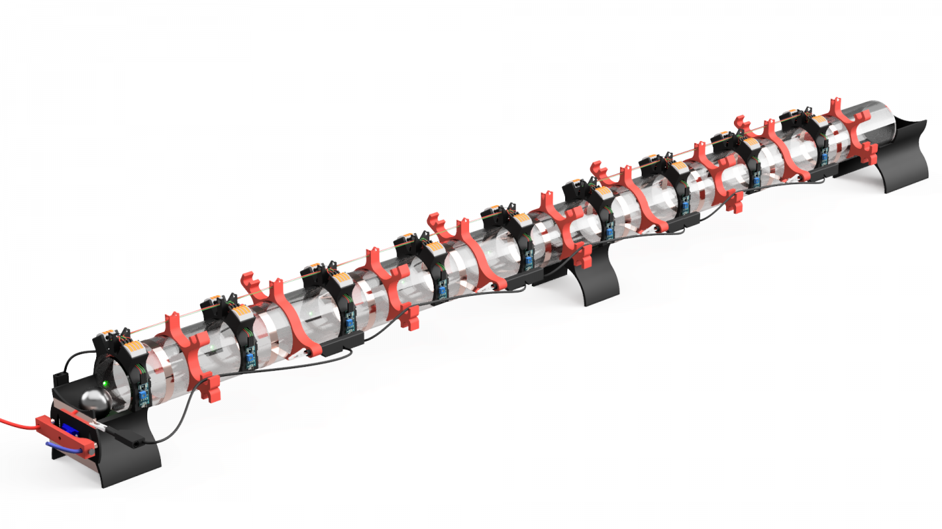
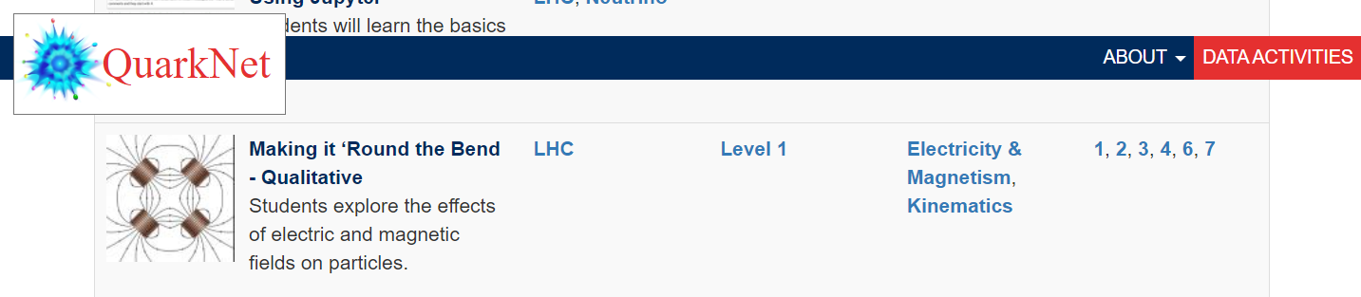
Helpful Material and Resources
CERN
  3D Printed Linac and other fun from cern.ch/per
  Applications of Particle Physics - CERN- 1994
QuarkNet: Making It ‘Round the Bend (Qualitative and Quantitative)
Great E&M Simulations like the Cyclotron
  PhET: Electric Field Hockey
  HTML5 Simulations for Physics
  Physics: E&M Simulations
  Physics Aviary

Slide 11
Agenda
Review our key takeaways about Particle Accelerators
Provide Appropriate Resources
Explain all components of the Accelerator Complex

Slide 12
References
CERN (2023). Physics Education Research. https://cern.ch/per
Duffy, Andrew. (2023). HTML5 Simulations for Physics. http://physics.bu.edu/~duffy/sims.html
Gilardoni, Simone. (2023). Intro to Particle Accelerators. ITW 2023.
Johnston, Karl. (2023). ISOLDE Physics. ITW 2023.
Muhammed, Sameed. (2023). Antimatter Research. ITW 2023.
Van Der Veken, Frederik. (2023). Feynman Diagrams, Lagrangians and Stuff. ITW 2023.
Vujanovic, Milena. (2023). Concept Maps. ITW 2023.
Wiener, Jeff. (2023). Particle Physics in the Classroom. ITW 2023.

Slide 13
Media Citations
https://cds.cern.ch/images/OPEN-PHO-ACCEL-2017-006-6/file?size=large
https://cds.cern.ch/record/2800984/files/CCC-v2022.png?subformat=icon-1440
https://www.youtube.com/watch?v=pQhbhpU9Wrg
https://www.youtube.com/watch?v=mlEABZVTge0
https://www.youtube.com/watch?v=gZEBE6cCOjM
https://www.youtube.com/watch?v=vIeRLeQq7V4
https://www.youtube.com/watch?v=Tv4KreXY_RU
https://scoollab.web.cern.ch/linac3D
https://cms.cern/sites/default/files/field/image/LHC_and_mountains-0503019-1-nice.jpg

Slide 14
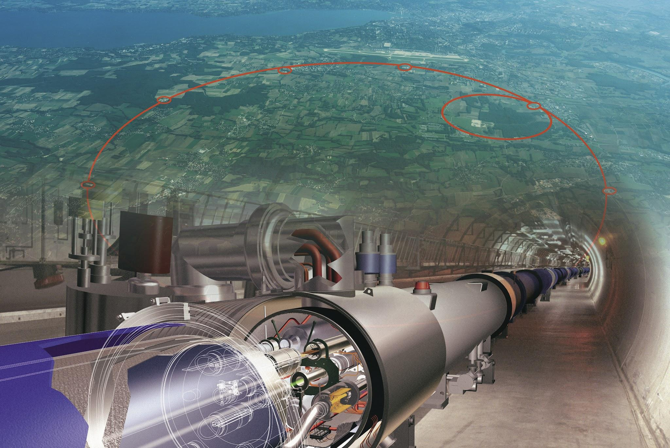
Thank You!
We look forward to your questions

