Slide 1

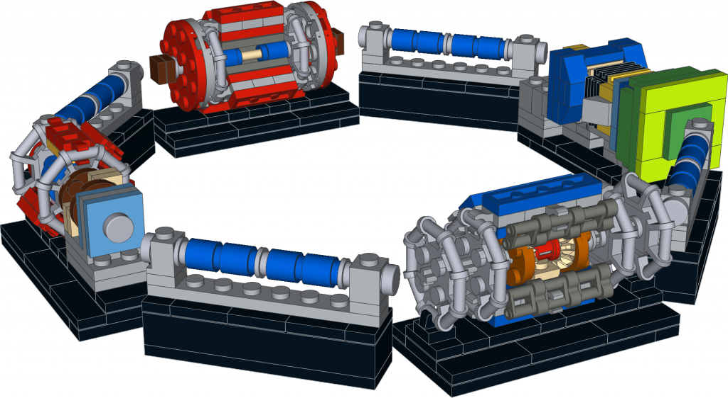
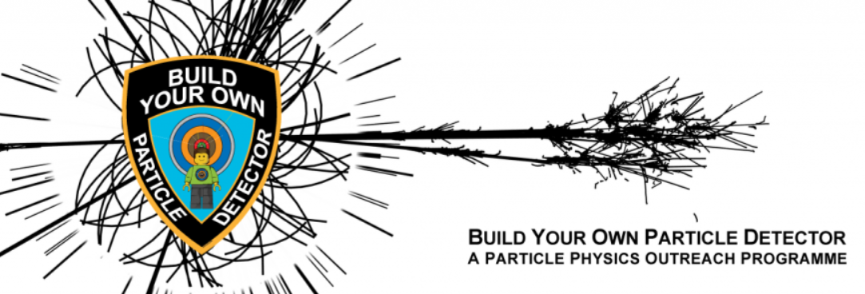
Lab workshop
LEGO detectors
Learn more about the different components of particle detectors.
Idea, models and Images by Nathan Readioff & Sascha Mehlhase
More information & files: https://build-your-own-particle-detector.org

Slide 2





We are your guides for this workshop
Who we are
School
Science
memory
My day at CERN
Let‘s get started!
What I like about CERN
Notes:
Name & Nationality
My first science memory
What I never liked about school
How a typical day looks like for me at CERN
What

Slide 3
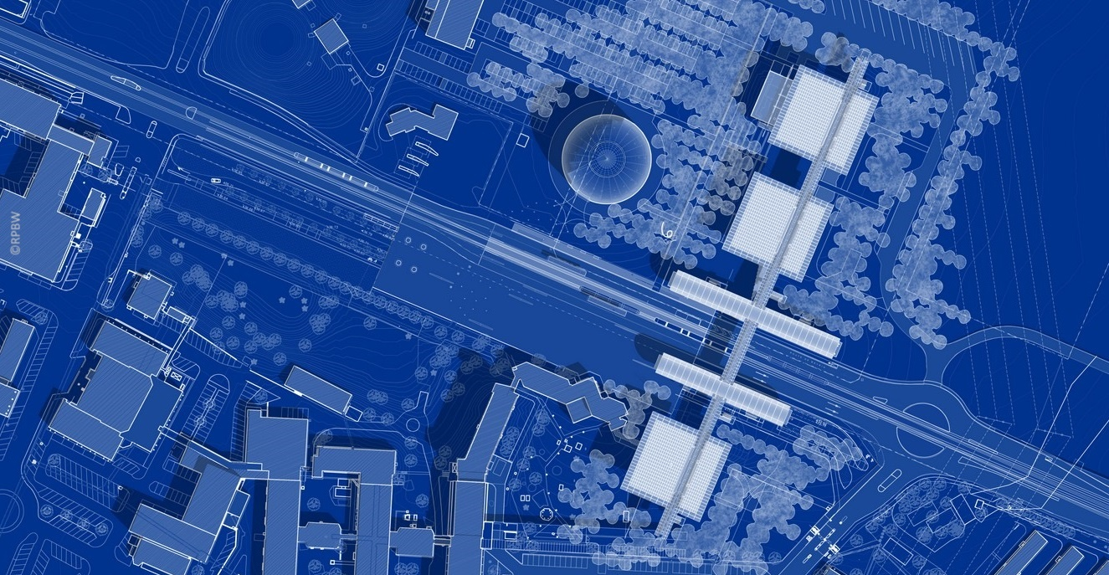
IdeaSquare
Science
Gateway
Auditorium
Globe
Reception
Shop
Restaurant
Labs
Exhibitions

Slide 4
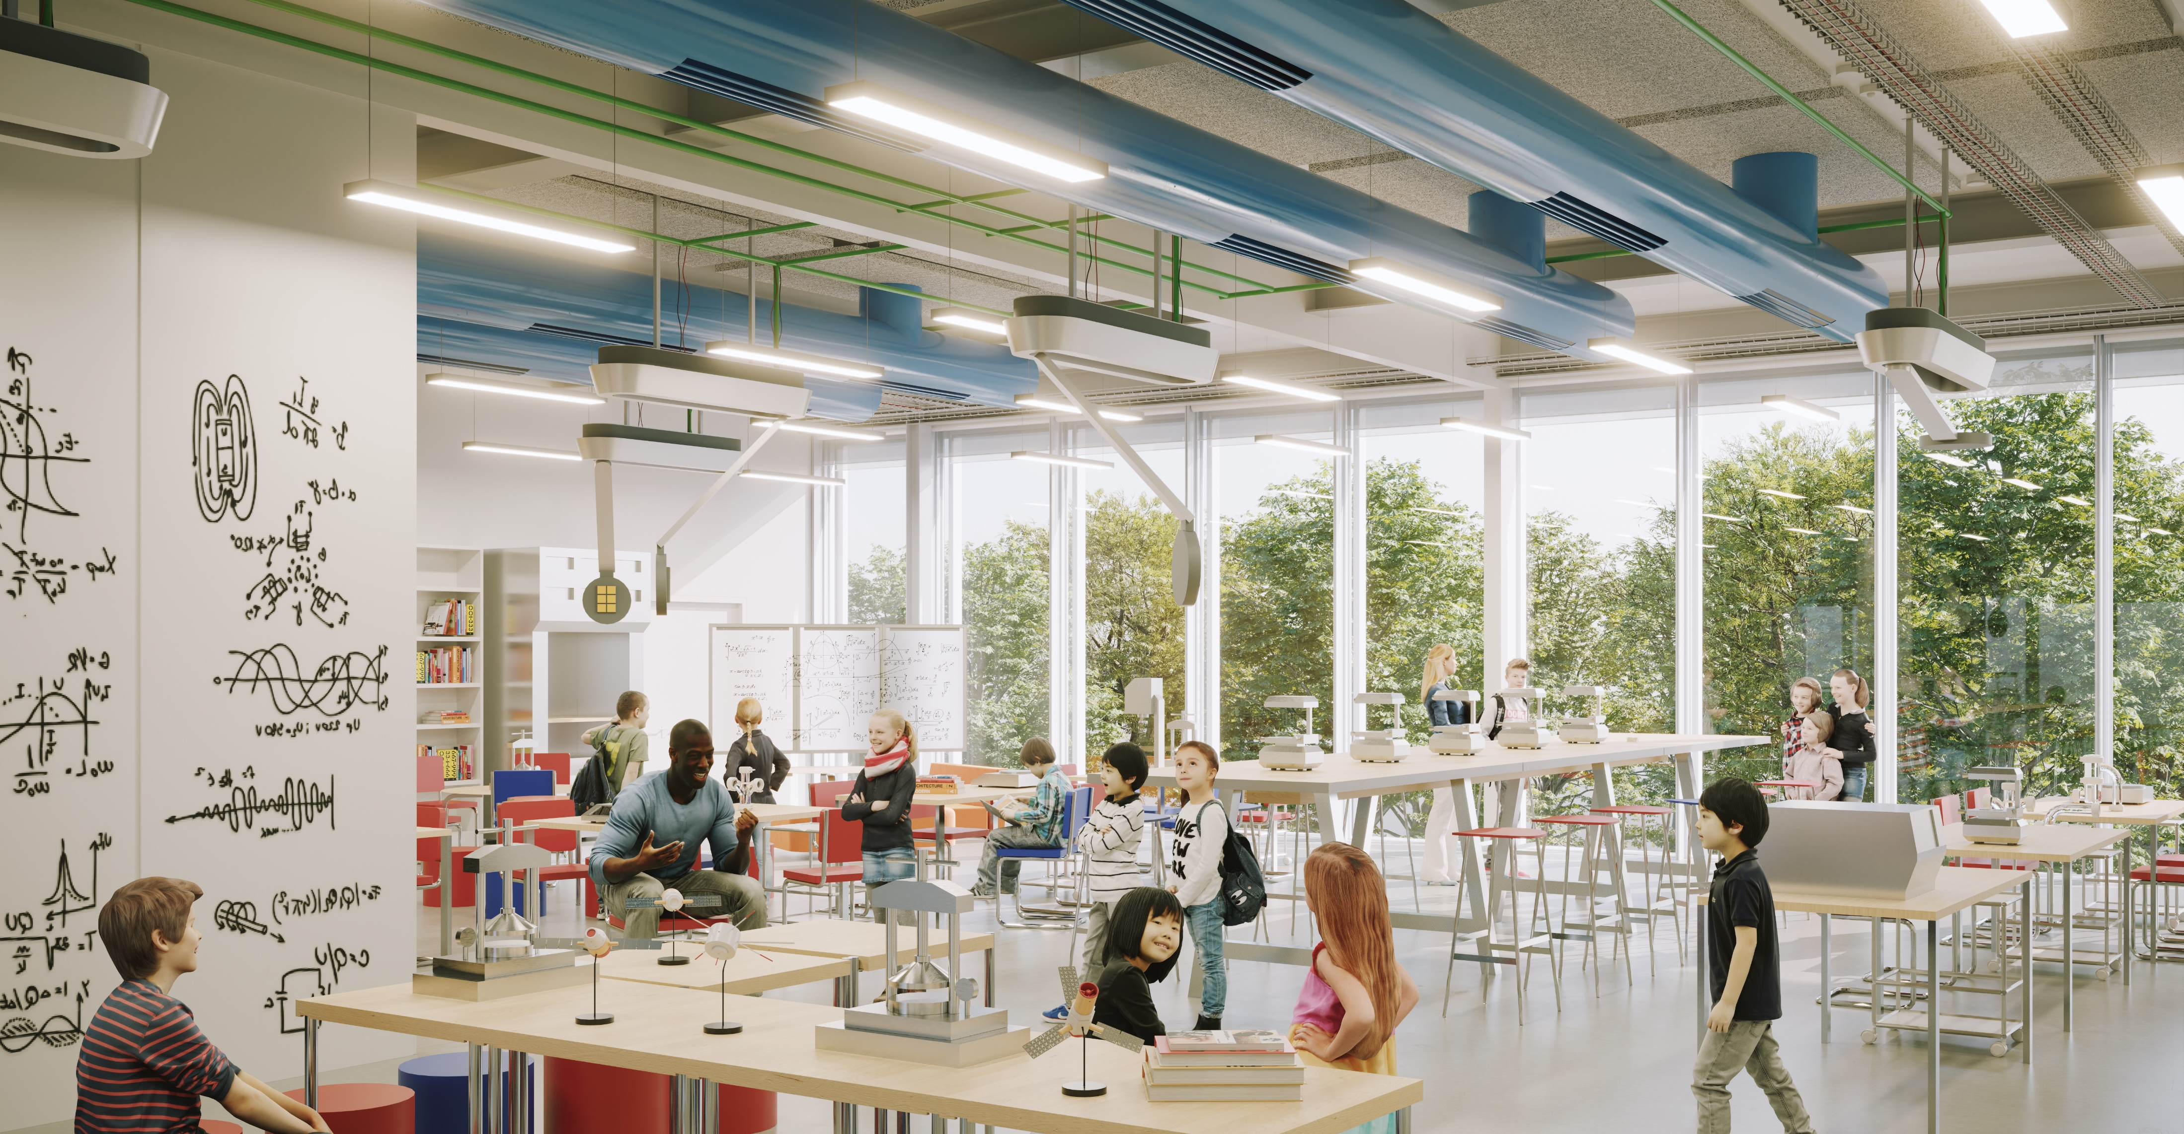
Labs

Slide 5
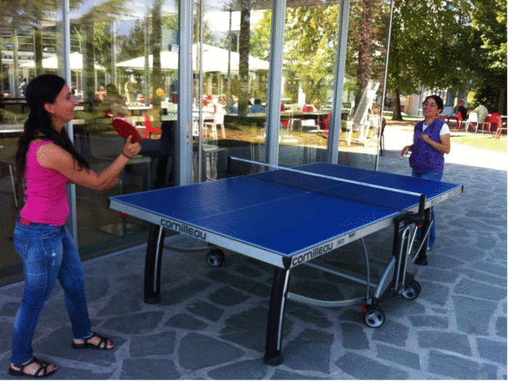
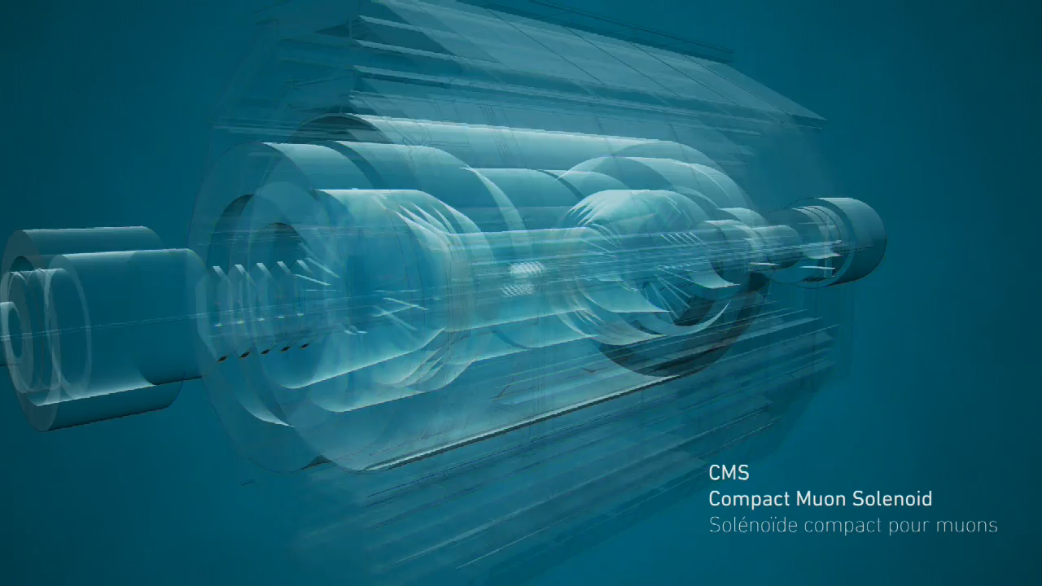
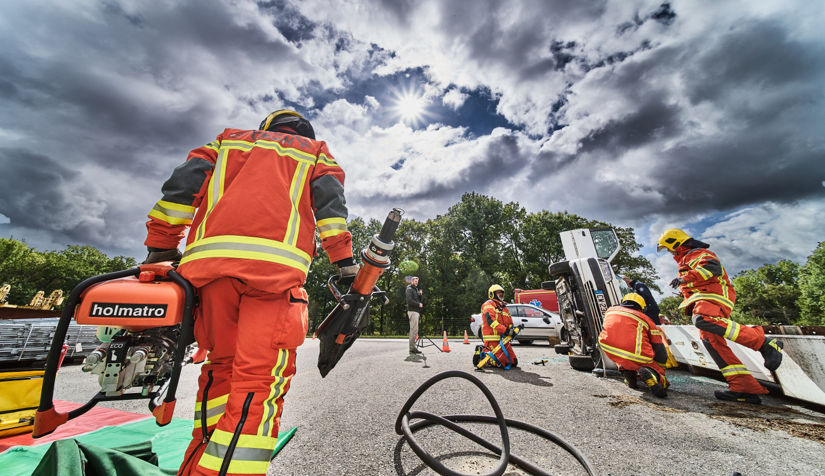

At CERN, scientists love collisions
1
Table tennis club
studying elastic collisions
3
That‘s what we need: E=mc² collision!
2
CERN firebrigade practising with inelastic collision

Slide 6
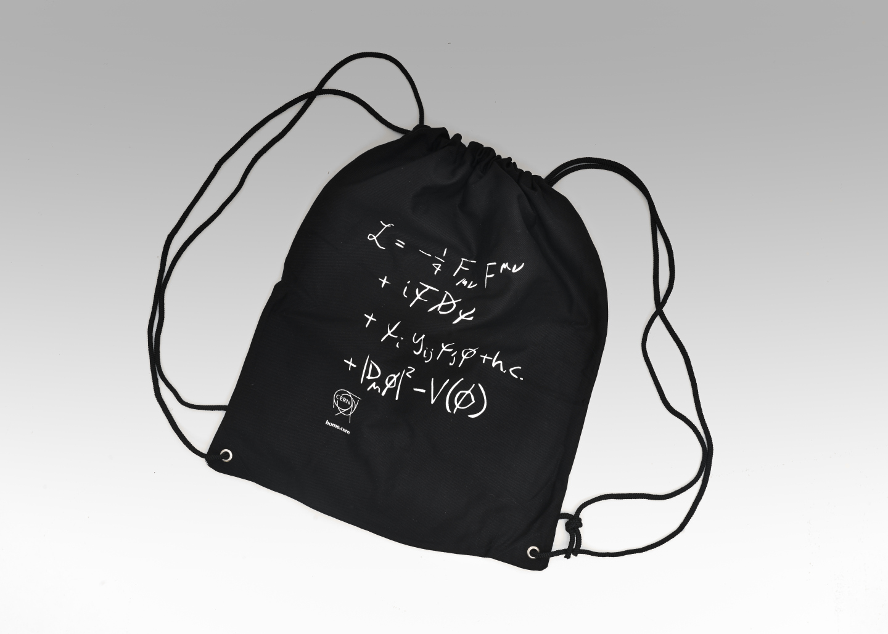
The mystery bag

Slide 7
Build your own detector

Slide 8
Lab workshop
LEGO detectors
Thanks for exploring with us!
Idea, models and Images by Nathan Readioff & Sascha Mehlhase
More information & files: https://build-your-own-particle-detector.org
Notes:
Final Fermi questions: How many electron accelerators do you think there are on Earth?
Magic trick:
UV lamp, fluorescent screen? Link to luminescence video Guillaume
Something with van der graaf, paper clip discharge
Balloon deflect water

Slide 9
Quiz
Notes:
What applications, food sterialisation
Quiz slide: what else can you do with electron accelerators? Cut things, produce solar cells, start chemical, sterialise food, generate light, generate X-ray – all correct

