Slide 1
An Introduction to Engineering at CERN
Ray Veness
CERN
Notes:
I am here to give you an introduction to Engineering at CERN, but I will start by talking about physics.

Slide 2
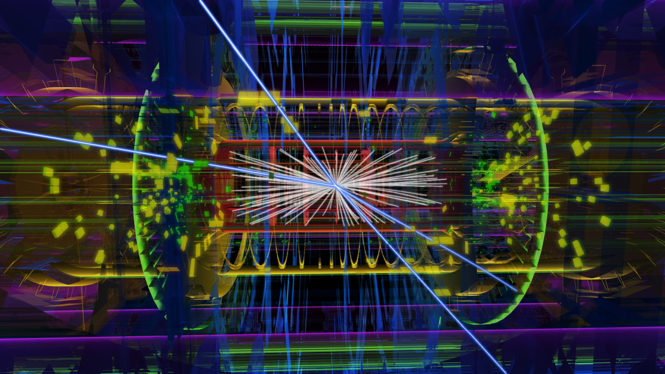
Notes:
CERN’s main role is to produce knowledge, understanding.
This is a Higgs boson decaying into 4 muons… one of the main reasons why the LHC was built was to see this.
In fact, it is not a Higgs, it’s
1 Petabyte/second of raw data synthesized, interpreted and turned into a 3D visualization that can be understood be a human.
So this is just data, and what about the data that it is made from?

Slide 3


Slide 4
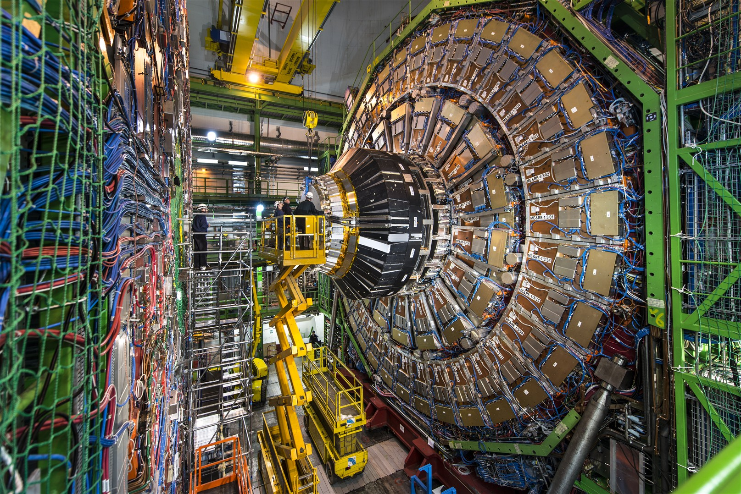
Notes:
An where does this data come from? Well, I have chosen the CMS experiment as this is where you will be on Friday afternoon

Slide 5
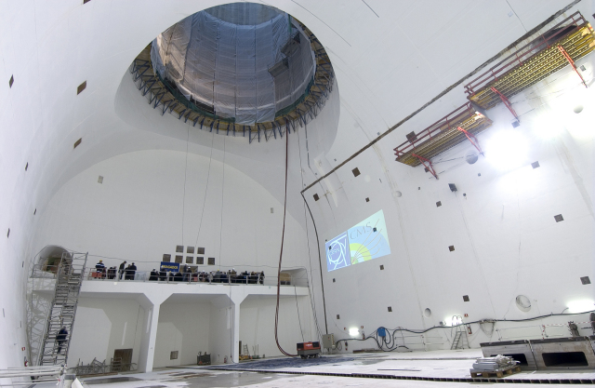

Slide 6
Data visualisation software design
Notes:
Large, international effort in making tools to analyse and then make understandable the data coming from the LHC.
In fact there is even an ‘open data portal’ where you can download real data, as well as open source software to do analysis and visualisation!

Slide 7
Computer hardware
Databases
Network Infrastructures

Slide 8
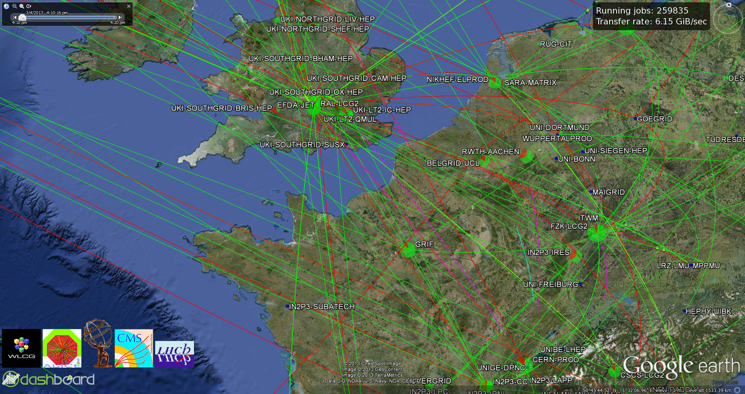
Grid computing
Notes:
The grid sends data around the world to institutes and universities, who then do the analysis on their local hardware.
15 petabytes of data per year.
Worlds largest computing grid
Gives access to the 8000 LHC physicists around the world

Slide 9
Micro-electronics
Control and data acquisition
Mechanical structures
Notes:
Superconducting magnets, cryogenics, – see them in SM18 tomorrow.

Slide 10
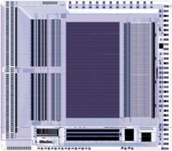

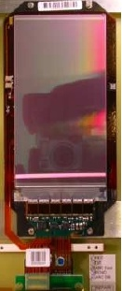
Microchips for Megastructures
Front-End ASIC
CMS experiment on the LHC accelerator at CERN
Silicon Tracker Hybrid
Micro-electronics
Notes:
205 m2 of silicon chip – about the same as a Tennis court.

Slide 11
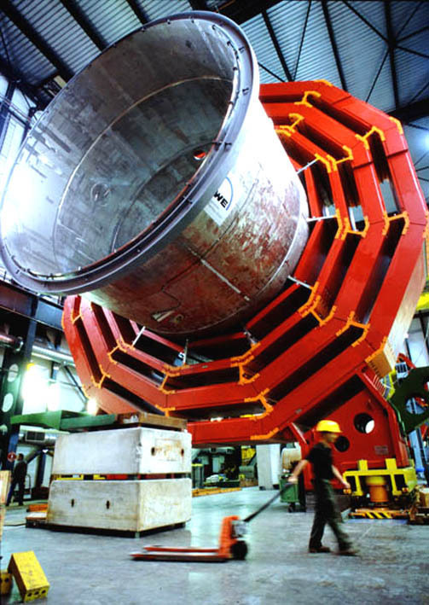
Superconducting magnets
Cryogenics
Power supplies
Notes:
4 Tesla superconducting solenoid – largest ever built
More powerful than an MRI scanner,

Slide 12
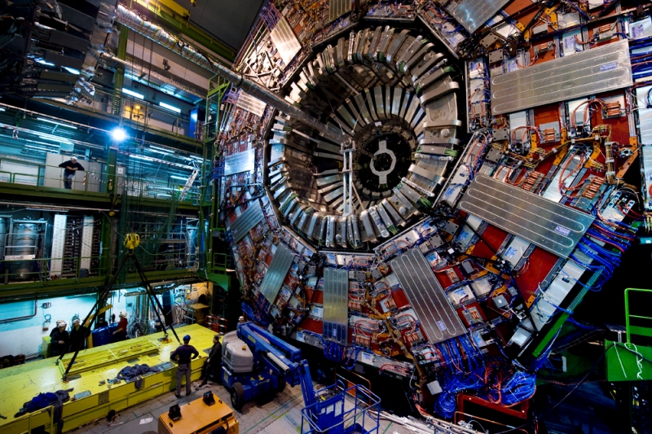
Ultra-high vacuum

Slide 13
Underground Civil structures
Cooling and ventilation
Heavy handling
Notes:
This is ship-in-a-bottle, but at real scale – these experiments weigh as much as a cruise liner, and they are installed 100 m underground.

Slide 14
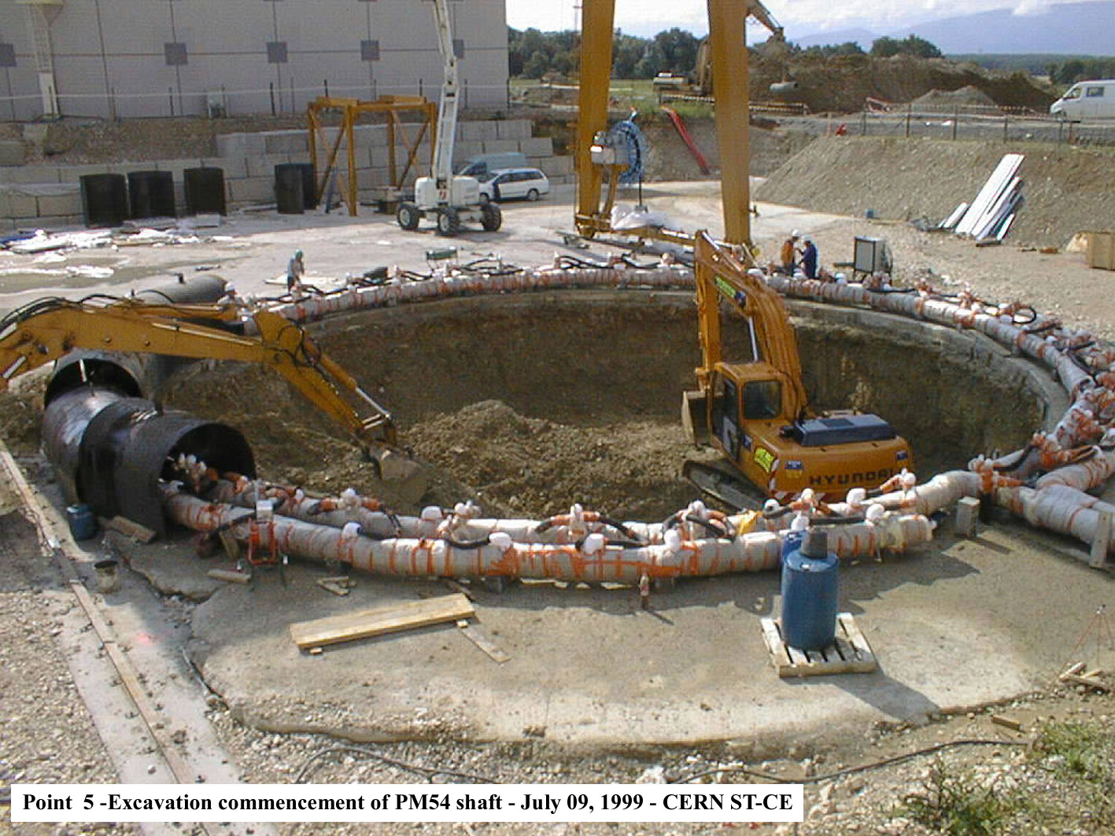

Slide 15
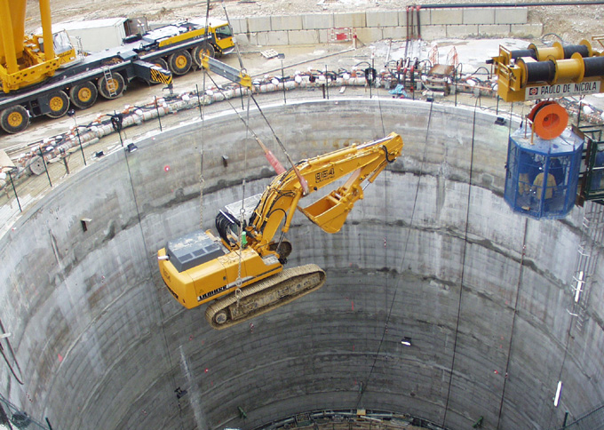

Slide 16
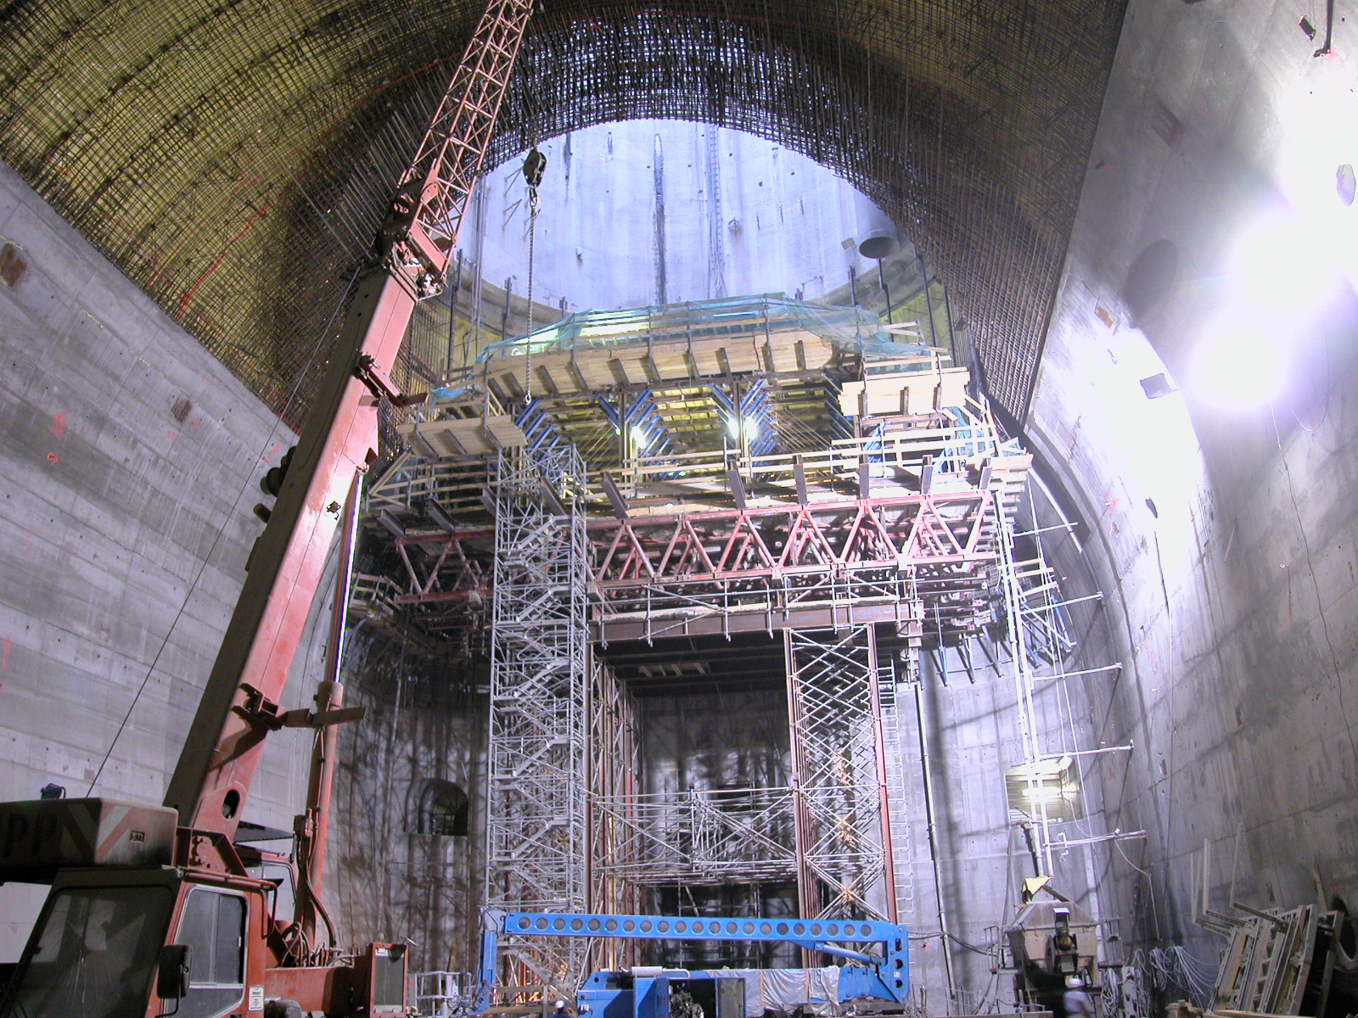
Total Concrete Volume = 90,000m3
2004

Slide 17
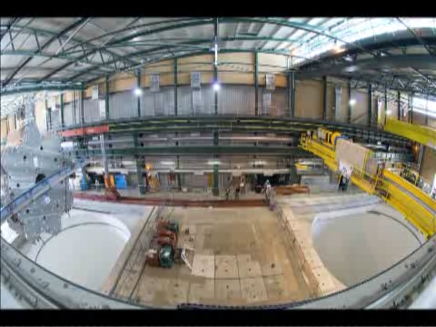
Notes:
So, I started off talking about Higgs Bosons and ended-up talking about concrete and cranes.
Question: What is this stuff? Is this theoretical physics? Is this particle physics? Who does it?

Slide 18

Notes:
Peter Higgs,
Theoretical Physicist
Nobel Prize winner.
Emeritus Professor of Physics at Edinburgh University?
Doesn’t and never has been employed by CERN.

Slide 19

Notes:
Brian Cox, Rock Star Physicist.
Experimental Physicist.
Professor of Physics at Manchester University
Member of the ATLAS collaboration.
Not him.
Engineering/engineers
… but if you start googling engineers, this is what you get…

Slide 20

Image courtesy British Gas
Notes:
Hopefully controvertial image – will come back to it.
But these things you have seen are all the products of engineering, and in fact, most of what CERN does, is engineering.

Slide 21
CERN Staff by job description
Engineers
-Electrical/Electronic
-Mechanical
-Civil
-Computing
Applied physicists
Technicians
Programmers
Accelerator operators
Notes:
Some numbers to back me up…
Not get carried away, some 1/3 are what most people would call engineers, 1/3 applied physicists and 1/3 computer scientists
But in fact, the boundaries between them are rather blurred anyway.
Eg. Tim Berners-Lee’s background is in physics. The last 2 directors of accelerators at CERN have been engineers.

Slide 22
Physics specification for an experimental beampipe : Nothing, contained by nothing!
Notes:
So, there is a huge range of fascinating engineering that I could talk you through for the next 20 minutes, but I thought I would rather say something personal, about probably the most interesting part of the LHC that I was responsible for, a part called the experimental beampipes:
If we come back to our nice event graphic, one beam coming in from one direction… hence a collider – Simone will take you though accelerators tomorrow.
Beam has to travel in very good vacuum, otherwise collisions with air cause background noise events
However, although particles collide in vacuum, detectors are in air, so there has to be some structure that holds this vacuum and be definition, every particle has to go thorough it before it can be seen by the detectors – the experimental beampipe.
So if you ask, as I did, the experiments what they want, their answer is clear:…. And they have half a billion of detector behind that depends on it.

Slide 23
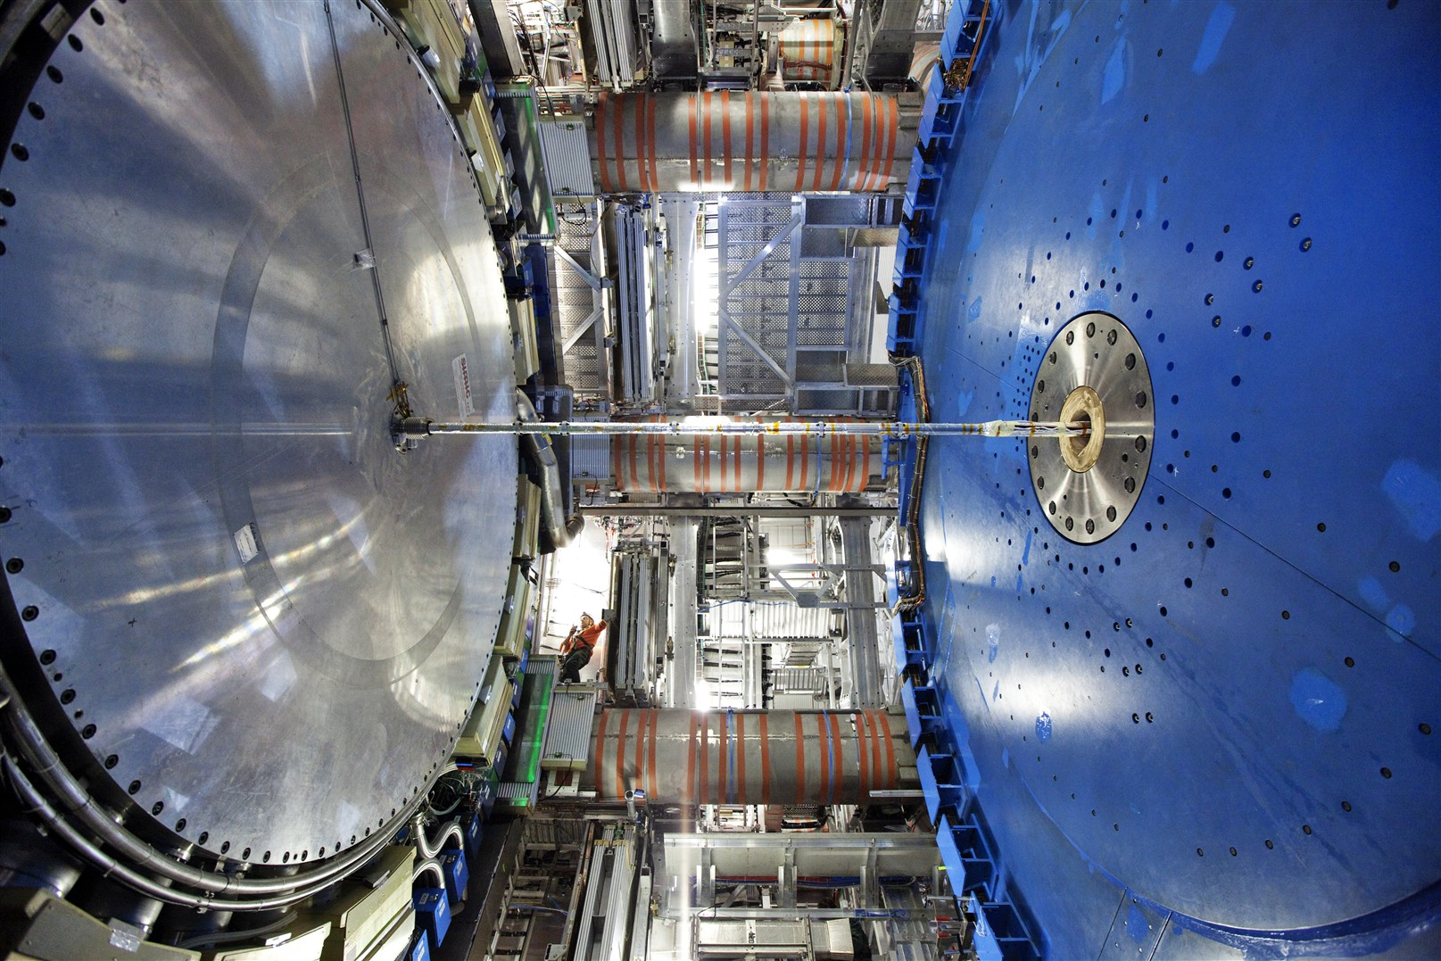
Notes:
If you look in reality, this is the environment and scale – you can see the guy.
First thing was discussion, negotiation, reach a concensus between what the experiements want, what the machine was willing to accept, and what we hoped was actually achieveable.

Slide 24
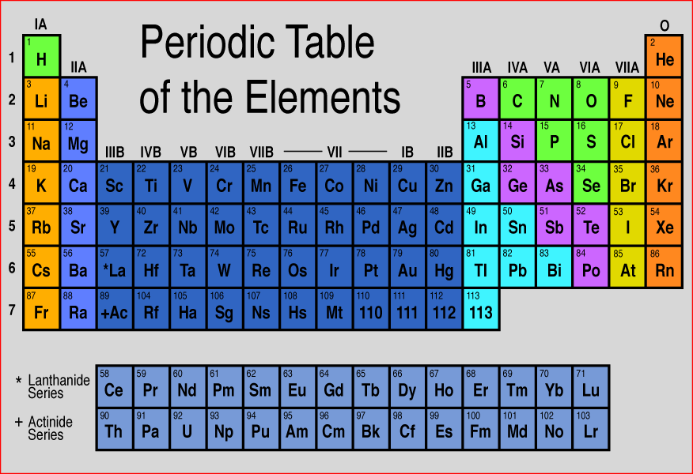
Nothing, contained by nothing!
Hydrogen is a gas at room temperature!
So is helium…
Lithium explodes in air… not so good
X
X
O
X
Beryllium… that would be good!
…except that it is pretty hard to get hold of!
Notes:
Then go back to first principles…

Slide 25

Beryllium metal is only really produced here in the USA…
…and here in Moscow.
… and here in Kazakhstan…
And the only places in the world that make these kind of complex parts are here in California…

Slide 26
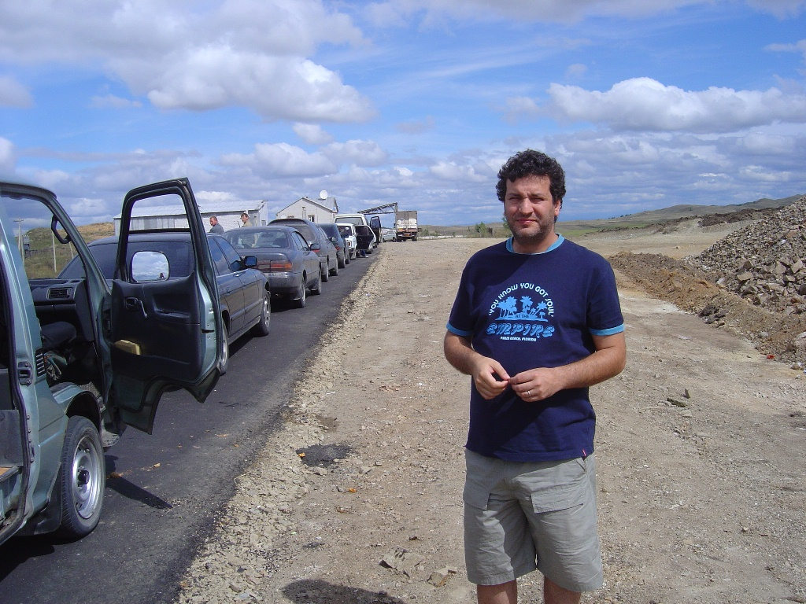
A photo I took of a CERN colleague, as we waited to cross the Khasakh-Russian border in 2004…
Notes:
So this is the exciting, outward bounds bit,
But what I am showing is that engineering means learning some particle physics and accelerator physics, but also material science, geography, commercial negotiation and a bit of Russian helps!

Slide 27
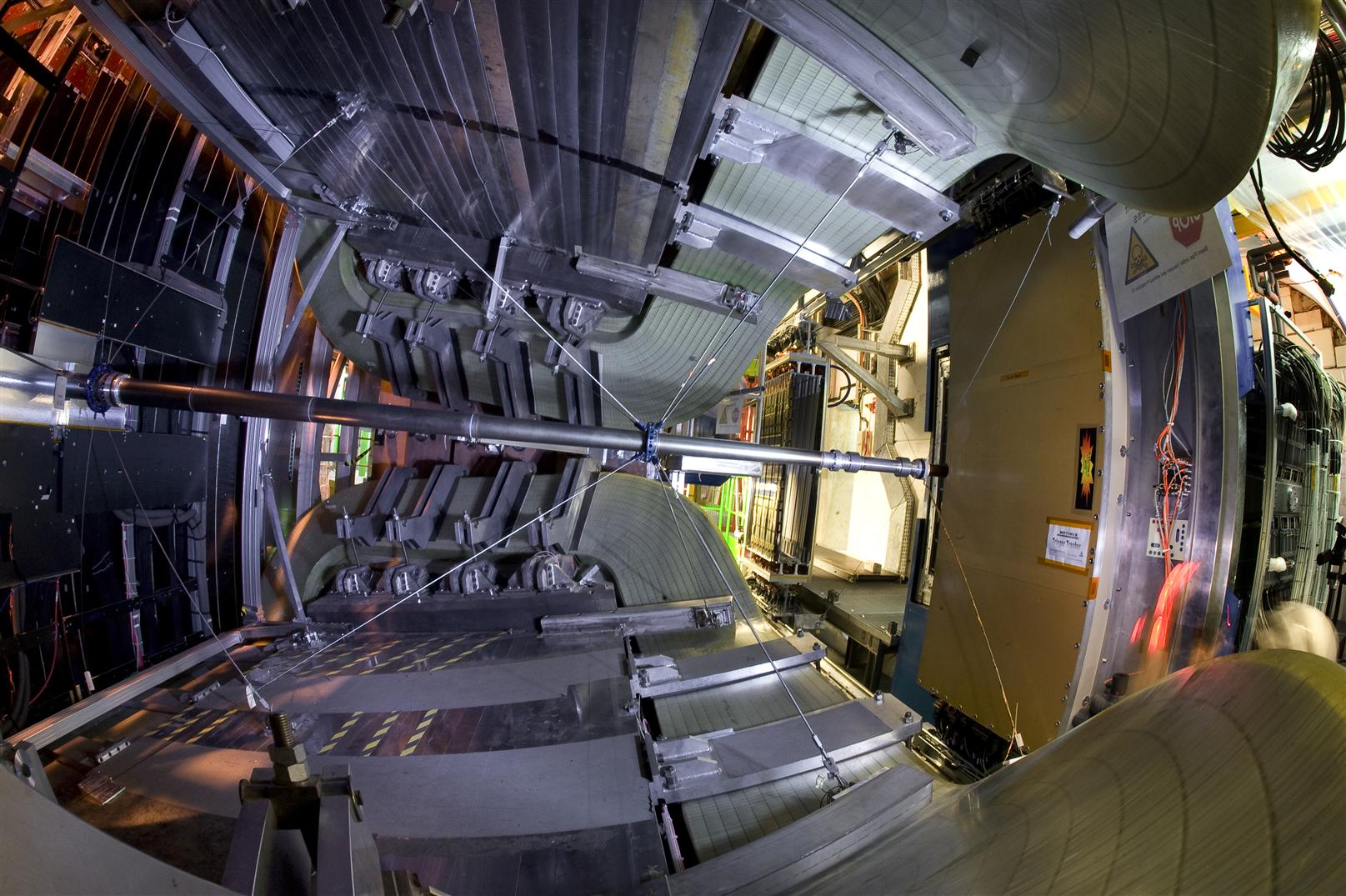
Notes:
So at the end of something like 10 years of design, manufacture and installation, by 2008 things were looking like this.
One of my beampipes with it’s spiderweb-like supports inside the LHCb experiment.

Slide 28
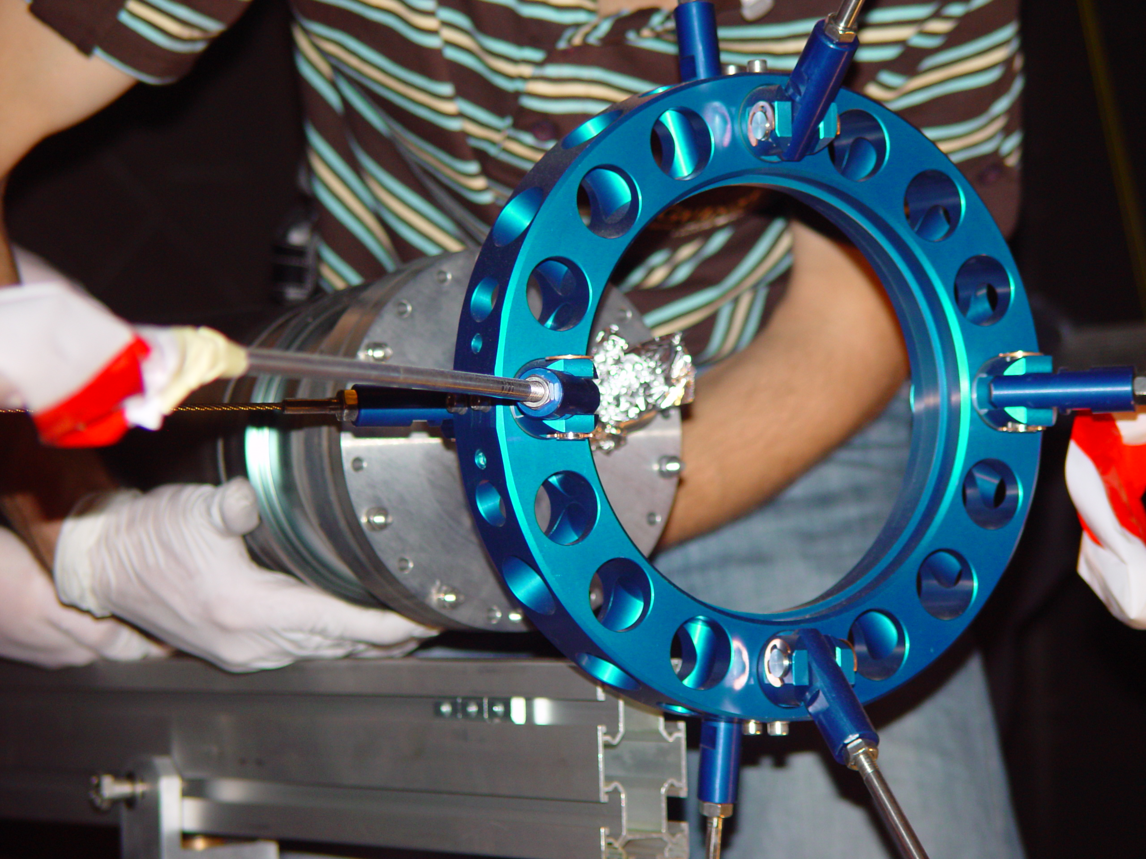
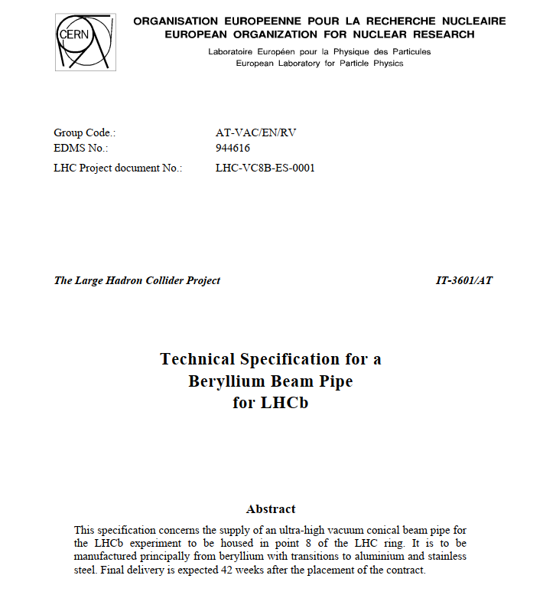
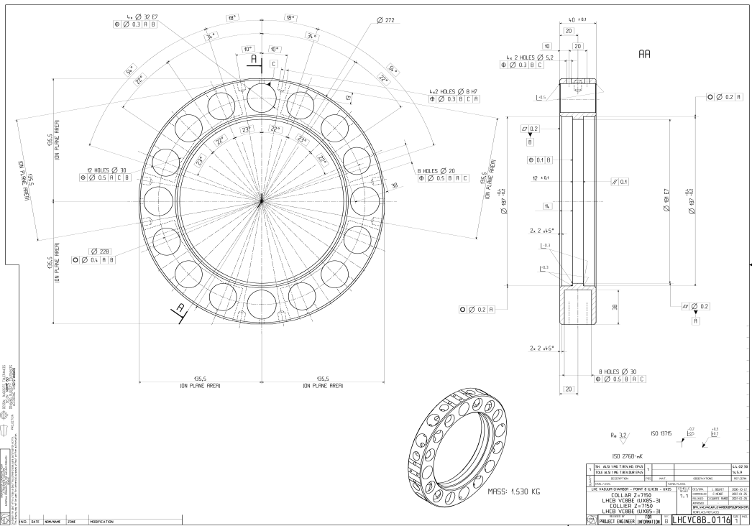
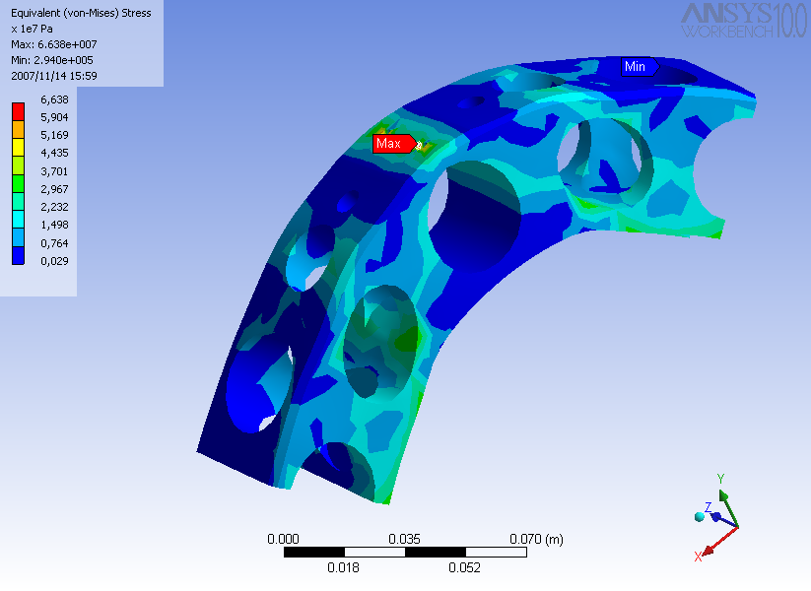
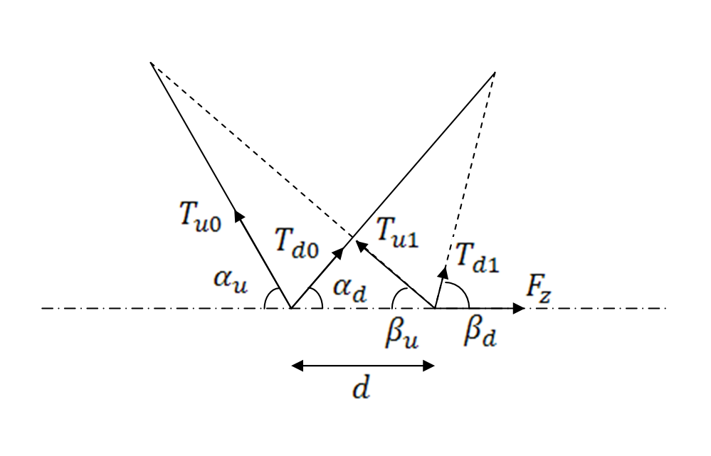

Slide 29
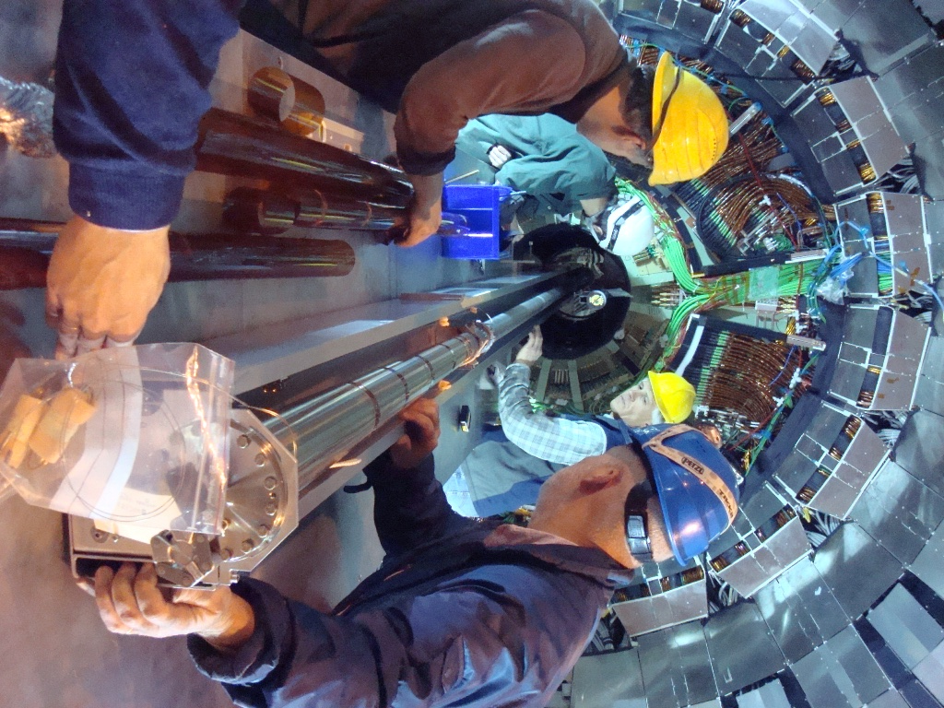
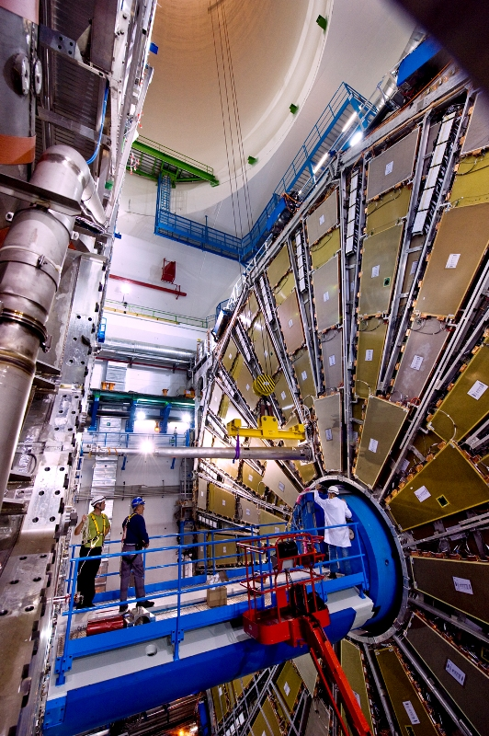
Notes:
Our team of technicians at the time installing another one inside the CMS experiment.
And a third – with me in the photo, lowering one of the last parts of the ATLAS experiment into place at the bottom of the 100 m shaft.

Slide 30
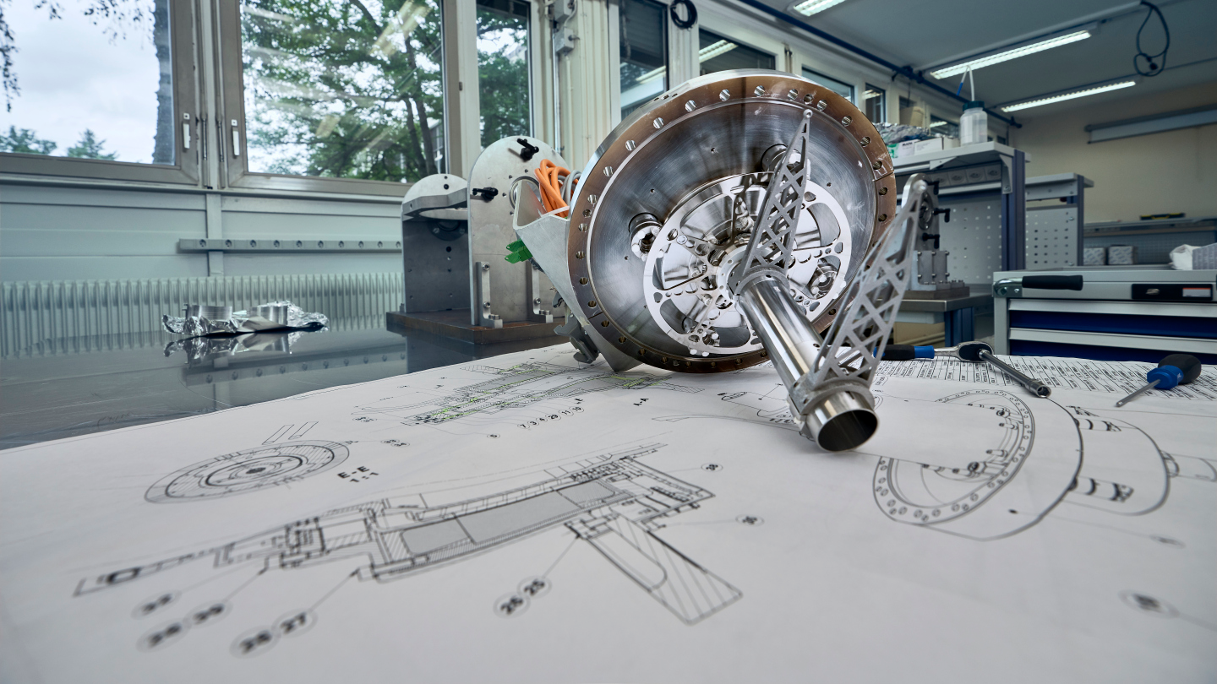
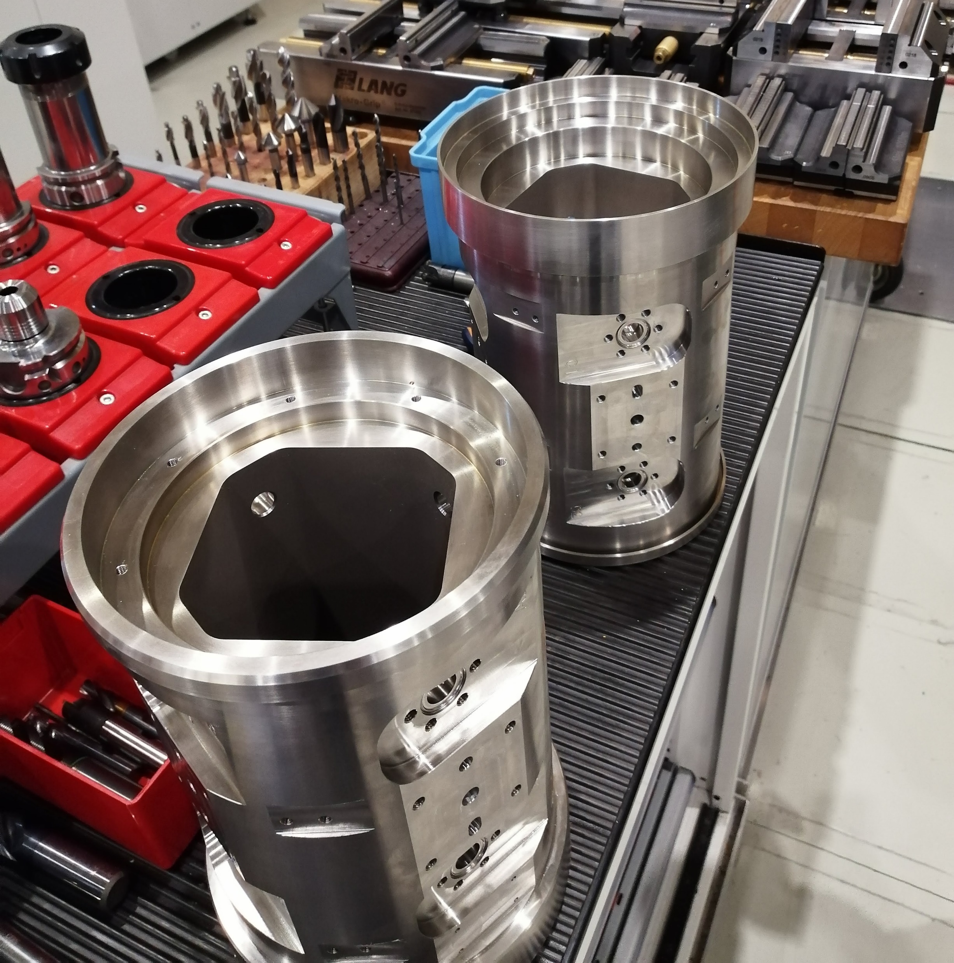
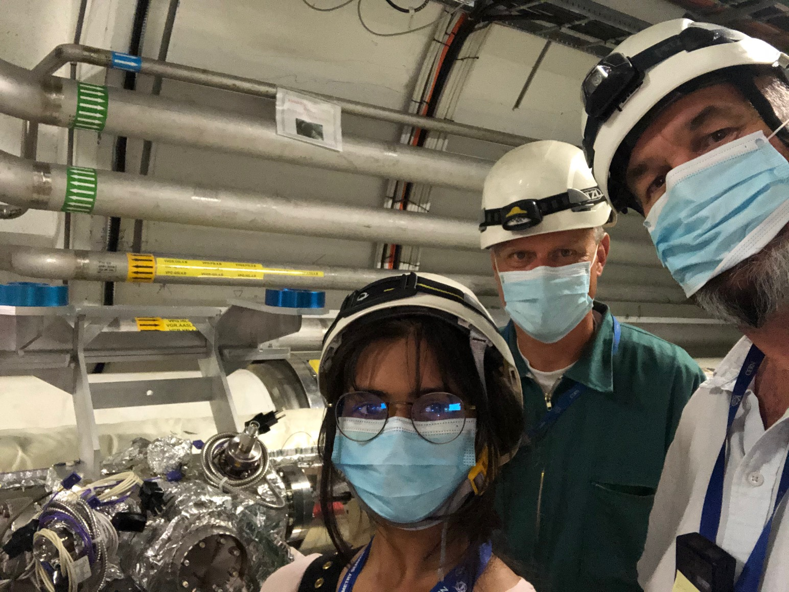
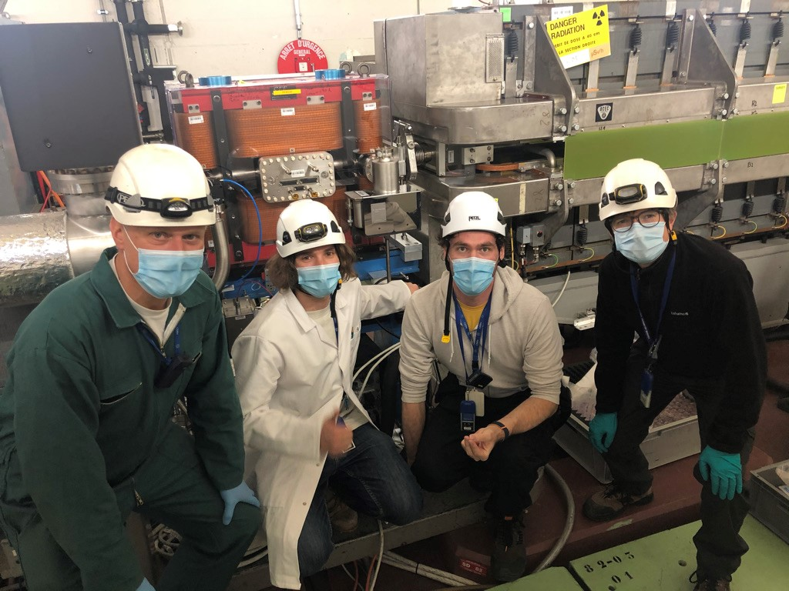
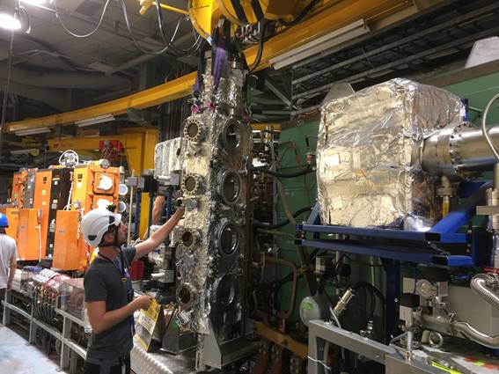
One slide on the recent long shutdown
More than 150 new beam instruments built and installed

Slide 31

Technician (France)
Technician (Portugal)
Technical Engineer (France)
Engineer (Germany)
Engineer (Poland)
Engineer (UK)
Technician (UK)
Engineer (Spain)
Technical Engineer (Italy)
Designer (UK)
Trainee (Italy)
Mechanic (France)
Doctoral Student (France)
Technician (France)
Missing: Engineer (Pakistan); Technician (Swiss); Engineer (Russia); Engineer (Ukraine)…
Beam Instrumentation Mechanics Section BBQ, June 2023

Slide 32
Cooling and ventilation technician
“…It’s my job to install your boiler and help with any boiler problems you may have…”
Notes:
So, before I finish, I want to come back to my British Gas ‘Engineer’.
This is actually kind of serious. There is a real shortage of Engineers in the UK, and this image is not really helping to encourage your best students to spend 4 years at university and go into an engineering career.

Slide 33
What is Engineering?
Oxford English Dictionary, 3rd Ed.
The branch of science and technology concerned with the development and modification of engines (in various senses), machines, structures, or other complicated systems and processes using specialized knowledge or skills, typically for public or commercial use…
Wikipedia
(from Latin ingenium, meaning "cleverness" and ingeniare, meaning "to contrive, devise") is the application of scientific, economic, social, and practical knowledge in order to invent, design, build, maintain, research, and improve structures, machines, devices, systems, materials and processes.
Notes:
OED is also not going to inspire anyone to study engineering, and this is not what we do!
Wikipedia is closer to the truth – and more the message to pass to aspiring engineers.

Slide 34
So engineering means…
Make something real out of dreams
  Creativity!
Discussion, negotiation, consensus:
  Communication!
Need to be ready for lifelong learning:
  particle and accelerator physics, material science, leadership, commerce, Russian…
Based, of course, on good science:
  Start from first principles
  But don’t re-invent the wheel… unless you need to!
  Good engineering design
Get it done, on time and on budget!

Slide 35
CERN
CERN is a particle physics facility
  But we employ very few particle physicists
  Most theoretical and experimental scientists work for our member institutes
…but most of what we do is “Engineering”
  2/3 of our staff are engineers, applied scientists or technicians
  Work together, we can produce the most amazing, complex and beautiful things

Slide 36
…and can I just ask you
You are seeing some incredible examples of engineering
  CMS, CCC, Data centre,
  Neutrino platform, AD/LEIR
Give your students a different impression of what a career in engineering might mean
  – CERN, along with the economies of all our countries, needs more engineers, both female and male!

Slide 37
Thank you!
…and please feel free to take some of our enthusiasm for engineering home with you!

Slide 38
Backup

Slide 39
Ray Veness, in a nutshell
Born and schooled in London, England
Studied Mechanical Engineering at Leicester University
  PhD in Solid Mechanics at Leicester University
2 years working on fusion energy technology at Culham Laboratory, Oxfordshire, UK
Recruited as a CERN staff in 1992
  Worked as a Section Leader in 5 different departments
Responsible for many parts of the LHC design, including all experimental vacuum systems
  Co-author of the ATLAS Higgs discovery publication(!)
Currently Section Leader and Deputy Group Leader for Beam Instrumentation (Accelerator Systems Department)

Slide 40
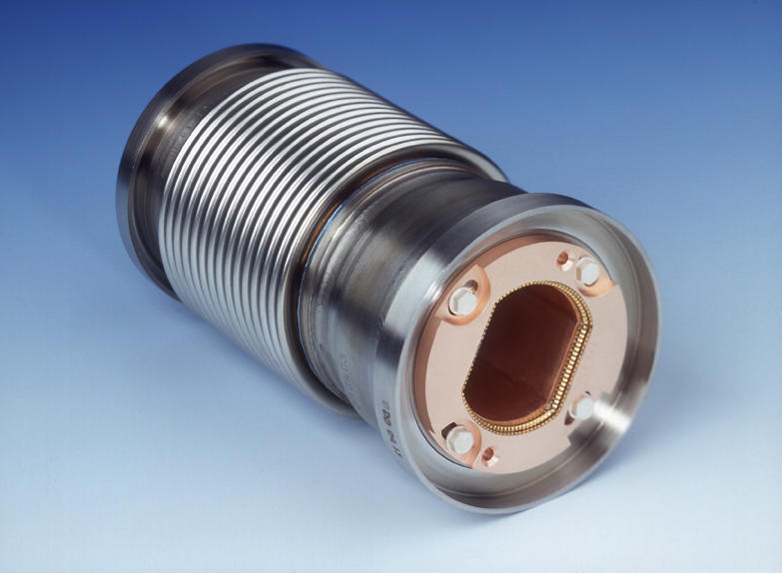
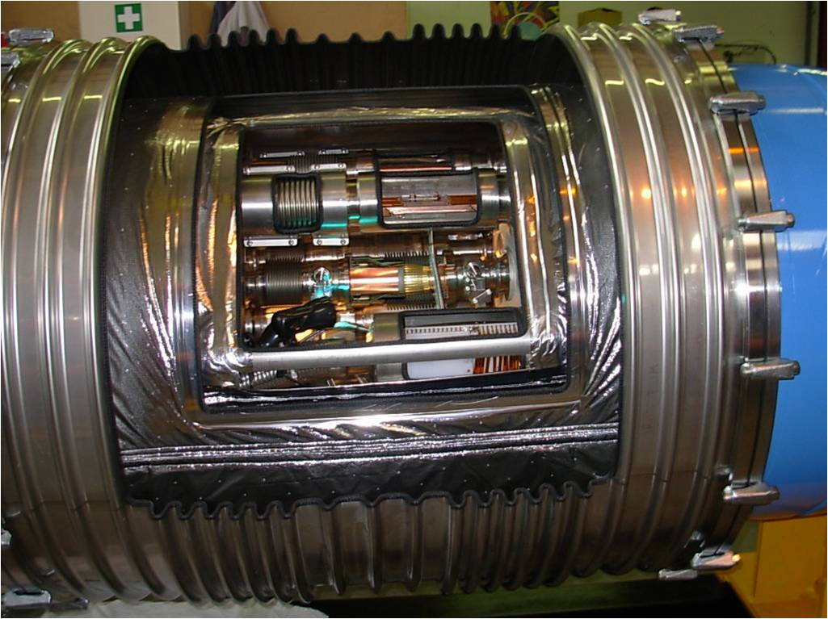
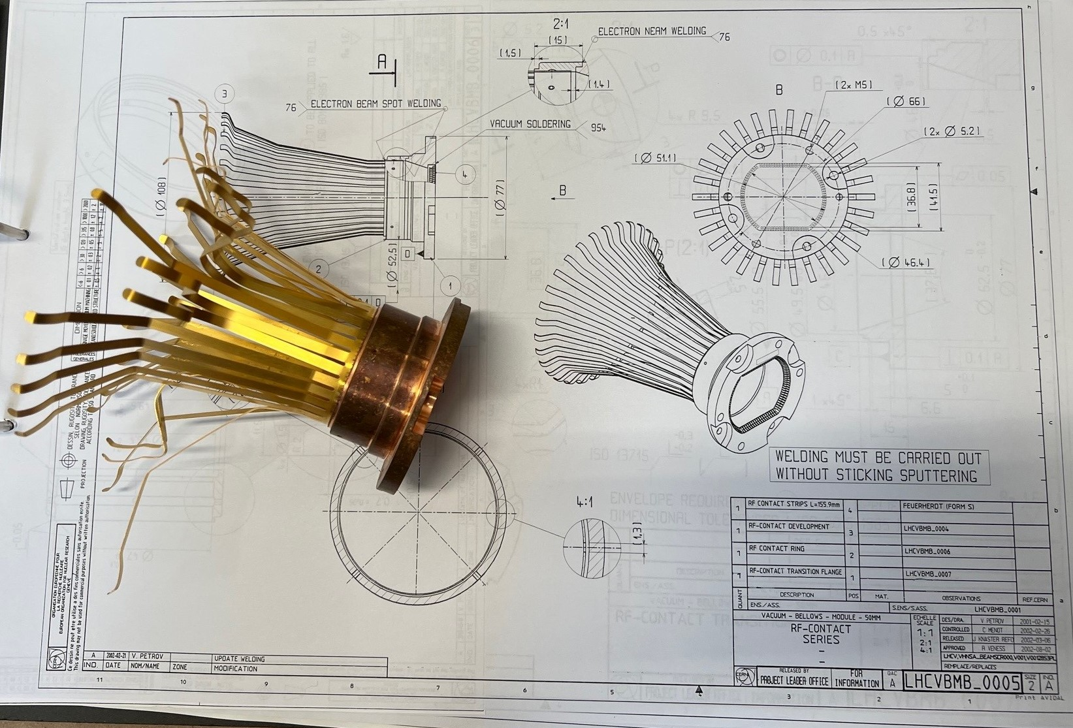
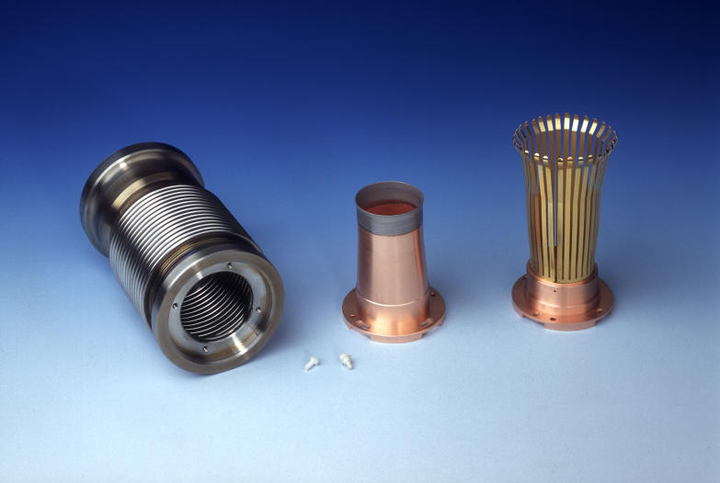

Slide 41
