Slide 1
Concept Maps
International Teacher Weeks Programme 2023
Milena Vujanović
07/08/2023

Slide 2
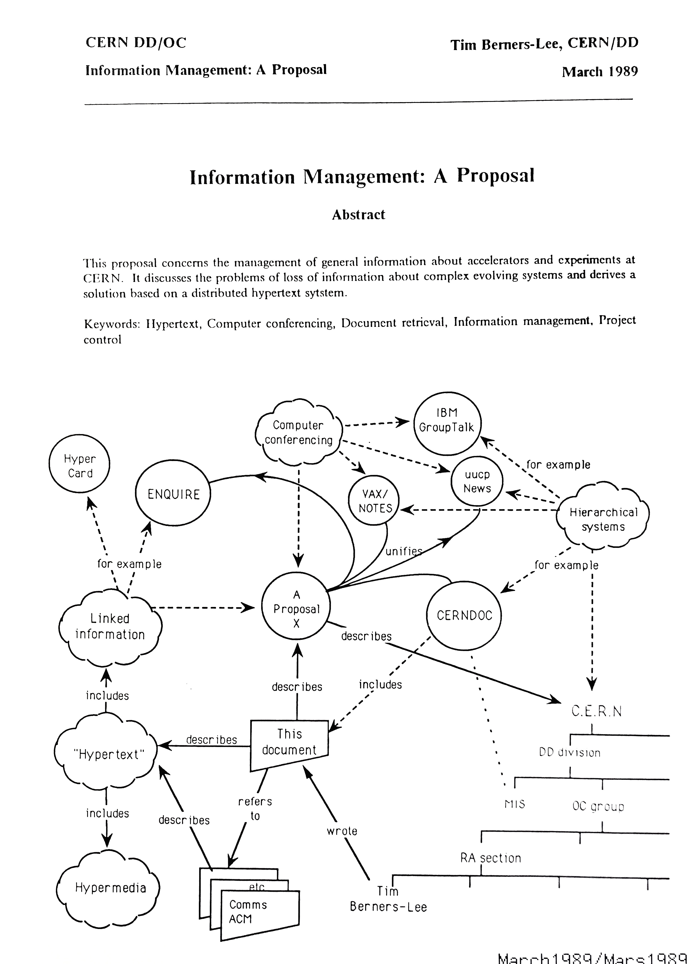


Slide 3
What do you know about concept maps?
Concept Map
is a
needs to answer
Graphic Organiser
Focus Question
represents
Organised Knowledge
is comprised of
Key Concepts
connected with
Linking words
is
are in
e.g.
consist of
Hierarchical Structure
contribute

Slide 4
Why do we do this?
It is benefitial to you because:
it will help you organise your knoweldge!
It is benefitial to me because:
I get a PhD! ☺

Slide 5
Constructing Concept Maps
1. Focus question
What do you know about Hogwarts?
Chose a starting concept and
2. Stop and think
2 – 5 key concepts

Slide 6
What do you know about Hogwarts?
2-5 key concepts
Link
School for magic
Students
Hogwarts
6

Slide 7
What do you know about Hogwarts?
2-5 key concepts
Link and use ARROWS
School for magic
Students
Hogwarts
7

Slide 8
What do you know about Hogwarts?
2-5 key concepts
Link and use ARROWS and LINKING WORDS !!!
School for magic
Students
is a
Hogwarts
has
VERY IMPORTANT!
8

Slide 9
What do you know about Hogwarts?
2-5 key concepts
Link and use ARROWS and LINKING WORDS !!!
Expand
SECRET TIP !!!
… and expand some more
attend
School for magic
Students
has
is a
Hogwarts
has
has many
are sorted in
attend
Secret Rooms
has
Four houses
Classes
e.g.
Gryffindor
Chamber of Secrets
e.g.
are
e.g.
Hufflepuff
Flying
e.g.
Potions
created
Ravenclaw
was opened by
Slytherin
Transfiguration
is heir of
USE EXAMPLES !!!
Voldemort
was a
9

Slide 10
Now, it is your turn!

Slide 12
What would you like your students to know about PARTICLE PHYSICS and CERN?

Slide 14
What would you like your students to know about PARTICLE PHYSICS and CERN?
Stop and think about the focus question
2. Chose your starting concept
3. Then chose 2 – 5 key concepts to start your map
4. Connect concepts with arrowed lines and linking words
5. Expand
QUESTIONS?
15 minutes

Slide 15
Time to write the code and sign the consent form!

Slide 16
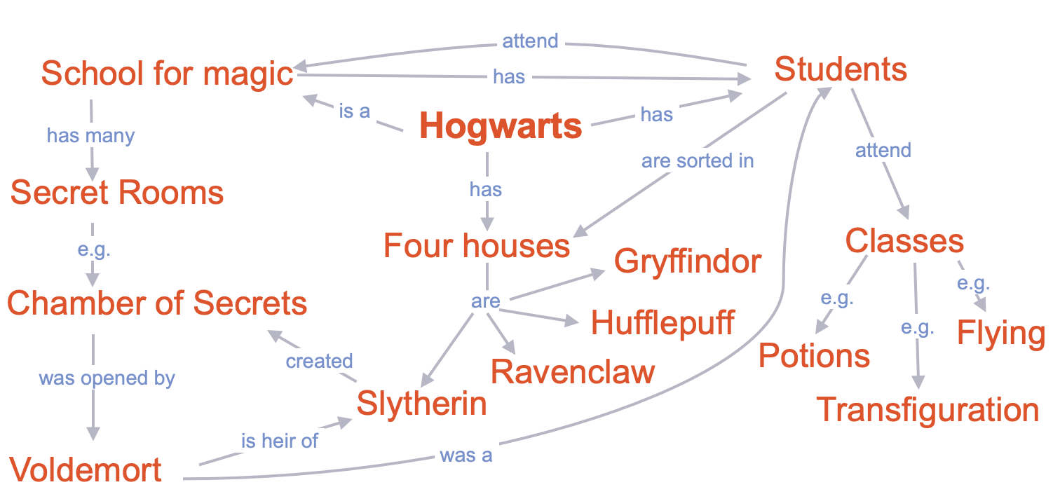
What would you like your students to know about PARTICLE PHYSICS and CERN?
Stop and think about the focus question
2. Chose your starting concept
3. Then chose 2 – 5 key concepts to start your map
4. Connect concepts with arrowed lines and linking words
5. Expand

Slide 17
Pens down!
Let’s talk! ☺

Slide 18


Thank you for your participation!
milena.vujanovic@cern.ch

