Slide 1
EGI - Identity Management
Steven Newhouse
Director, EGI.eu

Slide 2
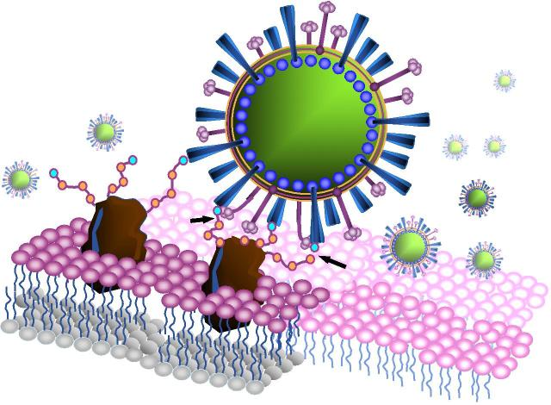
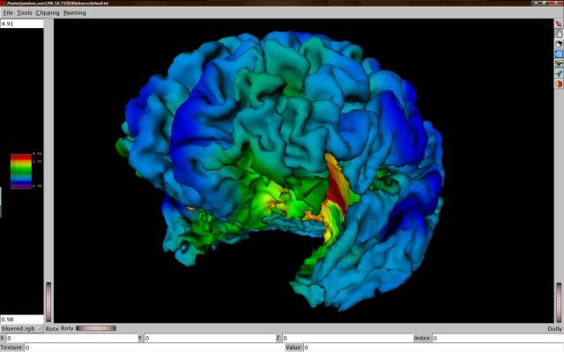
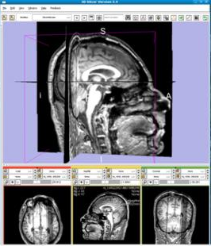
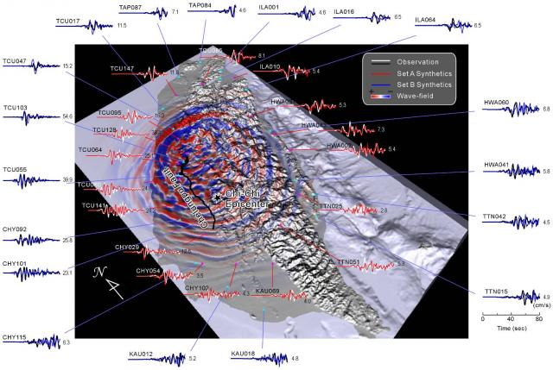
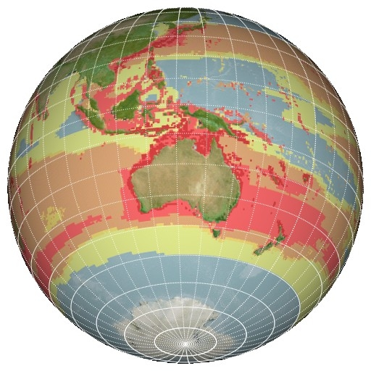
C21: Digital Research
Extracting Knowledge from the Data Deluge

Slide 3
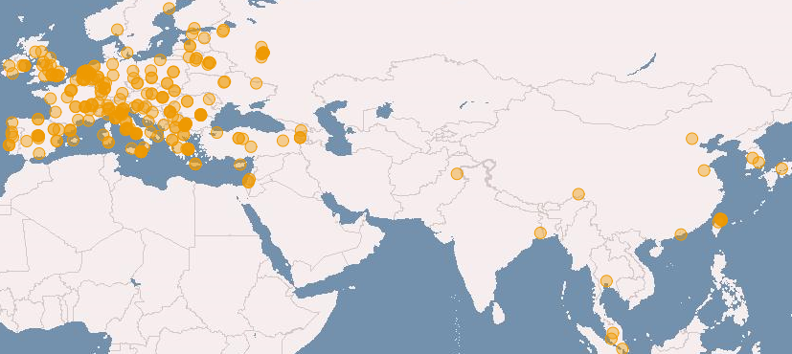
European Grid Infrastructure
(April 2011 and yearly increase)
Logical CPUs (cores)
239,840 EGI (+24.9%)
338,895 All
102 PB disk and 89 PB tape
Resource Centres
338 EGI
345 All (+6.8 %)
96 supporting MPI (+6.8%)
Countries (+11.5%)
51 EGI
57 All (+18.75)
38 NGIs providing resources
22 National Operations Centres
16 NGIs in 5 Federated Operations Centres
1 EIRO providing resources
18 countries in 4 non-European Operations Centres

Slide 4
Conflicting Issues
Federated Pan-European Infrastructure
  Need to deal with local laws & processes
  Complex as part of a global collaboration
  →Resource access needs to managed
Support multi-disciplinary user communities
  Each community has different operating models
  Different levels of technology expertise & use
  →Resource access tuned to the community

Slide 5
Key Points
Authentication token needs to be trusted
  Requires auditable procedures to give value
    e.g. EUGridPMA & IGTF (e.g. national X.509 CAs)
Attribute declarations need to be trusted & traced
  Based on the individual, e.g. staff/student
  Based on their community e.g. VO membership VOMS
Authorisation separated from authentication
  Performed locally for each service, e.g. ARGUS
Common policies underpinned by technology

Slide 6
Non-Proliferation Issue
Major concern for the EGI Council
  Local interpretation of international laws
  Compliance needs to be demonstrated
Need: Nationality Attribute
  No attribute → may mean no access

Slide 7
Future Challenges
Virtualisation changes the relationships
Multiple trust relationships
Multiple trust levels
Trust Relationship
Service
Multiple communities
Service
Service
Service
Service
Service
Service
Service
Service
Service
Service
Service
Trust Relationship
Virtual
Machine
Virtual
Machine
Virtual
Machine
Virtual
Machine
Multiple sources
Trust Relationship
Site Virtual Machine Management
Sandboxed site access

Slide 8
Implementation
Global interoperability is essential
  e.g. X.509, Kerberos, SAML, …
Quality of attribute is very important
  e.g. photo ID linked to IGTF X.509 certificate
  e.g. verified email address linked to login
Authorisation = Authentication + attributes
Ease of use critical to wider adoption
  e.g. short-lived certificate & security token servers
    → Convert ‘normal’ ID tokens to ‘Grid’ tokens

Slide 9
Conclusions
Virtualisation changes the game
  Can separate management from use
Security of the whole infrastructure critical
  Traceability across different tokens key
Need solutions with global scope
  Either deployment or interoperability
Contact: director@egi.eu

