Slide 1
Identity Management in DEISA/PRACE
Vincent RIBAILLIER, Federated Identity Workshop, CERN, June 9th, 2011
Notes:
1

Slide 2
History of European HPC projects
DEISA (Distributed European Infrastructure for Supercomputing Applications): May 2004 – April 2008
DEISA2 : May 2008 – April2011
  10 countries, 15 centers
PRACE (Partnership for Advanced Computing in Europe, Preparatory Phase): started in January 2008
  PRACE(-PP) (preparatory phase): January 2008 – June 2010
    14 countries
  PRACE 1-IP (first implementation phase): July 2010 – June 2012
    Focuses on “Tier-0” integration
    20 countries
  PRACE-2IP (second implementation phase): September 2011 – July 2013
    Focuses on “Tier-1” integration
    21 countries

Slide 3
The HPC ecosystem
T0
T1
T2
European resources
Addressed by PRACE-RI
(PRACE-1IP)
National resources
Addressed by PRACE-RI
(PRACE-2IP)
Regional resources

Slide 4

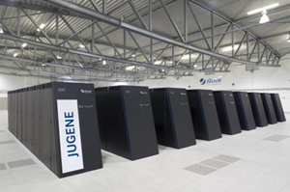
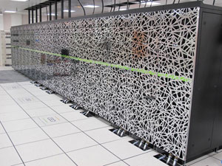
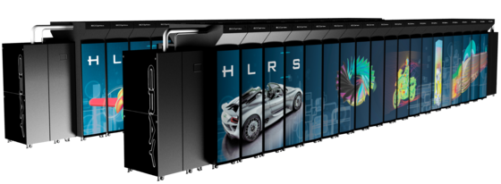
PRACE-RI
PRACE - RI
  Association Internationale Sans But Lucratif (created in 2010)
  Head office installed in Brussels
  21 countries members
PRACE operates Tier-0 resources
  JUGENE, FZJ, IBM Blue Gene/P, 1PF, July 2010
  CURIE, CEA, BULL, 1.6 PF, end of 2011
  HERMIT, HLRS, Cray XE6, 1 PF, November 2011
Funding secured until 2015
  > 400 M€ national funding
  48 + 20 M€ EC-funding

Slide 5
Accessing the PRACE RI
Access Model for Tier-0 systems
  Based on peer-review: “the best systems for the best science”
  Three types of resource allocations
    Test / evaluation access
      Only technical peer review
    Project access – for a specific project, grant period ~ 1 year
      Both technical and scientific peer review
    Program access – resources managed by a community
      Both technical and scientific peer review
Access Model for Tier-1 systems
  Based on DEISA model – review by national committees
Current calls: http://www.prace-ri.eu/hpc-access

Slide 6
DEISA Model
Single Sign-on, Secure login
DEISA Common Production Environment
S1
S2
S3
S4
S14
S15
S16
Different Supercomputers
Dedicated 10 Gb/s network – via GEANT2
DEISA highly performant continental global file system

Slide 7
The DEISA/PRACE security model
Authentication
  X.509 certificates (EUGridPMA, IGTF)
    Services using X.509 authentication : GSI-SSH, UNICORE, GridFTP, GRAM, web services
  SSO (MyProxy server)
Authorization
  LDAP used as an authorization database
  Fine grained management
    Attributes associated to projects (groups of persons)
    Attributes associated to accounts
Accounting
  Distributed database (DART for access)
  Accounting records compliant to OGF Usage Record format

Slide 8





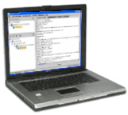



User registration
user
DB
user
DB
site A
site B
allowed
User
Review DB
Project attributes
LDAP
authz
user
DB
site C
a) PRACE Project Administration
b) Federated User Administration
c) Authorized Access to Resources

Slide 9
Federation services in DEISA/PRACE
Evaluation of Shibboleth started in 2009
Two scenarios tested:
  Authorization tokens issued as extensions in certificates by an IdP (Identity Provider) set up by DEISA
    Additional certificate attributes obtained from the user administration service (DUAS)
    Linking authorization information to IdP services not easy to implement
  X.509 certificates obtained through a federated service
    External IdPs for validating the user
    Service successfully tested in Germany
    To be successful such a service must be offered in more countries
    TERENA Certificate Service is very welcome

Slide 10
Planned activities (based also on user survey)
Federation facilities for AA
  Security Token Service (STS): On EMI roadmap is a study on ‘native integration’ of multiple security mechanisms, based around the Security Token Service (STS)
  Redesign of LDAP schema

Slide 11
What can STS do for PRACE
LDAP attributes could be translated into SAML assertions (similar to what was tested a year ago in DEISA based on Shibboleth v3)
  No need to import attribute data locally
Middleware must support this
Enables collaboration (trust model needed)
  Interoperability with VOMS communities
Use cases must be defined

Slide 12
Conclusion
X509 certificate model is currently acceptable for PRACE
It is part of PRACE technology evaluation program to follow what is going on in the identity federation field
  Interoperability is the key word
  PRACE is interested in open standards for the exchange of authentication and authorization information (SAML, XACML)
But interoperability is not always easy to achieve:
  There must be a common understanding of the meaning of credential attributes
  Progress in general is slow:
    Middleware products have often their own methods for validation
    Endpoints must also support open standards

Slide 13
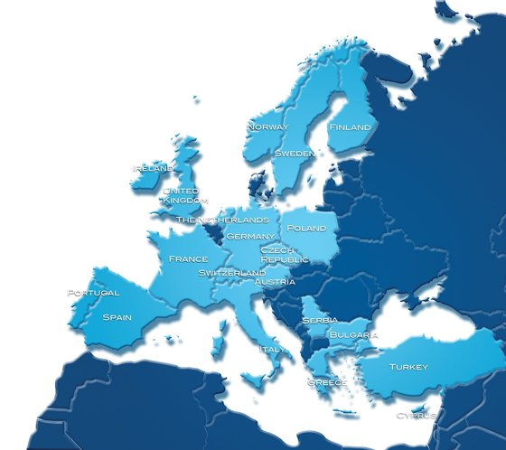
Questions?
http://www.deisa.eu
http://www.prace-ri.eu

