Slide 1
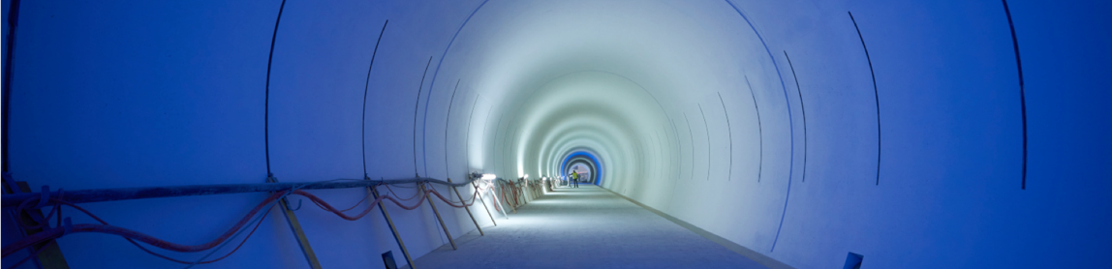
ATS update
Mike, Malika, Katy, Bren, Miguel, Rhodri
29th June 2023

Slide 2
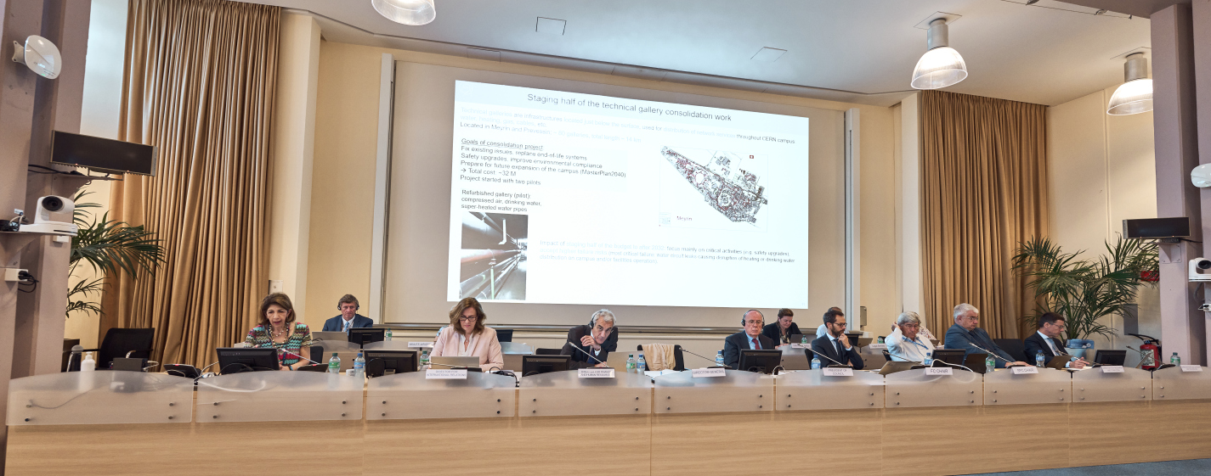
Council Week!
4 times a year, ATS gets to present:
Status of the Accelerator Complex, and upgrades (HL-LHC), and FCC Feasibility Study to:
    Scientific Policy Committee (SPC) - Monday/Tuesday
    Finance Committee (FC) - Wednesday
    Council (Restricted, Closed, Open) – Thursday/Friday
plus occasionally more targeted subjects (this time Medical Applications Strategy)

Slide 3
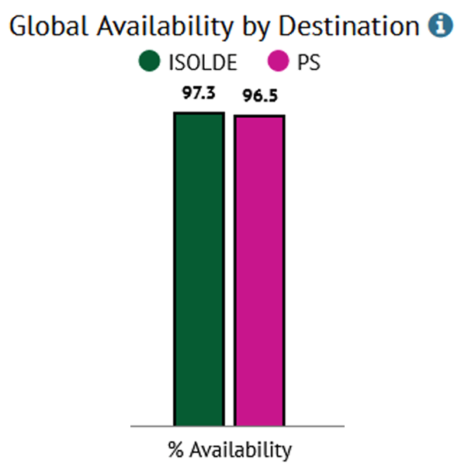
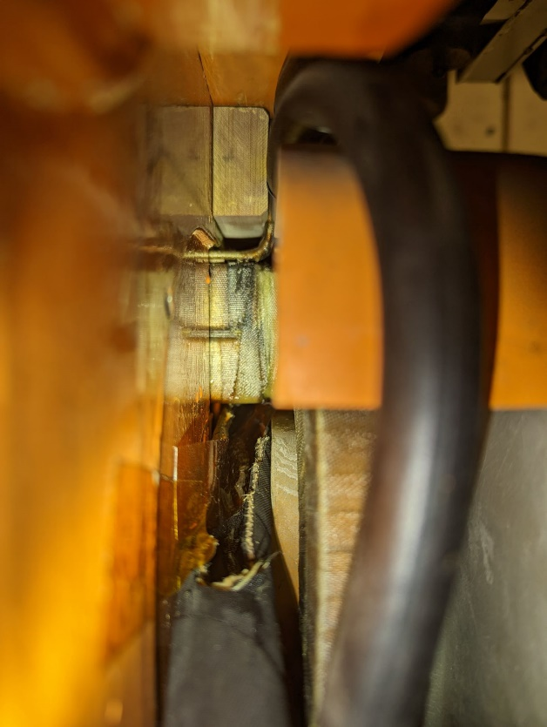
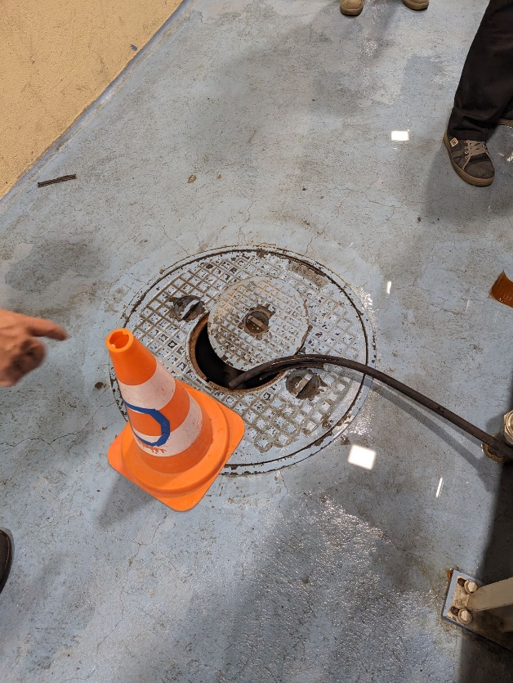
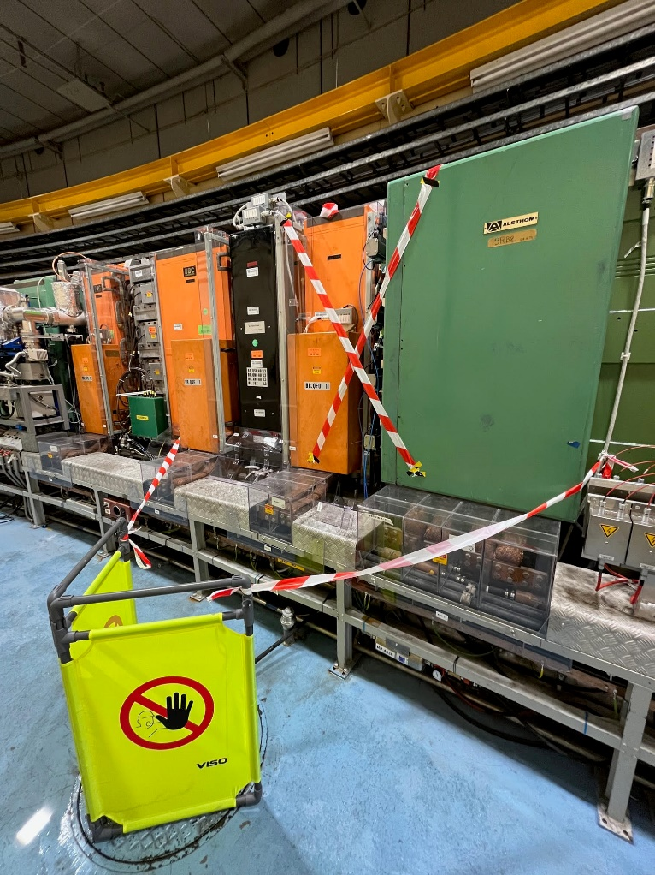
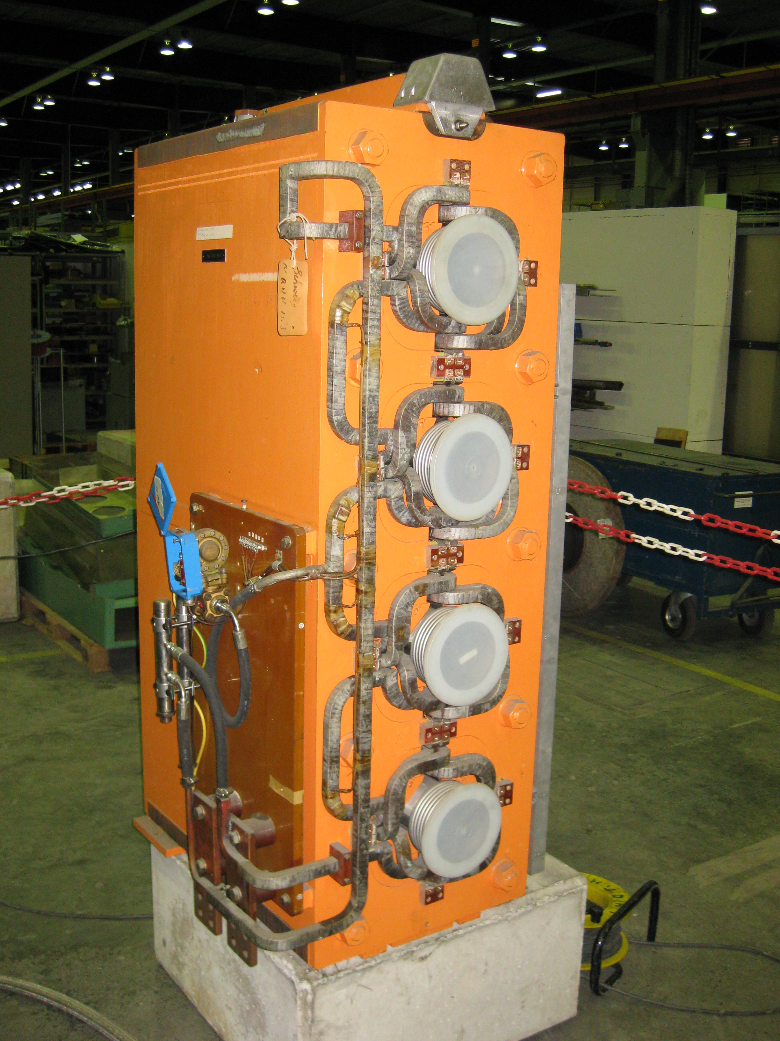
PS Booster
Good availability at > 96%
In 50 years of the PSB there have been no water leaks on the main quadrupole magnets
  Since LS2 leaks have appeared with several magnets exchanged during the YETS
  One new small leak has appeared since and is being closely monitored
A task force is in place to investigate the origin of these new leaks and propose mitigation measures and will report to LHC Injectors and Experimental Facilities Committee next week

Slide 4
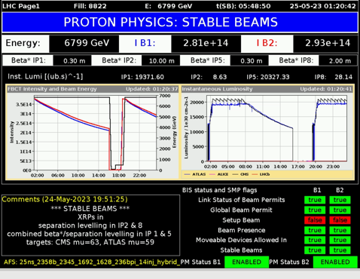
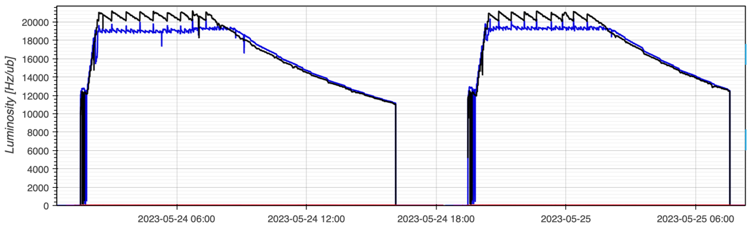
LHC Physics Performance to Date
New record: Integrated luminosity of 1.2 fb⁻¹ in 24h!
Peak levelling just above 2.0 x 10³⁴ cm⁻²s⁻¹
Pileup targets ATLAS/CMS = 59 / 63
  Thanks to combined separation β* levelling and separation levelling we can deliver different pile up to ATLAS and CMS
Max energy per beam at start of stable beams: 409 MJ
1.59 x 10¹¹ p/b (Injected: 1.61)
24th to 25th of May 2023

Slide 5






High Luminosity LHC – Interaction Region
Connection to LHC (UL)
Service gallery (UR)
DFHM
DFHX
SC Links
Q2a
Q1
TAXS
Q2b
Q3
CP
DFX
D1
DFM

Slide 6
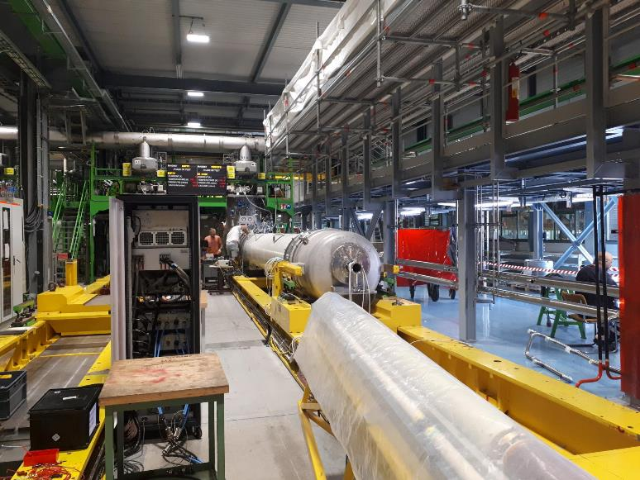
Q2: MQXFB Cryo-Module Assembly at CERN
MQXFBP3 test at CERN
  Nominal +300A @ 1.9K and TC ✓
MQXFB02 test at CERN
  nominal +300A @ 1.9K and TC ✓
Limitation @ 4.5K, but margins compatible with ultimate operation energy @ 1.9K
Both P3 and B02 went through 3 thermal cycles without degradation
On Track for Series Production of Nb₃Sn HL-LHC Triplet Quadrupole Magnets

Slide 7
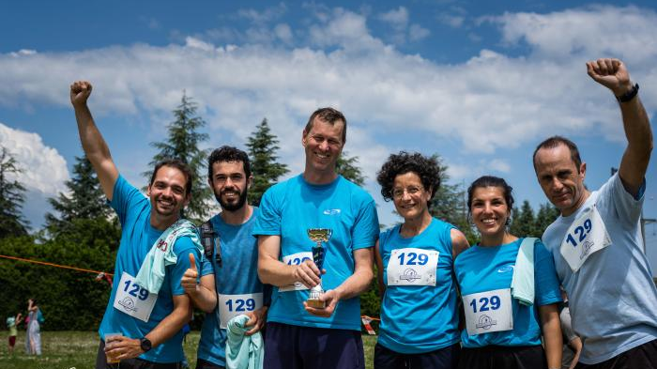
Fast & Luminous: third place in the Open Mixte Category of the 51st CERN Relay Race
On Wednesday 31 May 2023 at 12.15, the first ever bunch of HL-LHC particles accelerated itself around the 3.8 km circumference of the legendary CERN Relay Race.

Slide 8
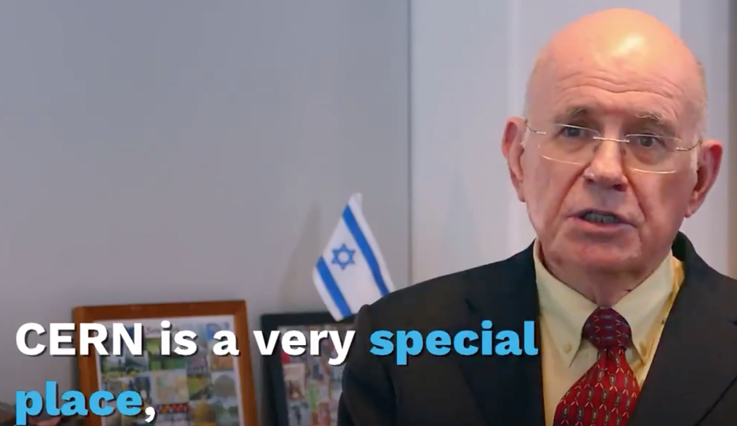
Eliezer Rabinovici – President of Council
“Please pass on my personal appreciation to everyone for the tremendous job they’re doing…”

Slide 9
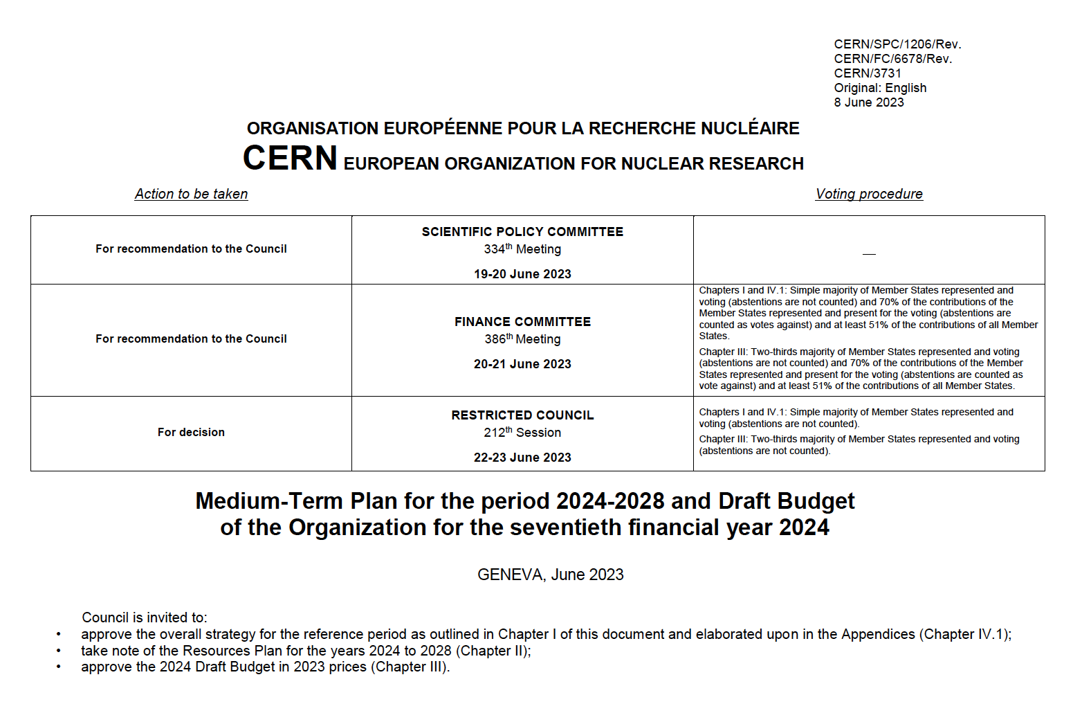

Slide 10
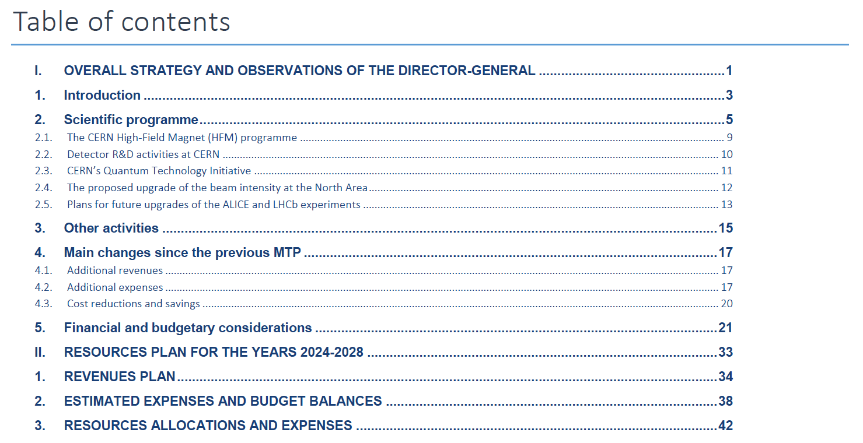
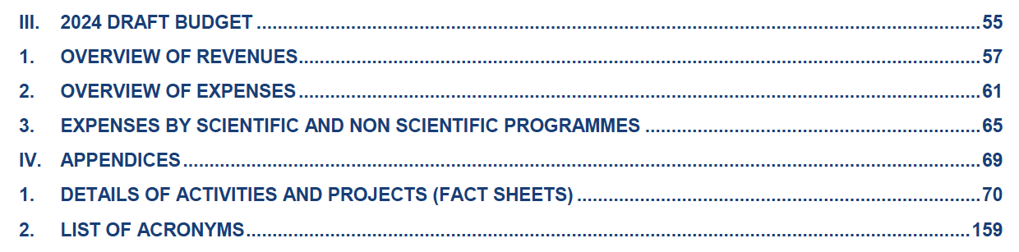

Slide 11
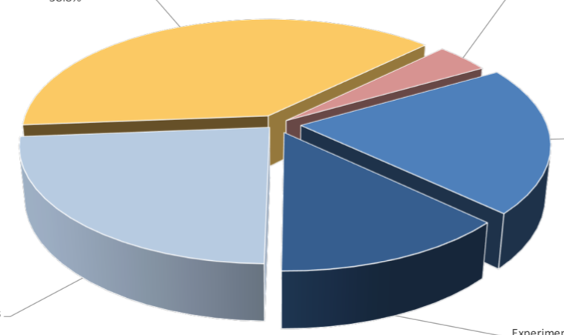
2024 Budget (M+P expenses)
Infrastructure, services and centralised expenses
~ 570 M (38.8%)
Safety, environment, energy, technical infrastructure,
computing support, buildings and site facilities,
international relations, etc.
Recapitalisation of Pension Fund:
60 M (4.1%)
Accelerator programme:
~ 300 M (20.4%)
Injectors, LHC, accelerator support
Experiments and research programme
~ 193 M (13.1%)
LHC and non-LHC experiments, theory,
computing, scientific support
Scientific projects
~ 345 M (23.5%)
HL-LHC, detectors upgrades
Neutrino Platform
Accelerator R&D, Detector R&D
Future colliders (FCC, CLIC, muon colliders)
Physics Beyond Colliders
~ 60% of Budget invested directly in the scientific programme
~ 40% for safety, environment and maintenance and renovation of scientific and general
infrastructure → attractive lab and efficient services for worldwide CERN community

Slide 12
Medium Term Plan 2023 - a balancing act
Cost reductions and savings: 316 M (2024-2028), 776 M (2024-2033) needed to offset additional expenses and reduce the Cumulative Budget Deficit (CBD)
    Cost saving measures for 74 M implemented in 2022-2023 prior to this MTP + 15 M of other savings in 2023
    Including staff contribution of 2.5% salary reduction in 2023
    Cost saving measures from the “440 M package” for 190 M implemented over 2024-2028 in this MTP
    125 M cost reductions over 2024-2028 linked to decrease of electricity costs (mainly from reduced tariffs)
Additional expenses: 187 M (2024-2028), 330 M (2024-2033)
    high-priority scientific projects requiring additional resources (mainly because of cost overrun due to inflation);
    consolidation of technical and site infrastructure
    safety, environment and sustainability
Additional revenues: 73.8 M in 2023 - additional contribution from MS & AMS
Reduction and savings have an impact: descoping, delaying, stopping activities; reliability, availability.

Slide 13
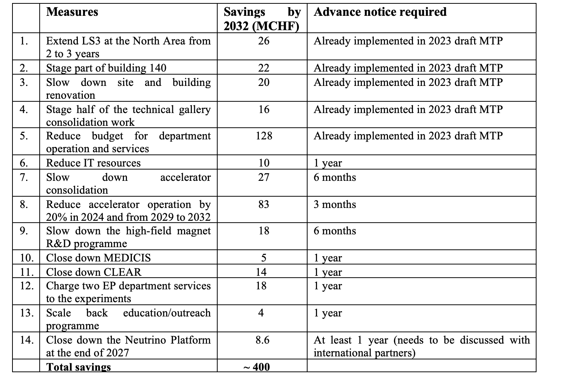
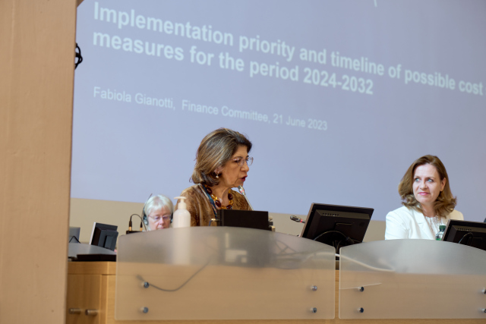
Cost savings measures from “440 M package”
NB To be revisited annually (i.e. update numbers, removing or adding items – not approved, not final.

Slide 14
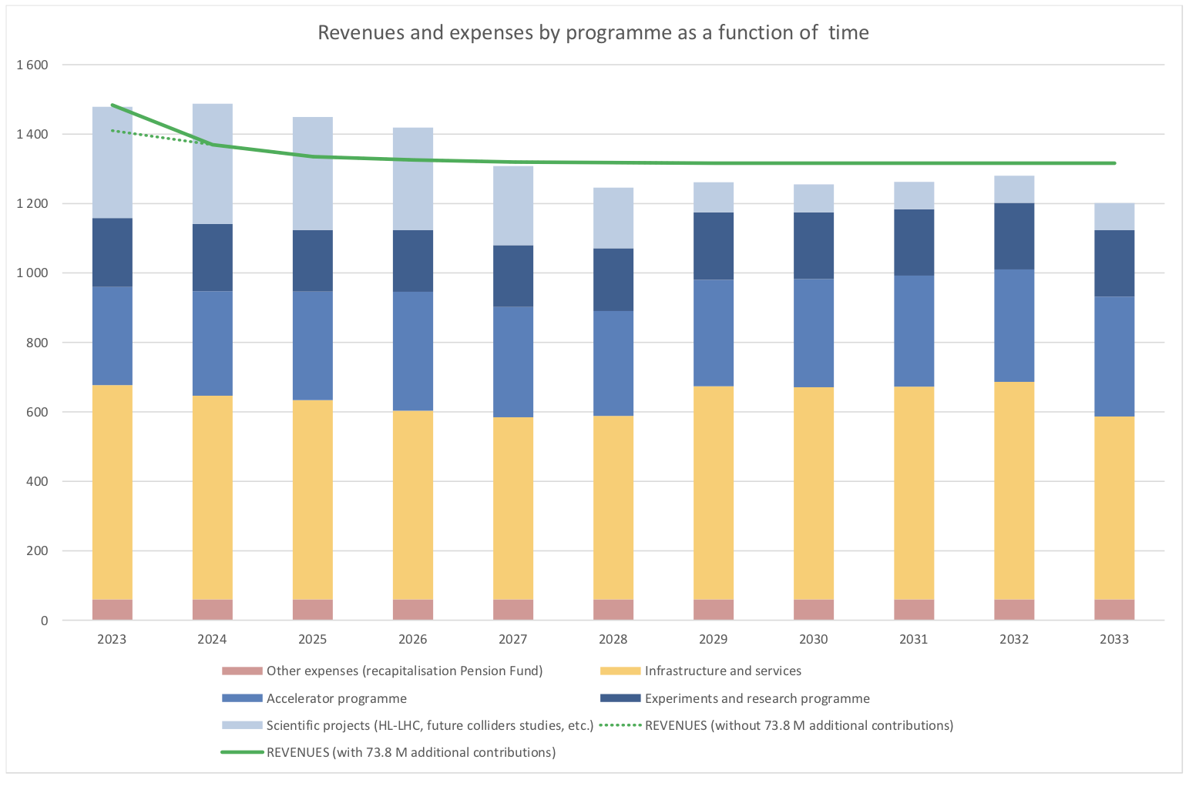
Revenues and expenses (M+P) versus time
Revenues are ~ constant
Expenses:
higher than revenues until 2026 (HL-LHC construction) ➤ CBD increases until 2026
kept lower than revenues at the end of HL-LHC construction ➤ reduce CBD to allow eventual investment in new projects

Slide 15
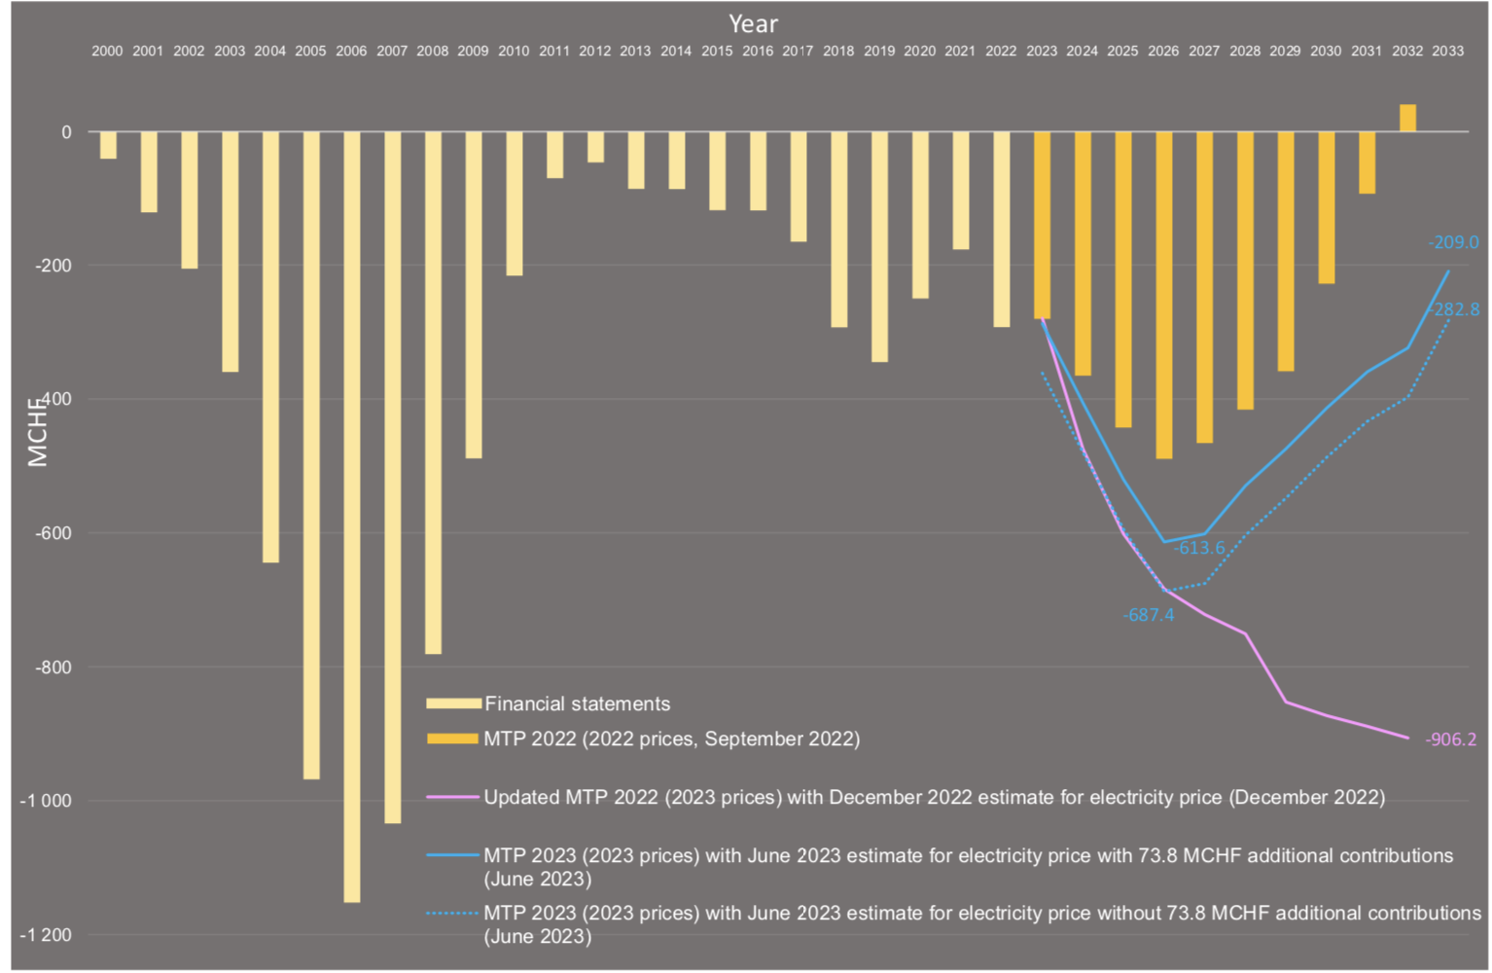
Cumulative budget deficit
CBD in 2023 MTP is back to reasonable shape, despite additional expenses, thanks to reduction of electricity costs, additional 73.8 M contribution from MS/AMS, and significant savings from CERN’s Budget.

Slide 16
Additional expenses
187 M (2024-2028), 330 M (2024-2033)
To cover:
    high-priority scientific projects requiring additional resources (mainly because of cost overrun due to inflation);
    consolidation of technical and site infrastructure
    safety, environment and sustainability
ATS activities supported include HL-LHC, FCC, Muon Collider, NA-CONS, ECN3 upgrade, ISOLDE consolidation, Superconducting RF
Shows strong support and trust in our operational and long-term programmes – really reflects the great work that it being done across the sector.

Slide 17
MTP - summary
This year’s MTP follows the turmoil of last year - things are settling down.
CERN’s scientific programme is supported: LHC programme and its upgrade; facilities and experiments at the injectors; accelerator, detector and computing R&D, and design studies for future colliders.
Additional resources are allocated to high-priority items: North Area consolidation, new SRF building, high-energy frontier, continuation of Detector R&D activities, etc.
These expenses are offset by the additional contribution, reduction in electricity costs and savings from the overall budget
CBD looking better… not dipping to ~zero in early 30s but heading in the right direction to support a bright future for the lab.

Slide 18
North Area: the future is colourful and dark and interesting!
Physics motivation remains strong
  The North Area is an ideal place to Hidden Sector searches in < O(10) GeV range
  Unique QCD possibilities
SPS is adapting well to the foreseen challenges
NA remains vitally important as a test facility

Slide 19
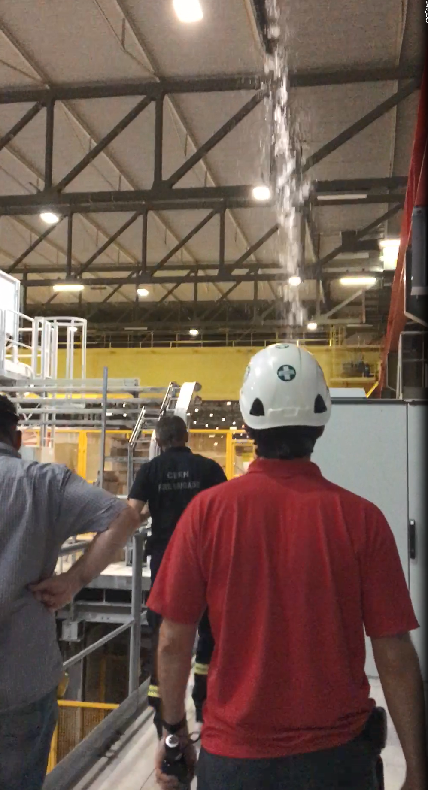
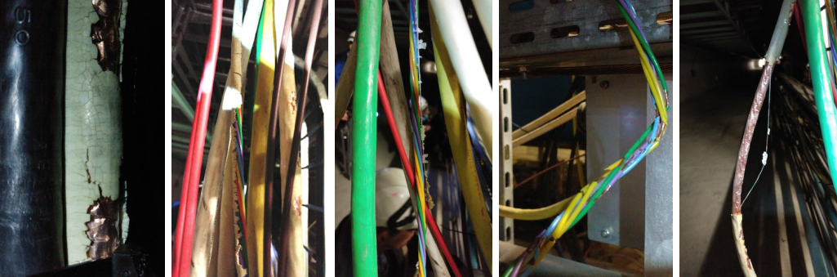
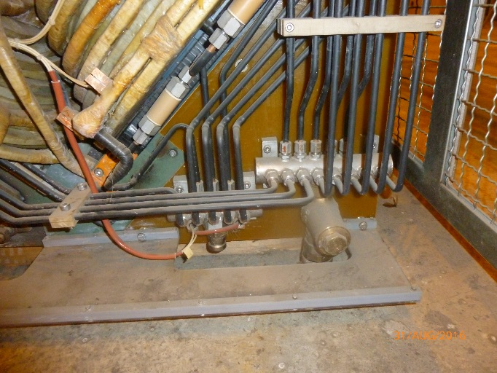
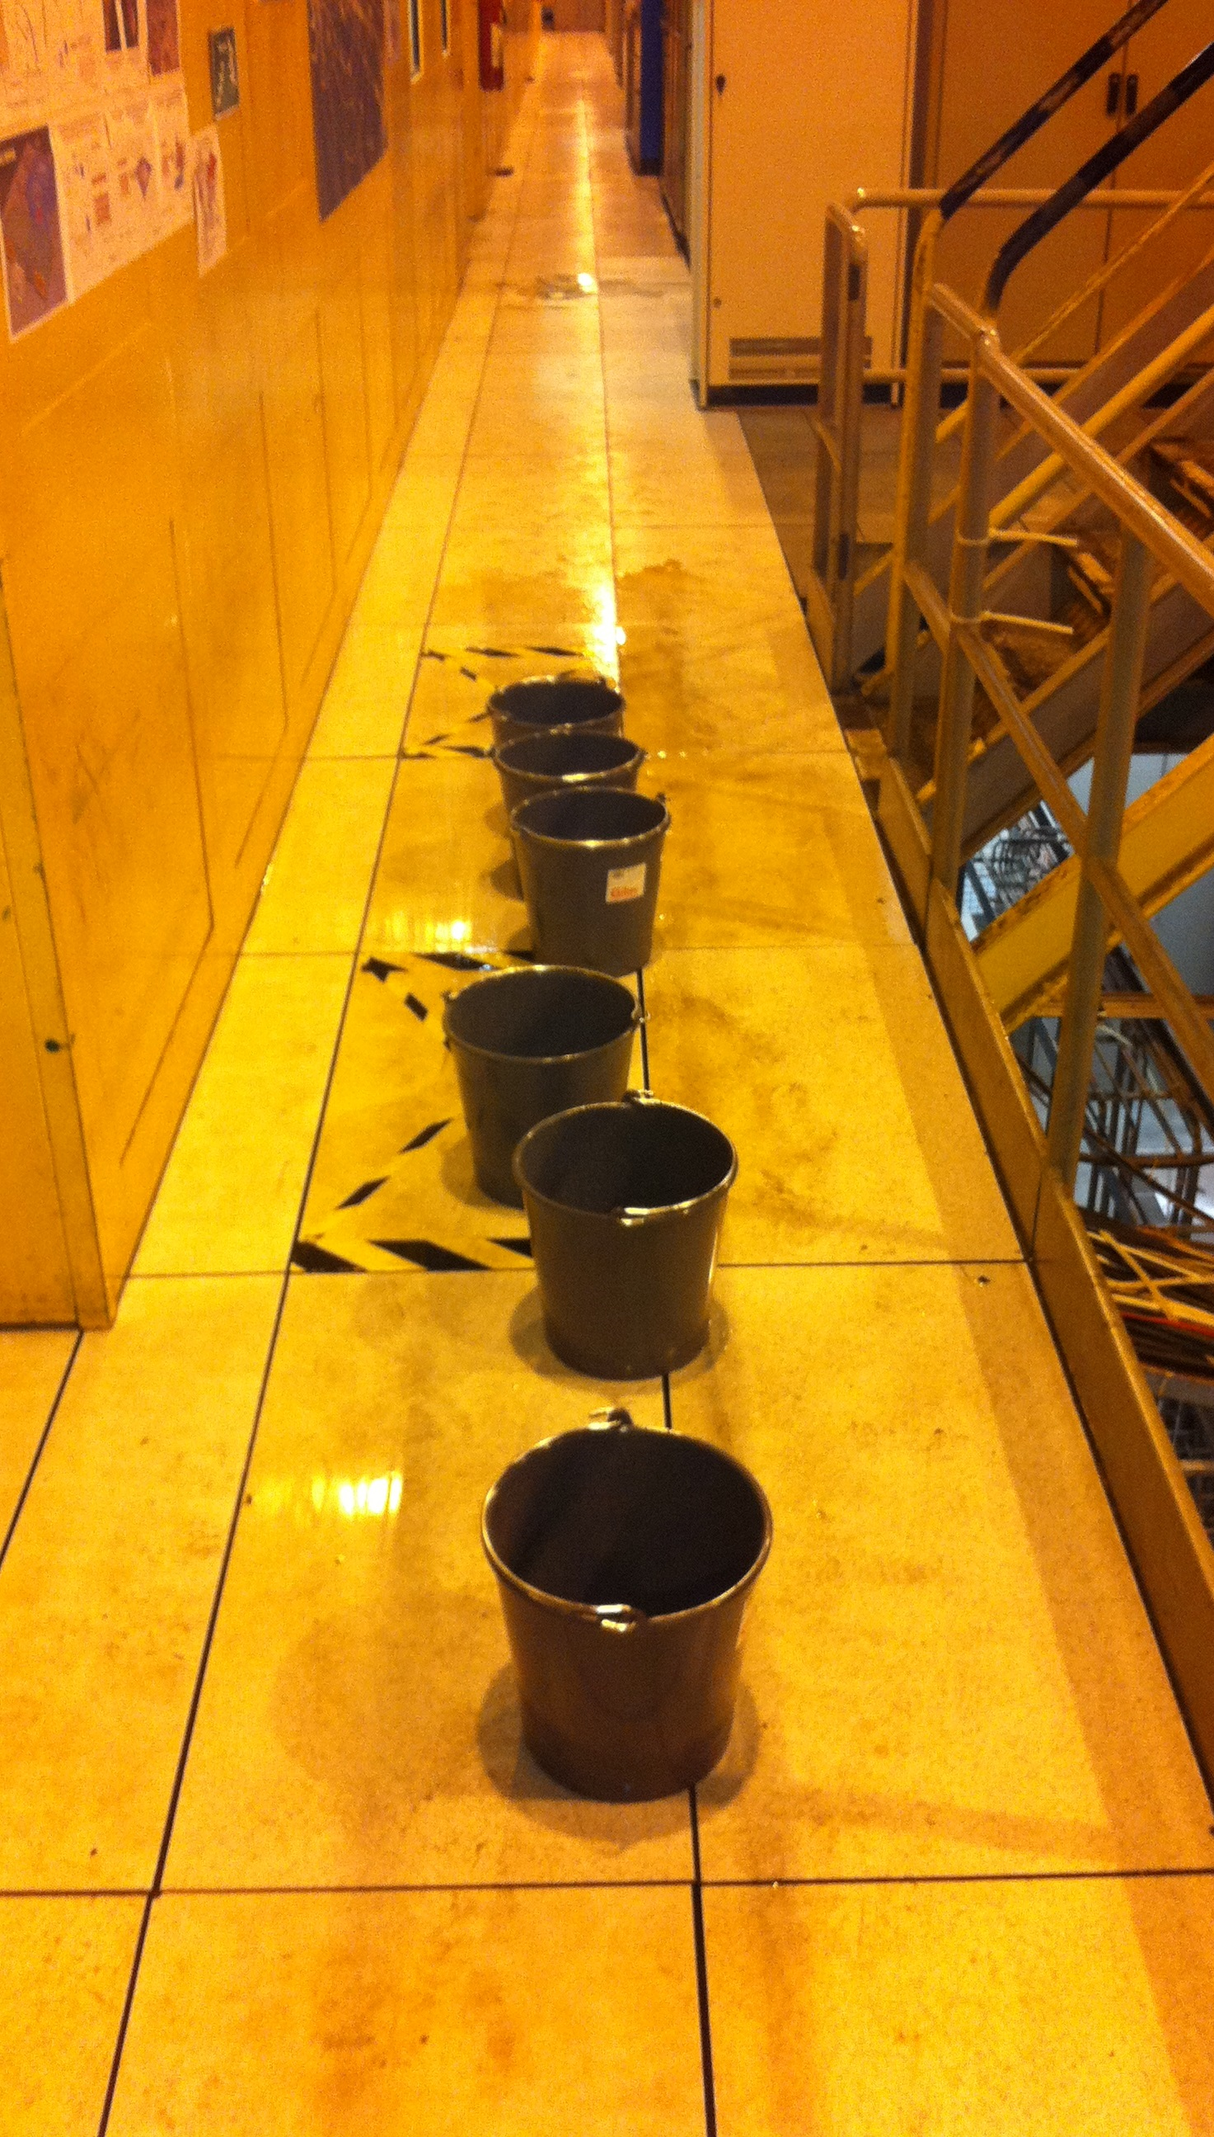
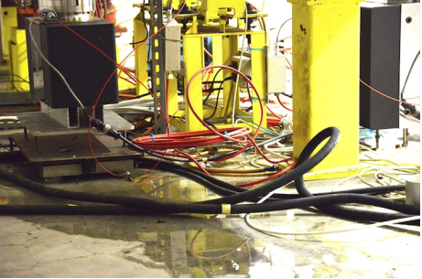
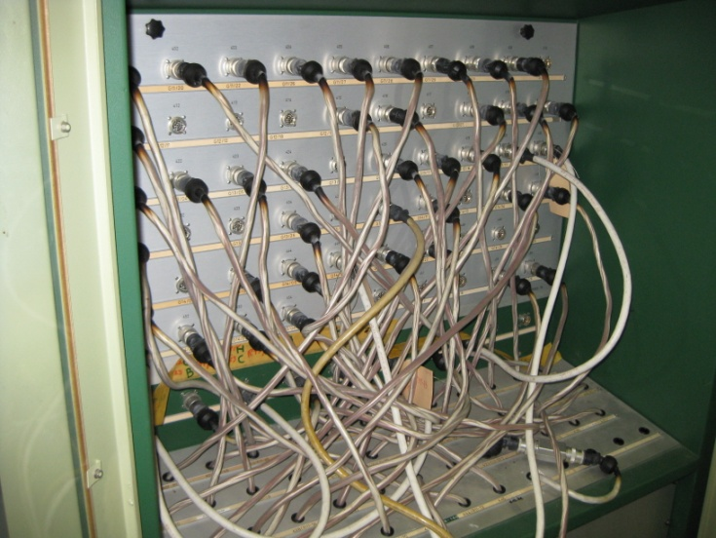

Some loving care and attention required!
Yacine Kadi

Slide 20
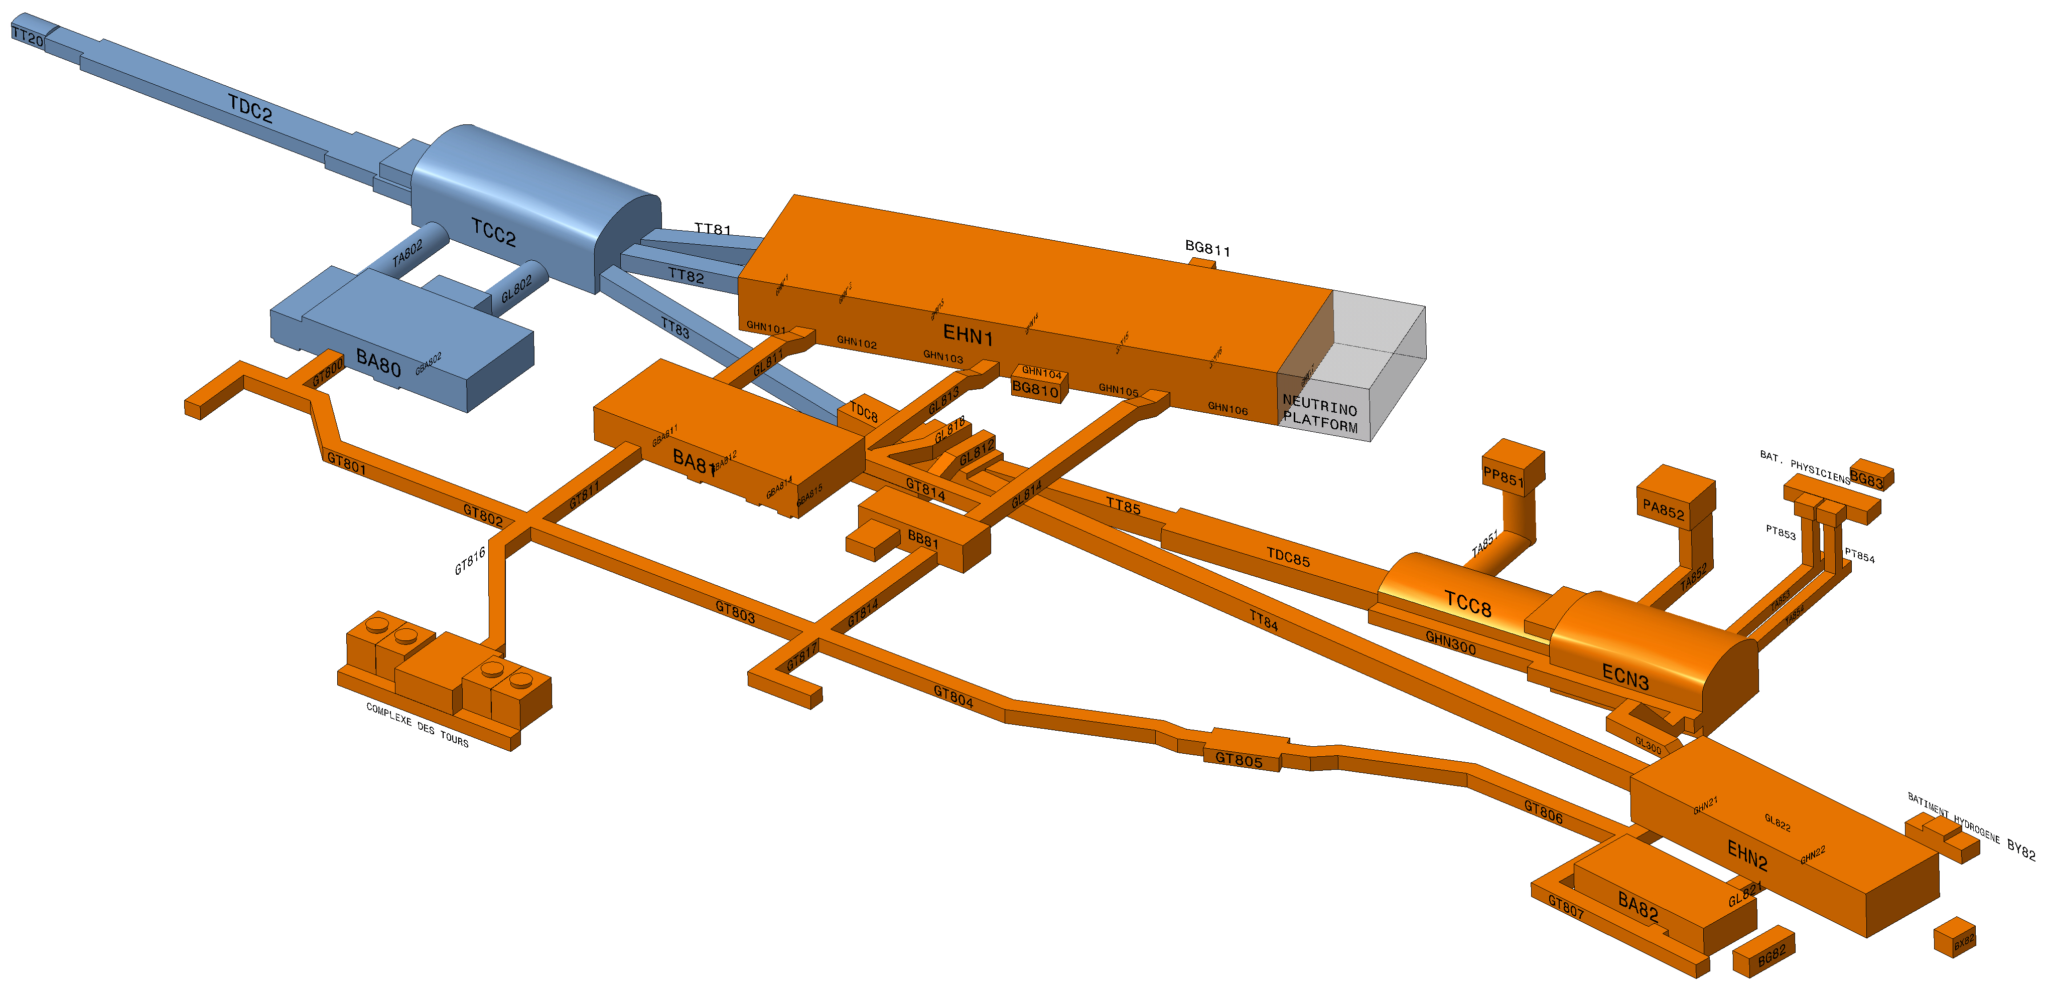
North Area Consolidation
A phase 2 extending up to LS4 will be mandatory to address all issues and reap the full benefits of the programme.
+20 MCHF assigned to Phase 1 – important additions including EL-CONS
65 MCHF (2028-2033) assigned to Phase 2 in the MTP23
Phase 1: 2019 - 2028 => priority to TT20 & NA transfer tunnels
Phase 2: 2029 - 2034 => H2, H4, H6, H8, M2 and K12 beam lines
R&D ATLAS, CMS
R&D ALICE, LHCb
R&D “PBC”
NA64
NA61
GIF ++
Neutrino
Platform
NA62
NA58

Slide 21
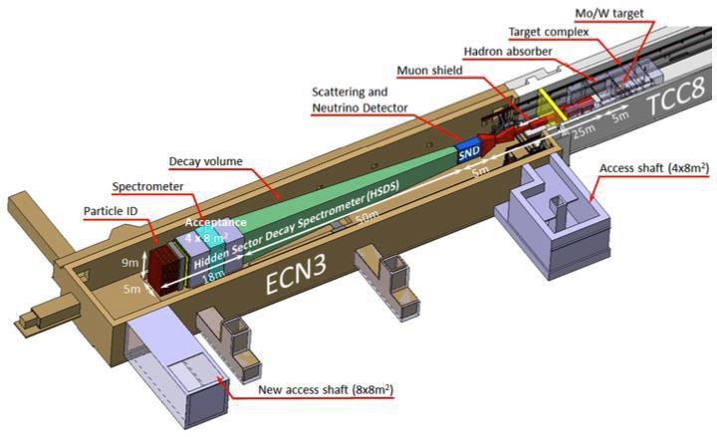
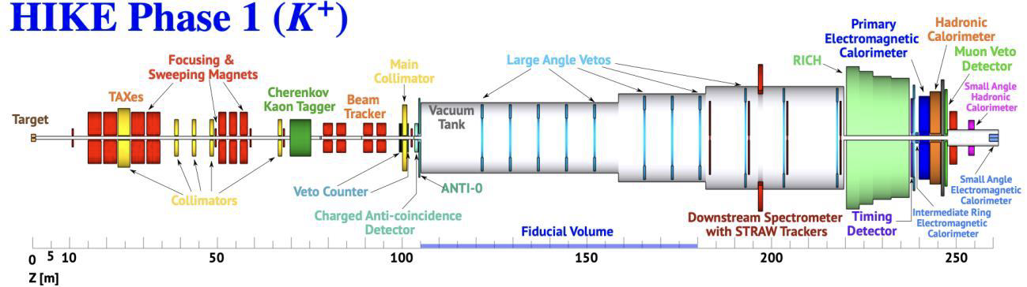
ECN3
A new high intensity facility in ECN3 is technically feasible and can be implemented in synergy with NA-CONS for operation in Run 4
An experiment-specific decision needed from the Research Board before the end of 2023 to start experiment specific detailed TDR phase in 2024
Facility and experiment approval at the end of 2023
First funding envelope approved for essential studies required for the project to go ahead in LS3 if approved
+ SHADOWS

Slide 22
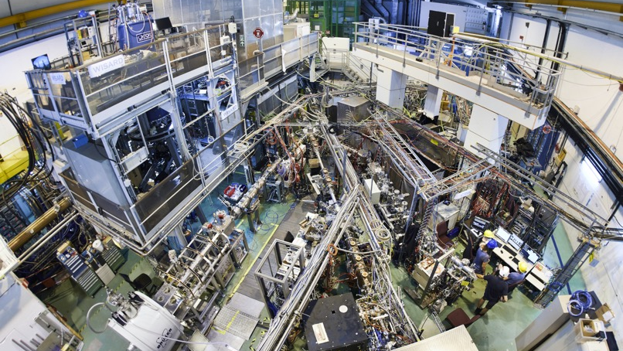

Slide 23
ISOLDE Consolidation
MTP23: urgent items (3.8 MCHF) as part of a combined package with accelerator consolidation to address most immediate needs:
Item | Comment
BTY line power converter consolidation | Compatible with 2 GeV
Beam dumps replacement in LS3 | Estimate ~12 MCHF (class 4) Further study + Market Survey
Fire Safety and Ventilation upgrade for ISOLDE primary areas (B197) | HSE stipulation
REXEBIS solenoid, long term spare | 2023 - 2026
Replacement of REX-ISOLDE solid state amplifiers | 2024+
Maintain HIE SC RF-cavities at ~100K during YETS | Study

Slide 24
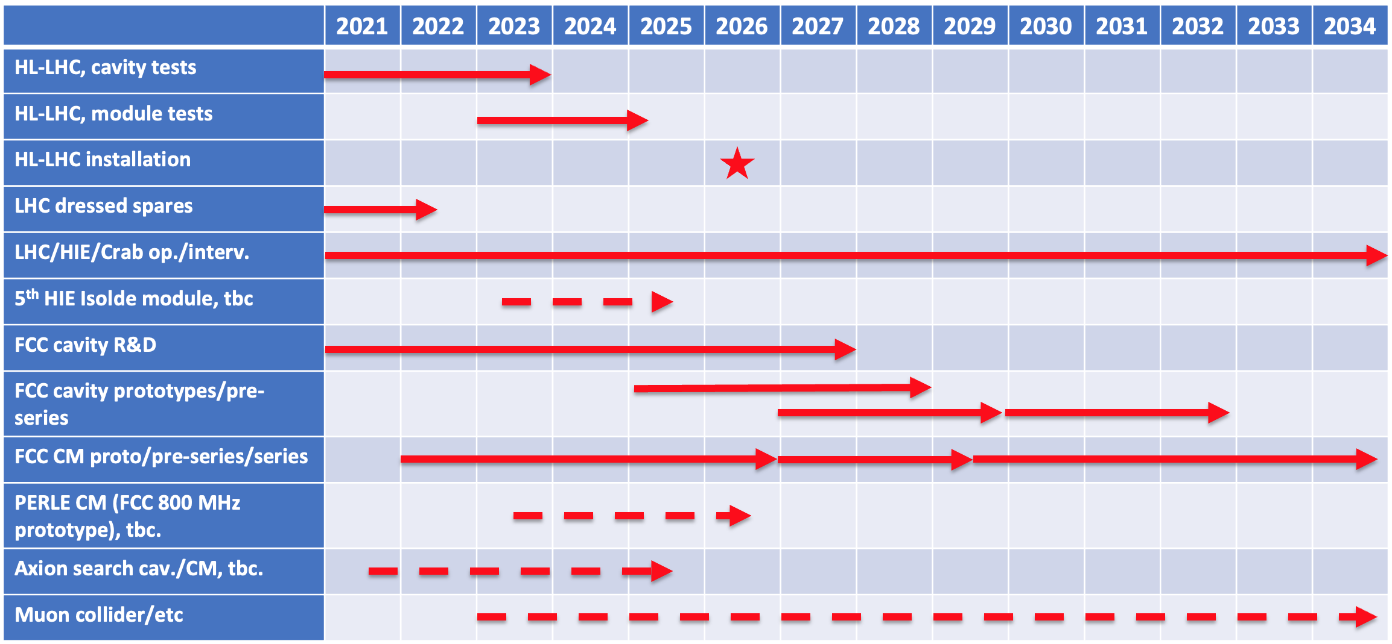
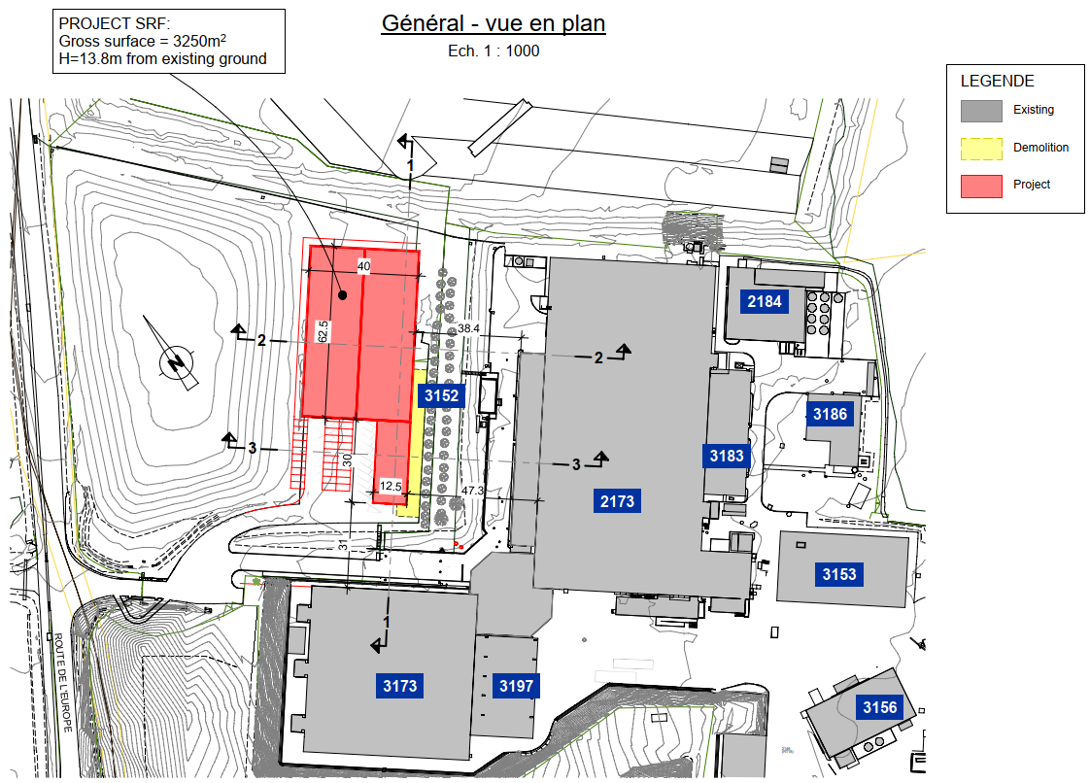
New CERN SRF building
Regrouping of the various scattered RF facilities vital for efficient R&D essential for any future CERN project using Superconducting RF
(Thin Film) SRF R&D is key to:
i) limit the power consumption of all new big projects
ii) reduce capital investment in the SRF systems
(no. of cavities, size of cryo-plants, electrical infrastructure, …)

Slide 25
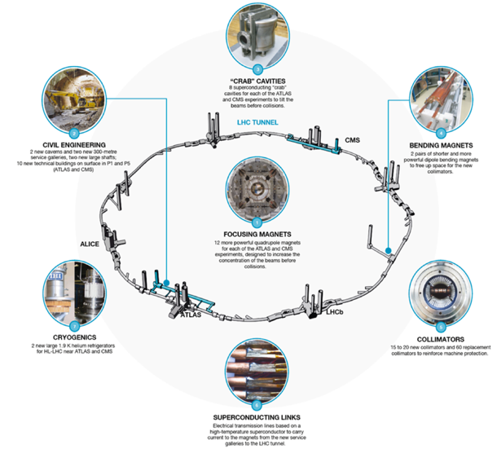
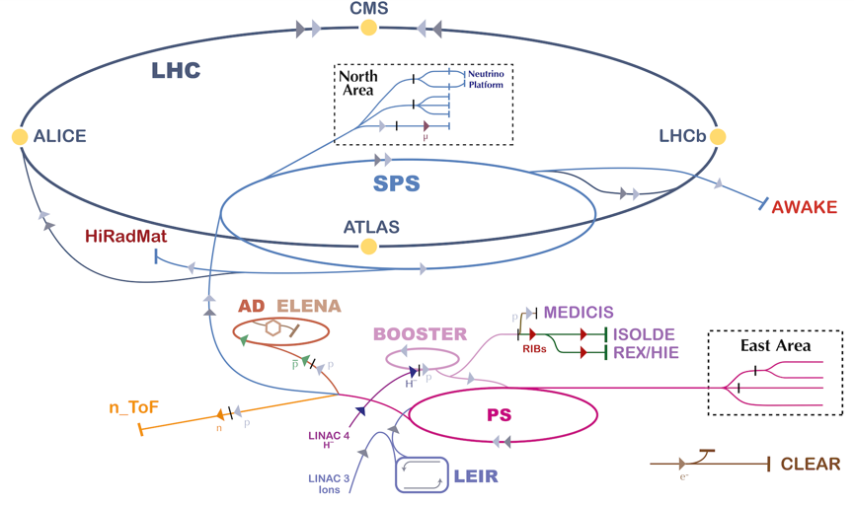
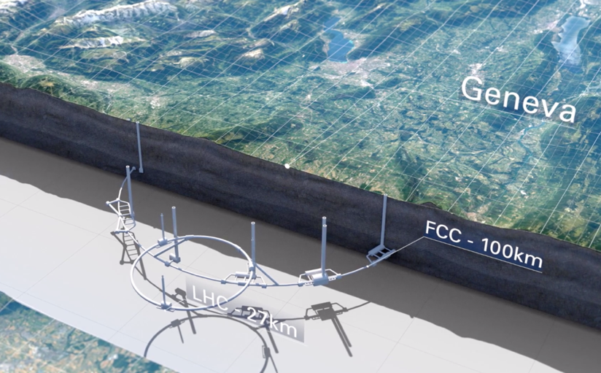
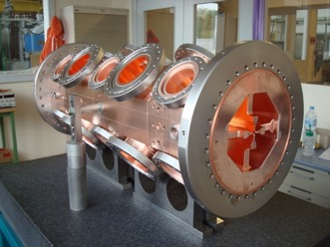
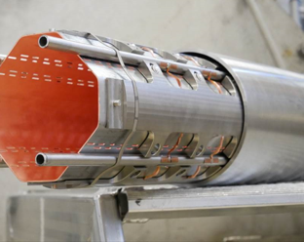

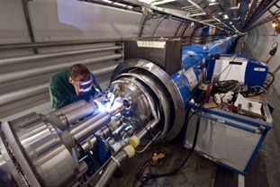
Exploitation
HL-LHC
Future Options
Technology/Engineering/R&D
A unique complex
Unique expertise and capabilities
A rich and well-motivated programme
A great future in front of us

Slide 26
Aligned, and continuing to align, with ESPPU-2020
Full, safe, exploitation of the remarkable potential of the complex
    Due regard to longevity & facility upgrades.
    Backed by a profound technology and engineering base and world-class support facilities.
HL-LHC - flagship machine at the energy frontier out to end ~2041
Future Colliders with FCC-FS as lead
Execution of a European Accelerator R&D Roadmap (High Field Magnets, RF, Muon Collider, Plasma Wakefield Acceleration)
Scientific diversity programme exploiting complex and facilities via Physics Beyond Colliders. Enthusiastic and ambitious user communities.
Sustainability and Societal impact, Outreach and Education as part of our mission. Nexus of an impressive collaborative ecosystem.

Slide 27
CERN’s future
Injector complex facilities and HL-LHC and associated engineering and technology is going take us out until the early 2040s
Our first choice next big machine is the FCC
    It is a credible option and a real possibility.
    There is strong physics motivation.
    If approved this will keep us busy for a long time.
    Hugely challenging infrastructure and technology.
    Sustainability will be key.
There are plan Bs.
An operating HL-LHC and preparation for the FCC should not prevent us from exploiting our remarkable capabilities to invest in R&D, diversity, innovation, knowledge transfer, medical applications, plasma, sustainable energy etc.

Slide 28


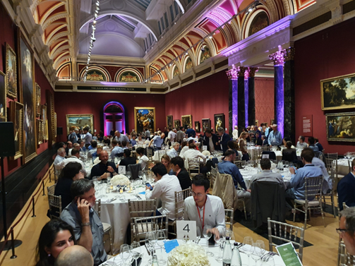
FCC Week 2023, 5 – 9 June, London
473 participants
362 on site incl. 62 1-day passes
111 remote
A very intense and productive week

Slide 29
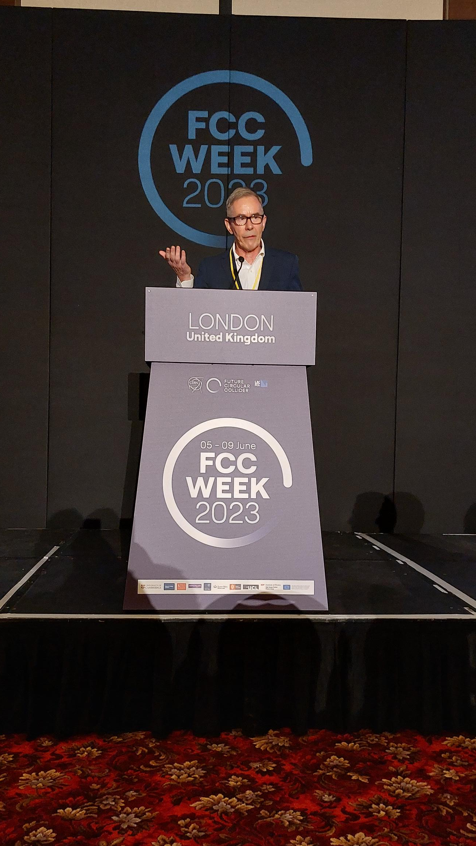
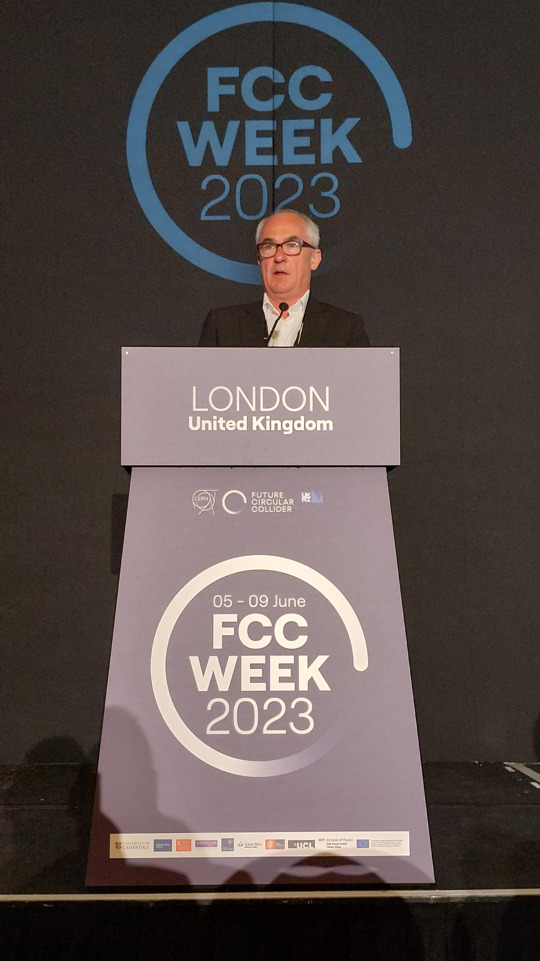
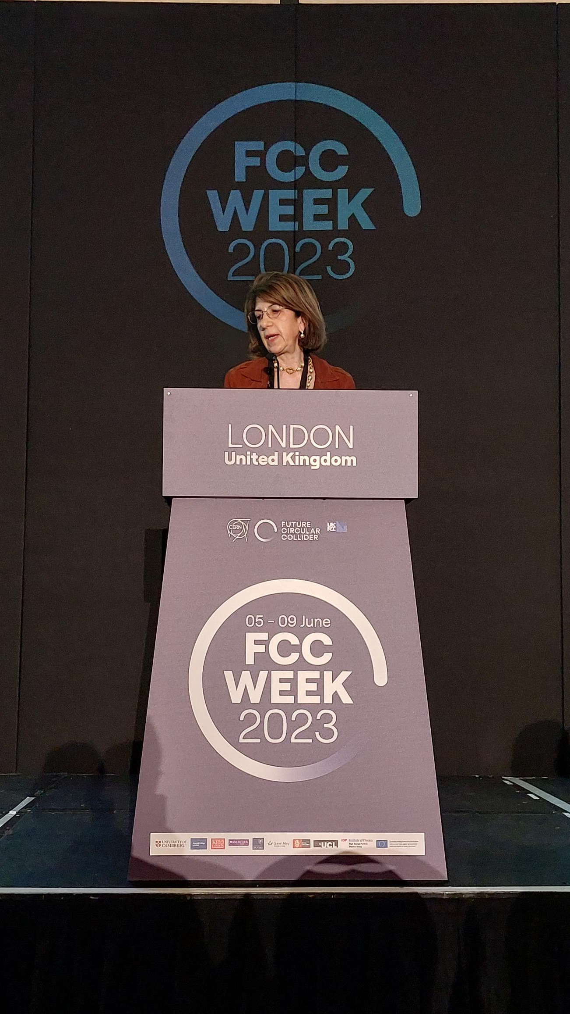
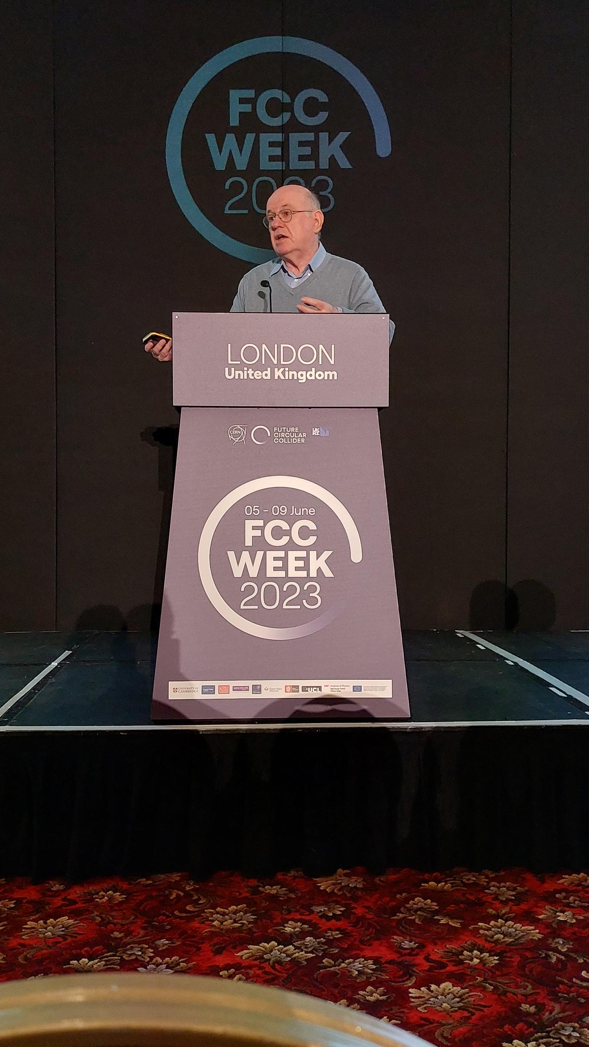
A good start!
FCC-ee the best Higgs factory, and UK fully supportive !
Eliezer Rabinovici,
President of
CERN Council
Ian Shipsey,
Oxford,
Opening Chair
Fabiola Gianotti,
CERN DG
Mark Thomson,
Executive Chair STFC

Slide 30
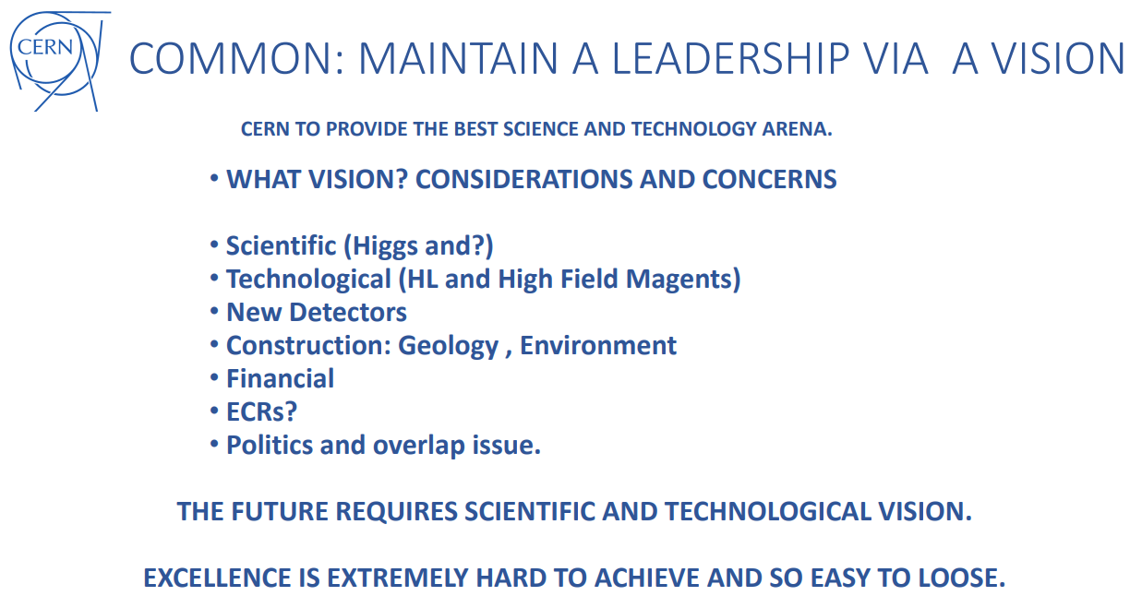
President of Council

Slide 31
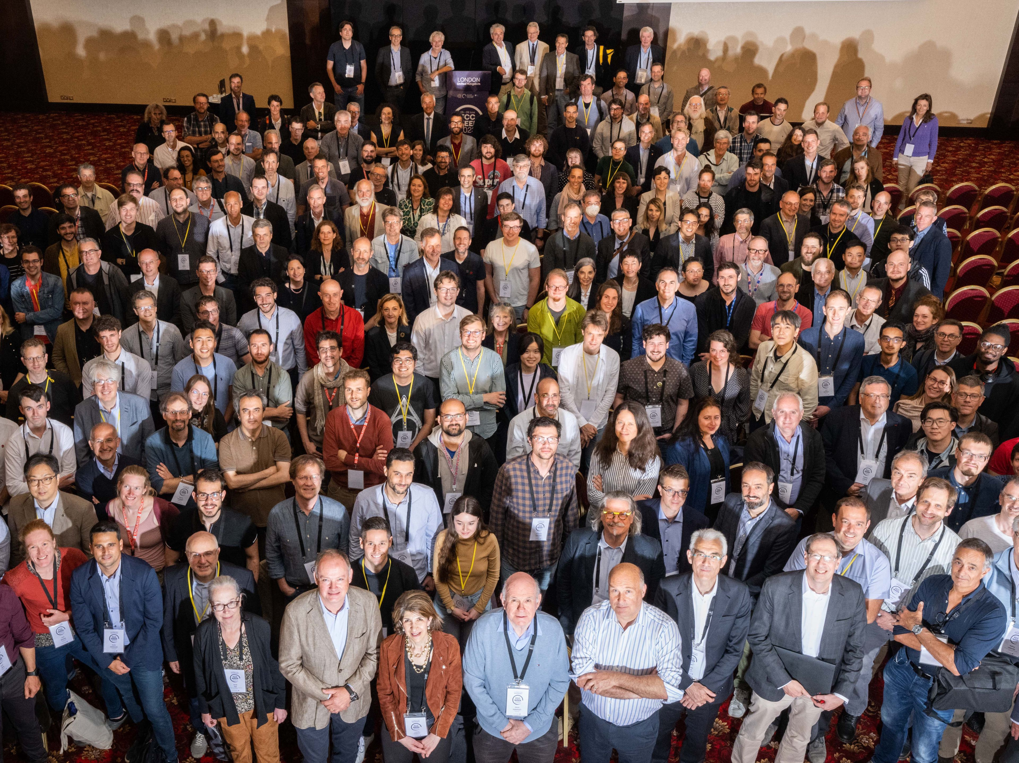
FCC Week 2023
473 participants
362 in person and 111 remote
Great progress everywhere!
A wonderful energetic & competent team and getting younger

Slide 32
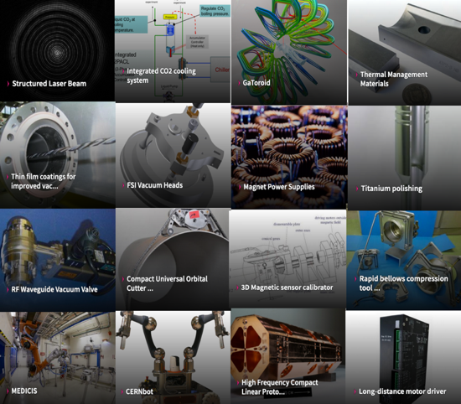
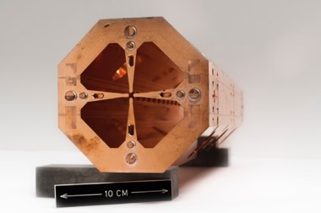
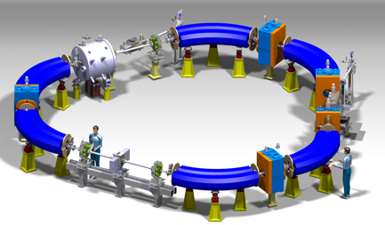
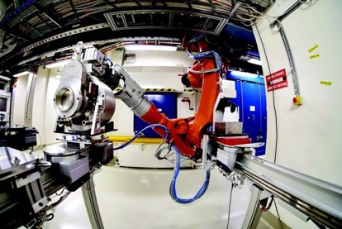
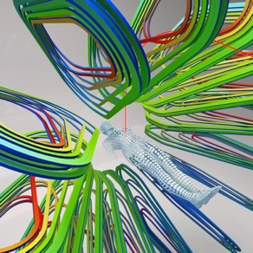




Environmental and societal impact
Awareness of knowledge and technology transfer and the associated societal impact is important at all phases…
Knowledge Transfer
Medical Applications
Compact high-frequency RFQ
Compact Helium Synchrotron
Sustainability
MEDICIS
Compact Gantries (GaToroid, SIGRUM)
Horizon
I.FAST | Fostering Innovation in Accelerator Science and Technology
RADNEXT | Radiation facility network
PRISMAP | European Medical Isotope programme
HITRIplus | Heavy Ion Therapy Research Integration
FCC-IS | FCC Innovation Study
EURO-LABS | European Labs for Accelerator Based Sciences

Slide 33

Electricity
EEX yesterday
Year | Euro/MWh
2024 | 177
2025 | 144
2026 | 109
2027 | 96
2028 | 79

Slide 34

Cost reduction - electricity
Adaption of accelerator schedule in 2024/2025 to minimize electricity costs while not impacting the overall number of days of physics production

Slide 35


Slide 36

European electricity market design
The Commission presented a proposal on 14 March to revise the rules for electricity market design and for improving the EU protection against market manipulation in the wholesale energy
This can be done by way of
  using more long-term contracts, such as power purchase agreements, and
  investment support should be structured as two-way contracts for difference

Slide 37

Power Purchase Agreements
Long term agreements (~15 years) based on renewables at agreed prices
Two ongoing projects at CERN
One PPA provider proposes ~45 GWh per year for a start in 2027. CERN has signed an NDA with the provider
    Management will come back to Finance Committee in Oct. 2023 for a decision
Another PPA provider up to ~170 GWh per year (split in 4 tranches) for a start in 2027. CERN has signed an NDA with the provider.

Slide 38

ATS Fusion Technology Coordination Unit (FTCU)
Coordinate efforts to support Fusion Technology
Technical experts with prior direct experience of activities within the field of magnetically confined fusion
  Provide in-person technical contributions to conceptual and engineering studies, analyses and reviews
  Act as point of contact for specific contributions that could be undertaken by CERN within their domain of expertise
  Liaising with KT and LS on administrative, IP and legal matters
  Liaising with energy and sustainability initiatives
Work compensated by the external contribution covering the full M+P engaged in the activity
Fusion Technology
Luca Bottura

Slide 39
Electrical Safety Project
Deadlines
Pilot deployment: YETS before LS3 (Nov. 2024).
Prioritized deployment start for LS3 (Nov. 2025)
Context
Scope
Mandate
Electrical safety reported as one of the main concerns in ATS, especially in injectors complex, during LS1 and during LS2.
Electrical Safety Project launched in ATS in 2021 to set-up Electrical Safety Management.
Phase 1 (2021-2022)
Report: EDMS 2691446;
External and internal benchmarking;
External expertise by E.S.T.I. with list of open points;
Phase 2: towards implementation (2023 - 2025)
Mandate 8th May 2023
Main objectives
Provide a clear knowledge of the electrical risk at a given point in time (operation / machines stop) in the ATS accelerators/ facilities.
Help make work / interventions safer w.r.t. to the electrical risk in the ATS accelerators/ facilities.
To achieve this, ESP will
Set-up processes (procedures/workflows).
Identify /define roles & responsibilities throughout the processes.
Put in place the Electrical Safety Expert Team (ESET).
Organize /provide documents & data, develop tools to support equipment groups and ESET in its future activity.
Electrical safety;
Accelerators complex: injectors, LHC and transfer lines.
Experimental areas: EA, NA, ISOLDE/HIE- ISOLDE, CLEAR, NTOF, AD, HiRadMat.
ATS projects: HL-LHC, AWAKE, NA-CONS.
Machine buildings linked to the accelerators complex.
Excluded from the scope: LHC experiments and CERN campus.
Anne Laure Perrot (PL) – Christophe Mugnier (DPL)

Slide 40

Staff Survey – ATS – January 23
Development Opportunities
    Career development
    Internal mobility
    Training
Work Environment
    Resources, resources, resources
    Retention of expertise
    State of offices and catering facilities
Vision
    Need to think about tailoring communications to reach all personnel
    Uncertainty about post HL-LHC era
    Resource prioritization

Slide 41

Results of Staff Surveys
Engagement is the degree to which your employees are inspired and energised by their work. It also refers to their positive connection to your organisation. Engaged employees experience their work as meaningful and rewarding, are proud of their jobs, and feel that they fit in at the organisation. They can go the extra mile because they love what they do and where they work. Your engagement score will tell you how enthusiastic your employees are about their work and how connected they feel to your organisation.
ATS lowest score < CERN < ATS highest score
79,3 < 83,2 < 85,3
86.2% enjoy their work
91.2% are proud to work at CERN
91.4% care about the future of CERN
but…!
Warm thanks for your participation with a representative response rate and your overall commitment. The departments/units come back to you with the detailed answers and analysis.

Slide 42







Recent staff survey - qualitative analysis
ATS Survey Oct 2022
Topics to address
Conclusion :
- People happy in their daily and immediate work environment (content and colleagues) and having the feeling to contribute directly to CERN mission
- But if we compare with the ATS Survey results, we can find similar outcome on Development opportunities and the vision (prioritisation of activities and resources) and, in addition, a need for recognition.
In addition to global ATS actions, each department is now working to towards implementing their own adapted actions following the surveys

Slide 43
ATS Internal Mobility
IM pool in place – a data base of available candidates who have raised their hands
Concerted drive by ATS management to systematically cross-check vacancies against IM pool for matches
- IM dedicated slots at ATS-MB (quarterly)
- End of year review to reallocate resources if needed
Well prepared : ATS wide consolidated data based* on APT/MPP
Being deployed
Sharing and brainstorming at ATS and dpmt levels in the Organization interest
Transparency
Priority on IM when possible : temporary, short assignments…
Action
Creativity
Discussions
Preparation
Co-funding : agreeing on taking risks, including financial ones
JOBs
MoP
Anticipation
Collective monitoring

Slide 44
Workload
Difficult one – there’s no doubt that the next 3 to 4 years are going to be (very) busy
Completion of HL-LHC construction will allow re-allocation of resources to other areas.
Nevertheless – we are aware of the issue
  Last year succeeded in getting replacement project posts (total 57 from various sources)
  All new activities must be resourced appropriately
  Looking for increased adaptability & mobility

Slide 45







New ATS Website incoming
ATS Common Hardware & Software Technologies Technical Board (CTTB) set-up to improve cross-group and synergetic developments

Slide 46


Slide 47






777 Prévessin
Passed adjudication last week
Should move in ~2027
~500 members of ATS

Slide 48


Slide 49
Diversity – actions within Departments
  Conscious selection with diversity in mind for TECH/DOCT/FELLOW
  Supervisors asked to look for candidates from a diverse population & to select most suitable candidate
  Has significantly increased the number of females and personnel from lowly represented MS in particular for TECH/DOCT
  Will result in more diverse talent pipeline in future for other statuses
  General initiative from HR with diversity followed-up at all stages of the staff recruitment process – still being improved
  All Departments now have a departmental action plan with concrete actions to be put in place with regular follow-up with the Departmental Diversity & Inclusion Officers

Slide 50





OUR VISION
scientific excellence through diversity and inclusion
OUR GOAL
to increase the nationality and gender diversity of Staff & Fellows (MPE) population by 2025
2020
25 by ‘25 Periodic Update: 01 June 2023
25 by ‘25 Strategy Proposal submitted to Director-General
* Departmental Review Exercise
D&I maturity assessment across 6 «GDEIB» benchmark categories:
Recruitment
Career Evolution
Benefits, Work-life integration
Leadership
Communications
L&D
2021
Enlarged Directorate endorses Strategy Proposal
Department Heads appoint 33 Focal Points
Kick-off meetings: Department Head + Focal Points
Focal Points create & consult Focus Groups
HR designs Departmental Nat / Gen Dashboards
** Departmental Fitness Plans
Selecting from >40 Action Menu items toward greater Nat / Gen diversity:
Appointment of DIO
Exit survey
Recruitment stats
Address unconscious bias in recruitment / promotion
Promote D&I learnings
Networking / Mentoring
2022
1st D&I Review Exercise *
Action Menu launched + Fitness Plans approved **
Departmental Diversity & Inclusion Officers (19 DIOs) appointed
DIOs establish a Community of Practice
2023
Women in STEM, MPEs professional categories 1,2,3
2020 | 12.36%
2021 | 13.22%
2022 | 14.00%
“Transforming Bias” Workshop Pilot
D&I analysis on nationality representation
Source: CERN Annual Personnel Statistics + HRT at 31 Dec 2022

Slide 51
Closing remarks
We’ve come through a difficult period with the help of everyone!
Challenges remain, adaptability and anticipation are going to be key.
Issues identified by the staff surveys are being actioned, we’ll keep on it, and report back periodically.
Really great to see the dedication, engagement, our creativity, ability to work together to solve problems… continuing to make CERN, as Eliezer put it, “a very special place”.
We can, and will, leverage our capabilities, reputation, and the strong support to assure a bright future for the lab.
Thanks and have a great summer!

