Slide 2
The IT Department
Innovation Model
Alberto Di Meglio
Head of Innovation
IT Department
IT Innovation & CERN openlab

Slide 3
CERN IT Department Core Missions
IT as Provider
IT as Optimiser
IT as Pioneer
IT as Connector
Increase CERN’s scientific, societal and economic impact
Meet the Information Technology needs of the Organization
R&D
Innovation
Operations
Engagement
Prepare for the challenges of the scientific programmes’
evolution and the lab’s future
Support CERN’s existing scientific programmes by
deploying production quality services

Slide 4
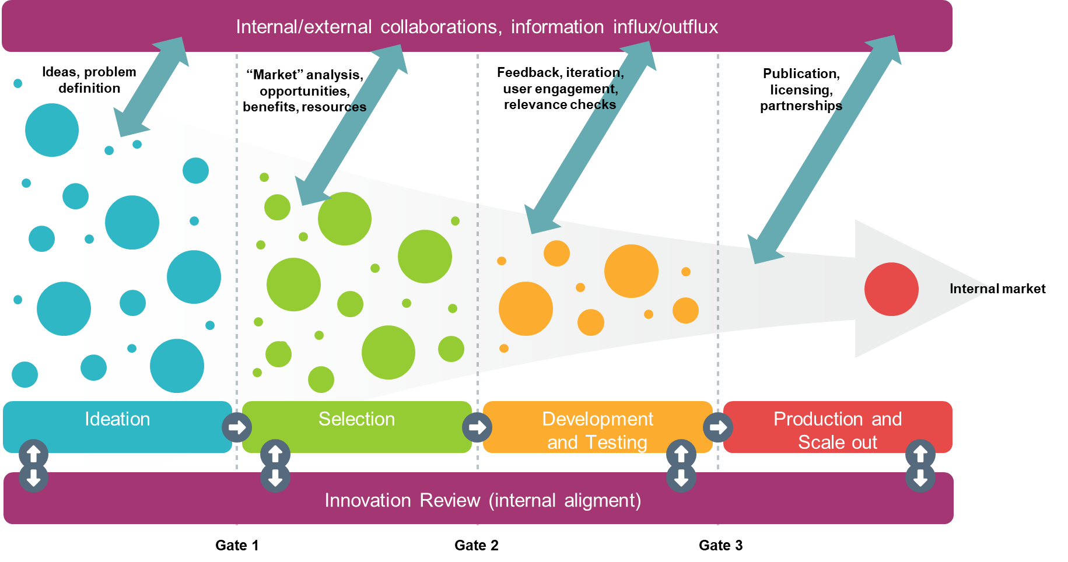
Open Innovation
“Innovation is the process of turning ideas into solutions to generate value”
There are several models of Innovation developed in the past 40+ years
The one we take as base model is the Open Innovation framework
Chesbrough, Henry William (1 March 2003). Open Innovation: The new imperative for creating and profiting from technology. Boston: Harvard Business School Press. ISBN 978-1578518371.

Slide 5
Innovation scopes
Project-based Innovation
Innovation resulting from continuous service improvements
Ideation
Innovation activities within stated objectives, expected results, transformation in addition to evolution, longer-term impact, dedicated resources, formal monitoring and reporting
User needs
Strategies
Part of the continuous optimisation and evolution of services in each Group, within standard operations budget, standard reporting
Informal channels and discussions, multiple formats

Slide 6
Innovation and collaboration channels
IT Projects
From
Engagement, Technical Delivery,
IT Ideation
Core strategic activities
KT Projects
KT Funds
Medical Apps
CIPEA
Impact Fund
CERN & Society Foundation,
etc.
CERN Programmes
Quantum Technology Initiative
DS&AI Initiatives
Open Science
CERN openlab
Industrial and academic projects
Short/Medium-Term
Public/private R&D partnerships
Strategic Partnerships
Ex. other international organisations
(ex. WHO, ESA)
Long-term industrial collaborations
EC Programmes
Horizon
Europe
EOSC
EuroHPC
EQF
Open Science
Internal funding
Co-development, investments, external funding
IT invests in supervision, knowledge, infrastructure
Programmes complementarity and alignment

Slide 7
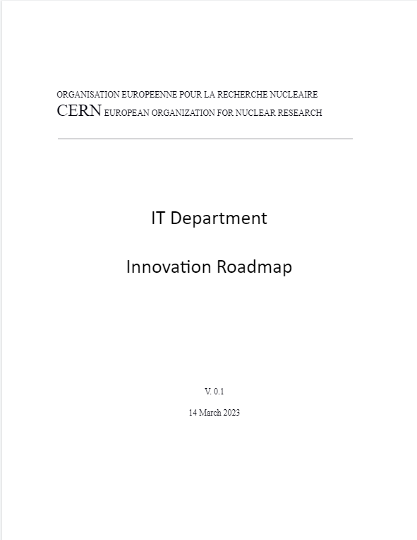
IT Innovation Roadmap
Formal document describing the Innovation strategy, objectives, processes, collaboration channels, etc.
Being developed in collaboration across the the IT Department functions and technical groups and the CERN community
Internal draft being review now before broader review across the community in April-May 2023
A version of this Roadmap will also be published a white paper building on and extending the traditional CERN openlab white paper published at the beginning of each new phase

Slide 8
SM/Higgs Characterisation
BSM, Dark Matter
Run3
HL-LHC Start
HL-LHC Runs
FCC
Low-Energy Physics, Neutrino Platform, Physics Beyond Colliders, Theory
2025
2030
2040
2050-2070
Short
Medium
Long-Term
Review of storage & computing strategies
Support for AI applications
Transition from on-premise to hybrid
Software Engineering
Operational integration with cloud/HPC infrastructures (network and resources)
AI operations at scale
Digital Twins PoC
Quantum NISQ
Distributed hierarchical storage/CDN/Data Lakes
Software Defined Heterogeneous Architectures
Future Storage Technologies
Digital Twins for Accelerators/Detectors design and operations
Foundation Models for Physics
Real-time AI
Quantum Technologies

Slide 9
Objectives at a glance
Open Science and Impact
Technology and services
Scale-up, collaborations
Long-term investigation
SDIs
Digital Twins
Foundation Models
Quantum Technologies
Artificial Intelligence
Algorithms, Platforms and Services
Computing
Heterogeneous Infrastructures and Software
Data Storage and Management
Hierarchical storage and data distribution

Slide 10
Objective 1: Introduce heterogeneous computing infrastructures and software engineering services and tools
Why (Impact)
What (Results)
Examples (activities)
CERN and experiments computing needs are evolving towards new computing architectures and services beyond what can be provided only from on-premise
Integrate heterogeneous resources on-premise, cloud, and HPC
Analysis Facilities
Support development of software able to exploit such resources
Performance and energy consumption
Assessment of performance and portability libraries (Intel oneAPI Intel)
ML/DL development, performance benchmarks (RAISE)
Partnerships and agreements with commercial Cloud providers and HPC centres for testing, validation, integration, software development (CERN openlab, EC projects, EuroHPC)
Software engineering, optimisation, benchmarks with experiments (MadGraph and AdePT)
Devel, test, training on GPUs, FPGAs, CUDA, C++
(E4, Nvidia, Micron, HSF)

Slide 11
Objective 2: Scale-up data management, data storage, databases towards HL-LHC requirements
Why (Impact)
What (Results)
Examples (activities)
HL-LHC comes with severely scaled-up requirements in terms of data volumes and analysis requirements and additional flexibility in moving data across the infrastructure but also across interactivity scopes (cold/warm/hot)
Analysis facilities
Assess CDNs, Data Lakes, different topologies and architectures. Set up PoCs
Interact/integrate with international data management initiatives and services
Synch&Share, ScienceMesh development (CS3MESH4EOSC)
DAOS evaluation for caches and databases (Intel)
Replication, cloud-enabled BC/DR (Oracle)
Data archival technologies and applications (ARCHIVER)

Slide 12
Objective 3: Support the introduction of AI in the community
Why (Impact)
What (Results)
Examples (activities)
AI has become an essential tool in all research activities, the IT department needs to support it and provide the necessary services. AI services require close coordination of networking, computing, storage and platforms
Revise the IT services portfolio and design new services based on best-of-breed technologies on-premise, cloud and HPC. Work in close collaboration with users and technology infrastructure providers. Take part in common algorithm development and optimisation
Generative Models for detector simulation (Intel, Nvidia)
AI models lifecycle, model repositories (Oracle)
Data acquisition denoising (IBM, Dune)
Event classification with Kubernetes (Google)
Network traffic optimisation (CS)
Graph networks for Reconstruction (CMS)
Neural Architecture Searches, hyperparameters tuning (various collaborations with HPC centres in EU and US)

Slide 13
Objective 4: Keep the IT Department at the forefront of R&D
Why (Impact)
What (Results)
Examples (activities)
CERN objectives as part of the HEP community are long term. Future programmes such as HL-LHC, Physics Beyond Colliders or the FCC require technologies not yet available today. CERN and CERN IT need to keep a leading role.
Investigate and set up PoC projects in emerging technologies like advanced AI and Foundational Models, Digital Twins, quantum computing, future network and storage technologies; collaborate with other labs and industry
Quantum Computing algorithms development and characterisation for various HEP applications (experiments and theory)
Long-term network & infrastructures
technology co-development (classic and quantum)
Digital Twins design and development for HEP detectors, robotics, industrial systems (InterTwin)
Foundation models for physics
Evaluation of emerging storage technologies (cristals, DNA-based storage)

Slide 14
Objective 5: Enable and Support Open Science and Societal Impact
Why (Impact)
What (Results)
Examples (activities)
CERN mission goes beyond HEP research, the broad objective of societal impact is an explicit part of such mission. Generating and sharing knowledge and supporting open science has a critical positive impact on CERN reputation
Engage in selected multi-disciplinary activities supporting the impact strategies defined by CERN (industry, medical, climate, aerospace/Earth observation)
Advance knowledge, contribute to open tools and policies, support other scientific communities
Innovation in digital asset management, reproducibility, collaboration tools where CERN technologies have measurable impact (Invenio, Zenodo, REANA, Onboard, etc.)
Digital Twins and Federated Learning for climate and social sciences, medical applications (InterTwin)
Contributions to open search tools and intelligent semantic analysis of scientific text and data (OpenWebSearch, CAiMiRA)
Innovative AI-based modelling and prediction of extreme whether phenomena (EMP2)
Quantum-safe and post-quantum applications (Quantumacy)

Slide 15
Innovation and collaboration channels
IT Projects
From
Engagement, Technical Delivery,
IT Ideation
Core strategic activities
KT Projects
KT Funds
Medical Apps
CIPEA
Impact Fund
CERN & Society Foundation,
etc.
CERN Programmes
Quantum Technology Initiative
DS&AI Initiatives
Open Science
CERN openlab
Industrial and academic projects
Short/Medium-Term
Public/private R&D partnerships
Strategic Partnerships
Ex. other international organisations
(ex. WHO, ESA)
Long-term industrial collaborations
EC Programmes
Horizon
Europe
EOSC
EuroHPC
EQF
Open Science
Internal funding
Co-development, investments, external funding
IT invests in supervision, knowledge, infrastructure
Programmes complementarity and alignment

Slide 16


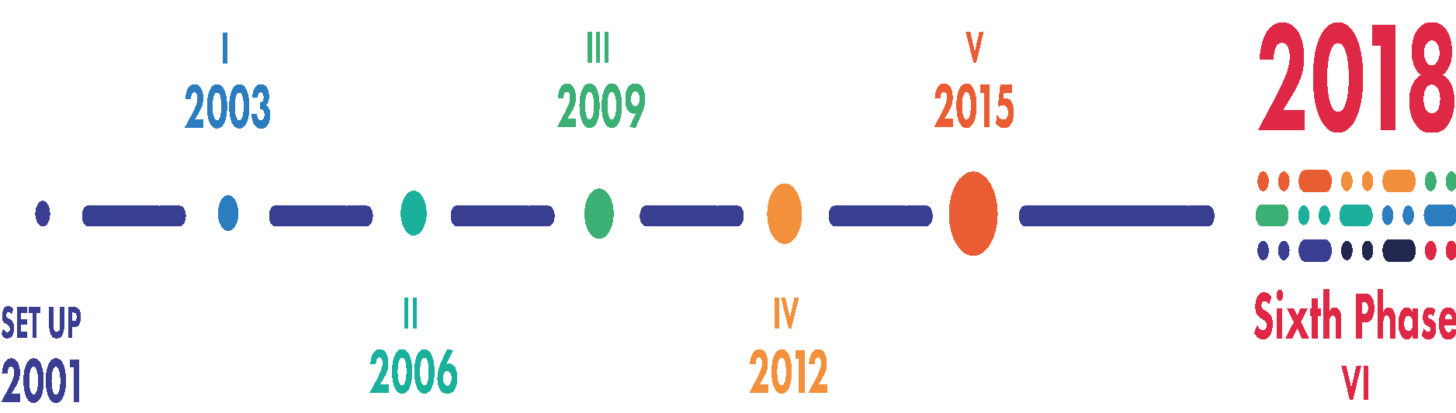


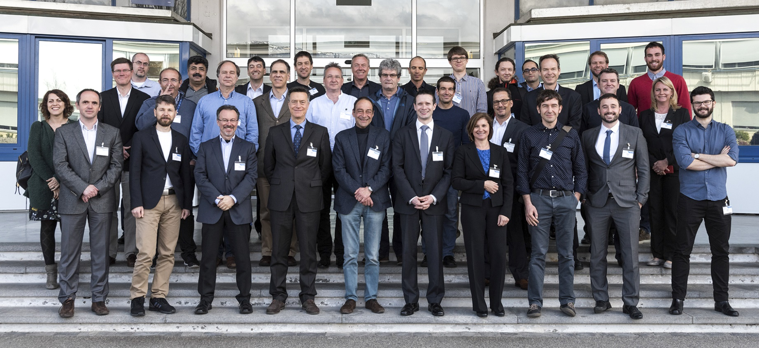
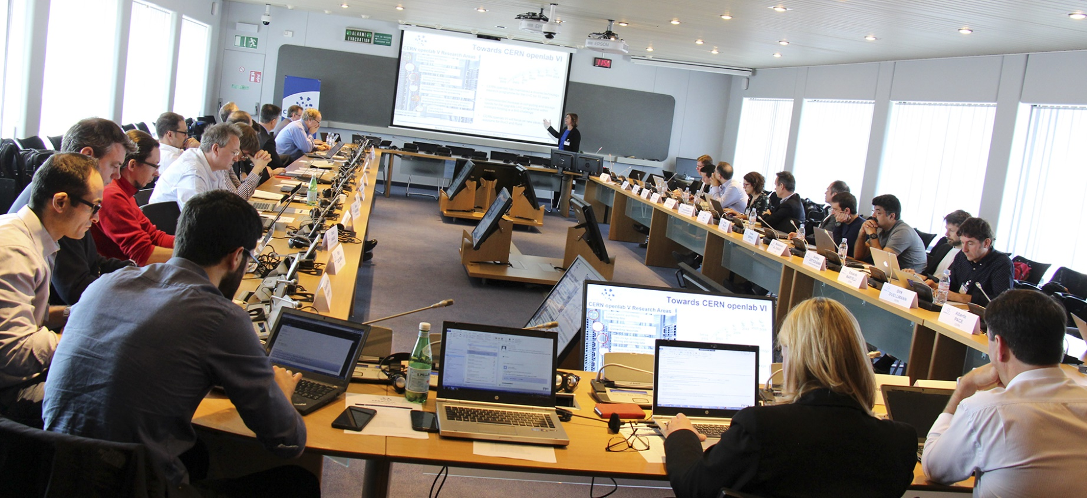
DRIVING INNOVATION
FOR 20 YEARS
2021
Seventh Phase
VII

Slide 17
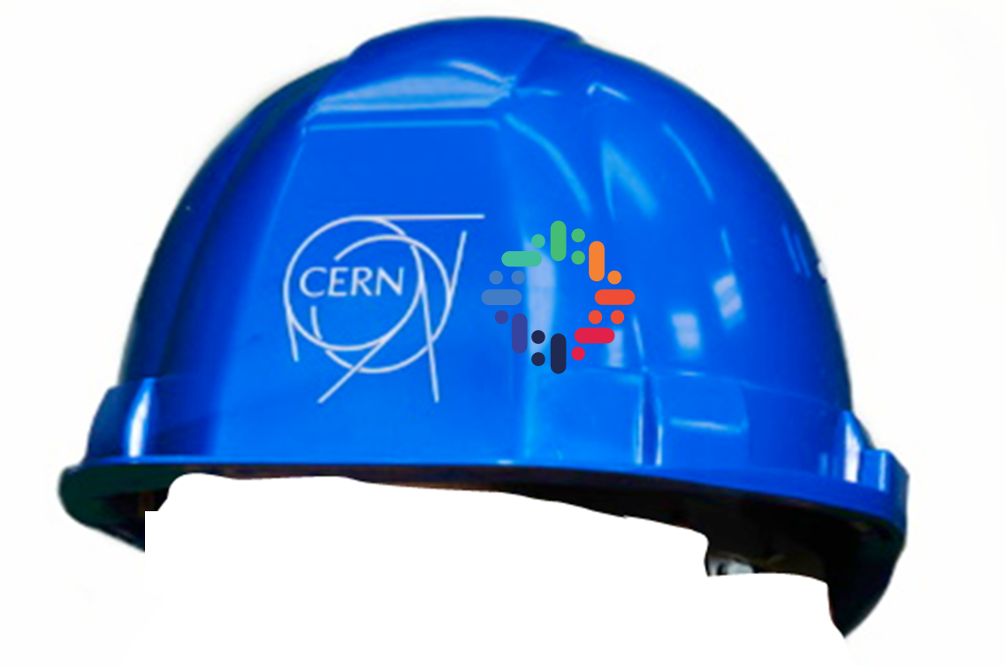
Thanks!
alberto.di.meglio@cern.ch
@AlbertoDiMeglio
IT Innovation & CERN openlab

