Slide 1
A safe summer: looking after your health
Medical service
June 2023
EDMS reference

Slide 2
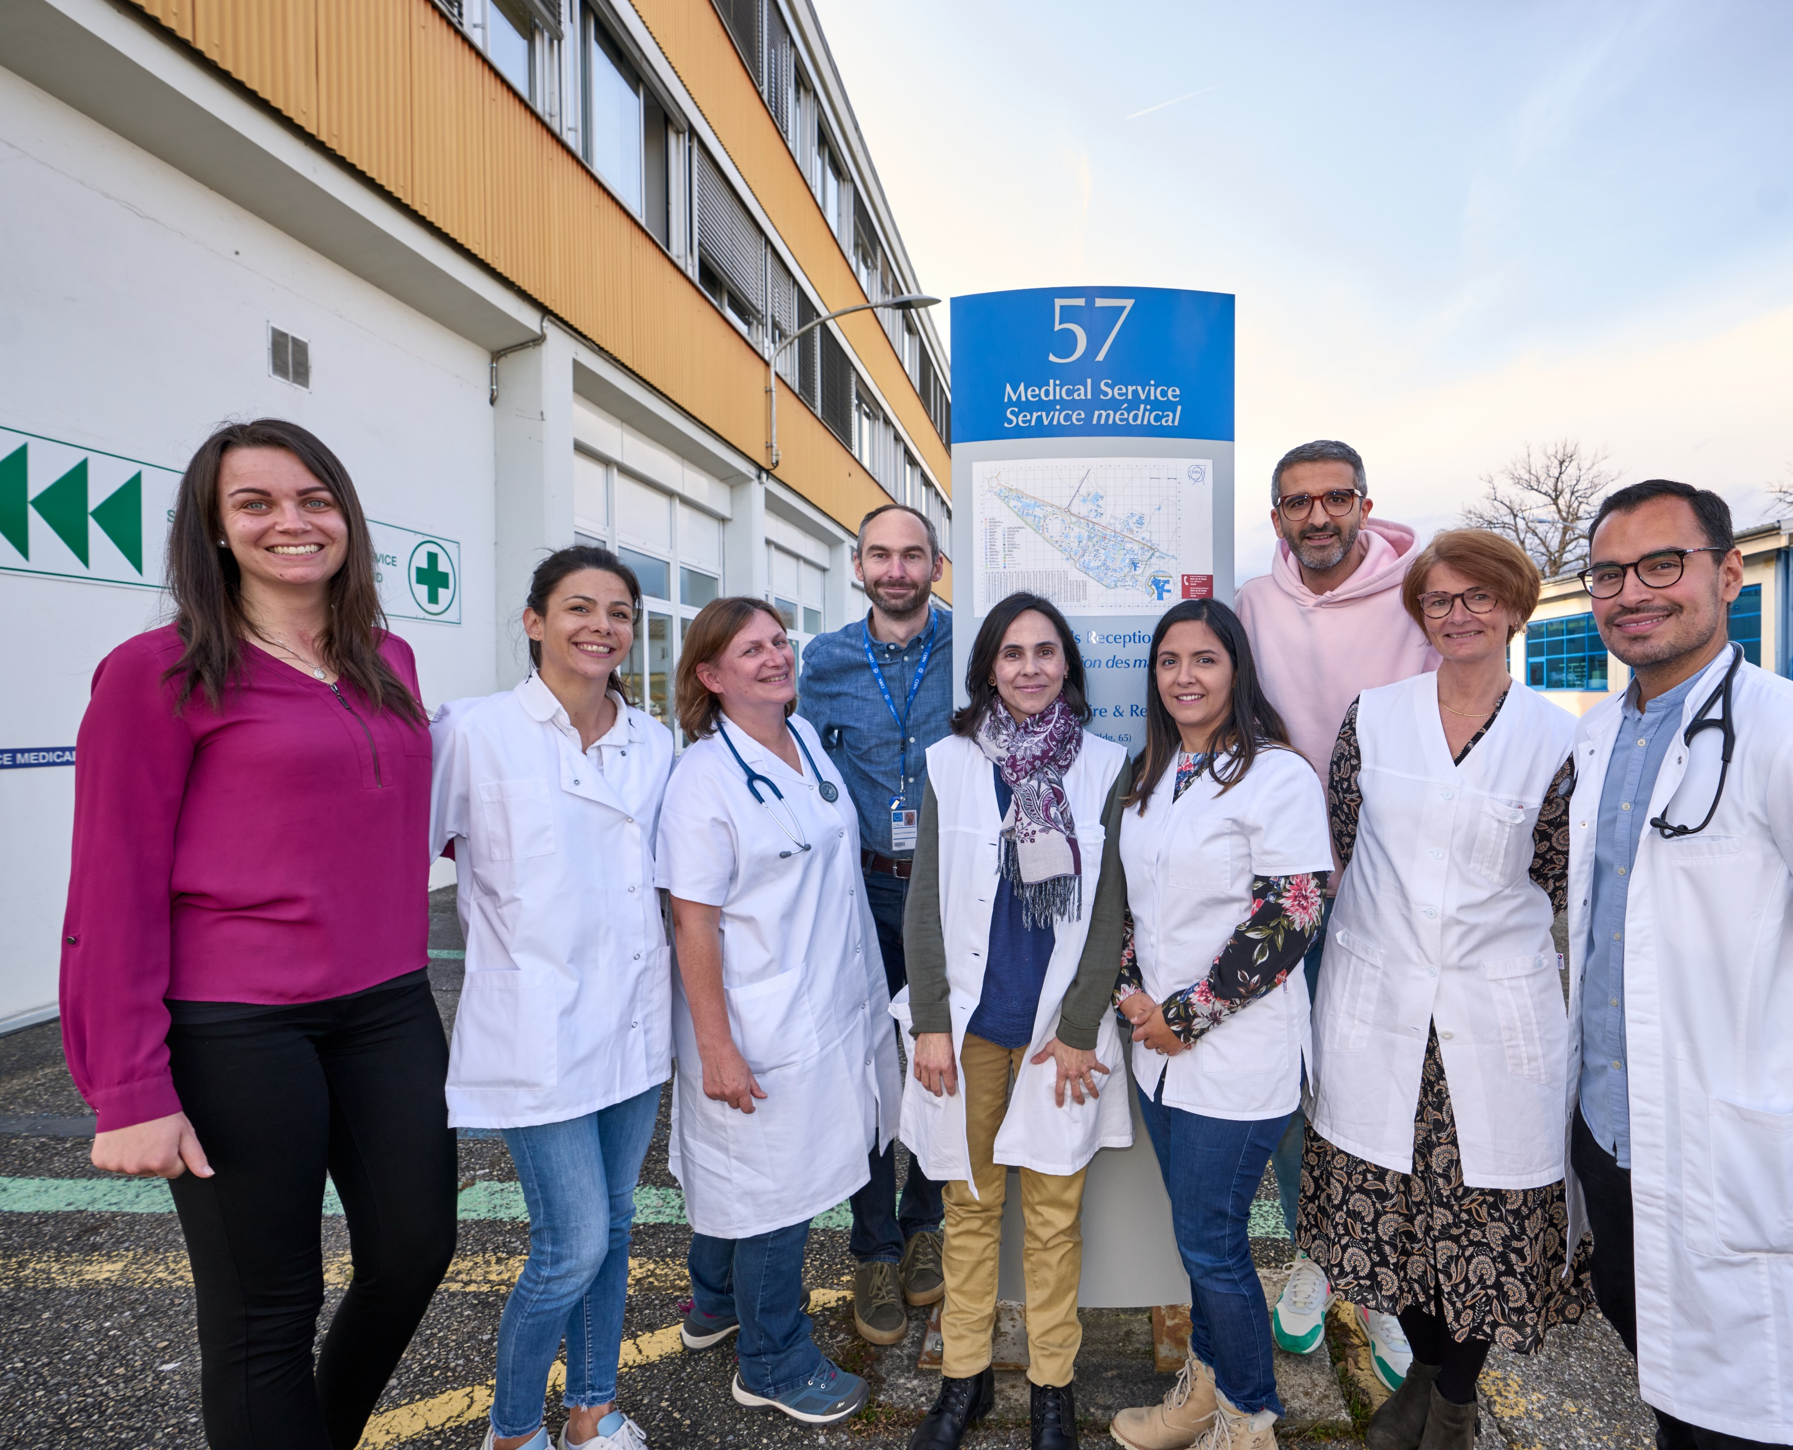
If you need primary care, advice or support
We are here for you!
  Building 57
  Monday – Friday
  8.00 - 12.30 | 13.30 - 17.00
  Ground floor: Infirmary
1st floor: Occupational Health Medicine and Psychologists
More resources on our website

Slide 3

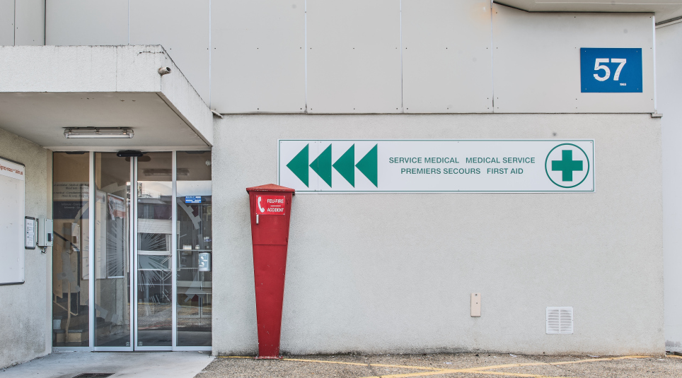

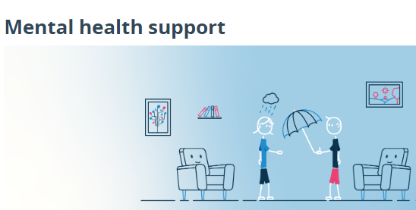
Health Support
In case of emergency
If you are at CERN : +41 22 76 74444
If you are outside CERN call 112 or
In FR call 15 - In CH call 144

Slide 4




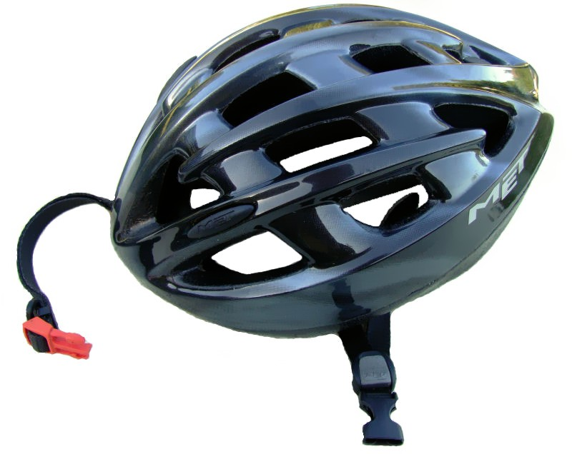




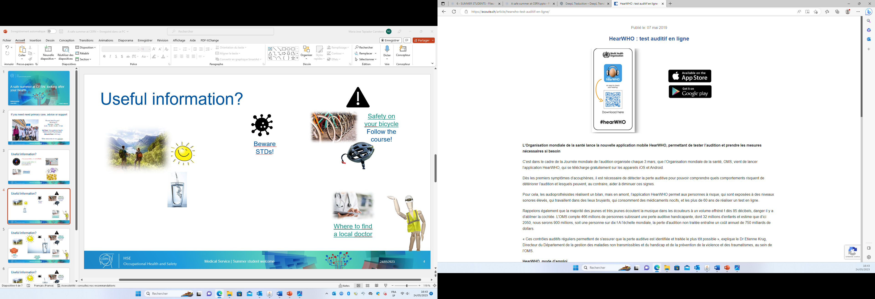





Useful information?

Slide 5
Have a great, safe time at CERN!

