Slide 1
Welcome to CERN openlab
Maria Girone – CERN openlab Head
Matteo Bunino
29/06/2023

Slide 2
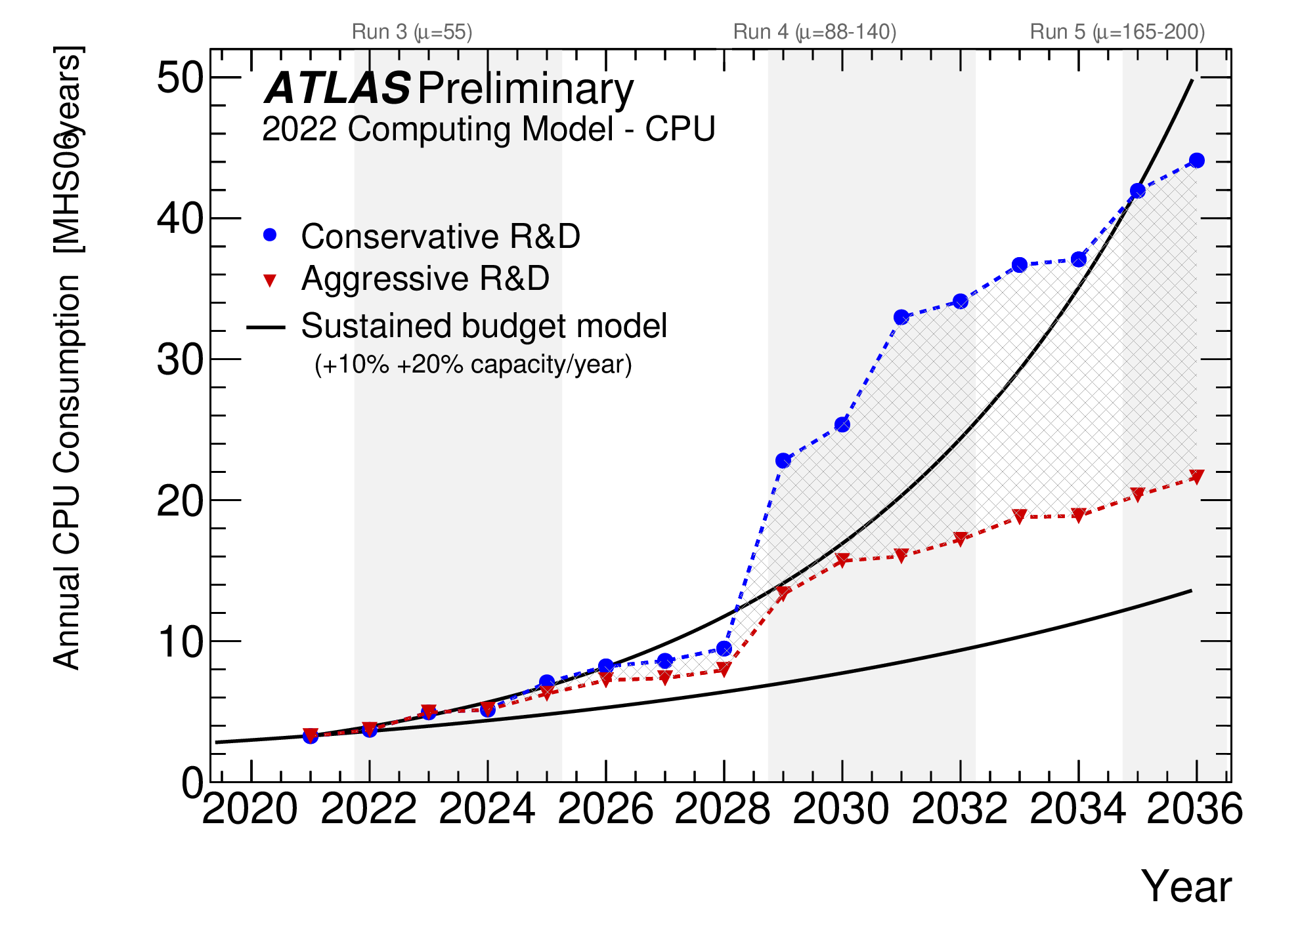
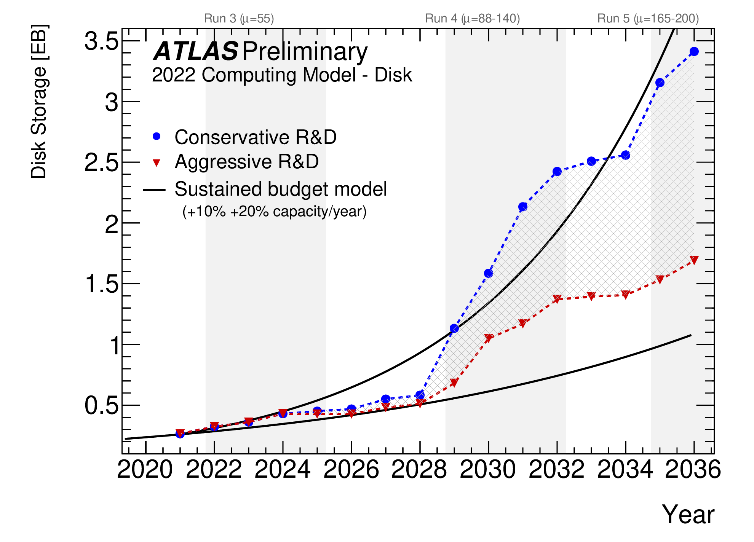

The HL-LHC brings unprecedented computing challenges: the total computing capacity required by the experiments is expected to be 10 times greater than today.
Large investments in R&D are needed to improve software and workflows, reduce storage needs, integrate new resources and solutions from technology providers.
  HL-LHC computing needs
Notes:
This is the evolution of ATLAS CPU and Storage needs from today to 2030.
. Using current software, hardware, and analysis techniques, it is estimated that the computing and stotage capacity will be 50-100 times higher than today.

Slide 3
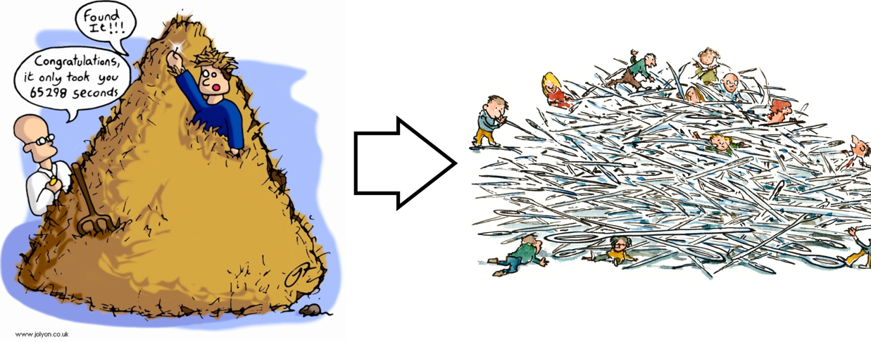
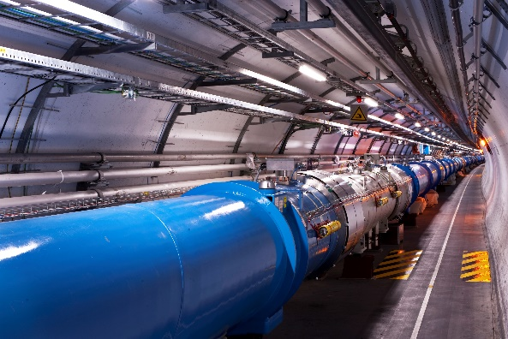
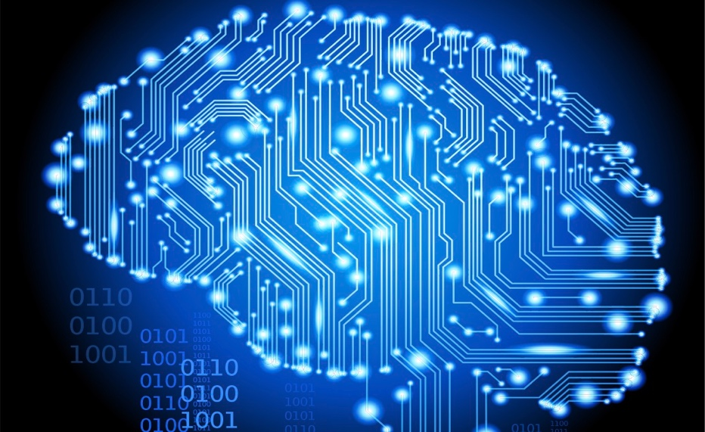
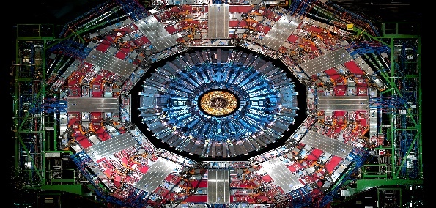
Upgraded Accelerator
Higher Luminosity
Changing Filtering
Paradigms
Higher Data Rates
Higher Sensitivity
R&D Investments
Code modernization, HPC and hardware accelerators
Reducing storage needs
New techniques, from AI to QC
Upgraded Detectors
Higher Granularity
Higher Occupancy
New Computing Challenges
  Upgraded program = new challenges

Slide 4
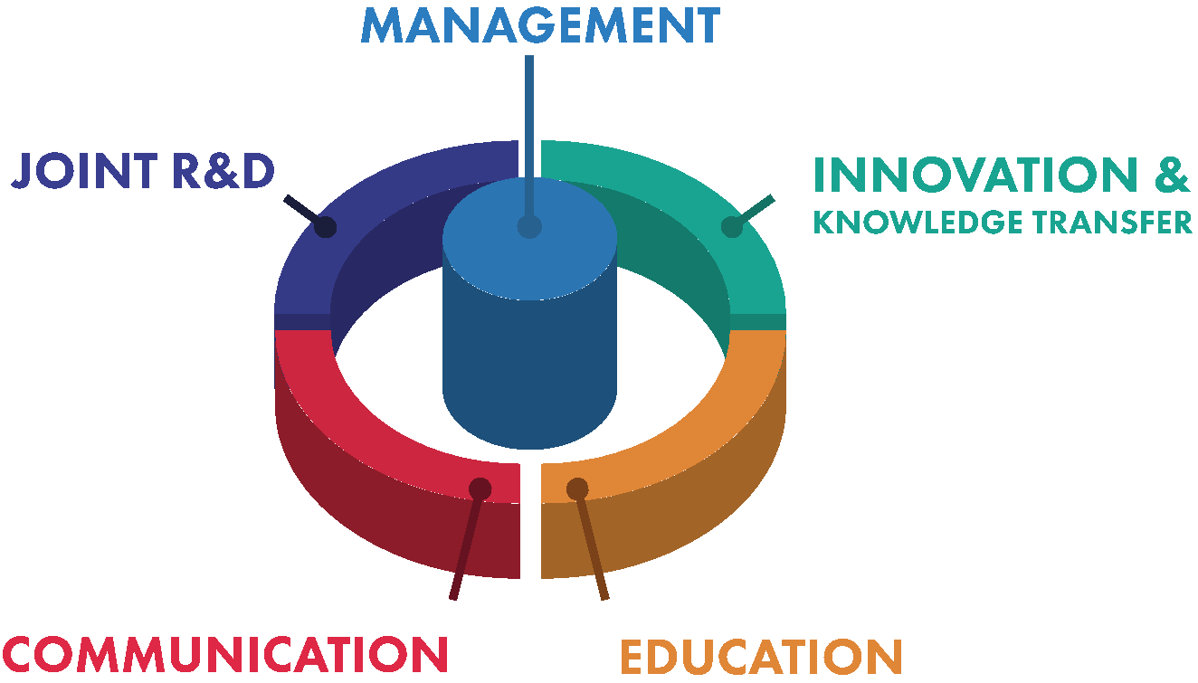
CERN OPENLAB’S MISSION
Our recipe for success
Evaluate and test state-of-the-art technologies in a
challenging environment and improve them in collaboration with industry.
Collaborate and exchange ideas with other communities to create knowledge and innovation.
Communicate results, demostrate impact, and reach new audiences.
Train the next generation of engineers/researchers, promote education and cultural exchanges.

Slide 5

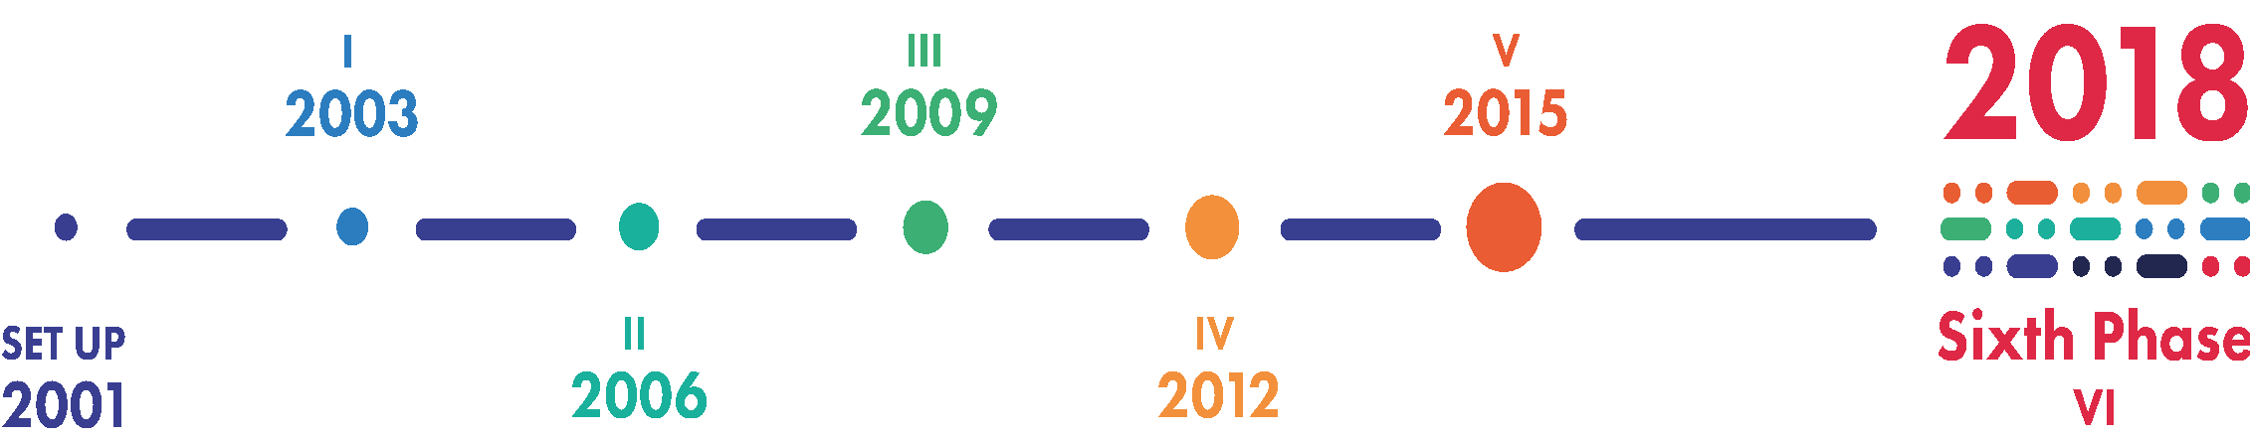




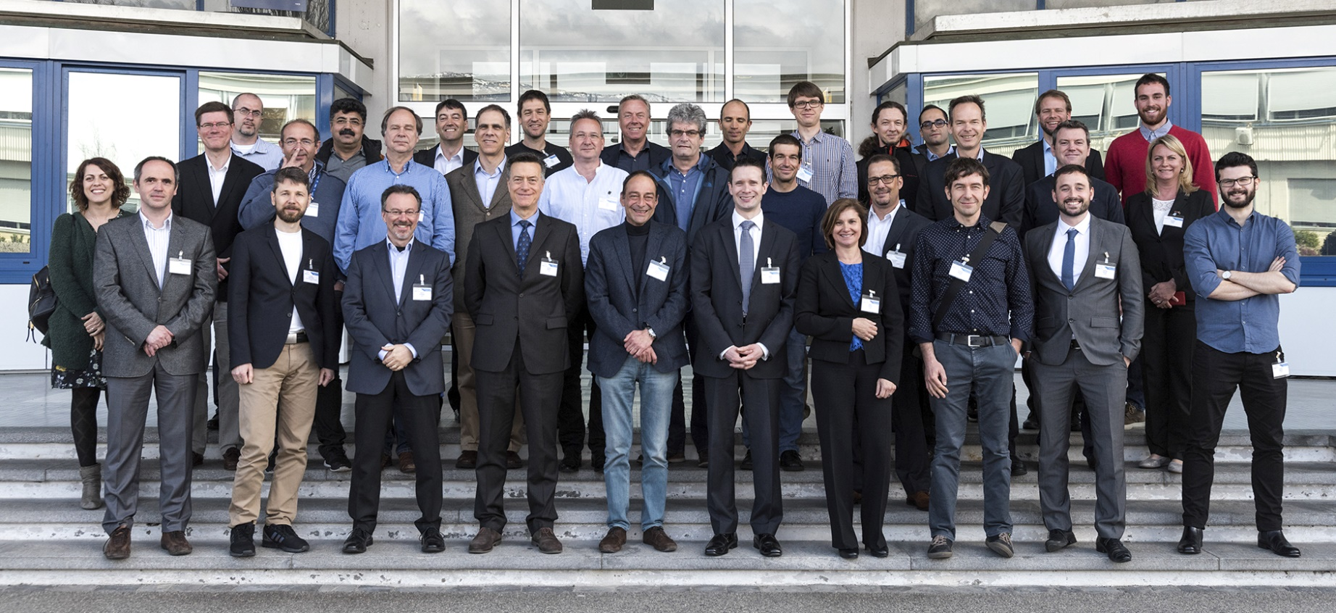
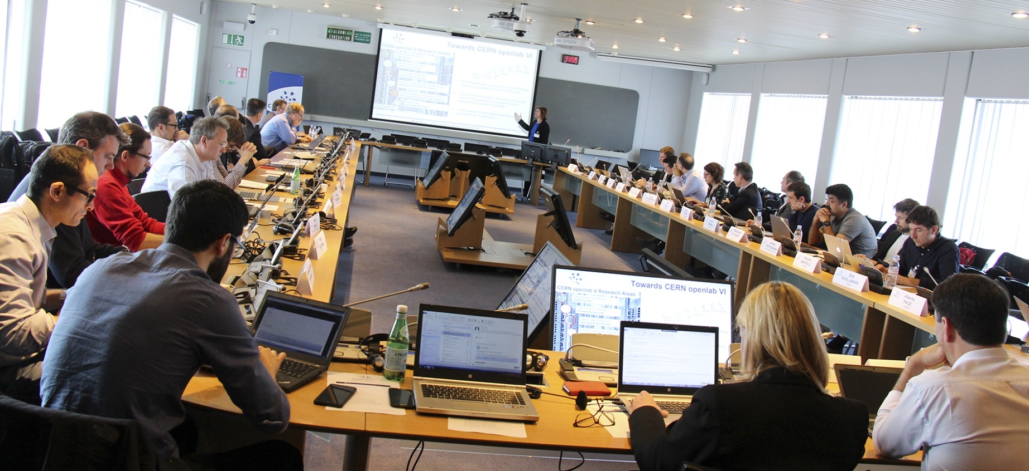
DRIVING INNOVATION
FOR 20 YEARS
2021
Seventh Phase
VII

Slide 6
Collaboration Model
Pick a challenging problem
Requirements
Check how this problem impacts or is impacted by industry
Assessment
Due Diligence
If a good match is found, define a joint project with a company
Technical Negotiation
Company invests because can get a return from the investment
Legal/Financial Negotiation
CERN openlab - Challenges in Computing

Slide 7





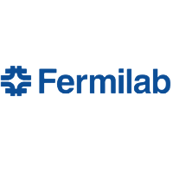







Collaboration members
PARTNERS
CONTRIBUTORS
RESEARCH

Slide 8


Strategic Innovation Areas
XT
eXascale Technologies
A comprehensive investigation of HPC and Cloud infrastructures, frameworks, tools to support key scientific workloads and applications, including AI, HPC, Digital Twins
AI-S
Artificial Intelligence
for Science
Analysis and development of algorithms, optimisation for new architectures,
interpretability,
synergies between Physics and other sciences
QTI-C
Quantum Technology Initiative - Computing
Assess the potential impact of quantum computing in HEP and other sciences, investigate quantum machine learning algorithms and areas of potential quantum advantage, set up a collaborative quantum computing (simulation) platform
MSC
Multi-Science Collaborations
Share the expertise and knowledge generated across all activities with other sciences, work with CERN KT
to explore novel applications of CERN computing systems and ideas, create collaborations and contribute to common solutions

Slide 9
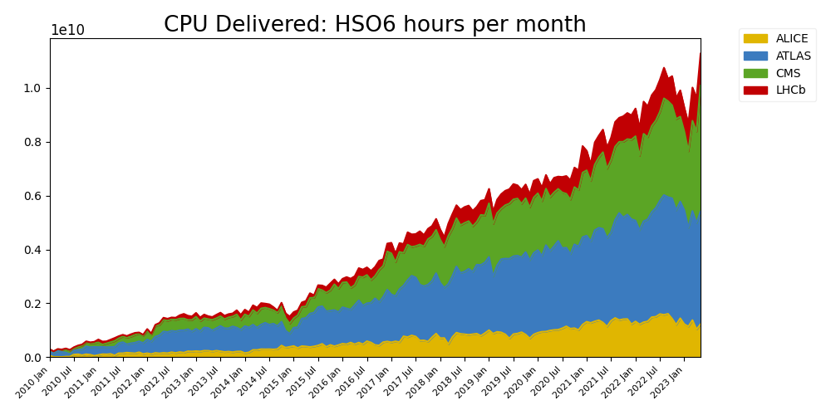
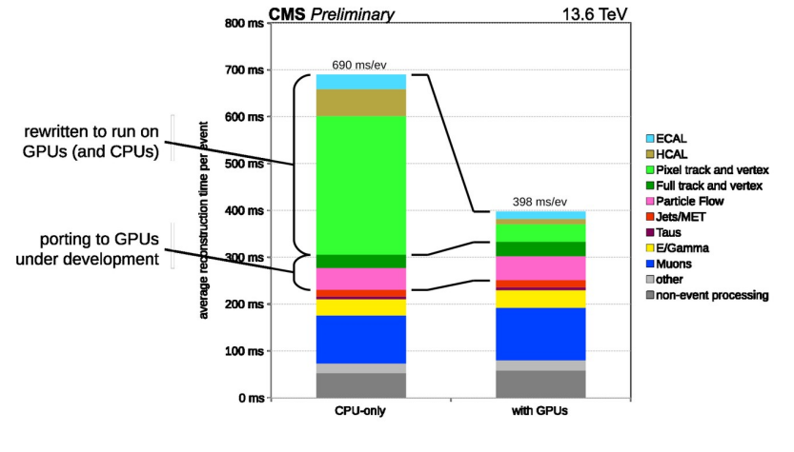
Exascale technologies: Heterogeneous Architectures Adoption
We collaborate with Intel, E4/NVIDIA, and Micron
Robust resource growth of resources:
Average +20% CPU and disk yearly growth.
Consistent with a ‘flat budget’ funding for computing centres, the de-facto adopted model across all Funding Agencies for the past 10 years
Run 3 – more than 40% online reconstruction offloaded to GPU. Image courtesy of Andrea Bocci et al.
WLCG resources: compute. Image courtesy of Alessandro Di Girolamo et al.
Notes:
Greater density, faster performance cost

Slide 10
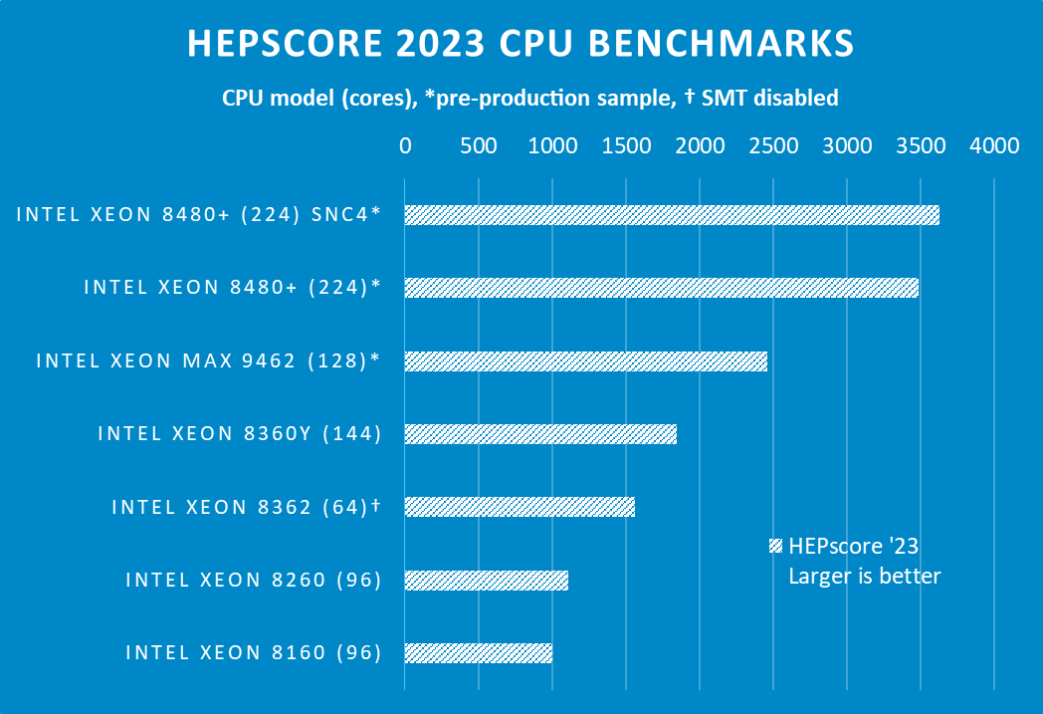
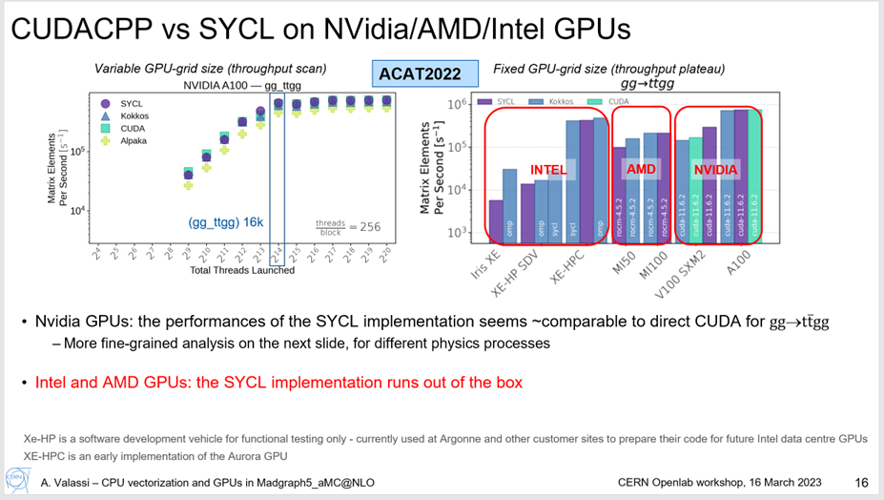
Exascale technologies: Heterogeneous Architectures Adoption
We collaborate with Intel, E4/NVIDIA, and Micron
CPU Benchmarking. Image courtesy of David Southwick et al.
GPU Benchmarking. Image courtesy of Andrea Valassi et al.
Notes:
Greater density, faster performance cost

Slide 11
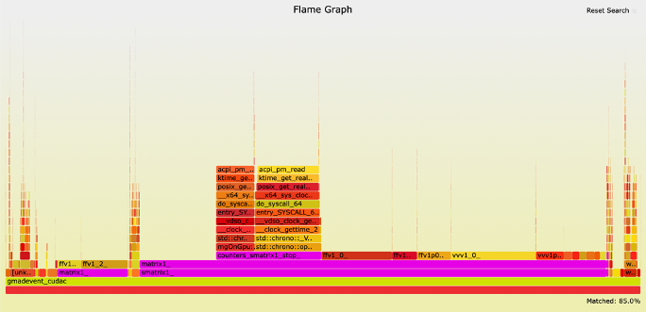
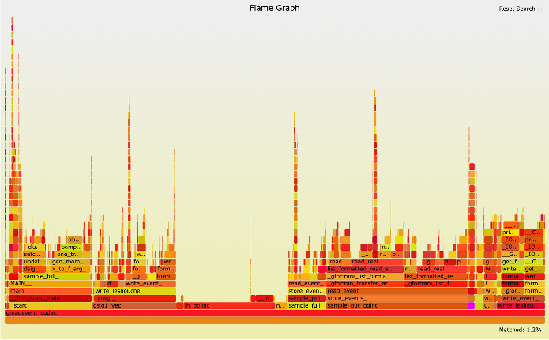


Exascale technologies: Heterogeneous Architectures Adoption (2)
Relevant lectures:
Fortran version
Cuda accelerated version
85 % of CPU time spent in so called “matrix element calculations”
Madgraph5_aMC@NLO speedup on NVidia GPUs for fast MCMC simulations.
Notes:
Greater density, faster performance cost

Slide 12
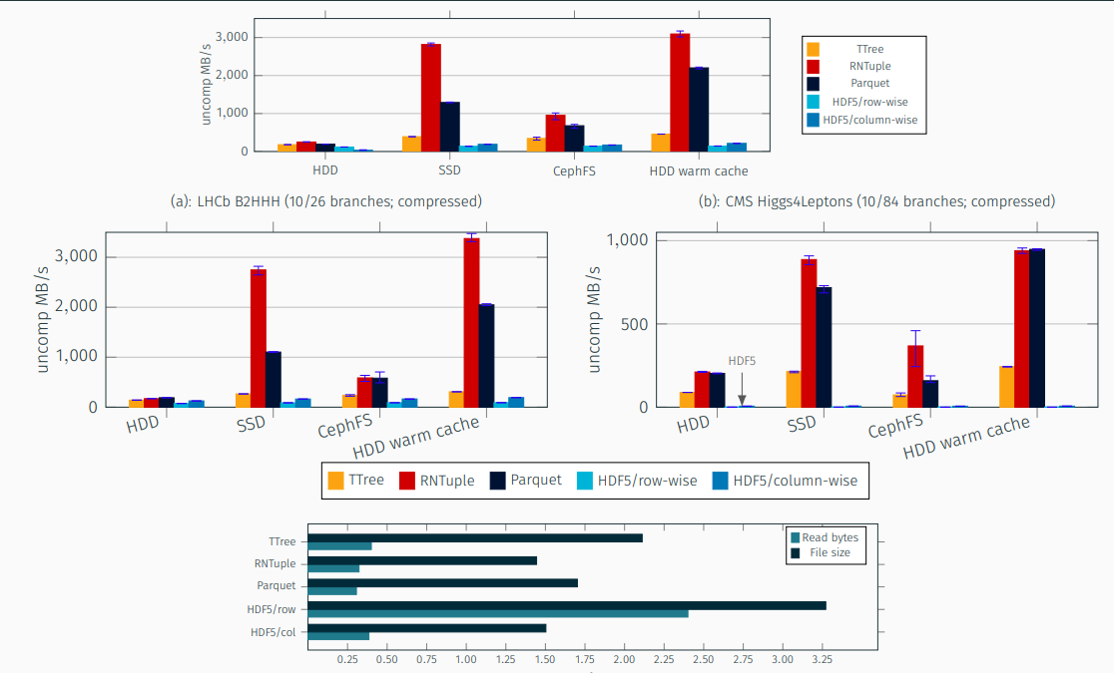
Exascale Technologies: Advanced Data and Storage Solutions
We collaborate with Intel, HPE, SIEMENS, Comtrade, and ORACLE.
ROOT’s RNTuple State of Affairs: Throughput and Size. Image courtesy of Javier López-Gómez et al.
Notes:
Greater density, faster performance cost

Slide 13
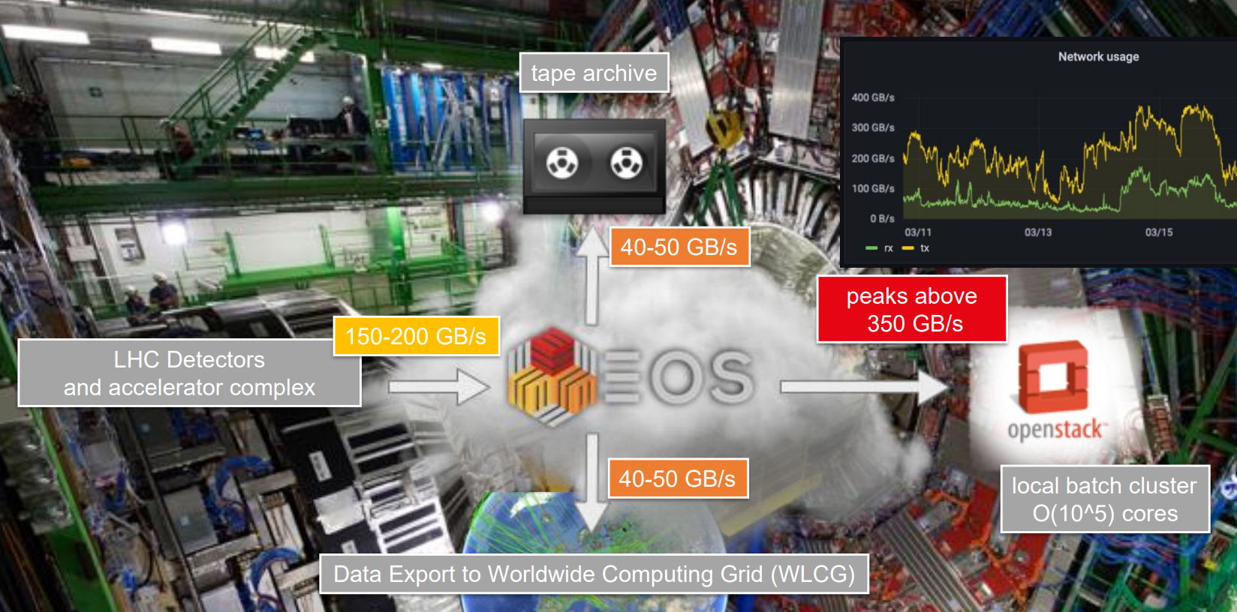
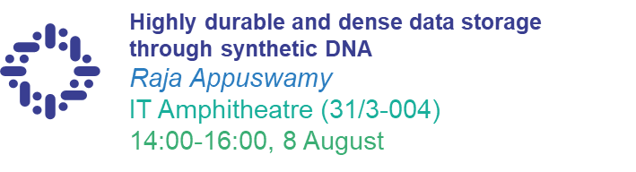
Exascale Technologies: Advanced Data and Storage Solutions (2)
We collaborate with Siemens, Comtrade, and Oracle.
Relevant lectures:
Physics data recording with EOS. Image courtesy of Luca Mascetti et al.
Notes:
Greater density, faster performance cost

Slide 14
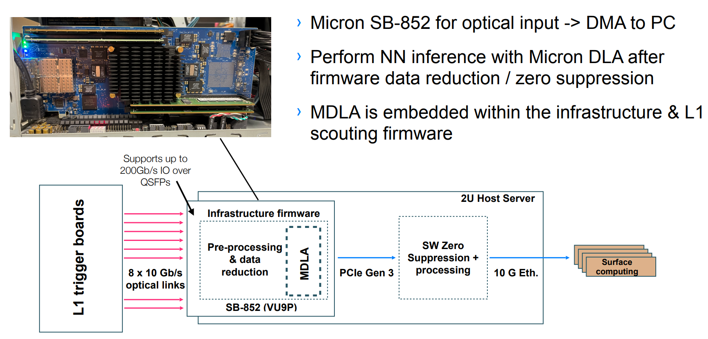
Exascale technologies: AI and HPC
We collaborate with Micron, E4/NVIDIA, and ORACLE.
Deep learning-based trigger embedded on Micron’s board. Image courtesy of Thomas James et al.
Notes:
Greater density, faster performance cost

Slide 15
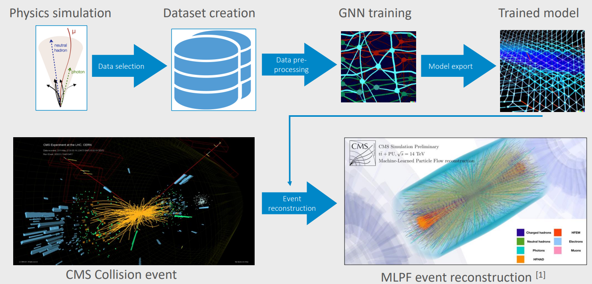
Exascale technologies: AI and HPC (2)
We take part to EC-funded CoE RAISE project
AI-based particle flow reconstruction workflow. Image courtesy of Eric Wulff et al.
Notes:
Greater density, faster performance cost

Slide 16
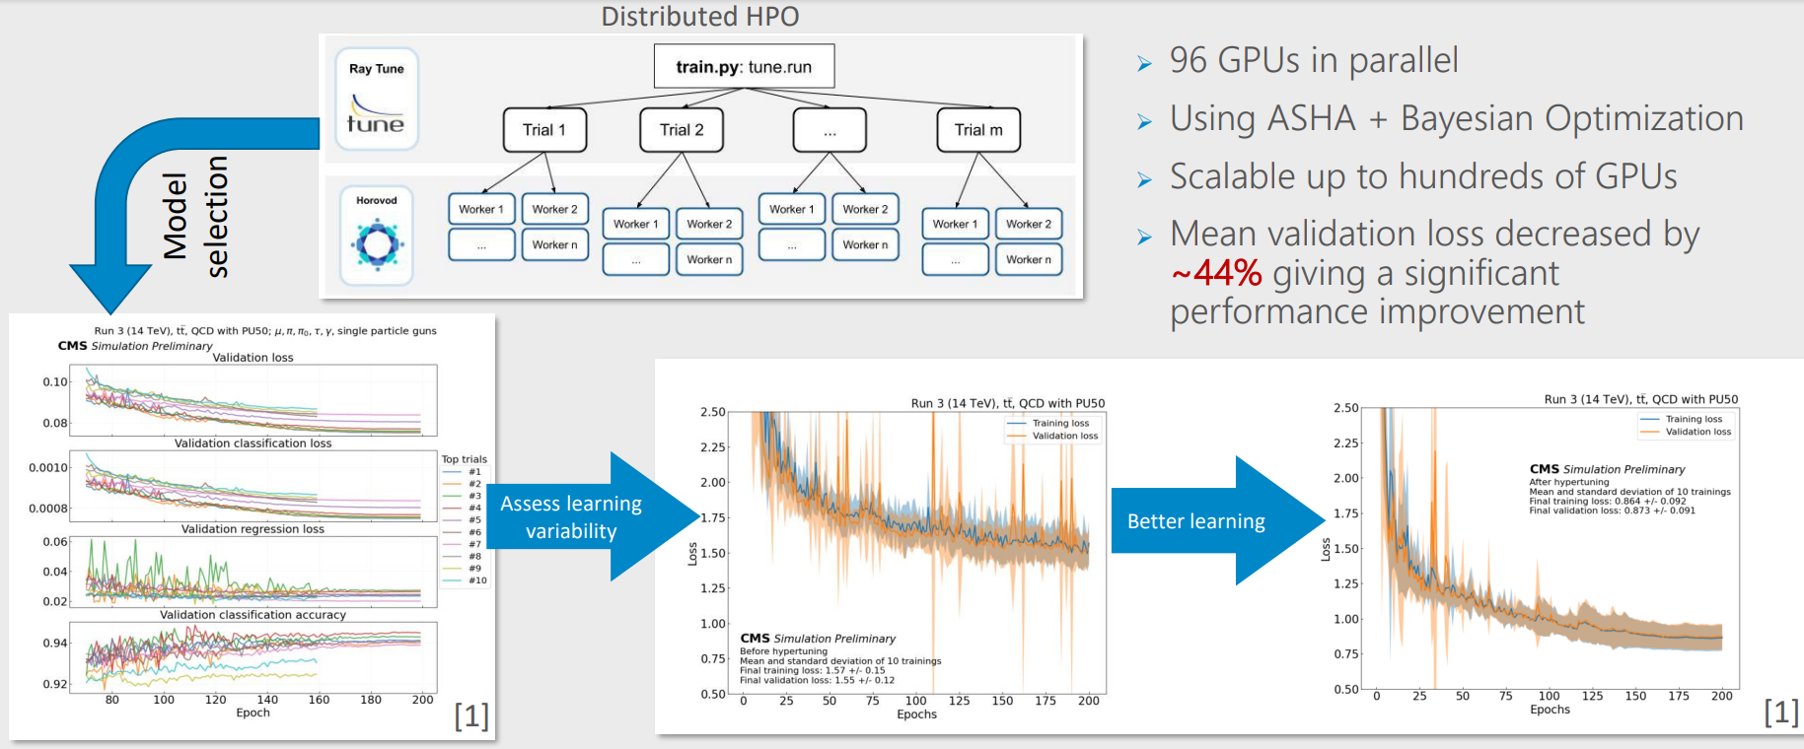
Exascale technologies: AI and HPC (3)
We take part to EC-funded CoE RAISE project
Large-scale distributed hyperparameter optimization (HPO). Image courtesy of Eric Wulff et al.
Notes:
Greater density, faster performance cost

Slide 17
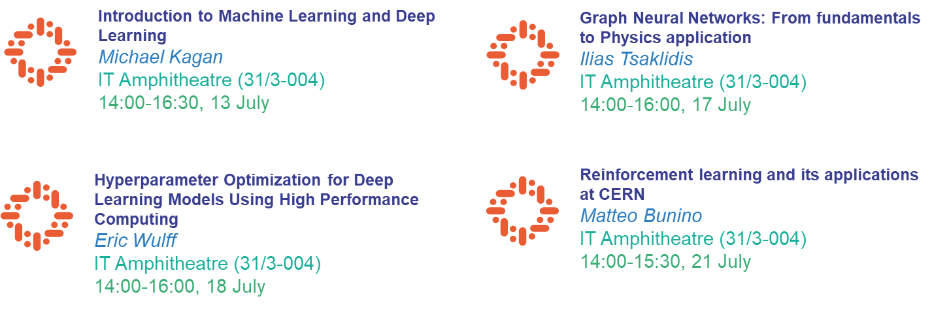
Exascale technologies: AI and HPC (3)
Proposed lectures
Notes:
Greater density, faster performance cost

Slide 18
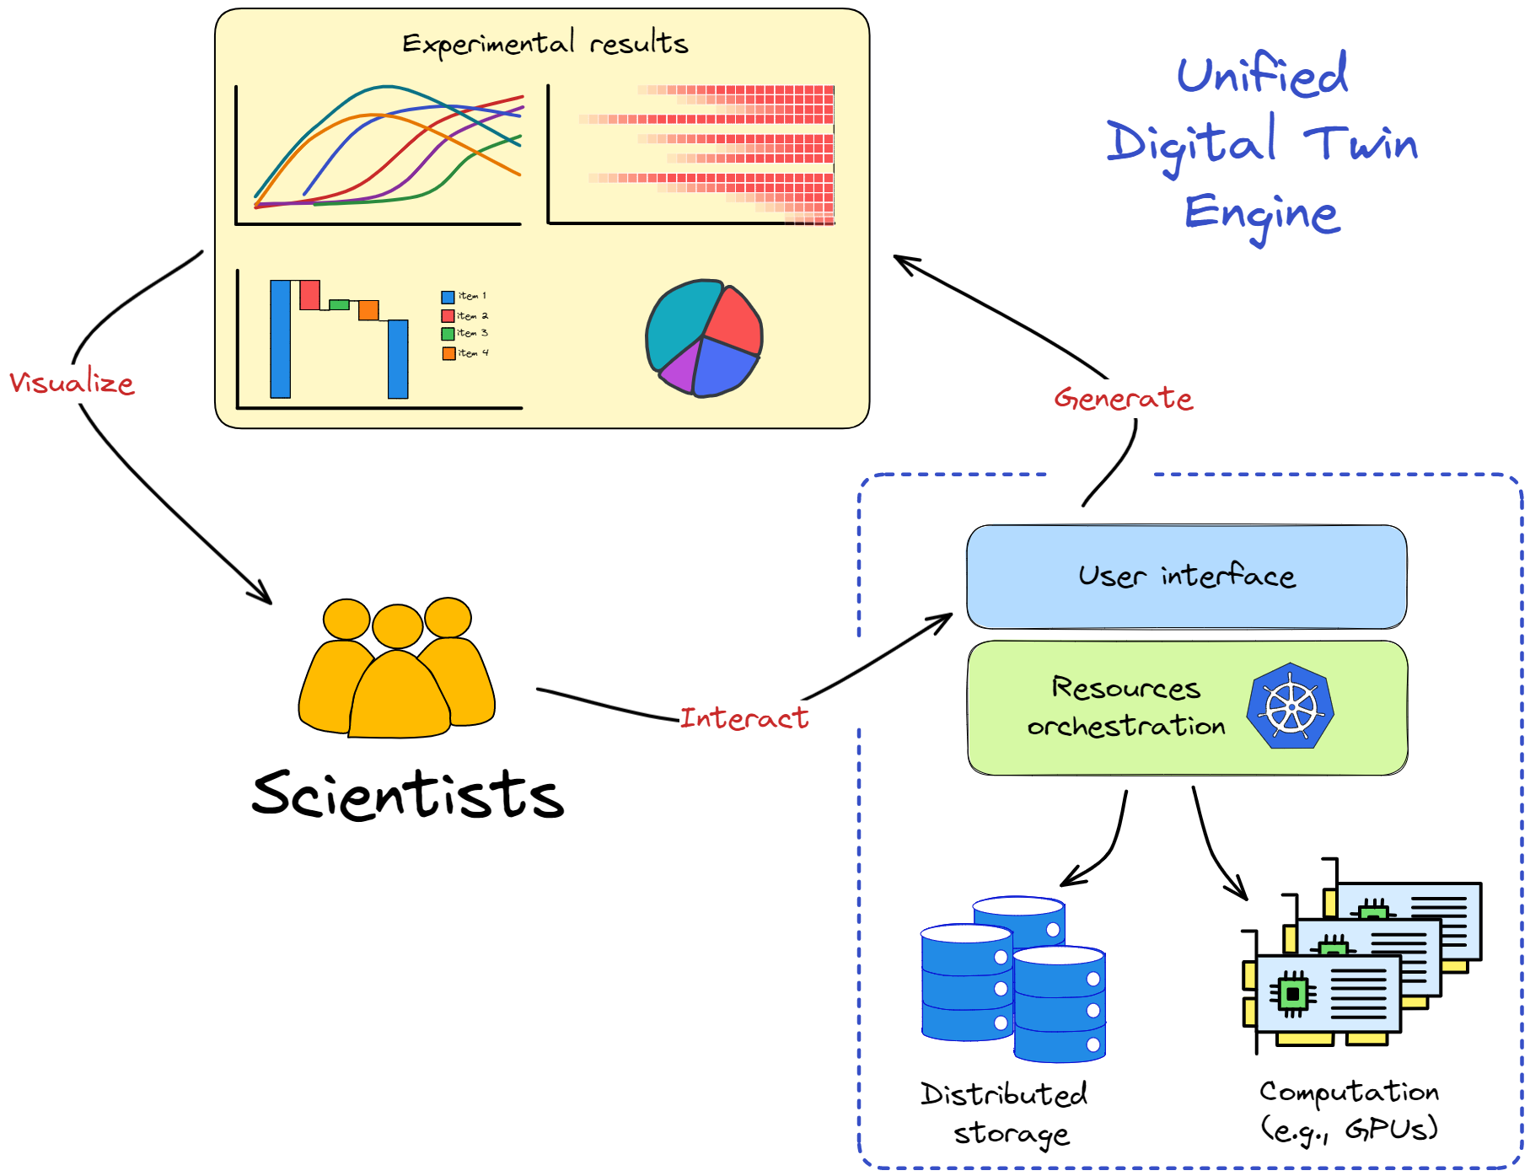
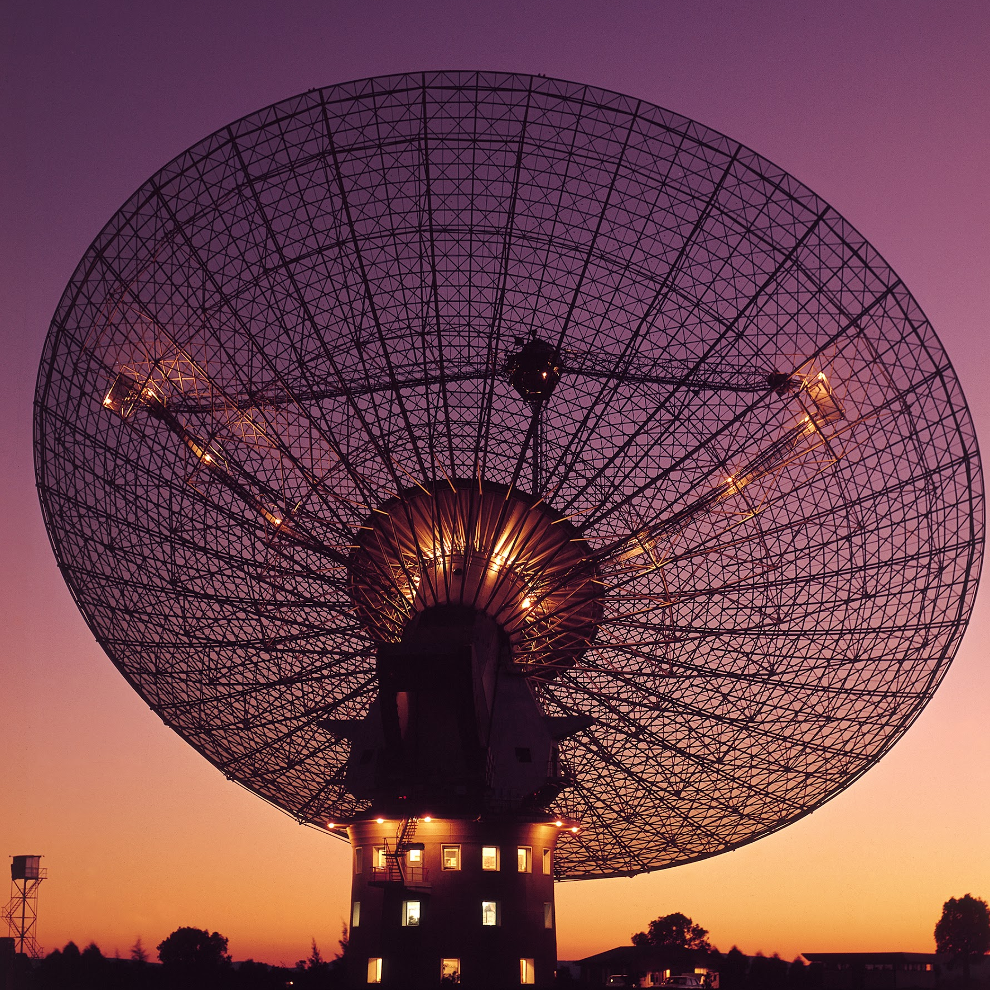
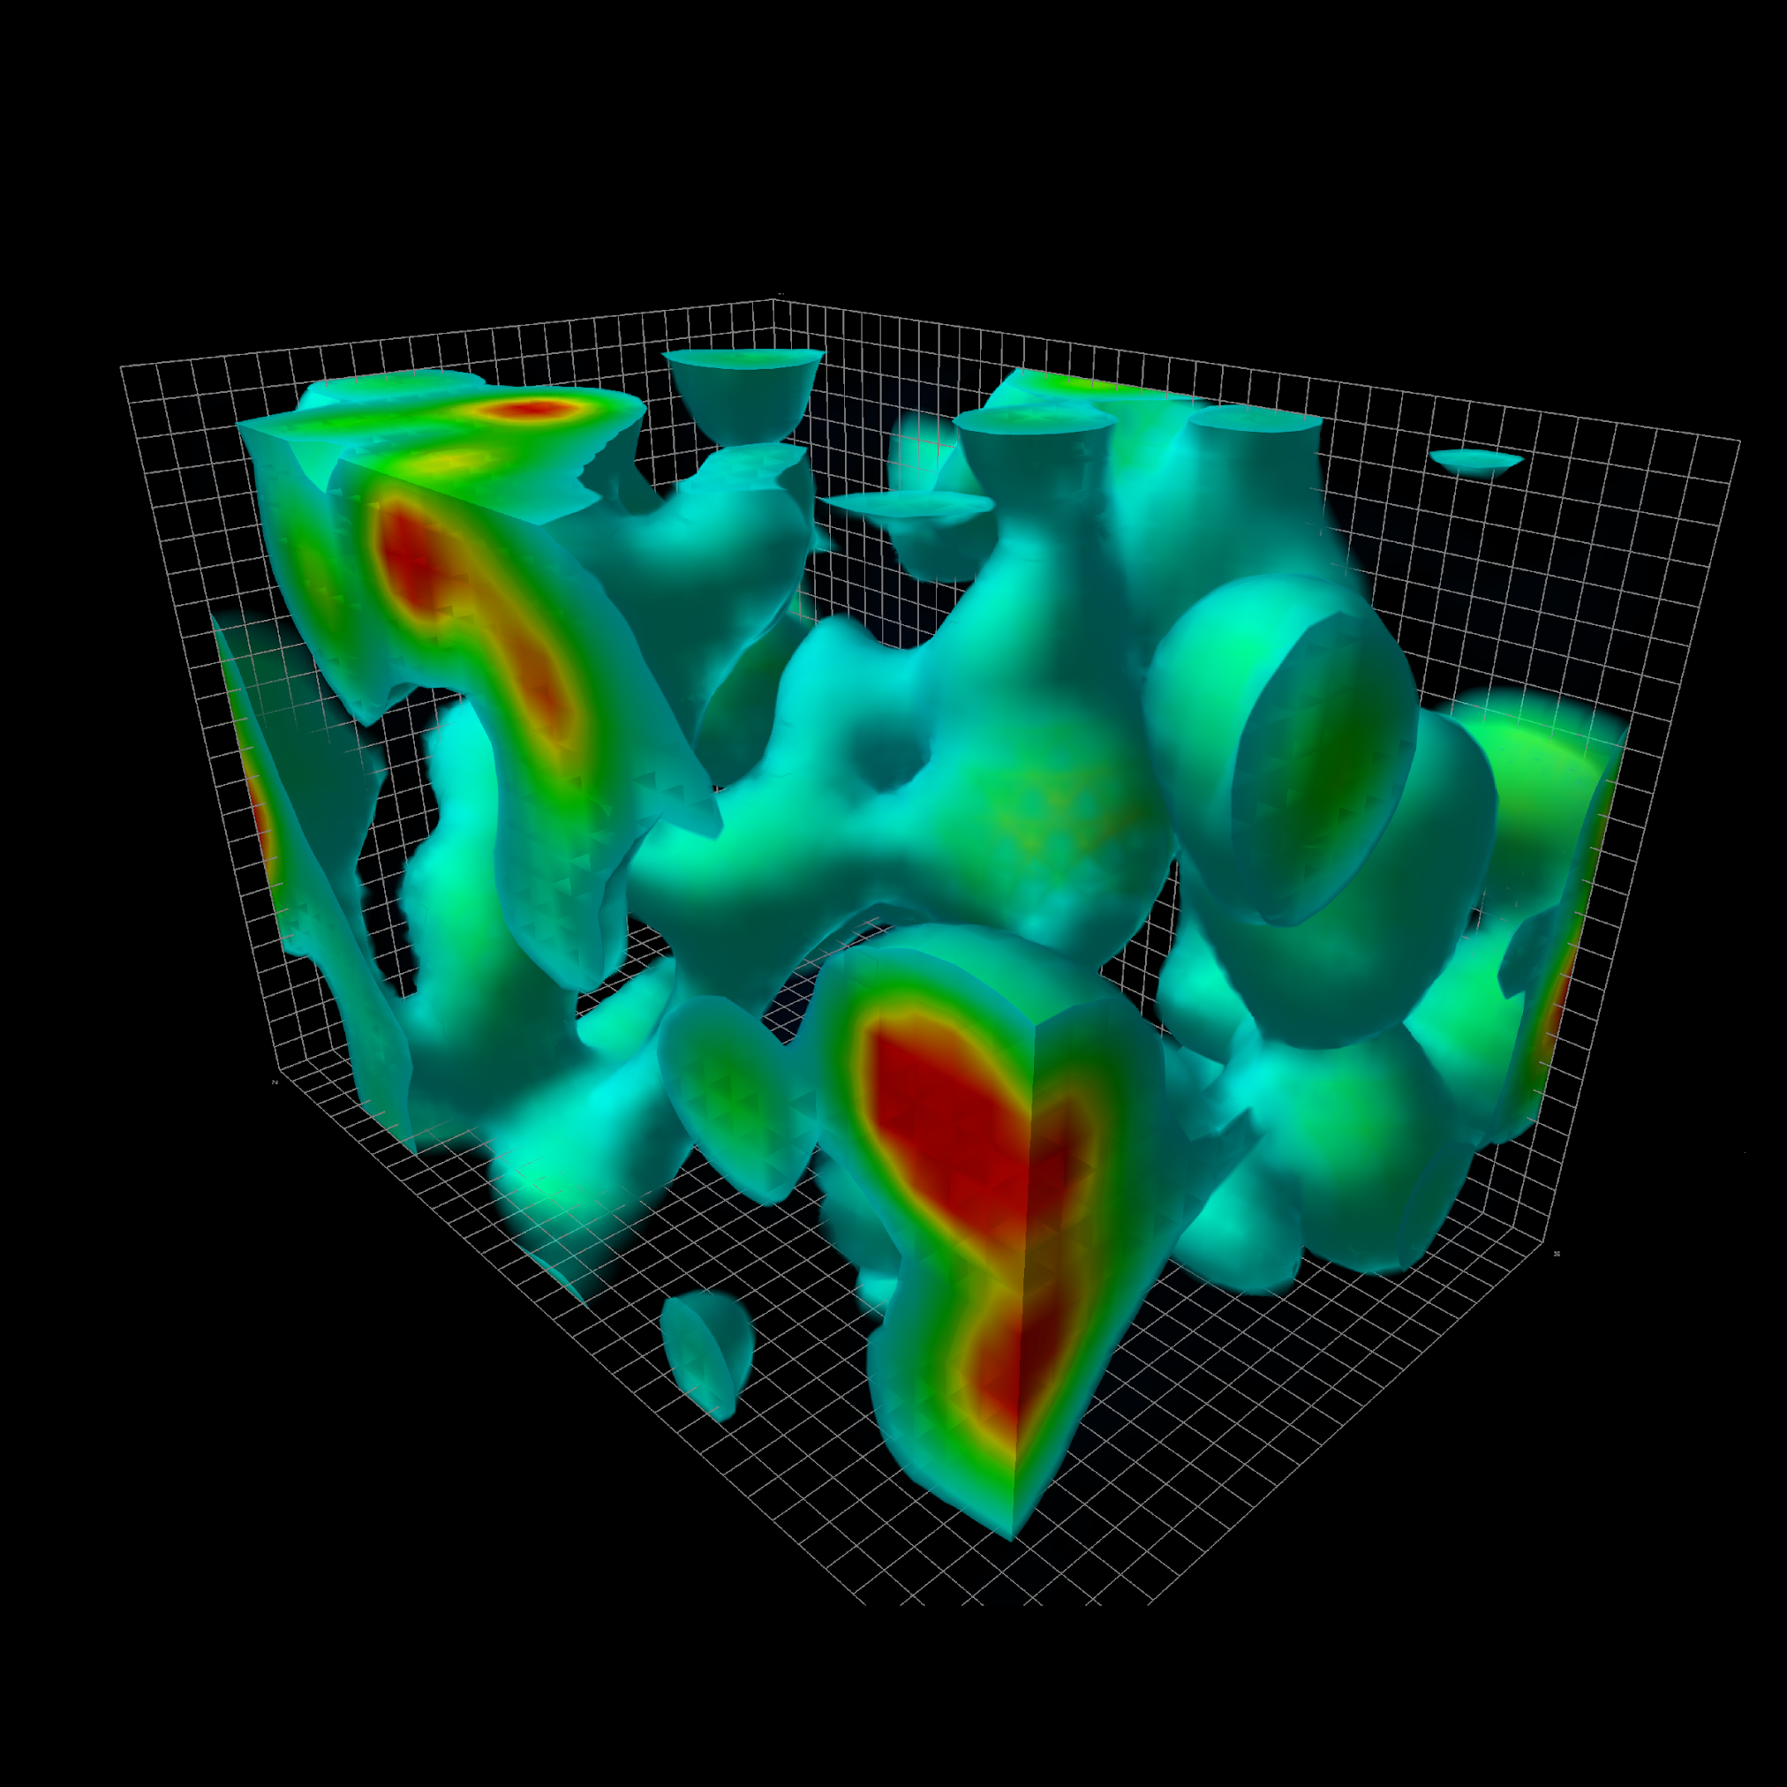
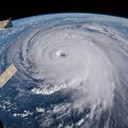
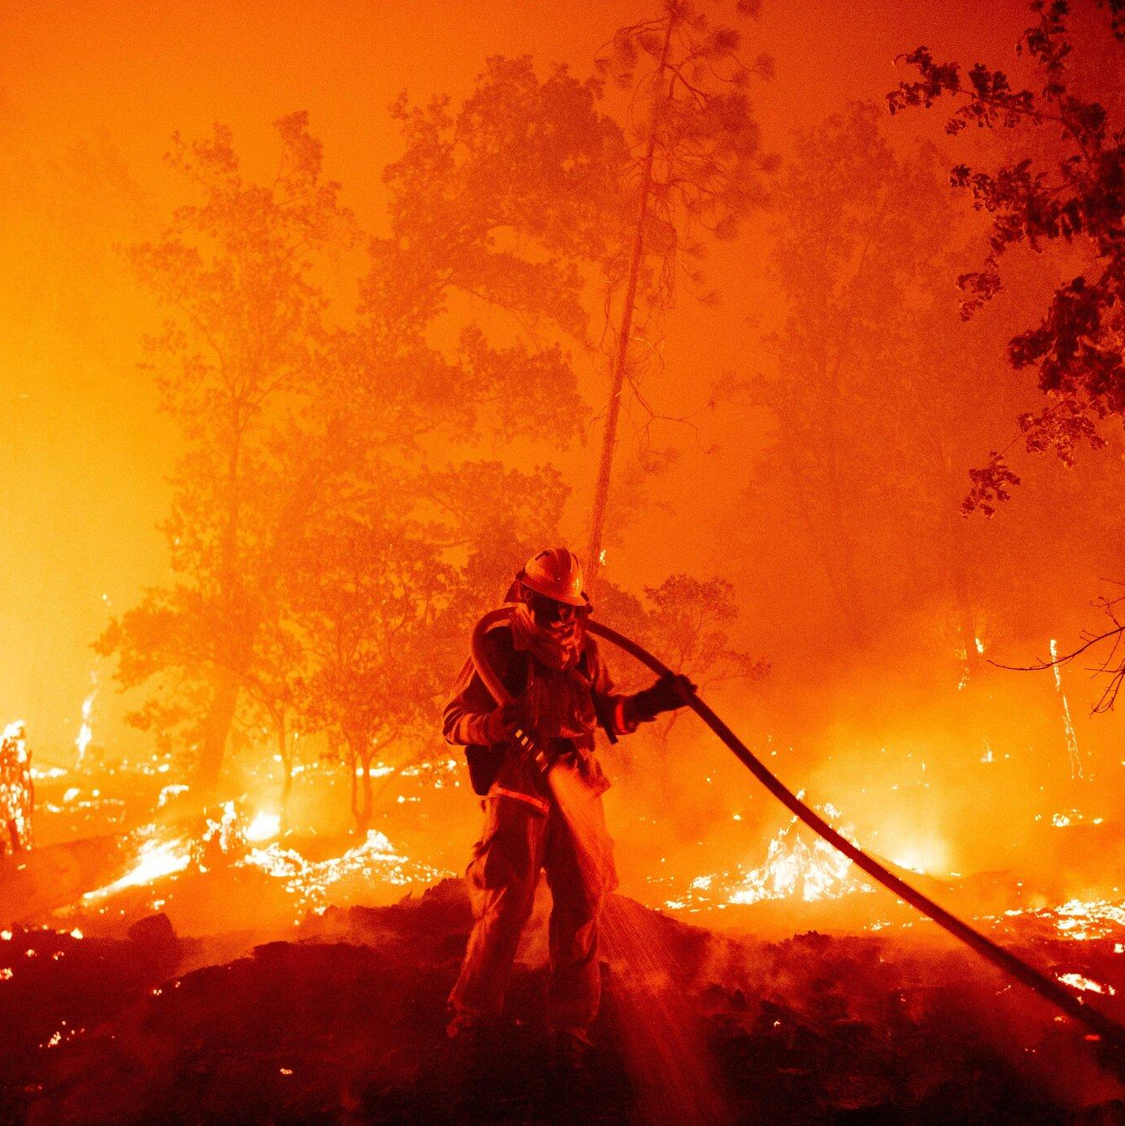
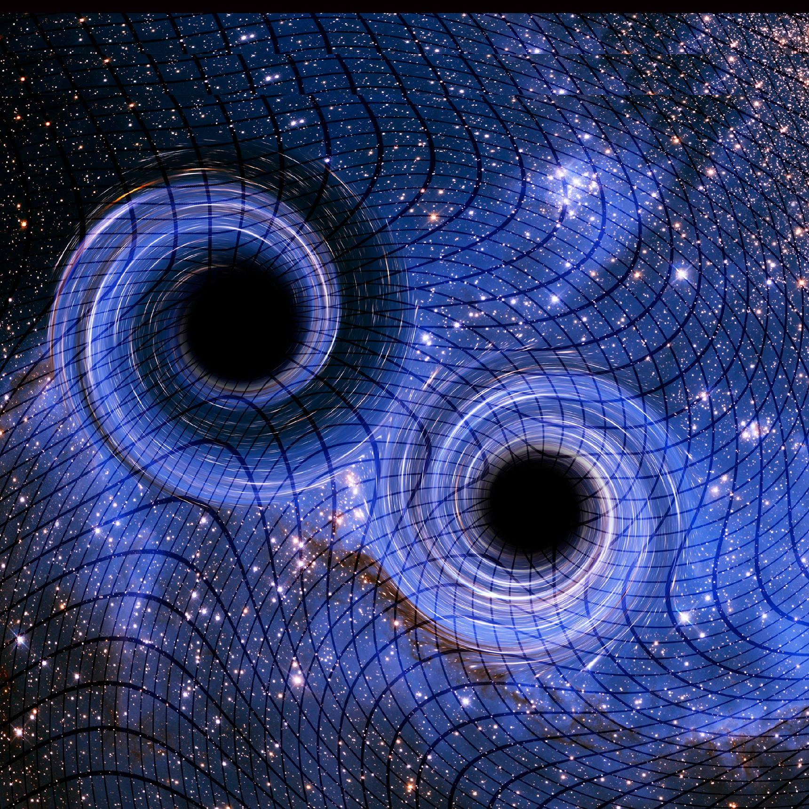

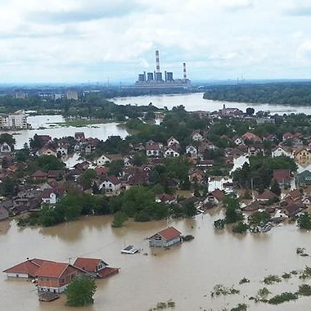
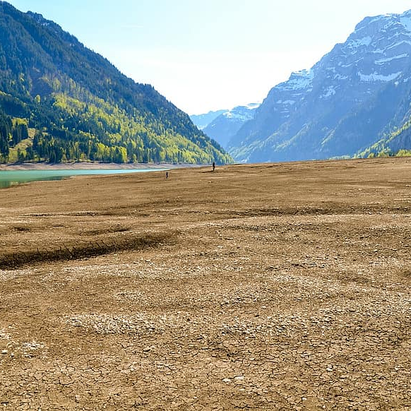
Digital Twins
We participate to EC project interTwin, and ECMWF’s EMPP.
InterTwin use cases
‹#›
Physics
Earth Observation
Image courtesy of Alexander Zoechbauer et al.
Notes:
Greater density, faster performance cost

Slide 19
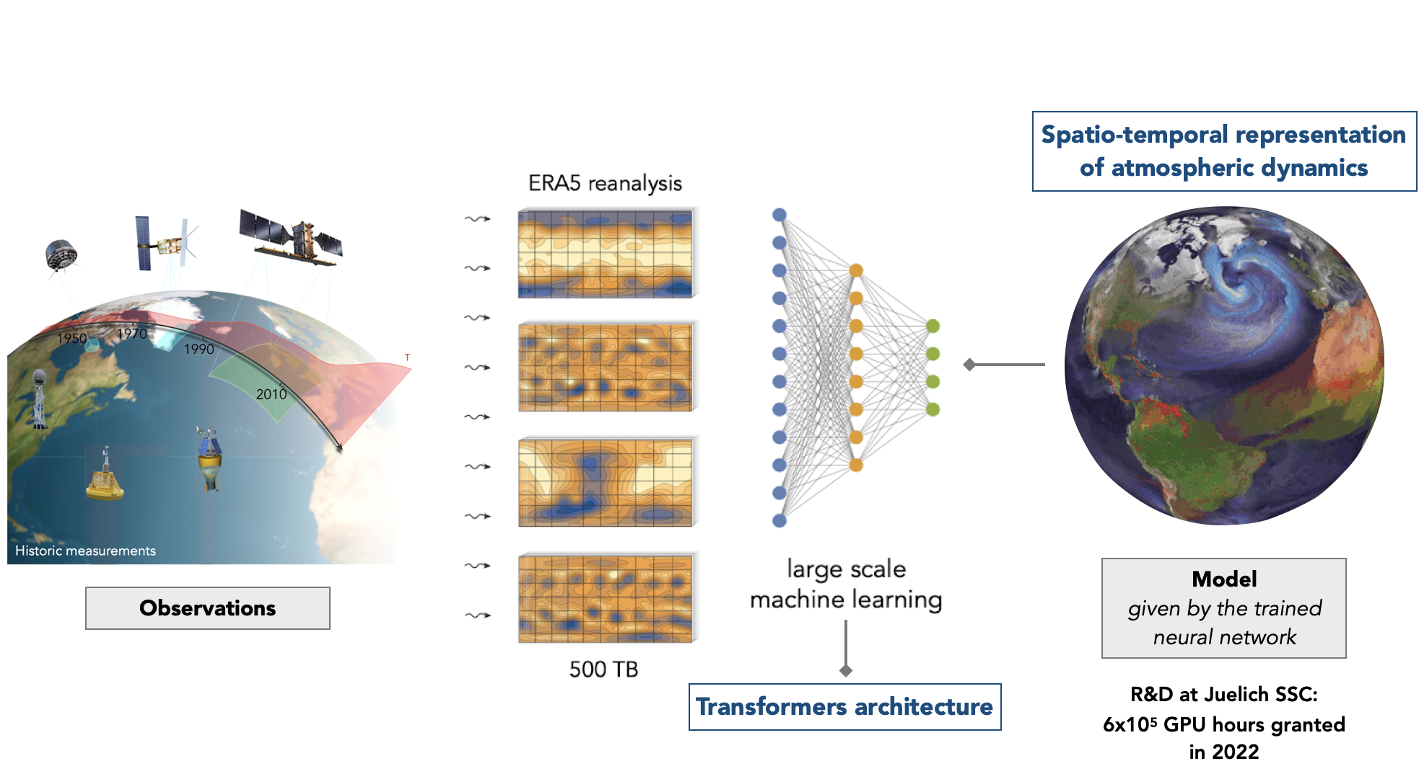
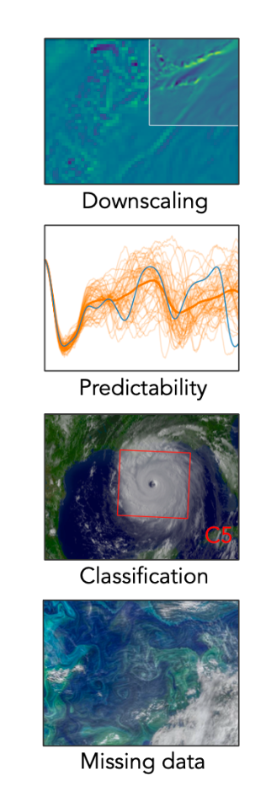

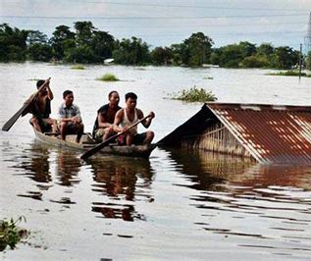



Digital Twins (2)
We participate to EC project interTwin, and ECMWF’s EMPP.
First proof-of-concept of a machine-learning based global environmental model trained on terabytes of observational data
Visual interface
Disaster support
R&D at Juelich SSC:
4x10⁶ GPU hours granted
in 2023
Applications
Image courtesy of Ilaria Luise et al.
Notes:
Greater density, faster performance cost

Slide 20
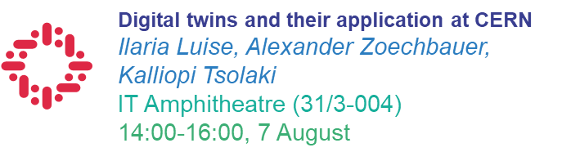
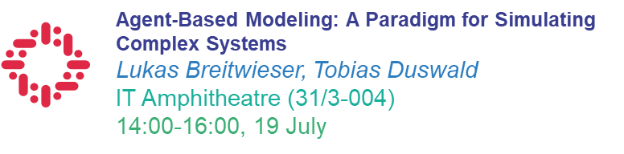
Digital Twins (3)
Proposed lectures
Notes:
Greater density, faster performance cost

Slide 21
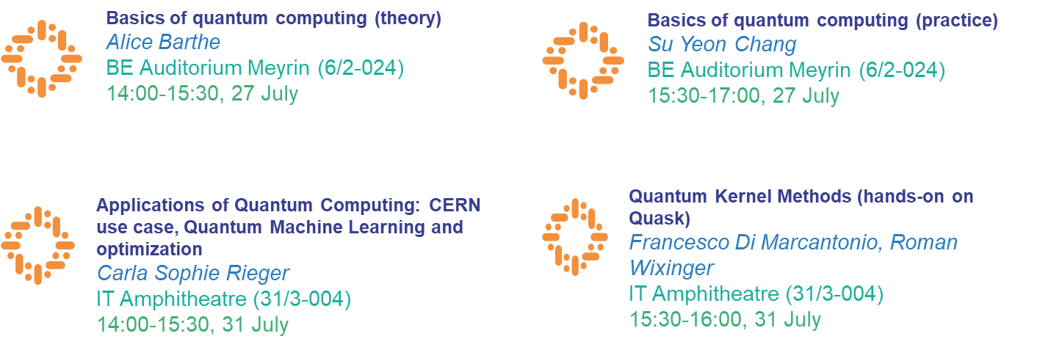
Quantum computing
Proposed lectures
Notes:
Greater density, faster performance cost

Slide 22
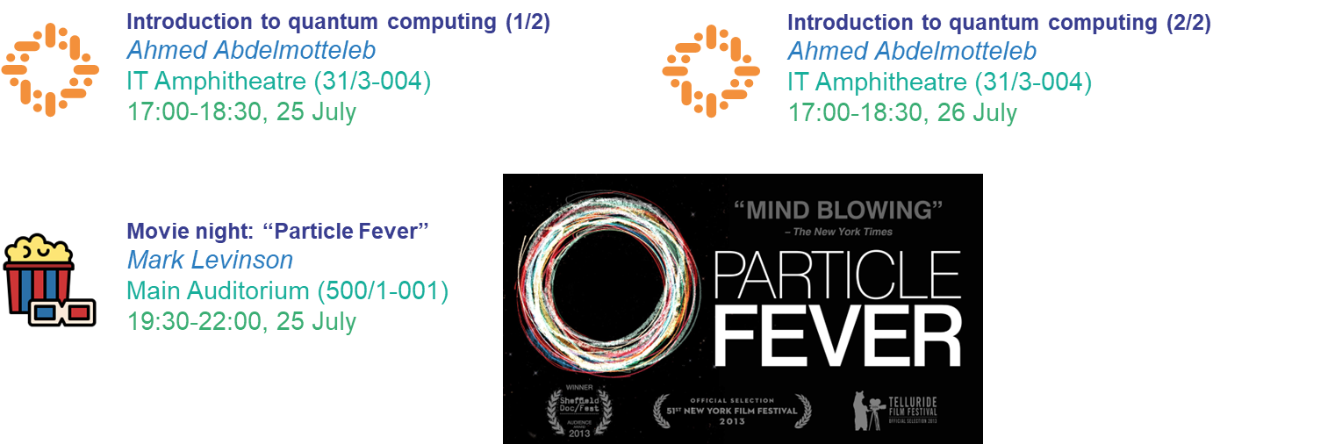
Evening lectures
Notes:
Greater density, faster performance cost

Slide 23

Thanks!

