Slide 1
Mechanical analysis for a block-type 14 T magnet,
2in1 configuration
June 2023
Emma Gautheron, Susana Izquierdo Bermudez, Juan Carlos Perez , Lucio Fiscarelli, Ezio Todesco

Slide 2
Outline
Model description
Analysis with key interference
Analysis with bladders

Slide 3
Model description

Slide 4
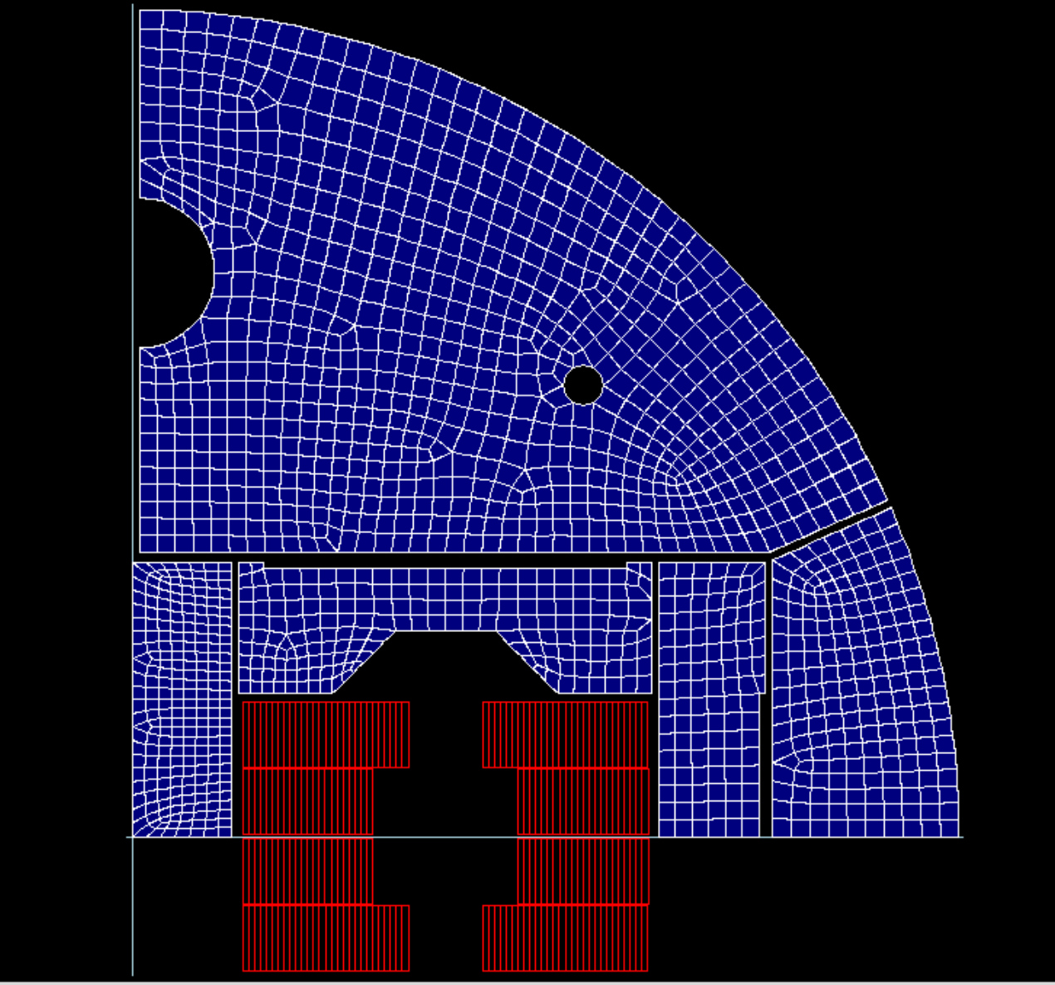
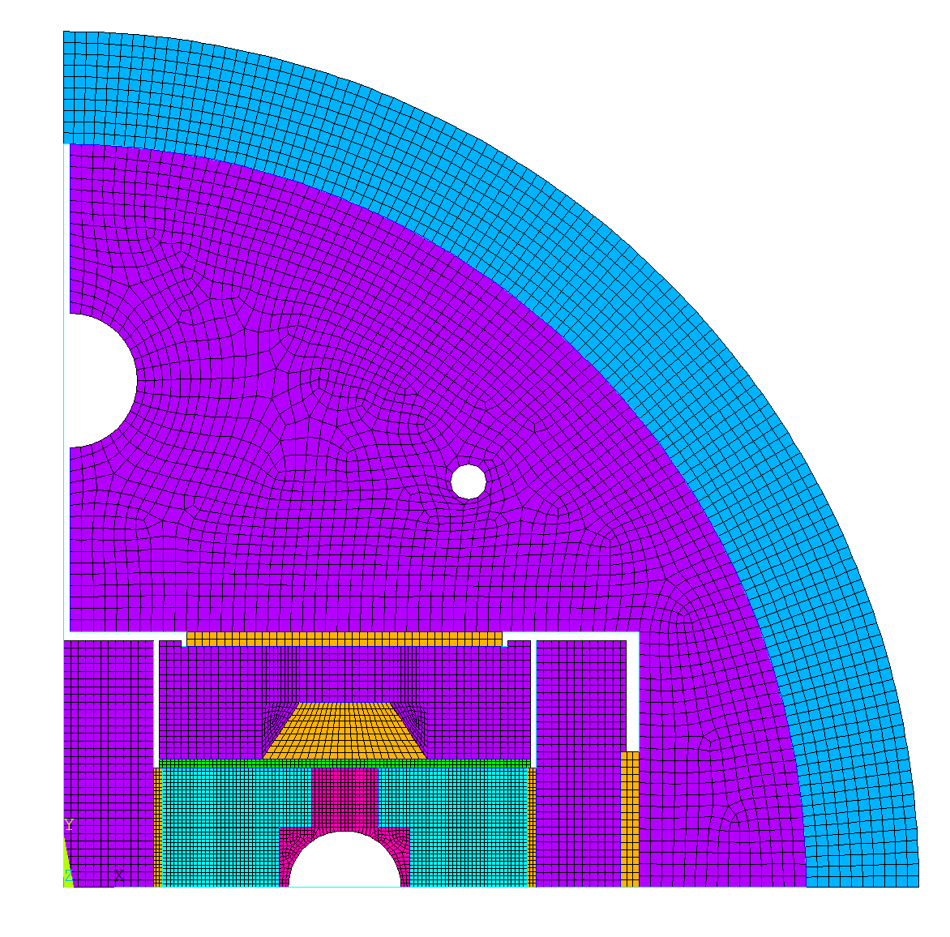
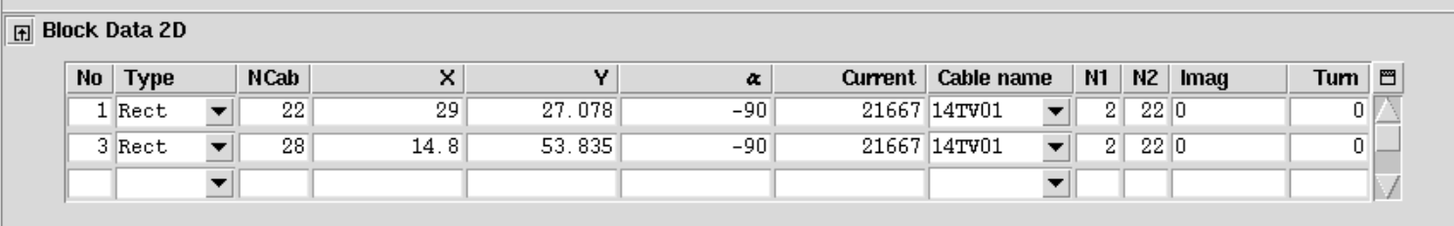
w/ Cable v1 (44 strands)
2D plane stress model
Coil modeled as linear isotropic with 25 GPa
(from Susana)

Slide 5
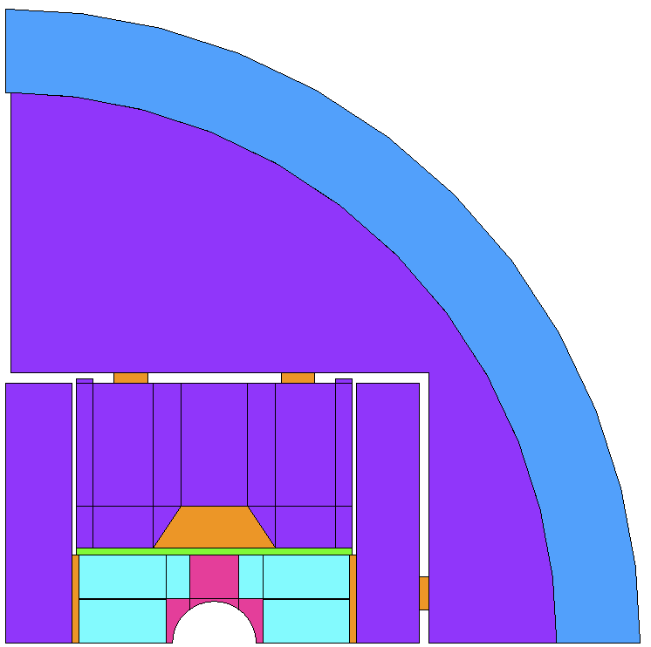
w/ Coil pack height = 156 mm
Inner support 4 mm
Alu shell thickness 50 mm
OD 760 mm
Keys 20 mm

Slide 6
Analysis w/ key interf

Slide 7
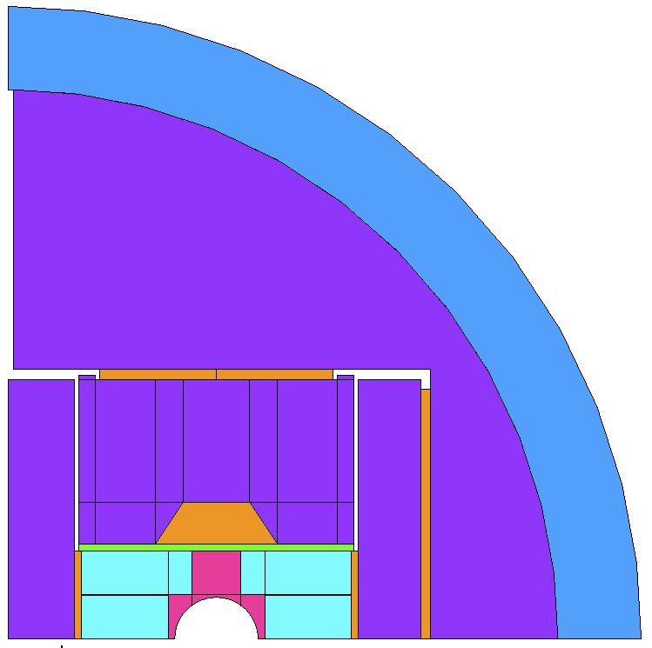
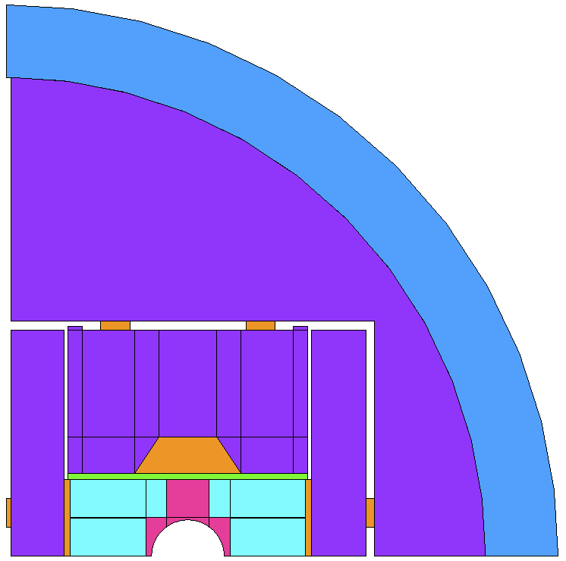
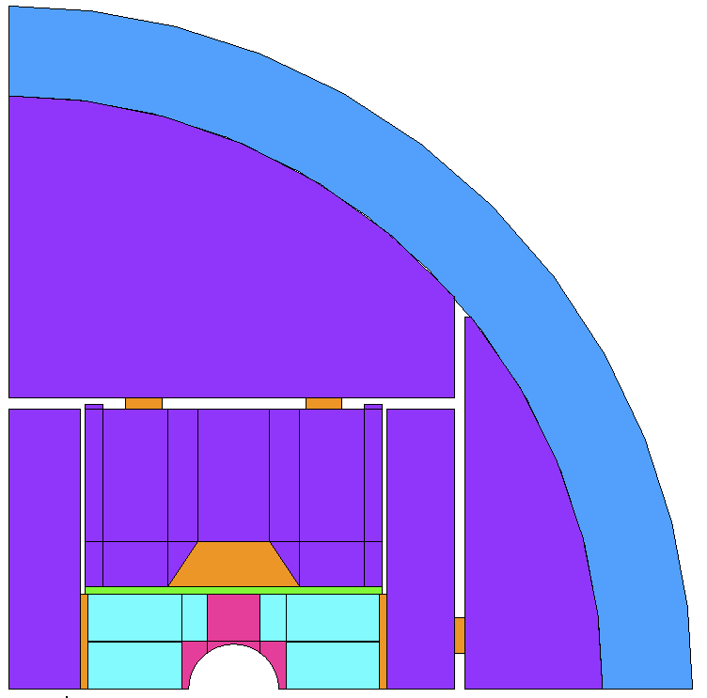
Overview of the versions
V11: frictionless
V13: friction 0.1-0.2
V14: keys 20 mm
V16: w/ middle key
V17: diag. cut yoke

Slide 8
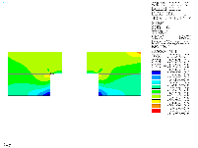
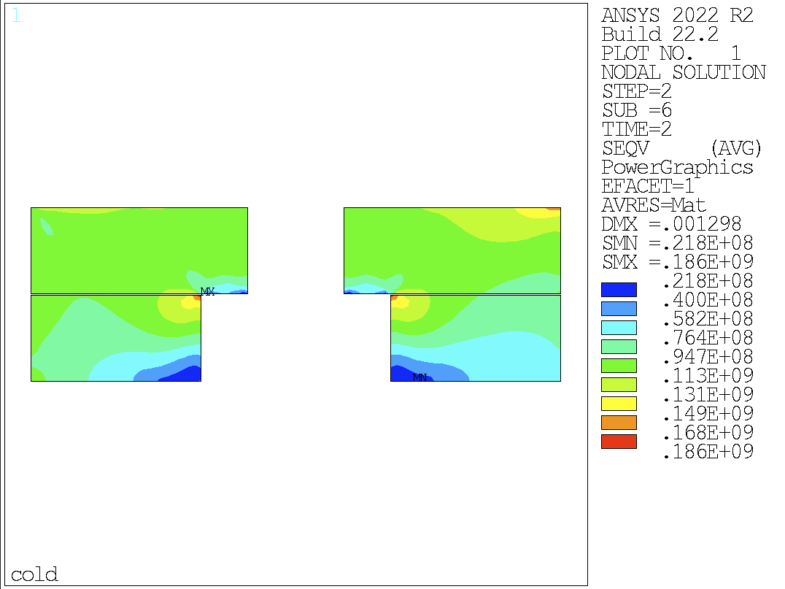
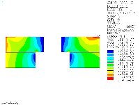
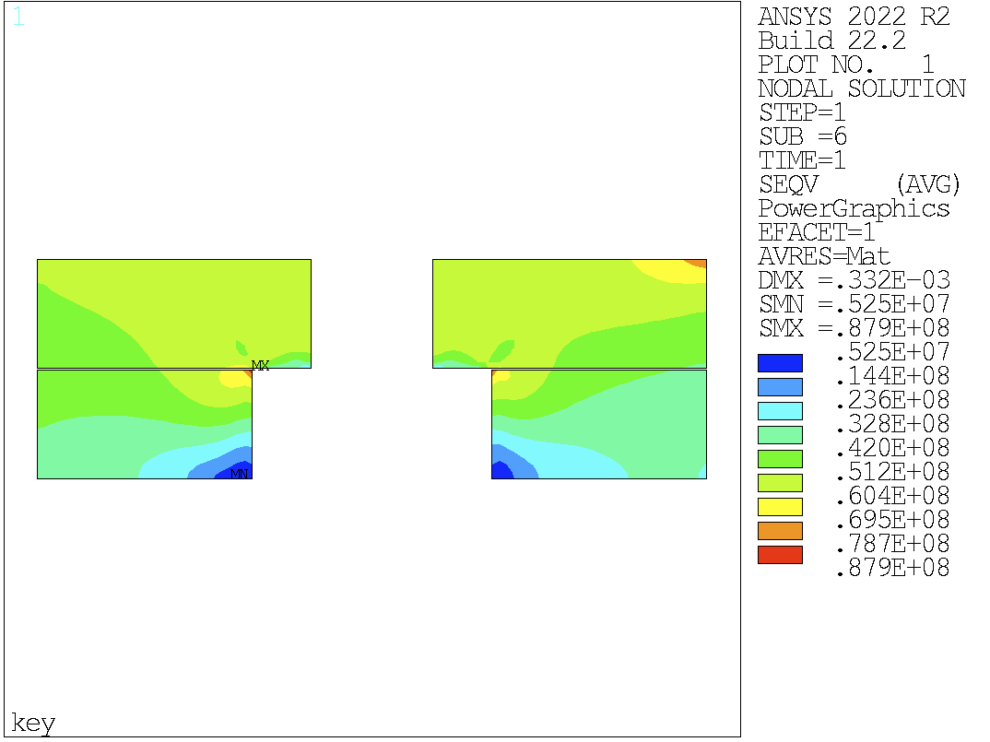
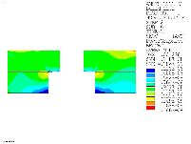
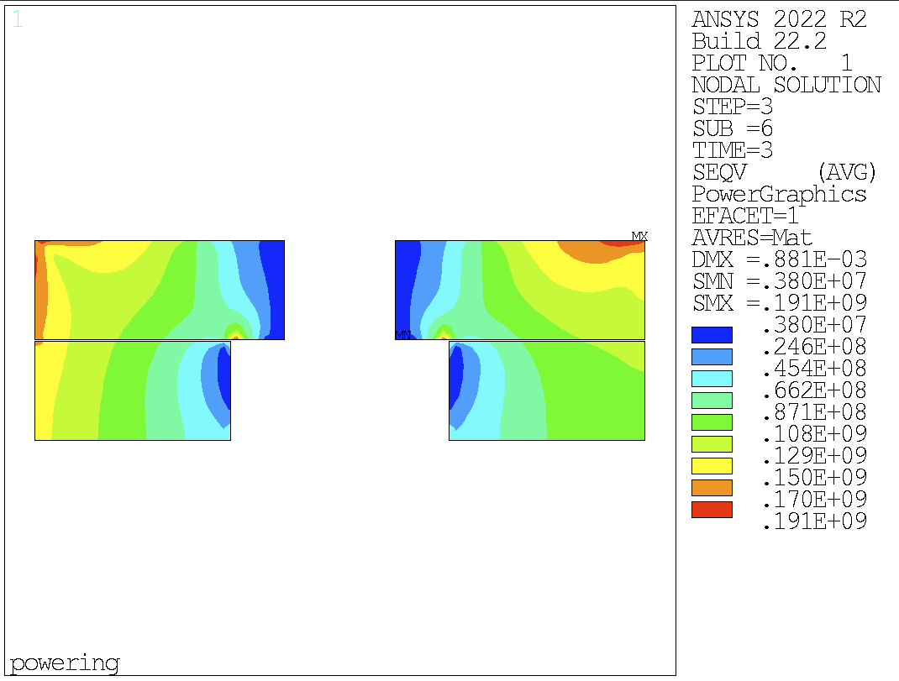
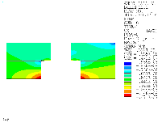
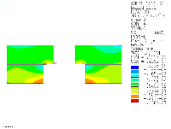
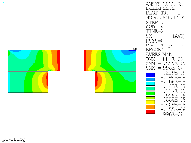
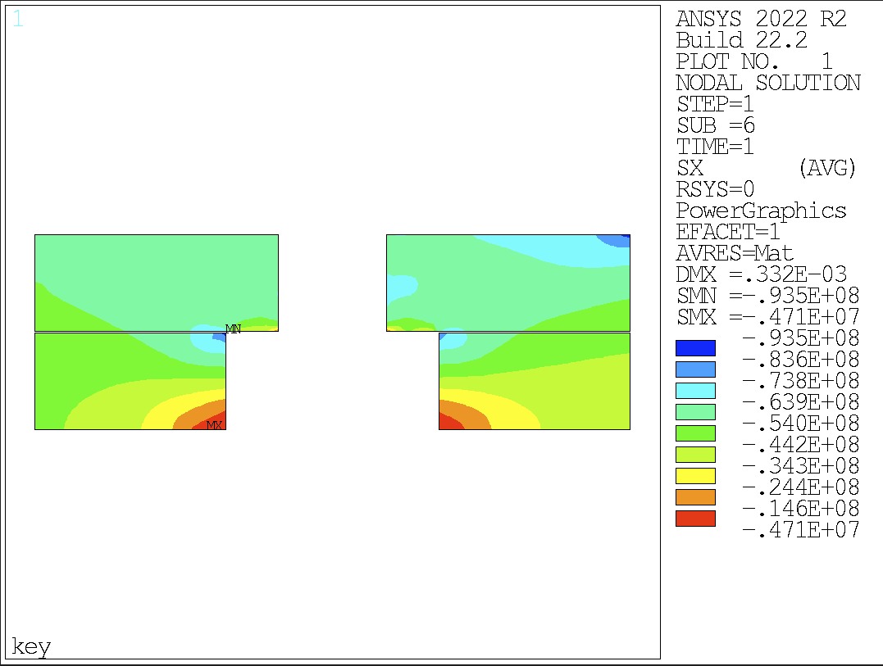
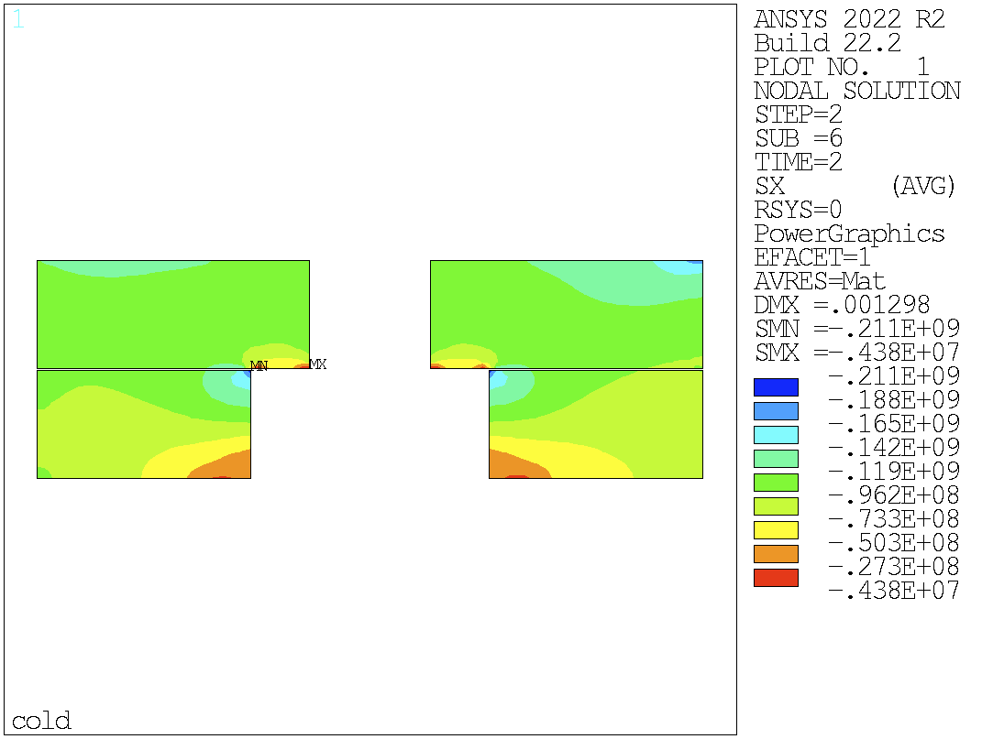
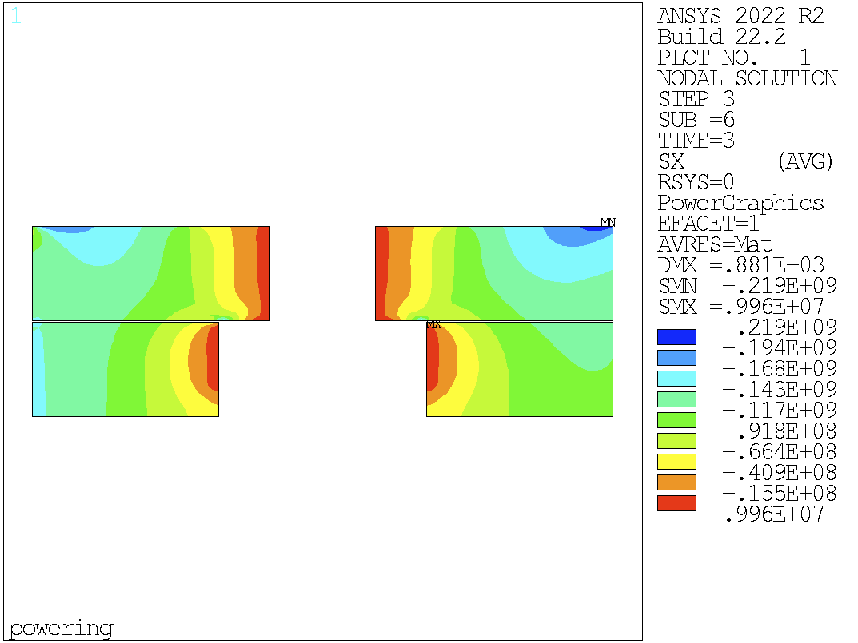
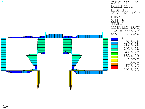
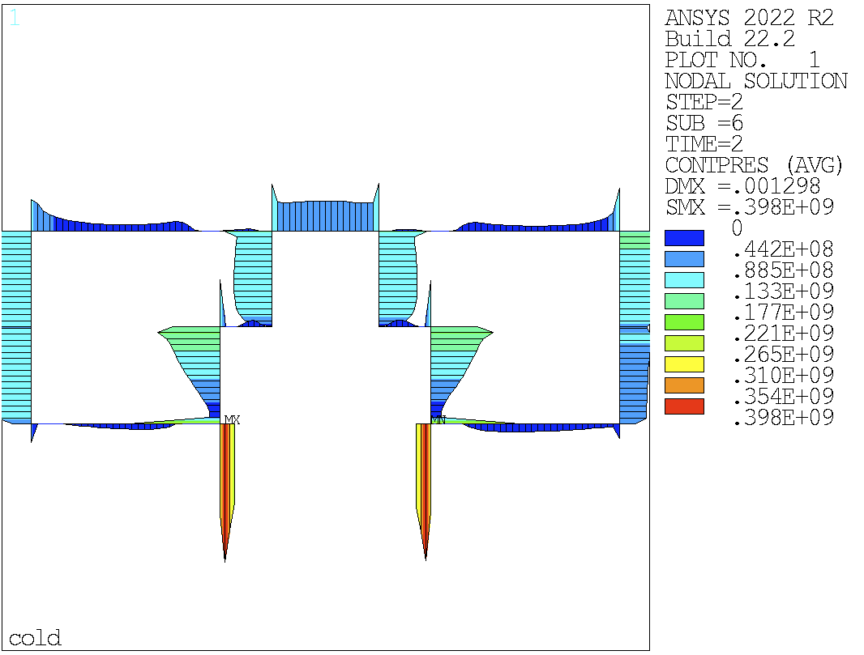
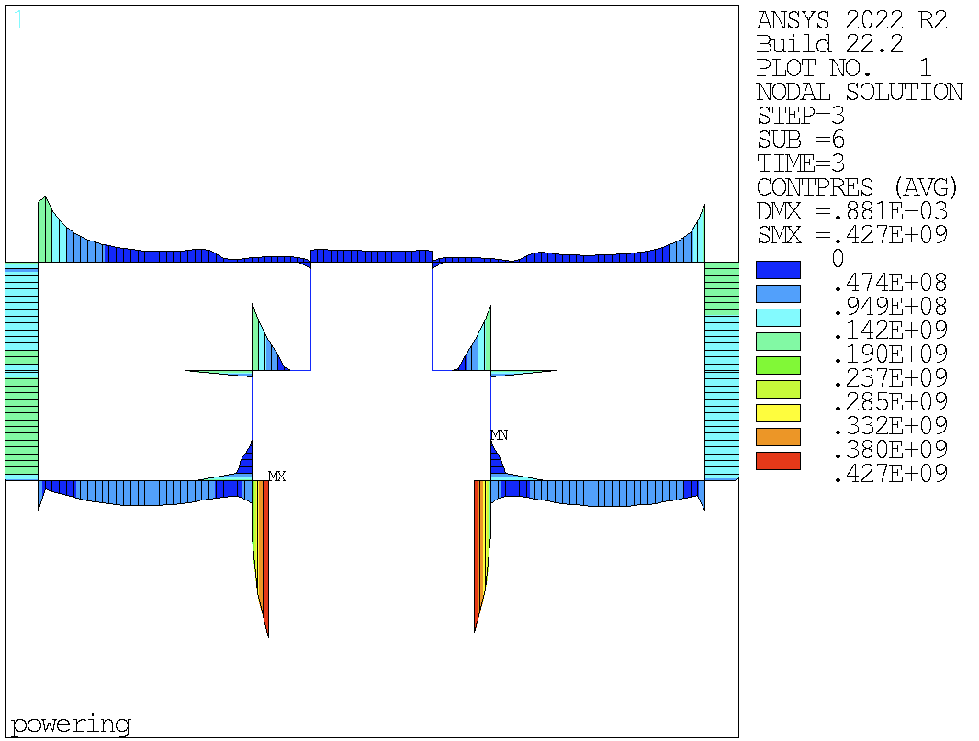
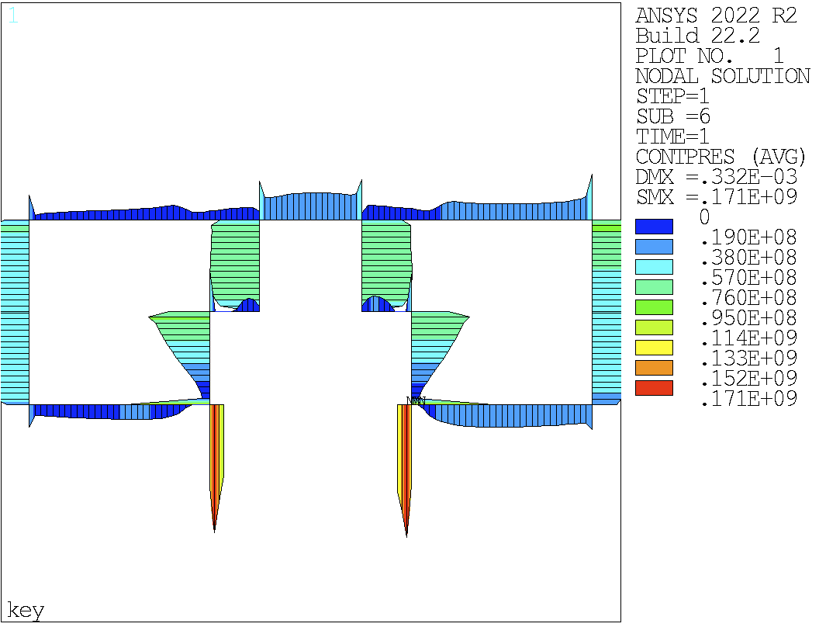
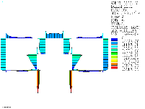
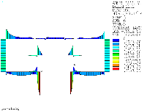
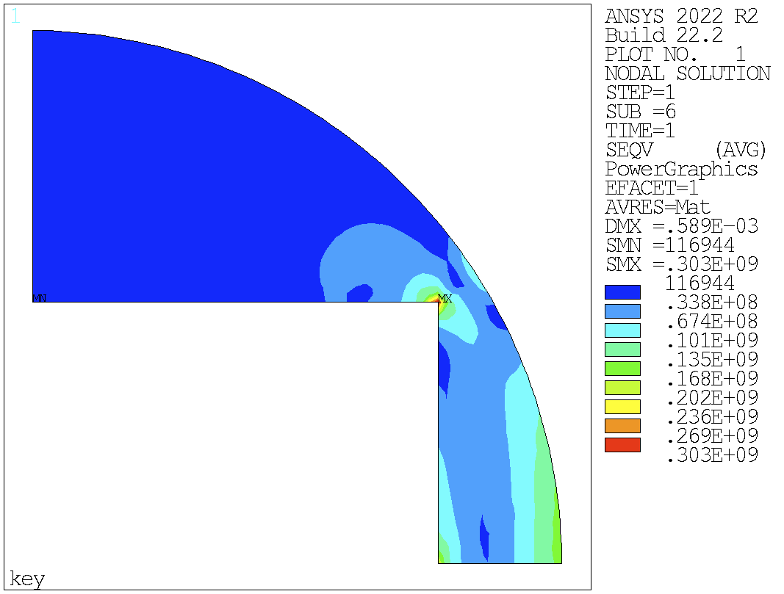
V11: frictionless + long keys
Vint = 0.05 mm
Hint = 0.9 mm
Coil stress distribution relatively symmetric
Too high stress but coil/pole detachment at powering
Too high peak stress in the yoke

Slide 9
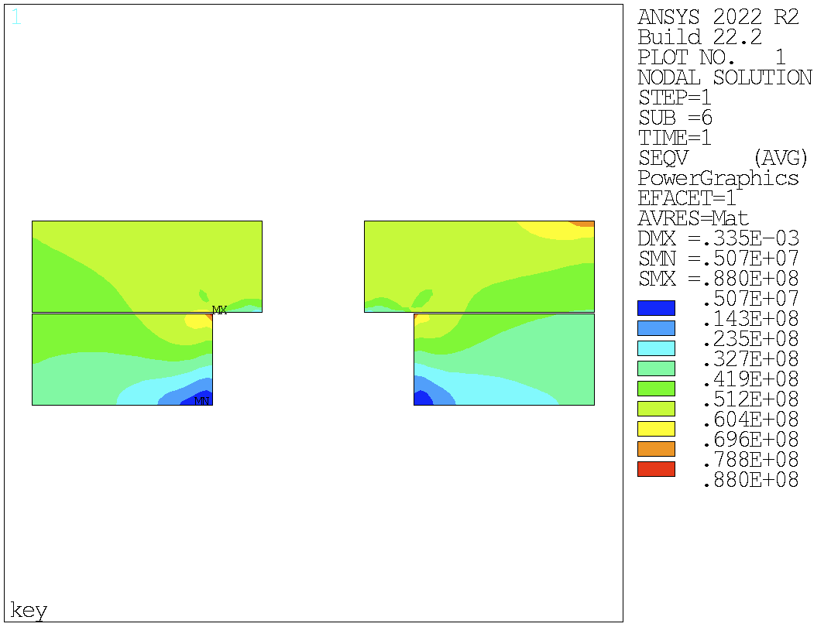
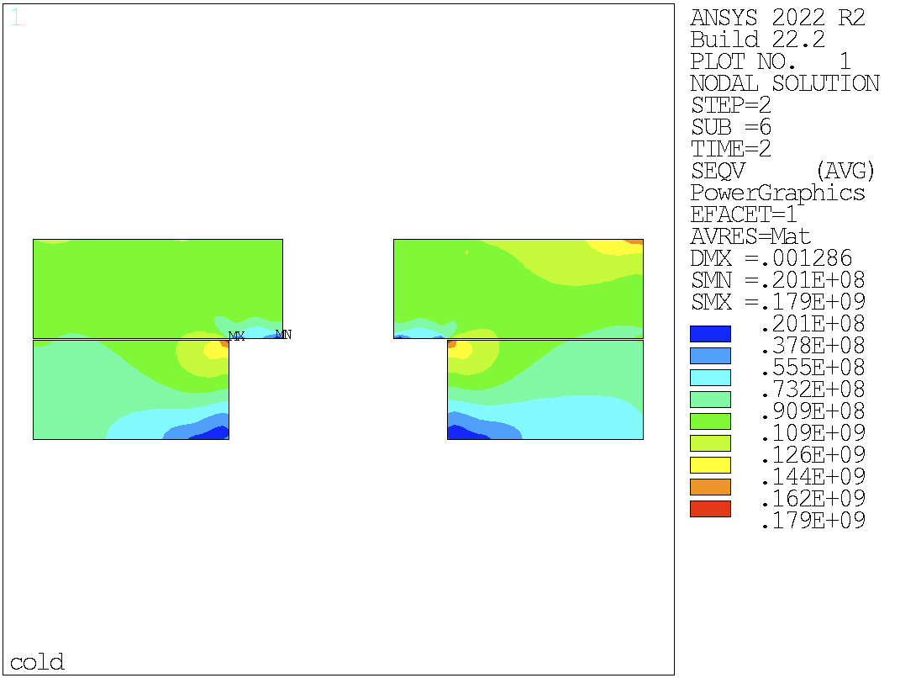
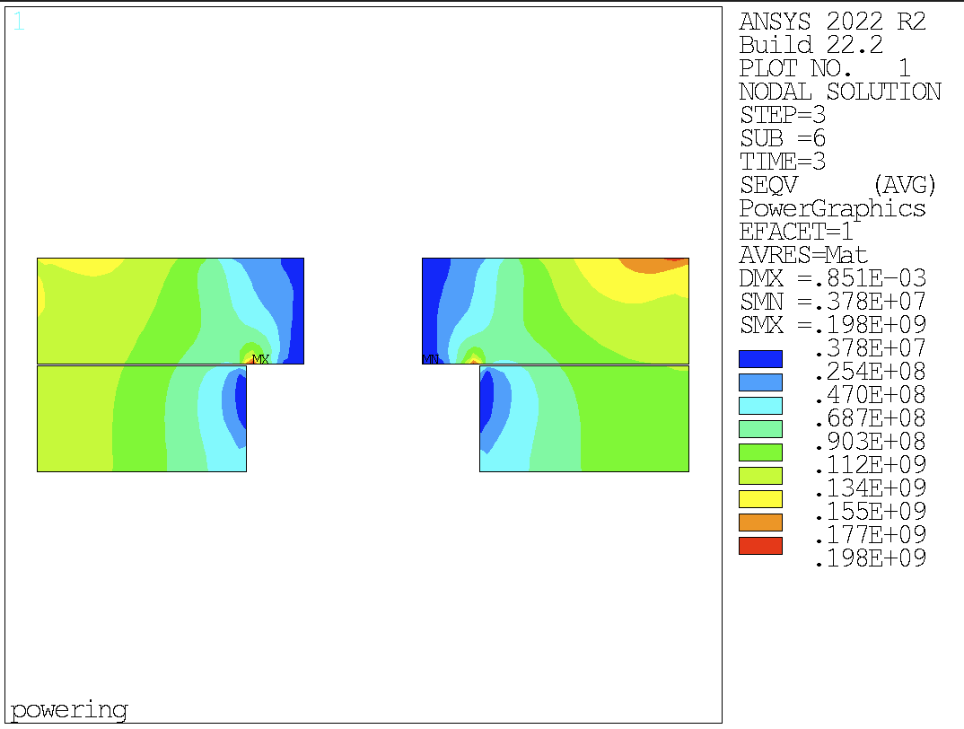
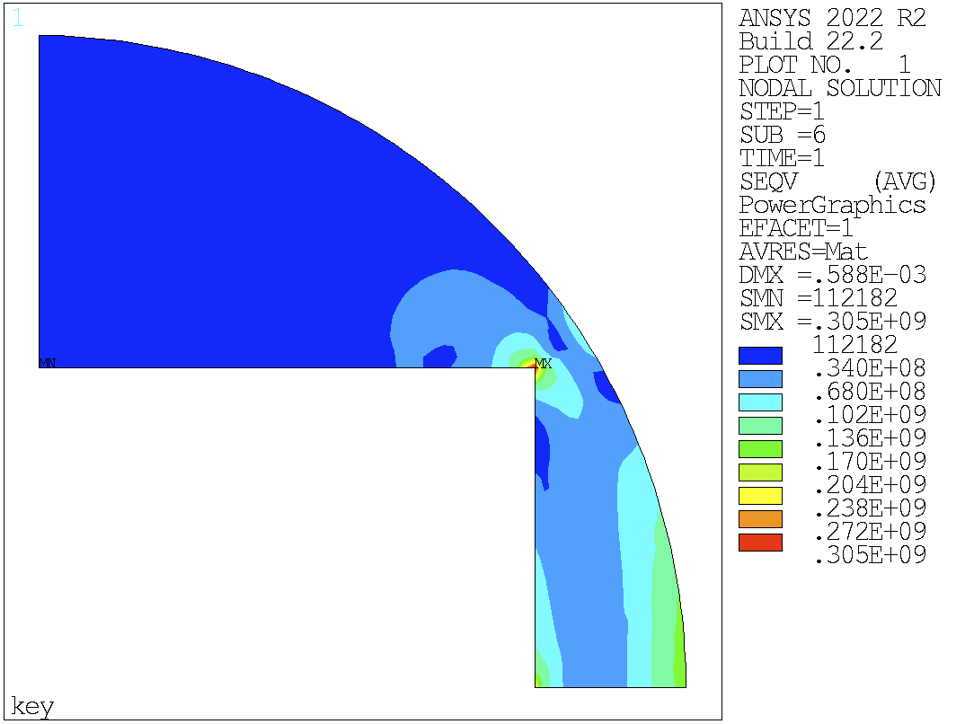
V13: friction + long keys
Vint = 0.05 mm
Hint = 0.9 mm
Coil stress distribution relatively symmetric
Too high stress but coil/pole detachment at powering
Too high peak stress in the yoke
Adding friction: the coil stress distribution is still relatively symmetric
No big impact on the stresses

Slide 10
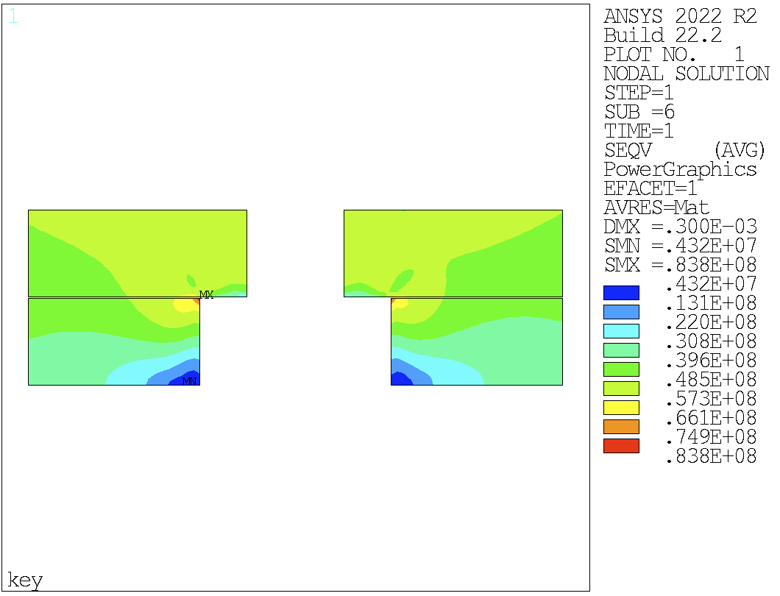
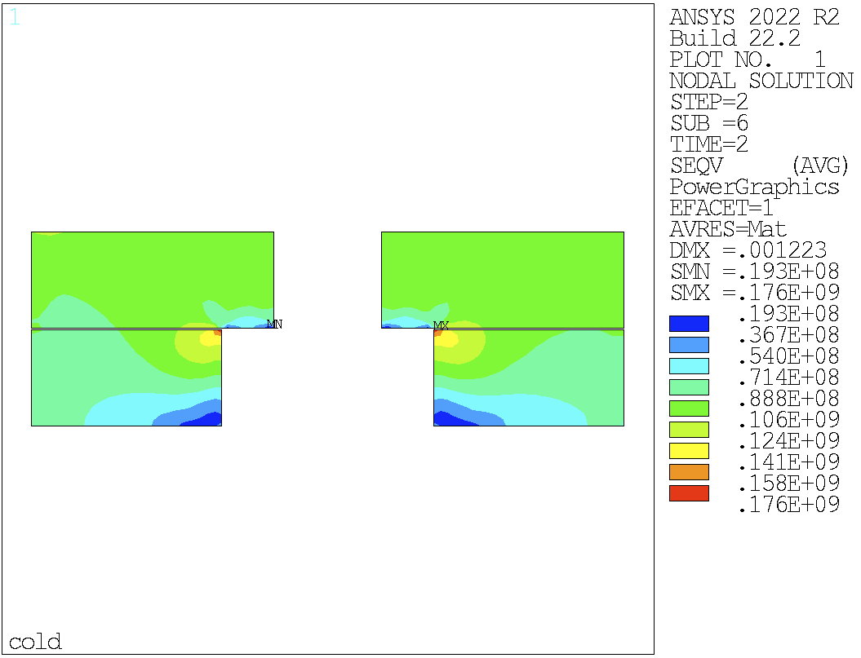
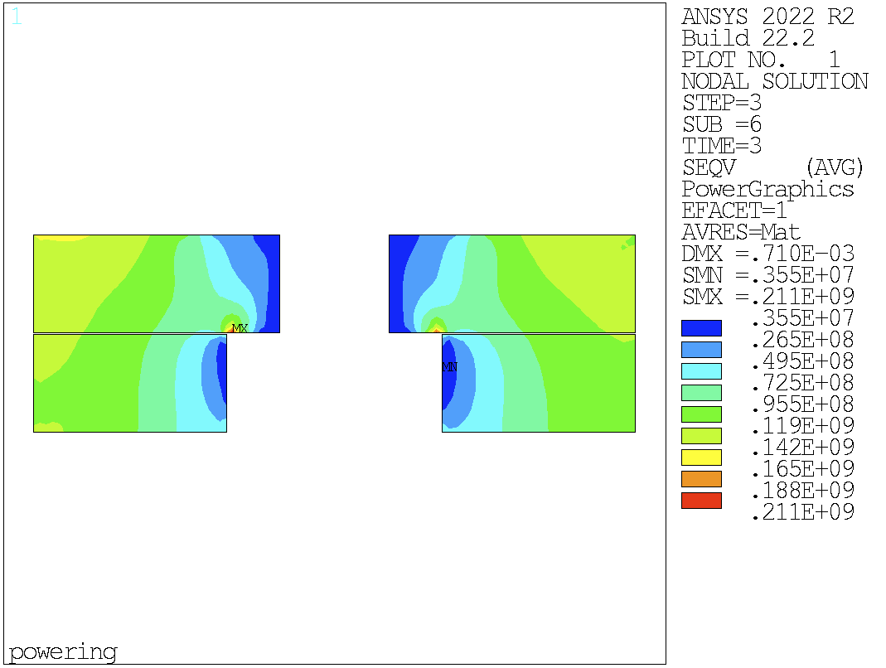
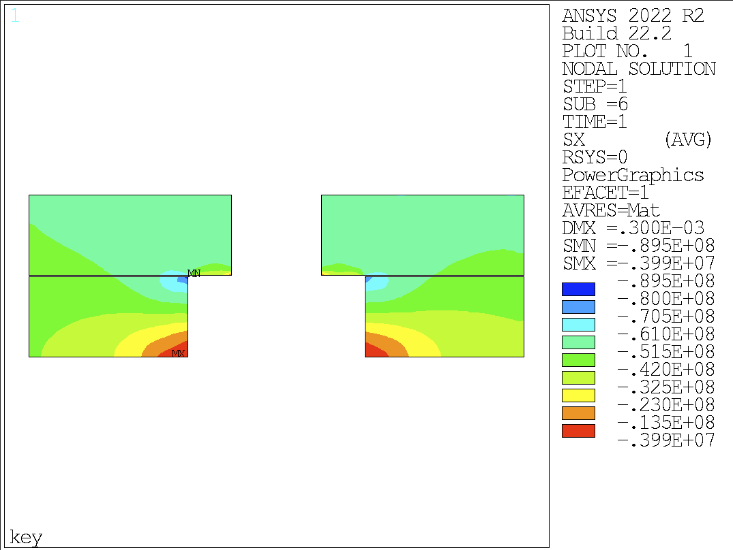
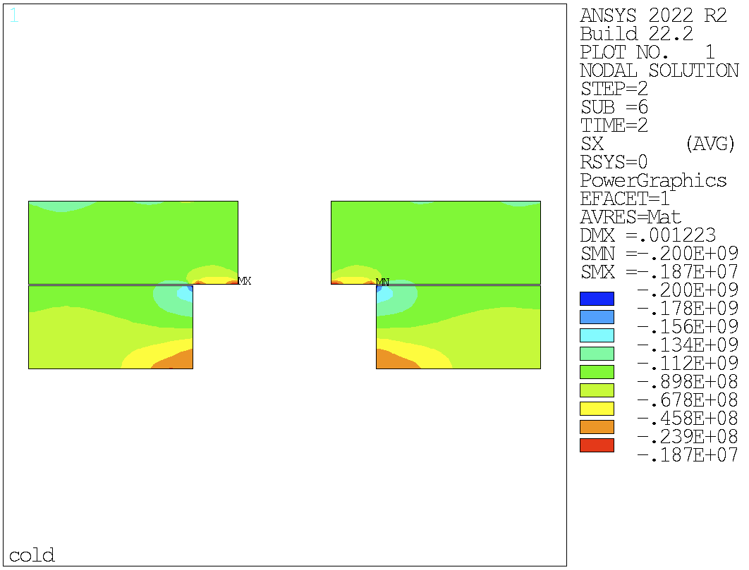
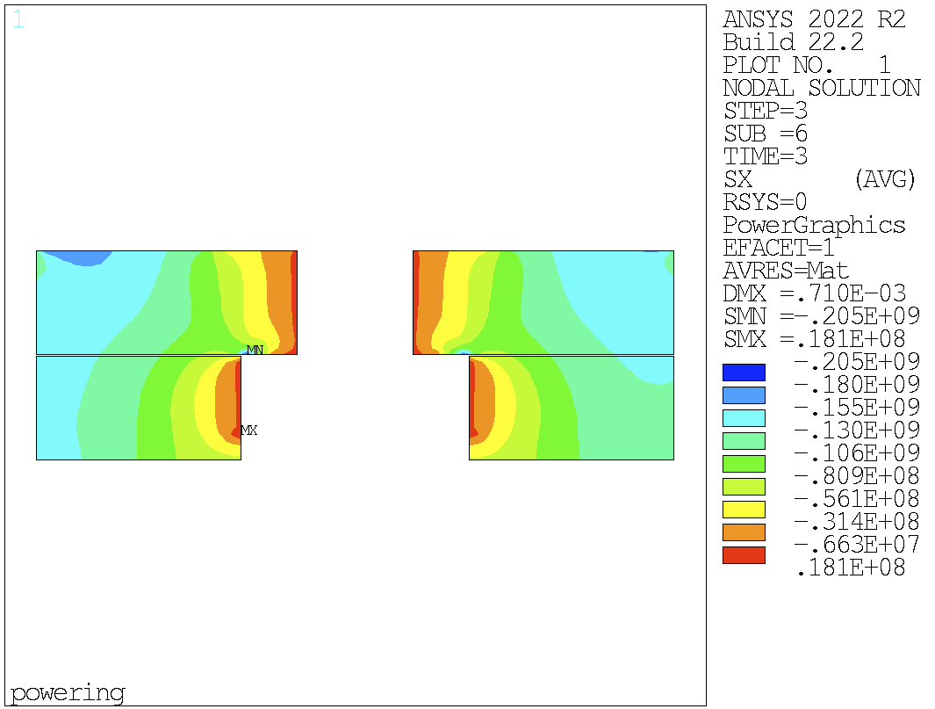
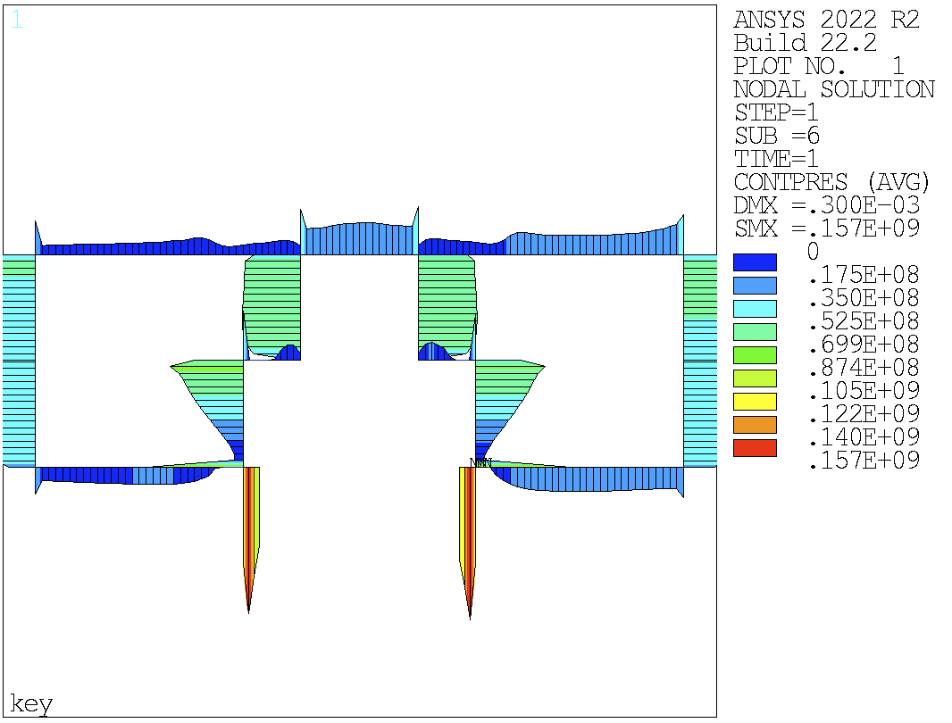
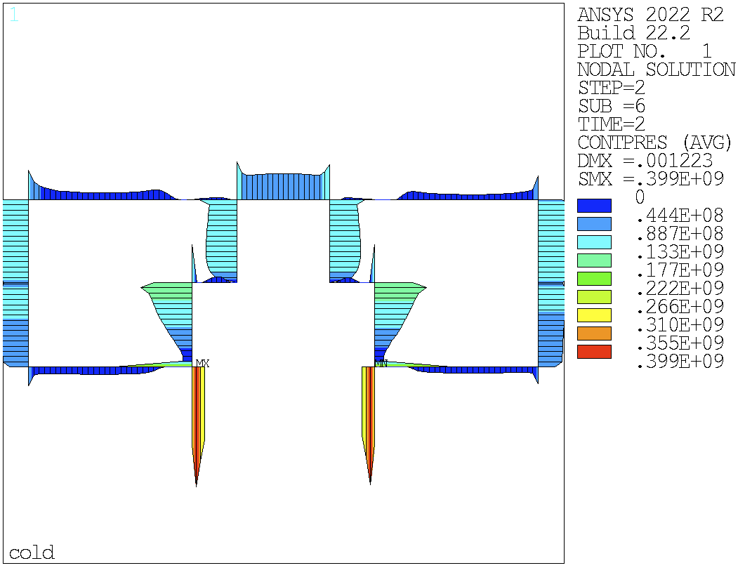
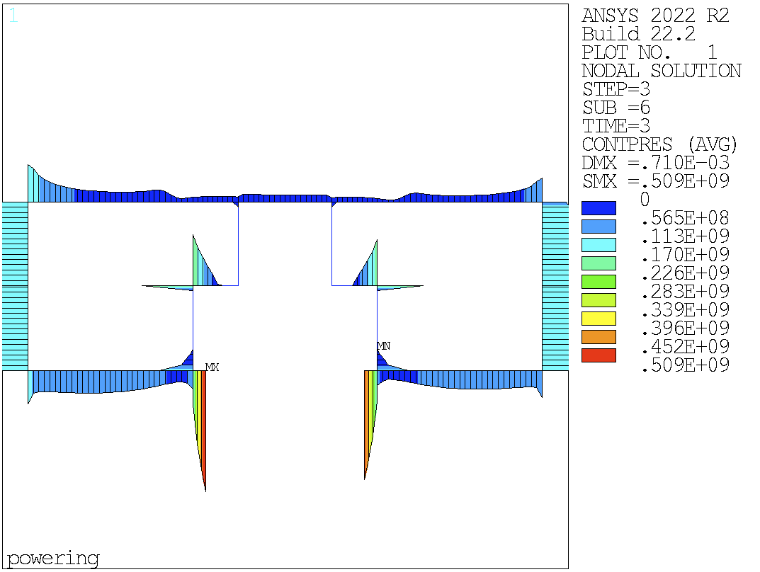
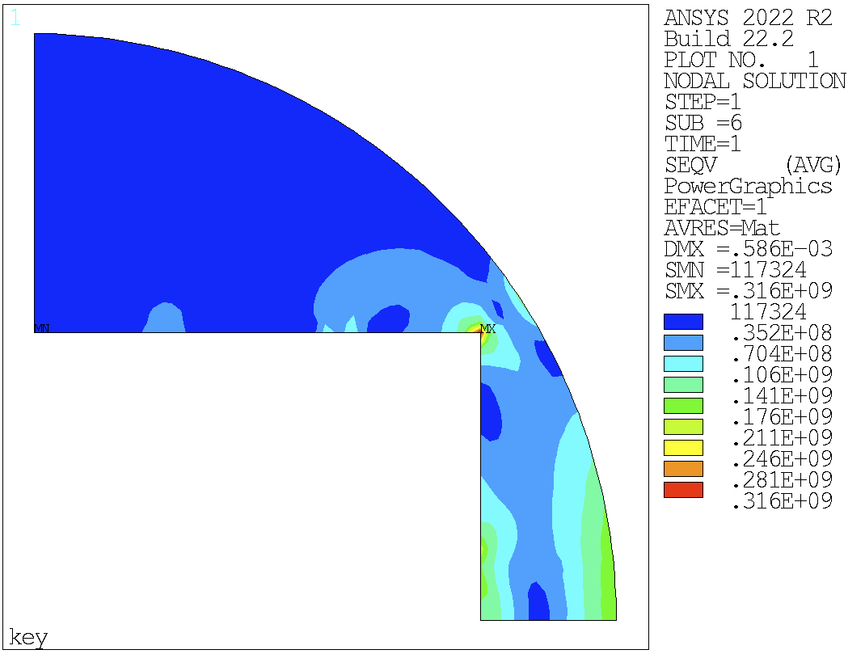
V14: friction + 20 mm keys
Vint = 0.05 mm
Hint = 0.9 mm
Coil stress distribution relatively symmetric
Too high stress but coil/pole detachment at powering
Too high peak stress in the yoke
Smaller key size: 10 MPa more peak stress in the yoke

Slide 11

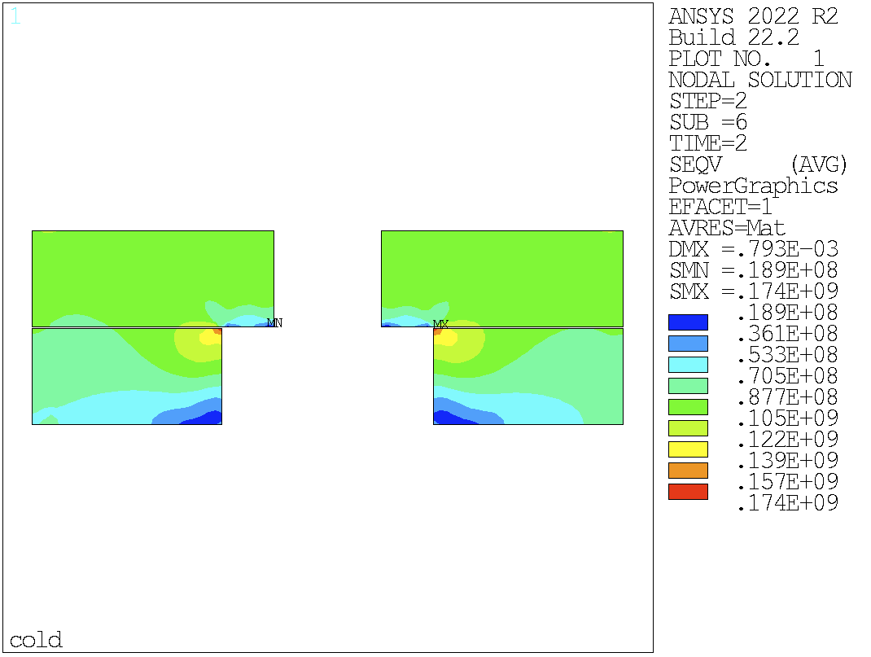
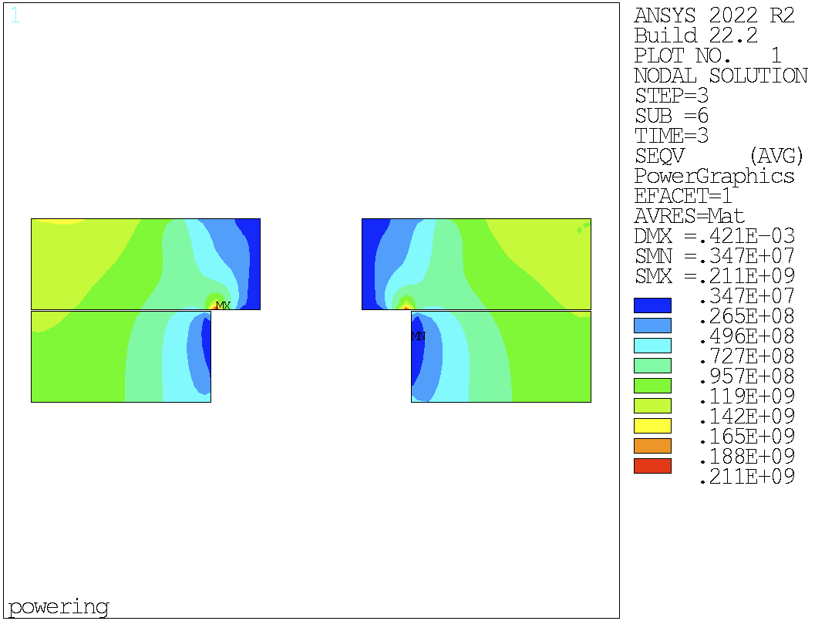
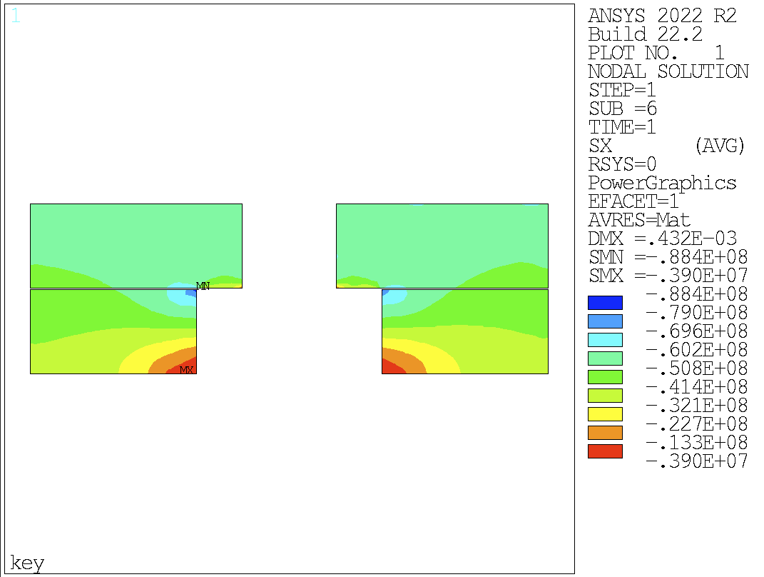
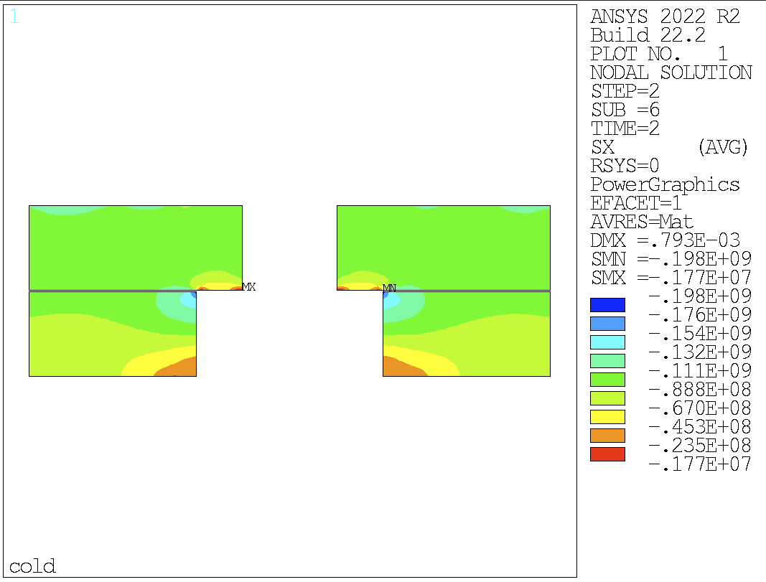
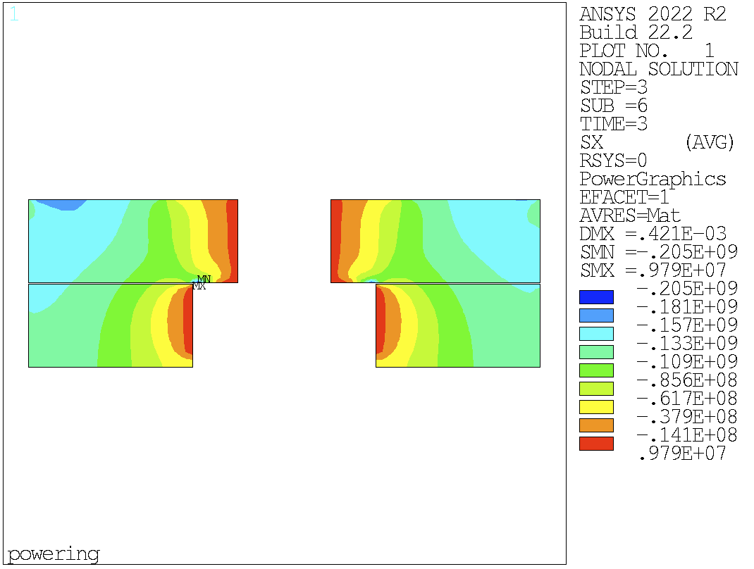
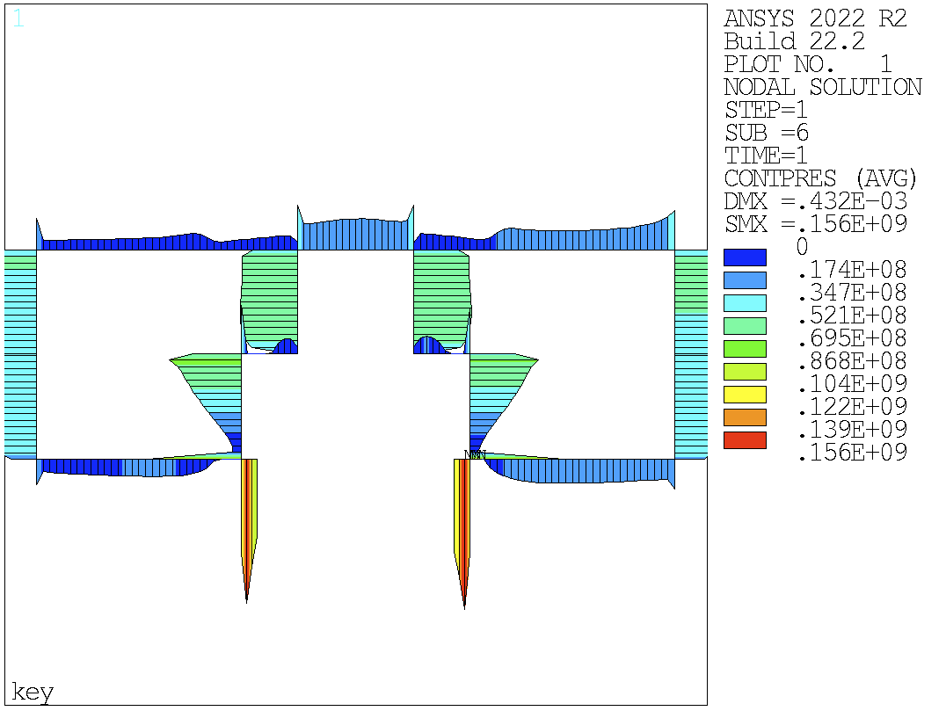
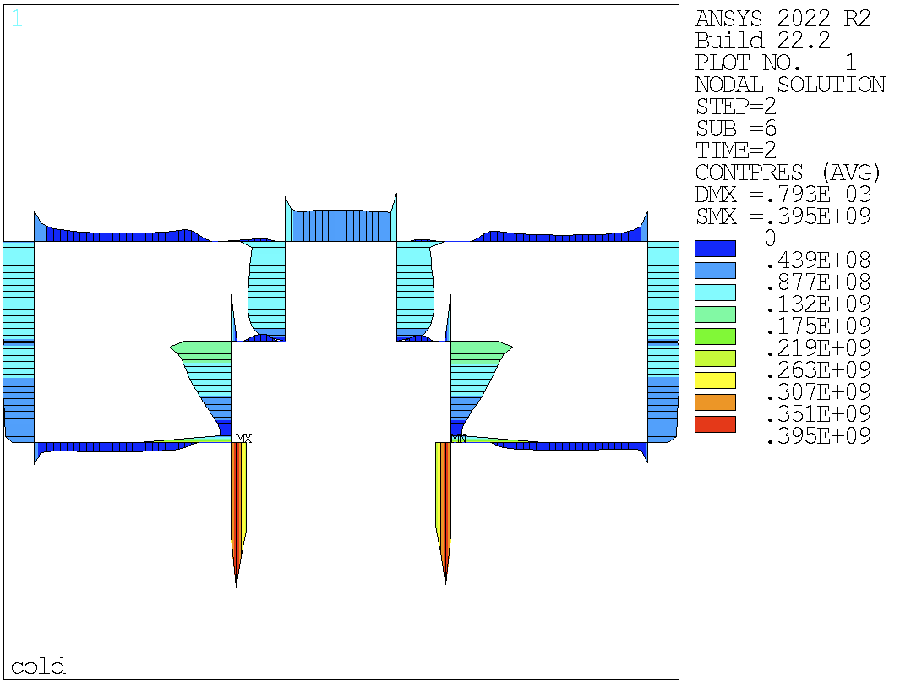
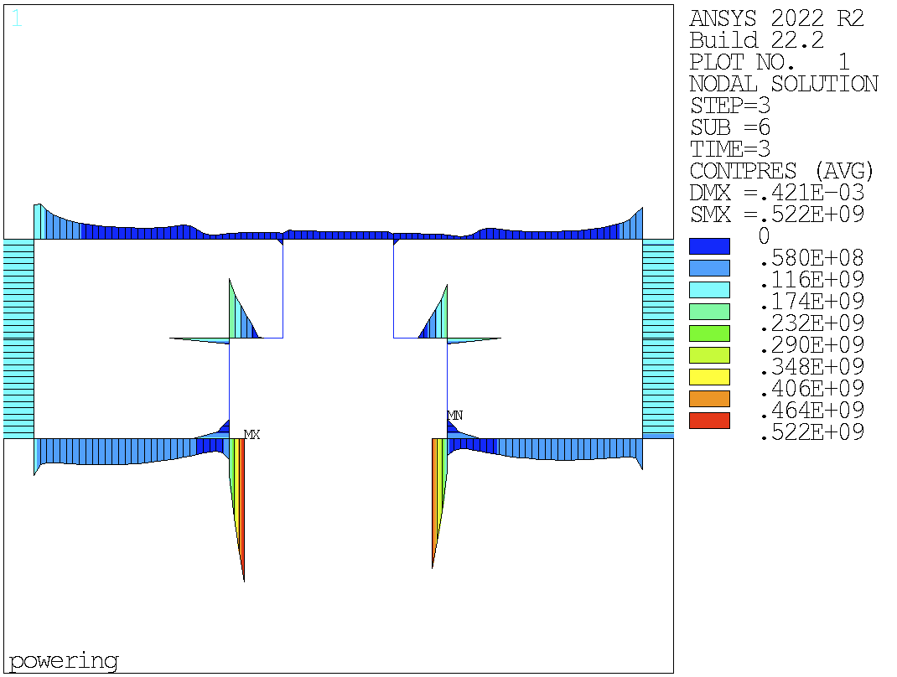

V16: friction + add. middle key
Vint = 0.05 mm
Hint = 0.45 mm
Mint = 0.45 mm
Middle key: no big impact

Slide 12
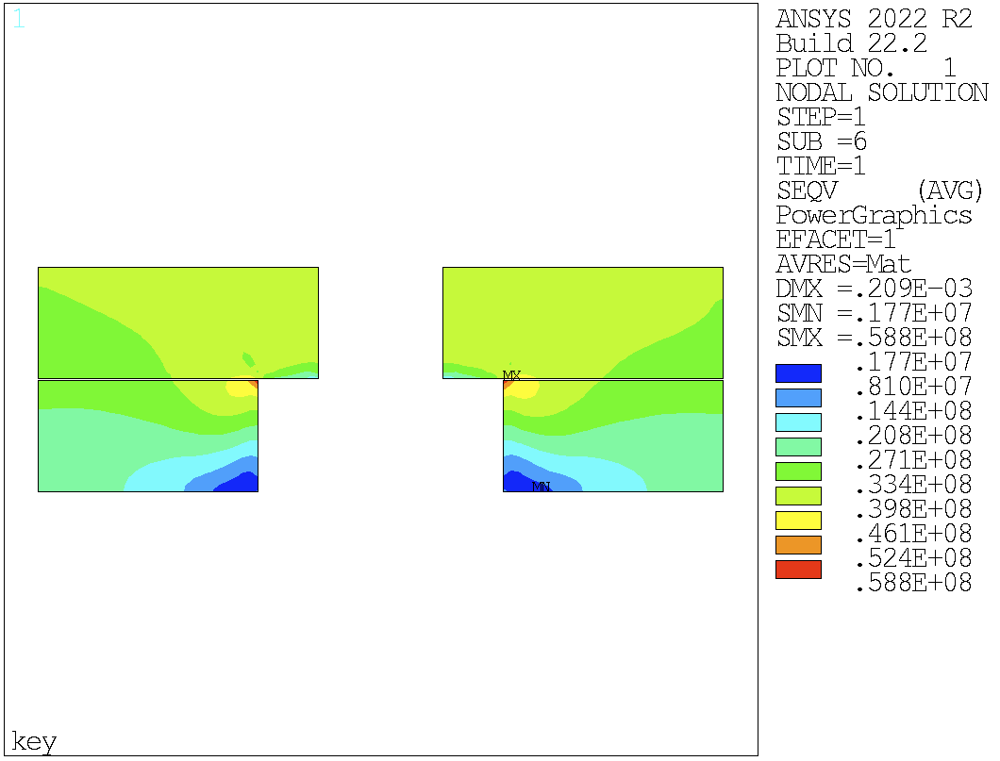
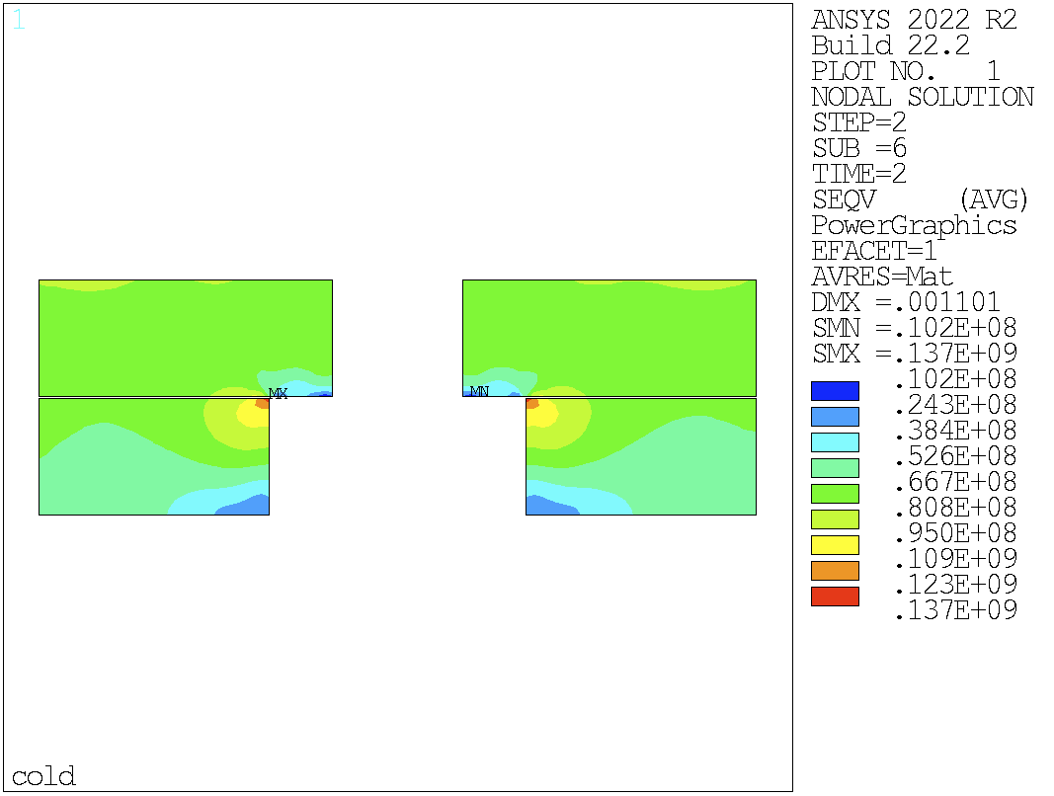








V17: friction + diag. cut yoke
Diagonally cut yoke: coil/pole detachment in both layers
Yoke under 200 MPa @RT

Slide 13
Analysis w/ bladders

Slide 14




v15
PARAMETER HPRES_BAR = 350.0000000
PARAMETER NSIDEPAD_UX_MM = -0.2006311079
PARAMETER NYOKE_UX_MM = 1.118263036
PARAMETER BKGAP_MM = 1.318894144

Slide 15




v17
PARAMETER HPRES_BAR = 350.0000000
PARAMETER NSIDEPAD_UX_MM = -0.2234287611
PARAMETER NYOKE_UX_MM = 0.8911231586
PARAMETER BKGAP_MM = 1.114551920

